Slide 1
Radiation stability study on melt processed and hot isostatically pressed multi-phase ceramics
Ming Tang,
Los Alamos National Laboratory, USA
Eric R. Vance,
Australian Nuclear Science and Technology Organisation, Australia
Jake W. Amoroso
Savannah River National Laboratory, USA
October 31, 2017, Sydney, AU
MRS2017-Scientific for Nuclear Waste Management Symposium 2017

Slide 2
Multi-phase Ceramic Waste Forms
Objective: Develop a reference ceramic waste form for the combined HLW raffinate stream (containing undissolved solids and soluble technetium) and potentially the TRU waste stream from fuels fabrication processes
– Ceramic waste form
• Multi-phase ceramics based on SYNROC materials developed by researchers since the late 1970s
Demonstrated geologic stability
• Target phase assemblage based on waste stream
“Hollandite” – (BaxCsy)(A+3)2x+y(Ti+4)8-2x-yO16
“pyrochlore” – (A+3)2Ti2O7
“perovskite” – (A+2)TiO3
“Zirconolite” – CaZrTi2O7
– Process technology
• Melt-Processing
Proven technology to immobilize high-level waste
Relatively few complex steps
– Comparison of multi-phase ceramic waste forms produced via melt-processing and HIP methods

Slide 3
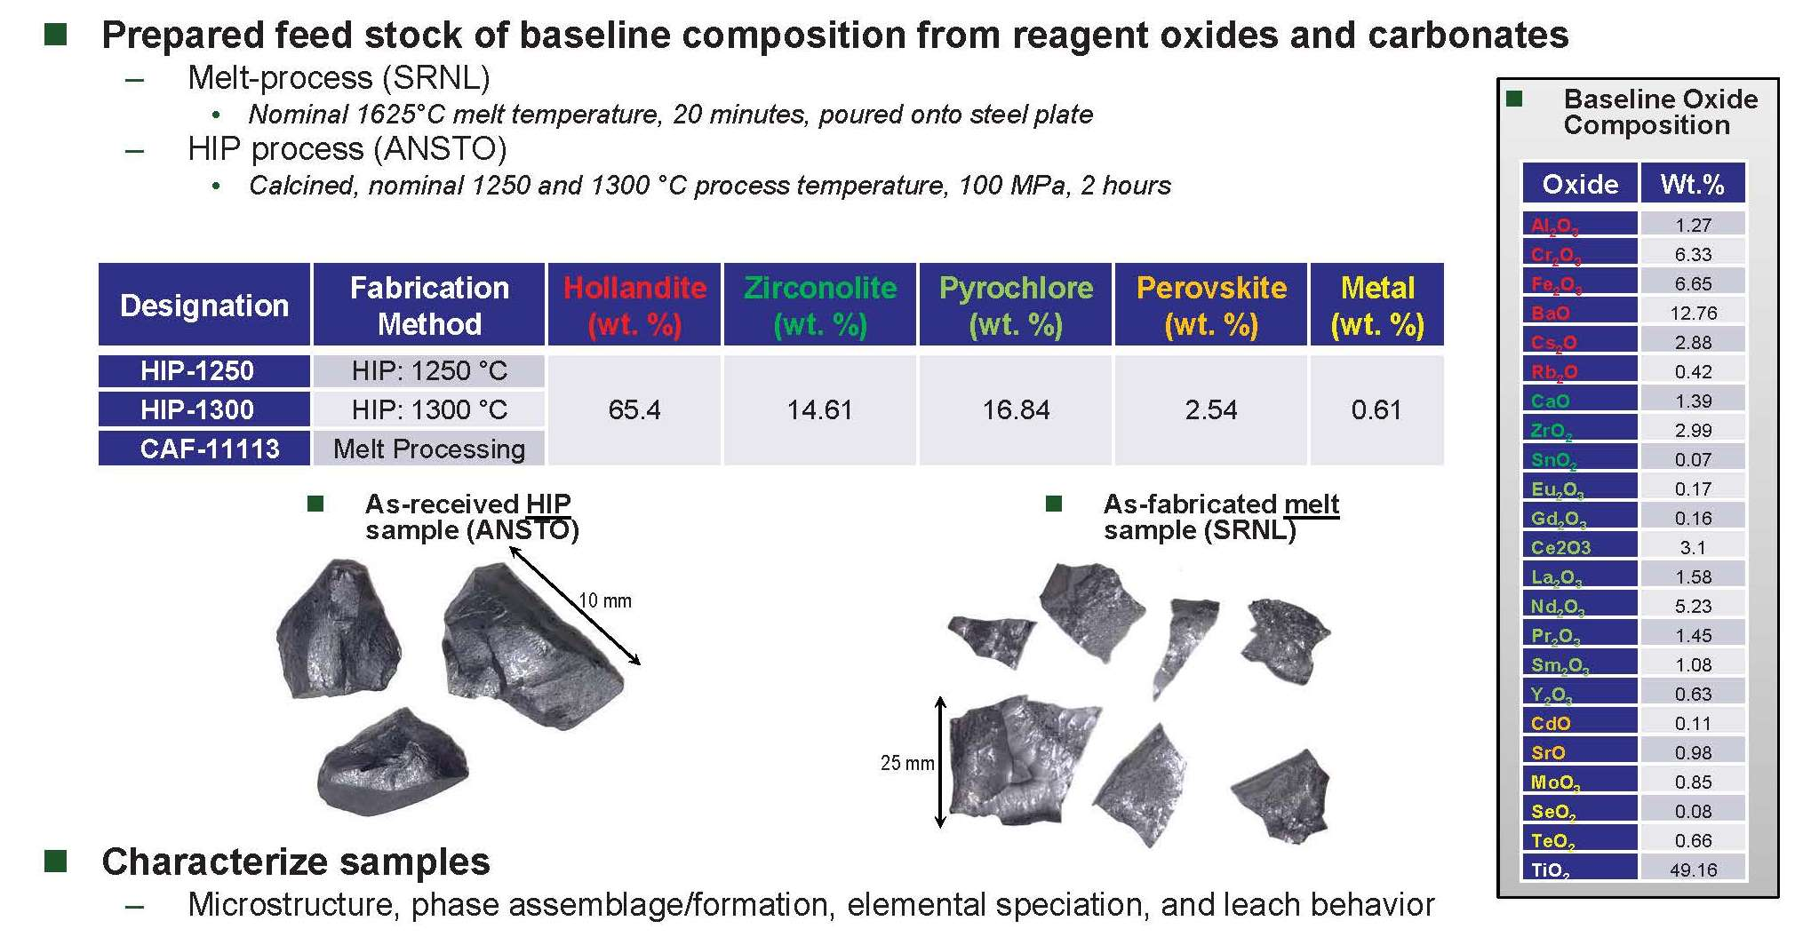
Experimental

Slide 4
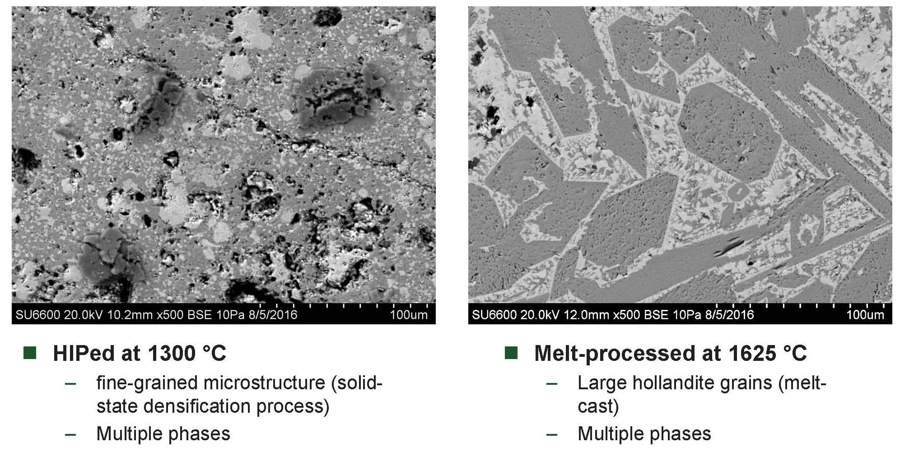
HIP vs. Melt Process Microstructure

Slide 5
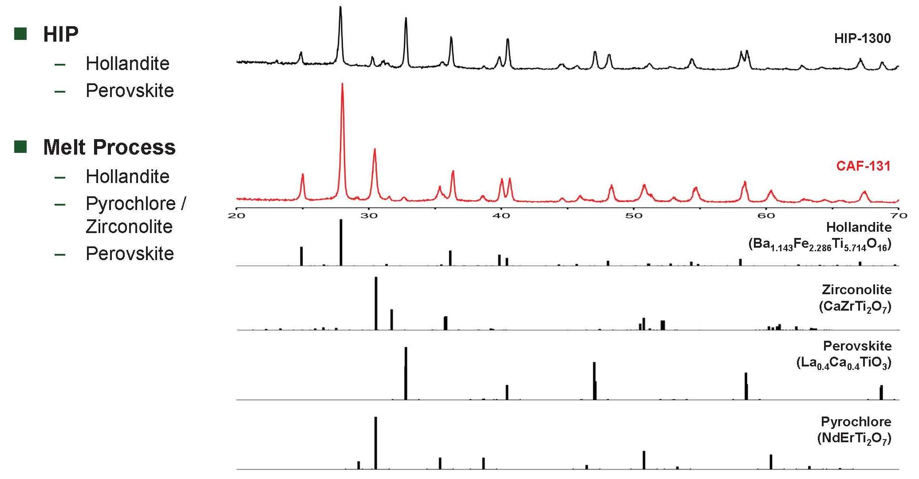
Phase Analysis (XRD)

Slide 6
Radiation in Nuclear Waste Forms
The principal sources of radiation in high-level wastes:
β-decay of the fission products (e.g. ¹³⁷Cs and ⁹⁰Sr)
energetic electrons (β particles), low energy recoil nuclei, and γ rays
α-decay of the actinide elements (e.g., U, Np, Pu, Am and Cm)
energetic α particles (4.5 to 5.5 MeV), energetic recoil nuclei (70-100 keV), and some γ rays
γ-decay produces photon
Several techniques to study radiation damage in nuclear wastes:
Actinides containing minerals
Short-lived actinides doping
Gamma irradiation utilizing ⁶⁰Co or ¹³⁷Cs sources
Neutron irradiation
charge particle (ion irradiation), which is a more cost-effective alternative to study radiation damage in materials in a rather short period of time

Slide 7
Radiation in Nuclear Waste Forms
Radiation effects (interaction of radiation with solids) include: (1)energy transfer to electron (ionization and electronic excitation from β/α particles, and γ rays), (2)energy transfer to nuclei (ballistic processes/atomic displacement from α recoil), (3)transmutations and gas production.
In present study, we performs:
ion irradiations: ion implanter at Ion Beam Materials Lab, LANL
heavy ion Kr (400 keV) used to simulate alpha recoil, displacement damage
light ion α (He, 200 keV), for ionization process
hundreds keV ions
Damaged layer
Waste form samples
~200-800 nm

Slide 8
Radiation damage study on ceramic waste forms
Structural/Microstructural evolution, microcracking, swelling/compaction
We will compare radiation response of multi-phase ceramic waste forms from different fabrication routes, HIPed and Melt processed

Slide 9
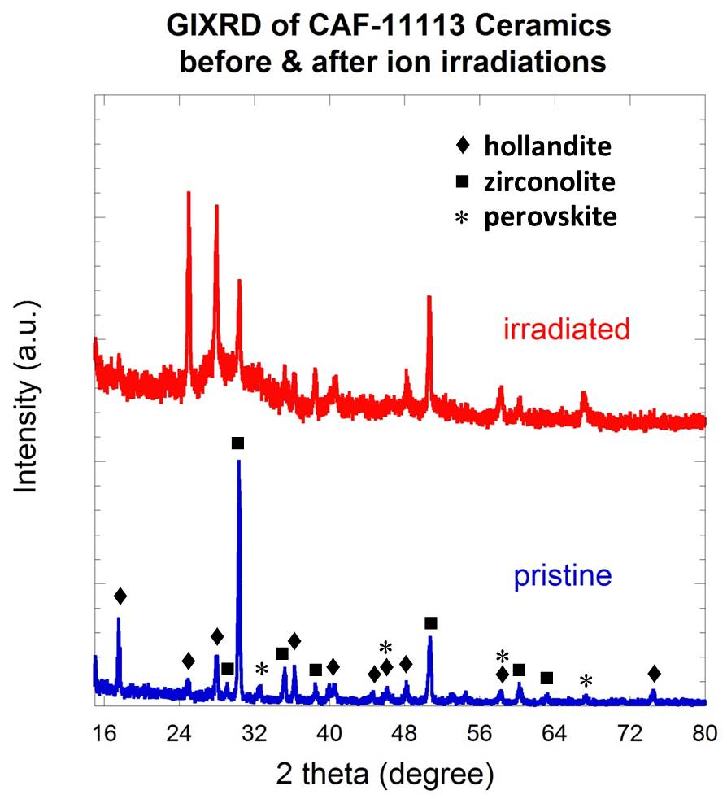
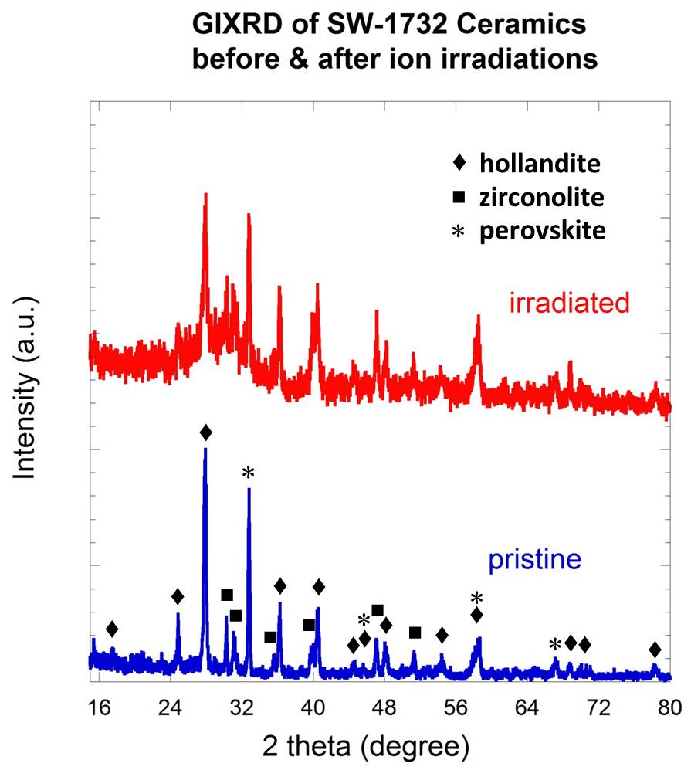
Kr irradiation on multi-phase ceramics from SRNL (Melt) and ANSTO (HIPed)
GIXRD patterns obtained from CAF-11113 (SRNL) and SW-1732 (ANSTO) before and after 400 keV Kr ion irradiation to a fluence of 5 × 10¹⁴ Kr/cm² (corresponding to peak displacement damage dose of ~ 1 dpa)
Three major crystalline phases including hollandite, zirconolite, and perovskite, are identified in both pristine multi-phase ceramic samples.
The onset of irradiation-induced amorphization was observed in both multi-phase ceramic samples.

Slide 10
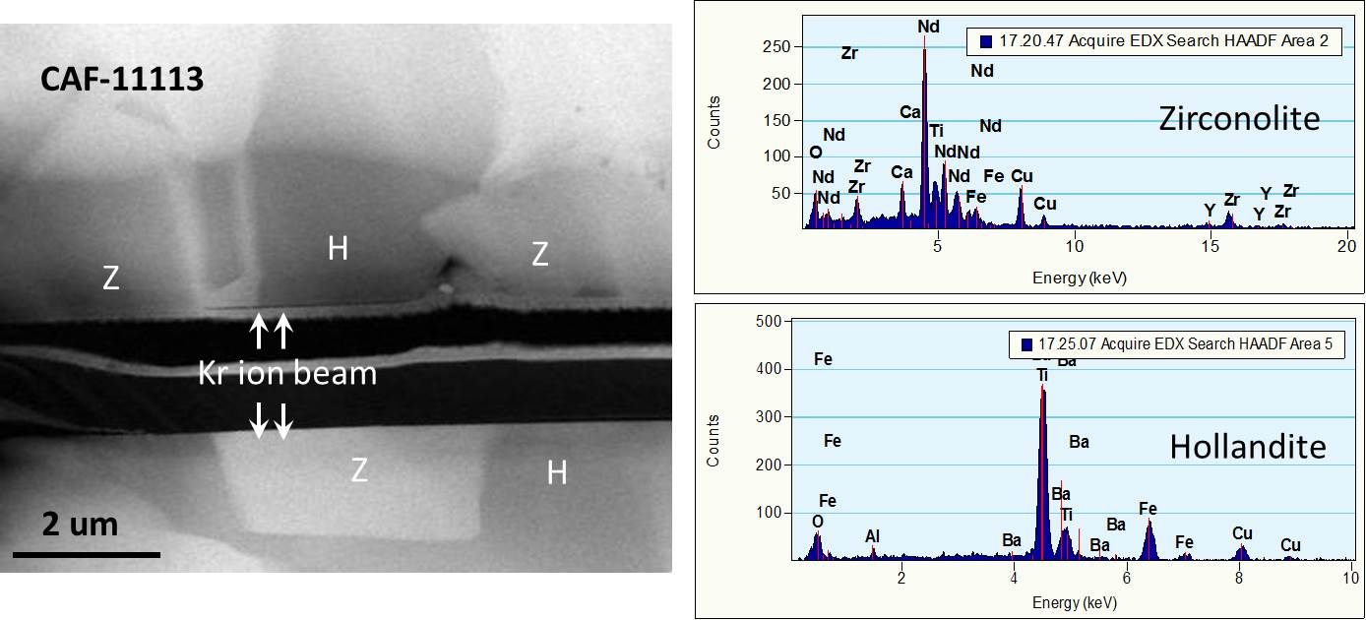
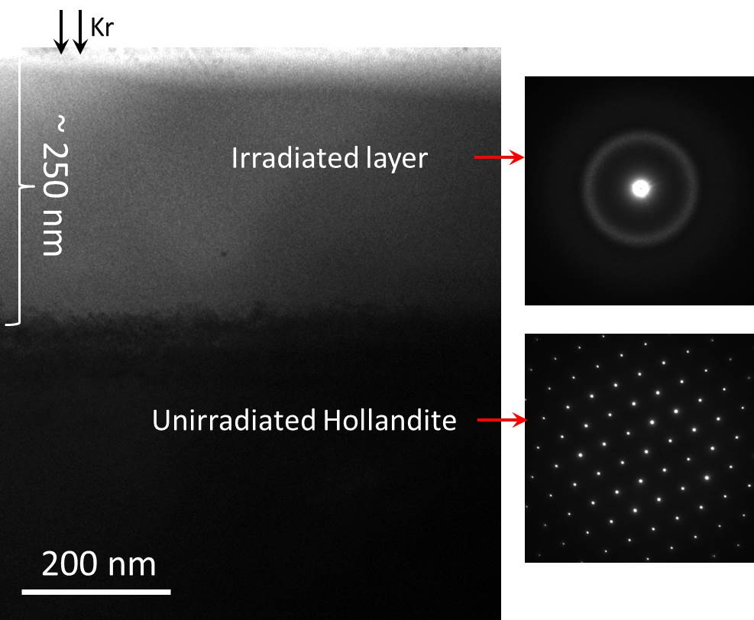
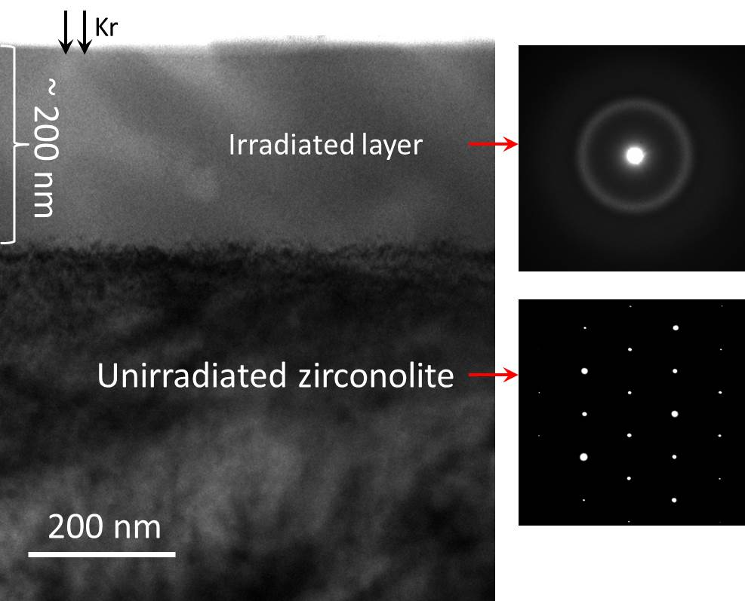
Cross-sectional TEM observation of Kr irradiated CAF-11113
Z: zirconolite
H: hollandite

Slide 11
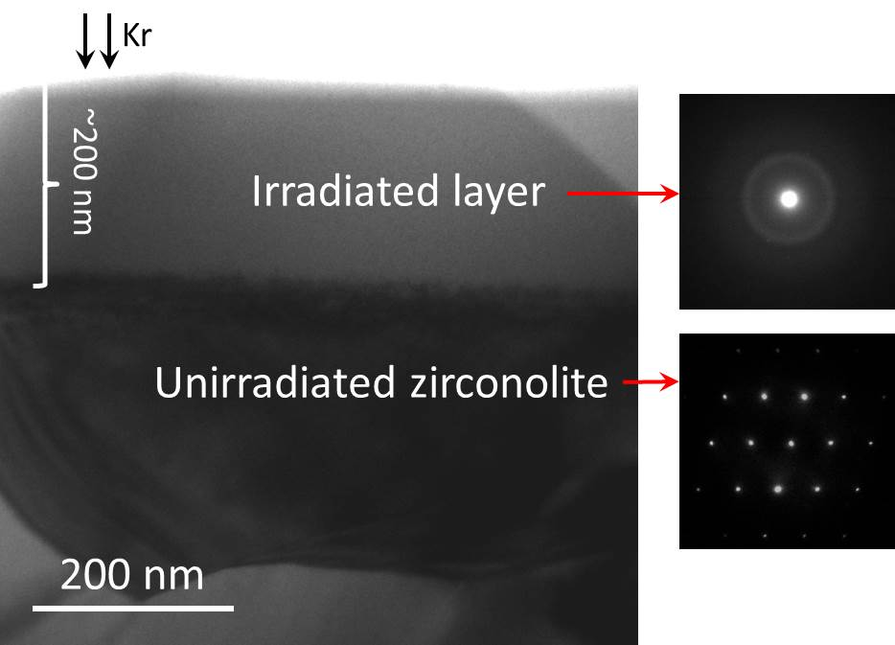
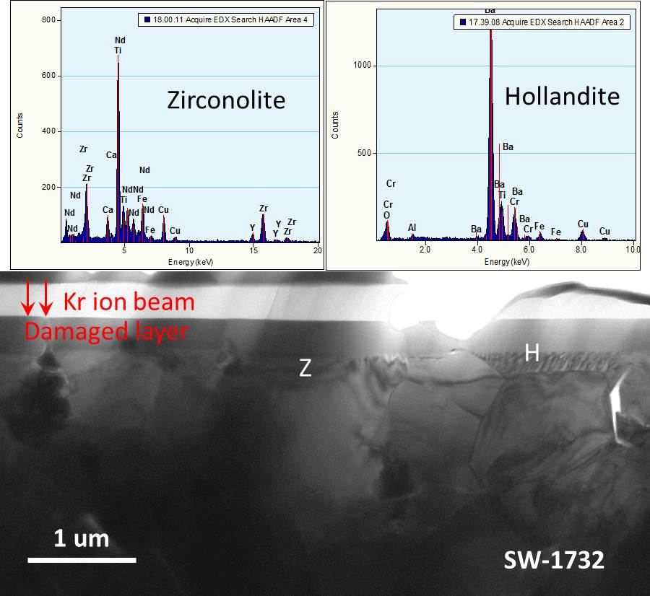
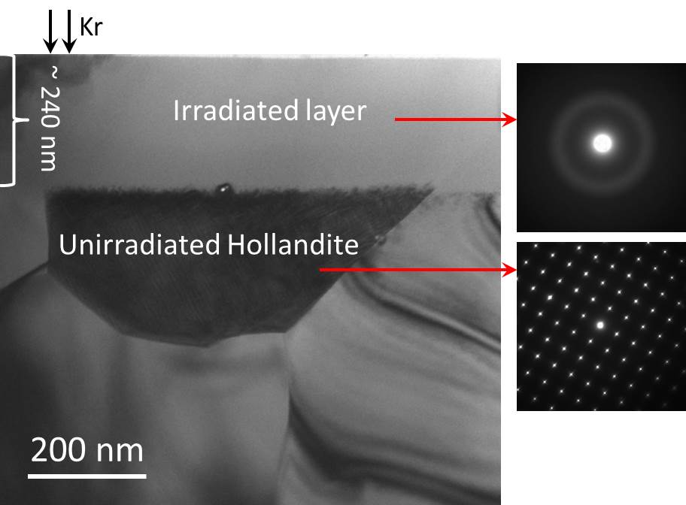
Cross-sectional TEM observation of Kr irradiated SW-1732
Z: zirconolite
H: hollandite

Slide 12
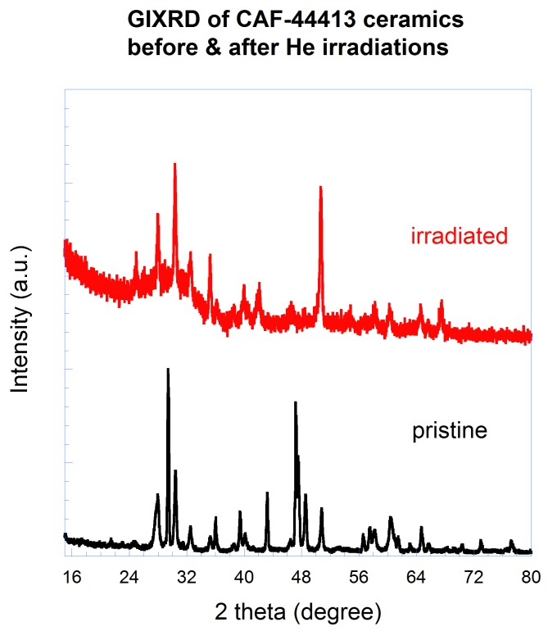
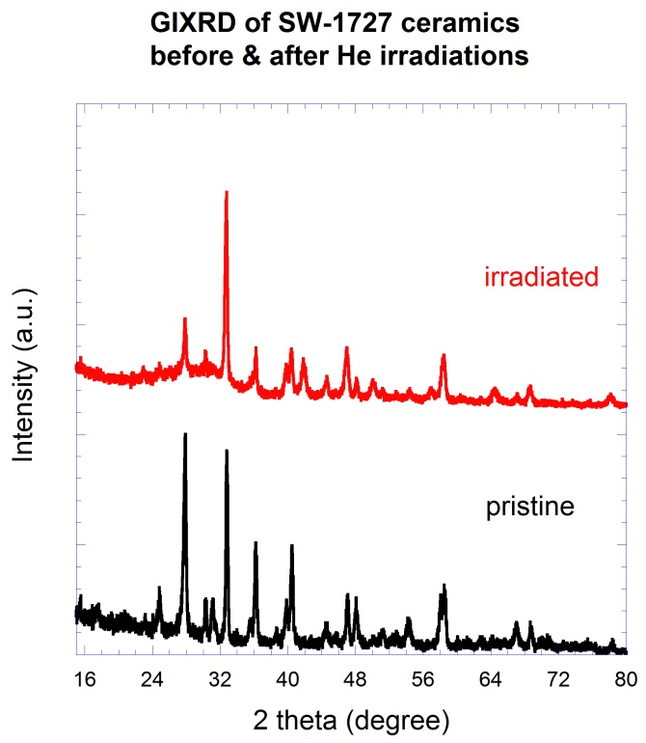
He irradiation on multi-phase ceramics from SRNL (Melt) and ANSTO (HIPed)
GIXRD patterns obtained from CAF-44413 (SRNL) and SW-1727 (ANSTO) before and after 200 keV He ion irradiation to a fluence of 2 × 10¹⁷ He/cm² (corresponding to peak displacement damage dose of ~ 5 dpa)
Three major crystalline phases including hollandite, zirconolite, and perovskite, are identified in both pristine multiphase ceramic samples.
The irradiation-induced amorphization was observed in both multiphase ceramic samples.

Slide 13
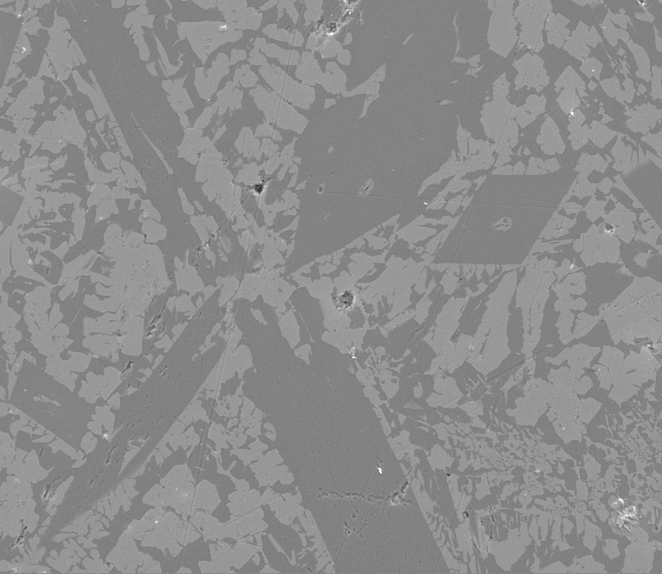
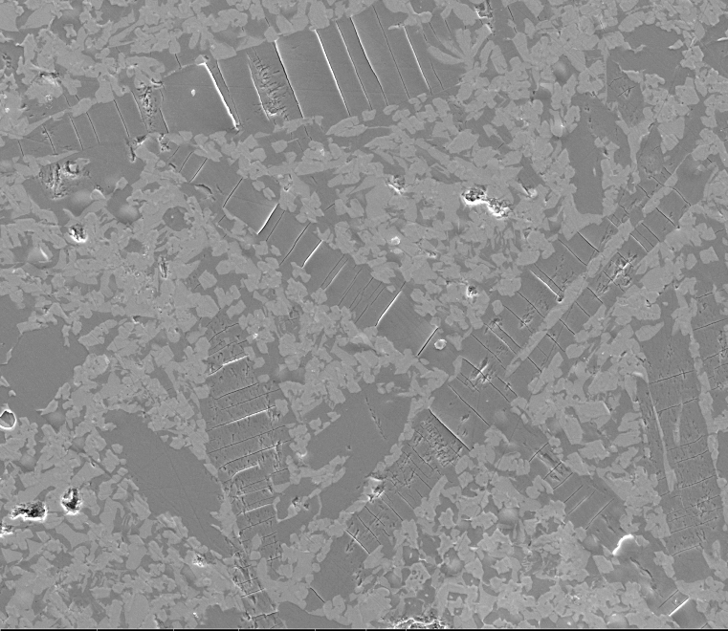
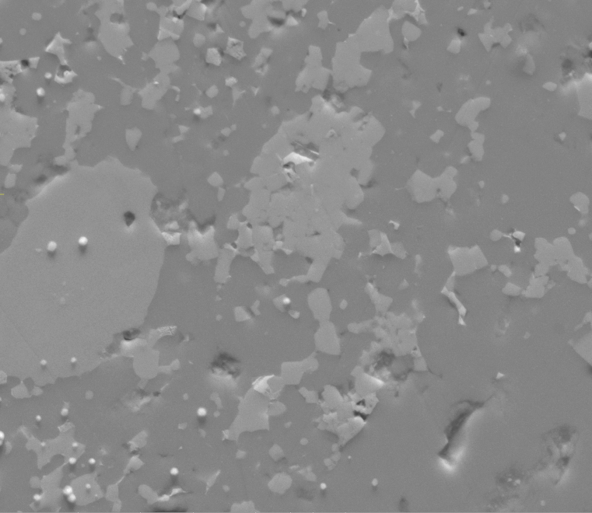
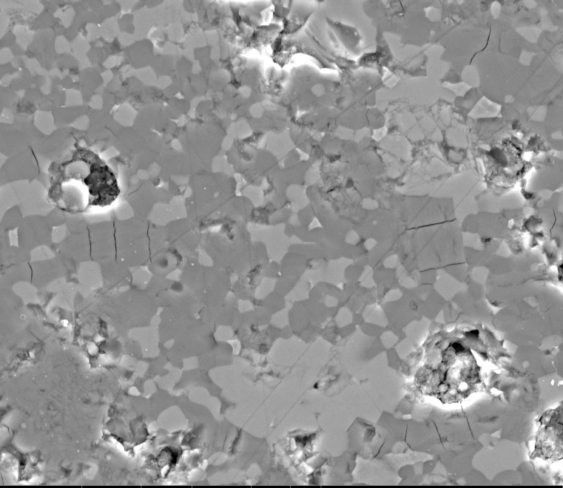
Microcracking on He irradiated multi-phase ceramics by SEM
Pristine CAF-11113
He irradiated CAF-11113
hollandite
hollandite
melt
50 um
50 um
Pristine SW-1727
He irradiated SW-1727
HIP
hollandite
10 um
10 um

Slide 14
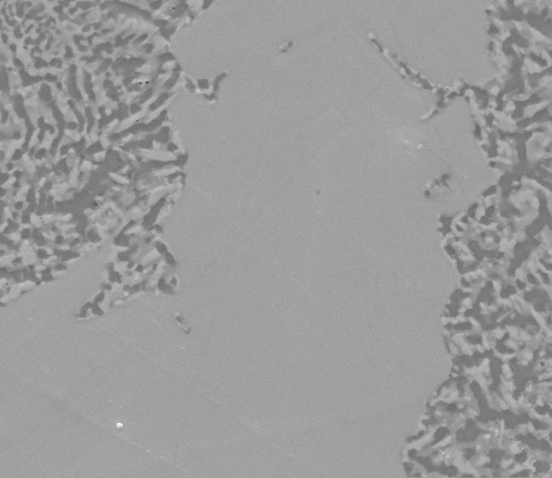
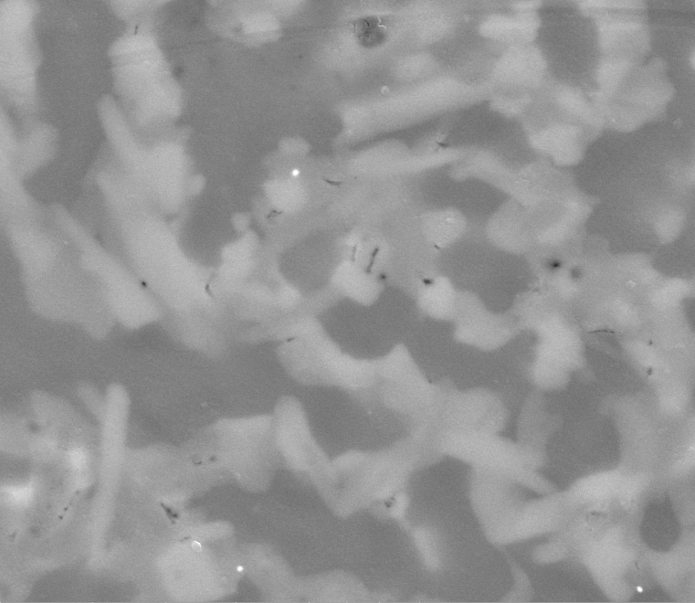
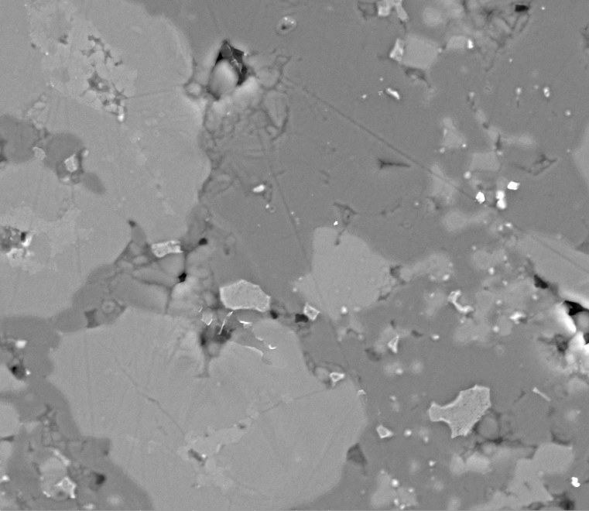
Microcracking on Kr irradiated multi-phase ceramics by SEM
Kr irradiated CAF-44413
Kr irradiated CAF-44413
melt
10 um
2 um
Kr irradiated SW-1727
hollandite
HIP
10 um

Slide 15
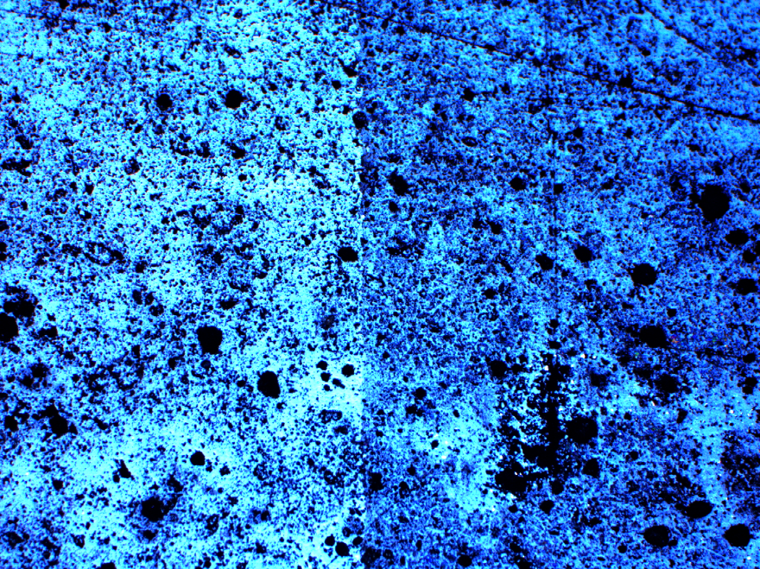
Swelling study experimental
Al foil
Ion beam irradiation
unirradiated
irradiated
AFM to get topography

Slide 16
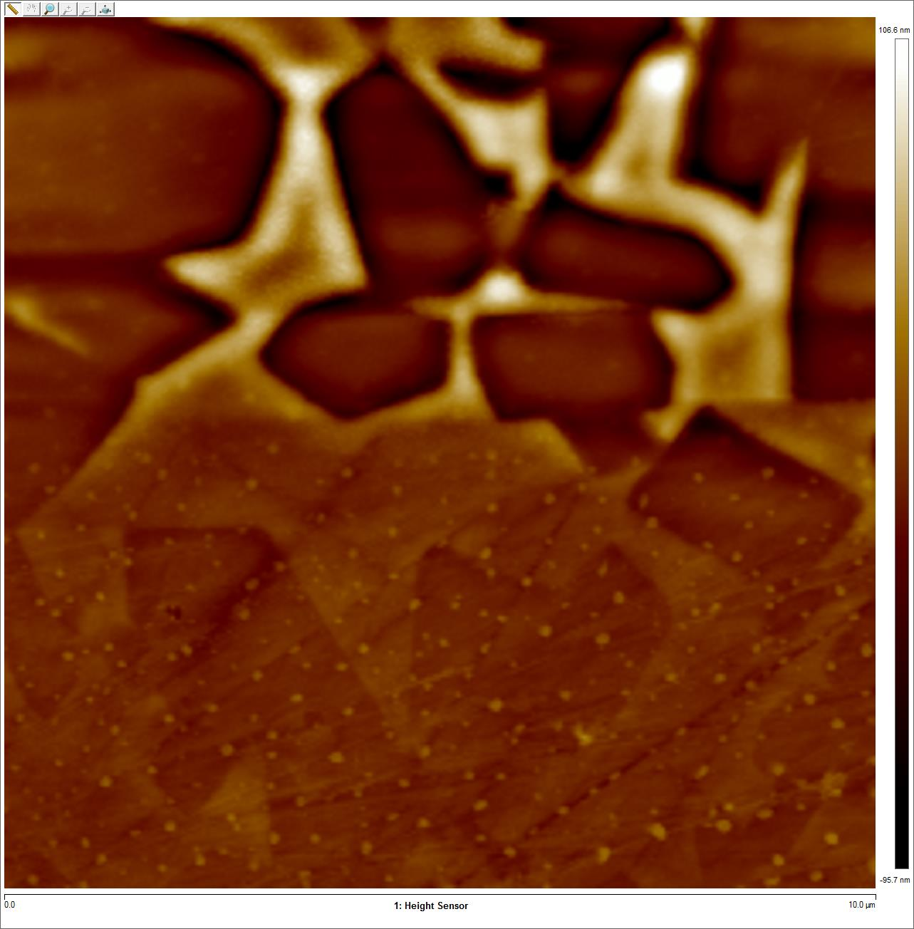
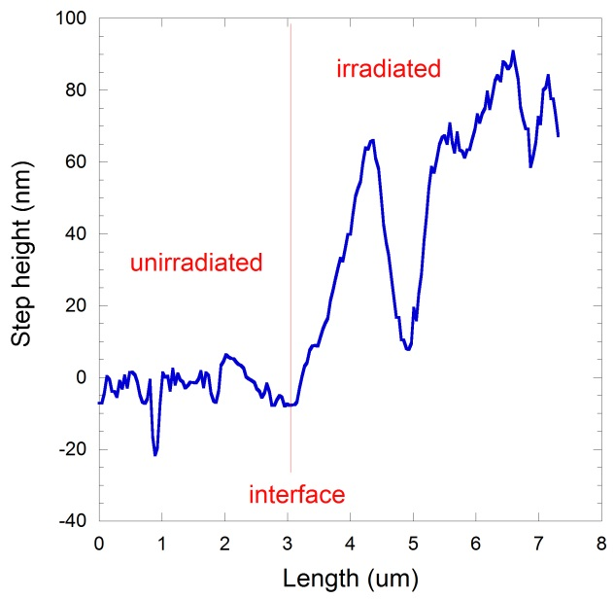
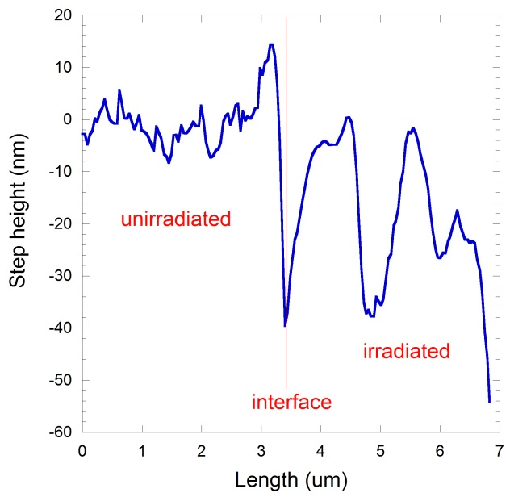
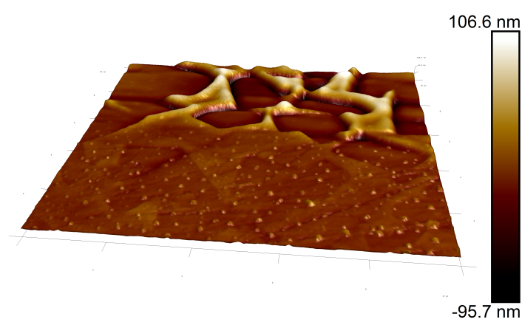
Swelling study on Kr irradiated multi-phase ceramic (HIPed) by AFM
unirradiated
irradiated
+15%
2D
40x40 um
-8%
3D

Slide 17
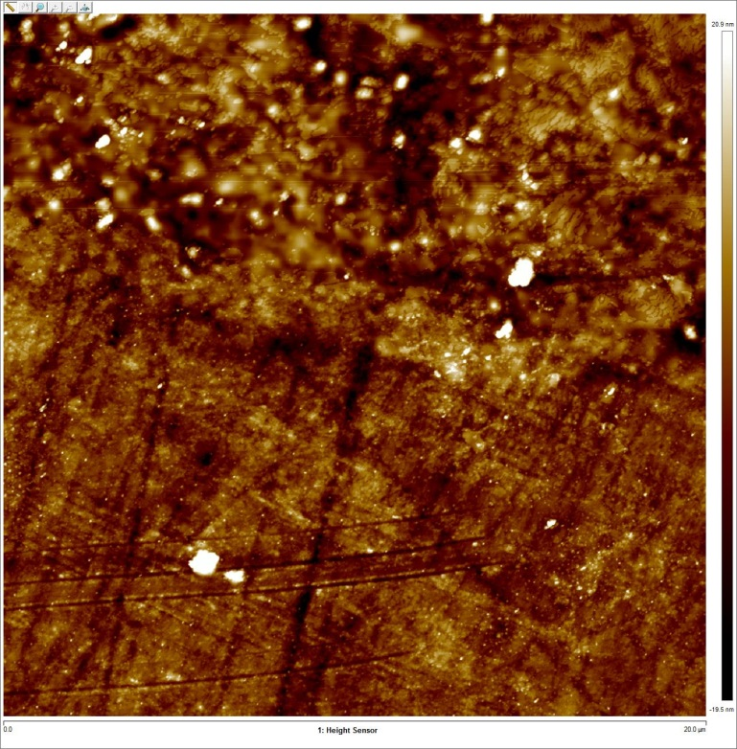
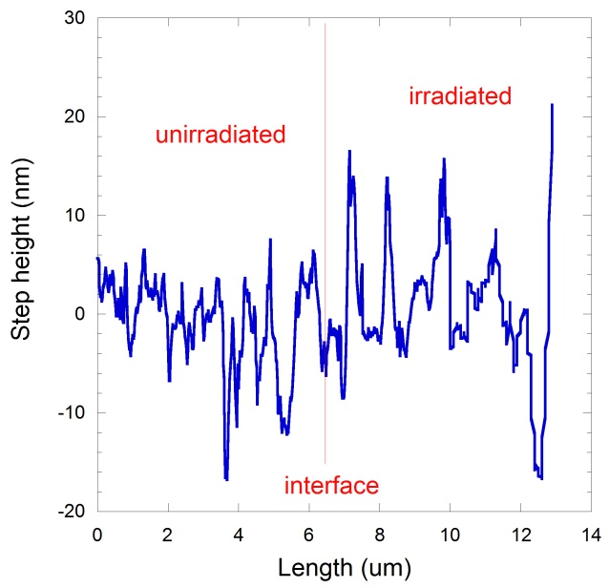
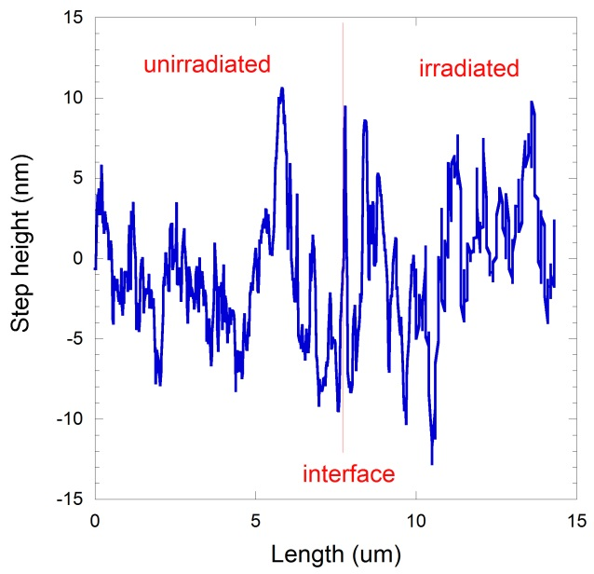
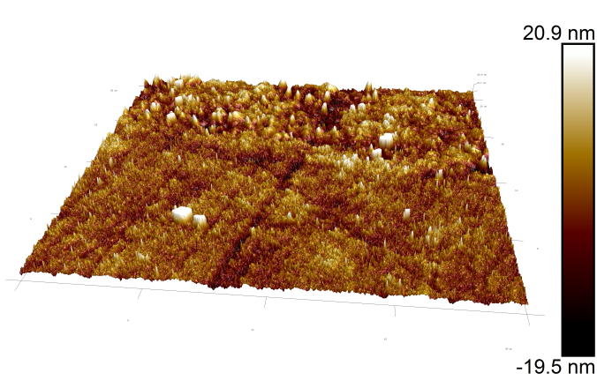
Swelling study on Kr irradiated multi-phase ceramic (melt) by AFM
unirradiated
irradiated
+2%
2D
40x40 um
+1%
3D

Slide 18
Conclusion
Similar radiation damage responses from HIPed and Melt processed multi-phase ceramic waste forms
For structural evolution, amorphization under light ion (He) irradiation occurs at higher dpa dose than heavy ion (Kr) irradiation, which suggests stronger radiation tolerance of ceramics under β and γ decay environments
Extensive microcracks observed in hollandite phase of He irradiated ceramics (HIPed and Melt), but only a few isolated small cracks found in Kr irradiated samples
Different swelling & compaction in different crystalline phases of irradiated multi-phase ceramics

Slide 19
Acknowledgements
This work is funded by
US DOE-NE Fuel Cycle Research and Development,
Material Recovery & Waste Forms Development Campaign

Slide 20
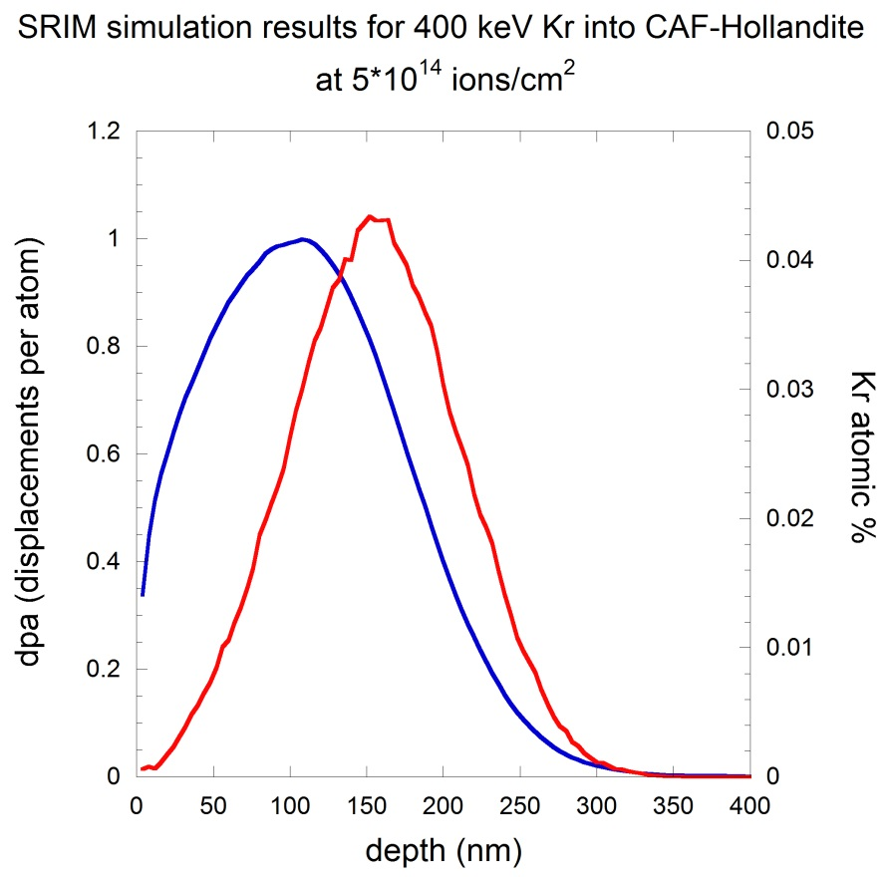
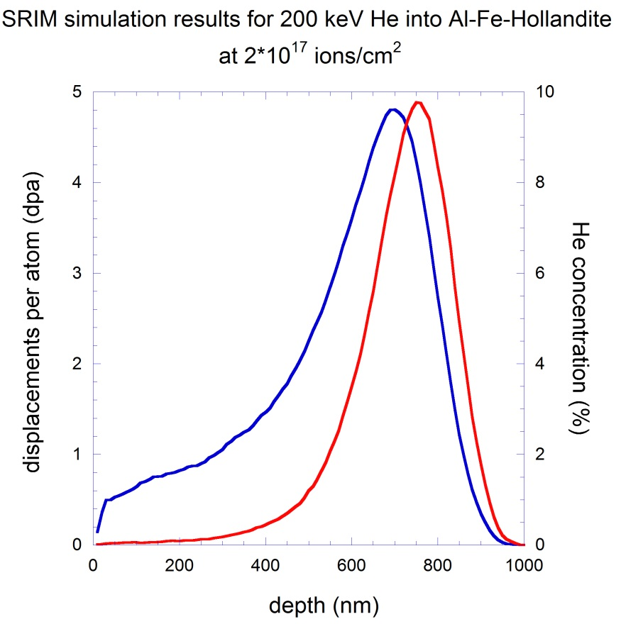
SRIM simulations on hollandites

Slide 21
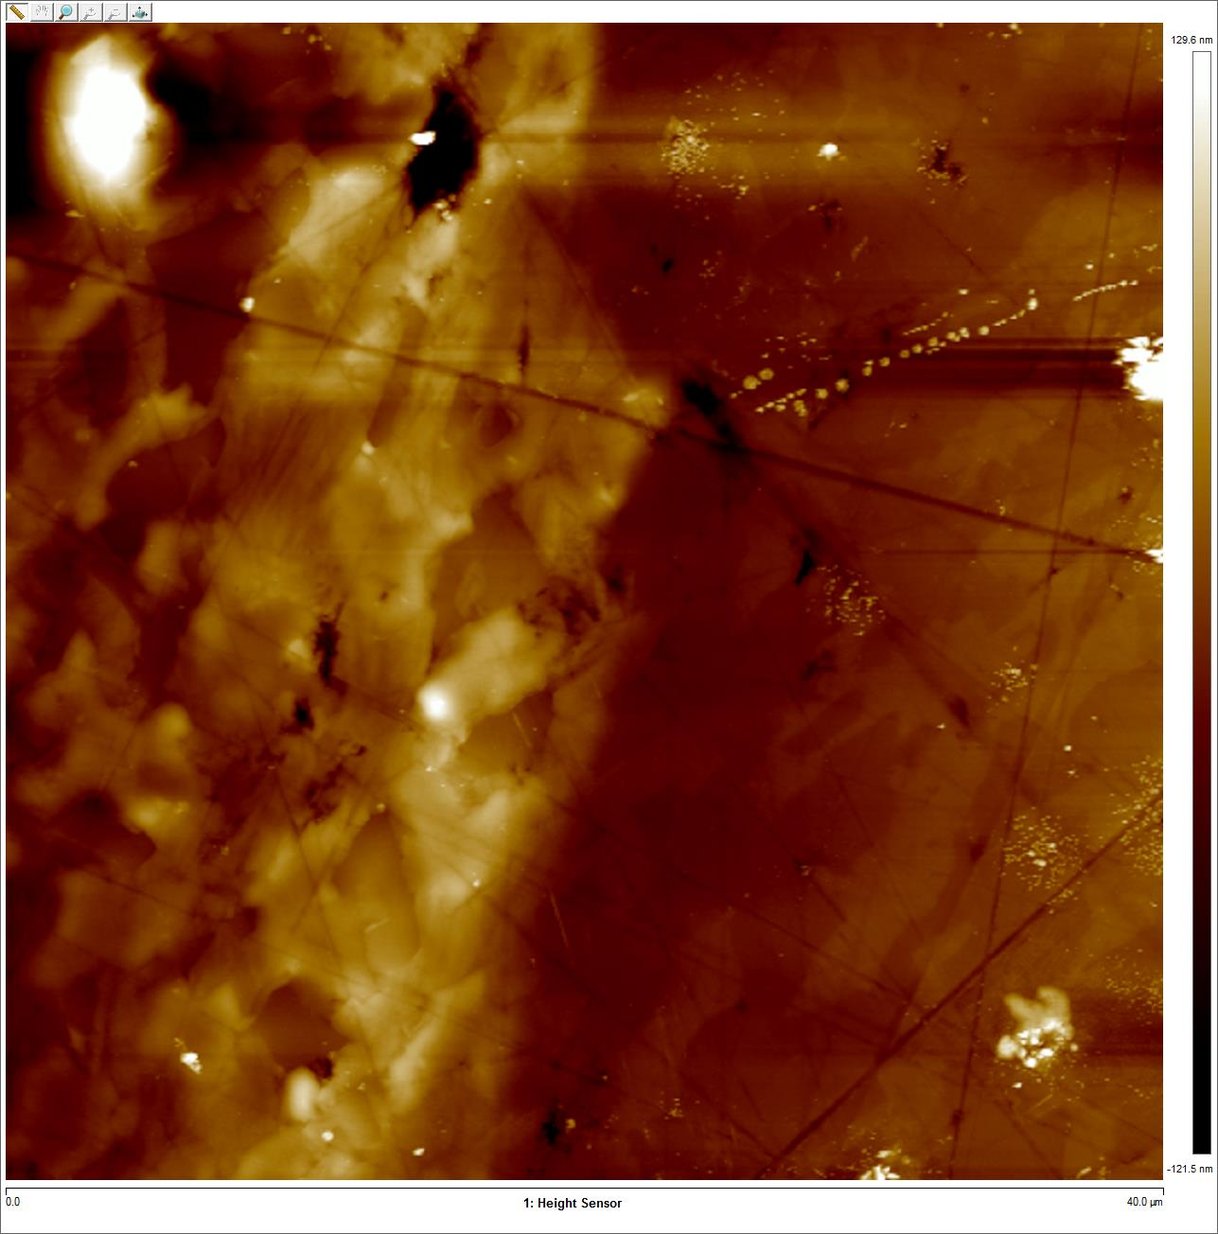
Swelling study on He irradiated multi-phase ceramic (melt) by AFM
unirradiated
irradiated
irradiated
Step height (nm)
-5%
2D
unirradiated
interface
Length (um)
40x40 um
irradiated
Step height (nm)
3D
-3%
interface

Slide 22
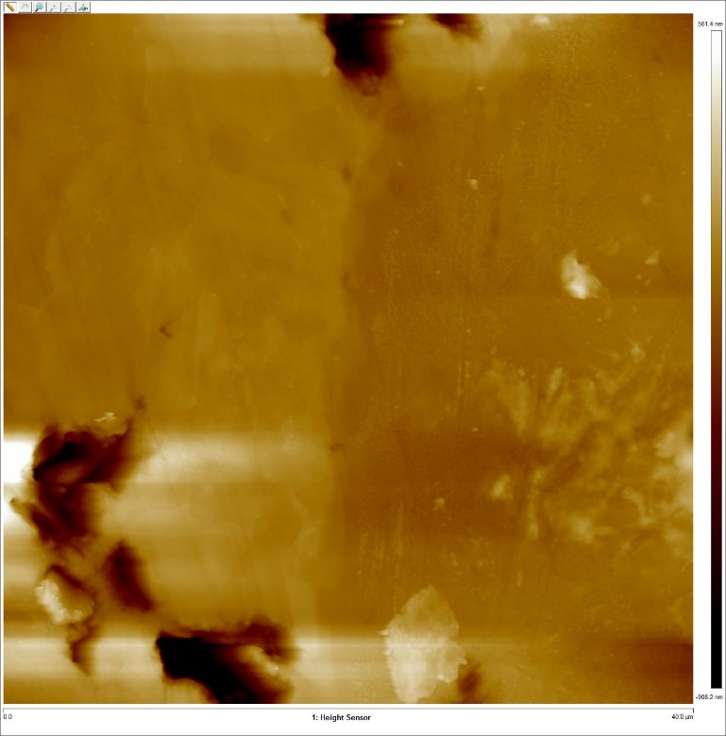
Swelling study on He irradiated multi-phase ceramic (HIPed) by AFM
unirradiated
irradiated
interface
-3%
Step height (nm)
irradiated
2D
unirradiated
Length (um)
40x40 um
interface
-6%
Step height (nm)
irradiated
3D
unirradiated
Length (um)

