Slide 1








The incorporation of U and Pu in zirconolite glass-ceramic wasteforms
Stephanie Thornber
Supervisors: Prof. Neil Hyatt¹, Dr. Martin Stennett¹, Dr. Daniel Gregg² and Dr. Lou Vance²
¹ Immobilisation Science Laboratory, Department of Materials Science & Engineering, The University of Sheffield
² ANSTO, Lucas Heights, NSW 2234, Australia
sthornber1@Sheffield.ac.uk
MRS 2017
Wednesday 1st November 2017, Sydney, Australia
@ISL_Sheffield
Notes:
Final year PhD student at Sheffield University
Developing zirconolite glass-ceramics for Pu residue immobilisation.
This presentation is a practice for my MRS preso next week, welcome any feedback and I apologise if it’s not 100% polished.

Slide 2
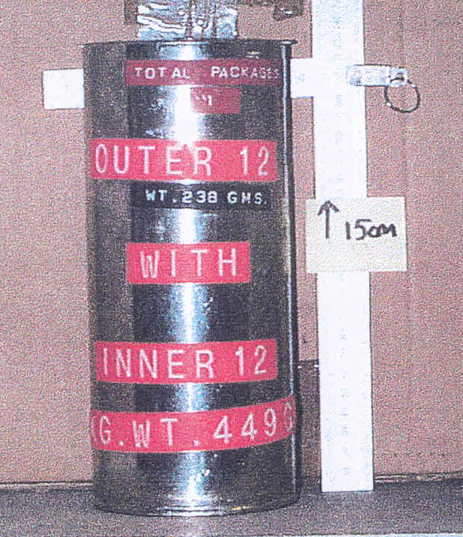
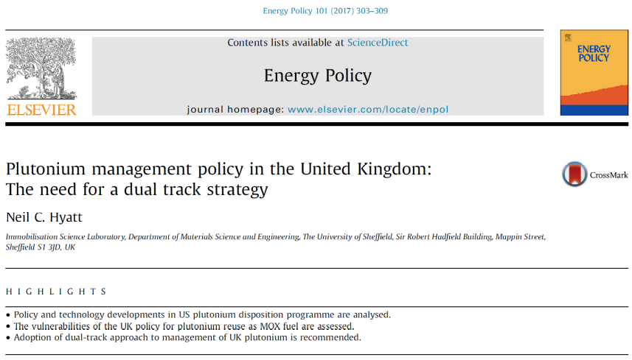
Background
Pu-residues
Higher activity wastes originating from multiple sources including; early R&D, reprocessing and MOx materials.
Heterogeneous
Glass formers
Refractory
Physically variable
These wastes are problematic for current vitrification technologies in terms of treatability, Pu accountancy and wasteform quality.
Pu stockpile
Image courtesy of NNL
Sellafield stores > 140 tonnes of civil separated PuO₂.
Current government policy is to fabricate the PuO₂ into MOx fuel for reuse.
Key risks:
UK has no current plans for MOx reactors
Not all material is suitable for fuel fabrication
Credible options are not fully mature
Immobilisation is required to deal with the whole stockpile.
N.C. Hyatt, Energy Policy, 101 (2017) 303.
sthornber1@Sheffield.ac.uk
Stephanie Thornber
University of Sheffield, UK
Notes:
Pu-residues are a category of Pu based high activity wastes in the UK.
Very heterogeneous and range from low to high purity levels.
All Pu content is in excess of PCM.
Some contain glass forming compounds and impurities including Cl from the degradation of packaging during storage.
Problematic for vitrification due to these properties. The refractory nature requires higher processing temperatures
Pu has low solubility and is know to separate. The pouring of vitreous wasteforms makes Pu accountancy and safeguards difficult
HIP is a potential consolidation method proposed by the Nuclear Decommissioning Authority in the UK.
Uses high temperatures and pressures to consolidate and densify wasteforms.
Advantages include; volume reduction, flexibility, hermetically sealed…..

Slide 3
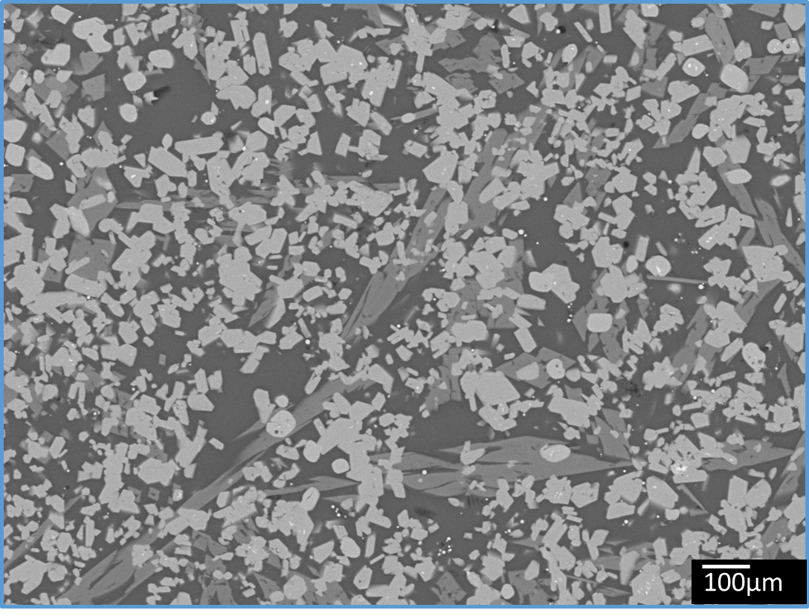
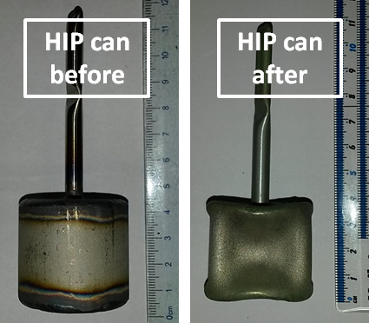
Background
Hot Isostatic Pressing
Advantages:
Batch process
Flexible to waste feed and material
Range of processing conditions
Hermetically sealed wasteforms
Significant volume reduction
No off-gas production
No limitations on the wasteform
Significant cost saving
Zirconolite Glass-Ceramics
Main advantages:
Proliferation resistance
Chemical durability
Chemical flexibility
Waste loading capacity
Ease of processing
Natural analogues
sthornber1@Sheffield.ac.uk
Stephanie Thornber
University of Sheffield, UK
Notes:
Pu-residues are a category of Pu based high activity wastes in the UK.
Very heterogeneous and range from low to high purity levels.
All Pu content is in excess of PCM.
Some contain glass forming compounds and impurities including Cl from the degradation of packaging during storage.
Problematic for vitrification due to these properties. The refractory nature requires higher processing temperatures
Pu has low solubility and is know to separate. The pouring of vitreous wasteforms makes Pu accountancy and safeguards difficult
HIP is a potential consolidation method proposed by the Nuclear Decommissioning Authority in the UK.
Uses high temperatures and pressures to consolidate and densify wasteforms.
Advantages include; volume reduction, flexibility, hermetically sealed…..

Slide 4
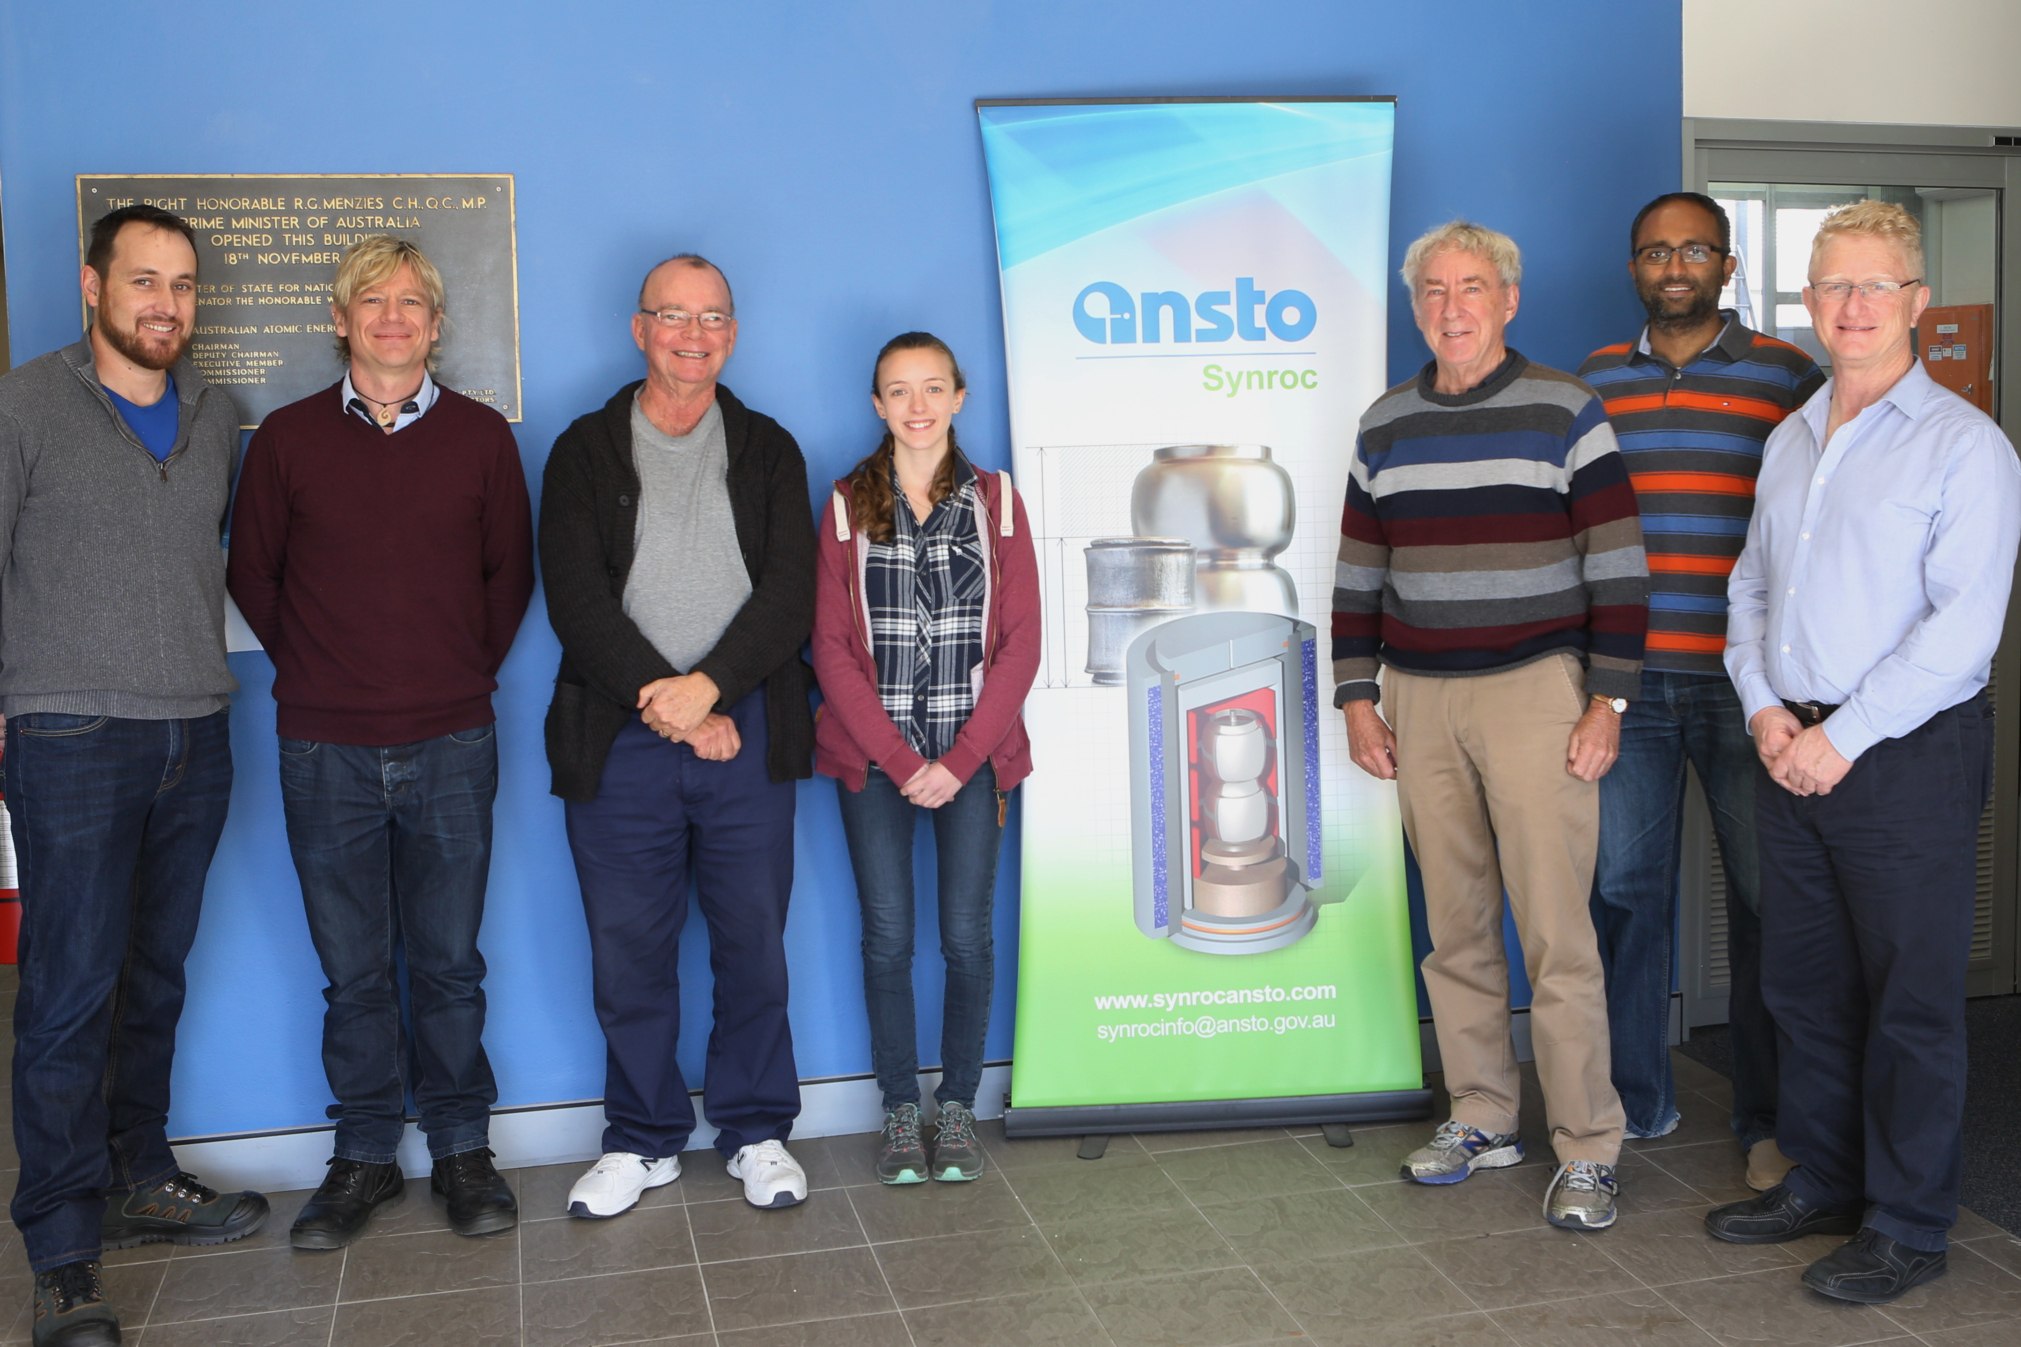
My PhD project
Inactive HIP process optimisation
Inactive formulation optimisation
Inactive waste incorporation studies
Cl contamination study
Low activity U studies
High activity U HIP studies
Pu sinter verification study
High activity Pu HIP studies
High activity U HIP studies
Pu sinter verification study
High activity Pu HIP studies
Inactive HIP process optimisation
Formulation optimisation experiments investigated the effect of glass composition on the phase assemblage of the glass-ceramic wasteform.
CeO₂ has been utilised as a PuO₂ surrogate for waste incorporation experiments.
Consideration of Cl contamination and its solubility limit in the glass-ceramic wasteform.
UO₂ was used as a radioactive PuO₂ surrogate.
PuO₂ sinter experiments were performed.
PuO₂ HIP samples were fabricated and characterised, investigating the effect of redox conditions on the behaviour of Pu partitioning in the wasteform.
Stephanie Thornber
University of Sheffield, UK
sthornber1@Sheffield.ac.uk
Stephanie Thornber
University of Sheffield, UK
Notes:
HIP has a large operating window and is flexible to processing different wastes and materials.
Allows Pu-residues to be considered case by case.
Different materials are proposed for different streams of the residues depending on their requirements
Eg…….
My project looking at glass-ceramics for low purity streams.
Through my thesis I have studied the effect of glass composition
CeO2 incorporation
Solubility of Cl
UO2 incorporation
PuO2 incorporation through sinters and HIP experiments
The active work has been conducted here at ANSTO and is the basis of my presentation today.
This work was funded by NDA and ANSTO.

Slide 5
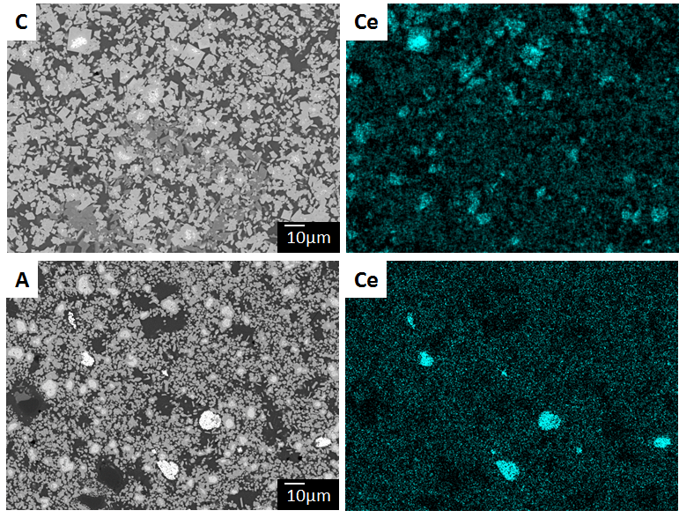
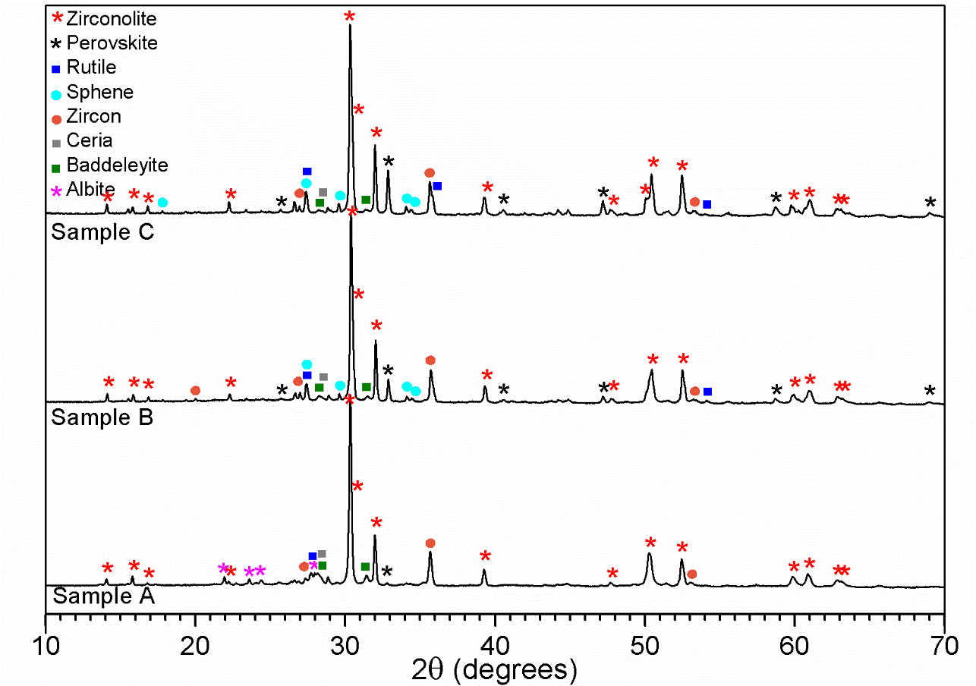
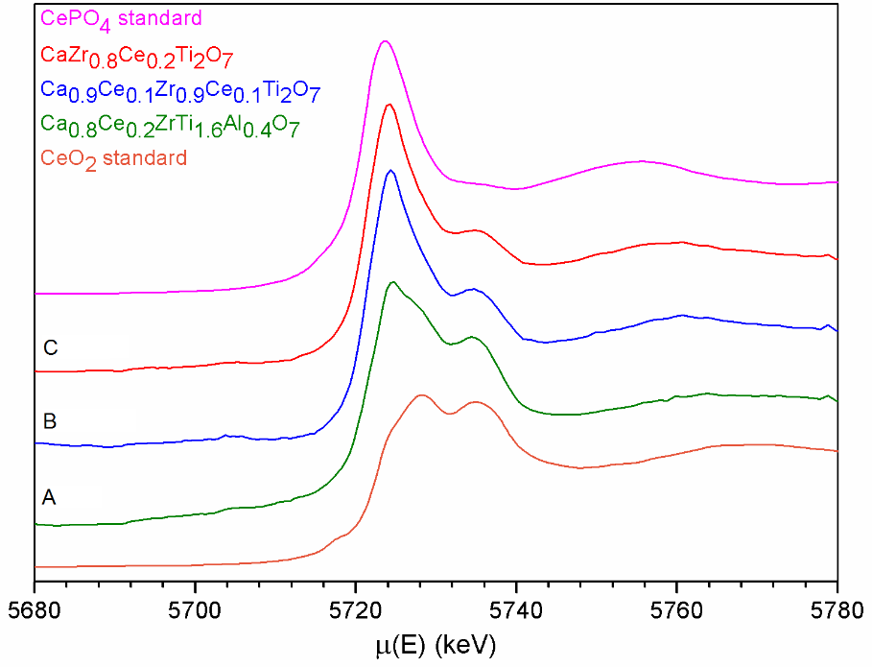
Inactive Ce Incorporation Study
Glass-ceramic (30/70), glass phase Na₂Al₂Si₆O₁₆.
Sample | Target ceramic composition | Target (actual) Ce oxidation state | Partitioning ratio
A | Ca_{0.8}Ce_{0.2}ZrTi_{1.6}Al_{0.4}O₇ | 4+ (3.8+) | 100 : 0
B | Ca_{0.9}Ce_{0.1}Zr_{0.9}Ce_{0.1}Ti₂O₇ | 3+ (3.2+) | 100 : 8
C | CaZr_{0.8}Ce_{0.2}Ti₂O₇ | 4+ (3.8+) | 100 : 4
sthornber1@Sheffield.ac.uk
Stephanie Thornber
University of Sheffield, UK

Slide 6
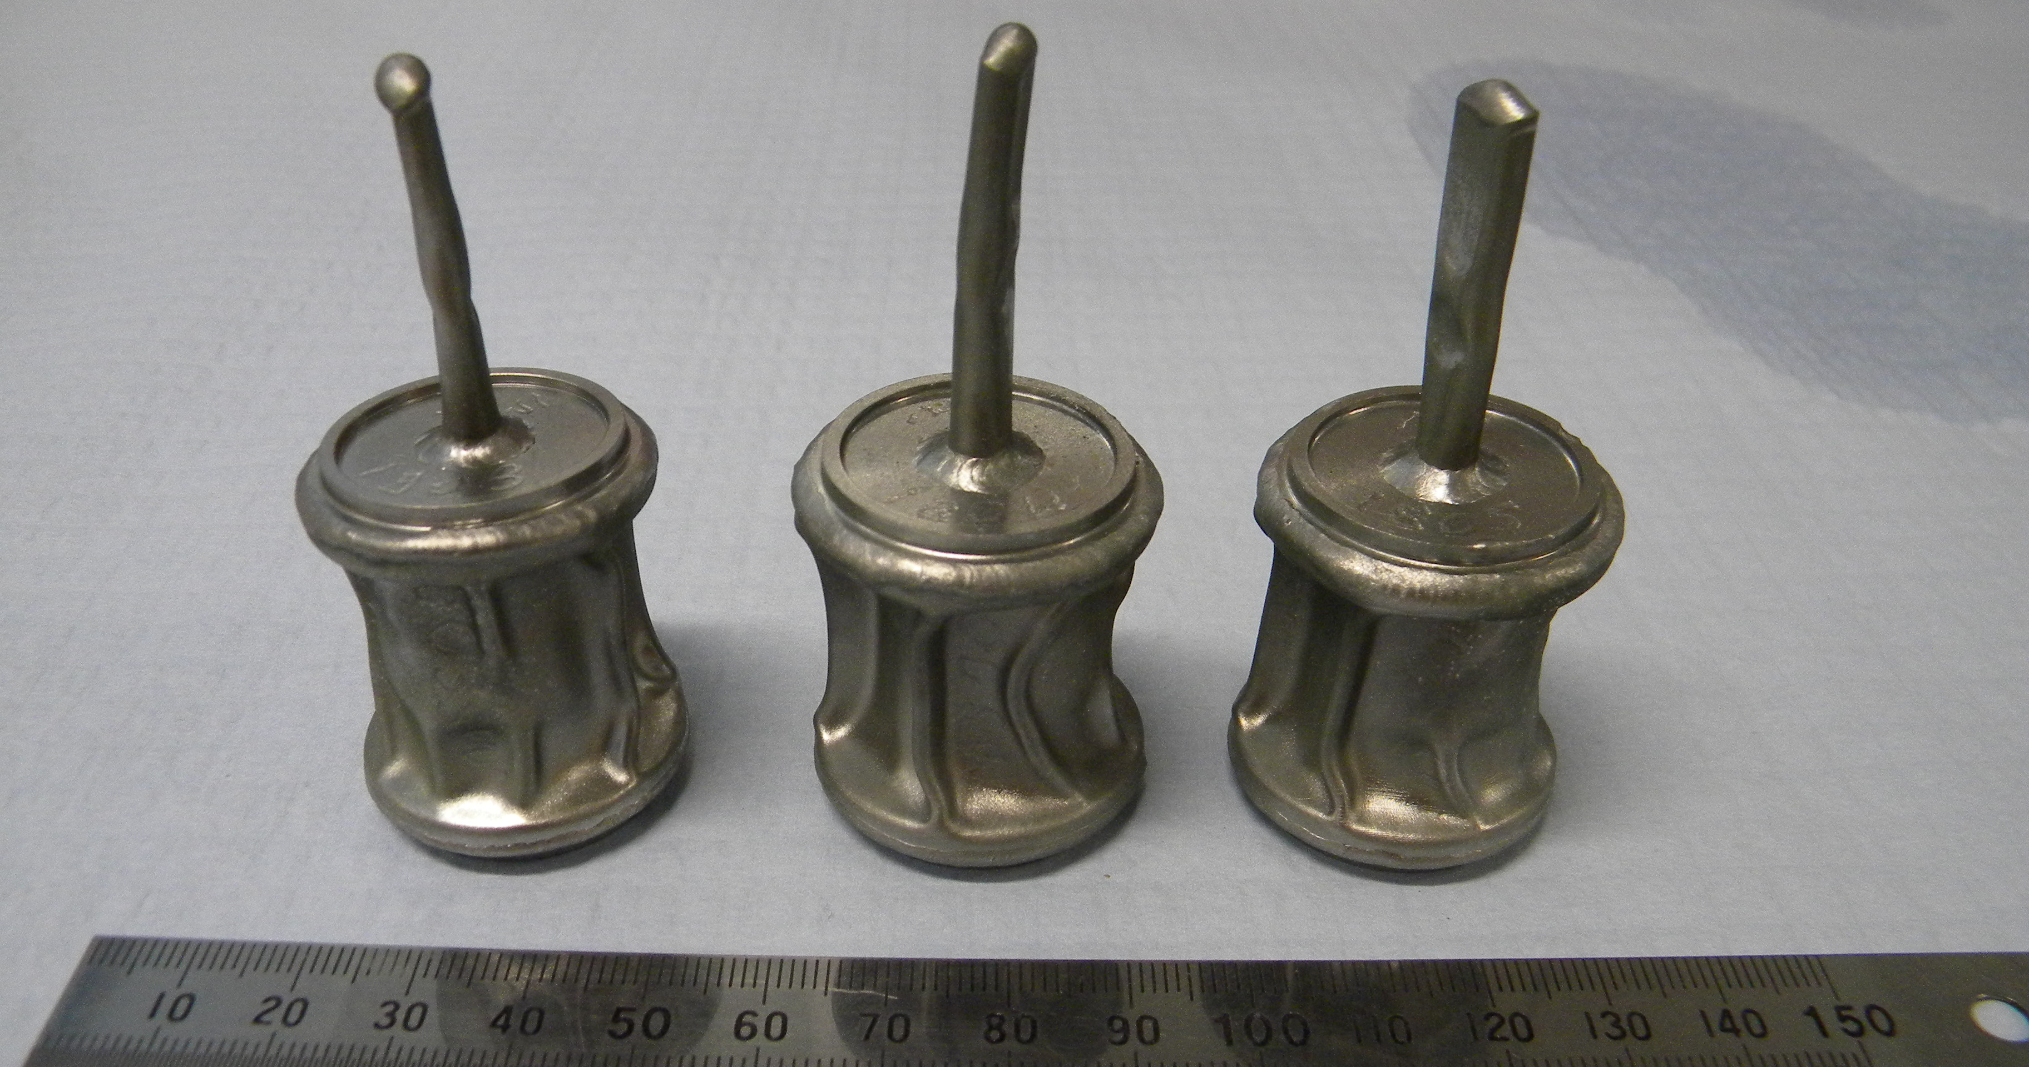
Uranium Incorporation Study
Glass-Ceramic (30/70) – glass phase Na₂Al₂Si₆O₁₆
HIP
XRD
Sample | Formulation | Redox agent
SW-1803 | CaZr_{0.8}U_{0.2}Ti₂O₇ | 2wt% Ti
SW-1804 | Ca_{0.8}U_{0.2}ZrTi_{1.6}Al_{0.4}O₇ | 2wt% Ti
SW-1805 | Ca_{0.95}Ce_{0.05}Zr_{0.8}U_{0.15}Ce_{0.05}Ti₂O₇ | 2wt% Ti
SEM
DRS
Precursors were milled at 500 rpm for 30 min in IPA.
UO₂ pellets were voloxidised to U₃O₈.
U₃O₈ added to the batch and ball milled overnight in cyclohexane.
Calcined at 700°C, 3hr under H₂/N₂ atmosphere.
2wt% Ti powder added before pressing into pellets.
HIPed at 1250 °C for 4 hr, under 100MPa of pressure.
sthornber1@Sheffield.ac.uk
Stephanie Thornber
University of Sheffield, UK
Notes:
We targeted 3 stoichiometries for the U samples again targeting U4+ on Zr and U4+ on Ca. The third sample targeted U4+ on Zr and included Ce3+ on Ca and Zr to see if perovskite forms like the Ce samples.
The U was added as U3O8. This was a compromise between surrogates. The UO2 inventory available had received previous high temperature heat treatments so the UO2 structure was very stable and highly unreactive. We voloxidised the UO2 pellets in air to produce the U3O8 powder. In this form the U is highly reactive to aid incorporation into the wasteform.
However, whilst the U3O8 is more representative of the Pu reactivity in the wastes we are trying to represent, Pu does not obtain the 5+ oxidation state. So the calcination was performed under reducing conditions to promote the reduction of U5+ to U4+. This was again helped by the reducing conditions in the HIP can during consolidation.
The samples were HIPed at 1250c 4hr under 100MPa of pressure.

Slide 7
Uranium Incorporation Study
Zirconolite - 3T structure stabilised.
Trace amount of undigested UO₂.
Reduced reactivity in SW-1804.
Preferential formation of sphene not perovskite in SW-1805.
sthornber1@Sheffield.ac.uk
Stephanie Thornber
University of Sheffield, UK
Notes:
SEM showed excellent waste incorporation on 1803 with only minor bright spots remaining. 1805 was the same.
1804 however had a different microstructure. Smaller grains and remaining UO2 suggest slower kinetics through the melt, inhibiting diffusion. Therefore we have inhibited waste digestion and reduced crystal growth.
In 1805 the microstructure was in agreement with 1803 and no CeO2 was seen. Interestingly the Ce generated the formation of sphene particles rather than perovskite as observed in my Ce samples. Why I’m still unsure….
The EDX compositional analysis again showed Ca site substitution and more Al in the Al charge compensated samples.
Due to the strong reducing conditions U was assumed 4+ and Ce3+, charge compensation occurred by Ti reduction. Increased Al = less Ti3+, Less U = less Ti3+. The partitioning ratios were again very good and consistent with the literature. Ce inhibited U partitioning a bit.

Slide 8
Uranium Incorporation Study
EDS compositional analysis
Target composition: CaZr_{0.8}U_{0.2}Ti₂O₇
Ca_{0.62}U_{0.32}Zr_{0.99}Ti⁴⁺_{1.51}Ti³⁺_{0.45}Al_{0.05}O₇
Ceramic : Glass partitioning: 100 : 2
Target composition: Ca_{0.8}U_{0.2}ZrTi_{1.6}Al_{0.4}O₇
Ca_{0.60}U_{0.32}Zr_{1.02}Ti⁴⁺_{1.43}Ti³⁺_{0.40}Al_{0.17}O₇
Ceramic : Glass partitioning: 100 : 2
Target composition: Ca_{0.95}Ce_{0.05}Zr_{0.8}U_{0.15}Ce_{0.05}Ti₂O₇
Ca_{0.64}U_{0.21}Ce_{0.05}Zr_{0.99}Ti⁴⁺_{1.77}Ti³⁺_{0.19}Al_{0.04}O₇
Ceramic : Glass partitioning: 100 : 4
sthornber1@Sheffield.ac.uk
Stephanie Thornber
University of Sheffield, UK
Notes:
The EDX data agrees with the stabilisation of 3T rather than 2M with the high U substitution. The literature reports 2M stabilisation upto 0.15f.u. and 3T at substitutions higher than that.
Another polytype reported is 4M structure but this is favoured in oxiding conditions according to the literature thus it is in agreement that we observe 3T due to the reducing conditions and level of U substitution occurring according to the EDX.

Slide 9
Uranium Incorporation Study
Sample | (Target) zirconolite composition and measured composition | Partitioning ratio C : G
SW-1803 | (CaZr_{0.8}U_{0.2}Ti₂O₇) Ca_{0.62}U_{0.32}Zr_{0.99}Ti⁴⁺_{1.51}Ti³⁺_{0.45}Al_{0.05}O₇ | 100 : 2
SW-1804 | (Ca_{0.8}U_{0.2}ZrTi_{1.6}Al_{0.4}O₇) Ca_{0.60}U_{0.32}Zr_{1.02}Ti⁴⁺_{1.43}Ti³⁺_{0.40}Al_{0.17}O₇ | 100 : 2
SW-1805 | (Ca_{0.95}Ce_{0.05}Zr_{0.8}U_{0.15}Ce_{0.05}Ti₂O₇) Ca_{0.64}U_{0.21}Ce_{0.05}Zr_{0.99}Ti⁴⁺_{1.77}Ti³⁺_{0.19}Al_{0.04}O₇ | 100 : 4
Structural transitions:
Increased substitutions result in structural transitions between zirconolite polytypes.
Oxidising conditions:
Zirconolite-2M → Zirconolite-4M → Pyrochlore
Reducing conditions:
Zirconolite-2M → Zirconolite-3T → Pyrochlore
0.15 f.u.
→
0.4 f.u.
→
0.6 f.u.
0.15 f.u.
→
0.3 f.u.
→
0.6 f.u.
I. E. Grey et al., J. Sol. State. Chem, 174, (2003), B. D. Begg et al., Mat. Res. Soc. Symp. 465, (1997), E. R. Vance et al., J. Am. Ceram. Soc, 85, (2002)
sthornber1@Sheffield.ac.uk
Stephanie Thornber
University of Sheffield, UK
Notes:
The EDX data agrees with the stabilisation of 3T rather than 2M with the high U substitution. The literature reports 2M stabilisation upto 0.15f.u. and 3T at substitutions higher than that.
Another polytype reported is 4M structure but this is favoured in oxiding conditions according to the literature thus it is in agreement that we observe 3T due to the reducing conditions and level of U substitution occurring according to the EDX.

Slide 10
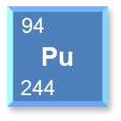
Plutonium Sinter Verification Study
Sintered samples were characterised to verify the PuO₂ reactivity before progressing to HIP samples.
PuO₂ powder was added as the oxide powder.
Calcined at 750°C, 3hr under H₂/N₂ atmosphere.
Redox agent was added before the pellets were pressed.
Sintered at 1250 °C for 4 h in air.
Formulation | Canister material | Redox agent
CaZr_{0.9}Pu_{0.1}Ti₂O₇ | Stainless Steel | 4wt% Ni
G
N
Z
7µm
sthornber1@Sheffield.ac.uk
Stephanie Thornber
University of Sheffield, UK
Notes:
No PuO2 or secondary Pu bearing phase was identified thus confirming complete digestion of the PuO2 waste.
This confirmed excellent reactivity of the Pu and were promising results for the HIP sample.
The major phase was identified as zirconolite 2M with minor phases zirconolite 3T adna NiTiO3.
The lower waste loading means we are still within the 2M stabilisation range so this makes sense.
The microstructure was…..
This sample was processed under oxidising conditions. Can’t expect Ti3+ charge compensation under these conditions.
Also don’t expect Pu3+ reduction so the Pu in the glass was higher than we expected from our previous Ce and U results.
That said, this sample was not dense and there is a chance we were detecting phases below the glass…. Errors

Slide 11
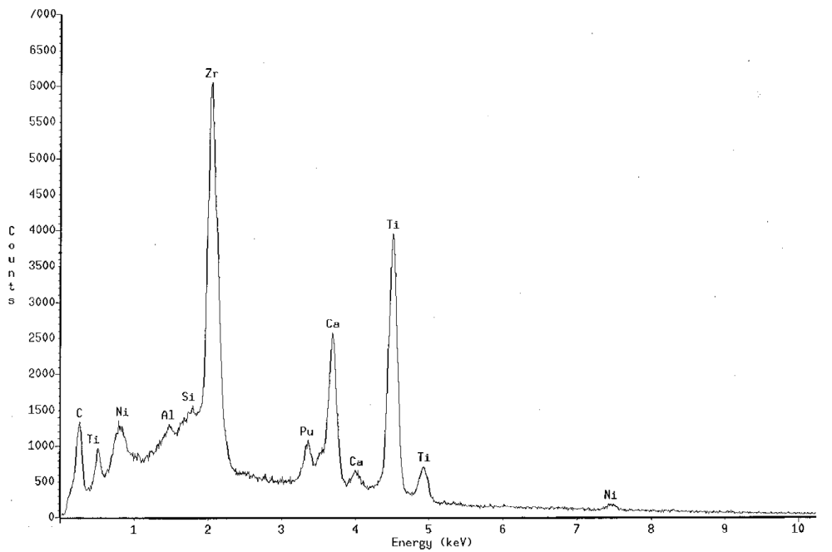
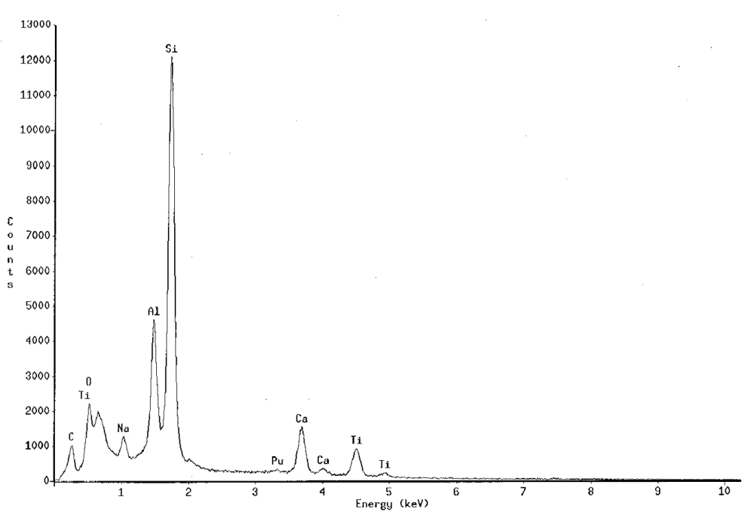
Plutonium Sinter Verification Study
Z = Zirconolite ceramic phase
G
Z
7µm
G = Na₂Al₂Si₆O₁₆ glass phase
Zirconolite composition | Partitioning ratio
Ca_{0.76}Pu_{0.11}Na_{0.10}Zr_{1.04}Ti_{1.79}Al_{0.04}Ni_{0.15}O₇ | 100 : 9
No undissolved PuO₂.
Excellent phase assemblage and microstructure.
Positive partitioning of the Pu into the ceramic phase.
sthornber1@Sheffield.ac.uk
Stephanie Thornber
University of Sheffield, UK
Notes:
No PuO2 or secondary Pu bearing phase was identified thus confirming complete digestion of the PuO2 waste.
This confirmed excellent reactivity of the Pu and were promising results for the HIP sample.
The major phase was identified as zirconolite 2M with minor phases zirconolite 3T adna NiTiO3.
The lower waste loading means we are still within the 2M stabilisation range so this makes sense.
The microstructure was…..
This sample was processed under oxidising conditions. Can’t expect Ti3+ charge compensation under these conditions.
Also don’t expect Pu3+ reduction so the Pu in the glass was higher than we expected from our previous Ce and U results.
That said, this sample was not dense and there is a chance we were detecting phases below the glass…. Errors

Slide 12
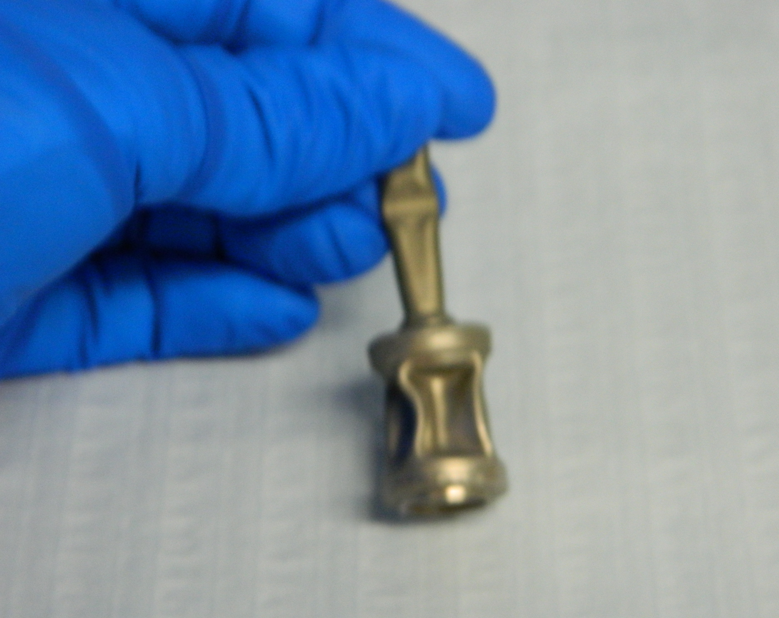
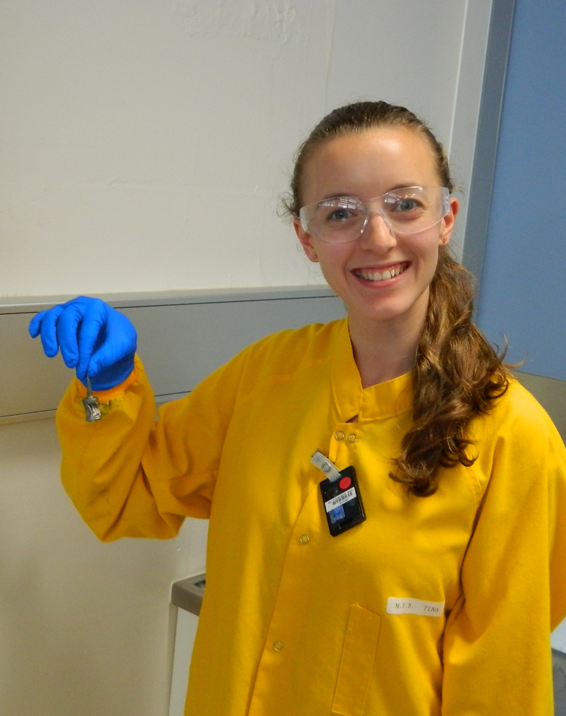
Plutonium HIP Incorporation Study
Sample | Formulation | Redox agent
SW-1811 | CaZr_{0.9}Pu_{0.1}Ti₂O₇ | 4wt% Ni
PuO₂ powder was added as the oxide powder.
Calcined at 750°C, 3hr under H₂/N₂ atmosphere.
Redox agent was added before the pellets were pressed.
HIPed at 1250 °C for 4 h under 100MPa of pressure.
Zirconolite composition
Ca_{0.81}Pu_{0.10}Na_{0.09}Zr_{0.95}Ti_{1.82}Al_{0.17}Ni_{0.01}O₇
80µm
1µm

Slide 13
Plutonium HIP Incorporation Study
Sample | Formulation | Redox agent
SW-1811 | CaZr_{0.9}Pu_{0.1}Ti₂O₇ | 4wt% Ni
PuO₂ powder was added as the oxide powder.
Calcined at 750°C, 3hr under H₂/N₂ atmosphere.
Redox agent was added before the pellets were pressed.
HIPed at 1250 °C for 4 h under 100MPa of pressure.
Zirconolite composition
Ca_{0.81}Pu_{0.10}Na_{0.09}Zr_{0.95}Ti_{1.82}Al_{0.17}Ni_{0.01}O₇
80µm
1µm

Slide 14
Summary
Zirconolite glass-ceramics consolidated by hot isostatic pressing for Pu disposition in the UK.
Successful waste incorporation was achieved with multiple waste analogues with preferential incorporation into the zirconolite phase.
The U samples achieved near complete incorporation, with preferential partitioning into the zirconolite phase.
Preferential Ca substitution occurred in all the U and Pu samples.
The higher waste loadings resulted in the stabilisation of zirconolite-3T when consolidated under reducing conditions.
Ti⁴⁺ reduction provided charge compensation for the U substituted samples.
The Pu samples achieved complete digestion of PuO₂ with agreeable phase assemblages and microstructures.
sthornber1@Sheffield.ac.uk
Stephanie Thornber
University of Sheffield, UK
Notes:
Why we don’t see Zr substitution when it has been reported in the literature I still don’t know.
Why sphene formed in U samples not perovskite, don’t know.

Slide 15
Acknowledgements
ANSTO team: Daniel Gregg, Lou Vance, Gerry Triani, Julie Nelson, Dorji Chavara, Ian Watson, Tim Palmer, Miodrag Jovanovik, Yingjie Zhang, Joel Davis
UoS team: Neil Hyatt, David Cartledge, NucleUS ISL
NDA: Mick Slater, Rick Short
Funding bodies: ANSTO, NDA
References
Nuclear Decommissioning Authority, Conditioning of Plutonium Residues by Hot Isostatic Pressing and Options for packaging and Disposal (pre-conceptual stage) Summary of Assessment Report. (2009).
N. C. Hyatt, Plutonium management policy in the United Kingdom: The need for a dual track strategy, Energy Policy, 101, 303-309 (2017).
C.R.Scales, E.R.Maddrell, N.Gawthorpe, B.D.Begg, S.Moricca, R.A.Day, M.W.A.Stewart, “Development of a process for the immobilization of actinide containing residues on the Sellafield site,” International conference of environmental remediation and radioactive waste management, (2005).
B. D. Begg, R. A. Day, A. Brownscombe, Structural effect of Pu substitutions on the Zr-site in zirconolite, Mat. Res. Soc. Symp. 663, (2001).
B. D. Begg, E. R. Vance, The incorporation of Ce in zirconolite, Mat. Res. Soc. Symp. 465, (1997).
E. R. Vance, G. R. Lumpkin, M. L. Carter, D. J. Cassidy, C. J. Ball, R. A. Day, B. D. Begg, The incorporation of U in zirconolite, J. Am. Ceram. Soc, 85, (2002).
I. E. Grey, W. G. Mumme, T. J. Ness, R. S. Roth, K. L. Smith, Structural relations between weberite and zirconolite polytypes—refinements of doped 3T and 4M Ca2Ta2O7 and 3T CaZrTi2O7, J. Sol. State. Chem, 174, (2003).
sthornber1@Sheffield.ac.uk
Stephanie Thornber
University of Sheffield, UK
Notes:
Thank the team here at ANSTO… and at UoS
Funding bodies ANSTO and NDA.

Slide 16
THANK YOU FOR LISTENING
sthornber1@Sheffield.ac.uk
Stephanie Thornber
University of Sheffield, UK

Slide 17
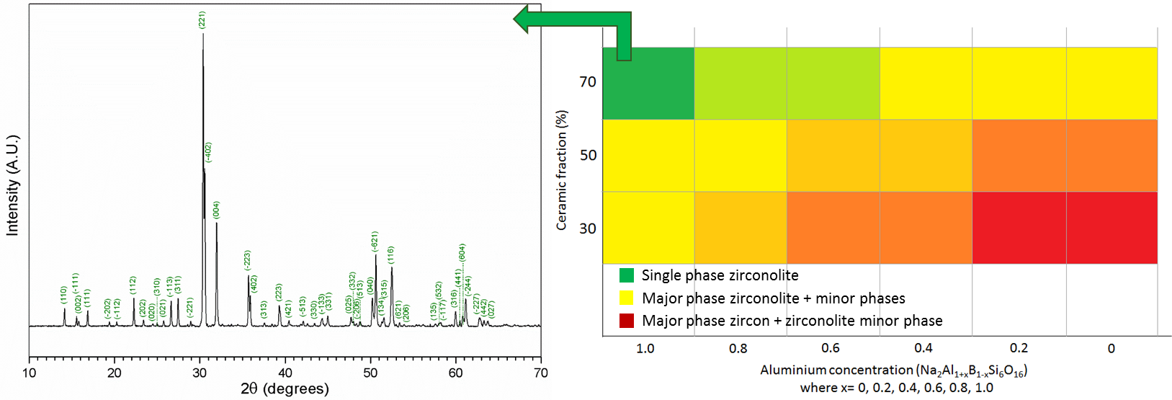
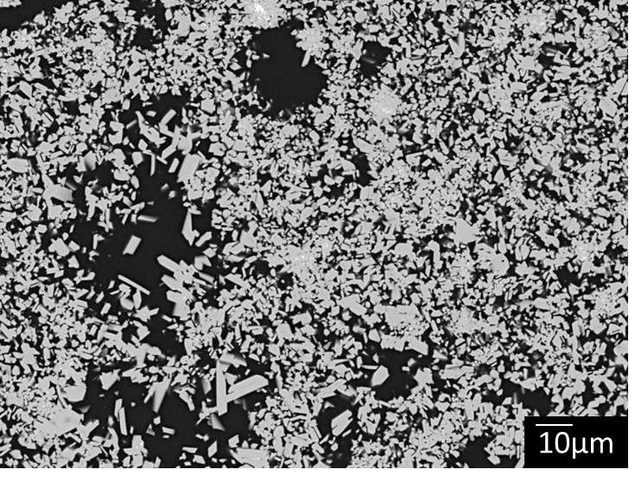
Effect of glass composition
30/70 wt% G/C
50/50 wt% G/C
70/30 wt% G/C
Na₂Al₂Si₆O₁₆
30 wt% Na₂Al₂Si₆O₁₆ + 70 wt% CaZrTi₂O₇
sthornber1@Sheffield.ac.uk
Stephanie Thornber
University of Sheffield, UK

Slide 18
Effect of CaF₂
CaF₂ is used as a digestion agent to improve waste incorporation into the wasteform.
¹⁹F is an active neutron source for (α,n)-reactions.
0.3 wt% CaF₂ additions:
Ca_{0.8}Ce_{0.2}ZrTi_{1.6}Al_{0.4}O₇
Ca_{0.9}Ce_{0.1}Zr_{0.9}Ce_{0.1}Ti₂O₇
Stephanie Thornber
University of Sheffield, UK

