Slide 1
Management of separated plutonium in the United Kingdom

Slide 2
Background
Plutonium has arisen from large scale reprocessing undertaken in the UK over many decades – programmes drawing to a conclusion
After completion of reprocessing, holdings will have risen to circa 140 tHM (~120 tHM UK owned, ~20 tHM overseas owned )
Material is produced in the form of plutonium dioxide powder from Magnox and Thorp Reprocessing plants.
Current UK policy is safe and secure long term storage.
Disposition options are being developed. Indefinite long term storage is not a complete lifecycle option - it requires continuous active management and significant security costs

Slide 3
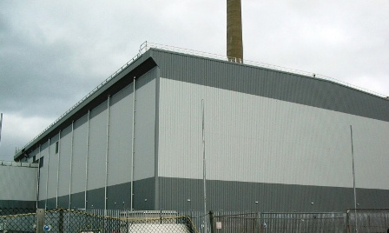
Safe and Secure Long Term Storage
Material at Sellafield being progressively transferred from older stores into Sellafield Product and Residue Store (SPRS)
Additional storage modules are planned so the facility will have capacity for the full UK inventory.

Slide 4
Plutonium Management Options
UK is considering a number of possible options to manage the UK plutonium stockpile:
Reuse as LWR MOX ( Areva Convert)
Reuse in Candu EC6 Reactors (CANMOX)
Reuse in GEH Prism Fast Reactor
Immobilisation – Hot Isostatic Pressing (HIP) is being investigated along with possible alternatives/complimentary technologies e.g. low spec MOX, Cold Press and Sinter
None of the options could be implemented before 2030 and would require 30 years or more of operation to work through the stockpile

Slide 5
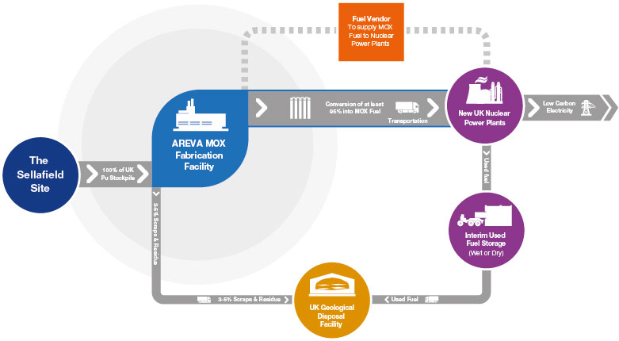
Areva Convert

Slide 6
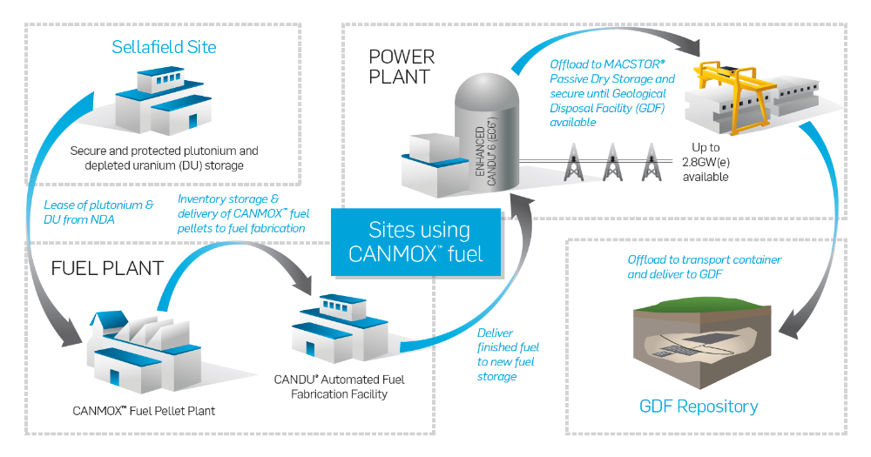
CANMOX

Slide 7
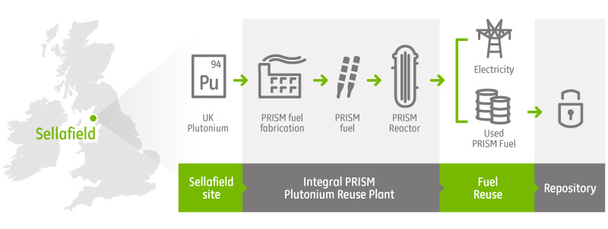
Prism

Slide 8
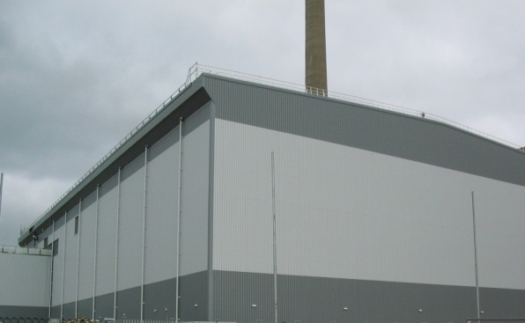
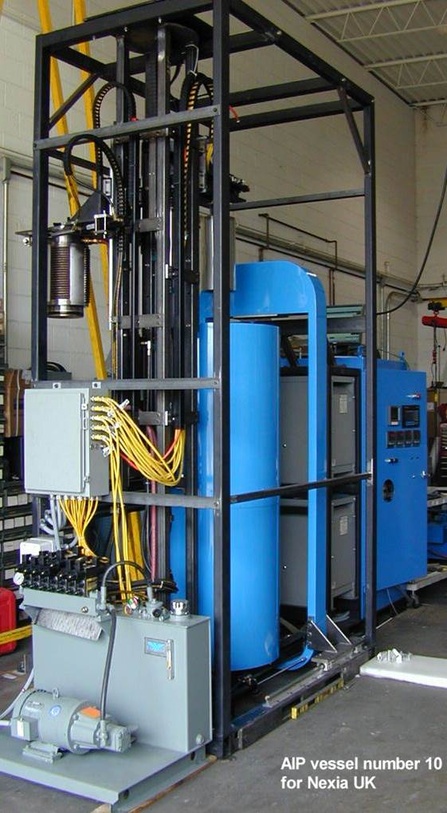
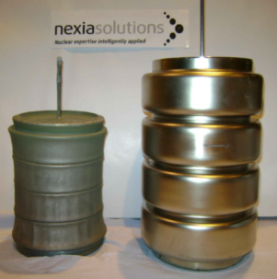
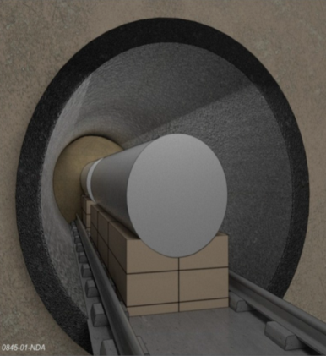
HIP Solution
Sellafield
Sellafield
PuO₂ transfer
SPRS
Hot Isostatic Pressing (HIP) facility
GDF
Location TBD

Slide 9
HIP Technology Roadmap
HIP requires approx. five years of development work to support the design of an industrial scale plant.
A technology roadmap has been produced key activities include:
Product storage options and link to GDF availability
Waste form selection (full ceramic or glass matrix)
Process flowsheet design – simple process needed.
Inactive rig trials
Safety case for use in active plant – concerns around high pressure and temperature in active environment and contamination control
Active rig trials - ~30g Pu in NNL Central Laboratory
Requirement for Engineering Demonstrator. To prove scale up and immobilise plutonium that is unsutiable for reuse possibly up 10t over ~ 10yrs

Slide 10
HIP progress to date
Product storage optioneering carried out. Cask storage emerging as an option.
Candidate wasteforms for stockpile treatment identified:
  Zirconolite ceramic (CaZrTi₂O₇)
  Zirconolite glass ceramic
  Betafite (CaUTi₂O₇) – sometimes know as Pyrochlore
  Cubic Zirconia (ZrO₂)
Inactive trials using cerium oxide as surrogate carried out. Incorporation rates of 20% achieved. Will take forward several formulations for active trials.
Work on HIP safety case ongoing
NNL designing plutonium active rig.

Slide 11
Immobilisation Forward Programme
Design and build of active HIP rig – 2017-18
Installation of active HIP rig in NNL Central Lab – 2019.
Small scale (30g Pu) active trials to confirm selected wasteform can produce acceptable product at incorporation rates of ~ 20% or above – 2020
Evaluation of alternative/complimentary immobilisation technologies eg low spec MOX, cold press and sinter (puck in canister)
Engagement of industrial partners to deliver an Engineering Demonstrator to prove immobilisation can be scaled up to an industrial scale~ 2030 and also work off material unsuitable for reuse over following decade.

Slide 12
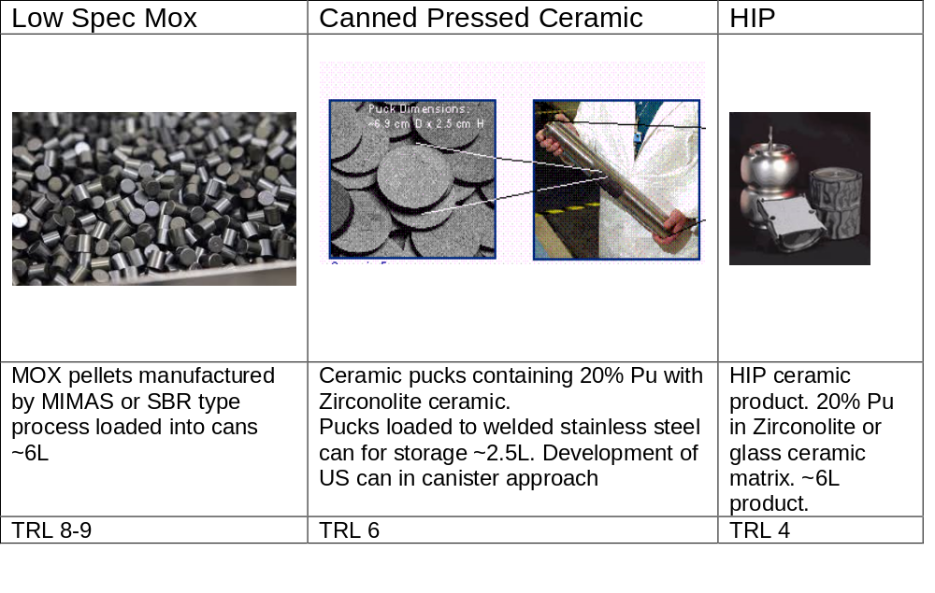
Alternatives to HIP

Slide 13
Summary/Conclusions
Current UK policy is long term secure storage with forward plans in place out to 2120
Future management options are being considered – reuse and/or immobilisation. Some of UK stockpile unsuitable for reuse.
All options would take 30 years or more to implement and are unlikely to be available before around 2030
Future policy is a matter for government and will be based on a range of factors including:
  Technical maturity
  Economics – total cost to UK taxpayer
  Commercial arrangements including MOX offtake by utilities
  Licensability,
  Disposability of used fuel/ immobilised product
  Secondary benefits e.g. UK R&D skills
All options result in a net cost to the UK taxpayer

