Slide 1

Digital autoradiography on C-14 labelled PMMA impregnated rock samples using the BeaverTM
Mikko Voutilainen, Eveliina Muuri, Juuso Sammaljärvi, Marja Siitari-Kauppi
Department of Chemistry, University of Helsinki
Jérôme Donnard, Samuel Duval
AI4R, Nantes, France

Slide 2
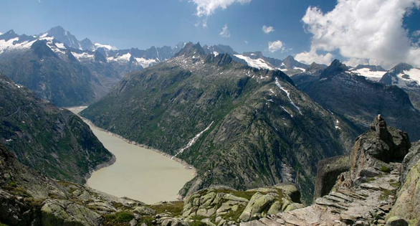
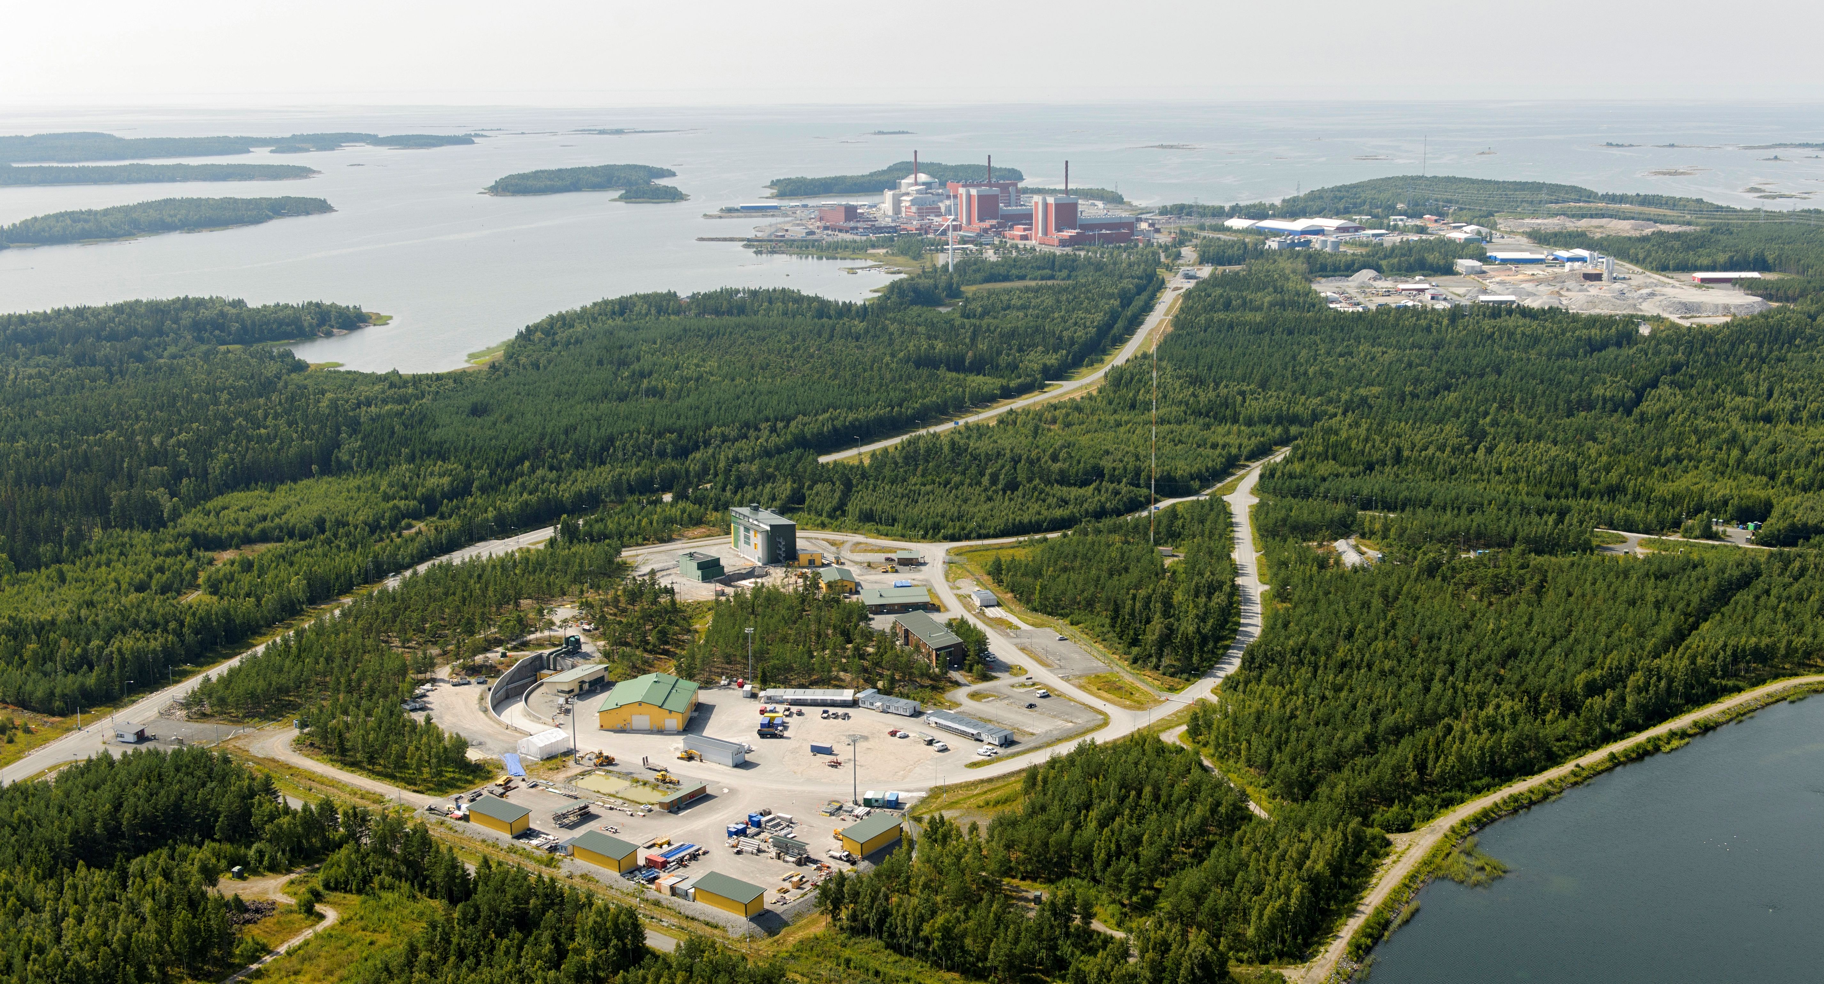
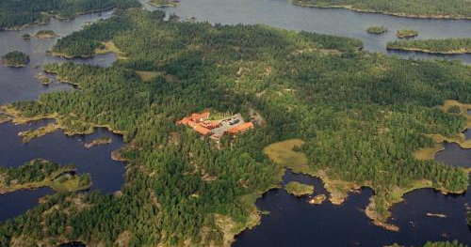



Background:
In situ test sites
The underground rock characterization facilities in crystalline rock formations are used to collect data for safe disposal of spent nuclear fuel and to develop excavation and final disposal techniques in realistic conditions
Grimsel, Switzerland
Grimsel test site (GTS) at an altitude of 1,730 m and at a depth of around 450 meters below the surface in central Switzerland
Olkiluoto, Finland
Underground rock characterization facility (ONKALO) on the coast of south-western Finland where the repository system is built in the depth of 400 meters below the surface
Äspö, Sweden
Äspö hard rock laboratory (HRL) on the coast of southern Sweden extends to depth of 500 meters and is located near Oskarshamn nuclear power plant

Slide 3
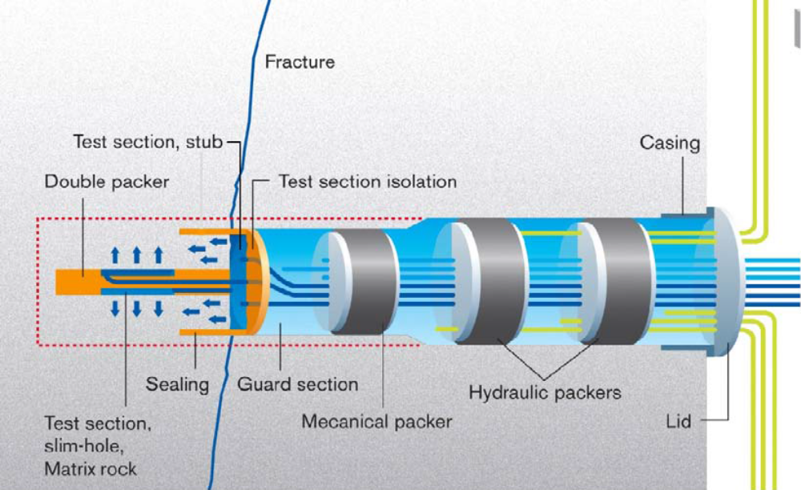
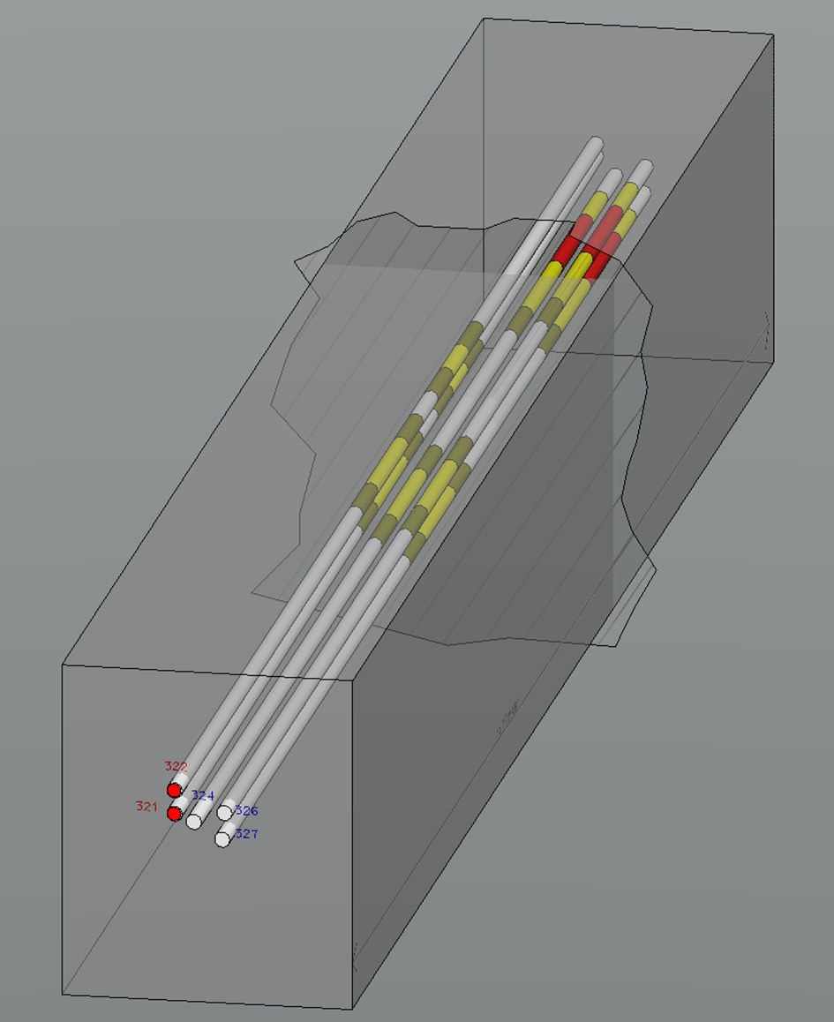
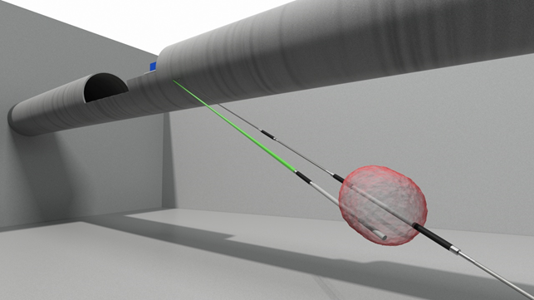
Background: In situ Diffusion and sorption experiments using radioactive tracers
Long Term Diffusion (LTD) experiments at GTS
Through- and In-diffusion experiments from source drillhole to observation drillhole
Rock Matrix Retention Properties (REPRO) experiments at ONKALO
1. Through- and In-diffusion experiment in drillholes
2. Advection-matrix diffusion experiment in a drillhole
Long Term Sorption Diffusion Experiment (LTDE-SD) at Äspö HRL
In-diffusion experiment from natural fracture surface and from drillhole

Slide 4
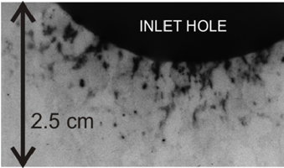
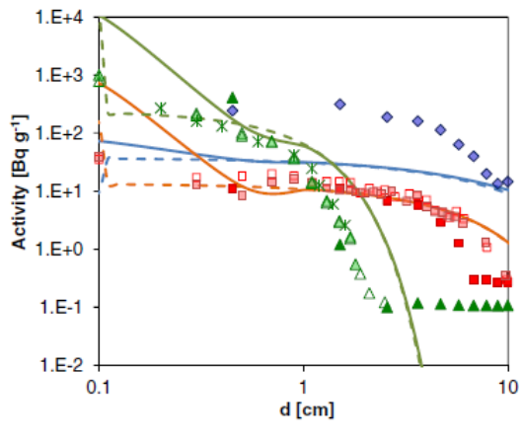
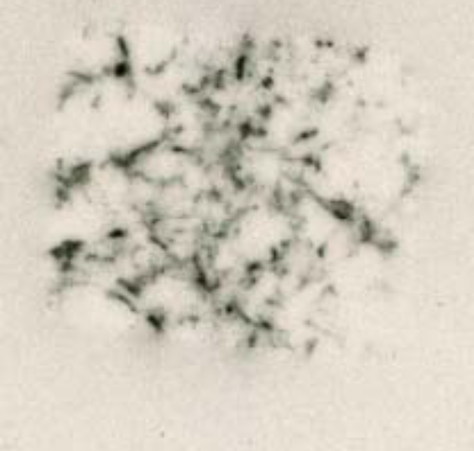
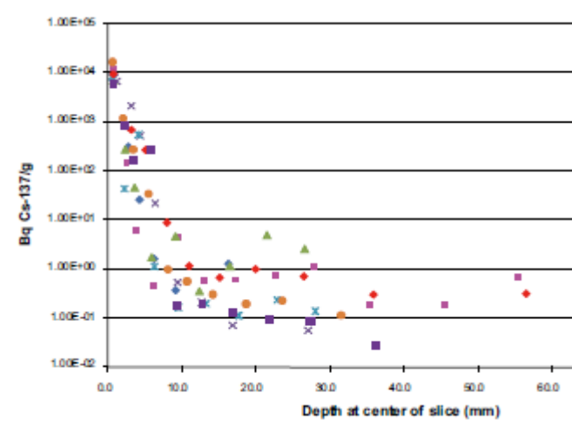
Motivation
Results affected by heterogeneous structure of the rock and can not be explained using homogenous models
→ Modelling Task 9 for SKB Task Force [4]
LTD experiment at Grimsel test site [1-2].
Our part of the project:
Structure characterization
of rock samples using X-ray microtomography, SEM/EDS and C-14-PMMA autoradiogrphy
Cs-134
HTO
Na-22
LTDE-SD at Äspö hard rock laboratory [3].
[1] Jokelainen et al.
J. Radioanal. Nucl. Chem.
295, 2153–2161, 2013
[2] Soler et al.
J. Contam. Hydrol.
179, 89–101, 2015
[3] Nilson et al.
SKB R-10-68, 2010.
[4] http://www.skb.se/taskforce/
Cs-137

Slide 5
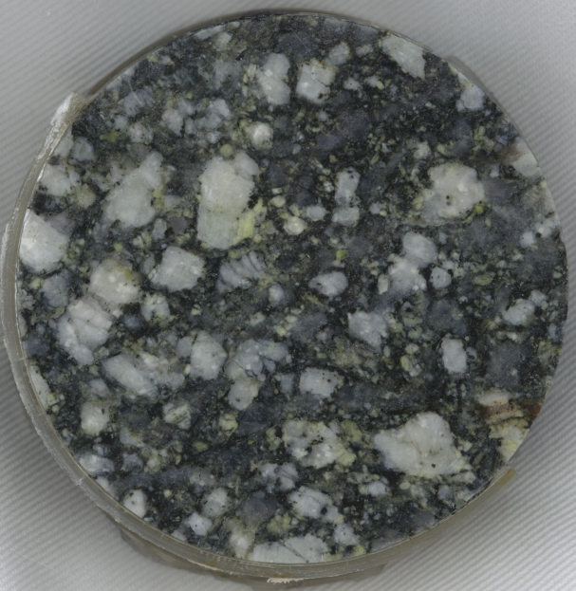
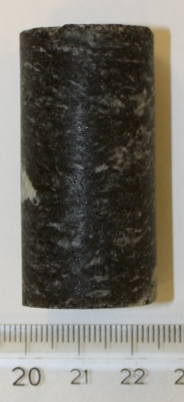
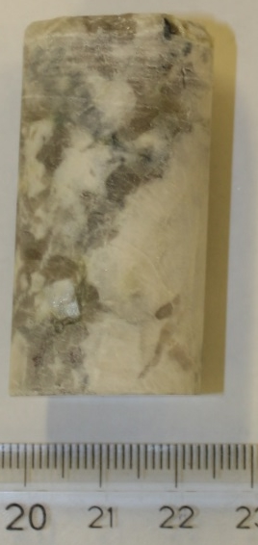
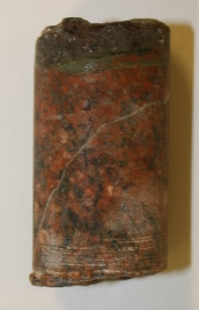
Rock Samples Studied by
C-14-PMMa autoradiography
The studied samples differ in terms of:
  Content of main minerals: Quartz, Plagioclase, K-feldspar and Biotite
  Alteration state: content of clay minerals, chloritization of biotite,…
  Mineral and pore structure
Grimsel granodiorite
Olkiluoto veined gneiss and pegmatitic granite
Äspö granodiorite

Slide 6
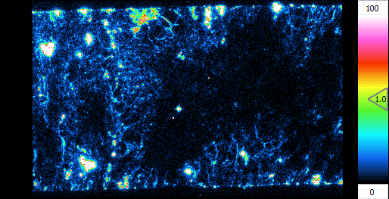
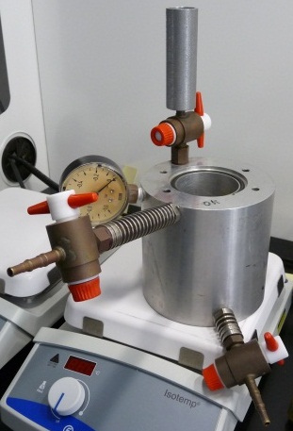
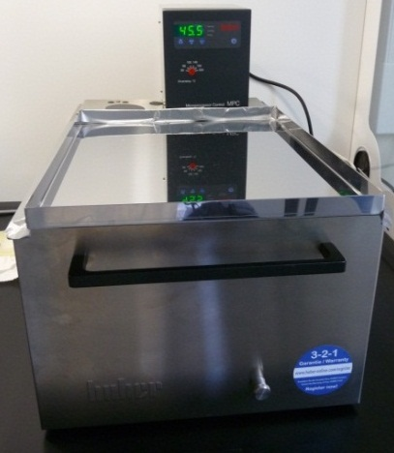
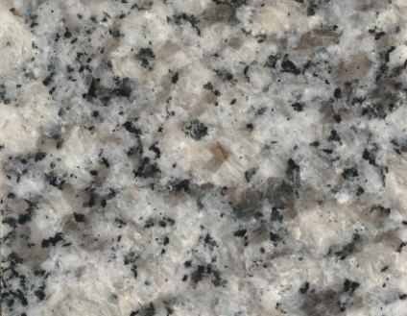
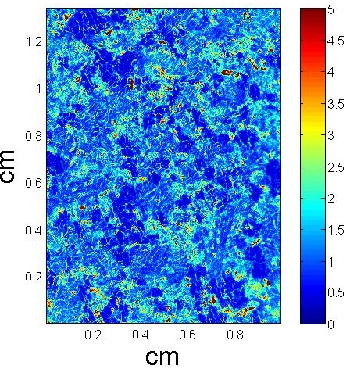
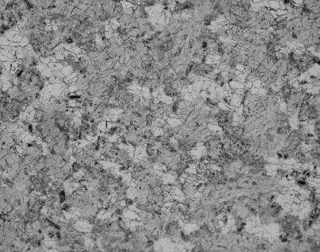

C-14-PMMA Autoradiography
Technique is based on intruding C-14-labelled methyl methacrylate (MMA) into a centimeter scale sample. The distribution of this radioactive tracer is then characterized using autoradiography and porosity using image analysis.
Counts/pixel
Filmless
Autoradiography
Impregnation
Polymerization
Sawing & Polishing
Image Analysis
Traditional Film
Autoradiography
Porosity distribution

Slide 7
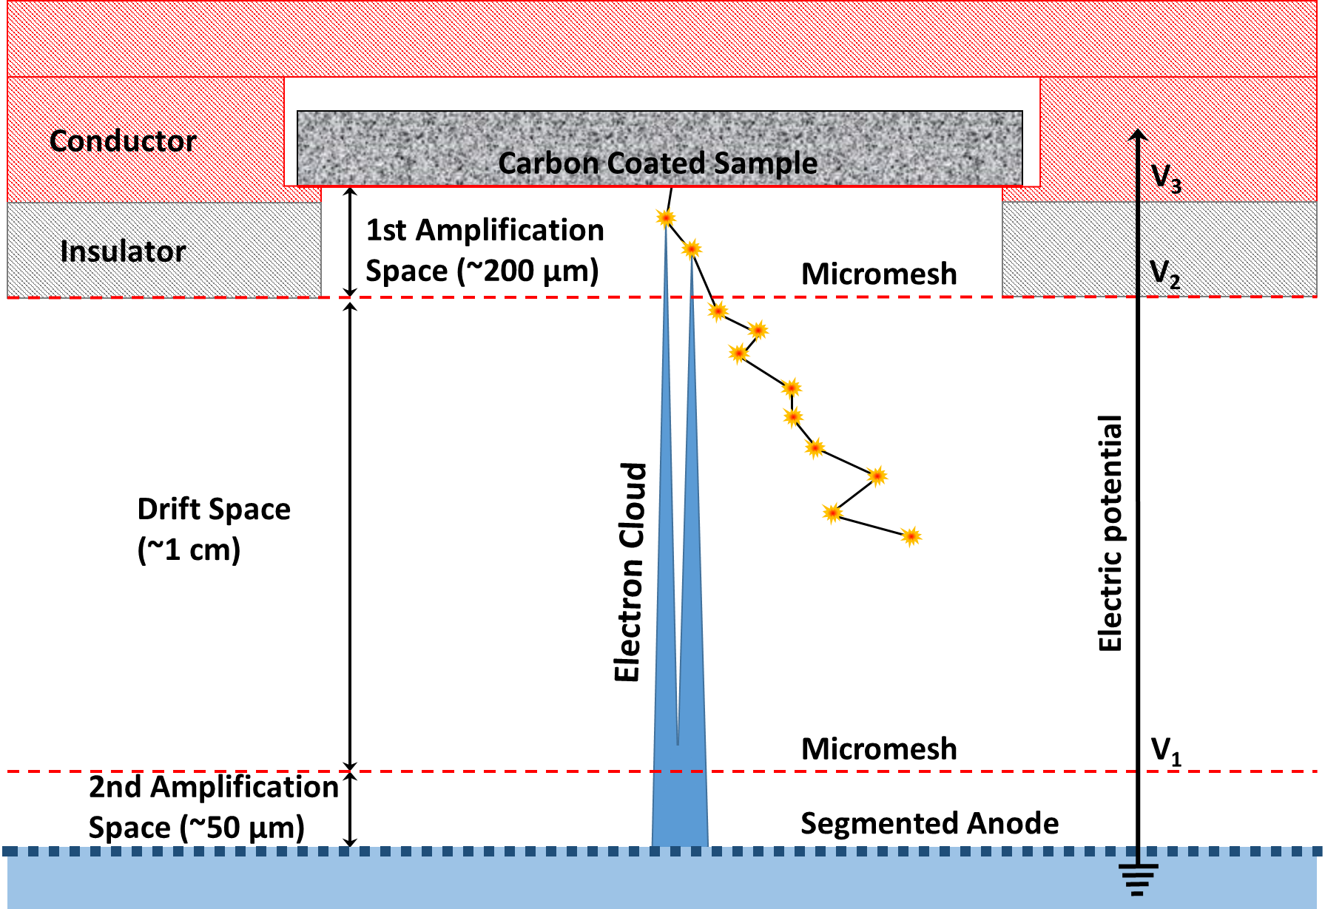
Novel filmless autoradiography method: Le beaver
C-14
(β,156.5 keV)

Slide 8

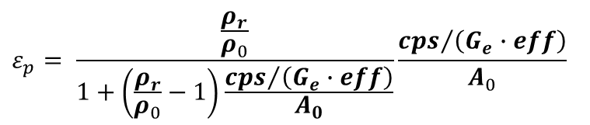
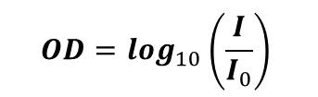
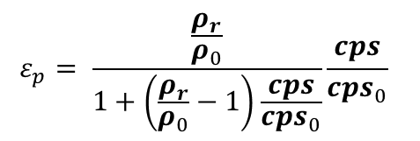
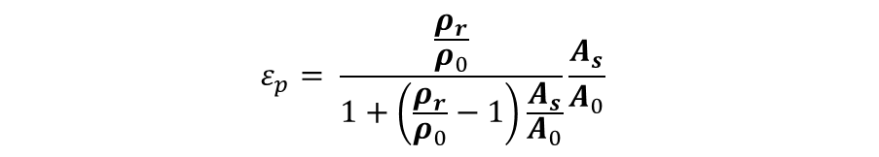
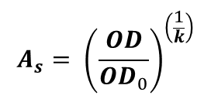
Traditional film autoradiography
VS.
Filmless autoradiography
Direct measurement without films:
  Improves sensitivity of the measurement especially with low activity areas
  Gives linear response as function of activity
  Calibration and effectivity calculation
$$OD=\log_{10}\left(\frac{I}{I_{0}}\right)$$
Porosity for single calibration sample:
Conversion of intensities to optical densities:
$$ε_{p}= \frac{\frac{ρ_{r}}{ρ_{0}}}{1+\left(\frac{ρ_{r}}{ρ_{0}}−1\right)\frac{cps}{{cps}_{0}}}\frac{cps}{{cps}_{0}}$$
Calibration using several samples:
$$OD={OD}_{0}×A_{cal}^{k}$$
$$A_{s}= {\left(\frac{OD}{{OD}_{0}}\right)}^{\left(\frac{1}{k}\right)}$$
Conversion of optical densities to activities:
Porosity using efficiency and statistical simulations:
$$ε_{p}= \frac{\frac{ρ_{r}}{ρ_{0}}}{1+\left(\frac{ρ_{r}}{ρ_{0}}−1\right)\frac{A_{s}}{A_{0}}}\frac{A_{s}}{A_{0}}$$
$$ε_{p}= \frac{\frac{ρ_{r}}{ρ_{0}}}{1+\left(\frac{ρ_{r}}{ρ_{0}}−1\right)\frac{{cps}/{\left(G_{e}∙eff\right)}}{A_{0}}}\frac{{cps}/{\left(G_{e}∙eff\right)}}{A_{0}}$$
Determination of porosity:

Slide 9
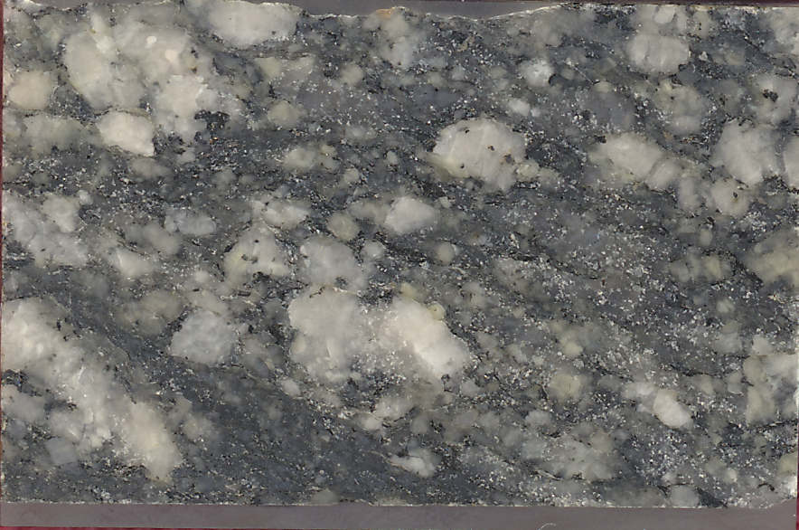
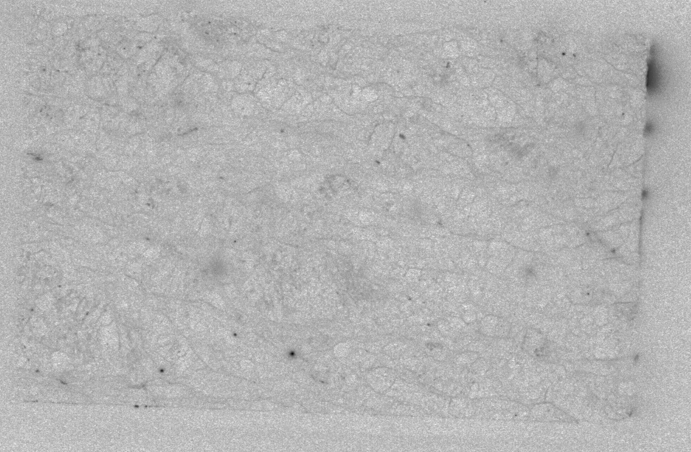
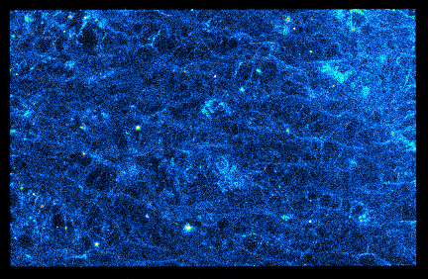

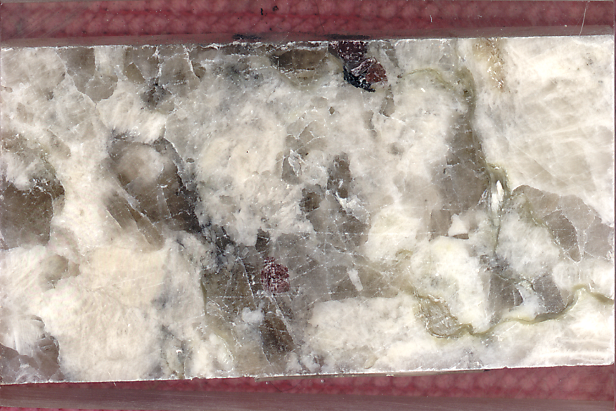
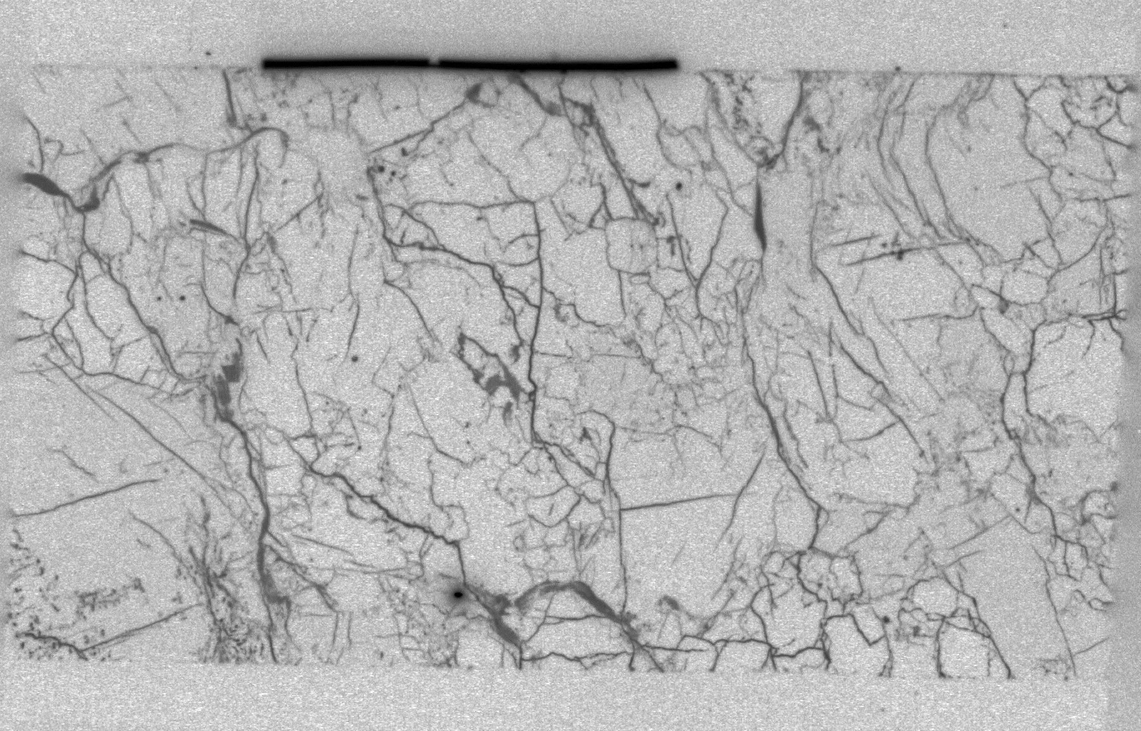
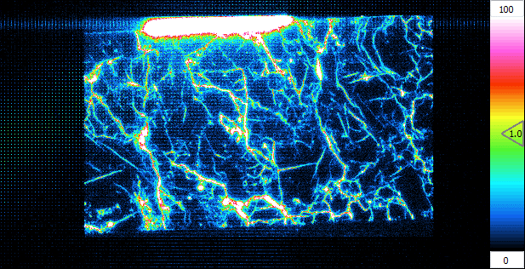
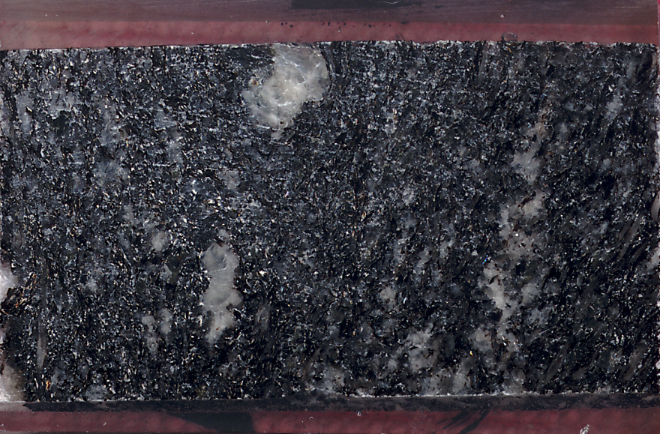
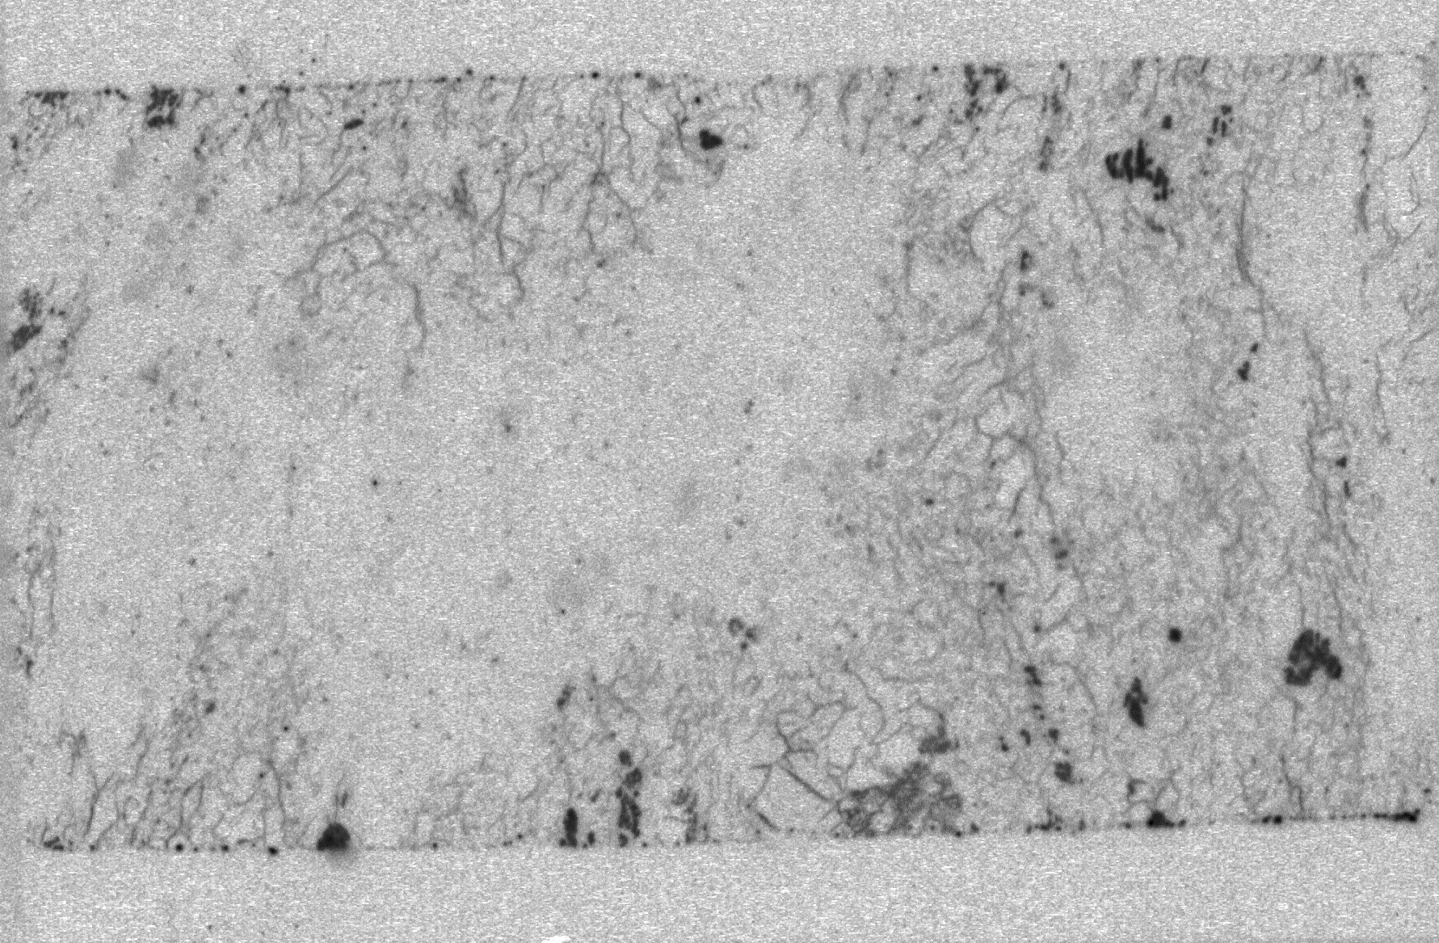
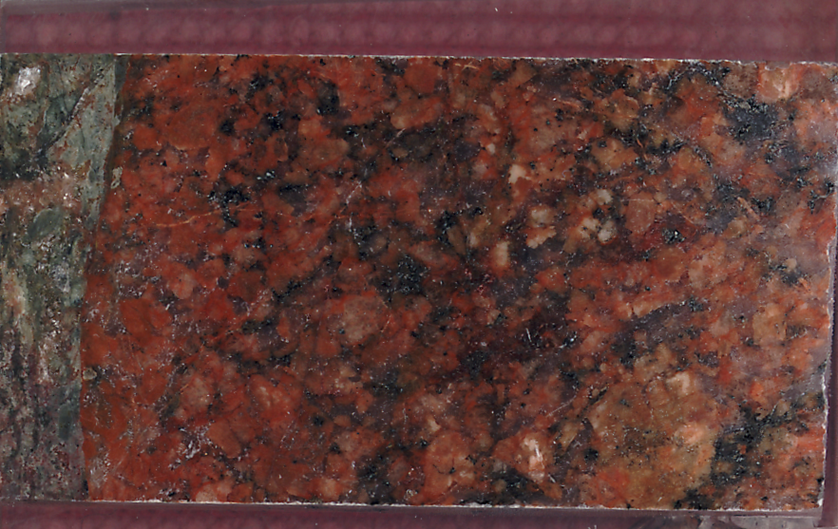
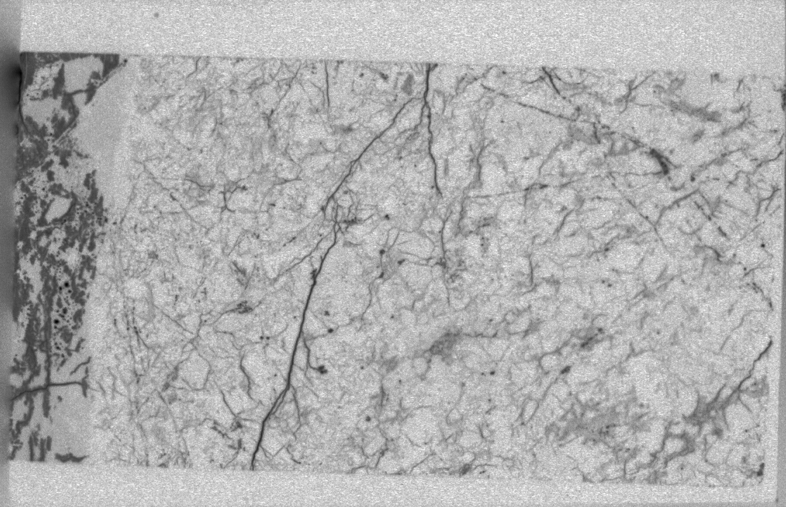
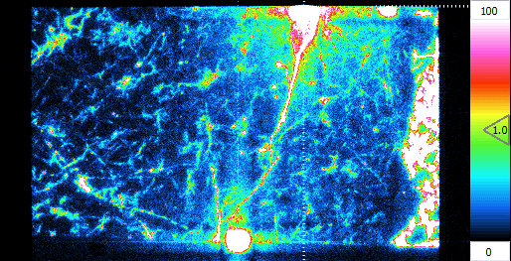
Comparison of the results
Scanned
rock surface
Film
autoradiography
Film
autoradiography
Grimsel
Granodiorite
Olkiluoto
Pegmatitic granite
Counts/pixel
Olkiluoto
Veined gneiss
Äspö
Granodiorite

Slide 10
Comparison of the ACTIVITY and POROSITY results
More sensitive filmless autoradiography gives slightly higher values than traditional film autoradiography
  Small artefacts interfere the comparison
Porosities and activities determined using standard calibration and standard calibration are in agreement
 | Film Autoradiography |  | Le Beaver Geant4 calibration |  | Le Beaver Standard calibration
 | Activity [Bq/ml] | Porosity [%] | Activity [Bq/ml] | Porosity [%] | Activity [Bq/ml] | Porosity [%]
Grimsel Granodiorite | 470 | 0.36 | 540 | 0.42 | 590 | 0.46
Olkiluoto Pegmatitic granite | 1200 | 0.31 | 2400 | 0.61 | 2600 | 0.67
Olkiluoto Veined gneiss | 610 | 0.15 | 1100 | 0.27 | 1200 | 0.30
Äspö Granodiorite | 2000 | 0.50 | 3100 | 0.79 | 3400 | 0.86

Slide 11
Artefacts and current challenges of the method
Converting activity fluxes into specific activities
  Calibration standard
  Theoretical calculations (e.g. Geant 4) [1]
Artefacts caused by:
Areas with high activity
Sample preparation
[1] Delayre et al., Comparison of Storage phosphor autoradiography and Micro pattern gas detector based Electronic autoradiography for the porosity characterisation of hydrothermally altered samples from Petite-Anse, Martinique. Submitted to publication.

Slide 12
conclusions
Films are not needed and the measurements are more sensitive especially when measuring low activities
Calibration can be done reliably using:
  Only one calibration standard
  Statistical calculations (e.g. Geant4)
Method offers reliable information about heterogeneity that can be used when analyzing the results of in situ experiments
Method can be used for wide variation of nuclides by changing electrical potentials and radioactive elements that are sorbed on mineral surfaces
Future prospects of the method:
  Performing α-spectroscopy is under development
  Separation of β-active elements with different β-energies, e.g. H-3 (18 keV) and C-14 (156 keV)

Slide 13
Thank you!

