Slide 1
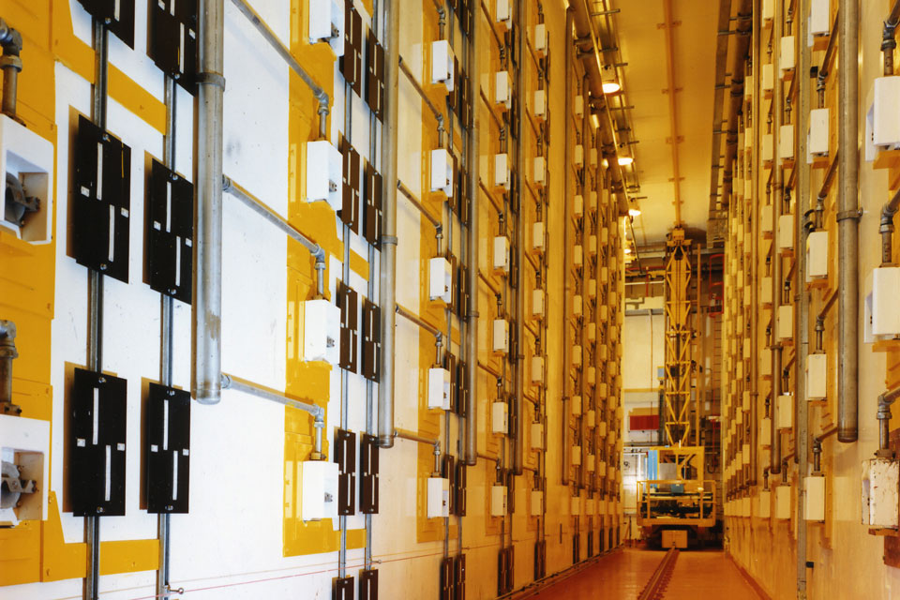




Synthesis and characterisation of rare Ce₃NbO₇ compounds for use as nuclear space batteries by neutron powder diffraction and X-ray absorption spectroscopy
Sean T. Barlow BSc (Hons) AMInstP
Martin C. Stennett¹, Russell J. Hand¹, Emma McCabe² & Neil C. Hyatt¹
1. Department of Materials Science & Engineering, The University of Sheffield, Sheffield S1 3JD, UK
2. School of Physical Sciences, University of Kent, Canterbury, CT2 7NH, UK
Scientific Basis for Nuclear Waste Management Symposium 2017, October 29 – November 3 | Sydney, Australia
Notes:
Good morning everyone, as you’ve just heard name is Sean Barlow and I’m a PhD student at the University of Sheffield’s Immobilisation Science Laboratory and my presentation this morning is on the work I have done on creating novel cerium niobite compounds, namely the Synthesis and characterisation of Ce₃NbO₇ for use as a potential nuclear space battery simulant.

Slide 2
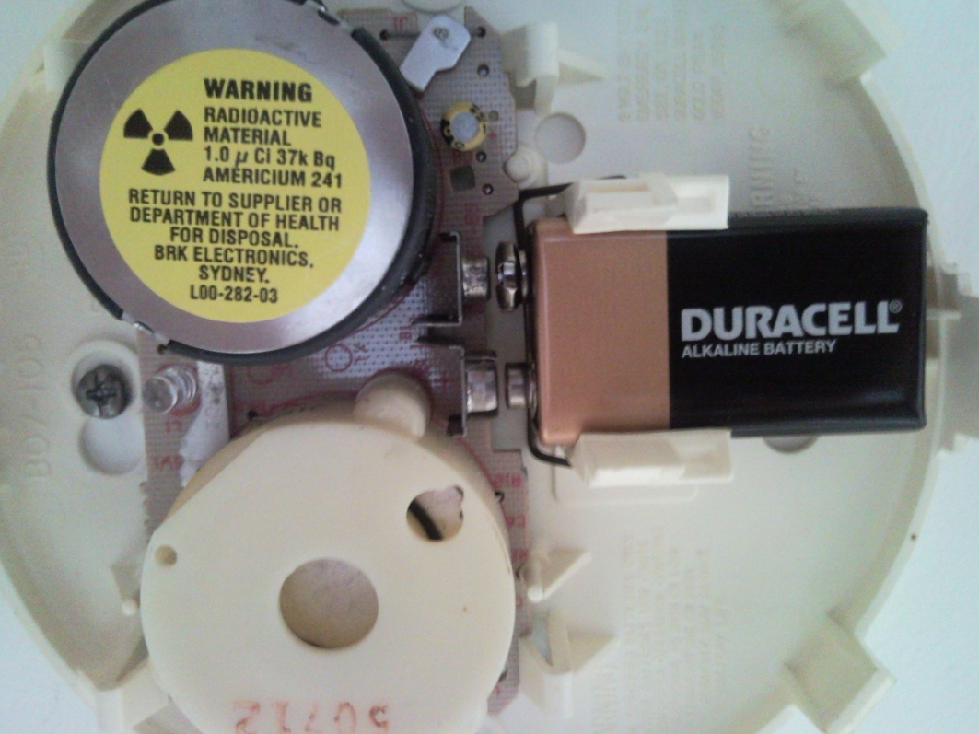
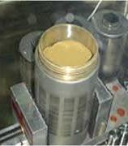
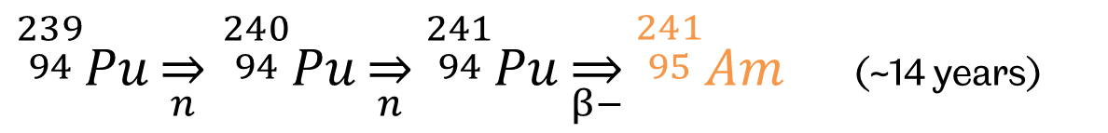
Worlds largest stockpile of plutonium ~114 tonnes
Thorp product store
PuO₂
Radioisotope Thermoelectric Generators (RTGs) (a.k.a Space Batteries)
    ${}_{}^{\begin{aligned}239 \\ 94\end{aligned}}{Pu\overset{⇒}{n}}$ ${}_{}^{\begin{aligned}240 \\ 94\end{aligned}}{Pu\overset{⇒}{n}{}_{}^{\begin{aligned}241 \\ 94\end{aligned}}{Pu\overset{⇒}{β−}{}_{}^{\begin{aligned}241 \\ 95\end{aligned}}{Am}}}$ (~14 years)
Notes:
UK has largest stockpile of separated civil plutonium than anywhere else in the world. From reprocessing activities that have taken place since 1950s.
Over a period of around 14 years Pu will decay to Am-241. Might of heard of it, common use in ionisation type smoke alarms. Can also be used in RTGs.

Slide 3

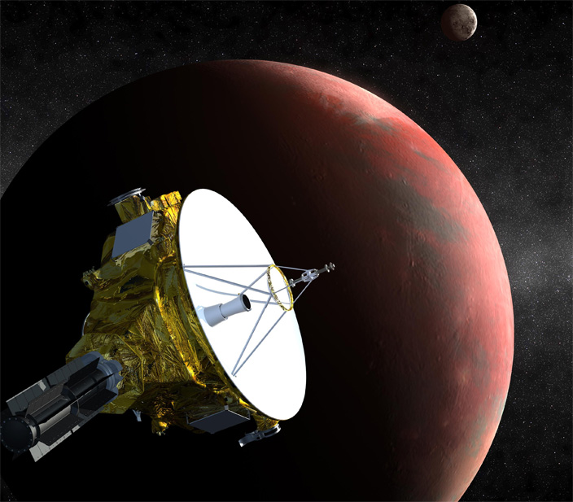



Voyager 1 & 2 (1977)
New Horizons (2006)
Cassini (1997)
Mars Science Laboratory, Curiosity (2011)
Notes:
Several missions to outer reaches of solar system use RTGs as sun is ineffective at massive distances.

Slide 4
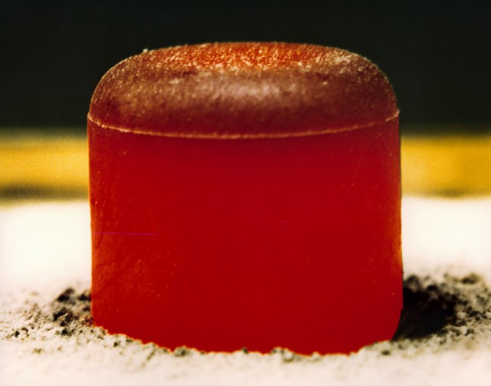
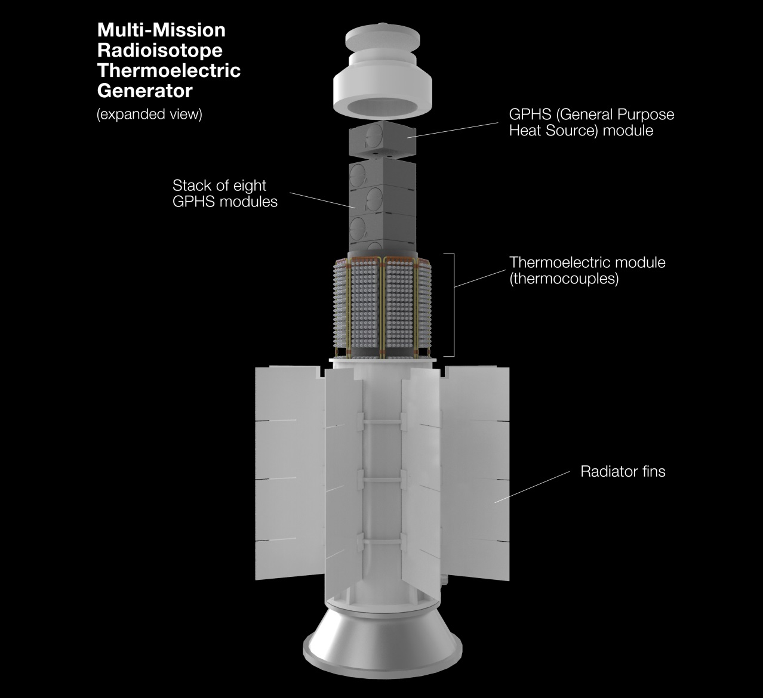
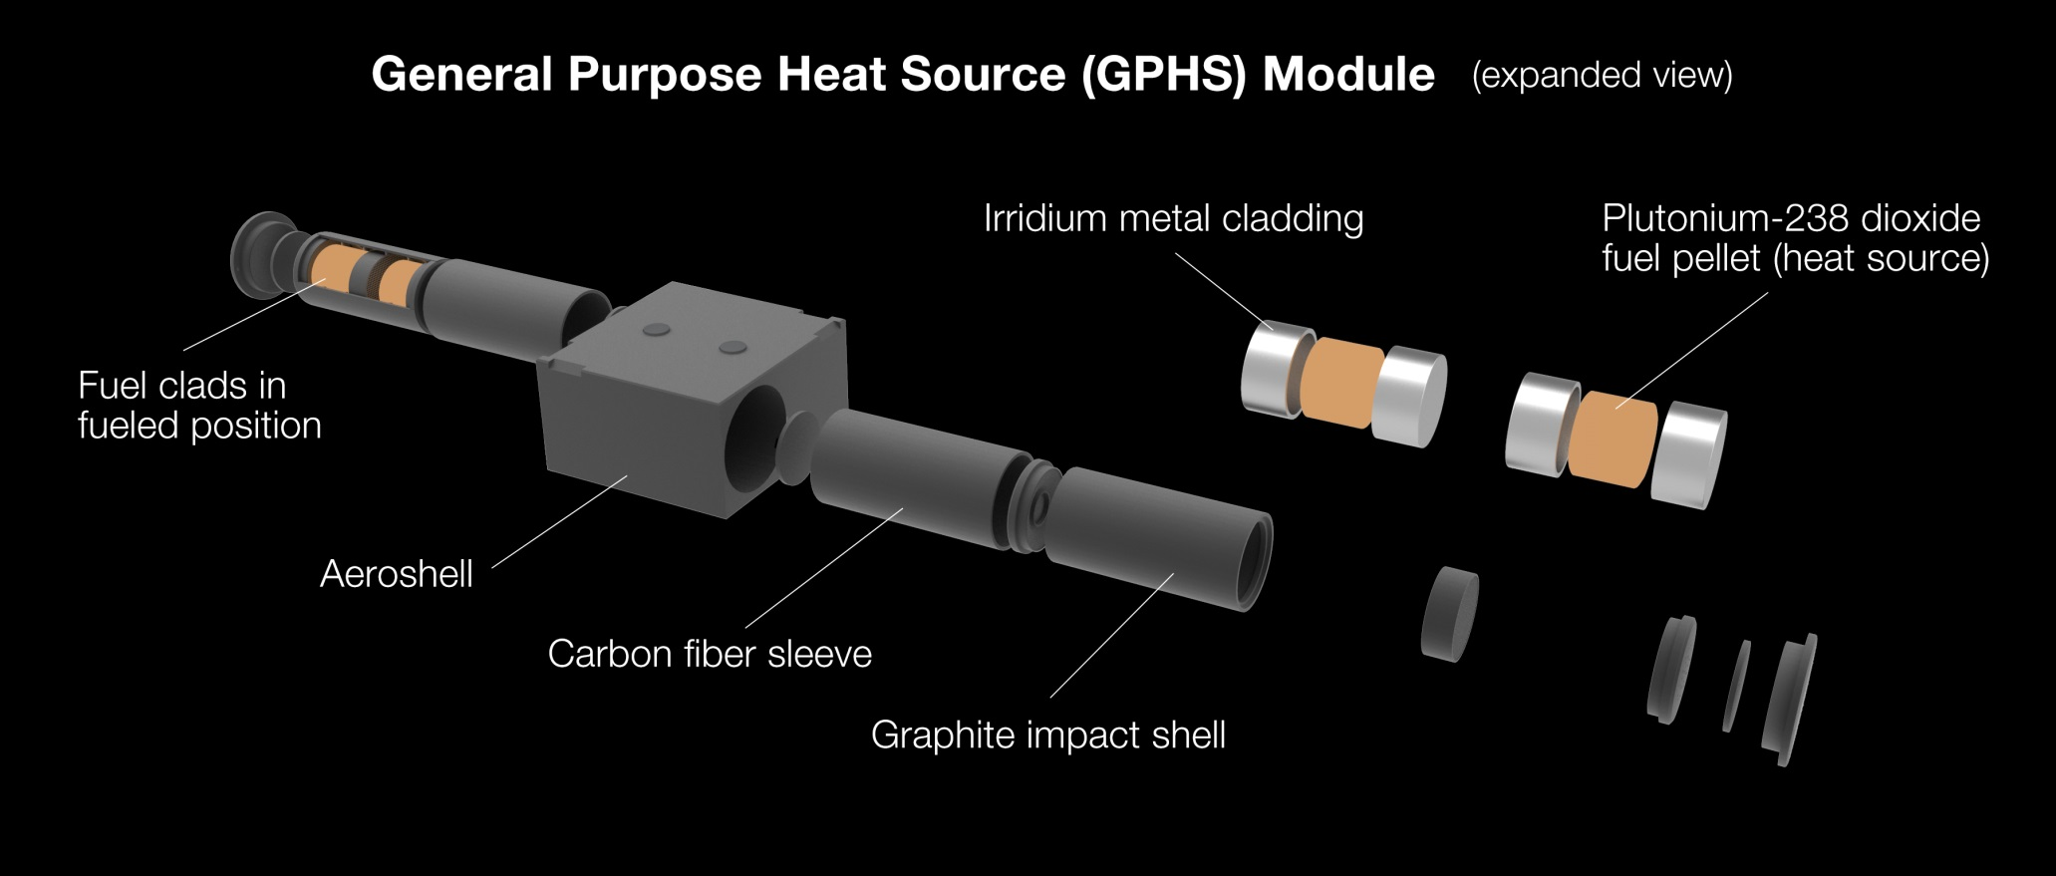
How does a RTG work?
Pu-238
Department of Materials Science and Engineering
Notes:
How? A pellet of glowing hot PuO2 (Pu238), the radioisotope of choice. Clad in iridium and encased in graphite and carbon fibre sleeves in GPHS. These units release lots of heat and are often stacked together in a thermoelectric generator such as this one. Heat sources stacked and surrounded in thermoelectric cells which convert heat into electricity via thermoelectric effect. The excess heat is then radiated out to heat the rest of the craft/unit

Slide 5
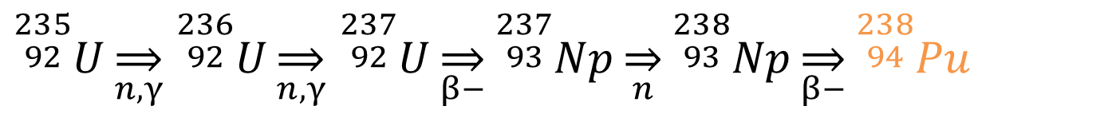
Why Am-241
Pu-238 is becoming scarce (several kg) – product of developing nuclear weapons
Neutron irradiation of Np-237 (by-product of weapons grade Pu-239)
US Stopped production in 1988 with closure of Savanna River
Small scale start-up at Oak Ridge National Laboratory (due to demand)
    ${}_{}^{\begin{aligned}235 \\ 92\end{aligned}}{U\overset{⇒}{n,γ}}$ ${}_{}^{\begin{aligned}236 \\ 92\end{aligned}}{U\overset{⇒}{n,γ}}$ ${}_{}^{\begin{aligned}237 \\ 92\end{aligned}}{U\overset{⇒}{β−}{}_{}^{\begin{aligned}237 \\ 93\end{aligned}}{Np\overset{⇒}{n}{}_{}^{\begin{aligned}238 \\ 93\end{aligned}}{Np\overset{⇒}{β−}{}_{}^{\begin{aligned}238 \\ 94\end{aligned}}{Pu}}}}$
Notes:
~82% of time U235 will fission, remaining 18% of time will capture and create U236
Eg: Curiosity rover has 4.8 kg of Pu
Cassini had 33 kg

Slide 6

Why Am-241
European Space Agency (ESA) identified Am-241 as isotope of choice:
    Utilisation of waste from nuclear industry – abundance
    Can be separated from economically
    High melting point
    Alpha decay only (minor gamma)
Separated Plutonium
Americium
Spent Uranium Fuel

Slide 7
Why Am-241
 | Plutonium-238 (PuO₂) | Americium-241 (AmO₂) | Strontium-90 (SrTiO₃) | Curium-244 (Cm₂O₃) | Caesium-137 (Cs₂O.Al₂O₃.2SiO₂)
Density (g·cm⁻³) | 11.46 | 12 | 3.92 | 10.6 | 3.1
Melting point (°C) | 2240 | 2205 | 1660 | 1950 | 1275
Power Density (W_{T}/Kg ) | 390 | 97 | 223 | 2510 | 81.4
Half-life (Years) | 87.5 | 432 | 27.7 | 18.1 | 30.0
Decay Type | Alpha (Gamma) | Alpha (Gamma) | Beta (Bremsstrahlung) | Alpha (Gamma) | Beta (Gamma + Bremsstrahlung)
Notes:
Pu-238 compared to 4 other radionuclides considered
Sr too much shielding required for space use – Use on ground in remote light houses (Soviet Era)
Cm too short a half life to be useful
Cs (glass) too low melting point, shorthalf life for the power density and needs sheilding
Am, although low power density, most suitable

Slide 8
Metal Matrix Composites (Cermets)
2 distinct metal phases
 | Americium | Iridium | Molybdenum | Tungsten | Niobium
Density (g·cm⁻³) | 12 | 22.42 | 10.28 | 19.25 | 8.57
Melting point (°C) | 1176 | 2446 | 2623 | 3422 | 2477
Thermal conductivity (W·m⁻¹·K⁻¹) | 10 | 147 | 138 | 173 | 53.7
Thermal expansion (µm·m⁻¹·K⁻¹) | 6.2 – 7.5 | 6.4 | 4.8 | 4.5 | 7.3

Slide 9
Weberite-type ceramic materials
Immobilisation of Americium in durable ceramic phase
Cannot use Americium in lab so we use Cerium as Surrogate for Americium
Ln₃NbO₇ where Ln=La, Pr, Nd, Sm, Eu, Gd, Tb, Dy, Ho, Er, Tm, Yb and Lu
Note Ce is missing
Difficult production method – Ce III readily oxidises to Ce IV
Difficulty pinpointing the space group
Pmna (#62) or Cmcm (#63)
Notes:
Looked at immobilisation of americium in durable ceramic phases – rather than encapsulating in iridium
Cannot use Am use Ce
Made several compounds but one of interest = Ln3NbO7 where Ln = lanthanide
Missing Ce, important as use Ce as surrogate for Am – Difficult manuf method – oxidation

Slide 10
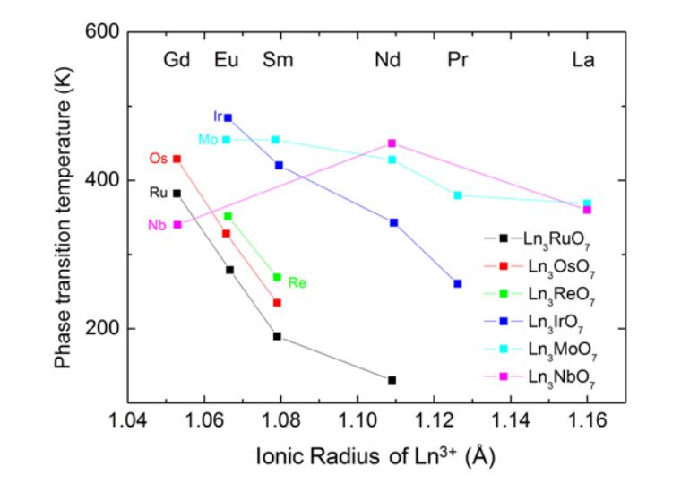
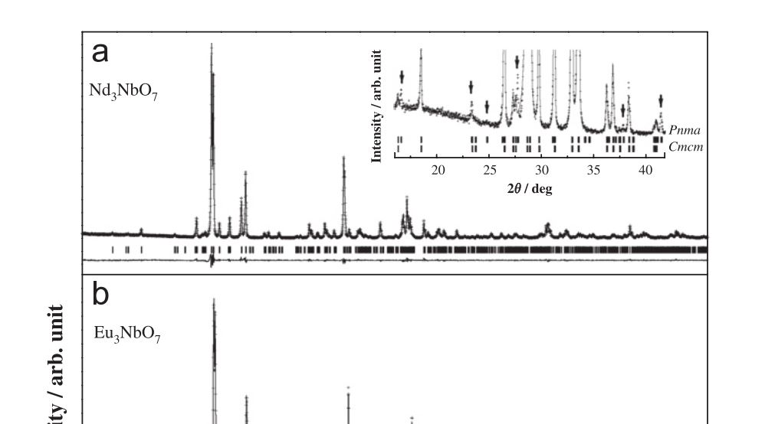
Weberite-type ceramic materials
Initially Cmcm (No. 63) model was best fit - Later studies Pnma (No. 62) model best
Phase transition from Pmcn to Cmcm is possible at elevated temperatures for Ln₃NbO₇ compounds
For Ce: ~ room temperature (could be both space groups together)
Pnma model fits best – extra peaks than Cmcm
L. Cai, J.C. Nino, Synchrotron and neutron powder diffraction study of phase transition in weberite-type Nd3NbO7 and La3NbO7, J. Solid State Chem. 184 (2011) 2263–2271. doi:10.1016/j.jssc.2011.06.017.
Y. Doi, Y. Harada, Y. Hinatsu, Crystal structures and magnetic properties of fluorite-related oxides Ln3NbO7 (Ln=lanthanides), J. Solid State Chem. 182 (2009) 709–715. doi:10.1016/j.jssc.2008.12.012.

Slide 11
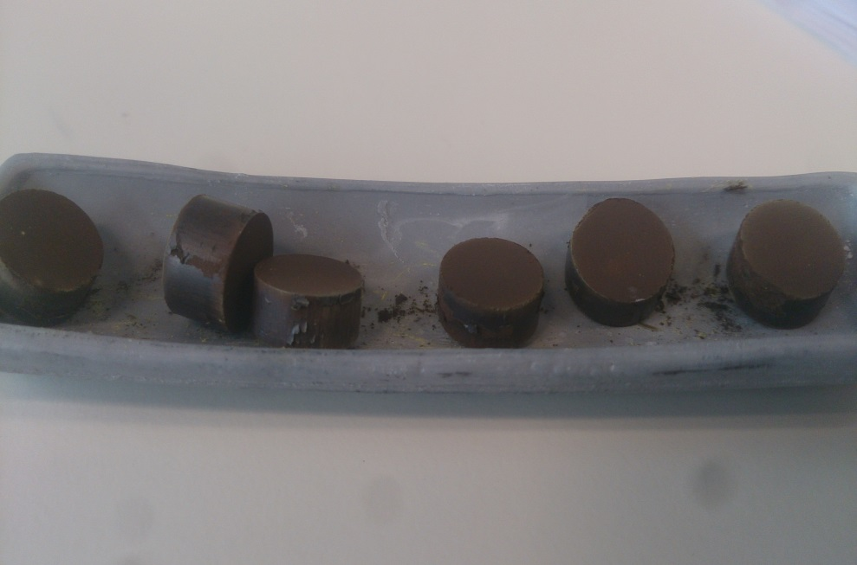
Synthesis Methodology
Difficult synthesis process – Ce (III) readily oxidises to Ce (IV)
Conventional reaction method - use flowing H₂/N₂ atmosphere and repeated reactions
XRD after each successive reaction, reducing impurity phases.
Method refined by removing the outer layer of the pellets before 2nd reacton
Ce₃NbO₇ pellets in alumina boats
Temp: 1250 °C (1523 K)
With flowing H₂/N₂ gas

Slide 12
Synthesis Methodology
Notes:
Stars indicate phase indexed to CeNbO4

Slide 13
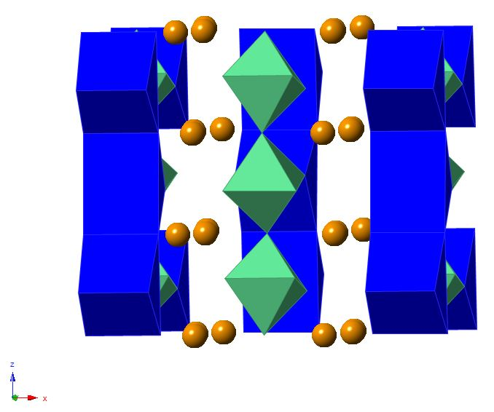
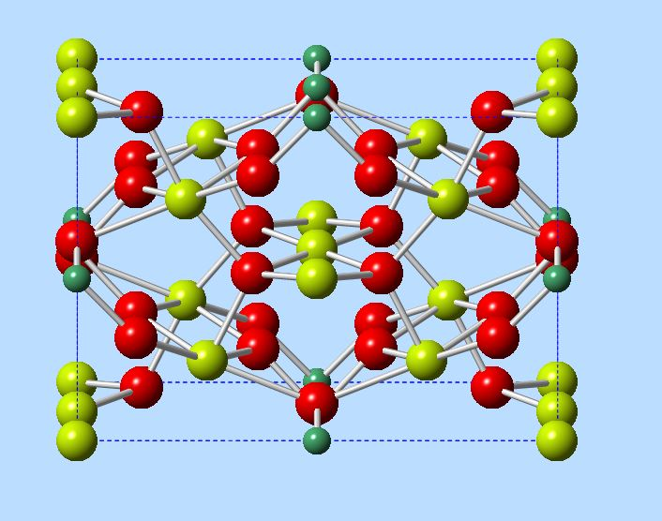
Crystal Structure
Ce(1)O₈
NbO₆
Ce(2)
Structure simulated from Nd₃NbO₇
Replaced Nd ions with Ce
Allowed for simulated XRD and ND patterns to index against
~[0 1 0] view
Orthorhombic, defect-fluorite crystal
Notes:
Because no crystal structure for Ce3NbO7 exists – use Nd – Orthorhombic Infinite bands/chains of edge sharing Ce and Nb in alternate pattern with Ce ions in between
Used to create simulanted XRD and ND patterns

Slide 14
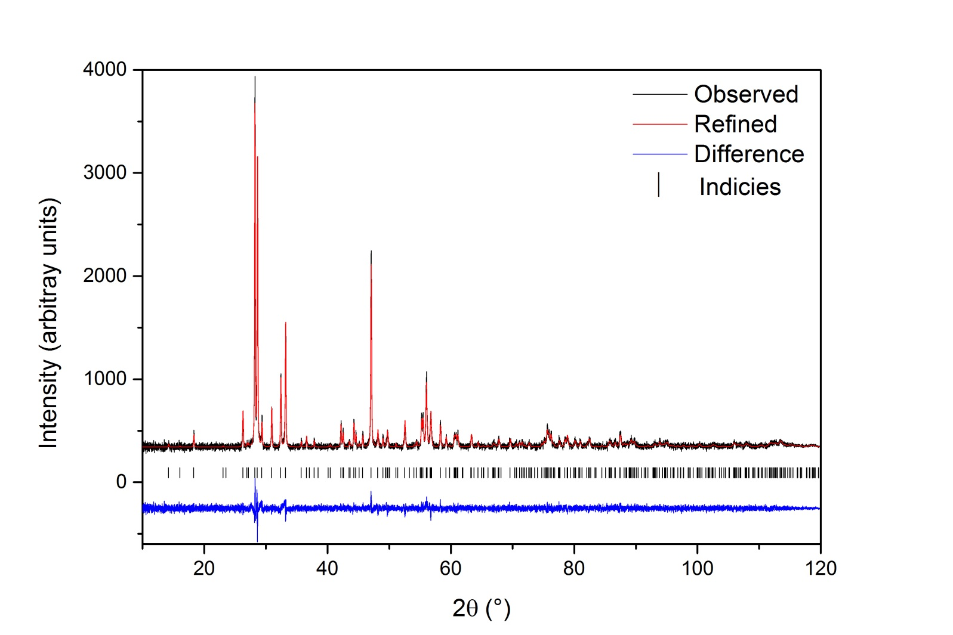
X-Ray Diffraction
New material – not in ICSD database
XRD shows good agreement, slight difference between observed data and refined crystal – needs more high resolution data
Notes:
XRD from STOE in transmission mode

Slide 15
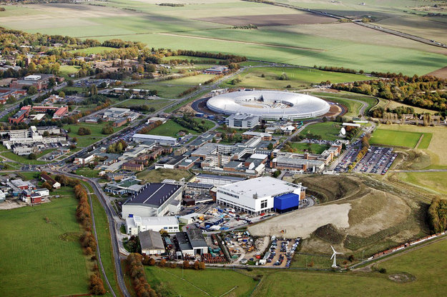
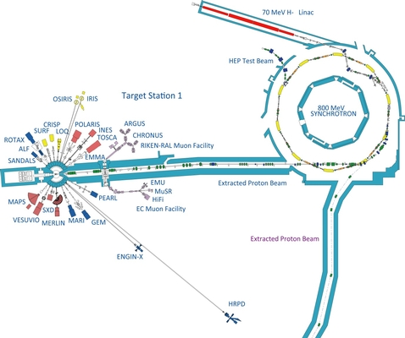
Neutron Diffraction
800 MeV Synchrotron into tungsten target @ 84% light speed
HRPD instrument – highest resolution in the world

Slide 16
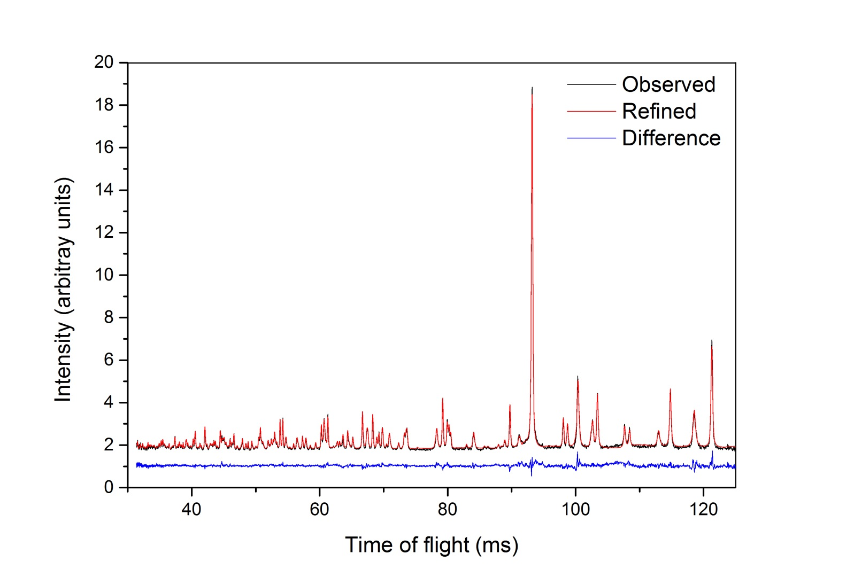
Neutron Diffraction
ND shows good agreement, slight difference between observed data and refined crystal
Possible Pseudosymmetry – Pnma is sub group of Cmcm – Y2 distortion mode
Phase transition from Pmcn to Cmcm is possible at elevated temperatures for Ln₃NbO₇ compounds

Slide 17
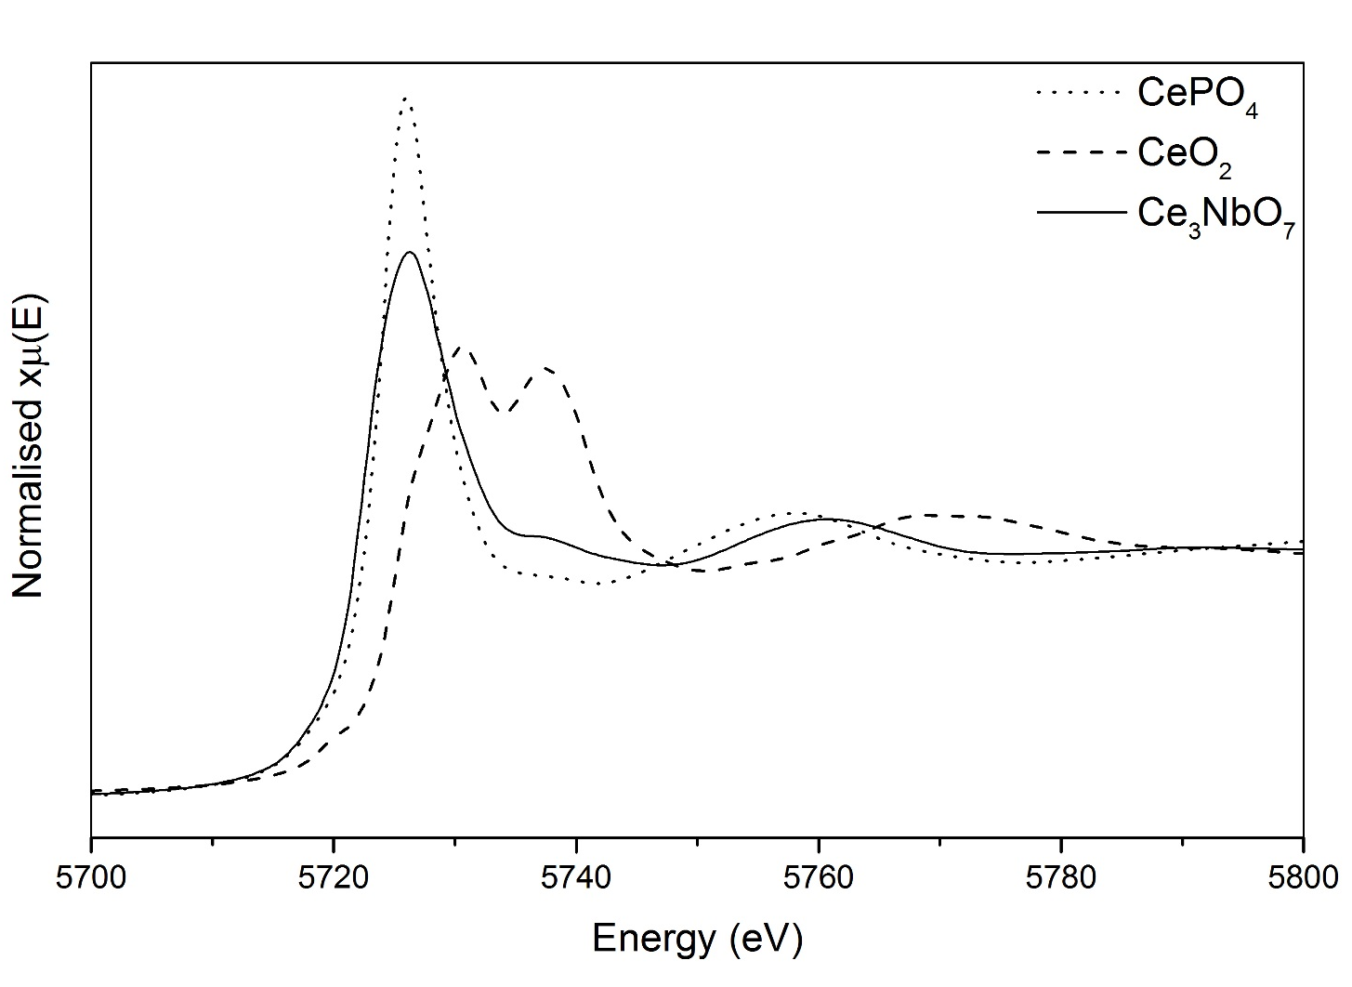
X-Ray Absorption Spectroscopy
Ce LIII edge spectroscopy
Compared to Ce-III and Ce-IV reference standards
Confirmation of chemical speciation of Ce within the structure
Average OS: 3.05
Notes:
XAS conducted at the Photon Factory in Japan – Ce L3 edge at ~5720 eV.
Compared our sample to 2 reference samples, Ce3 and Ce4. Form of the L3 edge suggests significant Ce3 contribution
Linear regression

Slide 18
Conclusions & Further Work
Am²⁴¹ has potential for use in future European RTG’s
Ce₃NbO₇ material can be produced in sizable quantities in the laboratory
  XRD, XAS, Magnetochemistry, Raman & Density
High resolution neutron data unable to pin down space group – Cmcm or Pnma
Possible pseudosymmetry structure with both space groups in two phases
Will use HT-XRD to explore phase transition region
Look into DTA/DSC for information on the phase transition

Slide 19

Special thanks to:
Prof Neil C. Hyatt
Dr Emma McCabe
Dr Martin C. Stennett
Dr Shi-Kuan Sun
& the ISL team
Thank you for listening!
The authors would like to thank the EPSRC (Grant EP/G037140/1) for funding this research which was performed in part at the MIDAS Facility, University of Sheffield, established with support from the Department of Energy and Climate Change.

