Slide 1


Solubility of the rhabdophane, LnPO₄·0.667 H₂O (Ln = La to Dy): implications for the long-term stability of monazite matrices.
S. Szenknectª; C. Gausseª; A. Mesbahª;
N. Clavierª; S. Neumeier^{b}; N. Dacheuxª.
ª CEA, ICSM – UMR 5257 CEA-CNRS-UM-ENSCM, Bagnols-sur-Cèze, France
^{b} Forschungszentrum Jülich, Institute for Energy and Climate, Jülich, Germany
stephanie.szenknect@cea.fr
01/11/2017, Sydney

Slide 2
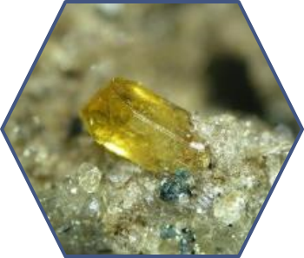
Why studying monazite ?
Most abundant lanthanides phosphate containing large amounts of Th and U ^{[1]} (up to 29 wt.% ThO₂ ^{[2]} and up to 16 wt.% ^{[3]})
Monazite
LnPO₄
Monoclinic system P2₁/n
Unaltered chemical composition over 100 millions years (useful for geochronology)
Very high resistance to irradiation ^{[4]}
(self-annealing, low temperature of recrystallization)
High capacity to incorporate various cations & polyoxoanions ^{[5]}
M^{III}/M^{III} : direct substitution
M^{IV}/M^{III} : single substitution (limited to few %)
M^{II} + M^{IV}/M^{III} : coupled substitution
(M^{III}+PO₄)/(M^{IV}+SiO₄): coupled mixed substitution
Identified as a promising radwaste matrix for the specific conditioning of trivalent or tetravalent actinides ^{[4]}
[1] Cuney M. et al Geology (2000) [2] Lumpkin G.R. The Canadian Mineralogist (1998) [3] Gramaccioli C. et al. American Mineralogist (1978)
[4] Ewing R.C. et al. Reviews in Mineralogy and Geochemistry (2002) [5] Clavier N. et al. Journal of European Ceramic Society (2011)

Slide 3
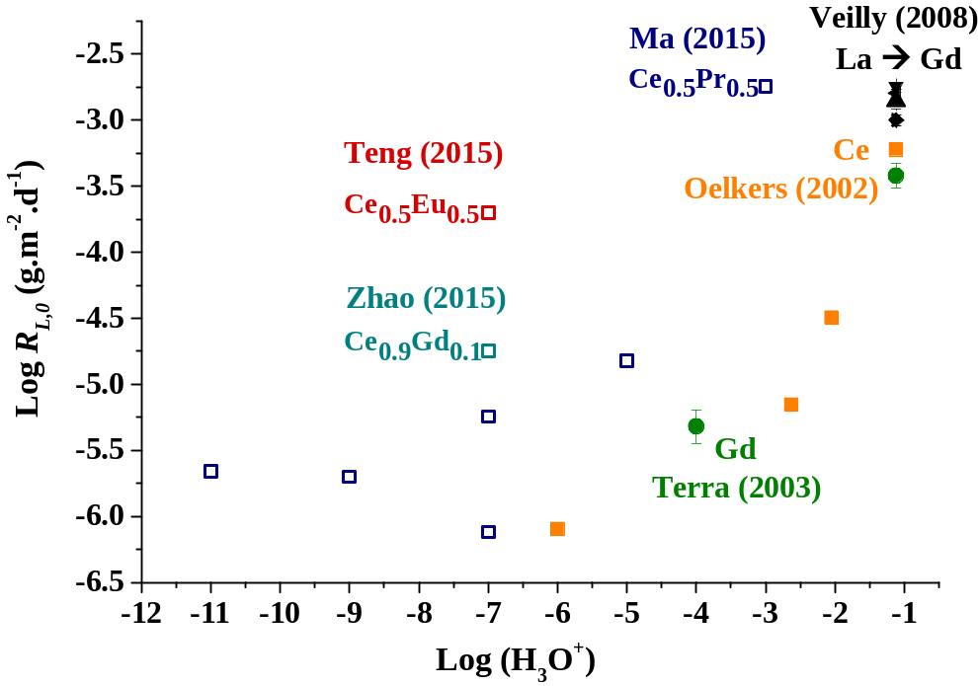
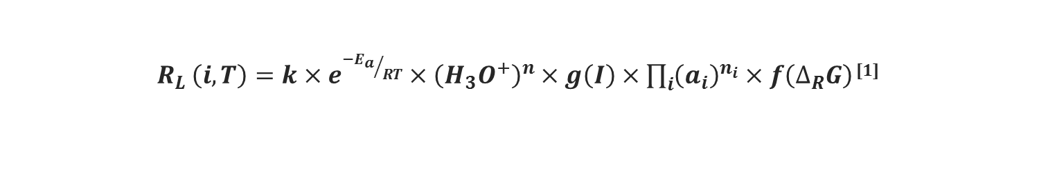
What is known about chemical durability ?
$R_{L }\left(i,T\right)=k×e^{{{−E}_{a}}/{RT}}×{\left(H_{3}O^{+}\right)}^{n}×g\left(I\right)×\prod_{i}{{\left(a_{i}\right)}^{n_{i}}}×f\left(∆_{R}G\right)$ ^{[1]}
Far from equilibrium : R_{L,0}
Very low dissolution rates
10⁻⁶ < R_{L,0} < 10⁻³ g.m⁻².d⁻¹
Lack of reliable kinetic data
Various protocols
Different solid compositions
Various temperatures
Numerous dissolution media
Need for a systematic study of the kinetics of dissolution
➲
Ma, J. et al. , J. Nucl. Mat. 2015, 465, 550-555. Oelkers, E. H.; Poitrasson, F., Chem. Geol. 2002, 191, 73-87. Teng, Y. et al., Ceram. Inter. 2015, 41, 10057-10062. Terra, O. et al., New J. Chem. 2003, 27, 957-967. Veilly, E. et al., Inorg. Chem. 2008, 47, 10971-10979. Zhao, X. et al., Ceram. Inter. 2015, 41, 11062-11068.

Slide 4
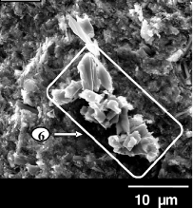


What is known about chemical durability ?
$$R_{L }\left(i,T\right)=k×e^{{{−E}_{a}}/{RT}}×{\left(H_{3}O^{+}\right)}^{n}×g\left(I\right)×\prod_{i}{{\left(a_{i}\right)}^{n_{i}}}×f\left(∆_{R}G\right)$$
^{[1]}
Near equilibrium: impact of saturation
Identification of neoformed phosphate-based phases
  LnPO₄·0.5H₂O
  Th₂(PO₄)₂(HPO₄)·H₂O
  (UO₂)₃(PO₄)₂·5H₂O…
T, saturation index and ionic radius dependency
H₂O
Heating
[2]
LnPO₄
Rhabdophane
T_{lim} = 90°C (La), 120°C (Ce), 150°C (Pr)
Need for a systematic study of the solubility of rhabdophane
Better constrain the relative stability domains of rhabdophane & monazite
180-250°C
700-900°C
LnPO₄ . ½ H₂O
Rhabdophane
Nd – Dy
LnPO₄
Monazite
T > T_{lim}
➲
H₂O
La, Ce, Pr
T < T_{lim}
Leaching
Leaching
H₂O
[1] Lasaga, A. C., Fundamental approaches in describing mineral dissolution and precipitation rates. In Chemical Weathering Rates of Silicate Minerals, White, A. F.; Brantley, S. L., Eds. 1995; Vol. 31, pp 23-86. [2] Dacheux, N.; Clavier, N.; Podor, R., American Mineralogist 2013, 98 (5-6), 833-847.

Slide 5
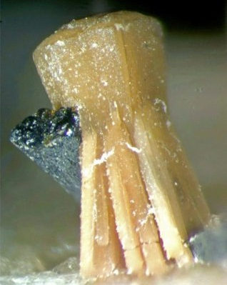
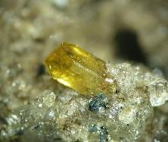
Outline
Homogeneous thermal conversion
Multiparametric study of the kinetics of dissolution
Rhabdophane
LnPO₄· 0.667H₂O
Monoclinic system C2
Leaching
Monazite
LnPO₄
Monoclinic system P2₁/n
Study of the solubility
Microstructural evolution at the surface of pellet during dissolution

Slide 6
Multiparametric study of the kinetics of dissolution of monazite,
LnPO₄ (Ln = La to Gd)
$$R_{L }\left(i,T\right)=k×e^{{{−E}_{a}}/{RT}}×{\left(H_{3}O^{+}\right)}^{n}×g\left(I\right)×\prod_{i}{{\left(a_{i}\right)}^{n_{i}}}×f\left(∆_{R}G\right)$$

Slide 7
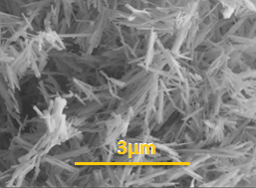
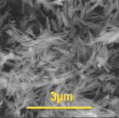
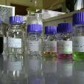
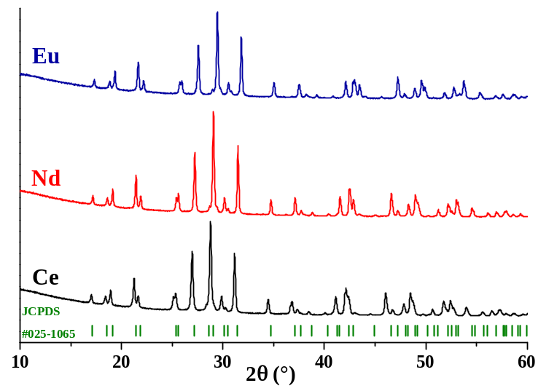
Dissolution kinetics of monazite : synthesis
Wet chemistry route
Characterization by XRD, SEM…
T = 900°C ^{[1]}
t = 6 h
T = 90°C
t = 14 d
LnPO₄ · 0.667H₂O ↓
Rhabdophane
LnPO₄
Monazite
LnCl₃ + H₃PO₄
Pure Monazite obtained whatever the lanthanide element (La → Gd)
Similar morphology but different size of needle like crystal
15.1 m².g⁻¹
2.9 m².g⁻¹
8.3 m².g⁻¹
CePO₄
EuPO₄
NdPO₄
[1] Jonasson, R.; Vance, E., Thermochimica acta 1986, 108, 65-72.

Slide 8
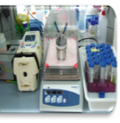
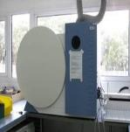
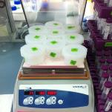

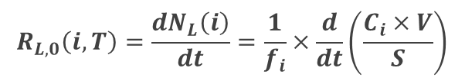
Dissolution kinetics of monazite: methodology
Study of the effect of the temperature, pH and Δ_{R}G on the normalized dissolution rate, R_{L}(i)
Far from equilibrium
0.1-0.5-1M HNO₃
298 - 363 K
Dynamic conditions
NdPO₄ 0.1 M -298 K
Dynamic conditions
$$Q\sim 2−4mL.h^{−1}$$
Analysis of the elementary concentrations
Near equilibrium
ICP-AES
Static conditions
0.1 M HNO₃ – 298 K
Concentration in solution (g.L⁻¹)
$$R_{L,0}\left(i,T\right)=\frac{{dN}_{L}\left(i\right)}{dt}=\frac{1}{f_{i}}×\frac{d}{dt}\left(\frac{C_{i}×V}{S}\right)$$
Mass ratio of (E_{i}) in the solid
Reactive surface area (m²)

Slide 9
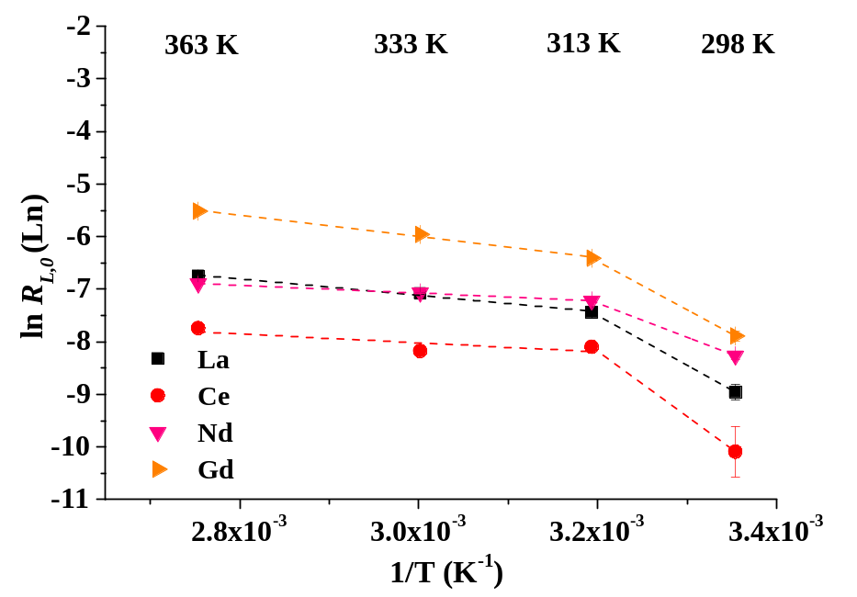
Dissolution kinetics of LnPO₄: effect of T
Increase of the dissolution rate with T
Determination of E_{app} : Arrhenius plot
LaPO₄ 0.1 M HNO₃
Dynamic conditions
Impact of f(ΔG_{r}) ?
0.1 M
➲
(4 ± 2) ×10⁻⁵ g.m⁻².d⁻¹ ≤ R_{L,0} (Ln) ≤ (4.0 ± 0.1)×10⁻³ g.m⁻².d⁻¹
Change in the rate-limiting step?
(Ce, 298 K)
(Gd, 363 K)
$$54±4≤E_{app}\left(1\right)≤103±25 kJ.mol^{−1}$$
➲
Similar behavior of all the lanthanides
(La → Gd)
T ≥ 313 K
$$6.2±0.2≤E_{app}(2)≤17±1 kJ.mol^{−1}$$
Gausse et al. Dissolution Kinetics of Monazite: a multiparametric study (submitted to Applied Geochemistry)

Slide 10
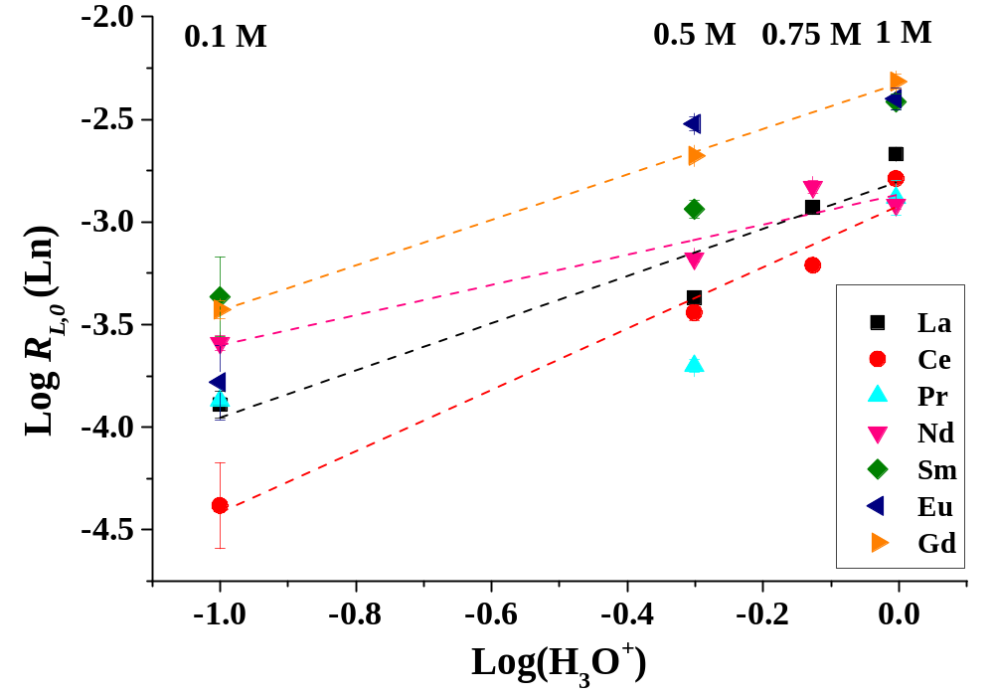


Dissolution kinetics of LnPO₄: effect of (H₃O⁺)
298 K: far from thermodynamic equilibrium
Determination of the partial order of the reaction relative to (H₃O⁺)
LaPO₄ -298 K
Dynamic conditions
(4 ± 2) ×10⁻⁵ g.m⁻².d⁻¹ ≤ R_{L} (Ln) ≤ (4.8 ± 0.4)×10⁻³ g.m⁻².d⁻¹
$$R_{L }\left(Ln,298 K\right)=k′′×{\left(H_{3}O^{+}\right)}^{n}$$
(Ce, 0.1 M)
(Gd, 1 M)
$$0.7±0.2≤n≤1.5±0.3$$
➲
Similar behavior of all the lanthanides
(La → Gd)
➲
Dissolution controlled by surface reactions
Gausse et al. Dissolution Kinetics of Monazite: a multiparametric study (submitted to Applied Geochemistry)

Slide 11
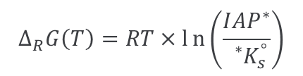

Dissolution kinetics of NdPO₄: effect of f($∆_{R}G$)
Dissolution of monazite in acidic media:
$${NdPO}_{4}+3H^{+}⇋{Nd}^{3+}+{H_{3}PO}_{4}^{}$$
t = 0
NdPO₄ – 0.1 M – 298 K
Static conditions
Impact of the saturation of the solution relative to the rhabdophane: more stable than monazite at 298 K ?
Precipitation of rhabdophane in acidic media:
${Nd}^{3+}+{H_{3}PO}_{4}^{}$ + $\text{0.667 }H_{2}O ⇋{NdPO}_{4}\text{∙}\text{ 0.667 }H_{2}O+3 H^{+}$
$$∆_{R}G\left(T\right)=RT×ln\left(\frac{{IAP}^{∗}}{{}_{}^{∗}{K_{s}^{°}}}\right)$$
$${}_{}^{∗}{K_{s}^{°}}=\left({Nd}^{3+}\right)\left(H_{3}PO_{4}\right){\left(H_{2}O\right)}^{0.667}{\left(H^{+}\right)}^{−3}$$
➲
Strong decrease of the dissolution rate with time:
Need to determine the solubility products of rhabdophanes
Evidence the precipitation of a neoformed phase
➲
R_{L,0} (Nd) = (2.2 ± 0.4) ×10⁻⁴ g.m⁻².d⁻¹
R_{L} (Nd) = (6 ± 1) ×10⁻⁶ g.m⁻².d⁻¹
Gausse et al. Dissolution Kinetics of Monazite: a multiparametric study (submitted to Applied Geochemistry)

Slide 12
Determination of the solubility products of rhabdophane LnPO₄·0.667H₂O
(Ln = La to Dy)
$${}_{}^{∗}{K_{s}^{°}}=\left({Ln}^{3+}\right)\left(H_{3}PO_{4}\right){\left(H_{2}O\right)}^{0.667}{\left(H^{+}\right)}^{−3}$$

Slide 13
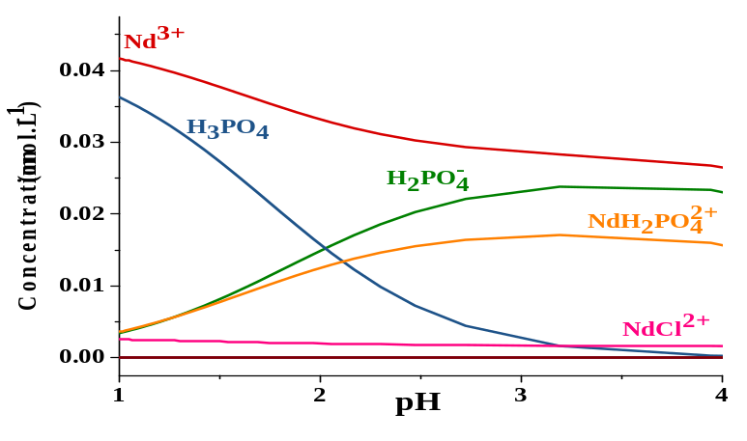

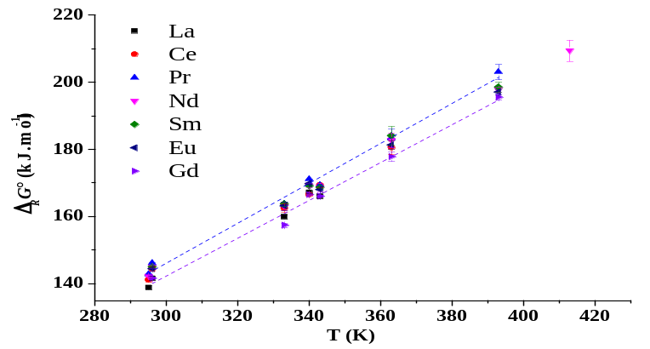
Determination of the thermodynamic properties: methodology
C_{i,o}
$${Ln}^{3+}+{PO}_{4}^{3−}+0.667H_{2}O→{LnPO}_{4}∙0.667H_{2}O$$
Solubility experiments
Over-saturation experiments
Reversibility of the equilibrium
Stability of the phase of interest
  Polyphased samples
  Neoformed phases
RT ; 60°C ; 70°C ; 90°C
C(i)
Equilibrium
Under-saturation experiments
RT ; 70°C
$${LnPO}_{4}∙0.667H_{2}O→{Ln}^{3+}+{PO}_{4}^{3−}+0.667H_{2}O$$
Time (days)
Speciation
Corrections of the activities
Composition of the solution
Non-ideality of the solution
Choosing the thermodynamic database (LLNL)
K°_{s,0}
Δ_{R}G°
Δ_{R}H°, Δ_{R}S°
Consistency of the database
Assessment of uncertainties

Slide 14
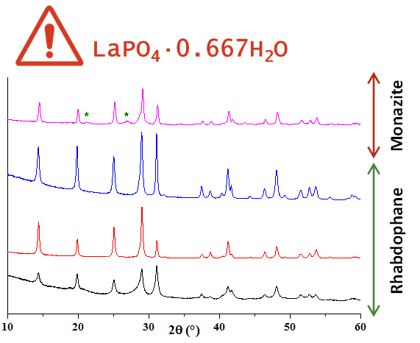
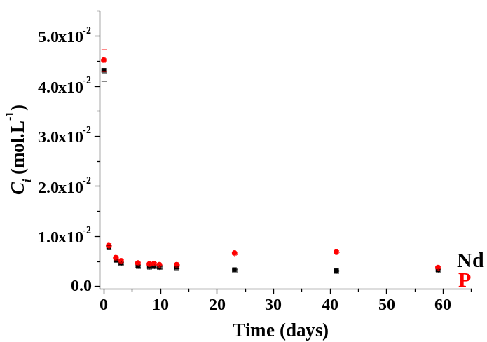
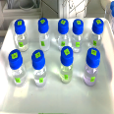
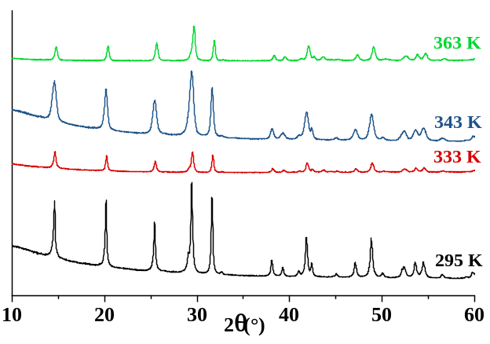
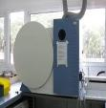
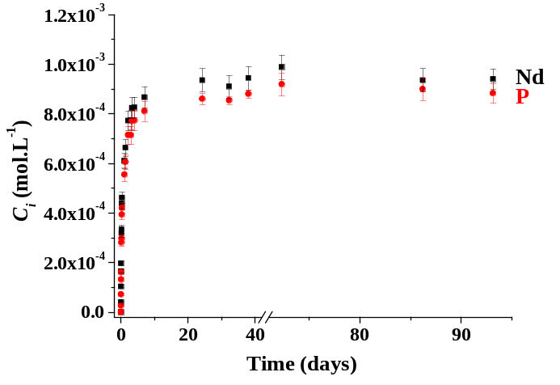
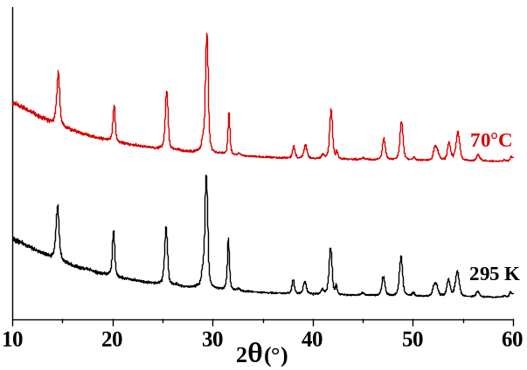



Solubility experiments
$$NdPO_{4}∙0.667H_{2}O⇋{Nd}^{3+}+{PO}_{4}^{3−}+0.667H_{2}O$$
0.1M HCl
295–333 -343-363 K
Over-saturation Conditions
363 K
Solubility Controlled
by rhabdophane
343 K
pH = 0.70 $±$ 0.05
Analysis of the elementary concentrations
Steady state
333 K
295 K
ICP-AES
0.1M HCl
295 - 343 K
Steady state
Under-saturation Conditions
Solubility Controlled
by rhabdophane
343 K
pH = 1.05 $±$ 0.05
Use of synthesized pure rhabdophane
for La to Dy (except Tb)
Gausse, C.; Szenknect, S.; Qin, D. W.; Mesbah, A.; Clavier, N.; Neumeier, S.; Bosbach, D.; Dacheux, N., European Journal of Inorganic Chemistry, 2016 (28), 4615-4630.

Slide 15
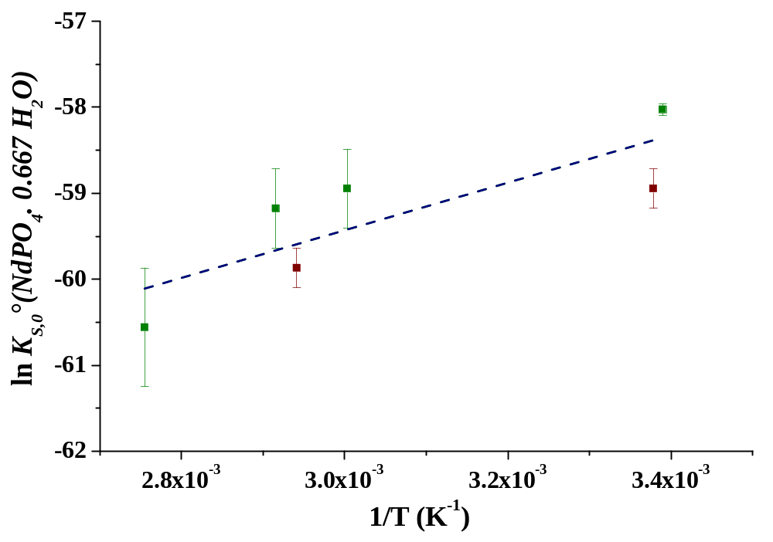

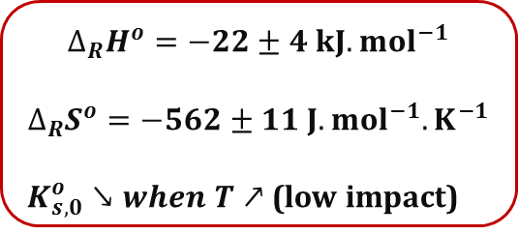

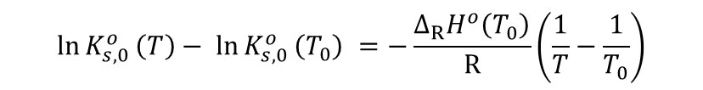

Thermodynamic constants of Nd-Rhabdophane
$$NdPO_{4}∙0.667H_{2}O⇋{Nd}^{3+}+{PO}_{4}^{3−}+0.667H_{2}O$$
$${}_{}^{}{K_{s,0}^{°}}=\left({Nd}^{3+}\right)\left(PO_{4}^{3−}\right){\left(H_{2}O\right)}^{0.667}$$
Over-saturation
–Δ_{R}H˚/R
$$\ln{K_{s,0}^{o}}\left(T\right)− \ln{K_{s,0}^{o}}\left(T_{0}\right) =−\frac{∆_{R}H^{o}\left(T_{0}\right)}{R}\left(\frac{1}{T}−\frac{1}{T_{0}}\right)$$
Under-saturation
$$∆_{R}G^{o}=−RT\ln{K_{s,0}^{o}}$$
$${∆RG}_{}^{o}={∆RH}_{}^{o}−T{∆RS}_{}^{o}$$
$$∆_{R}H^{o}=−22±4 {kJ.mol}^{−1}$$
$$∆_{R}S^{o}=−562±11 {J.mol}^{−1}{.K}^{−1}$$
$K_{s,0}^{o}↘when T↗$ (low impact)
Demonstration of the thermodynamic equilibrium
➲
Dissolution reaction: exothermic
Retrograde solubility
Gausse, C.; Szenknect, S.; Qin, D. W.; Mesbah, A.; Clavier, N.; Neumeier, S.; Bosbach, D.; Dacheux, N., European Journal of Inorganic Chemistry, 2016 (28), 4615-4630.

Slide 16
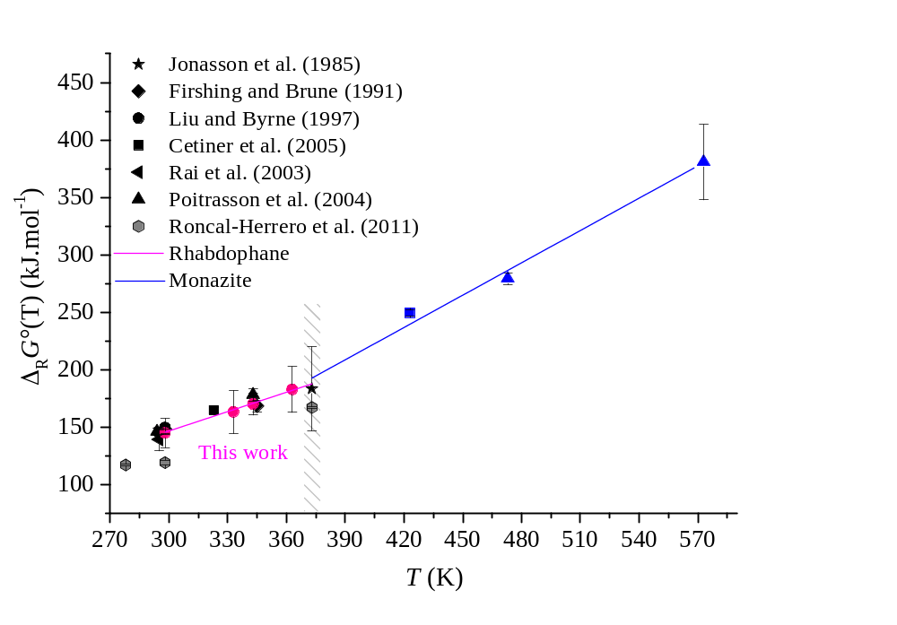
Comparison with literature data for Nd-monazite
Values reported in the litterature determined by dissolution of Nd-monazite

  Values previously assigned to monazite on the entire range of temperatures
Monazite
Rhabdophane
Due to similarities between the phases.
Due to the very low amount of dissolved monazite.
  Demonstration of the control of the concentrations in solution by Nd-rhabdophane for T ≤ 363 K (thanks to over- and under-saturation experiments)
Gausse, C.; Szenknect, S.; Qin, D. W.; Mesbah, A.; Clavier, N.; Neumeier, S.; Bosbach, D.; Dacheux, N., European Journal of Inorganic Chemistry, 2016 (28), 4615-4630.

Slide 17
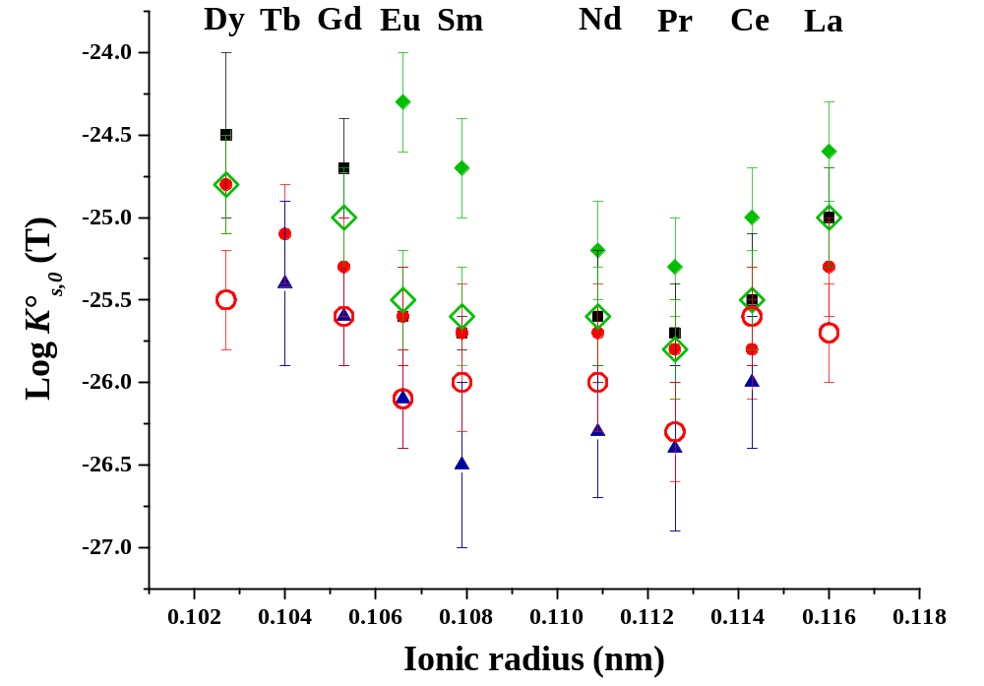
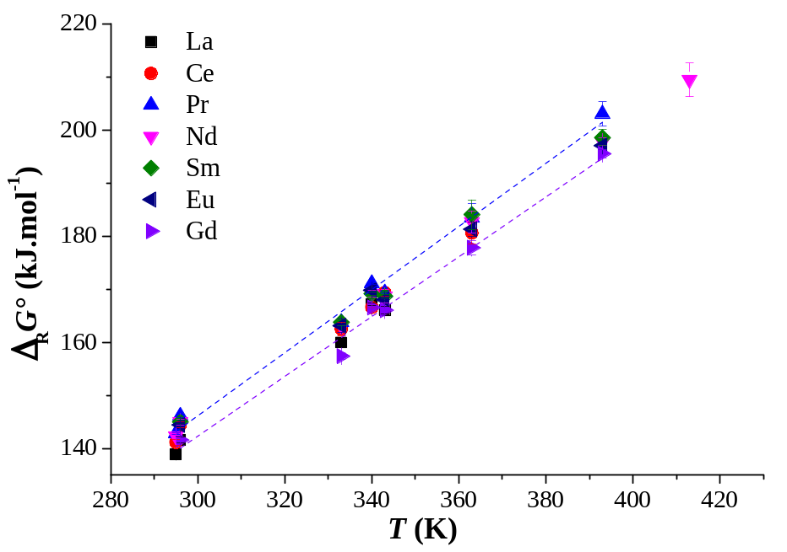
Thermodynamic constants of LnPO₄·0.667H₂O
(La to Dy)
/ 295 K
333 K
/ 343 K
❐ 363 K
Minimum of solubility observed at the middle of the lanthanides series (Nd-Sm)
-30 ± 8 kJ.mol⁻¹ (Pr) ≤ Δ_{R}H°(LnPO₄· 0.667 H₂O) ≤ -17 ± 7 kJ.mol⁻¹ (Eu)
-594 ± 23 J.mol⁻¹.K⁻¹(Pr) ≤ Δ_{R}S°(LnPO₄· 0.667 H₂O) ≤ -546 ± 19 J.mol⁻¹.K⁻¹(Eu)
Gausse, C.; Szenknect, S.; Qin, D. W.; Mesbah, A.; Clavier, N.; Neumeier, S.; Bosbach, D.; Dacheux, N., European Journal of Inorganic Chemistry, 2016 (28), 4615-4630.

Slide 18
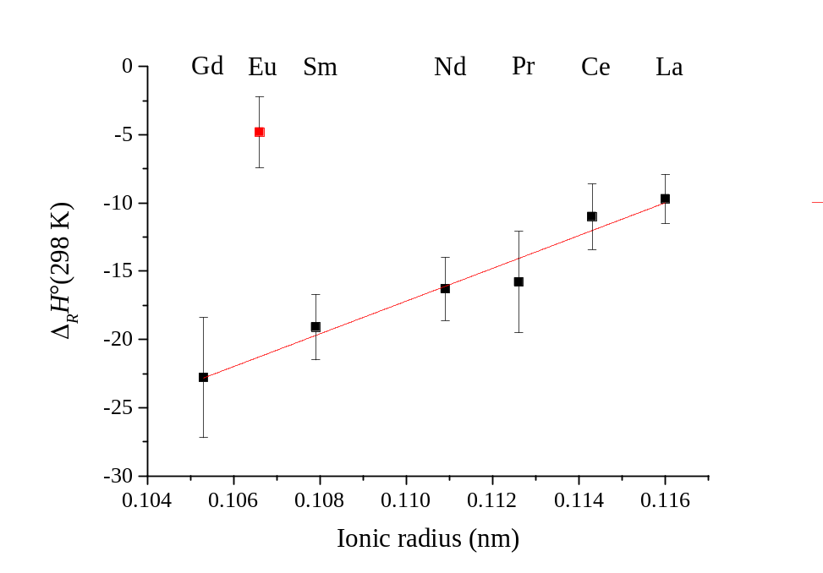
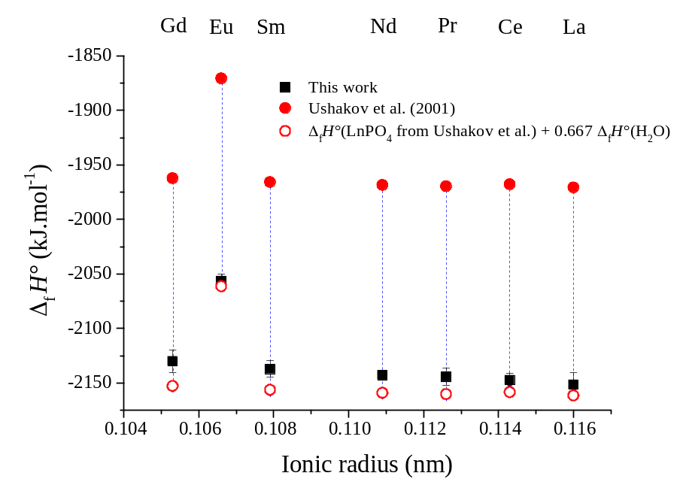
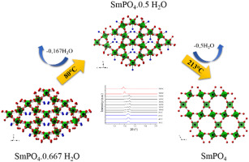
Enthalpy of dehydration reaction
Δ_{R}H° (Rh → M + 0.667 H₂O)= Δ_{f}H°(LnPO₄) + 0.667 Δ_{f}H°(H₂O) - Δ_{f}H°(LnPO₄· 0.667 H₂O)
Dehydration process studied over the combination of in situ high resolution synchrotron powder diffraction and TGA experiments [2]
➲
Δ_{R}H° ( 298 K)
[1] Ushakov, S. V.; Helean, K. B.; Navrotsky, A.; Boatner, L. A., Journal of Materials Research 2001, 16 (9), 2623-2633.
[2] Mesbah, A.; Clavier, N.; Elkaim, E.; Szenknect, S.; Dacheux, N., J Solid State Chem 2017, 249, 221-227.

Slide 19

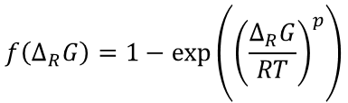

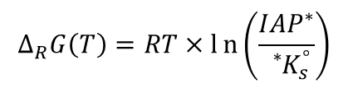
Implication for the long-term behavior of Nd-monazite
NdPO₄ – 0.1 M – 298 K
Static conditions
Strong influence of the solution saturation state
Kinetic regime
Far from equilibrium
Near equilibrium
$$∆_{R}G\left(T\right)=RT×ln\left(\frac{{IAP}^{∗}}{{}_{}^{∗}{K_{s}^{°}}}\right)$$
$${}_{}^{∗}{K_{s}^{°}}=−3.7 ±0.6$$
$$f\left(∆_{R}G\right)=1−exp⁡\left({\left(\frac{∆_{R}G}{RT}\right)}^{p}\right)$$
For the calculation of IAP*:
speciation with LLNL TDB ^{[1]}
Δ_{R}G (kJ.mol⁻¹)
Strong decrease of the monazite dissolution rate approaching equilibrium with rhabdophane
Favorable to the use of monazite as a radwaste matrix
➲
[1] Johnson, J. W. et al., Computers & Geosci., 1992, 18, 899-947.

Slide 20



Monitoring the microstructural evolution at monazite surface during dissolution
Powder
Pellet

Slide 21
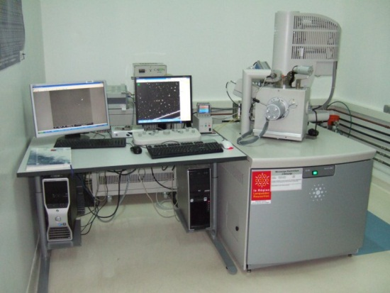
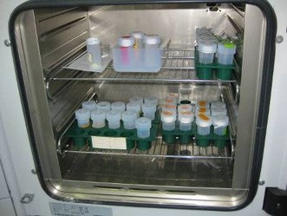

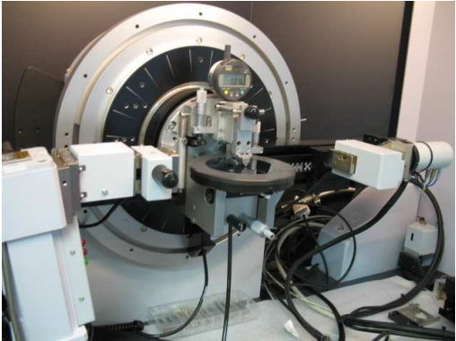
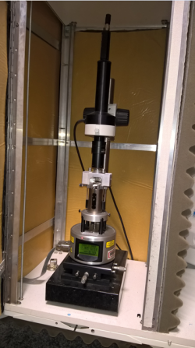
Methodology
Monitoring microstructural evolution at the surface of Nd-monazite sintered pellet:
use of complementary techniques
0.25 M HNO₃ 90°C
ESEM
ESEM : Monitoring of the evolution of the microstructure of the pellet at a submicron scale
AFM : track potential topographic changes of the surface of the solid at a nanometric scale
GI-XRR : access to physical properties of the solid surface (electron density, roughness)
Grazing Incidence X-rays
AFM
Szenknect, S.; Finkeldei, S.; Brandt, F.; Ravaux, J.; Odorico, M.; Podor, R.; Dacheux, N.; Bosbach, D., J. Nucl. Mater. 2017, 496, 97-108.
Szenknect, S.; Mesbah, A.; Horlait, D.; Clavier, N.; Dourdain, S.; Ravaux, J.; Dacheux, N., J. Phys. Chem. C 2012, 116 (22), 12027-12037.

Slide 22
Microstructural evolution at the surface of Nd-monazite:
ESEM
NdPO₄
0.25 M HNO₃ 90°C
ESEM images of a selected area
t = 0 d
t = 11 d
t = 162 d
t = 284 d
Δm/m₀ = 0.32 %
SI(rhabdophane) = –0.07
Δ_{R}G = -0.4 kJ.mol⁻¹
Detachment of grains
Preferential dissolution at grain boundaries and pre-existing defects
Chemo-mechanical corrosion ➔ Detachment of grains

Slide 23
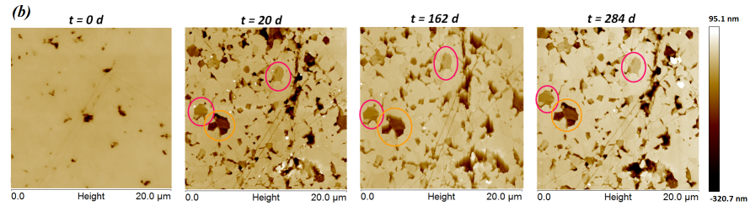
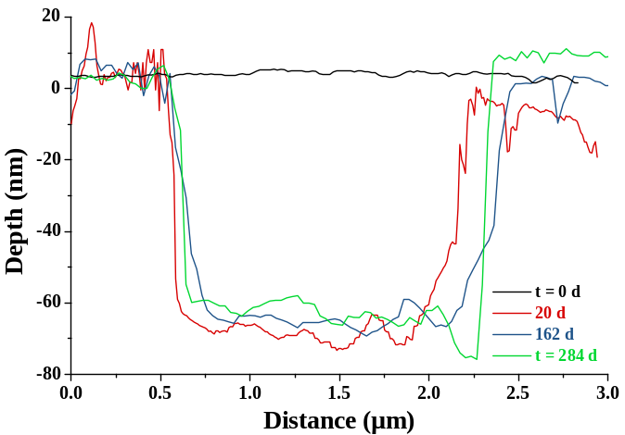
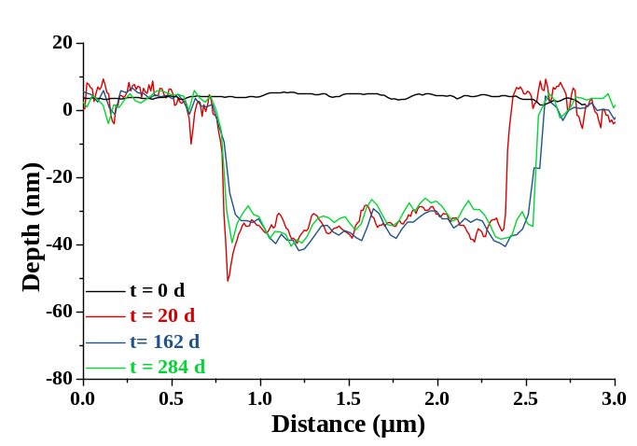
Microstructural evolution at the surface of Nd-monazite:
AFM
NdPO₄
0.25 M HNO₃ 90°C
Preferential dissolution at grain boundaries and pre-existing defects
Chemo-mechanical corrosion ➔ Detachment of grains
20 to 162 days: holes created by grain detachment became wider
162 to 284 days: evolution stopped

Slide 24
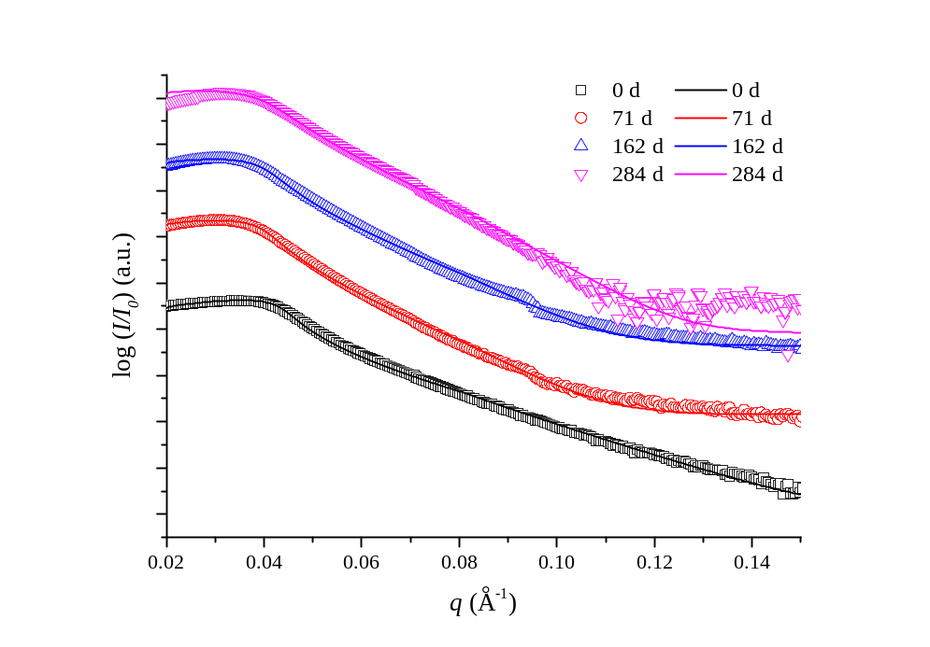
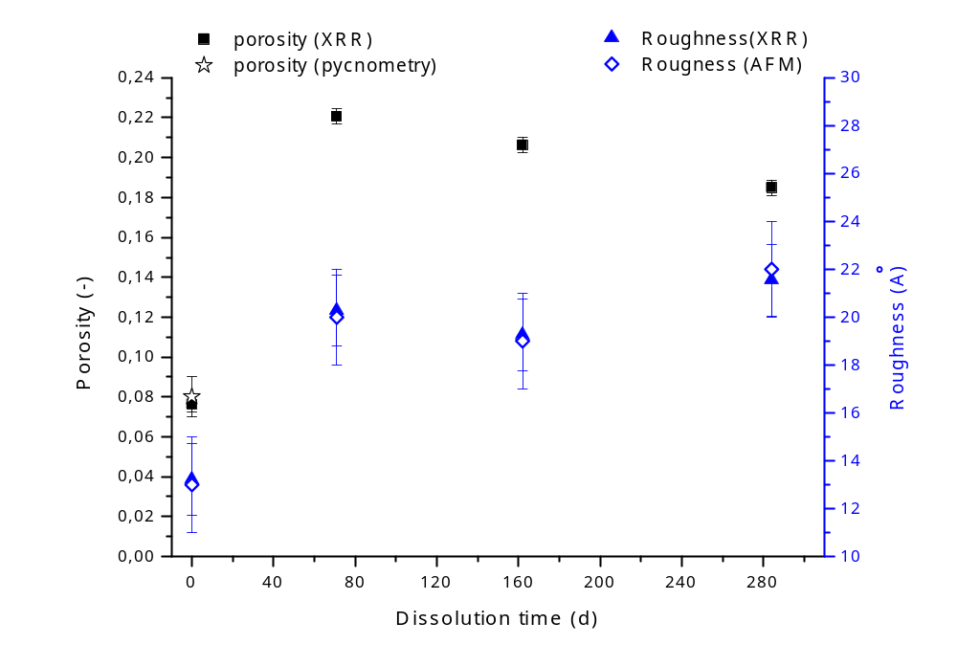
Microstructural evolution at the surface of Nd-monazite:
GI-XRR
NdPO₄
0.25 M HNO₃ 90°C
Strong influence of the solution saturation state
Δ_{R}G = -0.4 kJ.mol⁻¹
No oscillation observed: absence of surface layer or secondary phase precipitated at the surface pellet
≠
?
Increase then stabilization of microstructural properties (roughness and porosity):
Slow down linked to saturation state of the solution

Slide 25
Conclusions / prospects
Very high chemical durability of LnPO₄ (Ln = La to Dy) monazite confirmed even in acidic media and far from thermodynamic equilibrium
Relative stability domains of monazite and rhabdophane better constrained:
  ➔ control of the saturation state of the leaching solution by rhabdophane for T < 363 K
Quantification of the impact of the saturation state of the solution relative to the rhabdophane on the normalized dissolution rate of monazite
  ➔ decrease of the dissolution rate: positive impact in the context of nuclear waste disposal
Impact of microstructural parameters on the chemical durability :
  Synthesis ⬄ Sintering ⬄ Dissolution
  Transposition of the methodology for the study of the durability of Ln_{1-x}Ca_{x}Th_{x}PO₄ cheralites (Ph. D. of Danwei Qin at ICSM 2016-2020) ^{[1], [2]}.
[1] Qin, D.; Gausse, C.; Szenknect, S.; Mesbah, A.; Clavier, N.; Dacheux, N., The Journal of Chemical Thermodynamics 2017, 114, 151-164.
[2] Qin, D. W.; Mesbah, A.; Gausse, C.; Szenknect, S.; Dacheux, N.; Clavier, N., Journal of Nuclear Materials 2017, 492, 88-96.

Slide 26
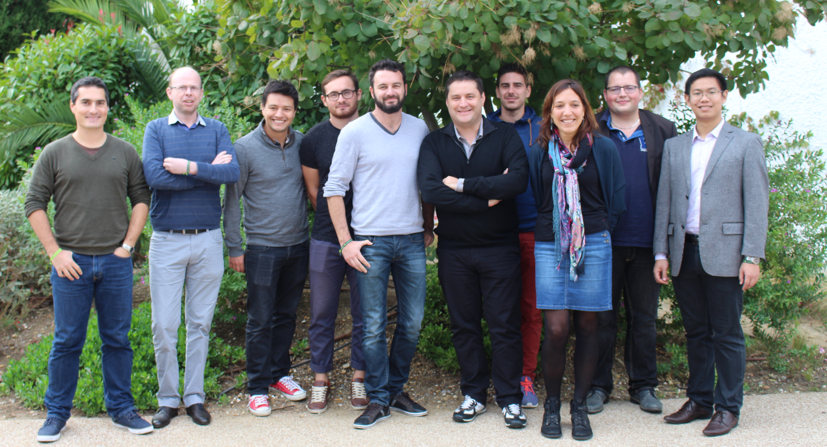
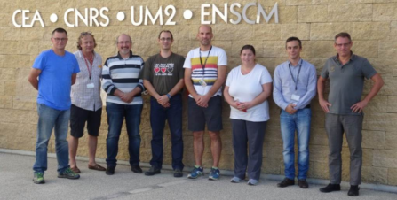
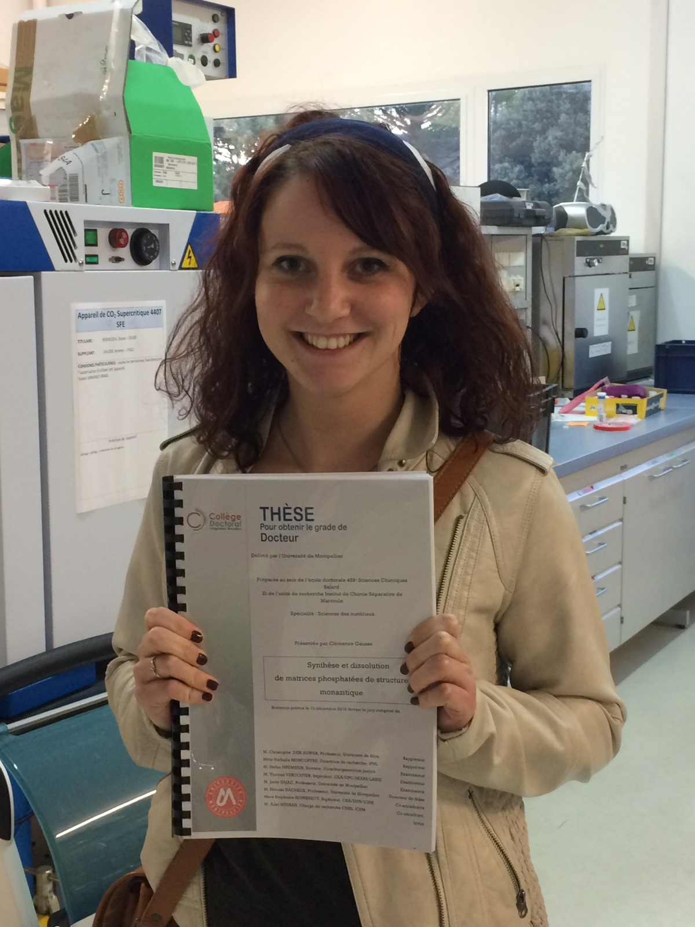



Thank you !
Interfaces of Material in Evolution (LIME)
Study of Matter in Environmental conditions (L2ME)
Dr. Clémence Gausse !
clem.gausse@orange.fr

Slide 28

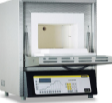


Preparation of the monazite pellet
Mechanical grinding:
45 min – 30 Hz
Uniaxial pressing:
500 MPa
Sintering:
1400°C – 8h – air
NdPO₄
Monazite powder
Homogeneous pellet
87% of total density with 6% of open porosity and 7% of closed porosity

Slide 29


