Slide 1


Aqueous leaching of high burnup UO₂ fuel under hydrogen conditions
Anders Puranen¹, Olivia Roth¹,
Lena Evins², Kastriot Spahiu²
¹Studsvik Nuclear AB
²SKB Sweden
Scientific Basis for Nuclear Waste Management
Sydney 2017

Slide 2
Introduction
The majority of irradiated fuel leaching studies have been performed under oxidising (aerated) conditions
H₂ is anticipated to form in a breached deep repository container
  In the Swedish KBS-3 repository design H₂ pressures of ~50 bar may occur
    One H₂ source corrosion of iron components at deposition depth of ~500 m
  Uranium concentration expected to be controlled by U(IV) solubility (am), ~3E-9 M
    Inhibition of UO₂ matrix dissolution
Limited data on fuel behaviour under strong hydrogen pressures
This experiment
Leaching of freshly crushed high burnup UO₂ fuel to assess radionuclide release and dissolution rates under hydrogen conditions
The employed fuel was irradiated in a commercial power reactor under standard operating conditions (FGR ~2.6%, peak cycle LHR ~24 kW/m)

Slide 3
Experimental overview
Fuel: PWR, local pellet BU ~65 MWd/kgU, irradiated in Ringhals 3 (rod 3V5Q13)
  Additional rod data in SKB Technical Report TR-11-03
2 g worth of freshly crushed fuel fragments ~1-2 mm size, placed in a gold fine mesh basket and pre-leached (2 mM NaHCO₃ solution)
  Cumulative pre-leaching under argon bubbling (4 contacts, 6 days total)
Autoclave leaching (430 days)
  Argon purging followed by pressurisation with 100% hydrogen to 50 bar, no gas replenishment. Total pressure evolution ~50 -> 29 bar. Room temperature.
  Simplified granitic groundwater, 10 mM NaCl, 2 mM NaHCO₃
  No replenishment of leaching solution, 950 -> 650 ml
  Liquid sampling system fitted with an in autoclave quartz filter (P4 frit, 10-16 µm)
  Solution samples centrifuged and analysed by ICP-MS
  Gas-MS sampling

Slide 4
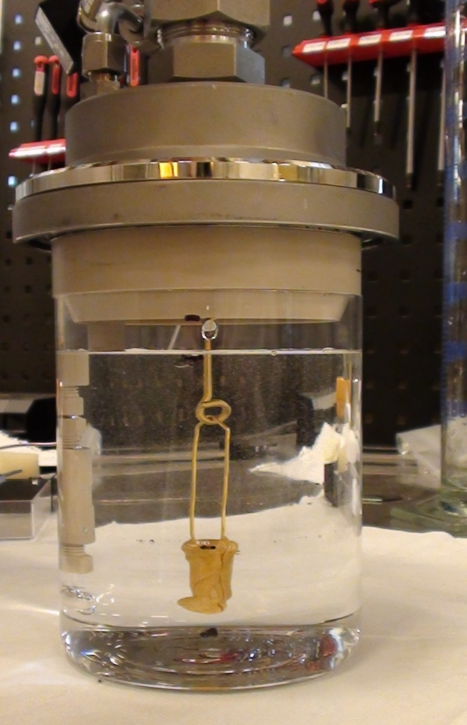
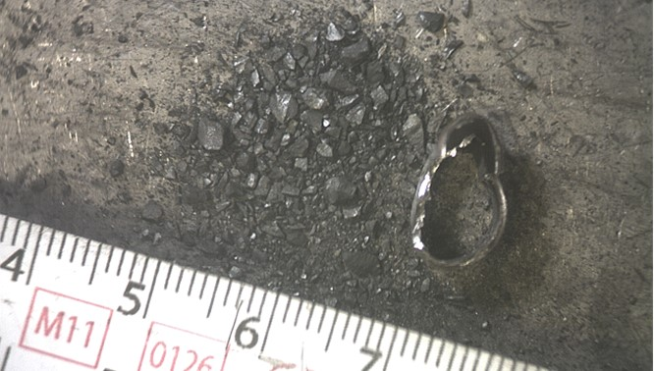
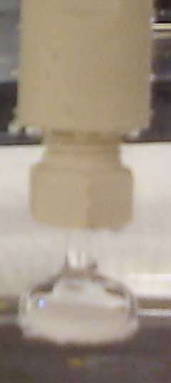
Fuel crushing and autoclave overview
~1-2 mm-sized fragments was obtained by compression of the cladding and fracturing of the fuel (no milling)
Autoclave with quartz inner vessel and PEEK internals, without lower portion of the pressure vessel

Slide 5
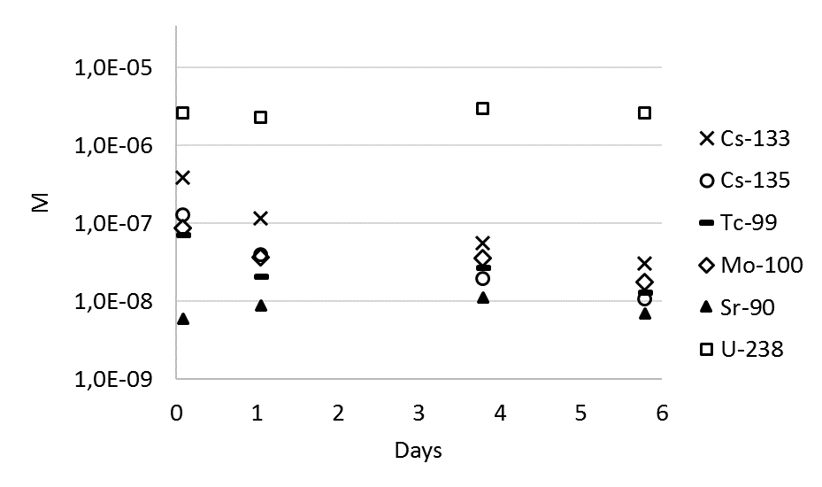
Pre-leaching, under argon bubbling
Cumulative pre-leaching, the sample is transferred to a new flask and leaching solution at each sampling
Note near constant U & Sr concentration in each sampling
Decreasing Cs-133, 135, Tc-99 & Mo-100 concentrations for each new leaching exposure

Slide 6
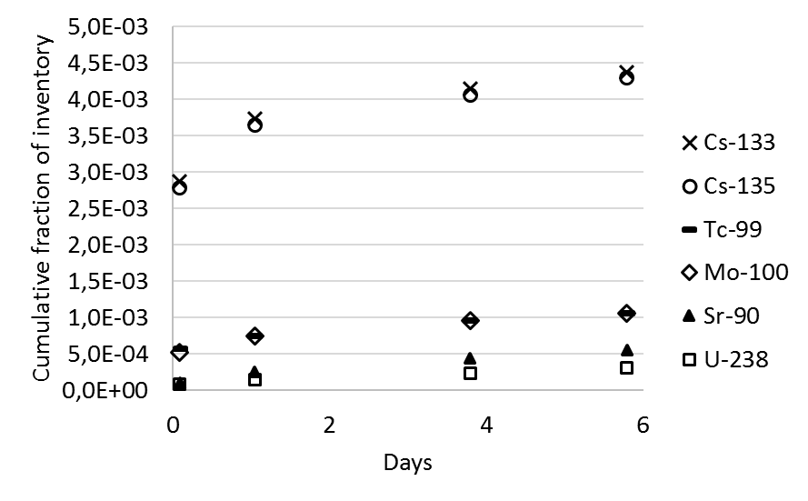
Pre-leaching, under argon bubbling
Pre-leaching of freshy crushed fragments to remove part of the instant release inventory
Same data as in previous slide but plotted as cumulative fraction of inventory released
~0.45% of Cs, ~0.1-0.04% of Tc, Mo, Sr and U inventory released in the 6 day pre-leach
Note coherent fractional releases for Cs-133 & 135, Tc-99 & Mo-100 and Sr-90 & U-238

Slide 7
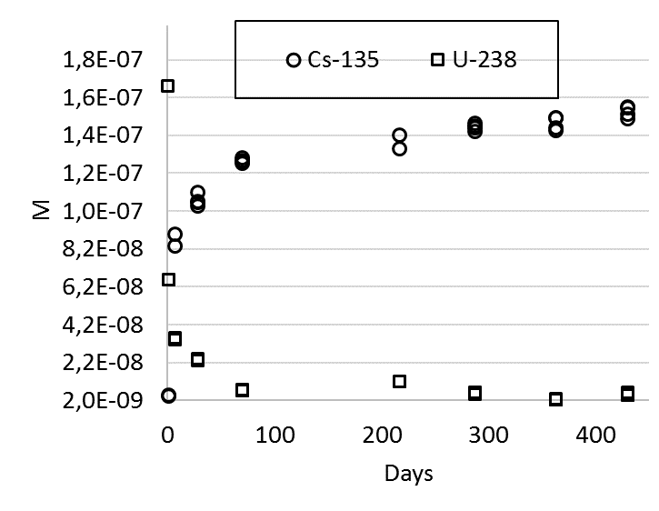
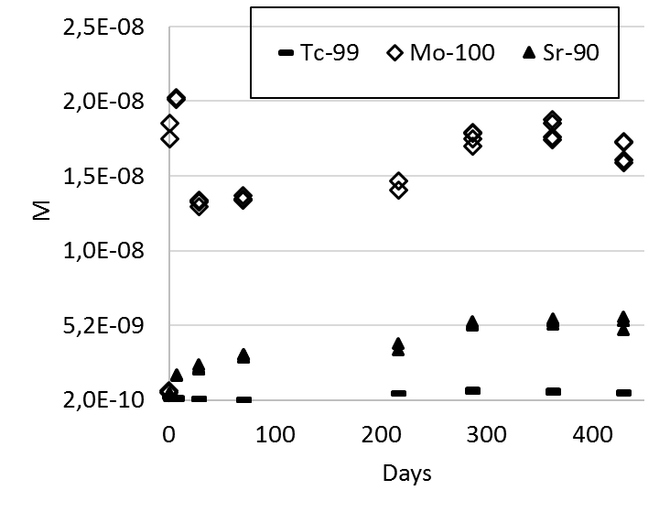
Results from the autoclave exposure, fill gas 50 bar H₂
No exchange or refilling of solution between samplings
Redox sensitive U decreasing to solubility levels of UO_{2(am)} ~2-4E-9 M
Gradually decreasing release rates of Cs and Sr
Redox sensitive Tc at very low concentrations ~2-7E-10 M
Mo concentration fairly constant, complex redox chemistry

Slide 8
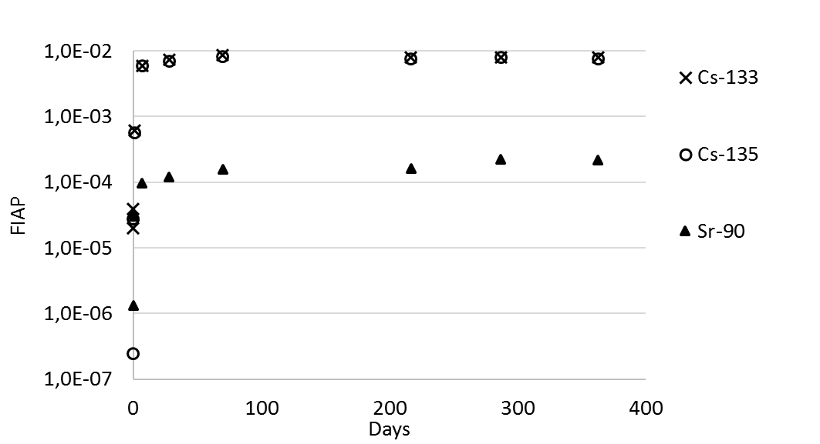
Results of autoclave exposure, fill pressure 50 bar H₂
Fraction of Inventory in Aqueous Phase
Release of redox insensitive & weakly adsorbing Cs and Sr mainly in the first days
  Cs release during 6 day pre-washing ~0.45%, in autoclave 363 day release ~0.8%
  Sr release during 6 day pre-washing ~0.05%, in autoclave 363 day release ~0.02%
  ”Low” per day fraction of inventory release rates beyond 70 days, ~1-2 orders of magnitude less than leaching in areated conditions

Slide 9
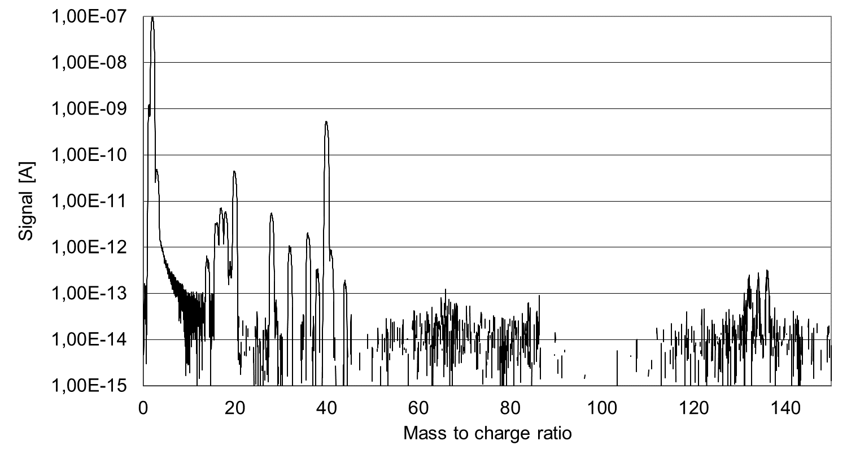
Autoclave gas-MS analysis at 363 days
Hydrogen ~98.5%
Argon ~1.4%
Trace Xe
Trace gases: ~345 ppm He, 169 ppm N₂, 39 ppm O₂, trace H₂O and CO₂ not quantified
Trace Xe signal, below quantification limit (~10 ppm)
Xe-signal appears fissiogenic, Xe-136, 134, 132 ratios in fair agreement with pin puncture (far from natural Xe isotopic composition)

Slide 10
Conclusions
The uranium concentration decreased to UO₂ solubility limits (<4E-9 M) within 70 days
  Indicates hydrogen inhibition of UO₂ matrix dissolution
Strongly decreasing Cs and Sr releases rates under hydrogen conditions
  Total Cs relases ~0.45% (pre-wash) + 0.8% in autoclave (in pile FGR was 2.6%)
  Sr fraction of inventory release ~1-2 orders of magnitude lower than Cs
  ”Low” per day release rates beyond 70 days compared to areated fuel leaching
    Work underway to quantify and compare release rates under hydrogen conditions with previous studies in areated conditions
Trace in autoclave Xe fission gas release detected
    Gas-MS analytical method under improvement to facilitate fission gas detection and quantification in autoclave experments

