Slide 1



Alkali technetium oxides and their relation to Tc loading in nuclear waste glasses
John McCloy, Jamie Weaver, Chuck Soderquist, & others
Sydney, Australia
November 2, 2017
Notes:
Alkali technetium oxides and their relation to Tc loading in nuclear waste glasses
John McCloy, Jamie Weaver, Chuck Soderquist (+others in acknowledgements)
Because of their radioactive nature, solid technetium-99 oxides have been rarely studied, and there is a dearth of modern spectra and diffraction patterns in the literature. This publication aims to address this by detailing a low-temperature synthesis method for pure, crystalline alkali pertechnetates, along with complete analysis by static and magic-angle-spinning nuclear magnetic resonance, Raman, neutron diffraction (ND), and X-ray absorption spectroscopy (XAS). Insight gained from these studies brings a deeper understanding of the periodic chemistry of alkali (Na,K,Rb,Cs) pertechnetates. Additionally, we report attempts to make 5- and 6-coordinate pertechnetate compounds of K, Na, and Li, i.e. TcO₅ ⁻ and TcO₆ ⁻. It was found that higher coordinated species are very sensitive to water, and easily decompose into their respective pertechnetates. It was difficult to obtain pure compounds, but mixtures of the pertechnetate and other phases were frequently found, as evidenced by XAS, ND, and Raman spectroscopy. Additionally, we summarize other work on Tc loading in glasses, effect on glass structure, and salt formation in overloaded samples. For glasses, XAS chemometrics based on principal component analysis and linear combination fitting suggests that Tc is speciated first as isolated Tc⁴⁺, as Tc content is increased, there is more Tc⁷⁺ which partitions first to K neighbors then to isolated sites. Preliminary work is reported assessing HTcO₄ and related compounds and their relationships to mechanisms of Tc volatility.

Slide 2
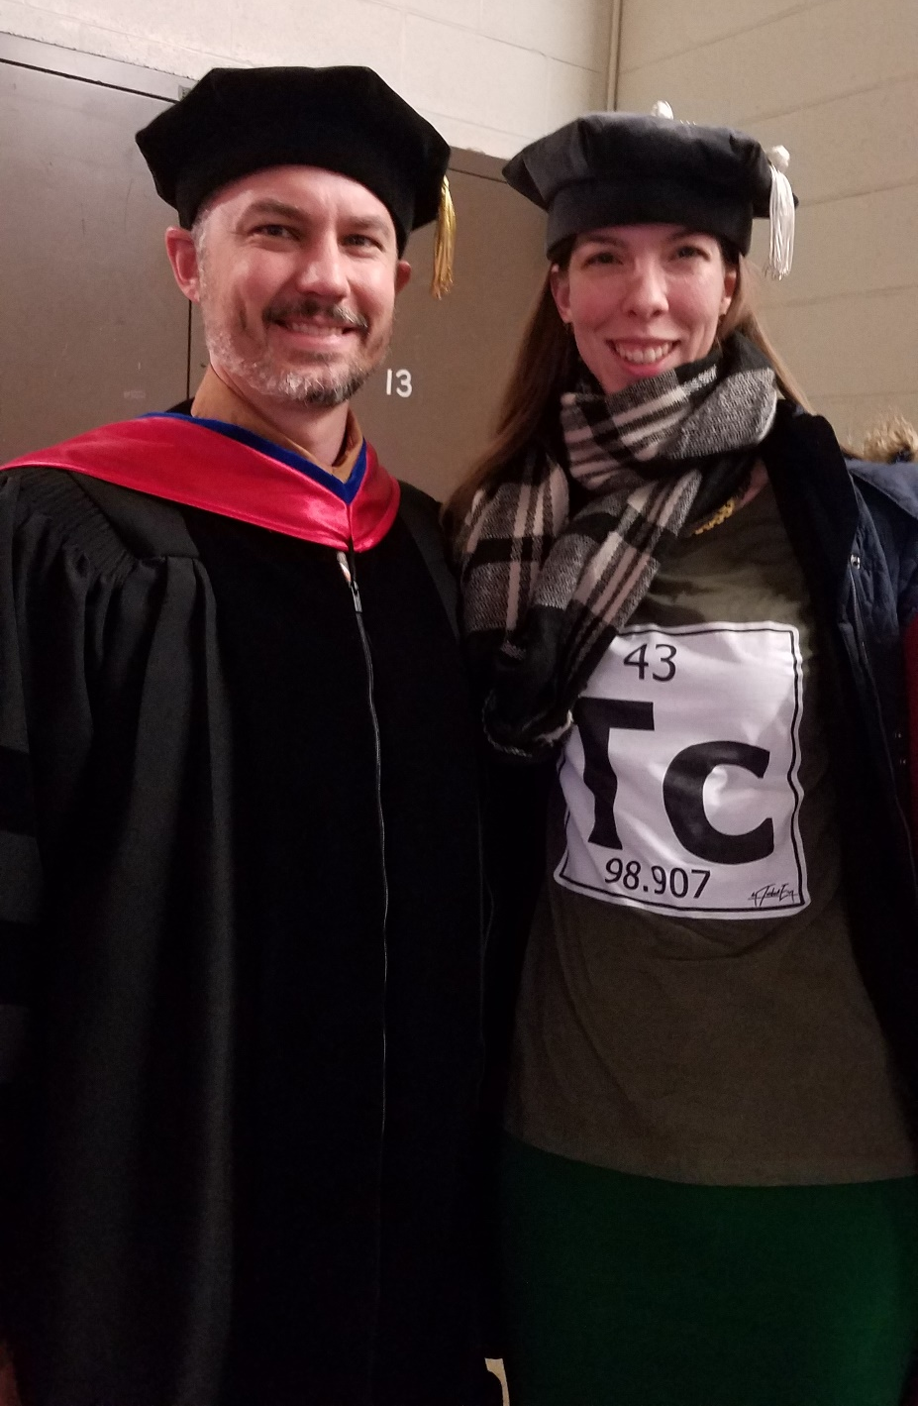









Acknowledgements
Chuck Soderquist
Paul Gassman
Albert Kruger
Eric Walter
Nancy Washton
Andy Lipton
UP# 48294
Wayne Lukens
Jamie Weaver
Jason Lonergan

Slide 3
Outline
Motivation
Tc in glass
TcO₄ compounds
TcO₅, TcO₆ compounds
Simulations & ongoing work

Slide 4
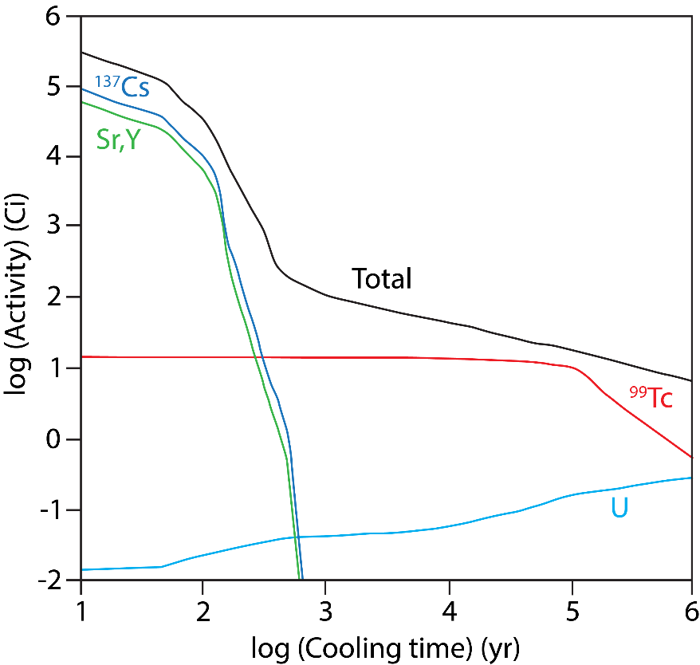
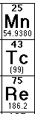
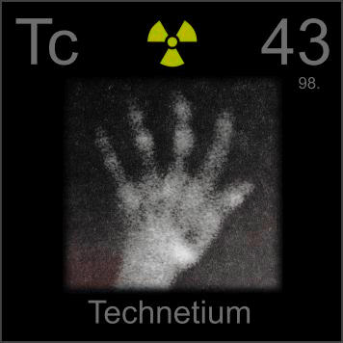
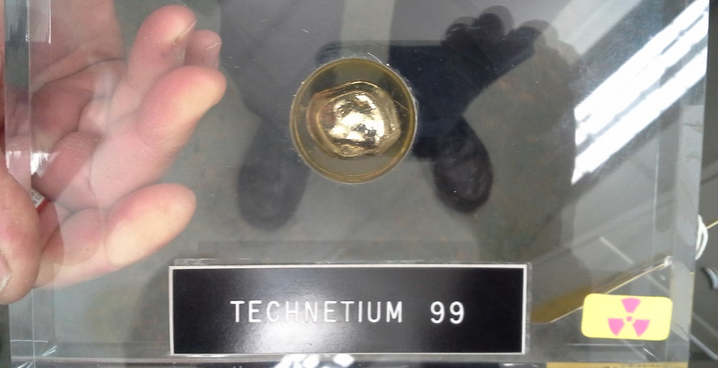
Technetium – why do we care?
Tc-99 is problematic radionuclide
  Half life 213,000 years
  TcO₄⁻ highly mobile in ground water
  Redox quite different than surrogate Re
For Hanford mission, Tc-99 is concern
  Hanford site: ~1500 kg (~25,000 Ci) of ⁹⁹Tc, 50-90+% to be immobilized in LAW glass
  Low retention of Tc: Solubility? Volatility?
Notes:
Characteristics of Tc-99
Specific disposal situation at Hanford
Where is the Tc at Hanford
----------
http://periodictable.com/Samples/043.1/s9s.JPG

Slide 5
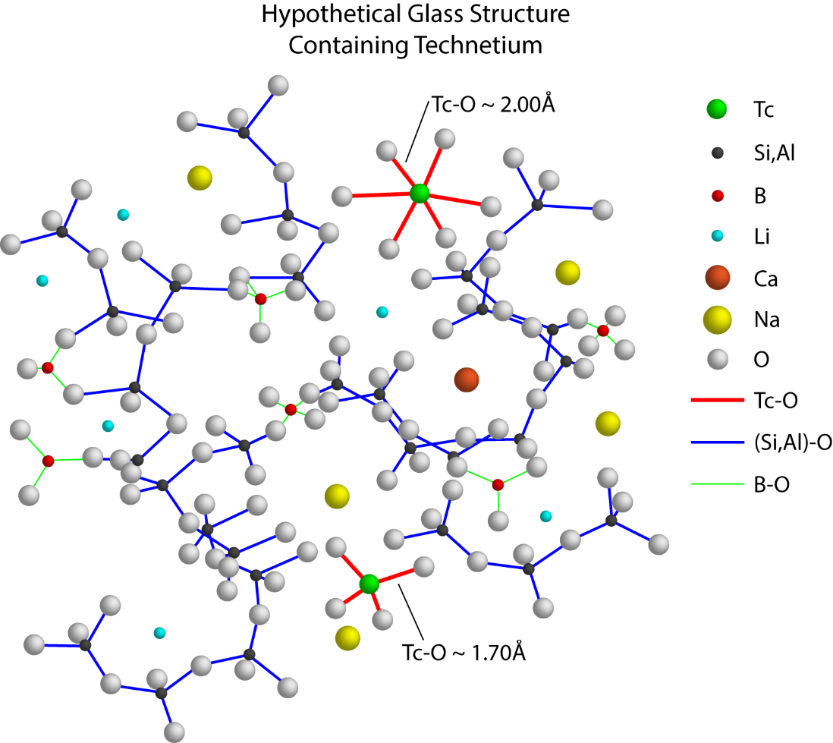
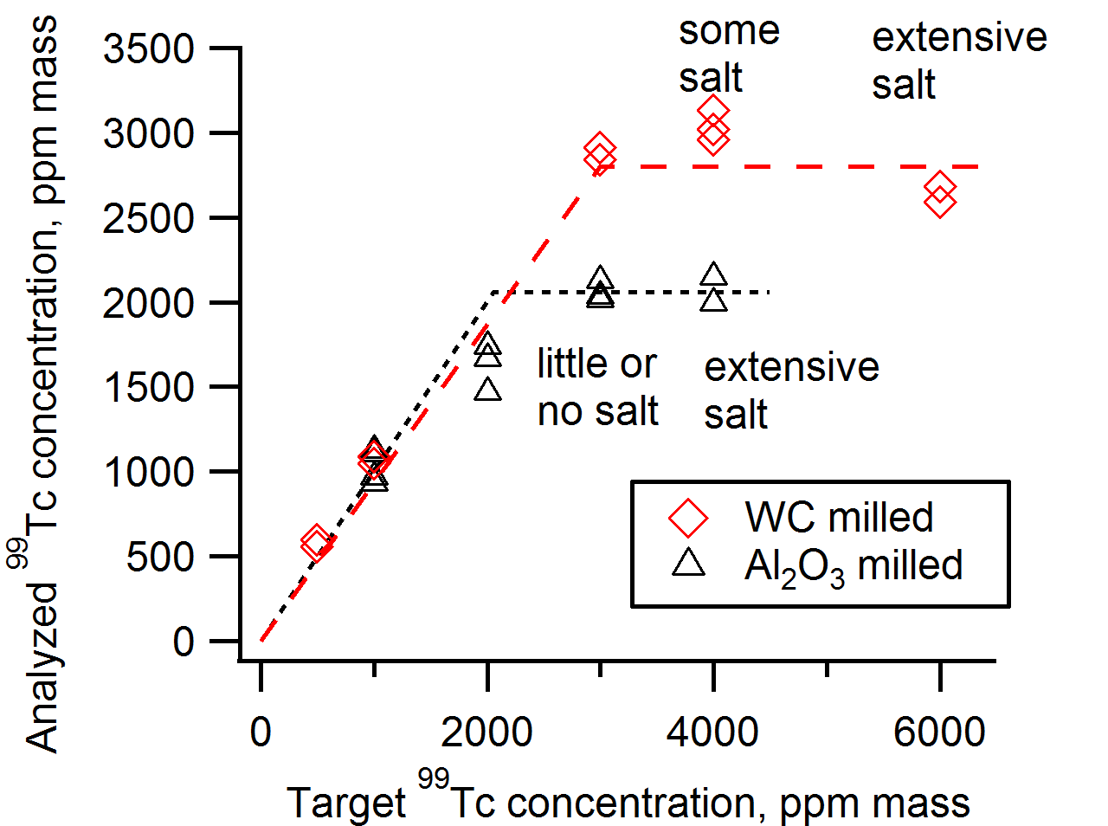
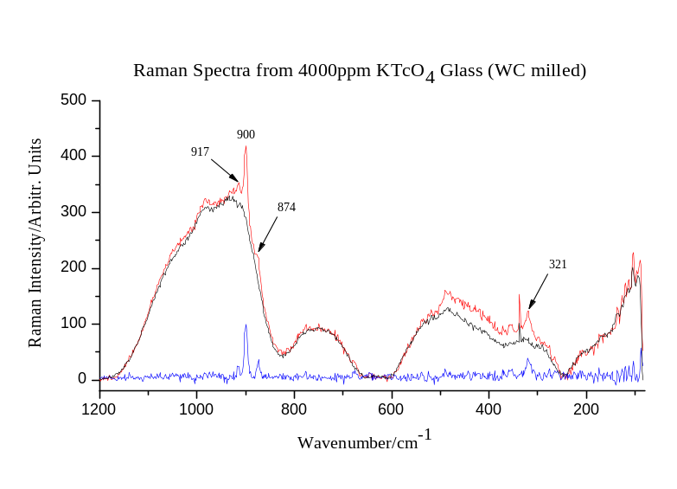
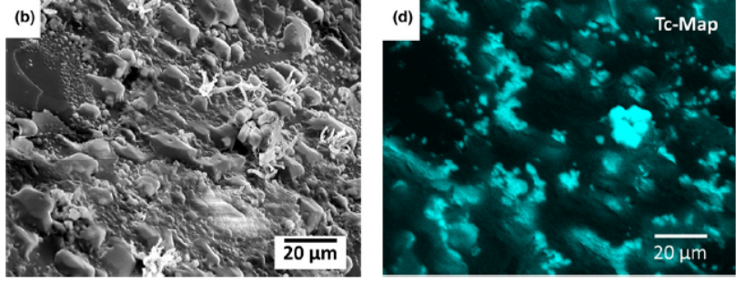
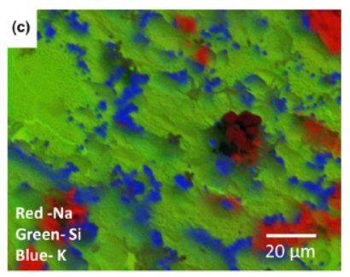
Tc in glass
Tc⁷⁺/Tc⁴⁺ 0 – 0.15
Tc⁷⁺/Tc⁴⁺ 0.2 – 0.8
4000 ppm Tc (WC)
A lot of Tc can go into glass
In glass, structure may be more complicated than traditional view
Not clear if Tc is clustering or crystallizing in glass
Salt phase formation
Soderquist et al, J. Nuclear Materials, 449, 173 (2014).
Gassman et al, J. Raman Spectroscopy, 45, 139 (2014).
Soderquist et al, J. Nuclear Materials, 99, 3924 (2016).
Notes:
Commonly accepted structural view
A lot can go in!
Not clear if it is clustering or crystallizing
Raman, XAS, SEM
Soderquist, C.Z., E.C. Buck, J.S. McCloy, M.J. Schweiger, and A.A. Kruger, "Formation of Technetium Salts in Hanford Low-Activity Waste Glass," Journal of the American Ceramic Society, 99(12), 3924–3931 (2016).
Soderquist, C.Z., M.J. Schweiger, D.-S. Kim, W.W. Lukens, and J.S. McCloy, "Redox-Dependent Solubility of Technetium in Low Activity Waste Glass," Journal of Nuclear Materials, 449(1-3), 173-180 (2014).
Gassman, P.L., J.S. McCloy, C.Z. Soderquist, and M.J. Schweiger, "Raman analysis of perrhenate and pertechnetate in alkali salts and borosilicate glasses," Journal of Raman Spectroscopy, 45(1), 139-147 (2014).

Slide 6
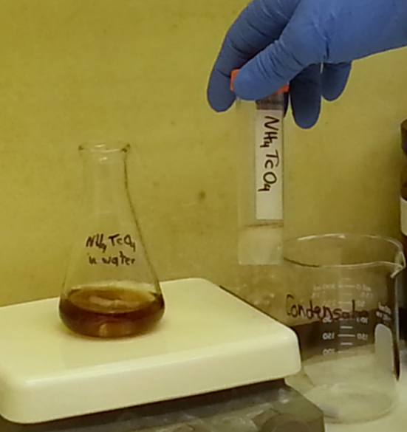
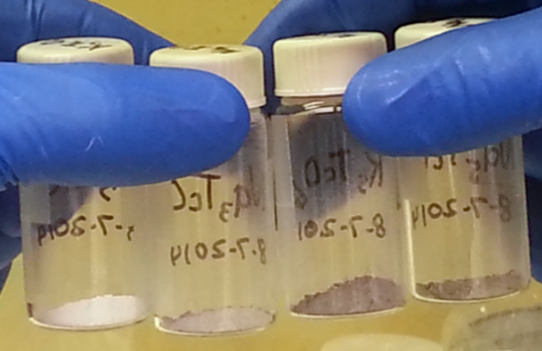
Pertechnetate Synthesis
Synthesis completed in a specialized hood in the Radiochemical Processing Laboratory (RPL) at Pacific Northwest National Laboratory
Batch sizes 0.5 – 20.0 grams of solid Tc oxides
1. NH₄TcO₄
2. Cation Exchange Column
3. Distillation & Crystallization
HTcO₄
LiTcO₄
NaTcO₄
KTcO₄
RbTcO₄
CsTcO₄
Na₃TcO₅
K₃TcO₅
Na₅TcO₆
K₅TcO₆
Li₅TcO₆
From M⁺TcO₄ and M⁺OH or M⁺₂CO₃

Slide 7
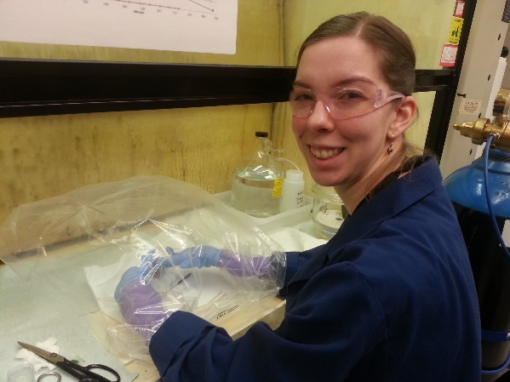
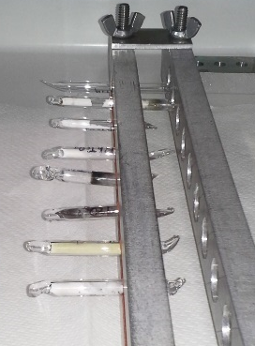
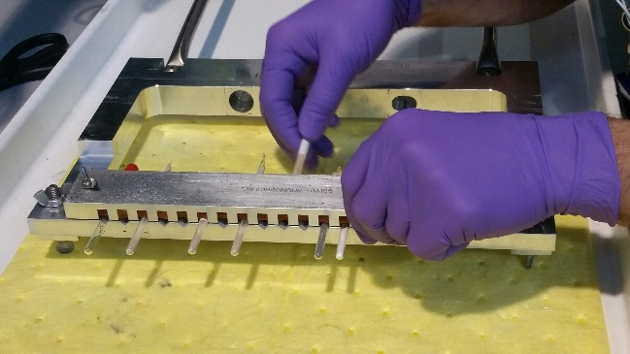
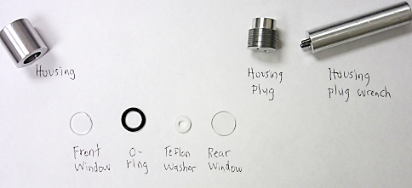
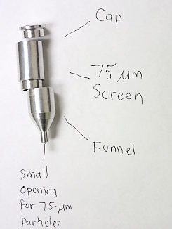
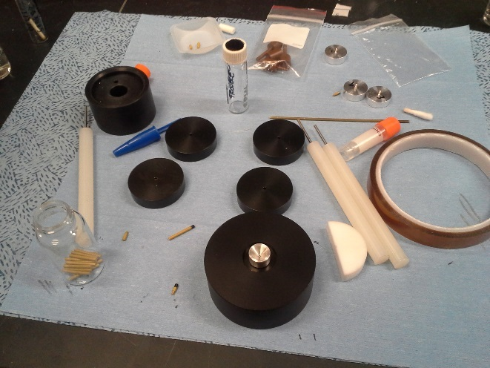
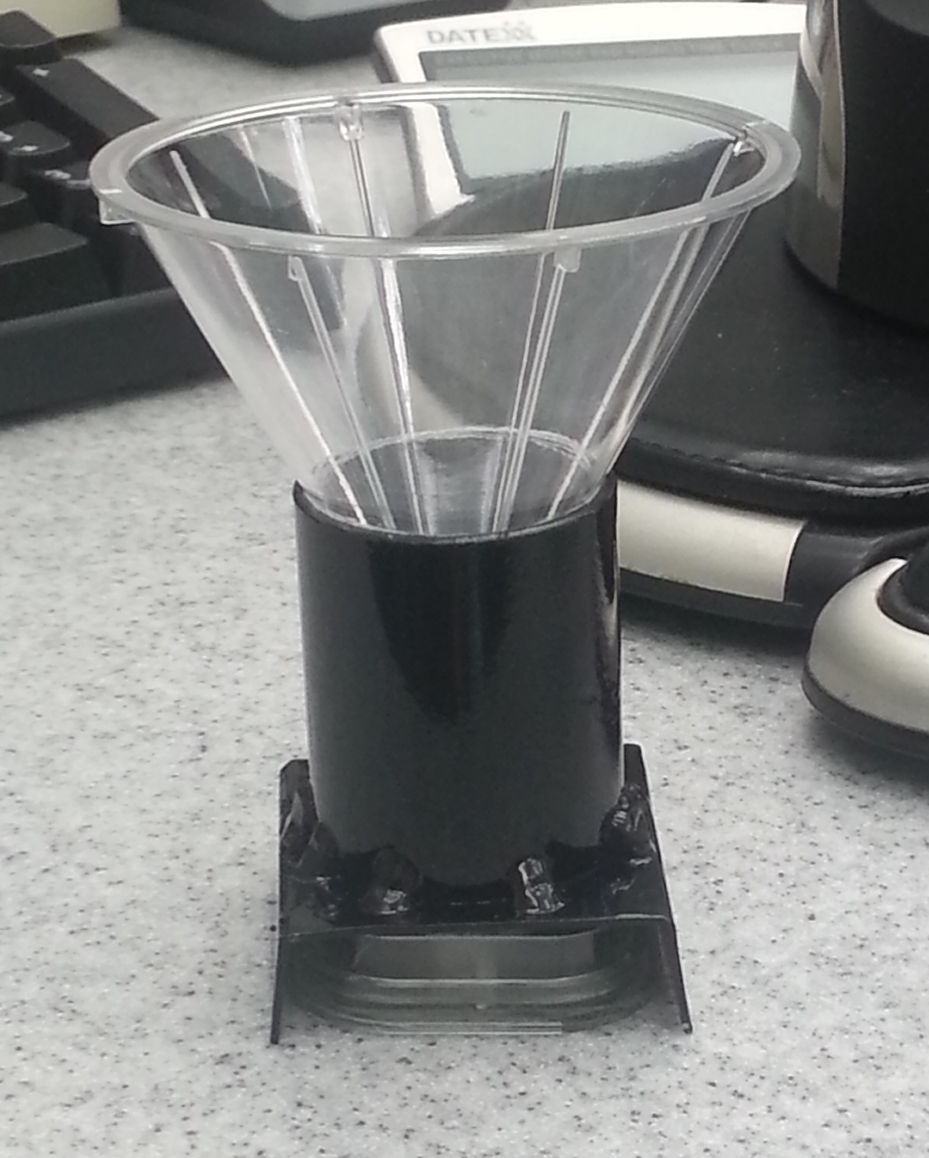
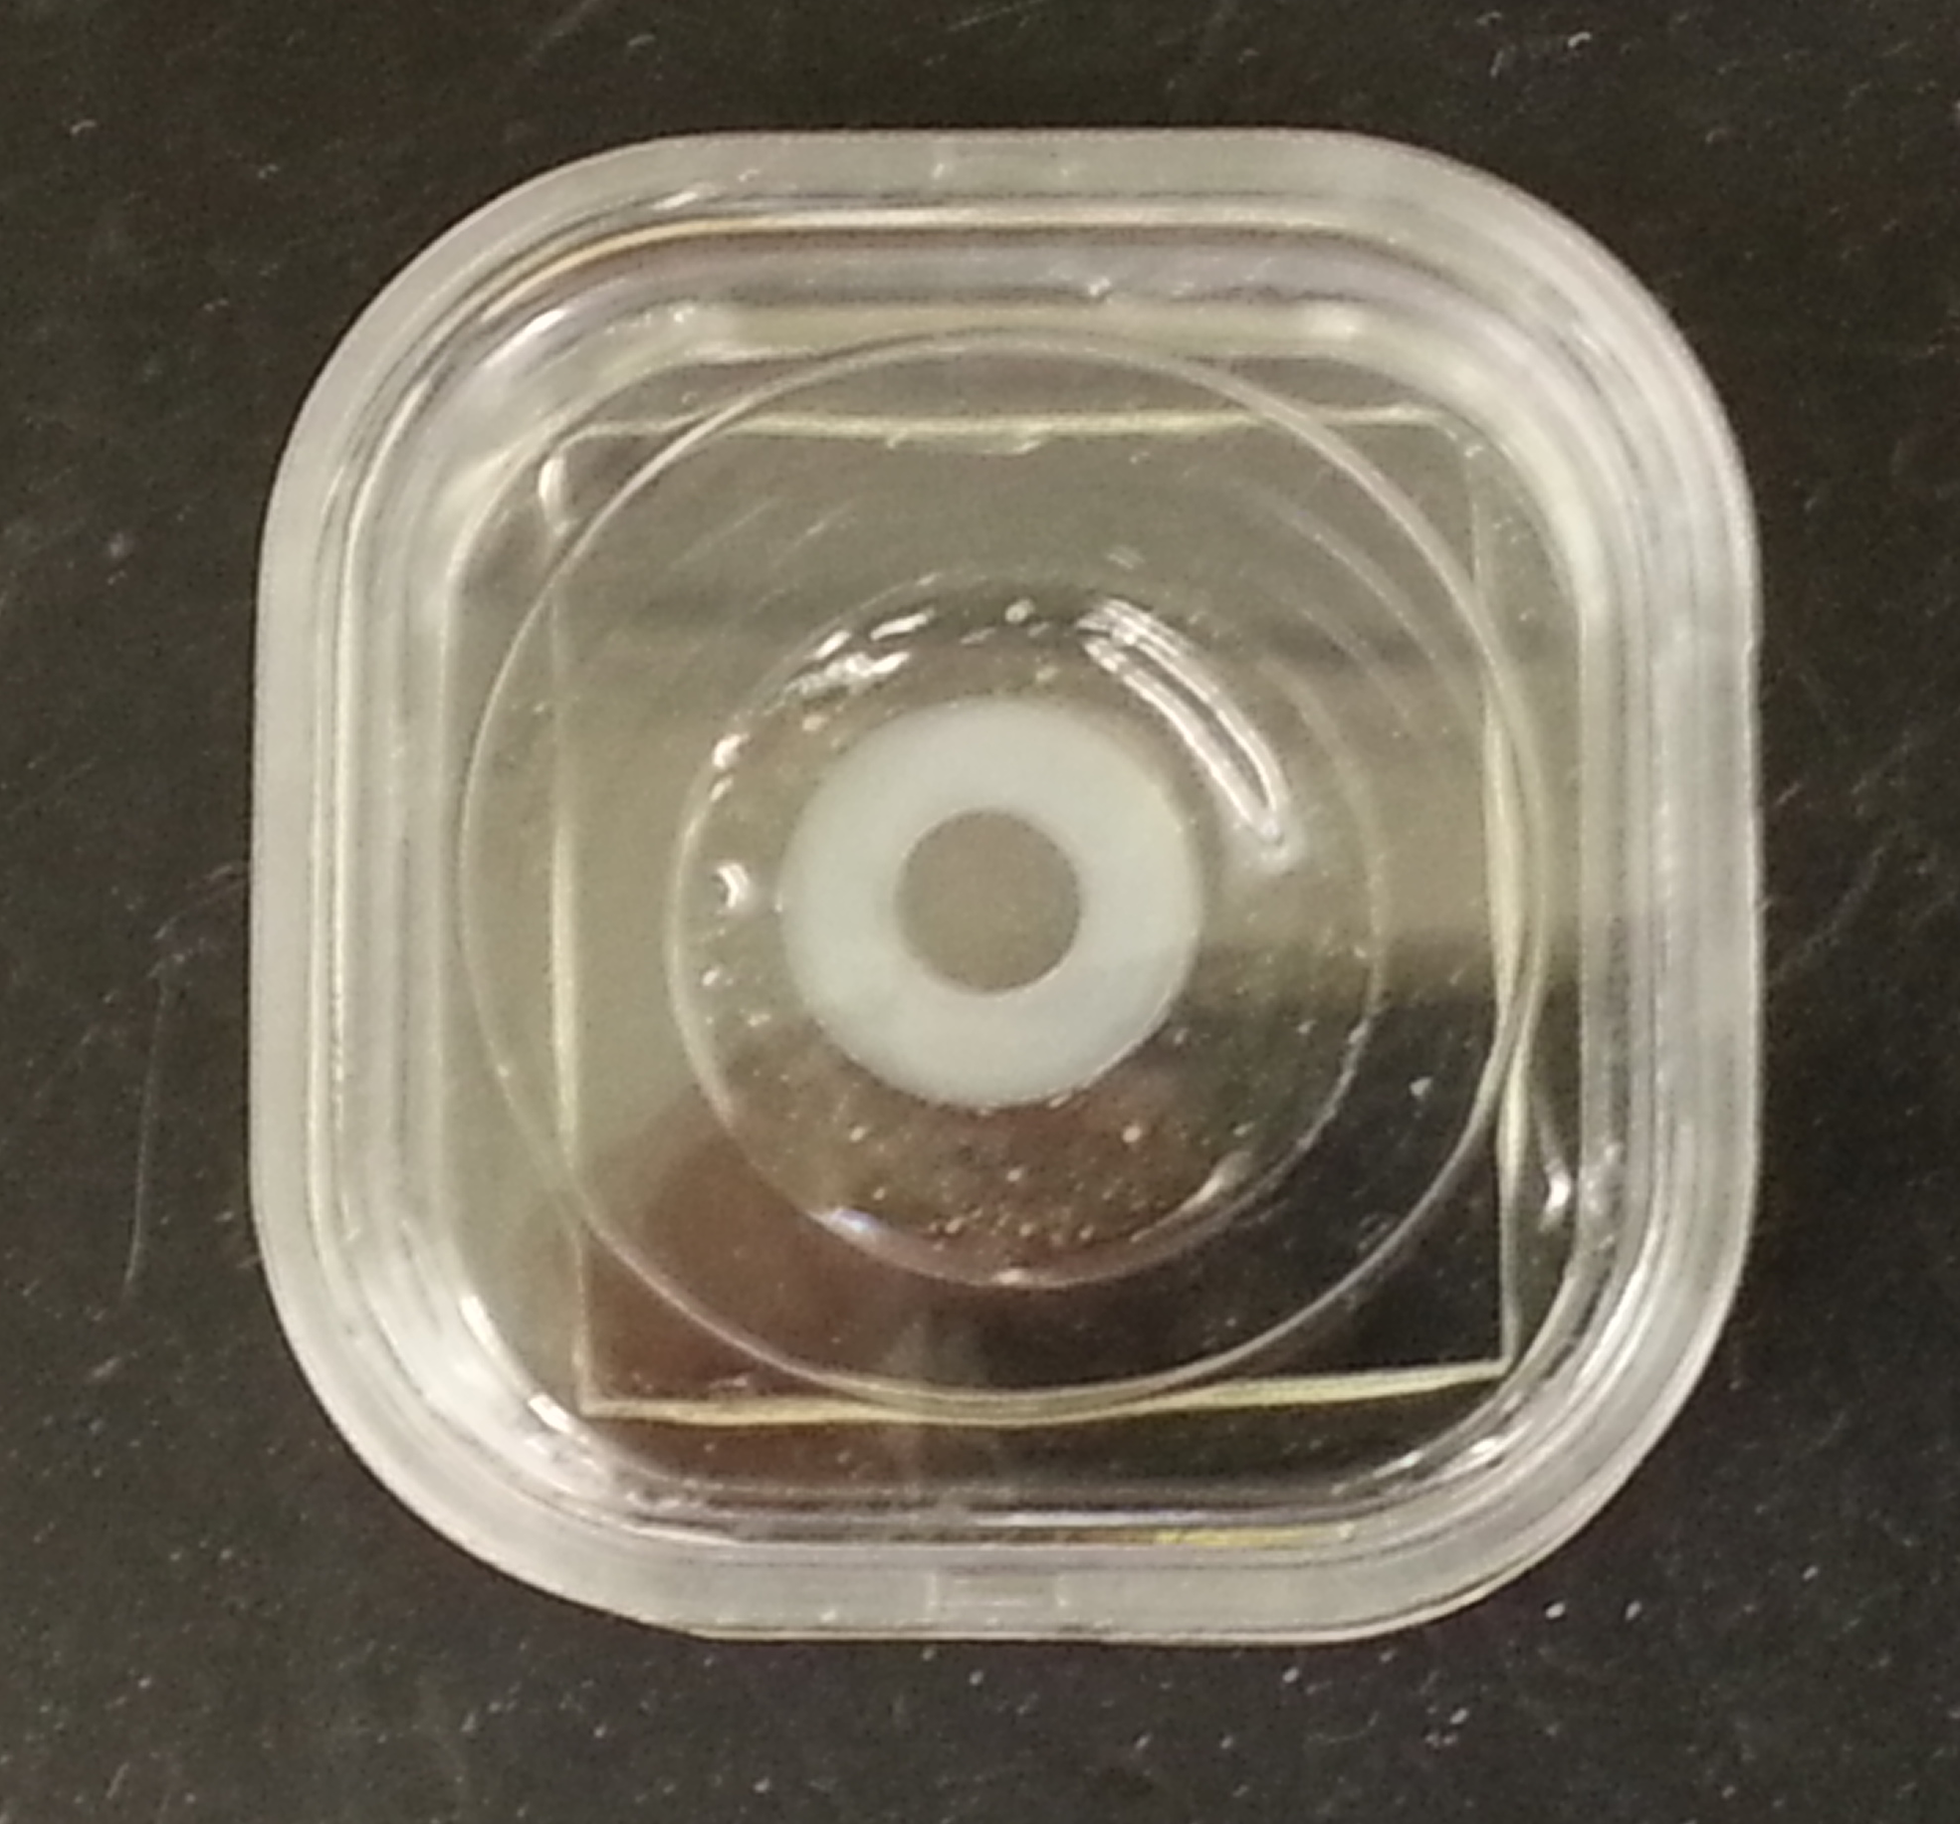
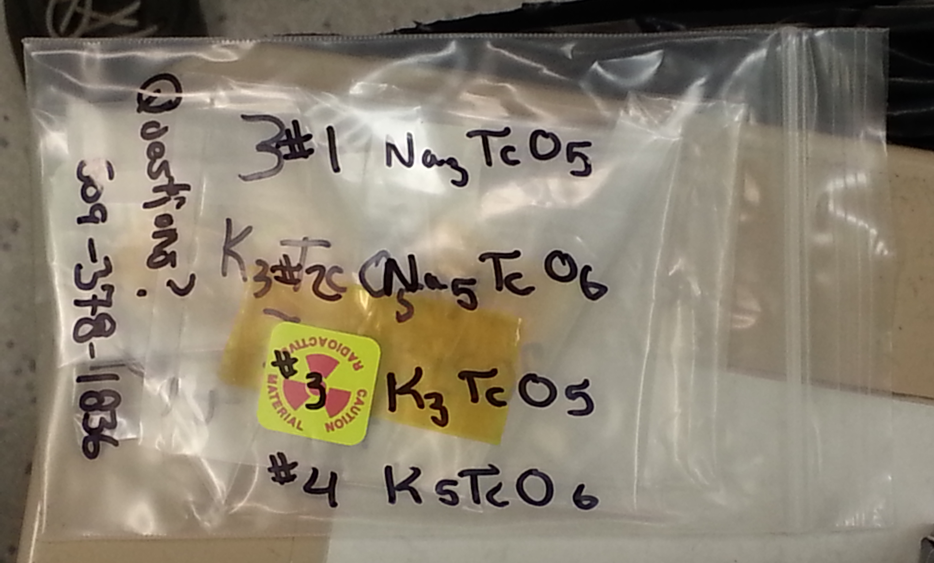
Analysis
Special tools and techniques had to be developed for loading & analyzing Tc-99 compounds
Issues included performing sample loading in radiological hood and sometimes inside glove bag, all to prevent dispersibility & interaction with water
ND ~1200 μCi (44.4 MBq)
NMR ~100 (3.70)
Raman ~50 (1.85)
XAS ~43 (1.59)
Raman
Neutron diffraction
XAS
MAS NMR
Notes:
In radiological hoods
In glove bags (to keep water out)
NMR
ND
XRD
EXAFS, XANES
Raman
XAS – 5 mg pertechnetate in 50 mg BN (per Wayne)
Per Chuck: Eight samples for XANES analysis are scheduled to ship tomorrow. Each sample has two or three milligrams of a
technetium compound, total activity conservatively estimated at 340 μCi.
So: 340/8=

Slide 8
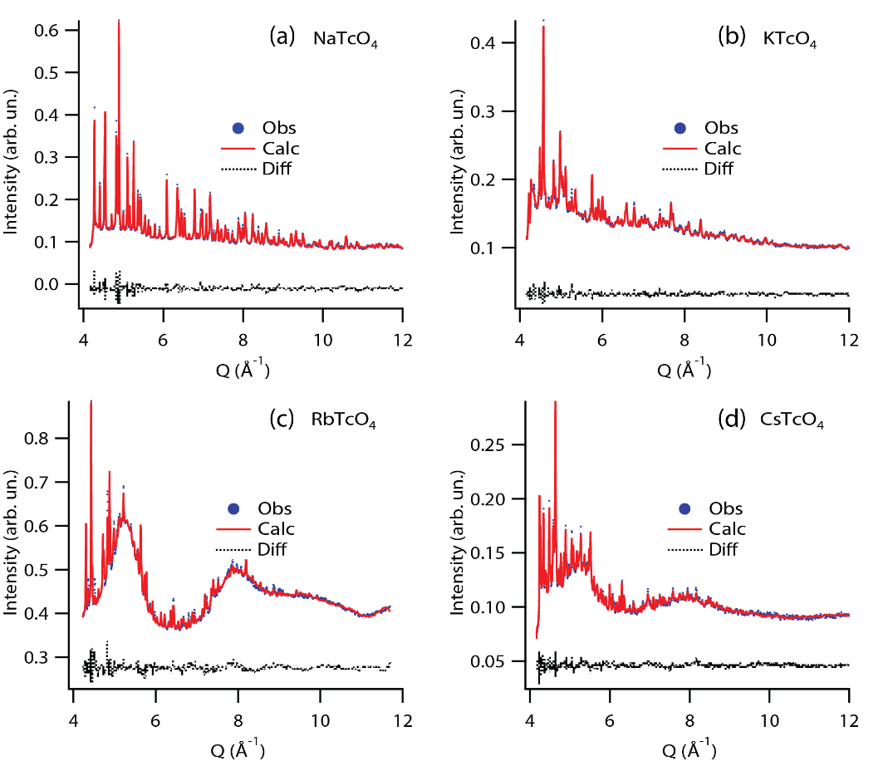
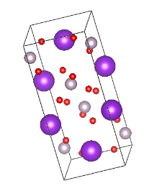
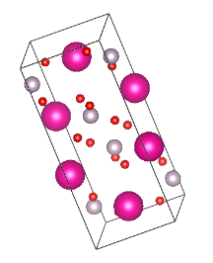
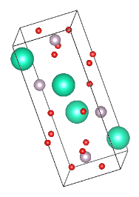
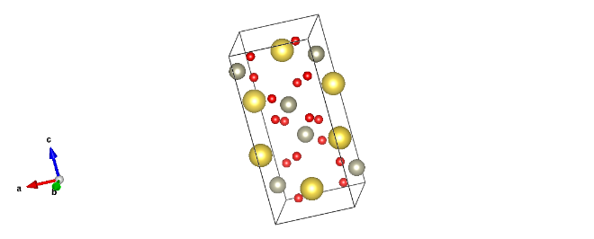
TcO₄ Pertechnetates: Neutron Diffraction
Compound | Tc -O bond length (Å) | O-Tc-O Angle (degrees) | Alkali-O bond length (Å) | χ²
NaTcO₄ | 1.71(2) | 107.29(1); 113.92(6) | 2.56(1), 2.61(1) | 20.160
KTcO₄ | 1.74(8) | 109.02(4); 110.0(5) | 2.83(5); 2.86(8) | 21.530
RbTcO₄ | 1.72(3) | 109.18(4); 110.04(74) | 3.02(1) | 1.210
CsTcO₄ | 1.66(1); 1.70(3) | 109.33(12); 113.6(4); 107.29(18); 109.9(4) | 3.05(9), 3.31(9), 3.24(6), 3.64(5) 3.13(9), 3.67(7), 3.08(9), 3.17(4), 3.77(4), 3.07(7), 3.46(6), 3.26(5) | 4.840
*
*
Initial difficulties with capillary XRD led to the use of ND
*Hump is SiO₂ glass background from sealed tube holder due to having less Tc powder for these
Gray = ⁹⁹Tc
Red = O
Scheelite (I4₁/a)
Ps-scheelite (Pnma)

Slide 9
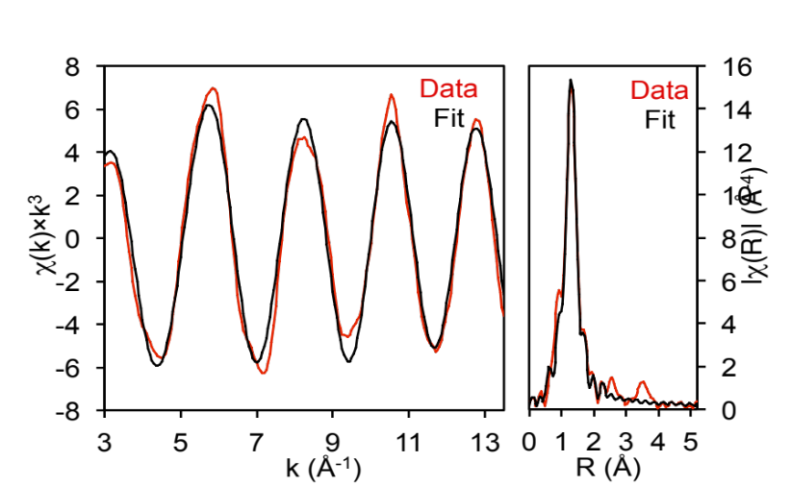
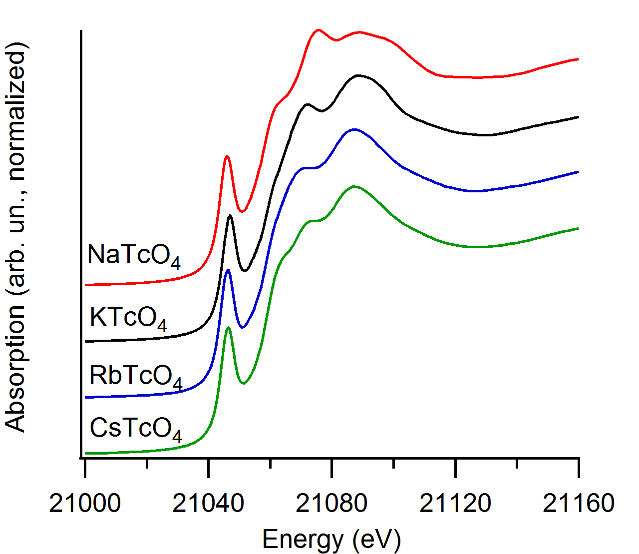
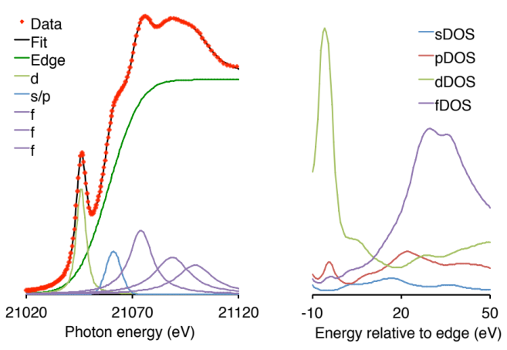
TcO₄ Pertechnetates: Tc K-edge XAS
XANES
EXAFS
NaTcO₄
Compound | # Neighboring O Atoms | σ² (Å²) | Tc-O Distance (Å)
NaTcO₄ | 3.6(2) | 0.0007(3) | 1.731(3)
KTcO₄ | 4.1(2) | 0.0010(3) | 1.736(3)
RbTcO₄ | 4.3(3) | 0.0011(5) | 1.713(5)
CsTcO₄ | 4.1(2) | 0.0011(3) | 1.723(5)
XANES transitions quite different, especially in sp and f transitions
For EXAFS, Tc-O bond distances very similar, but Na seems undercoordinated
NaTcO₄
Notes:
Density of states calculations preformed in FEFF, allows us to now use XANES data to help identify the presence of different pertechnetate salts in glass

Slide 10
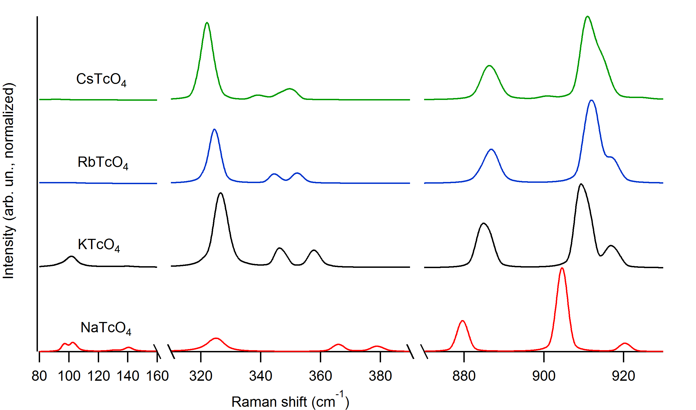
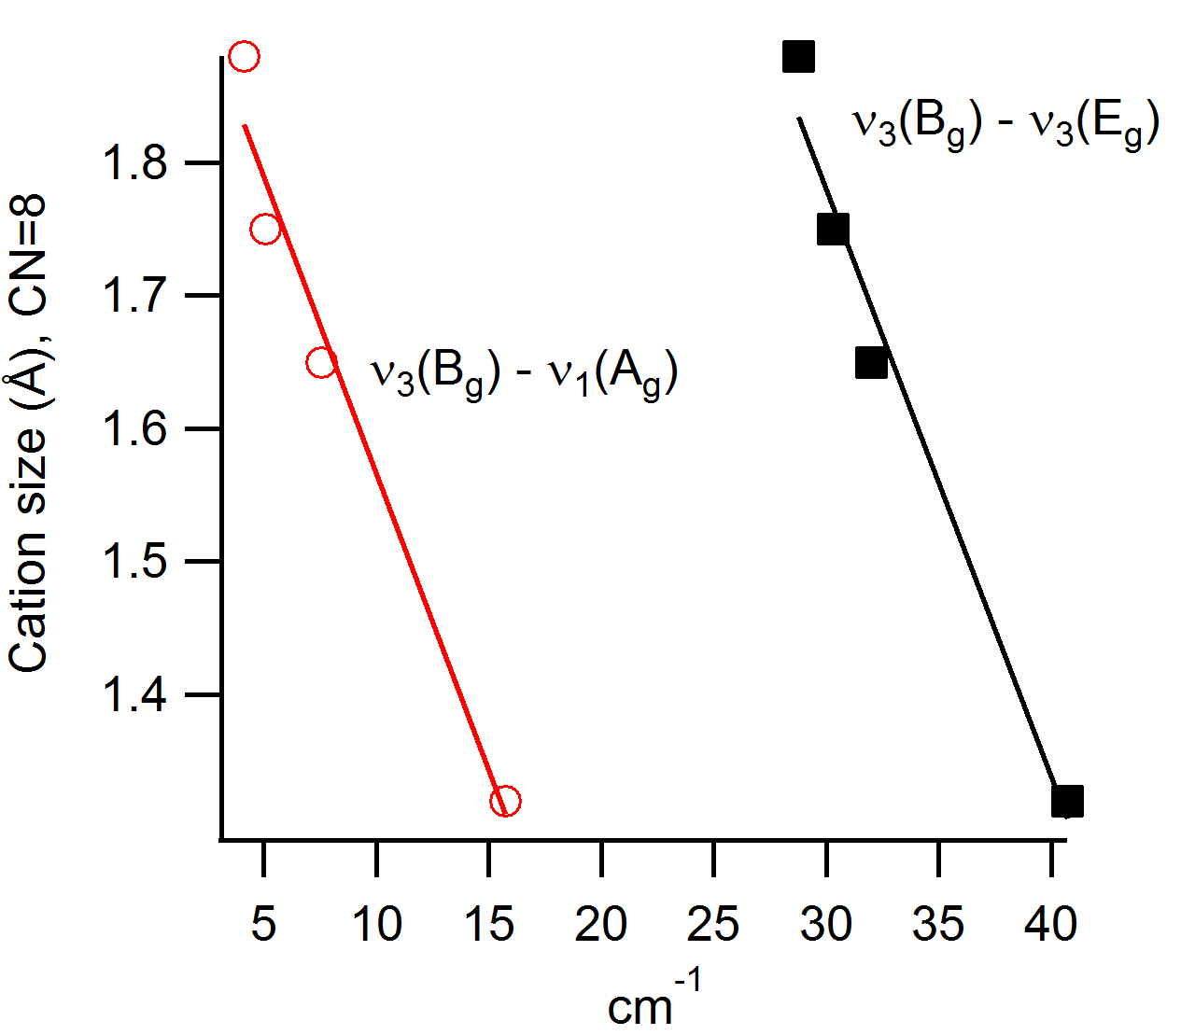
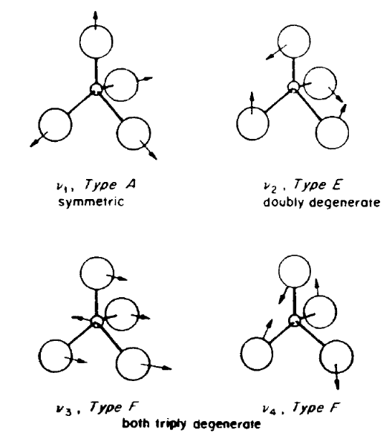
TcO₄ Pertechnetates: Raman
High resolution confocal Raman
532 nm excitation
1800 grooves/mm
ν₃(E_{g})
ν₁(A_{g})
ν₃(B_{g})
Some trends evident, particularly in spacing between stretching modes
CsTcO₄ (pseudo-scheelite) closely resembles RbTcO₄ (scheelite)
Large cation: vibrations similar to isolated TcO₄
Notes:
Alkali pertechnetates were analyzed using a Horiba high-resolution confocal inverted-stage microscopic Raman spectrometer (LabRam HR8000) with 600 or 1800 grooves/mm diffraction gratings, using a Nikon Eclipse Ti microscope. Laser excitation at 532 nm was provided by a Quantum Laser MPC-3000, which delivered ~20 mW of power to samples with an approximate spot diameter of 1 μm on the samples. Spectra were recorded using a Peltier-cooled Horiba Synapse charge-coupled device (CCD) detector with a 1024 × 256 pixel array. The spectrometer was calibrated using the line positions of a Hg pen lamp, and the band position of an amorphous Si wafer was used for frequency verification. Spectral resolution of the system, as described, was 1.8 cm⁻¹ /pixel with a laser spot size of 1.1 μm. The spectrometer was preliminarily centered at 1000 cm⁻¹ Raman shift from the 532 nm laser excitation, precluding measurement of some small shift external (skeletal) modes. The spectrometer position was changed to 950 cm⁻¹ to capture these low wavenumber peaks, allowing data collection from 1750 to ~50 cm⁻¹. The number of spectral acquisitions, count times, and the diameter of the confocal iris were varied to maximize the signal-to-noise ratio of spectra. Crystalline alkali pertechnetates only required 2–10 s of acquisition time to achieve very strong signal-to-noise ratios. Spectra from the crystalline solids did not require any spectral manipulation to provide very strong and well resolved Raman bands. On some occasions it was observed that mode intensities varied as a function of where on the sample the laser was probed. It is assumed that this is due to the various crystallographic orientations and geometry of the experiment.
-------
Is there an equivalent “shielding/deshielding” effect on nu_1 relative to TcO4-? – doesn’t seem like it.. Unless the shielding due to H in HTcO4 (has a larger WN nu_1) is relative to TcO4-(aq) where the water molecules are the “counter ion” or ligand. The WN shift for Na is lower than all the other measured alkali, and is lower WN that free TcO4-.. Is this a way of saying it’s “stiffer” and doesn’t transfer the energy to the vibration as well? Would this be something like a more covalent bond then?

Slide 11
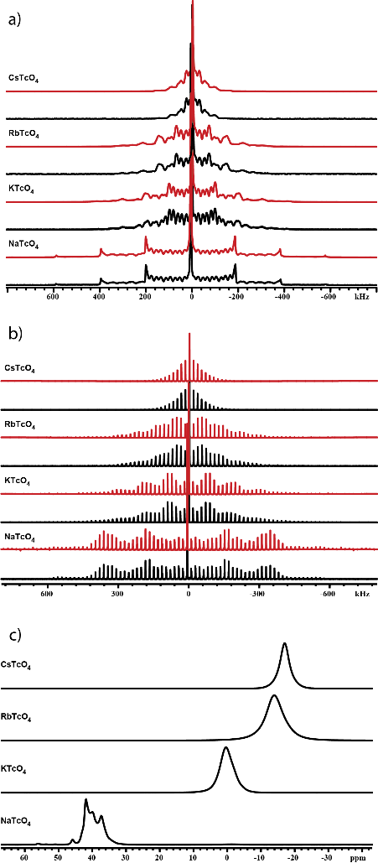
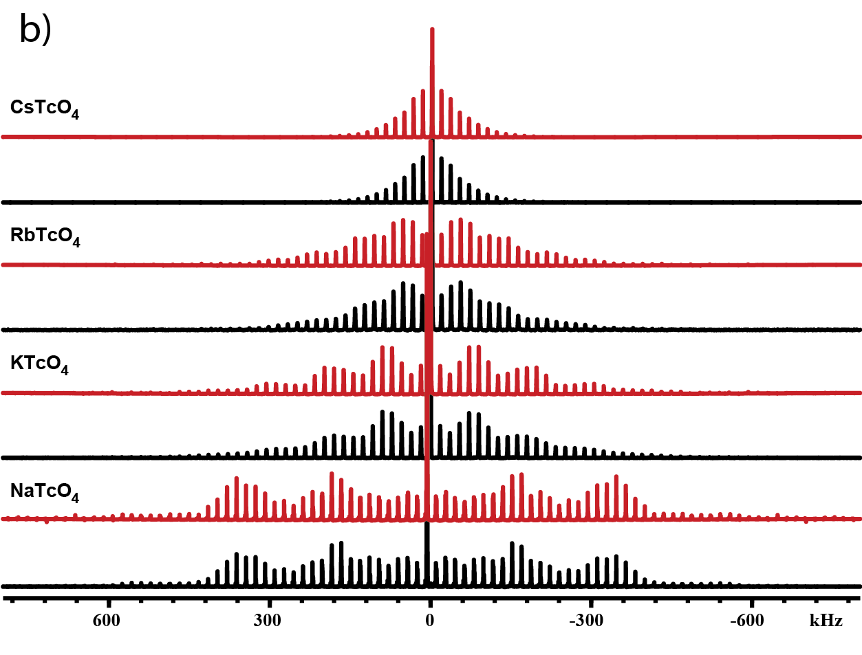
TcO₄ Pertechnetates: Tc-99 NMR
750 MHz (17.6 T)
750 MHz (17.6 T)
18 kHz (MAS)
“Static” NMR
MAS NMR
C_{q}(MHz)= 1.36,
δ_{iso} (ppm) = -16.8, η_{q}=0.228
C_{q}= 3.88, δ_{iso} = -13.4, η_{q}=0
C_{q}= 5.33, δ_{iso} = 1.5, η_{q}=0
Spinning sidebands
C_{q}= 9.38, δ_{iso} = 43.5, η_{q}=0
5
3
1
7
Tc-99 referenced to TcO₄⁻(aq)
Red (simulation); Black (experiment)
Tc-99 is a spin 9/2 nucleus:
1: -1/2 ↔ +1/2 (“central transition”, left after MAS)
3: -3/2 ↔ -1/2
5: -5/2 ↔ -3/2
7: -7/2 ↔ -5/2
9: -9/2 ↔ -7/2
central transition
Smaller C_{q} (MHz), tighter distribution of transitions in frequency space
Notes:
?Spinning not fast enough to remove all quadrupolar effects on NaTcO₄
?self irradiation causing reduction or defects
?impurity (nitrates),
---
Solid-state ⁹⁹Tc NMR spectra were acquired at ambient temperature in a wide-bore (89 mm) Bruker Biospin Ultrashield™ magnet operating at 16.6 T (750 MHz for ¹H) utilizing an AVANCE III spectrometer with a homebuilt 3.2 mm HX MAS probe (double tuned at ¹H and ⁹⁹Tc). Chemical shifts were referenced to external aqueous TcO₄⁻ (0.0 ppm). Solid samples of approximately 75µg of powdered alkali pertechnetate were packed into specially designed Torlon® inserts that were sealed and placed inside commercial 3.2 mm PENCIL style (Agilent or Revolution NMR) zirconia NMR rotors. Magic angle spinning (MAS) spectra were collected with selective RF pulses of 37 kHz (1.35 µs selective π/2), spin rate of 18 kHz, recycle times of 1.5 s. Static spectra were obtain utilizing a spin echo sequence (π/2 – τ – π/2 – τ) with τ values of 50 µs and 1µs selective π/2 pulses (50 kHz RF). The ⁹⁹Tc spectra were analyzed using finite pulse simulations with the SIMPSON program.(Bak et al., 2000)

Slide 12
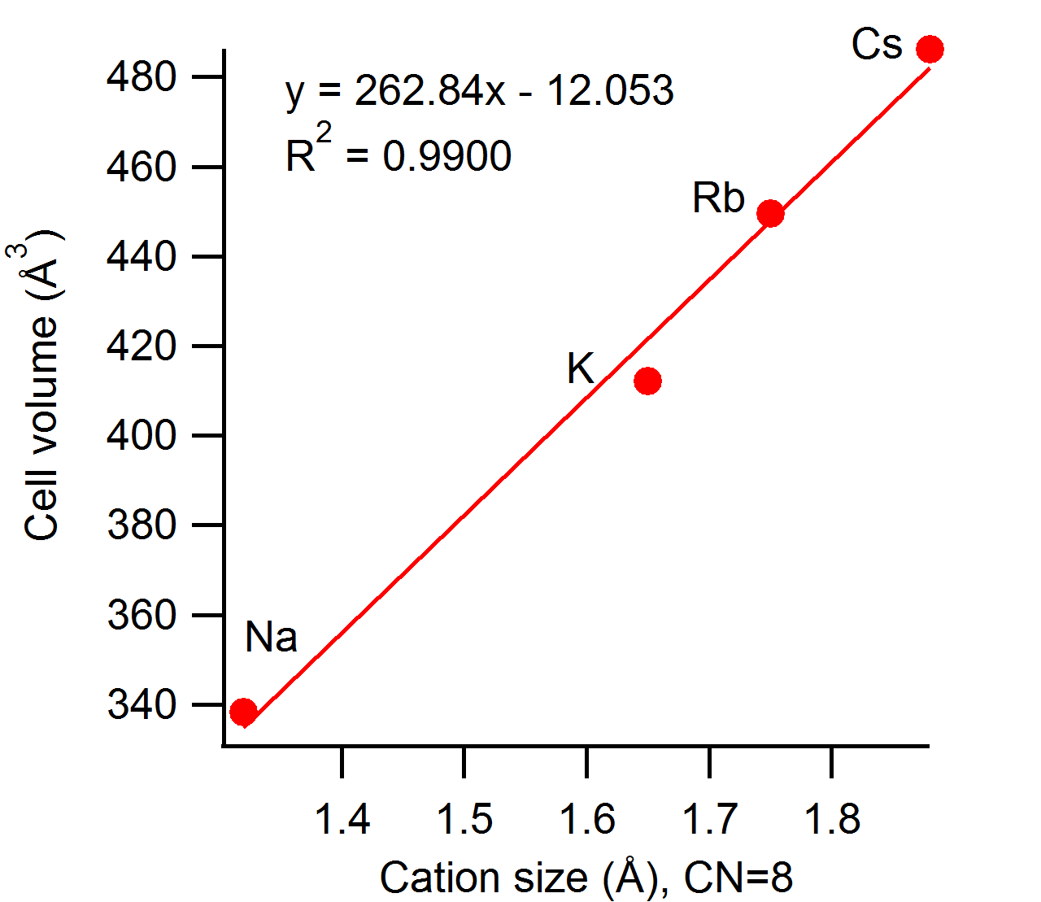
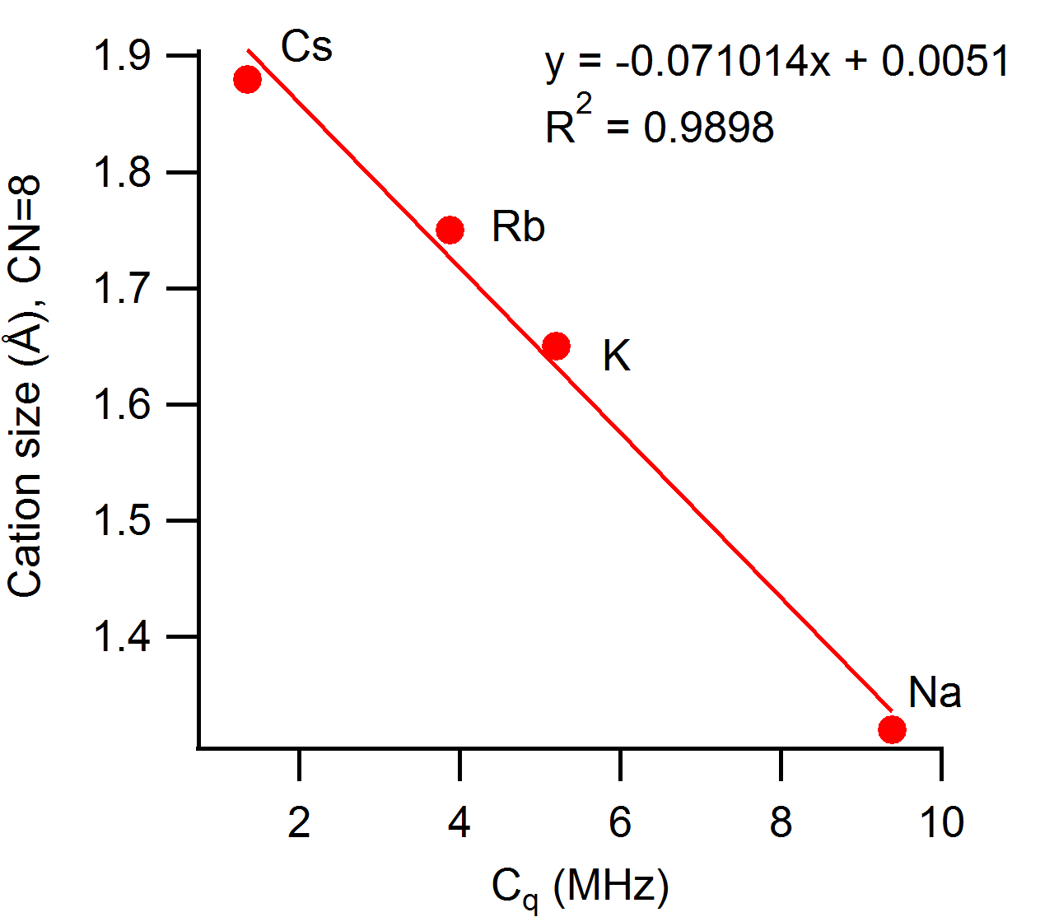
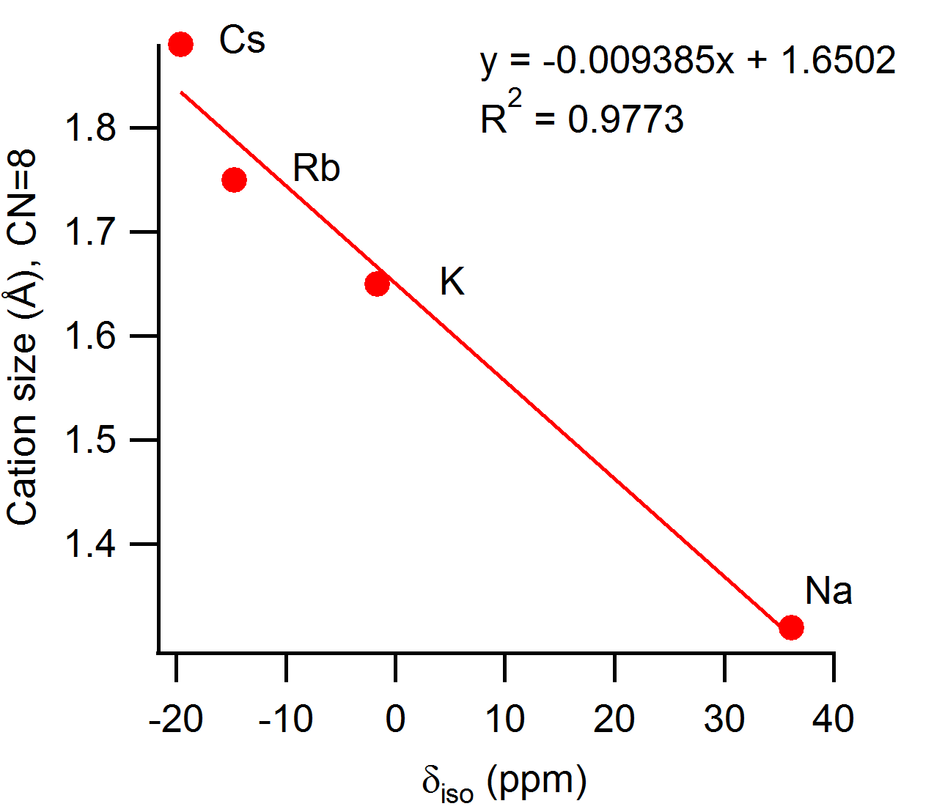
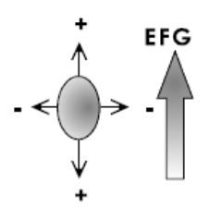
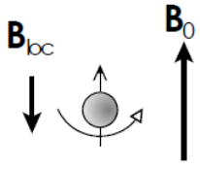
TcO₄ Pertechnetates: “Size matters”
Unit cell volume
Quadrupolar coupling
Isotropic chemical shift
η_{q}>0
η_{q}=0
Shield
TcO₄⁻ (aq)
De-shield
Bigger counter cation -> bigger unit cell
despite crystal structure change at Cs
From Tc-99 NMR, alkali size (# electrons) influences O in Tc-O bond, thus influencing Tc-99; for NaTcO₄:
  Na higher EN than other alkali thus attracts e-
  charge density relatively higher on alkali side of O
  Tc deshielded relative to TcO₄⁻
  Larger difference in O-Tc-O bond angles (more asymmetric) -> larger quadrupolar coupling
Weaver, J., C.Z. Soderquist, N.M. Washton, A.S. Lipton, P.L. Gassman, W.W. Lukens, A.A. Kruger, N.A. Wall, and J.S. McCloy, "Chemical Trends in Solid Alkali Pertechnetates," Inorganic Chemistry, 56(5), 2533-2544 (2017).
Notes:
Tc is not bound
Is the influence on the Tc-O bond
Related to Tc-O distances
Eta – asymmetry of quadrupolar coupling; was equal to zero for the scheelite
structures because of their axial symmetry but not for CsTcO4
Cations is interacting with oxygen which is influencing Tc-O bonds which effects delta and Cq
Tugging between cation & Tc
Deshielding: splitting between energy levels becomes larger
Shielding: splitting between energy levels becomes smaller
Jamie:
NaTcO4
ppm shift is high and positive (NMR)
Low shielding, reduced electron density around Tc atom
Oxygen is pulling electrons away more efficiently than with other counter cations
Cq is large (NMR)
Transitions of spin states is more spread out (i.e. more energy is needed to go from one spin state to the next) <- need to double check this
Still not sure why the transitions are showing up so strongly… might be due to good, consistent symmetry at the nucleus
The nucleus is interacting more strongly with non-uniform electric field gradients
The nucleus is strongly interacting with the electron density
6s->5p orbital interaction peak is stronger than other alkali (XANES)
Also 4f transition is less strong than other alkali
Need to look into this more…

Slide 13
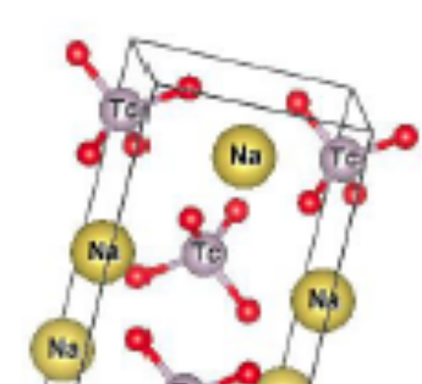
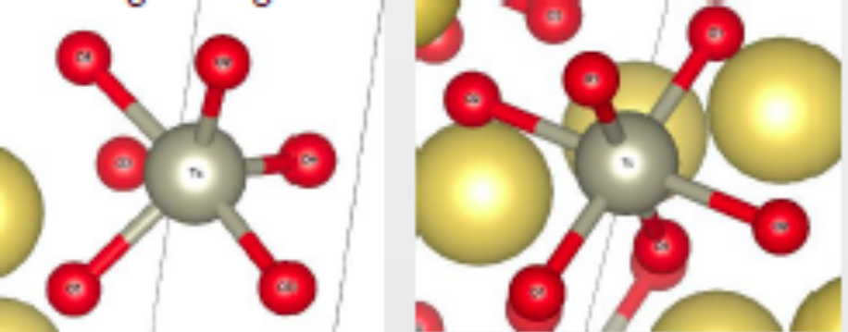
5- and 6-coordinated Tc(VII) Pertechnetates?
2Li₂O + LiTcO₄ → Li₅TcO₆ (250-450°C)
2Li₂CO₃ + LiTcO₄ → Li₅TcO₆ + 2CO₂ (600-650°C)
Li₂O + LiTcO₄ → Li₃TcO₅ (reaction T unknown)
4Li₅TcO₆ → 2Li₆TcO₆ + Tc₂O_{7(gas)} + 4Li₂O + ½O_{2(gas)} (>650°C)
Li₆TcO₆ → Li₄TcO₅ + Li₂O (750°C)
2Na₂O + NaTcO₄ → Na₅TcO₆ (250-450°C)
Na₂O + NaTcO₄ → Na₃TcO₅ (250-450°C)
K₂O + KTcO₄ → K₃TcO₅ (250-450°C)
750°C)
Tc(VII)
Tc(VI)
Tc(V)
Tc(VII)
TcO₄⁻
TcO₅³⁻
TcO₆⁵⁻
B. Kanellakopulos, The ternary oxide of 3-to 7-valent technetium with alkalis, Kernforschungszentrum. Inst. Radiochem., Karlsruhe, Germany, IssueAEC Accession No. 31424, Rept. No. KFK-197 (1964).
Keller, C. and B. Kanellakopulos, "Ternary oxides of tri- to septivalent technetium and alkali metals," Journal of Inorganic and Nuclear Chemistry, 27(4), 787-95 (1965).
Notes:
6 LiTcO4 + Tc+ 18 Li2O -> 7 Li6TcO6 – not correct
8 Li5TcO6 -> 6LiTcO6 + Tc2o7 + 1.5 O2 + 2 Li2O – not correct
Tc6+
Li₄TcO₅ is stable to at least 900°C. Like the Tc(VII) oxyanions, these Tc species are hypothesized to be sensitive to atmospheric moisture, and could quickly revert to pertechnetate salts if present at the surface of a sample when it is exposed to a humid atmosphere. Keller and Kanellakopulos [10] report that the Tc(VI) compounds dissolve in water to give a pink solution, which disproportionates to TcO₄⁻ and TcO₂·nH₂O (the same behavior as TcO₄²⁻). These Tc(VI) oxyanions are probably quite sensitive to atmospheric moisture and may quickly disappear from the surface of the sample when it is dissected and crushed. The simple Tc(VI) anion TcO₄²⁻ is known to be extremely sensitive to moisture [12].
Figure 1. Potential Tc(VII) structures for Tc in oxide glass (left: TcO₄⁻, middle: TcO₅³⁻, right: TcO₆⁵⁻).

Slide 14
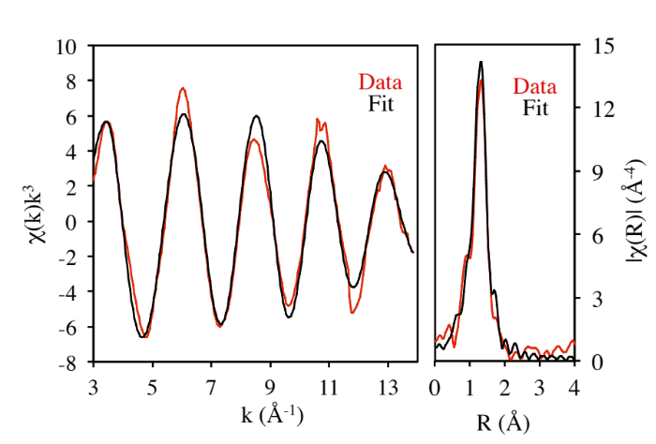
TcO5 and TcO6
Several synthesis approaches: Very hygroscopic, difficult to characterize
Probably impure: Na3, K3, Li5, Na5, K5
XAS: appear to be different than TcO4
EPR: some even Tc states due to impurity? radiolysis?
Raman: Li₅ReO₆ successful & matched literature
NMR: Li₅TcO₆ has strange Tc-99 pattern
Compounds are difficult to make in pure state; not very stable so hard to characterize; crystal structures not generally known
K₃TcO₅
Neighbor | # of Neighbors | Distance (Å) | σ² (Å²)
O | 4 | 1.72(1) | 0.0031(4)ª
O | 1 | 2.03(3) | 0.0031(4)ª
Weaver, J., C. Soderquist, P. Gassman, E. Walter, W. Lukens, and J.S. McCloy, "Synthesis and Characterization of 5- and 6- Coordinated Alkali Pertechnetates," MRS Advances, 2(10), 525-542 (2017).

Slide 15
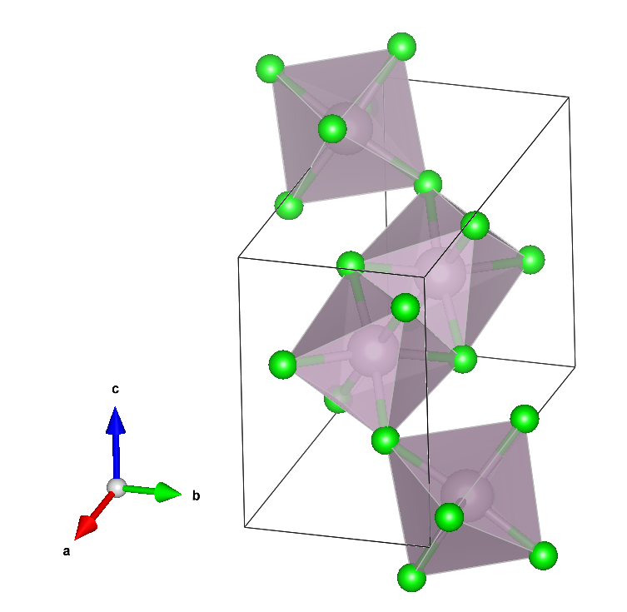
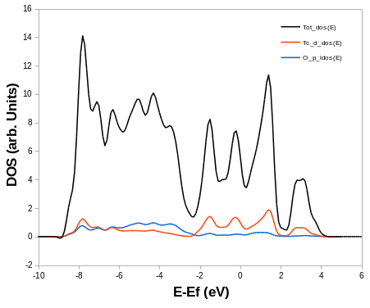
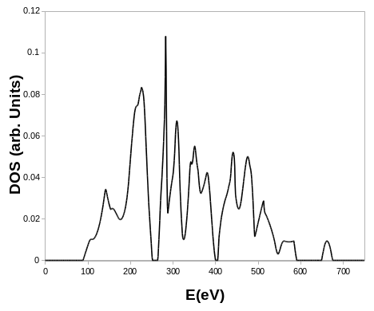
Current and future work
Establish DFT methods on TcO₂, Tc₂O₇ and compare to literature & spectroscopy
Calculate KTcO₄, NaTcO₄ and compare cal/exp Raman, NMR
Calculate “unknowns” LiTcO₄ and “HTcO₄”
In parallel, synthesize & characterize ReO5 and ReO6 compounds to refine methods
TcO₂
Electronic DOS
Phonon DOS

Slide 16

Thanks for staying to (almost) the bitter end of MRS 2017!

