Slide 1
Progress on Ongoing Waste form HIP projects
E. R. Vance, D. J. Gregg and D. T. Chavara
ANSTOsynroc, Locked Bag 2001, Kirrawee DC, NSW 2232, Australia
MRS2017, November 01, Sydney

Slide 2
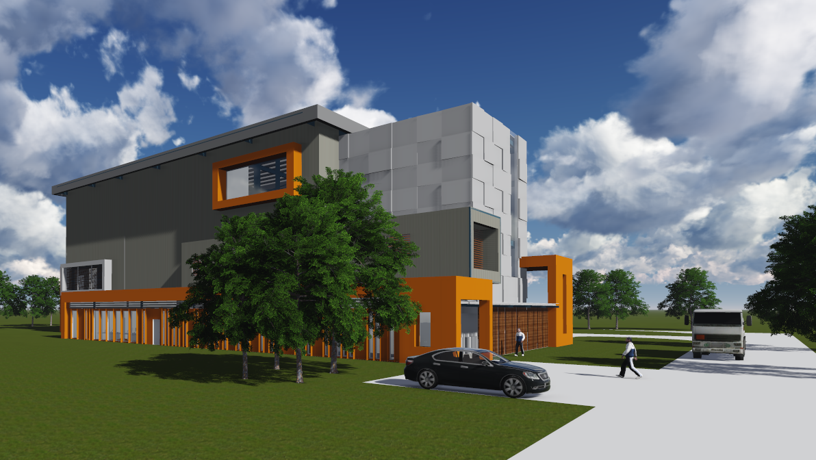
Projects
FLiNaK waste
Spent UO₂ fuel
ANM ILW
Acidic ⁹⁹Mo ILW
⁹⁹Mo LLLW
CuI

Slide 3
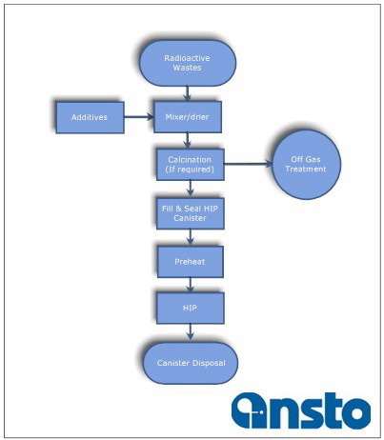
HIP process summary

Slide 4
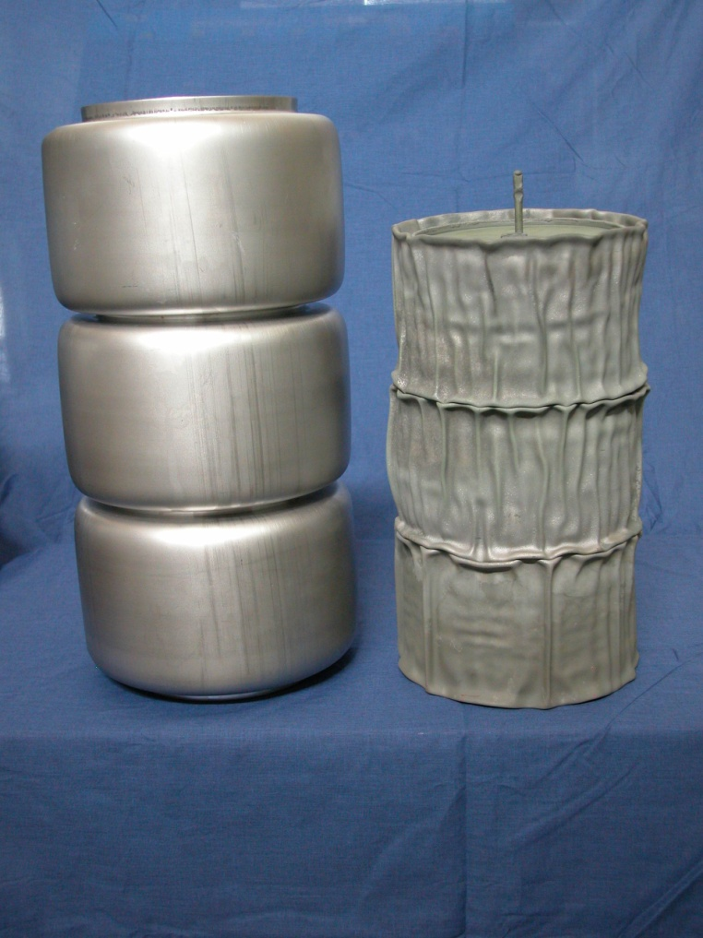
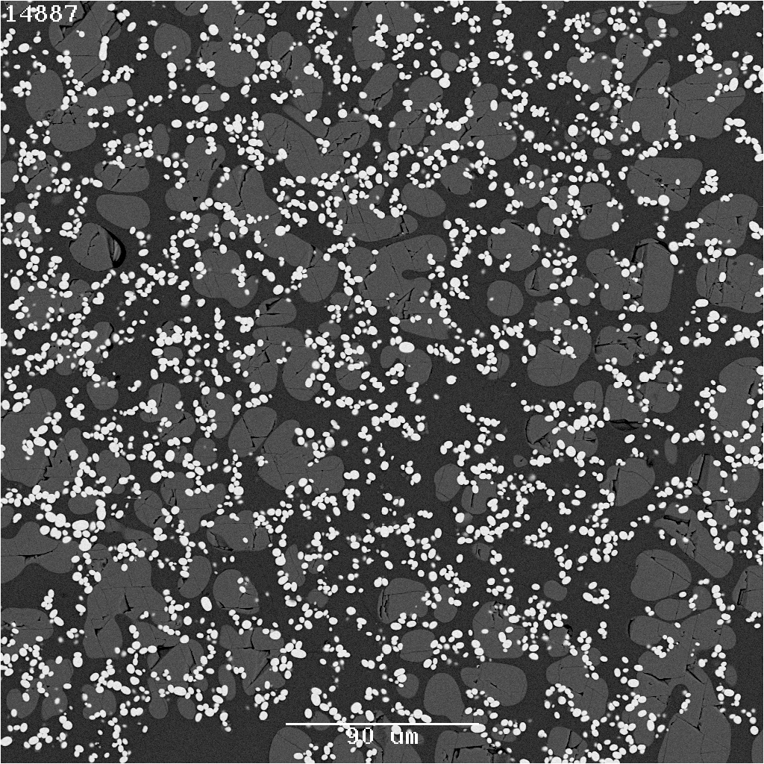
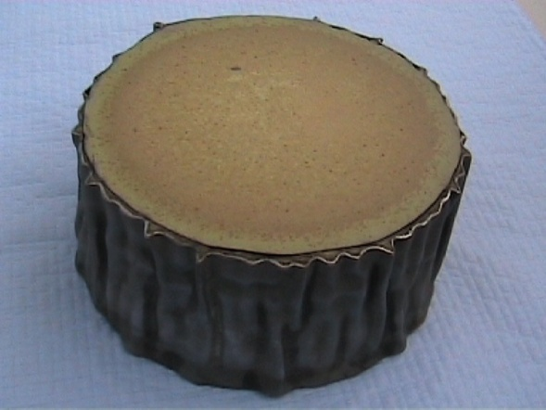
Idaho HLW calcines (USA)
Waste loading: 80%
Scale: 30 Kg
Durability: 100 x EA Glass
Final Volume: 35% reduction
(relative to untreated calcine)
glass
90μm

Slide 5
LiCl-KCl pyroprocessing waste
A lot of work on sodalite, Na₄Al₃Si₃O₁₂Cl, for 0.59LiCl-0.41KCl eutectic (waste loading ~13 wt.%).
Sintering with glass precursors-glass necessary to incorporate many FPs.
HIPing with glass precursor
Some work on removing Cl then using borosilicate glass for what’s left, but some ³⁶Cl to consider

Slide 6
FLiNaK pyroprocessing waste
Little work on FLiNaK eutectic (0.29LiF-0.12NaF-0.59KF): candidates include Ca₁₀(PO₄)₆F₂ apatite with non-Li alkalis in Ca site- need some glass for Li- but waste loading <10 wt%
Our approach is to add Ca to allow F to inhabit CaF₂ and Al,B, Si oxides for alkalis to inhabit glass.

Slide 7
FLiNaK
Starting chemicals were LiF,NaF and KF, plus Ca(OH)₂, Al(NO₃)₃.9H₂O,H₃BO₃, Ludox 50, stir-dried in water and calcined in air at 600ºC.
XRF agreed well with starting composition
XRD: CaF₂ with amorphous and minor phases.
LOI at 800ºC: <~3%
Plan is to HIP at 700 and 800ºC

Slide 8
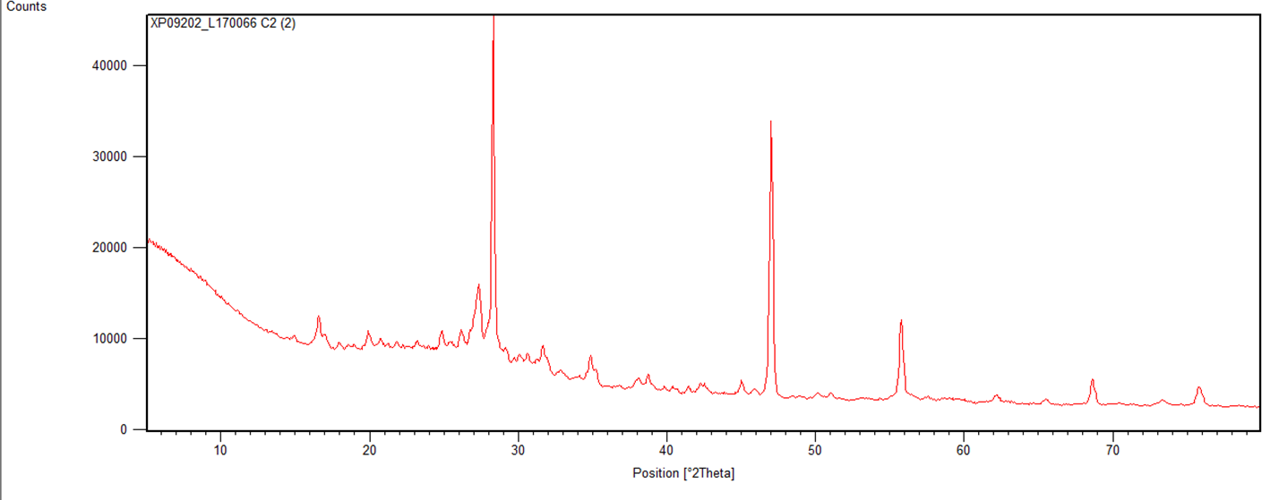
Calcined FLiNaK waste forms
*
Shows major CaF₂ + minors
*
*
*
*
*

Slide 9
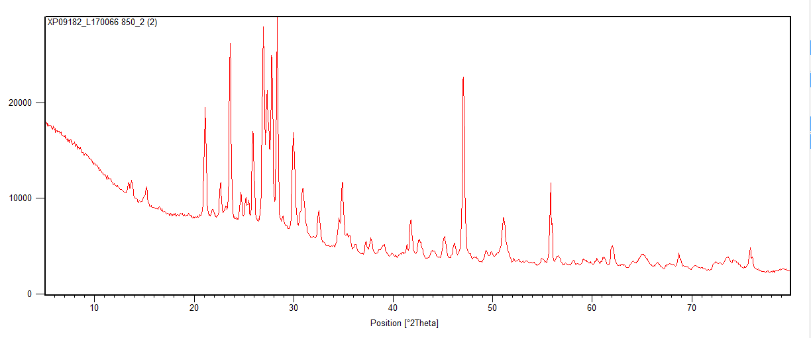
Sintered FLiNaK waste forms
*
Shows major CaF₂ + minors
*
*
*
*
*

Slide 10
Spent UO₂ Fuel
Original was sintered Synroc-F. Major phase is CaUTi₂O₇ plus minor hollandite and rutile. Waste loading ~45 wt%.
We have added glass for reactivity (using sol-gel methods) and second string of FP immobilisation and HIPed at 1250ºC/100MPa to get near 100% T.D.
Optimising redox conditions between allowing U⁵⁺ in over-oxidised conditions and Ti³⁺ in over-reduced conditions
Scale-up to L+ size to be carried out

Slide 11
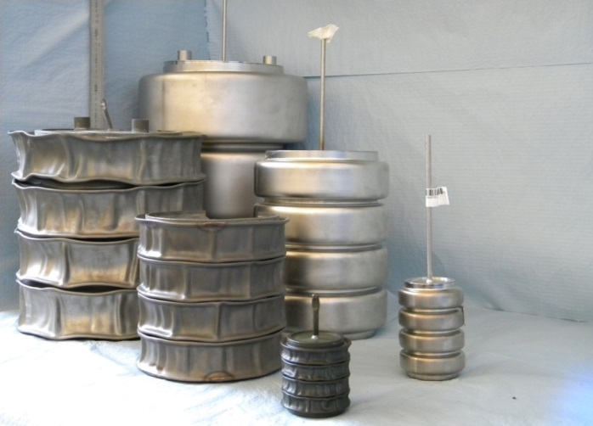
ANM ILW waste
~5000L/yr, mainly 6M NaOH
Achieved waste loading of ~26 wt% on HIPing ~25L container of calcine at 1100ºC/100MPa
Composition can tolerate chemical variations of +/- 10% and insensitive to minor impurities.
©

Slide 12
Acidic ⁹⁹Mo ILW
Waste is UO₂(NO₃)₂ solution plus minor FPs.
Waste form is close to synroc-F (Carter et al., JNM, 384, 322-6 (2009), HIPed at 1250ºC/100MPa.
Project is scale-up to ~1L size with ~20 wt% glass addition
Waste loading ~ 35 wt%.

Slide 13
ANM LLLW
Waste is basically Li₂SO₄ with minor components
Both alkalis and sulphate are problematic for cement so have looked at HIPed waste form (850ºC/100 MPa) in which SO₄²⁻ precipitated as BaSO₄ and Li incorporated in glass.
Waste loading close to 20 wt% and passes PCT for all elements.

Slide 14
CuI
CuCl powder will exchange Cl for I (near 100%)
CuI stable in Ar up to melting point of 605ºC
Low Ksp
HIPed CuI powder at 550ºC/100MPa) gave ~85% T.D.
I release in PCT <1%, but while OK with Ni or Cu powder, complete dissolution with Fe powder.
Can be made from Cu²⁺ salts

Slide 15
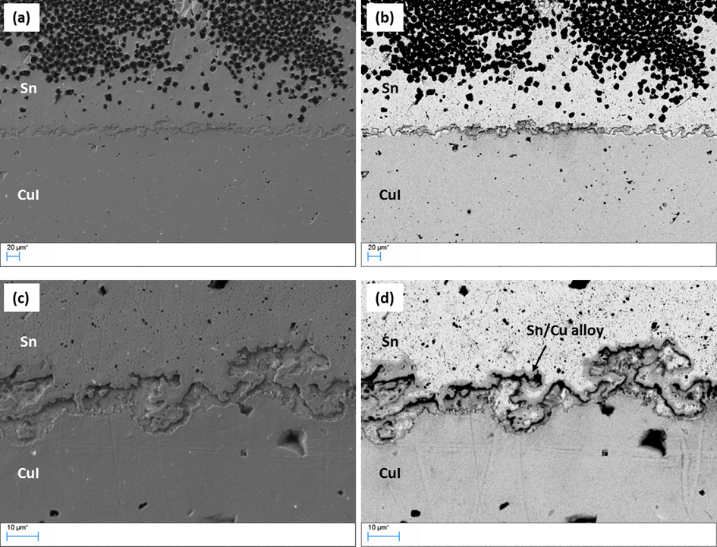
CuI
However for extra protection sintered a pellet at 550ºC in Ar (wt loss ~2% due to oxidation) and surrounded it with Sn metal powder and HIPed at 200ºC (M.P. of Sn is 231ºC)

Slide 16
Conclusion
Substantial progress is being made in several projects.
  Molten salt waste (Cl and F)
  ANM Wastes: ILW, LLW, legacy ILW acidic and filter cups
  Engineered wasteform for spent fuel
  Iodine wastes
  HIPed glass

