Slide 1
Current advances on titanate-based glass-ceramics for actinide immobilization
Y. Zhang, L. Kong, I. Karatchevtseva, R.D. Aughterson, T. Wei, D.J. Gregg,
Z. Zhang, G.R. Lumpkin, E.R. Vance, G. Triani
Scientific Basis for Nuclear Waste Management Symposium 2017, Sydney , Australia,
29 October ‒ 3 November 2017

Slide 2
Glass-ceramics for actinide immobilization
Actinide wastes generated from the entire nuclear fuel cycle:
  Conditioned for safe storage and future disposal
  Matrix: glasses and ceramics; glass-ceramics—emerging
Advantages of glass-ceramics for actinide immobilization:
  Durable ceramic phases to host actinides
  Chemical and processing flexibility of glass to accommodate processing chemicals
Titanate ceramic phases to be considered:
  Zirconolite (CaZrTi2O7)—France, ANSTO, NNL, Sheffield Uni
  Pyrochlore (Ln2Ti2O7/Ln2TiO5)
  Brannerite (AnTi2O6)

Slide 3
ANSTO’s research effort
Zirconolite glass-ceramics: before year 2000
  Ln surrogate work for processing conditions
  ANSTO—NNL agreement on Pu residues wastes
  U validations
  Pu validations
Pyrochlore glass-ceramics: from year 2008
  Ln surrogate work for processing conditions
  U and Pu validations
Brannerite glass-ceramics: from year 2008
  U and Pu validations
Highlights on U and Pu validations

Slide 4
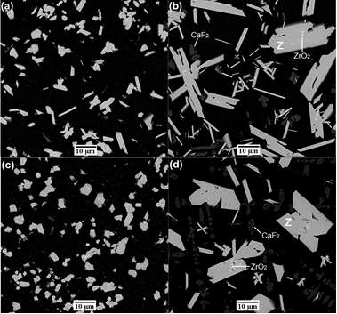
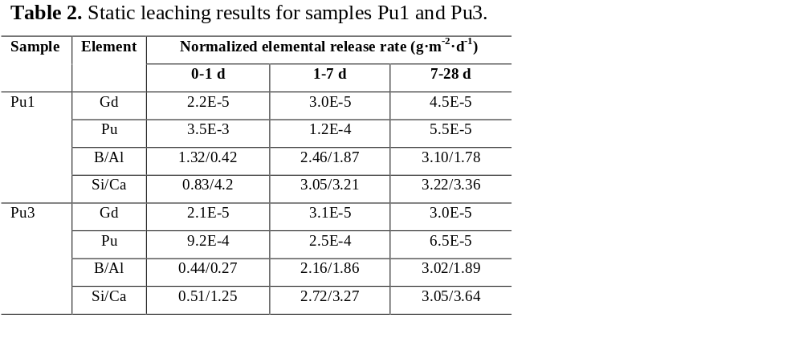
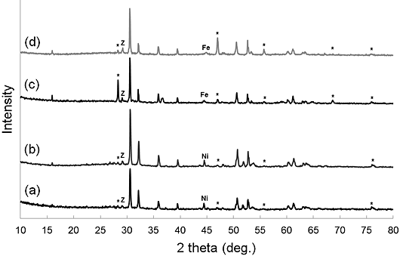
Case1: Zirconolite glass-ceramics
Sample | SiO₂ | B₂O₃ | Al₂O₃ | Na₂O | CaO | CaF₂ | ZrO₂ | TiO₂ | PuO₂ | Gd₂O₃
Pu1 | 17.9 | 0.9 | 12.4 | 2.2 | 17.8 | 9.2 | 15.6 | 18.3 | 3.4 | 2.3
Pu2 | 14.6 | 0.8 | 10.8 | 1.8 | 8.4 | 14.8 | 17.9 | 21.0 | 5.2 | 4.7
Pu3 | 18.0 | 0.9 | 12.5 | 2.2 | 17.3 | 9.2 | 15.7 | 18.4 | 3.5 | 2.3
Pu4 | 14.5 | 0.8 | 10.7 | 1.8 | 8.3 | 14.8 | 17.4 | 20.9 | 5.7 | 5.1
Sample processing conditions |  |  |  |  | Characterization results
Sample | Redox buffer | Processing |  | Targeting Pu f. u. | Zirconolite phase composition* |  |  |  | Pu valence (EDS/DRS)
Pu1 | Ni | 1270 ºC, 2h |  | 0.1 | Ca_{0.8}Gd_{0.1}Pu_{0.1}ZrTi_{1.7}Al_{0.3}O₇ |  |  |  | 4+/4+
Pu2 | Ni | 1270 ºC, 2h |  | 0.15 | Ca_{0.55}Gd_{0.18}Pu_{0.13}□_{0.14}ZrTi_{1.7}Al_{0.3}O₇ |  |  |  | 4+/4+
Pu3 | Fe | 1270 ºC, 2h |  | 0.1 | Ca_{0.68}Gd_{0.1}Pu_{0.1}□_{0.12}ZrTi_{1.68}Al_{0.32}O₇ |  |  |  | 3+/‒
Pu4 | Fe | 1270 ºC, 2h |  | 0.15 | Ca_{0.55}Gd_{0.2}Pu_{0.15}□_{0.1}ZrTi_{1.75}Al_{0.25}O₇ |  |  |  | 3+/‒
Zhang et al., J. Nucl. Mater., 490 (2017) 238-241.

Slide 5

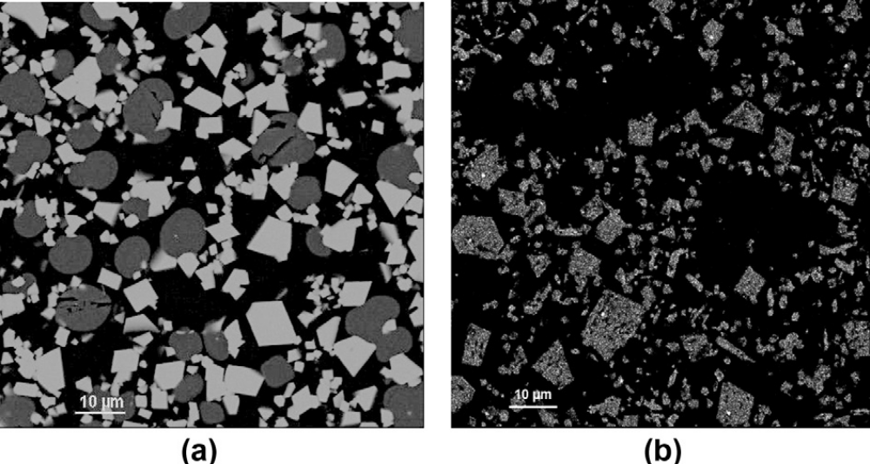
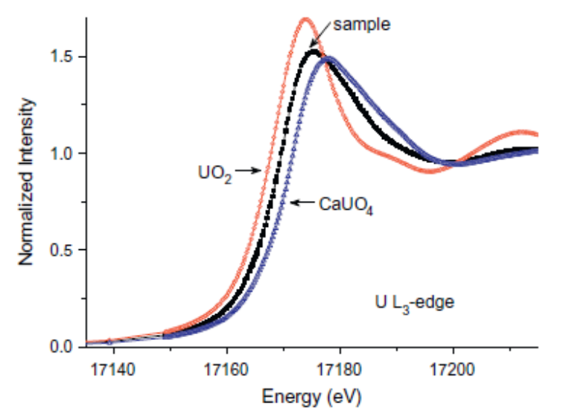
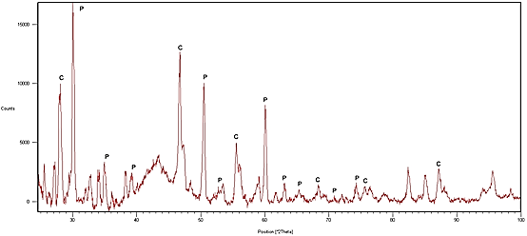
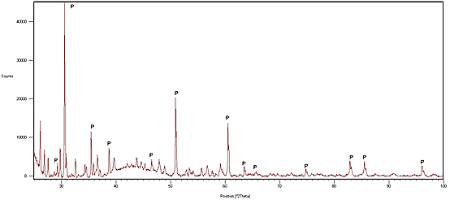
Case 2: Pyrochlore glass-ceramics with higher An loadings
Zhang et al., J. Nucl. Mater., 432 (2013) 545-547.

Slide 6
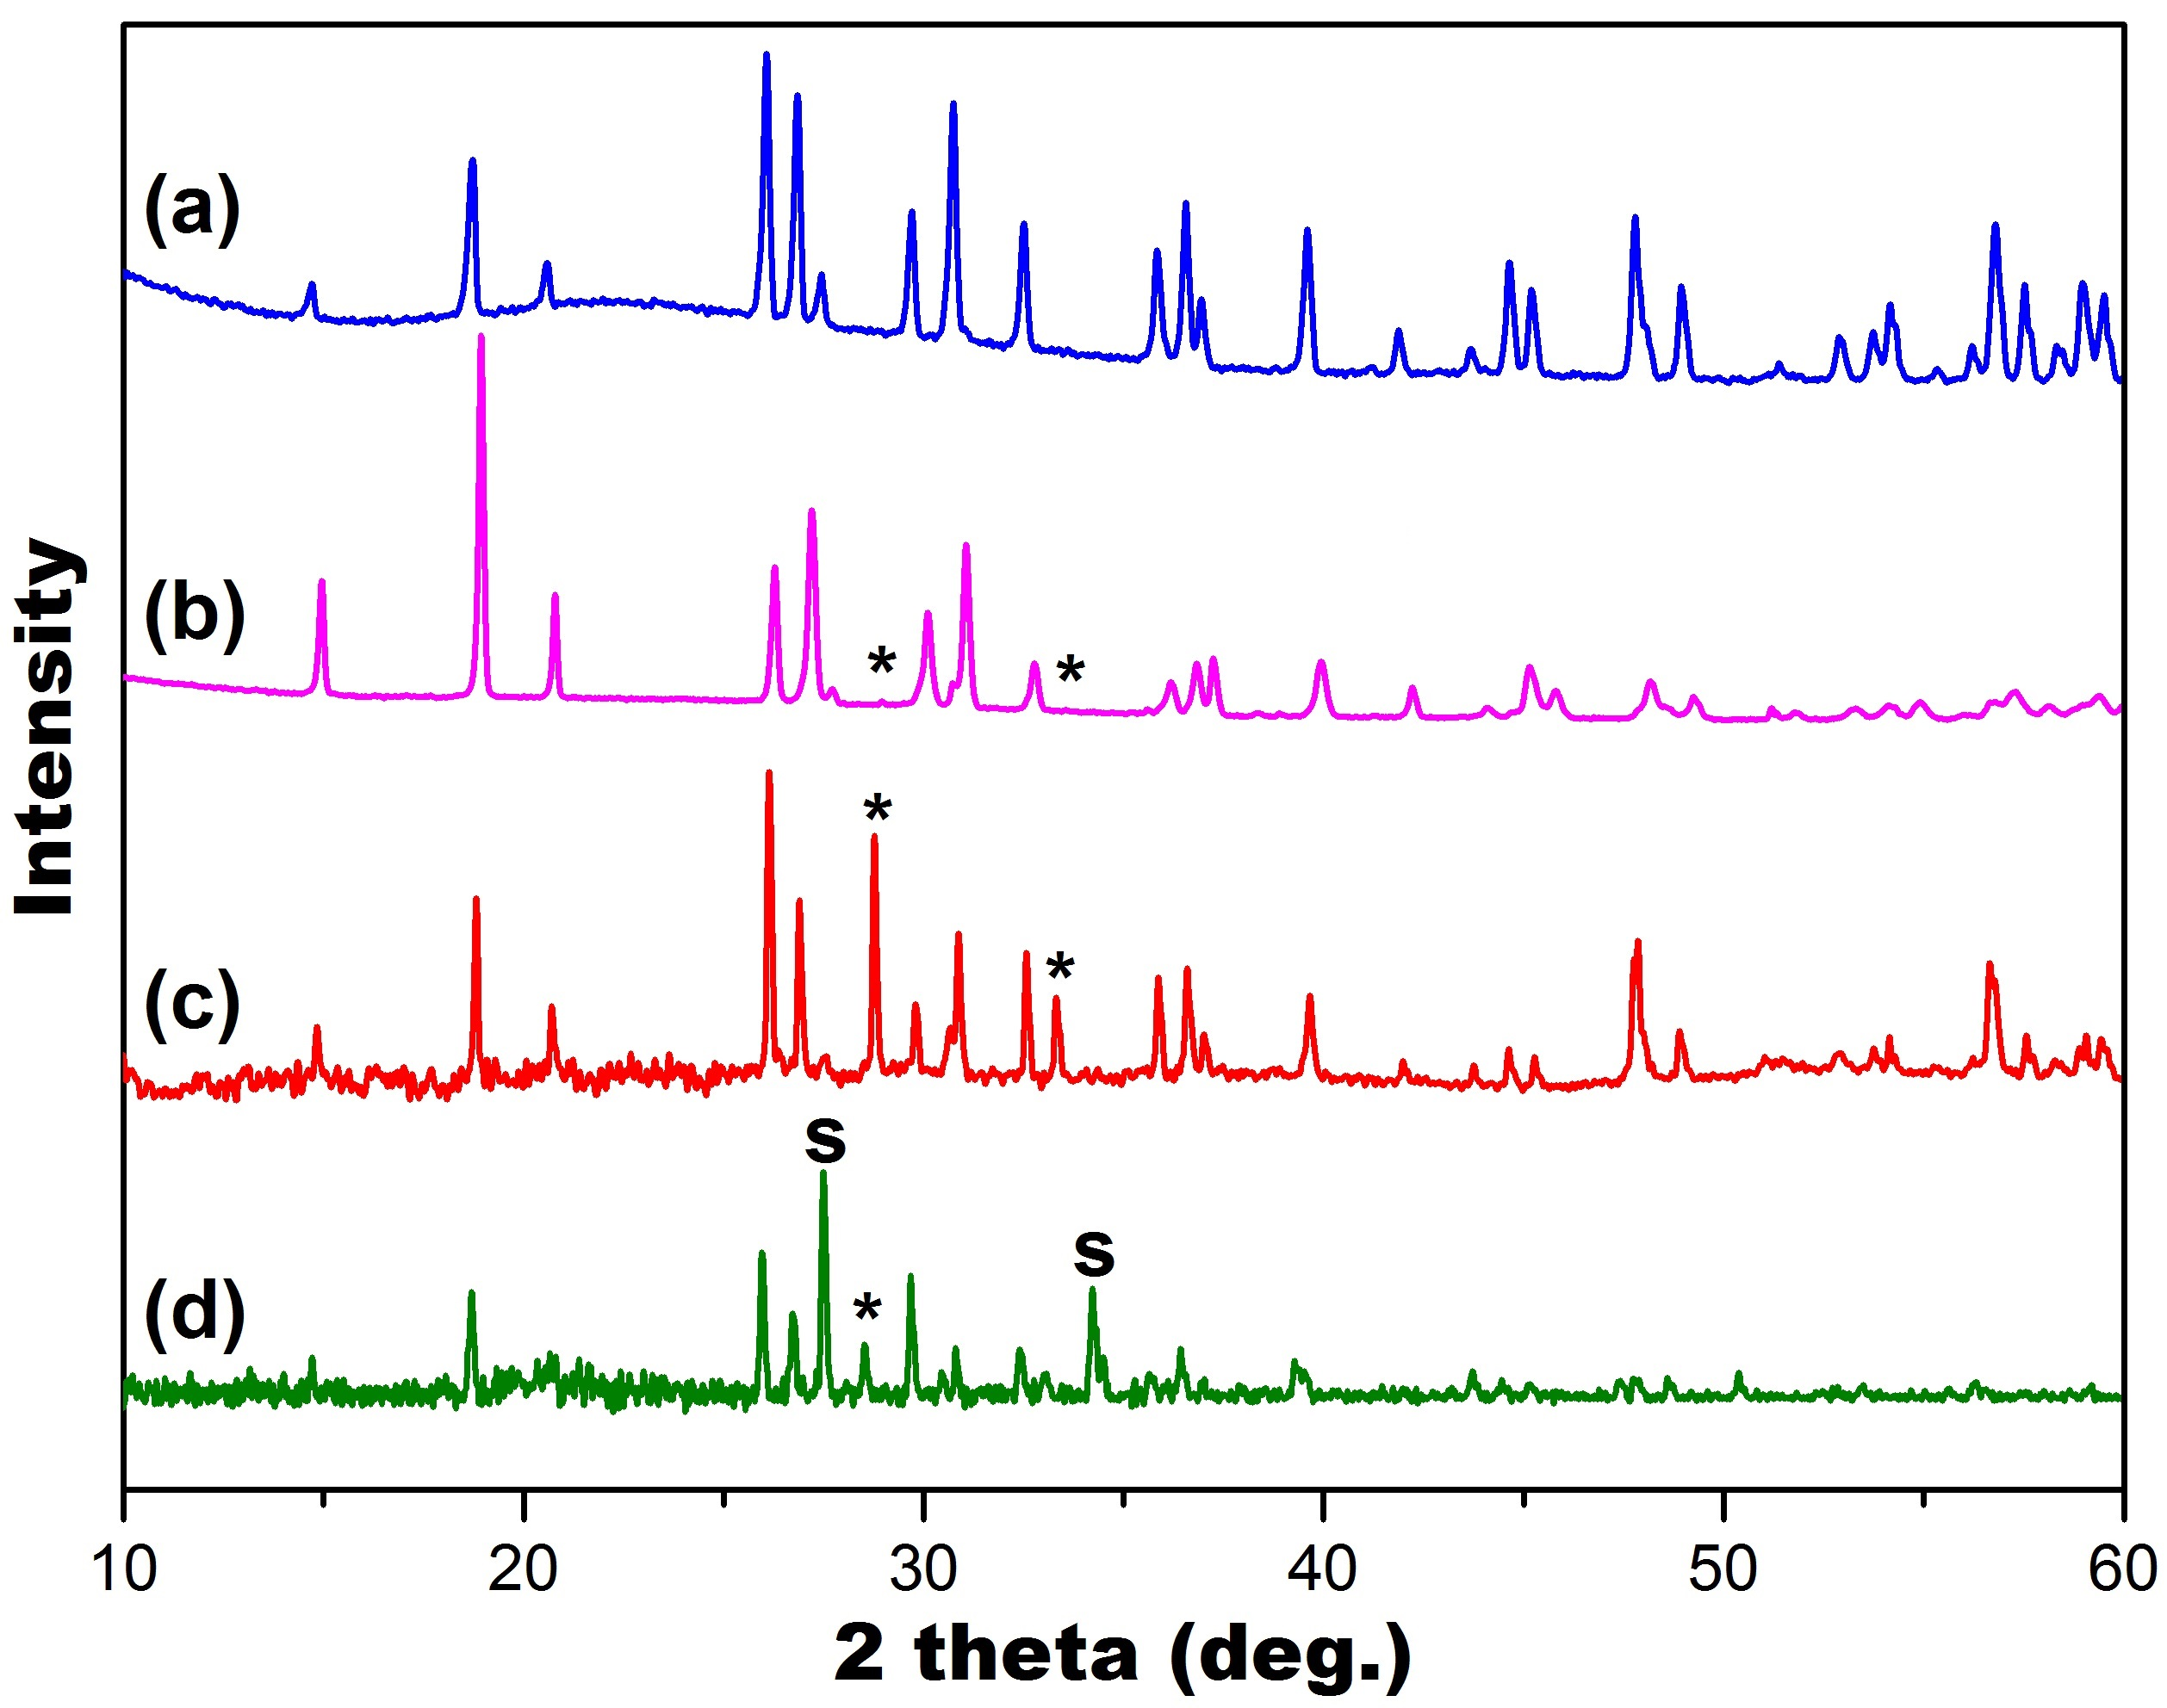
Case 3: Brannerite glass-ceramics
Oxide compositions (wt %)
Samples | SiO₂ | Na₂O/CaO | B₂O₃ | Al₂O₃ | TiO₂ | Y₂O₃/Gd₂O₃/HfO₂ | UO₂/PuO₂
U1 | 35.5 | 6.1/0 | 3.4 | 5.0 | 23.2 | 7.9/0/0 | 19.0/0
U2 | 35.5 | 6.1/0 | 3.4 | 5.0 | 21.0 | 3.6/0/0 | 25.8/0
Pu1 | 42.6 | 7.3/5.1 | 4.1 | 6.0 | 14.9 | 0/3.3/1.9 | 9.8/4.9
Pu2 | 35.5 | 6.1/6.3 | 3.4 | 5.0 | 18.6 | 0/4.1/2.3 | 12.2/6.1
Sample design and processing conditions |  |  |  |  | Results
Samples | Targeting phase |  | Conditions |  | Phase identified |  | U valence Design/Observed
U1 | Y_{0.5}U_{0.5}Ti₂O₆ |  | 1200 ºC in air |  | Y_{0.5}U_{0.5}Ti₂O₆ |  | 5+/5+
U2 | Y_{0.25}U_{0.75}Ti₂O₆ |  | 1200 ºC in air |  | Y_{0.5}U_{0.5}Ti₂O₆ UO₂ (<1%) |  | 5+; 4+/5+
Pu1 | Gd_{0.2}Hf_{0.2}U_{0.4}Pu_{0.2}Ti₂O₆ |  | 1200 ºC in argon |  | Gd_{0.2}Pu_{0.3}U_{0.5}Ti₂O₆ (U/Pu)O₂ (<5%) |  | 5+; 4+/5+
Pu2 | Gd_{0.2}Hf_{0.2}U_{0.4}Pu_{0.2}Ti₂O₆ |  | 1200 ºC in argon |  | Gd_{0.1}Hf_{0.1}Pu_{0.2}U_{0.6}Ti₂O₆ CaTiSiO₅ (∼20%) TiO₂ & (U/Pu)O₂ (<3%) |  | –
Zhang et al., J. Am. Ceram. Soc., 100 [9] (2017) 4341-4351.

Slide 7
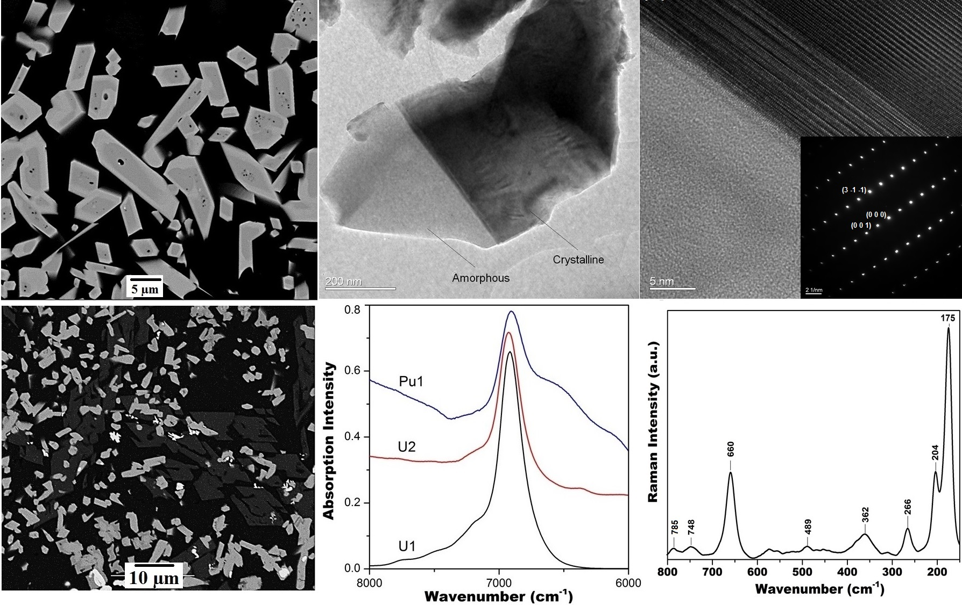
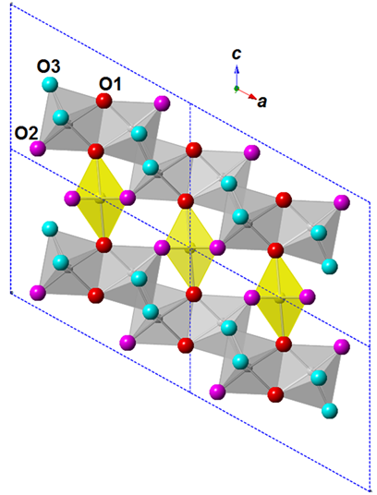
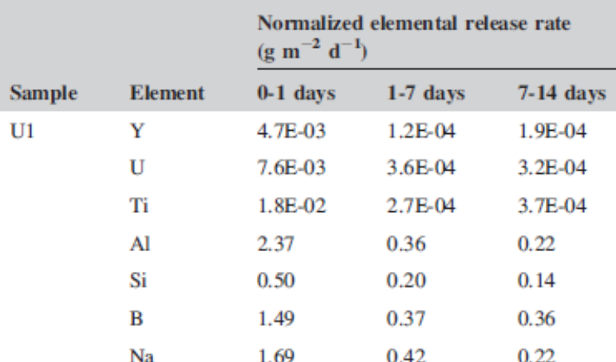
Micro-structure and spectroscopies
Zhang et al., J. Am. Ceram. Soc., 100 [9] (2017) 4341-4351.

Slide 8
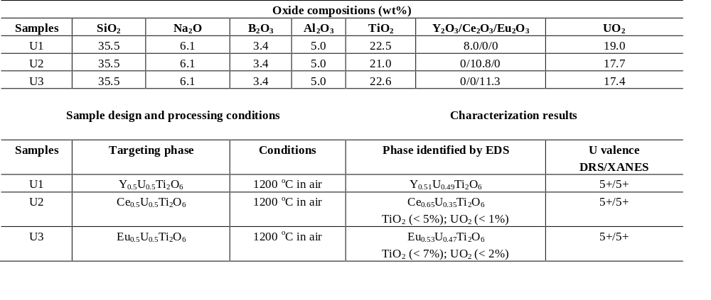
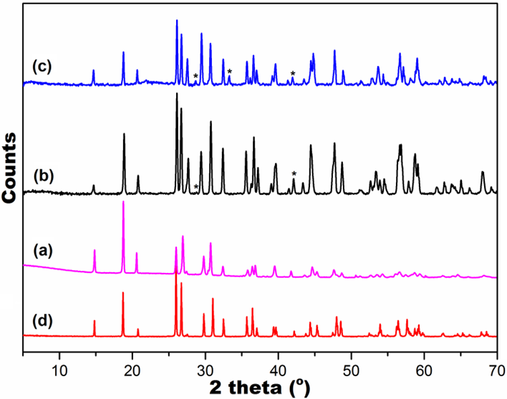
Case 4: Formation of uranium brannerite with Y/Ce/Eu in glass
Zhang et al, J. Alloys Compds., under review.

Slide 9
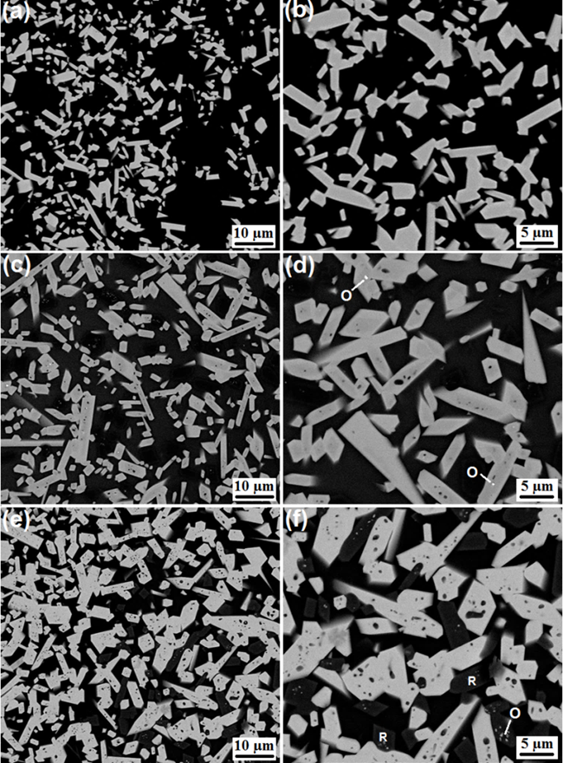
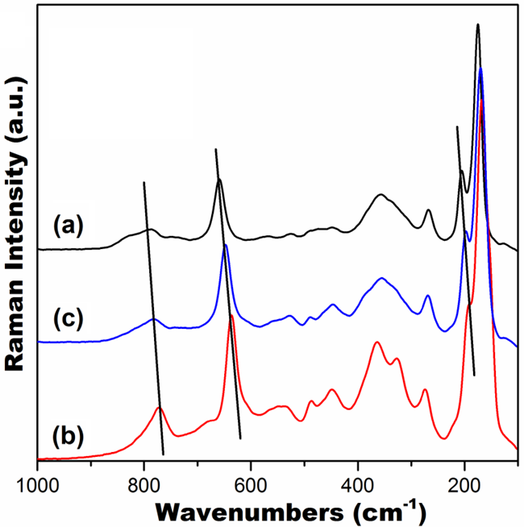
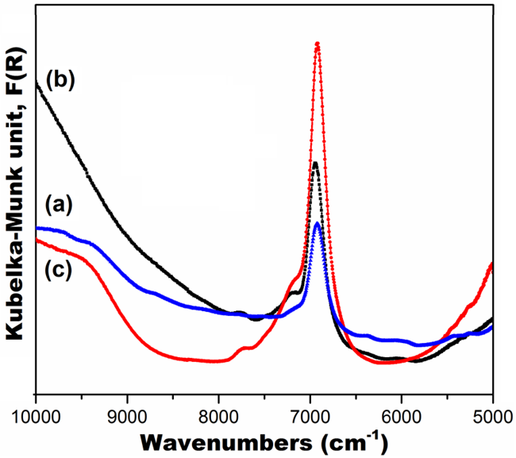
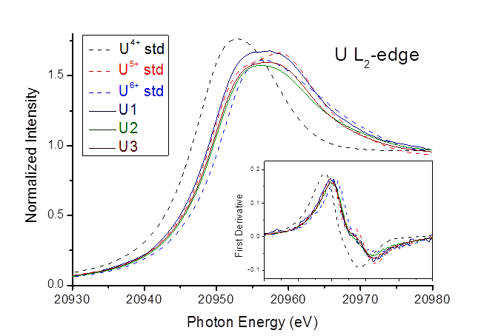
Micro-structures and spectroscopies
Zhang et al., J. Alloys Compds., under review.

Slide 10
Case 5: Phase evolution from pyrochlore to brannerite in glass
Oxide compositions (wt%)
Samples | SiO₂ | Na₂O | B₂O₃ | Al₂O₃ | TiO₂ | Y₂O₃/Gd₂O₃ | CaO | UO₂
Y1 | 35.32 | 6.07 | 3.41 | 4.99 | 21.04 | 29.16/0 | ‒ | ‒
Gd1 | 34.02 | 5.85 | 3.28 | 4.81 | 16.14 | 0/35.90 | ‒ | ‒
U1 | 34.99 | 6.02 | 3.38 | 4.95 | 16.56 | 22.96/0 | 4.27 | 6.86
U2 | 34.49 | 5.93 | 3.33 | 4.88 | 15.17 | 21.02/0 | 2.61 | 12.57
U3 | 31.65 | 5.44 | 3.05 | 4.47 | 16.35 | 22.66/0 | 2.81 | 13.55
U4 | 29.50 | 5.07 | 2.85 | 4.17 | 15.24 | 0/33.91 | 4.20 | 5.05
U5 | 29.54 | 5.08 | 2.85 | 4.18 | 14.01 | 0/31.18 | 3.86 | 9.29
Sample design and processing conditions |  |  |  |  | Results
Samples | Design phase |  | Conditions |  | Phase identified |  | U valence (DRS)
Y1 | Y₂Ti₂O₇ |  | 1200 ºC in air |  | Y₂Ti₂O₇ |  | –
Gd1 | Gd₂Ti₂O₇ |  | 1200 ºC in air |  | Gd₂Ti₂O₇ |  | –
U1 | YCa_{0.75}U_{0.25}Ti₂O₇ |  | 1200 ºC in air |  | Y_{1.40}Ca_{0.35}U_{0.20}Ti_{1.95}O₇ |  | 5+
U2 | YCa_{0.5}U_{0.5}Ti₂O₇ |  | 1200 ºC in air |  | Y_{0.5}U_{0.5}Ti₂O₆ Y_{1.50}Ca_{0.28}U_{0.22}Ti₂O₇ (∼40%) TiO₂ & UO₂ (<2%) |  | 5+ 5+
U3 | YCa_{0.25}U_{0.75}Ti₂O₇ |  | 1200 ºC in air |  | Y_{0.5}U_{0.5}Ti₂O_{6 ;} Y_{1.70}Ca_{0.15}U_{0.15}Ti₂O₇ (<10%) TiO₂ & UO₂ (<5%) |  | 5+ 5+
U4 | GdCa_{0.8}U_{0.2}Ti₂O₇ |  | 1200 ºC in air |  | Gd_{1.50}Ca_{0.30}U_{0.15}Ti_{1.95}O₇ |  | 5+
U5 | GdCa_{0.6}U_{0.4}Ti₂O₇ |  | 1200 ºC in air |  | Gd_{1.38}Ca_{0.31}U_{0.26}Ti_{1.95}O₇ Gd_{0.53}U_{0.51}Ti_{1.91}O₆ (∼45%) TiO₂ & UO₂ (<3%) |  | 5+ 5+
Zhang et al., J. Am. Ceram. Soc., 100 [11] (2017) 5335-5346.

Slide 11
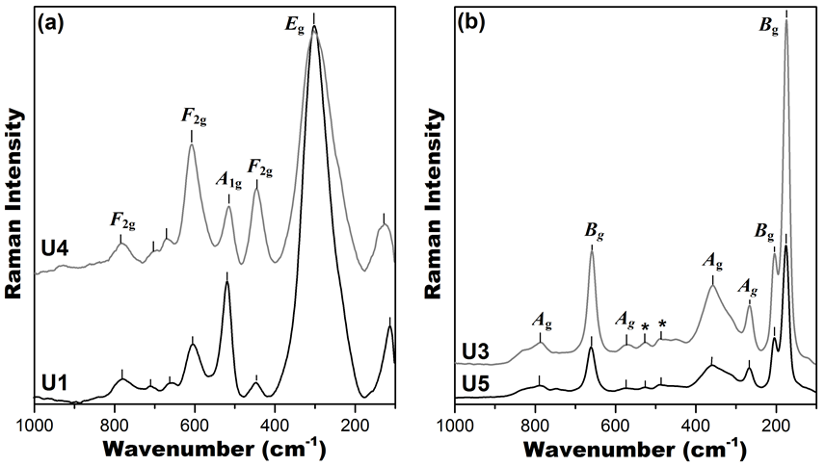
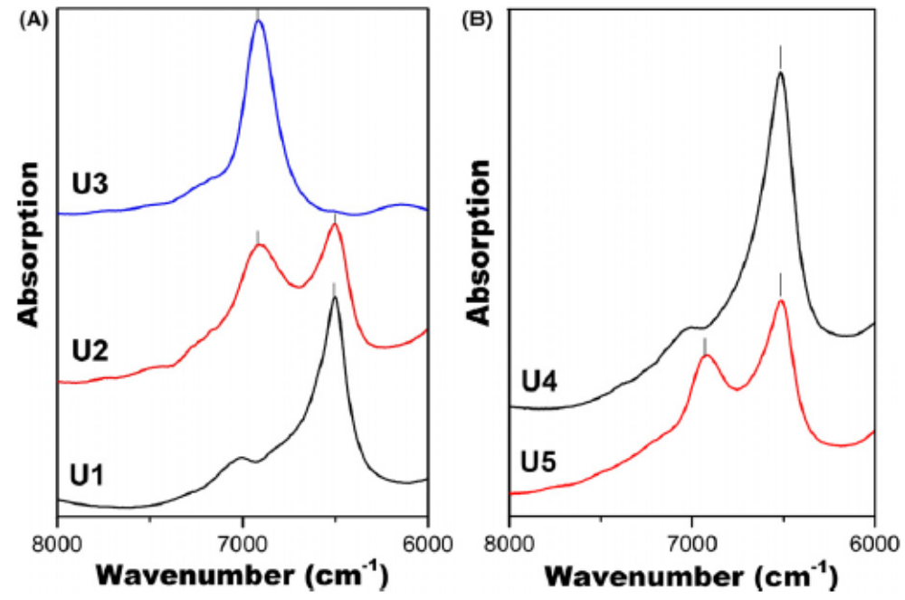
Structures and phase evolution
Y2Ti2O7
Gd2Ti2O7
Br
Y
Gd
Py
Zhang et al., J. Am. Ceram. Soc., 100 [11] (2017) 5335-5346.

Slide 12
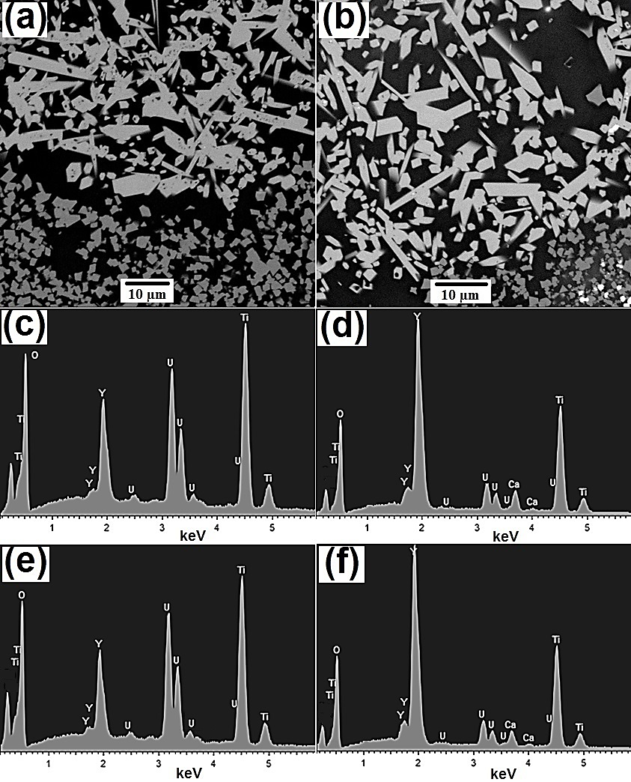
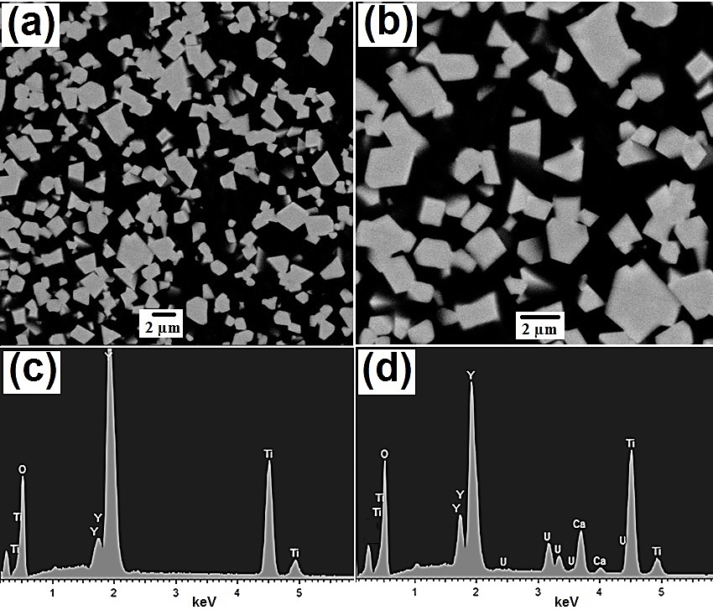
U substitution on Y site of Y2Ti2O7—SEM/EDS
Zhang et al., J. Am. Ceram. Soc., 100 [11] (2017) 5335-5346.

Slide 13
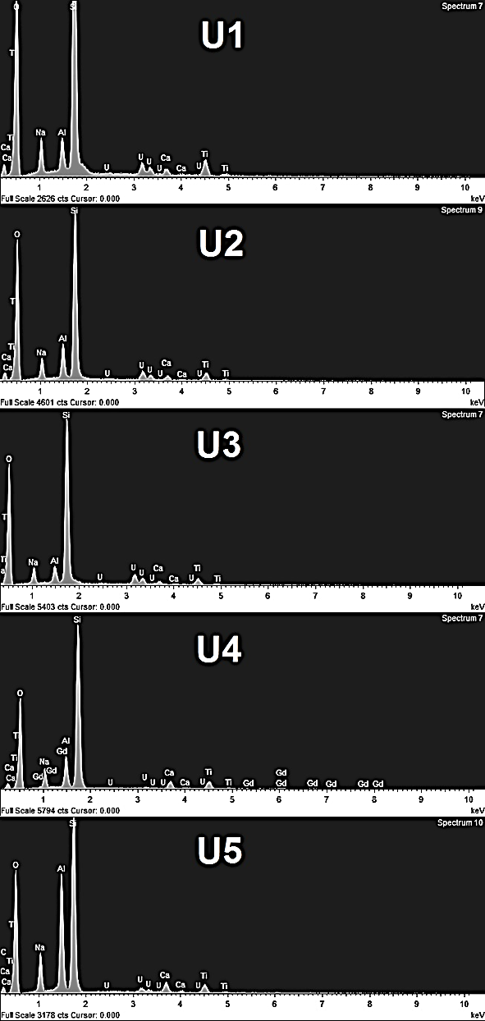
TEM-SAED U in residue glasses
Zhang et al., J. Am. Ceram. Soc., 100 [11] (2017) 5335-5346.

Slide 14
Summary and future work
Summary:
  Titanate (zirconolite/pyrochlore/brannerite) based glass-ceramics have been developed as potential waste forms
  Actinide validations on these glass-ceramic systems have been primarily addressed
  Pu(III)/Pu(IV) and U(IV)/U(V) can be incorporated in the designed ceramic phases
  End products showing good chemical durability
  Future work:
  Further plutonium validations with HIPPed glass-ceramics
  Ion irradiation studies currently in progress
  Accelerated alpha-radiation damage studies with Pu-238 doping
  Processing windows and waste form consolidation conditions
  Formulations for various actinide waste streams

Slide 15
Acknowledgement
Collaborators and ANSTO colleagues:
  Gordon Thorogood; Jessica Veliscek Carolan; Mihail Ionescu
Nuclear Materials Development and Characterization (NMDC) and Australian Synchrotron platforms at ANSTO for facility access
Thank you for your attention!
Questions?

