Slide 1


Partitioning of Ce, as a Simulant for Pu, in a Multi-phase Ceramic Nuclear Waste Form
Zhaoming Zhang¹, Kathryn Spiers², Lou Vance¹,
Joel Davis¹, Greg Lumpkin¹, Mark Blackford¹
¹Australian Nuclear Science & Technology Organisation (ANSTO), Lucas Heights, NSW, Australia
²Australian Synchrotron, Clayton, VIC, Australia

Slide 2
Outline
Pyrochlore and zirconolite ceramic waste forms are leading candidates for the immobilisation of Pu-rich nuclear wastes.
Ca_{0.71}Ce_{0.52}Y_{0.088}Hf_{0.22}Ti₂O_{~x} (x = 6.06 – 6.32) with Ce as substitute for Pu.
Sintered in (1) air at 1400ºC for 10 hrs,
(2) Ar at 1350ºC for 16 hrs.
XRD & SEM for phase assemblage and microstructure.
Determine Ce valence in individual mineral phases:
(1) XANES imaging, and (2) EELS/TEM.

Slide 3
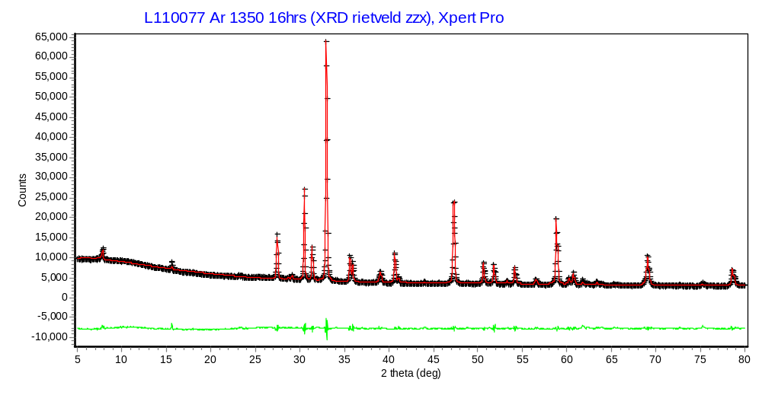
XRD pattern: Ar sintered sample
P
Perovskite (Pm-3m): a =3.8533 Å
Zirconolite 4M (C2/c): a=12.5051 Å, b=7.2294 Å, c=22.9608 Å, β=84.9335º
Rutile (P4₂/mnm): a =4.6289 Å, c =2.9859 Å
Z
P
P
R
Z
Z
Z
P
Z
R
P
Z
Z
R

Slide 4
SEM image and EDX: Ar sintered sample
Zirconolite 4M:
(Ca_{0.64}Ce_{0.38})(Hf_{0.57}Y_{0.39})Ti_{2.02}O_{6.97}
Z
P
R
Perovskite (ABO₃):
(Ca_{0.44}Ce_{0.37}Hf_{0.01}□_{0.18})Ti_{0.99}O₃
No Y, very little Hf
Rutile (TiO₂):
(Ti_{0.91}Hf_{0.09})O₂
pore

Slide 5
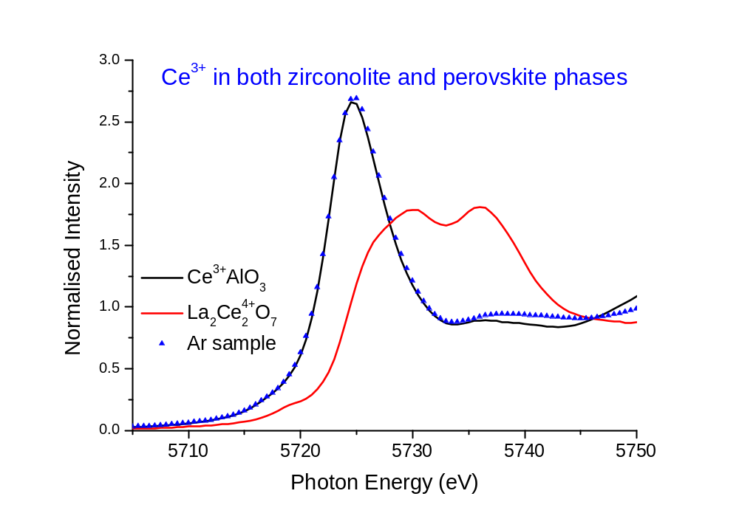
XANES at the Ce L₃-edge: Ar sample

Slide 6
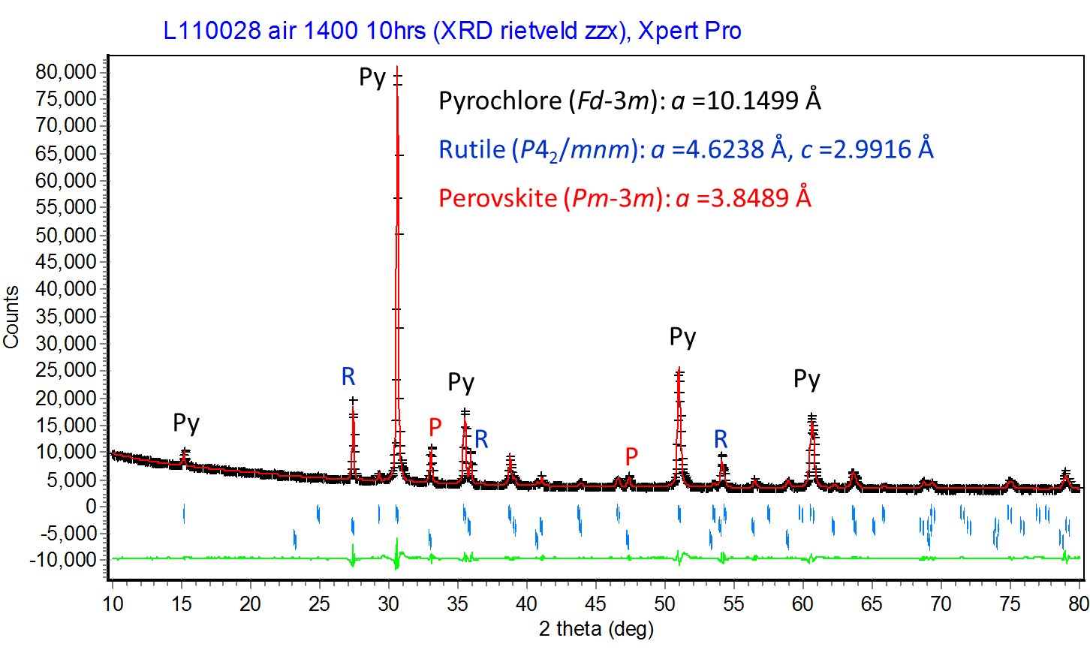
XRD pattern: air sintered sample

Slide 7
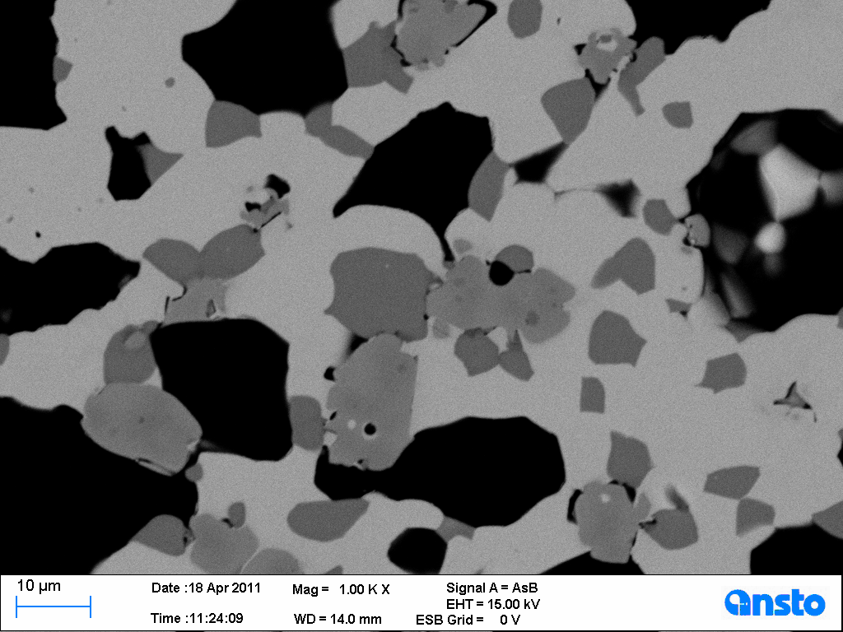
SEM image and EDX: air sintered sample
Pyrochlore (A₂B₂O₇):
(Ca_{0.79}Ce_{0.72}Hf_{0.32}Y_{0.17})Ti_{1.94}O₇
Py
Perovskite (ABO₃):
(Ca_{0.58}Ce_{0.27}Hf_{0.01}□_{0.14})Ti_{1.00}O₃
No Y, very little Hf
Rutile (TiO₂):
(Ti_{0.91}Hf_{0.09})O₂
R
P
pore

Slide 8
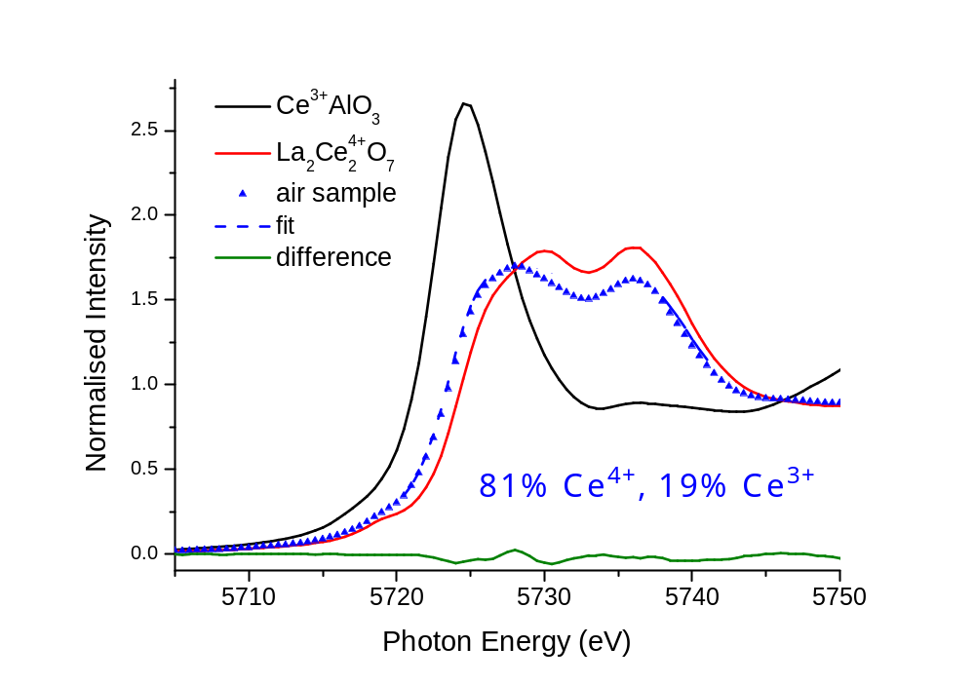
XANES at the Ce L₃-edge: air sample
Question:
Ce⁴⁺ in pyrochlore
& Ce³⁺ in perovskite?

Slide 9
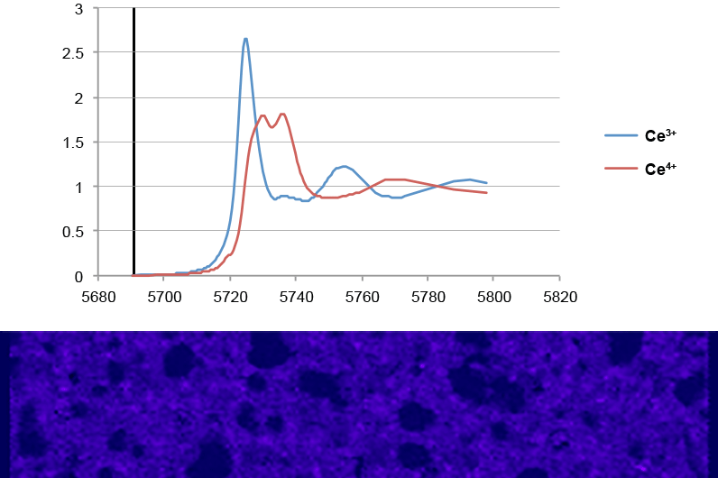

Cerium oxidation state: XANES imaging
100μm
500μm
Notes:
Still

Slide 10

XANES imaging of air sintered sample
100μm
500μm
Notes:
Animation

Slide 11

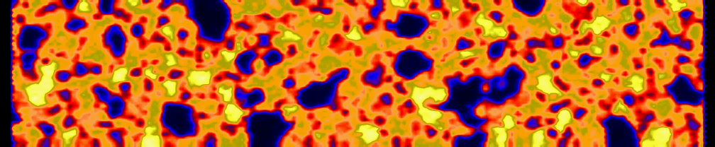
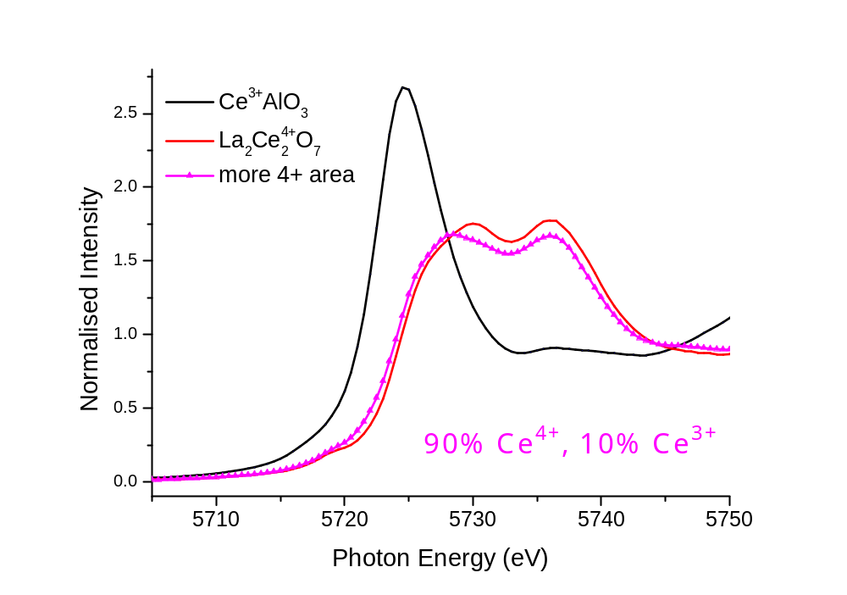
XANES Imaging of air sintered sample
25μm
①
②
 | Ca (at%) | Ce (at%) | Y (at%) | Hf (at%) | Ti (at%)
X-ray | 6.41 | 4.78 | 1.05 | 2.38 | 17.75
EDX | 7.22 | 6.58 | 1.55 | 2.90 | 17.75
pyrochlore ↔ Ce⁴⁺

Slide 12
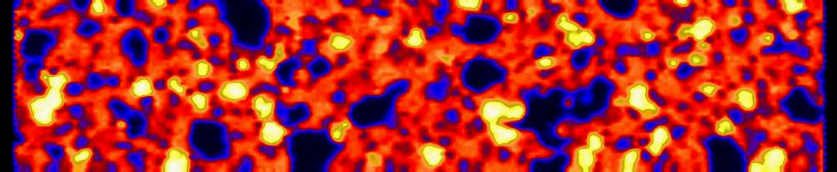

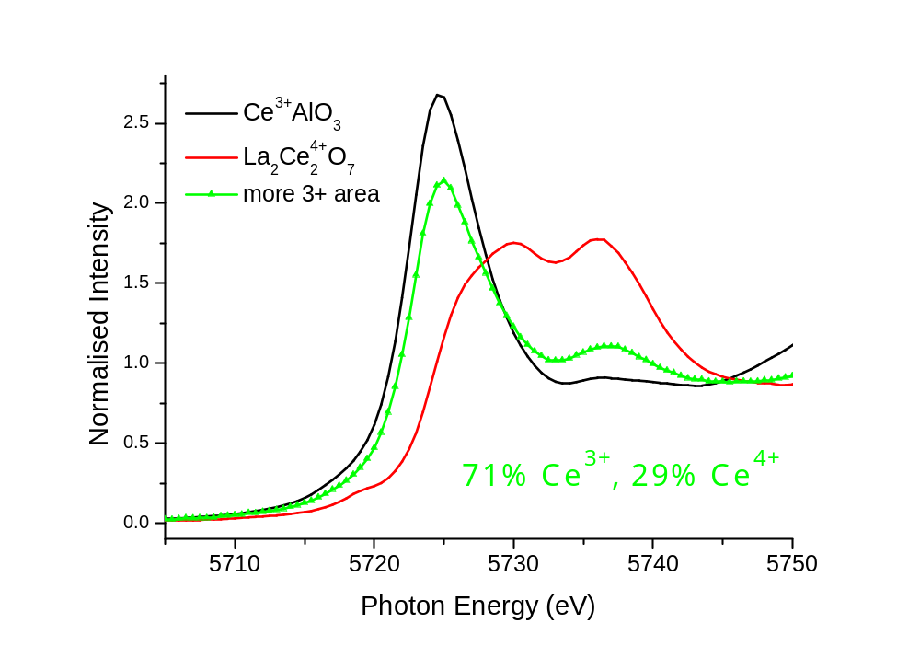
XANES Imaging of air sintered sample
25μm
①
②
 | Ca (at%) | Ce (at%) | Y (at%) | Hf (at%) | Ti (at%)
X-ray | 12.94 | 4.58 | 0.51 | 0.99 | 20.54
EDX | 11.94 | 5.47 | 0 | 0.27 | 20.54
perovskite ↔ Ce³⁺

Slide 13
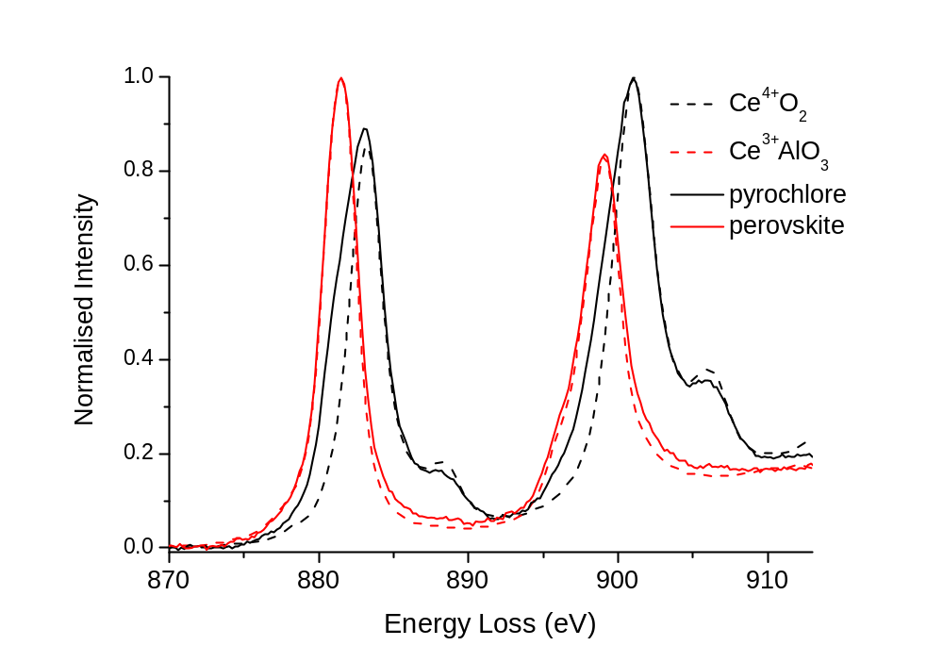
RT EELS(TEM) measurements at Ce M_{5,4}-edges
Ce³⁺ ↔ perovskite, and Ce⁴⁺ ↔ pyrochlore (reduction?)

Slide 14
Conclusions
Sintering in air → pyrochlore-rich ceramics incorporating Ce⁴⁺ with minor perovskite incorporating Ce³⁺
Sintering in Ar → perovskite + zirconolite 4M, both incorporating Ce³⁺
XANES imaging can provide us with information on the chemical speciation in individual mineral phases of multi-phase ceramics. However, it is difficult to probe individual grains.
EELS/TEM is a complementary technique.

Slide 15
Thank you

