Slide 1


Quantification of irradiation induced structural disorder in nuclear waste-form ceramics with µ-luminescence spectroscopy of lanthanides
Lenz, C.^{1,2}, Lumpkin, G.R.¹, Thorogood, G.J.¹, Ionescu, M.¹, Nasdala, L.²
¹ Australian Nuclear Science and Technology Organisation, Lucas Heights, Sydney, Australia
² Institut für Mineralogie und Kristallographie, Universität Wien, Austria

Slide 2
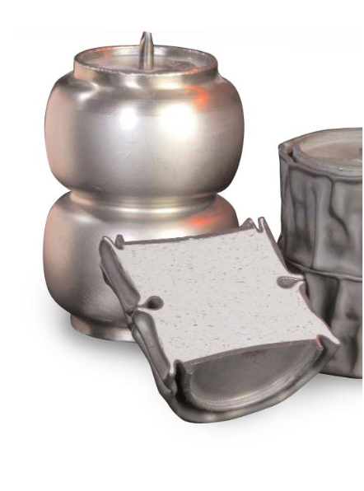
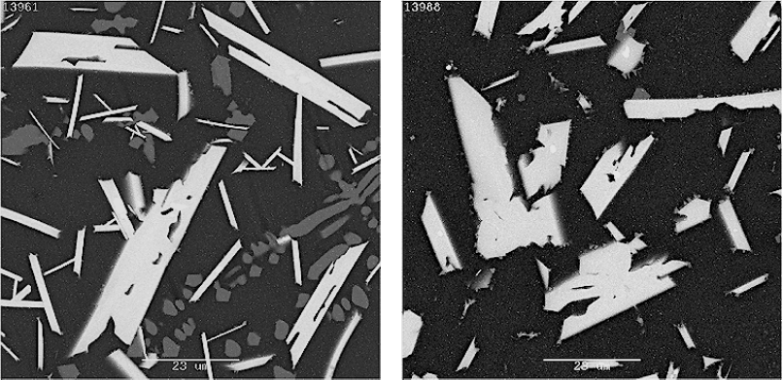
Challenges & Motivation
How to quantitatively characterise the structural state (crystallinity) of individual grains/crystallites in multi-phase ceramics proposed as nuclear waste-forms (e.g., SYNROC, glass-ceramics)?
Zirconolite glass-ceramics
Image width: 70 µm (each)
after Day et al. (2015)

Slide 3
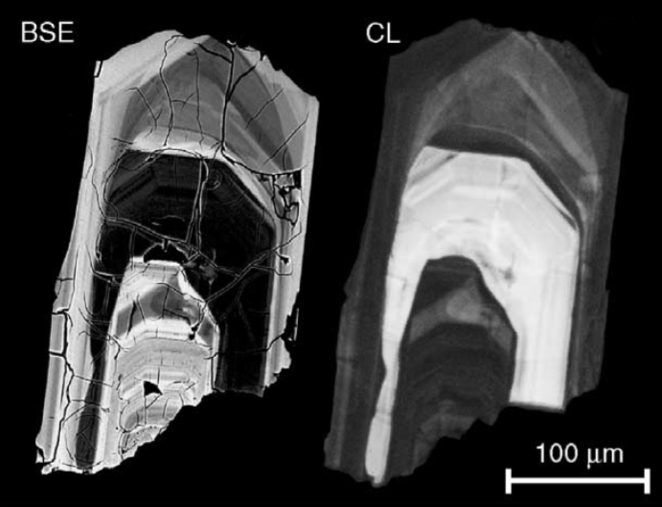
Challenges & Motivation
How to quantitatively characterise the structural state (crystallinity) of individual grains/crystallites in multi-phase ceramics proposed as nuclear waste-forms (e.g., SYNROC, glass-ceramics)?
Estimate radiation-damage accumulation in accessory minerals on µm-scale (e.g., zircon and other accessories!)
Zircon crystals from Andirondak Mts.
after Nasdala et al. (2005)

Slide 4
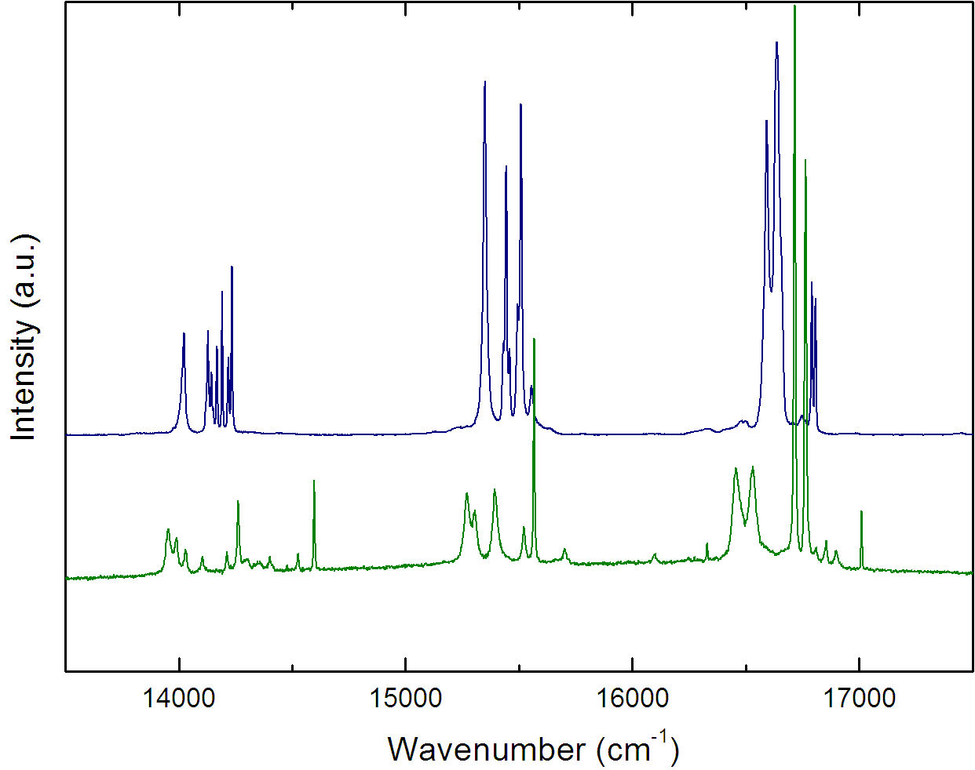
Ln³⁺ luminescence spectroscopy
Lanthanides are common (trace) elements in natural accessory minerals, e.g., zircon (ZrSiO₄), monazite & xenotime (LnPO₄), titanite (CaTiSiO₅)
Lanthanides may easily substitute in the crystal structure of many waste-form phases; and are commonly used as non-hazardous surrogates for some actinides
(e.g., Pu, U, and Th)
Xenotime−(Y), YPO₄:Sm³⁺
selected Ln have unique luminescence characteristics:
D_{2d}
Fig. Laser-induced photoluminescence spectra of synthetic xenotime−(Y) and monazite−(Ce) doped with Sm³⁺
(λ_{exc}= 488 nm; 77 K)
C₁
Monazite−(Ce), CePO₄:Sm³⁺

Slide 5
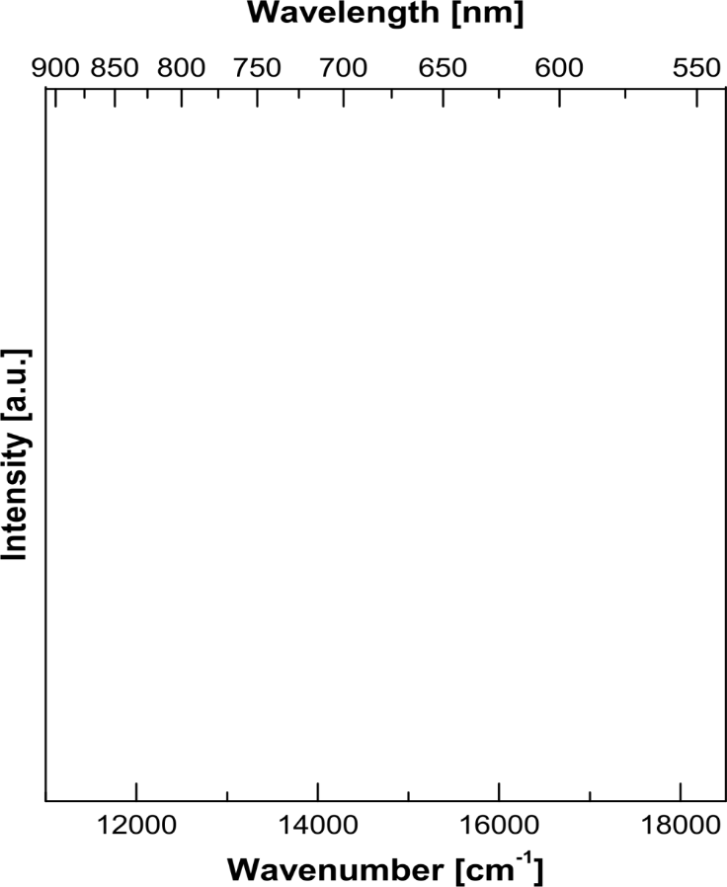
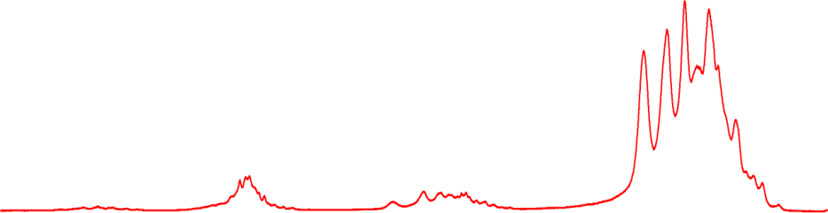
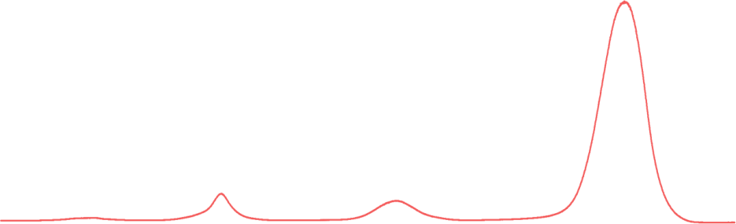
Ln³⁺ luminescence spectroscopy
Lanthanides are common (trace) elements in natural accessory minerals, e.g., zircon (ZrSiO₄), monazite & xenotime (LnPO₄), titanite (CaTiSiO₅)
Lanthanides may easily substitute in the crystal structure of many waste-form phases; and are commonly used as non-hazardous surrogates for some actinides
(e.g., Pu, U, and Th)
selected Ln have unique luminescence characteristics:
Dy³⁺ in titanite (CaTiSiO₅) crystal
Dy³⁺ in CaTiSiO₅ quenched glass
Application as structural probe!

Slide 6
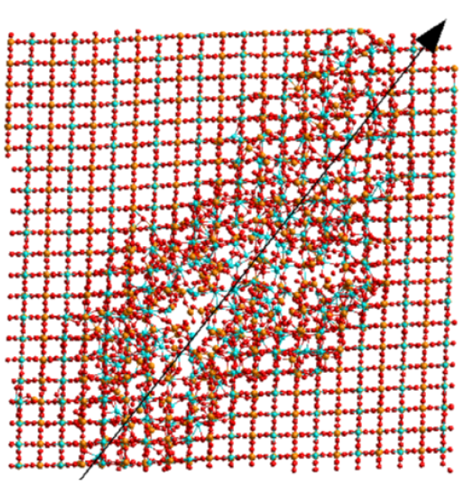
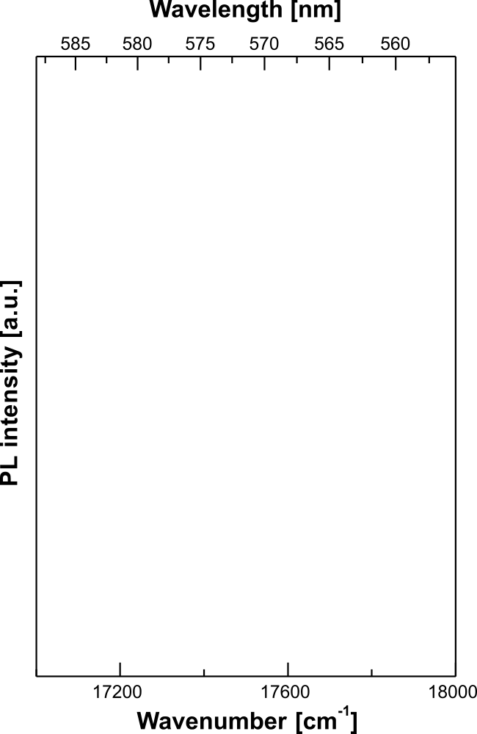
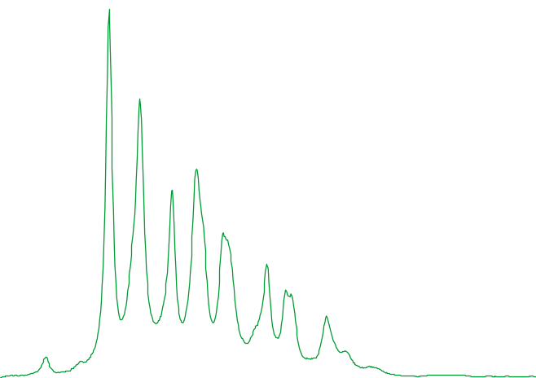

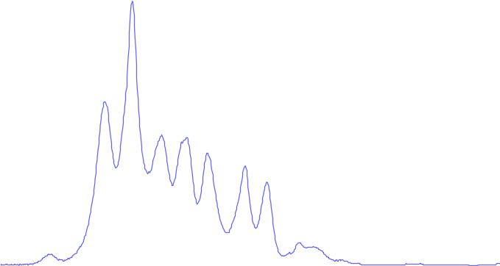
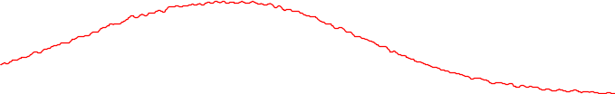
Ln³⁺ luminescence spectroscopy
= Dy³⁺
⁴F_{9/2} → ⁶H_{15/2}
Fig. Graphical representation of a MD simulation of a single 30keV recoil from a decay-event in zircon
(after Trachenko et al. 2003)

Slide 7
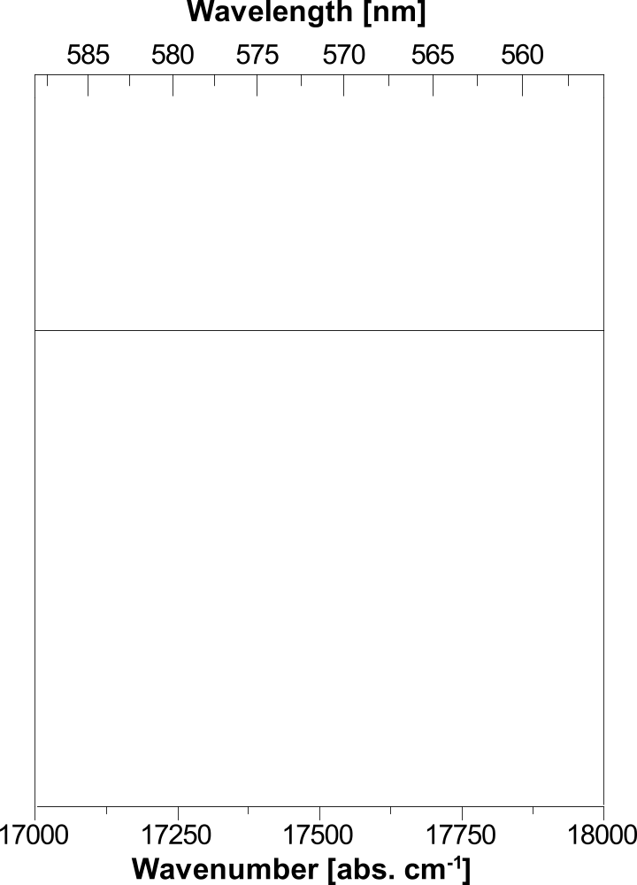
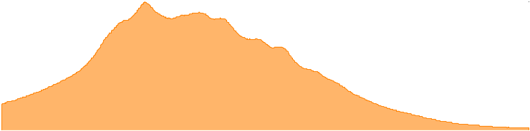
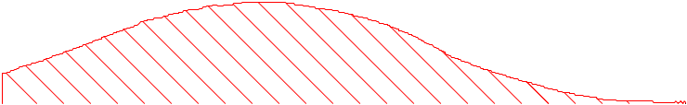
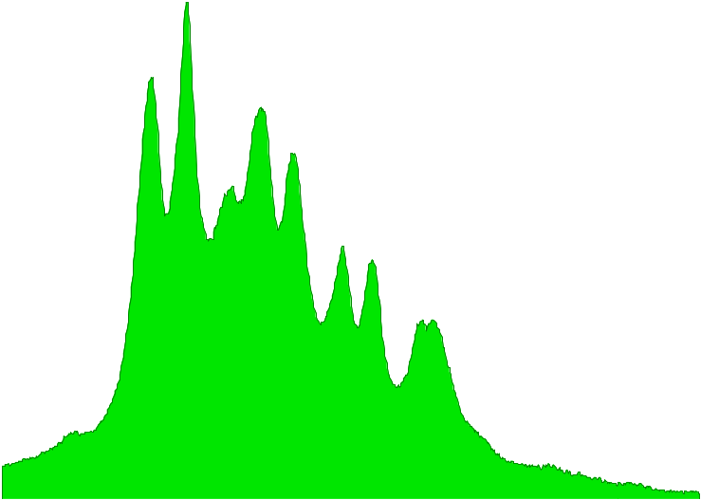
Ln³⁺ luminescence spectroscopy
= Dy³⁺
⁴F_{9/2} → ⁶H_{15/2}
Amorphous fraction = 75%
Amorphous fraction = 40%
Fig. Graphical representation of a MD simulation of a single 30keV recoil from a decay-event in zircon
(after Trachenko et al. 2003)

Slide 8
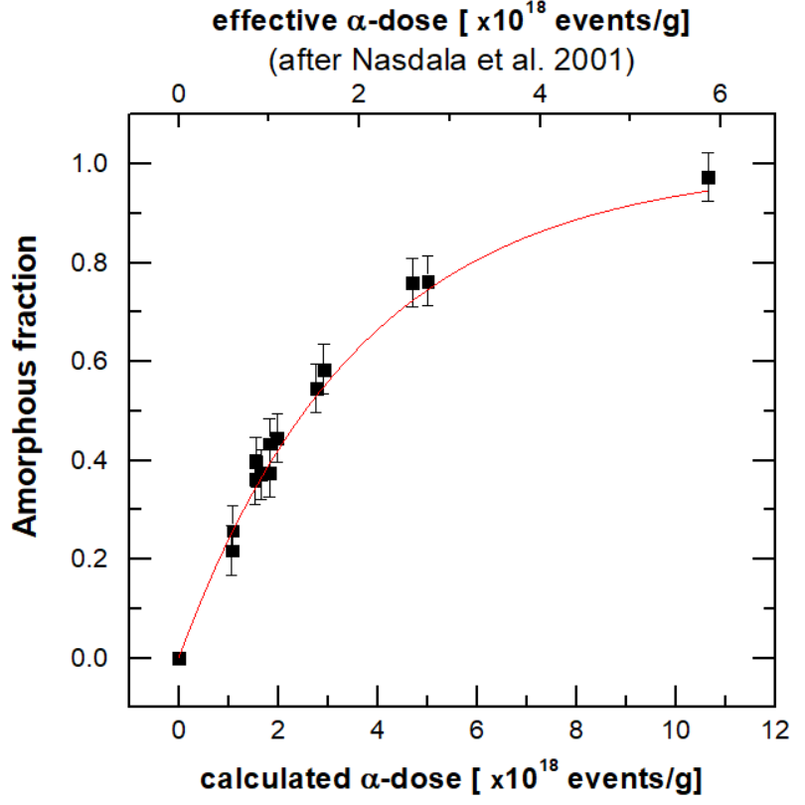
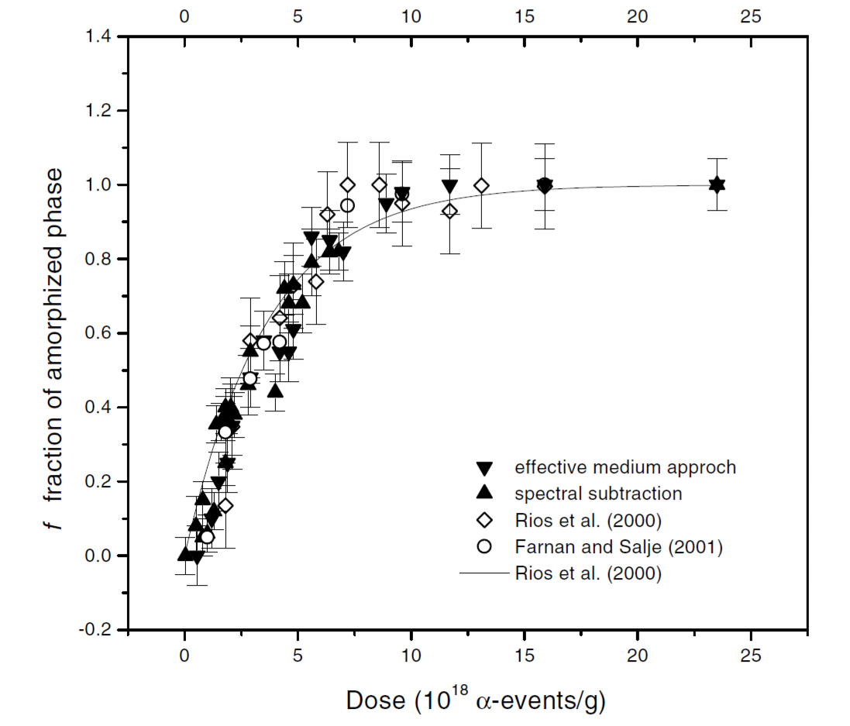
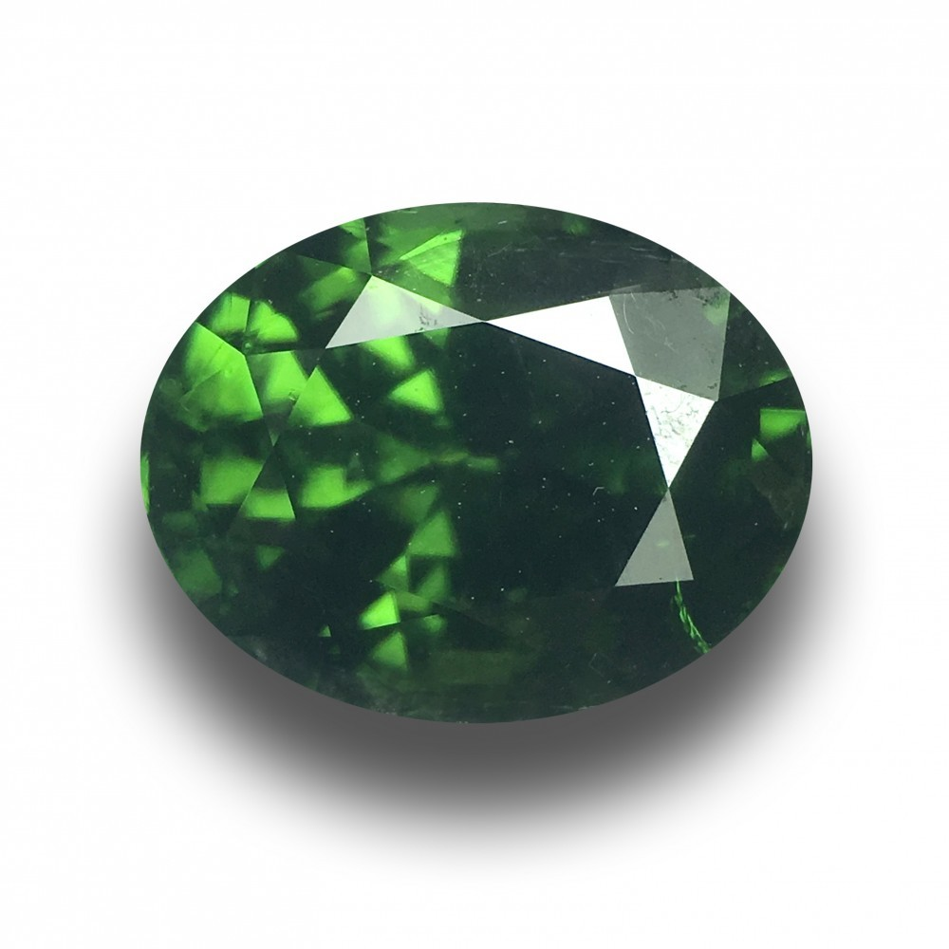

A test example:
Sri Lankan zircon single-crystals
Test with well-characterised, homogeneous, gem-quality samples from Sri Lankan gravels
Direct impact model:
$$fa=1−e^{Ba × D}$$
PL data
Fig. The amorphous fraction of Sri Lankan zircon samples estimated by the bulk techniques XRD and NMR
(summarised by Zhang and Salje 2001)
Fig. The amorphous fraction of Sri Lankan zircon samples as obtained by laser-induced photoluminecence of Dy³⁺

Slide 9
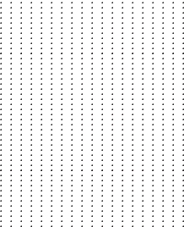
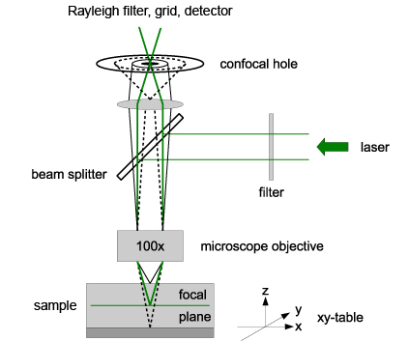
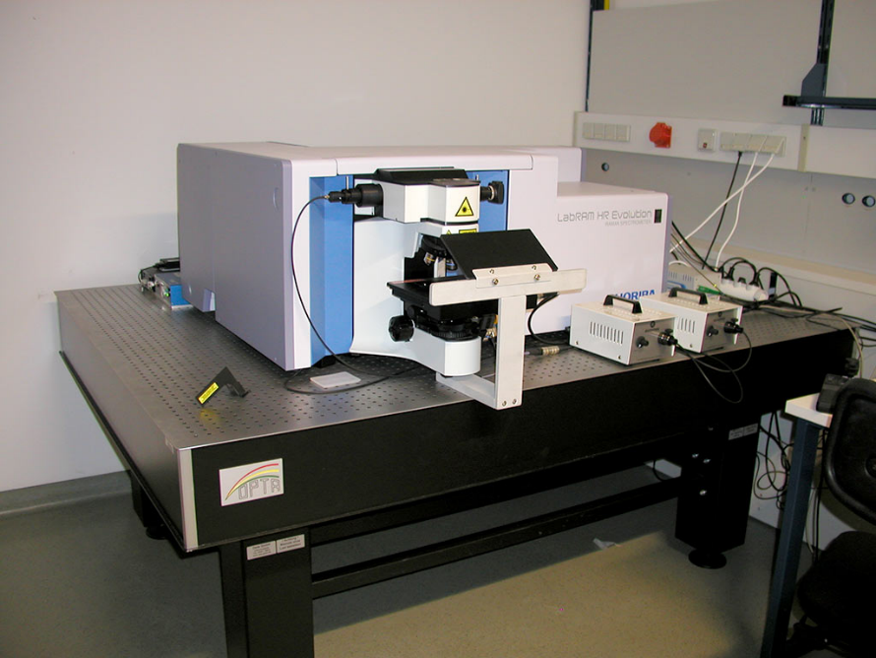
Confocal laser spectroscopy
hyperspectral mapping
Laser spectroscopy may be performed with confocal spectrometer set-up with spatial resolution down to 1 µm
planar
sample
y
x
Horiba Lab-Ram HR Evolution
with x-y-table

Slide 10
Application example:
Heavy-ion irradiated ceramics − Zircon
Heavy ion irradiation with a 10MV Tandem-Accelerator
Au ions, with 35, 22, 14 and 7 MeV at RT
max. total fluence 6.5x10¹³ ions/cm²
cold-pressed, sintered, mono-phase, polycrystalline zircon (ZrSiO₄) ceramic pellet
50%
21%
16%
13%

Slide 11
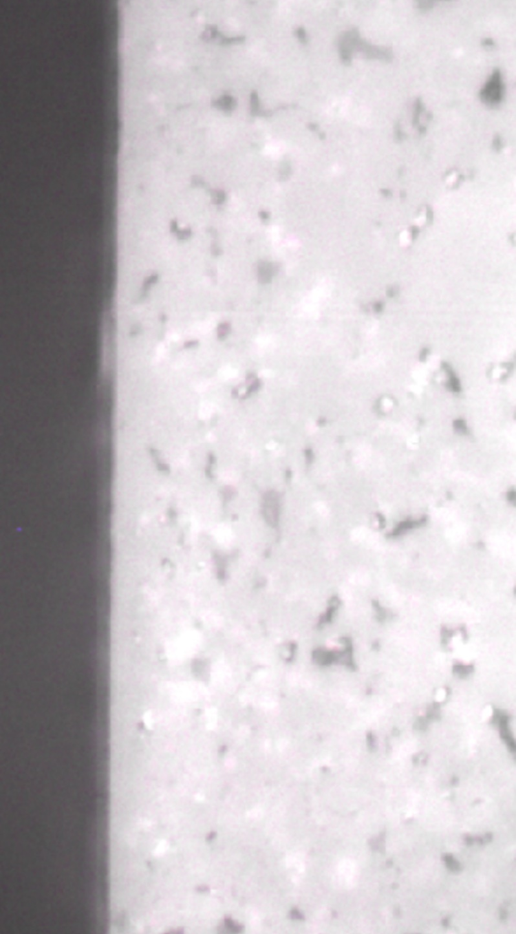
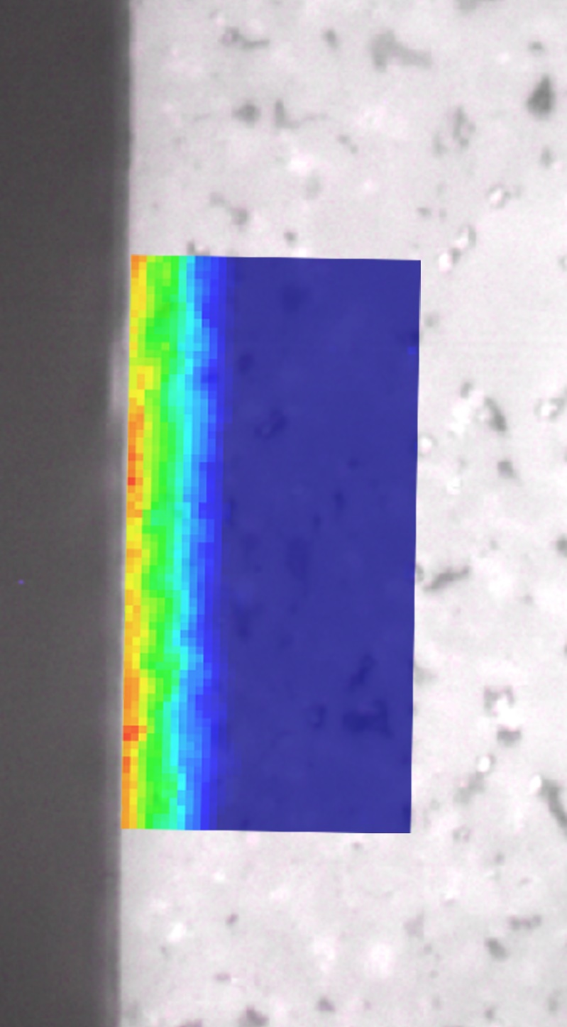
Application example:
Heavy-ion irradiated ceramics − Zircon
Heavy ion irradiation with a 10MV Tandem-Accelerator
Amorphous fraction obtained from PL of Dy³⁺
Au ions, with 35, 22, 14 and 7 MeV at RT
max. total fluence 6.5x10¹³ ions/cm²
cold-pressed, sintered, mono-phase zircon (ZrSiO₄) ceramic pellet
cut, mount and polished
FIB foil preparation for TEM
Direction of heavy-ion irradiation onto the sample
10 µm

Slide 12
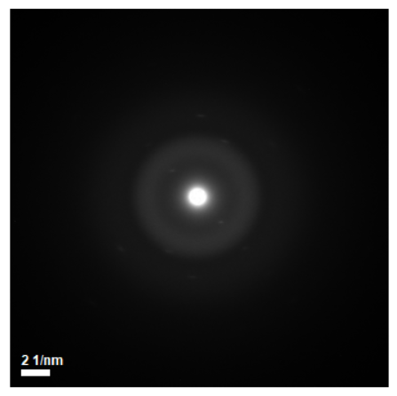
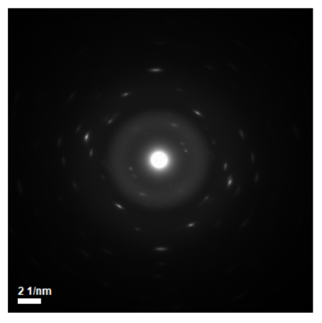
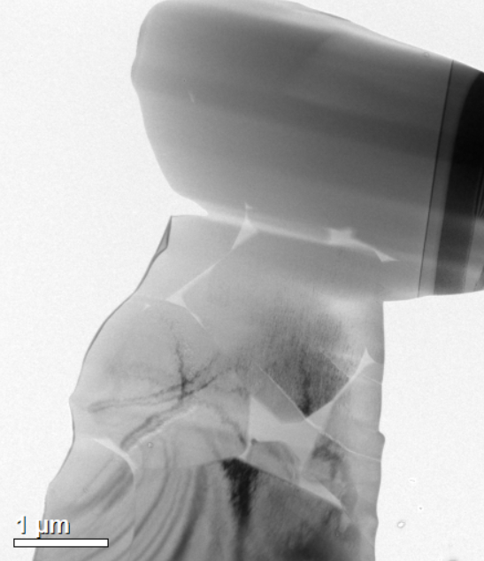
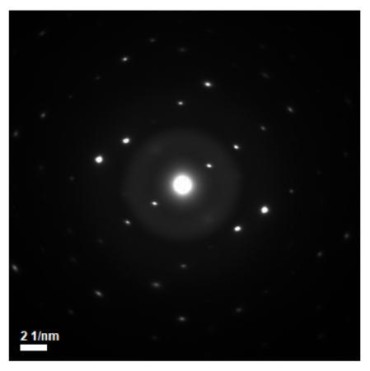
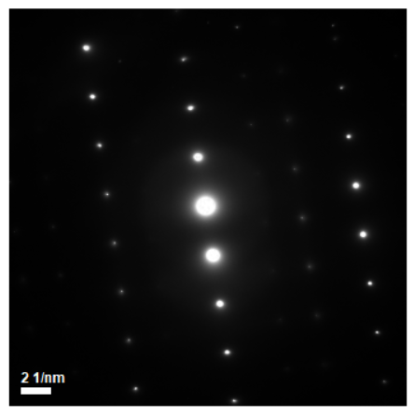
Application example:
Heavy-ion irradiated ceramics − Zircon
Heavy-ion irradiation
Fig. TEM image and SAED patterns of irradiated zircon ceramic

Slide 13

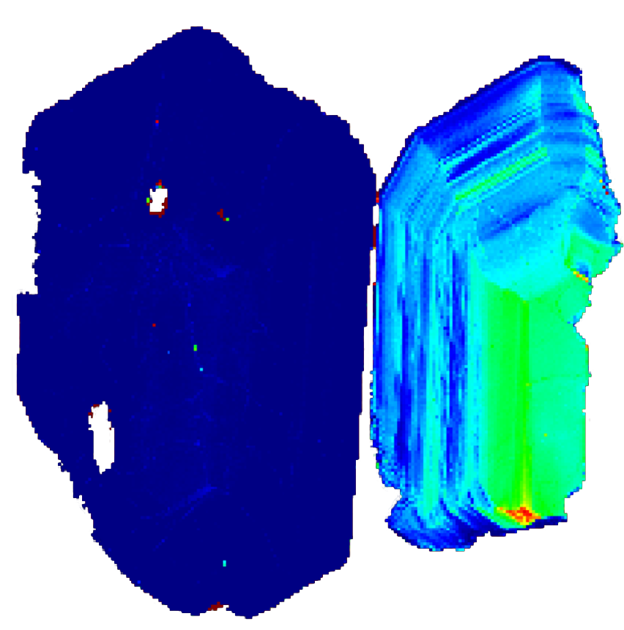
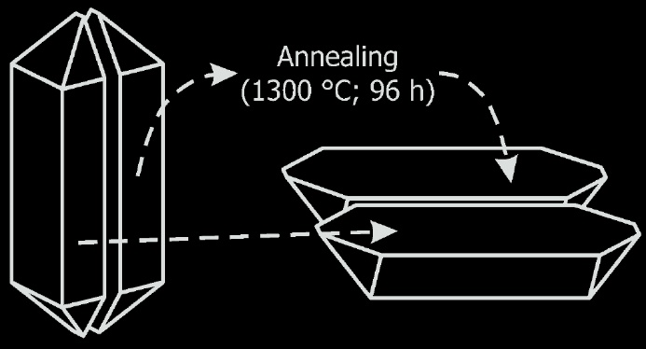
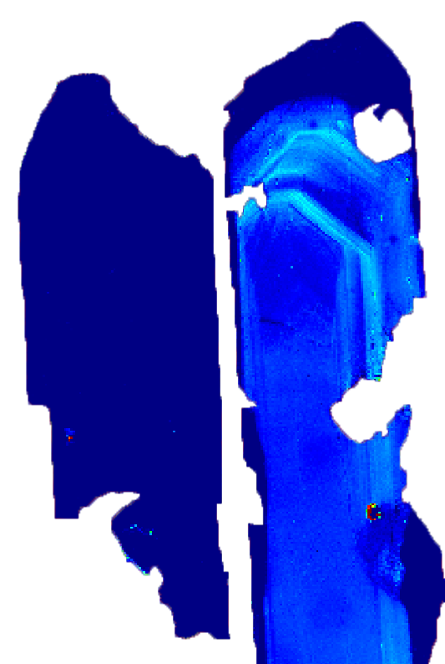
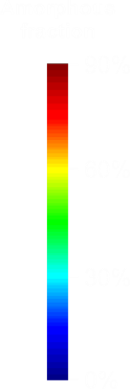
Test on natural analogue: Zircon
Overgrowth rim
U < 10 ppm
1 mm
Zoned core
80 – 200 ppm U
50 µm
Zircon
Potassic granulite,
Plešovice quarry, Czech Republic
(337.13 ± 0.37 Ma)
Zircon
Gabbro, Mulcahy lake intrusion,
Ontario, Canada
(2733 ± 1 Ma)

Slide 14

Summary & Outlook
Laser-induced photoluminescence spectroscopy of Ln³⁺ is a promising tool for the quantification of irradiation-induced damage in crystalline waste-form materials and accessory minerals.
The amorphous fraction can be directly derived from PL emission spectra
  Similar experiments with xenotime (YPO₄) and zirconolite (CaZrTi₂O₇) ceramics
  using the prominent Nd³⁺ emission have been conducted succesfully!
PL mapping with confocal spectrometer set-ups provides a detailed characterisation and visualisation of complex radiation-damage accumulation on µm scale.
Compare amorphous fraction obtained with PL with bulk,
but surface sensitive Grazing-incidence XRD data
Ion-irradiation experiments with some more potential
waste-form/nuclear-fuel materials

Slide 15



Thank you for your attention!
Special thanks:
Technical assistance
Chutimun Chanmuang (Uni Vienna)
Rob Aughterson (ANSTO)
Joel Davies (ANSTO)
Sample synthesis
Daniel Gregg & Lou Vance (ANSTO)
Dominik Talla (Uni Vienna)
Sample preparation
Andreas Wagner (Uni Vienna)
Kim Lou (ANSTO)

Slide 16
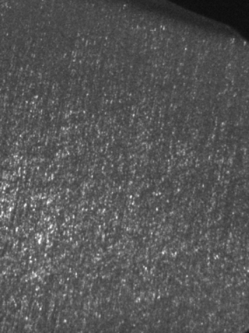

Additional information

Slide 17
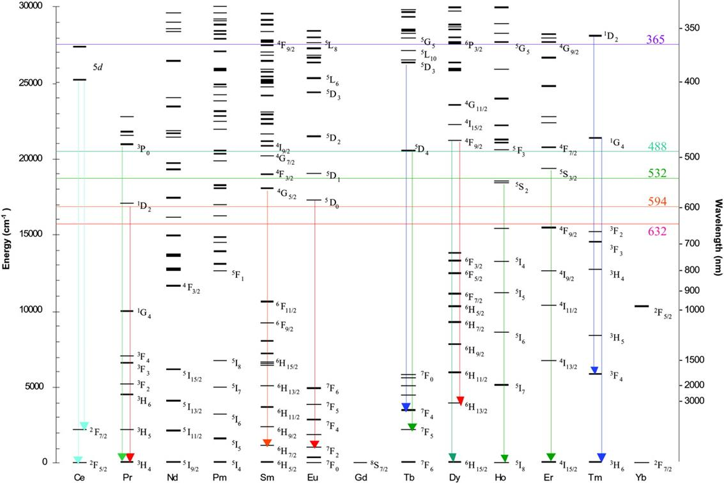
Dieke diagram:
Principal f-f transitions
Fig. Diagram of energy levels of Ln³⁺ in LnCl₃ (“Dieke diagram”; after Dieke and Crosswhite 1968)

Slide 18
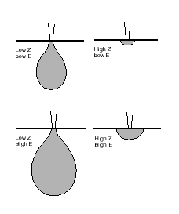
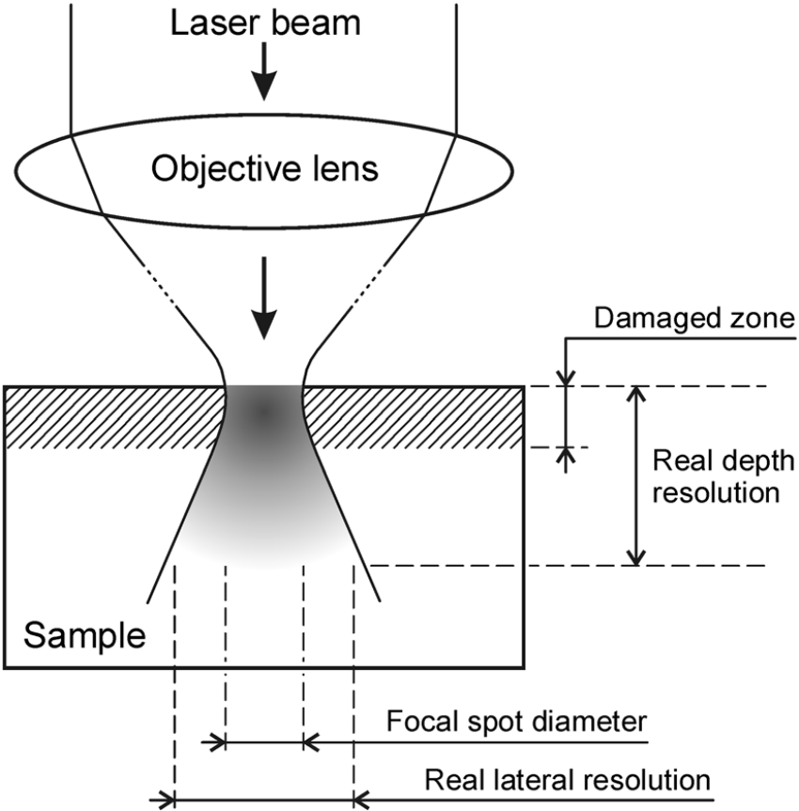
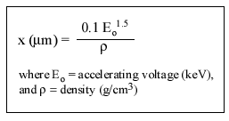
Spatial resolution: Confocal optics
vs. Electron-beam interaction
Fig. Simplified sketch (not to scale) of the beam path of a confocal Raman spectrometer near the focused surface of the sample. The analyzed volume-area is shown in gray. Its extension below the sample surface exceeds appreciably the depth of the irradiation-damaged zone (hatched). Note also that the real lateral resolution exceeds the focal-spot size (after Nasdala et al. 2010).

Slide 19
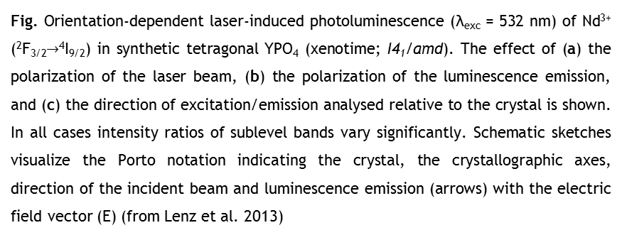
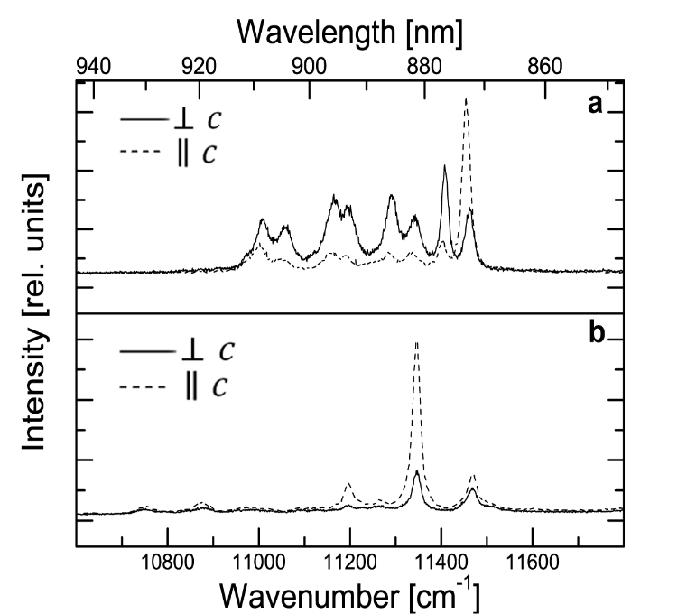
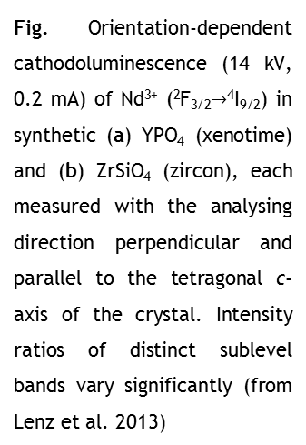
REE³⁺ intensities – Orientation dependence

Slide 20
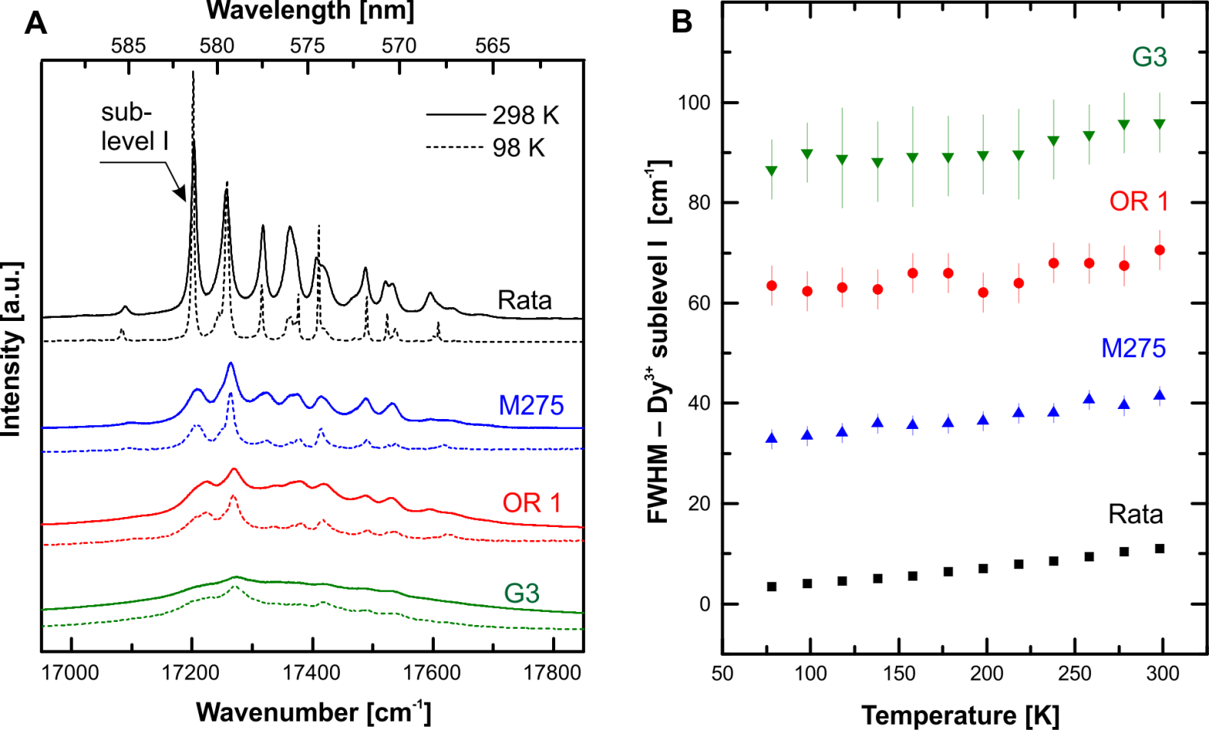
Band widths and the effect of temperature
Fig. Effect of temperature on the PL spectra of various gem-quality zircon samples ranging from well crystallised to severely radiation damaged. (A) Pairs of spectra showing the Dy³⁺ emission (⁴F_{9/2} → ⁶H_{13/2}) at ambient and low temperature. (B) Plot of the FWHM of Dy³⁺ sublevel I (see arrow in A) against temperature. Note that FWHMs of Dy³⁺ Stark’s levels depend strongly on the sample’s degree of radiation damage (cf. Fig 5) whereas temperature has rather moderate effects.

Slide 21
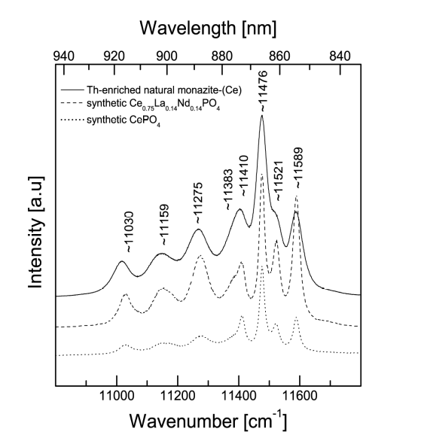
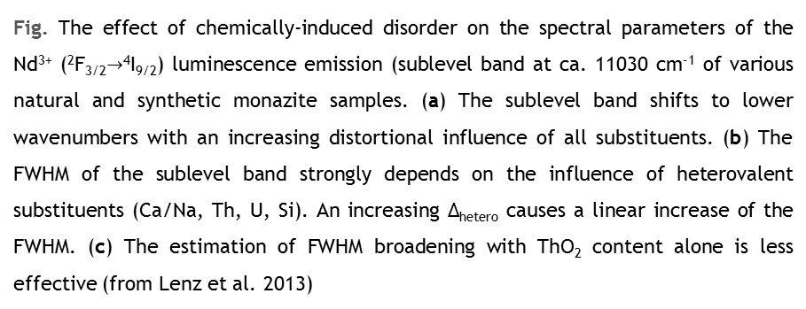
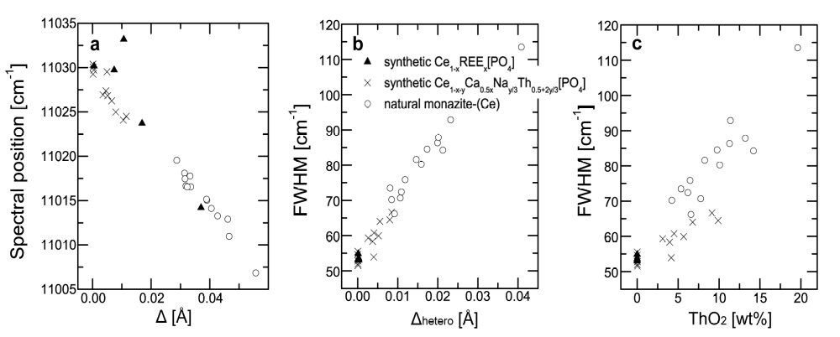
Band widths and compositionally-induced disorder

Slide 22

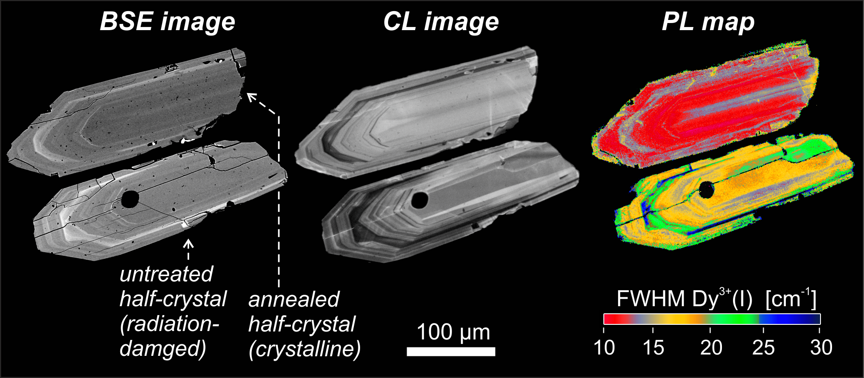
Band widths and structural disorder
Fig. Series of BSE and CL image (modified after Nasdala et al. 2006) and PL map (λ_{exc} = 473 nm) of a cut zircon from a rhyolite tuff from the Gyulakeszi formation near Pécs, Hungary (sample M2). The non-uniformity of the BSE intensity within the annealed crystal half indicates that slight FWHM variations of the PL might be due to moderate chemically-induced band broadening (after Lenz et al. 2015).

