Slide 1
Development of Ion Beam Irradiation of Glass-Ceramic Waste Form at ANSTO
Tao Wei, Mihail Ionescu, Yingjie Zhang, Linggen Kong, Daniel Gregg, Alan Xu, Inna Karatchevtseva, Greg Lumpkin, Lou Vance, Ken Short
Australian Nuclear Science and Technology Organisation, Australia
MRS2017-Scientific Basis for Nuclear Waste Management Symposium 2017, Sydney Australia, 29 October - 3 November 2017

Slide 2
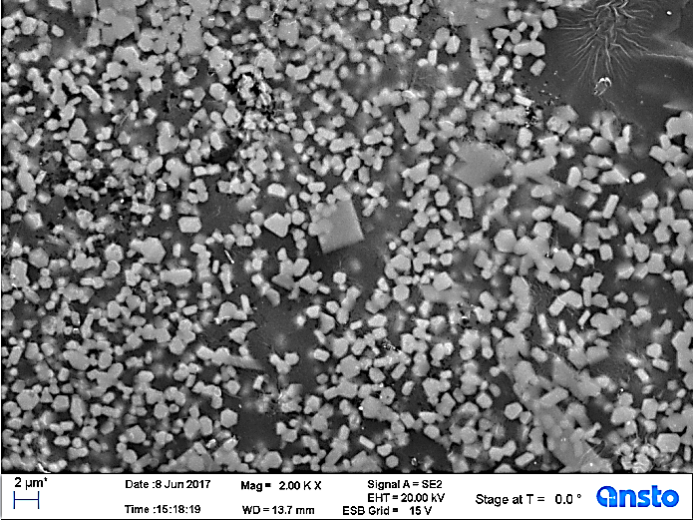
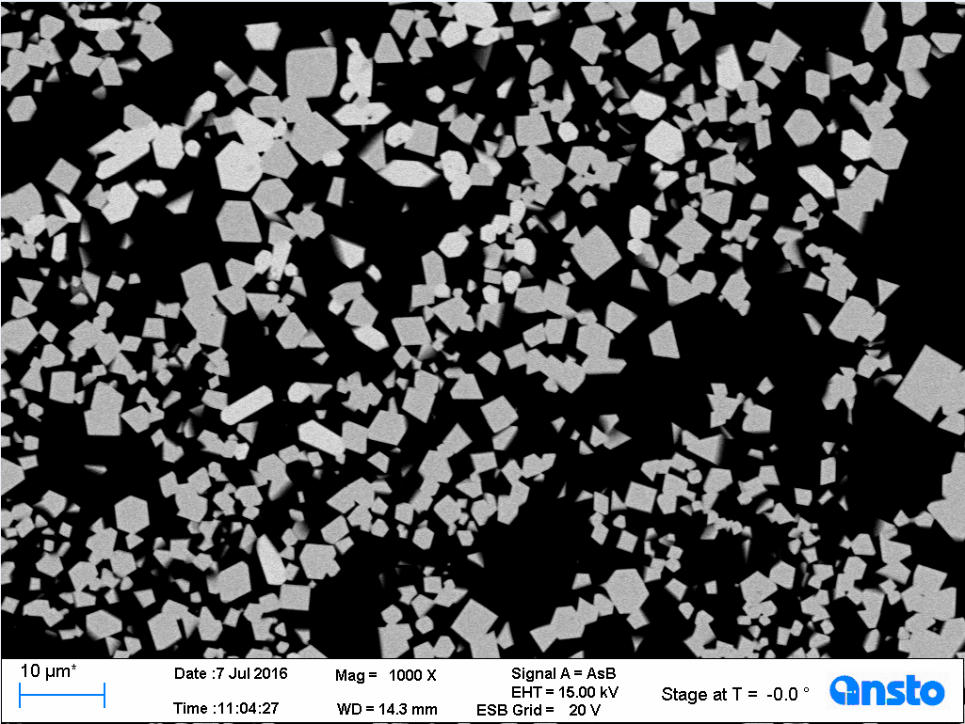
Glass-Ceramic Waste Form
A series of zirconolite and pyrochlore glass-ceramics have been developed at ANSTO.
Zirconolite and pyrochlore ceramics have the excellent chemical durability for the actinide immobilization;
Glasses have process and chemical flexibility.
CaZrTi₂O₇ zirconolite-glass
Gd₂Ti₂O₇ pyrochlore-glass

Slide 3
Radiation Damage of Waste Form
α–decay of actinides – a most serious damage:
Helium accumulation and helium bubbles;
Displaces around atoms in the trajectory;
Defects in the crystalline lattice;
Order-disorder transformation and irradiation-induced amorphisation.
Ion beam irradiation to simulate radiation damage.
Higher damage rate ( up to 10⁻³ dpa/s);
Controlled irradiation temperatures;
Minimal radio-activity on the samples.

Slide 4
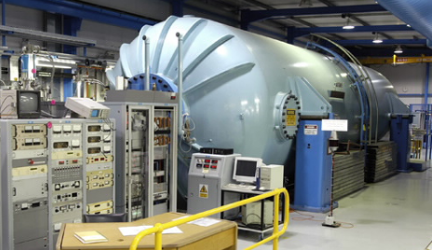
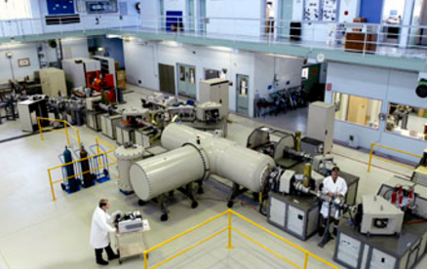
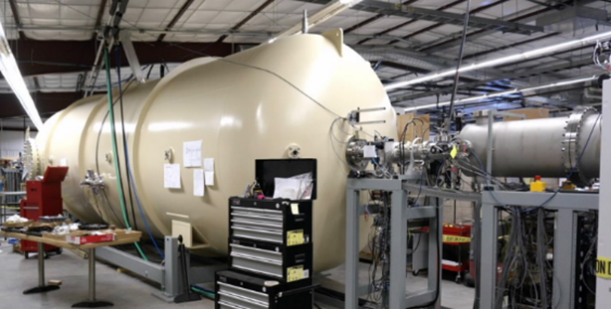
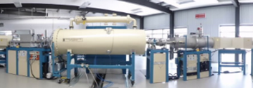
Ion Beam Irradiation Facilities at ANSTO
Four tandem ion accelerators;
ANTARES 10MV Van de Graaff
STAR 2MV Tandetron
SIRIUS 6MV Pelletron
VEGA 1MV Pelletron
Three ion irradiation beamlines at cryogenic and elevated temperatures.
10MV ANTARES and 6 MV SIRIUS accelerator: Au, Ni, Si, Fe, Ta, and Te ion beams, energy up to 35 MeV for Au ion beam;
2 MV STAR accelerator He ion beam, flux: 1.4 E12 ion/cm²/s;
Two low-energy He ion implanters (80 KeV).

Slide 5
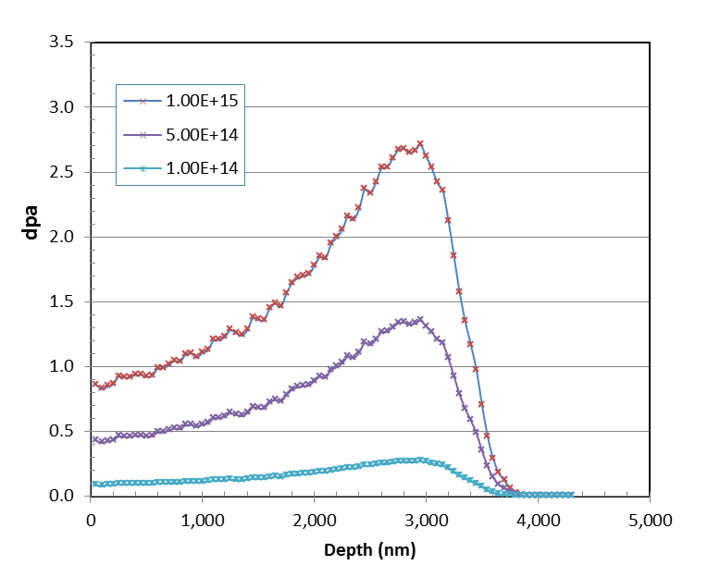
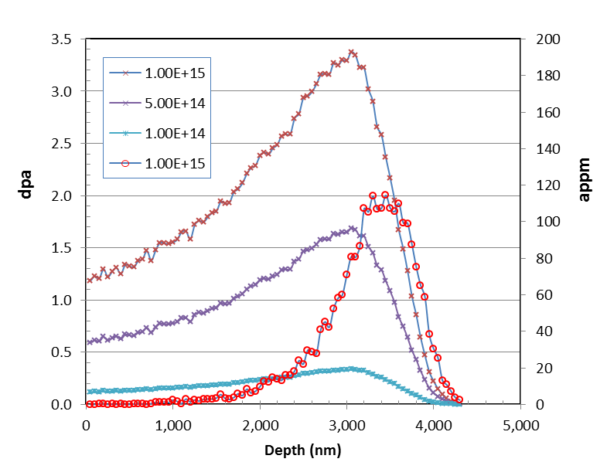
Ion Beam Irradiation
Displacement damage (dpa) produce by 21 MeV Au ion irradiation up to 1 x 10¹⁵ ion/cm²
~ 1 dpa near the surface
~ 2.7 - 3.3 dpa at the depth of 3 μm
CaZrTi₂O₇
Gd₂Ti₂O₇

Slide 6
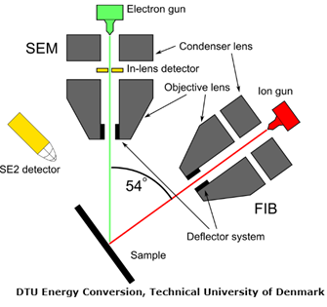
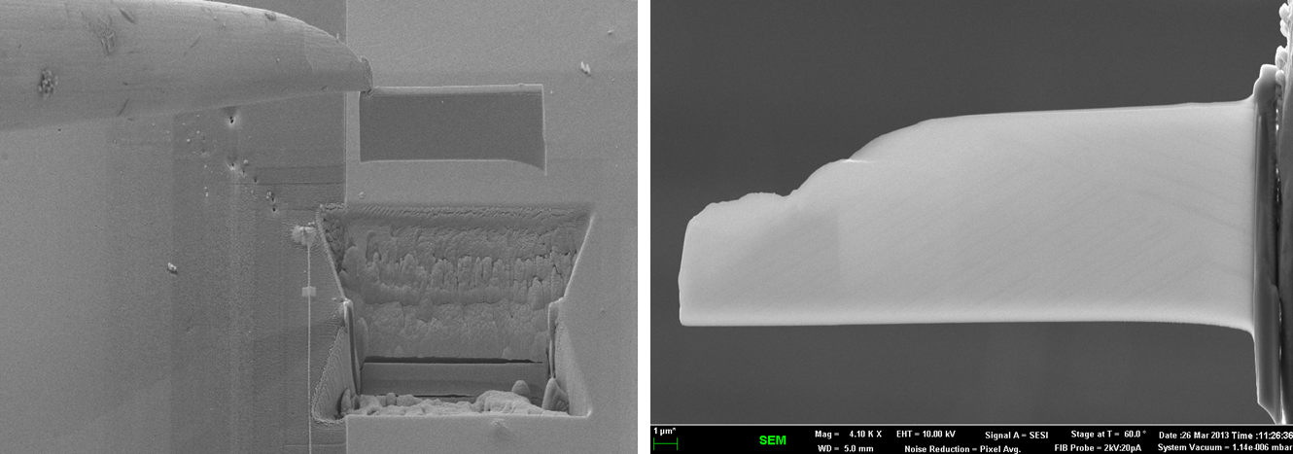
Post-irradiation Examination
Microstructural characterization
Glazing-incidence X-ray diffraction (GIXRD)
Raman spectroscopy
Carl Zeiss Auriga 60 crossbeam FIB-SEM system
Jeol F2200 FS™ transmission electron microscopy (TEM)
Cut and lift the TEM specimen in SEM
TEM specimen made by FIB
MTS™ Agilent® nano-indentation hardness testing
In situ micro-mechanical testing

Slide 7
Zirconolite-glass
Au ion beam irradiation effects
Surface SEM images
Unirradiated
50 μm
50 μm
Irradiated (4E+14 Au ion/cm²)
Irradiated (1E+15 Au ion/cm²)

Slide 8
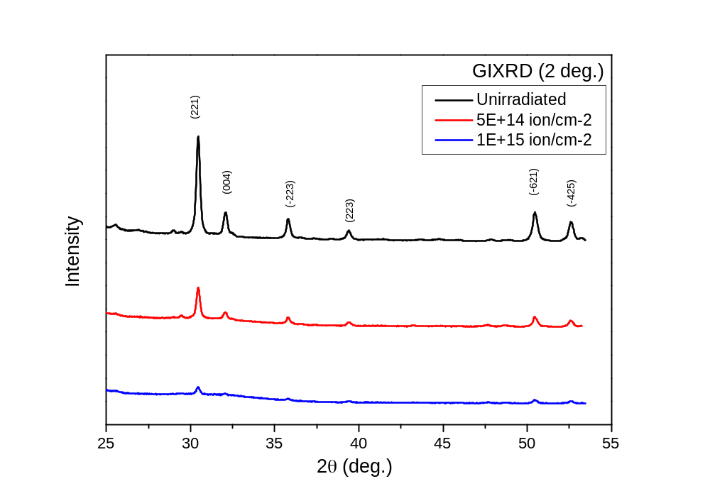
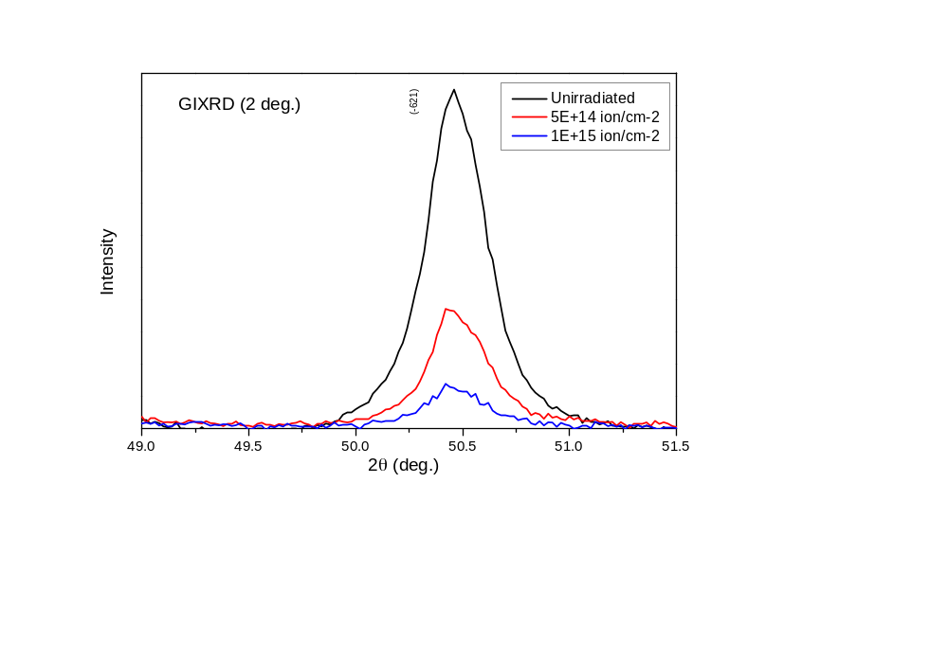
GIXRD Results of Zirconolite-glass
Crystallinity is reduced due to 21 MeV Au ion beam irradiation

Slide 9
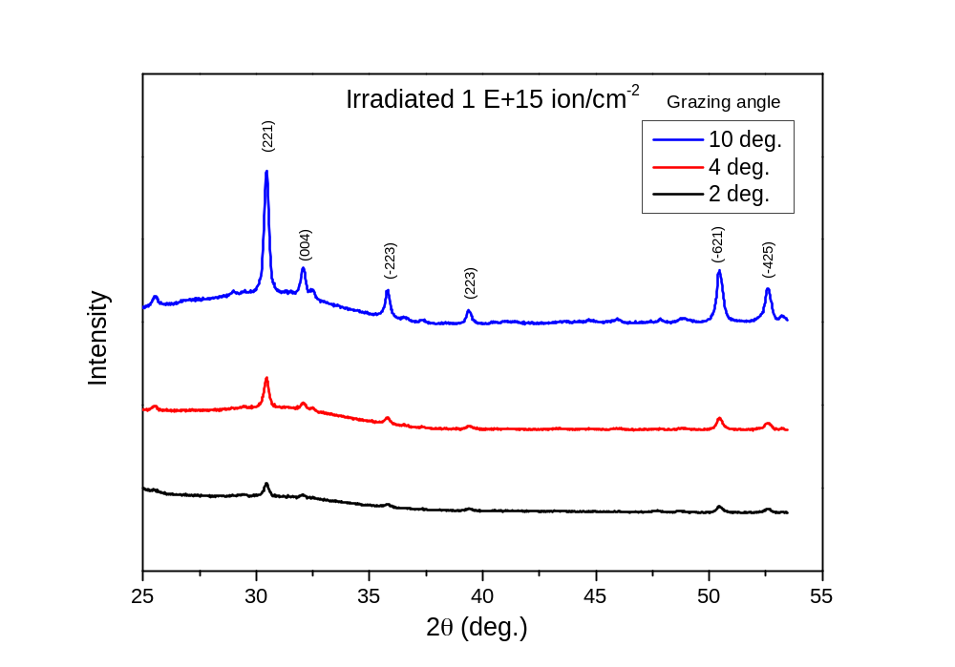
GIXRD Results from Different Grazing Angles

Slide 10
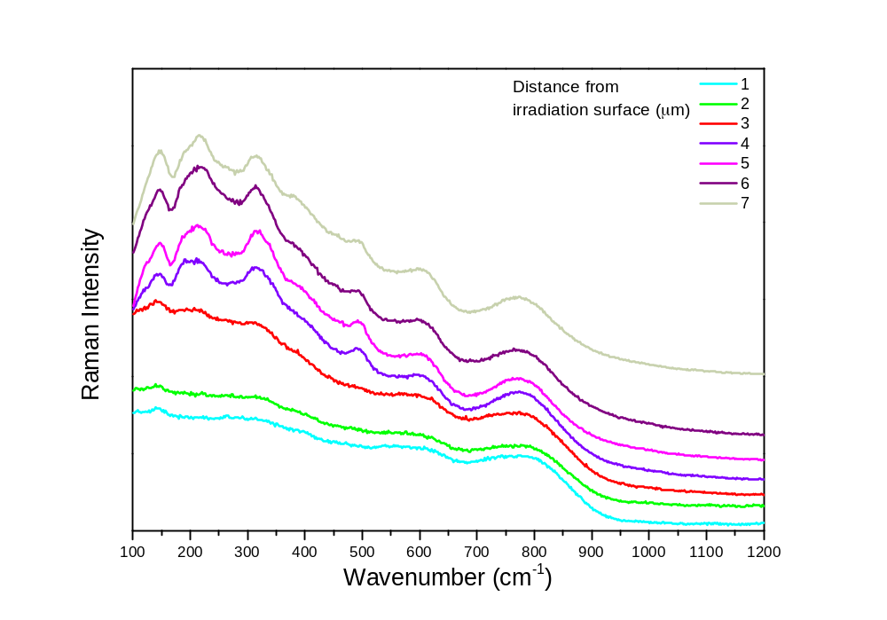
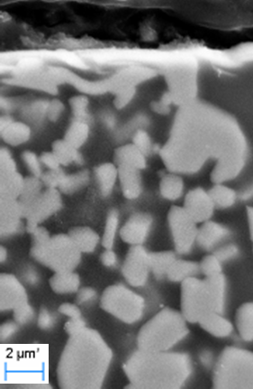
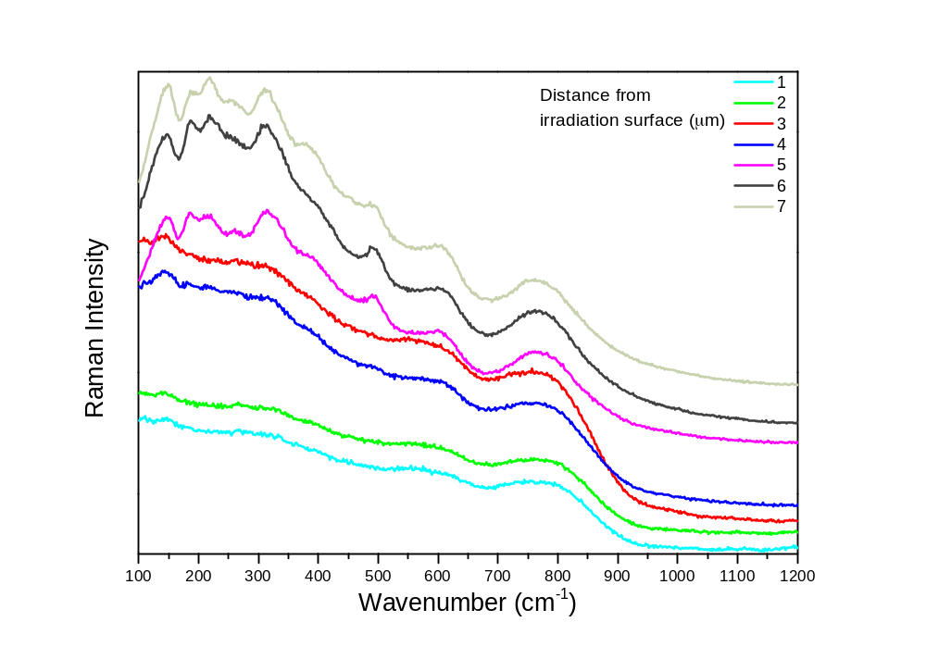
Raman spectra results
of irradiated zirconolite-glass
Cross-section
1x10¹⁴ Au ion/cm⁻²
1x10¹⁵ Au ion/cm⁻²

Slide 11
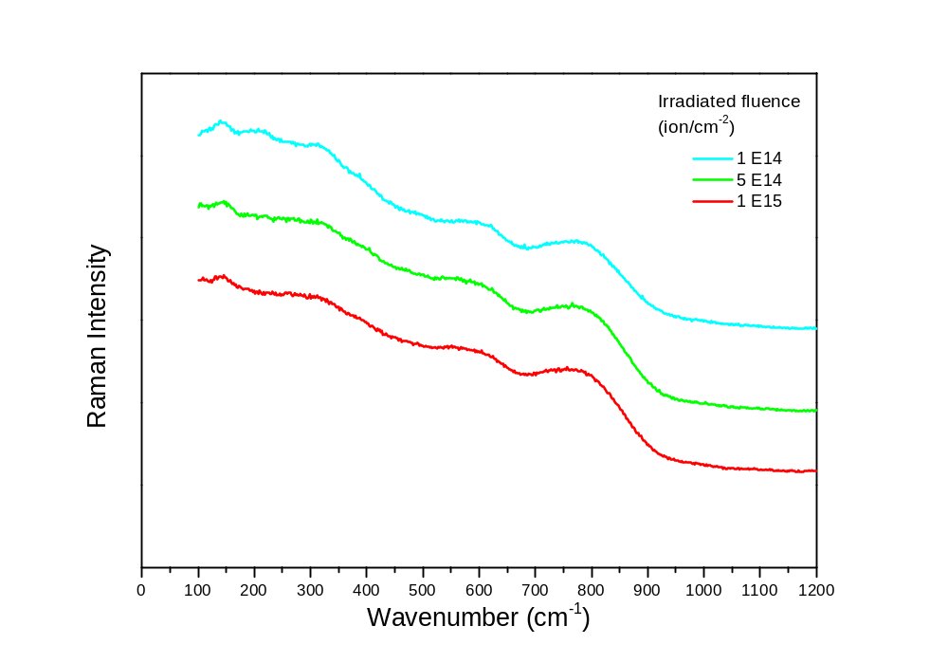
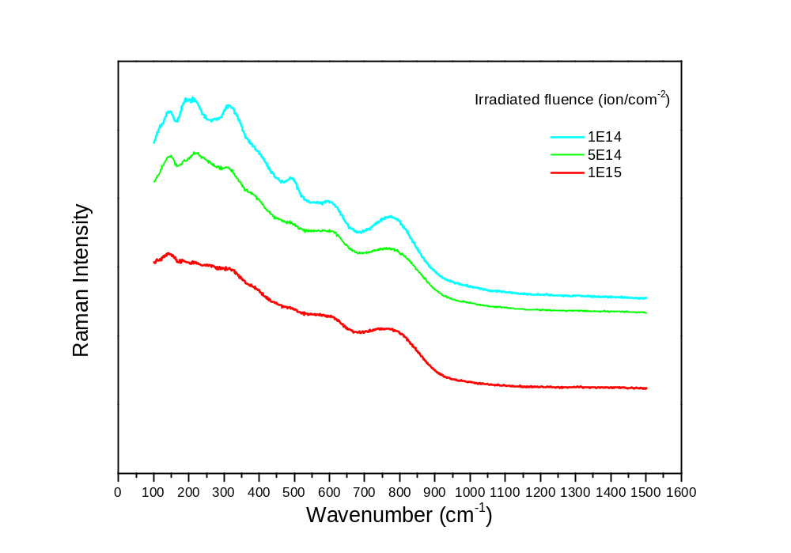
Raman spectra of Zirconolite-glass
Compared with different irradiation fluences
Measured at 3 µm from irradiation surface
Measured at 4 µm from irradiation surface

Slide 12
Pyrochlore-glass irradiated by Au ion beam 1X10¹⁵ ion/cm² at 21 MeV
Surface swelling/melting of glass-Gd₂Ti₂O₇

Slide 13
Pyrochlore-glass irradiated by He ion beam 3x10 ¹⁷ ion/cm² to simulate the alpha decay
Bubbles in the interface of glass-Gd₂Ti₂O₇
irradiated by He ion beam 3x10 ¹⁷ ion/cm²

Slide 14
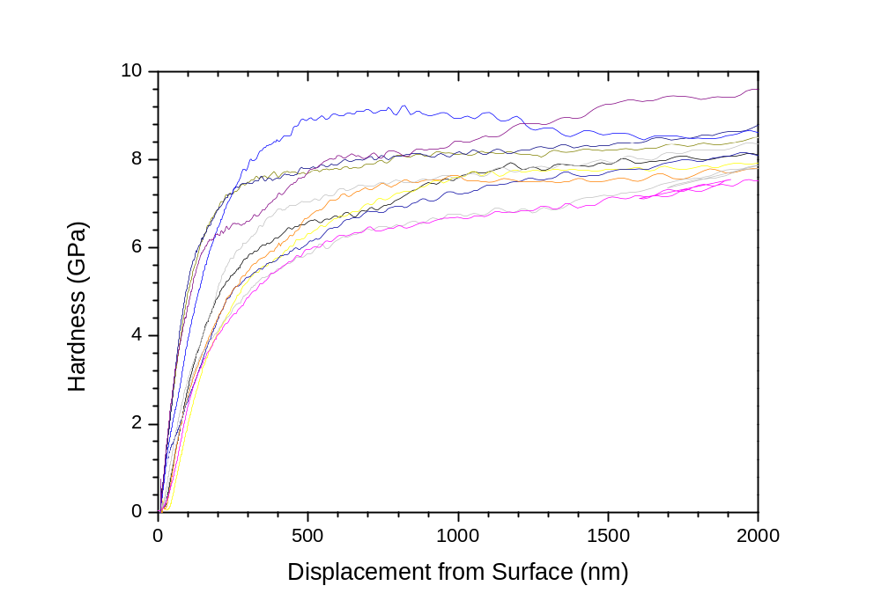
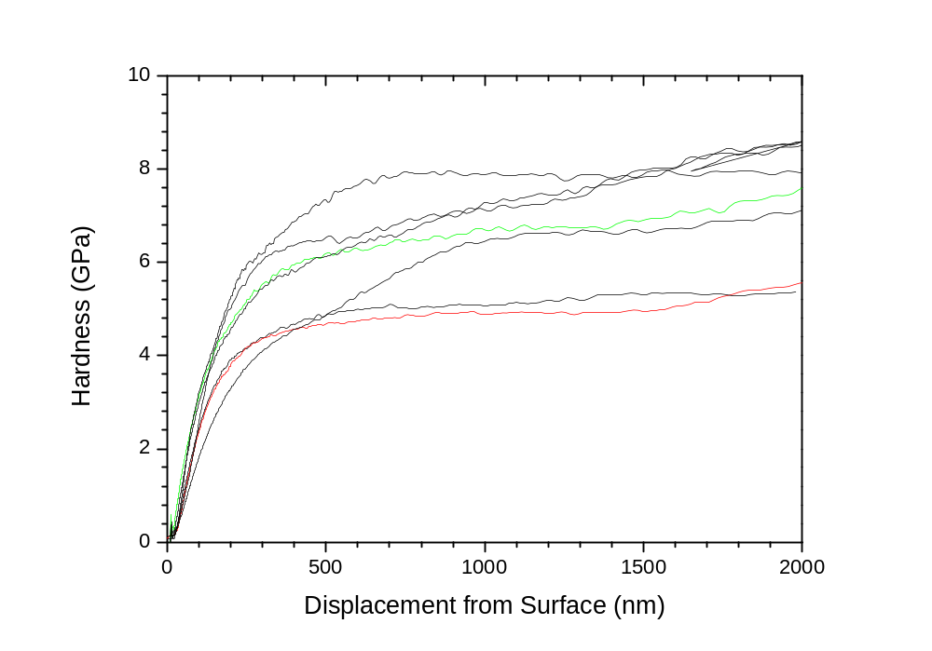
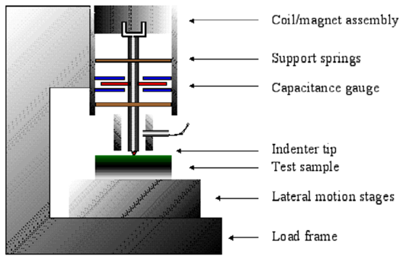
Nano-indentation Results
Unirradiated Zirconolite
Au ion beam irradiated
at a fluence of 1 x 10¹⁵ ion/cm²

Slide 15
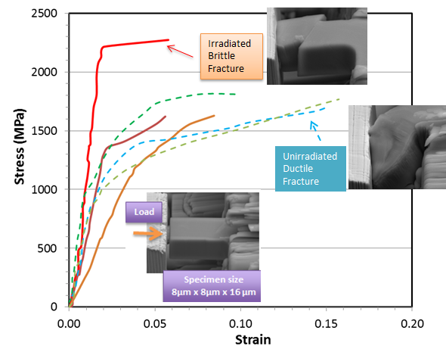
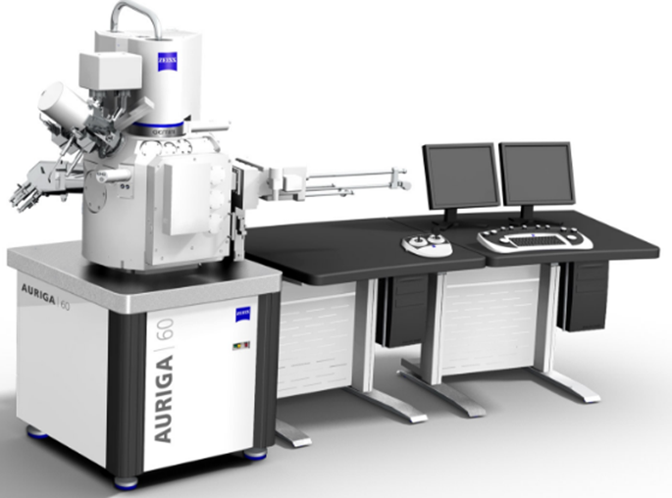
In situ Micro-compression Test
Helium beam irradiated intermetallic TiAl specimens compared to unirradiated ones.
T. Wei, et al. Nuclear Instruments and Methods in Physics Research B: (2017) 409: 288-292

Slide 16
Summary
ANSTO has the capability to conduct ion beam irradiation on nuclear waste form using accelerators on site. Facilities for post-irradiation examination has been developed at ANSTO.
Zirconolite-glass and pyrochlore-glass was irradiated by
Au ion beam up to 1x10¹⁵ ion cm⁻² to produce displacement damage;
He ion beam up to 3 x10¹⁷ ion cm⁻² to simulate the α-decay .
GIXRD results show crystallinity of zirconolite is reduced as Au ion irradiation fluence increases;
Raman spectra results show most damaged region by the 21 MeV Au ion beam irradiation is about 3 µm under the irradiation surface;
The hardness of the zirconolite-glass is reduced due to the displacement damage by Au irradiation;
Helium bubbles are observed on the boundary of Gd₂Ti₂O₇-glass in the surface of He irradiated samples (3x10¹⁷ ion/cm²) under SEM.

Slide 17
Thank for your attention

