Slide 1
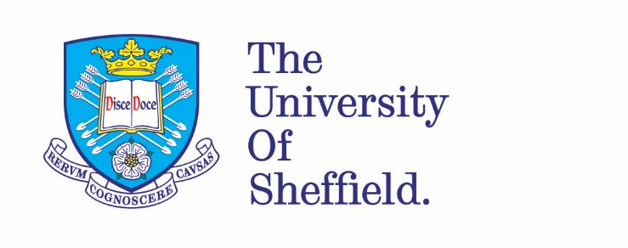
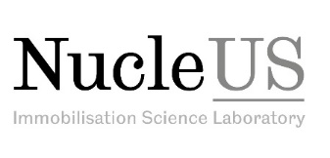



A study to develop a new glass formulation for the immobilisation of HLW containing molybdenum and large amounts of sodium
Russell J Hand, Clive Brigden & Lisa Hollands
ISL, University of Sheffield
Mike T Harrison; Cath Stephen, Michelle Eccles
NNL
Katy Spencer, Rebecca Sparkes, Michael Ingrams, Hannah Paterson
Sellafield Ltd
John Longmore, Rowan Patel
Cera Dynamics Ltd

Slide 2
1. Introduction
Background
Post-operational clean out (POCO) marks a transition from normal operations to decommissioning of the 8 "oldside" highly active storage tanks (HASTs) at Sellafield.
Last transfer of highly active liquor to these tanks was in 1971. There is no agitation facility. Large amount of precipitated solids (~ 2000 kg) have accumulated.
One of the main constituents is zirconium molybdate hydrate (ZMH) (ZrMo₂O₇(OH)₂.2H₂O).
An excess of washout reagent, possibly sodium carbonate (Na₂CO₃) is required to dissolve the solids for removal.

Slide 3
Requirements
A vitreous wasteform particularly capable of:
Accommodating large amounts of sodium and some molybdenum.
Fabricated from a base glass + waste combination procedure.
Melt at the operational temperature of ~ 1050°C.
Titanium in glasses
Titania (TiO₂) can form glasses when combined with a primary glass former.
Large amounts of sodium can be accommodated (up to ~ 40 mol% Na₂O) [1-3].
TiO₂ can help to lower the fusion temperature and viscosity of the system.
TiO₂ rarely features in nuclear waste glasses. The Indian AVS glass is an example, with a sodium content of 20.8 wt% Na₂O reported [4] and with a base glass TiO₂ content of 9.5 wt% (7.9 mol%) [5].

Slide 4








2. Experimental Strategy
Baseline series: The composition of the glass at full sodium content and prior to any waste substitution.
Base glass:
Composition derived from the relevant baseline series composition with the sodium content lowered to allow for the sodium content of waste.
Full product glass: Composition derived from baseline series plus waste components.

Slide 5
3. Liquid-liquid Na₂MoO₄ Phase Separation Effect of Al₂O₃ vs B₂O₃
Extent of liquid-liquid phase separation
Extent of liquid-liquid phase separation
 | Na₂MoO₄ phase separation/%
 | Al₂O₃ (mol%) |  | B₂O₃ (mol%)
Target MoO₃ /wt% | 2.5 | 10.0 | 10.0 | 15.0
3.4 | 19 | 6 | Nil | Nil
6.4 | 62 | - | Nil | Nil
7.4 | - | - | 5 | Nil
9.0 | 85 | 100 | 31 | 3
Significant Na₂MoO₄ phase separation occurs for relatively small amounts of Al₂O₃ and melt temperature and pour viscosity increase.
B₂O₃ significantly lowers phase separation and helps to lower melt temperature and pour viscosity (supported by [6-7]).
However, large amounts of B₂O₃ also lower aqueous durability of the glass. Al₂O₃ has been known to improve durability in glass.

Slide 6
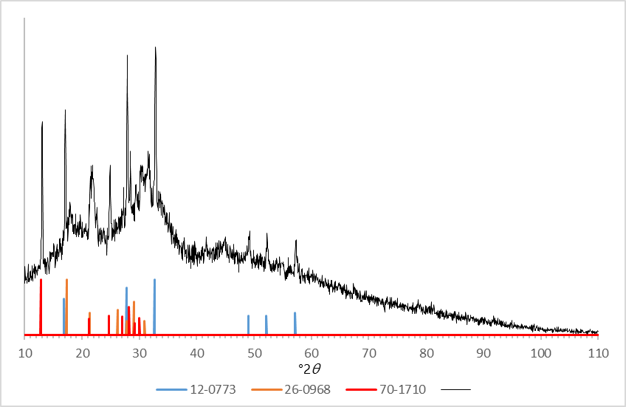
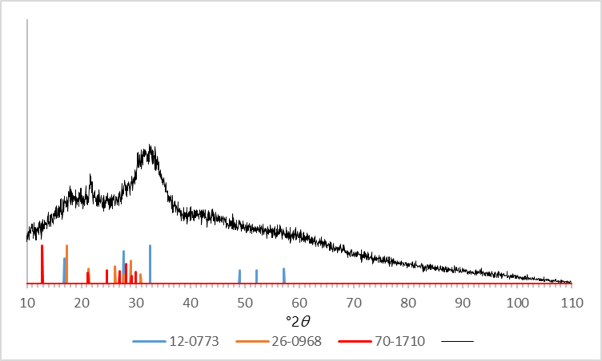

4. X-ray Diffraction Patterns
Intensity/I
Target 0.0 Al₂O₃ 15.0 B₂O₃ (mol%) 9.2 MoO₃ (wt%)
Target 2.5 Al₂O₃ 5.0 B₂O₃ (mol%) 3.4 MoO₃ (wt%)
ICCD pdf:
12-0773: Na₂MoO₄ - Cubic (Fd-3m); 26-0968: Na₂MoO₄ - Orthorhombic (Fddd); 70-1710: Na₂MoO₄.2H₂O - Orthorhombic (Pbca)

Slide 7
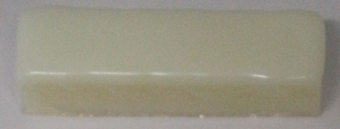
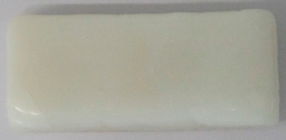
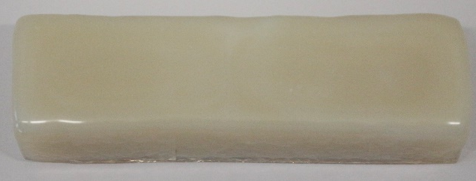
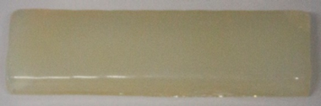
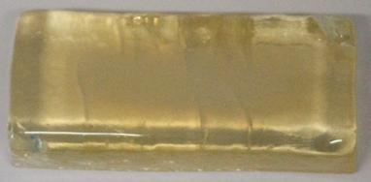
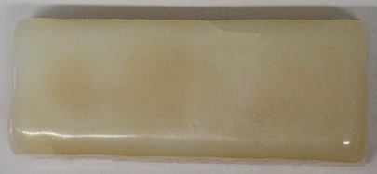
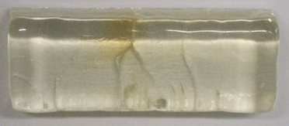
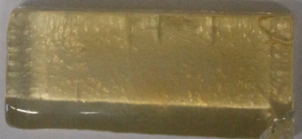
5. Sample photos
No Al₂O₃
2.5 mol% Al₂O₃
2.5 mol% B₂O₃
All 3.4 wt% MoO₃
Note:
Increase in translucency/transparency with increasing B₂O₃ content.
Increase in opacity in presence of Al₂O₃
What causes the opacity?
5.0 mol% B₂O₃
7.5 mol% B₂O₃
10.0 mol% B₂O₃

Slide 8
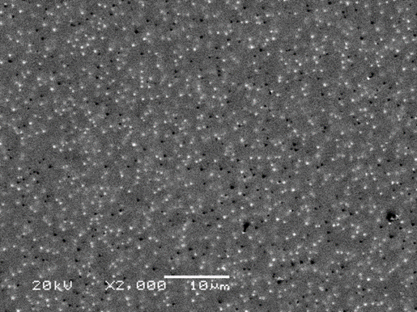
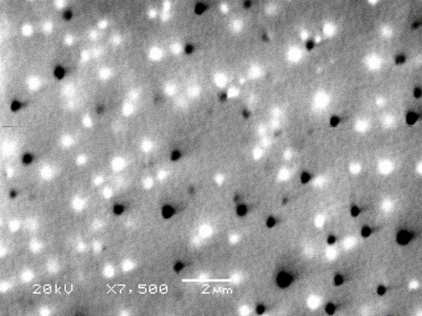
6. SEM Micrographs
Target sample content : 2.5 mol% Al₂O₃, 5.0 mol% B₂O₃ – 3.4 wt% MoO₃
Samples contain sub-micron scale small white crystals (< ~ 0.5 µm).
Enriched in Mo. Thought to be finely dispersed small crystallites of Na₂MoO₄.
A small amount will turn the sample opaque, due to light scattering.

Slide 9
7. Durability studies
PCT-B based tests. 150-75 µm, deionised H₂O, 90°C, SA/V 2000 m⁻¹. Target MoO₃ = 3.4. wt%.
A relatively small amount of Al₂O₃ very significantly decreases element leach rate.
General increase in boron element leach rate with increasing B₂O₃ content (sodium appears more independent). More significant at higher B₂O₃ content.

Slide 10
A relatively small amount of Al₂O₃ very significantly decreases element leach rate.
Molybdenum release rate shows a general increase with increasing B₂O₃ content without Al₂O₃.
Silicon release rate appears to be independent of B₂O₃ content.

Slide 11
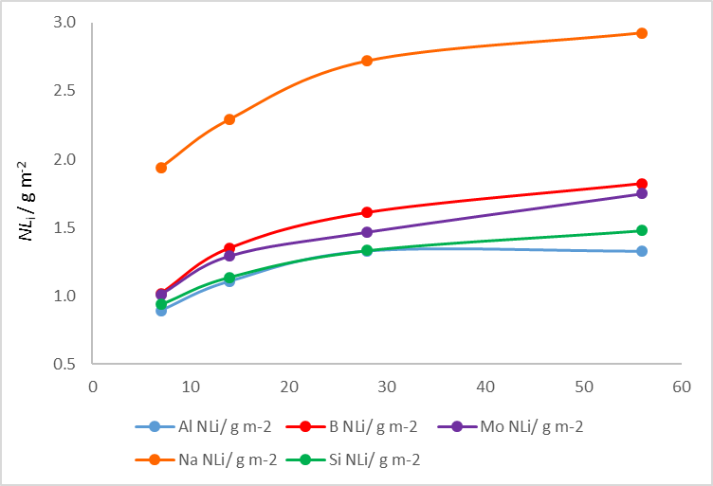
Normalised Element Release Up To 56 days
Low release rates for all elements.
Comparable with other high sodium and molybdenum containing waste glasses from literature [8-9].
Al release congruent with Si.
Ti below limit of detection and Zr ~ 2 orders of magnitude lower than the Mo release rate (50 ppb level in solution).
Silicon concentration 3-4 orders of magnitude below that which might be expected in pH range generated (12.6 to 12.8 [10]).
 | Sample Target Composition
Oxide | Na₂O | TiO₂ | Al₂O₃ | B₂O₃ | SiO₂ | MoO₃ | ZrO₂
mol% | 32.5 | 25.2 | 2.4 | 4.9 | 32.5 | 1.6 | 0.81
wt% | 29.2 | 29.2 | 3.6 | 4.9 | 28.3 | 3.4 | 1.5

Slide 12
8. Conclusions and Further Work
Homogeneous full product waste glasses containing large amounts of Na₂O and TiO₂ (each at around 29 wt%) and MoO₃ at 3.4 wt% can be made.
Show low normalised release rates for all elements. Comparable to other high sodium and molybdenum-containing glasses from literature.
A base glass can be successfully combined with a simulated waste feed to produce a full product glass with 50% of sodium (i.e. around 14.5 wt% Na₂O) coming from the waste.
Further work to include:
Determination of the boundary limits for waste incorporation.
Characterisation of the barrier layer.

Slide 13
References
Turnbull, R. C. and W. G. Lawrence (1952). "The role of titania in silica glasses” J. Amer. Ceram. Soc. 35 (2) 48-53.
Hamilton, E. H. and G. W. Cleek (1958). "Properties of sodium titanium silicate glasses” J. Res. Nat. Bur. Standards. 61 (2) 89-94.
Strimple, J. H. and E. A. Giess (1958). "Glass formation and properties of glasses in the system Na2O-B2O3-SiO2-TiO2" J. Amer. Ceram. Soc. 41 (7) 231-237.
Rani, N., J. P. Shrivastava, and R. K. Bajpai (2010). "Corrosion Mechanism in the Obsidian and its Comparison with the Nuclear Waste Glass for Long-Term Performance Assessment in the Geological Repository." Open Corr. J. 3 16-27.
Mishra, P. K., V. De, et al. (2013). "Preparation and characterisation of glass product with modified composition for vitrification of high level radioactive waste." J. Thermal Anal. Calorim. 112 (1) 103-108.
Caurant, D., O. Majerus, et al. (2007). "Effect of molybdenum on the structure and on the crystallization of SiO2-Na2O-CaO-B2O3 glasses." J. Amer. Ceram. Soc. 90 (3) 774-783.
Caurant, D., O. Majerus, et al. (2010). "Structural investigations of borosilicate glasses containing MoO3 by MAS NMR and Raman spectroscopies." J. Nucl. Mater. 396 (1) 94101. 56.
Muller, I. S., K. S. Matlack, et al. (2010). "Waste Loading Enhancements for Hanford LAW Glasses." Office of River Protection VSL-10R1790-1, Final Report.
Nicoleau, G., S. Schuller, et al, (2015). “Phase separation and crystallization effects on the structure and durability of molybdenum borosilicate glass.” J. Non-crystalline sollids. 427, 120-133.
Okamoto G., T. Okura, and K. Goto (1957). “Properties of silica in water.” Geochimica et Cosmochimica Acta, 12 123-132.

