Slide 1
³¹P nuclear magnetic resonance as a probe of plutonium incorporation and radiation damage in phosphates
Ian Farnan & Katie Gunderson
Lou Vance
ANSTO
Laura Martel & Joseph Somers
JRC-ITU Karlsruhe
Department of Earth Sciences & Cambridge Nuclear Energy Centre
MRS SBNWM Sydney, Australia, 29 October - 3 November 2017

Slide 2
Radiation resistance of zircon and xenotime
Monoclinic and tetragonal
phosphates are significantly more radiation tolerant than the corresponding silicate as measured by the critical amorphisation temperature
Meldrum et al. [2000]
MRS SBNWM Sydney, Australia, 29 October - 3 November 2017

Slide 3
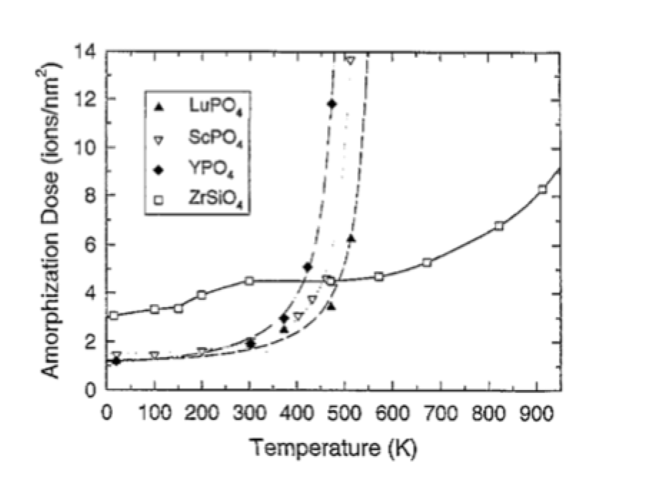
Radiation resistance of zircon and xenotime
Monoclinic and tetragonal
phosphates are significantly more radiation tolerant than the corresponding silicate as measured by the critical amorphisation temperature
Weber et al. [1997]
MRS SBNWM Sydney, Australia, 29 October - 3 November 2017

Slide 4
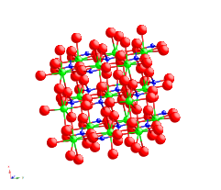
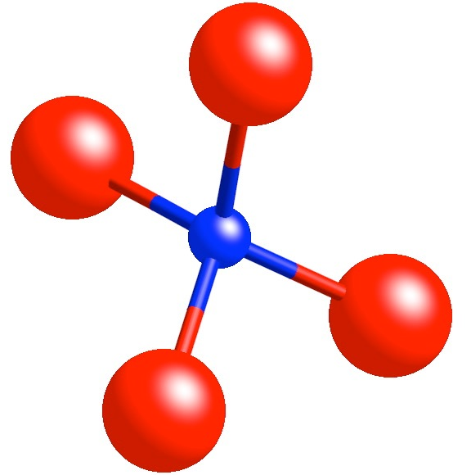

Comparison of zircon and xenotime
Zircon (ZrSiO4)
Orthosilicate (no bridging oxygens)
Xenotime (YPO4)
Orthophosphate
Q⁰ silicon forming chains with ZrO8 dodecahedra
phosphorus
YO8
actinides can substitute onto Zr site
Y
MRS SBNWM Sydney, Australia, 29 October - 3 November 2017

Slide 5
Lattice parameter variation in orthophosphates
MRS SBNWM Sydney, Australia, 29 October - 3 November 2017

Slide 6
Plutonium in xenotime
Can it substitute Pu into its structure?
Shift to lower 2 theta
MRS SBNWM Sydney, Australia, 29 October - 3 November 2017

Slide 7
Plutonium in xenotime
RE phosphates with xenotime structure
Pu solubility limit 5.4%
MRS SBNWM Sydney, Australia, 29 October - 3 November 2017

Slide 8
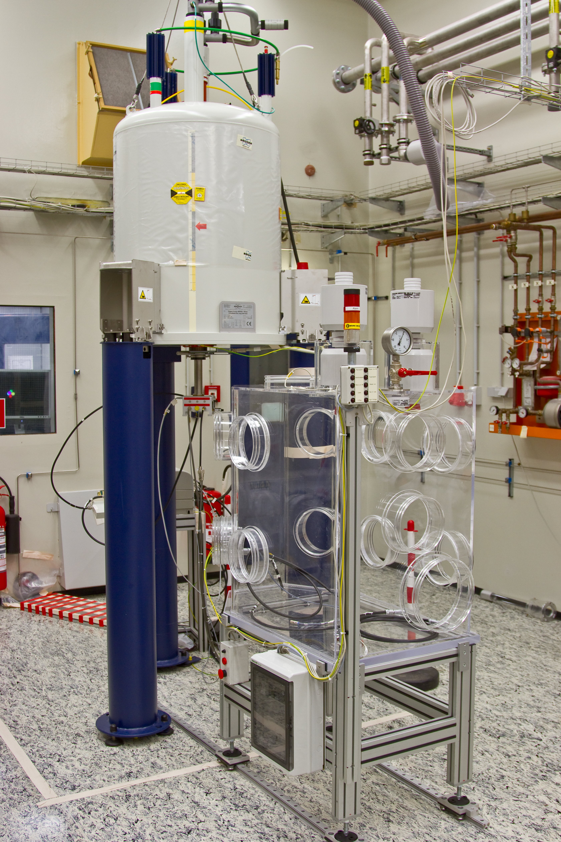
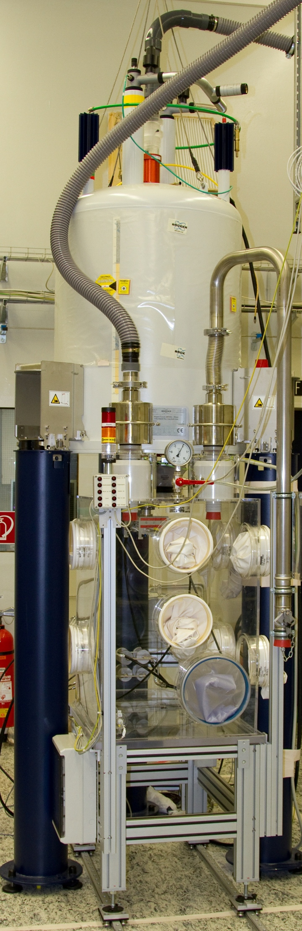
MASNMR of actinide materials - glovebox approach
Transuranic MASNMR, European Commission Joint Research Centre
Pu glovebox (GB) constructed on rails to slide under elevated 9.4 T WB magnet
Magnet legs 1.8 m, standard MAS stators supplied in NB probe bodies with length for 600 MHz system to allow mounting in GB.
1.3 mm rotor diameters allow samples to be spun to 55 kHz (3.3 x 10⁶ rpm)
This removes paramagnetic susceptibility broadening of 5f electrons and yields high resolution spectra.
MRS SBNWM Sydney, Australia, 29 October - 3 November 2017

Slide 9
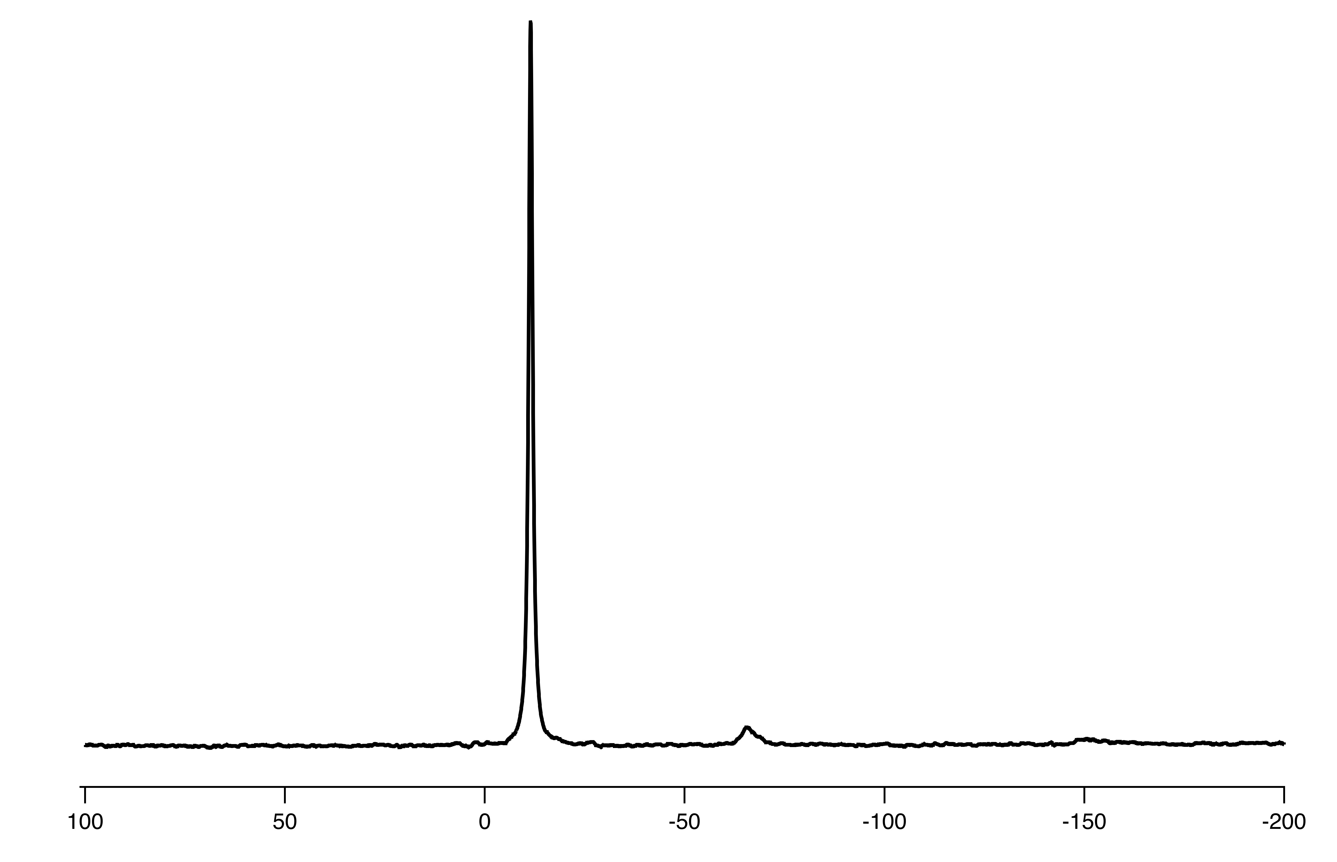
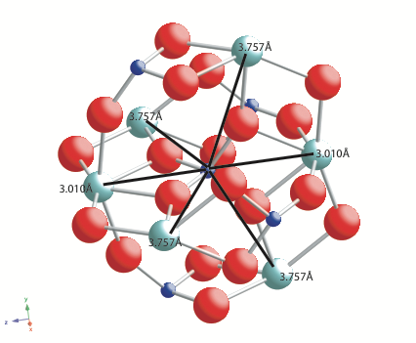
Pu incorporation in xenotime ³¹P NMR
4 % Pu in YPO4 (xenotime)
³¹P MASNMR @ 55 kHz
500 s pulse delay
MRS SBNWM Sydney, Australia, 29 October - 3 November 2017

Slide 10
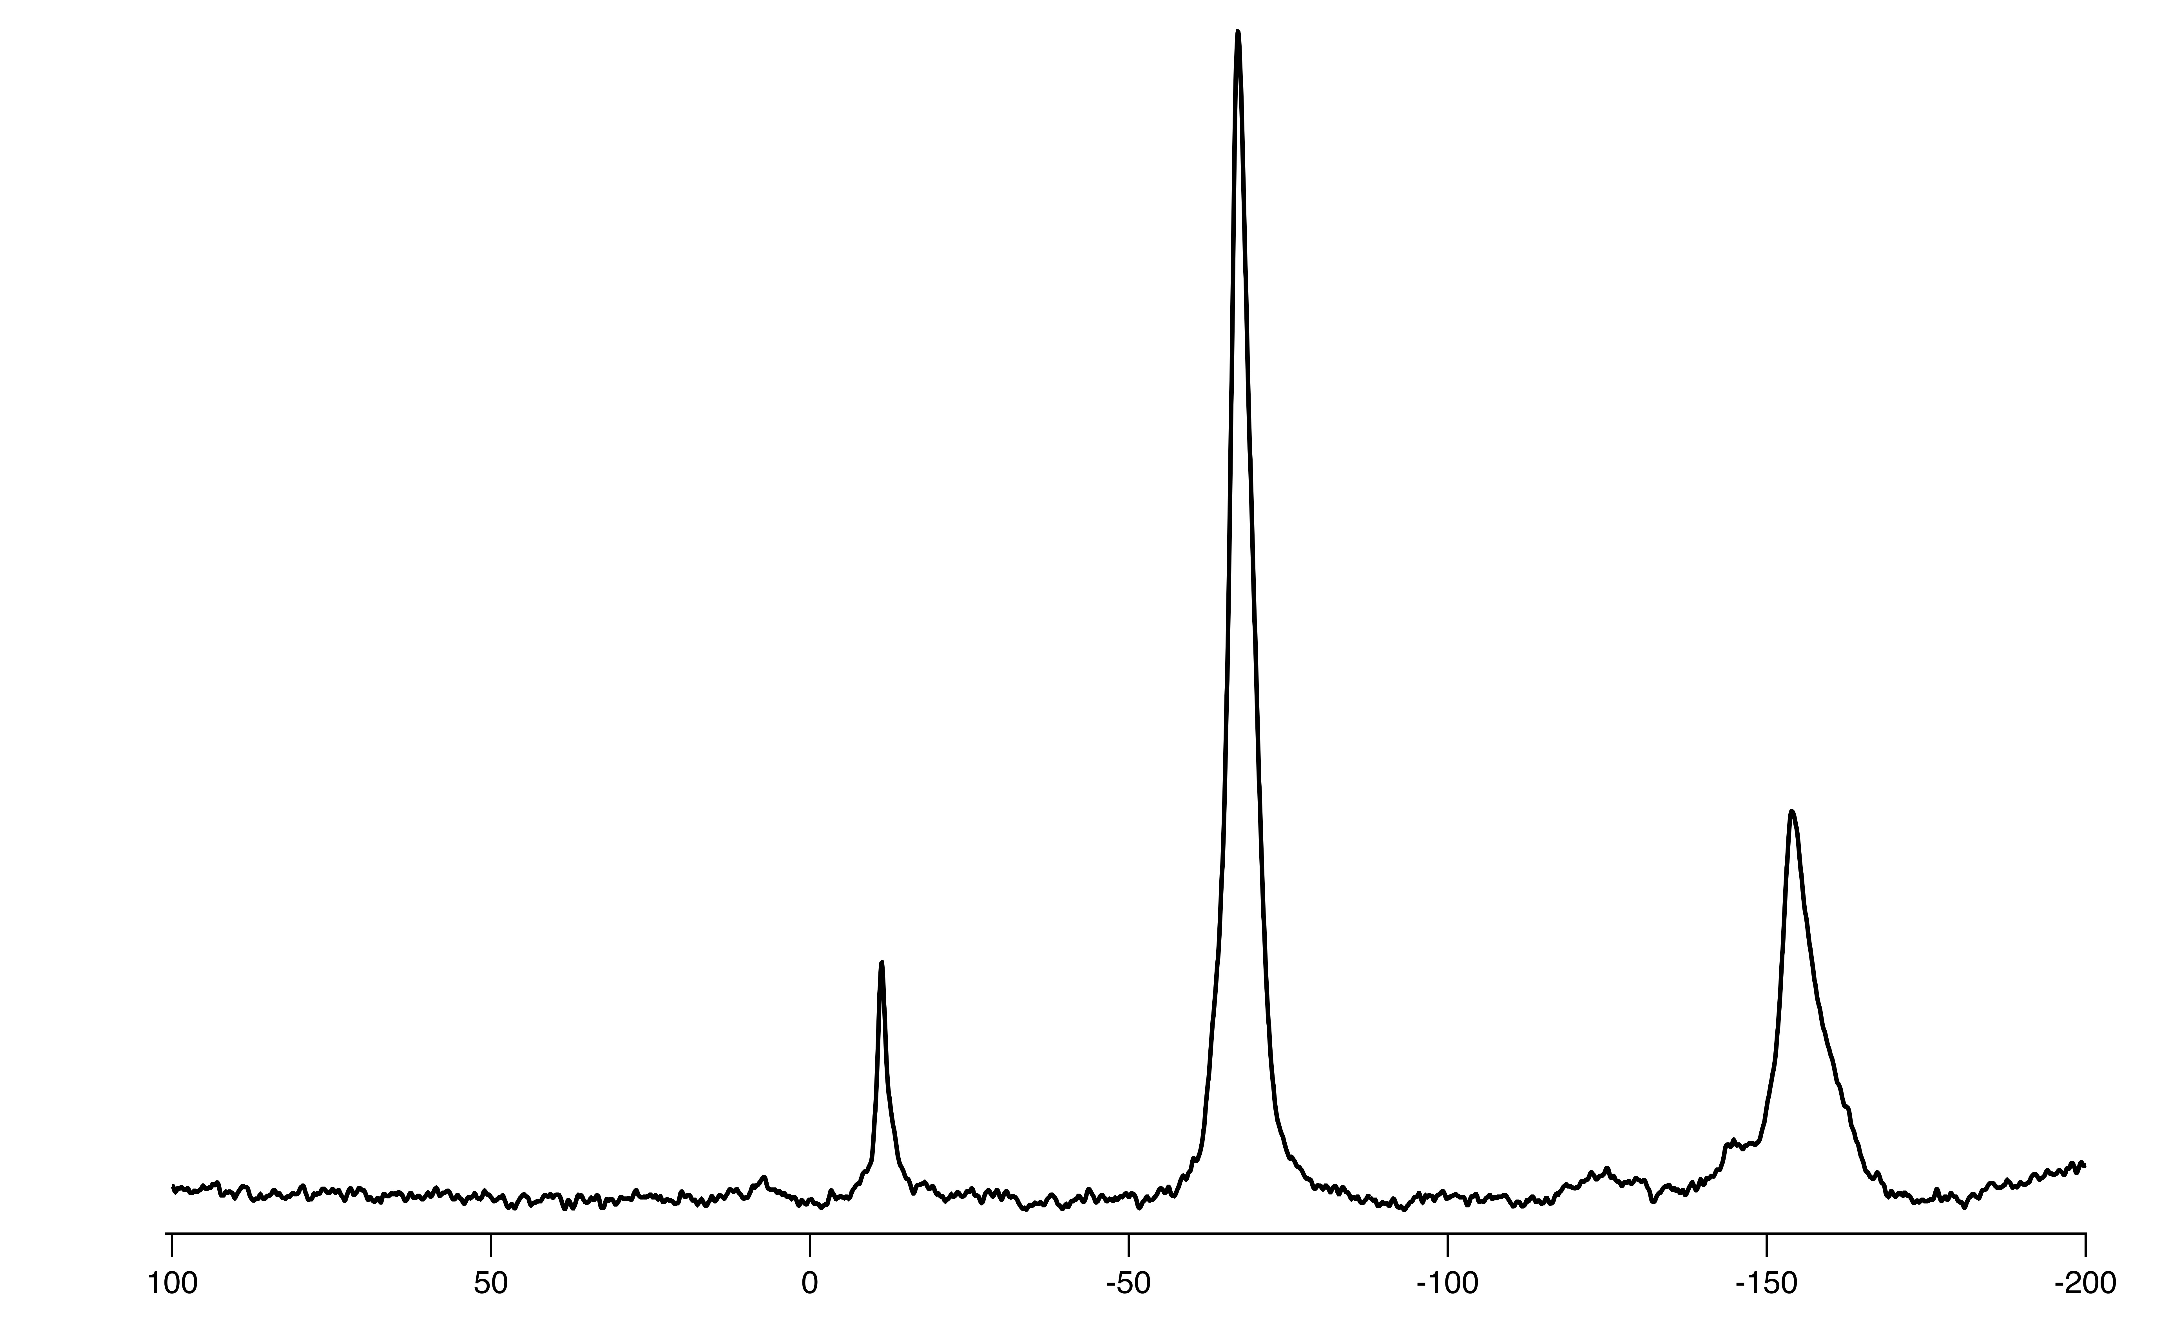
Pu incorporation in xenotime
4% Pu in YPO4 (xenotime)
³¹P MASNMR @ 55 kHz
50ms pulse delay
main peak
MRS SBNWM Sydney, Australia, 29 October - 3 November 2017

Slide 11
structural radiation damage in xenotime
4% ²³⁸Pu in YPO4, 2.1 x 10¹⁸ alpha/g
³¹P MASNMR @ 55 kHz
MRS SBNWM Sydney, Australia, 29 October - 3 November 2017

Slide 12
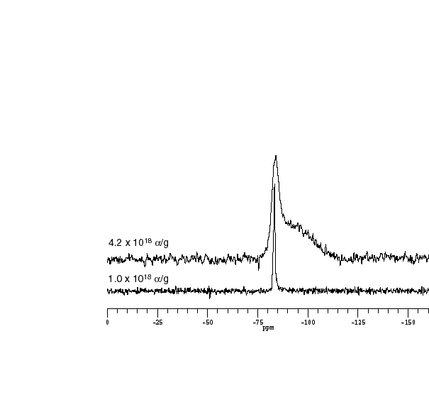
Pu radiation damage in xenotime
4% ²³⁸Pu in YPO4, 2.1 x 10¹⁸ alpha/g
Natural zircon ²³⁸U /570 million years
³¹P MASNMR @ 55 kHz
²⁹Si MASNMR @ 5 kHz
500 s pulse delay
MRS SBNWM Sydney, Australia, 29 October - 3 November 2017

Slide 13
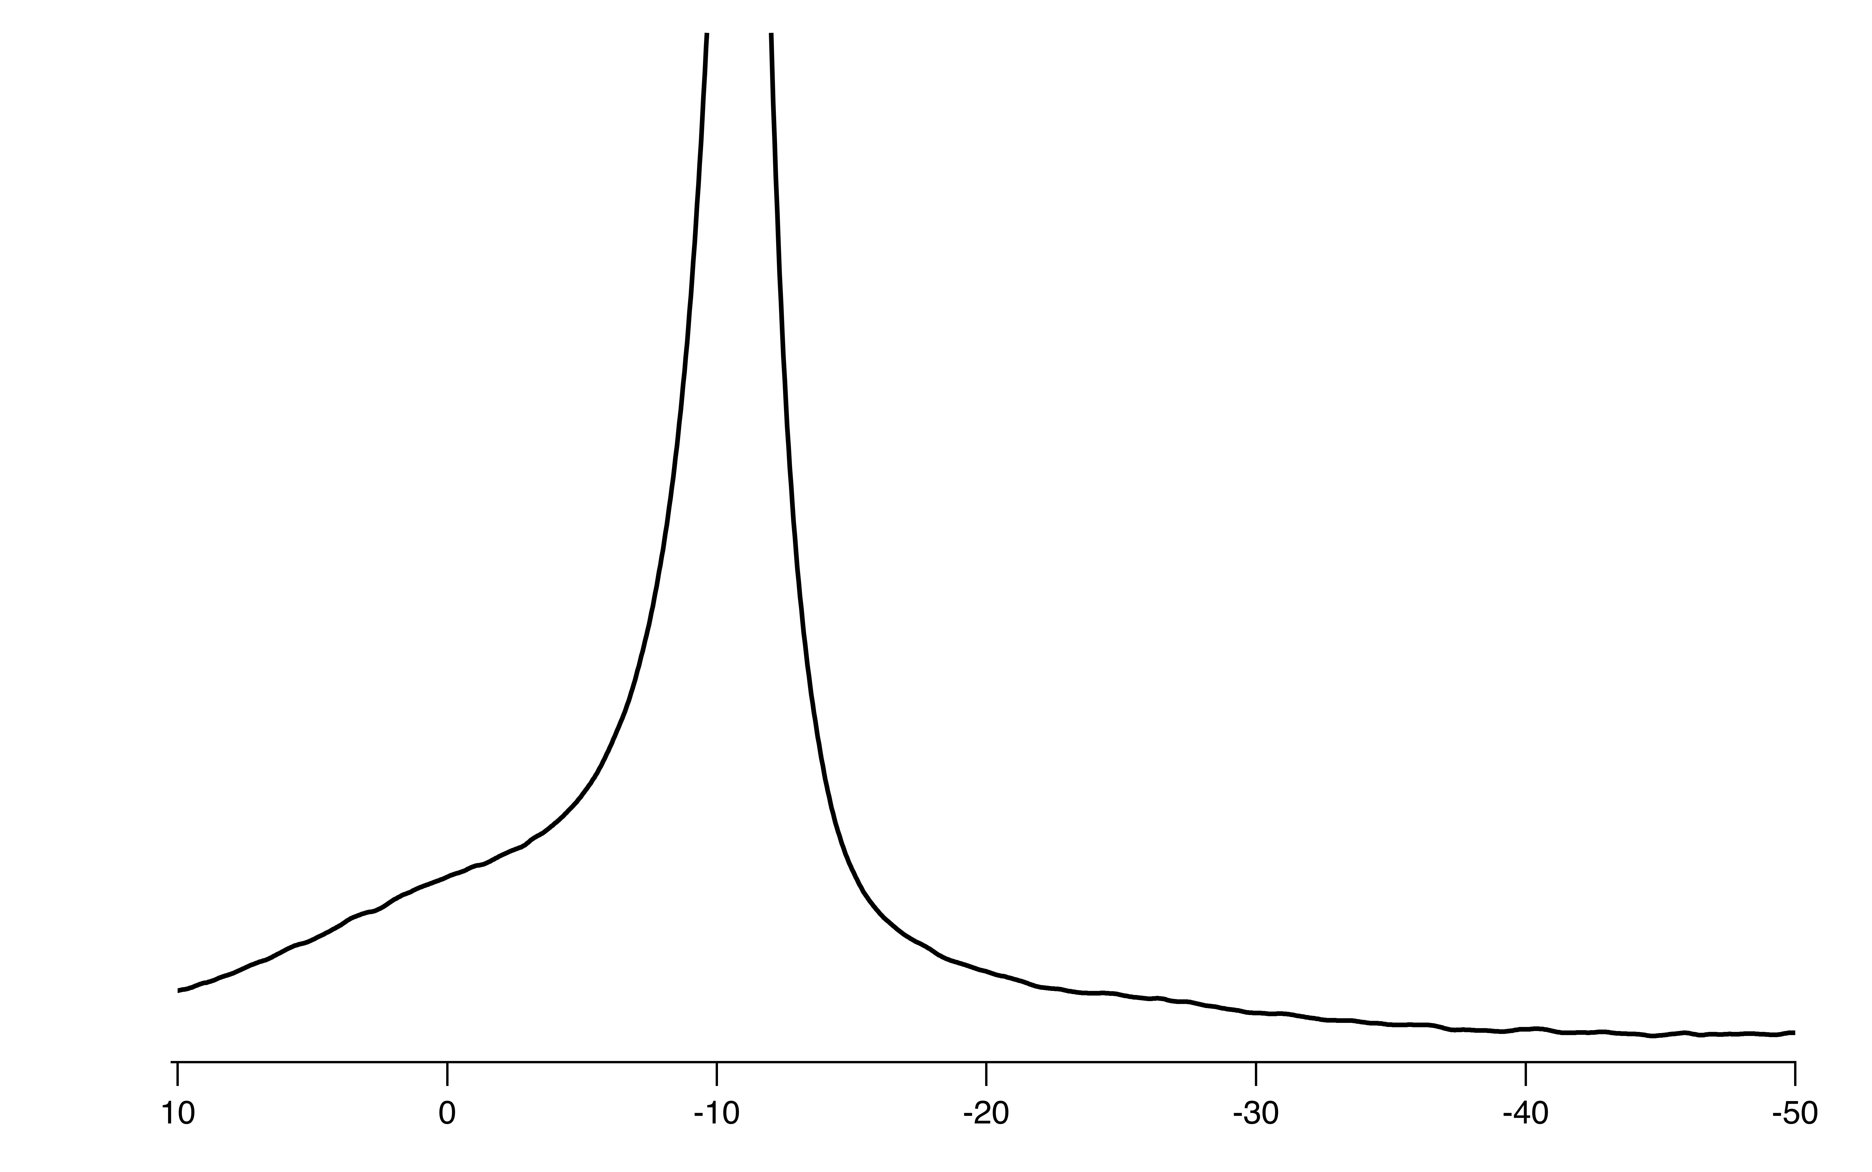
structural radiation damage in xenotime & zircon
²⁹Si MASNMR @ 5 kHz
4% ²³⁸Pu in YPO4, 2.1 x 10¹⁸ alpha/g
³¹P MASNMR @ 55 kHz
³¹P MASNMR shifts in phosphate glasses
MRS SBNWM Sydney, Australia, 29 October - 3 November 2017

Slide 14
Swift heavy ion radiation damage in xenotime
2 GeV Pb
³¹P MASNMR @ 20 kHz
MRS SBNWM Sydney, Australia, 29 October - 3 November 2017

Slide 15
Pu radiation damage in xenotime
²³⁸Pu damage in YPO4 (xenotime) and ZrSiO4 (zircon) from XRD
MRS SBNWM Sydney, Australia, 29 October - 3 November 2017

Slide 16
Acknowledgements
Summary
Can observe substitution of Pu into the xenotime structure by NMR
(transferred hyperfine shift from 5f electrons to phosphorus) - quantitative effect.
The structure of xenotime recovers from heavy recoil more readily than zircon
(phosphate vs silicate)
This is true for measured amorphised fraction and unit cell swelling.
The amount of radiation damage is lower and has a different structure
Amorphous structure is chemically controlled (lower tendency to polymerise)
Amorphous structure is similar for heavy recoil damage and SHI damage
Bill & Melinda Gates Foundation, Engineering & Physical Sciences Research Council (UK)
European Commission Framework 7 - Euract-NMR project: www.euract-nmr.eu
MRS SBNWM Sydney, Australia, 29 October - 3 November 2017

Slide 17
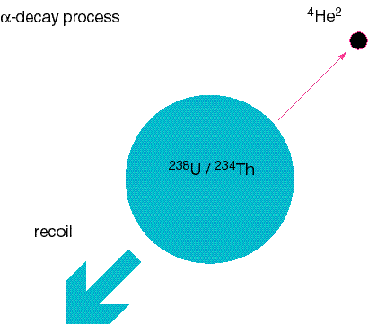
Alpha decay event
alpha particle travels about 13 µm and causes ionisations and a few atomic displacements along track then 100-200 atomic displacements at end of track.
~ 5 MeV
recoil of heavy daughter causes ~5000-6000 atomic displacements within 25 nm of event.
86 keV

Slide 18
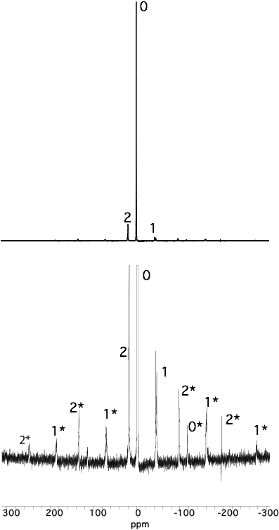
Ce incorporation in xenotime
3% Ce in YPO4 (xenotime)
³¹P MASNMR @ 20 kHz
pd=500s
pd=250ms
MRS SBNWM Sydney, Australia, 29 October - 3 November 2017

Slide 19
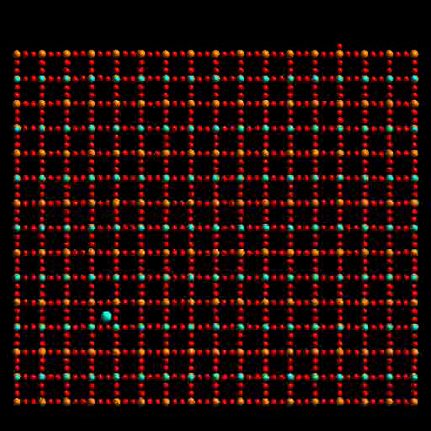
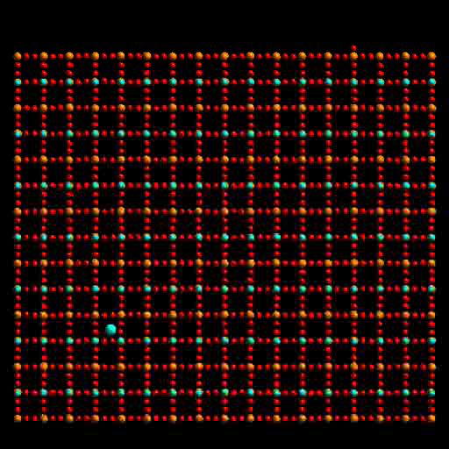
Alpha radiation damage
Alpha recoil in zircon (ZrSiO4)
30 keV heavy daughter recoil
ATAS 2016, Richland, WA, 7-10 November 2016

Slide 20
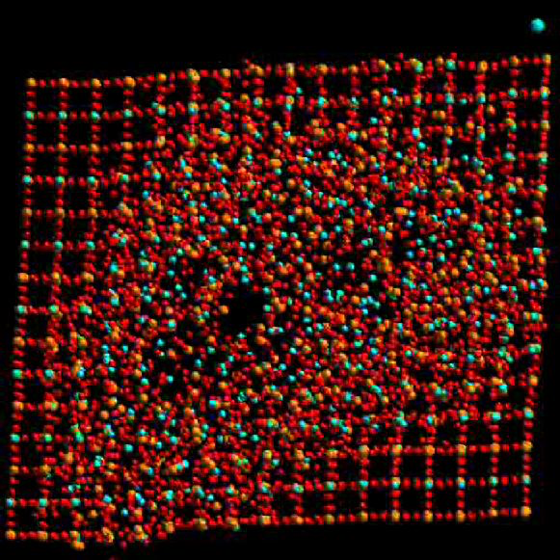
NMR as a measure of radiation damage
Single pulse ²⁹Si MASNMR (π/12 pulse every 300 s)
ATAS 2016, Richland ,WA, 7-10 November 2016

Slide 21
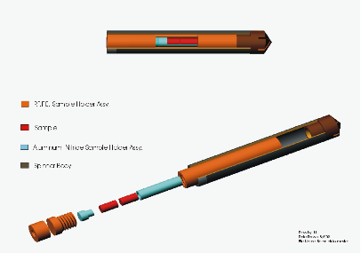
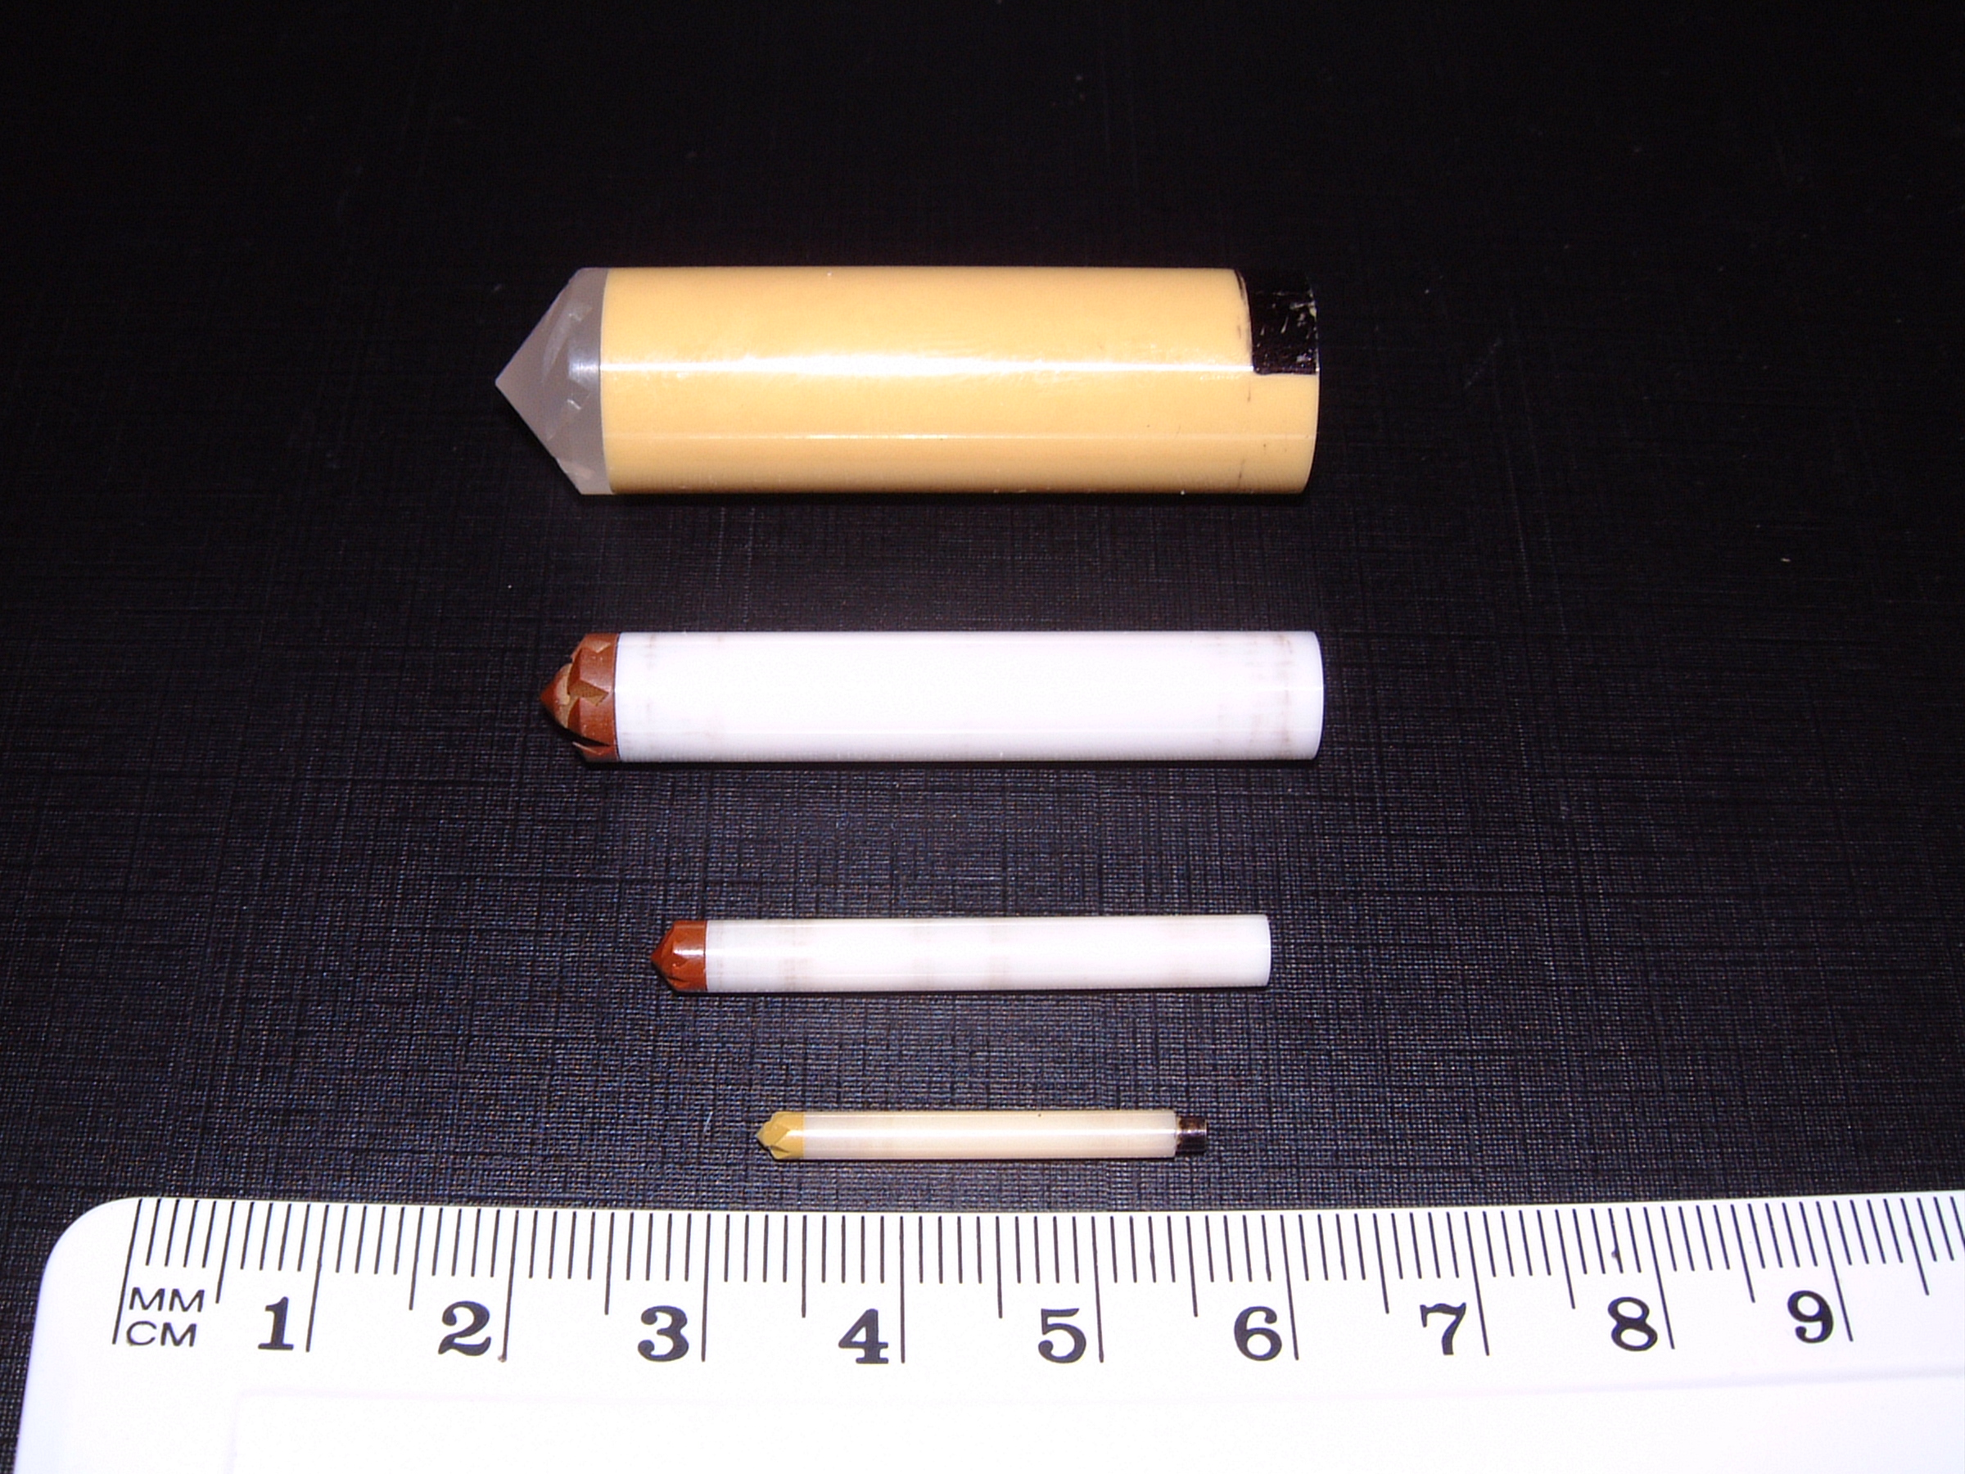
Strategies for MASNMR of actinide materials
Internal triple containment
Fast spinning requires small rotors
PTFE secondary containment
Sample core
AlN inner rotor
Pencil rotor
small rotors not compatible with internal containment
ATAS 2016, Richland, WA, 7-10 November 2016

Slide 22
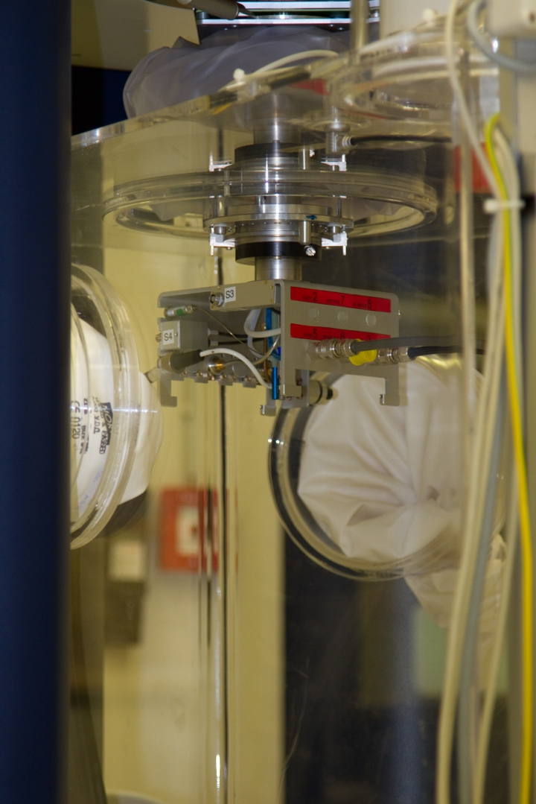
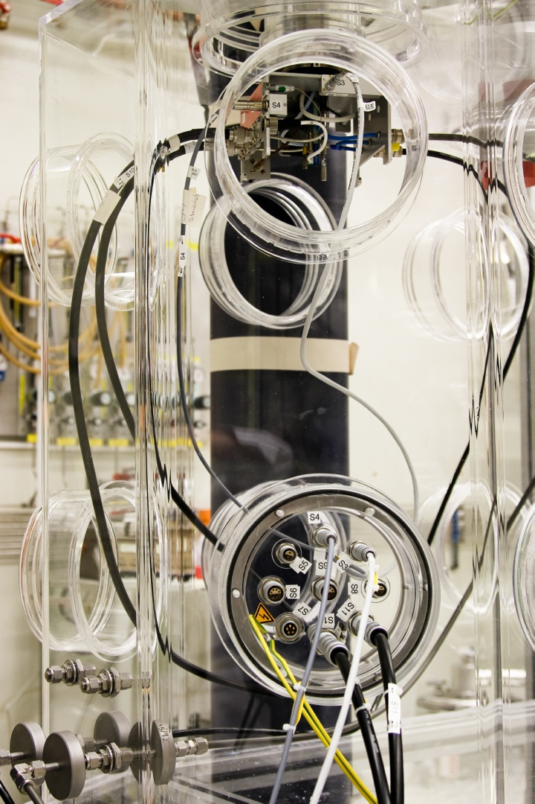
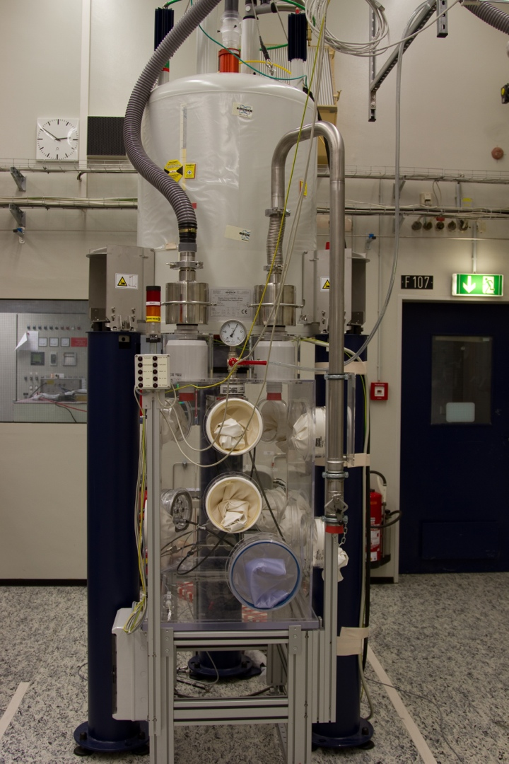
MASNMR of actinide materials - glovebox approach
Challenges for MASNMR in alpha GB
MAS probes introduce 100-200 l min⁻¹ N2 into GB
rad GBs operate at 0.95 atm, over pressure triggers alarm for lab.
can only use approved connectors in and out:
electrical/RF
and gas
ATAS 2016, Richland, WA, 7-10 November 2016

Slide 23
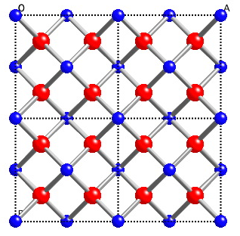
MASNMR of actinide materials
Actinide dioxides ¹⁷O MASNMR at 55kHz (1.3 mm rotor)
U0.4Th0.6O2
OTh4
ATAS 2016, Richland, WA, 7-10 November 2016

Slide 24
Comparison of zircon and xenotime
Xenotime (YPO4)
Orthophospate (no bridging oxygens)
Q⁰ phosphorus forming chains with YO8 dodecahedra
actinides can substitute onto Y site ?
ATAS 2016, Richland ,WA, 7-10 November 2016

Slide 25
NMR measurement of radiation damage
Partitioning between daughter recoil and alpha particle
α - particle damage without recoil
n⁰
⁴He²⁺
2
¹⁰B
⁷Li
¹⁰B (n, α) reaction
ATAS 2016, Richland, WA, 7-10 November 2016

Slide 26
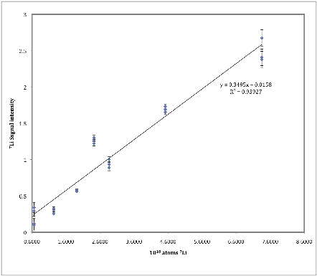
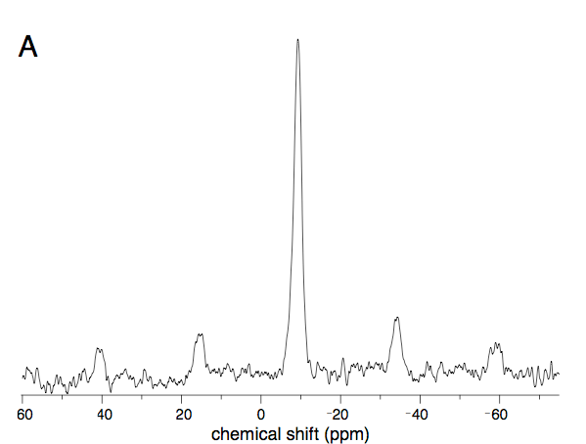
NMR measurement of radiation damage
¹⁰B (n, α) reaction
⁷Li MASNMR 28 day xenotime sample - direct detection of the ¹⁰B(n,α) nuclear reaction
3
⁷Li calibration with spodumene (LiAlSi2O6)
2
⁷Li signal intensity
1
0
0.6
2.6
4.6
6.6
8.6
⁷Li atoms x10¹⁸

Slide 27
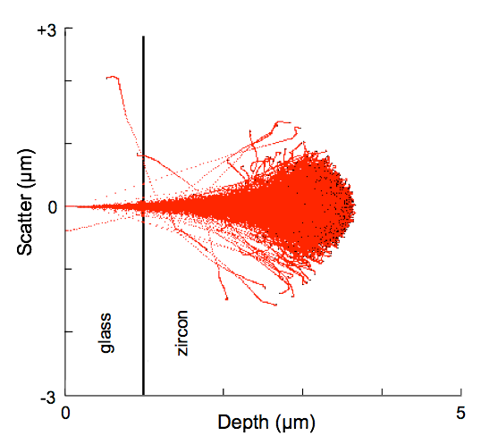
NMR measurement of radiation damage
¹⁰B (n, α) reaction
α-particle range
3
⁷Li calibration with spodumene (LiAlSi2O6)
2
⁷Li signal intensity
1
Xenotime
Pore
0.6
2.6
4.6
6.6
8.6
⁷Li atoms x10¹⁸

Slide 28
NMR measurement of radiation damage
¹⁰B (n, α) reaction
³¹P MASNMR @ 20 kHz

Slide 29
Swelling vs particle energy
alpha + recoil
alpha only (+ ⁷Li)

