Slide 1
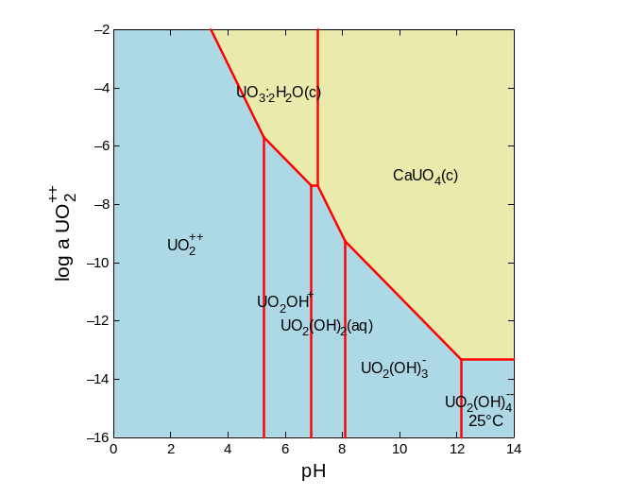
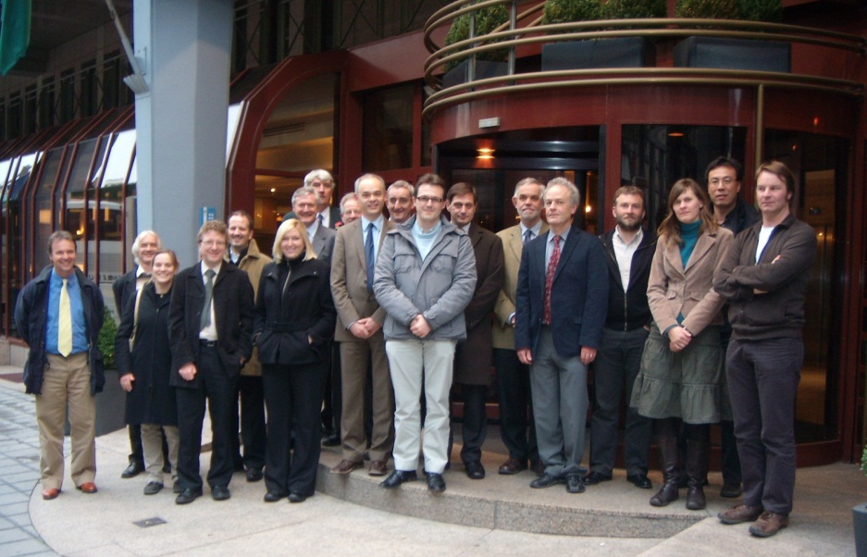
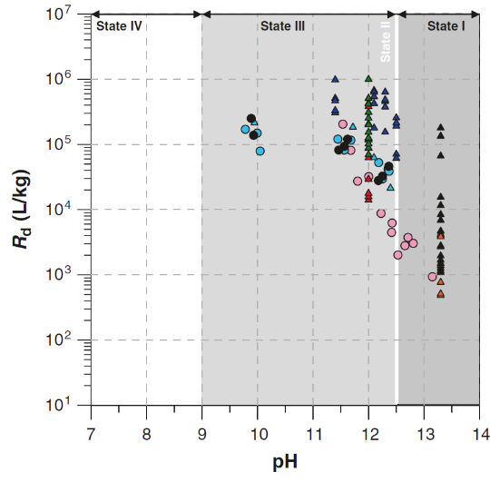
Radionuclide Sorption Behaviour on Fresh and Aged Cementitious Materials: A Comprehensive Database With 25 Elements
MRS 2017 Sydney
Dirk Mallants, Michael Ochs, Lian Wang
30 October-2 November 2017
Land AND Water

Slide 2
Challenge & Solution
Challenge:
  Safety assessments require
    sorption parameters (R_{D}) for large set of radionuclides for cementitious engineered barriers
    sorption parameters account for cement evolution (degradation)
Solution:
  Develop comprehensive R_{D} database for cementitious materials (benchmark cement)
  Establish relationship between R_{D} and main phases of cement evolution
Objective
  Compile R_{D} values from literature following strict selection and analysis procedures (QA/QC, international expert panel, process description)
  Select best estimate (uncertainty) R_{D} values for 25 elements for 4 cement evolution phases

Slide 3
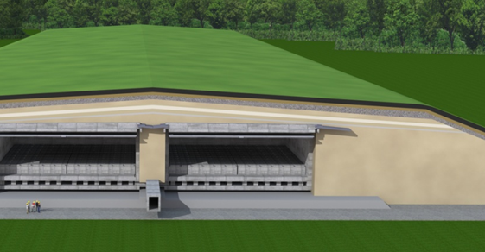
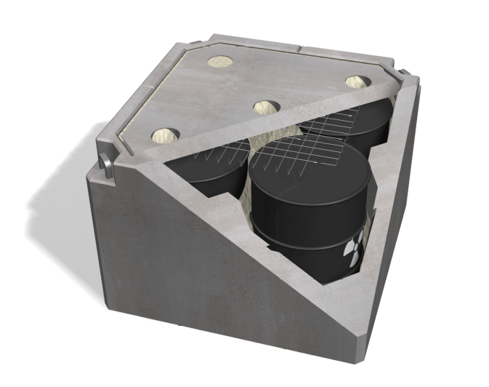
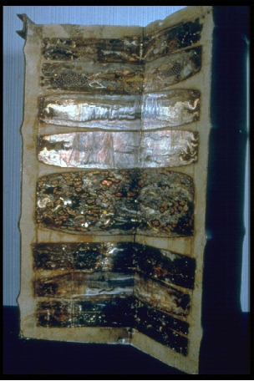
Cementitious Materials as Engineered Barrier
Multiple Engineered Barriers for LLW
Repository
Surface repository
  Faster cement
  degradation
  Oxidising
  conditions
Structural Material
For Concrete Vault
Concrete Disposal
Container &
Backfill Material
Conditioning Matrix

Slide 4
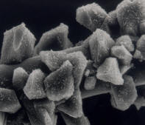
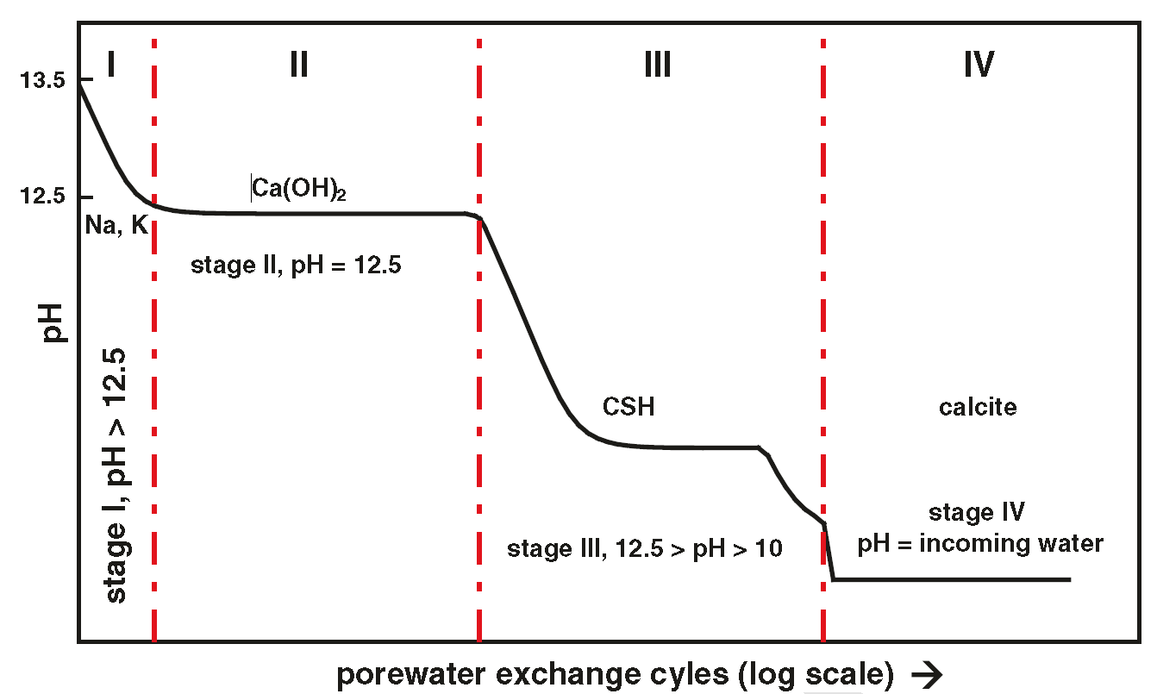
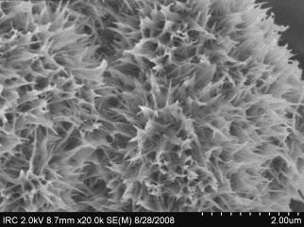
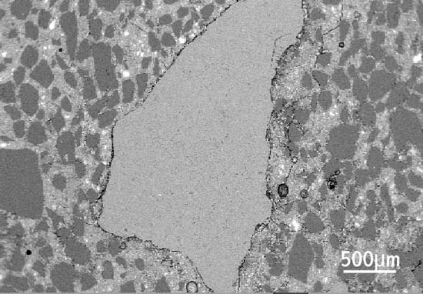
Evolution of cementitious materials
25wt% HCP
II
Simplified model
Four States:
  I: pH > 12.5 due to the presence of high concentrations of alkalis (Na and K)
  II: pH≈12.5 controlled by the solubility of portlandite (Ca(OH)₂)
  III: 10.5<pH<12.5 regulated by the equilibrium of amorphous C-S-H with the infiltrated water from the surrounding non-cementitious materials
  IV: pH < 10.5 controlled by aggregates (calcite - CaCO₃ <> AAR)
6 m²/g
Ca(OH)₂
Ca↓ => Ca/Si↓
60wt% HCP
150 m²/g
III
CSH
75wt%
1 m²/g
IIV
Calcite
Notes:
ONDRAF/NIRAS decided to apply the same
formulation to the cementitious backfill (premix mortar) but replacing siliceous sand by a
calcareous sand (limestone). Alkali-aggregate reaction (AAR) is a well known cause of
concrete deterioration. It arises from use of reactive (with cement) siliceous aggregates and
results in expansion and cracking. AAR is eliminated by using sand-grade high-purity
limestone aggregate (for coarse as well as for fine aggregate).

Slide 5
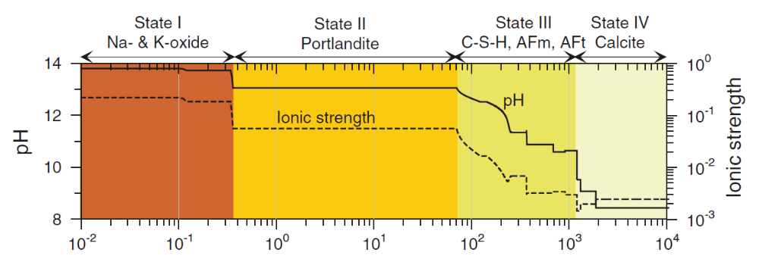
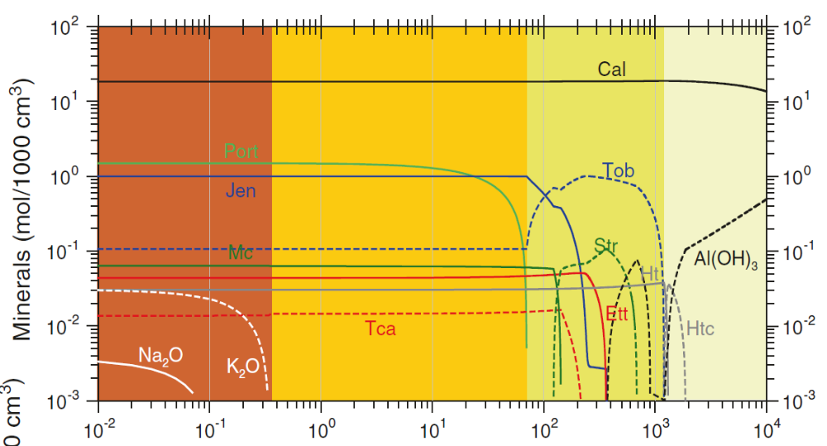
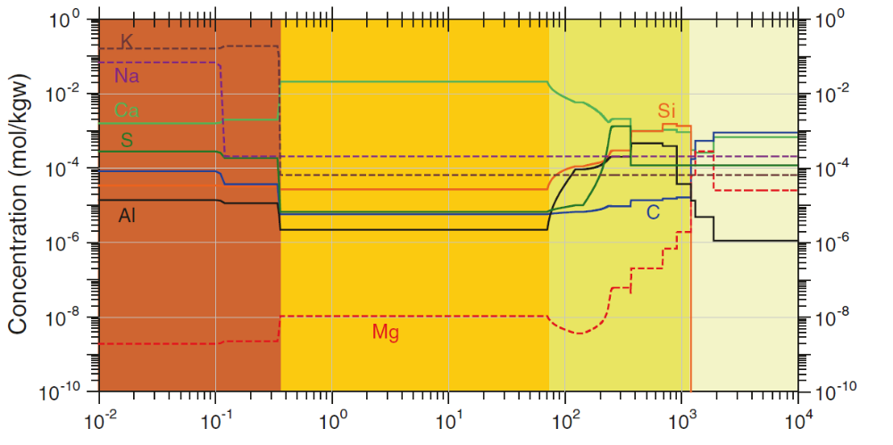
CSH
AFm
AFt
Afm, Aft: calcium aluminiumsulphate hydrates
Notes:
Ettringite and Tca (tricarboaluminate) is AFt: calcium aluminumsulphate hydrate
Afm: monocarboaluminate and strätlingite (containing silicium)

Slide 6
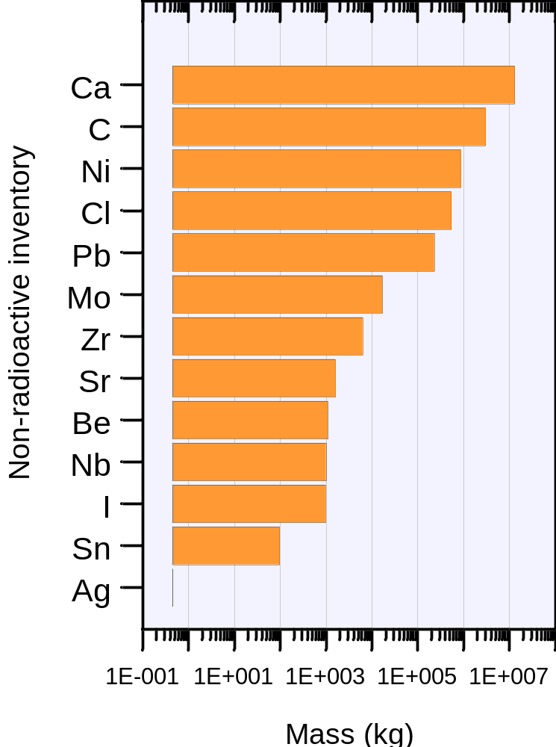
25 Elements: Radionuclides & Metals
Ag: ^{108m}Ag, ^{110m}Ag
Am: ²⁴¹Am
Be: ¹⁰Be
C: ¹⁴C
Ca: ⁴¹Ca, ⁴⁵Ca
Cl: ³⁶Cl
Cs: ¹³⁷Cs
H: ³H
I: ¹²⁵I, ¹³¹I, ¹²⁹I
Mo: ⁹³Mo
Nb: ⁹⁴Nb
Ni: ⁵⁹Ni, ⁶³Ni
Np: ²²⁷Np
Pa: ²³¹Pa
Pb: ²¹⁰Pb
Pd: ¹⁰⁷Pd
Pu: ²³⁸Pu, ²³⁹Pu, ²⁴⁰Pu, ²⁴¹Pu
Ra: ²²⁶Ra
Se: ⁷⁹Se
Sn: ¹²⁶Sn
Sr: ⁹⁰Sr
Tc: ⁹⁹Tc
Th: ²³⁰Th, ²³²Th
U: ²³⁴U, ²³⁵U, ²³⁸U
Zr: ⁹³Zr

Slide 7
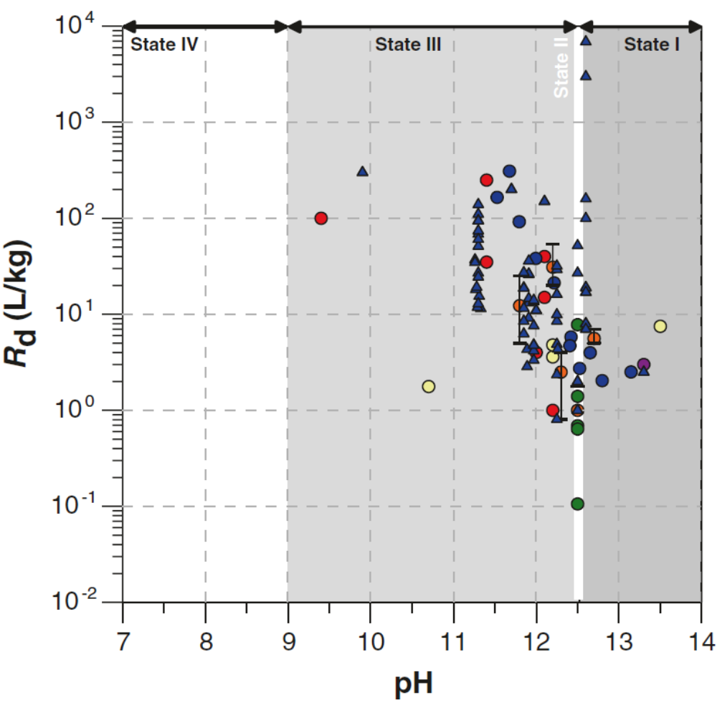
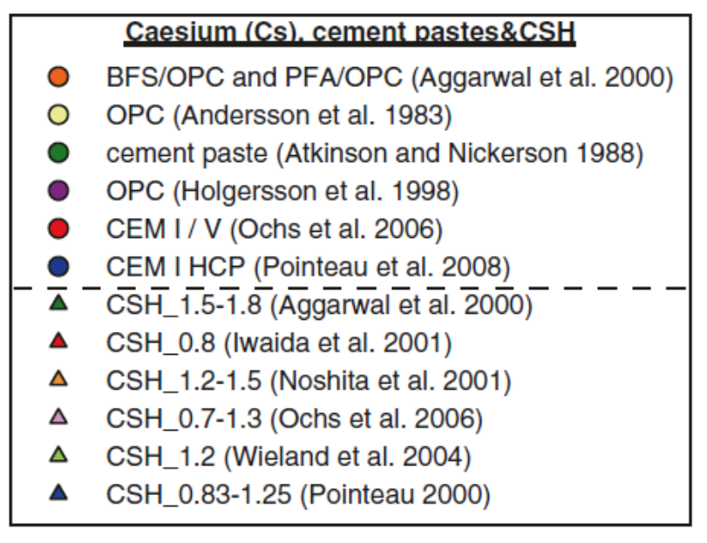
Cesium Sorption
Best Estimate [LL-UL] R_{D} (L/kg)
State 1: i.d. [0.1 - 10]
State 2: 2 [0.1 - 50]
State 3: 20 [1 - 300]
State 4: i.d.
Evolving cement

Slide 8
Cs: Sorption Mechanisms
Sorption mechanism:
  Simple speciation: Cs⁺
  Cs sorption mainly via ion exchange on the CSH phases
  Sorption on impurities in aggregates (clays, silica gel, …)
State I: i.d. [0.1 – 10 L/kg]
  Competition from other alkali metal ions (K, Na), ionic strength

Slide 9
Cs: Sorption Mechanisms
State II: 2 L/kg [0.1 – 50]
  Ionic strength and alkali decrease, sorption increases
  Competition with Ca for negatively charged CSH surfaces

Slide 10
Cs: Sorption Mechanisms
State III: 20 L/kg [1 – 300]
  Cs sorption increases with decreasing C/S ratio due to the condition of the interlayer CSH surface which changes sign as a function of C/S ratio
  Lower Ca²⁺ => increase in surface sites with high affinity for Cs

Slide 11
Cs: Sorption Mechanisms
State IV: i.d.
  calcareous aggregates contribute only slightly to Cs sorption
  higher silica and clays will give higher R_{d} values for caesium.

Slide 12
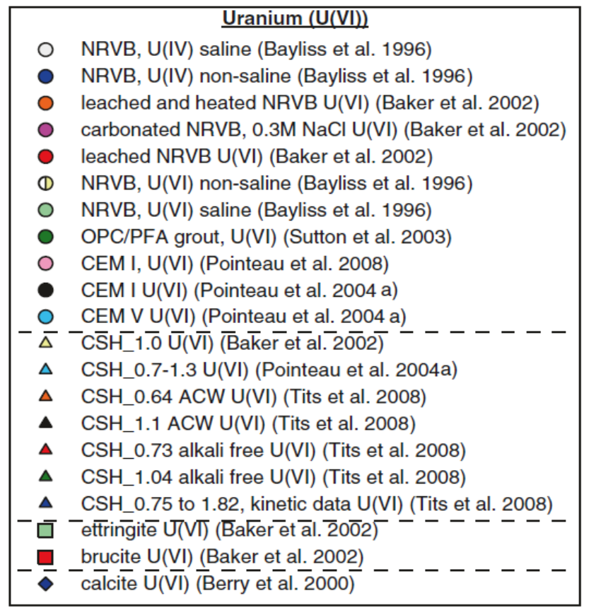
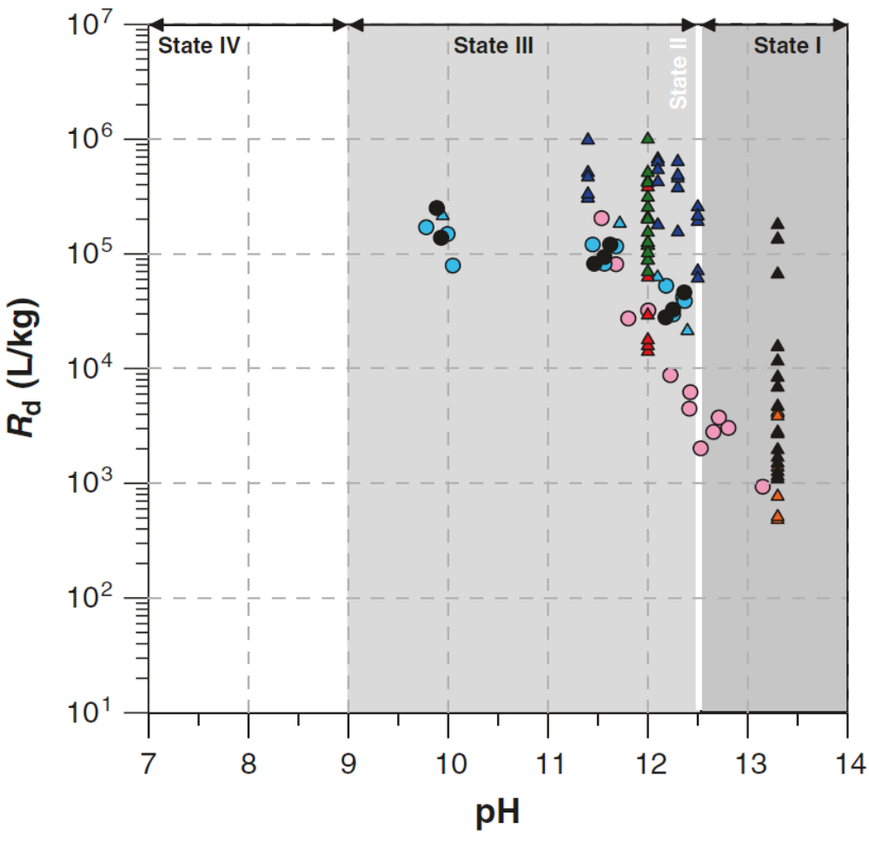
Uranium Sorption
Best Estimate R_{D} U(VI) (L/kg)
State 1: 2,000 [400 – 10,000]
State 2: 30,000 [3,000 – 300,000]
State 3: 30,000 [10,000 – 300,000]
State 4: 50 [5 – 500]
Evolving cement

Slide 13
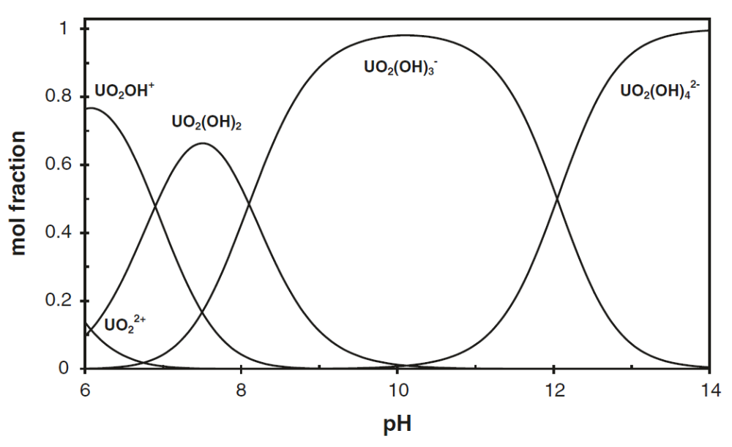
U: Sorption Mechanisms
U (VI)-speciation
Solubility-controlling
phase:
CaUO₄(c) 10⁻⁷ – 10⁻⁵ M
Sorption mechanisms:
  Linear sorption onto HCP
  and CSH, with U(VI) uptake increasing with decreasing Ca [Pointeau et al. 2008]
  Non-linear sorption onto CSH: co-precipitation of Ca and U(VI) on the sorbent [Tits et al. 2008]
  Ca influences U sorption
Notes:
U(VI) speciation in an oxidising cementitious environment is dominated by the hydrolysis species UO2(OH)3- and UO2(OH)3-2

Slide 14
U (VI) Sorption
State I : 2000 L/kg [400-10,000]
  Weaker sorption than in State II, III
State II: 30,000 L/kg [3,000 – 300,000]
  Higher Ca than State III => more competition for sorption sites
State III: 30,000 L/kg [10,000 – 300,000]
  Increased sorption due to loss of Ca resulting in increased availability of silanol sites for U sorption
  High sorption due to high surface area of CSH (150 m²/g)
State IV: 50 L/kg [5 – 500]
  Low sorption on calcite (small reactive surface: 0.2 – 1 m²/g)

Slide 15
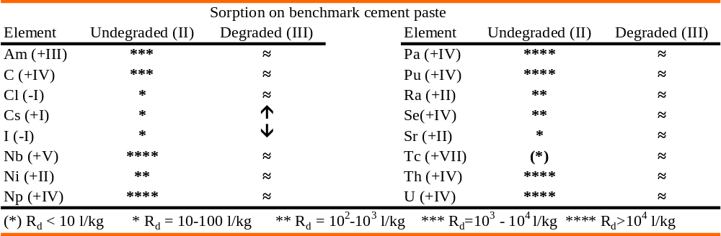
Summary of R_{D} values for evolving cement
, U (+VI)
Chemical degradation (evolution) of cement does generally not result in decreased sorption
CSH provide high density of non-specific sorption sites across both States II-III
Decrease of CSH mass during State III compensated by higher affinity due to decreased Ca in solution

Slide 16
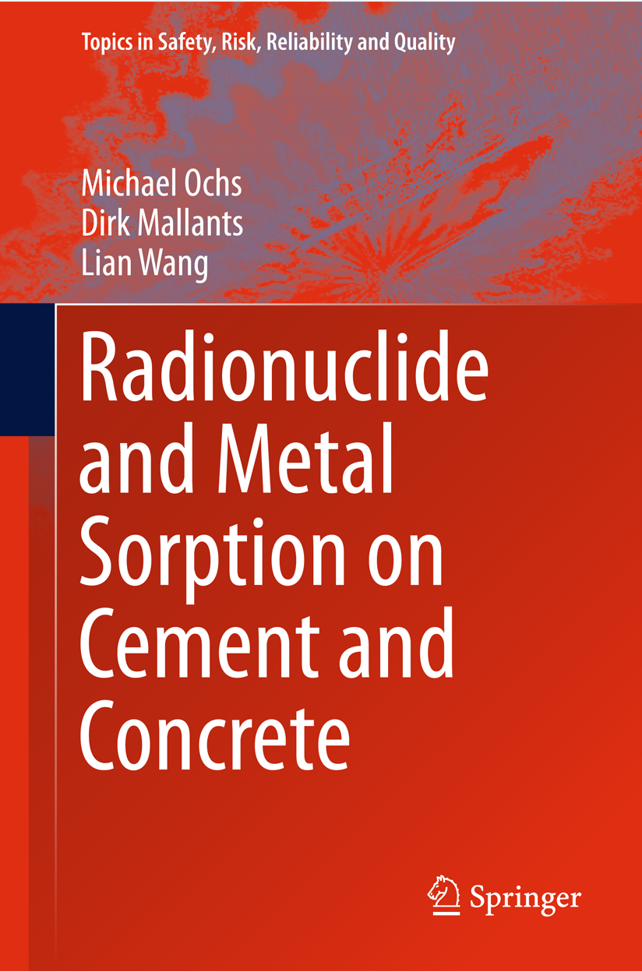
Conclusions
Critically reviewed radionuclide sorption data on cementitious materials for 25 elements
For each element sorption data were grouped according to one of four cement degradation states
Sorption behaviour was explained on the basis of cement pore water composition and available solid phases for sorption
Derived best estimate, LL, UL sorption values following expert panel elicitation
Cement degradation across State II-III does generally not result in decreased sorption values

Slide 17
Acknowledgements
Evelien Martens
Bernhard Schwyn
Ludovic Vielle-Petit
Erich Wieland
Steve Williams
John Berry
Virginie Blin
Pierre de Cannière
Christoph Gallé
Fred Glasser
Eric Giffaut
Alan Hooper
Diederik Jacques
David Lever

Slide 18
Thank you
CSIRO Land and Water
  Dirk Mallants
  Senior Principal Research Scientist
    t +61 8 8303 8595
    e dirk.mallants@csiro.au
    W http://www.csiro.au/en/Organisation-Structure/Divisions/Land-and-Water/DirkMallants.aspx
Land and water Flagship

Slide 19
Backup Slides

Slide 20
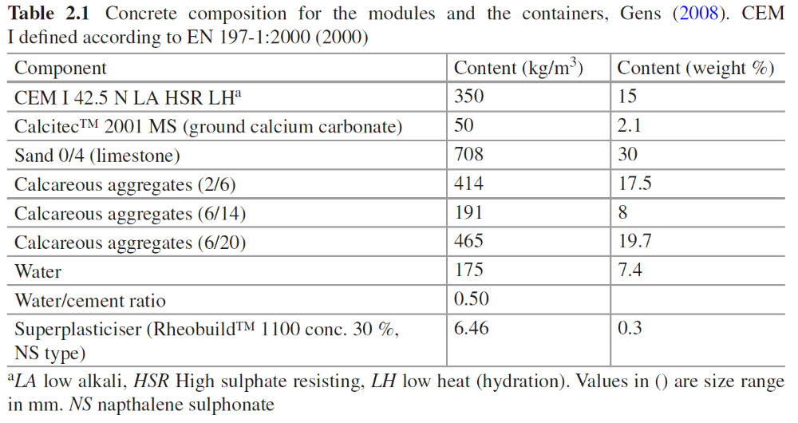
Benchmark Cement-1 Composition for LLW Disposal
Notes:
Alkali-aggregate reaction (AAR) is a well known cause of
concrete deterioration. It arises from use of reactive (with cement) siliceous aggregates and
results in expansion and cracking. AAR is eliminated by using sand-grade high-purity
limestone aggregate (for coarse as well as for fine aggregate).
The alkali-dolomite reaction, another reported cause of deterioration induced by aggregates, will be entirely avoided by
using limestones low in magnesia (no more than 2% each of magnesium, silicon and aluminum
as oxide) [68].

Slide 21
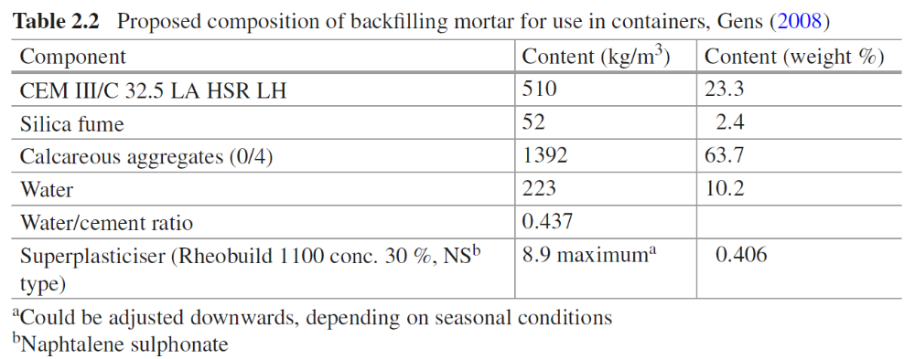
Benchmark Cement-2 Composition for LLW Disposal

Slide 22
Procedure for data selection and analysis
K_{d} (linear & reversible) or R_{d} (uptake)?
Experimental or calculated (thermodynamic models) values?
Batch tests or dynamic leaching experiments (model uncertainty)?
Keeping control of the oxidation state (redox sensitive elements)?
Dominant aqueous speciation for given experimental conditions?
Liquid-to-solid separation technique (removal of colloids)?
Liquid-to-solid (L/S) ratio (low reliability if high sorption & low L/S)
Single measurement point versus sorption isotherm
Initial tracer concentration (sorption, not solubility limitation)
Contact time for batch tests (equilibration time)
Pore water characteristics (cement state)
Solid type (crushed concrete, hardened cement paste, pure mineral phases eg CSH)
Focus on State II and III (State I is very short, IV has little sorption capacity)
Notes:
The sorption process can be quantified through use of the Kd constant if it is experimentally
demonstrated that sorption is linear and reversible. In the majority of the reported experimental
studies, however, neither the linearity nor the reversibility were tested. As a result, the reported
sorption values should be considered as a distribution ratio Rd (ℓ/kg):

Slide 23
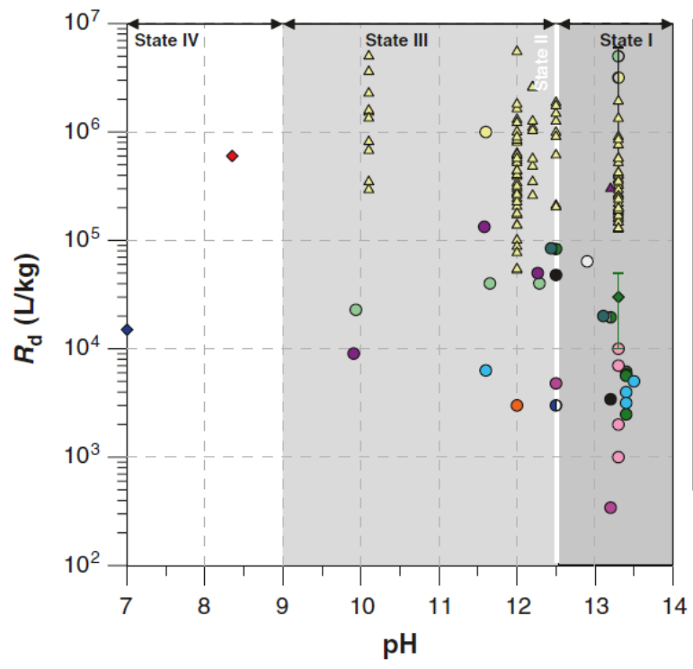
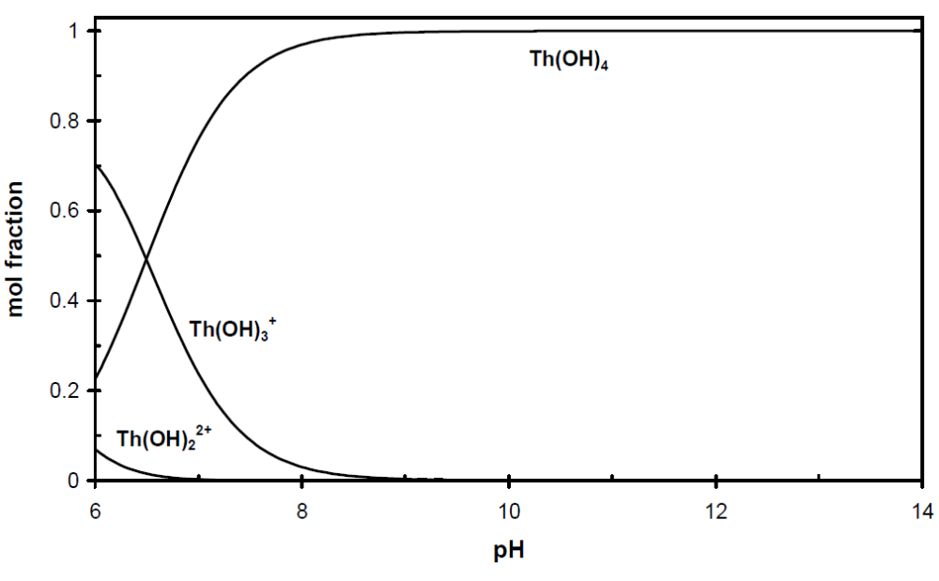
U(IV) Sorption
Based on Th(IV) data (chemical analogy); single species Th(OH)⁴ (aq)
State I, II, III, IV:
  30,000 L/kg
Thorium

