Slide 1
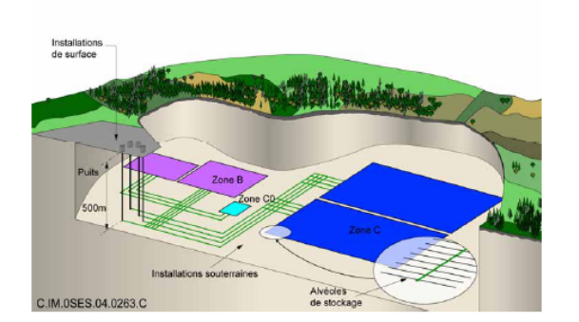
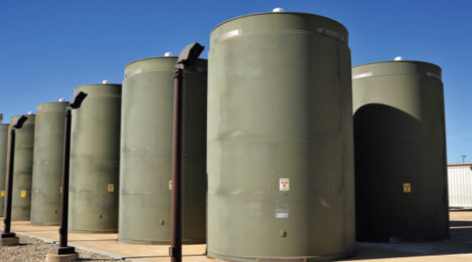
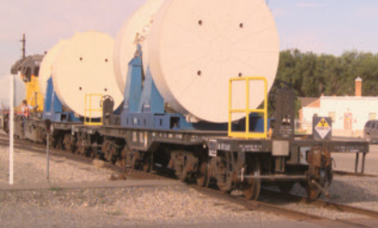
The Need for Integrating the Back End of the Nuclear Fuel Cycle
?
?
Dr. Evaristo J. Bonano, Senior Manager
Dr. Peter N. Swift, Senior Scientist
Sandia National Laboratories
MRS 2017 – Scientific Basis for Nuclear Waste Management 2017
Sydney, Australia
29 October – 3 November 2017
SAND2017-10676 PE

Slide 2
Introduction
Due to the lack of a repository site for the final disposal of spent nuclear fuel from commercial and defense-related activities as well as high-level radioactive waste, the back end of the nuclear fuel cycle (storage, transportation and disposal) in the US consists of independent components with different applicable regulations and different responsible entities therefore resulting in a lack of integration.
The current lack of integration can lead to major cost, technical, operational and regulatory implications.
In this presentation, we summarize work performed by various US national laboratories, including Sandia, that highlights the aforementioned implications.

Slide 3
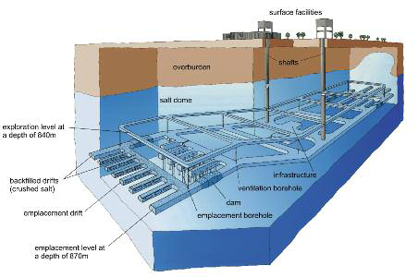
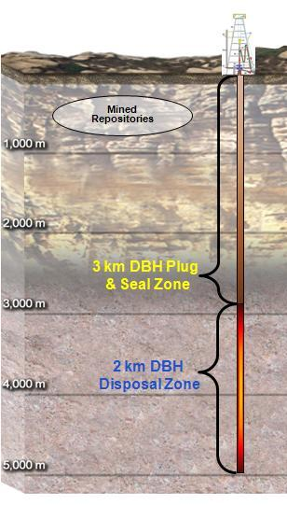
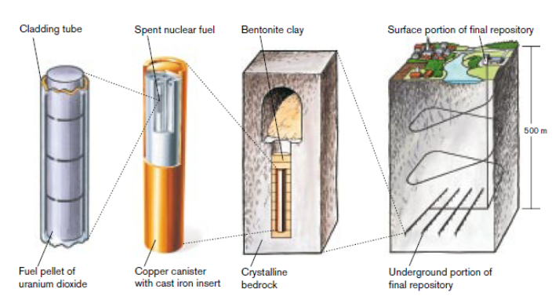
Spent Nuclear Fuel and High-Level Radioactive Waste Disposal: The Goal
Deep geologic disposal has been planned since the 1950s
“There has been, for decades, a worldwide consensus in the nuclear technical community for disposal through geological isolation of high-level waste (HLW), including spent nuclear fuel (SNF).”
“Geological disposal remains the only long-term solution available.”
  National Research Council, 2001

Slide 4
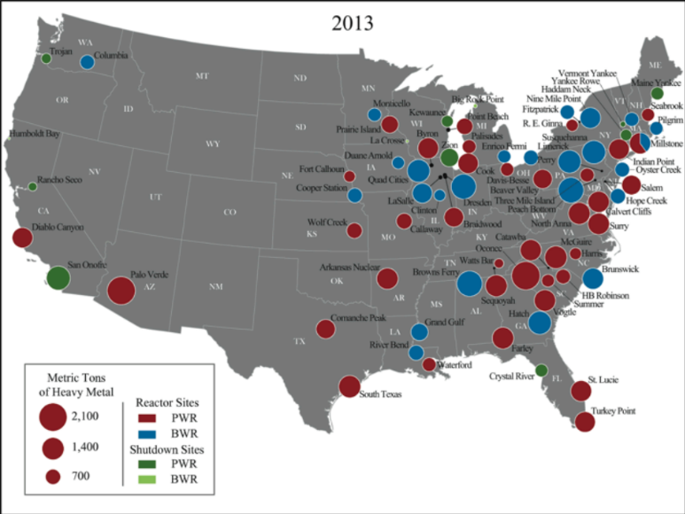
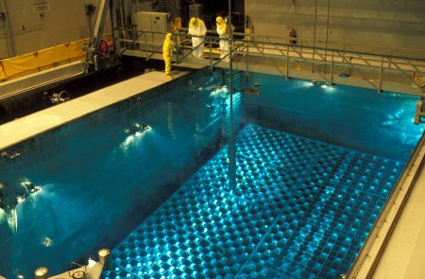
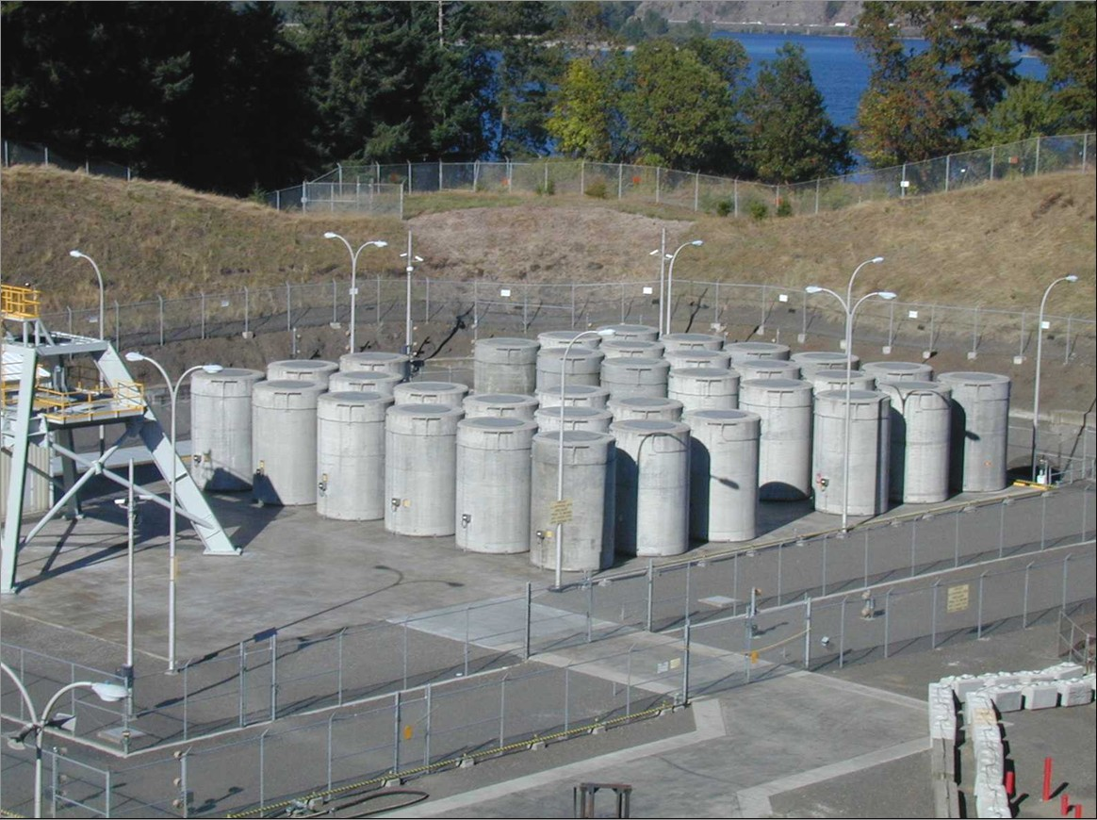
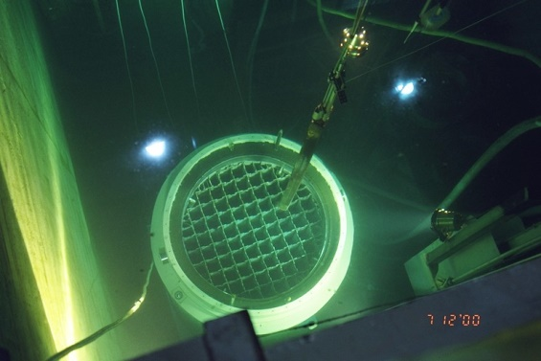
Geologic Disposal in the US: The Reality
Commercial Spent Nuclear Fuel (SNF) is in Temporary Storage at 75 Reactor Sites in 33 States
Pool storage provides cooling and shielding of radiation
  Primary risks for spent fuel pools are associated with loss of the cooling and shielding water
US pools have reached capacity limits and utilities have implemented dry storage
Some facilities have shutdown and all that remains is “stranded” fuel at an independent spent fuel storage installation (ISFSI)

Slide 5
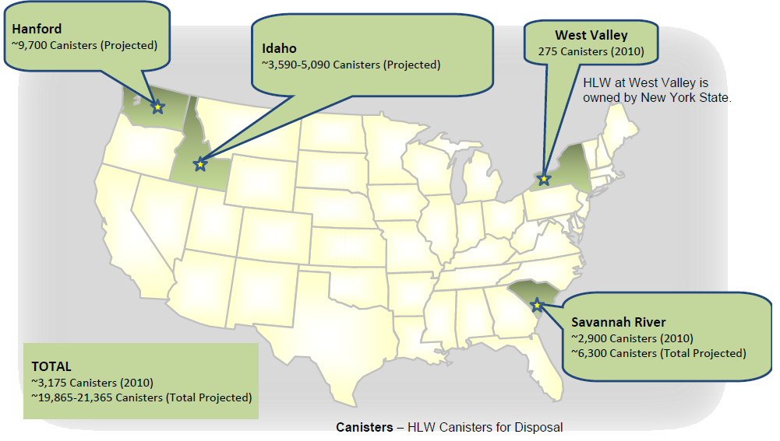
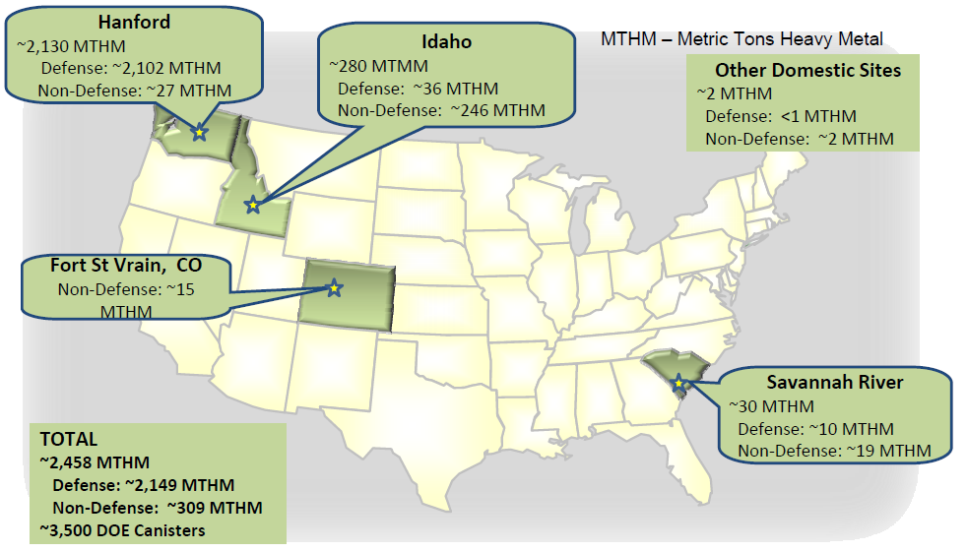
Geologic Disposal in the US: The Reality
DOE-managed SNF and High-Level Radioactive Waste (HLW) is in Temporary Storage at 5 Sites in 5 States
DOE-Managed HLW
~20,000 total canisters (projected)
DOE-Managed SNF
~2,458 Metric Tons
Source: Marcinowski, F., “Overview of DOE’s Spent Nuclear Fuel and High-Level Waste,” presentation to the Blue Ribbon Commission on America’s Nuclear Future, March 25, 2010, Washington DC.

Slide 6
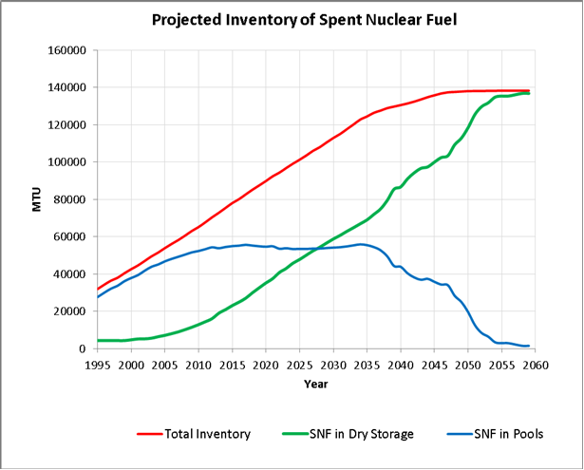
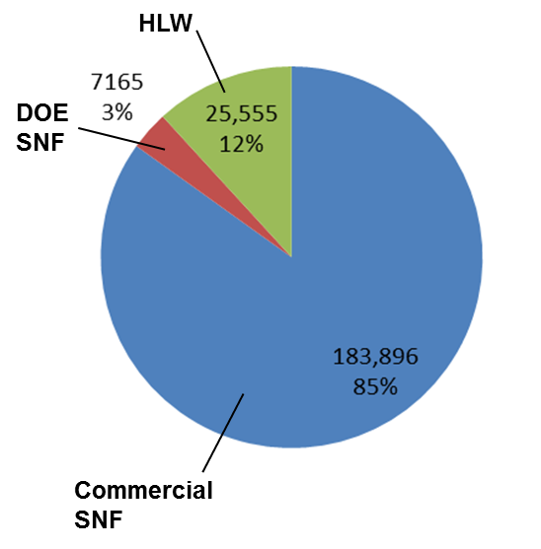
US Projections of Spent Nuclear Fuel (SNF) and High-Level Radioactive Waste (HLW)
Projected Volumes of SNF and HLW in 2048
Projection assumes full license renewals and no new reactor construction or disposal
Volumes shown in m³, assuming constant rate of nuclear power generation and packaging of future commercial SNF in existing designs of dual-purpose canisters
Approx. 80,150 MTHM (metric tons heavy metal) of SNF in storage in the US today
  25,400 MTHM in dry storage at reactor sites, in approximately 2,080 cask/canister systems
  Balance in pools, mainly at reactors
Approx. 2200 MTHM of SNF generated nationwide each year
  Approximately 160 new dry storage canisters are loaded each year in the US

Slide 7
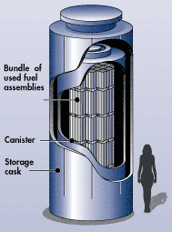
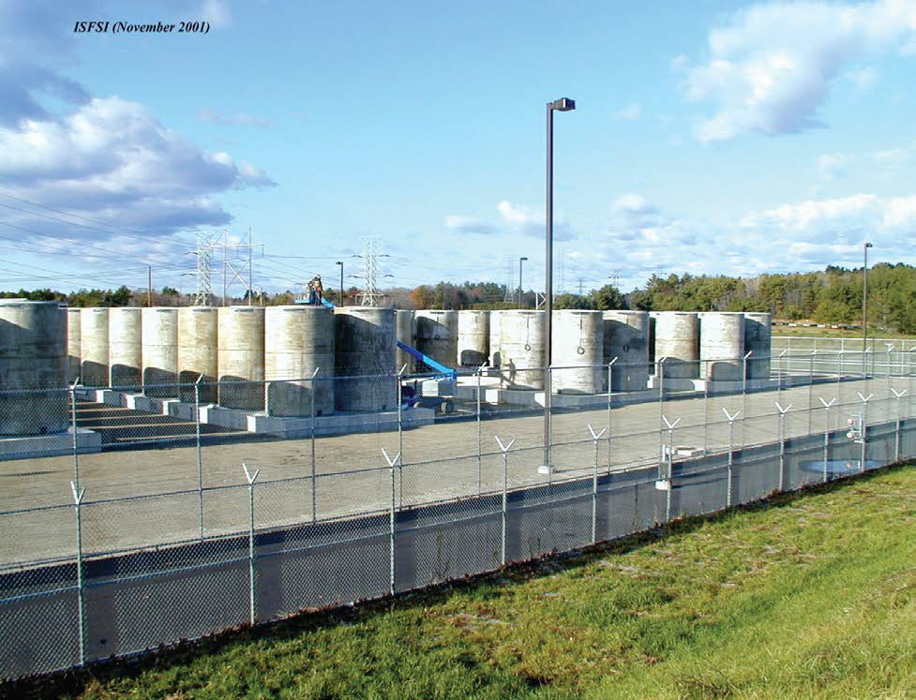
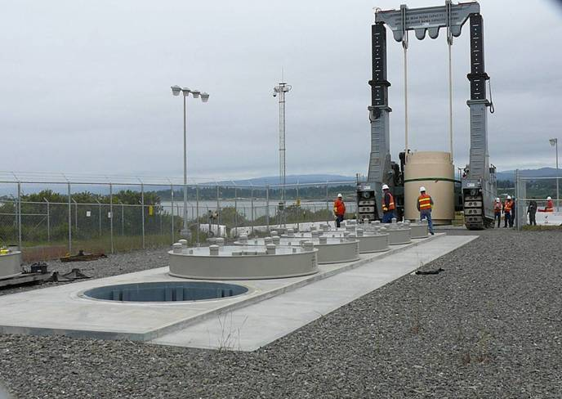
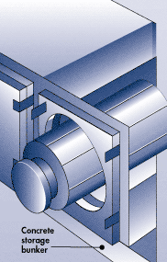
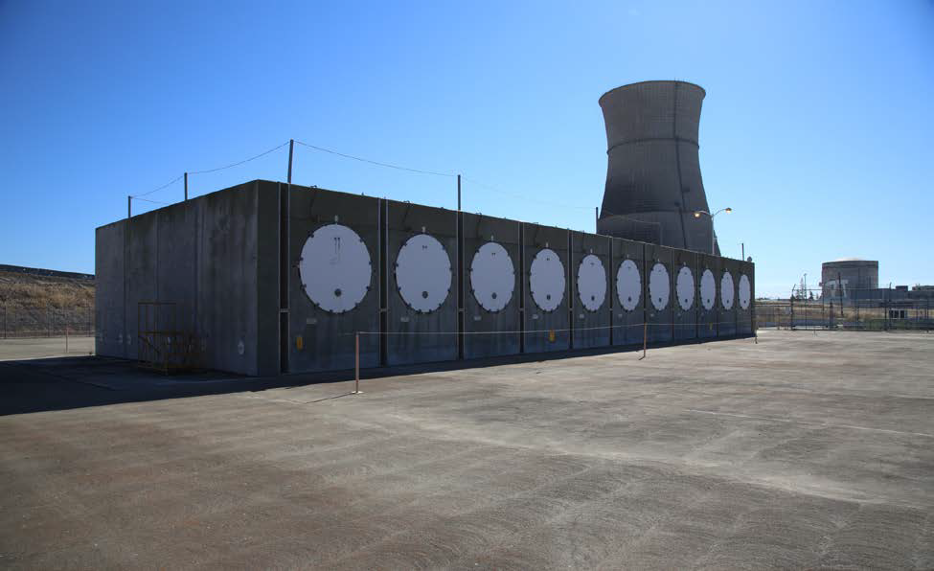
Storage Terminology
Dual purpose canister (DPC)
  A canister that is certified for both storage and transportation of spent nuclear fuel
Dry cask/canister storage systems
  The most common type of dry storage cask system is the vertical cask/canister system shown above, in which the inner stainless steel canister is removed from the storage overpack before being placed in a shielded transportation cask for transport
    Can be constructed both above and below grade
  Horizontal bunker-type systems and vaults are also in use
  Some older fuel is also stored as “bare fuel” in casks with bolted lids; few sites continue to load these systems
Multiple vendors provide NRC-certified dry storage systems to utilities

Slide 8
Observations on Current Practice
Current practice is safe and secure
  Extending current practice raises data needs; e.g., canister integrity, fuel integrity, aging management practices
Current practice is optimized for reactor site operations
  Occupational dose
  Operational efficiency of the reactor
  Cost effective on-site safety
Current practice is not optimized for transportation or disposal
  Thermal load, package size, and package design
Placing spent fuel in dry storage in dual purpose canisters (DPCs) commits the US to some combination of three options
  Repackaging spent fuel in the future
  Constructing one or more repositories that can accommodate DPCs
  Storing spent fuel at surface facilities indefinitely, repackaging as needed
Each option is technically feasible, but none is what was originally planned

Slide 9
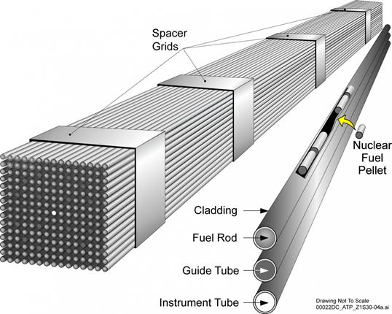
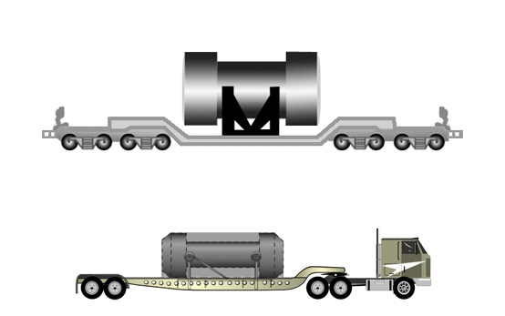
Current Storage and Transportation R&D
Spent fuel integrity
Current tests and analyses indicate that spent fuel is more robust than was previously thought
The DOE/EPRI High Burnup Confirmatory Data Project will obtain data after 10 years of dry storage to confirm current test and analysis results from parallel hot cell testing of “sister rods”
Storage system integrity
Stress corrosion cracking of canisters may be a concern in some parts of the country, and more work is needed in analysis and detection
Monitoring and Aging Management practices at storage sites will be important to confirm storage system performance during extended service
Spent fuel transportability following extended storage
The realistic stresses fuel experiences due to vibration and shock during normal transportation are far below yield and fatigue limits for cladding
Photo: energy.gov
Photo: nrc.gov
Energy.gov/pictures

Slide 10
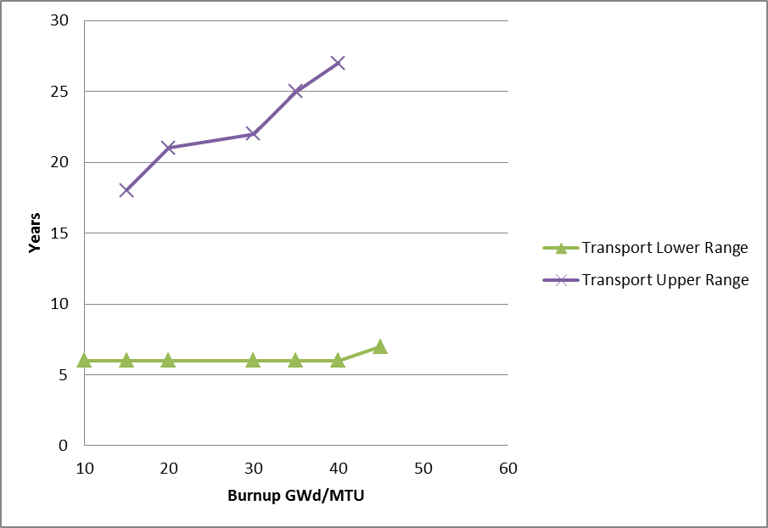
Transportation Considerations
Some DPCs may require decades of aging to cool spent fuel before they can be transported
  High-burnup fuels may require longer aging
  Cooling times are design-specific (in general, larger DPCs require longer cooling times)
Transportation casks remain to be certified for some DPC systems
Range of aging times required before transport, shown as a function of burnup
Source: Adapted from Stockman and Kalinina, SAND2013-2013P
Minimum cooling times for multiple cask/canister systems, based on NRC certificates of compliance for specific designs as of 2013.
Variation in times is due to the diversity of the current inventory, dominated by DPC size and heat transfer capabilities.

Slide 11
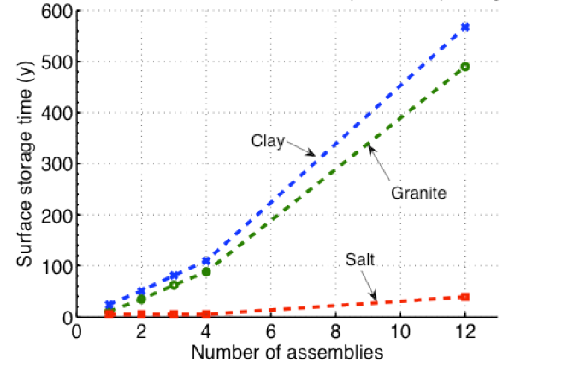
Repository Considerations:
Thermal Management
Decay Storage Needed to Meet WP Surface Temperature Limits vs.
WP Size or Capacity (PWR Assemblies; 60 GWd/MT Burnup)
Temperature limits based on current international and previous US concepts:
  100ºC for clay buffers and clay/shale media (e.g., SKB 2006)
  200ºC for salt (e.g., Salt Repository Project, Fluor 1986)
Final temperature constraints will be site- and design-specific
Source: Hardin et al. FCRD-USED-2011-000143 Rev. 2, 2011
Repository thermal constraints can be met by
  Aging
  Ventilation in the repository
  Decreasing package thermal output (size and burn-up)
  Increasing package and drift spacing in the repository

Slide 12
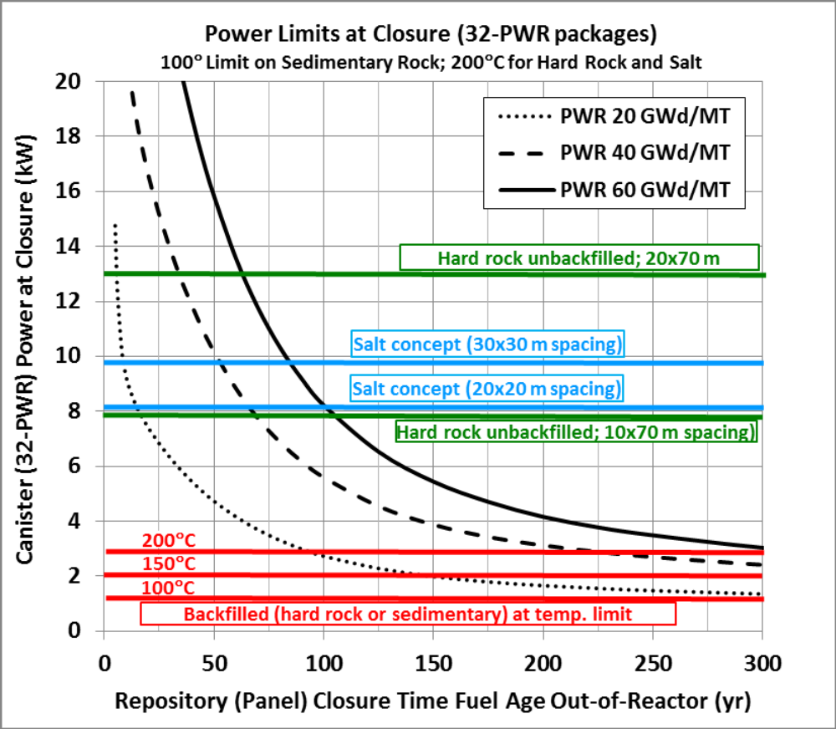
Thermal Load Management (cont.)
Higher burnup fuels require longer preclosure cooling times
Repository designs without backfill or in high-thermal-conductivity salt will need relatively shorter preclosure cooling times to accommodate large packages; underground spacing can have a large impact
Repository designs with thermal constraints on backfill will need long preclosure cooling times to accommodate large packages
Source: Hardin et al. 2015, FCRD-UFD-2015-000129 Rev 0 Figure 2-29

Slide 13
Repository Considerations:
Criticality Control
Some already-loaded DPCs pose complications for licensing analyses of postclosure criticality control
  Flooding by groundwater following canister degradation is a pre-requisite for criticality in any waste package
  Al-based neutron absorbers used in some DPCs will degrade in water
  Resulting reactivity increase can be offset by
    High-reliability disposal overpacks
    Uncredited margin in SNF configurations
    High chloride content in groundwater (e.g., in salt)
  Other options include
    Open DPCs before disposal to add criticality controls
    Include consequences of postclosure criticality in long-term performance estimates
  Case-by-case analysis of individual DPCs may be needed for licensing (function of enrichment and burn-up)

Slide 14
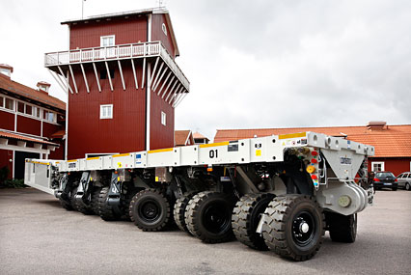
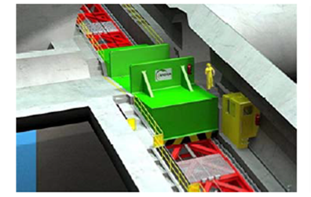
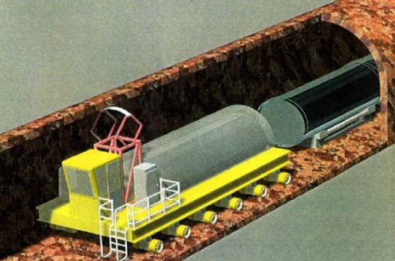
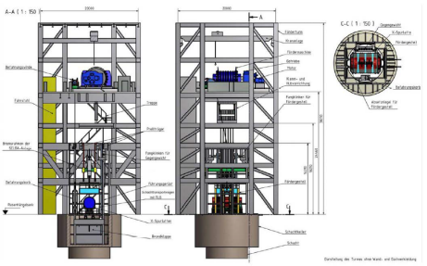
Other Considerations:
Waste Package Size
SKB Demo
(90 MT), Äspö
DPCs are massive, but not unprecedented
  Transportation, aging, and disposal canisters proposed for Yucca Mountain were in the range of sizes of existing DPCs
  With disposal overpack and transport shielding, total mass could be on the order of 150 metric tons
Size poses engineering challenges for handling during both transportation and disposal, but options are available
Andra Funicular Concept
Wheelift®
Transport-Emplacement Vehicle Concept
DBE Shaft Hoist Concept (85 MT)

Slide 15
Possible Options for an Integrated System
Introduce a standardized canister to be loaded at reactors in the future
  Selection of a standardized transportation, aging, and disposal (STAD) canister is repository-design and regulation specific
  Loading STADs directly from reactor pools (as proposed for Yucca Mountain) is unlikely to happen before perhaps 2030, by which time more than 50,000 MTHM of SNF will be in DPCs
    Later dates for repository and STAD selection will mean more fuel in DPCs
  Lack of present incentive for utilities to use standardized canister
Repackaging of SNF from DPCs to STADs at a consolidated storage facility
  Cost and schedule of repackaging
  Management of additional LLW stream (used DPCs)
Repository design options to handle multiple packaging systems
  Plan now for disposal of some DPCs, repackaging of others
Cost considerations–number of handling operations, number of packages, repository design, and complexity of licensing
Note: the DOE has relevant work in progress in each of these areas

Slide 16
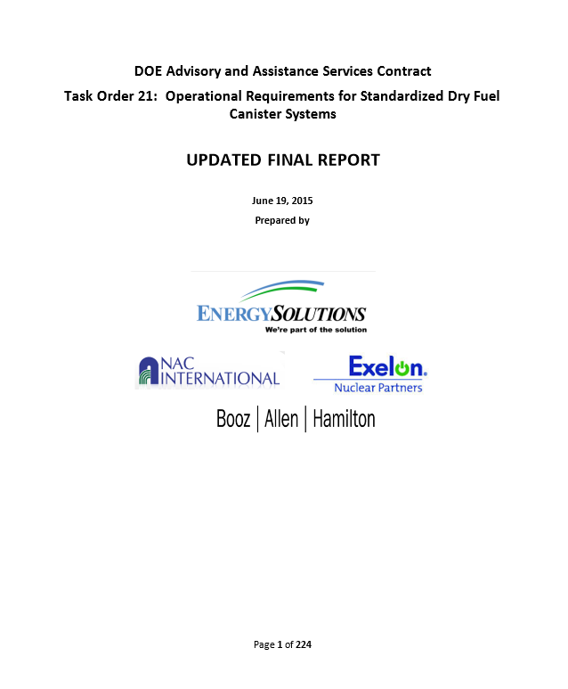
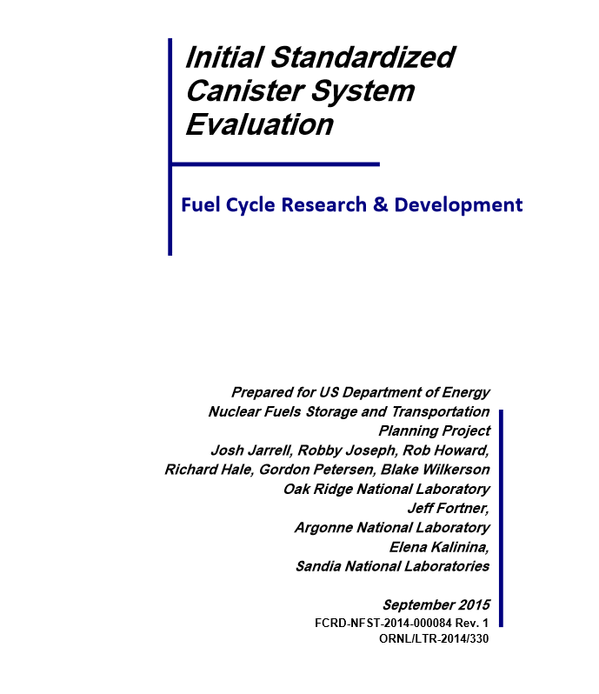
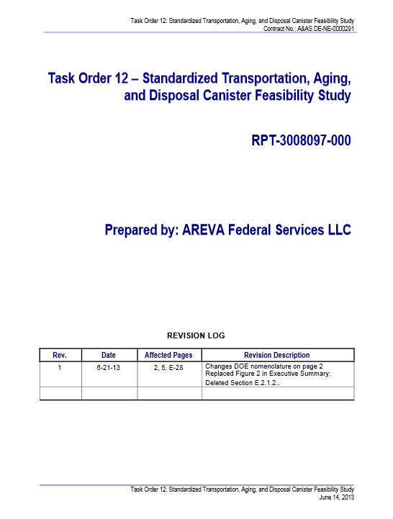
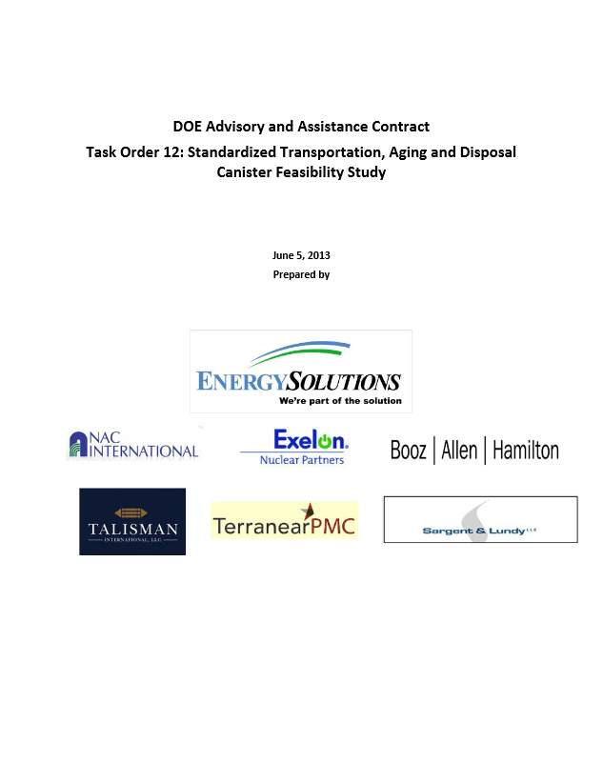
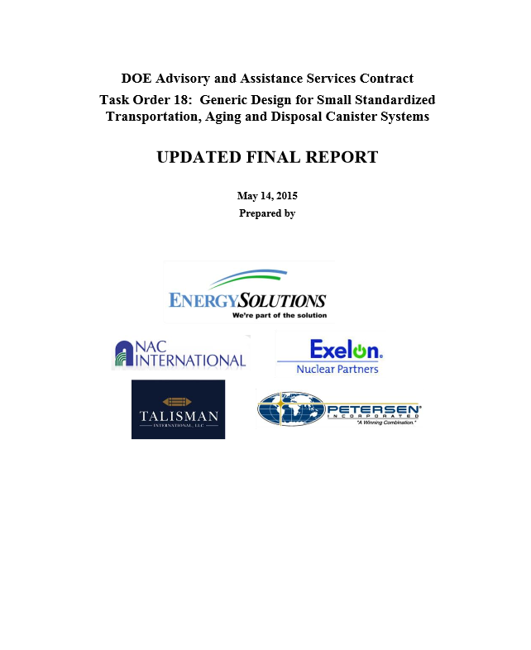
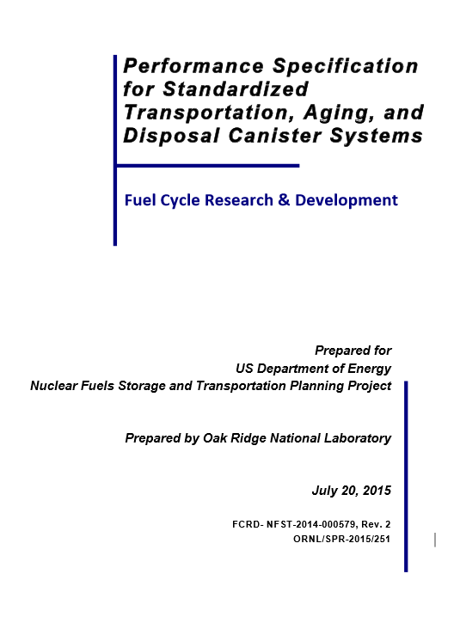
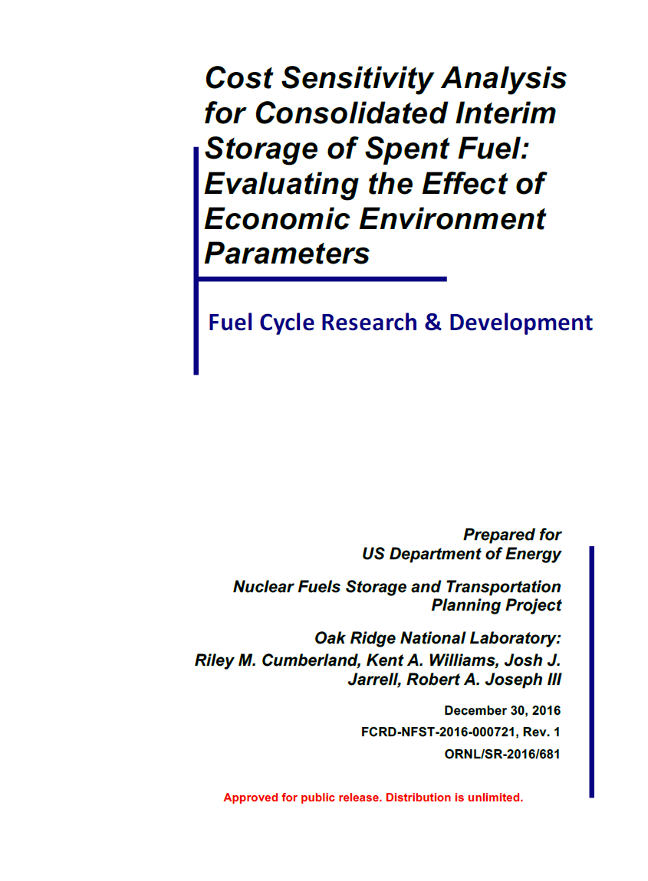
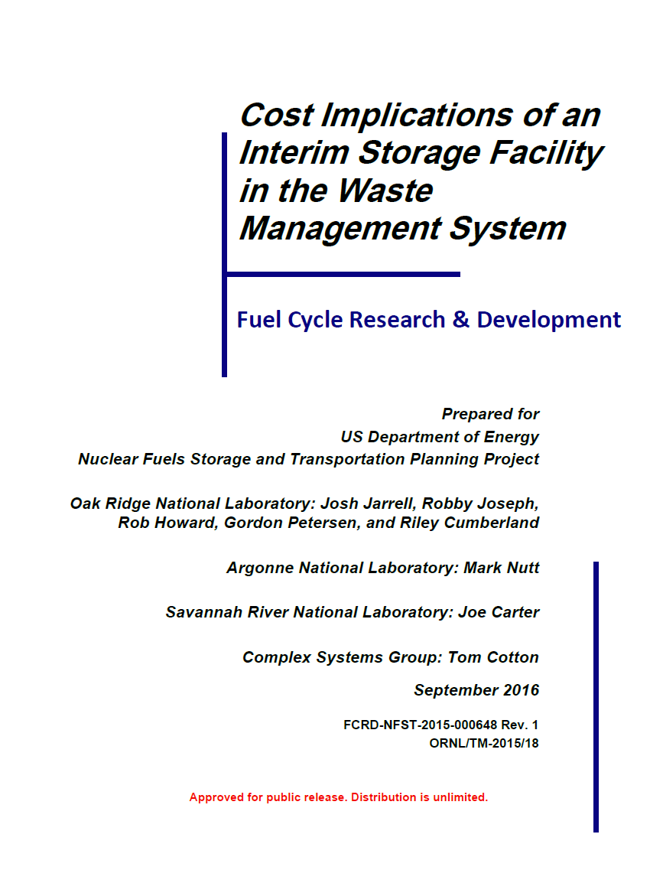
Recent DOE work on Standardized Canisters
Areva Federal Services, 2013, Task Order 12—Standardized Transportation, Aging, and Disposal Canister Feasibility Study, RPT-3008097-000.
Cumberland, R.M., K.A. Williams, J.J. Jarrel, R. A. Joseph III, 2016, Cost Sensitivity Analysis for Consolidated Interim Storage of Spent Fuel: Evaluating the Effect of Economic Environment Parameters, FCRD-NFST-2016-000721, Rev. 1, ORNL/SR-2016/681.
Energy Solutions et al., 2013, Task Order 12: Standardized Transportation, Aging, and Disposal Canister Feasibility Study.
Energy Solutions et al., 2015, Task Order 21: Operational Requirements for Standardized Dry Fuel Canister Systems, Updated Final Report.
Energy Solutions et al., 2015, Task Order 18: Generic Design for Small Standardized Treansportation, Aging, and Disposal Canister Systems, Updated Final Report.
Jarrell, J., R. Joseph, R. Howard, R. Hale, G. Petersen, B. Wilkerson, J. Fortner, E. Kalinina, Initial Standardized Canister System Evolution, FCRD-NFST-2014-000084, Rev. 1, ORNL/LTR-2014-330, U.S. Department of Energy Nuclear Fuels Storage and Transportation Planning Project.
Jarrell, J., R. Joseph, R. Howard, G. Petersen, R. Cumberland, M. Nutt, J. Carter, and T. Cotton, 2016, Cost Implications of an Interim Storage Facility in the Waste Management System, FCRD-NFST-2015-000648 Rev.1 ONRL/TM-2015/18.
Oak Ridge National Laboratory, 2015, Performance Specification for Standardized Transportation, Aging, and Disposal Canister Systems, FCRD-NFST-2014-000579, Rev. 2, ORNL/SPR-2015/251, U.S. Department of Energy Nuclear Fuels Storage and Transportation Planning Project.
All reports available at https://curie.ornl.gov/

Slide 17
International Perspectives
Potential Interface Issues in Spent Fuel Management, IAEA- TECDOC 1774, 2015:
  “A systems approach is needed to ensure that influences from and impacts on all phases of [the back end of nuclear] fuel cycle are taken into account when making decisions.”
  “The biggest uncertainty in successfully integrating the [back end of the nuclear fuel cycle] is the uncertainty relative to the end point.” In the US, the “end point” is geologic disposal.
  Successful integration requires an understanding of the full cycle and the willingness to make trade-offs [emphasis added] that assure success over all phases of the [back end of the nuclear fuel cycle] rather than optimizing for particular interfaces …”
  “Effective integration begins early in the planning process. Opportunities are lost if interfaces are not identified and addressed in the early stages of each of the [back end of the nuclear fuel cycle] phases.”

Slide 18
Non-Technical Issues
What would a better SNF/HLW integrated management system look like?
What metrics should be used to judge the effectiveness of an integrated SNF/HLW management system? (e.g., cost, safety, security?)
What barriers prevent the implementing of an integrated system?
Are the benefits of a better integrated system worth the cost?
What can a country (e.g., US) do now that will impact future practice?
Can we plan for flexibility and contingency in case a stable national policy is not achieved?
What are the implications of doing nothing now?

Slide 19
Concluding Remarks
We have highlighted the technical implications of lack integration of the back end of the nuclear fuel cycle using the current US situation as an example.
  Bottom line: Technical implications can be addressed; is a matter of cost and schedule.
In the form of questions, we have listed (based on our opinion) non-technical issues that would need to be resolved to achieve a better integrated system.
  These are difficult issues that fall in the policy and social science realm.
Integration of the back end of the nuclear fuel cycle requires consideration of the entire system employing system engineering principles
  Optimization of components of the system independent of each other does not seem to be a prudent approach.

Slide 20
References
Hardin, E., J. Blink, H. Greenberg M. Sutton, M. Fratoni, J. Carter, M. Dupont, R. Howard. 2011. Generic Repository Design Concepts and Thermal Analysis (FY11). FCRD-USED-2011-0002143 Rev. 2. U.S. Department of Energy, Office of Used Nuclear Fuel Disposition, December, 2011.
Hardin, E., T. Hadgu, D. Clayton, R. Howard, H. Greenberg, J. Blink, M. Sharma, M. Sutton, J. Carter, M. Dupont and P. Rodwell 2012. Repository Reference Disposal Concepts and Thermal Management Analysis. FCRD-USED-2012-000219 Rev. 2. U.S. Department of Energy, Office of Used Nuclear Fuel Disposition. November, 2012.
Hardin, E., D. Clayton, M. Martinez, G. Nieder-Westermann, R. Howard, H. Greenberg, J. Blink and T. Buscheck 2013. Collaborative Report on Disposal Concepts. FCRD-UFD-2013-000170 Rev. 0. U.S. Department of Energy, Office of Used Nuclear Fuel Disposition. September, 2013.
Hardin, E., L. Price, E. Kalinina, T. Hadgu, A. Ilgen, C Bryan, J. Scaglione, K. Banerjee, J. Clarity, R. Jubin, V. Sobes, R. Howard, J. Carter, T. Severynse, and F. Perry, 2015. Summary of Investigations on Technical Feasibility of Direct Disposal of Dual-Purpose Canisters, FCRD-UFD-2015-000129 Rev 0, U.S. Department of Energy, Office of Used Nuclear Fuel Disposition, May 2015.
International Energy Agency, 2015. Potential Interface Issues in Spent Fuel Management, IAEA-TECDOC-1774, October 2015.
National Research Council / National Academies, 2001. Disposition of High-Level Waste and Spent Nuclear Fuel: The Continuing Societal and Technical Challenges, Washington, DC, National Academy Press.
Stockman, C. and E. Kalinina, 2013. Cooling Times for Storage and Transportation of Spent Nuclear Fuel. SAND NO. 2013-2013P.

Slide 21
Thank you!
Contact Information:
Dr. Evaristo J. (Tito) Bonano, ejbonan@sandia.gov
Dr. Peter N. Swift, pnswift@sandia.gov
Advanced Nuclear Energy Programs
Sandia National Laboratories
Albuquerque, NM 87185 USA

