Slide 1


Characterisation of UK cement backfill material pre- and post-groundwater leaching experiments
Rita Vasconcelos,
Dr. Claire Corkhill and Prof. John Provis
Department of Materials Science and Engineering, The University of Sheffield
Scientific Basis for Nuclear Waste Management Symposium 2017
29th October – 3rd November 2017

Slide 2
UK Geological Disposal Facility Concept
NRVB (Nirex Reference Vault Backfill)
Portland cement; Ca(OH)₂; CaCO₃
High alkalinity for chemical conditioning
High permeability and porosity
High fluidity
Low strength
NDA, 2010. “Geological Disposal: Near-Field Evolution Status Report”

Slide 3
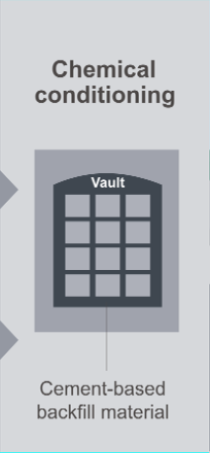
Project Objective
Backfill material
Interactions with the environment
Groundwater
Affect mineralogy and structural properties of cement
Thorough understanding of the initial chemistry and microstructure of NRVB
Leaching experiments
  Post-leaching characterisation

Slide 4
Characterisation of NRVB

Slide 5
Characterisation
Material | Content (kg m⁻³)
CEM I 52.5 N | 450
Hydrated lime | 170
Limestone flour | 495
Water | 615
Water/Solid ratio | 0.55
First characterisation performed in early 90’s
  Literature contains few details regarding methods and materials
Isothermal calorimetry
The four main hydrate stages were observed
NRVB demonstrated a intense sulfate depletion (4) reaction
The heat of hydration is smaller when compared to Portland cement (maximum ~ 230 J/g, Jansen et al. 2012)
Dissolution and reaction of tricalcium aluminate
Induction period
Alite and Belite reaction
Sulfate depletion
Vasconcelos et al., 2017. App. Geo. Chem. (in review)
Notes:
Determined to be….

Slide 6
Characterisation
After 28 days of curing
X-Ray Diffraction
Thermogravimetric-Mass spectroscopy
Between 100 to 200 °C – ettringite and monocarboaluminate/hemicarboaluminate
Between 400 to 500 °C – portlandite
Between 650 to 800 °C – calcite
Vasconcelos et al., 2017. App. Geo. Chem. (in review)

Slide 7
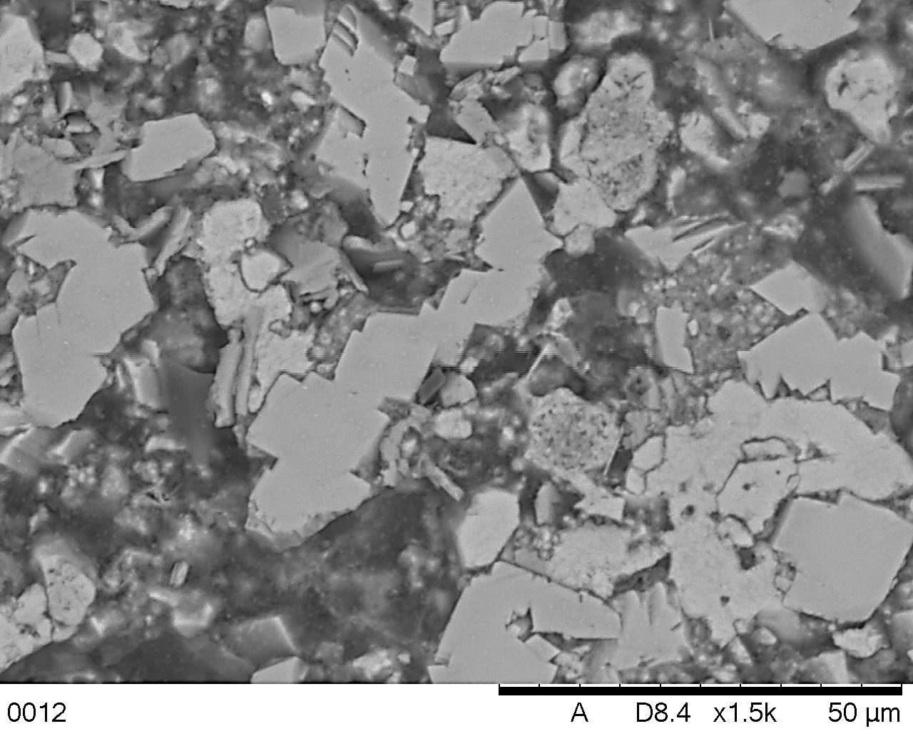
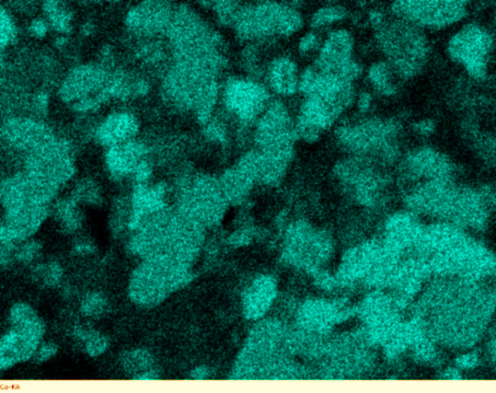
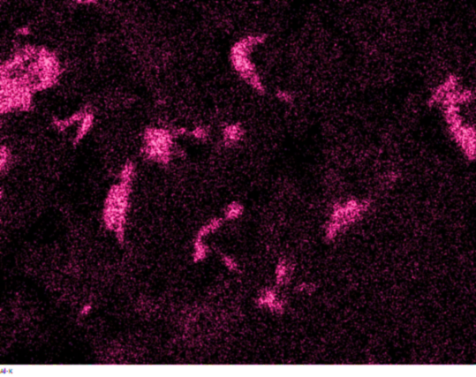
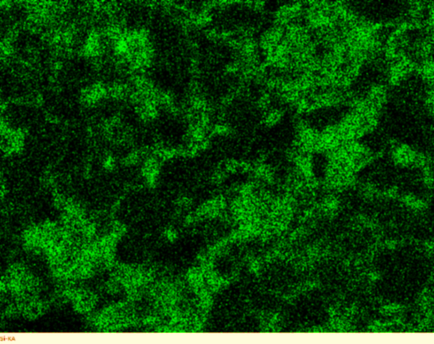
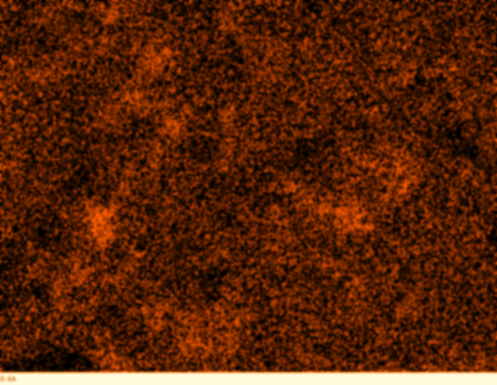
Characterisation
After 28 days of curing
Ca
Al
C
Si
S
D
B
A
Scanning electron microscope / Electron-dispersive X-ray Spectroscopy
Portlandite
C-S-H
Monocarboaluminate
Ettringite
Vasconcelos et al., 2017. App. Geo. Chem. (in review)

Slide 8
Characterisation
After 28 days of curing
²⁹Si NMR
²⁷Al NMR
Presence of unreacted Portland cement
Incorporation of Al in the C-(A)-S-H observed in ²⁹Si and ²⁷Al NMR
Formation of more AFm phase
Vasconcelos et al., 2017. App. Geo. Chem. (in review)
Notes:
Nuclear magnetic resonance spectroscopy

Slide 9
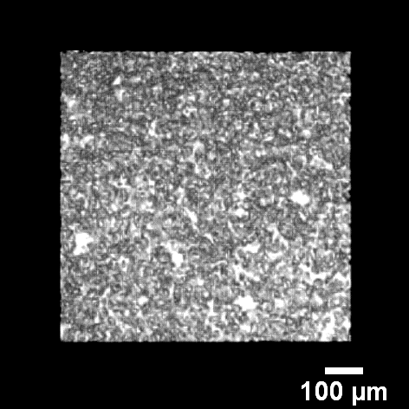
Characterisation
After 28 days of curing
Mercury Intrusion Porosimetry
NRVB = 32 ± 1 %
Pores size below 0.5 µm
X-Ray Computed Tomography
NRVB = 35 %
Pores in white
Vasconcelos et al., 2017. App. Geo. Chem. (in review)

Slide 10

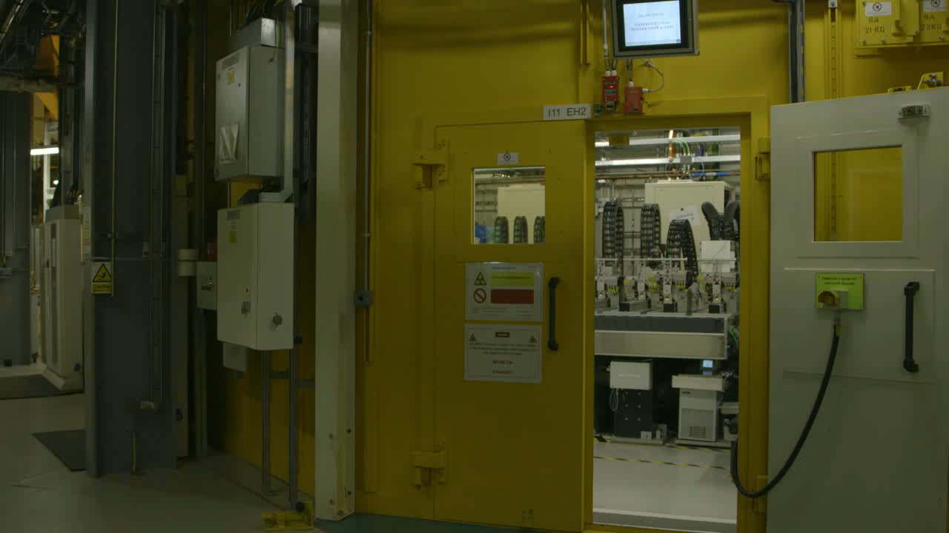
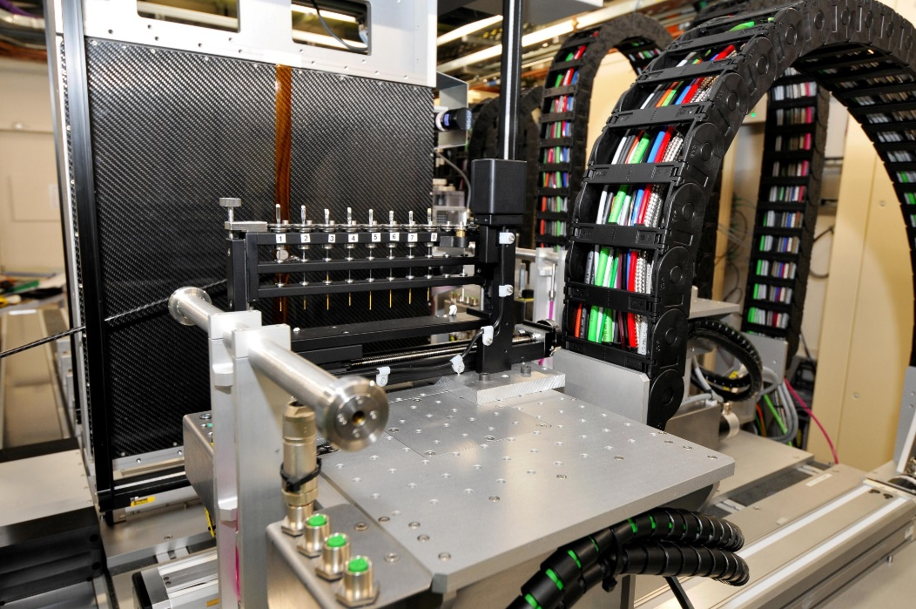
Characterisation: Long duration analysis of nuclear cement hydration by synchrotron XRD (Dr. Claire Corkhill)
Sample:
Nirex Reference Vault Backfill (NRVB)
Currently at Day 1124

Slide 11
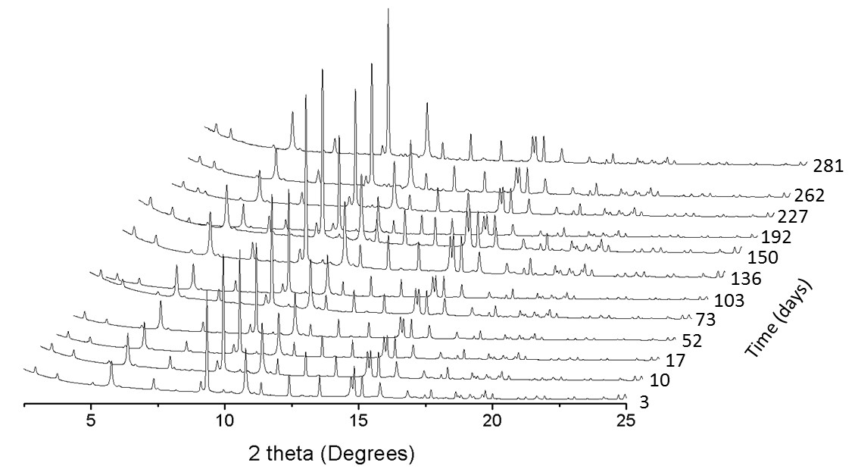
Characterisation
World first long-duration experiment
Study the cement hydration over more than 3 years
Cement samples are monitored through XRD measurements at specific times:
  30 mins to 72 hours: collected every 30 minutes on MAC array
  72 hours to 1 year: collected once per week on LDE detector
  1 year to 3 years: collected once per month on LDE detector
²⁹Si NMR: disappearance of the chemical shift corresponding to belite
Rietveld refinement to quantify the evolution of the phases
Aim is to understand the long-term evolution of the NRVB hydrate phases
Notes:
We know that after two years has evolved as shown in the Si NMR
However we don’t know how that evolution occurs over time. So this data is very important to understand….
Rietveld analysis of the 3 years data will be performed to calculate the hydration evolution of the phases

Slide 12
Leaching Experiments

Slide 13
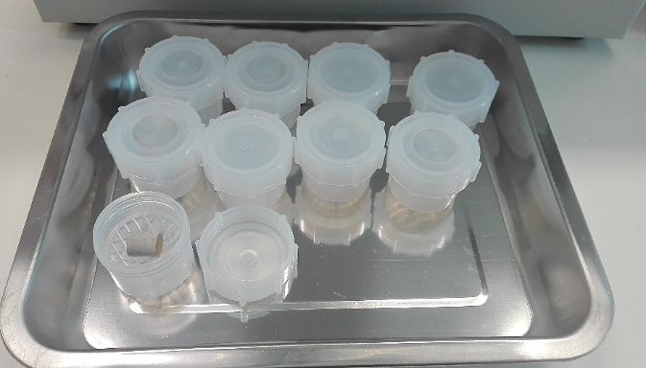
Preliminary Leaching Experiments
NRVB was cured for 28 days and cylinders prepared (15 x 15 mm). Ends of the cylinder were sealed with epoxy
NRVB cylinder placed in 50 mL of groundwater (granitic, clay and saline groundwater) at 40 °C, and sampled at specific intervals until 35 days
pH was measured and an increase was observed, as expected from geochemical modelling (Amphos 21)
Notes:
Representative of the different geological environments
L/S ratio = 10

Slide 14
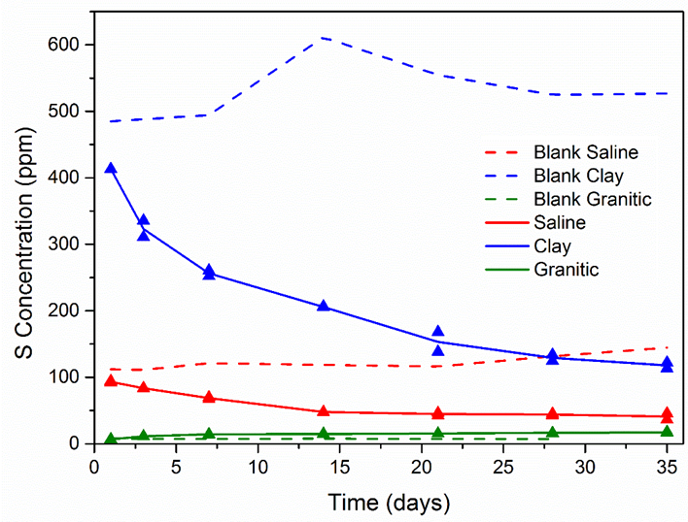
Preliminary Leaching Experiments
ICP-OES
XRD
Gradual decrease of the concentration of S, which is consistent with an uptake of sulfate by NRVB, as shown in the XRD (increasing ettringite)

Slide 15
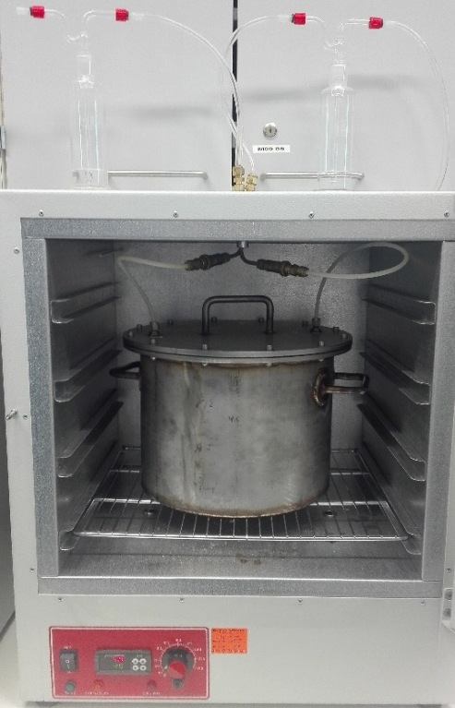
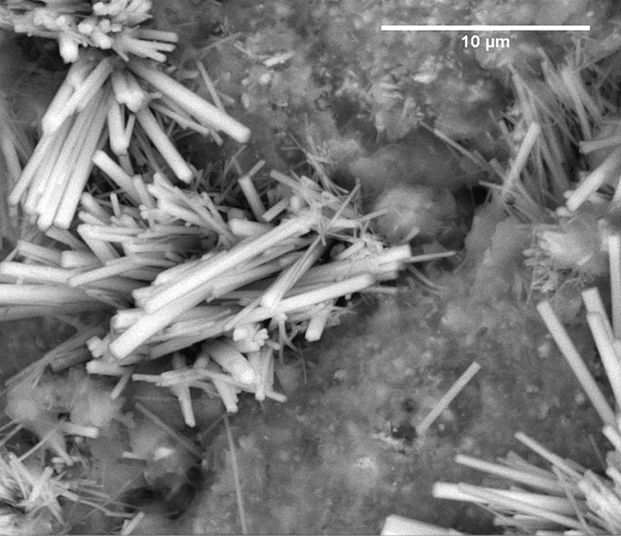
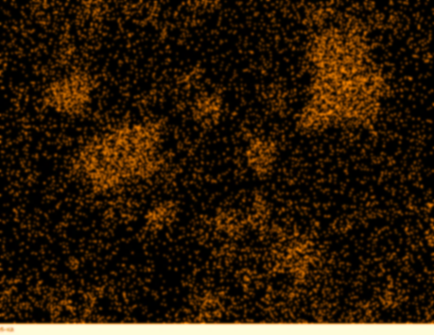
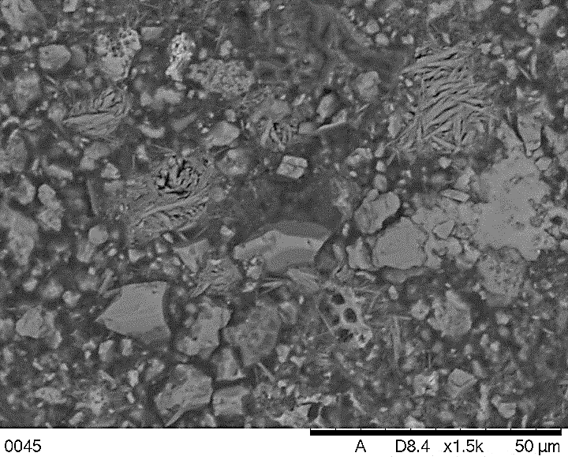
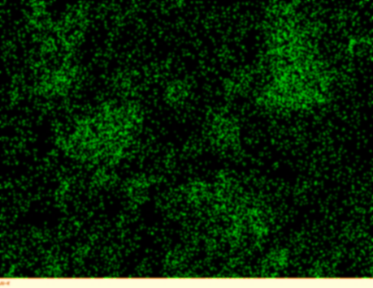
Long-duration leaching experiments
Semi-dynamic experiment: Cement placed in a 60 mL vessel; sampling and replacement of the groundwater every 2 months over 1.5 years;
Static experiment: Cement placed in a 2 L vessel; analysed at the end of the experiment; 1.5 years
All experiments performed at 40 °C and controlled nitrogen
Experimental analysis: XRD; XCT; TG-MS; SEM; ICP; IC
2 months
S
Mg(OH)₂
MgCO₃
Al
NRVB 4 months - Clay
Notes:
Is the localised expansion
L/S ratio = 200

Slide 16
Conclusions
Main phases observed in NRVB after 28 days of curing:
  Calcite, Portlandite, Ettringite, Monocarboaluminate, Hemicarboaluminate and C-(A)-S-H
In the leaching experiments, differences were observed after 1, 2 and 4 months
  Formation of ettringite, that might cause cracks
  Formation of brucite, that might cause changes in the porosity
Future Work
Analyse of the 3 years data from the long-duration synchrotron XRD experiment
Long-duration leaching experiments using two cements and three groundwaters
  NRVB
  Cebama reference cement (Portland cement blended with silica fume and blast furnace slag)
Post-leaching characterisation (XRD, SEM, XCT, TG-MS, ICP, IC)
Notes:
And afterwards do a complete post-leaching characterisation

Slide 17




Acknowledgements
The authors wish to acknowledge funding for this research from Radioactive Waste Management and the European Commission Horizon 2020 Research and Training Programme, Cebama, of the European Atomic Energy Community (EURATOM), under grant agreement number 662147. This research was performed in part at the MIDAS Facility, at the University of Sheffield, which was established with support from the Department of Energy and Climate Change.
Thank you to:
Dr. Amy Shelton (RWM)
Dr. Nicolas Beaudoin (Univ. Strathclyde)
Prof. Andrea Hamilton (Univ. Strathclyde)
Dr. Andres Idiart (Amphos 21)
Colleen Mann (University of Sheffield)

