Slide 1
Investigation of C-14 in the CRUD collected on the coolant filter for safety disposal of radioactive waste containing C-14 (I)
Scientific Basis for Nuclear
Waste Management
Symposium 2017
- C-14 release behavior and thermal decomposition characteristics of CRUD particles collected from the coolant filter of commercial PWR -
Kenichiro KINO
Nuclear Development Corporation（NDC）
Akira SAKASHITA
Mitsubishi Heavy Industries, LTD（MHI）
Kotaro NAKATA
Central Research Institute of Electric Power Industry（CRIEPI）
Shintaro TSUJI, Toshikazu WAKI
The KANSAI Electric Power Co., Inc.（KEPCO）
Nov.2017 Sydney

Slide 2
1. INTRODUCTION
C-14 are generated in NPP
¹⁴N（ｎ，ｐ）¹⁴C , ¹⁷O（ｎ，α）¹⁴C , ¹³C（ｎ，γ）¹⁴C
C-14 has various forms
Inorganic , Organic , Solubility , Hardly soluble
C-14 is attention in Japanese LLW disposal
Long half life(5730y) nuclide
The migration behavior will be change depending on its forms
However, the chemical form of C-14 is little known.
Objective of this study
For the solid LLW disposal
Clarify the chemical form of C-14 in PWR.
Our approach
The thermal decomposition behavior analysis of
C-14 and stable carbon in PWR CRUD

Slide 3
2. CONTENTS
1. Specimens
CRUD collected from demineralizer inlet filter which was used in commercial PWR plant IKATA 3u.
2. SEM/EDS and FT-IR analyses
Check about similarity of specimen between this study and previous research.
3. TG/MS and C-14 radiochemical analyses experiments
Thermal decomposition temperature and release component.
Thermal decomposition behaviors of stable and
radioactive carbon(C-14) in the CRUD.

Slide 4
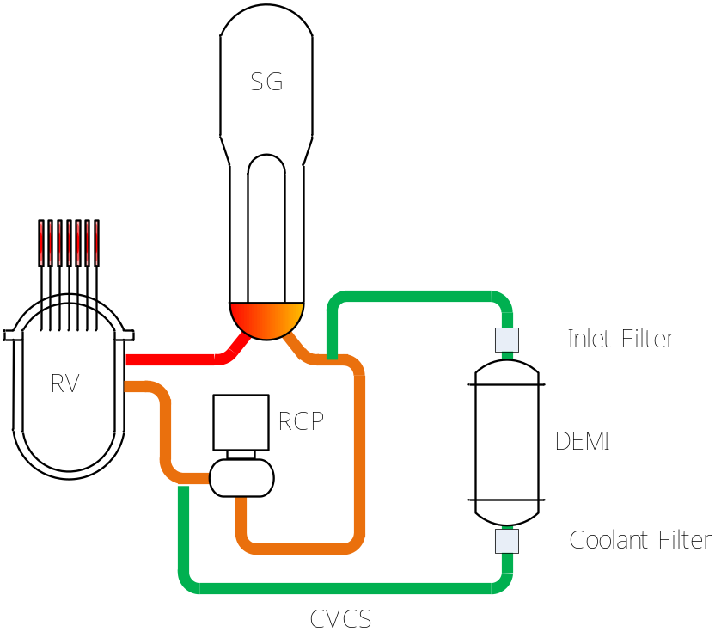
3. Specimens
CRUD is the main activity source of LLW
PWR has two kind of filter on CVCS
CRUD were captured by these filters
The specimen
Inlet filter of commercial PWR plant*¹.
*¹ IKATA Unit 3【PWR】
of Shikoku Electric Power Co., Inc.
Fig 1 Schematic diagram of PWR system
There was possibility that the coolant filter captured the crushed resin leaking from demineralizer.

Slide 5
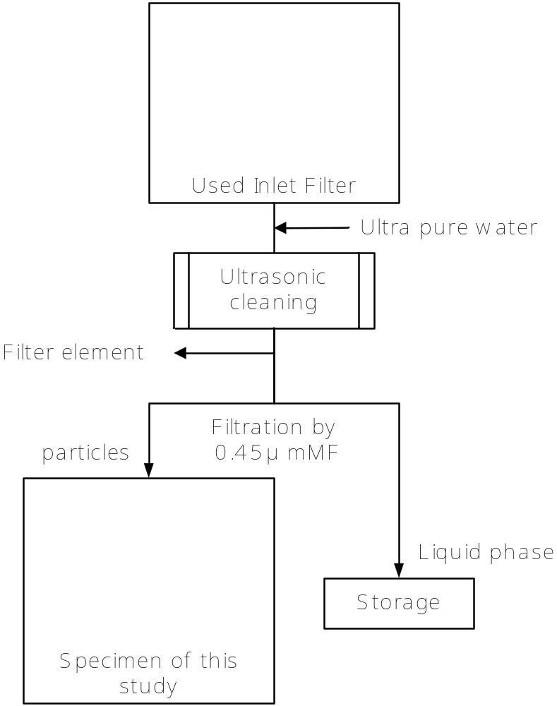
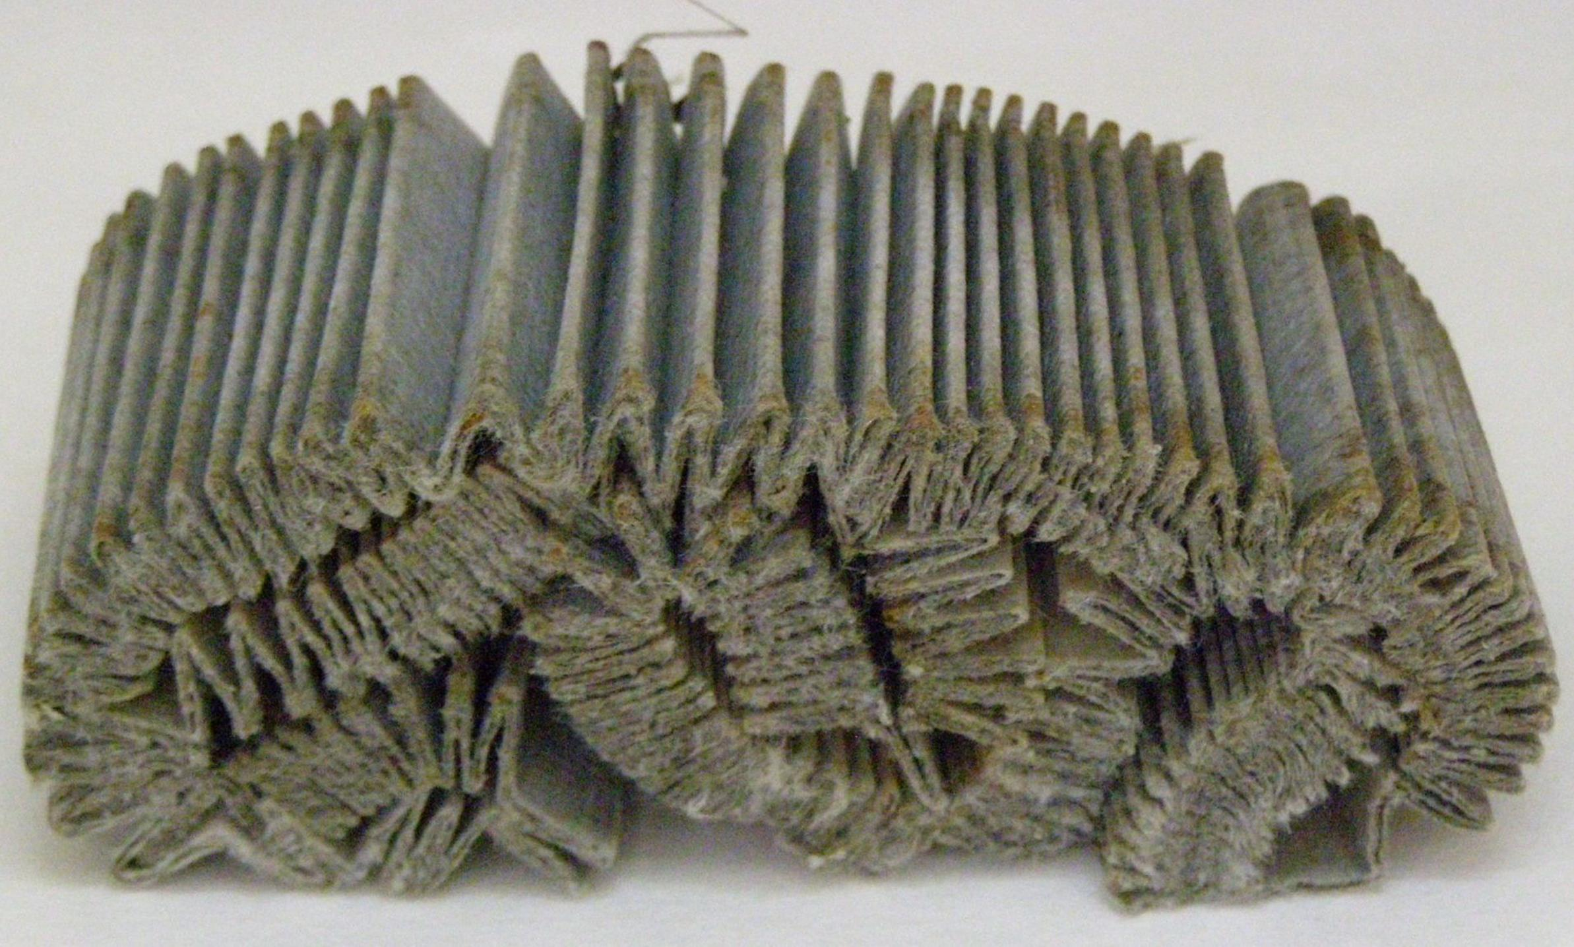
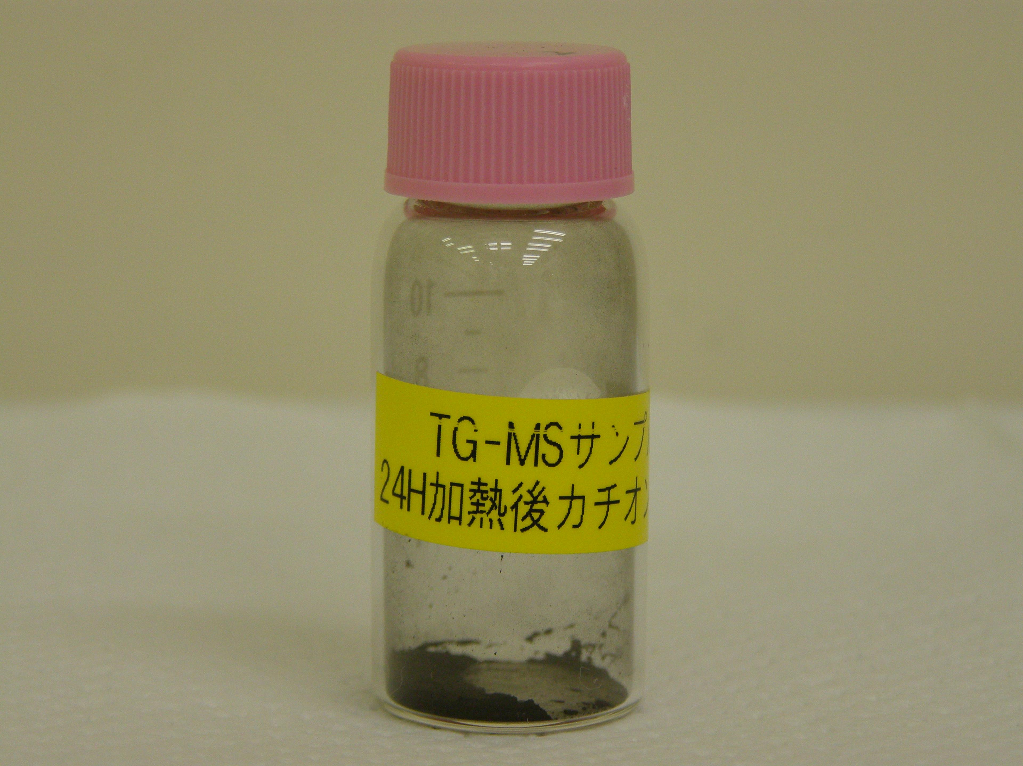
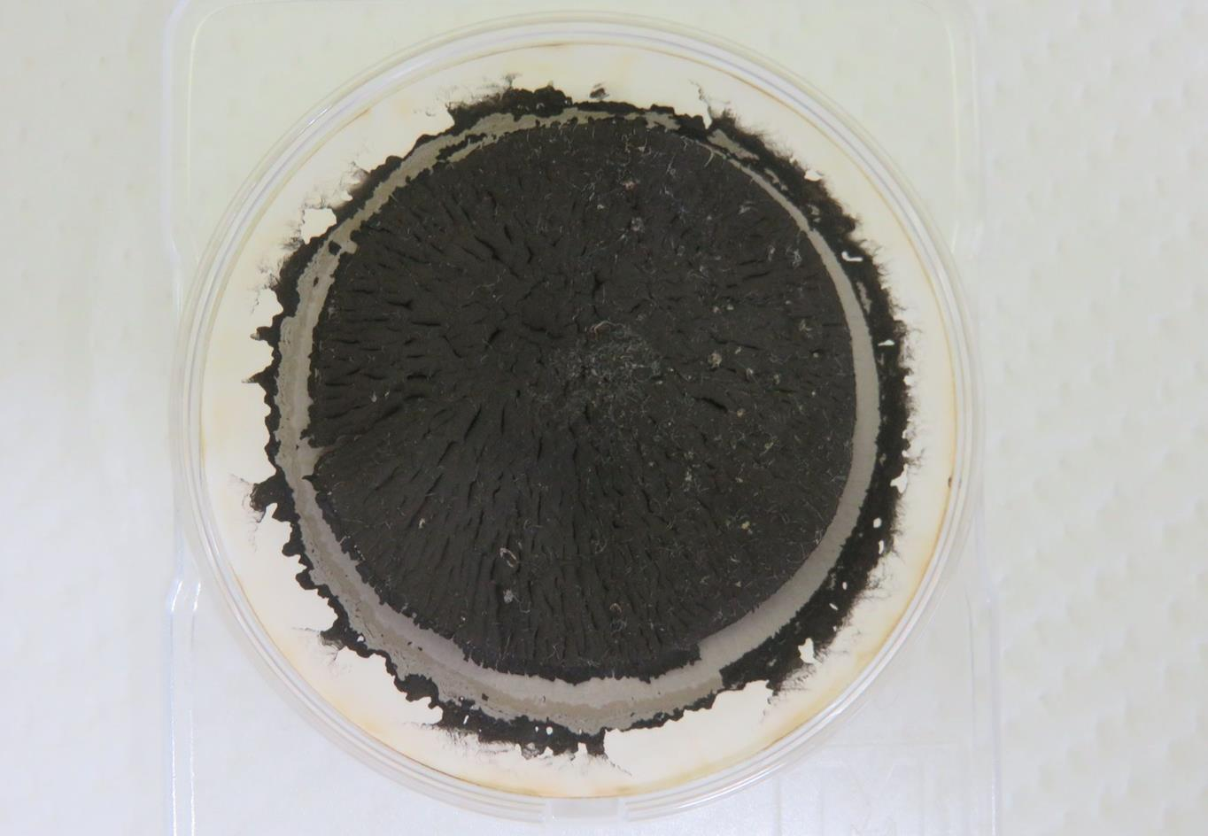
4. Preparation of an experimental samples
We use two kind of samples
Actual CRUD sample
Reference sample
Made from ion-exchange resin
Heat-treated by autoclave*².
Fig 3 Reference sample(non radioactive)
Both sample were black particles.
*² Investigation of C-14 in the CRUD collected on the coolant filter for safety disposal of radioactive waste containing C-14 (II)
Fig 2 Preparation Flow Diagram

Slide 6
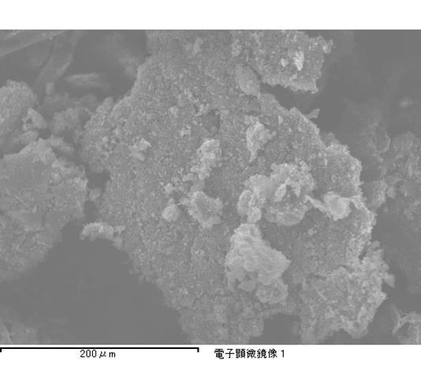
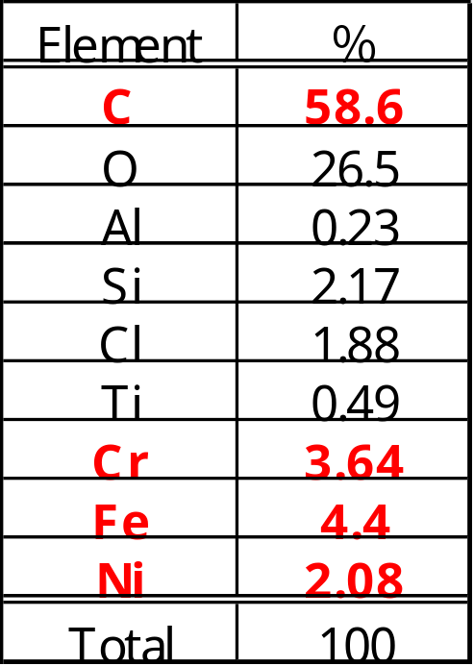
5. Result of the SEM analysis
SEM/EDS result
Small-grain on the flake shaped particle.
Similar result in United States (2001).
58.6% of carbon the element composition in this visual field.
Similar result in Japan(2008) → 30% to 70% carbon was detected.
Table 1 Element composition of DRUD
【IKATA 3u】
Fig 8 Secondary electron image in this study 【IKATA 3u】

Slide 7
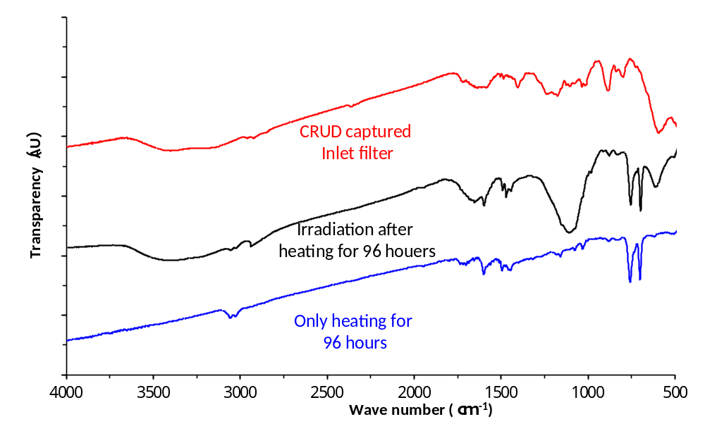
6. Result of the FT-IR analysis
FT-IR result
Hydrogen-bondable functional group
(-OH,-COOH)
CRUD sample
Reference sample with gamma-rays irradiation
Reference sample only heating
Aromatic C=C bond
Aliphatic C-H bond
Fig 9 FT-IR spectrum of CRUD in this study
Hydrogen-bondable functional group were observed without only heating sample.
CRUD contains aromatic and aliphatic organic carbon.
Similar result previous research in Japan(2008).
This sample is typical recently PWR CRUD.

Slide 8
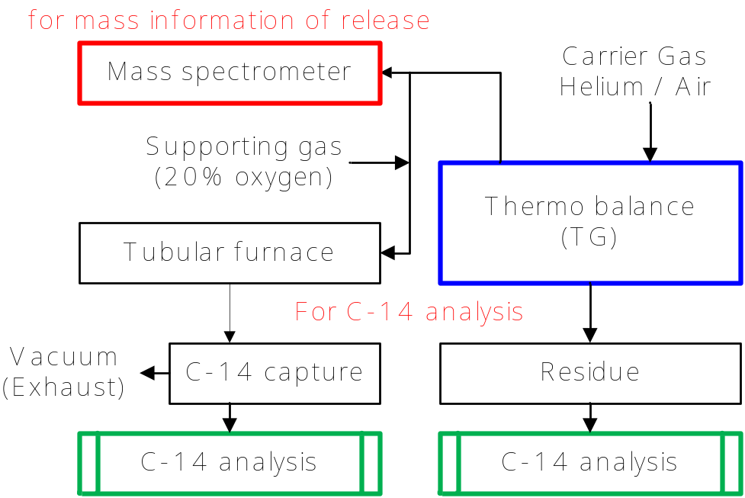
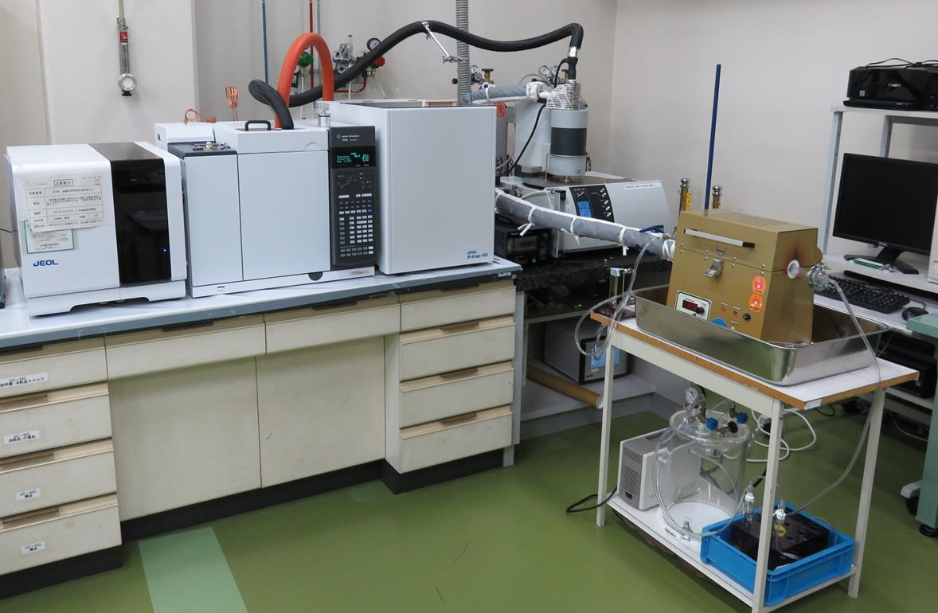
7. TG/MS and C-14 analyses experiment
Experimental procedure
Selected carrier gas Helium / Air
Heat up Room Temp to 900℃【20℃/min】
Monitor mass spectrum m/z = up to 1,000
Catch the C-14 in release gas by 1mol/L NaOH solution.
Analyze C-14
NaOH solution
Residue
Fig 6 Diagram of experiment apparatus
Analytical contents
Weight loss at heat-treatment : TG result
Released molecules : Mass spectrum
Decomposition behaviors of C-14 : Radiochemical analyses
C-14 in residue was measured by LSC, after the collect in captured solution as ¹⁴CO₂ by oxidized in tubular furnace heated to 950℃ with oxidation catalyst and air stream.
¹⁴CO₂ in captured solution was measured to mixed with liquid scintillator after the distillation.
Fig 7 experiment apparatus

Slide 9
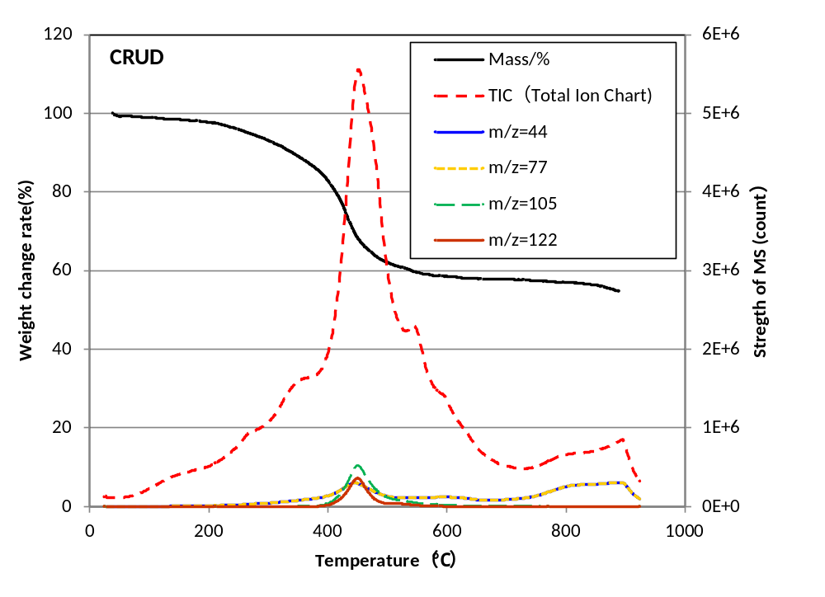
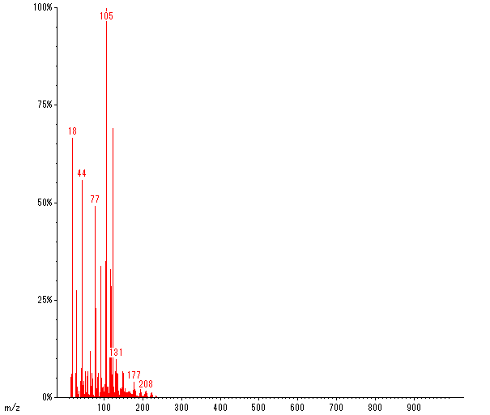
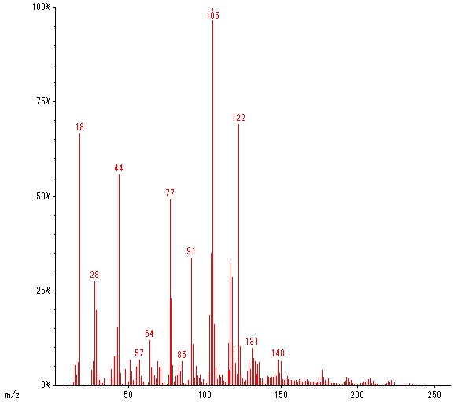
8. Result of the experiment (1)
TG/MS result
C₆H₅CH⁺CH₃
Full range Mass spectrum at 430℃
C₆H₅CH₂⁺
C₆H₅⁺
Fig 11 TG/MS Result of CRUD in the helium stream
Result of Mass spectrum
It was not detected molecules signal greater than m/z = 300.
CRUD contains aromatic hydrocarbons.

Slide 10
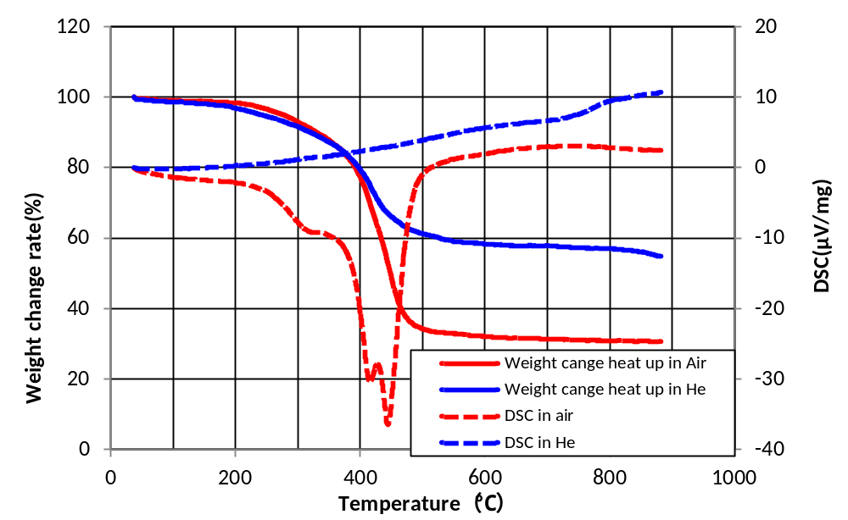
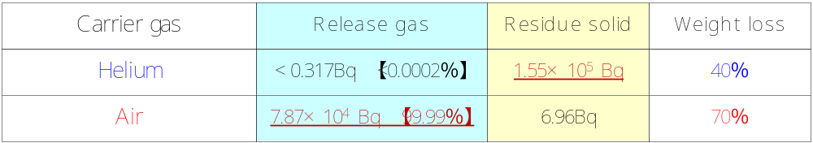
8. Result of the experiment (2)
TG-DSC result
The weight decreases in the range of 300 to 500℃.
The weight change rate in helium heating was smaller than air stream.
The peak of DSC is detected at 430℃ heating in air stream.
(Exothermic reaction)
CRUD sample contained flammable carbon.
Fig 10 TG-DSC spectrum of CRUD in this study
Table 2 Result of C-14 analyses
C-14 in CRUD is not released by heating with inert gas.
C-14 in CRUD is oxidized to CO₂ by heating with air.

Slide 11
9. Considerations on the results
The result of SEM/EDS and FT-IR analyses
The specimen of this study was characteristic PWR CRUD.
It contains a lot of carbon.
CRUD contains carbon which are considered to originate from ion- exchange resin.
These results are not inconsistent with previous research.
The result of TG/MS and C-14 analyses
The CRUD had aromatic hydrocarbons that was considered to generate from ion-exchange resin.
These are released by heating with helium gas.
C-14 in CRUD were not released by heating with helium gas.
C-14 was not contained in heat decomposable aromatic hydrocarbons.

Slide 12
10. CONCLUSIONS
Our specimen was similar CRUD with previous research.
The CRUD had aromatic hydrocarbons that was considered to generated from ion-exchange resin.
C-14 was not contained in heat decomposable aromatic hydrocarbons.
The chemical form of C-14 was not clarified.
It is considered that C-14 in CRUD was contained in thermally stable components.
Grasp of stability and characteristics of thermally stable C-14 in the disposal environment are future tasks.

Slide 13
Thank you very much for your attention

