Slide 1
Highly porous and stable metal–organic frameworks for actinide extraction and storage
CARBONI Michaël
Research Scientist at the French Atomic Energy Commission

Slide 2
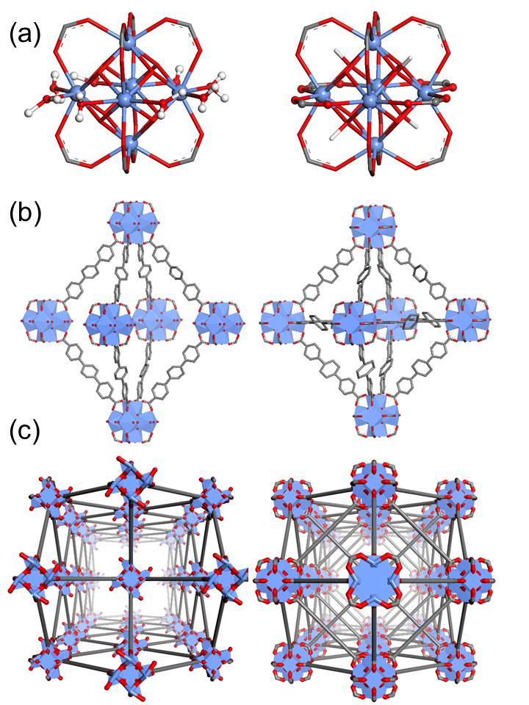
Metal-Organic Frameworks (MOFs)
MOF ?
Crystalline solids
Composed of organic ligands connected by metal ions or metal-clusters
Pores are interconnected to form network of channels
Very high surface areas
Versatile, tunable materials
Various applications
Carboni, M. ; Lin, Z., Abney, C.W. ; Zhang, T. ; Lin, W., Chemistry, A European J, 2014, 20, 14965.

Slide 3
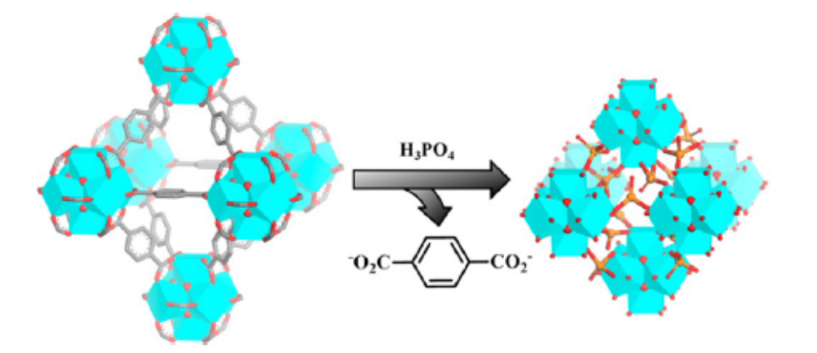
Hybrid materials for Actinides Extraction
Step 1
Metal extraction
(Functionalization)
Metal precipitation
(In-Situ)
Step 2
Conversion (Chemical or heat treatment)
Storage
Extraction + Storage

Slide 4
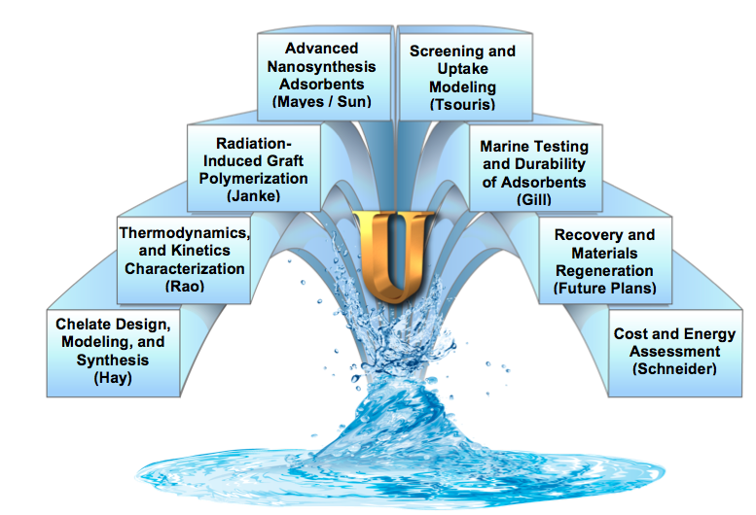
Metal extraction
Oak Ridge National Lab + NEUP :

Slide 5
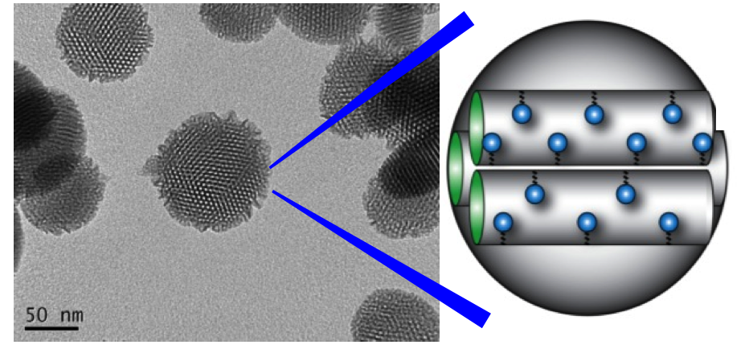
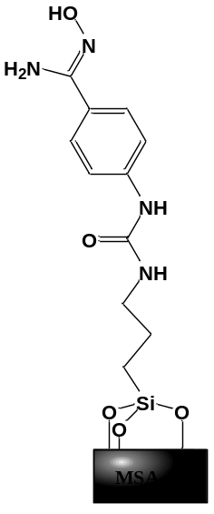
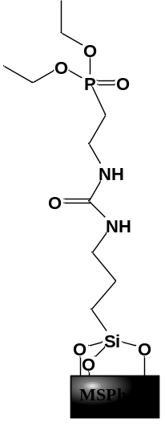
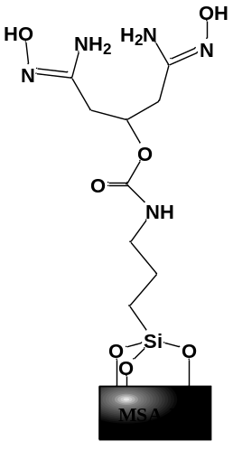
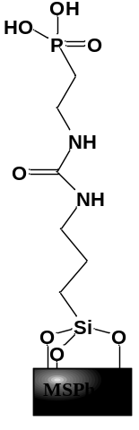
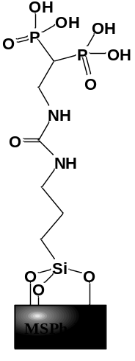
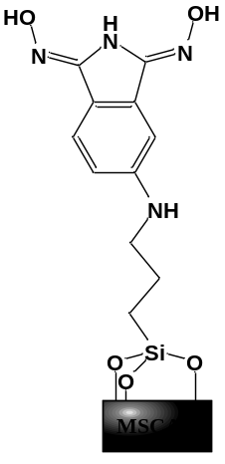
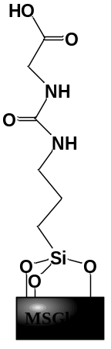
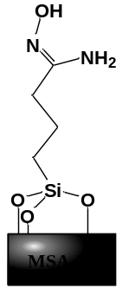
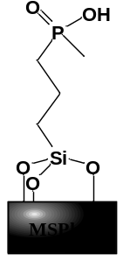
Metal extraction
We have developed a library of 9 different materials based on amidoxime, phosphoric acid, and carboxylic acid functional groups
Vivero-Escoto, J.L. ; Carboni, M. ; Abney, C.W. ; deKrafft, K.E. ; Lin, W. Microporous and Mesoporous Materials, 2013, 180, 22.

Slide 6
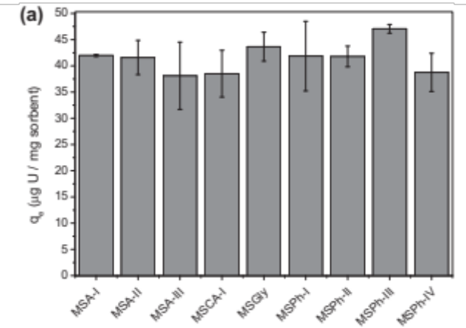
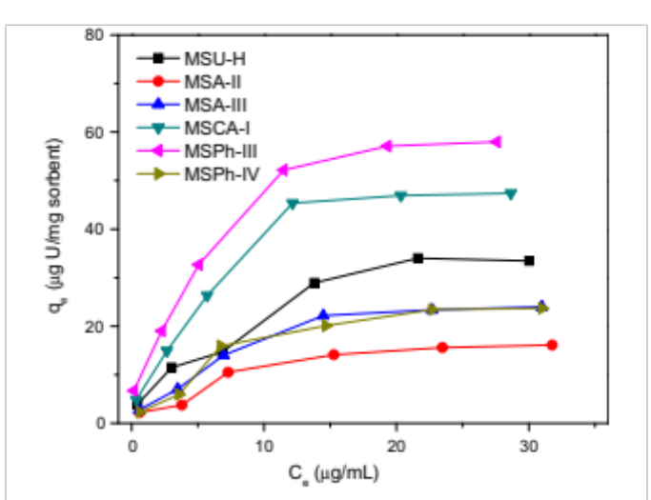
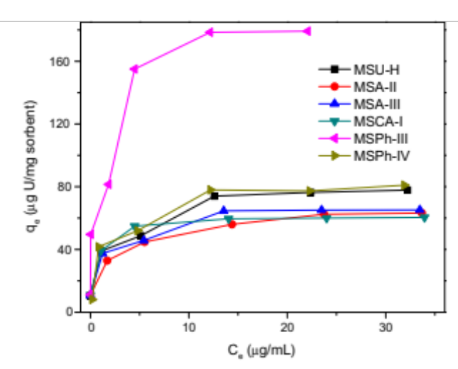
Metal extraction
Best material
Basic Water
Artificial Seawater
In basic water
q_{e} = 185.2 mg/g
In artificial Seawater
q_{e} = 66.7 mg/g
Pros
- Easy to functionalize
- Hydrophilic
Cons
- Non-specific adsorption of U by MSN
- Stability
Vivero-Escoto, J.L. ; Carboni, M. ; Abney, C.W. ; deKrafft, K.E. ; Lin, W. Microporous and Mesoporous Materials, 2013, 180, 22.

Slide 7
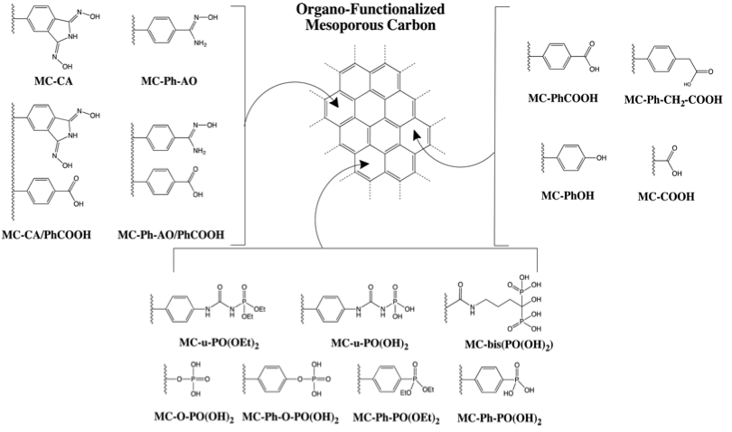
Metal extraction
Carboni, M. ; Abney, C.W. ; Taylor-Pashow, K. M. L. ; Vivero-Escoto, J.L. ; Lin, W. Industrial & Engineering Chemistry Research, 2013, 52, 43, 15187.

Slide 8
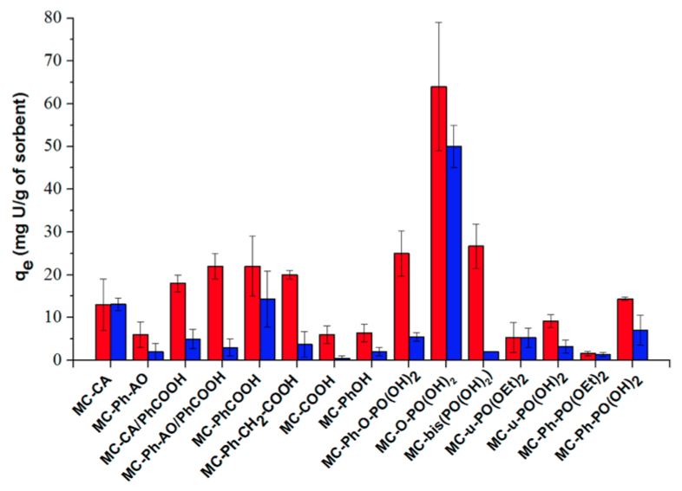
Metal extraction
60 mg/g
Pros
- No U sorption of by MCNs
- Stability
Cons
- Hard to functionalize
- Hydrophobicity
Carboni, M. ; Abney, C.W. ; Taylor-Pashow, K. M. L. ; Vivero-Escoto, J.L. ; Lin, W. Industrial & Engineering Chemistry Research, 2013, 52, 43, 15187.

Slide 9
Lab Activities on MOFs
MOFs for metal extraction ?

Slide 10
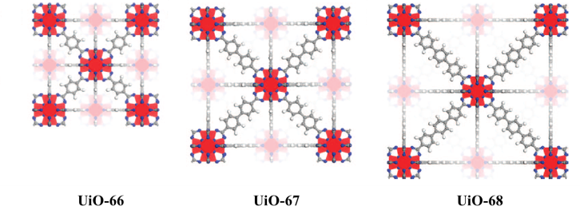
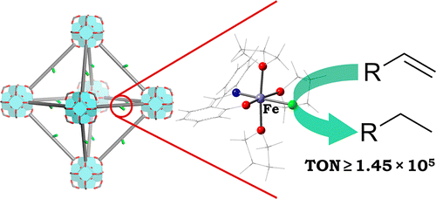
Metal extraction
Zr MOFs
UiO Family
High Stability
Easy tunability
Easy to synthesize
(1)
(2)
1 - Navarro Amador, R., Carboni, M., Meyer, D. , Mater. Lett. 2016, 166, 327.
2 - Manna, K; Zhang, T., Carboni, M.; Abney, C.W.; Lin, W., JACS, 2014, 136, 13182

Slide 11
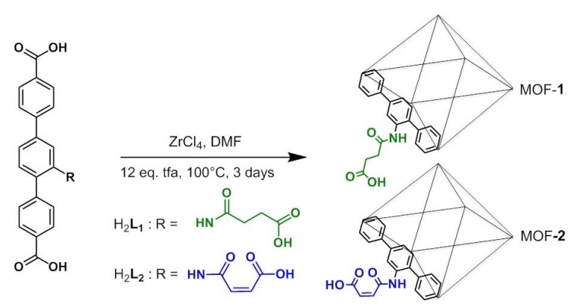
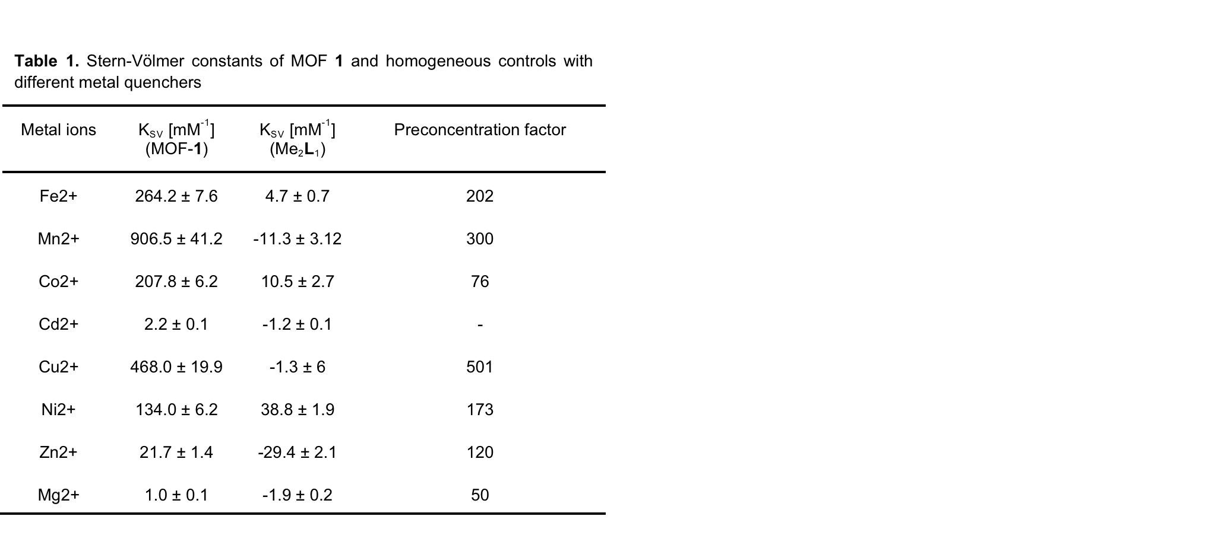
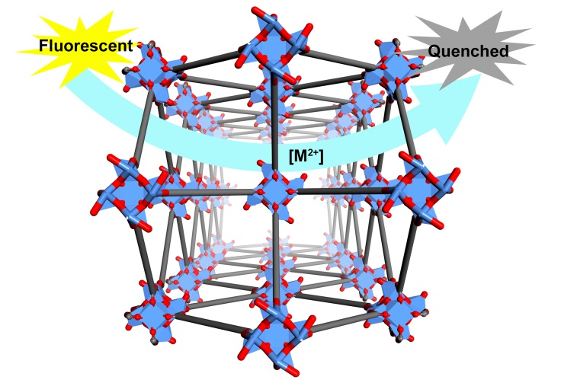
Metal extraction
First example
X-ray Structure
Zr6L4
Zr6L6
Carboni, M. ; Lin, Z., Abney, C.W. ; Zhang, T. ; Lin, W., Chemistry, A European J, 2014, 20, 14965.

Slide 12
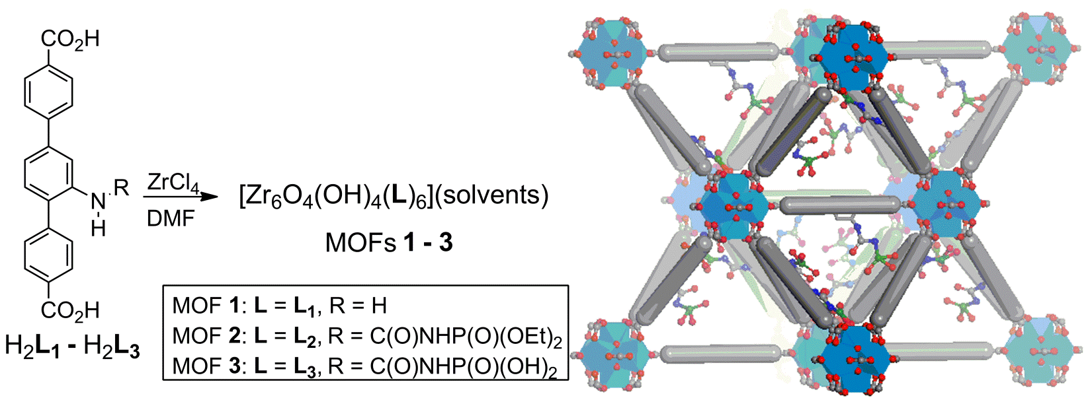
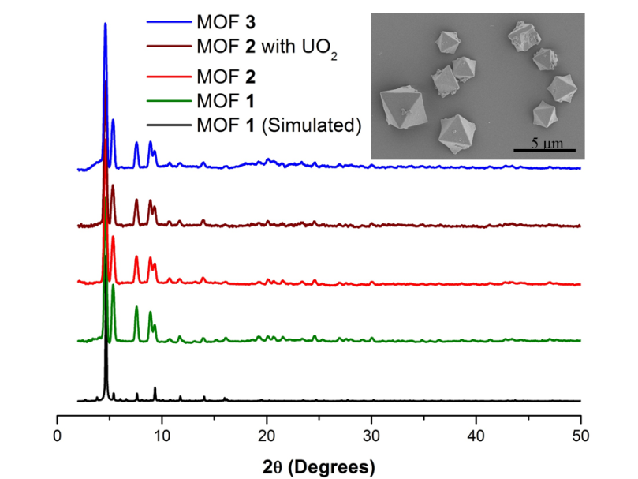
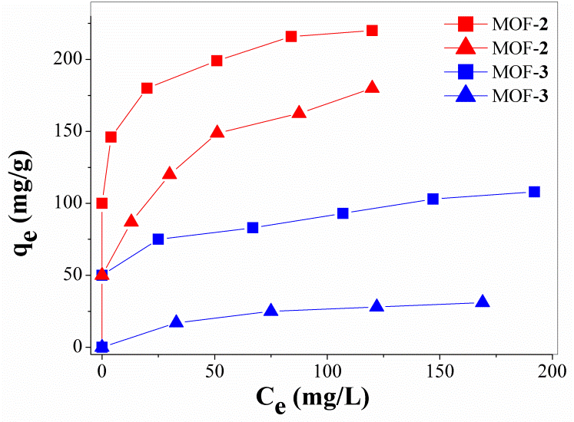
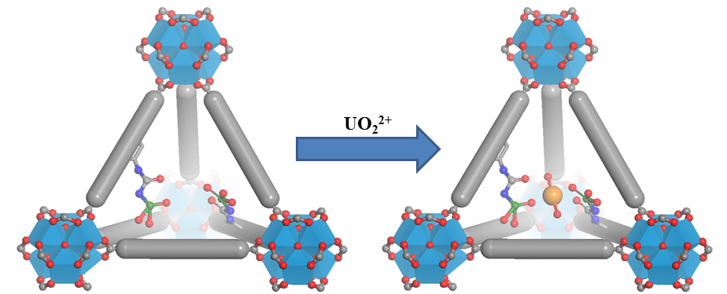
Metal extraction
Second example
Carboni, M. ; Abney, C.W. ; Liu, S. ; Lin, W., Chemical Science, 2013, 4, 2396.

Slide 13

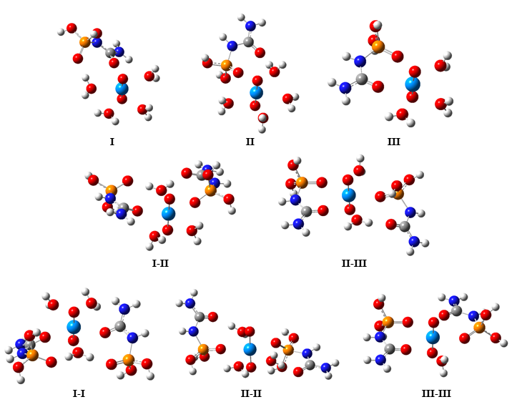
Metal extraction
Intra-sorbent distances of 4.5 – 4.8 Å
Cooperative binding interactions help explain high U affinity
Carboni, M. ; Abney, C.W. ; Liu, S. ; Lin, W., Chemical Science, 2013, 4, 2396.

Slide 14
Metal extraction
Stability of Zr-MOF in sulfuric conditions
0,1M H
SO
+ 1,4M SO
2-
OK
2
4
4
1M H
2
SO
4
0,1M H
2
SO
4
5
10
15
20
25
30
35
40
45
50
55
60
2 Theta (°)

Slide 15
Metal extraction
Stability of Zr-MOF in phosphoric conditions
0,1M H
3
PO
4
0,01M H
PO
3
4
avant contact
5
10
15
20
25
30
35
40
45
50
55
60
2 theta (°)

Slide 16
Metal extraction
How to o increase the stability ?
Lanthanide MOFs in phosphoric media ?
1 M H
PO
3
4
0,1 M H
PO
3
4
5
10
15
20
25
30
35
40
45
50
55
60
2 Theta (°)
Phosphonate linker instead of carboxy?

Slide 17
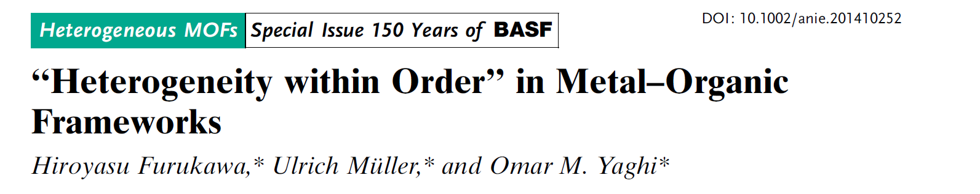
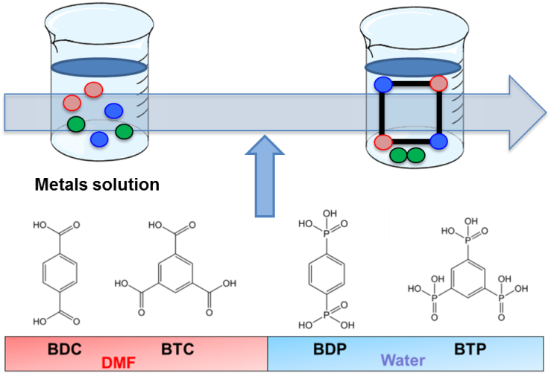
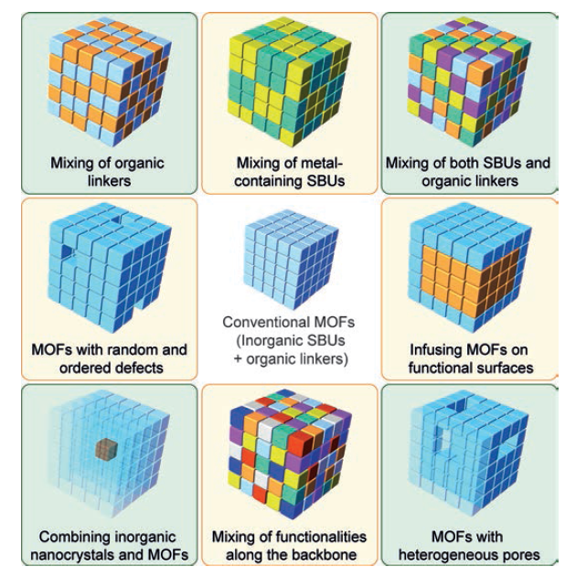
Metal precipitation
Selective precipitation as MOF
Thermal conversion
Storage
- Perez, E., Navarro-Amador, R., Carboni, M., Meyer, D., Materials Letters, 2016, 167, 188.
- E. Perez, M.L. Andre, R. Navarro Amador, F. Hyvrard, J. Borrini, M. Carboni, D. Meyer Journal of Hazardous Material, 2016, 317, 617.

Slide 18
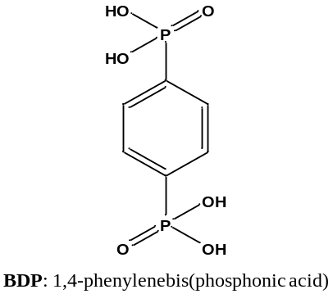
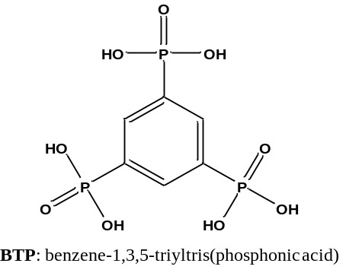
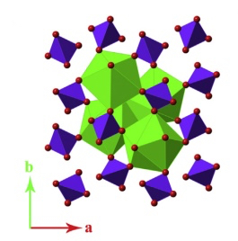
Metal precipitation
Phosphonates vs. Carboxylates: stronger bonds to metals
Bonds with M^{n+} (n = 1-4): metal valence increases, solubility decreases
Unconvertional MOFs: lack highly order structure, insolubility, great thermal stability
(Ref: Perez et al.)
Monazites
Light rare-earth elements (ThO2: 29 wt%; UO2: 16 wt%)
Can be converted from phosphonate-based MOFs

Slide 19
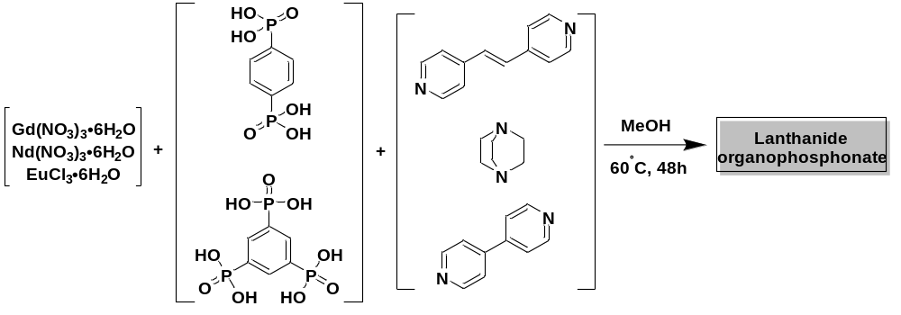
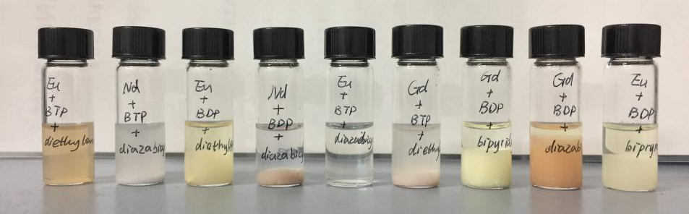
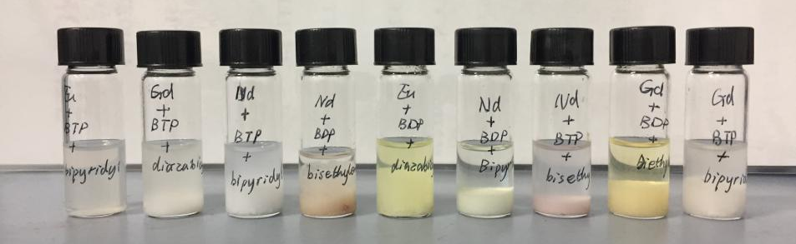
Metal precipitation
Lanthanide organophosphonates
Ln³⁺
+
Ligand
+
Spacer
[Ln_ligand_spacer]
1 : 1 : 2

Slide 20
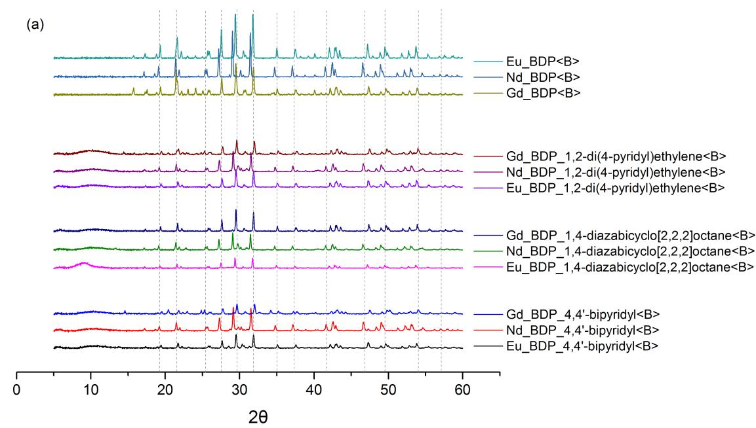
Metal precipitation
BDP-based Ln organophosphonates
Thermal conversion
Monazite lanthanide phosphates
LnPO₄
[Ln_BDP]
[Ln_BDP_spacer]

Slide 21
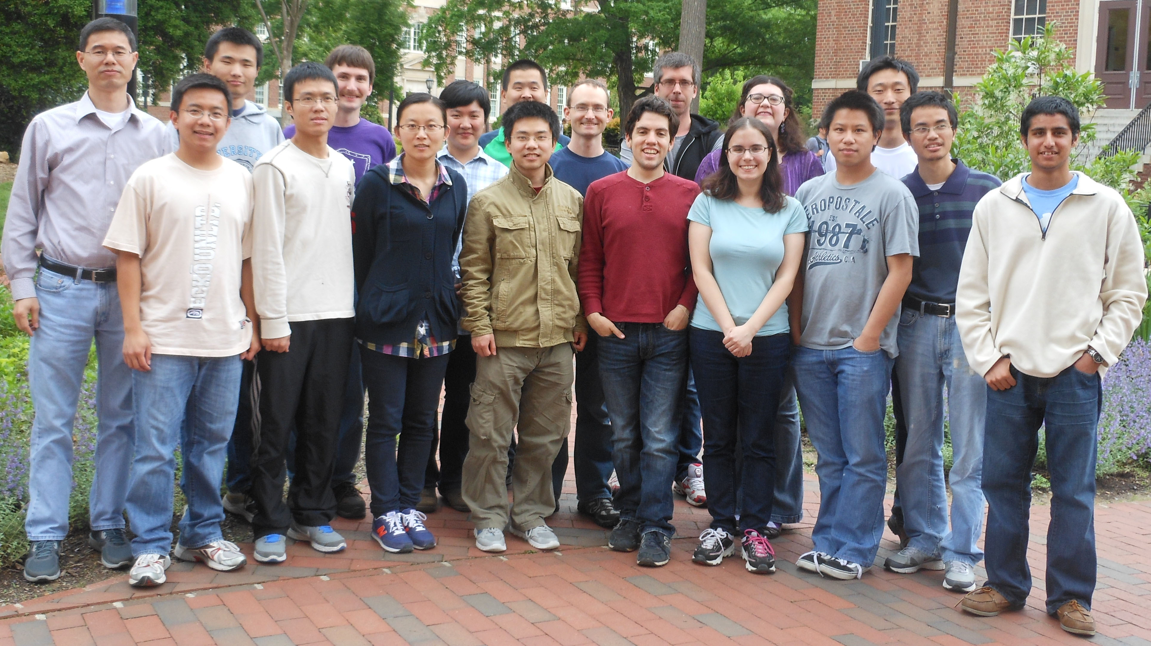
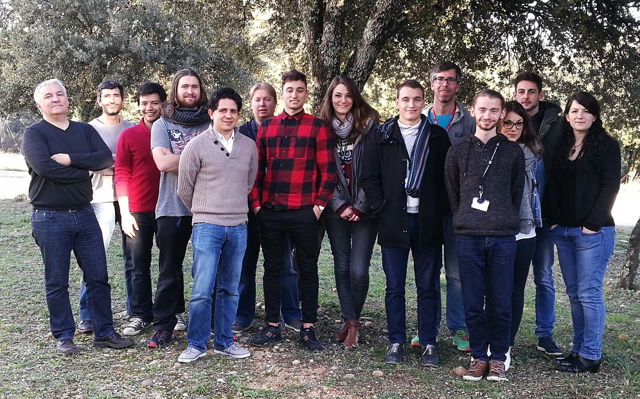


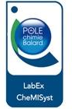


Thank you for your attention
Past Lab
New Lab

