Slide 1
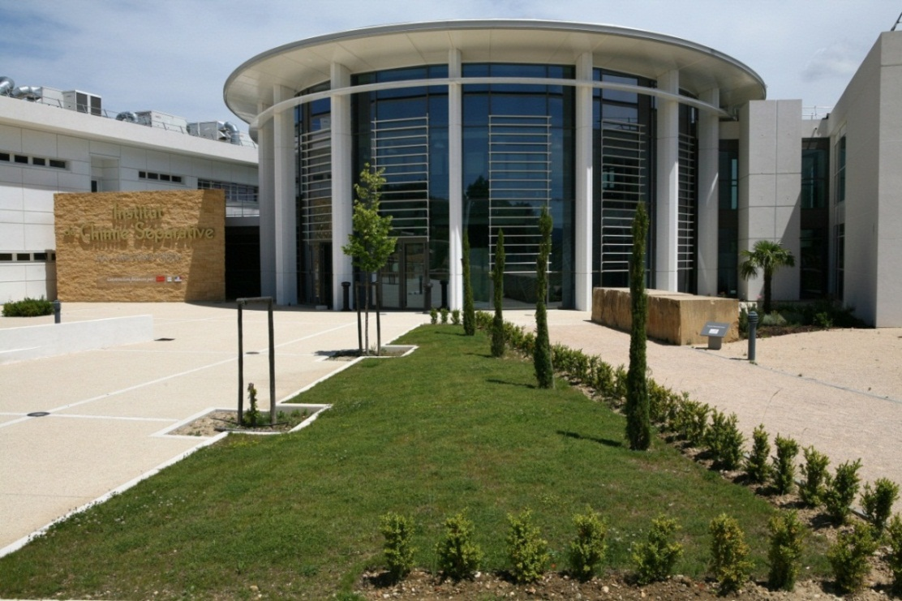







INSTITUT DE CHIMIE SEPARATIVE DE MARCOULE
Effect of Platinum-Group Metals (PGM) on the dissolution of uranium dioxide
T. Cordara ¹, S. Szenknect ¹, L. Claparede ¹,
Mesbah ¹, C. Lavalette ³ , R. Podor ²
N. Dacheux ¹
¹ ICSM/LIME, UMR 5257, CEA, CNRS, Univ. Montpellier, ENSCM
² ICSM/L2ME, UMR 5257, CEA, CNRS, Univ. Montpellier, ENSCM
³ AREVA NC / BG aval / DO recyclage / RDP, Paris

Slide 2
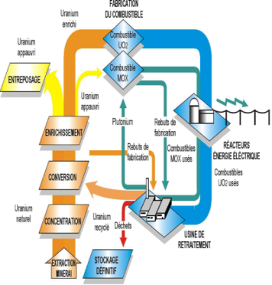
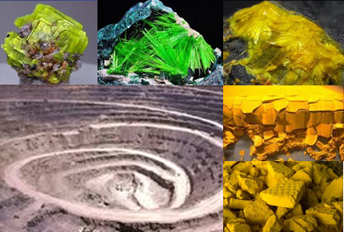
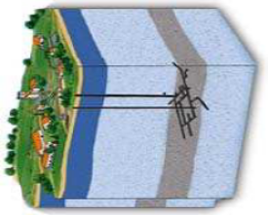

How can sample preparation impact dissolution ?
Transverse approach of the material elaboration
Sintering :
densification
microstructure
Dissolution
Leaching
Model compounds :
New ways of synthesis
New precursors
Properties in use :
Chemical durability
Long-term behavior
Optimized Syntheses
Dissolution of AnO₂, (An,Ln)O_{2-x} / Fluorite-type prepared from oxalate precipitation
  Conventional parameters ( chemical composition, temperature, acidity, … )
  Structural parameters ( oxygen vacancies, superstructure, secondary phases … )
  Microstructural parameters ( crystal defects, crystallite size, densification rate, … )
N. Dacheux et al. , SBNWM symposium 2017, Sydney, October 29 – November 03, 2017
1

Slide 3
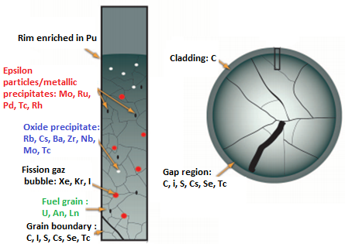
Distribution of FP in SNF
Spent Nuclear Fuel
  U (95 wt.%) – Pu (1 wt.%)
  MA (0.1 wt.%) – FP (4 wt.%)
More than 40 FP
4 main types
PGM
(Ru, Rh, Pd)
≈ 0.6 mol.%
Lanthanides
(La, Ce, Pr, Nd)
≈ 1 mol.%
Which impact of PGM on UO₂ dissolution ?
P. Burns, R.C. Ewing, A. Navrotsky, Science 2012, 335, 1184-1187
PRECCI Report, CEA, 2001, CEA-R-5958E
N. Dacheux et al. , SBNWM symposium 2017, Sydney, October 29 – November 03, 2017
2

Slide 4
Methodology
Structural and microstructural control of starting materials
Impact of dissolving solution :
pH, T, redox, composition…
Model compounds
Synthesis / Densification
R_{L} = k₀ × e^{-EA/RT} × a(H₃O⁺)^{n} × g(I) × Π a(i)^{ni} × f (Δ_{R}G (ξ,T) )
Dissolution experiments
Macroscopic dissolution rates
Macroscopic description of the dissolution
Microscopic description of the evolving interface
Monitoring of solid/liquid interface
Evolving structural and microstructural parameters
Operando analysis (ESEM, X-EDS, G-XRD, XRR, AFM)
 Topography, porosity, chemical composition of interface
N. Dacheux et al. , SBNWM symposium 2017, Sydney, October 29 – November 03, 2017
3

Slide 5


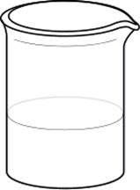
Samples elaboration
----
Evaluation of the reactive surface area during dissolution: SESAM method
Notes:
5
5

Slide 6
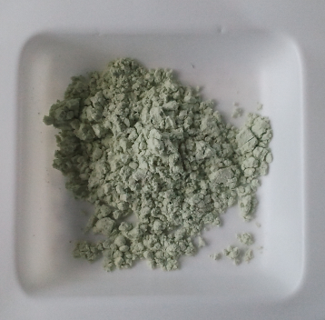
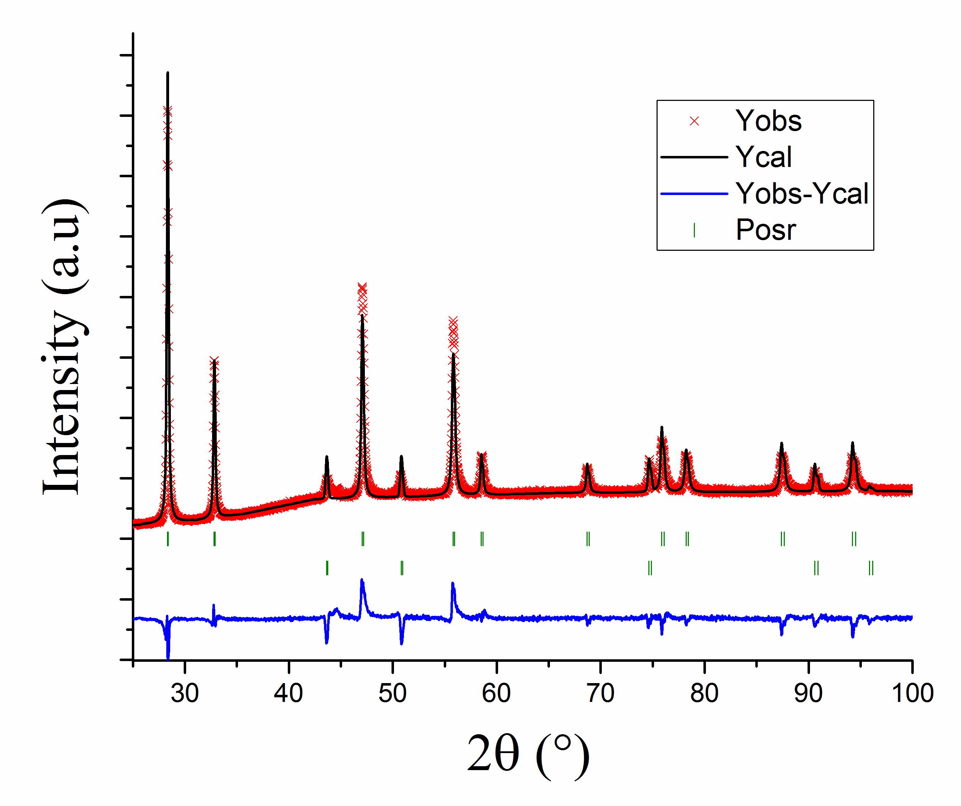
Preparation of UO₂ (reference)
Oxalate precipitation
Conversion
R. T.
H₂C₂O₄ : + 50%
U(C₂O₄)₂ . 2 H₂O
UO₂
Washing
(H₂O – EtOH)
10 µm
500ºC / 4 h
Air
then
Ar / H₂
Drying
(90ºC)
5 µm
Recovery yield (U) = 99.9 %
Platelet grains
3 µm in size
Application to PGM
U : 98.8 %
Ru : 6.5 %
Pd : 0 %
Rh : 17.8 %
a = 5.466 Å
Literature :
a = 5.469 Å
J. Tsuji, J. Alloys Compds, 1998, 271, 391
N. Dacheux et al. , SBNWM symposium 2017, Sydney, October 29 – November 03, 2017
4

Slide 7
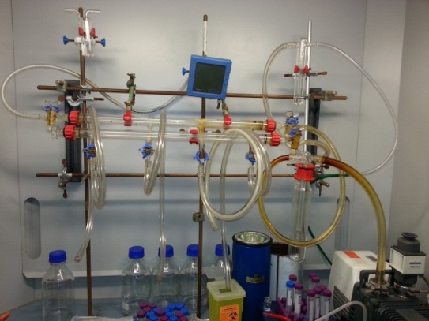


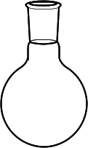
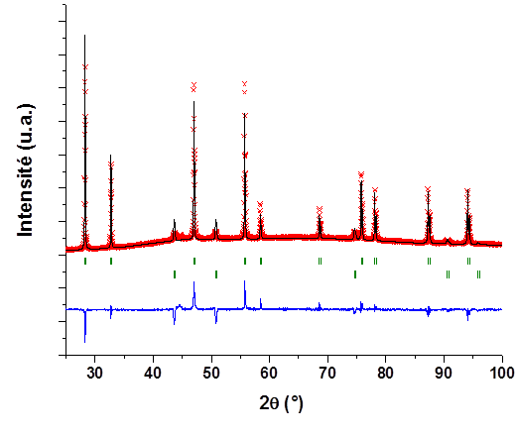
Preparation of PGM doped UO₂
Hydroxide precipitation
UO₂ doped with 3% PGM
Rh (10%) – Ru (55%) – Pd (35%)
Room temperature
Excess of NH₄OH
U(IV) + PGM
HCl
Washing
(water + ethanol)
Drying under vacuum
T = 40ºC
Precipitate
+
EtOH
m_{synthesised} ≤ 1 g
Conversion
Recovery yield
U : 99.9 %
Ru : 90 %
Pd : 100 %
Rh : 85 %
a = 5.470 Å
a = 5.466 Å (UO₂)
Crystallite size: 130 nm
Highly reactive
120 – 150 m².g⁻¹
Crystallite size: 2-5 nm
800ºC / 4 h
Ar / H₂
10 µm
No PGM in
UO₂ structure
J. Martinez, Patent FR3016360 – WO2015/107086, 2015
N. Clavier et al., Chem. Phys. Chem., 2017, 18, 2666-2674
N. Dacheux et al. , SBNWM symposium 2017, Sydney, October 29 – November 03, 2017
5

Slide 8
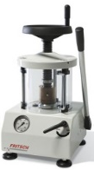

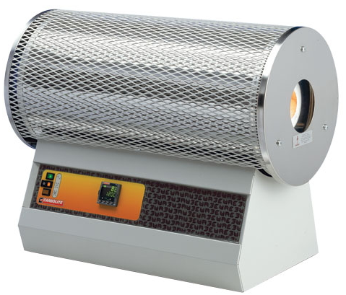
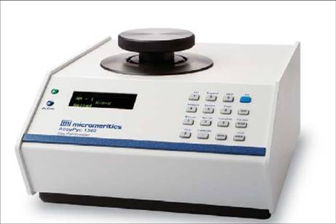
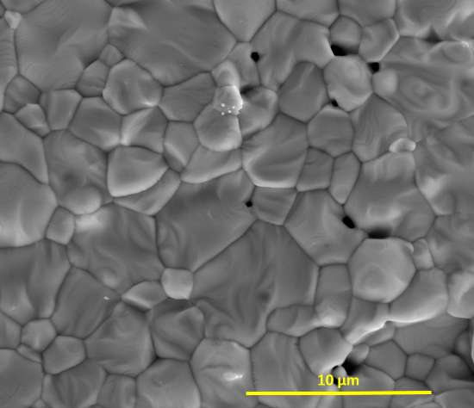
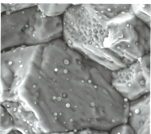
Preparation of sintered samples
Heating treatment
1550ºC / 8h
Ar – 5% H₂
Grinding step
30 Hz / 30 min
Uniaxial pressing
RT – 500 MPa
UO₂
UO₂ + PGM
Characterization
PXRD, BET, ESEM, Pycnometry
Ru, Rh, Pd bearing aggregates located at GB
(surface + inner)
4 µm
2 µm
5 µm
Densification rate : 93%
Densification rate : 89%
PGM-aggregates < 0.5 µm
UO₂ grains size ≈ 1 µm
SNF
J. Noirot, Monographie CEA, 2009, 25-28
N. Dacheux et al. , SBNWM symposium 2017, Sydney, October 29 – November 03, 2017
6

Slide 9
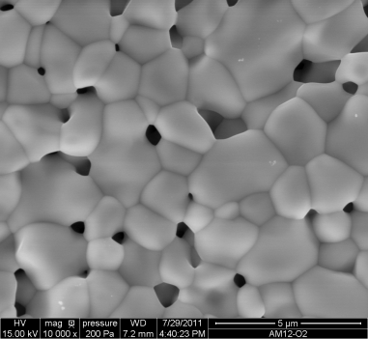

Evaluation of Specific Surface Area (SSA) :
SESAM method
φ
A = π φ ² / 4
❶
Disc surface
φ
Integration on image surface
❷
A = π φ ²
Image
Sample
Integration on sample surface
❸
Sample height
Integration on sample volume
❹
Correction by the
open porosity ratio
❺
Estimated specific
surface area
Grayscale threshold then binarization:
Surface area of the pores
N. Dacheux et al. , SBNWM symposium 2017, Sydney, October 29 – November 03, 2017
7

Slide 10
Evaluation of SSA: SESAM method
Compound | Specific Surface Area (m².g⁻¹)
 | BET method (Kr) | SESAM method | Geometrical
CeO₂ | 0.180 (20 pellets , ≈ 5 g) | 0.241 | 3.3 × 10⁻⁴
UO₂ (reference) | < LoD | 5.0 × 10⁻² | 2.6 × 10⁻⁴
UO₂ + PGM | < LoD | 2.0 × 10⁻² | 2.6 × 10⁻⁴
U_{0.9}Ln_{0.1}O_{1.95} | 1.5 × 10⁻² (5 pellets , ≈ 1 g) | 5.0 × 10⁻² | 2.9 × 10⁻⁴
× 1.3 - 3
× 76 - 730
Porous materials
Single crystals
Sintered pellets
Powders
≈ 1×10⁻³
≈ 5×10⁻¹
Geometrical
SESAM
BET
* T. Cordara, PhD, ICSM/CEA, Univ. Montpellier, Nov. 2017
N. Dacheux et al. , SBNWM symposium 2017, Sydney, October 29 – November 03, 2017
8

Slide 11
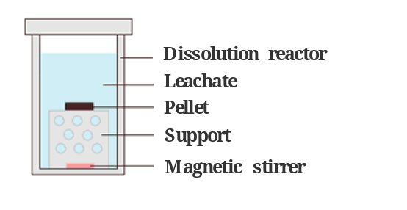
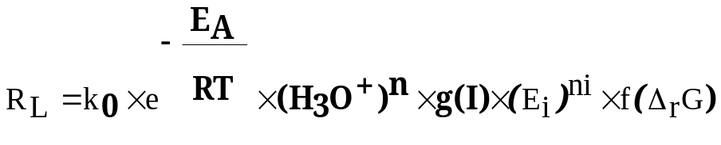
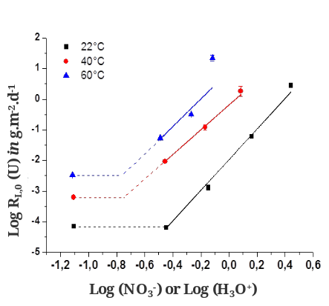
Macroscopic study
---
Multiparametric expression of the dissolution kinetics
A.C. Lasaga, Kinetic Theory in the Earth Sciences, Princeton Univ. Press, 1998
Notes:
11
11

Slide 12
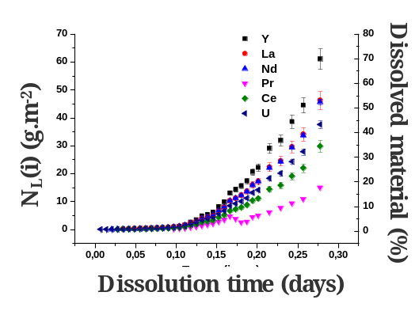
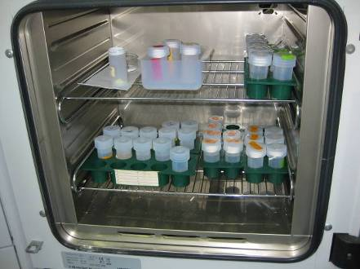
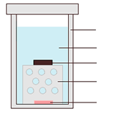
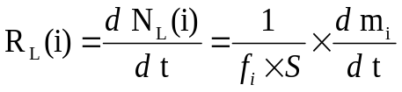
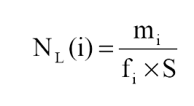
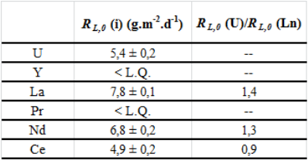
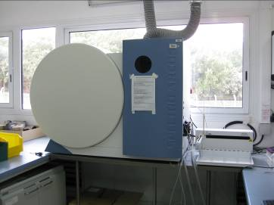
Dissolution test: experimental device
Sintered Pellet
Static conditions
Dissolution reactor
Leachate
Pellet
Support
Magnetic stirrer
Amount of (i) in solution (g)
Reactive surface area (m²)
Mass ratio of (i) in the solid
ICP–AES
ICP-MS
α liquid scintillation
R_{L}(i) ≈ R_{L}(j): congruent dissolution
R_{L}(i) ≠ R_{L}(j): incongruent dissolution
N. Dacheux et al. , SBNWM symposium 2017, Sydney, October 29 – November 03, 2017
9

Slide 13

General trend of UO₂ dissolution in nitric acid
Normalized dissolution rate
R_{L.0} (U) expressed in g.m⁻².d⁻¹
≈ 90
Kinetics
3 domains
❶
❷
❸
Steady state:
Constant rate
Dissolved mass, Δm/m₀ (%)
Induction period
R_{L.pulse} (U)
R_{L.0} (U)
R_{L.t} (U)
≈ 0.5
Increase of S
Increase of autocatalytic species
↗↗ of R_{L}(t)
≈ 0.05
R_{L,pulse}
R_{L,0}
Leaching time (days)
T. Cordara et al., J. Nucl. Mater. 2017, 496, 251-264
N. Dacheux et al. , SBNWM symposium 2017, Sydney, October 29 – November 03, 2017
10
Notes:
The influence of the uranium mole loading on the normalized dissolution rates was studied for several Th_{1-x}U_{x}O₂ solid solutions samples with various chemical compositions in 2 mol.L⁻¹ HNO₃ and at 60°C
You can see that after 170 days of leaching test , only 20 percent of the mixed oxide with a uranium mole loading of 0,16 are dissolved….
Conversely to that was observed for Th_{1-x}Ce_{x}O₂ solid solutions, the substitution of thorium by uranium (IV) led to a significant modification of the chemical durability of Th_{1-x}U_{x}O₂ solid solutions. Indeed, an increase of the normalized dissolution rates R_{L,0}(U) and R_{L,0}(Th) by three orders of magnitude is observed between Th_{0.84}U_{0.16}O₂ and Th_{0.29}U_{0.71}O₂. This strong effect is probably due to oxidation of tetravalent uranium into uranyl at the solid/liquid interface, as already described by De Pablo, as you have seen during Nicolas Dacheux talks.
the dissolution could occur in three steps: initial oxidation of uranium at the solid/liquid interface, protonation on the U(IV), Th(IV), U(VI) sites then detachment of the complexes formed at the interface.

Slide 14
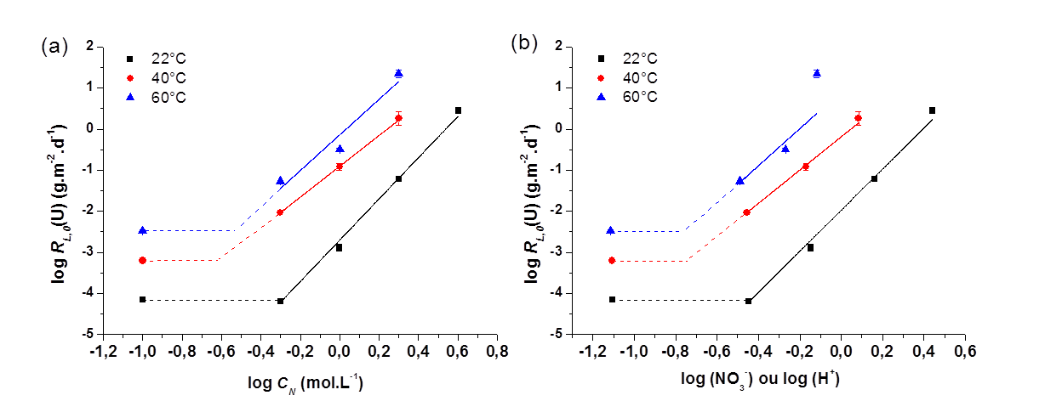
Impact of acid concentration on UO₂ dissolution
Reference Sintered UO₂
0.1 – 0.5 – 1 – 2M – 4M HNO₃
T : 22ºC – 40ºC – 60ºC
Static conditions
0.3M HNO₃
R_{L} = k_{T}’ × (H₃O⁺) ^{n}
Log R_{L,0} (U) in g.m⁻².d⁻¹
n = 4.1 – 5.0
0.5M HNO₃
Log (NO₃⁻) or Log (H₃O⁺)
Modification of the preponderant dissolution mechanism with acid concentration
C_{HNO3} < 0.5 M ⇒ Surface controlling reactions
C_{HNO3} > 0.5 M ⇒ Redox controlling reactions
N. Dacheux et al. , SBNWM symposium 2017, Sydney, October 29 – November 03, 2017
11
Notes:
The influence of the uranium mole loading on the normalized dissolution rates was studied for several Th_{1-x}U_{x}O₂ solid solutions samples with various chemical compositions in 2 mol.L⁻¹ HNO₃ and at 60°C
You can see that after 170 days of leaching test , only 20 percent of the mixed oxide with a uranium mole loading of 0,16 are dissolved….
Conversely to that was observed for Th_{1-x}Ce_{x}O₂ solid solutions, the substitution of thorium by uranium (IV) led to a significant modification of the chemical durability of Th_{1-x}U_{x}O₂ solid solutions. Indeed, an increase of the normalized dissolution rates R_{L,0}(U) and R_{L,0}(Th) by three orders of magnitude is observed between Th_{0.84}U_{0.16}O₂ and Th_{0.29}U_{0.71}O₂. This strong effect is probably due to oxidation of tetravalent uranium into uranyl at the solid/liquid interface, as already described by De Pablo, as you have seen during Nicolas Dacheux talks.
the dissolution could occur in three steps: initial oxidation of uranium at the solid/liquid interface, protonation on the U(IV), Th(IV), U(VI) sites then detachment of the complexes formed at the interface.

Slide 15
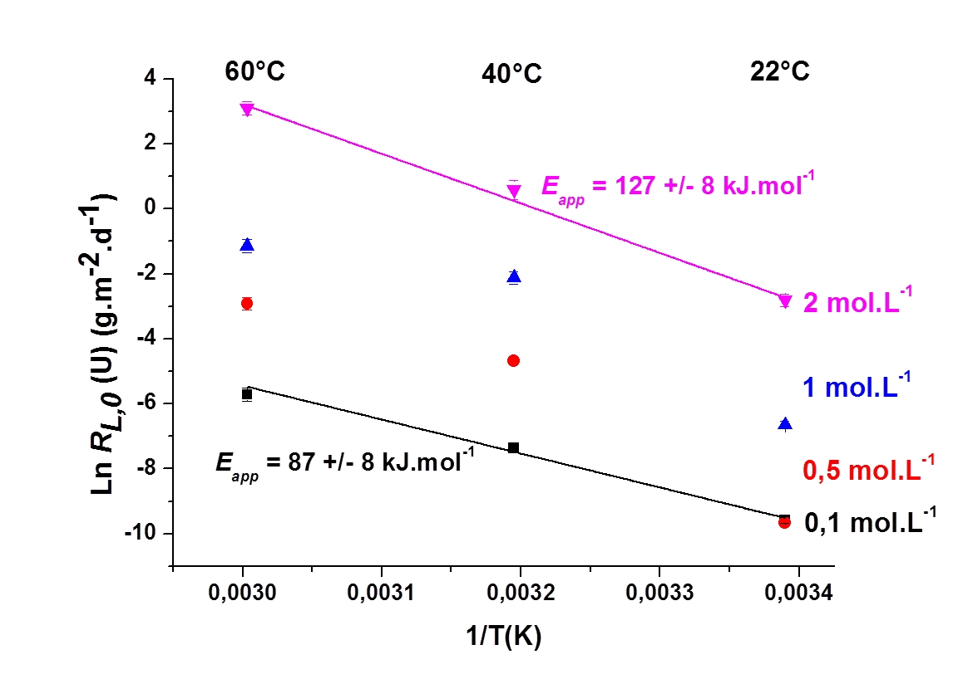

Impact of temperature on UO₂ dissolution
Reference Sintered UO₂
0.1 – 0.5 – 1 – 2M HNO₃
T : 22ºC – 40ºC – 60ºC
Static conditions
E_{app} = 127 ± 8 kJ.mol⁻¹
$$RL=k × e^{− \frac{EA}{RT}}$$
Ln R_{L,0}(U) (g.m⁻².d⁻¹)
E_{app} = 87 ± 8 kJ.mol⁻¹
Opposite T (K⁻¹)
Impact of the acid concentration on the activation energy due to change in predominant mechanism:
Surface controlling ⇒ Redox controlling reactions
N. Dacheux et al. , SBNWM symposium 2017, Sydney, October 29 – November 03, 2017
12
Notes:
The influence of the uranium mole loading on the normalized dissolution rates was studied for several Th_{1-x}U_{x}O₂ solid solutions samples with various chemical compositions in 2 mol.L⁻¹ HNO₃ and at 60°C
You can see that after 170 days of leaching test , only 20 percent of the mixed oxide with a uranium mole loading of 0,16 are dissolved….
Conversely to that was observed for Th_{1-x}Ce_{x}O₂ solid solutions, the substitution of thorium by uranium (IV) led to a significant modification of the chemical durability of Th_{1-x}U_{x}O₂ solid solutions. Indeed, an increase of the normalized dissolution rates R_{L,0}(U) and R_{L,0}(Th) by three orders of magnitude is observed between Th_{0.84}U_{0.16}O₂ and Th_{0.29}U_{0.71}O₂. This strong effect is probably due to oxidation of tetravalent uranium into uranyl at the solid/liquid interface, as already described by De Pablo, as you have seen during Nicolas Dacheux talks.
the dissolution could occur in three steps: initial oxidation of uranium at the solid/liquid interface, protonation on the U(IV), Th(IV), U(VI) sites then detachment of the complexes formed at the interface.

Slide 16
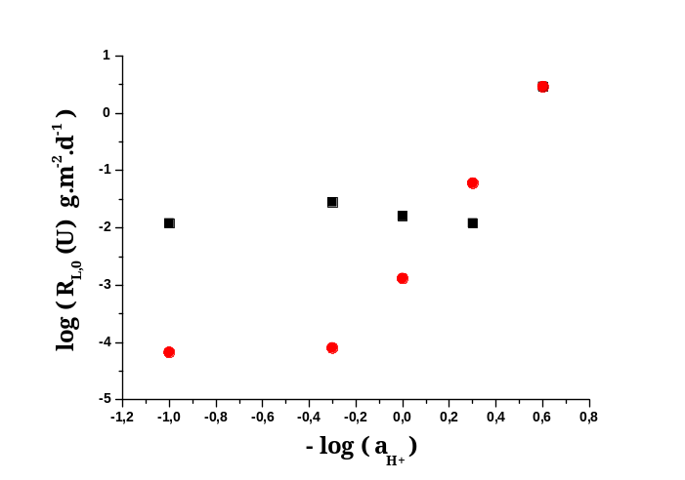
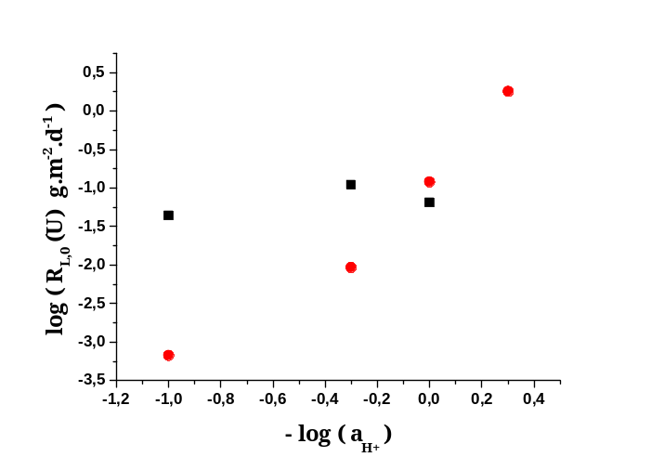
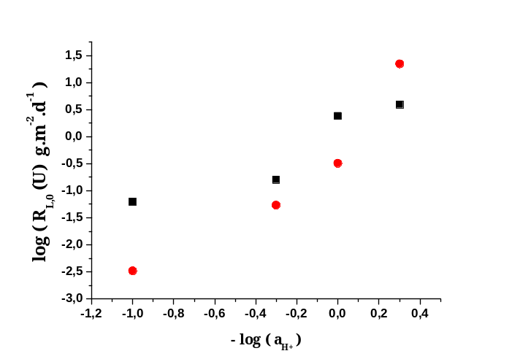
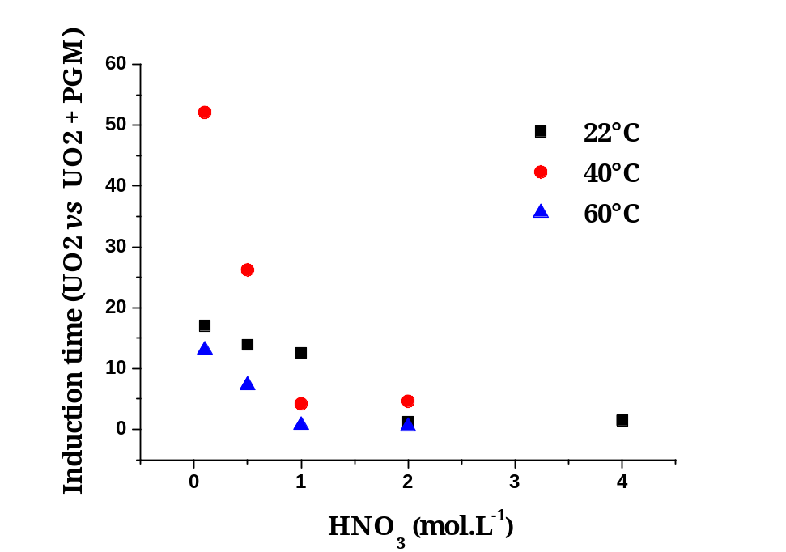
Impact of PGM on UO₂ dissolution
UO₂ doped with 3% PGM
Rh (10%) – Ru (55%) – Pd (35%)
0.1 – 0.5 – 1 – 2M – 4M HNO₃
T : 22ºC – 40ºC – 60ºC
Static conditions
22ºC
UO₂
40ºC
60ºC
UO₂ + PGM
Reduction
Very strong impact of PGM on R_{L,0}(U)
More important in less acidic media
Associated to reduction of induction period
N. Dacheux et al. , SBNWM symposium 2017, Sydney, October 29 – November 03, 2017
13
Notes:
The influence of the uranium mole loading on the normalized dissolution rates was studied for several Th_{1-x}U_{x}O₂ solid solutions samples with various chemical compositions in 2 mol.L⁻¹ HNO₃ and at 60°C
You can see that after 170 days of leaching test , only 20 percent of the mixed oxide with a uranium mole loading of 0,16 are dissolved….
Conversely to that was observed for Th_{1-x}Ce_{x}O₂ solid solutions, the substitution of thorium by uranium (IV) led to a significant modification of the chemical durability of Th_{1-x}U_{x}O₂ solid solutions. Indeed, an increase of the normalized dissolution rates R_{L,0}(U) and R_{L,0}(Th) by three orders of magnitude is observed between Th_{0.84}U_{0.16}O₂ and Th_{0.29}U_{0.71}O₂. This strong effect is probably due to oxidation of tetravalent uranium into uranyl at the solid/liquid interface, as already described by De Pablo, as you have seen during Nicolas Dacheux talks.
the dissolution could occur in three steps: initial oxidation of uranium at the solid/liquid interface, protonation on the U(IV), Th(IV), U(VI) sites then detachment of the complexes formed at the interface.

Slide 17
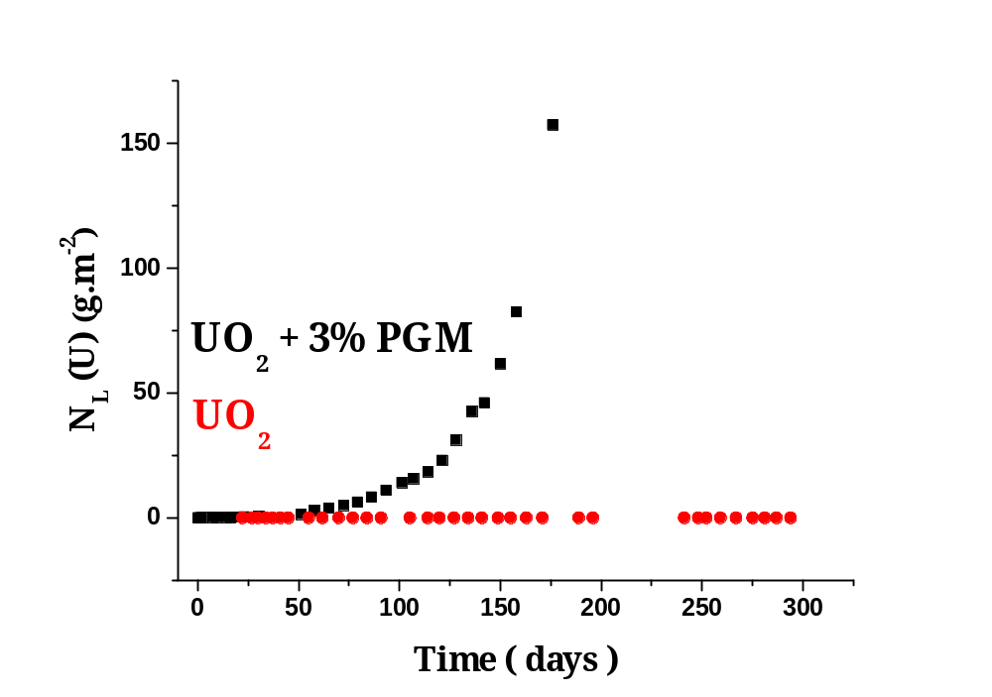
Impact of PGM on UO₂ dissolution
UO₂ doped with 3 mol% PGM
Rh (10%) – Ru (55%) – Pd (35%)
68 % dissolved U
0.1 M HNO₃ – 22ºC
Static conditions
× 4000
R_{L,0}
× 200
UO₂ + PGM
R_{L,0} (U) = (1.2 ± 0.2) × 10⁻² g.m⁻².d⁻¹
UO₂
R_{L,0} (U) = (6.7 ± 0.3) × 10⁻⁴ g.m⁻².d⁻¹
0.016 % dissolved U
Strong impact associated to the presence of PGM on R_{L,0}(U)
Same results for individual incorporation (Rh, Ru or Pd)
Solid contribution @ the solid/liquid interface ?
Solution contribution: reduction of HNO₃ by PGM then production of autocatalytic species in solution (e.g. HNO₂) ?
N. Dacheux et al. , SBNWM symposium 2017, Sydney, October 29 – November 03, 2017
14
Notes:
The influence of the uranium mole loading on the normalized dissolution rates was studied for several Th_{1-x}U_{x}O₂ solid solutions samples with various chemical compositions in 2 mol.L⁻¹ HNO₃ and at 60°C
You can see that after 170 days of leaching test , only 20 percent of the mixed oxide with a uranium mole loading of 0,16 are dissolved….
Conversely to that was observed for Th_{1-x}Ce_{x}O₂ solid solutions, the substitution of thorium by uranium (IV) led to a significant modification of the chemical durability of Th_{1-x}U_{x}O₂ solid solutions. Indeed, an increase of the normalized dissolution rates R_{L,0}(U) and R_{L,0}(Th) by three orders of magnitude is observed between Th_{0.84}U_{0.16}O₂ and Th_{0.29}U_{0.71}O₂. This strong effect is probably due to oxidation of tetravalent uranium into uranyl at the solid/liquid interface, as already described by De Pablo, as you have seen during Nicolas Dacheux talks.
the dissolution could occur in three steps: initial oxidation of uranium at the solid/liquid interface, protonation on the U(IV), Th(IV), U(VI) sites then detachment of the complexes formed at the interface.

Slide 18
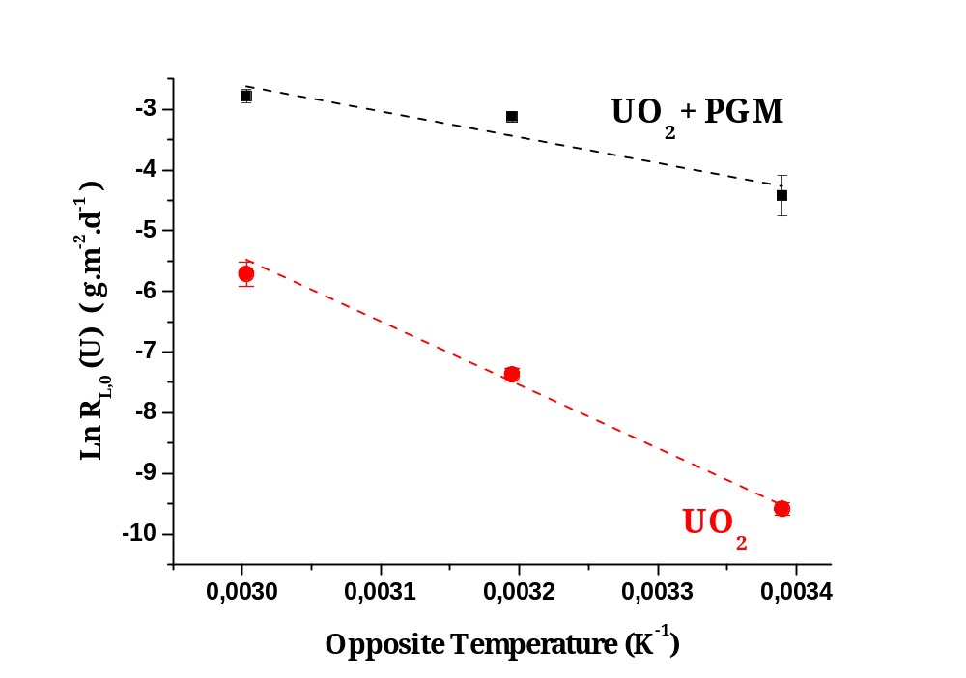
Catalytic process associated to PGM
UO₂ doped with 3 mol% PGM
Rh (10%) – Ru (55%) – Pd (35%)
E_{app} = 35 ± 12 kJ.mol⁻¹
0.1 M HNO₃
T : 22ºC – 40ºC – 60ºC
Static conditions
E_{app} = 87 ± 8 kJ.mol⁻¹
Predominant dissolution reaction
Catalytic
predominant
Significant decrease of E_{A} with PGM
Redox
predominant
Catalytic process
Predominant in less acidic media
Solution + at solid/liquid interface ?
N. Dacheux et al. , SBNWM symposium 2017, Sydney, October 29 – November 03, 2017
15
Notes:
The influence of the uranium mole loading on the normalized dissolution rates was studied for several Th_{1-x}U_{x}O₂ solid solutions samples with various chemical compositions in 2 mol.L⁻¹ HNO₃ and at 60°C
You can see that after 170 days of leaching test , only 20 percent of the mixed oxide with a uranium mole loading of 0,16 are dissolved….
Conversely to that was observed for Th_{1-x}Ce_{x}O₂ solid solutions, the substitution of thorium by uranium (IV) led to a significant modification of the chemical durability of Th_{1-x}U_{x}O₂ solid solutions. Indeed, an increase of the normalized dissolution rates R_{L,0}(U) and R_{L,0}(Th) by three orders of magnitude is observed between Th_{0.84}U_{0.16}O₂ and Th_{0.29}U_{0.71}O₂. This strong effect is probably due to oxidation of tetravalent uranium into uranyl at the solid/liquid interface, as already described by De Pablo, as you have seen during Nicolas Dacheux talks.
the dissolution could occur in three steps: initial oxidation of uranium at the solid/liquid interface, protonation on the U(IV), Th(IV), U(VI) sites then detachment of the complexes formed at the interface.

Slide 19
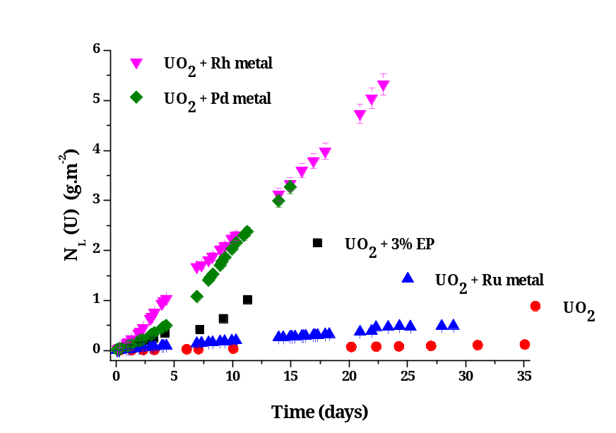
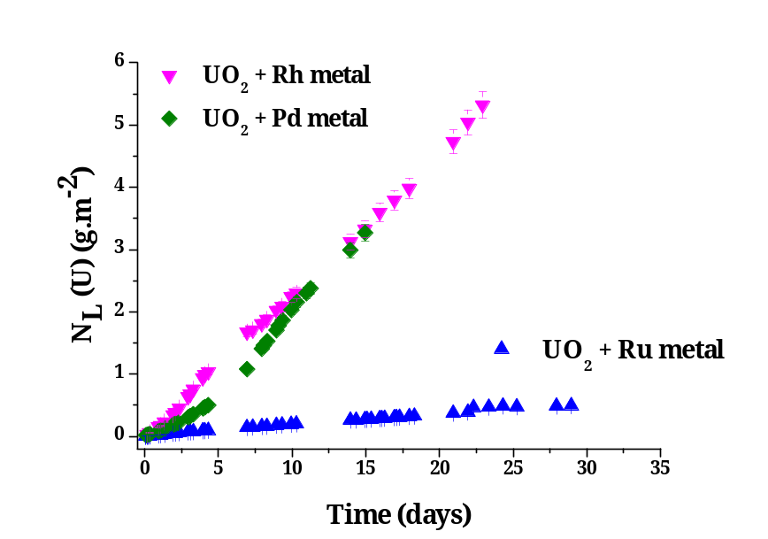
Impact of PGM : contribution in solution
Sintered UO₂
+ PGM (in solution)
Dissolution reactor
0.1 HNO₃ – 60ºC
Static conditions
Leachate
UO₂ Pellet
PGM metallic powder
✵
✵
Support
✵
✵
Magnetic stirrer
Rh: R_{L,0} (U) = (2.3 ± 0.1) × 10⁻¹ g.m⁻².d⁻¹
Pd: R_{L,0} (U) = (9.3 ± 0.2) × 10⁻² g.m⁻².d⁻¹
Ru: R_{L,0} (U) = (1.8 ± 0.1) × 10⁻² g.m⁻².d⁻¹
R_{L,0}
× 70
Pure UO₂
R_{L,0} (U) = (3.3 ± 0.1) × 10⁻³ g.m⁻².d⁻¹
Increase of R_{L,0} (U) in the
presence of PGM powders
Catalytic effect associated
to PGM in solution
N. Dacheux et al. , SBNWM symposium 2017, Sydney, October 29 – November 03, 2017
16
Notes:
The influence of the uranium mole loading on the normalized dissolution rates was studied for several Th_{1-x}U_{x}O₂ solid solutions samples with various chemical compositions in 2 mol.L⁻¹ HNO₃ and at 60°C
You can see that after 170 days of leaching test , only 20 percent of the mixed oxide with a uranium mole loading of 0,16 are dissolved….
Conversely to that was observed for Th_{1-x}Ce_{x}O₂ solid solutions, the substitution of thorium by uranium (IV) led to a significant modification of the chemical durability of Th_{1-x}U_{x}O₂ solid solutions. Indeed, an increase of the normalized dissolution rates R_{L,0}(U) and R_{L,0}(Th) by three orders of magnitude is observed between Th_{0.84}U_{0.16}O₂ and Th_{0.29}U_{0.71}O₂. This strong effect is probably due to oxidation of tetravalent uranium into uranyl at the solid/liquid interface, as already described by De Pablo, as you have seen during Nicolas Dacheux talks.
the dissolution could occur in three steps: initial oxidation of uranium at the solid/liquid interface, protonation on the U(IV), Th(IV), U(VI) sites then detachment of the complexes formed at the interface.

Slide 20
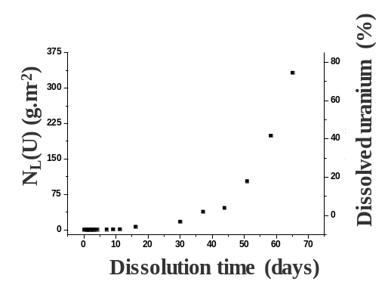
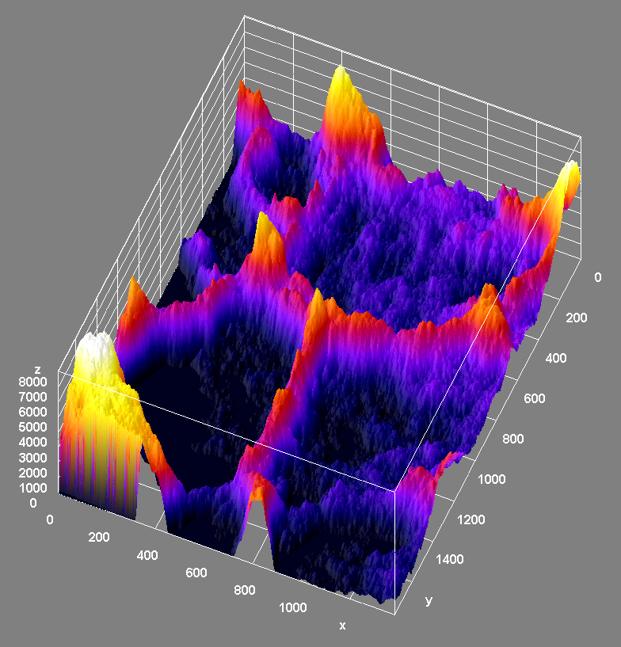
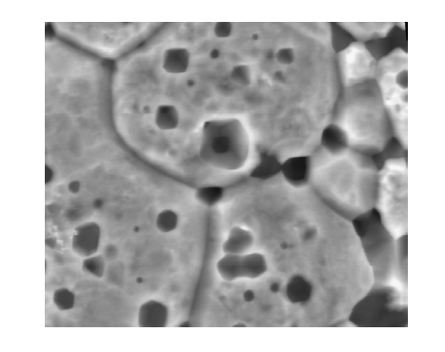
Microscopic study
---
Microstructural evolution of solid/solution interface
Notes:
20
20

Slide 21
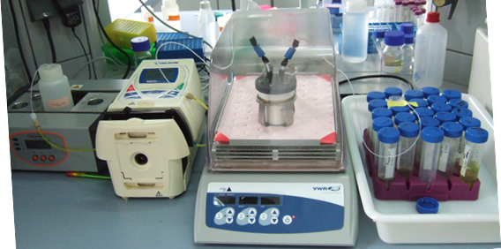
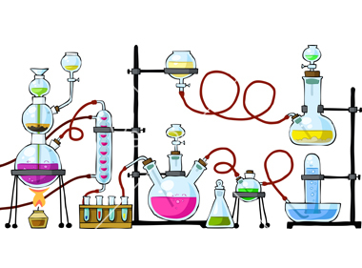
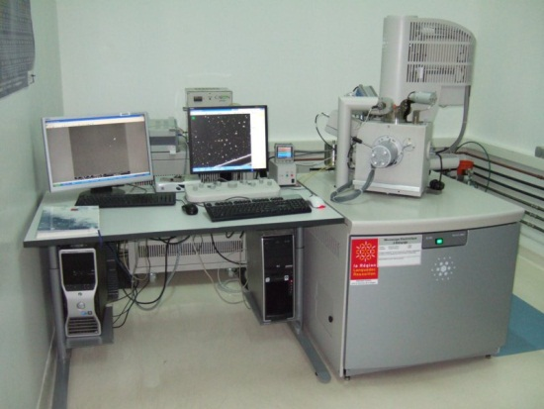

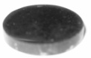
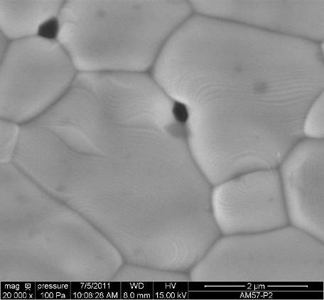

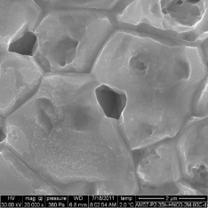
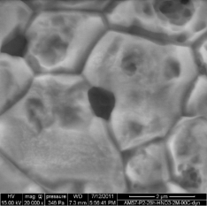
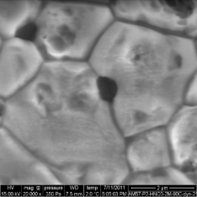
Operando study of evolving interface during dissolution
Dissolution tests
Environmental SEM observations
…
N. Dacheux et al. , SBNWM symposium 2017, Sydney, October 29 – November 03, 2017
17

Slide 22
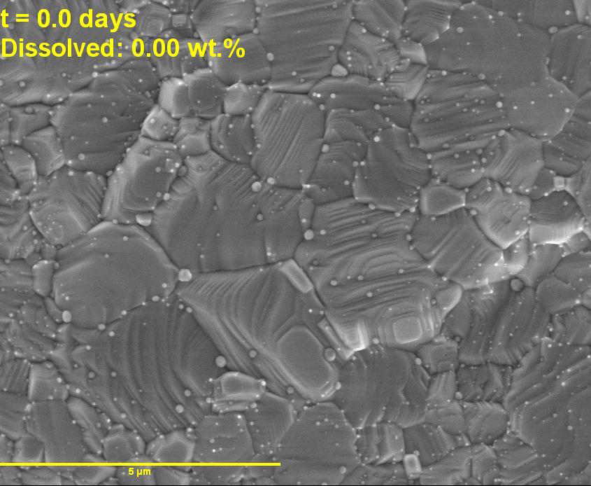
Impact of PGM : contribution at the solid/solution
interface
UO₂ pellet with 3 mol.% PGM
0.1 M HNO₃ – T = 60ºC
Dissolution time : 58 days
Heterogeneous dissolution
Preferential dissolution zones :
GB, triple junctions, pores
PGM / UO₂ / Solution interface
Evolution of N_{L}(U)
Surface reactions
controlling dissolution
Impact of PGM
@ Solid/Liquid interface
T. Cordara, PhD, ICSM/CEA, Univ. Montpellier, Nov 2017
N. Dacheux et al. , SBNWM symposium 2017, Sydney, October 29 – November 03, 2017
18

Slide 23
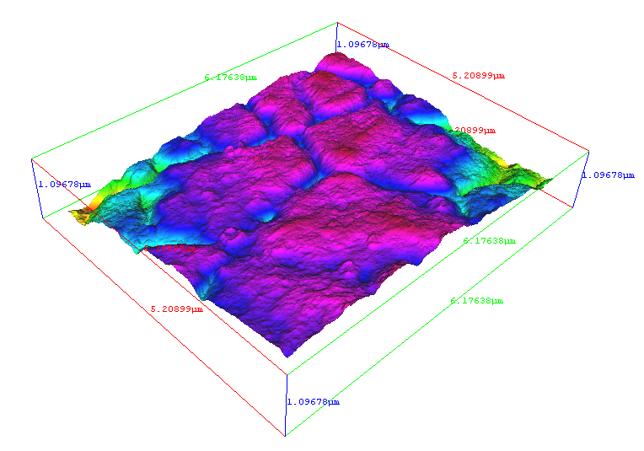

3D analysis of the dissolution of UO₂ + PGM
Sintered UO₂ doped with 3 mol% Rh-Ru-Pd
0.1 M HNO₃ – 60°C
Operando ESEM:
Sequence of stereoscopic images
t = 0h
t = 96h
t = 287h
t = 645h
t = 1392h
3 µm
3 µm
3 µm
3 µm
3 µm
3D Reconstruction
287 hours
645 hours
Zones of interest: Access to dissolved volumes
* T. Cordara, PhD, ICSM/CEA, Univ. Montpellier, Nov. 2017
N. Dacheux et al. , SBNWM symposium 2017, Sydney, October 29 – November 03, 2017
19

Slide 24



3D analysis of the dissolution of UO₂ + PGM
GB1
GB1
GB3
GB2
R_{L,0} (global) = 7.4 × 10⁻² g.m⁻².d⁻¹
R_{L,0} (GB) = (6.5 to 8.4 ) × 10⁻² g.m⁻².d⁻¹
Starting global dissolution directly linked to the dissolution of GB
N. Dacheux et al. , SBNWM symposium 2017, Sydney, October 29 – November 03, 2017
20

Slide 25



Conclusions & Outlooks
Strong impact of PGM on R_{L,0}(U)
Impact in solution
Impact at
S/L interface
N. Dacheux et al. , SBNWM symposium 2017, Sydney, October 29 – November 03, 2017
21

Slide 26









Acknowledgements
Scientific contribution and technical support
Laboratory of Evolving Interfaces in Materials
Laboratory of Matter in Environmental Conditions
IT Department
J. Favrichon
A. Delannoy
(SIP2D)
H.P Brau (MET)
J. Ravaux
(ESEM and X-EDS)
Ph. Moisy
A. Salvatores
X. Machuron Mandard
S. Grandjean
www.icsm.fr
Dr. R. Podor
(ESEM and X-EDS)
Financial support
B. Corso (PXRD)
CEA & AREVA
CNRS – Univ. Montpellier
METSA
EU: TALISMAN, GENIORS
GENIORS

Slide 27
And you for listening…

Slide 28


Impact of HNO₂ on dissolution
U_{0.75}Th_{0.25}O₂
4 M
2 M
1 M
0.5 M
0.1 M
0.05 M
■ HNO₃
NaNO₂ 3×10⁻² M
NaNO₂ 2×10⁻² M
■ H₂SO₄
■ HCl
NaNO₂ 1×10⁻² M
❐ HNO₃ + hydrazinium
→ HCl + NaNO₂
Strong increase of the dissolution rate with HNO₂
Lower impact of H₃O⁺ et NO₃⁻
F. Tocino, PhD, ICSM/CEA, Univ. Montpellier, Dec. 2015
T. Dalger, PhD, ICSM/CEA, Univ. Montpellier, 2016–2019
T. Dalger et al., J. Nucl. Mater., To be submitted
N. Dacheux et al. , SBNWM symposium 2017, Sydney, October 29 – November 03, 2017

