Slide 1
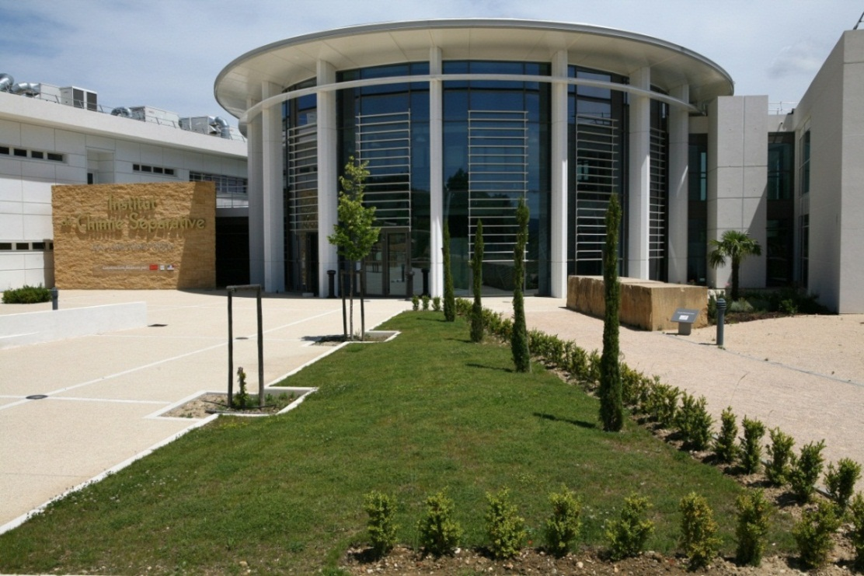







INSTITUT DE CHIMIE SEPARATIVE DE MARCOULE
Effect of lanthanide elements on the dissolution of uranium dioxide
T. Cordara ¹, L. Claparede ¹, S. Szenknect ¹,
Mesbah ¹, C. Lavalette ³ , R. Podor ²
N. Dacheux ¹
¹ ICSM/LIME, UMR 5257, CEA, CNRS, Univ. Montpellier, ENSCM
² ICSM/L2ME, UMR 5257, CEA, CNRS, Univ. Montpellier, ENSCM
³ AREVA NC / BG aval / DO recyclage / RDP, Paris

Slide 2
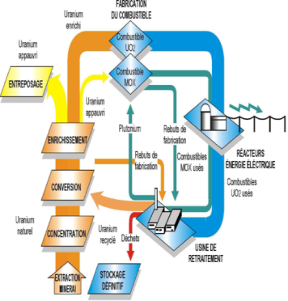
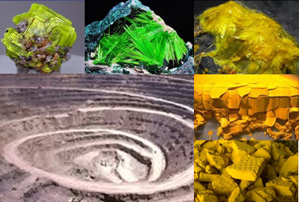
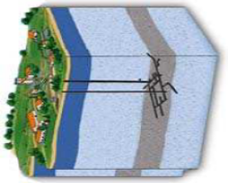

How can sample preparation impact dissolution ?
Transverse approach of the material elaboration
Sintering :
densification
microstructure
Dissolution
Leaching
Model compounds :
New ways of synthesis
New precursors
Properties in use :
Chemical durability
Long-term behavior
Optimized Syntheses
Dissolution of AnO₂, (An,Ln)O_{2-x} / Fluorite-type prepared from oxalate precipitation
  Conventional parameters ( chemical composition, temperature, acidity, … )
  Structural parameters ( oxygen vacancies, superstructure, secondary phases, … )
  Microstructural parameters ( crystal defects, crystallite size, densification rate, … )
N. Dacheux et al. , SBNWM symposium 2017, Sydney, October 29 – November 03, 2017
1

Slide 3
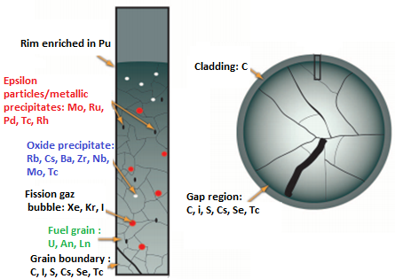
Distribution of FP in SNF
Spent Nuclear Fuel
  U (95 wt.%) – Pu (1 wt.%)
  MA (0.1 wt.%) – FP (4 wt.%)
More than 40 FP
4 main types
PGM
(Ru, Rh, Pd)
≈ 0.6 mol.%
Next talk …
Lanthanides
(La, Ce, Pr, Nd)
≈ 1 mol.%
Which impact of FP on UO₂ dissolution ?
P. Burns, R.C. Ewing, A. Navrotsky, Science 2012, 335, 1184-1187
PRECCI Report, CEA, 2001, CEA-R-5958E
N. Dacheux et al. , SBNWM symposium 2017, Sydney, October 29 – November 03, 2017
2

Slide 4
Methodology
Structural and microstructural control of starting materials
Impact of dissolving solution :
pH, T, redox, composition…
Model compounds
Synthesis / Densification
R_{L} = k₀ × e^{-EA/RT} × a(H₃O⁺)^{n} × g(I) × Π a(i)^{ni} × f (Δ_{R}G (ξ,T) )
Dissolution experiments
Macroscopic dissolution rates
Macroscopic description of the dissolution
Microscopic description of the evolving interface
Monitoring of solid/liquid interface
Evolving structural and microstructural parameters
Operando analysis (ESEM, X-EDS, G-XRD, XRR, AFM)
 Topography, porosity, chemical composition of interface
N. Dacheux et al. , SBNWM symposium 2017, Sydney, October 29 – November 03, 2017
3

Slide 5


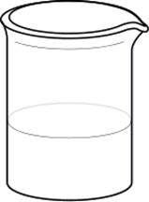
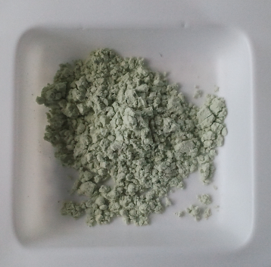
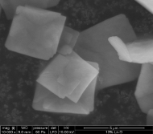
Samples elaboration
----
Sintering
Notes:
5
5

Slide 6
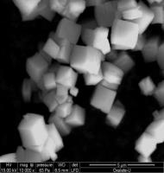
Preparation of U_{1-x}Ln_{x}O_{2-x/2}
Oxalate precipitation
Conversion
(U_{1-x}Ln_{x})(C₂O₄)_{2−x/2} . n H₂O (x = 0.1 & 0.2)
Y : 7% - La : 13% - Ce : 26% - Pr : 12% - Nd : 42%
R. T.
H₂C₂O₄ : + 50%
U_{1−x}Ln_{x}O_{2−x/2}
Washing
( H₂O – EtOH )
500ºC / 4 h
Air
then
Ar / H₂
Drying
( 90ºC )
5 µm
5 µm
Platelet grains
≈ 5 µm in size
 | Expected mole ratio | Obtained (Dissolution) | Recovery yield (%)
U | 0.9 | 0.89 ± 0.04 | 99.3 ✓
Ln(III) | 0.1 | 0.11 ± 0.02
Y | 0.07 | 0.06 ± 0.02 | 99.9 ✓
La | 0.13 | 0.14 ± 0.03 | 93.8 ✓
Ce | 0.26 | 0.31 ± 0.05 | 92.9 ✓
Pr | 0.12 | 0.13 ± 0.08 | 98.7 ✓
Nd | 0.42 | 0.42 ± 0.04 | 95.6 ✓
Full dissolution
ICP-AES
N. Dacheux et al. , SBNWM symposium 2017, Sydney, October 29 – November 03, 2017
4

Slide 7
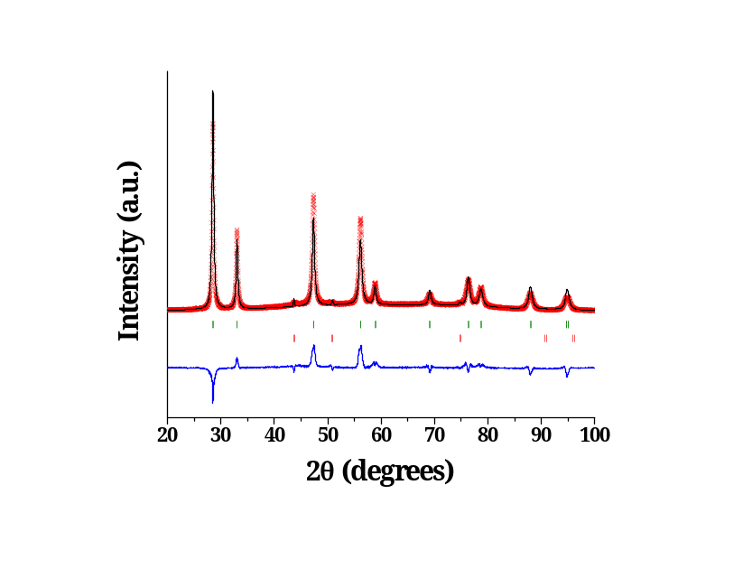
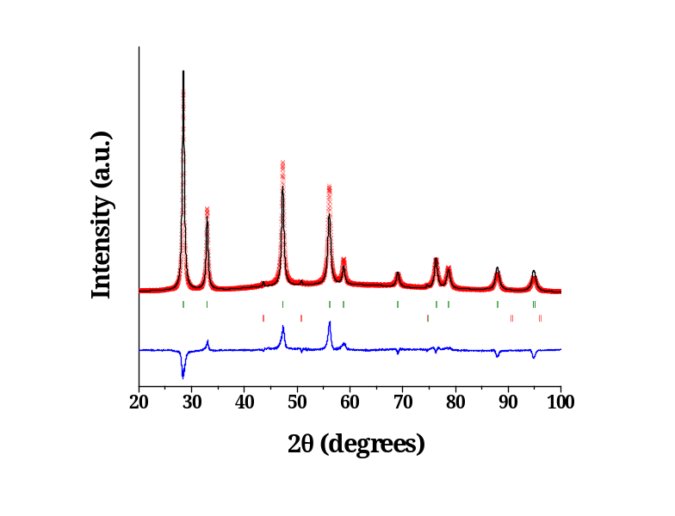
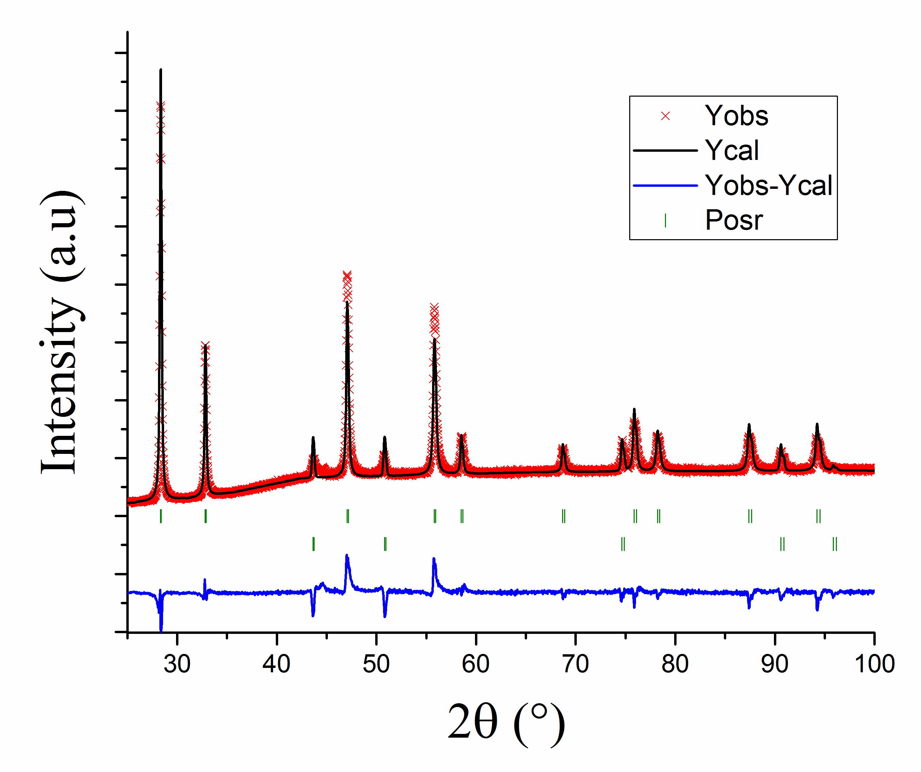
Characterization of U_{1-x}Ln_{x}O_{2-x/2} samples
UO₂
U_{0.9}Ln_{0.1}O_{1.95}
U_{0.8}Ln_{0.2}O_{1.9}
Intensity (a.u.)
2θ (degrees )
a = 5.466 Å
a = 5.442 Å
a = 5.438 Å
Literature :
a = 5.469 Å
Incorporation of Ln(III) in the UO₂
Fluorite-type structure
J. Tsuji, J. Alloys Compds, 1998, 271, 391
N. Dacheux et al. , SBNWM symposium 2017, Sydney, October 29 – November 03, 2017
5

Slide 8
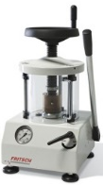

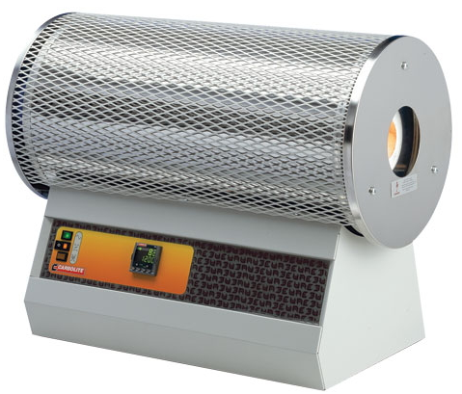
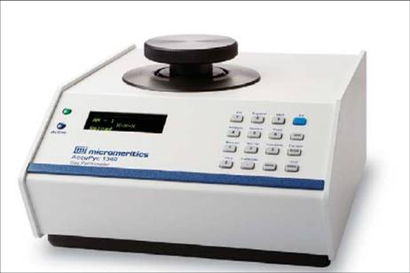
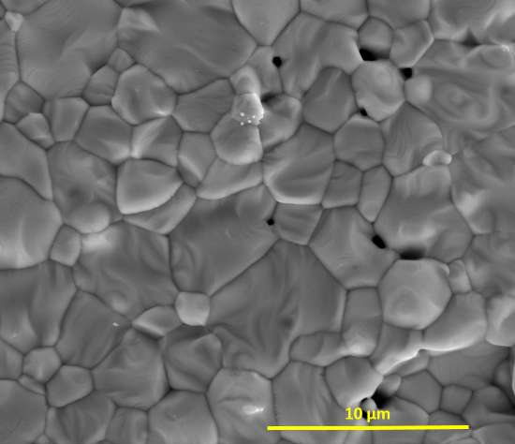
Sintering of U_{1-x}Ln_{x}O_{2-x/2} samples
Heating treatment
1550ºC / 8h
Ar – 5% H₂
Grinding step
30 Hz / 30 min
Uniaxial pressing
RT – 500 MPa
UO₂
Characterization
PXRD, BET, ESEM, Pycnometry
U_{0.9}Ln_{0.1}O_{1.95}
U_{0.8}Ln_{0.2}O_{1.9}
4 µm
4 µm
Densification rate: 93%
Average grain size: 11.8 µm
SSA: 5 × 10⁻³ m².g⁻¹
Densification rate: 90%
Average grain size: 3.4 µm
SSA: 5 × 10⁻² m².g⁻¹
Densification rate: 87%
Average grain size: 0.9 µm
SSA: 1 × 10⁻² m².g⁻¹
N. Dacheux et al. , SBNWM symposium 2017, Sydney, October 29 – November 03, 2017
6

Slide 9
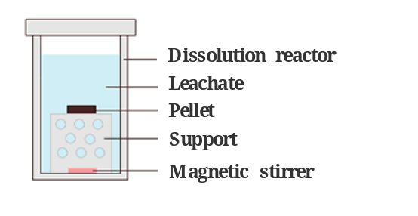
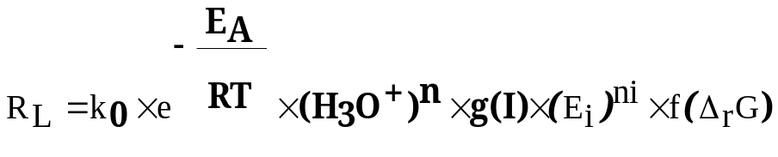
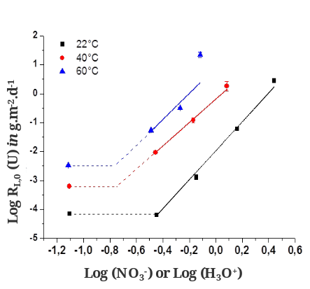
Macroscopic study
---
Multiparametric expression of the dissolution kinetics
A.C. Lasaga, Kinetic Theory in the Earth Sciences, Princeton Univ. Press, 1998
Notes:
9
9

Slide 10
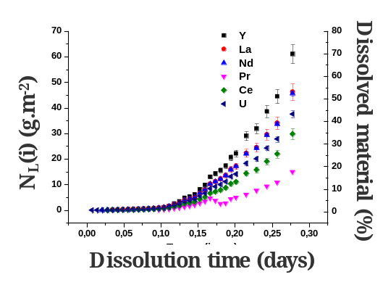
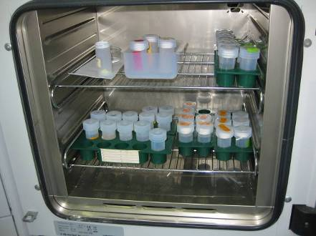
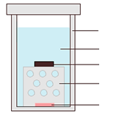
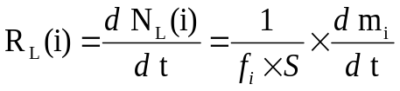
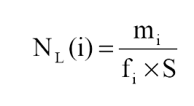
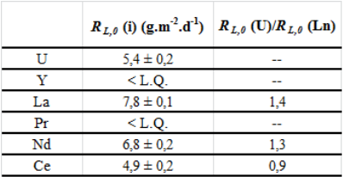
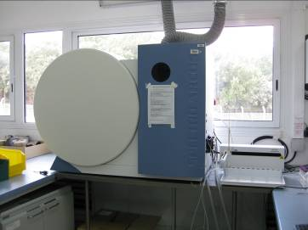
Dissolution test: experimental device
Sintered Pellet
Static conditions
Dissolution reactor
Leachate
Pellet
Support
Magnetic stirrer
Amount of (i) in solution (g)
Reactive surface area (m²)
Mass ratio of (i) in the solid
ICP–AES
ICP-MS
α liquid scintillation
R_{L}(i) ≈ R_{L}(j): congruent dissolution
R_{L}(i) ≠ R_{L}(j): incongruent dissolution
N. Dacheux et al. , SBNWM symposium 2017, Sydney, October 29 – November 03, 2017
7

Slide 11
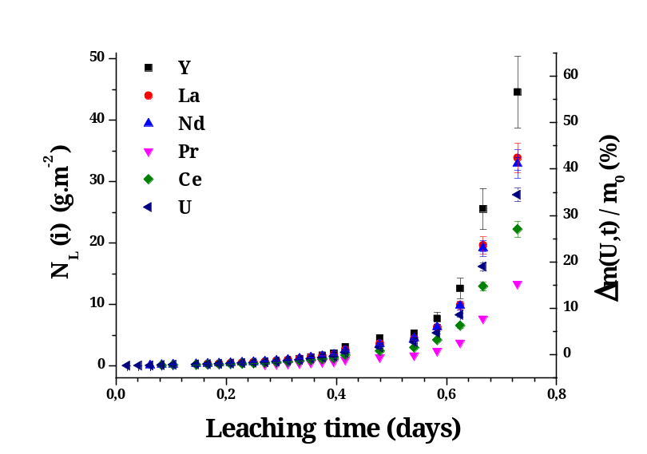
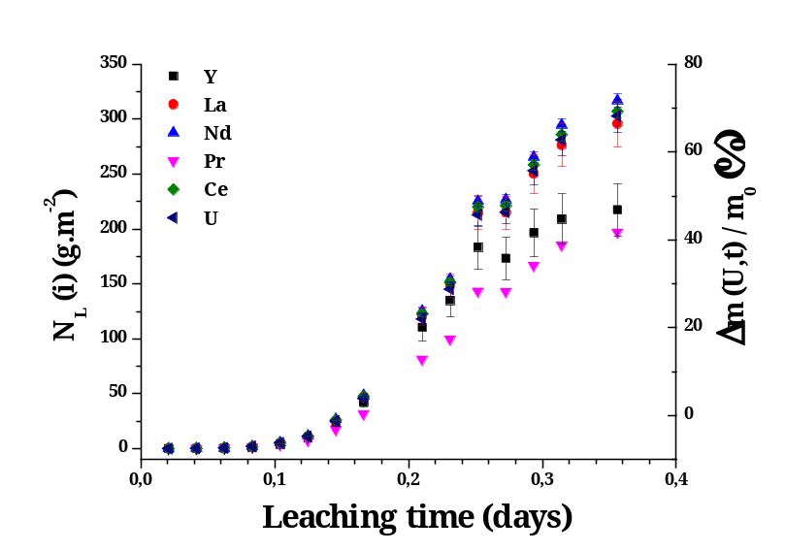
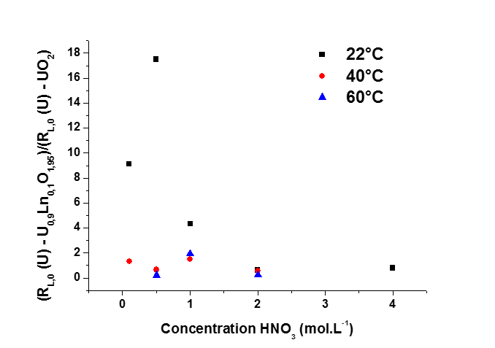
Nature of the dissolution of U_{1-x}Ln_{x}O_{2-x/2}
U_{0.9}Ln_{0.1}O_{1.95}
U_{0.8}Ln_{0.2}O_{1.9}
Congruent dissolution Ln(III) / U
In agreement with other systems (Th- & Ce-based)
Strong impact of Ln(III) on R_{L,0} for low acicity (C_{HNO3} < 1M)
e.g. increase by a factor up to ≈ 20 for U_{0.9}Ln_{0.1}O_{1.95} vs. UO₂
Small impact for higher acid concentrations (C_{HNO3} > 2M)
D. Horlait et al., J. Mater. Chem. A 2014, 2, 5193 – J. Nucl. Mater., 2012, 429, 237; S. Szenknect et al., J. Phys. Chem. C 2012, 116, 12027
N. Dacheux et al. , SBNWM symposium 2017, Sydney, October 29 – November 03, 2017
8
Notes:
The influence of the uranium mole loading on the normalized dissolution rates was studied for several Th_{1-x}U_{x}O₂ solid solutions samples with various chemical compositions in 2 mol.L⁻¹ HNO₃ and at 60°C
You can see that after 170 days of leaching test , only 20 percent of the mixed oxide with a uranium mole loading of 0,16 are dissolved….
Conversely to that was observed for Th_{1-x}Ce_{x}O₂ solid solutions, the substitution of thorium by uranium (IV) led to a significant modification of the chemical durability of Th_{1-x}U_{x}O₂ solid solutions. Indeed, an increase of the normalized dissolution rates R_{L,0}(U) and R_{L,0}(Th) by three orders of magnitude is observed between Th_{0.84}U_{0.16}O₂ and Th_{0.29}U_{0.71}O₂. This strong effect is probably due to oxidation of tetravalent uranium into uranyl at the solid/liquid interface, as already described by De Pablo, as you have seen during Nicolas Dacheux talks.
the dissolution could occur in three steps: initial oxidation of uranium at the solid/liquid interface, protonation on the U(IV), Th(IV), U(VI) sites then detachment of the complexes formed at the interface.

Slide 12
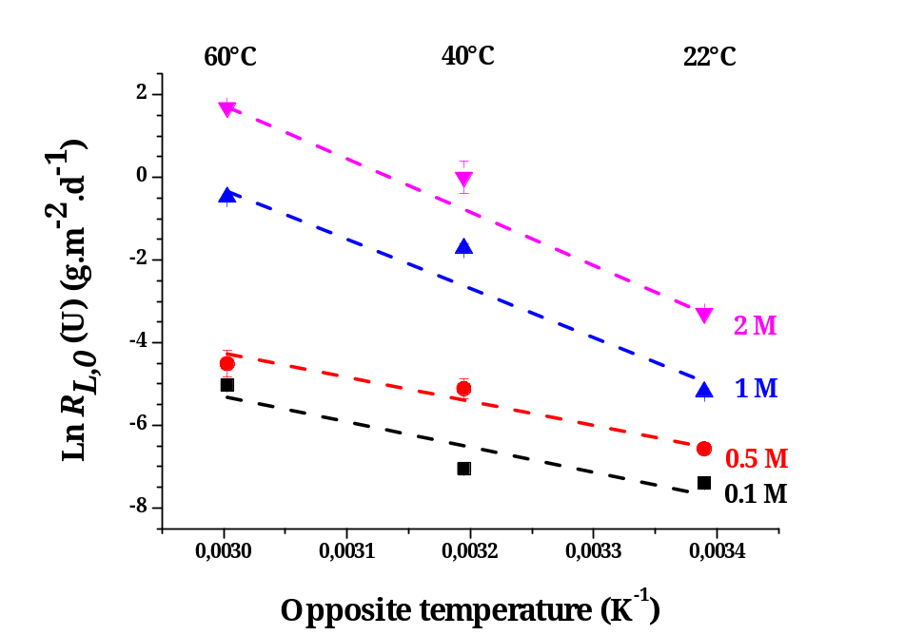
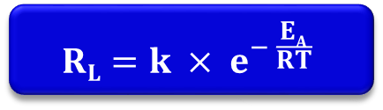
Impact of temperature on U_{0.9}Ln_{0.1}O_{1.95} dissolution
Sintered U_{0.9}Ln_{0.1}O_{1.95}
0.1 – 0.5 – 1 – 2M – 4M HNO₃
T : 22ºC – 40ºC – 60ºC
Static conditions
99 ±19 kJ.mol⁻¹
107 ± 4 kJ.mol⁻¹
48 ± 10 kJ.mol⁻¹
$$RL=k × e^{− \frac{EA}{RT}}$$
51 ± 11 kJ.mol⁻¹
C_{HNO3} < 0.5 M ⇒ E_{app} ≈ 50 kJ.mol⁻¹
  Surface controlling reactions
C_{HNO3} > 0.5 M ⇒ E_{app} ≈ 100 kJ.mol⁻¹
  Redox controlling reactions
Impact of the acid concentration on the activation energy
N. Dacheux et al. , SBNWM symposium 2017, Sydney, October 29 – November 03, 2017
9
Notes:
The influence of the uranium mole loading on the normalized dissolution rates was studied for several Th_{1-x}U_{x}O₂ solid solutions samples with various chemical compositions in 2 mol.L⁻¹ HNO₃ and at 60°C
You can see that after 170 days of leaching test , only 20 percent of the mixed oxide with a uranium mole loading of 0,16 are dissolved….
Conversely to that was observed for Th_{1-x}Ce_{x}O₂ solid solutions, the substitution of thorium by uranium (IV) led to a significant modification of the chemical durability of Th_{1-x}U_{x}O₂ solid solutions. Indeed, an increase of the normalized dissolution rates R_{L,0}(U) and R_{L,0}(Th) by three orders of magnitude is observed between Th_{0.84}U_{0.16}O₂ and Th_{0.29}U_{0.71}O₂. This strong effect is probably due to oxidation of tetravalent uranium into uranyl at the solid/liquid interface, as already described by De Pablo, as you have seen during Nicolas Dacheux talks.
the dissolution could occur in three steps: initial oxidation of uranium at the solid/liquid interface, protonation on the U(IV), Th(IV), U(VI) sites then detachment of the complexes formed at the interface.

Slide 13
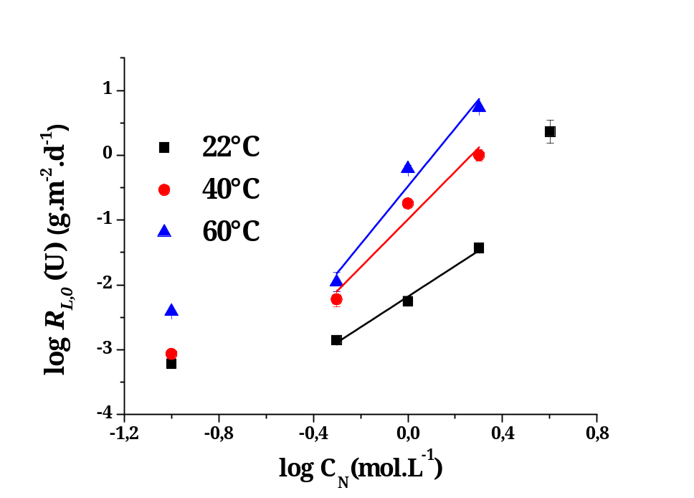
Effect of acid concentration on U_{0.9}Ln_{0.1}O_{1.95} dissolution
Sintered U_{0.9}Ln_{0.1}O_{1.95}
0.1 M
0.5 M
1 M
2 M
4 M
0.1 – 0.5 – 1 – 2M – 4M HNO₃
T : 22ºC – 40ºC – 60ºC
Static conditions
R_{L} = k_{T}’ × (C_{N}) ^{n’}
n' = 2.3 – 4.5
0.5 M HNO₃
Modification of the preponderant dissolution mechanism with acid concentration
C_{HNO3} < 0.5 M ⇒ Surface controlling reactions
C_{HNO3} > 0.5 M ⇒ Redox controlling reactions
N. Dacheux et al. , SBNWM symposium 2017, Sydney, October 29 – November 03, 2017
10
Notes:
The influence of the uranium mole loading on the normalized dissolution rates was studied for several Th_{1-x}U_{x}O₂ solid solutions samples with various chemical compositions in 2 mol.L⁻¹ HNO₃ and at 60°C
You can see that after 170 days of leaching test , only 20 percent of the mixed oxide with a uranium mole loading of 0,16 are dissolved….
Conversely to that was observed for Th_{1-x}Ce_{x}O₂ solid solutions, the substitution of thorium by uranium (IV) led to a significant modification of the chemical durability of Th_{1-x}U_{x}O₂ solid solutions. Indeed, an increase of the normalized dissolution rates R_{L,0}(U) and R_{L,0}(Th) by three orders of magnitude is observed between Th_{0.84}U_{0.16}O₂ and Th_{0.29}U_{0.71}O₂. This strong effect is probably due to oxidation of tetravalent uranium into uranyl at the solid/liquid interface, as already described by De Pablo, as you have seen during Nicolas Dacheux talks.
the dissolution could occur in three steps: initial oxidation of uranium at the solid/liquid interface, protonation on the U(IV), Th(IV), U(VI) sites then detachment of the complexes formed at the interface.

Slide 14
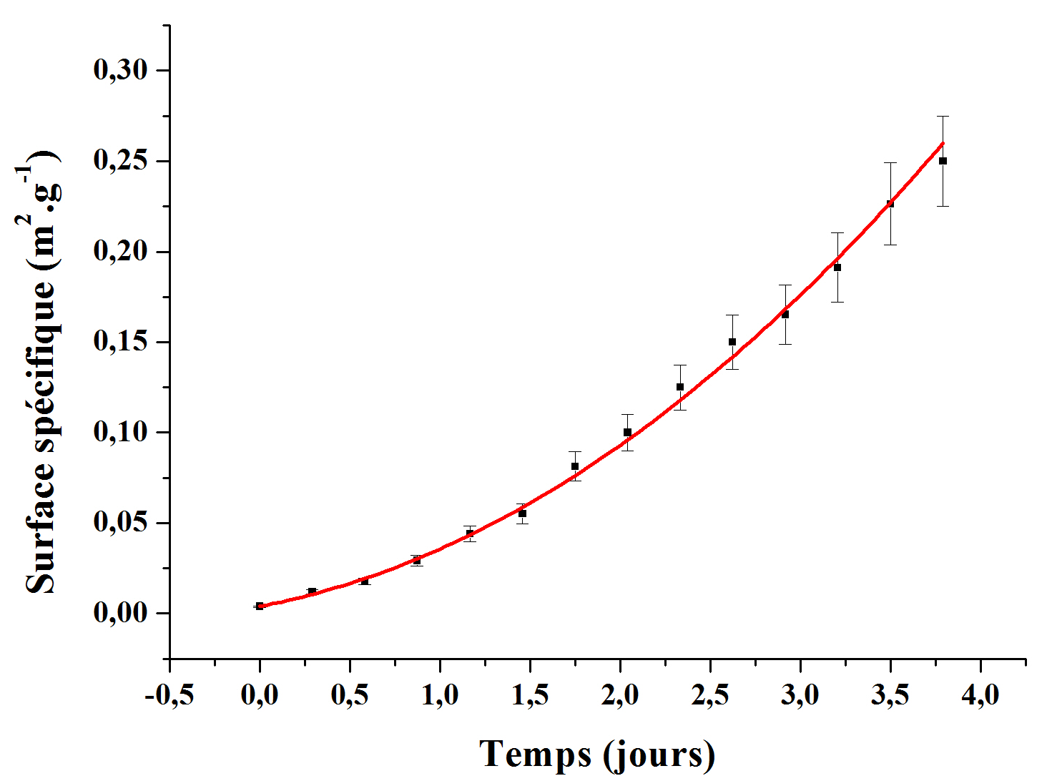
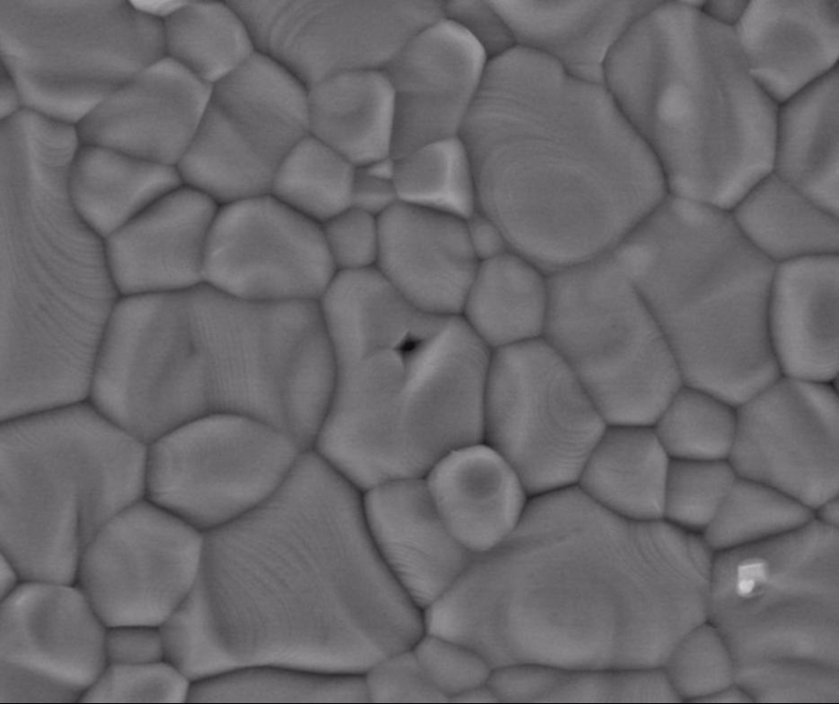
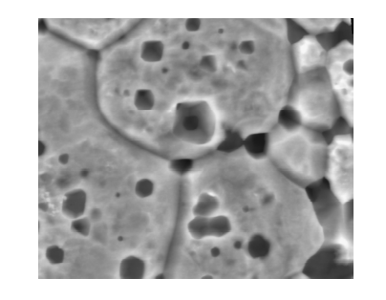
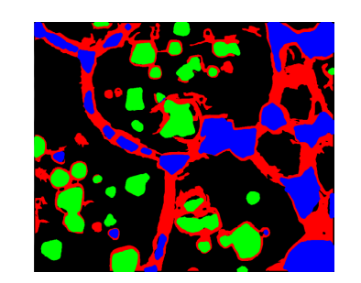
Microscopic study
---
Microstructural evolution of solid/solution interface
Notes:
14
14

Slide 15
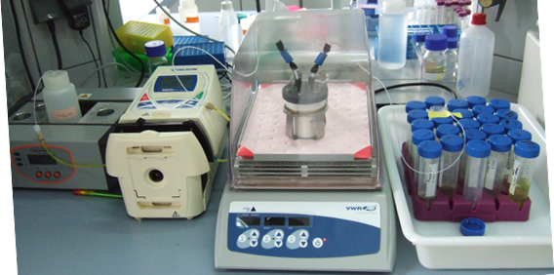
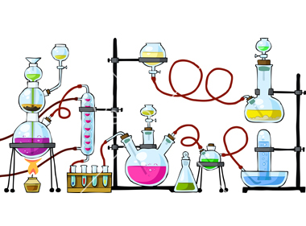
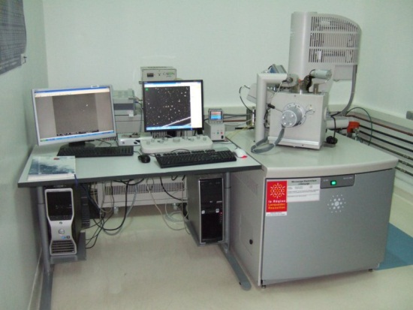

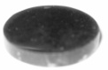
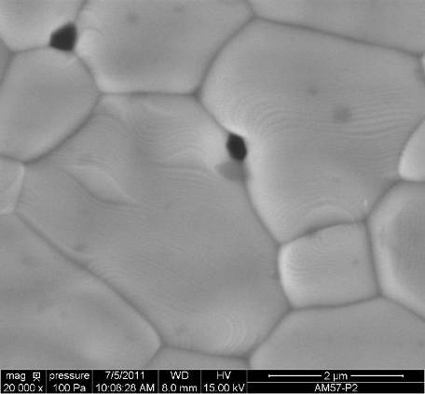

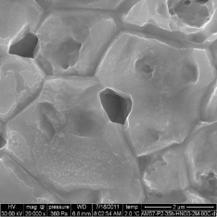
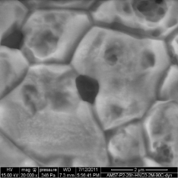
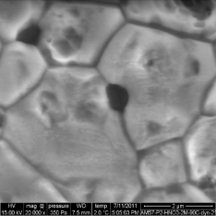
Operando study of evolving interface during dissolution
Dissolution tests
Environmental SEM observations
…
N. Dacheux et al. , SBNWM symposium 2017, Sydney, October 29 – November 03, 2017
11

Slide 16
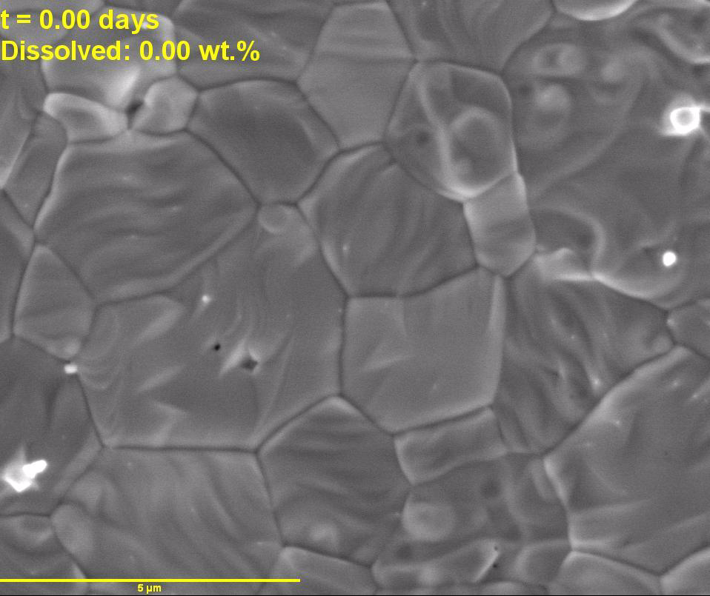
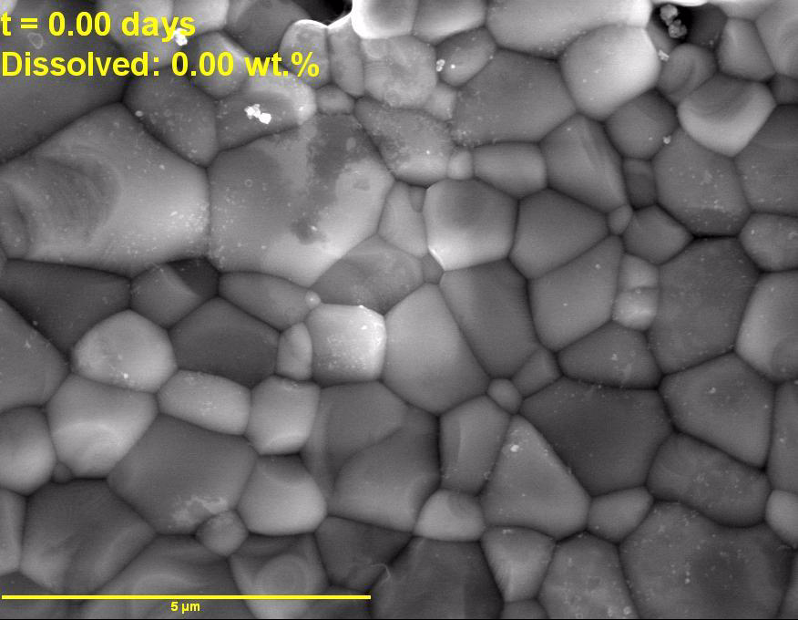
Monitoring of solid/liquid interface during dissolution by ESEM
UO₂ pellet
1 M HNO₃ – T = 60ºC
Dissolution time : 3.2 days
U_{1.9}Ln_{0.1}O_{1.95} pellet
1 M HNO₃ – T = 60ºC
Dissolution time : 1.6 days
Homogeneous dissolution
Microstructural evolution
Oxidation of U(IV)
Preferential dissolution zones (GB)
Ln(III) – enrichment in GB
 Decrease of energy of cohesion
T. Cordara, PhD, ICSM/CEA, Univ. Montpellier, Nov 2017
D. Horlait et al., J. Nucl. Mater., 2012, 429, 237
S. Szenknect et al., J. Phys. Chem. C 2012, 116, 12027
N. Dacheux et al. , SBNWM symposium 2017, Sydney, October 29 – November 03, 2017
12

Slide 17
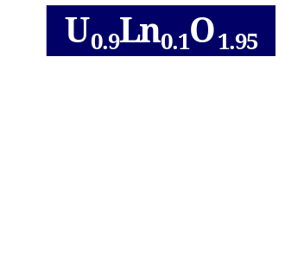
Conclusions & Outlooks
Incorporation of Ln(III) in the UO₂
Solid solutions with fluorite-type structure
Well densified pellets
Strong impact of lanthanides on the dissolution of UO₂ in the lower concentrated acid solution
Macroscopic description
Microscopic description
Modification of the preponderant dissolution mechanism with acid concentration ( @ 0.5M HNO₃ )
Surface ⇒ Redox
controlling reactions
Existence of preferential
dissolution zones
Ln(III) – enrichment in GB
 Decrease of energy of cohesion
N. Dacheux et al. , SBNWM symposium 2017, Sydney, October 29 – November 03, 2017
13

Slide 18
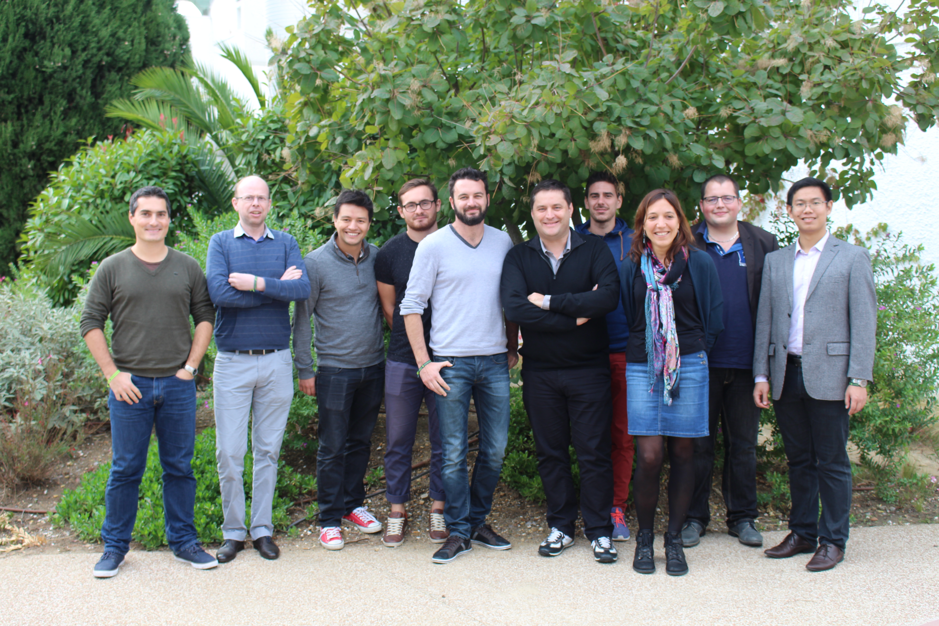
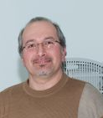



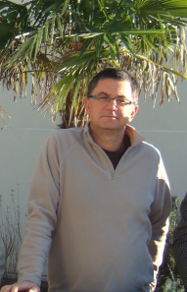



Acknowledgements
Scientific contribution and technical support
Laboratory of Evolving Interfaces in Materials
Laboratory of Matter in Environmental Conditions
IT Department
J. Favrichon
A. Delannoy
(SIP2D)
H.P Brau (MET)
J. Ravaux
(ESEM and X-EDS)
A. Salvatores
X. Machuron Mandard
S. Grandjean
www.icsm.fr
Dr. R. Podor
(ESEM and X-EDS)
Financial support
B. Corso (PXRD)
CEA & AREVA
CNRS – Univ. Montpellier
METSA
EU: TALISMAN, GENIORS
GENIORS

Slide 19
And you for listening…

Slide 21

General trend of UO₂ dissolution in nitric acid
Normalized dissolution rate
R_{L.0} (U) expressed in g.m⁻².d⁻¹
≈ 90
Kinetics
3 domains
❶
❷
❸
Steady state:
Constant rate
Dissolved mass, Δm/m₀ (%)
Induction period
R_{L.pulse} (U)
R_{L.0} (U)
R_{L.t} (U)
≈ 0.5
Increase of S
Increase of autocatalytic species
↗↗ of R_{L}(t)
≈ 0.05
R_{L,pulse}
R_{L,0}
Leaching time (days)
T. Cordara et al., J. Nucl. Mater. 2017, 496, 251-264
N. Dacheux et al. , SBNWM symposium 2017, Sydney, October 29 – November 03, 2017
Notes:
The influence of the uranium mole loading on the normalized dissolution rates was studied for several Th_{1-x}U_{x}O₂ solid solutions samples with various chemical compositions in 2 mol.L⁻¹ HNO₃ and at 60°C
You can see that after 170 days of leaching test , only 20 percent of the mixed oxide with a uranium mole loading of 0,16 are dissolved….
Conversely to that was observed for Th_{1-x}Ce_{x}O₂ solid solutions, the substitution of thorium by uranium (IV) led to a significant modification of the chemical durability of Th_{1-x}U_{x}O₂ solid solutions. Indeed, an increase of the normalized dissolution rates R_{L,0}(U) and R_{L,0}(Th) by three orders of magnitude is observed between Th_{0.84}U_{0.16}O₂ and Th_{0.29}U_{0.71}O₂. This strong effect is probably due to oxidation of tetravalent uranium into uranyl at the solid/liquid interface, as already described by De Pablo, as you have seen during Nicolas Dacheux talks.
the dissolution could occur in three steps: initial oxidation of uranium at the solid/liquid interface, protonation on the U(IV), Th(IV), U(VI) sites then detachment of the complexes formed at the interface.

