Slide 1
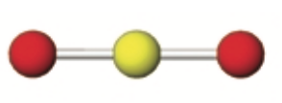
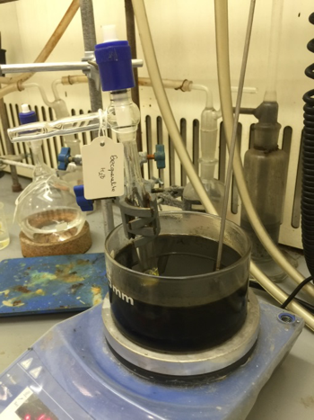
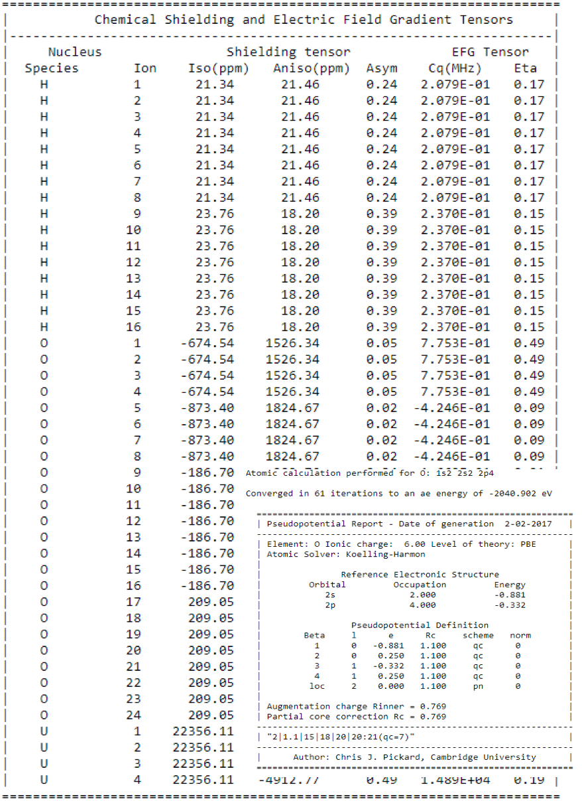
Solid State MAS-NMR for characterizing uranium minerals produced during dissolution of spent nuclear fuel
Beng Thye Tan¹, Robert Baker², Ian Farnan¹
¹Department of Earth Sciences, University of Cambridge,
²Department of Chemistry, Trinity College, Dublin
Notes:
Thank you for the interesting keynote and speeches today! I have benefitted greatly. I am Beng Thye and I am here to share my turnkey research project encompassing sample fabrication, XRD and crystal structure analysis, NMR experiments and analysis and lastly DFT calculations to back my experimental data.

Slide 2
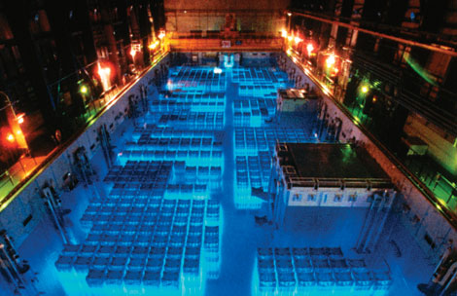
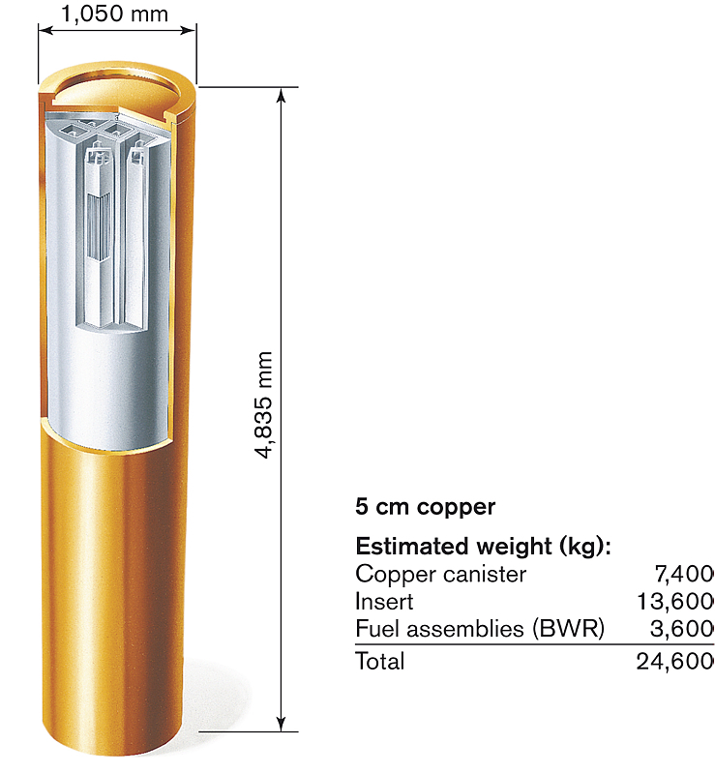
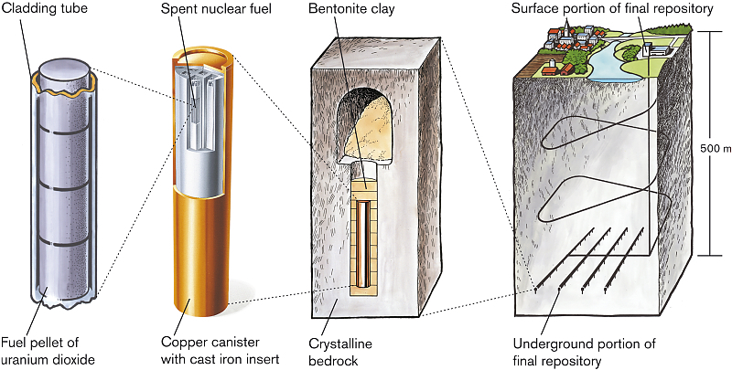
Rationale
Migration of uranium and other actinides from underground repositories will depend on the minerals¹ formed when spent nuclear fuel reacts with groundwater containing soluble ions in the anoxic² environment of the repository.
Secondary phases of possible uranium minerals were fabricated to develop a better understanding of their chemical structure.
Although these are oxic fabrication, but they could occur under anoxic conditions if there was local oxidation due to water radiolysis.
Spent Fuel Pool
[1] R. J. Baker, Coord. Chem. Rev., 2014, 123-136
[2] Amme, M., Wiss et al, J. Nuc. Mat., 2005 341, 209-233.
For the bentonite-canister near field, redox potentials of about -100 to -300 mV (SHE) are estimated.
Notes:
I am glad to be scheduled in this session where many have already discussed the reasons and concerns of underground repositories.
Migration of radioactivity from underground repository will likely occur when groundwater ingresses into underground repositories and react with the spent nuclear fuel which is made up of 96% Uranium dioxide, 3 % fission products and the remaining being plutonium and minor actinides.
Hence, possible uranium secondary phases were fabricated in collaboration with Trinity College Dublin under the supervision of Prof Robert Baker from the Dept of Chemistry.
We are also working with high surface area UO2 to produce altered surfaces. O17 NMR can be used to detect in- situ dissolution and precipitation of uranium secondary phases.

Slide 3
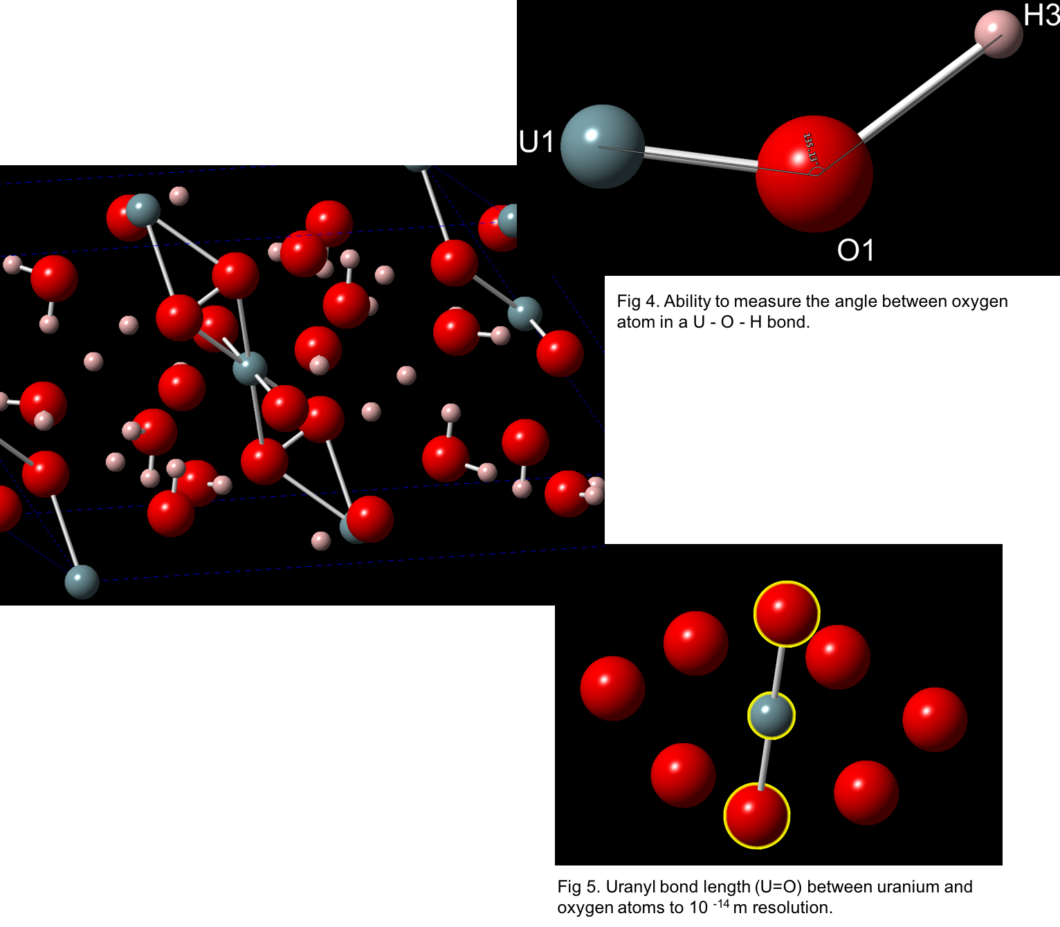
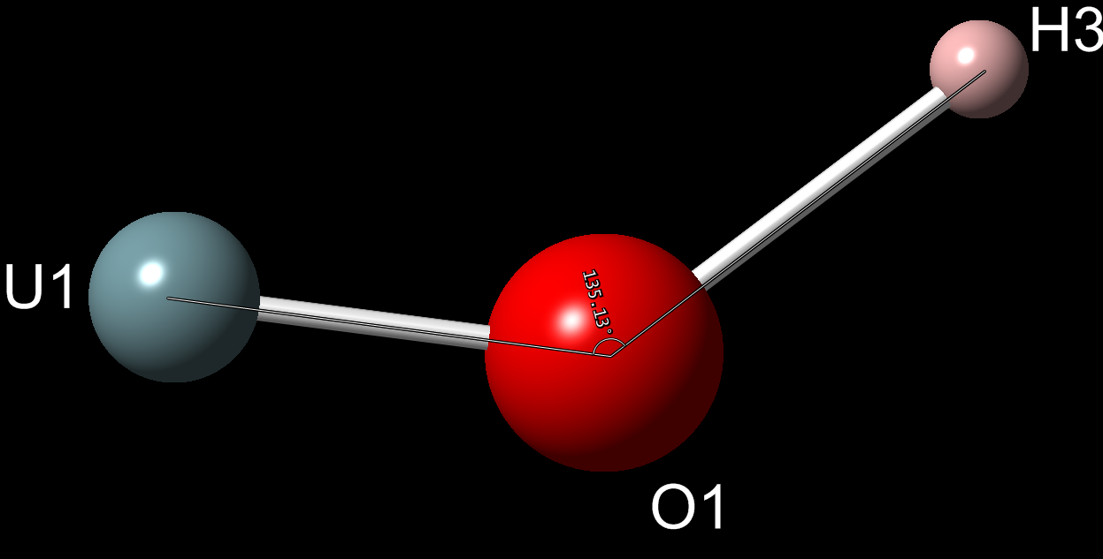
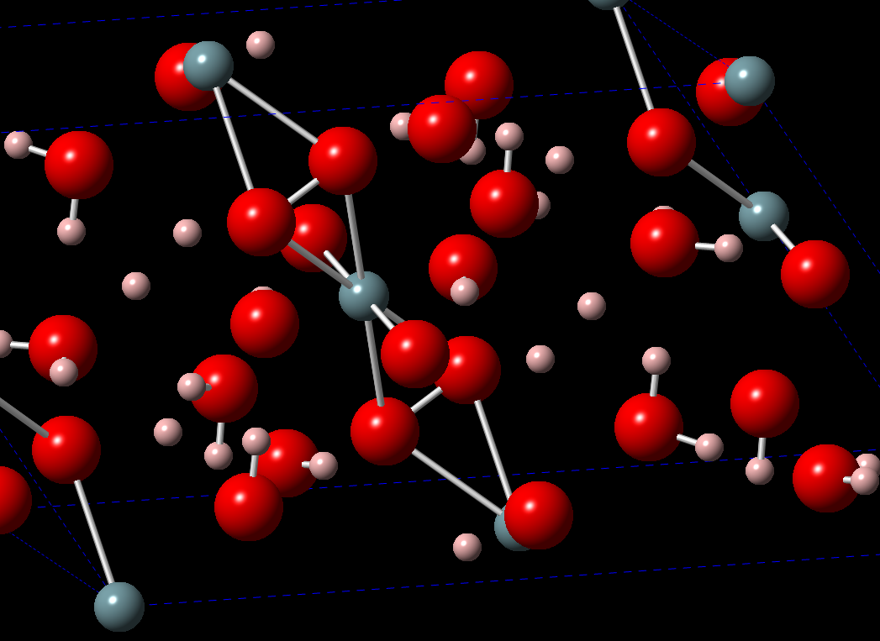
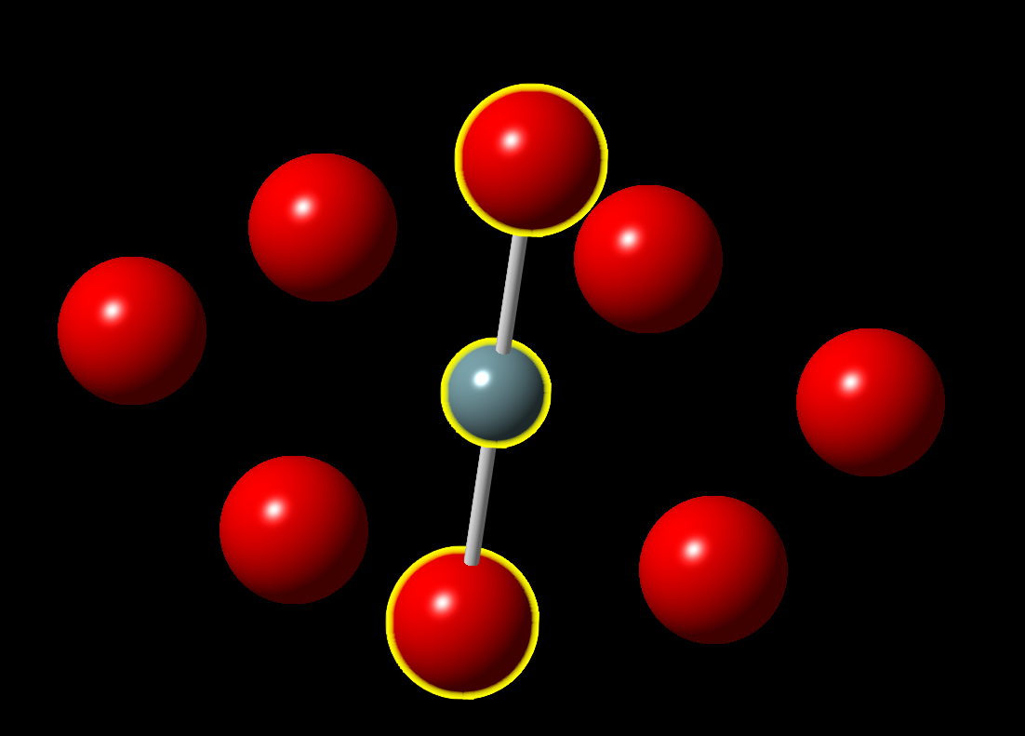
Existing XRD literature
Structural analysis of minerals from XRD literature with Crystalmaker™,
measuring the uranyl (U=O) bond lengths
comparing the angles.
the different oxygen environment can be examined
Notes:
By analysing the crystal structure of these fabricated minerals such as their bond lengths and angles, we are able to examine the different oxygen environments.

Slide 4
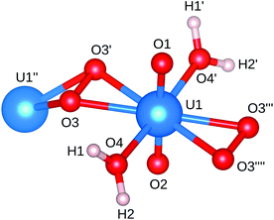
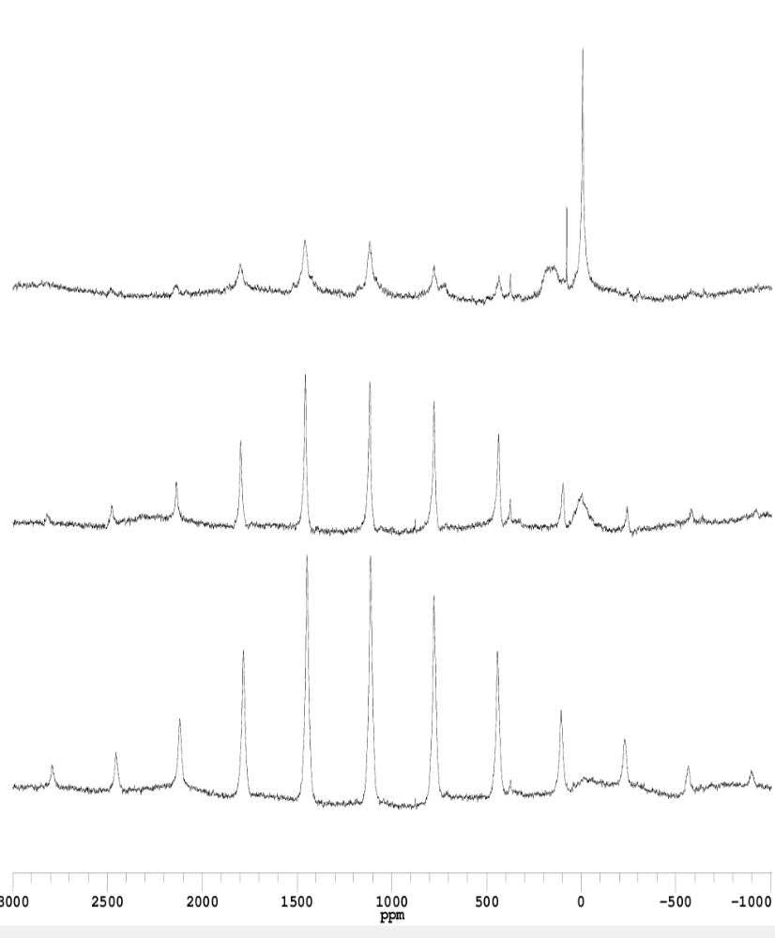
A typical structure: Studtite
Different oxygen environments
O₁ = U = O₂ (Linear Uranyl ions- UO₂²⁺)
O₃-O₃¹ (Peroxide ions O₂²⁻)
H-O-H (Water molecule, H₂O)
*
*
*
*
*
*
*
*
*
*
NMR Spectrum of Studtite
with a single uranyl peak.
* Spinning sidebands
O=U=O
O-O
H-O-H
Notes:
A relatively simple structure is studtite.
The structure of studtite contains one symmetrically unique U6+ cation and six O atoms, two of which (O4 and O4¹) correspond to H2O groups. A pair of symmetrically equivalent O3 atoms are bonded to form a peroxide group, with an O3-O3 separation of 1.46 Å. The U6+ cation is strongly bonded to two oxygen atoms, O1 and O2, resulting in a linear (UO2)2+ uranyl ion. Together, they form a distorted hexagonal bipyramid. The bond within the peroxide group is parallel to the equatorial plane of the hexagonal bipyramid, and defines an equatorial edge of the polyhedron
Hence, there are 3 different oxygen environments which can be detected by O- 17 NMR...
This is a relatively simple crystal structure with a small unit cell.
Most of our samples are minerals with large unit cells,
XRD does not capture positions of hydrogen and also precursor alteration phases could be amorphous.
Therfore, O17 NMR is a good way to study them, but there is little information to go on.
Hence we are making uranyl minerals that contain O17 as a way of ultimately interpreting amorphous phases

Slide 5
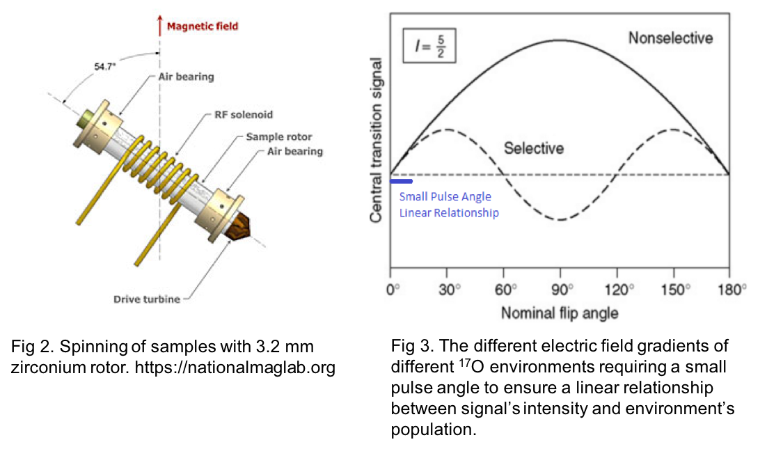
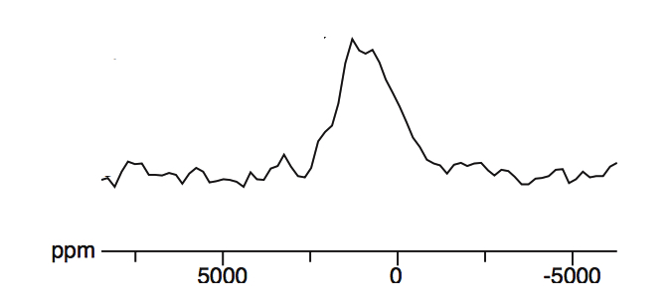
MAS-NMR Analysis
30- 35 mg of each sample was loaded into zirconia rotors in an anoxic glovebox.
¹⁷O Nuclear Magnetic Resonance (NMR) spectroscopy was conducted with a 9.39 T magnetic field with rotor spinning at 18 kHz at a small pulse angle⁸ of about 10⁰.
Without spinning, poor resolution spanning 5000 ppm
Notes:
We pulse at a small angle to ensure a linear relationship between signal’s intensity and their corresponding environment’s population.
We spin at the magic angle to average out the orientation-dependent frequencies i.e the anisotropies.
A disadvantage of spinning is the presence of spinning sidebands. These are repetitive signals (i.e. peaks) that result from the modulation of the magnetic field at the spinning frequency.
But the advantage of spinning for solid state NMR is the increased resolution.

Slide 6
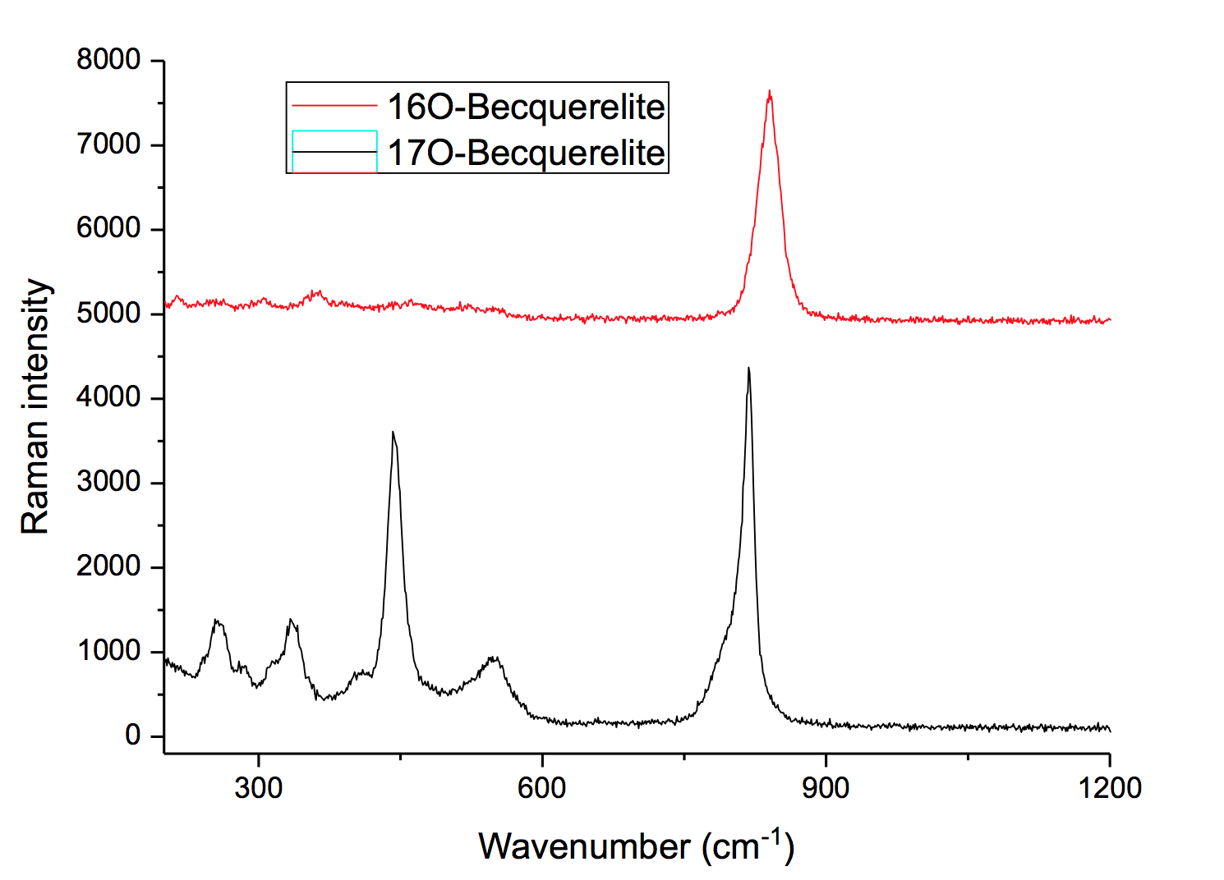
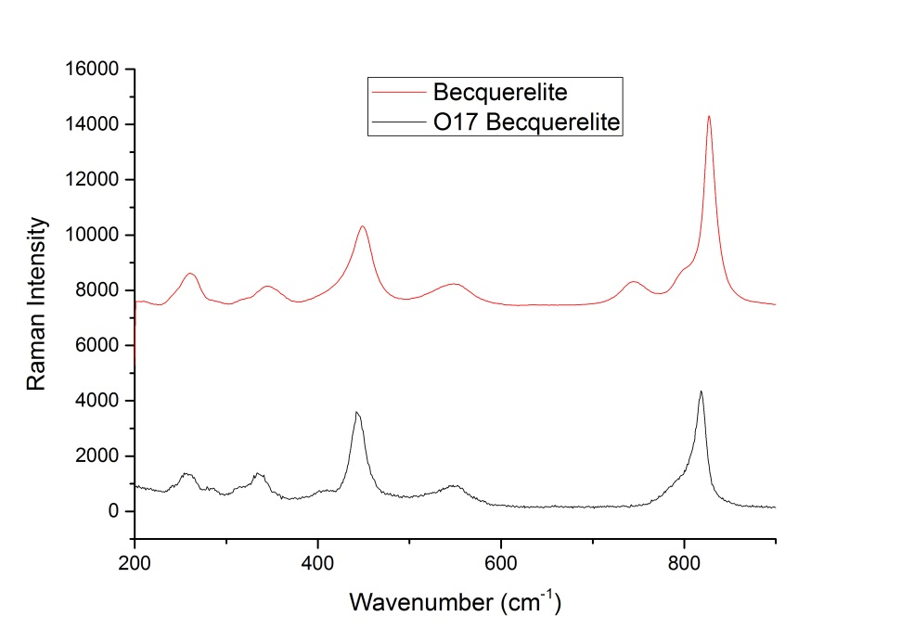
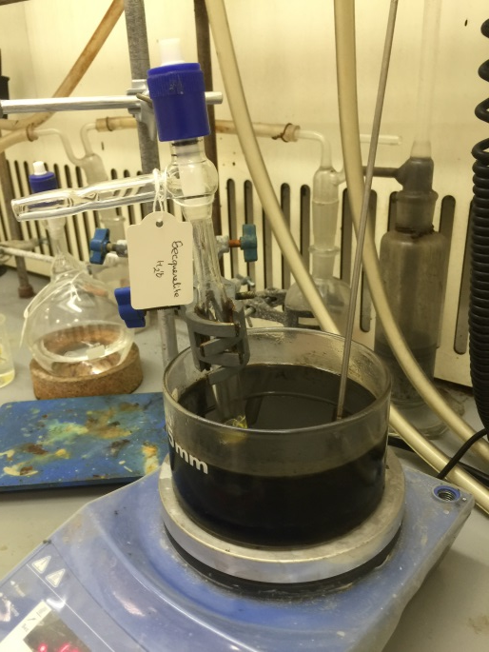
Fabrication
Fabrication and isotopic enrichment with NMR-sensitive ¹⁷O to characterize these samples.
a) Andersonite³, Na₂Ca(UO₂)(CO₃)₃ · 6H₂O
b) Becquerelite⁴, Ca(UO₂)₆O₄(OH)₆ · 8H₂O
c) Grimselite⁵, K₃Na(UO₂)(CO₃)₃ · H₂O
d) Metaschoepite⁶, (UO₂)₄O(OH)₆ · 5H₂O
e) Studtite⁷, [(UO₂)(O₂)(H₂O)₂] · 2H₂O
The shifting and broadening is related to the isotopic disorder of the crystal lattice.
Shifted oxygen peak
Fig 1. Raman spectroscopies of Becquerelite formed with normal H₂O and H₂¹⁷O with a shifted oxygen peak, demonstrating the successful isotopic enrichment
Emission and Raman spectroscopies show the same peaks. The peak corresponding to oxygen element (750 cm⁻¹) is higher due to the heavier ¹⁷O atom. This demonstrated the successful isotopic enrichment of the mineral.
Emission and Raman spectroscopies show the same peaks. The peak corresponding to oxygen element (750 cm⁻¹) is higher due to the heavier ¹⁷O atom. This demonstrated the successful isotopic enrichment of the mineral.
Emission and Raman spectroscopies show the same peaks. The peak corresponding to oxygen element (750 cm⁻¹) is higher due to the heavier ¹⁷O atom. This demonstrated the successful isotopic enrichment of the mineral.
Emission and Raman spectroscopies show the same peaks. The peak corresponding to oxygen element (750 cm⁻¹) is higher due to the heavier ¹⁷O atom. This demonstrated the successful isotopic enrichment of the mineral.
Emission and Raman spectroscopies show the same peaks. The peak corresponding to oxygen element (750 cm⁻¹) is higher due to the heavier ¹⁷O atom. This demonstrated the successful isotopic enrichment of the mineral.
Emission and Raman spectroscopies show the same peaks. The peak corresponding to oxygen element (750 cm⁻¹) is higher due to the heavier ¹⁷O atom. This demonstrated the successful isotopic enrichment of the mineral.
Emission and Raman spectroscopies show the same peaks. The peak corresponding to oxygen element (750 cm⁻¹) is higher due to the heavier ¹⁷O atom. This demonstrated the successful isotopic enrichment of the mineral.
Emission and Raman spectroscopies show the same peaks. The peak corresponding to oxygen element (750 cm⁻¹) is higher due to the heavier ¹⁷O atom. This demonstrated the successful isotopic enrichment of the mineral.
Shifted oxygen peak
Fig 1. Oil bath for heat treatment and reaction of H₂¹⁷O Becquerelite
Fig 2. Raman spectroscopies of Becquerelite formed with normal H₂O and H₂¹⁷O
Fig 1. Oil bath for heat treatment and reaction of H₂¹⁷O Becquerelite
Fig 2. Raman spectroscopies of Becquerelite formed with normal H₂O and H₂¹⁷O
Fig 1. Oil bath for heat treatment and reaction of H₂¹⁷O Becquerelite
Fig 2. Raman spectroscopies of Becquerelite formed with normal H₂O and H₂¹⁷O
Fig 1. Oil bath for heat treatment and reaction of H₂¹⁷O Becquerelite
Fig 2. Raman spectroscopies of Becquerelite formed with normal H₂O and H₂¹⁷O
Fig 1. Oil bath for heat treatment and reaction of H₂¹⁷O Becquerelite
Fig 2. Raman spectroscopies of Becquerelite formed with normal H₂O and H₂¹⁷O
Fig 1. Oil bath for heat treatment and reaction of H₂¹⁷O Becquerelite
Fig 2. Raman spectroscopies of Becquerelite formed with normal H₂O and H₂¹⁷O
Fig 1. Oil bath for heat treatment and reaction of H₂¹⁷O Becquerelite
Fig 2. Raman spectroscopies of Becquerelite formed with normal H₂O and H₂¹⁷O
Fig 1. Oil bath for heat treatment and reaction of H₂¹⁷O Becquerelite
Fig 2. Raman spectroscopies of Becquerelite formed with normal H₂O and H₂¹⁷O
Fig 2. Raman spectroscopies of Becquerelite formed with normal H₂O and H₂¹⁷O
Notes:
We chose these minerals because of the common constituents present in groundwater.
We chose to isotopically enrich them with O-17 with a nuclear spin of 5/2 as the natural abundance of O-17 is low at 0.04%.
To demonstrate successful isotopic enrichment of the mineral, we perform raman and emission spectroscopies to compare with the non-enriched form…. The peak corresponding to uranyl bond (750 cm⁻¹) is lower due to the heavier ¹⁷O atom.
With that, lets look at some NMR spectra obtained...

Slide 7
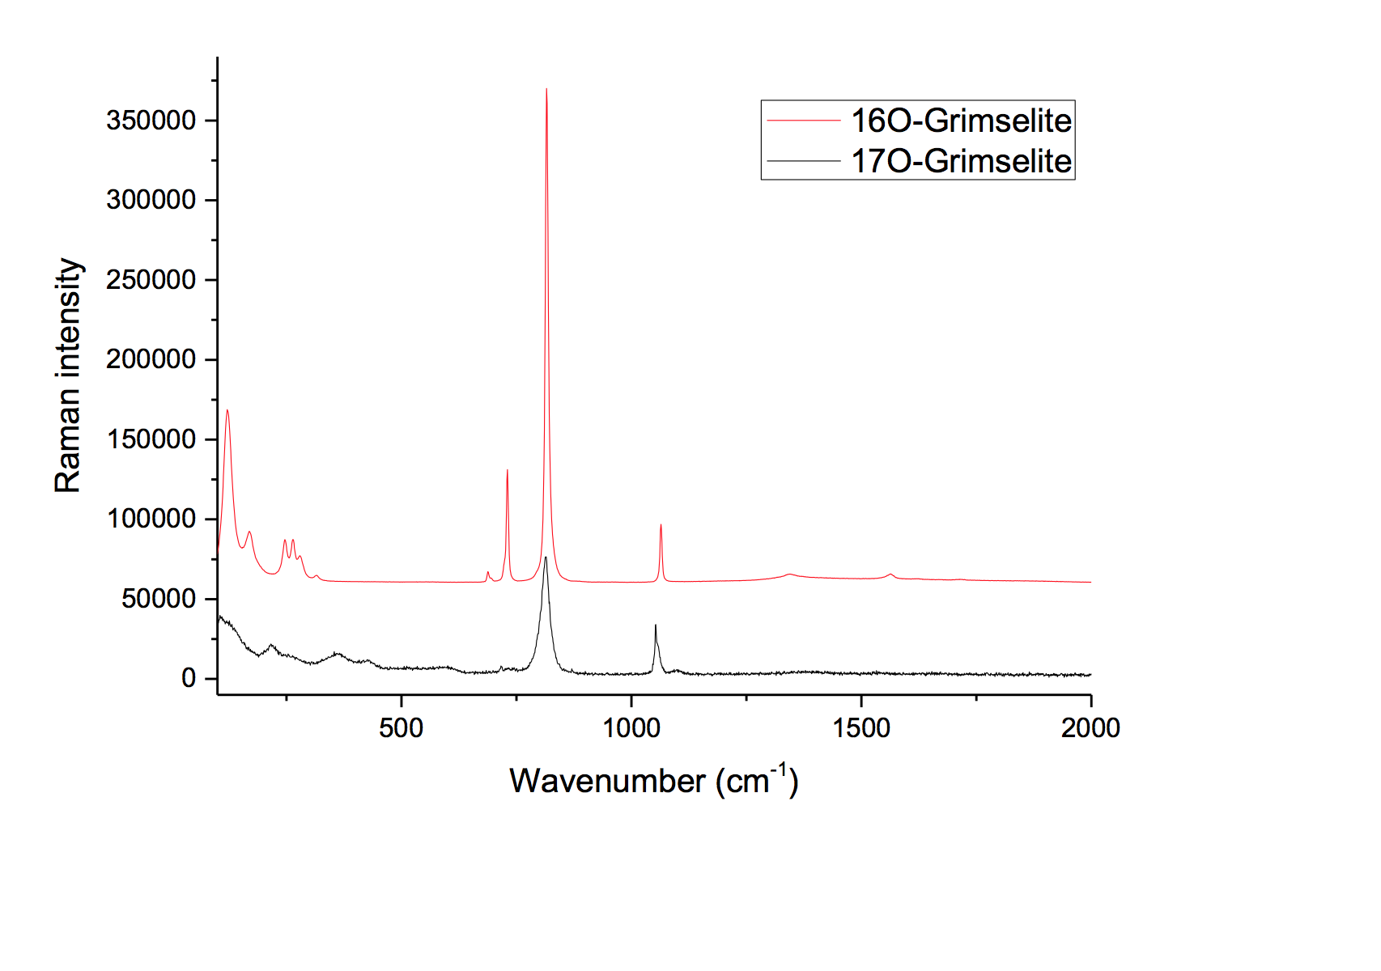
Grimselite
1 uranyl peak at about 1100 ppm
a strong quadrupolar interaction at about 250 ppm
indicates the presence of more than one ¹⁷O environment.
Andersonite
2 uranyl peaks at about 1100 ppm.
2 unique uranyl bond lengths of 1.7763 Å and 1.8078 Å that are separated by a chemical shift of 47.3 ppm
good resolution with a gradient of 150 ppm/ 0.1 Å
Fabrication seems to favor non-uranyl oxygen.
O=U=O
*
*
O=U=O
*
*
*
*
*
*
Notes:
The grimselite data shows good correlations with our DFT calculations which will be shown later. The uranyl peak seems to be smaller due to our fabrication reaction which favors the non- uranyl oxygen
Recently published theoretical calculations done with uranyl solution (of 140 ppm/ 0.1 Å. ) agrees with our data.
For more complicated structures..

Slide 8
*
*
For more complicated structure with multiple uranyl bonds of different lengths, we can deconvolve them to resolve the isotropic chemical shifts corresponding to different oxygen environments.
*
*
*
*
*
Increased Proximity of uranium atom
(shorter bond length)
Shielding of Oxygen Nucleus
(Smaller ppm values)
Notes:
~ 1100 ppm
By the way, the manifold isotropic central peak can be detected by spinning at different speed as the spinning sideband will move away at higher speed..
Particularly, we focused on the uranyl bond length as a main component affecting the magnetic resonance, as you will appreciate the proximity of the uranium atom with its high electron density will have a large impact on the shielding of the oxygen nucleus resulting in a smaller shift in the resonant frequency or in normalized terms a smaller ppm value.

Slide 9
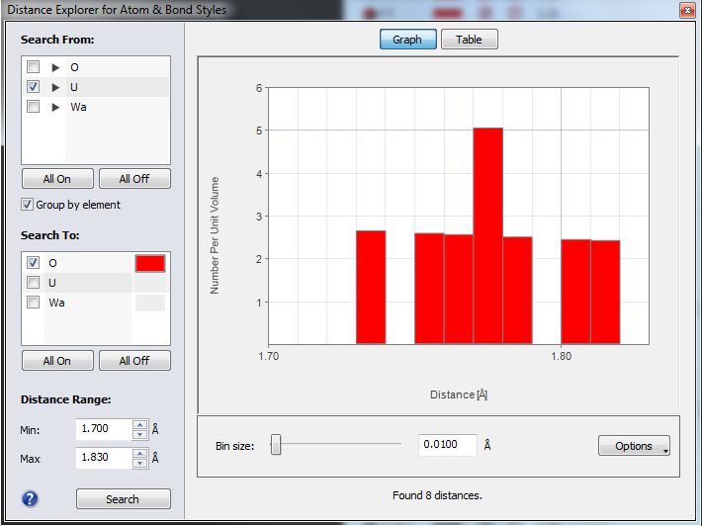
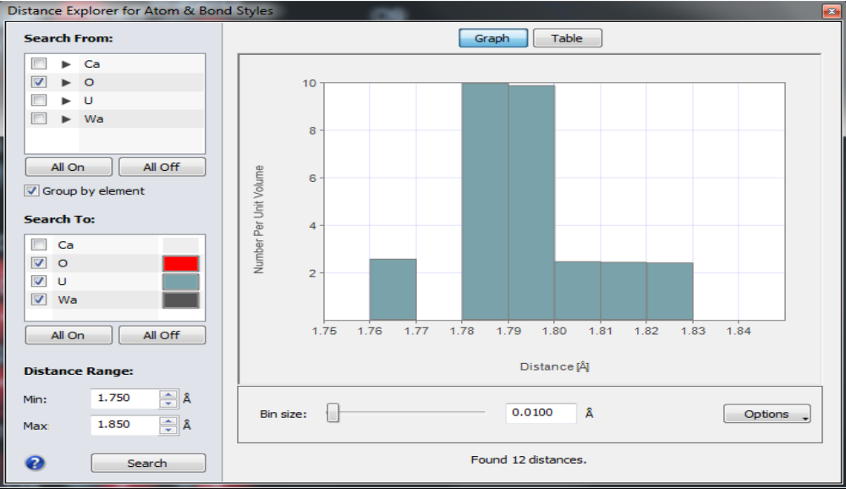
*
*
*
Centre isotropic band
*
*
*
*
*
*
*
*
* Spinning sideband manifold, separated by the spinning speed in frequency unit
Notes:
For Metaschoepite, there are 12 different uranyl bond lengths within 7 regions of 0.1 Å. It was shown clearly that we are able to deconvolve the centre bands to 7 peaks with a close fit in area too.
For Becquerelite, there are 8 unique uranyl bond lengths within 6 regions of 0.1 Å. It was shown clearly that we are able to deconvolve the centre isotropic bands to 6 peaks with a close fit to the intensities and relative positions of the expected chemical shift.
We can also observe that a shorter bond length results in greater shielding and hence a smaller resonance frequency i.e. a smaller ppm shift.

Slide 10
Fig 11. Graph of Chemical Shift/ ppm against Uranyl Bond Length/ Angstrom
Notes:
¹⁷O chemical shift in ppm was plotted against the uranyl bond lengths (from XRD literature) and we noted high linear correlations with R² values of 0.97 to 0.98 for each secondary phase.
Different secondary phases include different ions which will affect the chemical shift due to the additional electron shielding/ deshielding. Ignoring such effects, we obtain a linear relationship for each secondary phase.

Slide 11
Work in progress: "First principles methods using CASTEP"
Gauge Including Projector Augmented Waves (GIPAW) was employed to calculate NMR spectroscopy on our samples.
This program calculates the electric field gradients and chemical shielding tensors due to the surrounding atoms of the oxygen atom on a first-principal basis.
Prior to that, we geometrically optimise the crystal structure by reducing the force per unit atom. This also position the hydrogen atoms in the water molecules as well, which are often absent in XRD data.
Notes:
GIPAW (Gauge Including Projector Augmented Waves) is a DFT based method to calculate magnetic resonance properties, exploiting the full translational symmetry of crystals. The use of pseudopotentials and plane waves provides an excellent balance of speed and accuracy.
GIPAW calculations are naturally adapted to ordered crystalline solids, since size convergence is effectively achieved by using primitive unit cells with well-converged k-point (quadrature) grids for Brillouin zone integrations.

Slide 12
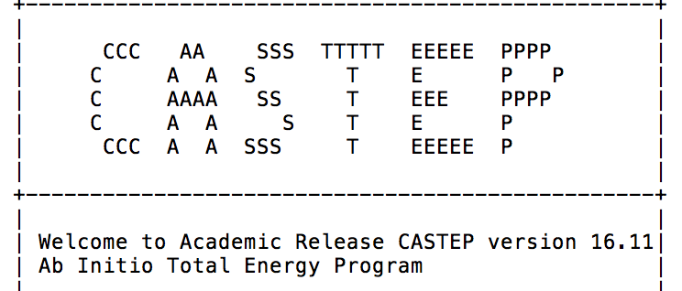
Grimselite
=============== | ============= | ============== | ============
| | Chemical | Shielding Tensor
|-------------- | ------------- | -------------- | ------------
| Nucleus |  | Shielding tensor
| Species | Ion | Iso(ppm) | Aniso(ppm) | ppm after reference
| O | 1 | -82.38 | -316.7 | 257.73
| O | 2 | -77.19 | -291.57 | 252.54
| O | 3 | -56.83 | 234.71 | 232.18
| O | 4 | -63.82 | 246.05 | 239.17
| O | 5 | -60.36 | -261.55 | 235.71
| O | 6 | -57.6 | -264.64 | 232.95
| O | 7 | -63.12 | -278.31 | 238.47
| O | 8 | -71.12 | -282.34 | 246.47
| O | 9 | -8.29 | 221.99 | 183.64
| O | 10 | 0.13 | 209.21 | 175.22
| O | 11 | -74.8 | -296.39 | 250.15
| O | 12 | -80.23 | -324.61 | 255.58
| O | 13 | -902.65 | 1880.65 | 1078
| O | 14 | -902.98 | 1880.98 | 1078.33
| O | 15 | -902.63 | 1880.6 | 1077.98
| O | 16 | -902.95 | 1880.9 | 1078.3
| O | 17 | 27.68 | 251.37 | 147.67
| O | 18 | 31.05 | 246.51 | 144.3
| O | 19 | 38.25 | 186.59 | 137.1
| O | 20 | 39.46 | 184.84 | 135.89
| O | 21 | 33.06 | 236.71 | 142.29
| O | 22 | 28.64 | 243.21 | 146.71
| O | 23 | 200.58 | 108.69 | -25.23
| O | 24 | 202.1 | 109.17 | -26.75
| O | 25 | 200.55 | 108.57 | -25.2
| O | 26 | 202.06 | 109.07 | -26.71
Notes:
After geometrically optimizing the structure, the calculated NMR parameters fits quite closely with our experimental NMR spectra. The calculations verified there to be one uranyl oxygen peak at about 1078 ppm and a large quadrupolar interaction at 100 to 250 ppm.

Slide 13
Conclusion
Recent theoretical Ab Initio Molecular Dynamics Calculation⁹ on uranyl solution (140 ppm shift/ 0.1 Å) agrees with our experimental data.
With ¹⁷O NMR, we obtain high resolution information on the oxygen environment in alteration phases of UO₂, and we are beginning to get systematic data on variation of structure with chemical shift that will allow interpretation of amorphous phases.
There is potential to investigate the inclusion of other actinides into these uranyl alteration phases.
[9] Alex Marchenko et. al., Inorganic Chemistry, 2017, 56, 7384-7396
Notes:
Which most of us will agree is an important issue for spent nuclear fuel research.

Slide 14
Q&A

