Slide 1
Simplified UK Magnox waste glass alteration layer characterisation using
²⁹Si,¹⁷O and ²⁵Mg NMR techniques
Rui Guo & Ian Farnan
Notes:
MAGnesium Non-OXdising

Slide 2
Background
Mixture Windscale (MW) 25 wt% waste load glass: MW25 (borosilicate glass)
Full-component MW25 simulant glass: 23-oxide components
Simplified 6-oxide components glass:
“to study the effect of Mg on glass dissolution as opposed to Ca”
Leached in deionised water;
Leached in ¹⁷O enriched (45%) water;
MgEM made using ²⁵Mg enriched (99.7%) MgO as precursor (leached in deionised water).
MgEM CaEM
Cation | Al | B | La (REs) | Mg/Ca | Na (alkalis) | Si
mol% | 4.87 | 27.58 | 1.72 | 6.54 | 15.38 | 43.91
Notes:
Simplified 6-oxide component glasses were made to study the effect of magnesium against calcium on dissolution;

Slide 3
Motivation
“1. Leached in deionised water”
“3. MgEM made using ²⁵Mg enriched (99.7%) MgO as precursor (leached in deionised water)”
4 weeks
Notes:
Would the deposit of magnesium back onto the surface contribute to the drastically different dissolution rates;
It is important to understand in what form they have been incorporated;

Slide 4
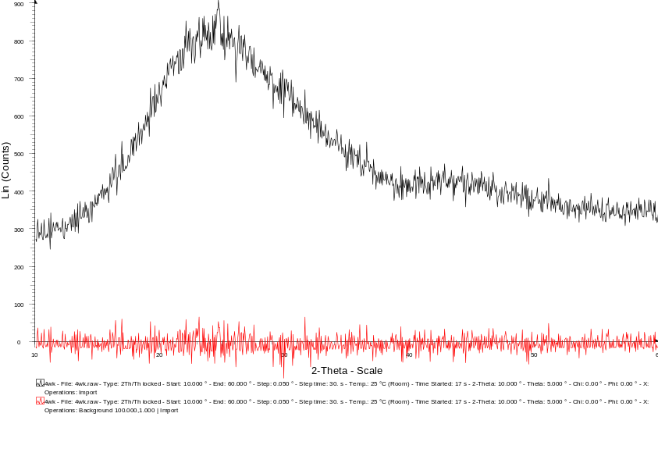
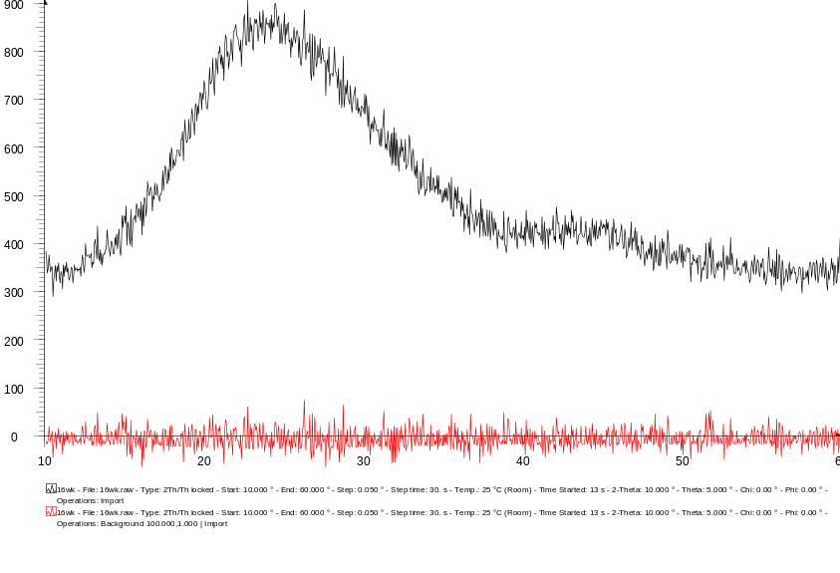
XRD
4wk leached
16wk leached
To use multinuclear NMR techniques to characterise the altered layer that results from re-organisation processes and precipitation reactions
Notes:
Any proto-crystalline or amorphous phase would be difficult to be seen by XRD;
NMR does not care long range order, it only uses magnetic nuclei as probe for local chemistry and structural environments, therefore could provide insightful information;

Slide 5


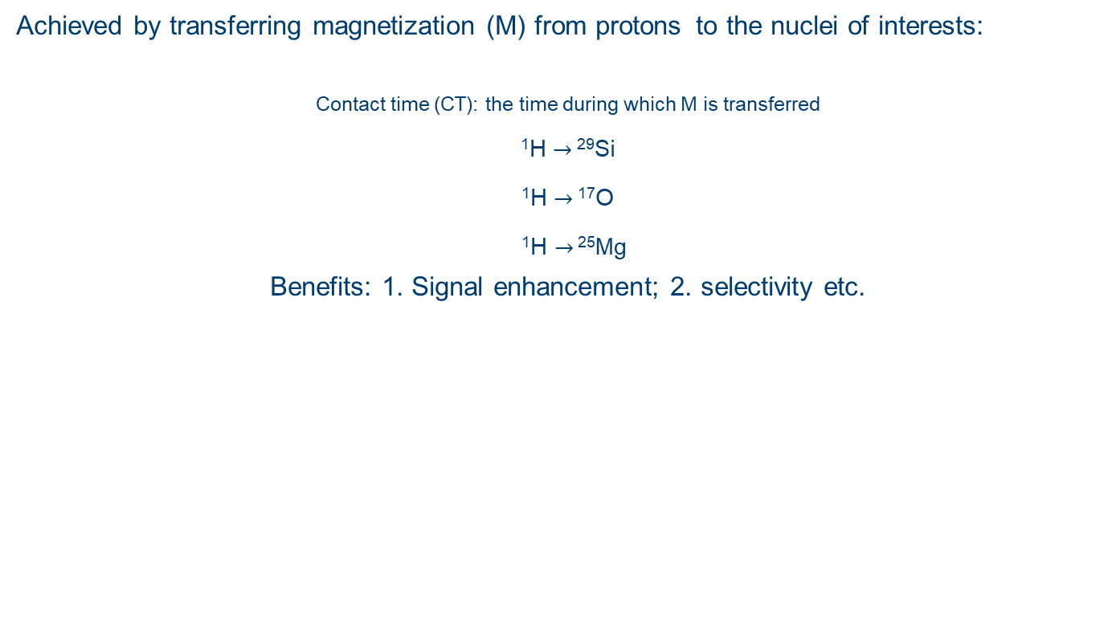
Cross polarisation (CP) NMR
Achieved by transferring magnetization (M) from protons ^{to the nuclei of interests:}
Contact time (CT): the time during which M is transferred
¹H $→$ ²⁹Si
¹H $→$ ¹⁷O
¹H $→$ ²⁵Mg
Benefits: 1. Signal enhancement; 2. selectivity etc.
~3 $μ$m
~100 $μ$m
Experimentally difficult!
Notes:
To explain and explore CT later;
The diameter of glass particles in question is at the scale of 100 um while the longest leached samples, based on B concentration in solution, only builds up an altered layer with an effective thickness of ~3 um;

Slide 6
Mixture Windscale (MW) 25 wt% waste load glass: MW25
Full-component MW25 simulant glass: 23-oxide components
Simplified 6-oxide components glass:
Leached in deionised water;
Leached in ¹⁷O enriched (40%) water;
Made using ²⁵Mg enriched (99.7%) MgO as precursor.
Cation | Al | B | La (REs) | Mg | Na (alkalis) | Si
mol% | 4.87 | 27.58 | 1.72 | 6.54 | 15.38 | 43.91

Slide 7
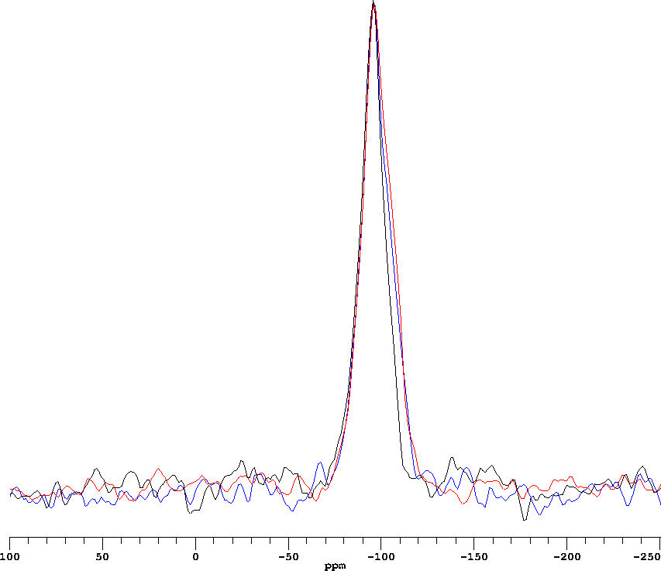
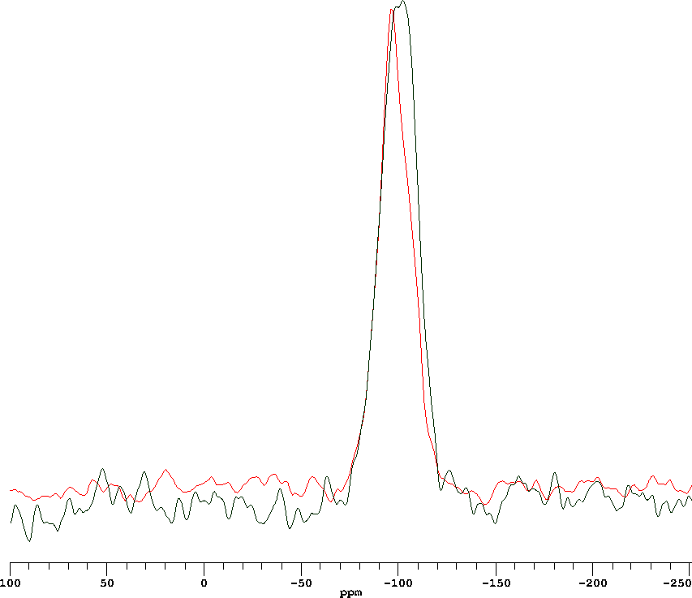





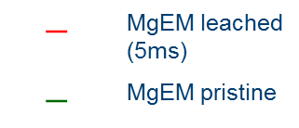
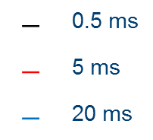

²⁹Si CPMAS: depolymerisation
$$↓$$
$$−$$
-90~-100 ppm
$$↓$$
$$−$$
~-110 ppm
The position of the primary peak is in the range of -90~-100 ppm, which mainly corresponds Q3 species i.e. Si connected to 3 bridging oxygens (BOs) and 1 non-bridging oxygen (NBO), in this case, Si-OH. As CT increases, Si species that are more electronically shielded get cross polarised i.e. Q4, which locate further from protons.
$$−$$ | 0.5 ms
$$−$$ | 5 ms
$$−$$ | 20 ms
$$−$$ | MgEM leached (5ms)
$$−$$ | MgEM pristine
$$↓$$
$$−$$
~-110 ppm
Notes:
Altered layer gets depolymerised due to hydration & hydrolysis, which is also illustrated by comparison with single pulse spectrum of pristine glass;

Slide 8
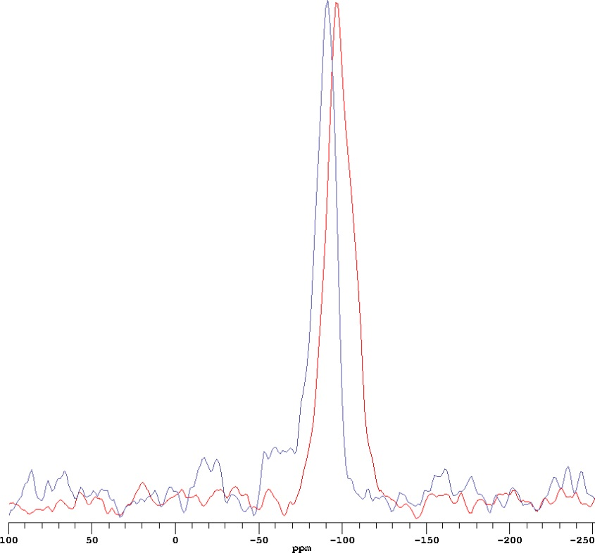
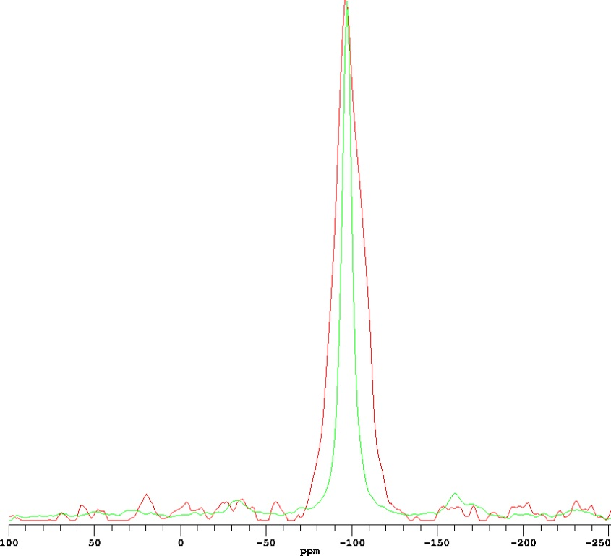


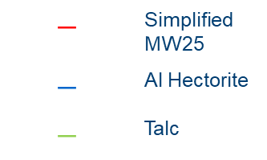
²⁹Si CPMAS : other minerals
Aluminous hectorite precipitate on AVM-10 French glass
(B. Thien et al. App. Caly Sci. 49 (2010) 135-141)
~-90 ppm
$$→$$
$$←$$
~-96 ppm
$$−$$ | Simplified MW25
$$−$$ | Al Hectorite
$$−$$ | Talc
Notes:
If there is any local reorganization that took place with magnesium deposit, what mineral structure would it be similar to;
The XRD identified aluminous hectorite phase found as a result of AVM-10 glass (~6 wt% MgO) dissolution after 2500 days by adding MgCl2 after 114 days;

Slide 9
Mixture Windscale (MW) 25 wt% waste load glass: MW25
Full-component MW25 simulant glass: 23-oxide components
Simplified 6-oxide components glass:
Leached in deionised water;
Leached in ¹⁷O enriched (40%) water;
Made using ²⁵Mg enriched (99.7%) MgO as precursor.
Cation | Al | B | La (REs) | Mg | Na (alkalis) | Si
mol% | 4.87 | 27.58 | 1.72 | 6.54 | 15.38 | 43.91

Slide 10
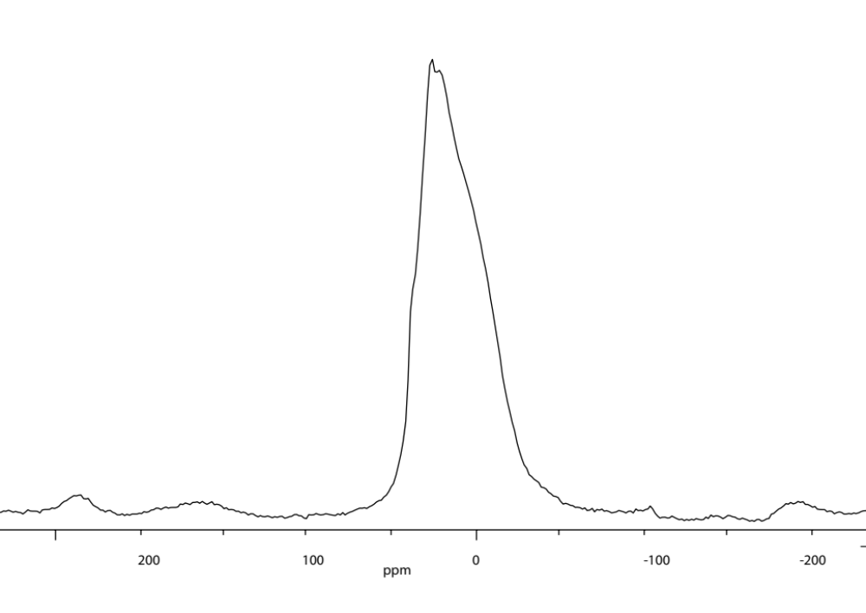
¹⁷O NMR
Since the natural abundance of ¹⁷O is ~0.038%, the NMR signal detected must be selectively from the altered glass surface which “incorporates” the ¹⁷O from the enriched water, even without CP!
Line features indicate multiple oxygen sites in the altered layer but could not be resolved
Single-pulse MAS @15 kHz

Slide 11
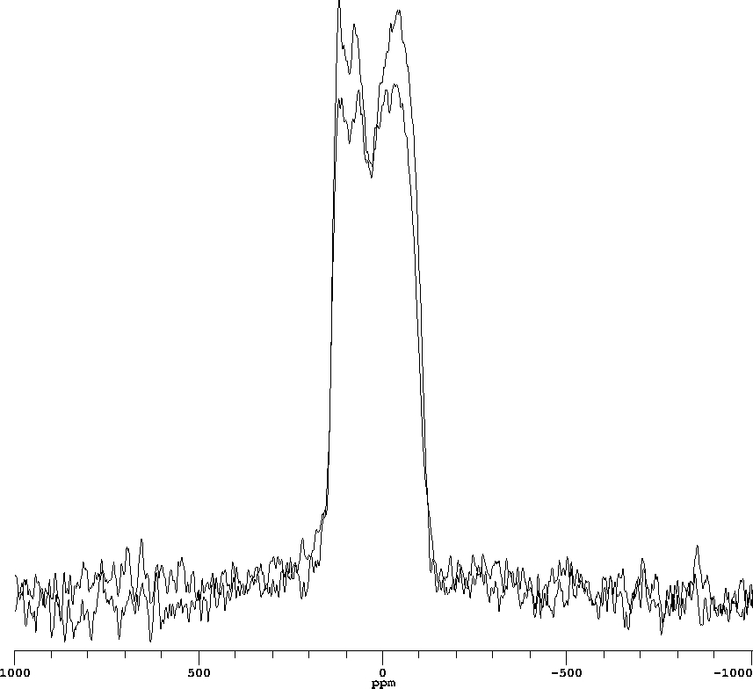
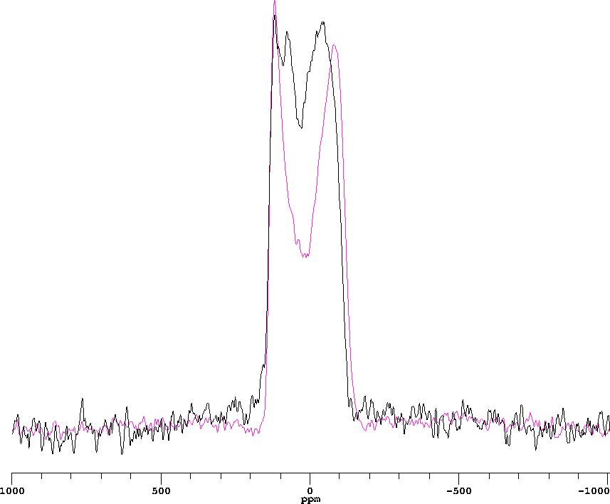
Static echo spectra
Since the natural abundance of ¹⁷O is ~0.038%, the NMR signal detected must be selectively from the altered glass surface which “incorporates” the ¹⁷O from the enriched water, even without CP!
¹H decoupled
Protonated bridging oxygens (BO) as signal pulled up by ¹H decoupling
SiO2
Notes:
Static experiment could disperse the resonance frequencies and yield line features;
Without constraints that are available to known samples, it is difficult to fit the experimental spectra like this;

Slide 12
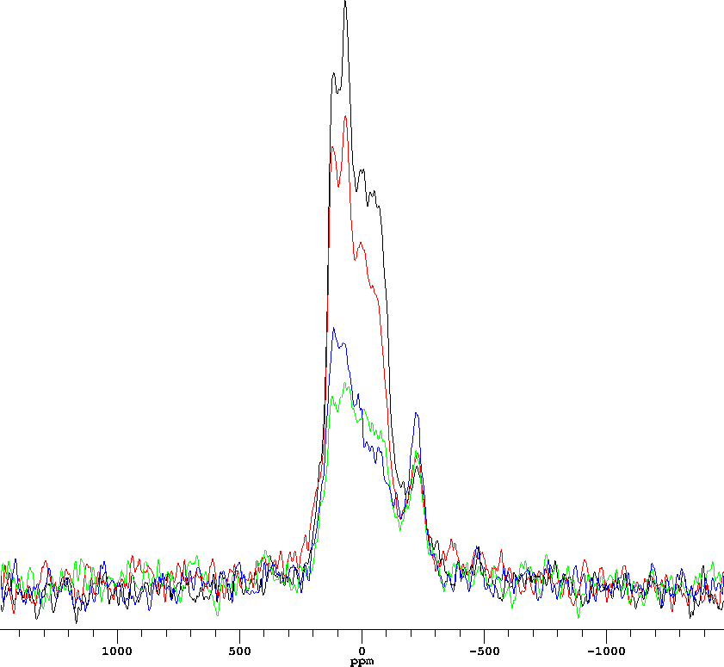
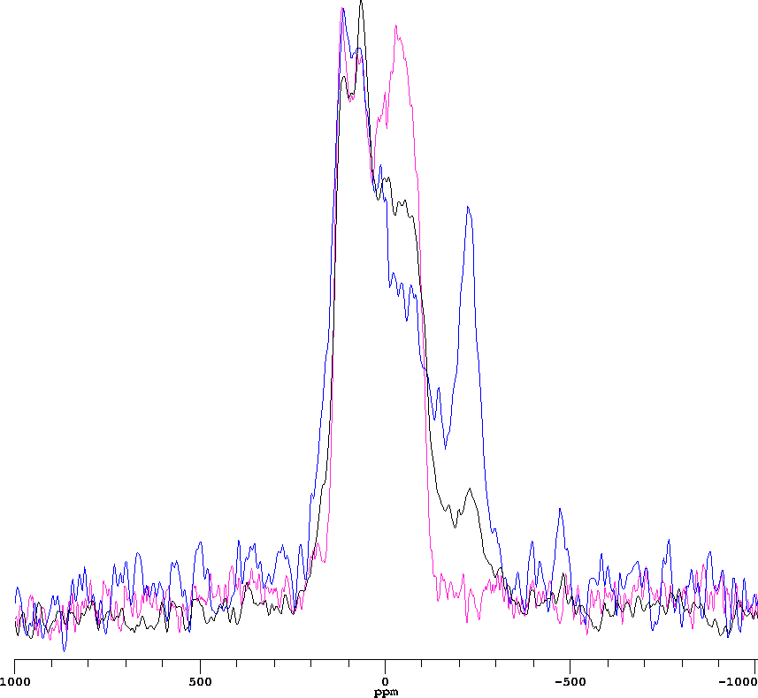
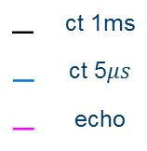
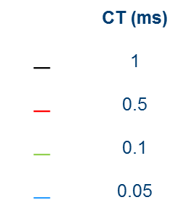
Static CP
How about CP?
 | CT (ms)
$$−$$ | 1
$$−$$ | 0.5
$$−$$ | 0.1
$$−$$ | 0.05
Hydroxyl oxygen signals get accentuated with shorter CT because of shorter O-H distance, which are absent in the echo spectra!
$$−$$ | ct 1ms
$$−$$ | ct 5$μs$
$$−$$ | echo
Notes:
The signals seen in the static echo spectra must contain BOs that are protonated, which is consistent with the decoupling results;

Slide 13
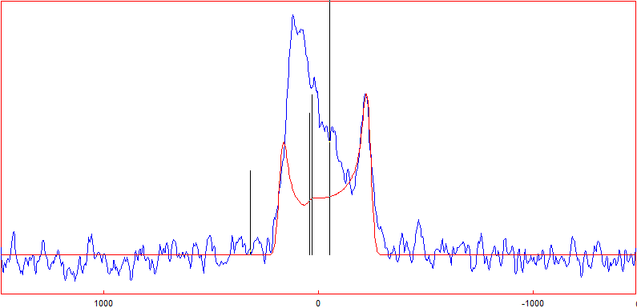
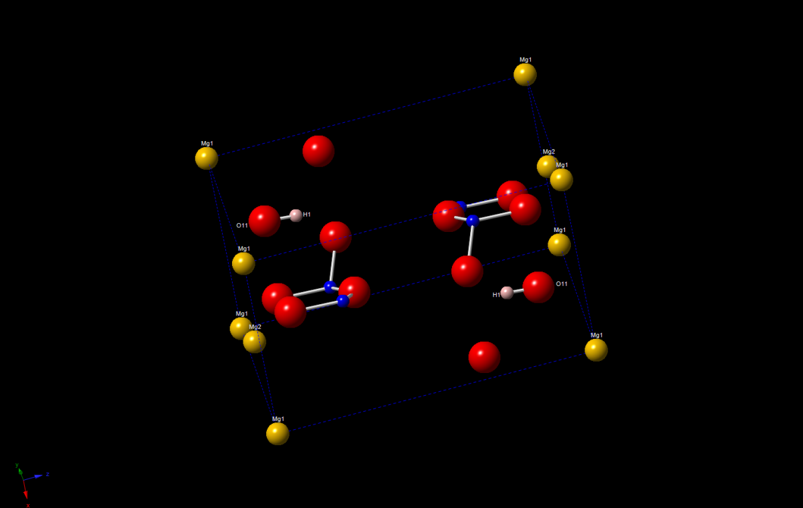
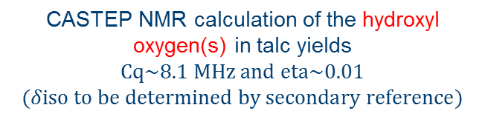
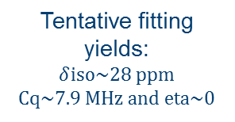
Calculation and simulation
Tentative fitting yields:
$δ$iso~28 ppm
Cq~7.9 MHz and eta~0
CASTEP NMR calculation of the hydroxyl oxygen(s) in talc yields
Cq~8.1 MHz and eta~0.01 ($δiso to be determined by secondary reference)$
Notes:
CASTEP NMR-DFT theory based code for calculating electronic structures. In this case, NMR parameters;
The lineshape is far too complicated to categorically assign that fitting to talc but similar local –OH structures must exist;

Slide 14
Mixture Windscale (MW) 25 wt% waste load glass: MW25
Full-component MW25 simulant glass: 23-oxide components
Simplified 6-oxide components glass:
Leached in deionised water;
Leached in ¹⁷O enriched (40%) water;
Made using ²⁵Mg enriched (99.7%) MgO as precursor.
Cation | Al | B | La (REs) | Mg | Na (alkalis) | Si
mol% | 4.87 | 27.58 | 1.72 | 6.54 | 15.38 | 43.91

Slide 15
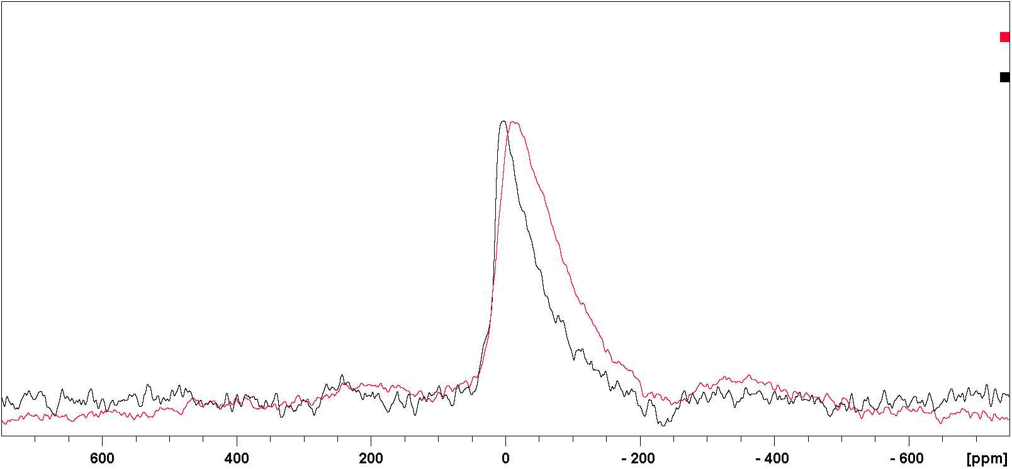
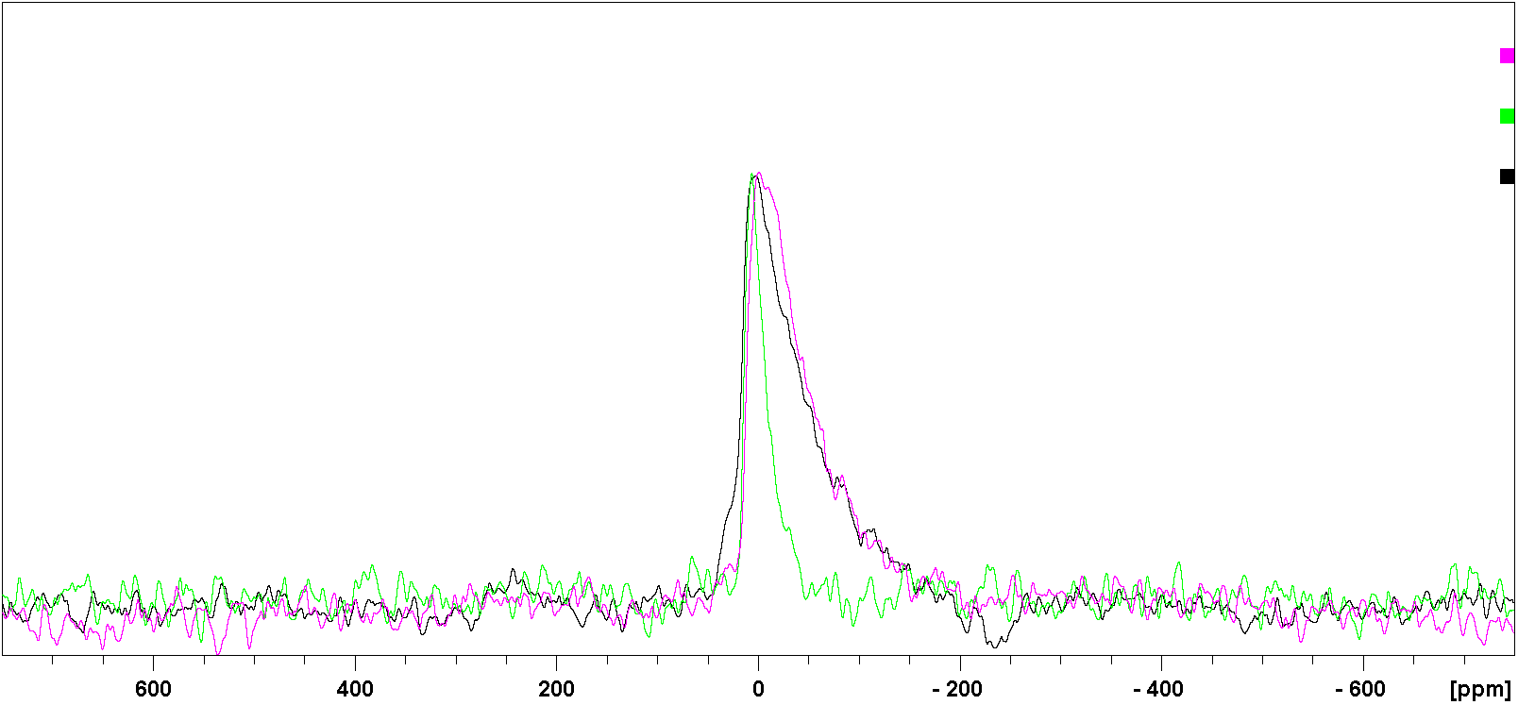
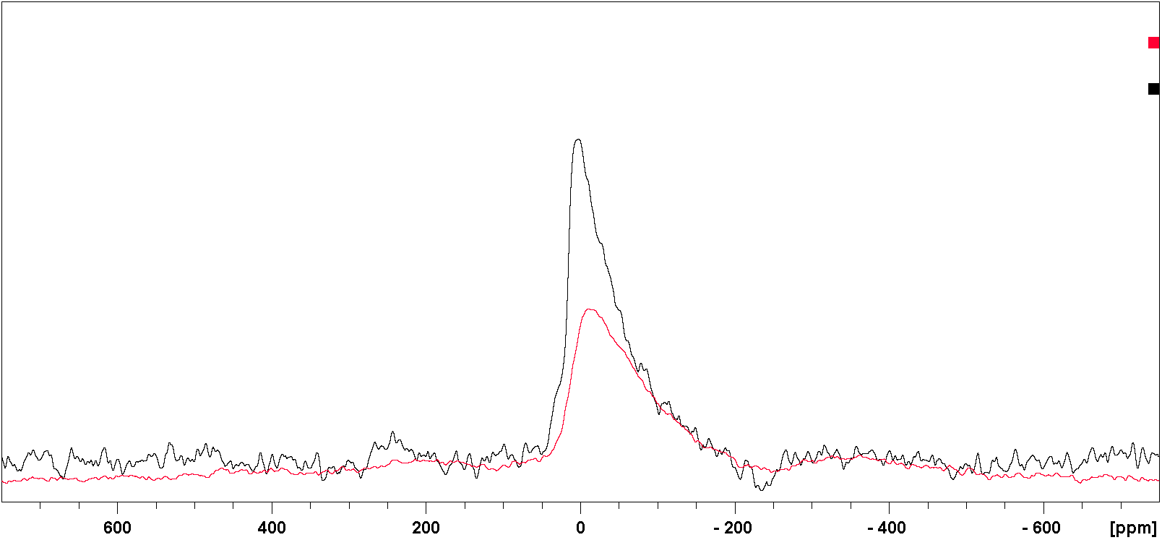
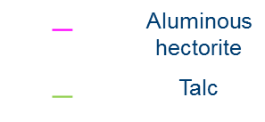
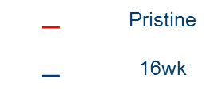
²⁵Mg NMR
One of the toughest nuclei to be observed in solid-state NMR:
High magnetic field & isotopic enrichment; long acquisition time & poor resolution!
$$−$$ | Pristine
$$−$$ | 16wk
$$−$$ | Aluminous hectorite
$$−$$ | Talc
UK 850 MHz Solid-state NMR facility
14 kHz MAS dfs_spinecho
Notes:
The Mg speciations contribute to the peak shift although the majority signal is still from the pristine glass;

Slide 16
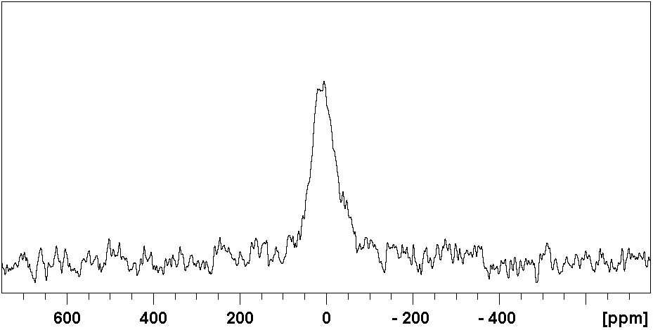
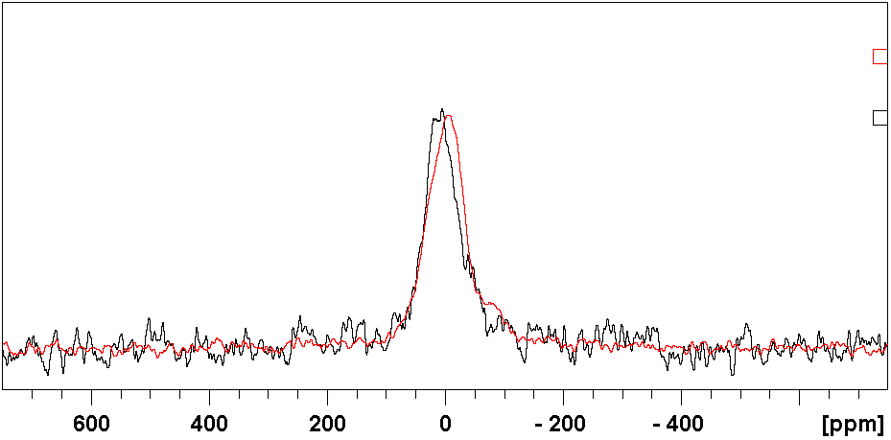
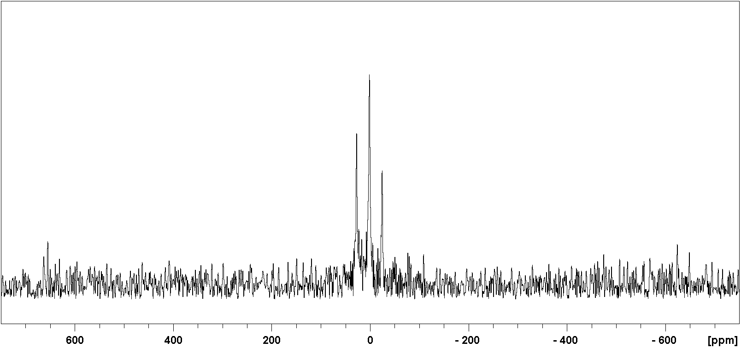
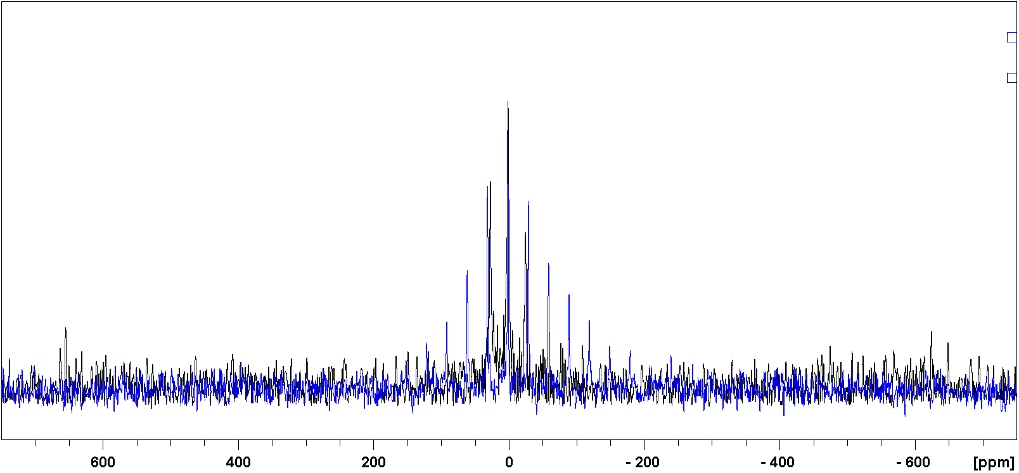
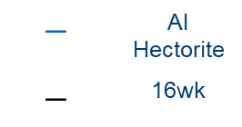
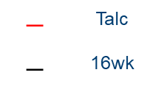
How about CP?
static cp
$$−$$ | Talc
$$−$$ | 16wk
qcpmg
$$−$$ | Al Hectorite
$$−$$ | 16wk
Mg environment closer to that in talc than Al hectorite consistent with ²⁹Si NMR results
Notes:
Based on CASTEP calculation, two magnesium sites in talc have very similar isotropic chemical shifts; CP at different CT time could result in intensity distortion;
The broadening of Al Hectorite spectrum might be due to paramagnetic effects;

Slide 17
Summary
Alteration layer of MgEM glass is depolymerized and the local silicon environments similar to that of talc;
Bridging oxygens (BOs) are protonated. Hydroxyl oxygens are only seen in CP conditions with short CT with local oxygen environments resemble that of talc;
Mg environments are closer to that of talc which is consistent with silicon and oxygen results;
Precipitates possess a talc-like structure while other Mg-silicates also need to be “tested”.

Slide 18
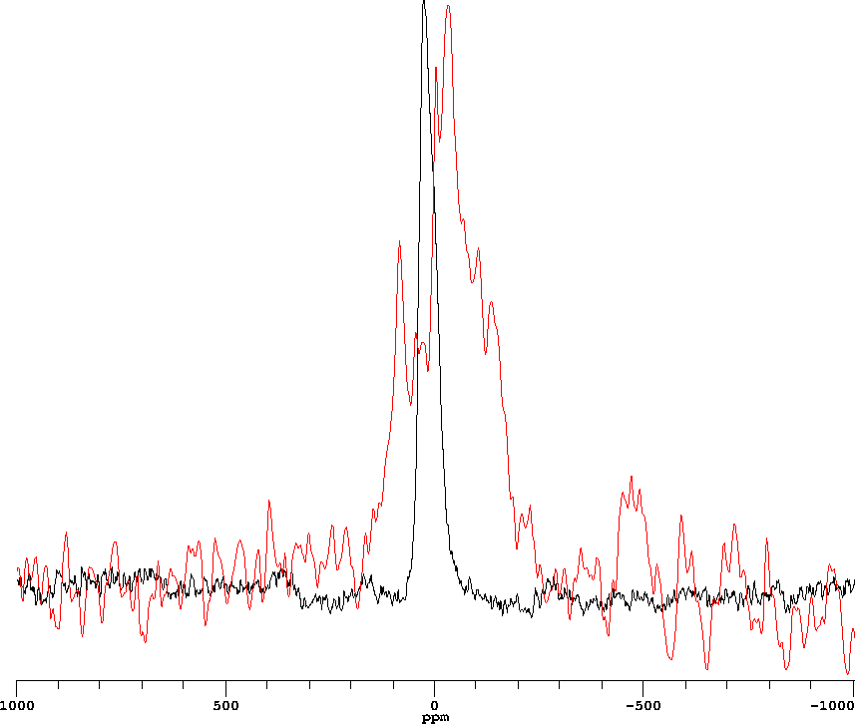
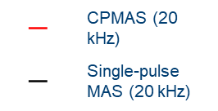
Future work
CPMAS experiments to improve oxygen-17 and magnesium-25 static CP spectra resolutions;
CASTEP NMR calculations on other magnesium silicates such as hectorite & sepiolite etc. where isotopic enrichment is not always viable.
$$−$$ | CPMAS (20 kHz)
$$−$$ | Single-pulse MAS (20 kHz)
Promising results from ¹⁷O CPMAS

Slide 19


Acknowledgements
The UK 850 MHz solid-state NMR Facility used in this research was funded by EPSRC and BBSRC (contract reference PR140003), as well as the University of Warwick including via part funding through Birmingham Science City Advanced Materials Projects 1 and 2 supported by Advantage West Midlands (AWM) and the European Regional Development Fund (ERDF);

Slide 20
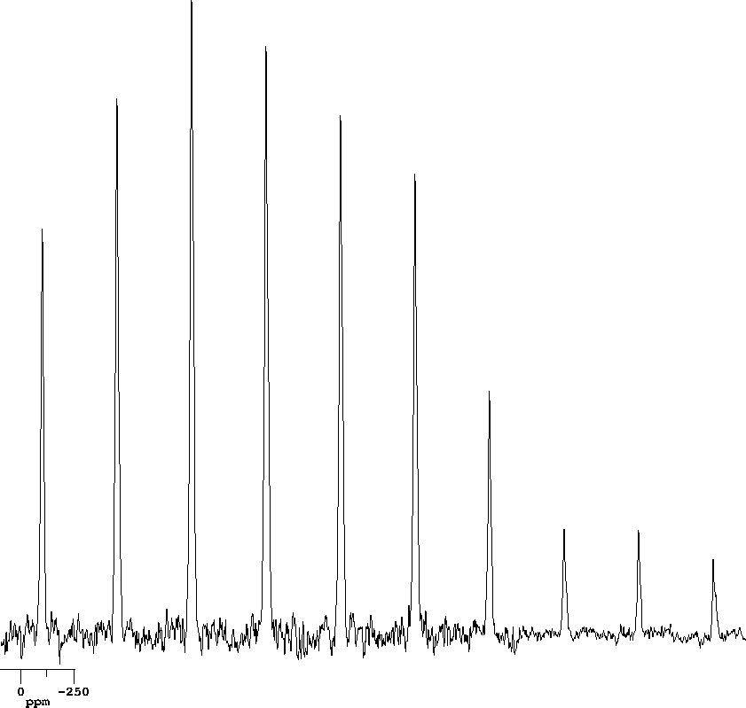
²⁹Si CPMAS dynamics
Transfer efficiency depends on ¹H-²⁹Si spatial distance and in competition with ¹H relaxation in RF;
5
10
1
15
20
0.5
Overall intensity evolves. How about lineshape?
30
CT (ms)
40
60
80
Notes:
First of all, CT has a huge impact on the line intensity as the build-up of M transfer is in competition with proton relaxation;
The second effect is lineshape as further located nuclei could be excited with increasing CT, which might have different resonance frequency;

