Slide 1
Status of Used Nuclear Fuel and Radioactive Waste Long-term Management Programs in Canada
M. Garamszeghy, Manager, Technology Assessment & Planning
Scientific Basis for Nuclear Waste Management Symposium, Sydney, October, 2017

Slide 2
Background
Canada has a wide range of nuclear activities that produce radioactive wastes and used nuclear fuel, including:
  Uranium mining and milling
  Nuclear fuel fabrication
  Nuclear research reactors
  Nuclear power reactors
  Radio-isotope production & use
  Nuclear research
  Decommissioning and cleanup of historic facilities
  Medical and industrial applications, etc.
Notes:
Nuclear history goes back to 1920’s in Canada with the mining of radium & uranium in NWT
Currently 19 reactors operational, all are CANDU pressurized heavy water reactors fuel by natural (unenriched) uranium
3 have undergone refurbishment and life extension, 10 more will be refurbished and life extended over the next 15 or so yrs
7 research reactors of various sizes and types currently in operation at AECL CRL and various universities
Several shut down power and research reactors undergoing decommissioning

Slide 3
Responsibilities
The Government of Canada Policy Framework for Radioactive Waste specifies that:
  The Government of Canada is responsible for developing policy and regulating and overseeing radioactive waste producers and owners to ensure that they comply with legal requirements and that they meet their operational and funding responsibilities in accordance with approved long-term waste management (disposal) plans.
  Waste producers and owners are responsible, in accordance with the “polluter pays principle”, for funding, organizing, managing and operating long-term waste management facilities and other facilities required for their waste.
The policy framework recognizes that arrangements may be different for the broad categories of radioactive waste found in Canada, namely nuclear fuel waste, low- and intermediate-level radioactive waste and uranium-mine waste rock and mill tailings.
Notes:
Policy framework put in place in 1996

Slide 4

Responsibilities (2)
Legislative and Policy
Regulatory Framework
Framework
Canadian Nuclear Safety Commission
Natural Resources Canada (NRCan)
(CNSC)
Independent Regulator
Nuclear Fuel
Intermediate
-
Level
Low
-
Level
Uranium Mine and
Waste
Radioactive Waste
Radioactive Waste
Mill Tailings
Federal
Nuclear
Utilities and
Federal
Utilities and
Federal
Operating
Inactive
Fuel Waste Act
Industry
Responsibility
Industry
Responsibility
Nuclear
Waste
Ontario Power
Atomic Energy of
OPG
AECL
Cameco
Provinces
Management
Generation
Canada Limited
HQ
AREVA
Former
Organization
(OPG)
(AECL)
operators
(NWMO) -
Hydro
-
Québec
NB Power
APM project
(HQ)
Cameco
New Brunswick
Power
(NB Power)
Utilities and
Industry

Slide 5
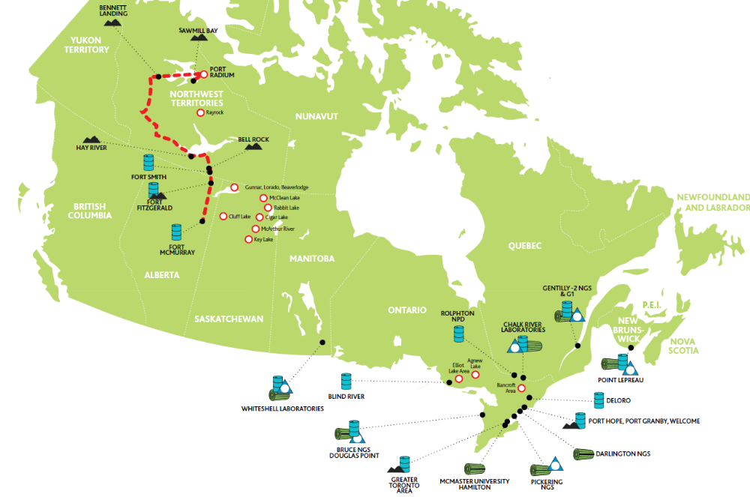
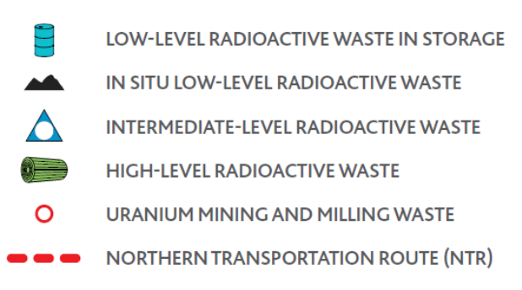
Major Radioactive Waste Management Sites
Notes:
Area of Canada is ~10 million km2
Australia is ~7.7 million km2

Slide 6
Inventory of wastes in Canada
Waste Type | Total Amount
“On-going” VLLW/LLW | 259,000 m³
Historic VLLW/LLW | 2,100,000 m³
ILW | 33,000 m³
Used fuel | 53,000 MT
Uranium Mine & Mill Tailings | 218 million MT
Inventory data as of Dec 31, 2016
Numbers are rounded
MT = Metric tonne
Notes:
VLLW is included as part of LLW,
Historic VLLW/LLW is mostly contaminated soils from past activities (e.g. uranium & radium processing & usage)
UMM excludes 170 million MT of waste rock (overburden)

Slide 7
NWMO: Who We Are
Formed in 2002 as required by the Federal Nuclear Fuel Waste Act (NFWA)
Owned and funded by Canada’s nuclear energy corporations as required by the NFWA
Operates on a not-for-profit basis
Our mission is to develop and implement collaboratively with Canadians, a management approach for the long-term care of Canada’s used nuclear fuel that is socially acceptable, technically sound, environmentally responsible, and economically feasible.
Notes:
- NWMO also provides engineering and licensing support services to OPG for the development of their LILW repository

Slide 8
Used Nuclear Fuel

Slide 9
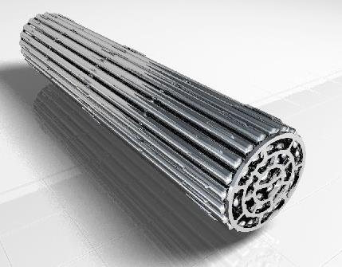
Current UF Inventory
“Standard” CANDU fuel bundle is ~100 mm OD x ~500 mm long
Several variations (number of fuel elements, end plate configuration, etc)
Un-enriched, Uranium oxide with zircalloy cladding
Contains ~20 kg U
To end of Dec 2016, total of 2.75 million bundles (~53,000 MTHM) in interim storage
At the end of the planned operation of Canada’s existing nuclear reactors, the number of used nuclear fuel bundles could total up to about 5.2 million (104,000 MTHM).
Notes:
About 55% of UF in wet storage, 45% in dry storage
Fuel moved from wet to dry after 6-10 yrs
Variety of CDN designed dry storage facilities used – concrete casks, steel & concrete, modular vaults, depending on waste owner
Largest waste owner (OPG) uses steel-concrete-steel casks, each holding 384 bundles ~7.5 MTHM of fuel

Slide 10
Adaptive Phased Management (APM)
APM emerged from dialogue with citizens and experts – best met key priorities
A Technical Method
A Management System
Centralized containment and isolation of used nuclear fuel in deep geological repository
Continuous monitoring
Potential for retrievability
Optional step of shallow underground storage*
* Temporary shallow storage at the deep geological repository is optional and not currently included in the NWMO’s implementation plan
Flexibility in pace and manner of implementation
Phased and adaptive decision-making
Responsive to advances in technology, research, Aboriginal Traditional Knowledge, societal values
Open, inclusive, fair siting process - seek informed, willing host community
Sustained engagement of people
and communities throughout implementation
APM selected by Federal government June 2007

Slide 11
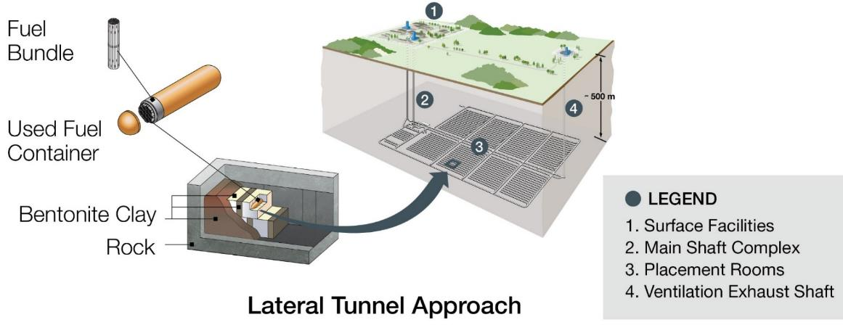
National Infrastructure Project
Protection of health, safety and environment
Multi-barrier system
  Engineered barriers (Optimized for CANDU fuel)
  Geological isolation
Long-term partnership between NWMO and community, decades of sustainable operations
Robust technology
Strongly regulated by Canadian Nuclear Safety Commission
Notes:
Crystalline (granite) and sedimentary (limestone) host rocks are being investigated
Reference depth is 500 m
Underground footprint is ~6 km2
Surface footprint is <1 km2

Slide 12
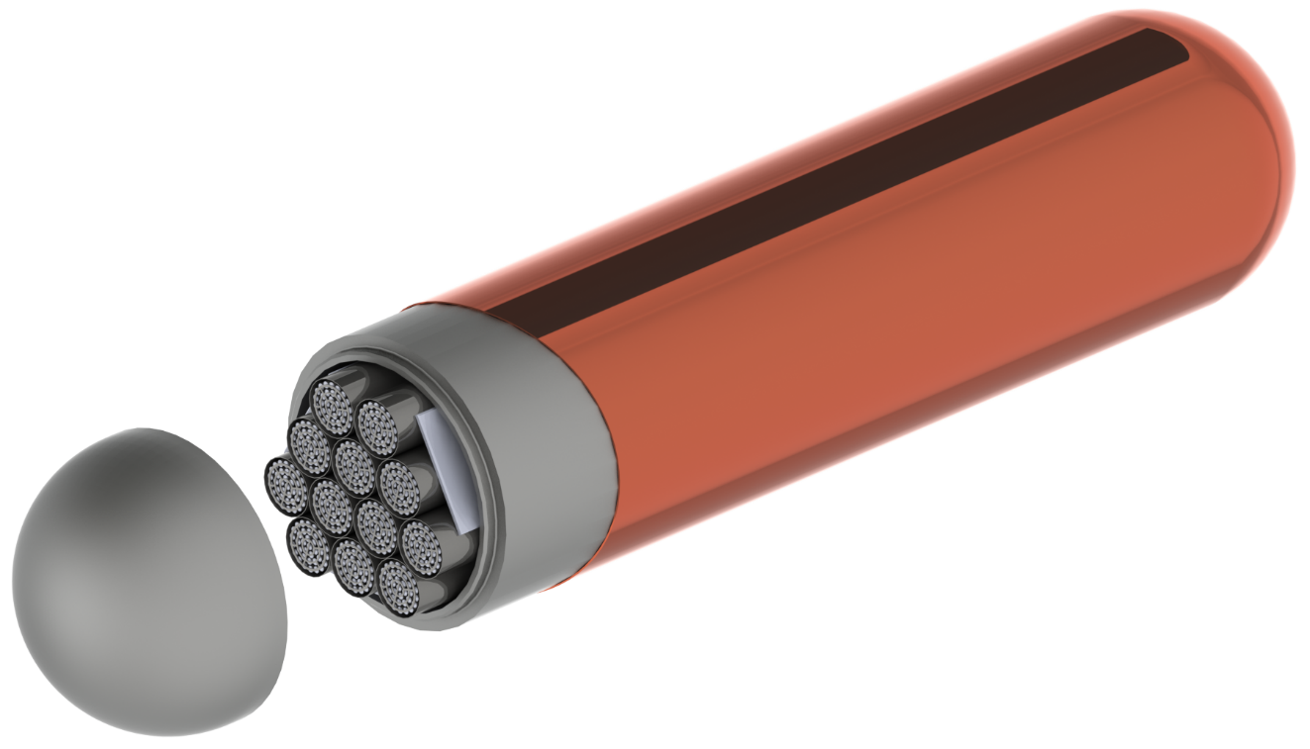
Safe Containment: A Made-in-Canada Approach
Manageable weight
Integral backing with partial penetration seal weld
Integral Copper Coating
Standard ASME/ASTM Materials and Sizes
Hemispherical Heads
Notes:
In 2014 the NWMO refined its container design to one that is optimized for the used CANDU fuel produced by Canadian nuclear power reactors. This made in Canada approach can be manufactured entirely in Canadian manufacturing facilities and provides another example of economic opportunity for the siting area.
Pressure vessel grade steel provides the strength to resist extreme loading on top of the repository, including the massive buildup of ice that will occur during future ice ages, while the copper exterior provides a corrosion-resistant barrier.
A unique feature of the NWMO’s UFC design is that it involves directly applying the copper coating onto the steel container.
The design uses standard nuclear grade materials and proven manufacturing processes to simplify fabrication. Machining, welding, non-destructive examination, and the copper coating of prototypes are all currently being completed at centres of excellence across Canada.
The American Society for Testing and Materials (ASTM) issues standards on material
The American Society of Mechanical Engineers (ASME), specifies standards for materials to be used in construction and infrastructure

Slide 13
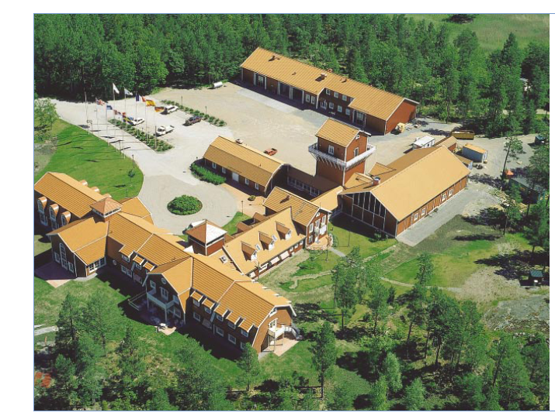
Project Features
Key APM facilities include:
National Centre of Expertise;
Used fuel container manufacturing plant
Used fuel packaging plant;
Sealing material compaction plant;
Deep geological repository (DGR);
Used fuel transport package manufacturing plant;
Used fuel transportation system, including vehicle maintenance and ancillary facilities.
  The Centre of Expertise will be home to technical & social research and technology demonstration programs involving scientists and other experts in a wide variety of disciplines
  Environmental monitoring and laboratory
  Hub for national and international knowledge sharing (similar to centres in Sweden and Finland)
  Hub for detailed site characterization at site (core storage and logging, materials laboratory)
Äspö Hard Rock Laboratory outside Oskarshamn, Sweden

Slide 14
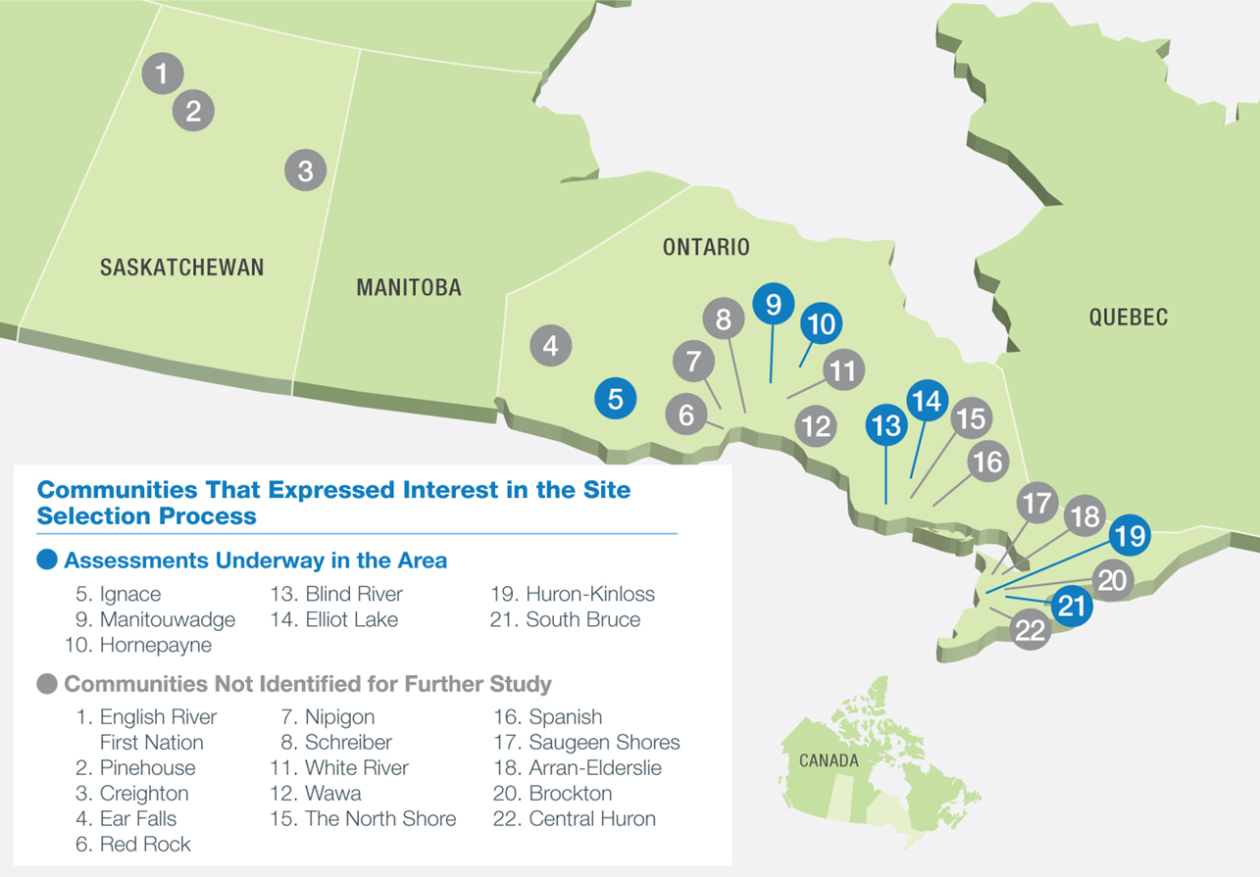
Site Selection
Notes:
Currently 7 communities still in the process: Huron/Kinloss, South Bruce, Ignace, Elliot Lake, Blind River, Manitouwadge, and Hornpayne
None have “backed out”. Some have been eliminated for a variety of reasons after initial screening.
Process will continue until one or two preferred sites have been selected for detailed characterization

Slide 15
Multiple Stages of Assessment and Dialogue
Initial Screening
(few months) COMPLETE
For all requesting communities (22)
Preliminary Assessment (Desktop)
(~18 months) COMPLETE
For all requesting communities that passed Initial Screenings (21)
For small number of communities with high potential to meet siting requirements (7 still in progress)
Preliminary Assessment (Field Work)
(~2014-2023) IN PROGRESS
Detailed Site Characterization
(~ 2023- 2028)
(initiate licensing process)
  Initiate activities at preferred candidate site, including building of Centre of Expertise
    Timelines are illustrative, to guide planning. Actual timelines may vary. Selection of site assumes sufficient technical and social assessment completed to support confidence around safety case, transportation and potential for partnership
15
Notes:
Project is not schedule driven
Timelines will be adapted to a pace acceptable to the community
Different communities will advance at different paces

Slide 16
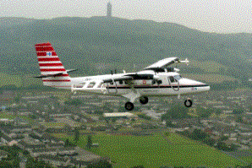
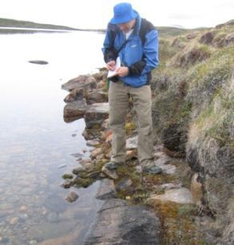
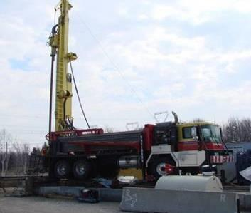
Preliminary Field Investigations
Initial Studies
Intensive Field Work
High resolution airborne geophysical surveys
Observing geological features and detailed mapping
Borehole Drilling &Testing
In Collaboration with Communities
Notes:
Drilling expected to start in one community (Ignace) this month
further drilling planned for 2018.

Slide 17
Future Steps
  Acceptance to host the repository is confirmed.
  Formal agreement to host the repository is ratified, subject to all regulatory requirements being met and regulatory approval received.
  An independent, formal and public process is conducted by regulatory authorities to ensure all requirements are satisfied.
  Construction and operation of an underground demonstration facility proceeds.
  Construction and operation of the repository proceeds.
Notes:
- Facility operation is expected to start in mid-2040s

Slide 18
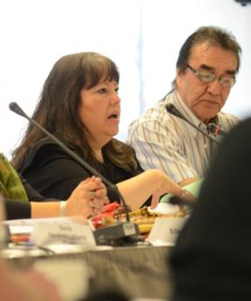
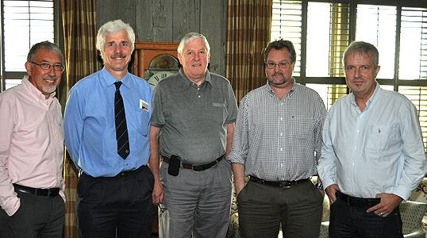
Advice and Peer Reviews
Advisory Council (NFWA requirement)
  Examine and comment on NWMO’s triennial reports
  Meet quarterly to provide counsel and guidance
Council of Elders
  Advise on respectful engagement, Aboriginal rights, policies, indigenous knowledge
Municipal Forum
  Share best practices in local government engagement
Geoscientific Review Group
  Reviews plans, methods, findings for site evaluations against international best practice
Technical peer reviews/advisory groups
  As needed to support technical program
Notes:
Advisory council a body required by legislation .
Act requires Board to establish this Council and lists some required areas of experience that must be reflected in membership. Members must bring expertise in technical and social areas, as well as ATK. Review and input into our workplans quarterly basis, ensure we leading extensive engagement and technical programs.
As we assumed our mandate for delivering APM program, identified a number of other more specific areas
Council of Elders plays an important role in advising NWMO. Not a body required by legislation, NWMO seeks to be guided by Elders in our work.
Municipal Forum provides advice on our engagement with municipal communities and organizations. Advising on best practices on engagement and community capacity building.
Geoscientific Review Group- established when we started siting process.
integral role in reviewing geoscience workplans before conducting surveys or field work. They review our findings and interpretations. Small group of national and international experts who bring specific expertise in geophysics, geological investigations and experience in siting assessments in Australia (Sandy Cruden from Monash), Canada, Switzerland, and Sweden.. Membership will evolve over time as our site investigations require more specific areas of expertise
Will likely be other groups as we move forward.
This rigour in external review not only builds external trust and credibility for public, but also builds confidence of our own Board of Directors., to know our work is being guided by many experts.

Slide 19
Technical Research & Collaboration
  Broad based research program to investigate aspects relevant to Canadian repository, in order to build confidence and reduce uncertainties.
  NWMO maintains watching brief on alternative technologies.
  Since 2010 the NWMO has funded over 85 research contracts at 21 Canadian universities and colleges, as well as several more at international universities:
    Engineered Barrier System (e.g., corrosion, bentonite, failure mode effect analysis simulation)
    Geosciences (e.g., hydro geochemistry, seismicity, groundwater systems)
    Transportation Assessments (e.g., time-distance studies)
Notes:
You will be hearing from about some of our sponsored research during this conference
Since 2010, the NWMO has funded 85 agreements with 21 institutions for an approximate total of $15 million. Institutions include:
Carleton University
Conestoga College and Instuture of Technology and Advanced Learning
McMaster University
Royal Military College of Canada
Ryerson University
Trent University
Université Laval
University of Alberta
University of British Columbia
University of Manitoba
University of New Brunswick
University of Ontario Institute of Technology
University of Ottawa
University of Saskatchewan
University of Toronto
University of Western Ontario
University of Windsor
Wilfred Laurier University
York University
As well, the NWMO has invested approximately $1.3 million to the National Research Council for research into cold spray copper coating for the nuclear fuel container.

Slide 20
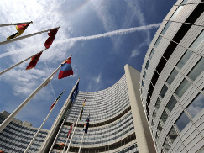
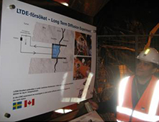
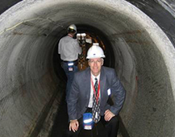
NWMO’s International Co-operation
Partnerships:
  Let us share in research of mutual interest
  Allow us to collaborate in technical development and demonstration
  Encourage us to share learning and experiences
  Ensure NWMO stays abreast of best international practice
NWMO has signed co-operation agreements with:
  Finland
  Sweden
  France
  Japan
NWMO is active in international organizations:
  EDRAM (Canada, U.S, UK, France, Sweden, Switzerland, Finland, Spain, Belgium)
  Nuclear Energy Agency (NEA) of OECD
  International Atomic Energy Agency (IAEA)
  United Kingdom
  Switzerland
  South Korea
Notes:
There are many ways that NWMO is active in the international community
One way we do this is via agreements signed with another country. NWMO currently has signed cooperation agreements with 7 countries:
Through these agreements we undertake to work on demonstration and research projects together, advance technical and engineering designs, and share experiences and learning on siting processes
Another way we contribute is through work with international organizations:
NWMO staff participate in committees of the NEA of OECD: multinational committees of specialists that address key elements of sustainable waste management planning.
Staff also participate in workshops and expert groups at IAEA located in Vienna.
As well, NWMO’s President and CEOs of our sister organizations in other countries meet annually for exchanges of progress with implementing national radioactive waste management programs. (~ EDRAM).
We have also set up international expert groups to provide advice and peer review our work.
These partnerships with a strong history of cooperation and sharing, are very valuable. They allow collaboration with others to test and demonstrate different components of deep geological repositories.

Slide 21
Low- & Intermediate-Level Radioactive Wastes

Slide 22
L&ILW Background
Each waste owner is responsible for life-cycle management of their own wastes (including disposal)
Major waste owners are:
  Ontario Power Generation (operator/owner of all but two nuclear power plants in Canada)
  Federal Government (AECL), nuclear research activities, legacy and historic wastes
  Mining companies (uranium mining & milling wastes)
Major waste owners are all developing their own solutions for LILW long-term management
Notes:
- In Canada, VLLW is currently included in the LLW category and is not managed separately

Slide 23
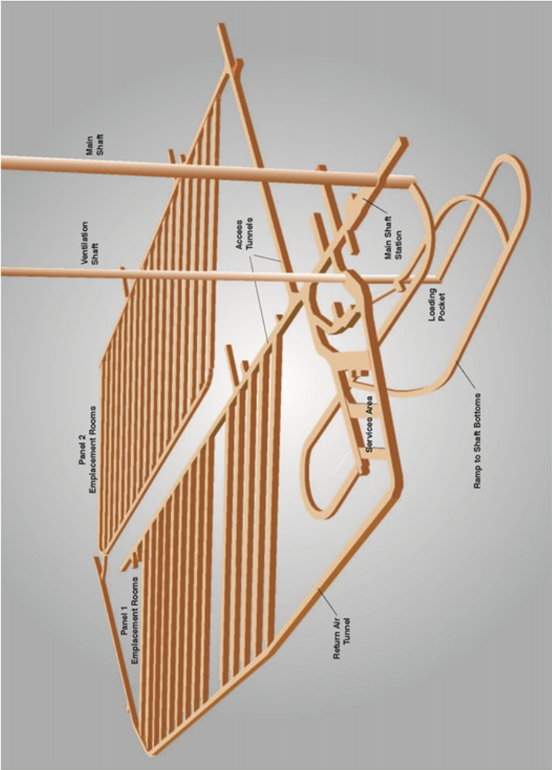
OPG DGR for L&ILW
For OPG-owned wastes: Deep Geological Disposal in sedimentary rock
  Currently under regulatory review
  EA & construction licence decision expected in ??
  Designed for co-disposal of LLW and ILW (community preference & less costly than 2 separate facilities)
Reference depth of 680 m, 400 million yr old limestone rock
Capacity of 200,000 m³ (as packaged) LLW and ILW
Volunteer host community
Located on existing Bruce nuclear site, adjacent to OPG’s waste management facility
Expected operation in mid to late 2020s
Notes:
Project was initiated by request from local community to address long-term management issues
Other options examined at time of original decision included near surface vaults, shallow caverns and enhanced storage
These other options were rejected because they did not provide total or long-term solution for both LLW and ILW

Slide 24
OPG DGR for L&ILW (2)
Only waste from operation & maintenance of OPG owned facilities
Waste is typical CANDU NPP L&ILW in non-combustible containers of various configurations (compacted and non-compacted DAW, incinerator ash, IX resins, filters, replaced components, etc.)
Facility is sited in a willing host community (community approached OPG to jointly develop a long-term plan for the waste)
Community is also currently host to 8 operating NPPs (one of the largest nuclear power sites in the world), one shutdown demonstration reactor, two LILW storage facilities and two used fuel dry storage facilities
High degree of nuclear knowledge and acceptance in the area
Official hosting agreement was signed in 2004. Provides for total of about $30 million compensation to Kincardine and surrounding municipalities over life of project
Independently conducted community poll in 2005 was overwhelmingly supportive (60% yes, 22% no, 13% neutral, 5% don’t know/refused)

Slide 25
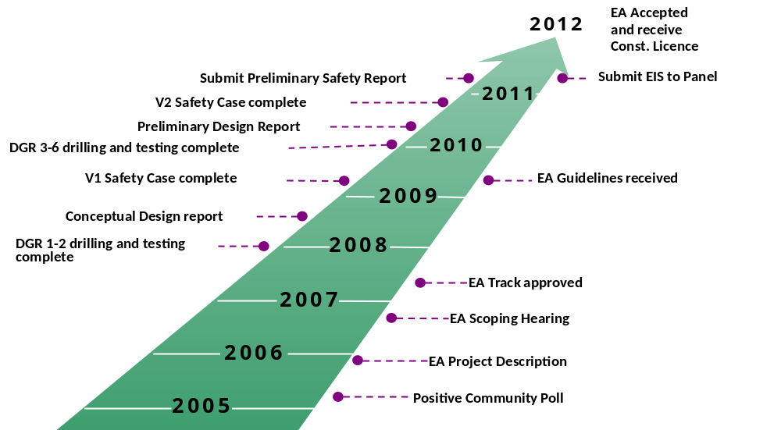
OPG DGR for L&ILW (2010 Schedule)
Original schedule (circa 2010)
Notes:
- Original schedule was very optimistic, but doable based on info available at the time

Slide 26
OPG DGR for L&ILW (Current Status)
So what happened after the EA and licensing documentation was submitted in April 2011?
  A federal election delayed the appointment of the Joint Review Panel (JRP) to Jan 2012
  Public comment period from Feb 2012 to May 2013, during which JRP issued a total of ~575 information requests (IRs) for more details or explanations
  31 days of hearings held in fall 2013 and fall 2014, 246 participants, 20,000 pages of information reviewed. ~10 additional IRs issued.
  JRP report submitted May 2015, recommending the EA approval of the DGR to the federal government
  CEAA held 90 day public comment period on potential conditions related to possible mitigation measures and follow-up programs that may be required if the project is approved to proceed. (Decision was expected in Sept but extended to December.)
  Minister was supposed to respond by Dec 2015. However, another federal election in fall 2015 resulted in a change of government

Slide 27
OPG DGR for L&ILW (Current Status - 2)
So what happened after the EA and licensing documentation was submitted in April 2011 (continued)?
  New Minister of Environment requested an extension to March 2016
  Subsequently requested 3 more technical studies:
    Environmental effects of alternate locations;
    An updated analysis of potential combined environmental effects of the DGR site and a potential NWMO used fuel site located close to the proposed site; and
    an updated list of OPG’s commitments to mitigate any identified adverse effects from the project
  OPG submitted their responses at end of 2016
  Another request for additional info received in August 2017, related to Aboriginal impacts
  Minister’s EA decision originally expected in late 2017. Now ??
  If positive, project moves forward to the licensing decision phase
Notes:
- Further delay likely to be at least 2 yrs
- New federal govt has big agenda for “reconciliation” – addressing past injustices to aboriginal peoples.

Slide 28
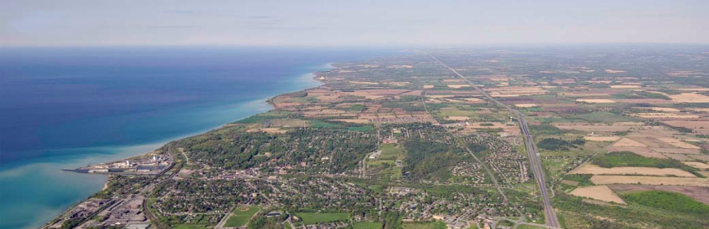
Long-term Management of Historic LLW
Port Hope Area Initiative represents Canada’s commitment to clean up and safely manage historic low‐level radioactive waste from former Canadian Crown Corporation, Eldorado Nuclear Limited (1933‐88)
Federal funding of $1.28 Billion
One initiative, two projects – Port Hope Project and Port Granby Project
Volume of LLW represents approximately 60% of the total volume (across all locations) of LLW AECL is managing
Lake Ontario
Port Granby
Port Hope

Slide 29
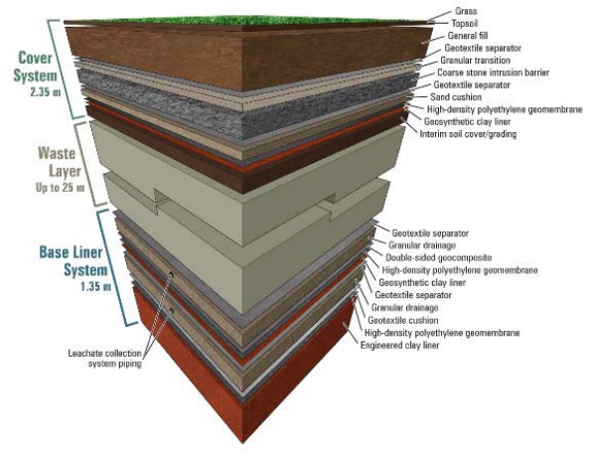
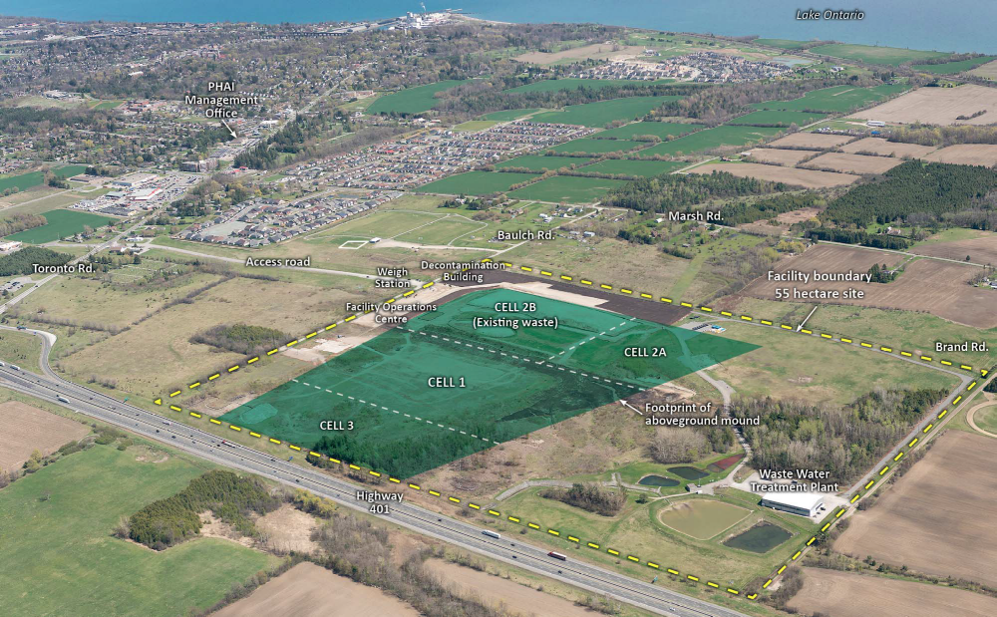
Port Hope Long-term Waste Management Facility
Lake Ontario
Port Granby
Port Hope

Slide 30
Status of Port Hope Area Initiative Projects
Port Hope engineered containment mound to house 1.2 million m³ of historic LLW located in the Port Hope community (existing waste management sites and contaminated sites)
  Water treatment plant constructed and operational
  Waste cell under construction. Expected complete by Mar 2018.
  Waste transfers to start in 2018
  Port Hope Project completion anticipated 2022
Port Granby engineered containment mound to house approximately 450,000 m³ of historic LLW located in Clarington (existing waste management sites)
  Waste cell constructed
  ~50% of the waste emplaced
  Project capped and closed milestone 2018

Slide 31
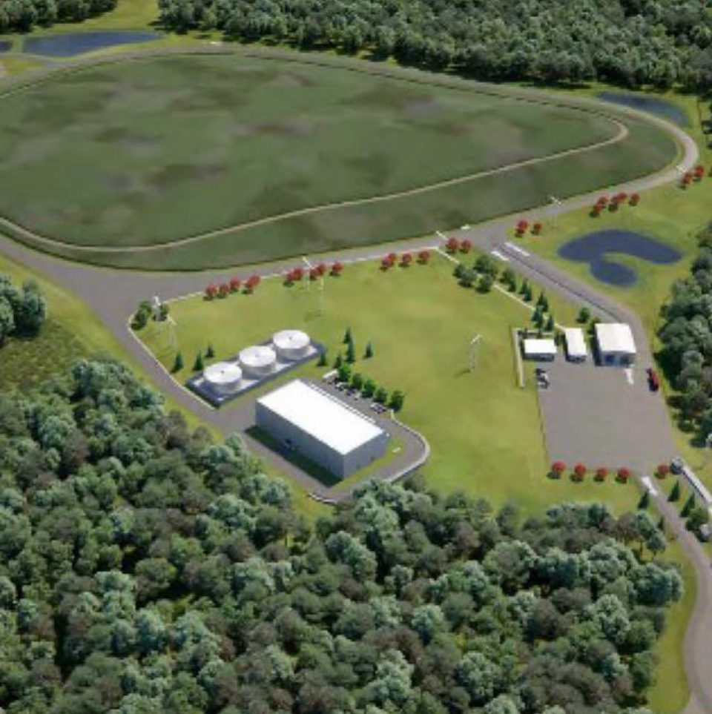
Disposal of other AECL LLW: Proposed Near-Surface Disposal Facility at Chalk River
Near-surface, engineered mound for AECL’s legacy, on-going and decommissioning wastes
  >90% of wastes will originate at Chalk River Laboratories site
To be located on the existing Chalk River site (~34 ha area req’d on a ~4000 ha site)
1 million m³ total capacity, mainly LLW, with small amount of short-lived ILW
Constructed in 2 phases:
  - 525,000 m³
  - 475,000 m³ (~2040 timeframe)

Slide 32
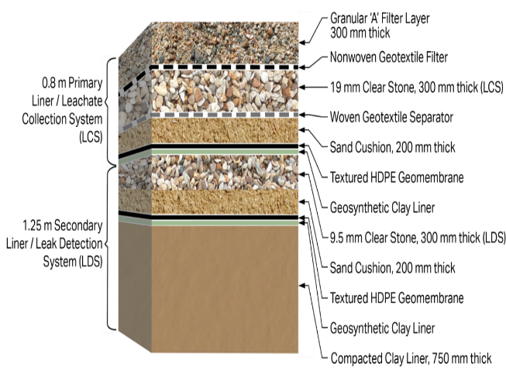
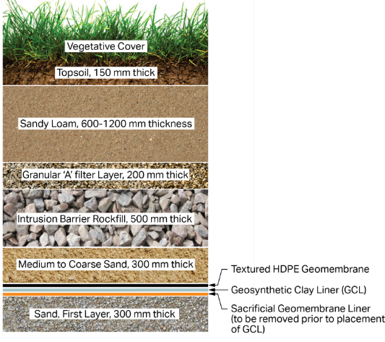
Proposed Near Surface Disposal Facility at Chalk River (2)
Final cap & cover system
Multi-layered engineered liner and cap systems
Integral leachate collection system
Wastes include packaged, and bulk unpackaged solids (e.g. soils, debris)
Base Liner System
Design Improvements for “Defence in Depth” via construction materials, specifications and analysis

Slide 33
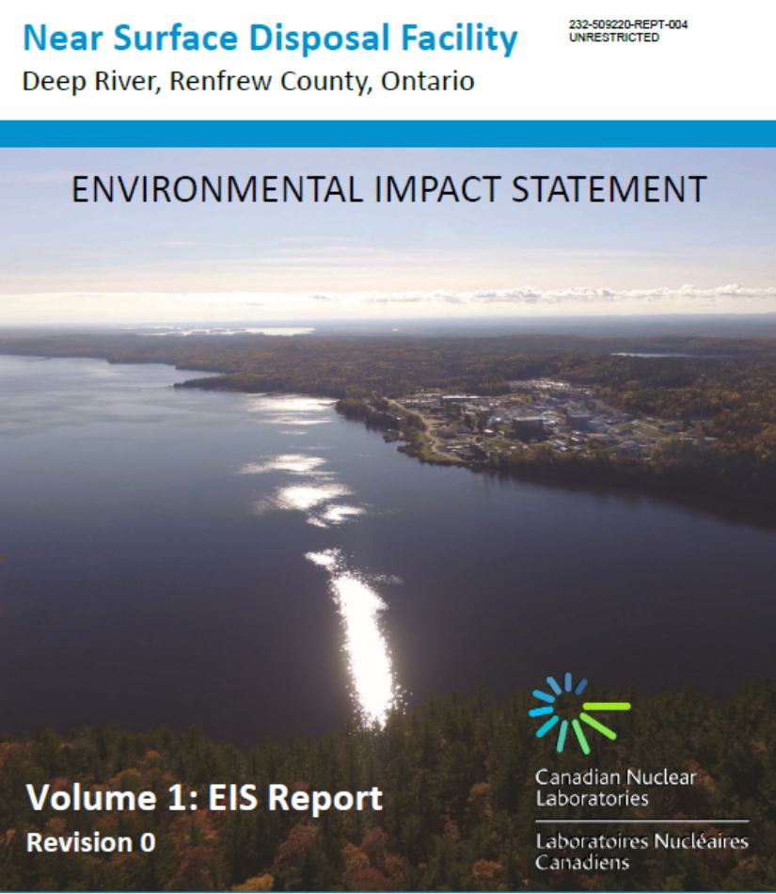
Proposed Near Surface Disposal Facility at Chalk River (3)
Federal regulatory review under way
EA and licensing decisions expected in 2018
First phase of construction expected to be completed by 2020

Slide 34
Waste Management Status Summary
All radioactive waste in Canada is safely managed.
Progress is being made towards long-term waste management solutions:
  OPG is currently well advanced in the EA for a DGR for all of its operational L&ILW. Ministerial decision-making continues…
  AECL’s Port Hope Area Initiative facilities licensed and being implemented.
  AECL’s proposed near-surface disposal facility in the environmental assessment stage.
  NWMO is in the siting process for a used fuel DGR (based on a well-informed, voluntary host community).
There is a single organization (NWMO) with the legislated mandate for long-term management of used (spent) nuclear fuel.
Each waste owner is responsible for the funding and long-term management of their L&ILW.
All wastes are currently stored by their owners in facilities of various designs (both above-ground buildings and other structures at or just below ground surface).

Slide 35
Further Reading
www.nwmo.ca
www.opgdgr.com
www.cnl.ca
www.nuclearsafety.gc.ca/eng/
Notes:
- Detailed documentation for all proposed facilities is publicly available via the internet

Slide 36

Questions?

Slide 37
Backup slides

Slide 38
Responsibilities
Canadian Nuclear Safety Commission (CNSC) – the federal nuclear regulator under the Nuclear and Safety Control Act and the “responsible authority” for nuclear projects under the Canadian Environmental Assessment Act. Consists of two parts: the “Commission” (tribunal) and staff.
Canadian Environmental Assessment Agency (CEEA) – the federal agency responsible for administering the environmental assessment process.
Joint Review Panel (JRP) – joint panel set up by CNSC and CEAA to review the EA and a specific licence application of a nuclear project, as referred to by the Minister of Environment (Note that this is no longer used for nuclear projects. The OPG DGR was the last nuclear project to undergo this process).
Proponent (project owner / operator) – the eventual licence holder. Prepares the EA, safety report and supporting documentation

Slide 39
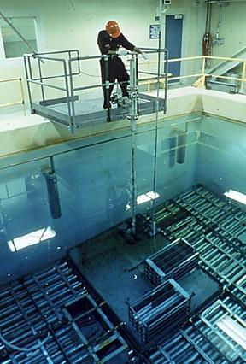
Wet Storage
Used nuclear fuel initially very hot thermally and highly radioactive
Stored in water pools at each reactor site for cooling and shielding
Pool water (light water) kept separate from other water circuits (mostly heavy water)
Notes:
Typical pool capacity is ~400,000 bundles at a multi reactor site (Bruce, Pickering Darlington)
~ 50,000 bundles at single reactor site (Pt Lepreau, Gentilly)
Typical CANDU produces 4000 to 6000 bundles per year
CANDU reactors feature online, on power refuelling

Slide 40
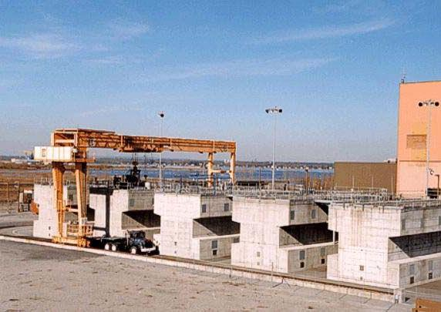
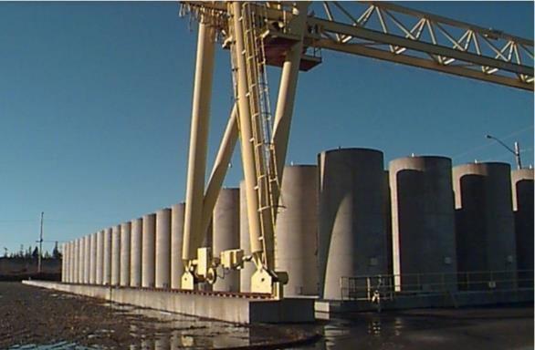
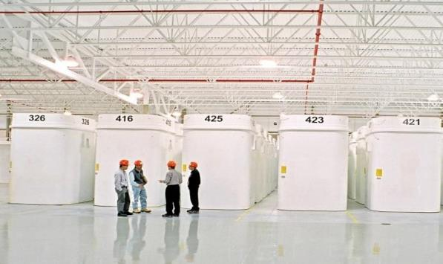
Dry Storage
After about 7 to 10 years, used fuel is cool enough to move to dry storage
Excellent storage safety record
Gentilly (Québec)
Point Lepreau (New Brunswick)
Used Fuel Storage at OPG Western Waste Management Facility (Ontario)
Notes:
Currently about 45% of the UF is dry stored
This will rise to about 65% by 2030
A variety of dry storage designs are used
Most common type is OPG Dry Storage Container (DSC) used at its 3 nuclear sites, accounting for ~80% of current total
Steel-concrete-steel construction, holding 384 bundles, ~70 tonnes when loaded

Slide 41
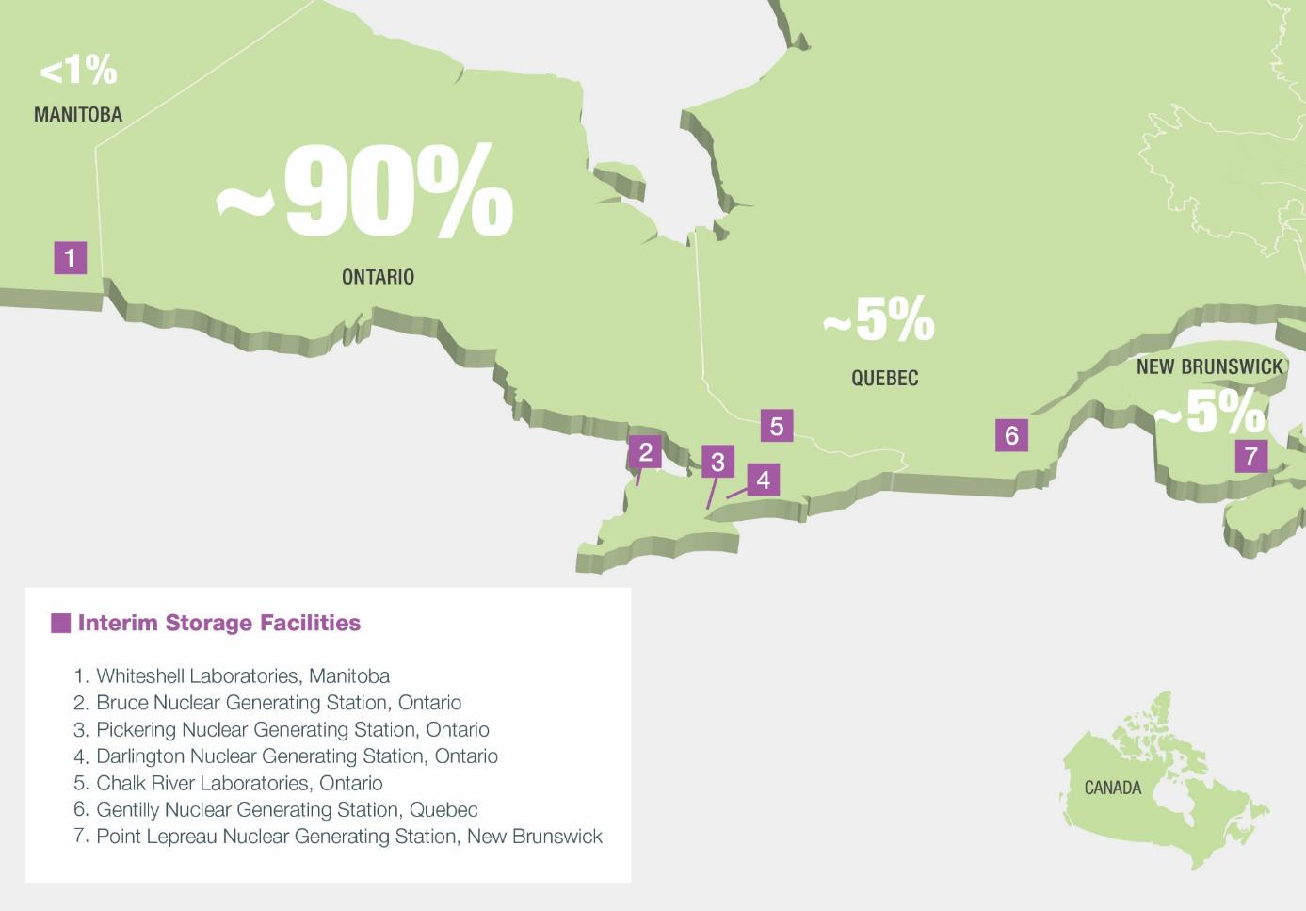

Slide 42
Objective of Assessments of Sites:
To develop confidence on selection of a preferred location to take into detailed site characterization
  Confidence a deep geological repository can be developed with strong safety case at that location
Safety
Transportation
Partnership
  Confidence a safe, secure and socially acceptable transportation plan can be developed
  Confidence a strong partnership can be developed – with interested community, First Nation and Métis communities in the area, and surrounding communities

Slide 43
Engagement
NWMO engagement is:
  Community driven to explore learning and partnership
  Guided by NWMO Aboriginal Policy and Indigenous Knowledge Policy
Ongoing engagement with municipalities and Aboriginal communities in potential siting areas
  e.g., Resource programs to support learning, site tours, monthly meetings of Community Liaison Committees, open houses, participation at community events, attendance at municipal association conferences, and community attendance at industry conferences
Expanded regional engagement
Phased engagement on transportation with siting areas, hub communities, municipal associations, first responder associations, etc.
Several bodies advise on engagement approach, including:
  Municipal Forum, Council of Elders and Youth, Interjurisdictional Transportation Planning Group

Slide 44
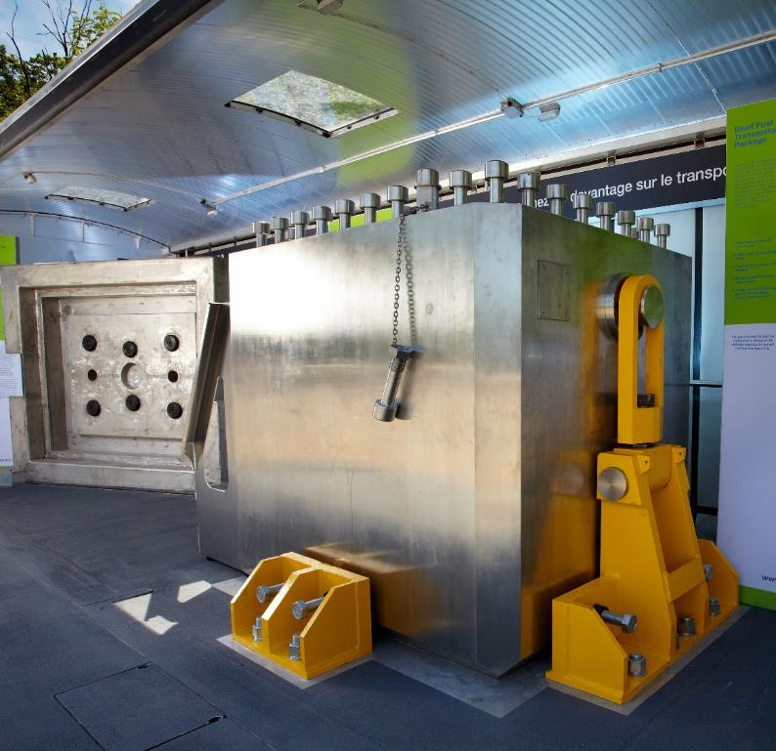
Used Nuclear Fuel Transportation
Highly regulated with an excellent safety record
Robust package designs based on international standards & testing
Road and rail are currently being studied as possible modes
APM repository operations assumed to start 2040-2045
Transportation timeframe approximately 38 years
  Average of 2 trucks per day; or
  Average of 5 rail shipments per month

Slide 45
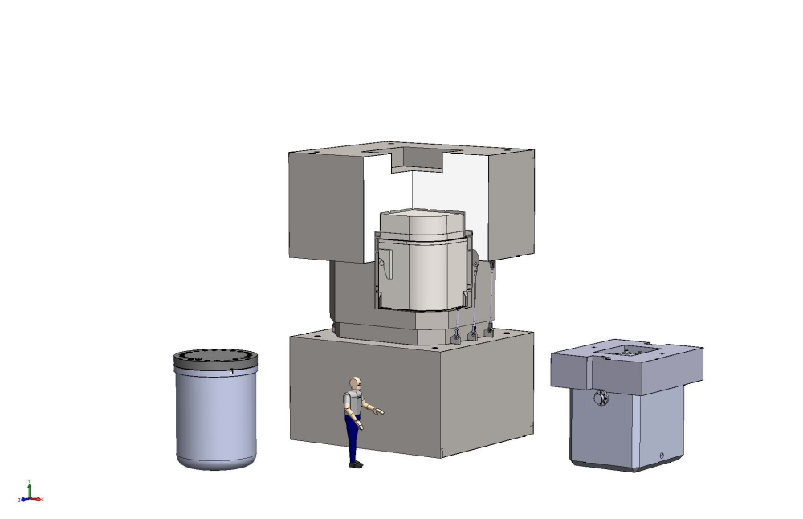
Transportation Package Options
Dry Storage Container –Transportation Package (DSC-TP):
100 tonnes
384 fuel bundles in 4 modules
Used Fuel Transportation Package (UFTP):
35 tonnes
192 fuel bundles in 2 modules
Basket Transportation Package (BTP):
25 tonnes
  180 fuel bundles in 3 baskets
Under development for AECL style baskets (non-OPG used fuel)
Certified to transport OPG used fuel in modules

Slide 46
Engagement on Transportation
The transportation engagement plan is intended to:
  have a phased evolution of focus and dialogue
  identify social considerations that inform the development of a framework for transportation planning that is responsive to what is learned each year
  inform technical work plans, as required.
In September 2016, NWMO published the transportation discussion document – entitled Planning Transportation for APM - to support transportation engagement activities.
  Public attitude research on the questions posed in this discussion document is being undertaken in 2017
At the local and regional level, the NWMO will use a variety of engagement methodologies and materials in a phased manner to identify questions and priorities of Canadians
NWMO will prepare a report on What We Heard, and a draft framework emerging from the dialogue in 2018/2019

Slide 47
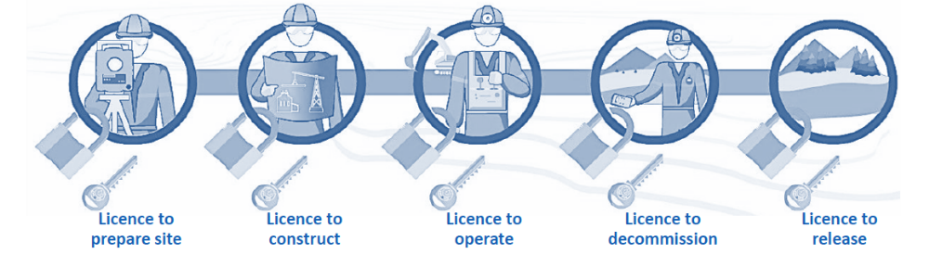
Licensing Process in Canada
A series of licences are required from the CNSC over the lifecycle of a nuclear project
Site preparation and construction licences can be combined
Site preparation/construction and decommissioning licence applications generally trigger an Environmental Assessment as well
  Two step process: EA approval, followed by licensing decision
Waste management facilities have separate licences from NPPs
Licence conditions and waste acceptance criteria (WAC) are facility-specific

Slide 48
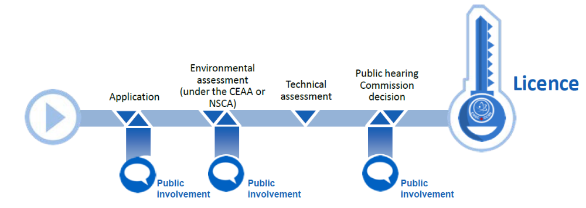
Licensing Process in Canada (2)
Entire process typically takes several years or more to complete for the first licence (Site Prep/Construction), including EA
Performance-based and prescriptive regulations
Waste disposal projects will trigger an Environmental Assessment
Ongoing Aboriginal and public involvement
  The CNSC and licensees are responsible for regular, clear communications and information to stakeholders and the public
  Crown (i.e. Federal Government) “duty to consult” with Aboriginal groups

Slide 49
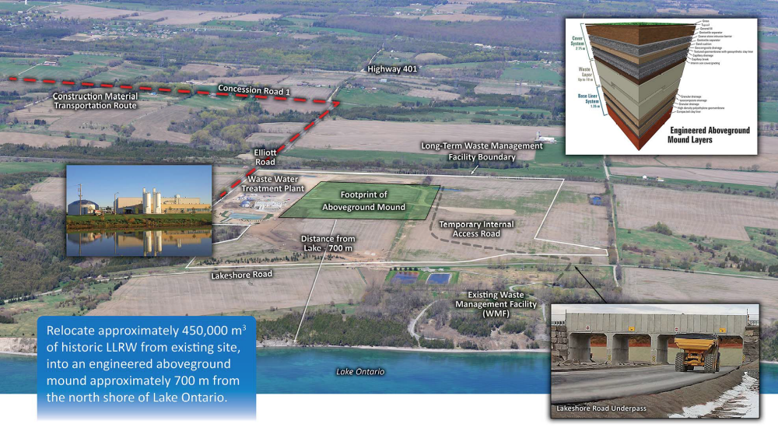
Port Granby Long-term Waste Management Facility
Lake Ontario
Port Granby
Port Hope

Slide 50
Costs
APM facility for UF: ~$18.3 billion (2015) total
  $2.1 billion Siting & Licensing
  $3.8 billion Construction
  $9.4 billion Operations (including UF transportation)
  $3 billion Long-term monitoring & closure
OPG DGR: ~$2 billion total
  $0.9 billion Construction
  $0.8 billion Operations
  $0.3 billion Closure & decommissioning
AECL NSDF: ~$600 million (2016) total
  $215 million Phase 1 construction
  $110 million Phase 2 construction
  $240 million for 50 yrs of operation
  $5 million long-term surveillance & maintenance
  $30 million for final disposition
AECL PHAI: ~$1.28 billion total

