Slide 1
Advanced Materials and Processes for Application to the Back-end of the Nuclear Fuel Cycle
Vittorio (Victor) Luca
Comisión Nacional de Energía Atómica
Acknowledgements: The presenter expresses his sincere gratitude to the conference organizers for the kind invitation and the IAEA for financial assistance

Slide 2
>60 YEARS of NUCLEAR ACTIVITY IN ARGENTINA
3 NUCLEAR POWER PLANTS
6 RESEARCH REACTORS
4 ACCELERATORS
3 NUCLEAR RESEARCH CENTERS
1 TECHNOLOGICAL CENTER
1 HEAVY WATER PLANT
2 IRRADIATION PLANTS
2 URANIUM MINING FACILITIES
1 URANIUM ENRICHMENT FACILITY
376 INDUSTRIAL APPLICATION FACILITIES
3 NUCLEAR MEDICINE SCHOOLS
68 COBALT THERAPY CENTERS
57 BRAQUITHERAPY CENTERS
309 NUCLEAR MEDICINE CENTERS
45 MEDICAL ACCELERATORS
408 IMMUNE ESSAYS LABS
No Repository!

Slide 3
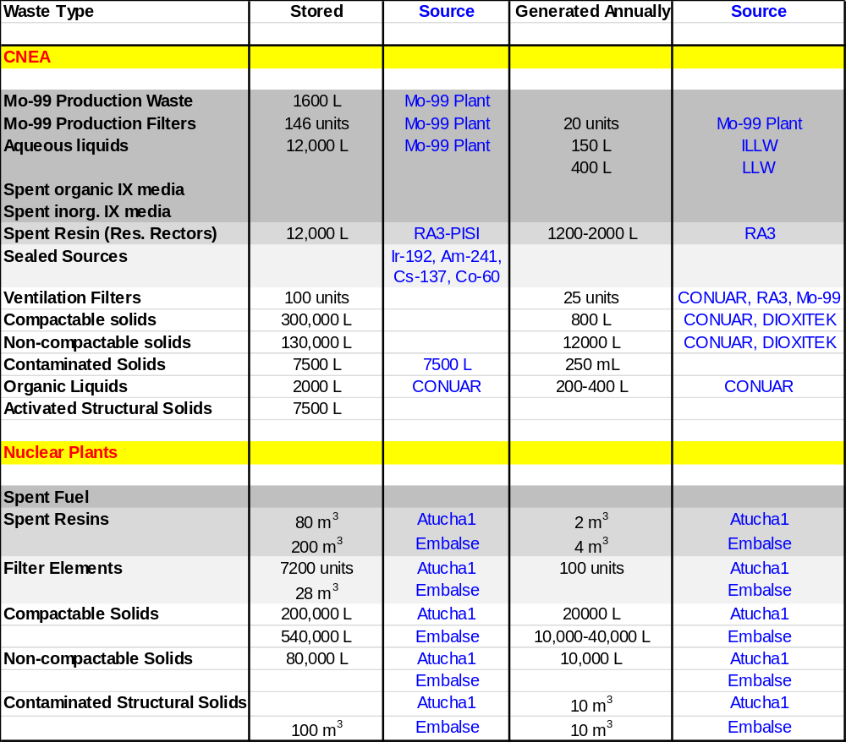
CNEA Waste Streams
Priority 2
Priority 1

Slide 4




Research Group Activities
Banchi, Castro, Rodriguez
Civitate
Treatment of gaseous efluentes from IX resin processing
Sansierra, Alvarez
Treatment & Conditioning of spent IX resins
Curi
CST use and immobilization
Tejada
Zr(IV)-organophosphonate coordination polymers for LN³⁺/AN³⁺ separations
Collaborators
CNEA: Cerchietti, Custo, Alurralde, Vega, Halac, Vaccaro, Alvarado, Quintana, Cestau, Sobra…
ANSTO: Veliscek-Carolan, Scales, Hanley…
ICSM: Arrachart, Rey
Manzini, Dos Santos, Talavera-Ramos, Telleria-Narvaiz
Target materials for cleaner ⁹⁹Mo production
Notes:
https://www.youtube.com/watch?v=rw9zbeHEXY8

Slide 5
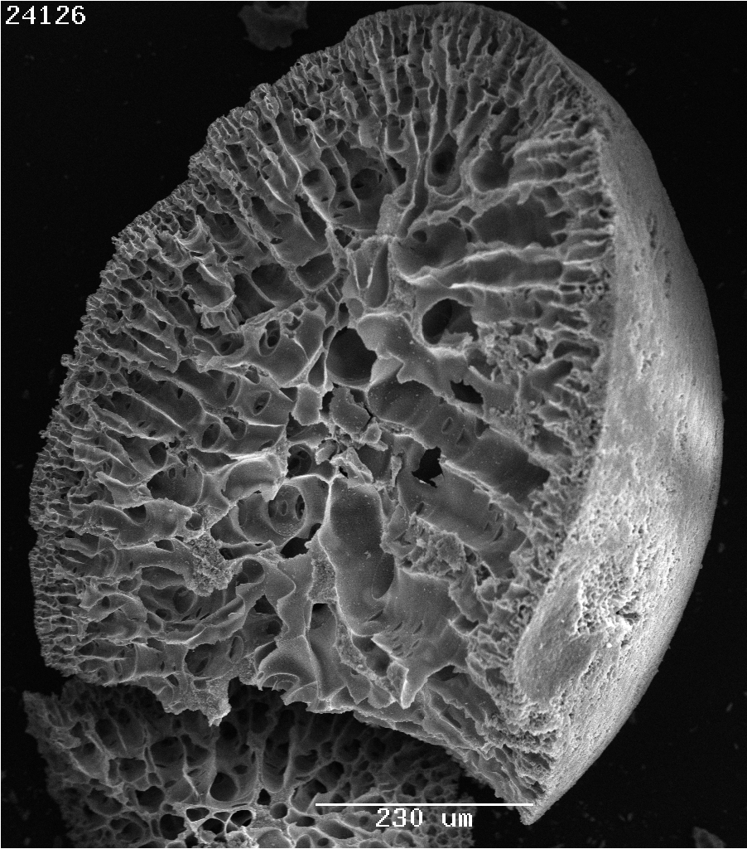
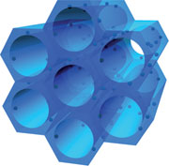
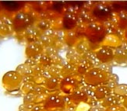
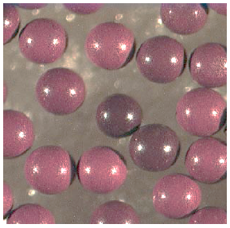
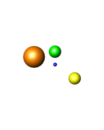
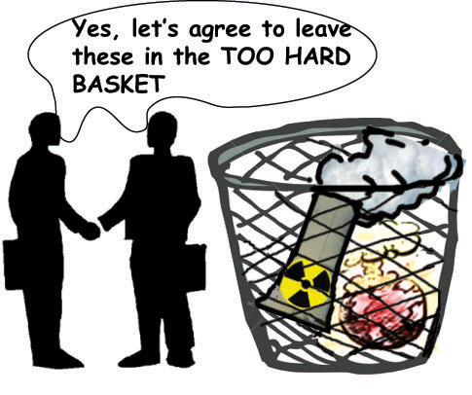
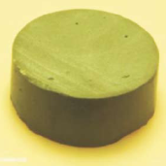
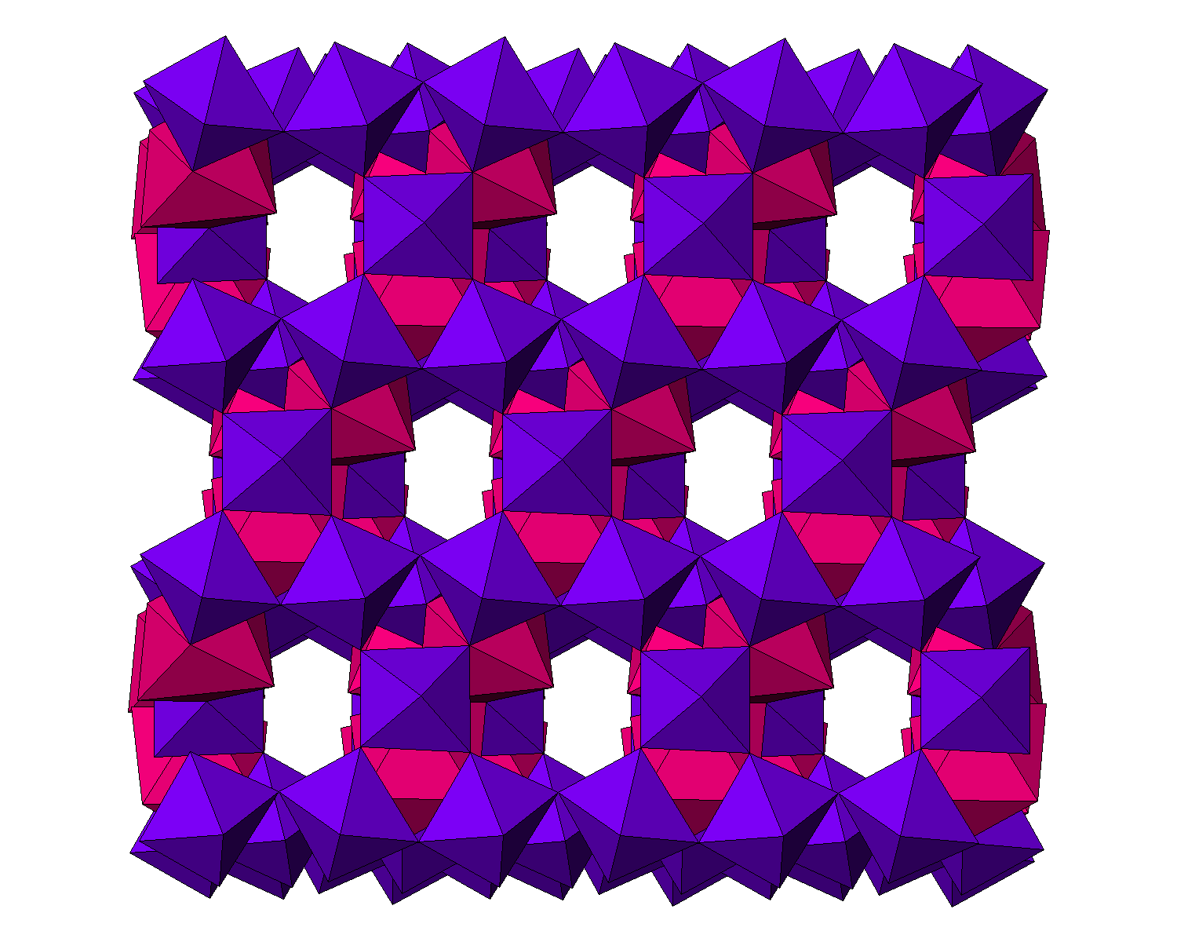
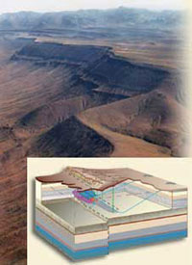
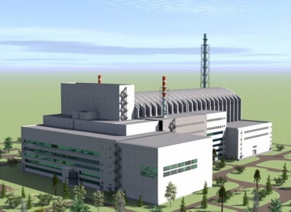
Cradle-to-Grave Concept for Radioactive Waste Management
Step 1
Utilization and/or development of predominantly inorganic & hybrid adsorbents with tailorable porosity and composition
(e.g. Zr_{x}Ti_{1-x}O₂).
SdVB Resin
2 – 10 nm
Zr_{x}Ti_{1-x}O₂
Step 2
Funcionalization of adsorbent surfaces to enhanced selectivity for target species
( e.g. Polyphosphonic acids).
RF Resin
Ceramic with hierarchical porosity
Step 3
Selective extraction of target species.
Option 2
Use as recyclable inert matrix e.g. ZrC, SiC, ZrO₂, Al₂O₃…
Option 1: Cradle-to-Grave
Simple convertion to dense highly insoluble ceramic,
glass or other
∆
Requirements
Transparent to neutrons
Stable in very high radiation fields
Good chemical stability
High thermal conductivity
No phase changes
Recyclable/reprocessable
(i.e. soluble in HNO₃)
5 mm Porous Monolith
Deep underground
repository disposal
Transmutation in FR, LWR or ADS
Notes:
In the paper by Degueldre and Paratte (Concepts for an inert matrix fuel, an overview. J. Nucl. Mater. 1999,274,1) similar ideas are also articulated.

Slide 6
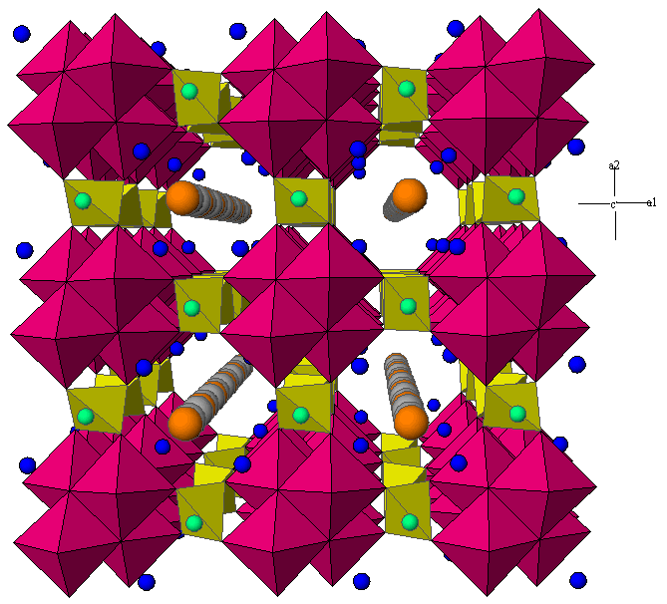
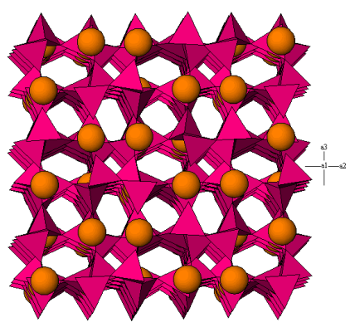
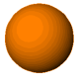

¹³⁷Cs-selective Silicotitanate
Cradle-to-Grave
Sorbent Columns
Contaminated waste
liquid
Decontaminated
liquid
CST Sitinakite
Na₂Ti₂SiO₇.H₂O
Pollucite
CsTiSi₂O_{6.5}
Δ
Cs⁺
Na⁺
Leach rates several orders of magnitude lower than that of borosilicate glass
Nyman et al. Mater. Res. Soc. Symp. Proc. 1999, 556, 71
Su et al. Mater. Res. Soc. Symp. Proc. 1999, 556, 77
Tomasberger et al. Radiochim. Acta 2001, 89, 145

Slide 7
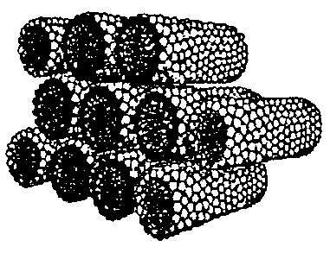
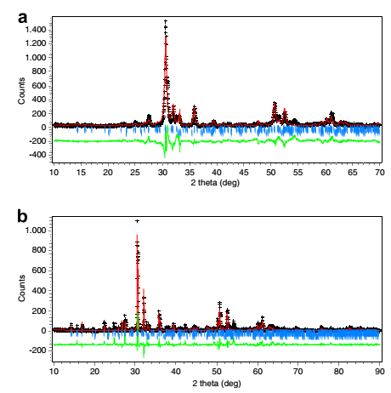
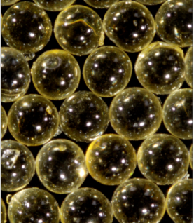
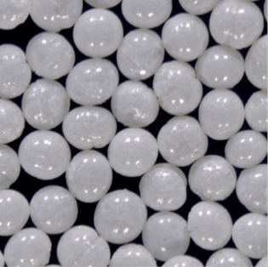
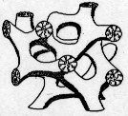

Mesoporous Zr_{0.33}Ti_{0.66}O₂
Uniform porosity (monomodal)
Homogenous distribution of Zr and Ti
Very high thermal stability
Conversion to zirconolite possible
Able to be produced directly in column-ready bead form
Luca et al. Micro. Meso. Mater. 2007, 103, 123
Griffith et al. Langmuir 2008, 24,12312
Sizgek et al. Langmuir 2008, 24, 12323
900 ºC
Uncalcined
Calcined 450 ºC
1 mm
1300 ºC
Δ
Notes:
Thus bidentate bridging coordination of the carboxylate dominates as the proportion of metal centers increases
Monodentate coordination is usually distinguished by a large ∆υ = (υsym – υasy) whereas for bidentate coordination ∆υ is smaller than in the free acid or simple salts

Slide 8
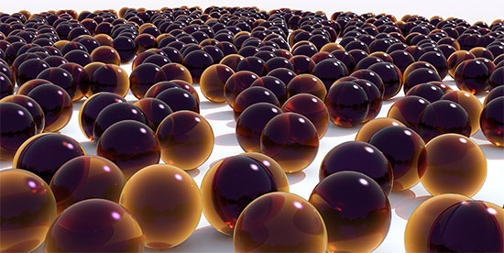
Treatment and Conditioning of Spent Resins

Slide 9
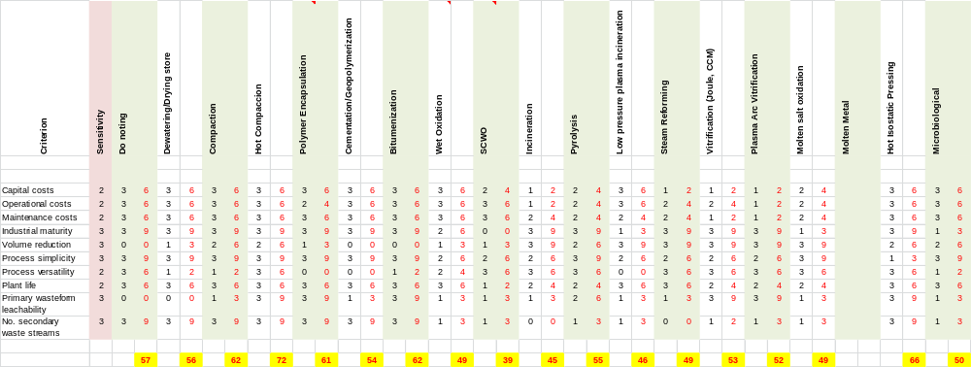
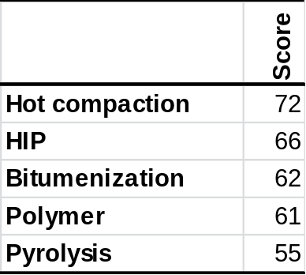
Down Selection Methodology
Sensitivity Factor
Criteria/Indicators
BAT (Best Available Technology) Analysis (IAEA, TECDOC 1744)
Short List

Slide 10
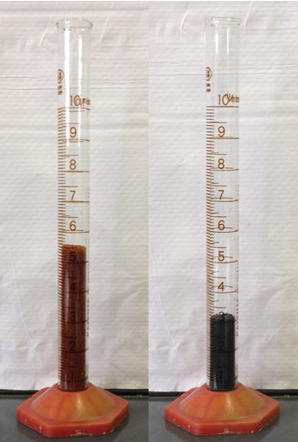
Processes Considered
Direct Immobilization
Polymer (e.g. Socodei, France)
Cement (OPC-based, Geopolymer) Bitumen (e.g. Sweden)
Ceramicrete, Duralith, SiAl, Cast Stone
Destructive Treatment
Pyrolisis (e.g. Belgoprocess)
FBSR (e.g. THOR, USA)
Incineration
Vitrification
Thermal Plasma
Microbioligical
Wet Oxidation
Acid Digestion
Molten salt
Catalytic oxidation
Supercritical Water Oxidation
Electrochemical Oxidation
Thermochemical methods
HIP
Pyrolisis (300  50 ºC)
Simple process
Volume reduction
Flameless
Versatile
Ultra stable products
Minimal 2º wastes

Slide 11
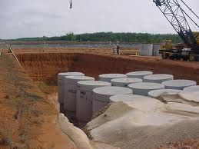
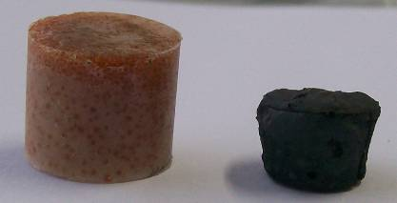
Options Considered for Treatment and Conditioning of Spent IX Resins
Polymer
MERCURE process, Socodei, Francia
500 m³/year
Opción 1
Polímero
Contenidor de Alta Integridad
Pirolisis
300-600 ºC
Opción 2
Polímero
Pirolisis
300-600 ºC
HIP?
Opción 3

Slide 12
Treatment and Conditioning of Spent IX Resinas
Is it possible to develop a low temperature pyrolysis process that results in a volume reduction and at the same time confines that entire radionuclide inventory within the matrix that is generated?
What are the relations between process temperature and the structure microstructure and the chemical properties of the products generated?
Experimental Setup
Tubular Oven
N₂, Ar, CH₄ …
Traps
Cs, Sr, Co y Ni-saturated resins

Slide 13
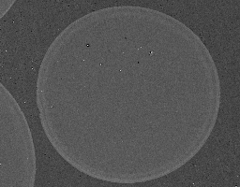

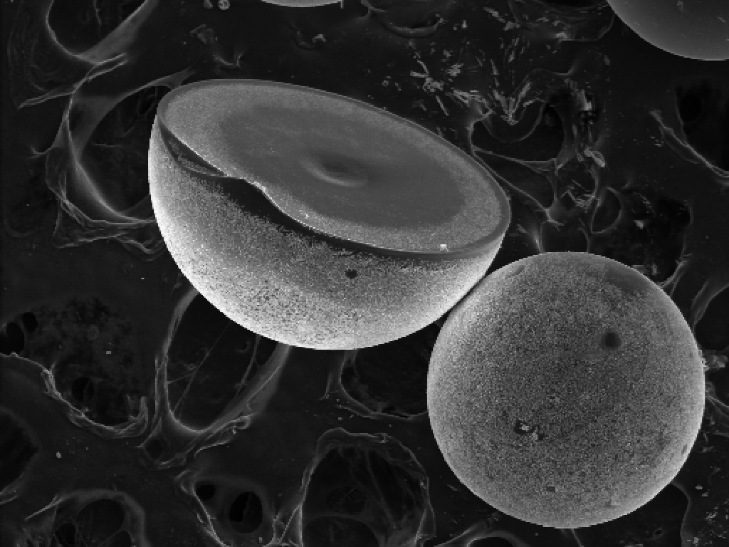



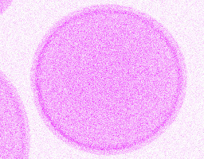
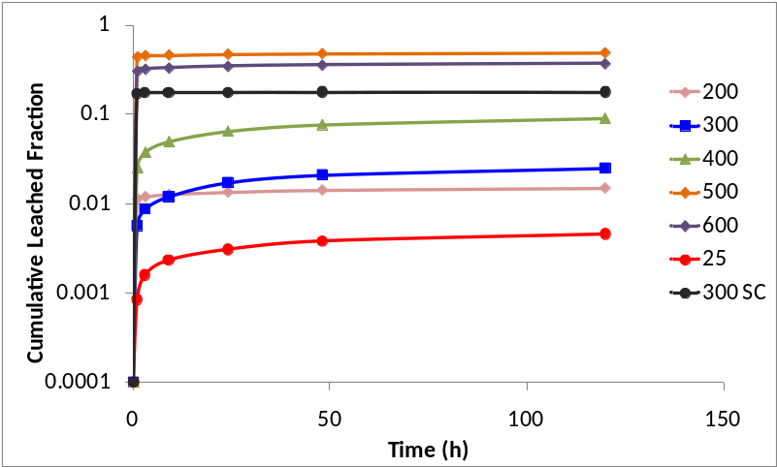
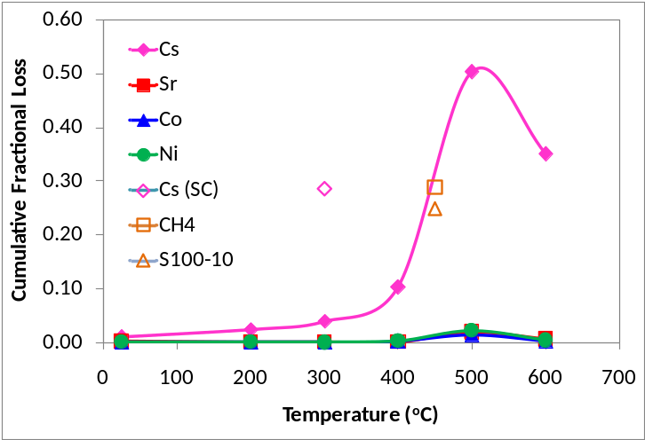
Thermal Treatment of Cation Exchange Resins
Cation exchange resin (Lewatit® MonoPlus S100H)
600 ºC/N₂
Sr
Cs, Sr, Co & Ni-saturated
Δ, N₂
Cs
Ni
Co
10 ºC/min
Cs
S
Luca et al. J. Nucl. Mater. 2012, 424, 1

Slide 14
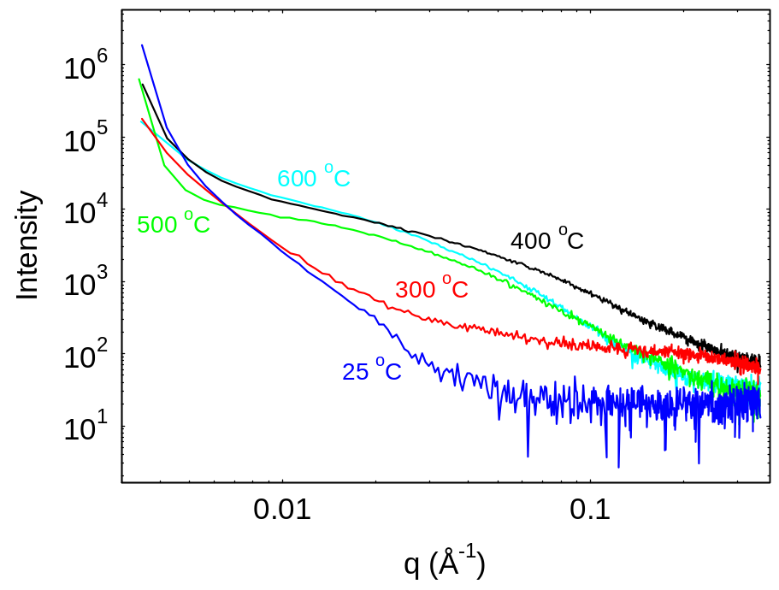
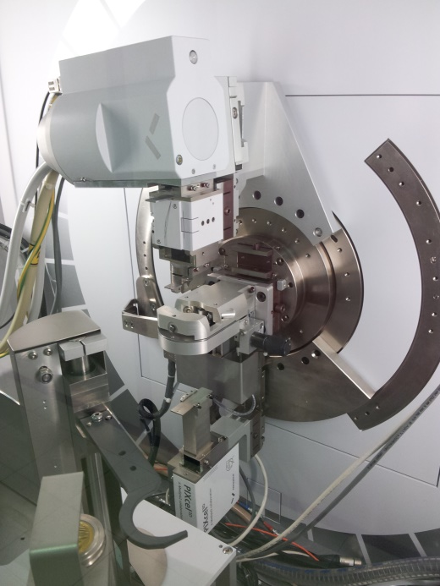
Fracción lixiviada Instantáneamente
Cs
What are the chemical caracteristics of resins pyrolyzed at low temperature?
How can we modify these products in order to improve their performance?

Slide 15
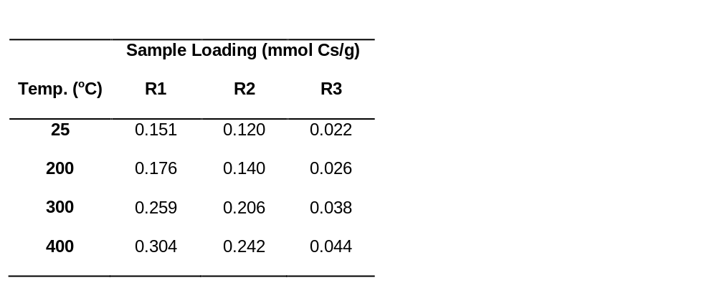
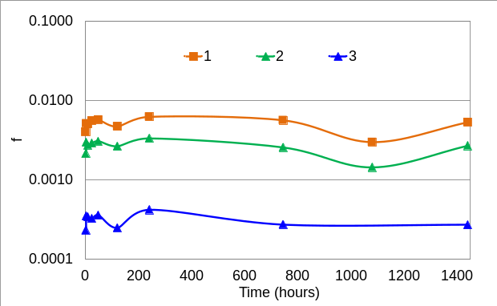
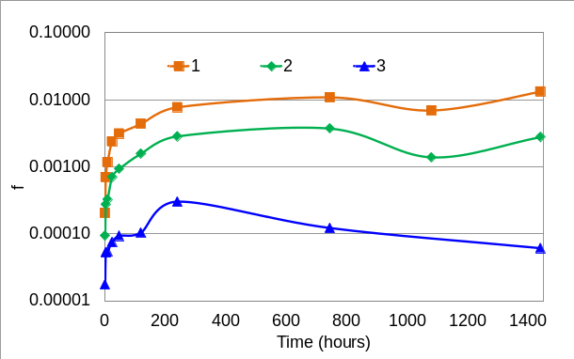
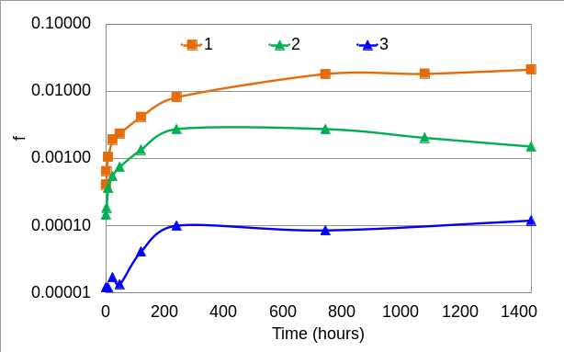
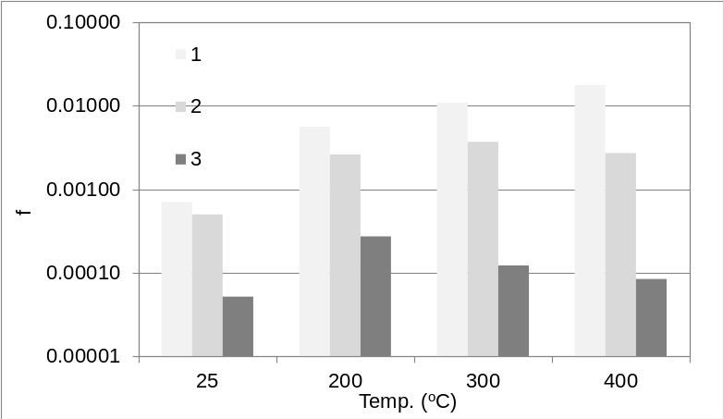
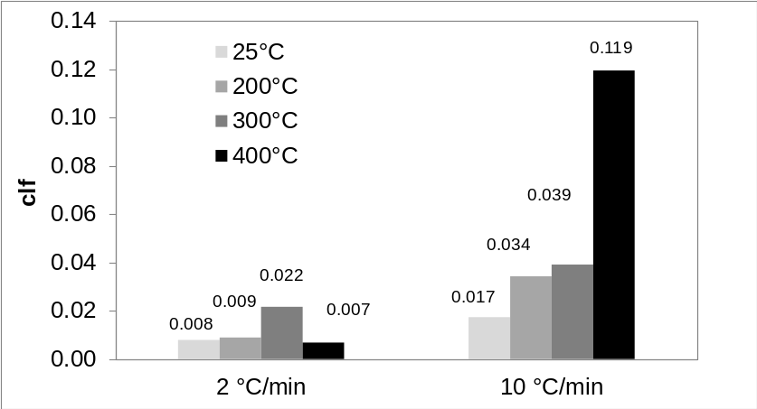
Leaching as a Function of Loading
[¹³⁷Cs] of Typical Spent PHWR Resins  0.051 nmol/g
300 ºC
400 ºC
200 ºC

Slide 16
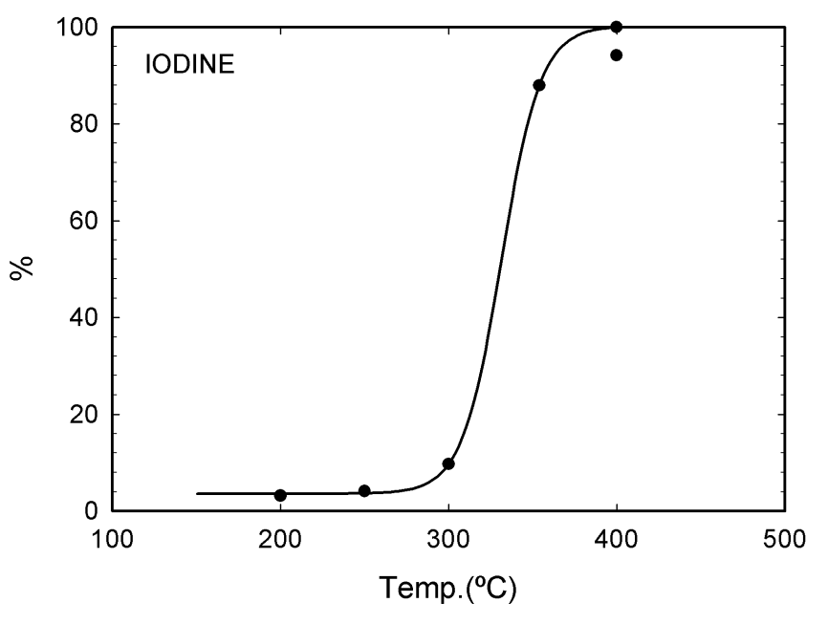
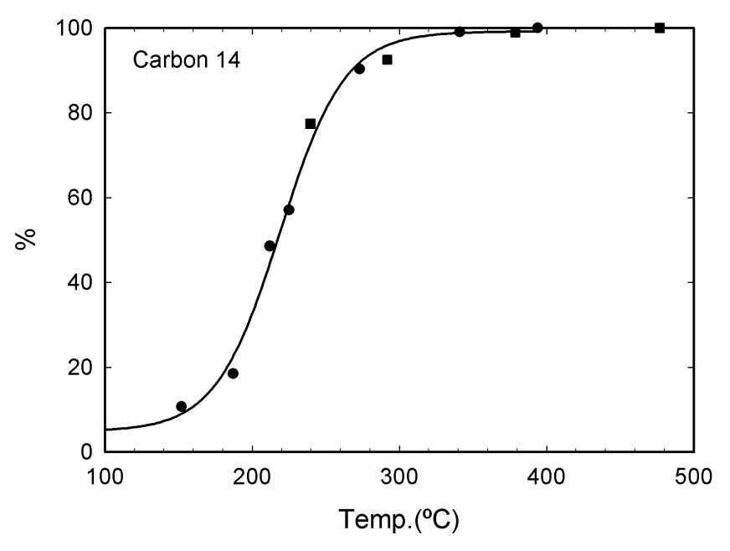
Anion Exchange Resins (Lewatit® Monoplus M500)
Anion exchange resins are more complex than their cation exchange resin counterparts since they trap isotopes that have long half lives, are highly volatile and biocompatible.
³⁶Cl⁻ T_{1/2} = 3.01x10⁵ years
¹²⁹I⁻ T_{1/2} = 1.57x10⁷ years
¹⁴CO₃²⁻ T_{1/2} = 5.73x10³ years
⁹⁹TcO₄⁻ T_{1/2} = 2.111x10⁵ years
Luca et al. J. Environ. Chem. Eng. 2017, 5, 4165
Upper limit for ¹⁴C retention is around 200 ºC.
For ¹²⁹I it would be around 300 ºC.
LCMS Detection of ¹²⁷I at Reactor Outflow
¹⁴C by Scintillation Counting

Slide 17
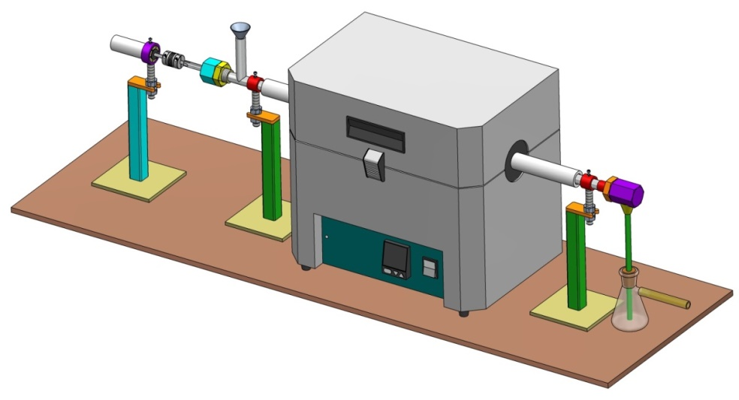
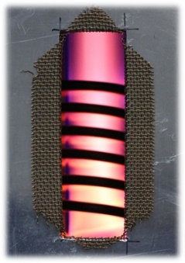
Simplified Process Flow Sheet
²H, ³H
Recycle/Disposition
Spent Resin
Polymer Encapsulation
(Epoxy, phenolic resin…)
Resin Dewatering
Low Temperature
Pyrolysis
Interim Storage/Repository
High Performance Plasma treatment or Post Combustion System
¹⁴C,¹²⁹I…
Radionuclide Capture
in Selective Adsorbents
Bench-Scale Demo  Pilot Scale at Kg/h Throughput (cold and then hot)

Slide 18
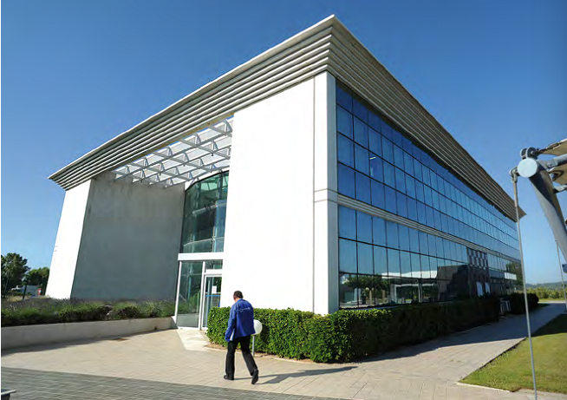
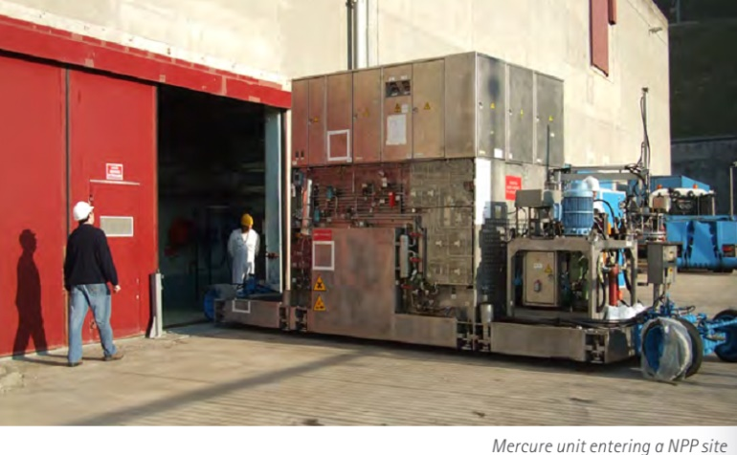
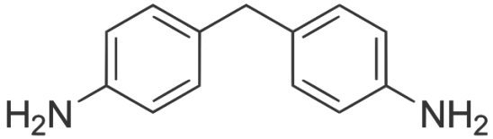
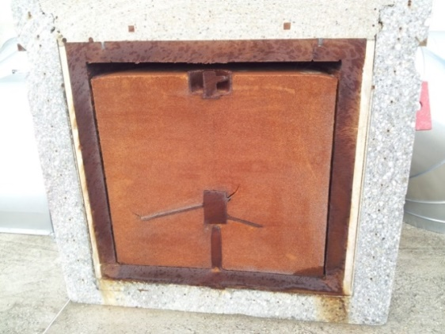
Mercure Process - SOCODEI
The only process that at present meets ANDRA requirements for the disposition of spent IX resins.
Limited exudation of water
Low exothermicity
Confinement of radioactivity
Good compressive strength (>8MPa)
Low leaching
Resistance to thermal cycling
homogeneous
Resistance to radiation
Max packet dose of 2 mSv/h. Ahora <0.75 mSv/h.
Not flammable
The process depends on the polymeric reaction between an epoxide and D7M6 hardner.
>400 / año
1.2 m³
^{57,58,60}Co, ^{110m}Ag, ^{134,137}Cs…

Slide 19
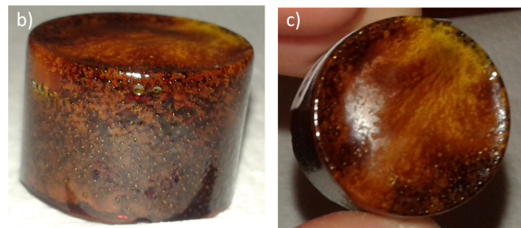
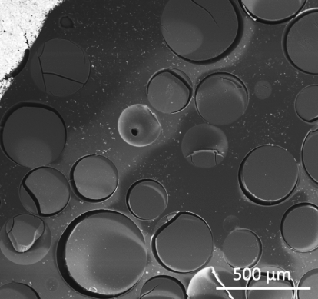
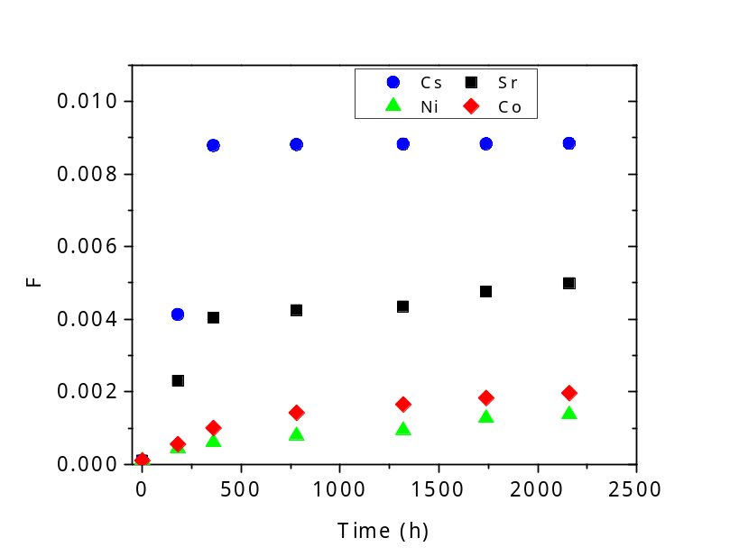
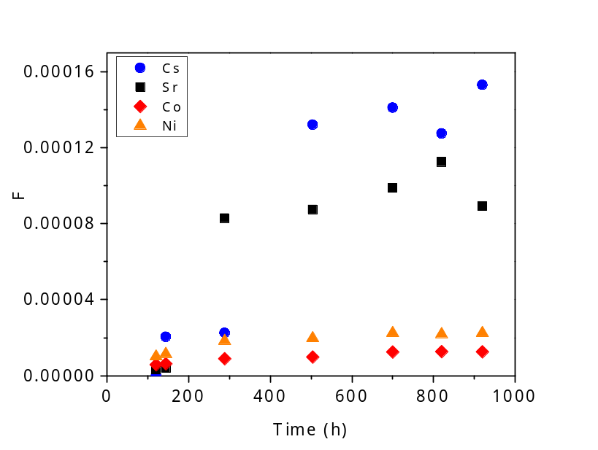
Spent IX Resin Immobilization
Phenolic Resin-SiO₂ Nanocomposites
NC-5 + RII
a
b
c
RII
NC-5: 70 % RII (300 ºC), 27 % Resol, 3 % SiO₂ (fume)
Ultrapure Water
Ultrapure Water
Cumulative leached fraction (F) of Cs⁺, Sr²⁺, Co²⁺, Ni²⁺ -saturated resins
Cumulative leached fraction (F) of Cs⁺, Sr²⁺, Co²⁺, Ni²⁺ -saturated resin-composites

Slide 20




Spent IX Resin Immobilization
Resol-SiO₂ Nanocomposites
RII
NC-5: 70 % RII (300 ºC), 27 % Resol, 3 % SiO₂ (fume)
HNO₃ 1M
HNO₃ 1M
HNO₃/NaNO₃ 1M
HNO₃/NaNO₃ 1M

Slide 21



Natural Analogues
99 Million Years
Xing et al. - A mid-Cretaceous enantiornithine (Aves) hatchling preserved in Burmese amber with unusual plumage. Gondwana Research. 2017, 49, 264

Slide 22

Zirconium Phosphonate Coordination Polymers for LN and AN Separations and Immobilization

Slide 23




European Reference Process
Chemical similarity of LN and AN elements makes their separation non-trivial
Am, Cm
Am, Cm
Am
PUREX
DIAMEX
SANEX
DIAMEX
LN
FPs
Cs,Sr,I,Tc
LN
U
Pu
Np
Glass
Cm

Slide 24



Preparation and Adsorption Properties of Zr(IV) – Poliphosphonates
Zr(IV)-based polyphosphonate MOFs are LN and AN selective & are highly insoluble
Veliscek et al. Sep. Pur. Technol. 2014, 129, 150-158
ANSTO
Veliscek et al. MMM 2017, 252, 90-104
nZrOCl₂.8H₂O/
ZrCl₄/,
Δ
Amorphous
Precipitate/gel
1.
+
NaOH/HNO₃
+
Luca et al. Hydromet.. 2015, 154, 118-128
Δ
2.
+
NaOH
8 mol/L
+
nZrOCl₂.8H₂O
Amorphous
Precipitate/gel
Luca et al. Inorg. Chem. 2016, 55, 7928-7943
Δ
3.
+
nZrOCl₂.8H₂O
Poorly Crystalline
nZrCl₄
nZr(OPr)₄

Slide 25




Zr
Coordination Polymers for LN Separations
Luca et al. Inorg. Chem. 2016, (in press)
3000 nm
Zirconium Thorium Pyrophosphate
(ZrTh)P₂O₇ Cubic P a -3
800 – 1000 ºC

Slide 26




900 ºC/air
900 ºC/N₂
Th_{0.049}La_{0.013}Ce_{0.015}Pr_{0.015}Nd_{0.015}Gd_{0.013}Dy_{0.015}Ho_{0.014}Sr_{0.025}Zr_{0.84}P_{1.84}O_{6.56}
Th_{0.058}La_{0.009}Ce_{0.009}Pr_{0.012}Nd_{0.012}Gd_{0.009}Dy_{0.012}Ho_{0.011}Sr_{0.033}Zr_{0.83}O_{1.93}
No Detectable leachable!!

Slide 27
Radiation Stability of Zr(IV)-polyphosphonate Coordination Polymer Hybrids
Zr-ATMP Coordination Polymer
nZrOCl₂.8H₂O/
ZrCl₄/,
Δ
Amorphous
Precipitate/gel
1.
+
NaOH/HNO₃
+

Slide 28




ATMP-Zr (coordination polymer)
Ce
Eu
Gd
Lu
Notes:
Each element present at about 1 ppm

Slide 29


ATMP-Zr (coordination polymer)
Gd
Lu
U
Th

Slide 30

ATMP-Zr (coordination polymer)
³¹P MAS NMR

Slide 31




Cleaner ⁹⁹Mo Production Methods
⁹⁹Mo accounts for 30 million diagnostic procedures annually

Slide 32

Mo-99 Production Methods
Advantages
Disadvantages
- High specific activity (Ci/g)
- Needs targets enriched in ²³⁵U.
- Processing complex.
- Generates radwaste.
- Simple & convenient
- No waste!
- Low specific activity
(2 vs 10.000 Ci/g).
- Needs ⁹⁸Mo.

Slide 33


RA-10 Project
Objetives
1. Structural necessities
https://www.youtube.com/watch?v=qe1jYmStc_4
2. Nuclear technology for national development
3. Radioisotopes for health
⁹⁹Tc is a derivative of ⁹⁹Mo which is the most utilized radioisotope in nuclear medicine and is used for the detection of disease and thus contributes to the saving of lives. Globally more than 80.000 procedures utilizing this isotope are undertaken per day. In our country more than 2 million patients are processed per year. The increase in the production of ⁹⁹Mo will enable Argentina to satisfy the national requires and also help to satisfy an increasing international demand (about 10% of global production). This will enable us to consolidate our leadership position in the provision of radioisotopes for medical applications.
Notes:
Fabbri - Proyecto RA-10.pdf
https://www.cab.cnea.gov.ar/index.php/proyecto-ra-10/61-espanol/proyectos/ra-10/278-objetivos-y-metas
http://www.cnea.gov.ar/RA10-objetivosymetas

Slide 34
Simplified CNEA Process Flowsheet
Sameh & Ache, Radiochimica Acta 1987, 41, 65-72.
Wash H₂SO₄-KSCN, strip Mo with NaOH
Wash H₂SO₄-KSCN, strip Mo with NaOH
Mo stripped alkaline Na₂SO₄ soln
1
Xe-133
8
Al₂O₃ column
3
4
AG1-X8 column
Chelex columns
I-131 retention
^{VI}Mo(SCN)₄³⁻/H₂SO₄
1
2
Mo-99
~
U-235 recycle
(U-238, Sr-90, LA³⁺…)
~
Boil-down & pH adjust
CST column
7
2
ILLW
6
LLLW
5
4 M NaOH, 0.4 M Al³⁺
Notes:
A. Sameh & H.J. Ache, Production Techniques of Fission Molybdenum-99, Radiochimica Acta 1987, 41, 65-72.

Slide 35


ANSTO Mo-99 Production
1965 - 2008
For 6 can run
Produce 850 mL of 1.1 M UO₂²⁺ in
0.75 M HNO₃ + 12 ppm Mo + ~ 300 FPs
45 g Uranium Dioxide (UO₂) 2.2% ²³⁵U
Magnesium Oxide (MgO)
8M Nitric Acid
Holding Tank
UO₂ (Minor MgO)
( Minor MgO)
Sieving
`Rocket´ can
Irradiated 7 days
Dissolution
Bulk MgO
Stage 1. Load
Stage 4. 0.01M Ammonia wash
Packed Alumina
Column 32 x 120 mm
Flow rate = 5 mL/min
Stage 3. Water wash
Stage 2. 1M HNO₃ wash (800 mL)
Stage 5.
Strip 1M Ammonia
Stage 1
Mo-99
Absorption
Stage 7.
Purification
C1
C1
C1
C2
8M HNO₃
Ammonia-rich
Condensate
Primary
Liquid Waste
80% U Deportment
Secondary
Liquid Waste
Mo-99 Product
Stage 6. Boil down
Stage 8. Boil down to
specified vol.
Notes:
Five production runs per week totaling 675 Ci (25,000 GBq) at EOB. Simple acid-side process that served for 50 years that could be improved with better solid-extractants, i.e. to replace alumina.

Slide 36


Slide 37





Wastestream 2: Filter cake of ^{235/238}UO₂.ZH₂O
Uranium can be easily recovered from the filter cake using a variety of processes. For instance PUREX, UREX SX processes or using Extraction Chromatography.
Impregnación
TBP
XAD7
`PUREX in a Column´
Vaccaro et al., Argentina’s Efforts to Recover and Down-blend Irradiated HEU from Mo-99 Production Targets. RERTR 2016

Slide 38




Traditional versus New Approaches
Improve process from
the head-end?
?
Target Fabrication
13.0 cm
3.5 cm
Irradiation
UAl_{x} dispersion Target
Nordion (Canada)
IRE (Belgica)
IPPE (Russia)
ANSTO (Australia)
Dissolution
CNEA (Argentina)
NECSA-NTP (S. Africa)
MALLINCKRODT (Holland)
Sublimation
or
Leaching
Acid
Alkaline
Improve
recovery step?
Recover ⁹⁹Mo
Recovery ²³⁵U
Adsorption/IX
LLW/ILW
500-1000 L/year ILLW

Slide 39
Denis Levins et al.
ANSTO's Radioactive Waste Management Policy Preliminary Environmental Review
ANSTO/E728
May 1996
“The present method of molybdenum-99 production should be reassessed from a cleaner production viewpoint. This will involve consideration of modifications to the process to eliminate ammonium salts in the waste and, more radically, assessment of alternative technologies with the aim of reducing liquid waste volumes and/or activities.”
Green Chemistry is the area of chemistry and chemical engineering that focuses on the design of processes that minimize the generation of toxic substances.
Today it is not good enough to just have a process. We need to have the cleanest possible process!

Slide 40

Methods for Production of ⁹⁹Mo (Review)
M.P. Zykov* and G.E. Kodina**
* Khlopin Radium Institute, Research and Production Association, St. Petersburb, Russia
** Institute of Biophysics, Russian Academoy of Sciences, Moscow, Russia
Received May 14 1998
Radiochemistry 1999, 41 (3), 193-204
Methods and apparatus for selective gaseous extraction of molybdenum-99 and other fission product radioisotopes
WO 2011156446A2 filed 8-Jun-2011
WO 2011156446A3
General Atomics
MoO₂Cl₂
CONCLUSION
The choice of a particular scheme for the production of ⁹⁹Mo is, as a rule, Primarily governed by availability of the equipment and raw materials. Traditional “wet” processes for the production of fission molybdenum are successfully used up to now. At the same time, the major problem in this field is the utilization of radioactive wastes. Ultimately, waste management may be the most expensive part of any process scheme, taking into account the modern attitude to environmental problems. In this context we believe sublimation procedures to be the most promising for the future, since these procedures yield a high-purity product with minimal wastes.

Slide 41



⁹⁹Mo or ^{99m}Tc by Sublimation
Kurze Originalmitteilungen
On the Sublimation of ^{99m}Tc from Irradiated Molybdenum Trioxide
E. Hallaba, H.A. El-Asray
Environmental Health Studies 1975, 11, 290
Zsinka ^{99m}Tc Sublimation Generators
Radiochimica Acta 41, 91-96 (1987)

Slide 42



Hypothetical Target Parameters
11 .0 mm
Porous microsphers (500-1000 μm) of ZrC_{x}, SiC, MAX, UC_{x}..
Pore dimaeters 10-100 nm.
Free space for fission gases
Al or Zr irradiation can (500-800 μm)
Loading of pores with between 0 y 100% UO₂, UC_{x} or other
n
55.0 mm
n
FP
Neutron flux
1– 10x10¹³ ncm⁻²s⁻¹
²³⁵U
⁹⁹Mo
Actual Microsphere
Maximum packing
$$μ_{Kepler}=μ_{ccp}=μ_{hcp}=\frac{π}{3\sqrt{2}}≈74.05\%$$
Van Til, Sphere Irradiation (JRC-IET)
V ~ 7.3 cm³ x 0.75 ~ 5.475
But microspheres are 50% porous  5.475 * 0.5 ~ 2.74 cm³
400 μm
Notes:
Van Til - SPHERE irradiation

Slide 43

High Resolution SEM of Mesoporous Y-stabilized ZrO₂
Elm et al. ACS Appl. Mater. Inter. 2015, 7, 11792.
Nanocrystals
Nanopore
n
R  n  
FP
R = reaction rate
n = no. target nuclei
 = neutron flux
= cross section (600 barns)
37 barns (⁹⁹Mo) 6.1 %
n
²³⁵U
⁹⁹Mo

Slide 44

Thermo-hydraulic Modeling with Dionisio
11 .0 mm
Soba & Denis, J. Nucl. Mater. 2008, 374, 32-43
f = 1.75-3.5 x 10¹³ n cm⁻² s⁻¹
55.0 mm
Flux
U density

Slide 45





Microspherical Materials Through Ion Exchange and Polymer Templating
[Zr₄(OH)₈(H₂O)₁₆Cl₆]²⁺
Gel-IER
Macroporous IER
1100 ºC/air
1100 ºC/N₂
1350 ºC/Ar
S_{BET} ~600 m²/g
S_{BET}  0 m²/g
Scales et al., MMM 2017, (in press)

Slide 46






Synthesis of Porous Zirconium Oxycarbonitride Micospheres
Polyzirconoxane
∆
+
1350 ºC
N₂-H₂ (5%)
Nitriding ZrO₂ using N₂-H₂(5%)
ZrN + O₂ → ZrO₂ + 1/2N₂
ZrC + O₂ → ZrO₂ + 1/2CO₂

Slide 47

ZrC-Carbon Composite Microspheres
ZrHC-1
Cycle | Ads (%) | Des (%)
1 | > 99 | 86
2 | > 99 | 91
3 | > 99 | 96
4 | > 99 | 83
Mo
U
Sr
Cs
U
Mo
0.025 mmol/L
Sr
Cs
Scales et al. MMM 2015, 212, 100-109
Load uranium as UO₂²⁺ at 3 < pH < 11.
Strip Cs⁺, Sr²⁺ and UO₂²⁺ using mildly acid solution 2 < pH < 3.
Extract MoO₄⁻ using mildly alkaline solution pH > 11.

Slide 48

ZrOCN-Carbon Composite Microspheres
ZrC
ZrOCN
ZrOCN
96%
Nano- graphite
G
Notes:
ZrC = LD27-20J. Surfaces would need to be functionalized to impart actinide selectivity.

Slide 49




Experiments in Progress
⁹⁸Mo
Carbon
ZrC
ZrOCN
ZrO₂
Al₂O₃
SnO₂
UO₂
…
Ce
²³⁸U
Ce-143
Ce-141
Pr-143

Slide 50





Oxidation of Nanocrystalline Zirconium Carbides
ZrC
ZrO₂
+
2O₂
+
CO₂

Slide 51

Radiation Response of Nanoporous Materials
If nanoporous/nanostructured materials are going to be use in high radiation fields then:
How do they respond to different kinds of radiation?
Can we use them as targets for the production of fission ⁹⁹Mo?
Notes:
Next generation of nuclear systems will need materials that are stable in extreme environments!
Motivations: (1) to see how nanomaterials respond to radiation, (2) to apply advanced materials as targets.

Slide 52





Radiation Response of Mesoporous Silicate and Borosilicate Thin Films
Position of main reflection → cell dimension
Intensity → contrast & order
meso-Ti_{0.66}Zr_{0.33}O₂
θ
θ
60-100 nm
Glass
Silicon substrate
First studies of radiation damage of nanoporous silicates
Dourdain et al. J. Nucl. Mater. 2012, 427, 411
92 MeV Xe⁺ 1x10¹⁴ cm⁻²
2D Hexagonal
3D Hexagonal

Slide 53





Radiation Response of Mesoporous Silicate and Borosilicate Thin Films
¹⁰B + 1n → ⁷Li + ⁴He (2.8 MeV) + γ (478 KeV) RA3 Ezeiza
n
Si
⁴He²⁺
O
B
⁷Li³⁺

Slide 54

Radiation Response of Mesoporous Silicate and Borosilicate Thin Films
Manzini et al. NIM B 2017, (in press)
¹⁰B + 1n → ⁷Li + ⁴He (2.8 MeV) + γ (478 KeV) RA3 Ezeiza
d-spacing is maximum for B content of 5 % and then decreases again.
The d-spacing contracts as a function of irradation time for given B content.
Area of main reflection is relatively unaltered as a function of irradiation time for given B content.

Slide 55

Iodine Ion Irradiations of Mesoporous Silicate and Borosilicate Thin Films
70 MeV
180 keV
TANDAR accelerator

Slide 56



Radiation Response of Mesoporous and Nanocrystalline Zirconium Oxide Thin Films
Manzini et al. J. Nucl. Mater. 2016, 482, 175
No irradiado
70 MeV, 10¹⁴ cm⁻²
0.002 dpa
70 MeV, 10¹⁴ cm⁻²
1.73 dpa
132 keV, 10¹⁴ cm⁻²
Poca diferencia en los parámetros de la celda cristalina luego de irradiar a 70 MeV (0.002 dpa) 132 keV (1.73 dpa).

Slide 57



Radiation Tolerance of Mesoporous Nanocrystalline Zirconia
82 dpa
180 keV, 10¹⁶ cm⁻²
82 dpa
Ce_{0.10}Zr_{0.90}O₂

Slide 58




Radiation Tolerance of Mesoporous Nanocrystalline Zirconia
82 dpa
180 keV, 10¹⁶ cm⁻²
BCZ-350
200 nm
BCZ-350i
200 nm

Slide 59
Main Conclusions
A capability for conducting novel research relevant to the back-end of the nuclear fuel cycle has been established.
Scientific underpinnings have been established for a new low-temperature pyrolysis process for the treatment of spent IX resins that generates highly stable pyropolymers.
New LN and AN selective Zr(IV)-coordination polymers have been developed that lend themselves to facile end-of-life management (cradle-to-grave).
Strategy has been developed for the development for the cleaner production ⁹⁹Mo from the fission of LEU.
Provided first insights into the radiation response of mesoporous nanocrystalline zirconia and LN-zirconia thin films.

Slide 60




Conditioning of Spent CST Columns - Direct Containerization
Direct Containerization in High Integrity Container
Cast from lead
Lined with iron for mechanical strength
Presently used for storing Co-60 (1900 Ci)
30 of the Cs-CST columns have 750 Ci ¹³⁷Cs

Slide 61



In-Situ Immobilization/Conditioning of CST
Phenolic Resin
¹³⁷CsNaTi₂SiO₇.H₂O

Slide 62















a
b
c
2
1
3
4
C
Na
Cs
200 μm
Nb
Ti
Zr
Si
Ni
Mn
Fe
Cr

Slide 63



