Slide 1
Functionalised Titania and Zirconia Materials for Selective Actinide and Lanthanide Separations
Jessica Veliscek-Carolan
Katrina A. Jolliffe, Vittorio Luca, Tracey L. Hanley

Slide 2
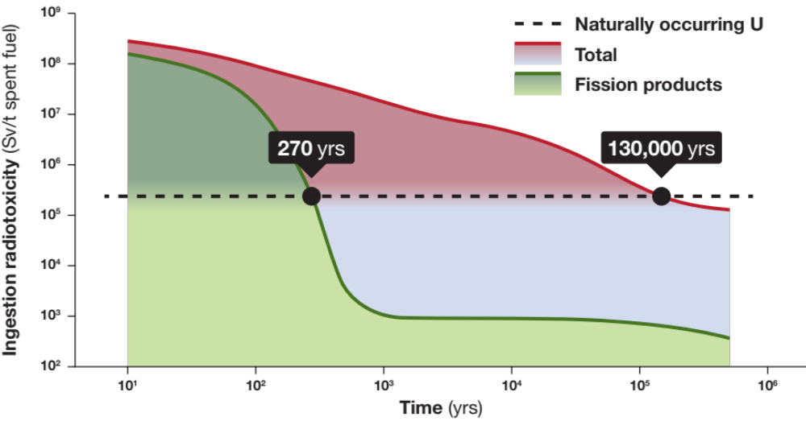
Benefits of Partitioning and Transmutation
Processing allows more complete use of actinides and results in less hazardous waste
Notes:
Usually done with solvent extraction but my research focusses on using solid phase materials to do these separations.

Slide 3
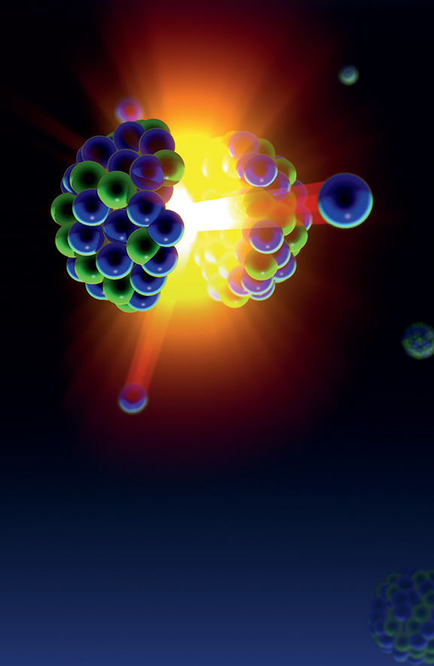
The challenge with solid sorbent materials
Require hydrolytic and radiolytic stability for nuclear applications
Titania/zirconia substrate
  Stable
  Cheap
  Non-toxic
  Potential wasteform or transmutation matrix
Stable

Slide 4


The challenge with solid sorbent materials
Organic functional groups to impart selectivity
Selective
Notes:
Head group (indicate) varies as different functional groups depending on the element we are trying to extract

Slide 5
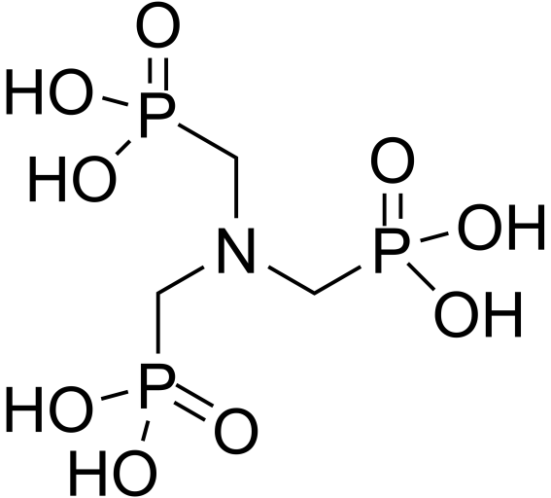
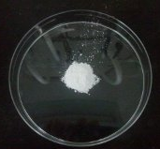
1. Zirconium Organophosphonates (ZrP)
ZrCl₄
or
Zr(OiPr)₄
HT
+
+
H₂O/H⁺
120/160ºC
Amorphous
Incorporating phosphonate into structure allows higher loading and increases hydrolytic stability
Changing ATMP:Zr ratio, Zr precursor, pH and temperature affects porosity and sorption properties
Veliscek-Carolan et al. (2014) Separation and Purification Technology 129, 150
Veliscek-Carolan et al. (2017) Microporous and Mesoporous Materials, submitted
Notes:
First did functionalisation via co-condensation, this method allows a large number of functional groups to be introduced and the hope was that this would lead to high capacity for the element to be separated, in this case we were targeting Ln.
Simple to make – via hydrothermal synthesis. Varied amount of ATMP, precusor Zr, pH, temp
Explain – will use ZrP, please remember this abbrev (audience)

Slide 6
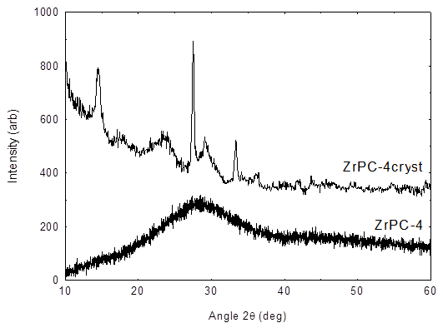
1. Zirconium Organophosphonates (ZrP)
ZrCl₄
or
Zr(OiPr)₄
HT
+
+
H₂O/H⁺
pH 4
+
KF
160ºC
Crystalline ZrPC-4cryst
Notes:
Also made one sample with KF addition to induce crystallinity, to see what impact that would have on the structure, porosity and sorption properties of the material
Focus on varying Zr/P ratio under these conditions

Slide 7
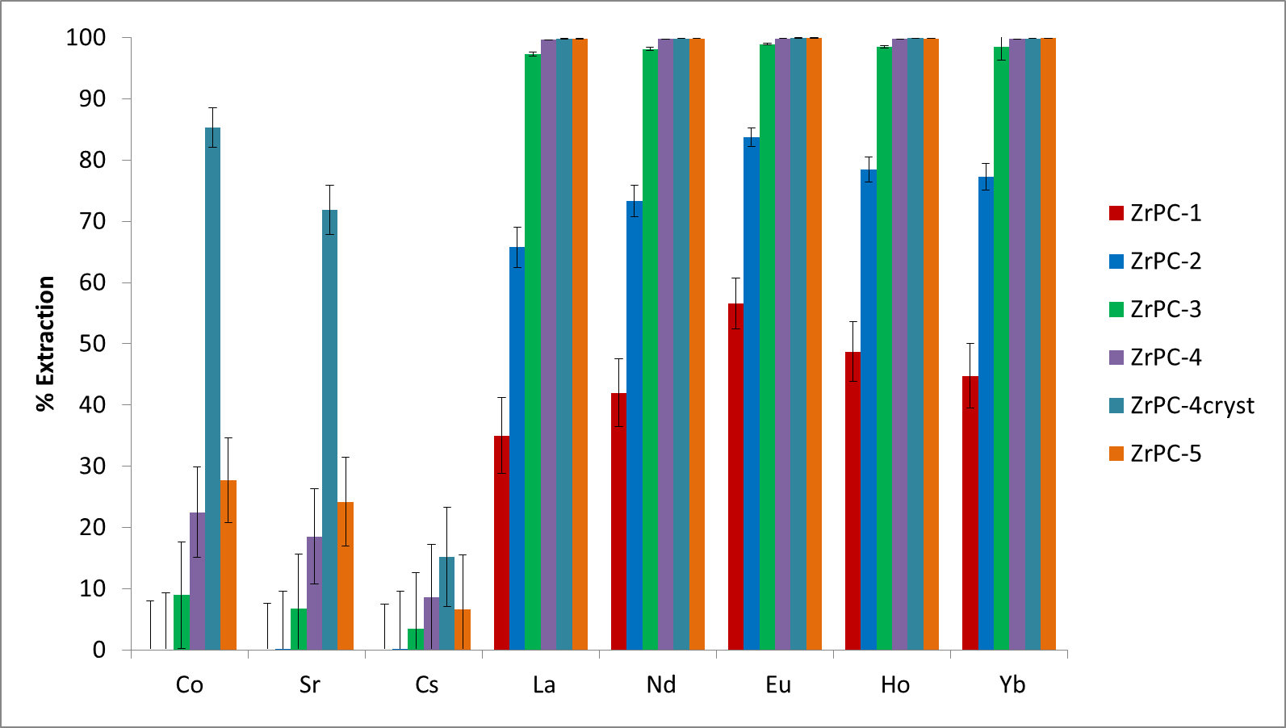
1. ZrP Competitive Sorption
Sorption Conditions:
0.1M HNO₃
0.1mM elements
Competitive
V/m 100
Triplicate
24h
Notes:
Explain experiment
Selectivity for Ln over mono and divalent cations Cs, Sr and Co seen.
Even some intra-Ln selectivity seen
Crystalline version much less selective
Capacities for the samples that showed quantitative Ln adsorption in these competitive binding experiments were done…

Slide 8
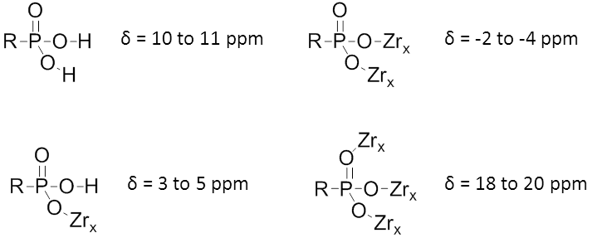
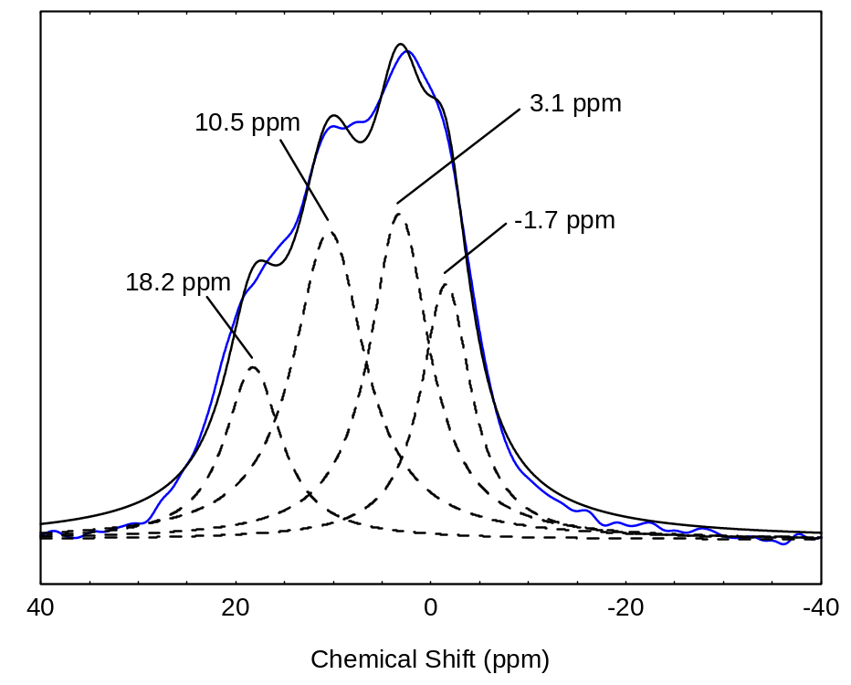
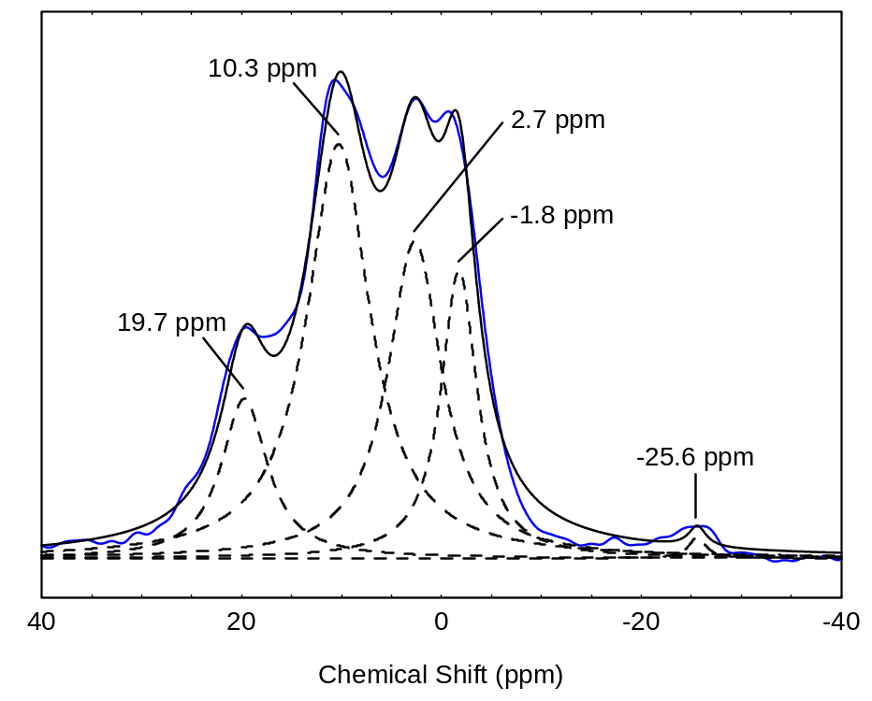
1. ZrP ³¹P MAS-NMR
ZrPC-3 ZrPC-5
Notes:
As increase ATMP decrease PO3Zr3 and PO3HZr but increase PO3H2, so more free phosphonate to bind Ln
Solid state NMR done with UNSW

Slide 9
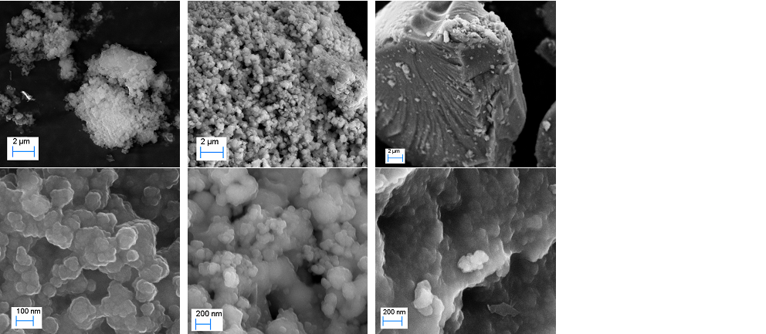
1. ZrP Porosity
500 m²/g
1 m²/g
Increasing ATMP
Notes:
50nm agglomerated particles → solid micron sized particles with possible nanolayers
Porosity also changed/decreased with increasing addition of ATMP from 500 m2/g for ZrP0.5 to 300 m2/g for ZrP0.67 to 25 m2/g for ZrP0.75 and 1m2/g for ZrP0.8.
Image shows ZrPC-67, 75 and 80 (I think).

Slide 10
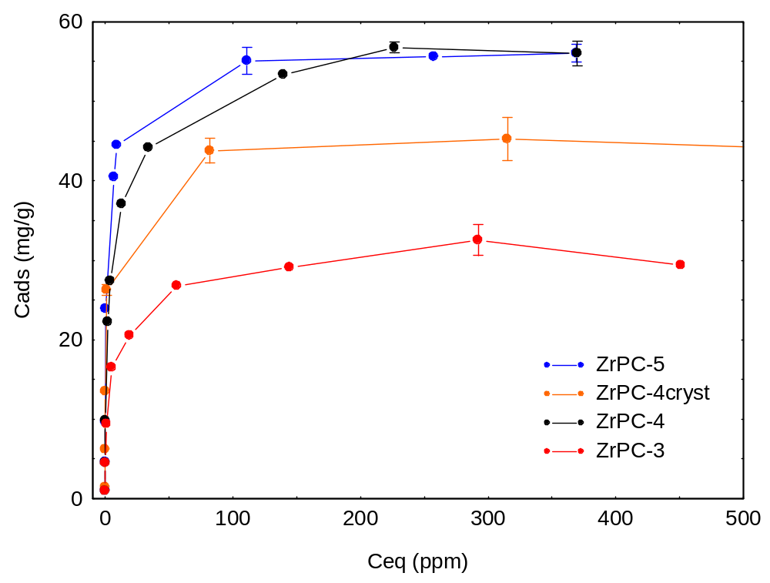
1. ZrP Capacities
Sorption Conditions:
0.1M HNO₃
V/m 100
Triplicate
24h
Capacities:
ZrPC-3: 37 mg/g
ZrPC-4: 82 mg/g
ZrPC-4cryst: 47 mg/g
ZrPC-5: 60 mg/g
Notes:
SA decreased 300 to 25 m2/g between -3 and -4 but Ln capacity increased!
So how can a material with 1m2/g surface area sorb 60 mg/g Eu?
Crystalline material also has lower capacity as well as lower selectivity

Slide 11
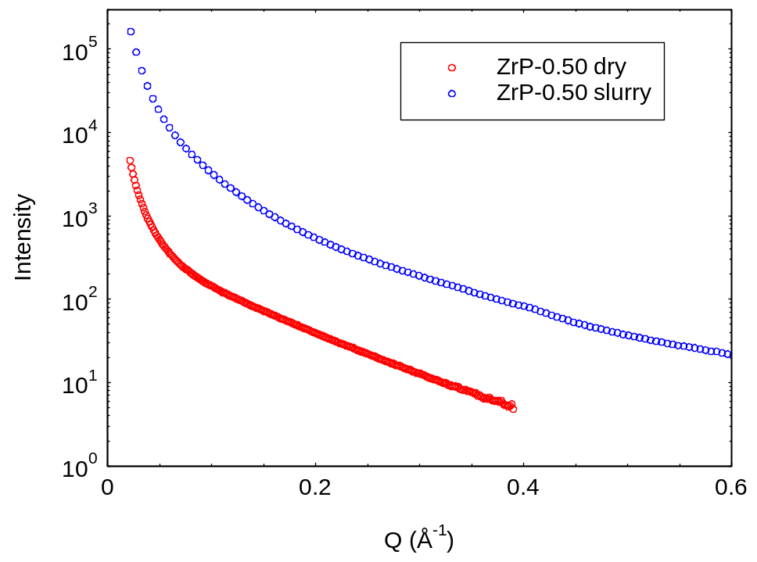
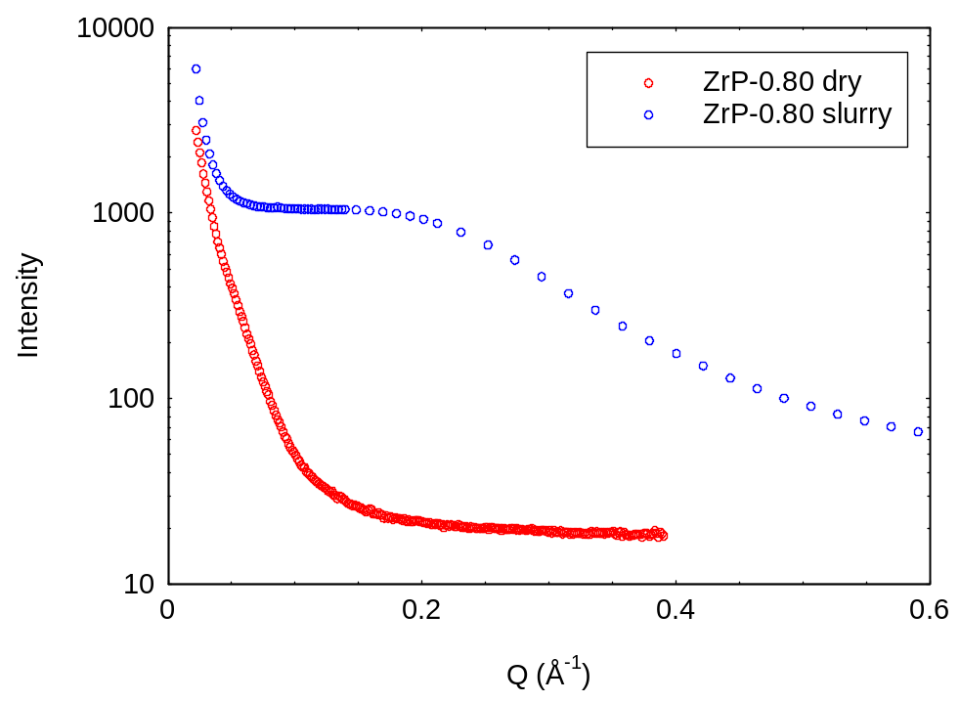
1. ZrP Small Angle X-ray Scattering
ZrPC-1 ZrPC-5
Dry Slurry (wet)
Notes:
Change in structure when wet rather than dry explains the fact that the low surface area materials gave the highest sorption capacities.
BET surface areas measured when dry – not necessarily a good indication of whether a material will be a good, high capacity sorbent.
Explain more about how SAXS works – shape/slope is the same, therefore …

Slide 12
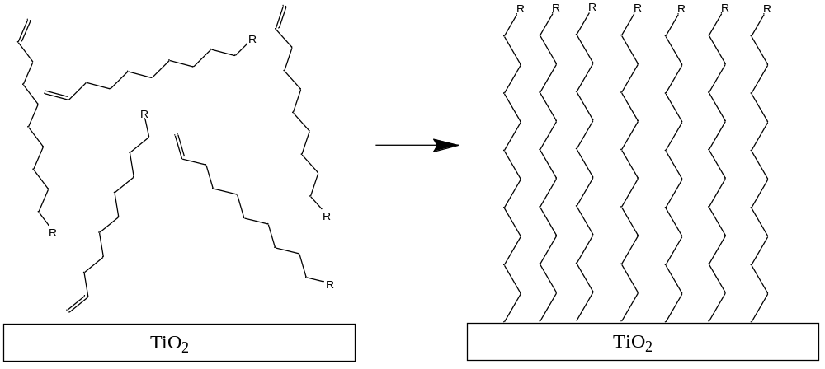
2. Functionalised Titania
Alkyl chains induce self-assembly on titania surface
Heating causes alkene to react with surface to give covalent functionalisation
Veliscek-Carolan et al. (2013) ACS Applied Materials and Interfaces 5, 11984
Notes:
Functionalisation by grafting instead of co-condensation allows greater control over the functional group being introduced and the structure of the framework being functionalised.
Ligand used for func include alkyl chain for self-ass and alkene to form covalent bond with titania surface – wanted covalent bond rather than grafting to surface with a COOH or phosphate group (more commonly used) because it was hoped the covalent bond would be more stable to hydrolysis and radiolysis. Prev covalent bonding to titania done with uv, we showed the same reaction could be achieved just using heat.

Slide 13
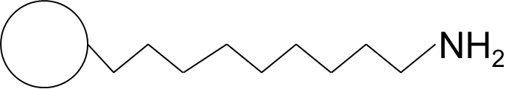
2. Functionalised Titania: Particles
TiO₂-NonFunctionalised
pH | 2 | 3 | 5 | 7
Ce | 0 | 5 ± 9 | 79 ± 4 | ≥ 99.9
Eu | 1 ± 9 | 7 ± 9 | 66 ± 4 | ≥ 99.9
Yb | 0 | 7 ± 9 | 47 ± 5 | ≥ 99.9
Cs | x | 0.2 ± 10 | 1 ± 11 | 1 ± 10
Sr | 2 ± 9 | 5 ± 9 | 15 ± 8 | 20 ± 8
U | 19 ± 8 | 49 ± 5 | ≥ 99.9 | ≥ 99.9
TiO₂-NH₂
pH | 2 | 3 | 5 | 6-7
Ce | 0 | 10 ± 15 | 99 ± 1 | ≥ 99.8
Eu | 0 | 13 ± 18 | ≥ 99.9 | ≥ 99.8
Yb | 0 | 2 ± 9 | 99 ± 2 | ≥ 99.8
Cs | 0 | 0 | 0 | 14 ± 10
Sr | 0 | 0 | 2 ± 9 | 98 ± 1
U | 29 ± 9 | 89 ± 15 | ≥ 99.9 | 99 ± 1
Sorption Conditions:
1 ppm elements
Individual elements
Nitrate media
V/m 200
Triplicate
24h
Notes:
In this case targeting U
U extraction is enhanced, even at low pH where amine should be protonated. Possibly due to anionic U nitrate complexes.

Slide 14
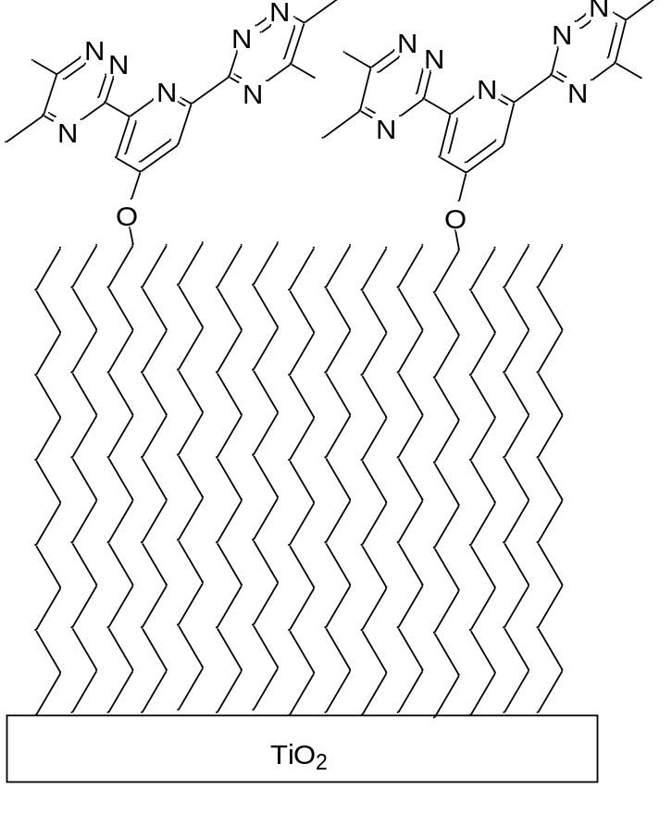
2. Functionalised Titania
Minor Actinide-Lanthanide Separation:
Necessary to transmutate minor actinides
Lanthanides are highly neutron absorbing
Challenging due to chemical similarity
Notes:
So then functionalise with this bistriazinylpyridine (BTP) ligand which has been used in SX for successful MA-Ln sep. Modified with O and alkyl chain as the electron withdrawing O makes the ligand more basic so it has a higher separation factor and alkyl chain to enable functionalisation, as before.
Put alkene ligands between BTP to give them some room to move. Tried different ratios of 1:2, 1:4 and 1:8 but they made no difference to the results so will just show results for 1:8 ratio. (Maybe no diff because ratio that ends up on the surface is the same no matter what is in the functionalisation solution – elemental analysis is not sensitive enough to discriminate because the level of func is quite low.)
Transmutate = neutron capture to convert them into another element
MA contribute largely to the long lifetime of waste so are a particularly important target for separation.

Slide 15
2. BTP Functionalised Titania Particles
Nanoparticles Results
Sorption Conditions:
0.01M HNO₃
10 ppb
V/m 200
Duplicate
24h
Functional group | ± 10 % EtOH | Am (%) | Eu (%)
None | - | 1 ± 2 | 1 ± 3
alkene | - | 1 ± 2 | 1 ± 3
BTP | - | 13 ± 2 | 0 ± 2
 | + | 22 ± 2 | 0 ± 3
Notes:
First did NP for proof of concept.
Am = minor actinides
Eu = lanthanide
pH 1-2 targeted because this is the pH of strip solution from TRUEX/DIAMEX. Results are all at pH 2 because no sorption was seen at pH 1
Yes, BTP functional group gives selectivity
Ethanol appears to improve sorption, initially presumed this was due to improved contact between the solution and the functionalised titania, which would have a hydrophobic surface due to the func.

Slide 16
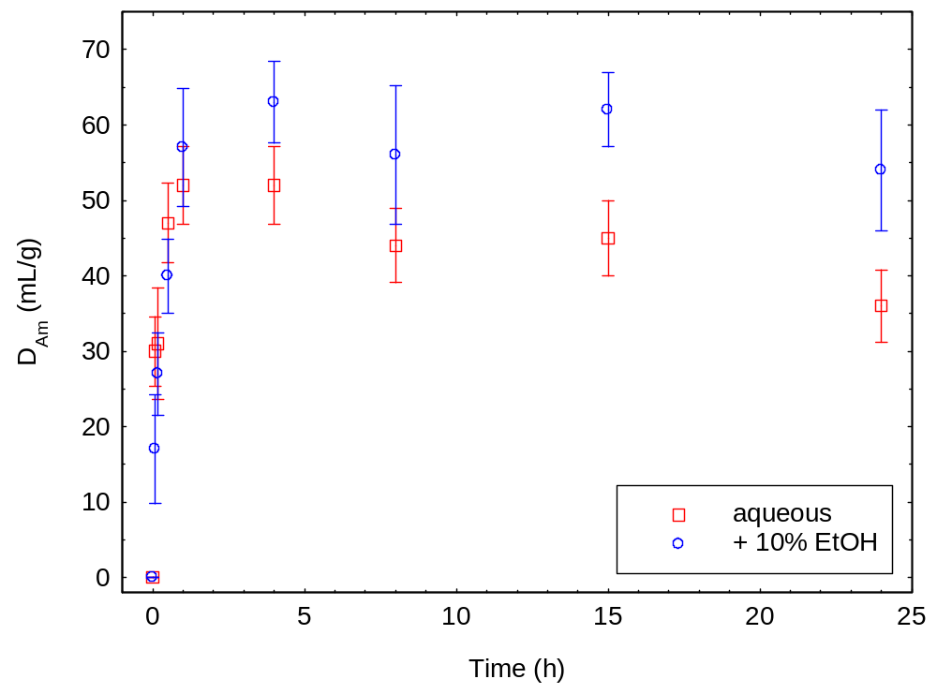
2. BTP Functionalised Titania Particles
Kinetics of BTP functionalised titania nanoparticles
Notes:
BUT kinetics told a different story
With and without EtOH same until 1h, but for longer contact times aqueous solutions showed decreasing Am extraction.
Thus, the improved performance of EtOH solutions may be due to the EtOH providing some protection against radiolysis, rather than improved contact between the sorbent and the solution as first assumed
Explain that radiolytic damage is not a big problem if going to use the material as a trans matrix or wasteform precursor

Slide 17
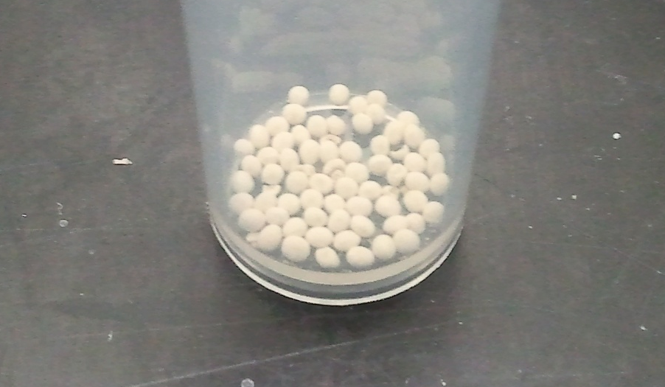
2. Functionalised Titania: Beads
Ideal packing in chromatographic columns
Hierarchical porosity
140 m²/g surface area
1-2 Millimetre diameter
Veliscek-Carolan et al., (2015), Chemical Communications 51, 11726
Notes:
Have made ordered mesopores as a powder but this is not so useful for a column
No clogging and ease of handling for column packing of beads

Slide 18

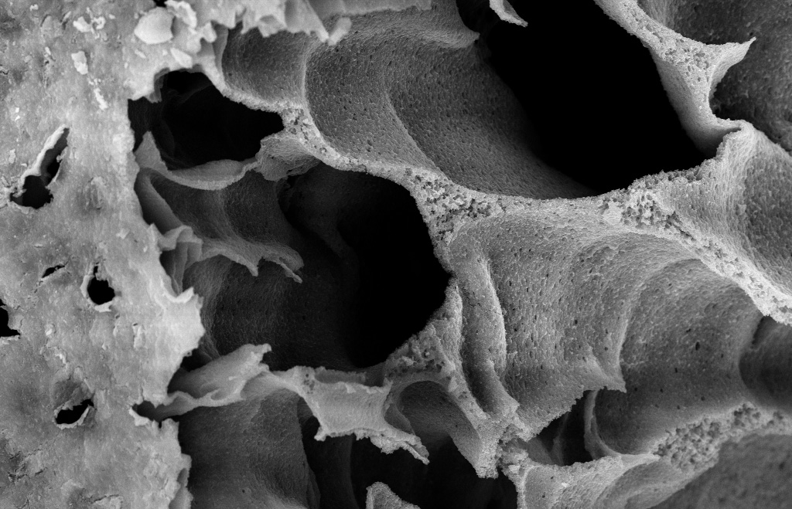
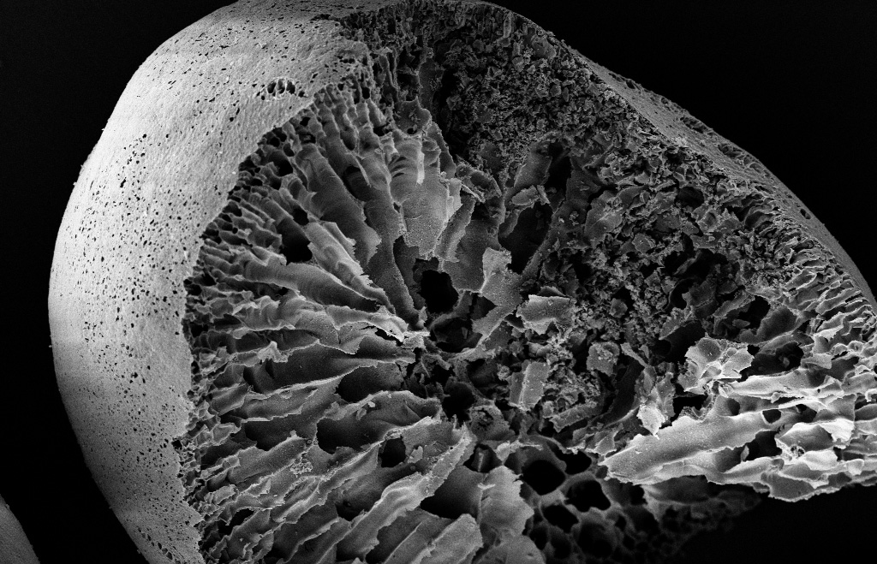
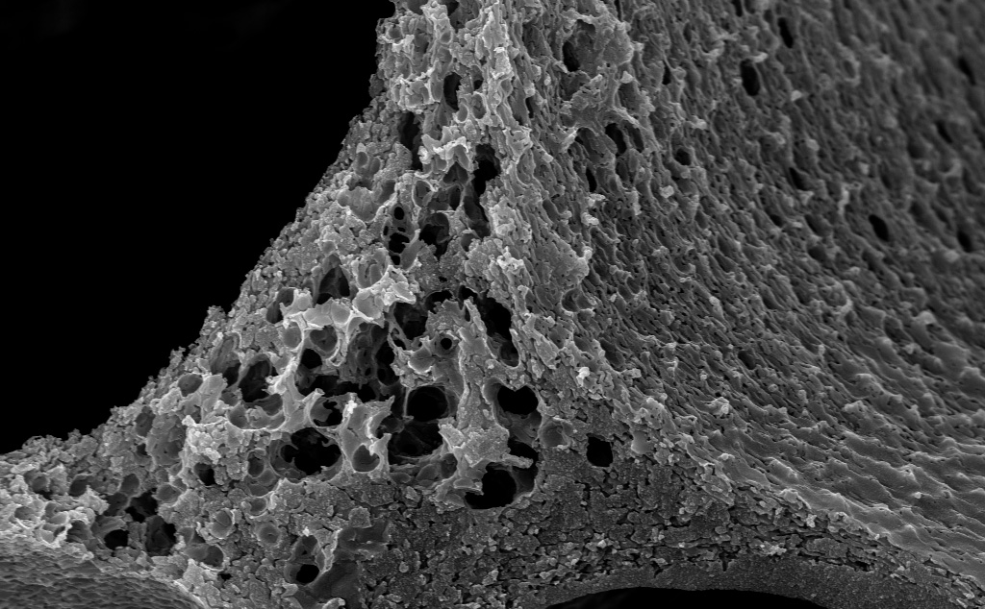
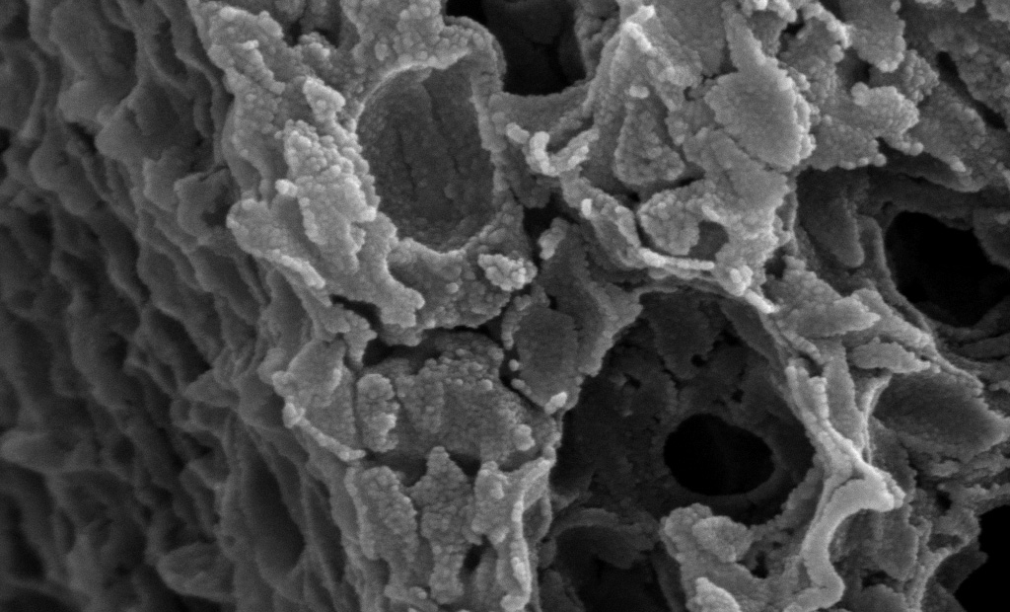
2. Functionalised Titania: Beads
100 nm
100 µm
5 µm
1 µm
Notes:
In this case the framework material used not only had ordered mesopores but also had macropores and was in the shape of a bead. Macropores and ordered mesopores should improve kinetics/mass transport properties.

Slide 19
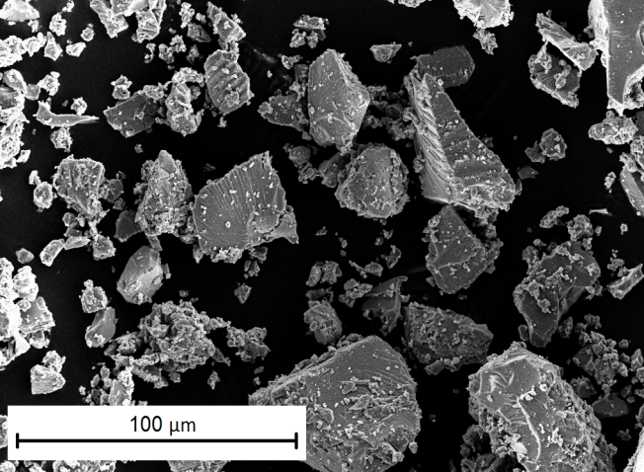
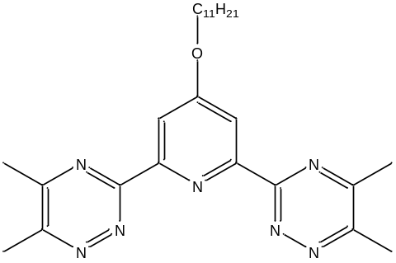

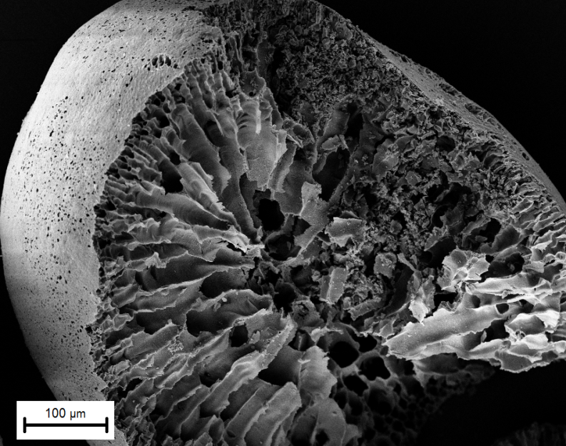
2. Functionalised Titania Beads
Particles
22 ± 2 % Am
0 ± 3 % Eu
2 hours
Porous Bead
44 ± 2 % Am
1 ± 2 % Eu
30 mins
Notes:
Comparison of NP with beads under the same conditions
Beads show higher extraction , same selectivity and faster kinetics, so it is worthwhile making the more complex framework material.

Slide 20
Conclusions
Zirconium organophosphonates
  High capacity, fast kinetics, selective lanthanide sorbents
  Change in porosity when wet
Functionalised titania nanoparticles and beads
  Functional group controls selectivity
  More complex frameworks can provide improved performance
Future work
  Effects of drying and conversion to ceramics of zirconium organophosphonates
  Increase capacity of functionalised titania
  Radiolytic stability
Notes:
Functional group chosen can be tailored to target whatever element you are interested in selectively separating (I have focussed on Ln and An today).
Beads give better capacity and kinetics than nanoparticles

Slide 21
Acknowledgements
Tracey Hanley, ANSTO
Kate Jolliffe, University of Sydney
Victor Luca, CNEA Argentina
Aditya Rawal, University of New South Wales
Other ANSTO colleagues:
Robert Knott (SAXS)
Joel Davis (SEM)
Rob Aughterson (TEM)
Gordon Thorogood (XRD)
Inna Karatchevtseva (BET)
Notes:
All other colleagues (not supervisors) at ANSTO. Audience for listening.

Slide 22
Notes:
Use ANSTO picture (OPAL). Watermark ? On top

