Slide 1
Synthesis and Structure of Novel Oxide Compounds Containing RE = Y, Yb, Gd, Sm, and La and M = Zr, Ti, and Sn
R. Newman,¹ R.D., Aughterson,² G.R. Lumpkin³*
¹Imperial College, London, UK; ²Nuclear Materials Development and Characterisation, ANSTO-NSTLI; ³Nuclear Fuel Cycle Research, ANSTO-NSTLI

Slide 2
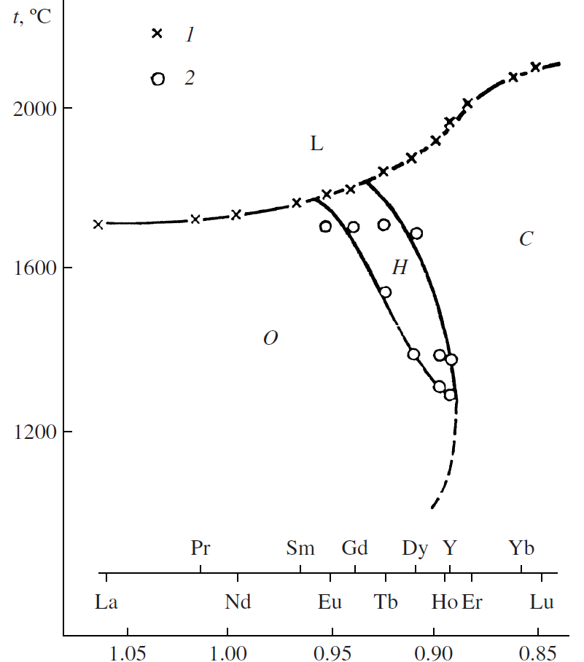
Introduction
Developmental work following earlier period of research by Russian workers, e.g., Shepelev and Petrova (2008)
Lau et al. (2007, 2008) and Whittle et al. (2011) studied structure of Ho₂TiO₅ and Y₂TiO₅ in some detail (radiation effects from Whittle et al.)
Aughterson et al. (2014-2017) focussed on synthesis, structure, radiation effects, and some properties for the RE₂TiO₅ series and certain solid-solutions
Tracy et al. (2012), Zhang et al. (2013), swift heavy ions, tracks, etc.
Our interest is mainly in finding new candidate materials for IMFs and waste forms, with REE flexibility and radiation tolerance
Possible phase relations in the RE₂TiO₅ system after Shepelev and Petrova (2008). O = orthorhombic, H = hexagonal, and C = cubic structures

Slide 3
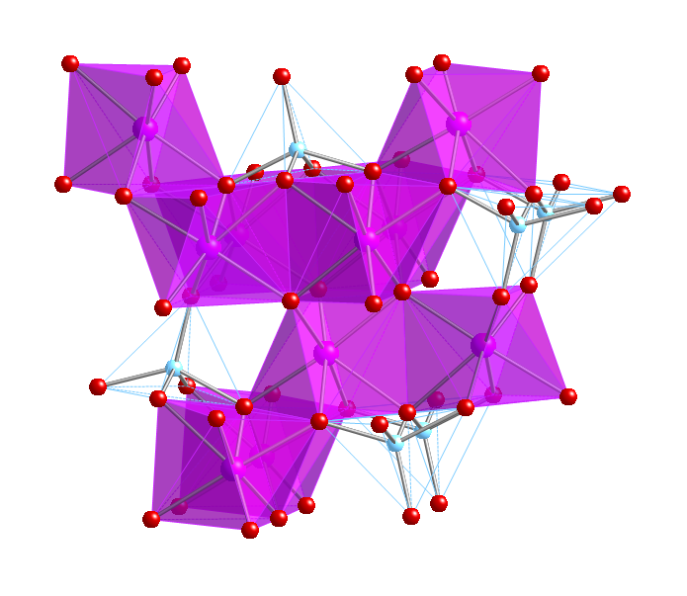
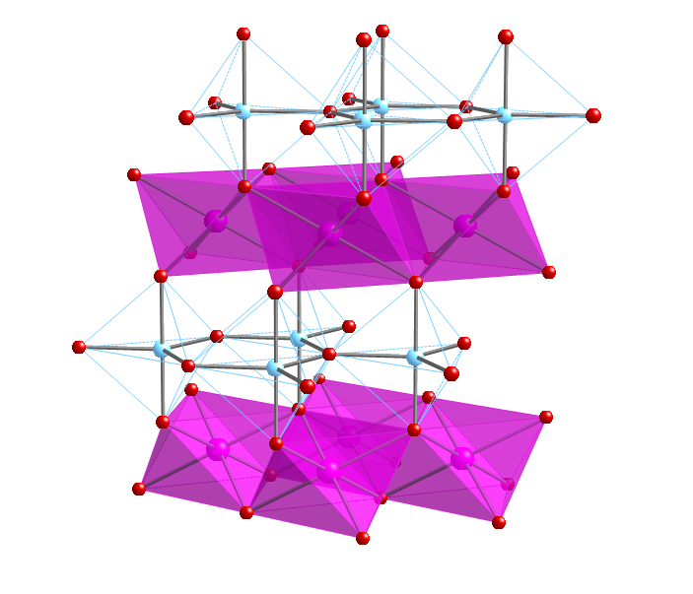
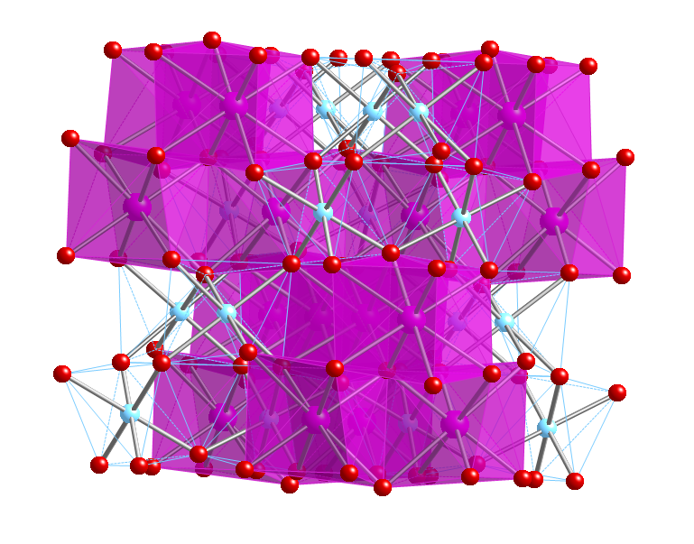
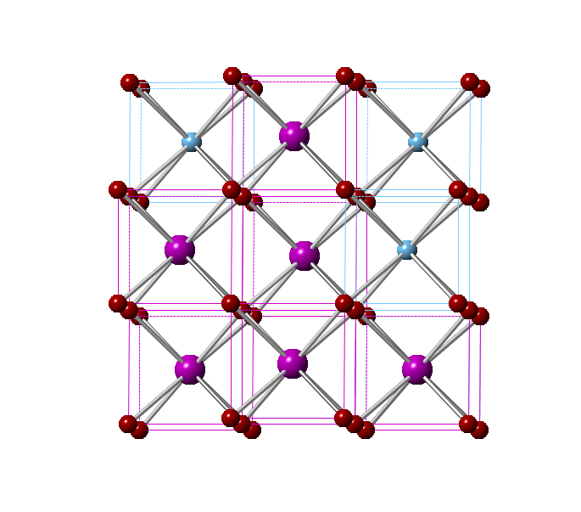
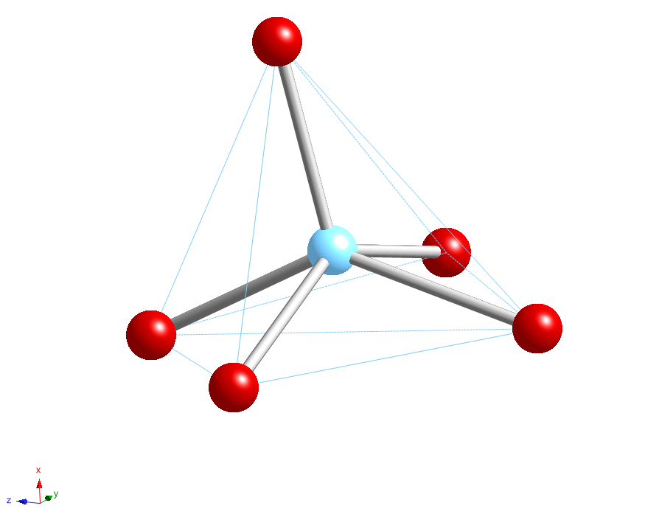
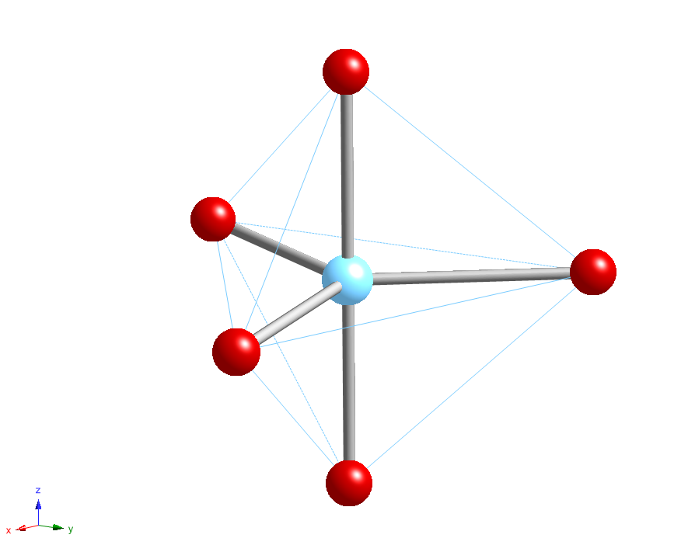
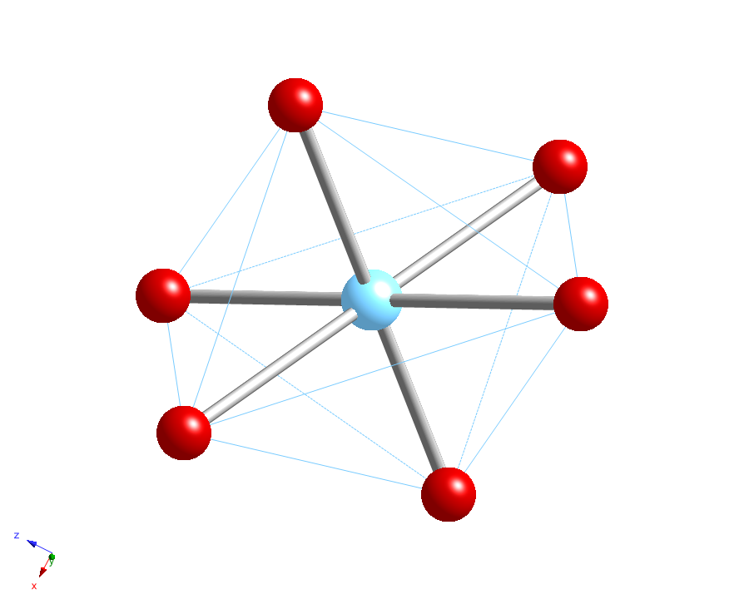
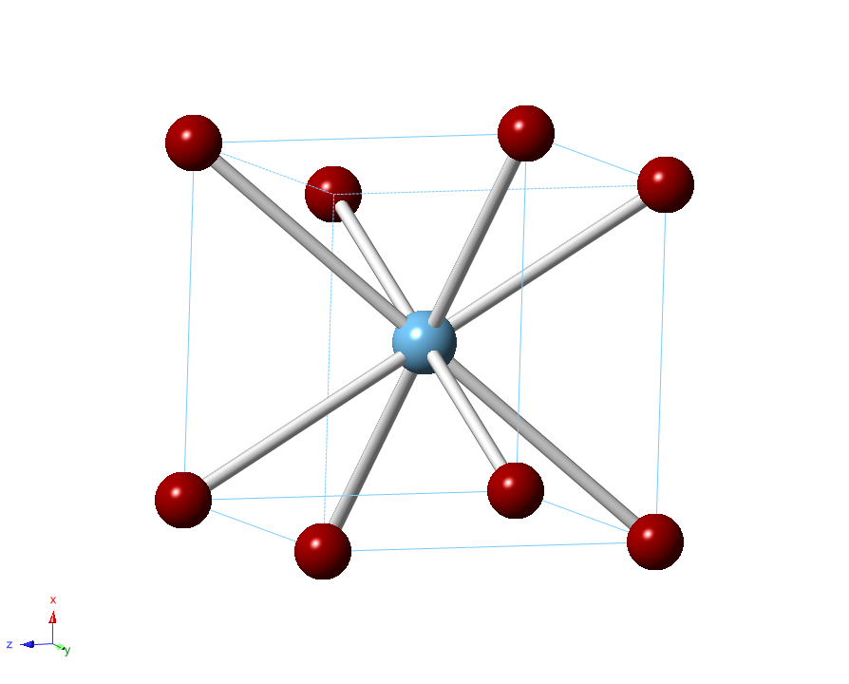
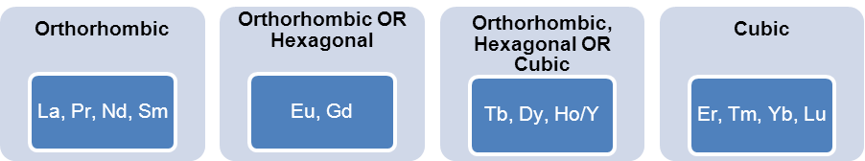
Summary of Structure Types
Aughterson et al. (2014) J. Solid State Chem. 213, 182-192; Aughterson et al. (2015) J. Solid State Chem. 227, 60-67

Slide 4
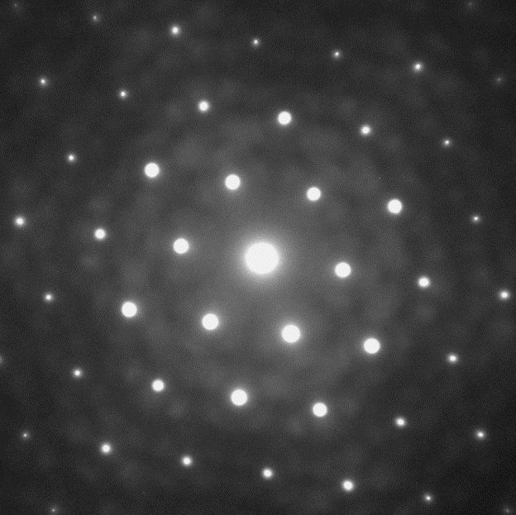
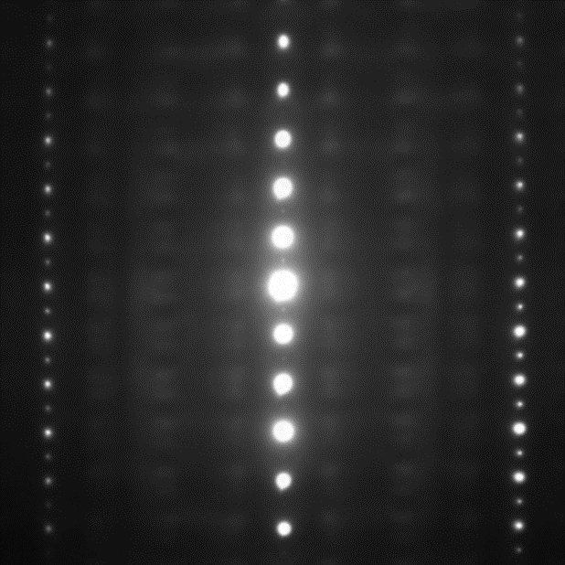
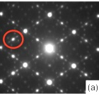
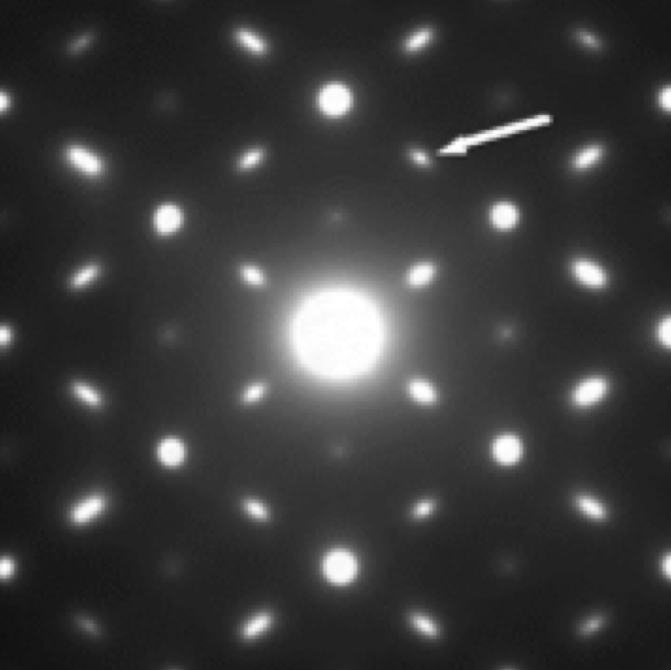
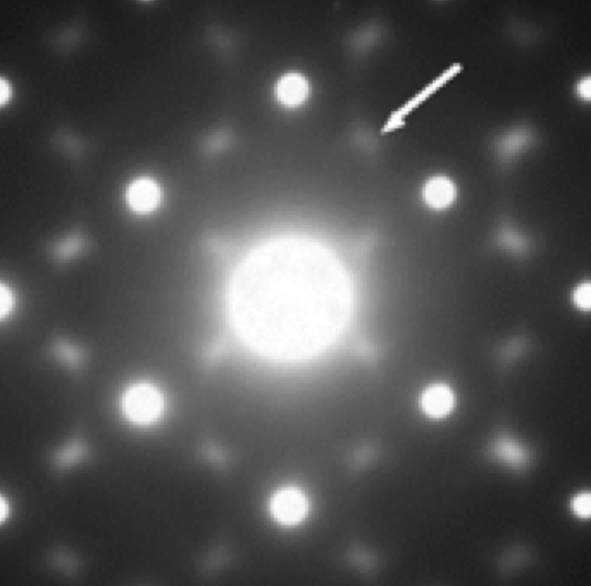
Order-Disorder Observed by TEM
[001]
[-120]
Hexagonal Sm_{1.6}Yb_{0.4}TiO₅
Trigonal bipyramid: 60% Ti, 20% Ln, and 20% vacancies
Disorder (dynamic?)
Cubic Phases
From Y/Ho to Yb
Cation/anion disorder
Modulated structure
3{111}* & 7{662}* G_{F} ± ½{111}* More diffuse
Aughterson et al. (2014) J. Solid State Chem. 213, 182-192

Slide 5
Synthesis of Materials
Bulk polycrystalline samples were synthesized in the conventional oxide route
Milled with 12 mm ZrO₂ balls using organic solvents
Pellets were consolidated by 20 MPa uniaxial pressing followed by cold isostatic pressing at 250 MPa
Calcined and then sintered at 1500 °C for 48 hours
Gd₂TiO₅
Yb₂SnO₅
Yb₂O₃

Slide 6
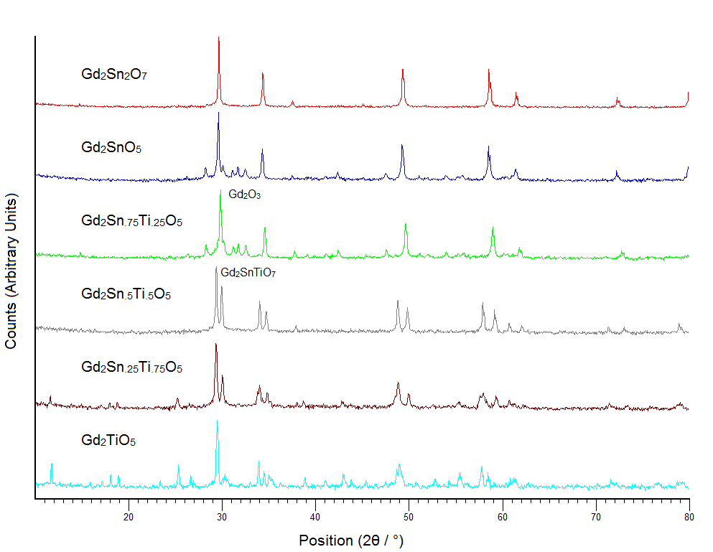
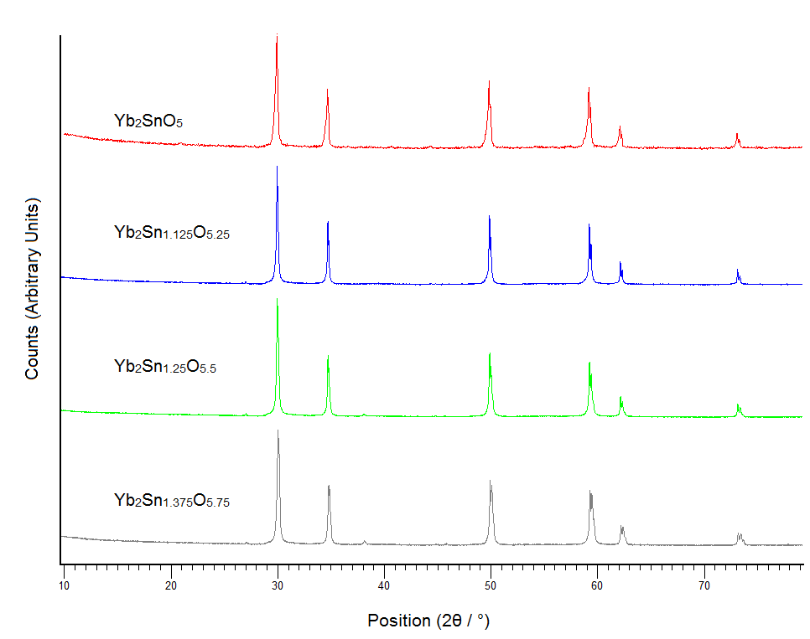
XRD Results
Target pyrochlore Gd₂Sn₂O₇ ✓
Target (unknown) Gd₂SnO₅ ✗
Target (unknown) Gd₂(Sn_{x}Ti_{1-x})O₅ ✗
Target orthorhombic Gd₂TiO₅ ✓
Target defect fluorite Sm₂ZrO₅ ✓
Target (unknown) Yb₂Sn_{1+x}O_{5+2x}
Defect flourite Yb₂SnO₅ ✗
Defect flourite Yb₂Sn_{1.125}O_{5.25} ✓
Defect flourite Yb₂Sn_{1.25}O_{5.5} ✓
Defect flourite Yb₂Sn_{1.375}O_{5.75} ✓

Slide 7
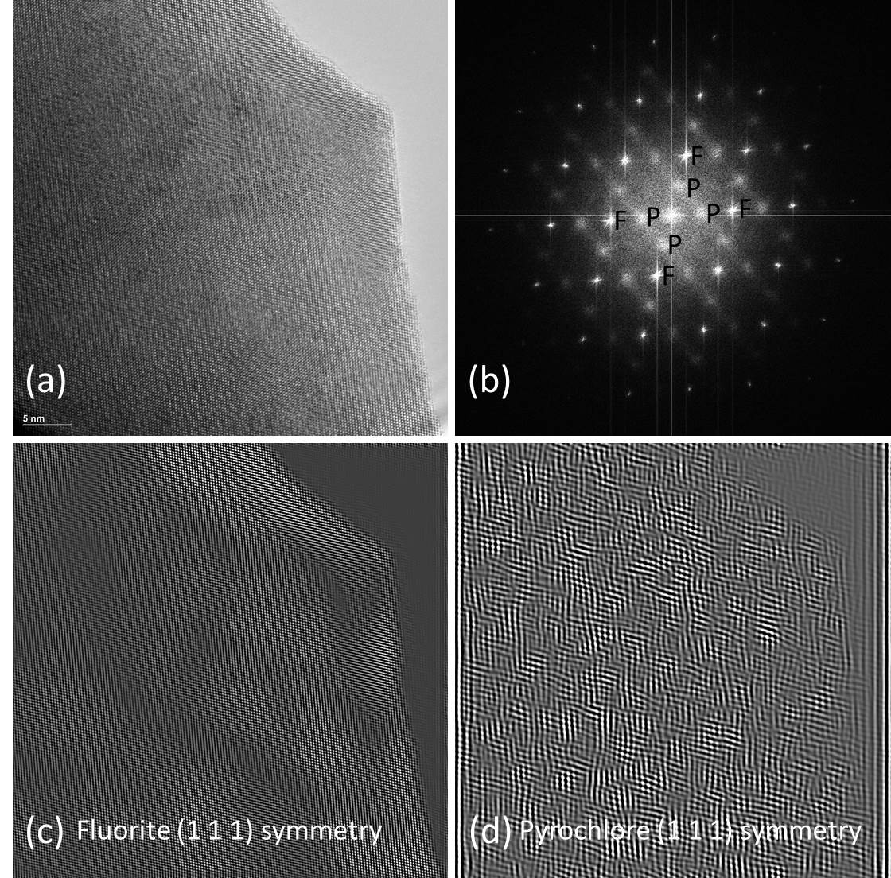
TEM Analysis - Nanostructure
HRTEM image of Sm₂ZrO₅ taken with the JEOL 2200 fs in NMDC at ANSTO
FFT obtained from (a) showing a [110] type zone axis orientation
Inverse FFT obtained from a fluorite (F) subcell diffracted beam in (b).
Inverse FFT obtained from a pyrochlore (P) type modulated beam in (b), showing a “domain” structure on the scale of 2-5 nm.

Slide 8
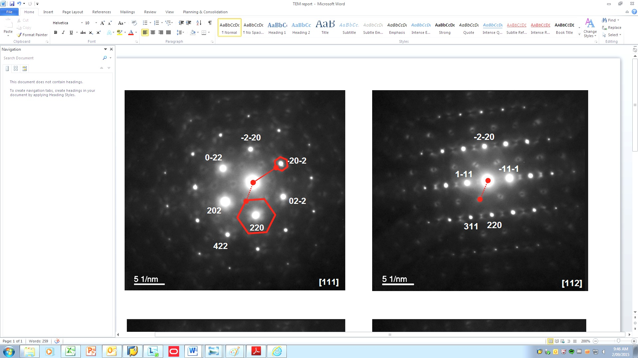


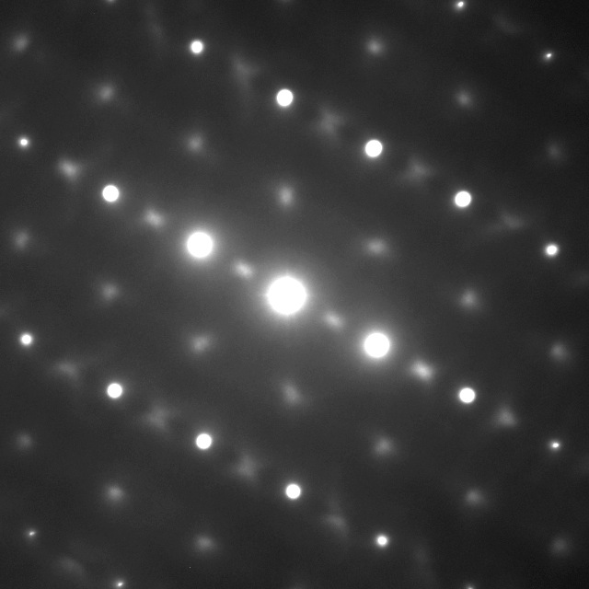

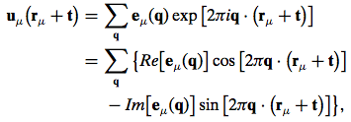
Electron Diffraction
[111] Zone Defect flourite Yb₂Sn_{1.125}O_{5.25} [131] Zone
[111]
[110]
[131]
Withers (2015) IUCrJ 2, 74-84.
Defect flourite Yb₂TO₅

Slide 9
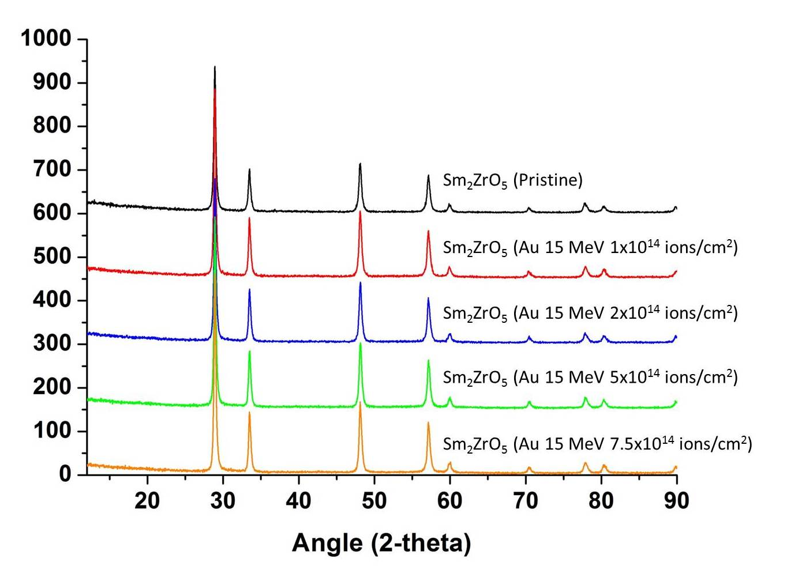
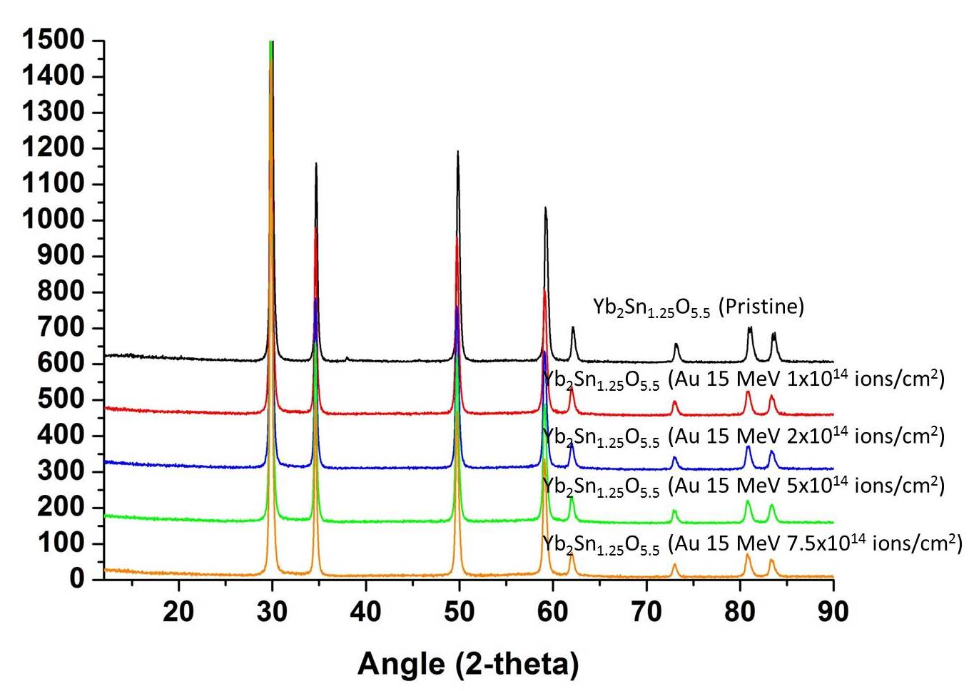
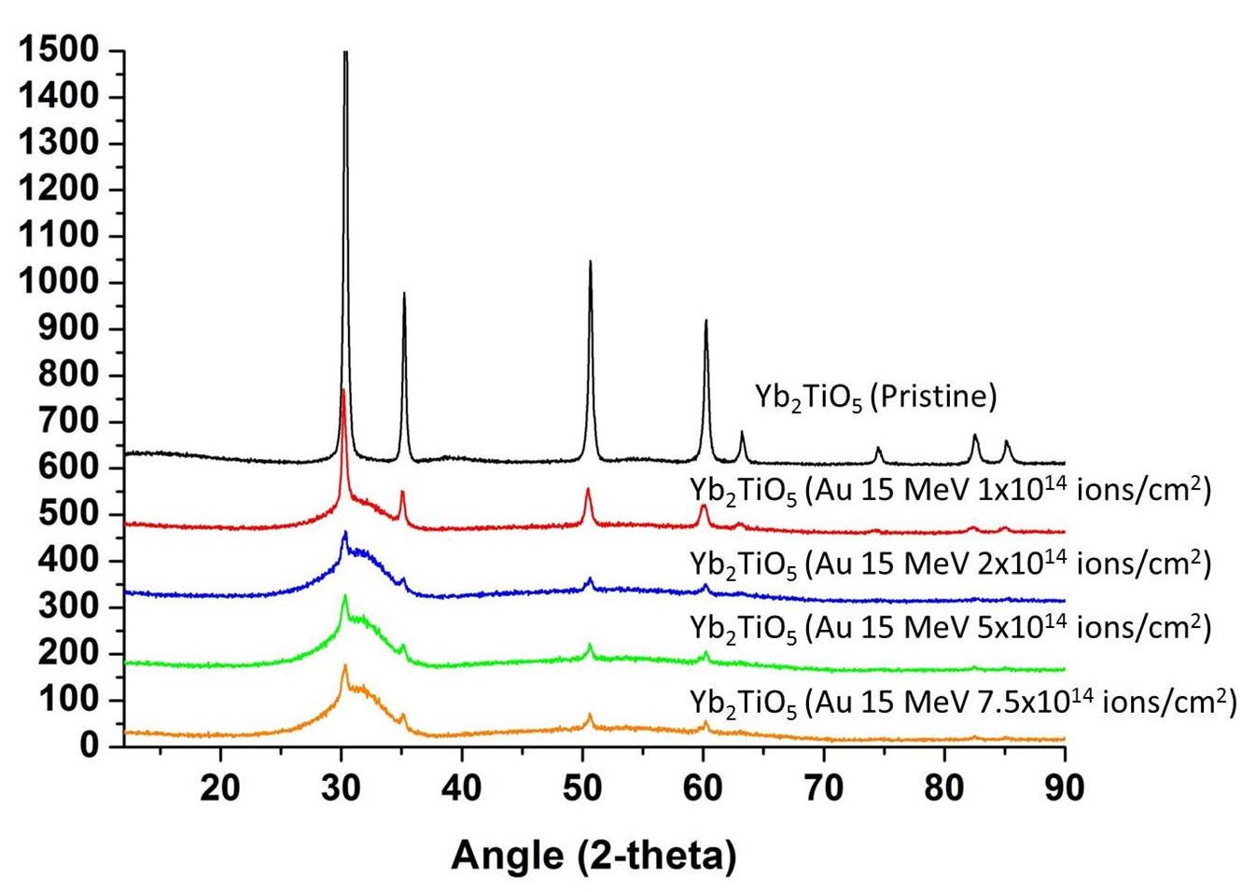
Radiation Damage Effects
Pellets irradiated at CAS at ANSTO using ANTARES
15 MeV Au ions @ fluences of 1, 2, 5, and 7.5 × 10¹⁴ ions cm⁻²
Previous unpublished work from the IVEM-Tandem at ANL (1 MeV Kr)
GIXRD conducted at NMDC at ANSTO with incident angles of 3 and 5°
Sm₂ZrO₅
Yb₂Sn_{1.25}O_{5.5}
Yb₂TiO₅
Remains crystalline to
7.5 × 10¹⁴ ions cm⁻²
IVEM, no amorphization at 50 K
Remains crystalline to
7.5 × 10¹⁴ ions cm⁻²
No IVEM data are available
Possibly amorphous*
2 × 10¹⁴ ions cm⁻²
IVEM, T_{c} = 479 K

Slide 10
Summary & Conclusions
We conducted an exploratory study of RE₂M_{1+x}O_{5+2x} compounds with RE = La, Gd, Sm, and Yb and M = Ti, Zr, and Sn with partial success
New single phase samples were obtained for Sm₂ZrO₅ and Yb₂Sn_{1+x}O_{5+2x} compositions, basic structures determined by XRD, and complex scattering effects studied by TEM
Initial ion irradiations indicate that Sm₂ZrO₅ and Yb₂Sn_{1.25}O_{5.5} (and possibly other Yb₂Sn_{1+x}O_{5+2x} compositions) are radiation tolerant, unlike Yb₂TiO₅ and other cubic, defect fluorite type Re₂TiO₅ compounds
Thanks to Mihail Ionescu for arranging the ion irradiations in the CAS at ANSTO. We acknowledge Pete Baldo and Ed Ryan for assistance on the IVEM-Tandem at ANL.

