Slide 1
Ambient-Cured Geopolymers for Nuclear Waste Storage
Isadora de Borba Busch
Supphatuch Ukritnukun, Pramod Koshy, Charles C. Sorrell
School of Materials Science and Engineering, UNSW Sydney
Daniel Gregg, Eric Lou Vance, Gerry Triani
ANSTO

Slide 2
Outline
Introduction and Background
  Nuclear Waste Categories
  Geopolymers
  Current Technologies
Experimental Plan
Results and Discussion
Conclusions and Future Work
2

Slide 3
Introduction & Background

Slide 4
Nuclear Waste Categories - 1
  Geopolymers is the potential candidate for ILW storage
  OPC is currently being used for LLW storage
Schematic of super-compaction process for LLW/ILW immobilisation
4
Image reference: IAEA, Classification of Radioactive Waste
Notes:
Co2 emission from cement production incurred through the consumption of fossil fuel, use of electricity and chemical decomposition of lime stone during clinkerisation

Slide 5
Nuclear Waste Categories - 2
Ordinary Portland cement (OPC):
Calcium Silicate Hydrate (C-S-H)
2(3CaO•SiO₂) + 6H₂O 3CaO•2SiO₂•3H₂O + 3Ca(OH)₂
C-S-H is contributed for compressive strength
IRRADIATION → WATER DISSOCIATION → H₂
Geopolymers :
M_{n} (– (SiO₂)_{z} – AlO₂)_{n}, wH₂O
Lower water content than OPC
Na₂O – Al₂O₃ – SiO₂ – H₂O : N-A-S-H
2 types of water:
Bound and Unbound
CaO – Al₂O₃ – SiO₂ – H₂O : C-A-S-H
Can be dehydrated without losing its properties
Na₂O – CaO – Al₂O₃ – SiO₂ – H₂O : N-(C)-A-S-H
5
Source: Development of Geopolymers for Nuclear Waste Immobilisation - ANSTO
Notes:
Co2 emission from cement production incurred through the consumption of fossil fuel, use of electricity and chemical decomposition of lime stone during clinkerisation

Slide 6
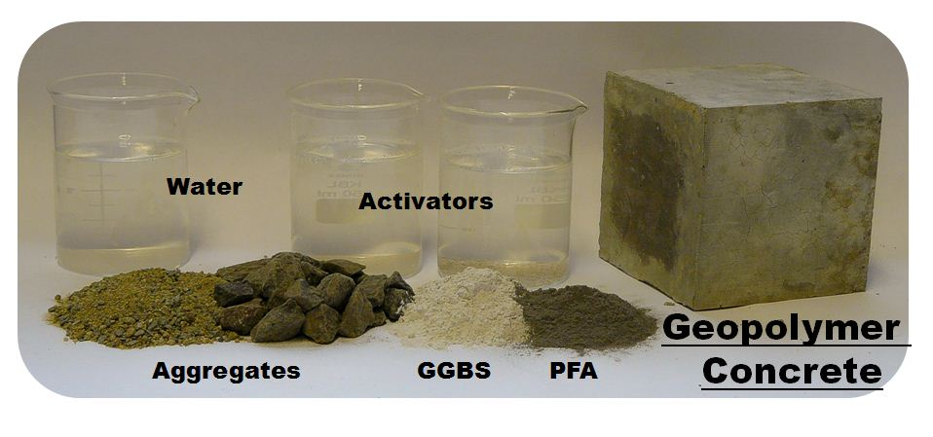
Geopolymers – General
Utilisation of industrial by-product
40-90% reduction in CO₂ emission
Improved compressive and tensile strength
Improved resistance to fire and aggressive acids
Aluminosilicate Materials (FA, GGBFS, MK)
+
Alkaline Activators (NaOH, Na₂SiO₃)
+
Aggregates
+
H₂O
Curing at 25°C or (40° – 80°C)
H₂O
Alkaline
Activators
Geopolymer
Mortar
Aggregates
GGBFS
FA
6
Image source accessed on 27/10/2017: https://theconstructor.org/concrete/geopolymer-concrete-ecofriendly-construction-material/9430/

Slide 7
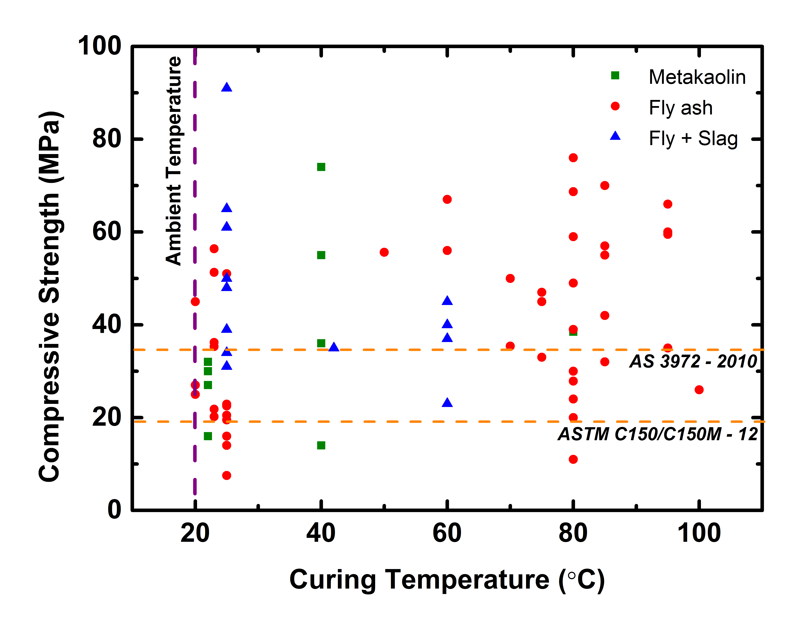
Geopolymers – Current Technologies
UNSW – Mix Design
Increase applicability for industry (cured at 25°C)
Reproducible mix design
High compressive strength
Appropriate setting time
Appropriate workability
Compilation of >20 studies (Na-based system)
Majority of the work utilised high temperature curing in order to achieve > 35 MPa
Fly ash and metakaolin based geopolymer generally requires high temperature curing
7

Slide 8
UNSW – ANSTO Joint Project
Experimental Plan

Slide 9
Experimental Plan
9

Slide 10
Experimental Plan
Materials | ID | Binder | Alkaline Activator | Aggregates | Curing Condition (Temp / Time)
UNSW – Paste | UNSW – GP | FA + GGBFS | NaOH + Na₂SiO₃ | - | 25°C / 50d
UNSW – Mortar | UNSW – GM | FA + GGBFS | NaOH + Na₂SiO₃ | Fine | 25°C / 28d
ANSTO – Paste | ANSTO – GP | MK | Not Provided | - | 60°C / 48h
Rocla – Concrete | Rocla – GC | FA + GGBFS | NaOH + Na₂SiO₃ | Fine + Coarse | 80°C / N/A

Slide 11
Results &
Discussion

Slide 12
XRF - Chemical Analysis
Oxide | UNSW – GP (wt%) | UNSW – GM (wt%) | ANSTO – GP (wt%) | Rocla – GC (wt%)
SiO₂ | 42.72 | 65.04 | 47.49 | 69.80
Al₂O₃ | 12.91 | 6.94 | 18.79 | 12.10
CaO | 11.16 | 7.16 | 0.02 | 4.90
Fe₂O₃ | 0.00 | 0.76 | 0.32 | 2.80
Na₂O | 6.46 | 3.13 | 12.67 | 5.70
K₂O | 0.97 | 0.64 | 0.14 | 2.60
MgO | 1.67 | 0.93 | 0.03 | 0.70
TiO₂ | 0.55 | 0.32 | 0.34 | 0.60
P₂O₅ | 0.05 | 0.03 | 0.00 | 0.00
SO₃ | 0.33 | 0.17 | 0.00 | 0.40
Mn₃O₄ | 1.22 | 0.09 | 0.00 | 0.10
SrO | 0.04 | 0.03 | 0.00 | 0.00
ZrO₂ | 0.03 | 0.04 | 0.00 | 0.00
LOI | 22.26 | 14.31 | 20.20 | 0.30
Molar Si/Al | 2.84 | 7.71 | 2.14 | 4.90
Molar Na/Al | 0.83 | 0.72 | 1.11 | 0.77
13

Slide 13
Compressive Strength
Ambient Curing
AS 3972 - 2010
28 days (minimum)
14

Slide 14
Mineralogy
Sand
-Ca
+Ca
Geopolymer
network
15

Slide 15
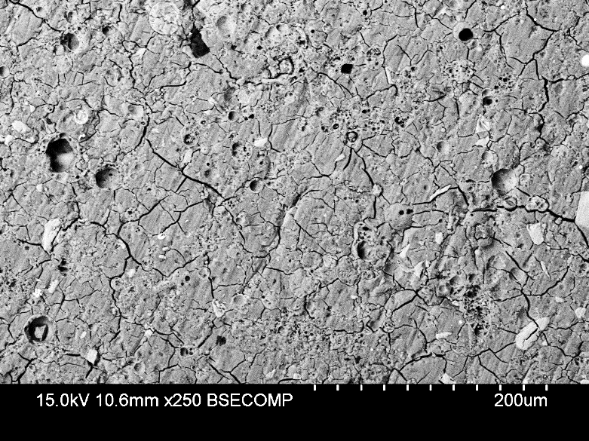
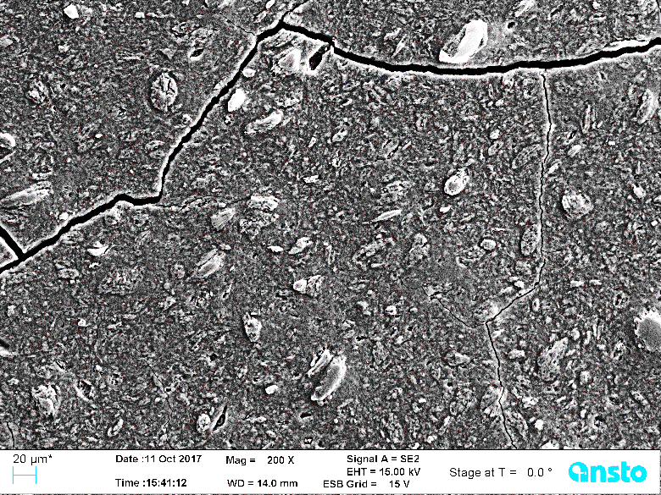
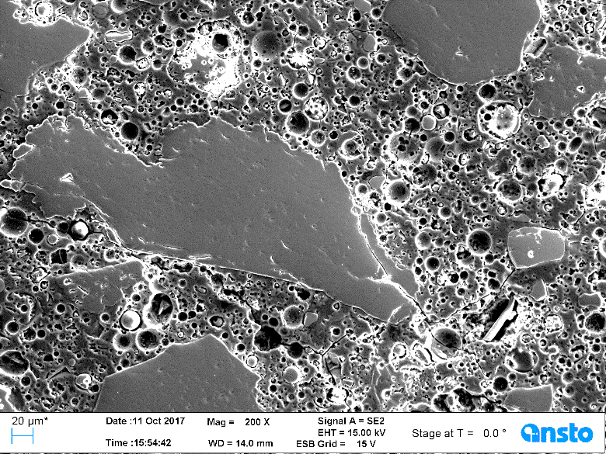
Microstructural Analysis
N-(C)-A-S-H
N-(C)-A-S-H
Unreacted
Slag
Sand
Unreacted
FA
UNSW - GP
N-(C)-A-S-H
UNSW – GM
N-A-S-H
Rock
Sand
ANSTO – GP
Rocla – GC
16

Slide 16
Leaching Test
Preliminary data – ANS test
 | OPC | UNSW - GP | UNSW - GM | ANSTO - MK
Na | ~8-9 | 8.6 | 8.7 | 7.7
Al | - | 12.4 | 13.1 | 13.8
OPC PCT has values for Na of > 30 g/L (ie >30 % loss).
ANSTO – MK has PCT values of ~20g/L (ie 20% loss to the leach solution).
UNSW PTC results were not available in time for this presentation.
17

Slide 17
Conclusions &
Future Work

Slide 18
Conclusions
New high-strength geopolymers that were cured in ambient temperature have been developed.
UNSW mix design showed better properties than OPC.
Sample irradiated for 15 days did not show any visible damage.
Ambient-cured geopolymers are a potentially interesting OPC substitute for LLW/ILW storage.
Future Work
Retrieve the samples after 1, 3, 6, and 12 months of irradiation.
Analyze the extent of deterioration after irradiation.
Evaluate the potential of using ambient-cured geopolymers for ILW storage.
19

Slide 19
Thank you!

