Slide 1
Synthesis and Characterisation of
Glass-Ln₂Ti₂O₇ Pyrochlore
Linggen Kong, Yingjie Zhang, Inna Karatchevtseva
ANSTO
MRS2017 Sydney

Slide 2
Aim of this work
Develop a method to produce glass-Ln₂Ti₂O₇ pyrochlore
Investigate the processing conditions

Slide 3
Reaction scheme flow chart
Glass powder: Na₂AlBSi₆O₁₆ heated at 550ºC

Slide 4
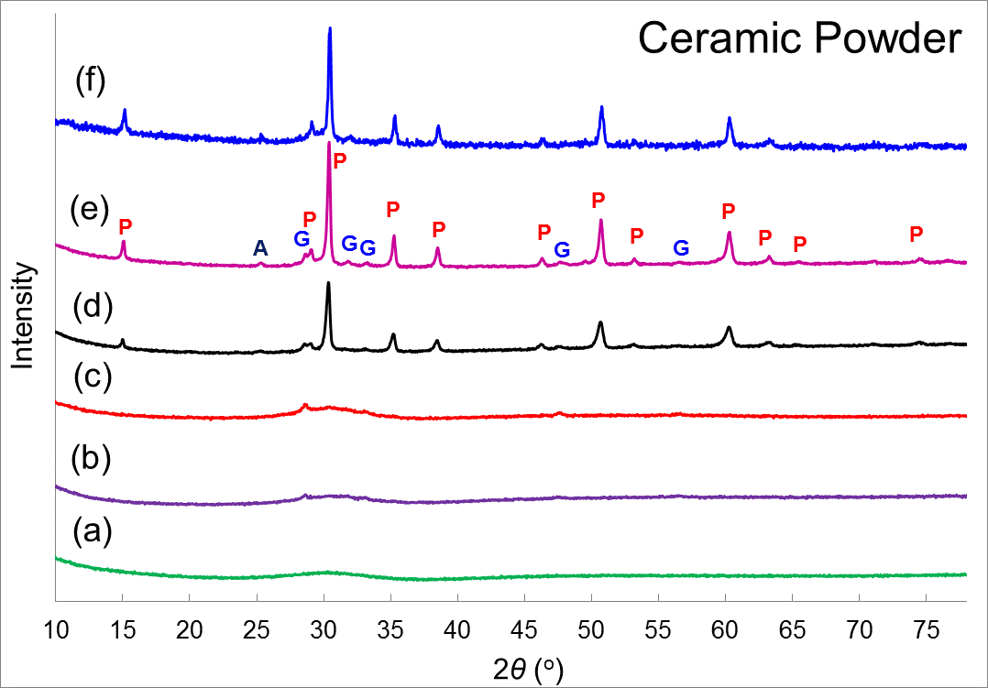
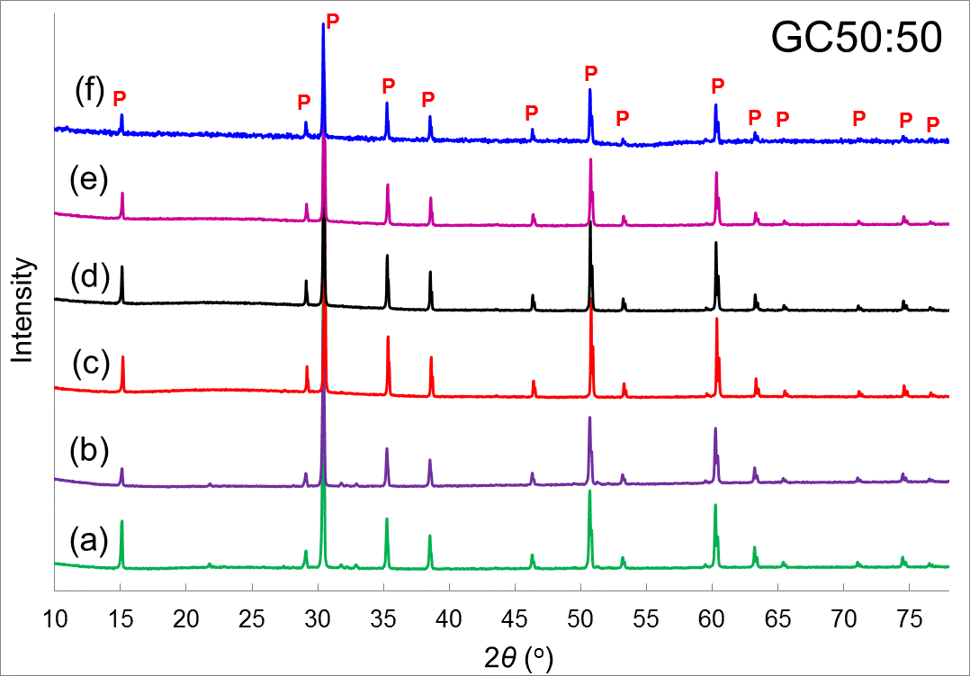
Confirmation of pyrochlore internal crystallization
(GdTi)-complex powders calcined for 4 h at (a) 450◦C,(b) 550◦C, (c) 650◦C, (d) 700◦C, (e) 750◦C, (f) 800◦C
GC50:50 pellets sintered at 1200◦C for 6 h using the mixture of corresponding powders and the glass precursor powder.
A: anatase TiO₂, G: Gd₂O₃,
P: Gd₂Ti₂O₇ pyrochlore

Slide 5
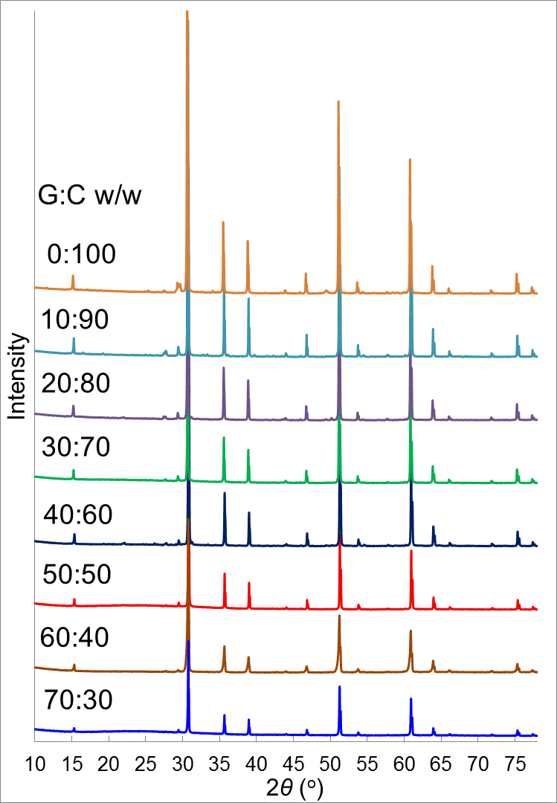
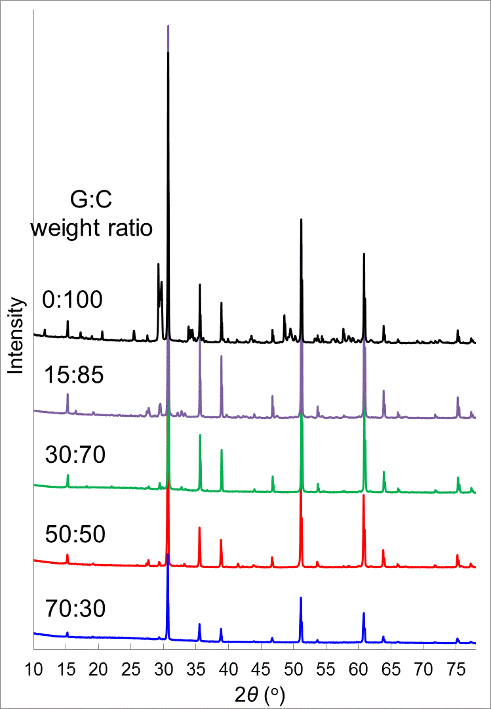
GC weight ratio effect (glass-Y₂Ti₂O₇)
1200◦C
6 h
1200◦C
6 h
This method
Using oxides

Slide 6
SEM glass-Y₂Ti₂O₇
(a) 50:50 (b) 40:60 (c) 30:70 (d) 20:80 (e) 10:90
(f) 0:100
1200◦C, 6 h

Slide 7
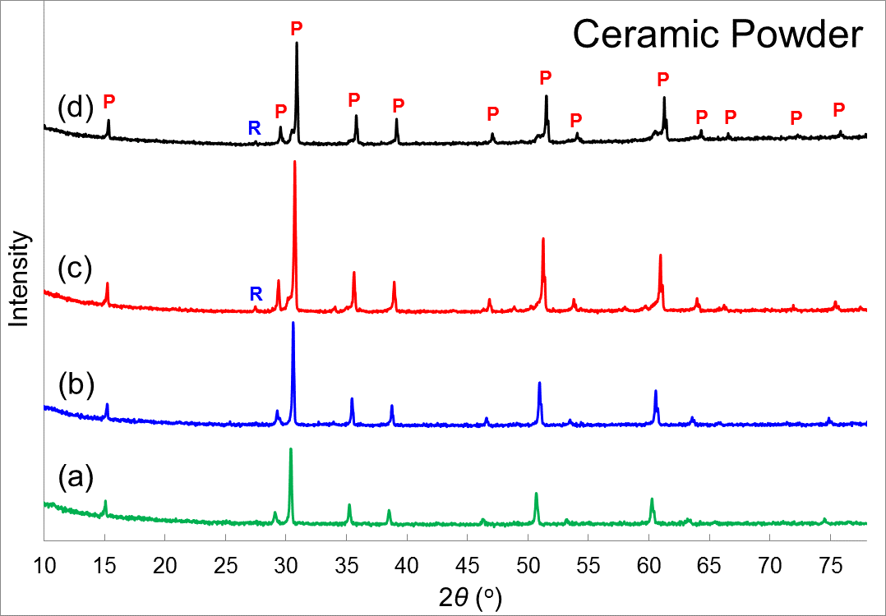
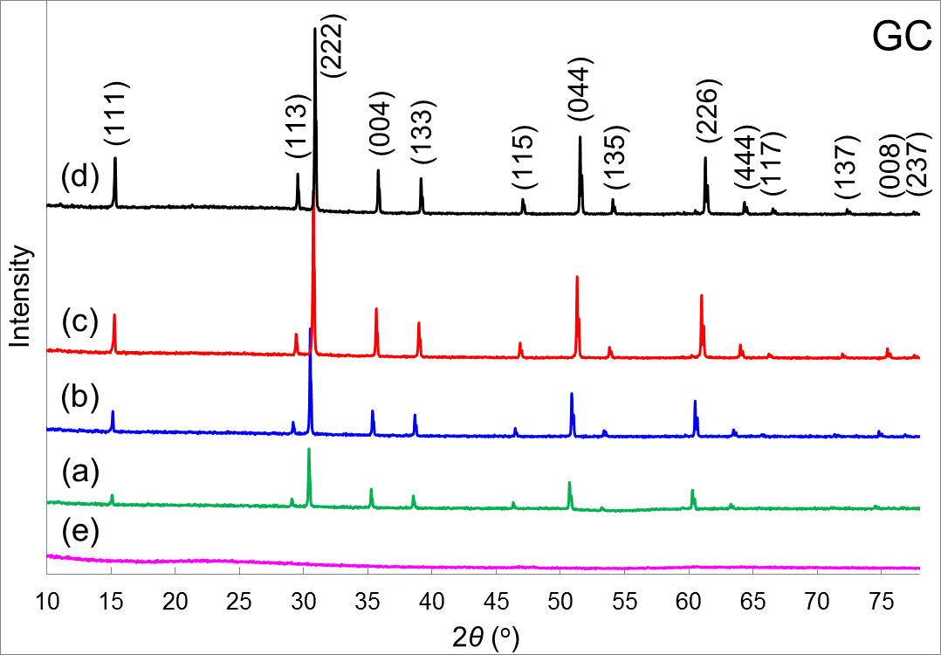
XRD
Samples were sintered at 1200◦C for 6 h.
Gd₂Ti₂O₇, (b) Tb₂Ti₂O₇, (c) Er₂Ti₂O₇, (d) Yb₂Ti₂O₇, (e) pure glass.
R: rutile TiO₂, P: Ln₂Ti₂O₇ pyrochlore.

Slide 8
SEM of glass-Ln₂Ti₂O₇
(a) Gd₂Ti₂O₇ (b) Tb₂Ti₂O₇ (c) Er₂Ti₂O₇ (d) Yb₂Ti₂O₇
1200◦C
6 h

Slide 9
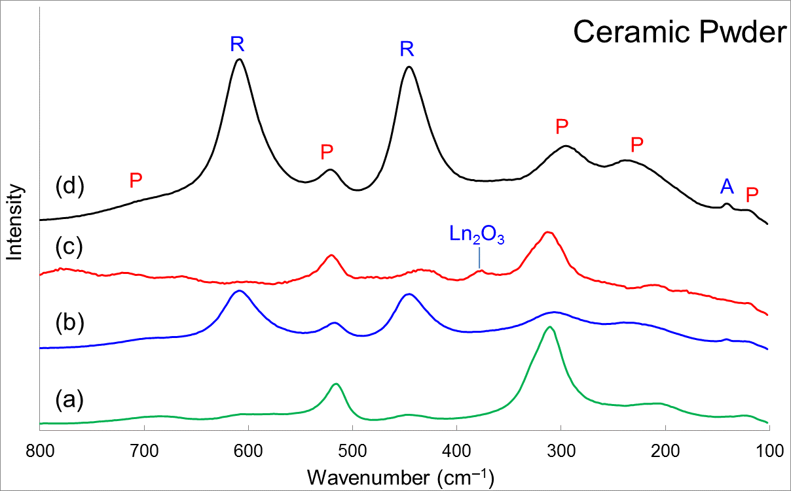
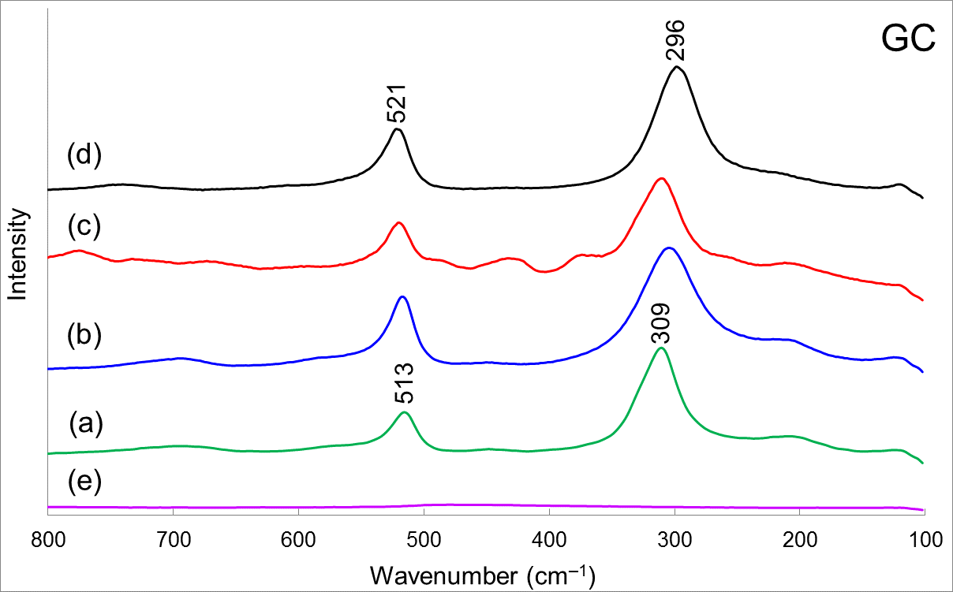
Raman
Samples were sintered at 1200◦C for 6 h.
Gd₂Ti₂O₇, (b) Tb₂Ti₂O₇, (c) Er₂Ti₂O₇, (d) Yb₂Ti₂O₇, (e) pure glass.
R: rutile TiO₂, A: anatase TiO₂, P: Ln₂Ti₂O₇ pyrochlore.

Slide 10
Conclusion
A new method was developed to produce glass-Ln₂Ti₂O₇ pyrochlore at 1200ºC sintering.
Ln₂Ti₂O₇ pyrochlore was internally crystallized in glass.
Pyrochlore was uniformly distributed in glass matrix.
High ceramic to glass weight ratio led to some impurities.

Slide 11
?

