Slide 1
New aspects of the mechanism of hydrogen effect on spent fuel dissolution.
Kastriot Spahiu
SKB & Chalmers University of Technology, Sweden

Slide 2
Recent results from a Ph. D. thesis at Chalmers
In the first experiment the effect of bromide on homogeneous alpha radiolysis was investigated. The major difficulty was the preparation of stable solutions of Pu(VI) at pH>8 to avoid bromide loss. It is well known that Br- affects much γ-radiolysis in H₂ saturated solutions, however α-radiolysis dominates when spent fuel is expected to contact groundwater.
The second experiment was based on the data of Nilsson &Jonsson, J. Nucl. Mater. 410 (2011) 89-93, reporting the majority of H₂O₂ decomposed to water and O₂. The first step in H₂O₂ decomposition is bond breaking and formation of 2 OH· radicals. The reaction rates of free OH-radicals with H₂O₂ and H₂ are quite similar:
OH· + H₂O₂ = H₂O + O-O-H· k= 2.7 10⁷ M⁻¹ s⁻¹.
OH· + H₂ = H₂O + H· k = 4.3 10⁷ M⁻¹ s⁻¹.
The decomposition of H₂O₂ to water and O₂ indicates that the reaction of surface bound OH· radicals proceeds with measurable rate. It is then worth attempting to measure their reaction with H₂, but using D₂ instead in order to quantify its occurrence through HDO analysis.
In the third experiment the potential formation of HDO in the presence of D₂ was investigated. In this system dominated by the strong α-radiolysis of the MOX surface and the absence of metallic particles in the solid, only the α-emitting surface can contribute in the activation of D₂.

Slide 3
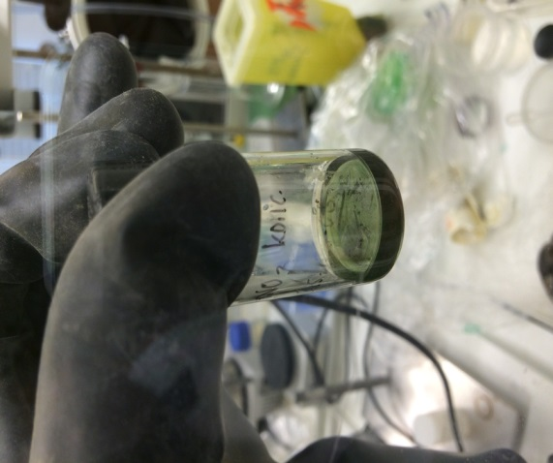
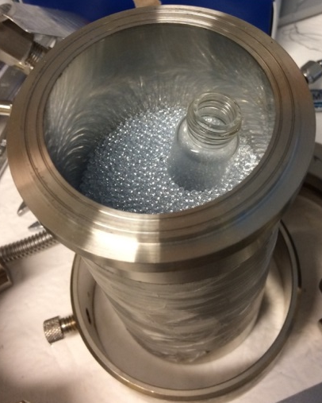
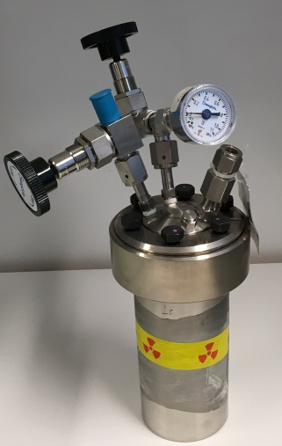
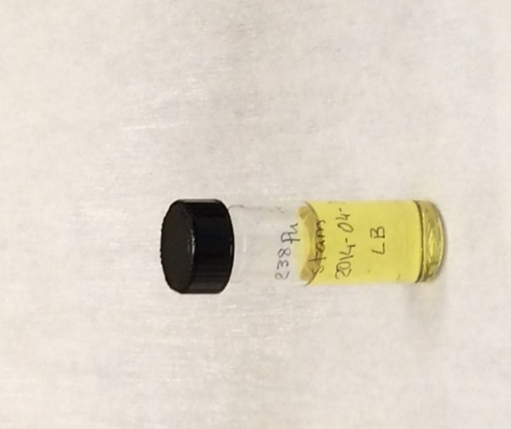
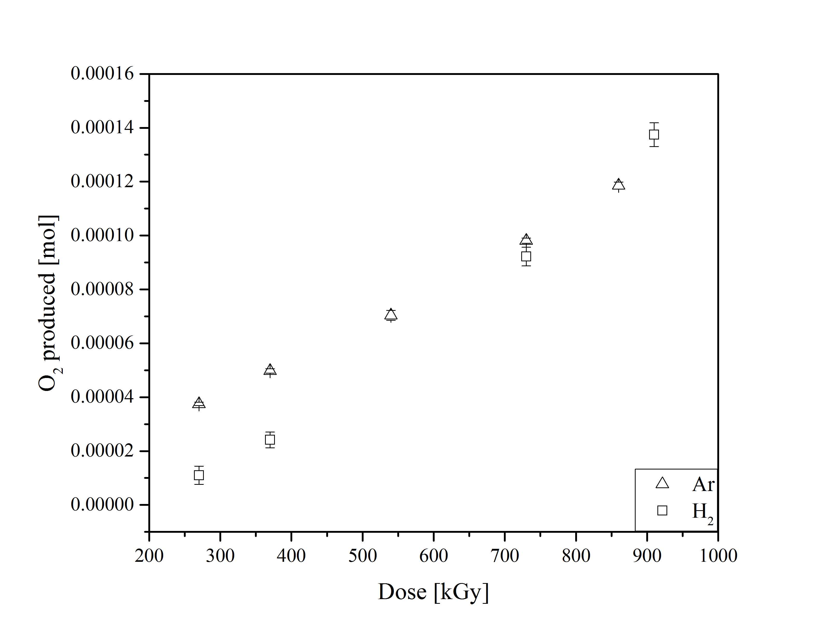
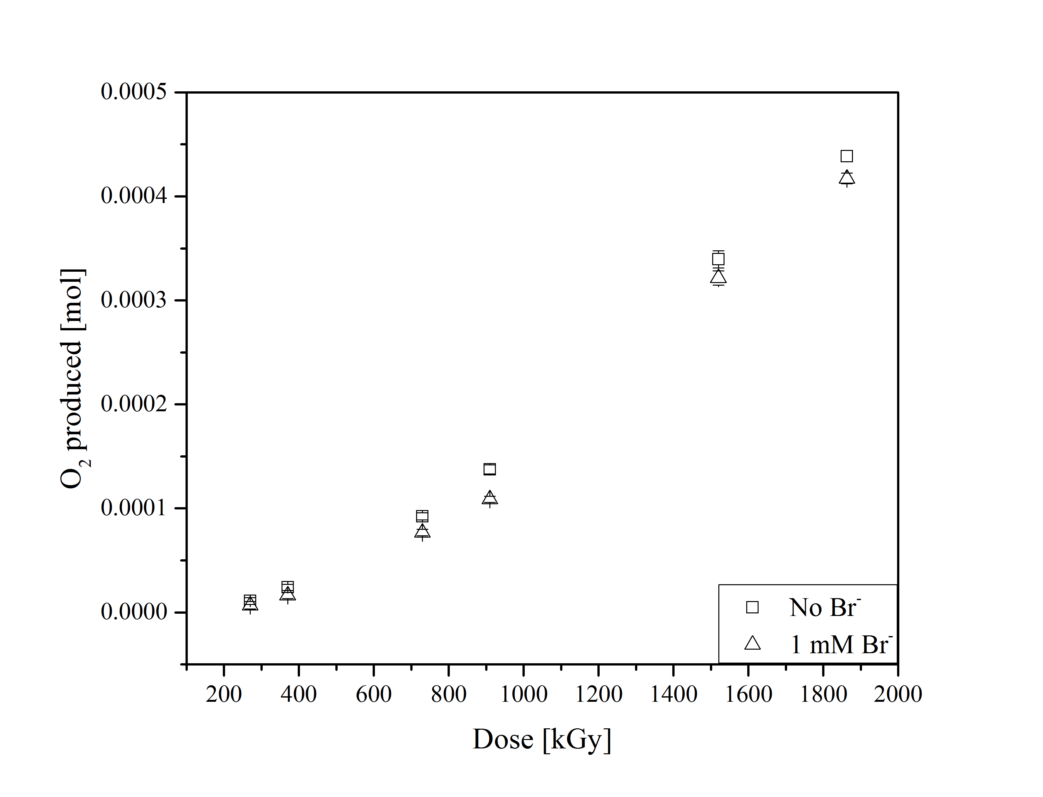
Homogeneus α-radiolysis of ²³⁸Pu(VI)-solutions
Bauhn et al., MRS Advances, Energy and Sustainability, Vol. 2, Issue 13 (2017) pp.711-716.

Slide 4
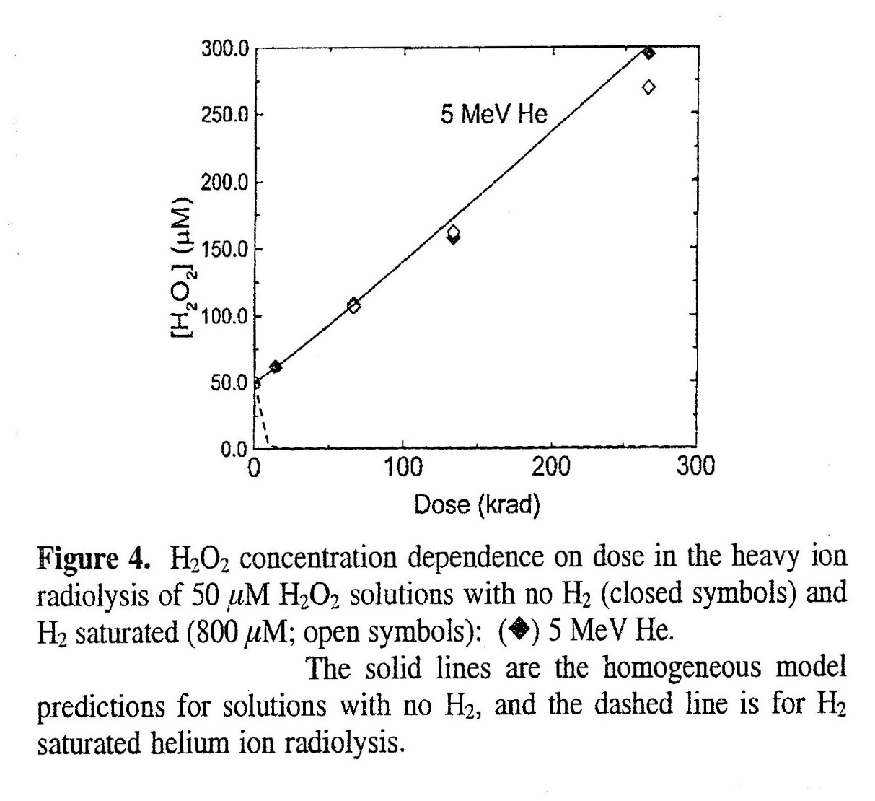
Results of the Br-study.
The results of the study with ²³⁸Pu solutions, i.e. homogeneous alpha radiolysis, indicate that bromide does not have any effect on the production of α-radiolytic oxidants in the presence of hydrogen. The oxygen and H₂O₂ concentrations measured in solutions with bromide are even slightly lower than in solutions without bromide.
However, the major result of this study is the absence of any hydrogen effect on the oxidant production during homogeneous alpha radiolysis, i.e. O₂ and H₂O₂ production in solution is similar under H₂ and Ar pressure.
This confirms the results of Pastina&LaVerne, 2001(left), in spite of the questioning of the volume affected by dose ( Trummer&Jonsson, J. Nucl. Mater. 233 (2010) 334) and re-opens the question of the inhomogeneity effects during α-radiolysis modelling.
Pastina&LaVerne, J.Phys. Chem. A 105 (2001) 9316.

Slide 5
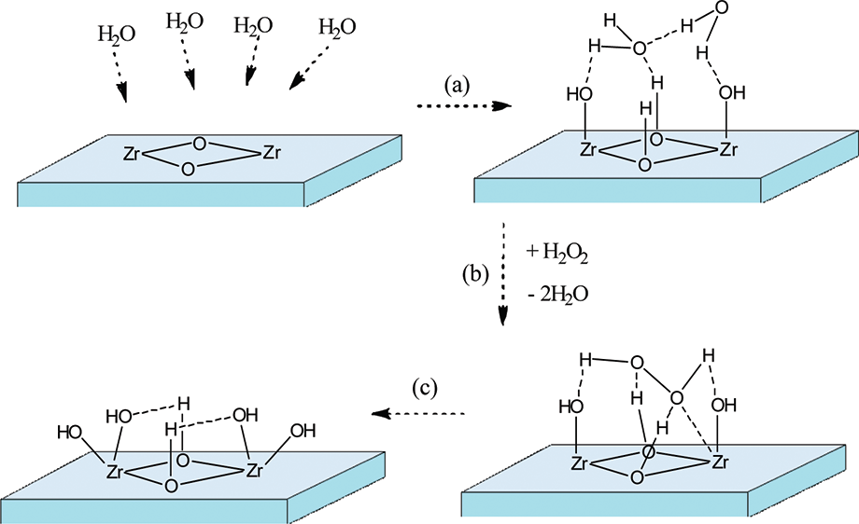
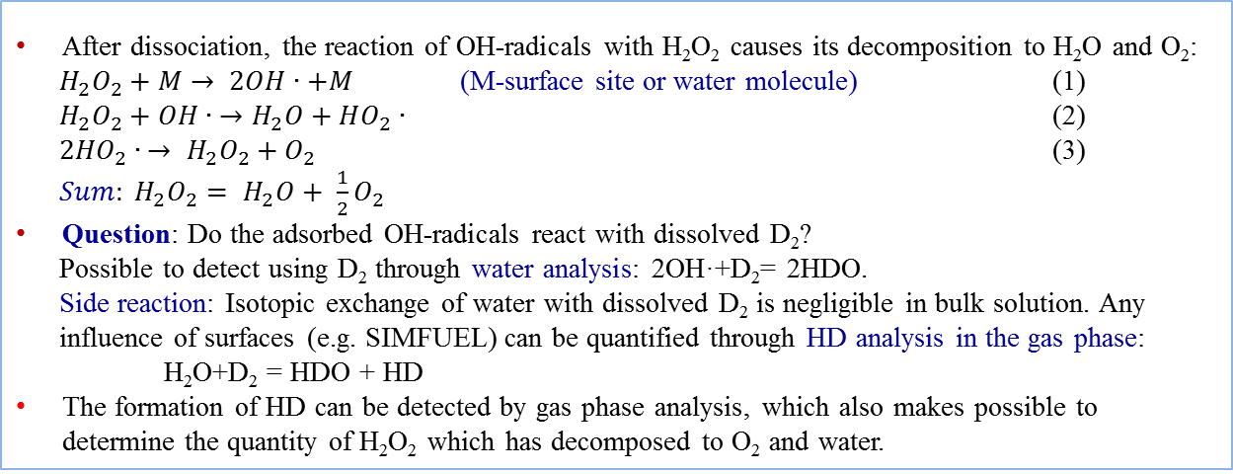
Backgrund and method for SIMFUEL study
Lousada et al, J. Phys Chem.C 116 (2012) 9533.
After dissociation, the reaction of OH-radicals with H₂O₂ causes its decomposition to H₂O and O₂:
$H_{2}O_{2}+M→ 2OH∙+M$ (M-surface site or water molecule) (1)
$H_{2}O_{2}+OH∙ →H_{2}O+HO_{2}∙$ (2)
${2HO}_{2}∙ → H_{2}O_{2}+O_{2}$ (3) ${Sum: H}_{2}O_{2}= H_{2}O+ {\frac{1}{2}O}_{2}$
Question: Do the adsorbed OH-radicals react with dissolved D₂?
Possible to detect using D₂ through water analysis: 2OH·+D₂= 2HDO.
Side reaction: Isotopic exchange of water with dissolved D₂ is negligible in bulk solution. Any influence of surfaces (e.g. SIMFUEL) can be quantified through HD analysis in the gas phase:
H₂O+D₂ = HDO + HD
The formation of HD can be detected by gas phase analysis, which also makes possible to determine the quantity of H₂O₂ which has decomposed to O₂ and water.

Slide 6
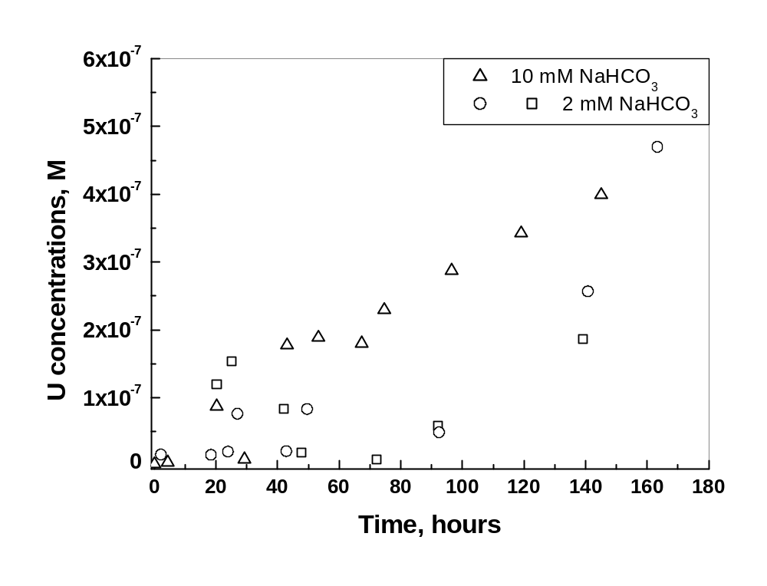
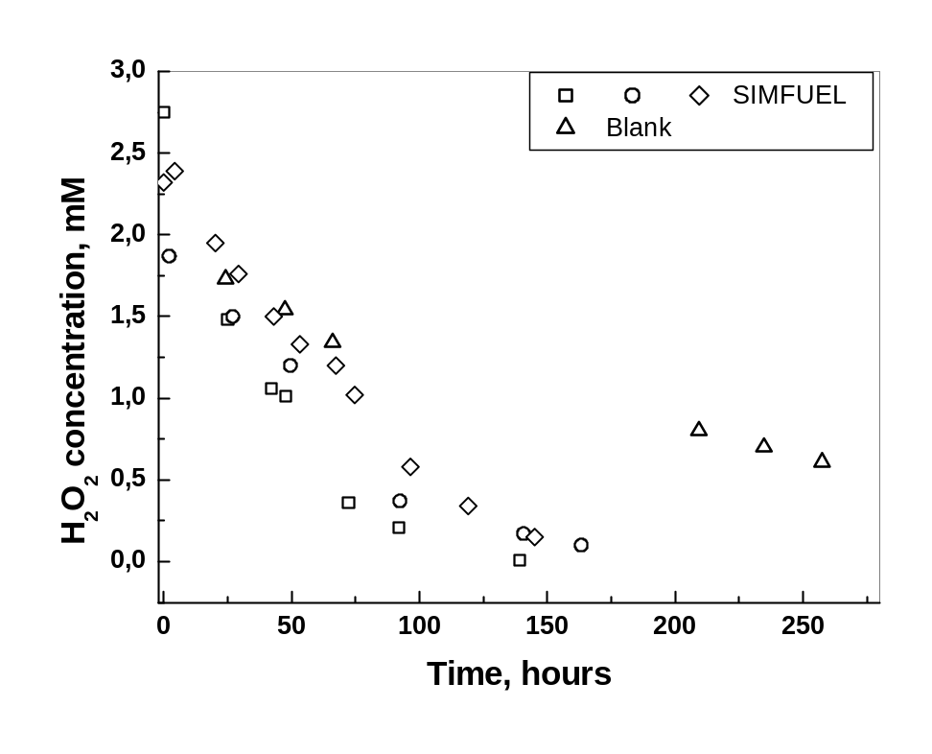
H₂O₂ and U concentrations as function of time.

Slide 7
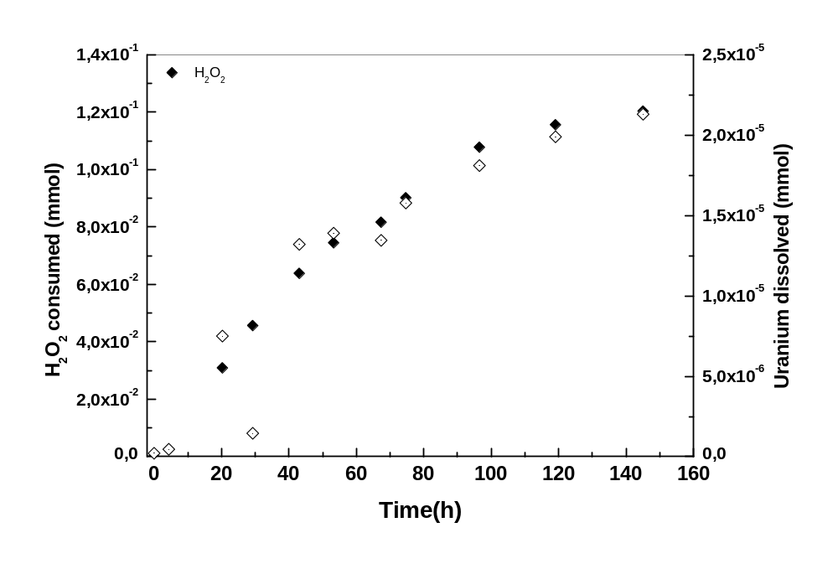
H₂O₂ consumed compared to U dissolved
Note the different scale for the left and right Y-axis! Only <0.02% of H₂O₂ gives U(VI)!

Slide 8
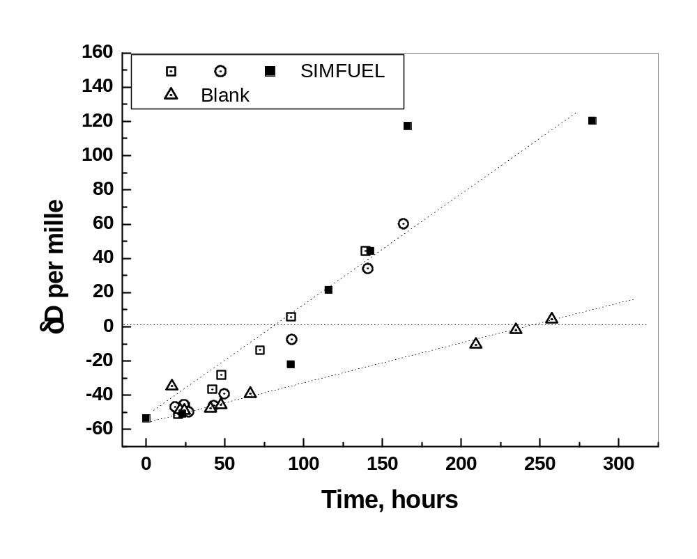
Formation of HDO during SIMFUEL+H₂O₂ test

Slide 9
Results of the SIMFUEL tests.
The amount of H₂O₂ which produces oxidized U(VI) is very small, < 0.02% of the total amount of hydrogen peroxide consumed. This means that the rest, 99.8 % has decomposed to two OH· radicals, which have reacted either with H₂O₂ molecules to produce water and O₂, or with dissolved D₂ to give HDO. The production of HDO was analyzed in three tests, but gas phase analysis was possible only for the fourth test (filled symbols), carried out semi-quantitatively at Studsvik Nuclear.
For this last test, in total 0.216 mmol HDO were formed during the 283 hour experiment. Gas phase analysis indicates 300 ppm HD formed during 283 hours, corresponding to 0.041 mmol HD. This corresponds to equally much HDO formed through: H₂O+D₂=HDO+HD. The rest, i.e. 0.216-0.041=0.176 mmol originate from reaction of D₂ with OH-radicals. This number of moles corresponds to half as much moles H₂O₂ reacting with D₂, i.e. H₂O₂+D₂=2HDO or 0.176/2=0.088 mmol H₂O₂.This means that 0.088 mmol H₂O₂ reacted with deuterium to give HDO.
The total number of moles of H₂O₂ calculated from the concentration analyzed 1 hour after flushing is 0.111 mmol. This means that the fraction of hydrogen peroxide that reacted with deuterium is 0.0088/0.111= 0.793, i.e. 79.3%. On the other hand, the gas analysis indicates also ~305 ppm O₂, which would result from the decomposition of 0.078 mmol H₂O₂. Thus we do not have mass balance (0.088+0.078> 0.111 mmol); we consider the gas analysis carried out without D₂-based standards as more uncertain than the HDO analysis.
It is clear that the amount of hydrogen peroxide consumed through uranium dissolution is very small, 0.02% and the ICP-MS data are quite reliable. The relative amounts of hydrogen peroxide which has decomposed to water and oxygen or has reacted with D₂ are prone to large uncertainties, due to the extensive flushing and lack of D₂-based standards. Anyhow the knowledge of these proportions is much more important for the case of the much lower H₂O₂ concentrations produced by α-radiolysis, investigated in the next study.

Slide 10
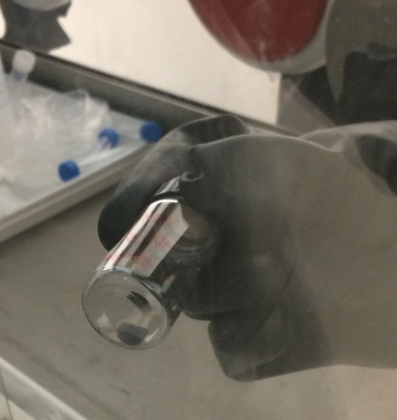

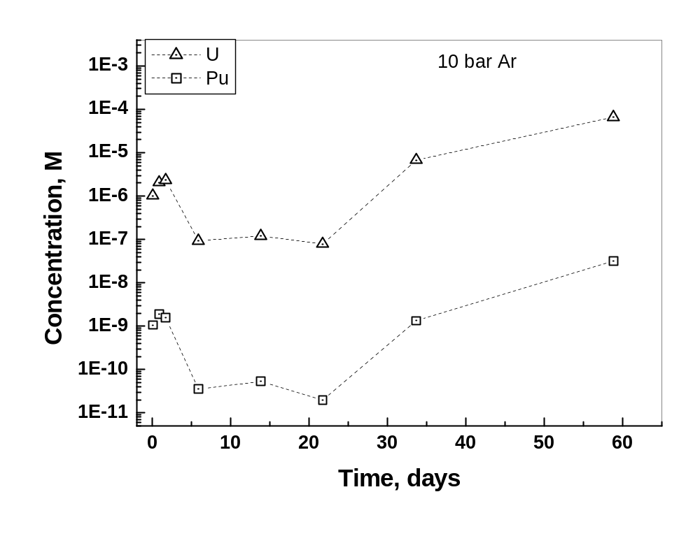
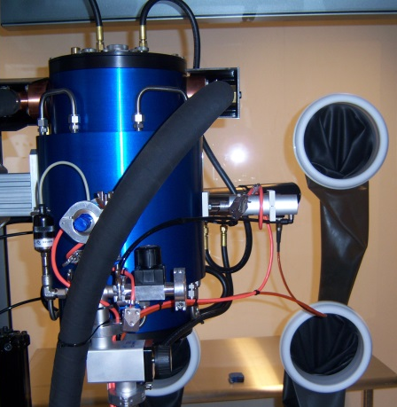
(U,Pu)O₂ leaching under Ar and D₂.
Unirradiated Melox MOX pellet.
(U, Pu)O₂(s) with 24% Pu
5 GBq/g α-activity
Alpha dose rate 22.7 kGy/h
2-3 orders lower β,γ dose rates.
Leached under Ar and D₂

Slide 11
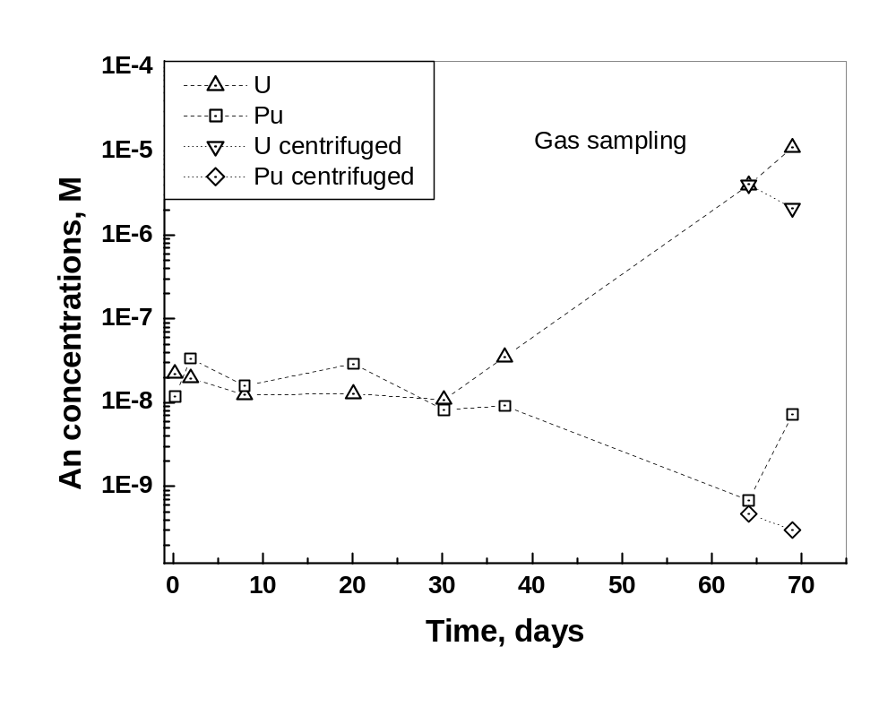
MOX leaching under D₂
Leachate sample no. | Pressure in autoclave | Dissolved D₂
1 | 1.00 MPa | 7.9 mM
2 | 0.96 MPa | 7.6 mM
3 | 0.90 MPa | 7.1 mM
4 | 0.85 MPa | 6.7 mM
5 | 0.81 MPa | 6.4 mM
6 | 0.77 MPa | 6.1 mM
7 | 0.57 MPa | 4.5 mM
8 | 0.55 MPa | 4.3 mM

Slide 12
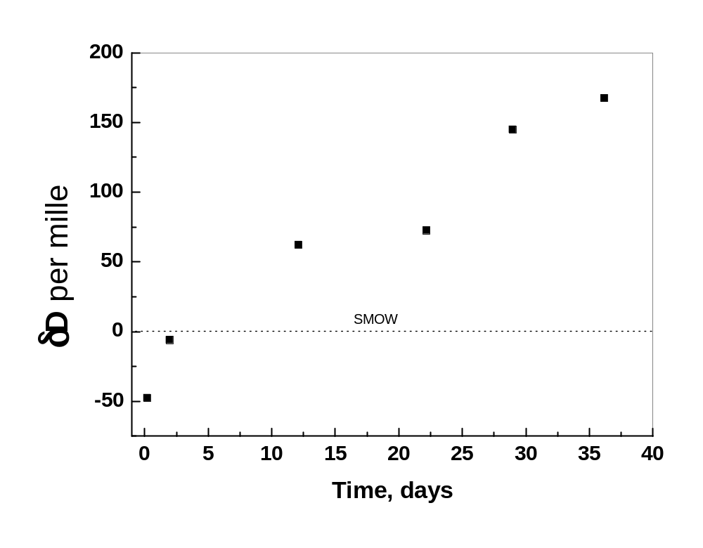
HDO formed during the MOX test under 1 MPa D₂.

Slide 13
Conclusions from the MOX study.
The dissolution data under Ar indicate the effect of the radiolytic oxidants produced by the strong α-radiation and the influence of Pu-doping of the UO₂ matrix, resulting in relatively fast dissolution of the matrix.
The results under 10 bar D₂ atmosphere indicate that during the first 30 days the oxidative dissolution of the un-irradiated MOX pellet was completely cancelled by the presence of D₂.
The complete absence of O₂ in the gas atmosphere and the absence of U(VI) production in solution lead to the conclusion that all H₂O₂ and other oxidants produced by the radiolysis were consumed by D₂ to give HDO.
The amounts of HDO analysed in the solution (0.27 mmol) are more than one order of magnitude higher than the calculated H₂O₂ production for the given dose rate (0.0128 mmol H₂O₂ would give 0.0256 mmol HDO). This means that the highly radioactive surface of the mixed actinide oxide acts as very good hydrogen catalyst, causing H₂O-D₂ exchange.

Slide 14
Summary and conclusions
The results of homogeneous alpha radiolysis indicate almost no consumption of H₂O₂ in bulk solution in the presence of hydrogen and no effect of bromide. The first part re-opens the question of inhomogeneity effects during α-radiolysis raised by Pastina& LaVerne in 2001, and then questioned by Trummer&Jonsson in 2010.
The SIMFUEL results show that only a very small part of H₂O₂ causes oxidative U dissolution (<0.02%), the major part is either is consumed by H₂ to give water (~79 %) or decomposes to water and O₂ (~21-47 %). Oxygen is ~200 times slower oxidant of the fuel matrix than H₂O₂. These proportions can be somehow different for the much smaller radiolytic H₂O₂ concentrations, and this needs further investigation.
The results with the MOX fuel pellet indicate a stop of the oxidative dissolution for D₂ concentrations over a given limit, even though metallic particles are absent in this case. The most striking result though is the large production of HDO, caused by the presence of the mixed actinide oxide surface and its radiation. Such surfaces have a summary effect of a strong hydrogen catalyst.
The news that the main α-radiolysis oxidant is partially consumed by hydrogen and partially decomposed to water and oxygen is a step forward in the understanding of the hydrogen effect. The same holds for the hydrogen catalytic properties of the alpha emitting actinide oxide surfaces, which have been reported also by Haschke et al. 1996 and Icenhour et al, 2004.

Slide 15
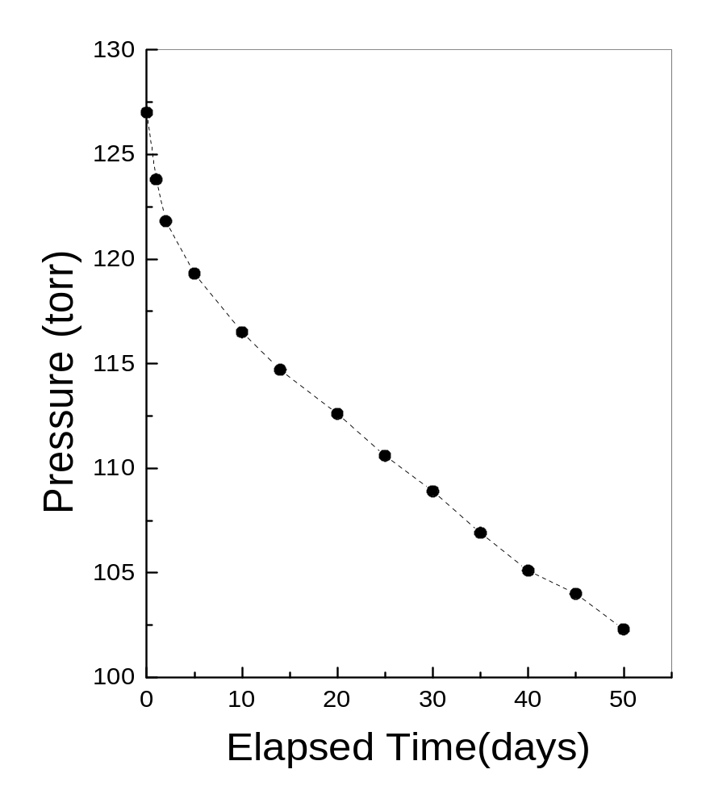
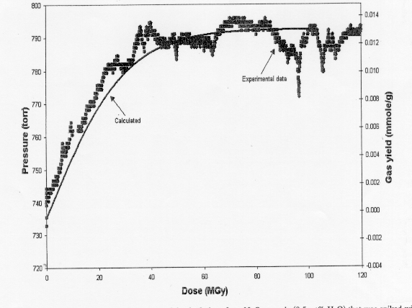
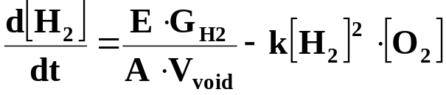
Radiolytic gas production from water sorbed on ²⁴⁴Cm doped NpO₂(s) [Icenhour et al., Nucl. Tech. 2004].
Recombination reactions
2:1 mixture D₂+O₂ over PuO₂(s), 25 °C [Haschke et al., J. All. Comp. 1996].

Slide 16
Thank you!

