Slide 1



Modelling the Corrosion of Spent Nuclear Fuel Inside a Failed Waste Container Fuel Inside a Failed Waste Container
Nazhen Liu, Ziyan Zhu, Linda Wu, Zack Qin, David Shoesmith
Department of Chemistry and Surface Science Western
The University of Western Ontario
London, ON, Canada
This project is funded under a Collaborative Research and Development agreement between NSERC and the Nuclear Waste Management Organization

Slide 2
OUTLINE
Canadian disposal scenario
Redox conditions inside a failed nuclear waste container
A few key fuel properties
A one dimensional model for fuel corrosion
The need for a two dimensional model
The influence of H₂ from alpha radiolysis and steel corrosion
How much H₂ is required to completely suppress fuel corrosion?
Can the model be validated ?

Slide 3

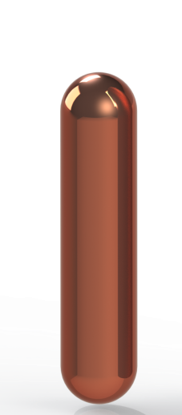

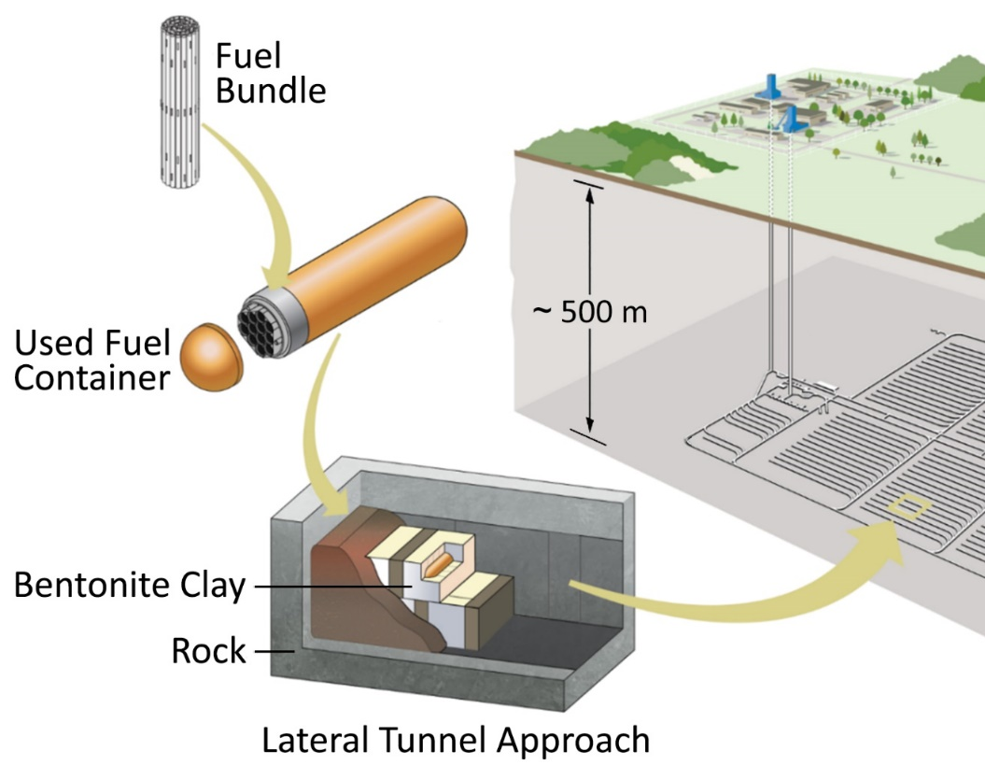
The Canadian Scenario for the Disposal of High Level Nuclear Waste (Used Nuclear Fuel)
~0.57 m
~2.5 m
Cu-coated carbon steel container
Electrodeposited
Cold spray
Notes:
I can say that this is potentially the most dangerous failure mode (and that’s why NWMO is investing in researching this)
The motivation behind my research is ensuring the safe long-term management used nuclear fuel. Canada’s proposed long term management method involves placing used fuel bundles in a copper-coated carbon steel container (the Cu coating being either electrodeposited or cold spray), (sealing the containers), and placing them ~500 m below ground in a deep geological repository. In the repository, the containers will eventually come into contact with groundwater and can begin to corrode. This is where my research comes in.
These containers are the primary engineered barrier within the multi-barrier system proposed for the permanent disposal of spent nuclear fuel.

Slide 4
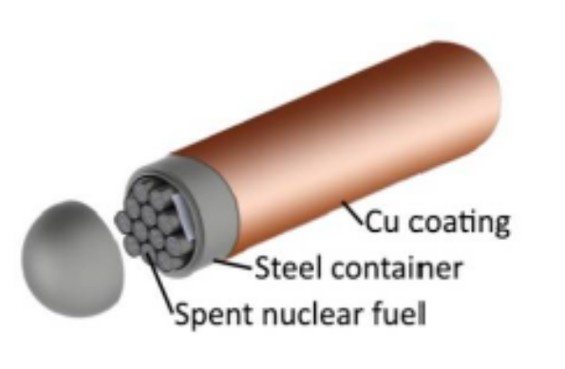
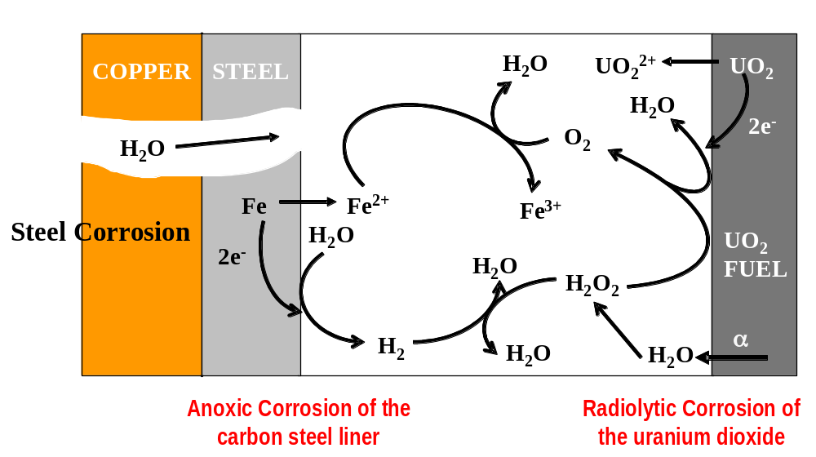
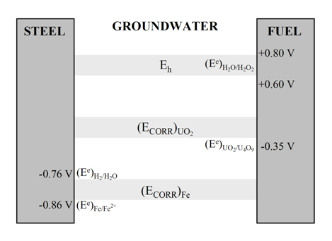
Redox Conditions Inside a Failed Container
Large redox gradient exists within the container

Slide 5
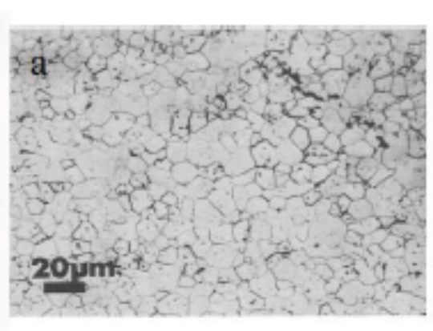
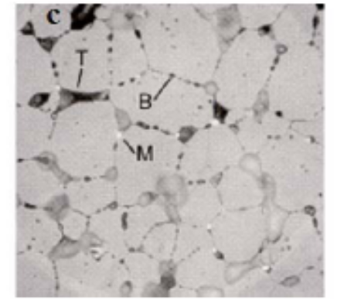
The Key Fuel (UO₂) Properties which influence its reactivity
Grain boundary tunnels
Grain boundary fission bubbles
In-reactor Fission
Rare earth-doped large grains
Small grains
Residual grain boundary porosity
Residual non-stoichiometry in grain boundaries
Noble metal (Ru, Pd, Mo) particles
In-reactor irradiation produces a network of noble metal particles (potential cathodes?) within a conductive, oxidizable UO₂ matrix (reactive anode?)

Slide 6
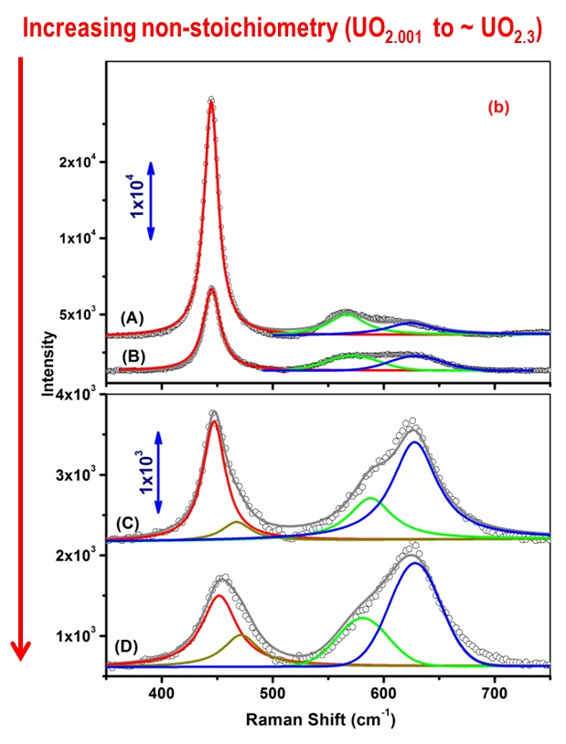
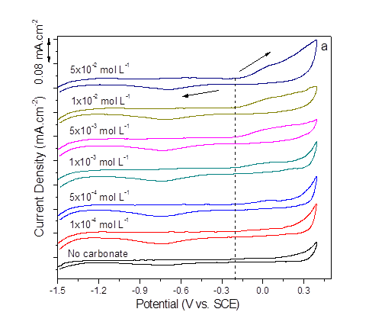
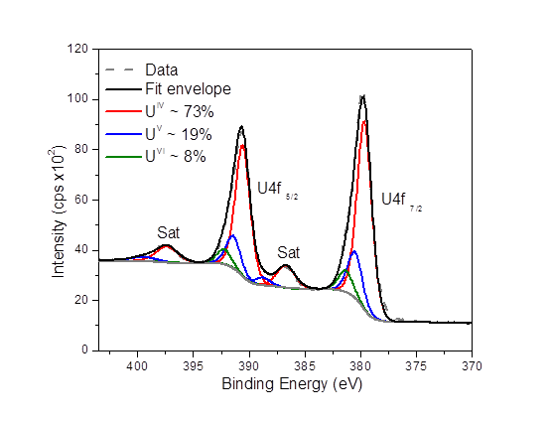
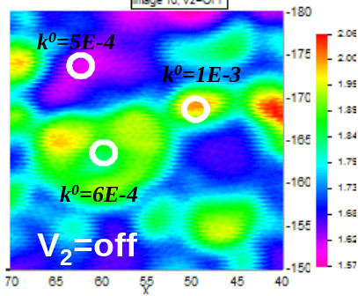
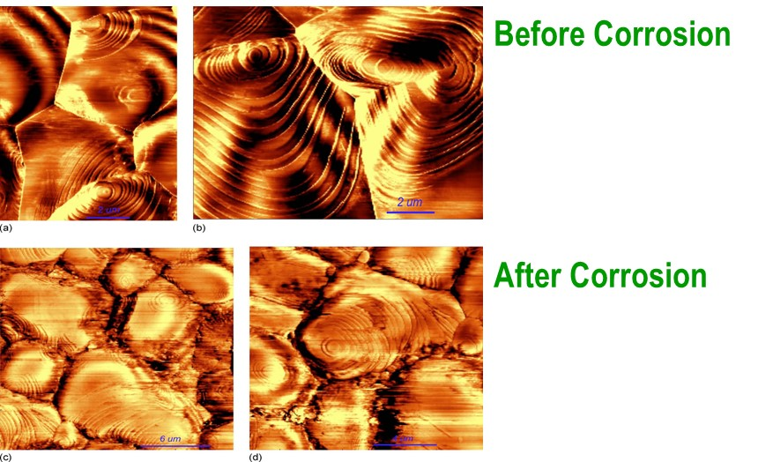
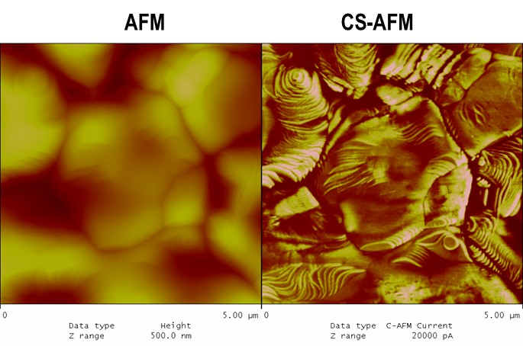
Extensive Electrochemical/Spectroscopic/Microscopic Studies of Simulated Fuel Properties have been undertaken
MicroRaman spectroscopy used to determine the influence of doping on the UO₂ matrix
Electrochemical methods used to study UO₂ reactivity and the kinetics of oxidant reduction reactions
X-ray photoelectron spectroscopy used to determine surface composition
Scanning Electrochemical Microscopy (SECM) used to determine lateral variations in reactivity
Atomic Force Microscopy (AFM) used to detect corrosion damage
Current sensing AFM used to relate surface conductivity to composition
N. Liu et al: Corrosion of Nuclear Fuel Inside a Failed Waste Container; The Encyclopedia of Interfacial Chemistry: Surface Science and Electrochemistry

Slide 7
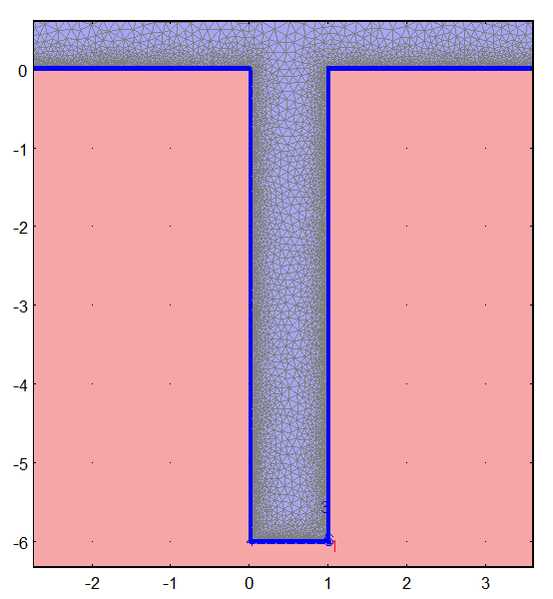
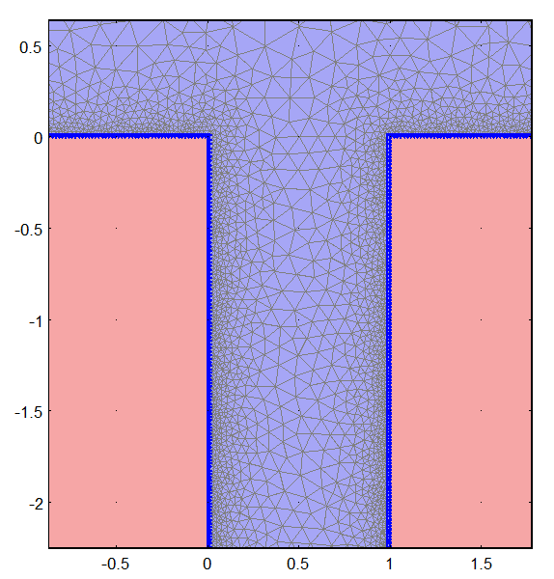


One and Two-dimensional Models Developed for Fuel Dissolution/Radionuclide Release inside a Failed Container
Numerical simulations are applied by the commercially available modelling package, COMSOL Multiphysics based on finite element methods.
The diluted species transportation module is used
Diffusion-reaction equation at steady state
diffusion
reaction
Finite element mesh for a fuel fracture
Notes:
The simple equations that model these finite elements are then assembled into a larger system of equations that models the entire problem.

Slide 8
Reactions Inside a Failed Container
Groundwater

Slide 9
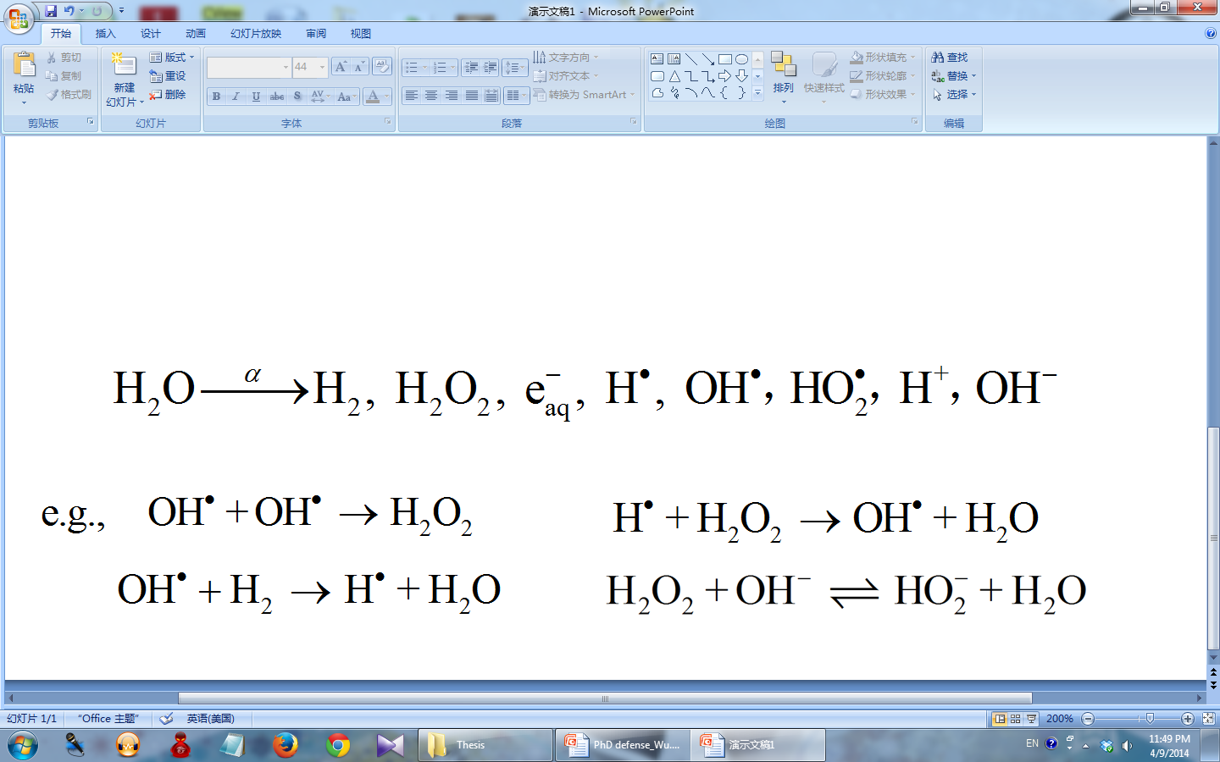
Reactions Inside a Failed Container
13 μm
Radiation zone

Slide 10

Reactions Inside a Failed Container

Slide 11
Reactions Inside a Failed Container
ε

Slide 12
Reactions inside a Failed Container

Slide 13

Reactions Inside a Failed Container
4
F.J. Millero, and S. Sotolongo, Geochim. Cosmochim. Acta 53 (1989) 1867.

Slide 14
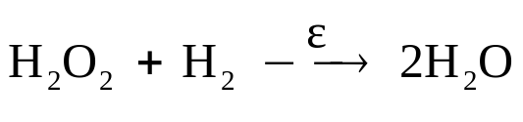

The Key Reactions Controlling Fuel Corrosion/Dissolution Inside a Failed Container

Slide 15
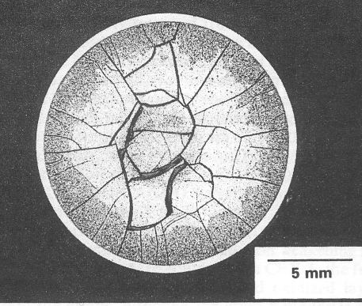
Due to the fractured nature of the fuel a two dimensional model is required
Cross section of used CANDU fuel pellets
Fractures allow groundwater access to the internal structure of a pellet

Slide 16


Effect of Geometry
Bulk [H₂]
Critical [H₂]
Bulk solution
Fe²⁺, H₂
Diffusion zone
H₂O₂, H₂
H₂O₂, H₂
Radiation zone
H₂O₂, H₂
Fractured fuel pellet
    L. Wu, N. Liu, Z. Qin, and D.W. Shoesmith, J. Electrochem. Soc. 161(8) (2014) E3259-E3266.

Slide 17
THE INFLUENCE OF HYDROGEN ON THE FUEL CORROSION PROCESS

Slide 18
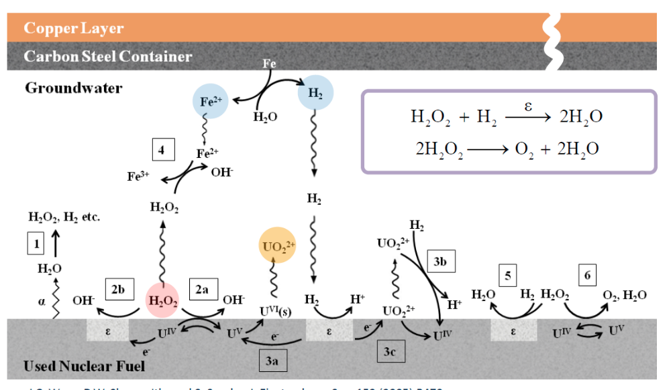
The Kinetics of Redox Controlling Reactions
Reactions involving H₂
Alpha radiation dose rate
Production of H₂ by both radiolysis and steel corrosion
Reaction of H₂ with H₂O₂

Slide 19
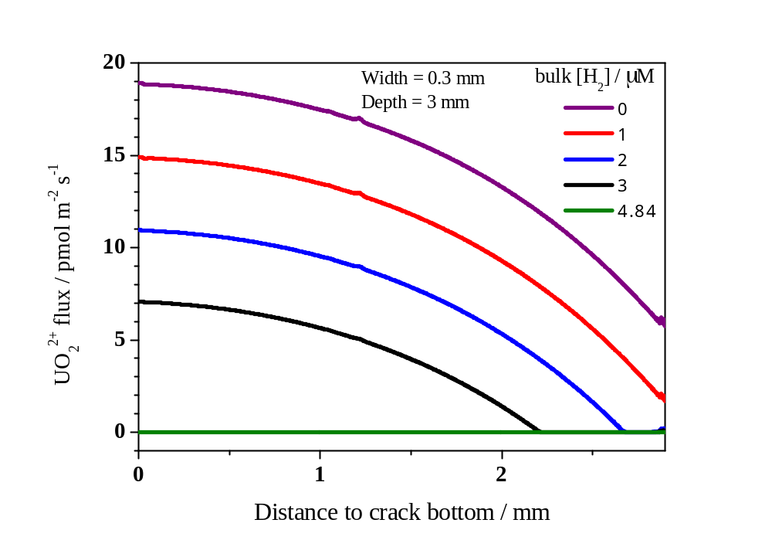

Corrosion Rate Inside a Crack
The critical [H₂] is defined as the minimum bulk [H₂] (from carbon steel corrosion) required to completely suppress fuel corrosion.
As the bulk [H₂] increases fuel dissolution becomes progressively more suppressed
bulk solution
bulk [H₂]
The Critical [H₂]

Slide 20
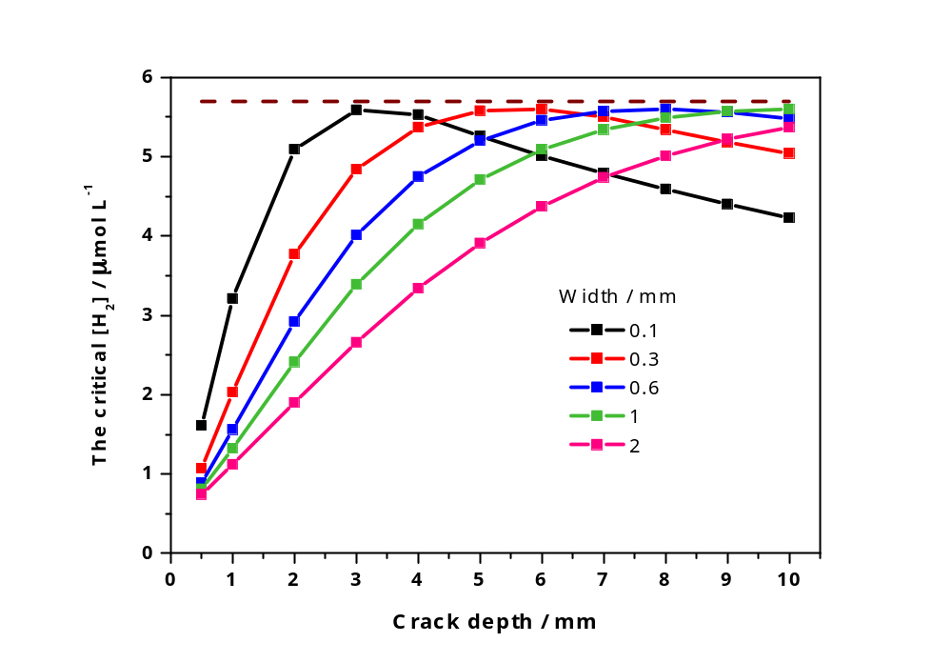
Factors Influencing the Critical [H₂]
Crack geometry
The calculated critical [H₂] in cracks with different widths and depths, with α dose rate = 9.03 × 10⁵ Gy a⁻¹.
There exists an upper limit (5.7 μmol L⁻¹ indicated by the dashed line) for the critical [H₂] for the anticipated range of possible crack geometries.
    L. Wu, N. Liu, Z. Qin, and D.W. Shoesmith, J. Electrochem. Soc. 161(8) (2014) E3259-E3266.

Slide 21
Separation of Internal and External H₂ Effects

Slide 22
Separation of Internal and External H₂ Effects
Bulk solution
Fe²⁺, H₂
Diffusion zone
H₂O₂, H₂
H₂O₂, H₂
Radiation zone
H₂O₂, H₂
Fractured fuel pellet
The effects of radiolytic (internal) H₂ and H₂ from steel corrosion are separated by calculating the ratio of their concentrations at specific locations

Slide 23

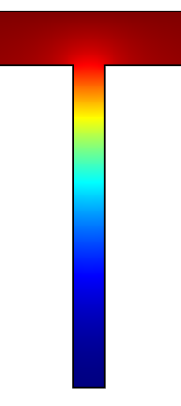
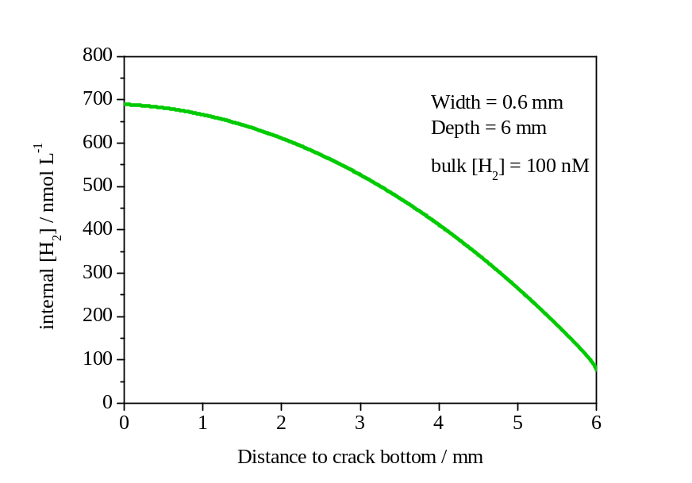
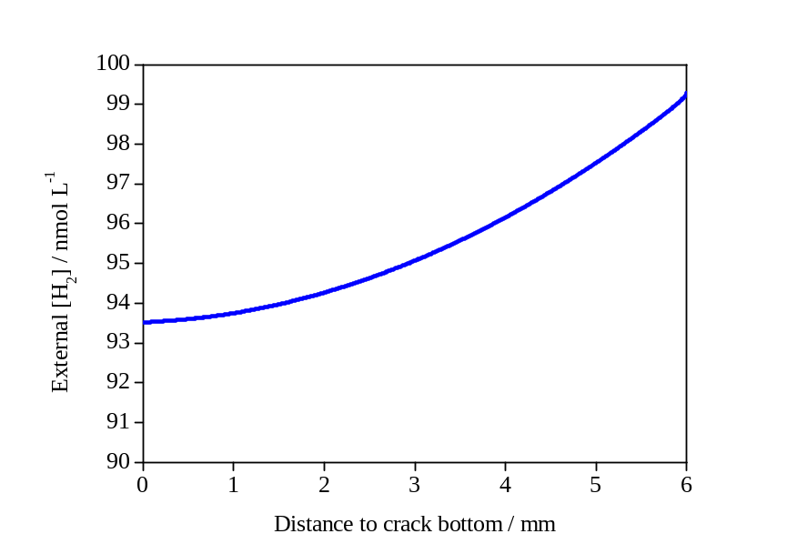
Separation of Internal and External H₂ Effects
nmol L⁻¹
nmol L⁻¹
600
500
400
300
200
100
0
99
98
97
96
95
94
Internal
[H₂]
External
[H₂]
Internal [H₂] / nmol L⁻¹
External [H₂] / nmol L⁻¹
Distance to crack bottom / mm
Distance to crack bottom / mm

Slide 24
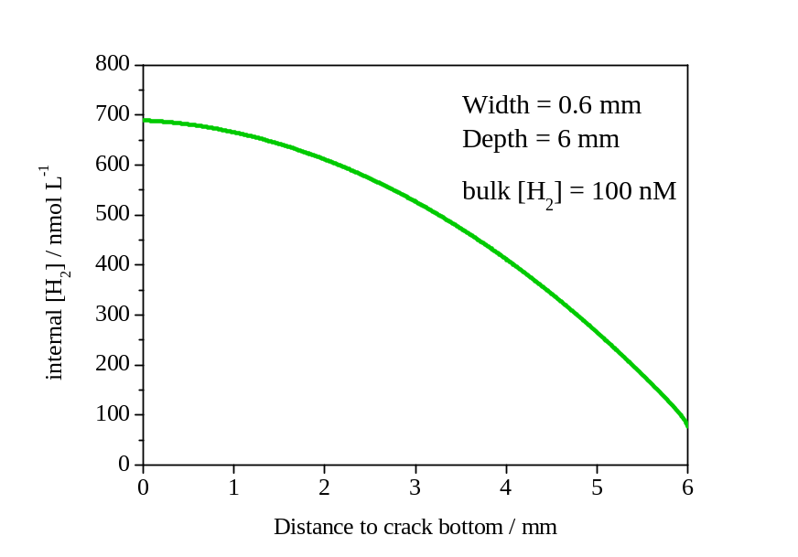
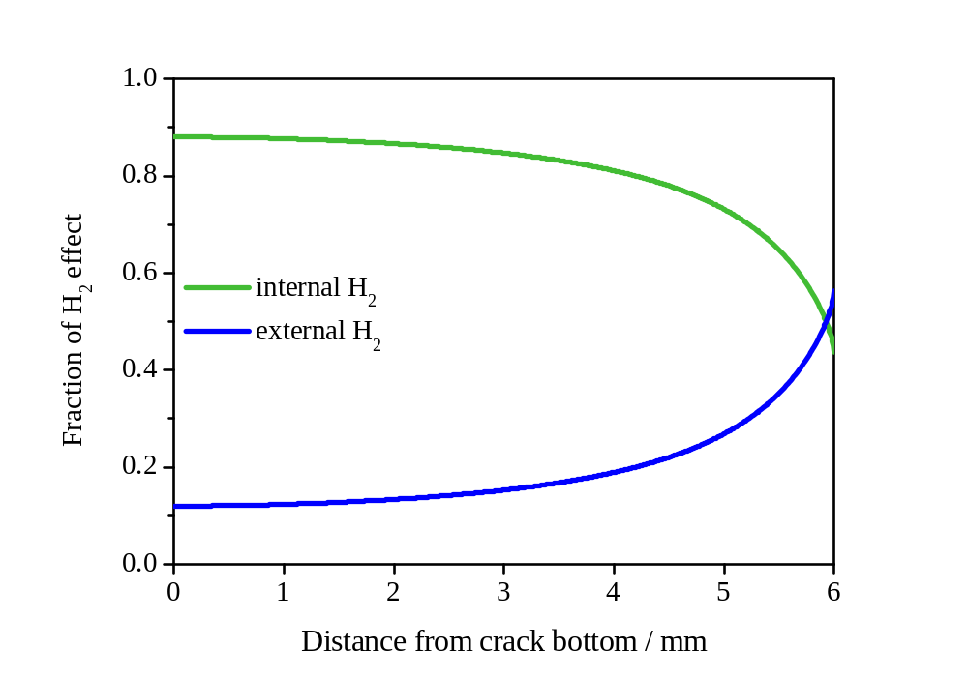
Separation of Internal and External H₂ Effects
Fraction of internal H₂ effect :
Internal [H₂] / nmol L⁻¹
internal [H₂]
internal [H₂] + external [H₂]
Distance to crack bottom / mm
Fraction of H₂ Effect
External [H₂] / nmol L⁻¹
Distance to crack bottom / mm
Distance to crack bottom / mm

Slide 25




Separation of Internal and External H₂ Effects
Internal [H₂] inside a crack
nmol L⁻¹
600
500
400
300
200
100
0
0.5 mm
1 mm
3 mm
As the crack depth increases with a constant width,
there is an accumulation of radiolytic internal H_{2.}
6 mm

Slide 26
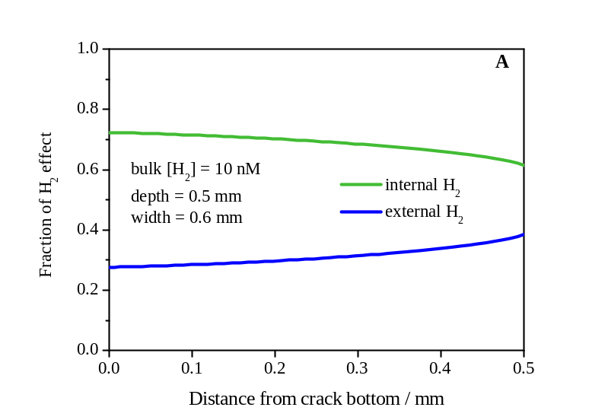
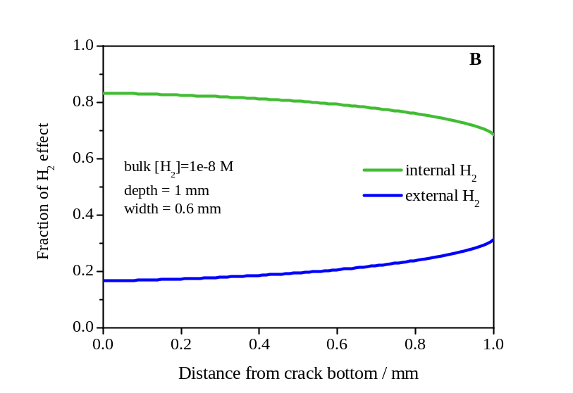
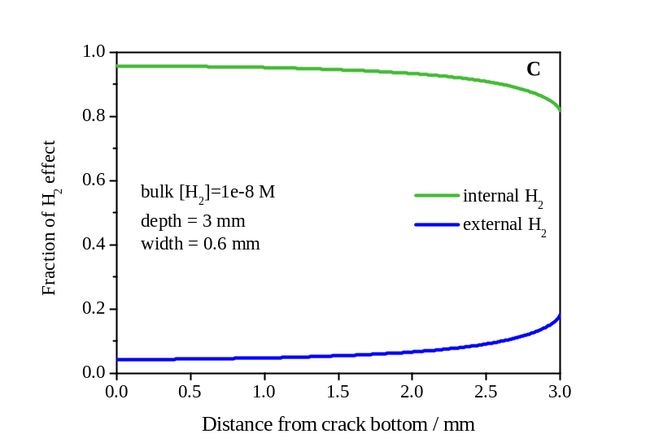
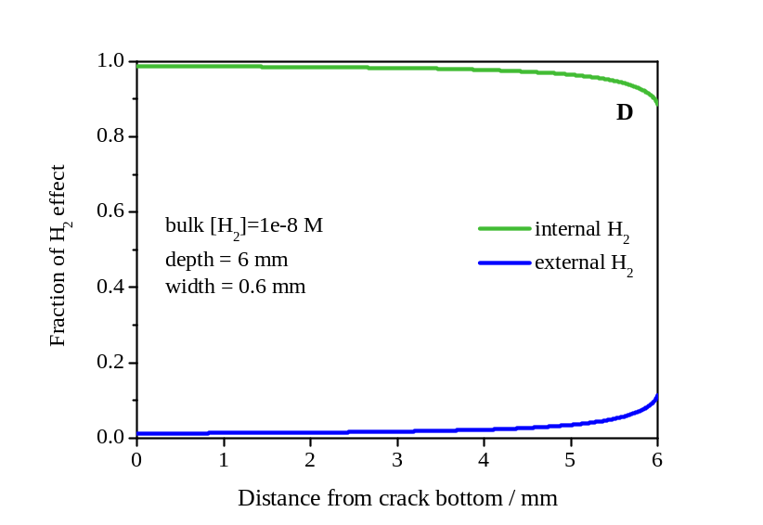
Separation of Internal and External H₂ Effects
Crack depth
Fraction of H₂ Effect
Fraction of H₂ Effect
Bulk [H₂] = 10 nM
Depth = 0.5 mm
Width = 0.6 mm
Bulk [H₂] = 10 nM
Depth = 1 mm
Width = 0.6 mm
Distance to crack bottom / mm
Distance to crack bottom / mm
Fraction of H₂ Effect
Fraction of H₂ Effect
Bulk [H₂] = 10 nM
Depth = 3 mm
Width = 0.6 mm
Bulk [H₂] = 10 nM
Depth = 6 mm
Width = 0.6 mm
Distance to crack bottom / mm
Distance to crack bottom / mm
As the fracture depth increases for a constant fracture width, the fraction of UO₂ corrosion suppressed by internal H₂ increases.

Slide 27

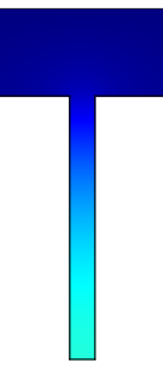
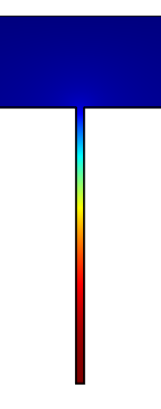
Separation of Internal and External H₂ Effects
Internal [H₂] inside a crack
nmol L⁻¹
900
800
700
600
500
400
300
200
100
0
0.6 mm
0.3 mm
0.1 mm
As the crack gets narrower with a constant depth,
there is an accumulation of radiolytic internal H_{2.}

Slide 28
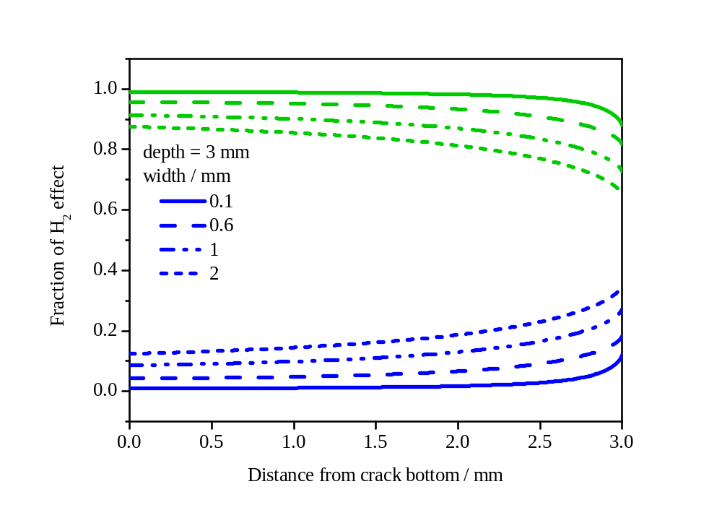
Separation of Internal and External H₂ Effects
Crack width
Internal H₂
Fraction of H₂ Effect
External H₂
Distance to crack bottom / mm
As the crack gets narrower with a constant fracture depth, the fraction of internal H₂ effect on the suppression of UO₂ corrosion increases.
Liu et al. Roles of radiolytic and externally generated hydrogen …. Environ.Sci.Technol. 59, 12348 (2016)

Slide 29
Can this Model be Validated by Comparison to Corrosion Rates Measured on Fuel Specimens?

Slide 30
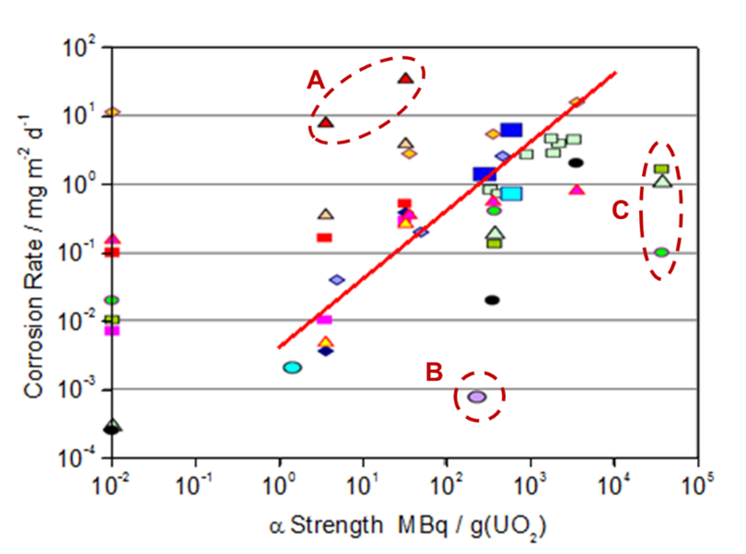
Corrosion rates of α-doped UO₂. non-doped UO₂ (0.01 MBq.g⁻¹(UO₂), SIMFUEL and some spent fuels
Linear least squares fit used by the Canadian Nuclear Waste Management Organization in safety assessments (A,B.C data not included)
Carbol et al. Swedish Nuclear Fuel and Waste Management Company Report SKB-TR-05-09 (2005)

Slide 31
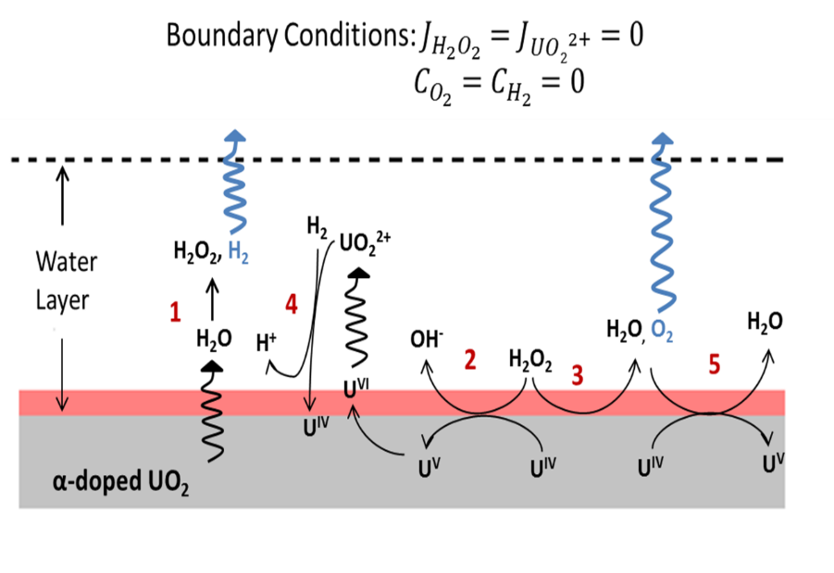
Model Reconfigured to Represent the Conditions in the Fuel Experiments

Slide 32
Model calculation compared to the full measurement set
Model calculation compared only to the data measured on specimens similar to those used in compiling the model data base
The dominant influence on fuel corrosion is the radiolytic dose rate
Liu et al. Modelling the radiolytic corrosion of α-doped UO₂ and spent nuclear fuel,
J.Nucl.Mater, 494, 87 (2017)

Slide 33
On-going and Future Studies
Incorporation of more representative radiolysis model taking into account the alpha radiolysis of chloride containing groundwaters.
The consequences of H₂O₂ decomposition to produce the less reactive but also less readily scavenged O₂
The consequences of corrosion product deposition within fuel fractures.
A more appropriate analysis of the distribution of radionuclides within the fuel.
Extension of the model to a full fuel bundle with different modes of failure.
Incorporate the he α-radiolysis –H₂ effect
Modelling the Cigar Lake deposit to validate the model

Slide 34


Acknowledgements
Zach
Qin
Nazhen Liu
Zach Qin
Michael Wu
Nazhen
Liu
Ziyan
Zhu
This research is funded under the Industrial Research Chair agreement between the Canadian Natural Sciences and Engineering Research Council (NSERC) and NWMO (Nuclear Waste Management Organization), Canada.

Slide 35
Reactions Inside a Failed Container
    J.C. Wren, D.W. Shoesmith, and S. Sunder, J. Electrochem. Soc. 152 (2005) B470.
    S. Nilsson and M. Jonsson, J. Nucl. Mater. 372 (2008) 160.

Slide 36
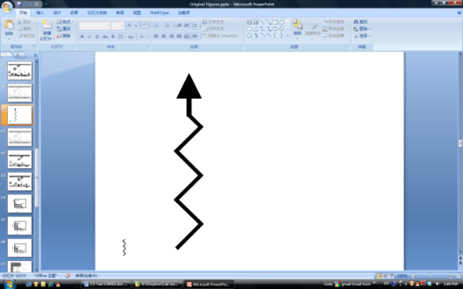
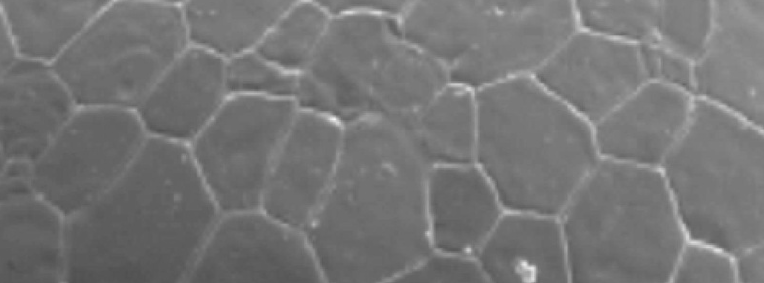
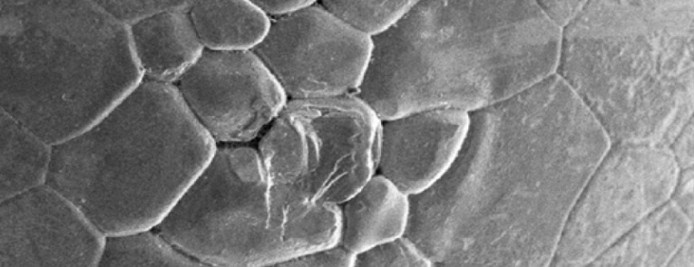
Effect of radiolytic H₂
Published experiments show radiolytic H₂ suppresses fuel corrosion
Closed atmosphere
Open atmosphere
~ inside a deep crack
α
α
H₂O₂
H₂
H₂O₂
H₂
UO₂²⁺
Solution
Solution
UO₂
15 μm
UO₂
15 μm
15 μm
15 μm
A. Traboulsi, J. Vandenborre, G. Blain, B. Humbert, J. Barbet, M. Fattahi, J. Phys. Chem. C 118 (2014) 1071-1080.

Slide 37
The Kinetics of Redox Controlling Reactions
Reactions involving H₂
Reaction 3 (c)has been shown to be independent of [H₂] down to [H₂] = 1.17 x 10⁻³M. This is unlikely to be the case at the lower concentrations anticipated.

Slide 38
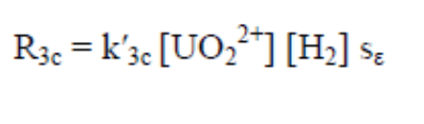
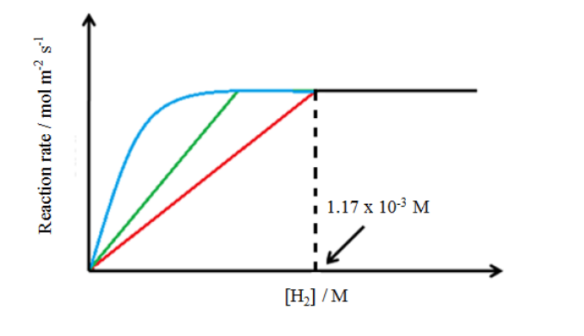
Kinetics of redox reactions involving H₂
We assume the reaction will eventually become first order in [H₂]
Three kinetic scenarios
Reaction becomes first order for [H₂] < 1.17 x 10⁻⁶M
Reaction remains independent to a lower [H₂] before becoming first order
The rate changes non-linearly with [H₂]
The first scenario is adopted yielding a conservatively low rate constant
This procedure is conservative since it minimizes the effect of H₂ on fuel corrosion
A similar procedure is adopted for other reactions involving H₂

Slide 39
The influence of H₂O₂ Decomposition
Experiments show decomposition occurs
The O₂ produced reacts much more slowly with UO₂ than H₂O₂
No detailed kinetic analysis has been performed

Slide 40
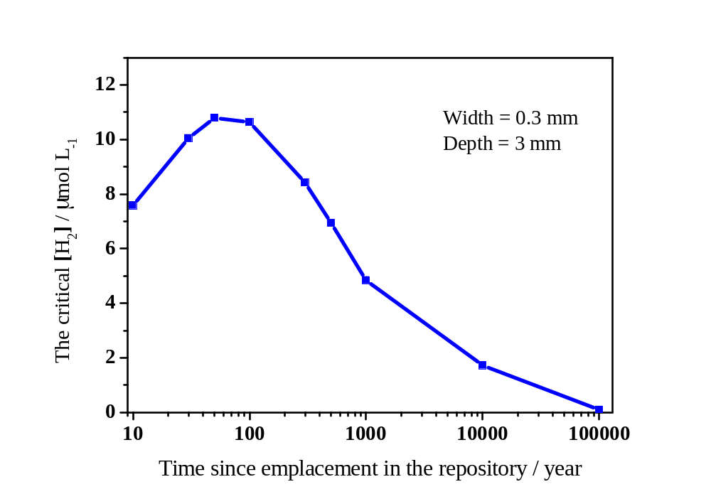
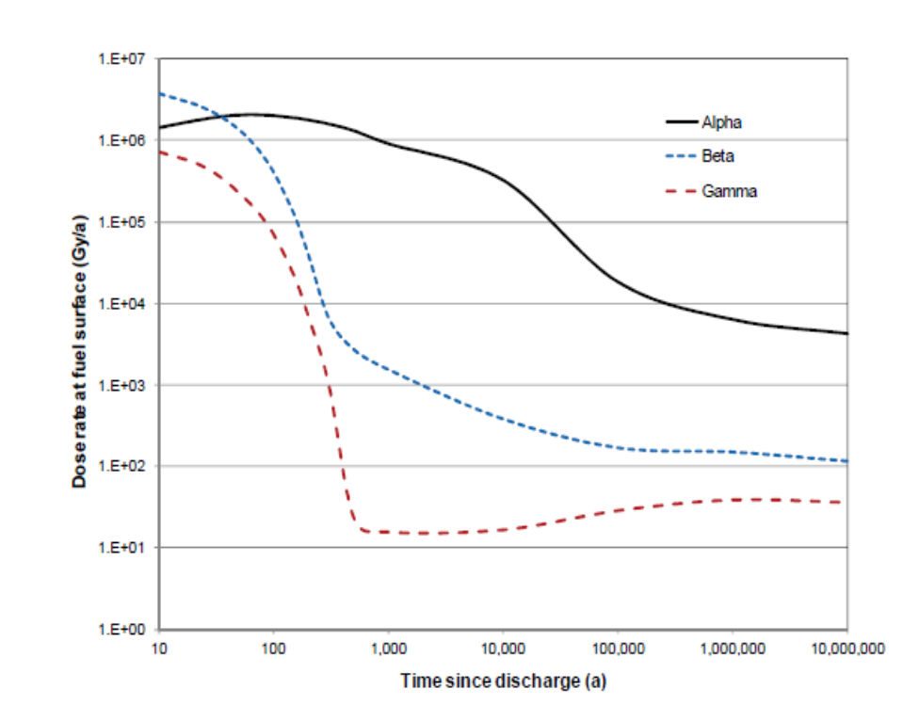
Factors Influencing the Critical [H₂]
α dose rate
The Critical [H₂] / μmol L⁻¹
1 E +07
1 E +06
1 E +05
1 E +04
1 E +03
1 E +02
1 E +01
1 E +00
Dose rate at fuel surface (Gy/a)
α
10 10² 10³ 10⁴ 10⁵
Time since emplacement in the repository / year
β
ϒ
10 10² 10³ 10⁴ 10⁵ 10⁶ 10⁷
Time since discharge (a)

Slide 41
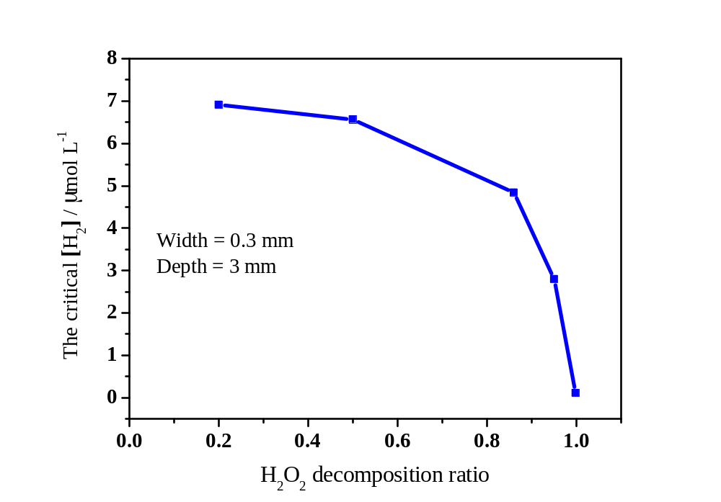

Factors Influencing the critical [H₂]
H₂O₂ decomposition ratio
The Critical [H₂] / μmol L⁻¹
Fraction of H₂O₂ going to decomposition
rather than fuel corrosion
H₂O₂ decomposition ratio
R. Pehrman, M. Trummer, C.M. Lousada, M. Jonsson, J. Nucl. Mater. 430 (2012) 6.
L. Wu, D.W. Shoesmith, Electrochim. Acta 137 (2014) 83.
L. Wu, J.S. Goldik, D.W. Shoesmith, J. Electrochem. Soc. 161(6) (2014) C363.

Slide 42
While the groundwater entering the failed container will be anoxic H₂O radiolysis due to radioactive decay within the fuel will establish oxidizing conditions
Radiolytic Corrosion and
The fuel will corrode and release radionuclides at a rate determined by the radiolytic oxidizing conditions
RN
Only alpha radiation significant
RN
Corrosion as U^{VI}
? ?
Dissolution as U^{IV}

Slide 43
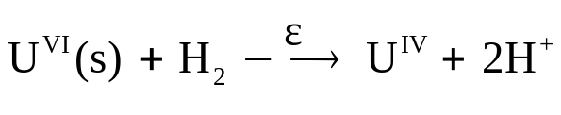
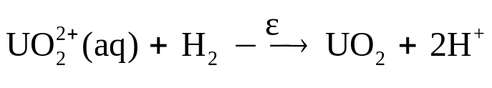
Reactions Inside a Failed Container
4
M.E. Broczkowski, J.J. Noël, D.W. Shoesmith, J. Nucl. Mater. 346 (2005) 16.
M.E. Broczkowski, J.J. Noël, D.W. Shoesmith, J. Electroanal. Chem. 602 (2007) 8.
M.E. Broczkowski, P.G. Keech, J.J. Noël, D.W. Shoesmith, J. Electrochem. Soc. 157 (2010) C275.

