Slide 1

Emulsions and Prussian Blue Analogues: Towards new nanomaterials for Cs uptake
Jérémy Causse, CEA Marcoule, Insitut de Chimie Séparative, France
MRS2017, Sydney, November 02nd

Slide 2
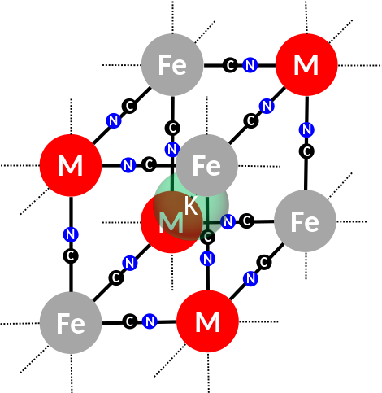
Definitions
EMULSIONS
Oil-in-water (O/W) or water-in-oil dispersions (W/O)
Surfactant needed to stabilise liquid/liquid interface
Droplets size from nm to μm
Template for macro/mesoporous materials
W
O
PRUSSIAN BLUE ANALOGUES
Alk_{x}M_{y}[M’_{z}(CN)₆]_{n} …
… but we will stay focused on K_{x}M_{y}[Fe(CN)₆]_{n}
Easy to prepare
Cs uptake (nuclear decontamination)

Slide 3
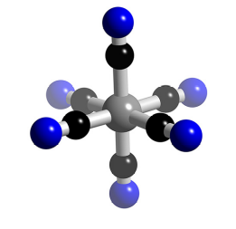

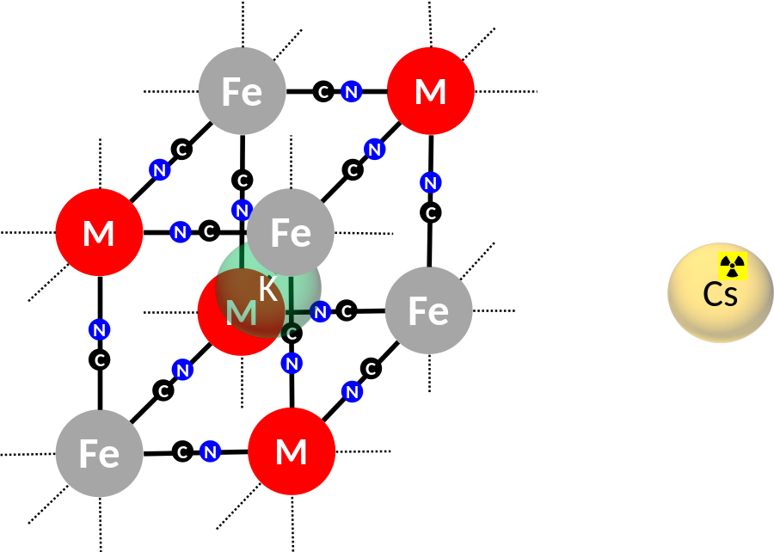
PBA formation
K⁺
K⁺
K⁺
K⁺
M²⁺
[Fe(CN)₆]⁴⁻
Classical PBA or Metal Hexacyanoferrate (MHCF)
K acts as charge compensator
PRUSSIAN BLUE ANALOGUES
Liquid Waste treatment
Cs immobilization on solid support
Design of MHCF functionalized silica
Exch. K-Cs

Slide 4
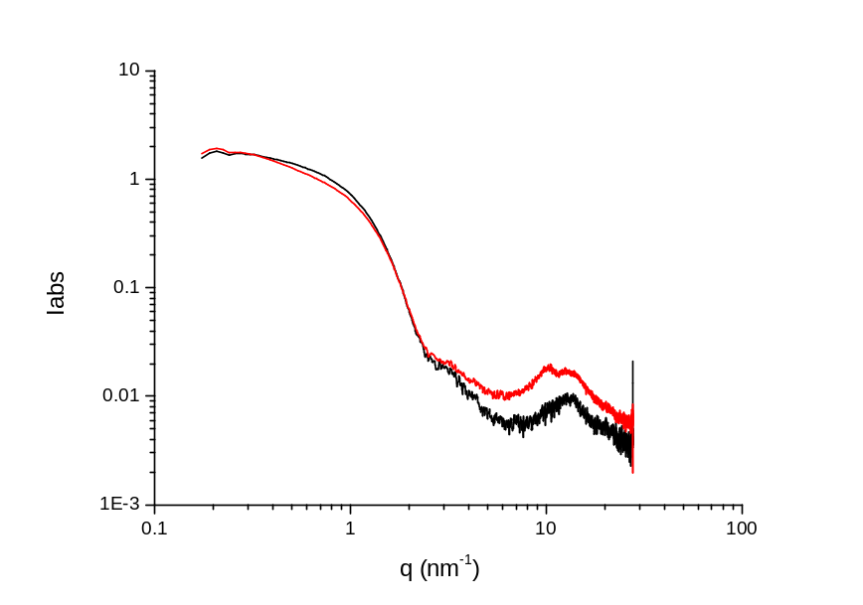
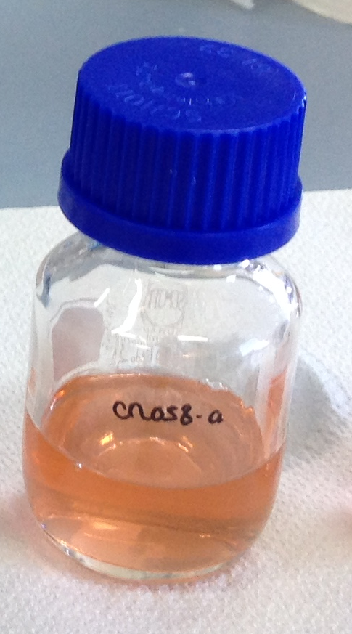
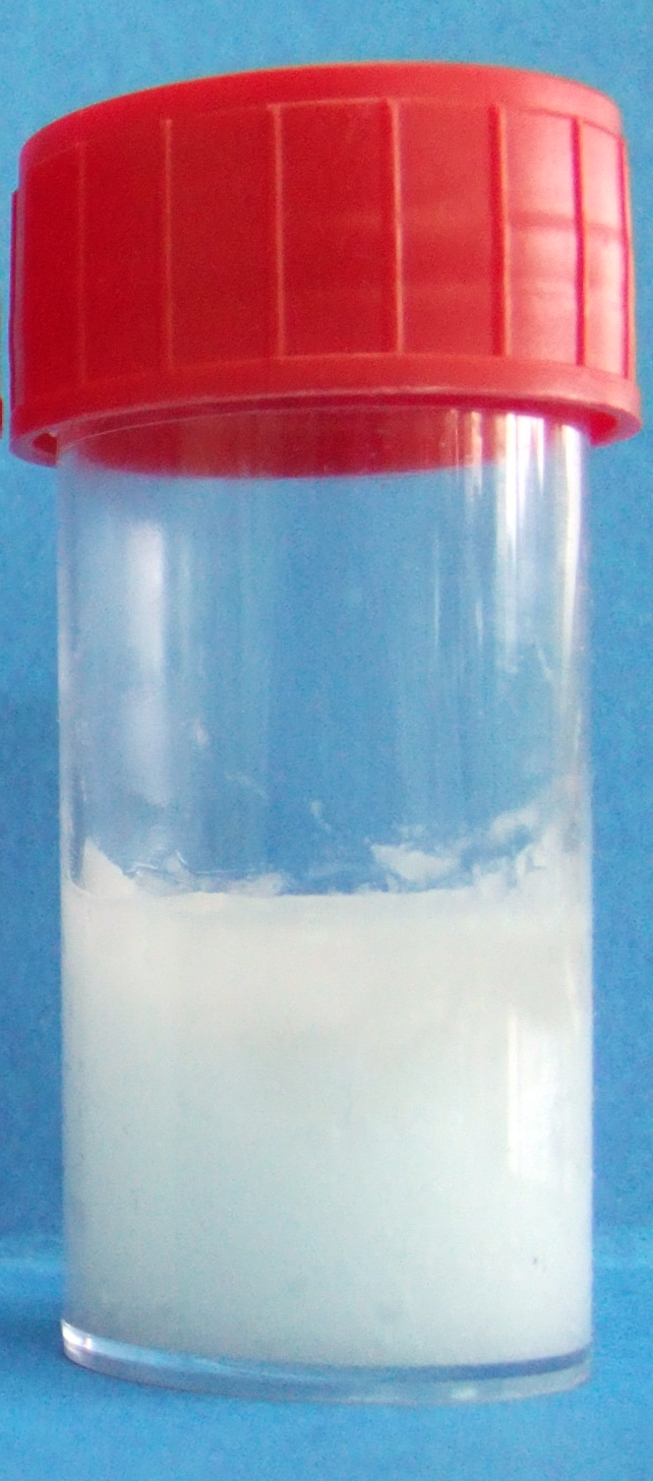
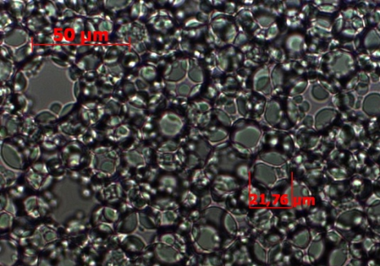
Emulsions
☹ Not enough time ☹
Microemulsion
Transparent
Nanodroplets
Template for nanoparticles (NPs)
R_{droplets}=1.7nm
HIPE
High-Internal Phase Emulsion
Φ_{INNER PHASE} >50%
White
5μm < Droplet size < 20μm
Template for porous monoliths

Slide 5
HIPEs for monolith synthesis

Slide 6
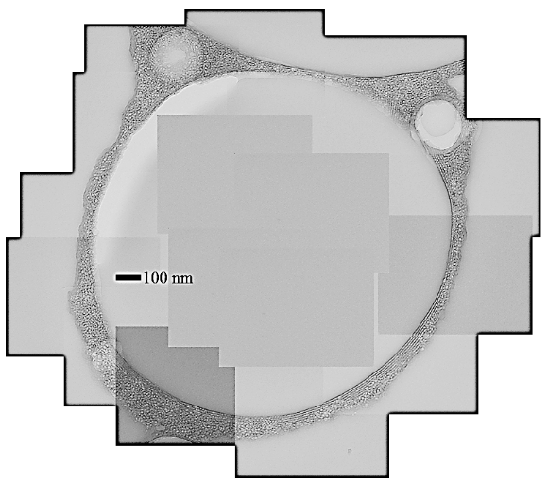
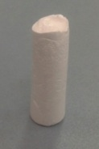
HIPE for macro/mesoporous monoliths
Si(OH)₄
Si(OH)₄
Si(OH)₄
Interconnected macropores
1-20 μm
Si(OH)₄
Si(OH)₄
Si(OH)₄
Si(OH)₄
Si(OH)₄
Si(OH)₄
Si(OH)₄
Mesopores
2-10 nm
Si(OH)₄
Si(OH)₄
Si(OH)₄
Si(OH)₄
Si(OH)₄
Si(OH)₄
Si(OH)₄
Si(OH)₄
Φ_{oil} around 73%vol
Silica precursor in water phase
Oil removal to empty macropores
Materials for continuous processes (not possible with powder)
SEM
TEM

Slide 7
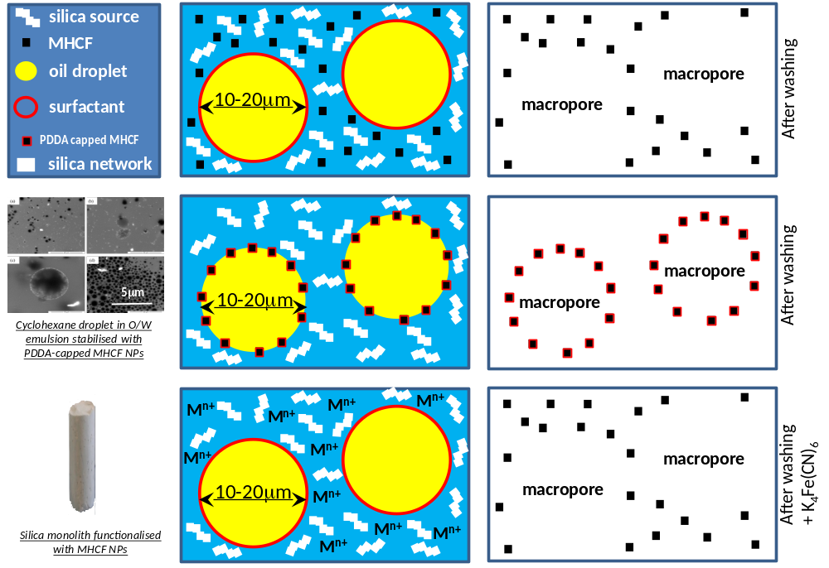
Functionalised monoliths with PBA particles
3 different functionalisation routes
1
2
3
Premaking of PBA NPs
Use of a colloidal suspension as precursor
Metal ions in the aqueous phase
Use of metal species as nucleation point for PBA particles growth
Design of PBA NPs with O/W interfacial activity
Use of a Pickering emulsion as precursor

Slide 8
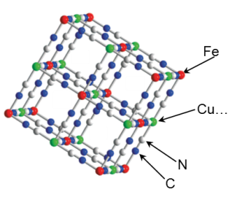
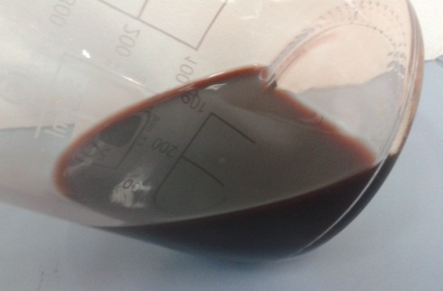
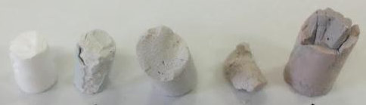
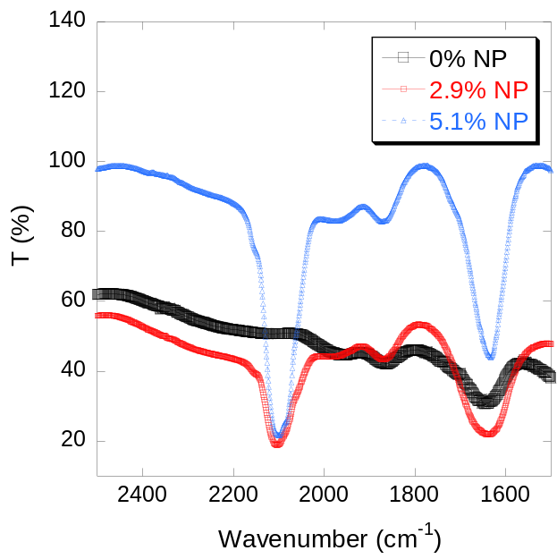
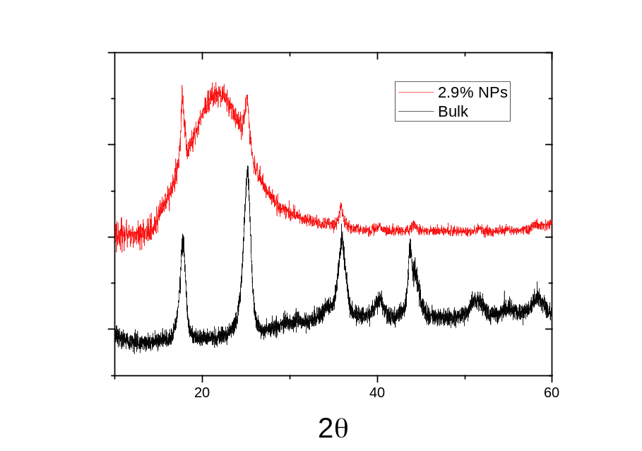
1. Colloidal suspension
CuFC
CuHCF colloidal suspension
XRD
FTIR
R
ν_{CN}

Slide 9
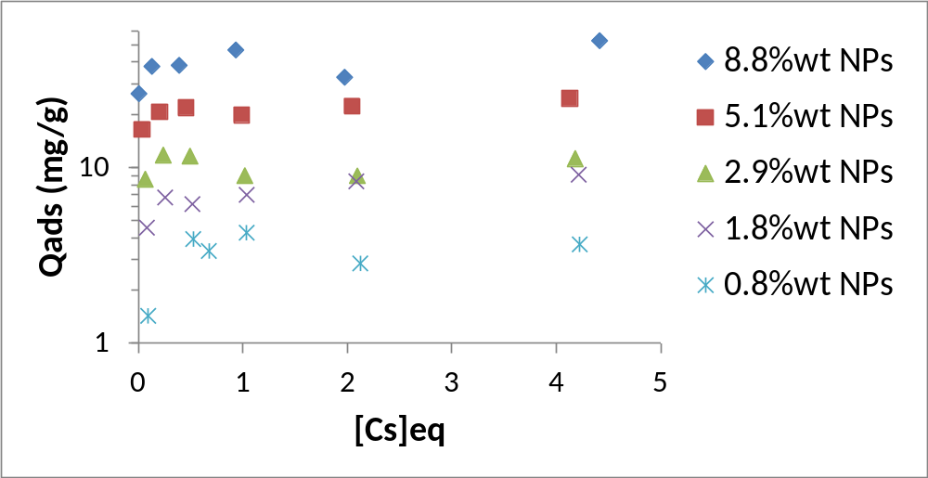
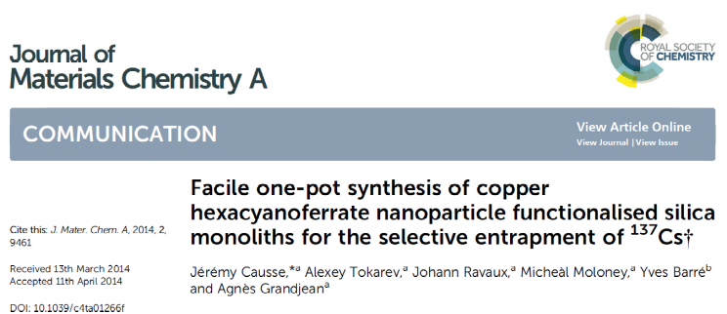
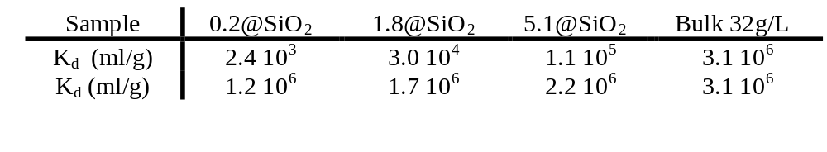
1. Colloidal suspension
Sorption capacity of 30-40 mg/g
Synthetic solution: 41250 Bq/l of Cs¹³⁷ (1. 10⁻¹⁰M) + 0,5M NaNO₃ + SO₄²⁻ + PO₄³⁻ + K + Mg + Ca (1,10⁻³M)
24 hours contact time with NP 0.2%wt : A_{final}=5500Bq/l , DF=7,5
24 hours contact time with NP 1.8%wt : A_{final}=600Bq/l , DF=69

Slide 10
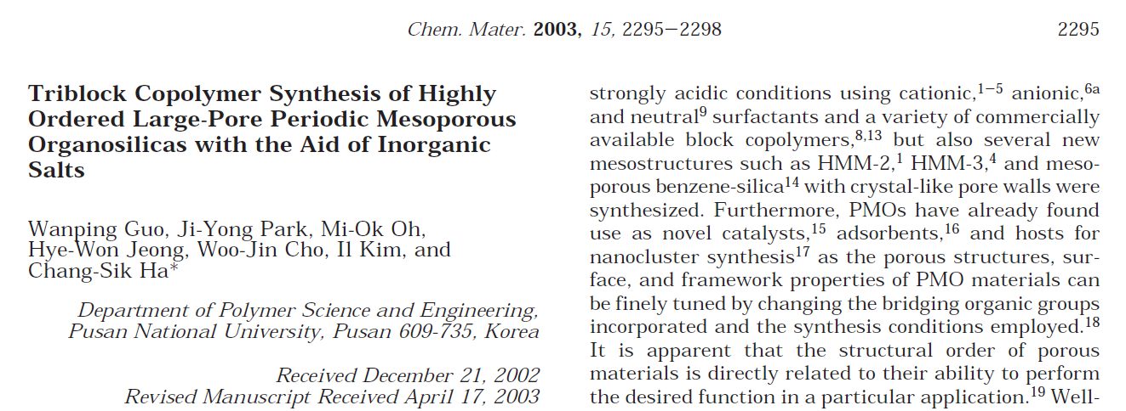
1. Colloidal suspension: salting-out
Oil
NPs favours dehydration of P123
P123 « is » more hydrophobic
Hydrophobic core of the micelle is bigger
P123 cmc decreases
More micelles with bigger core for the same concentration of [P123]
Oil
Oil
[P123] =
[NPs] ↑
Oil
Oil
Oil
21 mai 2014

Slide 11



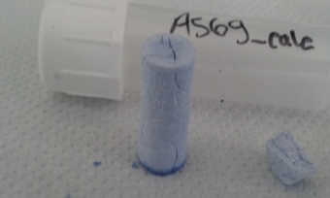
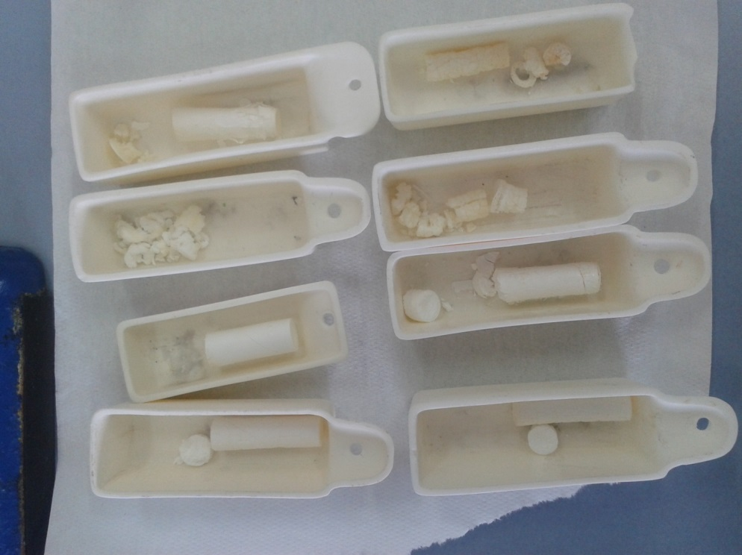
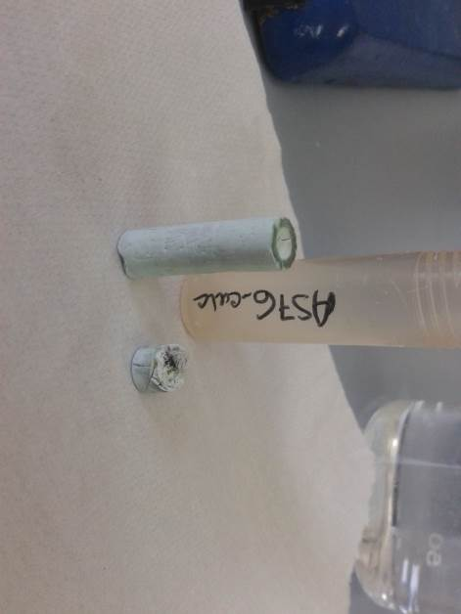
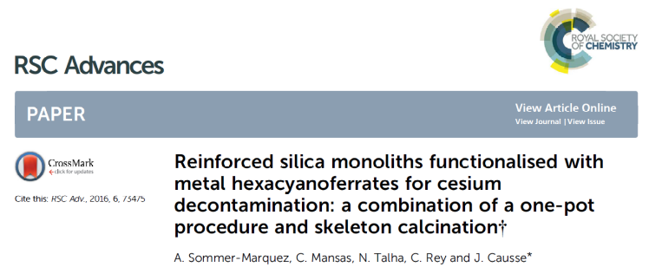
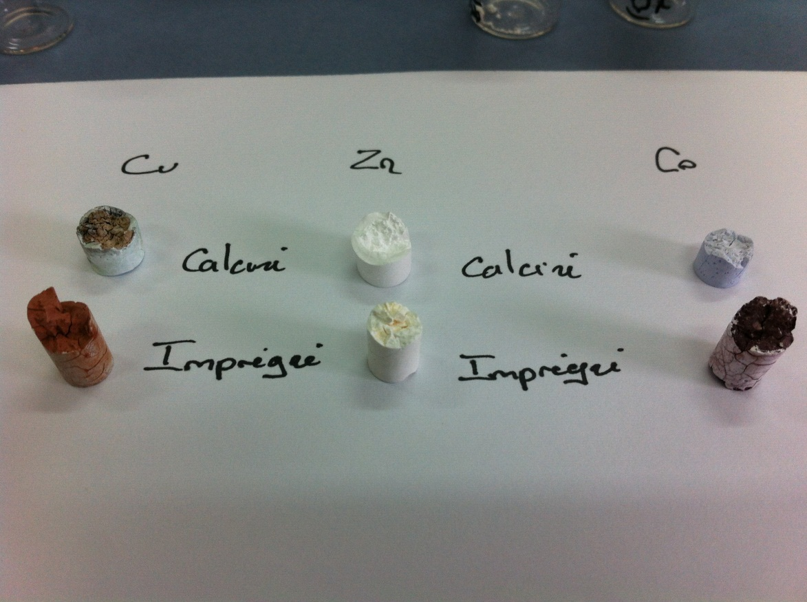
2. Metal Ions
Co²⁺
Co²⁺
Co²⁺
Co²⁺
Co²⁺
Co²⁺
Co²⁺
Co²⁺
Only metal is present during monolith synthesis
Calcination is possible because MHCF is not present yet
Monolith mechanical strength is increased
Co²⁺
Co²⁺
Co²⁺
Co²⁺
Co²⁺
Co²⁺
Co²⁺
Co²⁺
Co²⁺
Co²⁺
Calcination 500°C
Co-monolith
Zn-monolith
Cu-monolith
Impregnation with aqueous solution of K₄FeCN₆

Slide 12
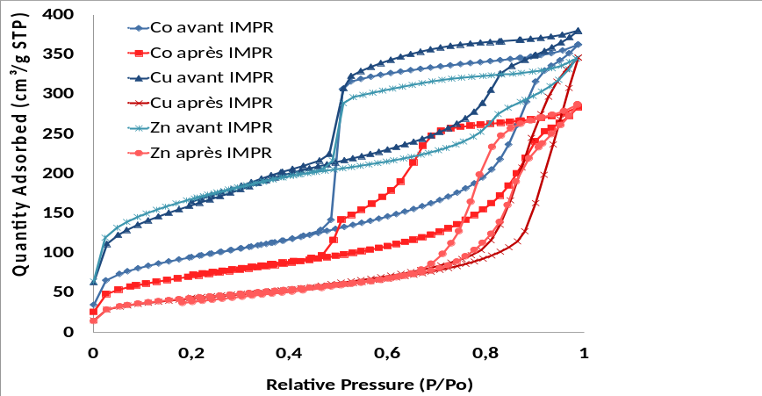
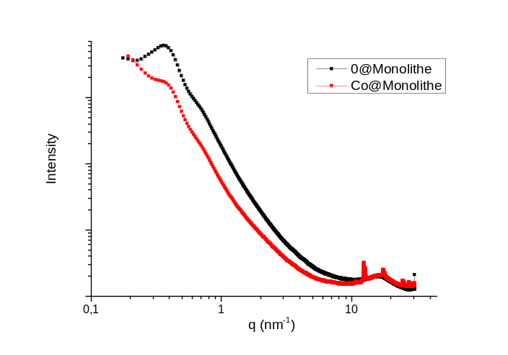
2. Metal ions
Co
Zn
Cu
SEM: Cubic particles (from 50nm to 300nm) inside macropores
BET: decrease of specific surface after impregnation
SAXS: decrease of the intensity of mesopores signal
BET+SAXS: presence of some smaller NPs inside mesopores? (no proof with TEM)

Slide 13
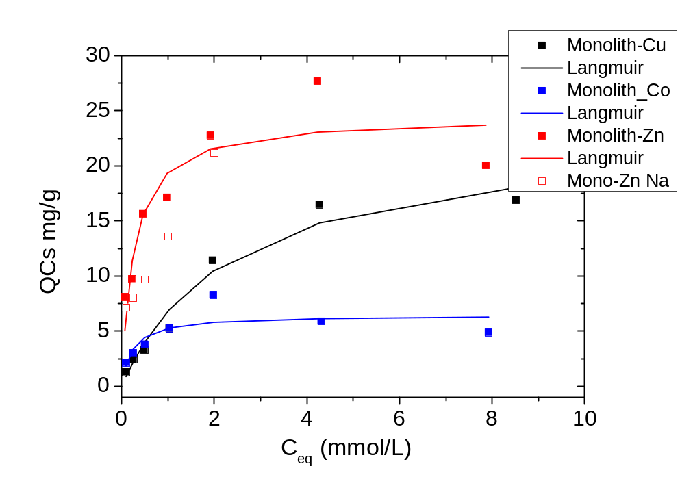
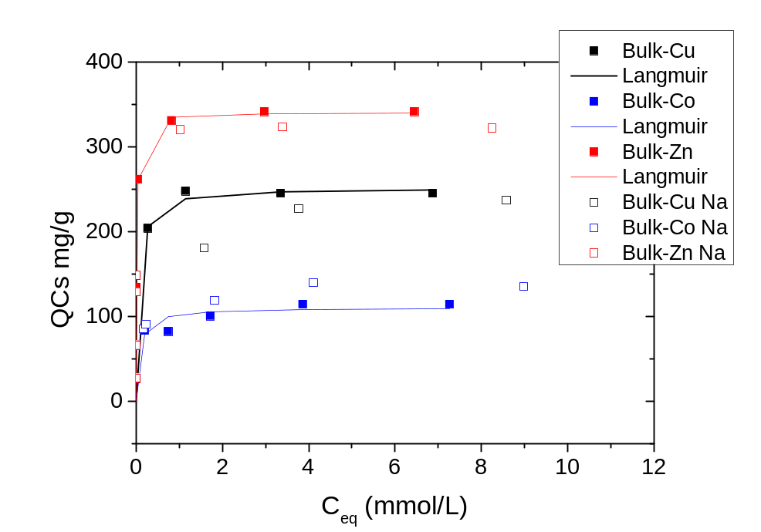
2. Metal ions
[Na]/[Cs]=10
Silica Monolith
Bulk
7,4%wt ZnPBA
6,9%wt CuPBA
7,4%wt CoPBA
≈ 7%wt PBA particles in the monoliths
Cs sorption capacity ≈ 25mg/g for ZnPBA
Same efficiency hierarchy for bulks and monoliths

Slide 14
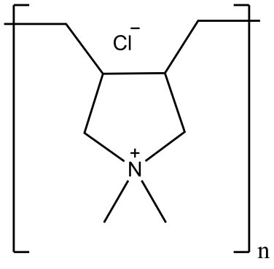

3. Pickering emulsions
PBA NPs very hydrophilic
Not active at O/W interface
Surface modification needed
Surface modification
H
H
L
L
H
L
H
H
L
L
H
H
L
L
H
H
L
L
H = PDDA
L = CH₃-(CH₂)_{n}-NH₂
PDDA
With PDDA: Interfacial activity
With Alkylamines: No interfacial activity
Interest: Location of PBA on the surface of macropores

Slide 15
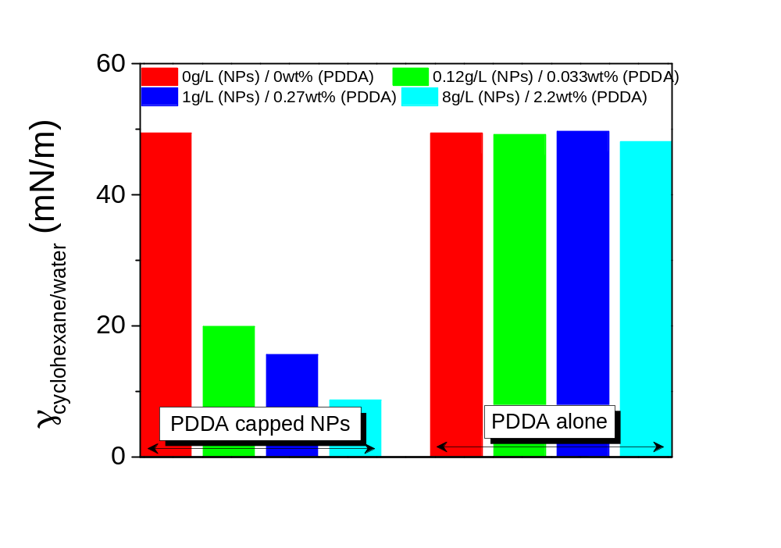
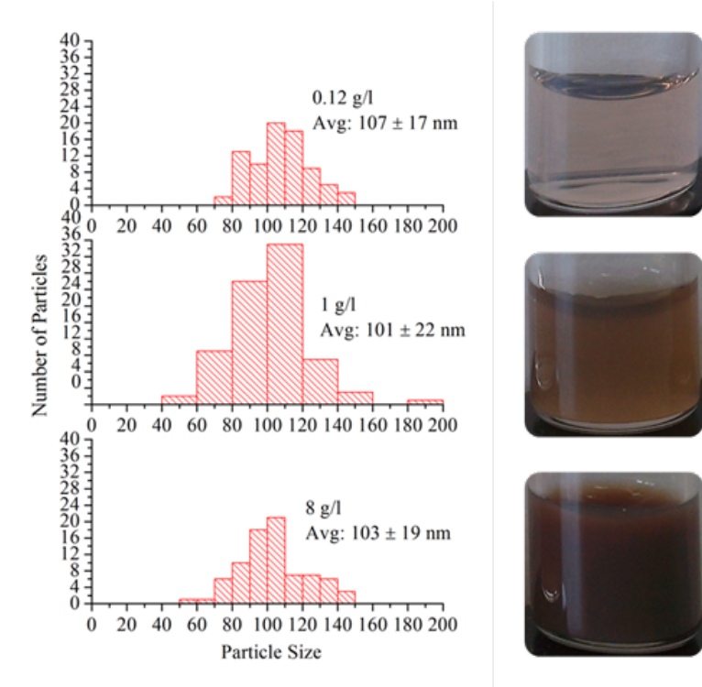
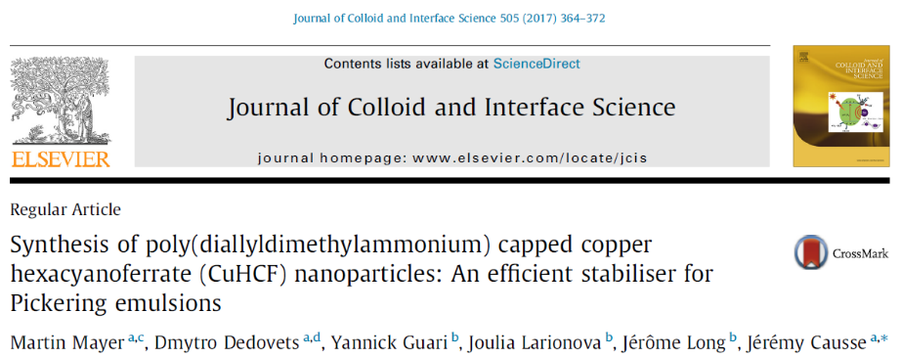
3. Pickering emulsions
CuHCF NPs covered with PDDA lower water/cyclohexane interfacial tension values

Slide 16
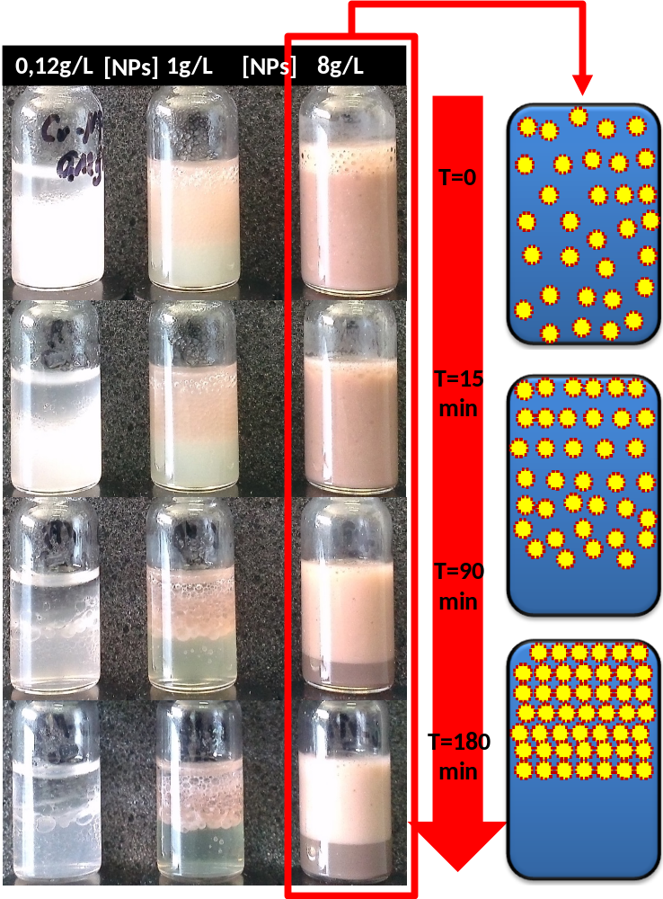
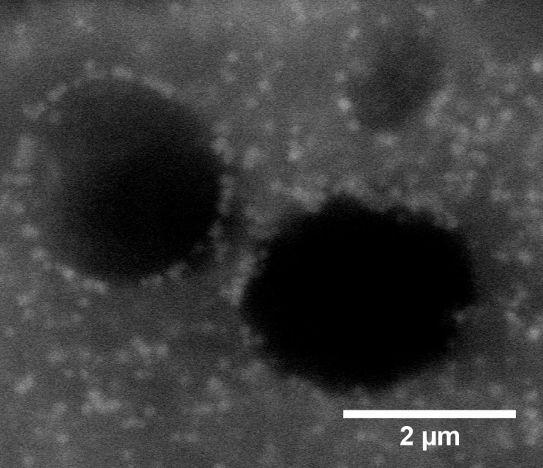
3. Pickering emulsions
Wet-SEM image
O/W 50/50 mix
Stable emulsions for [NPs]=8g/L
Creaming due to oil buyoancy
Road to functionalised materials
To be continued…

Slide 17
II – Microemulsion for NPs synthesis

Slide 18
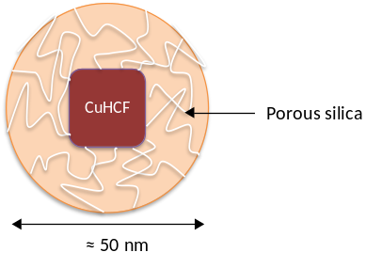
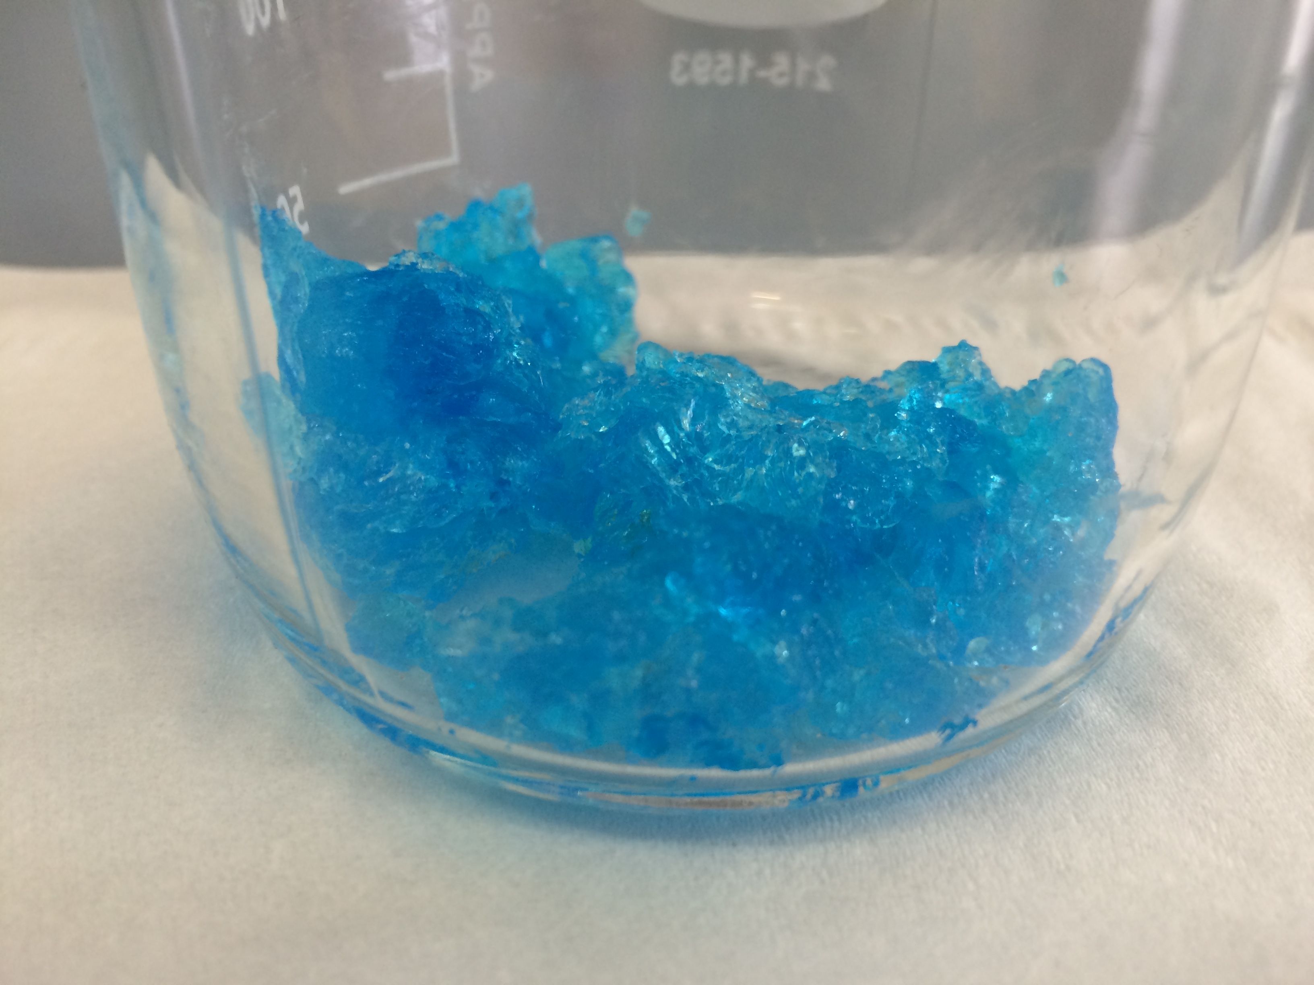
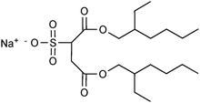




Core shell nanoparticles PBA@SiO₂
1) Modification of the surfactant
Ion exchange
Cu(NO₃)₂
Cu²⁺
2) Synthesis of core-shell NPs
1)Synthesis of CuHCF NPs
2)Growth of a silica shell
$w =\frac{n_{water}}{n_{AOT}}$
$h =\frac{n_{water}}{n_{TEOS}}$
[Cu(AOT)₂]=0,044M
isooctane
w=5
Very stable µemulsion
Generally, more concentrated system
More variable parameters (w, [K₂CuFe(CN)₆], pH, [TEOS])
→easier to characterize
$$\frac{n_{Cu}}{n_{Fe}}=\frac{4}{3}$$
Basic condition NH₄OH (1,338 M)
h= 4,8
TEOS
[Na(AOT)] = 0,1M
isooctane
[K₄Fe(CN)₆]=0,05M
w=5

Slide 19
Core shell nanoparticles PBA@SiO₂
STEM-HAADF images
D_{NP}=20-30 nm
D_{core}=2-4nm

Slide 20
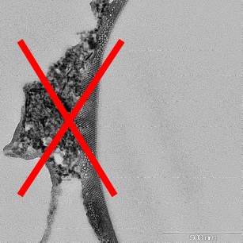

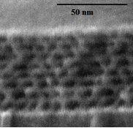
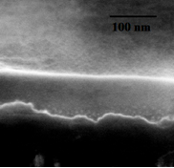
Why those NPs?
To use it as materials precursor
Membranes, gels, monoliths …
HIPEs stabilisation
A model material for separation/conditioning strategy
Before irradiation
After irradiation
Troom; Ar:20MeV, 10¹⁵ cm⁻²
Irradiation with heavy ions
Densification of the mesoporous silica¹
A possible closure of the material
Directly a containment material?
¹ S. Dourdain, X. Deschanels, G. Toquer, C. Grygiel, I. Monnet, S. Pellet-Rostaing, A. Grandjean J. Nucl. Mat. (2012), 427, 411-414

Slide 21
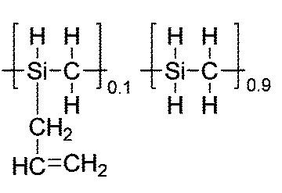
Outlook
HIPE - Monoliths
Silica support is controlled
Other inorganic matrices
Reverse W/O HIPE with O=SMP10
SiC monoliths for solar energy
SiCO monoliths with mechanical strength increase with regard to SiO₂
SMP10: SiC or SiCO precursor

Slide 22
Microemulsion - NPs
Before irradiation
After irradiation
Directly a containment material?
Irradiation with heavy ions
Densification of the mesoporous silica¹
A possible closure of the material

Slide 23

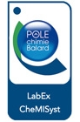




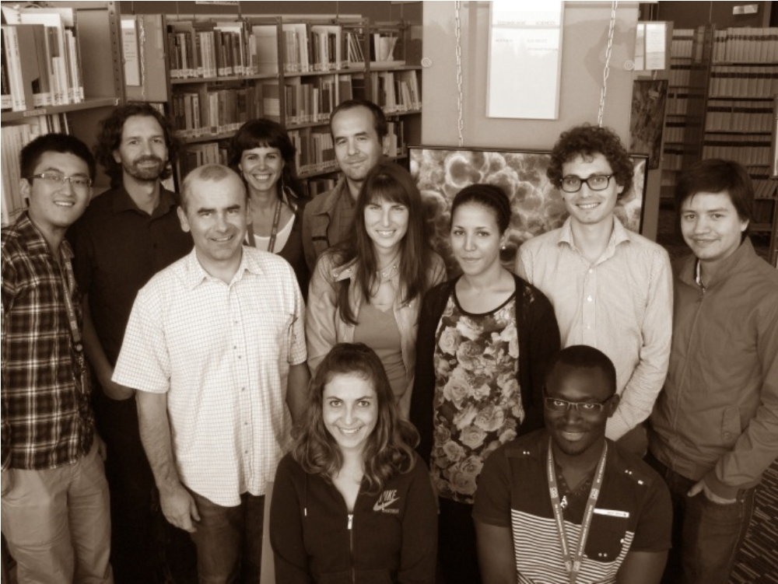
Acknowledgements
Alicia Sommer-Marquez
Post-Doc
Martin Mayer
Master Trainee
Clémentine Mansas
Ph-D student
Najat Talha
Technician

