Slide 1
Preparation of Ln_{1-2x}Ca_{x}Th_{x}PO₄.nH₂O rhabdophane-type as low precursors to monazite-Cheralite ceramics
Danwen Qin, Adel Mesbah, Stéphanie Szenknect, Nicolas Dacheux, Nicolas Clavier
Thorium incorporation in phosphates matrices: the case of xenotime
Adel Mesbah, Nicolas Clavier, Stéphanie Szenknect, Janeth Lozano-Rodriguez, Nicolas Dacheux.
Adel.mesbah@cea.fr

Slide 2
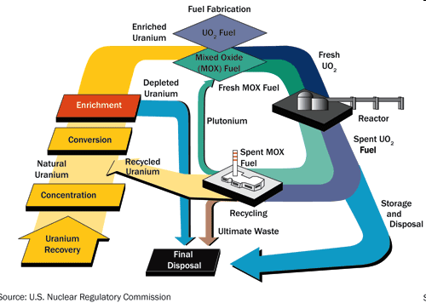
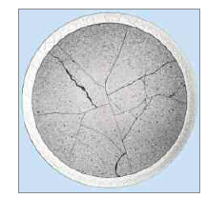
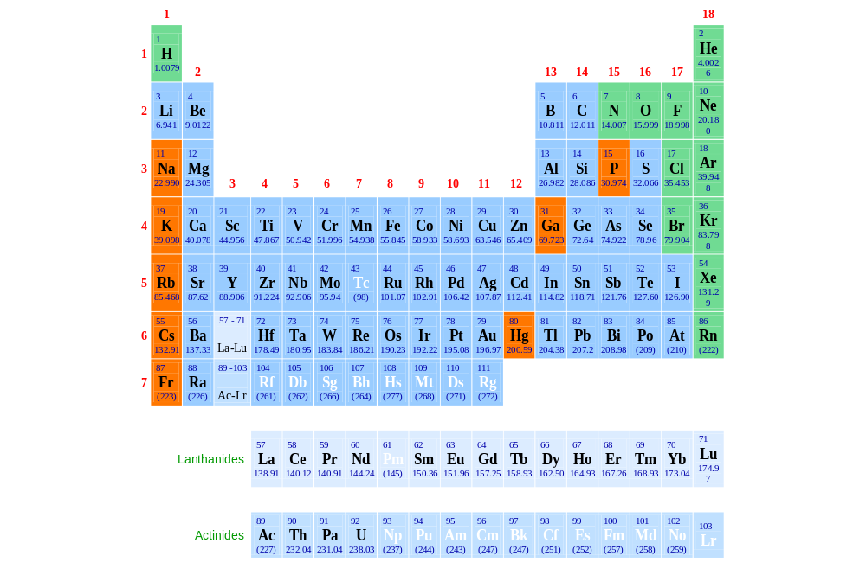
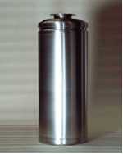
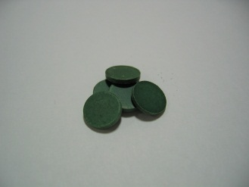
Long term disposal of nuclear wastes
Conditioning and storage of High level Wastes: Actinides

Slide 3
Which Matrix?
Different matrices have been considered
  Glass matrices
    Borosilicate (R7T7 in France)
    ATS (Alkaline-Tin-Silicate)
    LaBS: Glass enriched with lanthanides
    Glasses containing high amount of phosphates
  Ceramics
    Pyrocholore (Ln₂Ti₂O₇, CaPuTi₂O₇)
    Brannerite
    Zirconolite (CaZrTi₂O₇)
    Perovskite (CaTiO₃)
    Silicate : Zircon (ZrSiO₄), coffinite (USiO₄)
    Phosphate : Monazite, xenotime (LnPO₄), Cheralite (CaAn(PO₄)₂), Apatite, thorium phosphate diphosphate (TPD)
  Glass-ceramics

Slide 4
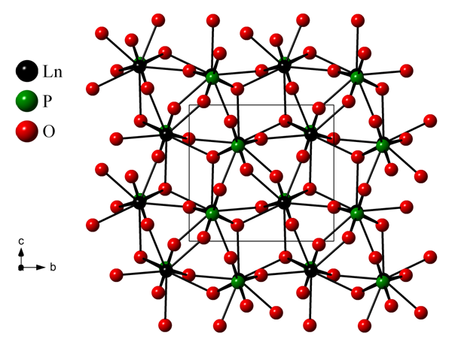
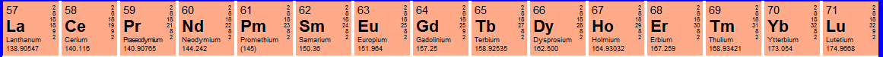
REEPO₄. nH₂O compounds
Rhabdophane¹: REEPO₄, 0.667H₂O
Monazite²: REEPO₄
Monoclinic, C2
Monoclinic, P2₁/n
Churchite³: REEPO₄ 2H₂O
Xenotime²: REEPO₄
Monoclinic, C2/c
Tetragonal, I4₁/amd
1- A. Mesbah et al, Cryst. Growth. Des, 14 (10), 5090–5098, 2014, 2- Ni, Y. X. et al, Am. Min. 80, 21-26, 1995 3- Hikichi, Y et al, J. Amer. Ceram Soc, 1989, 72, 1073-1076.

Slide 5
Why the REEPO₄ compounds?
Remarkable chemical flexibility
Direct substitution : M^{III}/M^{III} :
  La → Gd ; Pu → Es ; Tb & Bi (thermal limitations) ⇒ Solid solutions
Single substitution : M^{I}/M^{III} & M^{IV}/M^{III} :
  M^{I}M^{IV}₂(PO₄)₃ compounds
Coupled substitution : M^{II}+M^{IV}/M^{III} :
  (M^{III},M^{II},M^{IV})(PO₄) compounds
Coupled mixed substitution : (M^{III}+X^{V}O₄)/(M^{IV}+Y^{IV}O₄) or (M^{III}+X^{V}O₄)/(M^{II}+Z^{VI}O₄)
  (M^{III},M^{IV})(PO₄, SiO₄) ⇒ LaPO₄ – ThSiO₄ (huttonite, monoclinic P2₁/n)
            ErPO₄ – ThSiO₄ (Zircon, tetragonal I4₁/amd)
N. Clavier, R. Podor, N. Dacheux, J. Europ. Ceram. Soc. 31 (2011) 941-976 (REVIEW)

Slide 6
Incorporation of thorium in REEPO₄
Th(IV)
Ak²⁺ + Th⁴⁺ <-> 2 REE³⁺
Th⁴⁺ + SiO₄⁴⁻ <->
REE³⁺ + PO₄³⁻
Ak_{x}Th_{x}REE_{1-2x}PO₄
Th_{1-x}REE_{x}(PO₄)_{x}(SiO₄)_{1-x}
Challenge:
Synthesis of homogeneous compounds
Avoid grinding steps
solid-state chemistry methods
Use of wet chemistry methods
Thermal conversion to anhydrous compounds: Monazite-cheralite-xenotime

Slide 7
Light REE (La to Gd)
REEPO_{4.}nH₂O
Monoclinic, C2
Rhabdopane
- H₂O
Thermal conversion
Between 500°C and 900°C
REEPO₄
Monoclinic, P2₁/n
Monazite

Slide 8

The crystal structure of the Rhabdophane
Hexagonal form*, P3₁21: a= 7.069(3) Å, 6.443(5) Å
Le-bail refinement in P3₁21
Problem
The hexagonal structure doesn’t match with the Synchrotron data
R. Mooney, acta Crystallographica, 3 (1950) 337-340, Journal of Chemical Physics (1948), 16, 1003-1003

Slide 9
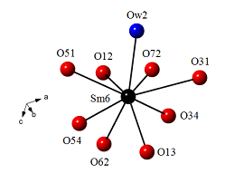
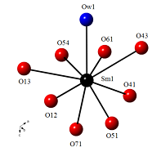
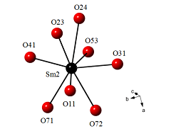
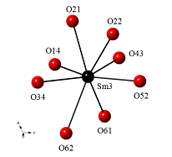
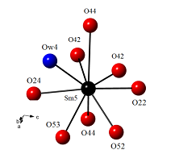
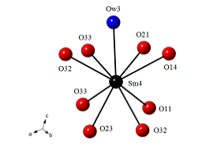
LnPO₄. 0.667H₂O: the monoclinic form
SmPO₄.0.667 H₂O
Monoclinic C2, a = 28.0903(1) Å, b = 6.9466(1) Å,
c= 12.0304(1) Å, β = 115.23(1)° and V = 2123.4 (1) Å³ with Z = 24
LnPO₄. nH₂O
A. Mesbah et al, Cryst. Growth. Des, 14 (10), 5090–5098, 2014

Slide 10
Thermal behavior: toward the monazite
TGA Analysis
Pellet of SmPO₄. 0.667 H₂O
Dilatometry experiment
Swelling of 1%
CuKα_{1,2}
Stabilization of LnPO₄.0.5H₂O?
LnPO₄
Remember
CaSO₄.0.5H₂O
?
LnPO₄.0.5H₂O
In situ PXRD

Slide 11
In the pursuit of the crystal structure
Monoclinic, C2
SmPO₄.0.5 H₂O
-0,167H₂O
-0,5H₂O
80°C
213°C
Monoclinic, C2
Hexagonal, P3₁21
SmPO₄.0.667 H₂O
Synchrotron Soleil
SmPO₄
Mesbah et al, Crystal Growth & Design 14 (10), 5090-5098, 2014
Mesbah et al, J. Solid. Stat. Chem, 249, 221-227, 2017

Slide 12
Synchrotron
SmPO₄.0.5 H₂O
CaSO₄.0.5 H₂O
SmPO₄.0.667 H₂O
CaSO₄.0.625 H₂O

Slide 13
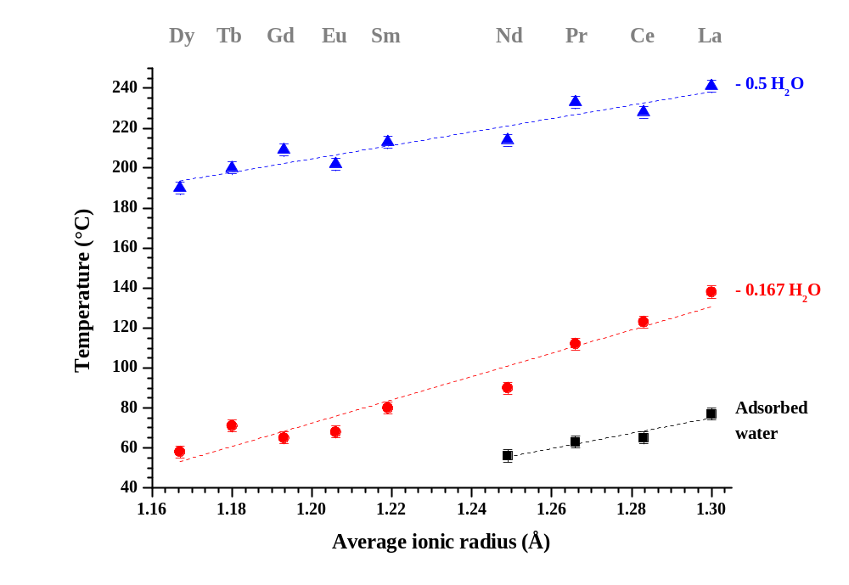
LnPO4.nH₂O
Larger Channels
LnPO₄
LnPO_{4.}0.5H₂O
LnPO_{4.}0.667H₂O
When you think it’s over it begins again

Slide 14
Light REE (La to Gd)
Ca_{x}Th_{x}REE_{1-2x}PO_{4.}nH₂O
Monoclinic, C2
Rhabdopane
- H₂O
Thermal conversion
Between 500°C and 900°C
Ca_{x}Th_{x}REE_{1-2x}PO₄
Monoclinic, P2₁/n
Monazite-Cheralite

Slide 15
Ca_{x}Th_{x}REE_{1-2x}PO₄
Synthesis of the hydrated forms
Rhabdophane structure type
Ca_{x}Th_{x}REE_{1-2x}PO₄. nH₂O
x CaCl₂ + x Th(NO₃)₄ + 1-2x REECl₃ + H₃PO₄→ Ca_{x}Th_{x}REE_{1-2x}PO₄. nH₂O + 3H⁺ + 4xNO₃⁻ + 3-4x Cl⁻
What is the trick to stabilize pure and homogeneous compounds ?
Temperature of synthesis
Multiparametric study
Heating time
Reactants stoichiometry

Slide 16
Multiparametric study
Reactants stoichiometry
 |  |  | Ca | Th | Pr | P/( Ca + Th +Pr)
110 | 1 | 4 | 0.069±0.003 | 0.110±0.004 | 0.821±0.026 | 1.038 ± 0.036
110 | 2 | 4 | 0.095±0.005 | 0.100±0.005 | 0.805±0.034 | 0.981 ± 0.071
110 | 5 | 4 | 0.083±0.004 | 0.109±0.004 | 0.808±0.031 | 1.042 ± 0.043
110 | 10 | 4 | 0.111±0.004 | 0.105±0.003 | 0.785±0.024 | 1.031 ± 0.035
Need excess of calcium
Ca:Th =10:1
110°C
4 days
Stoichiometric and Pure rhabdophane
Temperature of synthesis
Heating time
D. Qin, A. Mesbah et al, J. Nucl. Mat, 492, 88–96, 2017

Slide 17
Ca_{x}Th_{x}REE_{1-2x}PO₄.nH₂O
Excess of calcium during the synthesis
1000°C
Limit of substitution at x = 0.15
D. Qin, A. Mesbah et al, J. Nucl. Mat, 492, 88–96, 2017

Slide 18
What’s about the pH of synthesis

Slide 19
Impact of pH
pH = 8
Ca_{0.5}Th_{0.5}PO₄.nH₂O
Formation of a complete solid solution
Slight change of slope
Cationic ordering ?
1100°C
Ca_{0.5}Th_{0.5}PO₄

Slide 20
From silicates to phosphates
Th_{1-x}Er_{x}(SiO₄)_{1-x}(PO₄)_{x}

Slide 21
Th_{1-x}Er_{x}(SiO₄)_{1-x}(PO₄)_{x}
Th_{1-x}Er_{x}(SiO₄)_{1-x}(PO₄)_{x}
Huttonite, monoclinic P2₁/n
Zircon, tetragonal, I4₁/amd
Synthesis
Attempts by mixing the reactants in acidic conditions led to the formation of amorphous powders
Synthesis of pure Th_{1-x}Er_{x}(SiO₄)_{1-x}(PO₄)_{x} in application of the previous protocol¹ used to synthesize Coffinite USiO₄
250°C for 7 days
1- Mesbah et al, Inorg. Chem, 2015, 54 (14), pp 6687–6696

Slide 22
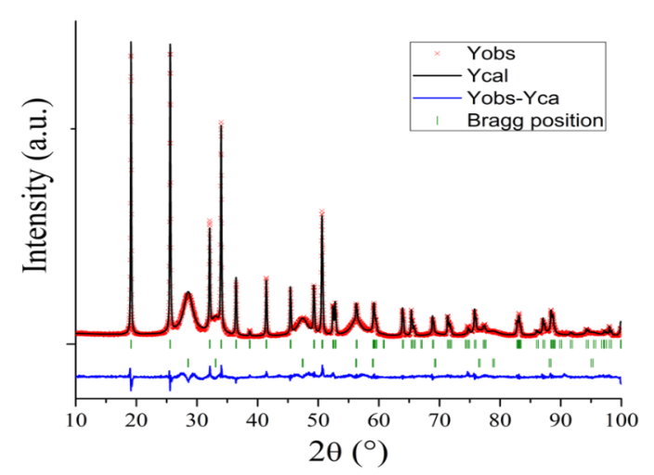
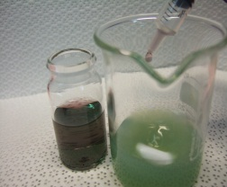
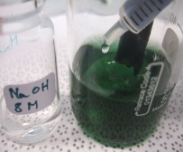
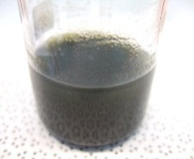
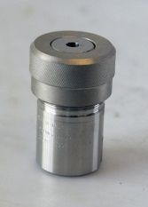
Coffinite ?
All syntheses performed in an inert glove box (Ar) to prevent U⁴⁺ oxidation
Stoichiometric mixture of reactants in hydrochloric media
Basification up to 8.5 (NaOH)
pH buffering (NaHCO₃)
Hydrothermal treatment
×
11.3
1 mmol UCl₄
+ 1mmol Na₂SiO₃
[CO₃²⁻] = 0.5 M
250°C, 45 bars, 30 d
Mesbah et al, Inorg. Chem, 54 (14), 6687-6696, 2015.

Slide 23
Th_{1-x}Er_{x}(SiO₄)_{1-x}(PO₄)_{x}
Formation of solid solution
in agreement with the Vegard’s law
Si⁴⁺
0.4 Å
Th⁴⁺
1.19 Å
P⁵⁺
0.31 Å
Stabilization of a synthetic
Th_{1-x}Er_{x}(SiO₄)_{1-x}(PO₄)_{x}
solid solution
Er³⁺
1.14 Å
1- A.Mesbah et al, Inorg. Chem, 55 (21), 11273-11282, 2016

Slide 24
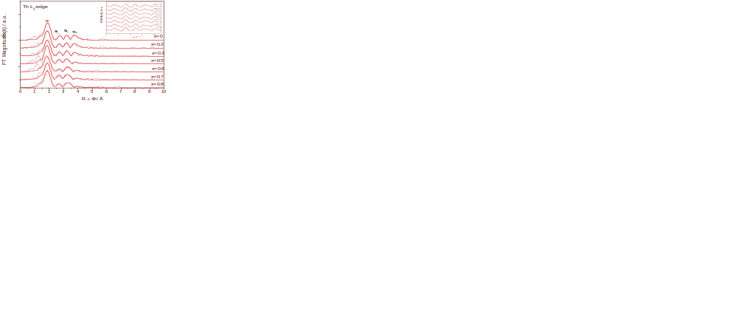
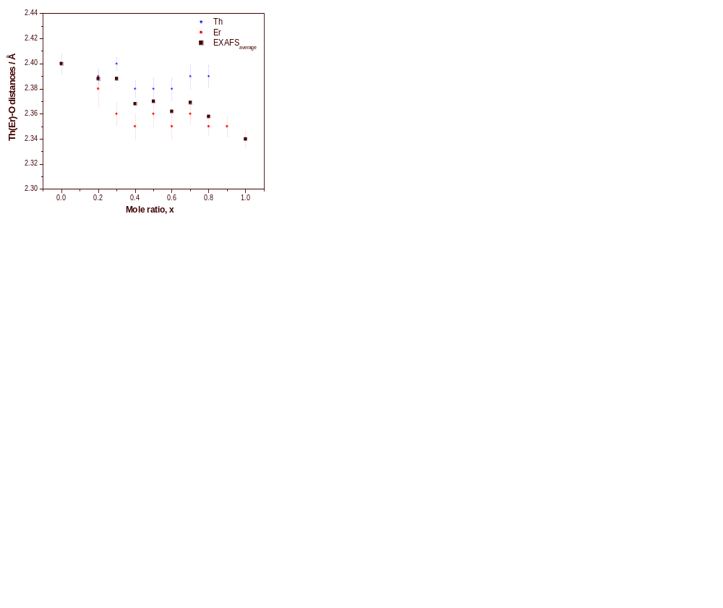
Local structure: EXAFS
Stability of the Th-O distances
Evolution of the Er-O distances

Slide 25
Spectroscopy

Slide 26
Conclusion and Perspectives
Wet chemistry methods
Pure and homogeneous compounds
Incorporation of An⁴⁺
Ca_{x}Th_{x}REE_{1-2x}PO₄.nH₂O
Th_{1-x}Er_{x}(SiO₄)_{1-x}(PO₄)_{x}
Thermal treatment: conversion
Ca_{x}Th_{x}REE_{1-2x}PO₄
Th_{1-x}Er_{x}(SiO₄)_{1-x}(PO₄)_{x}
Sintering capability
Chemical durability : dissolution kinetics and thermodynamics

Slide 27
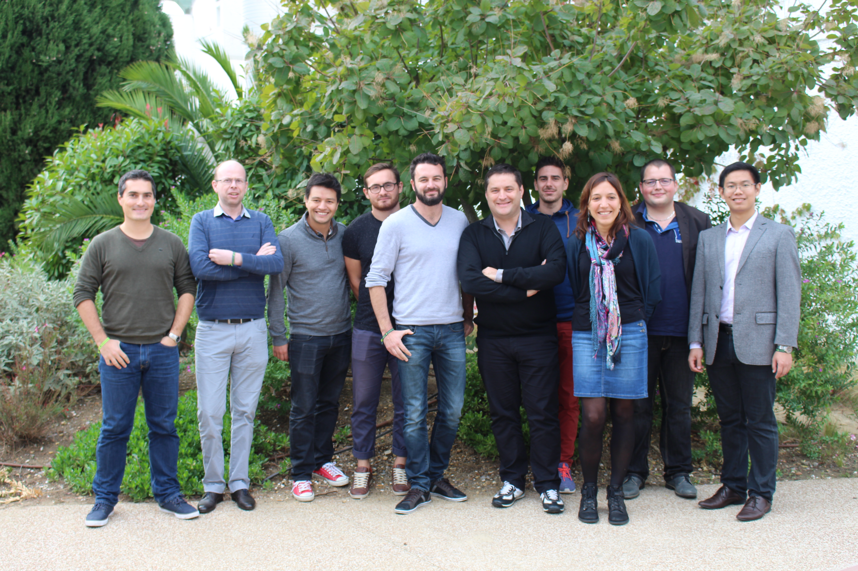
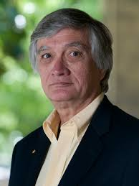





Acknowledgments
Laboratory of Evolving Interfaces in Materials
Rod Ewing
Alexandra Navrotsky
www.icsm.fr
Thank you for your attention !
26

