Slide 1
Synthesis and characterization of brannerite UTi₂O₆
Adel Mesbah, Stéphanie Szenknect, Nicolas Dacheux
Julien Marcadier, Daniel Beauffort, Anne-Magali Seydoux, Virginie Chapon, Aurelien Eglinger, Phillipe Gonclaves, Yann Batonneau, Maurice Pagel
Adel.mesbah@cea.fr

Slide 2
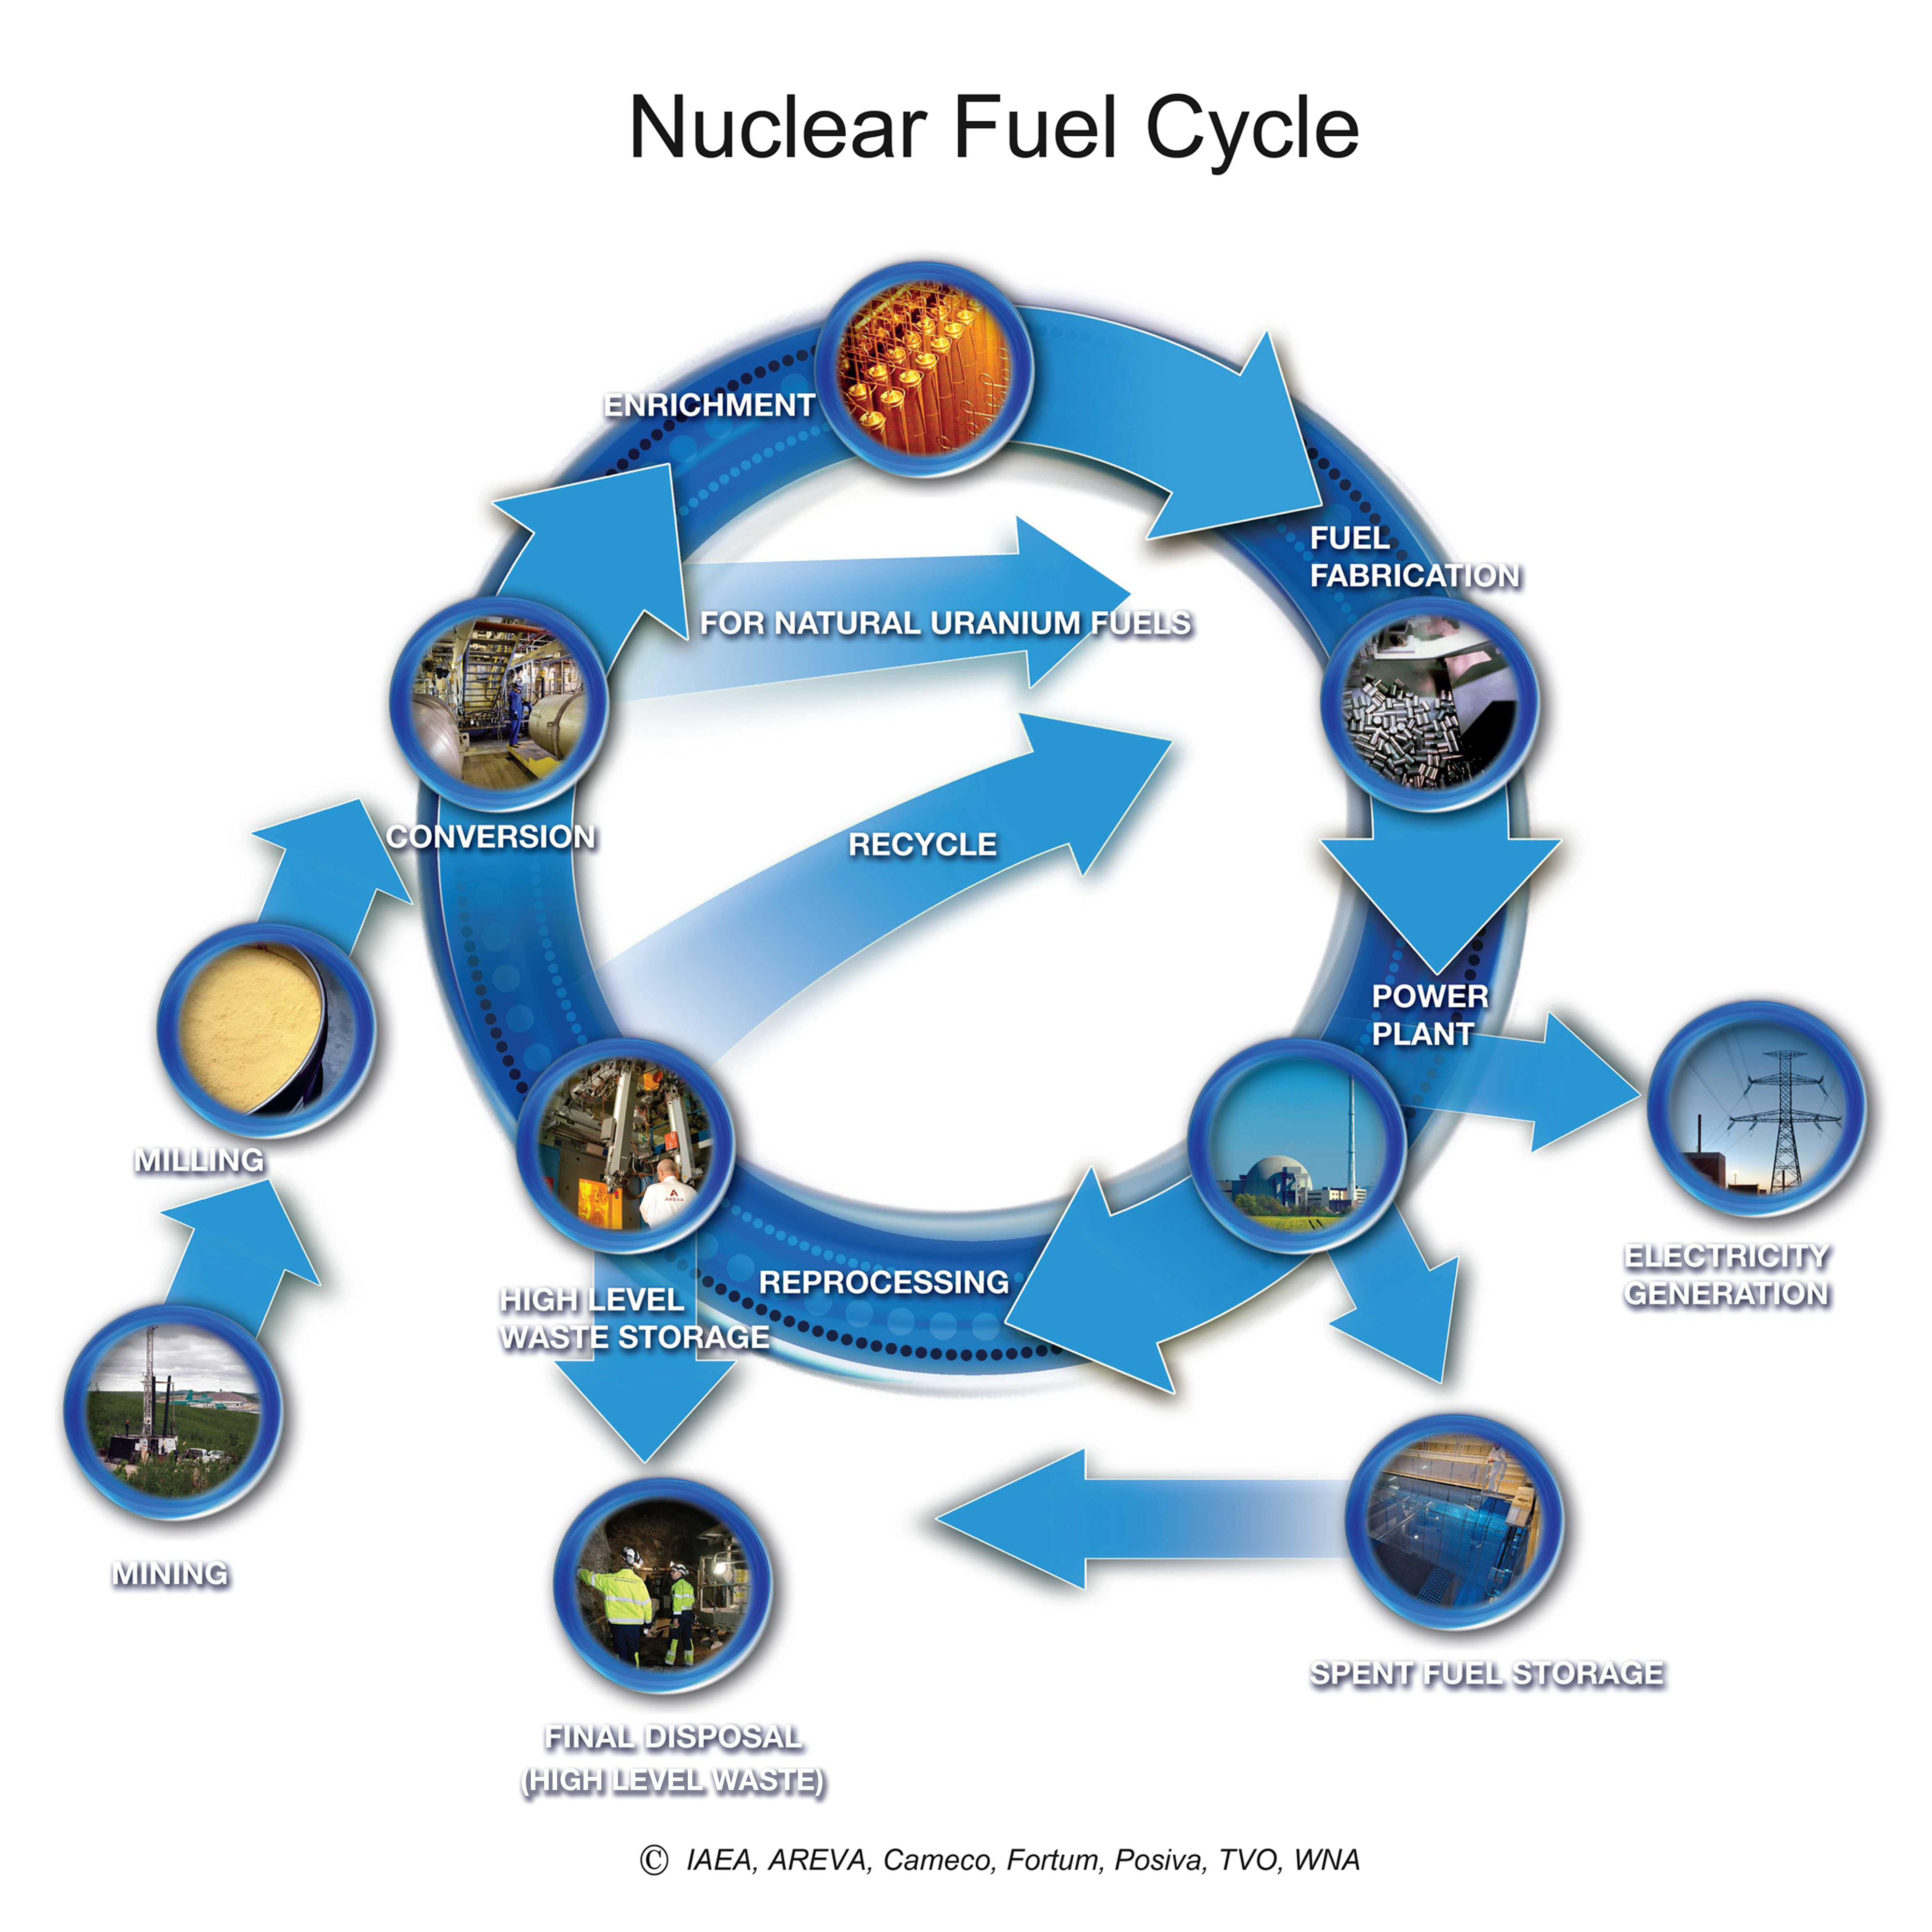
Why Brannerite ?
Front-End
Third source of U⁴⁺ on earth: UTi₂O₆
(U, Ca, Y, Ce, La, Pb, Th)(Ti, Si, Al Fe)₂O₆¹
Phases identified in different places:²
Elliot Lake (Canada), Mount Isa (Australia), Kirovograd (Ukraine), Crocker Well (Australia), Witwatersrand (South Africa)…
Back-End
Exhausting of U-resources
Ceramics for the specific conditioning of HLW
Possible host ceramic for actinides³
Enter in the composition of the Synroc
1. Bowell, R. J.; Grogan, J.; Hutton-Ashkenny, M.; Brough, C.; Penman, K.; Sapsford, D. J. Minerals Engineering 2011, 24, 1305. 2. Guilligan.R, Nikoloski. A.N, Minerals Engeneering, 2015, 71, 34-48, 3. S.V.Yudintsev et al, Radiochemstry, 333-348, 2016

Slide 3
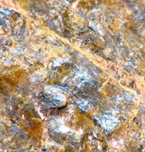
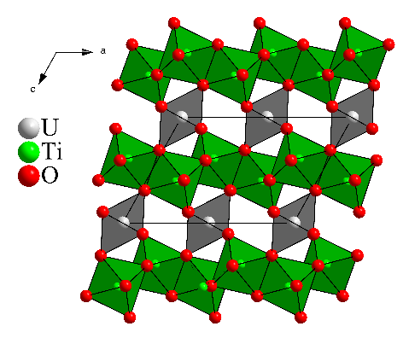
How it looks
Crystal structure
UTi₂O₆: Monoclinic C2/m
a = 9.822 Å, b = 3.824 Å, c 7.036 Å et β = 118.84°
Natural mineral is metamict
(U, Ca, Y, Ce, La, Pb, Th)(Ti, Si, Al Fe)₂O₆¹
Phases identified in different places²:
Elliot Lake (Canada), Mount Isa (Australia), Kirovograd (Ukraine), Crocker Well (Australia), Witwatersrand (South Africa)…
Brannerite: refractory phase to dissolution
Only few thermodynamic data⁴
Thermal treatment
Precedent works: More dedicated to the extraction of U under aggressive conditions
Requires heating at 1000°C in order to recover the crystallinity
1. Bowell, R. J.; Grogan, J.; Hutton-Ashkenny, M.; Brough, C.; Penman, K.; Sapsford, D. J. Minerals Engineering 2011, 24, 1305. 2. Guilligan.R, Nikoloski. A.N, Minerals Engeneering, 2015, 71, 34-48, 4. KB Helean et al, J. Nucl. Mater, 231-244, 2003

Slide 4
Challenges
Pure Brannerite
Free from TiO₂ and UO₂
Multiparametric dissolution experiments
Acid concentration, T, complexing agent, Redox

Slide 5
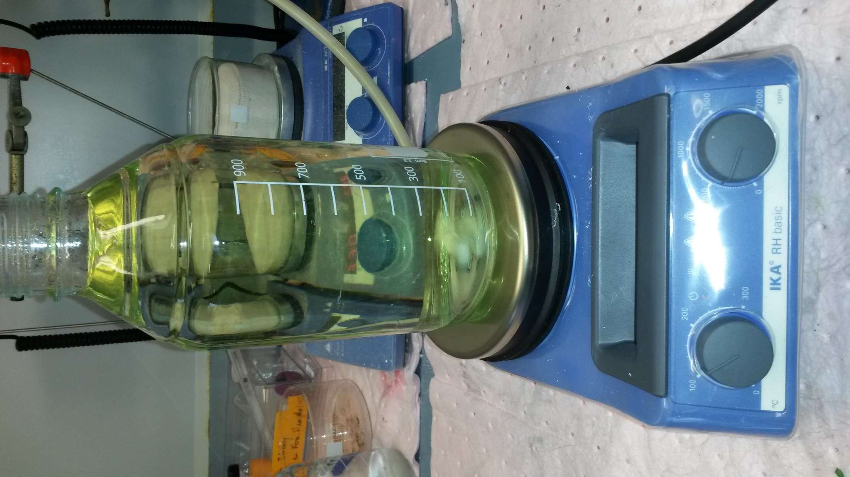
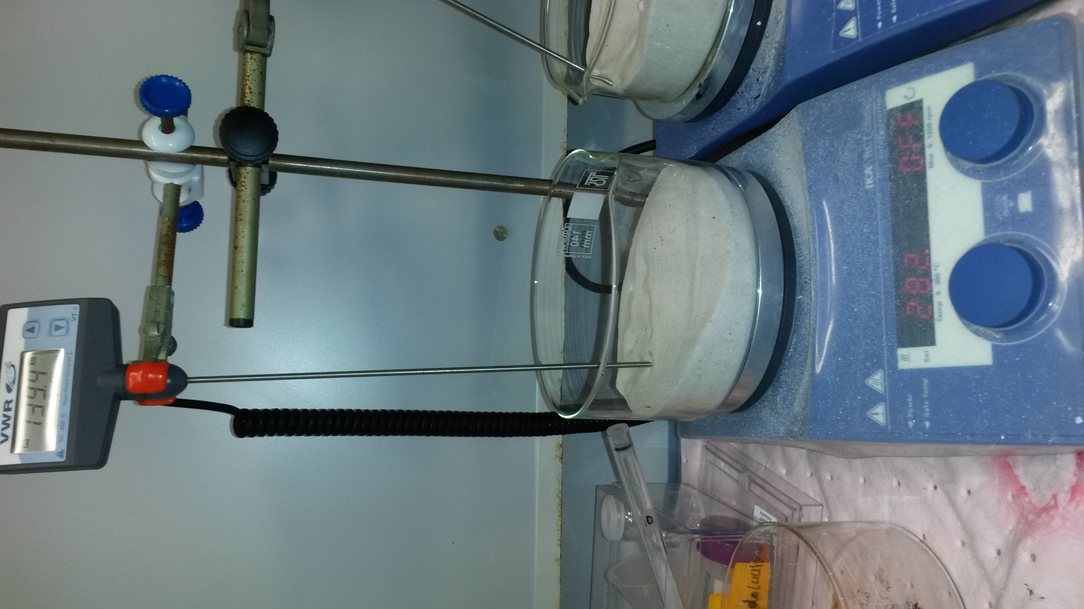
How to prepare brannerite
Different methods: Synthesis of precursors
Acetate method¹
uranium acetate + TiOSO₄.2H₂O in oxalic solution
Evaporation of the solution at 200°C, calcination at 600°C
Milling and thermal heating at 1200°C for 96h
Alkoxyde/nitrate route²
Titanium Isopropoxyde (IV) + uranyl nitrate solution
Wet milling 16 h, thermal treatment at 1400 °C for 14h
Solid state synthesis
UO₂ + TiO₂
Uranium oxide (UO₂) et de titanium (TiO₂) under the form of powders
1 –F.A. Charalambous et al, Hydrometallurgy, 139, 1-8, 2013
2 – A.E. Ringwood, et. Al, in W. Lutze and R.C. Ewing (Eds), Radioactive Waste Forms for the future “SynRoc”, 223-334, 1988

Slide 6
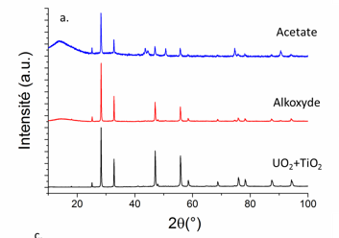
Which atmosphere?
Ar/H₂
Air
Ti₃O₅ + UO₂
TiO₂ + U₃O₈
Ar or N₂
Agrees with what was already reported in the literature
UTi₂O₆ + UO₂
E.R Vance, et al, J. Amer. Cerm. Soc, 141–144, 2001

Slide 7
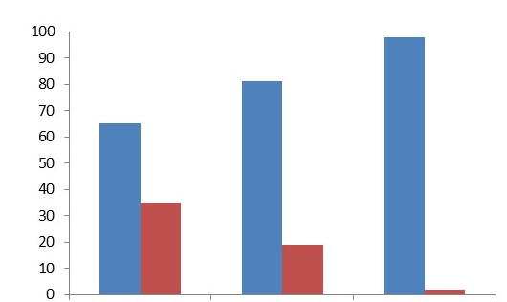
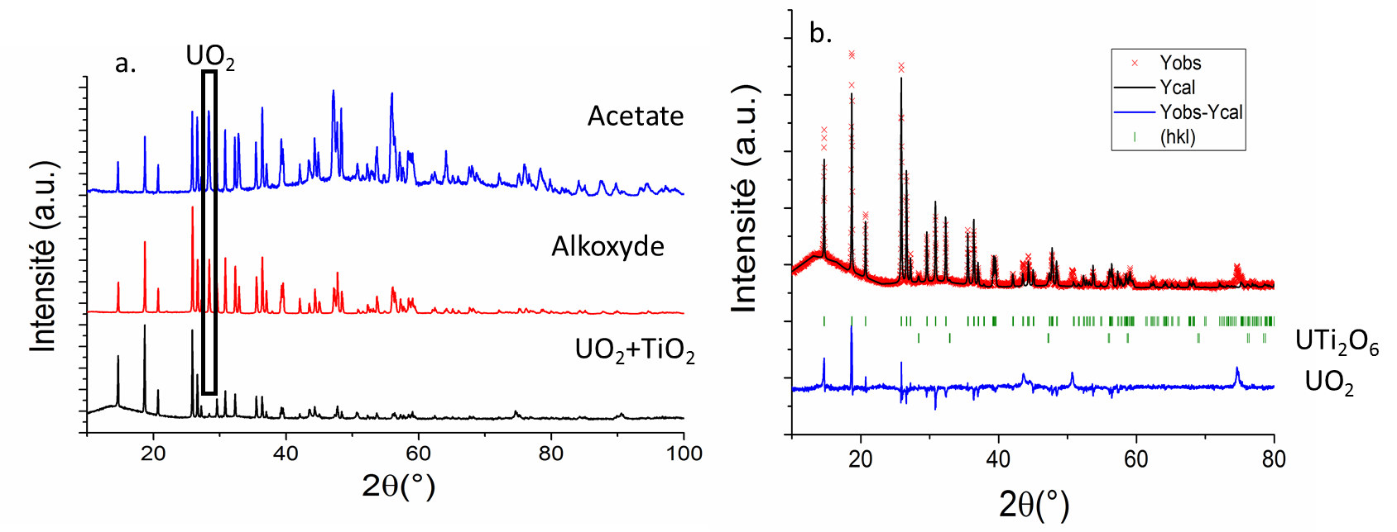

Synthesis under Argon at 1300°C
Calcination (Ar/H₂, 600°C, 5h) + Milling (12h, 30.0 s⁻¹) + pelletizing (~1,5 bar) + thermal treatment (Ar, 1300°C, 72h)
Mixing UO₂ + TiO₂ offers better results
Acetate
Alkoxyde
UO₂ + TiO₂
Molar % of UTi₂O₆ vs UO₂
Introduction of the accurate amount of reactants
Long time of Grinding

Slide 8
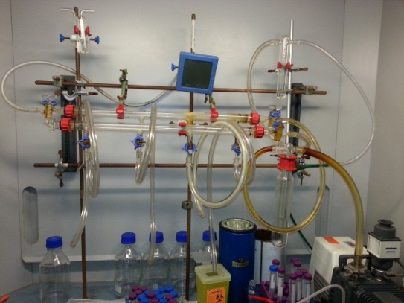


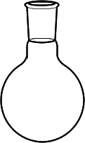
Hydroxide method
Eliminate the grinding step
Room temperature
Excess of NH₄OH
U(IV) + Ti
HCl
Washing
(water + ethanol)
Drying under vacuum
T = 40ºC
m_{synthesised} ≤ 1 g
Precipitate
+
EtOH
Evaporation under vacuum: High specific surface area
Direct thermal treatment at 1300°C during three days under Ar (Low Oxygen content)
J. Martinez, Patent FR3016360 – WO2015/107086, 2015

Slide 9

Synthèse par voie hydroxyde
One step synthesis
Free from TiO₂
Free from UO₂
Pure brannerite in a couple of days

Slide 10
Thermal behavior

Slide 11
In Situ PXRD under N₂
Use of UO₂ and TiO₂ after 6 hours of mechanical grinding
1100°C
1h for each PXRD pattern
5°C/min
3h
1h
collection

Slide 12
In Situ PXRD under N₂
900 °C
800 °C
700 °C
600 °C
Crystallization of U₃O₈ + TiO₂
500 °C
400 °C
300 °C
200 °C
Oxidation of uranium
100 °C
40 °C
500°C
grinding of UO₂ + TiO₂ during 12h
U₃O₈ + TiO₂ nanometric
Crystallization U₃O₈ + TiO₂

Slide 13
In Situ PXRD under N₂
1100 °C
1000°C: reduction U₃O₈
1100 °C
1100 °C
UO₂
1100 °C
1000 °C
900 °C
800 °C
Crystallization U₃O₈ + TiO₂
700 °C
600 °C

Slide 14
In Situ PXRD under N₂
Formation of brannerite at 1100°C after 5 hours
Direct synthesis of brannerite from U₃O₈ + TiO₂

Slide 15
Summary
One step and rapid synthesis of pure brannerite by following the hydroxide method (Ar or N₂)
large specific surface area
Pure brannerite
Highly reactive particles
Improved homogeneity
Lower time of synthesis
Under inert atmosphere (Argon or Nitrogen) with low oxygen content
UO₂
Ti - source
Brannerite (UTi₂O₆)
U₃O₈

Slide 16
What’s next: dissolution
Literature
H₂SO₄ (2M, 70-90°C) in presence of Fe
Extraction of uranium
UTi₂O₆ + Fe₂(SO₄)₃ → 2FeSO₄ + UO₂SO₄ + 2TiO₂
TiO₂ + H₂SO₄ → TiOSO₄ + H₂O
2Fe²⁺ + MnO₂ + 4H⁺ → 2Fe³⁺ + Mn²⁺ + 2H₂O
Mostly focused on natural samples
Multiparametric dissolution experiments: determination of the kinetic parameters
Acid concentration, T, complexing agent, Redox
Coffinite (USiO₄) was usually found as alteration product in some places
Role of silicate ?
1- F.A. Charalambous et al, Hydrometallurgy, 139, 1-8, 2013, 2. Guilligan.R, Nikoloski. A.N, Minerals Engeneering, 71, 34-48, 2015 (Review) and multiple research works in hydrometallurgy.

Slide 17
Leaching/dissolution
X 20
0.1 M H₂SO₄₊ Fe
X 2
0.1 M H₂SO₄₊ Si
0.1 M H₂SO₄
Detailed results coming soon (NEXT Year in Boston)
% Dissolved U : x 2 with presence of silicate

Slide 18
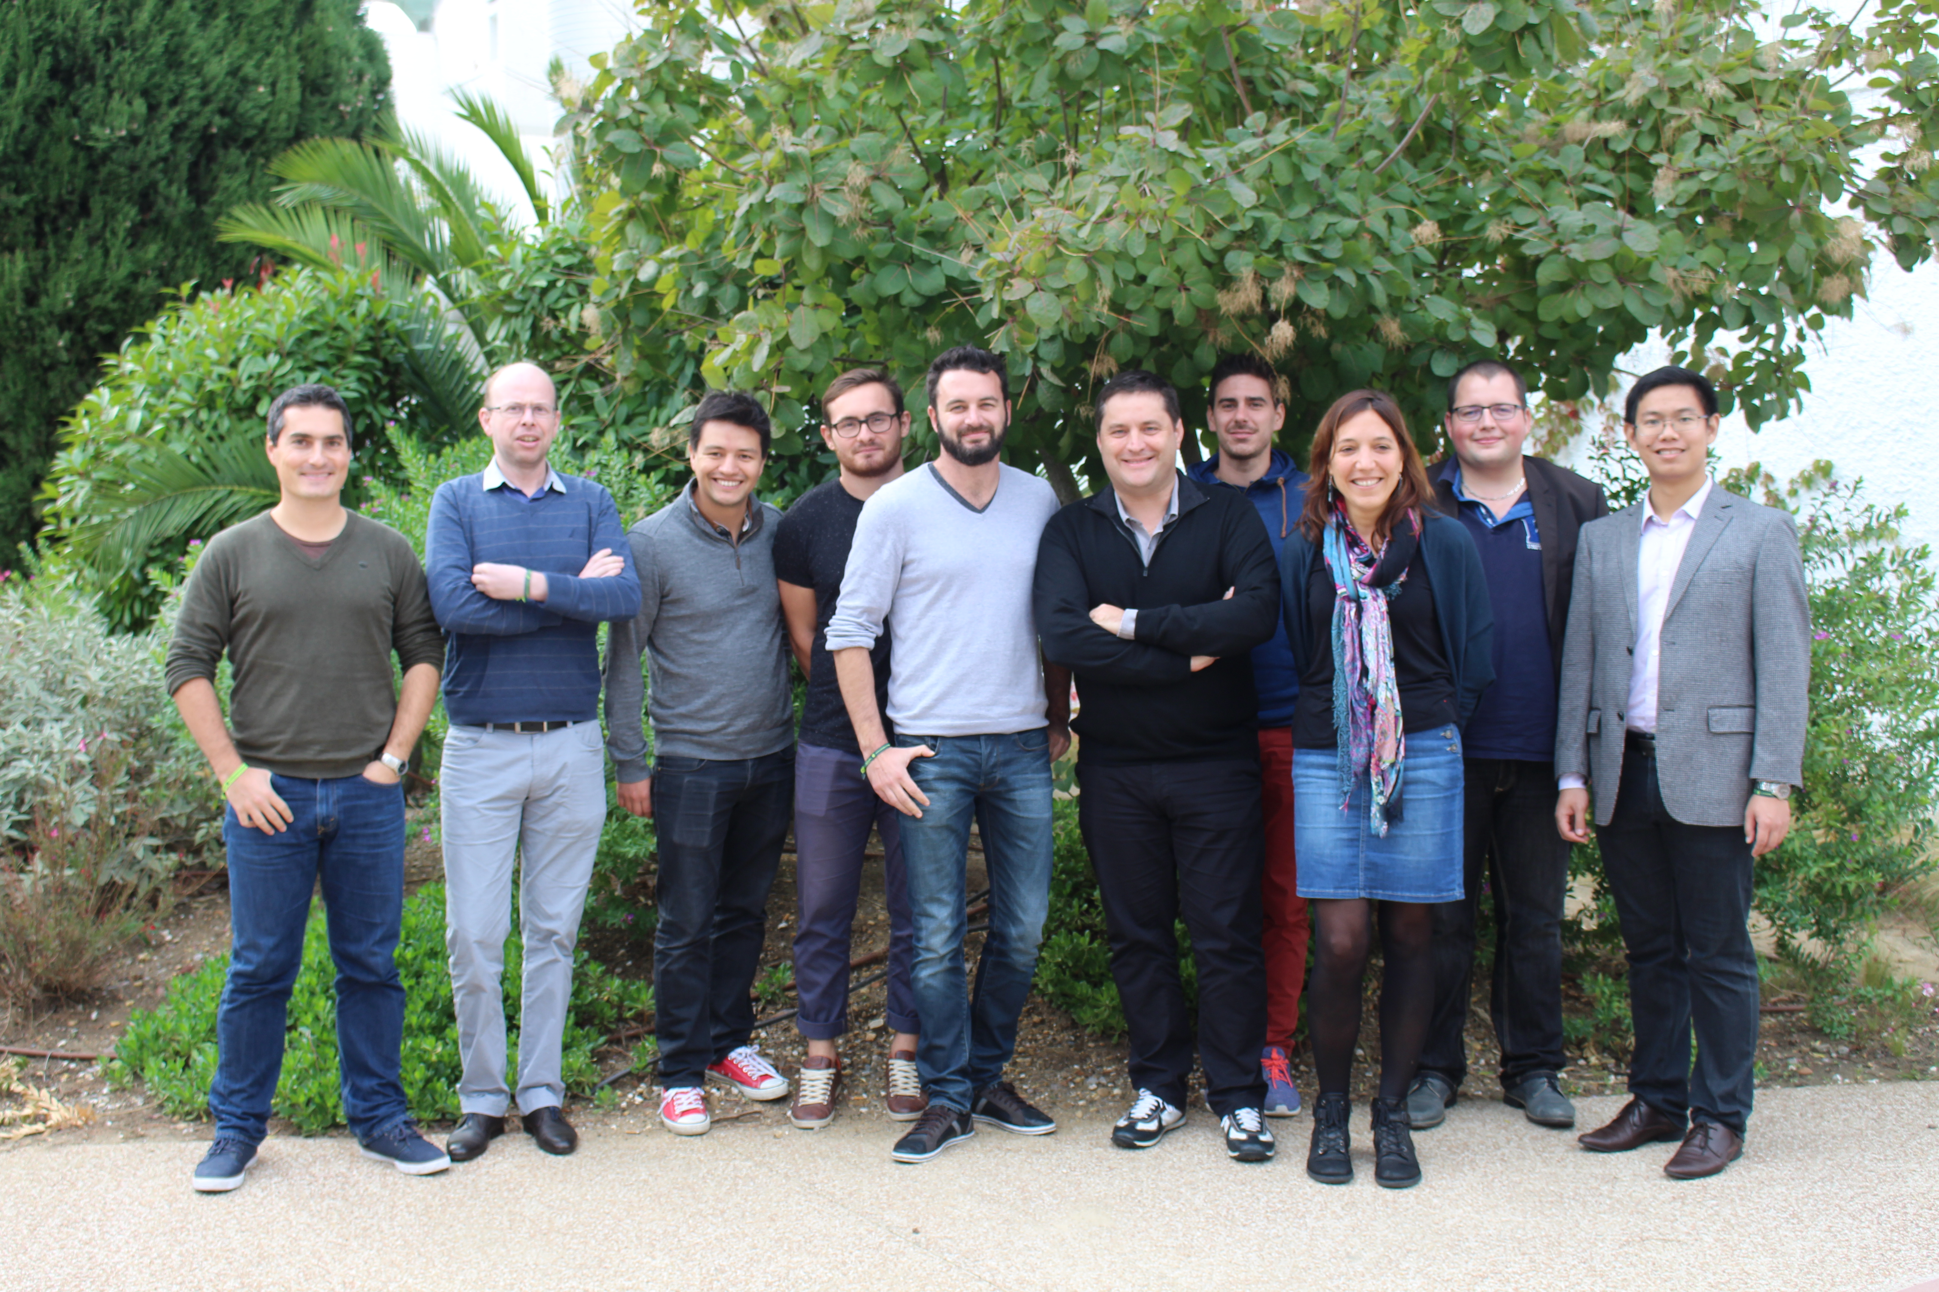


Acknowledgments
Laboratory of Evolving Interfaces in Materials
Ressources
Julien Marcadier, Daniel Beauffort, Anne-Magali Seydoux, Virginie Chapon, Aurelien Eglinger, Phillipe Gonclaves, Yann Batonneau, Maurice Pagel
www.icsm.fr
Thank you for your attention !
17

