Slide 1
Effect of Carbonate on Lanthanides Migration Behavior in Compacted Bentonite
Kazuya Idemitsu, Kazuyuki Fujii, Yuki Kakoi, Noriya Okubo, Yaohiro Inagaki, Tatsumi Arima
Dept. of Applied Quantum Physics and Nuclear Engineering, Kyushu Univ., 744 Motooka, Nishi-ku, Fukuoka, Japan

Slide 2
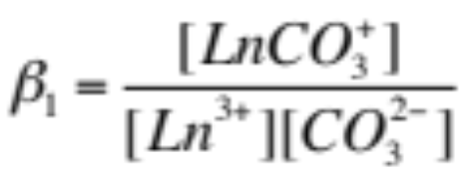
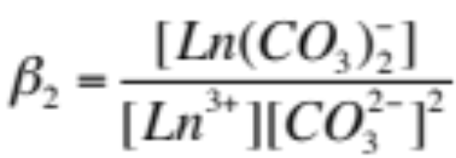
Objective
To investigate the effect of carbonate ion
for diffusion of lanthanides in compacted bentonite
Ln³⁺ + CO₃²⁻
LnCO₃⁺
Ln³⁺ + 2CO₃²⁻
Ln(CO₃)₂⁻
Lanthanide Atomic No. | La 57 | Ce 58 | Pr 59 | Nd 60 | Pm 61 | Sm 62 | Eu 63 | Gd 64 | Tb 65 | Dy 66 | Ho 67 | Er 68 | Tm 69 | Yb 70 | Lu 71
Actinide Atomic No. | Ac 89 | Th 90 | Pa 91 | U 92 | Np 93 | Pu 94 | Am 95 | Cm 96 | Bk 97 | Cf 98 | Es 99 | Fm 100 | Md 101 | No 102 | Lr 103

Slide 3
Diffusion Experiment
Compacted bentonite
Carbonated
water
Saturate with
carbonated water
Bentonite specimen
Ø:10 mm H: 10mm
Spike tracer
Acrylic plate
Porous filter
Diffusion test
Tracer solution
Ln(NO₃)₃
analysis

Slide 4
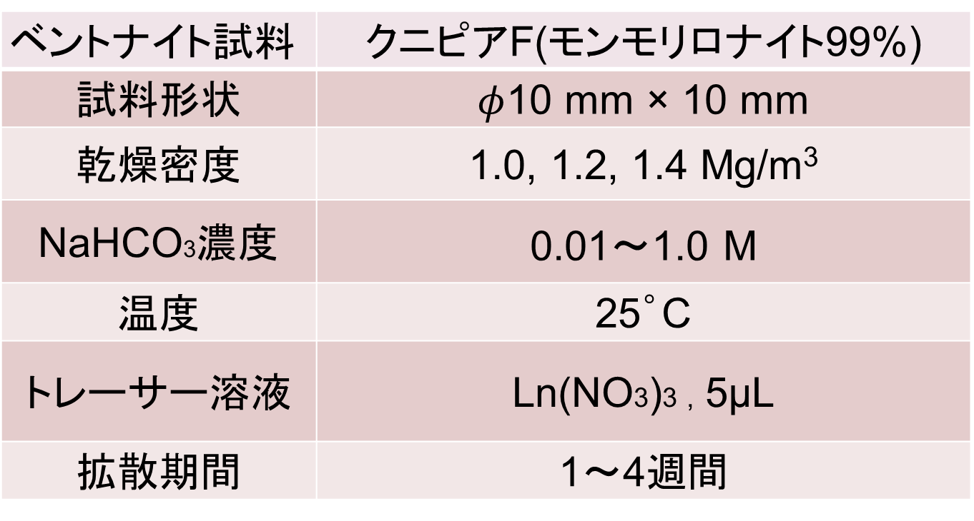
Experimental conditions
Bentonite | Kunipia F® (Mont.>99%)
Size
Dry density | 1.0, 1.2, 1.4 Mg/m³
NaHCO3 | 0.01～1.0 M
Temp. | 25°C
Tracer | Ln(NO3)3 , 10μM, 5µL
Diffusion period | 1～4 weeks

Slide 5
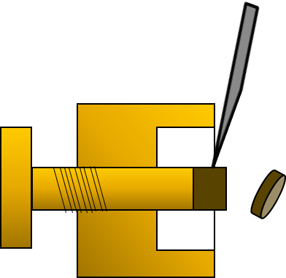


Measurement
Knife
Bentonite specimen
1N HNO₃
(1) Slice
(2) Extract ions
(3) Centrifugation
and
sampling
(4) Ln concentration measurement
with ICP-MS (Agilent 7500)

Slide 6
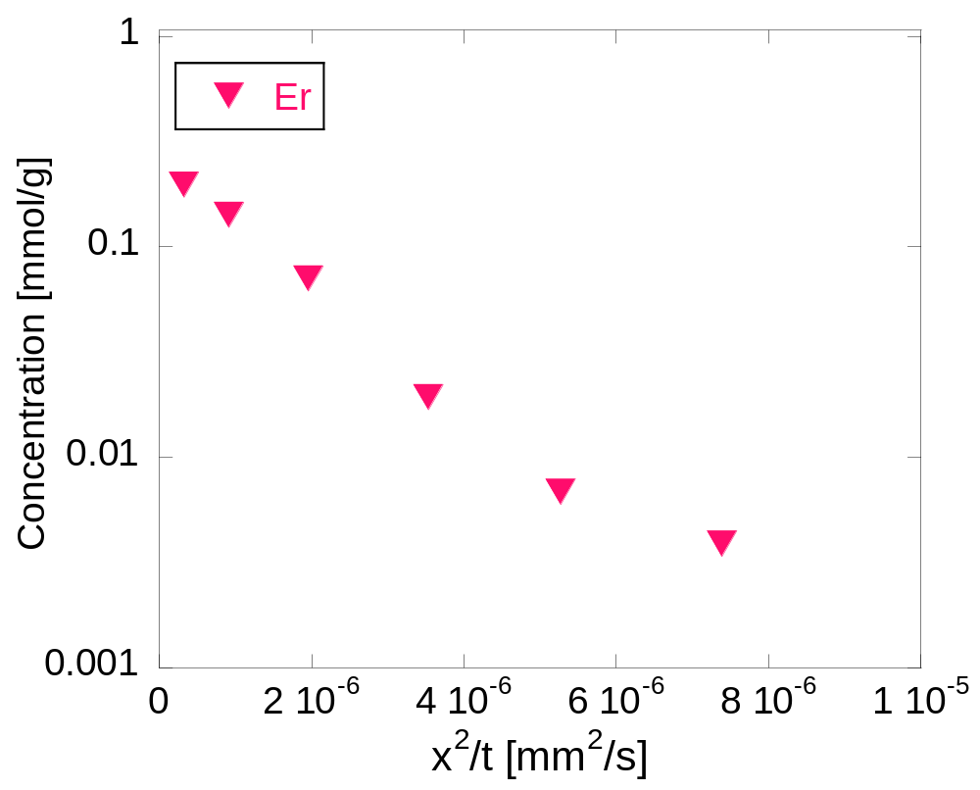
Result Er Profile (1.0M, 1.2 Mg/m³)

Slide 7
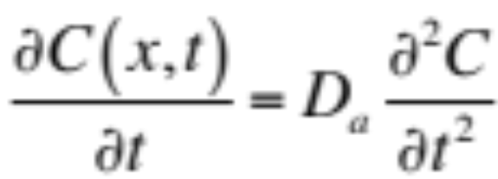
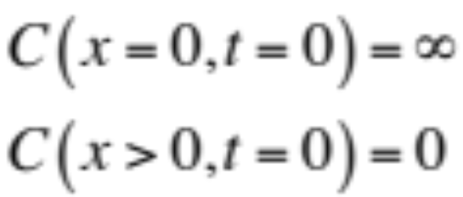
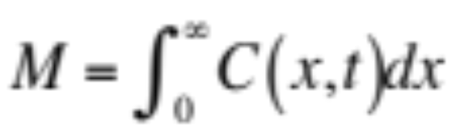
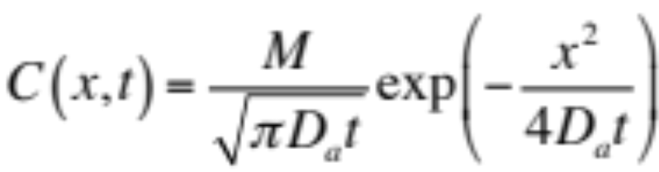
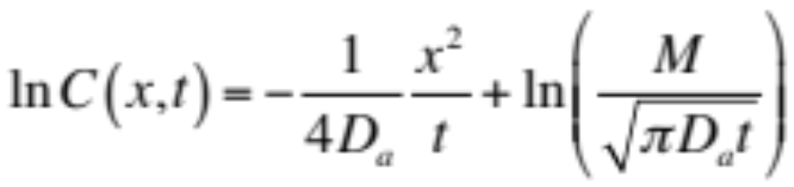
Analysis (instantaneous planar source)
・Diffusion equation
D_{a} : Apparent diffusion coefficient
[m²/s]
・Initial and boundary conditions
・Solution

Slide 8
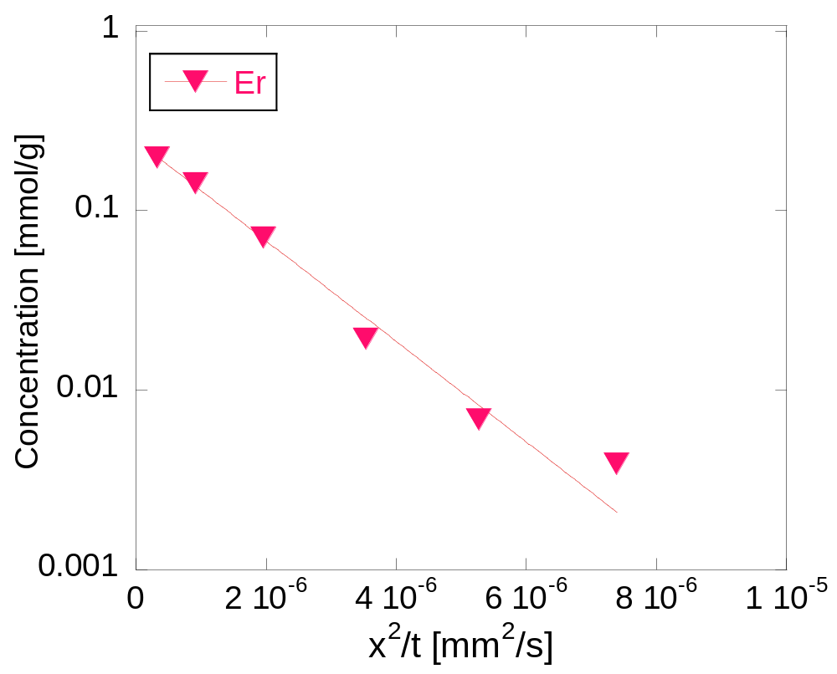
Analysis (1.0M, 1.2 Mg/m³)
Da=(3.9±0.2)×10⁻¹³ [m²/s]

Slide 9
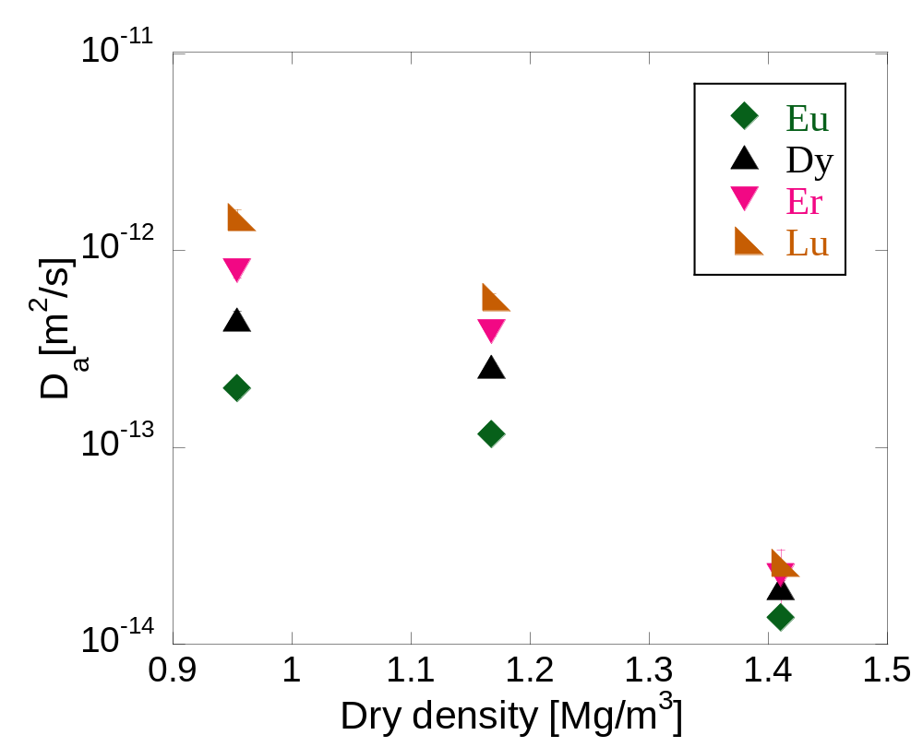
Dry density dependence
NaHCO₃ 1.0 M
D_{a} decreased with dry density.

Slide 10
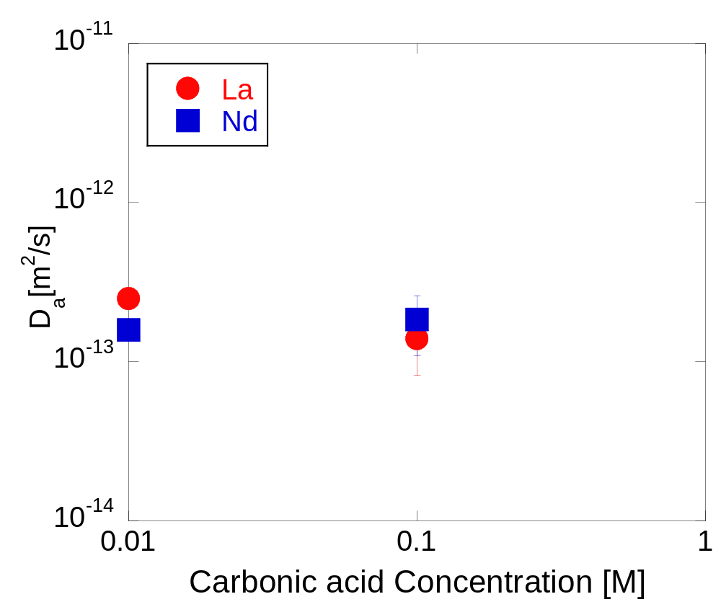
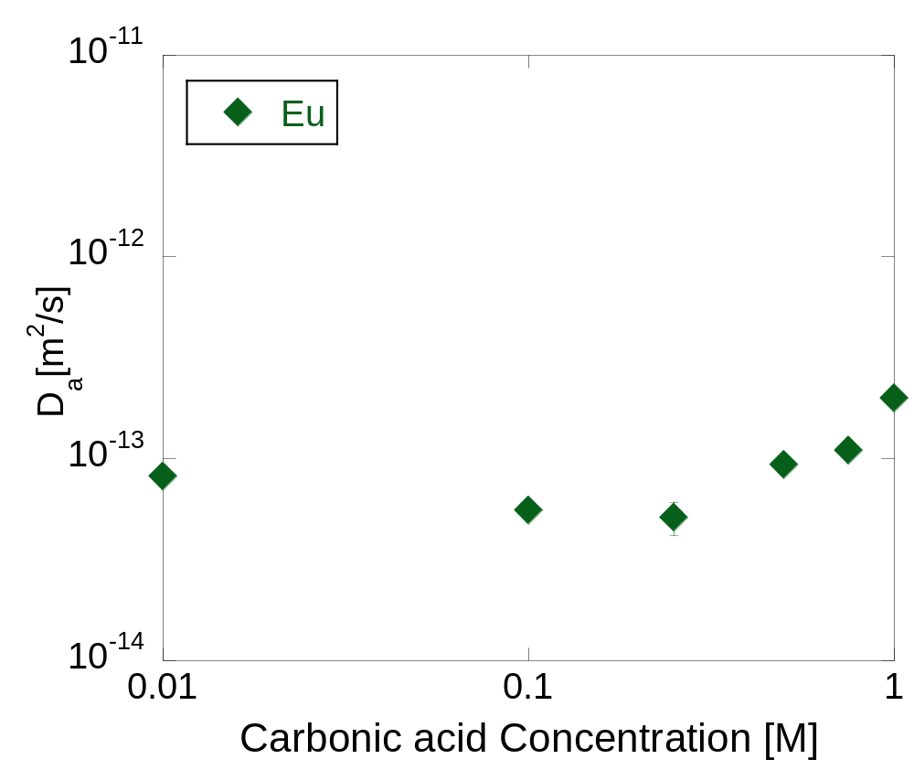
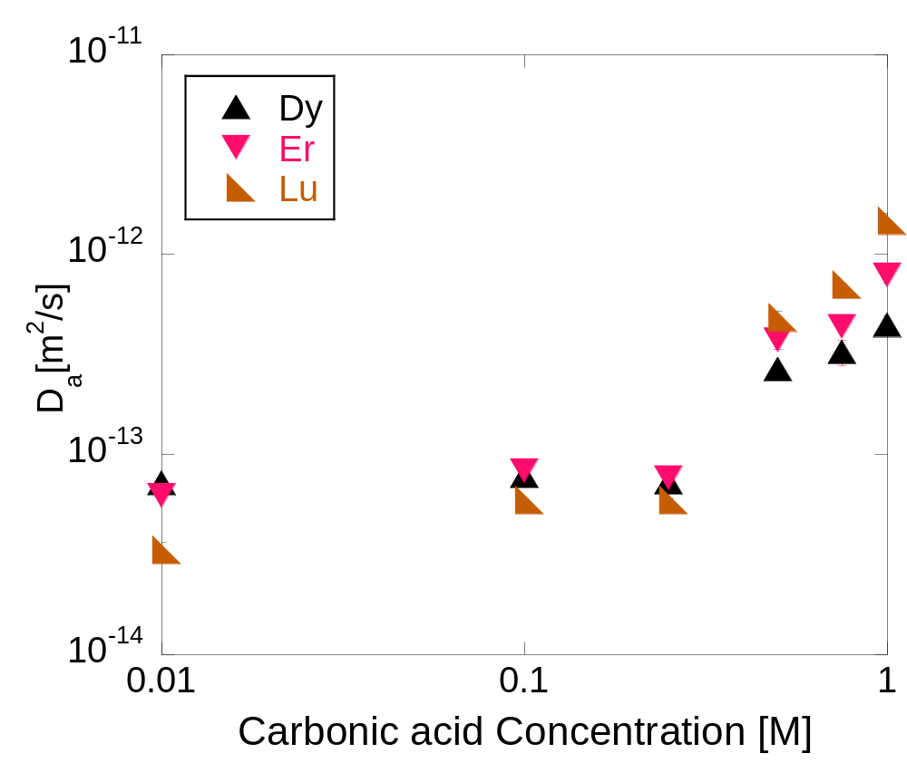
Carbonate concentrasion dependence
Dry density1.0 Mg/m³
La, Nd
Da decreased.
Eu
Da decreased then increased.
Dy, Er, Lu
Da increased.
0.25

Slide 11
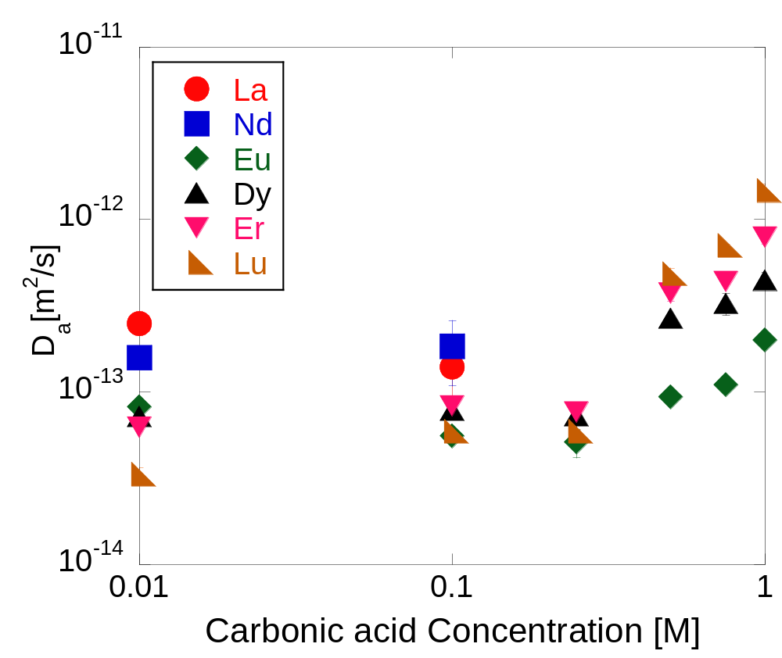
Carbonate concentration dependence
La, Nd
Dry density1.0 Mg/m³
Da decreased.
Eu
Da decreased then increased.
Dy, Er, Lu
Da increased.
0.25

Slide 12

pH measurement on and in bentonite
pH electrode (H260GNP, LMS Co., Ltd.)
Upper solution
Pore solution

Slide 13
pH measurement on and in bentonite
Upper solution
 | 1.2 Mg/m³ | 1.4 Mg/m³ | 1.6 Mg/m³
0.1M | 9.4 | 9.3 | 9.4
0.5M | 11.0? | 9.6 | 9.9
1.0M | 9.6 | 9.5 | 9.5
Pore solution
 | 1.2 Mg/m³ | 1.4 Mg/m³ | 1.6 Mg/m³
0.1M | 8.9 | 9.0 | 8.4
0.5M | 10.2? | 9.8 | 10.3
1.0M | 9.3 | 10.0 | 10.0

Slide 14
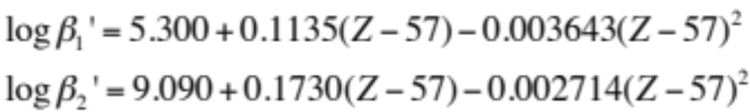
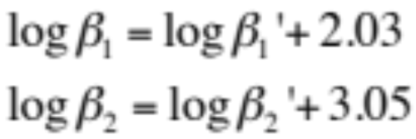
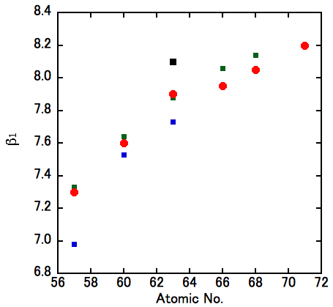
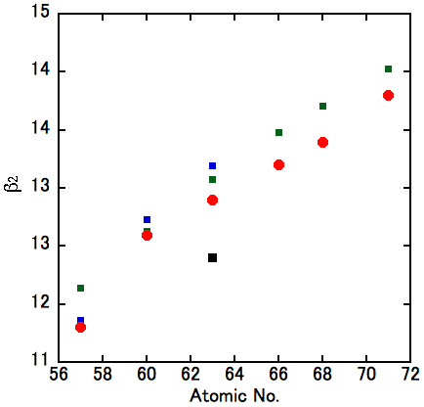
Complexation constant of lanthanides
Lanthanide Carbonate in sea water
Kirk J. Cantrell and Robert H. Byrne, Geochimica et Cosmochimica Acta Vol.51 ,1987
K. Spahiu, J. Bruno, TR95-35, A selected thermodynamic database for REE to be used in HLNW performance assessment exercises, 1995.
La Nd Eu Dy Er Lu
La Nd Eu Dy Er Lu
W. Hummel, et.al., Nagra/PSI Chemical Thermodynamic Data Base 01/01, 2002
β1
β2
GeoChemistWB
GeoChemistWB

Slide 15
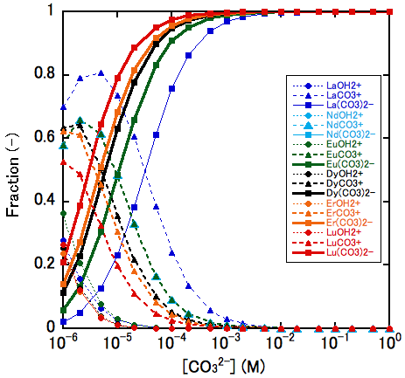
[Ln(CO₃)₂⁻], [LnCO₃⁺] fraction
LnCO₃⁺ Ln(CO₃)₂⁻
Pore solution ?
Upper solution
Lu
La

Slide 16
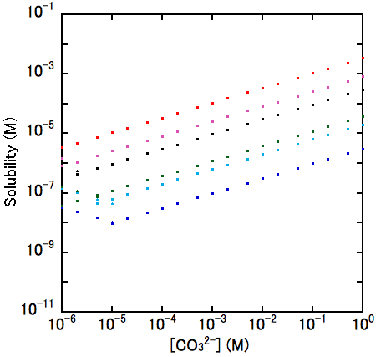
[Ln(CO₃)₂⁻], [LnCO₃⁺], Ln₂(CO₃)₃
Ln₂(CO₃)₃ (s)
2Ln³⁺ + 3CO₃²⁻
Ln₂(CO₃)₃ (s)
Lu
 | pK_{sp}
Lu | 33.0
Er | 33.6
Dy | 34
Eu | 35
Nd | 34.65
La | 35.3
Er
Dy
Eu
Nd
La
LnCO₃⁺
Ln (CO₃)₂⁻
K. Spahiu et.al. 1985

Slide 17
Conclusion
In the lower bicarbonate conditions than 0.25 M La had the largest Da of ca. 10⁻¹³ m²/s at 1.0 Mg/m³ and Da was small as atomic No. becomes big.
In the higher bicarbonate conditions than 0.25 M Lu had the largest Da and Da was small as atomic No. becomes small.
Especially La and Nd had smaller diffusion coefficient than 10⁻¹⁴ m²/s even at 1.0 Mg/m³. This could be caused by precipitation of carbonate.
Da of Lu increased from 2 x 10⁻¹⁴ to 10⁻¹² m²/s with bicarbonate concentration up to 1.0 M.
[CO₃²⁻] in pore water would be much lower than that in contact solution.

