Slide 1
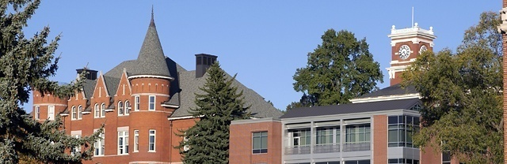
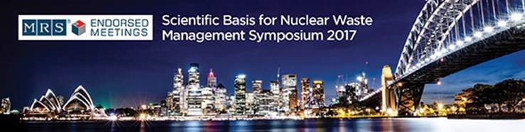
Effects of Li, Ca, Fe, and B on NaAlSiO₄ nepheline crystallization in high level waste glasses
John S. McCloy, José Marcial, Mostafa Ahmadzadeh, Yaqoot Shaharyar, Ambar Deshkar, Ashutosh Goel
Glass Wasteforms
Sydney, Australia
Oct 31, 2017
http://labs.wsu.edu/mccloy/
Notes:
Effects of Li, Ca, Fe, and B on NaAlSiO₄ nepheline crystallization in high level waste glasses
John McCloy, José Marcial, Mostafa Ahmadzadeh, Yaqoot Shaharyar, Ambar Deshkar, Ashutosh Goel (+ others in acknowledgements)
Owing to high concentrations of Al₂O₃ from dissolved fuel cladding and Na₂O from basification of the waste, about half of the high-level waste by volume at Hanford, Washington, USA is rich in both Na and Al. Formulations of high waste-loading glasses result in lower amounts of SiO₂, which often leads to undesirable precipitation of nepheline (NaAlSiO₄). Nepheline crystallization can be affected by modifiers (Li, Ca) added to lower viscosity and improve electrical conductivity of the melt. Also, B is frequently added to reduce viscosity, and Fe is present in varying amounts from steel tank corrosion. Given the existence of various natural minerals of the stoichiometries (Na,Li,Ca_{0.5})(Al,Fe,B)SiO₄, we sought to study the effects of substitution in the stoichiometric nepheline glass on the resulting crystallization. We summarize here several years of work, including characterization by nuclear magnetic resonance, vibrating sample magnetometry, Raman spectroscopy, thermal analysis, x-ray diffraction, electron microscopy, and electron microprobe.

Slide 2
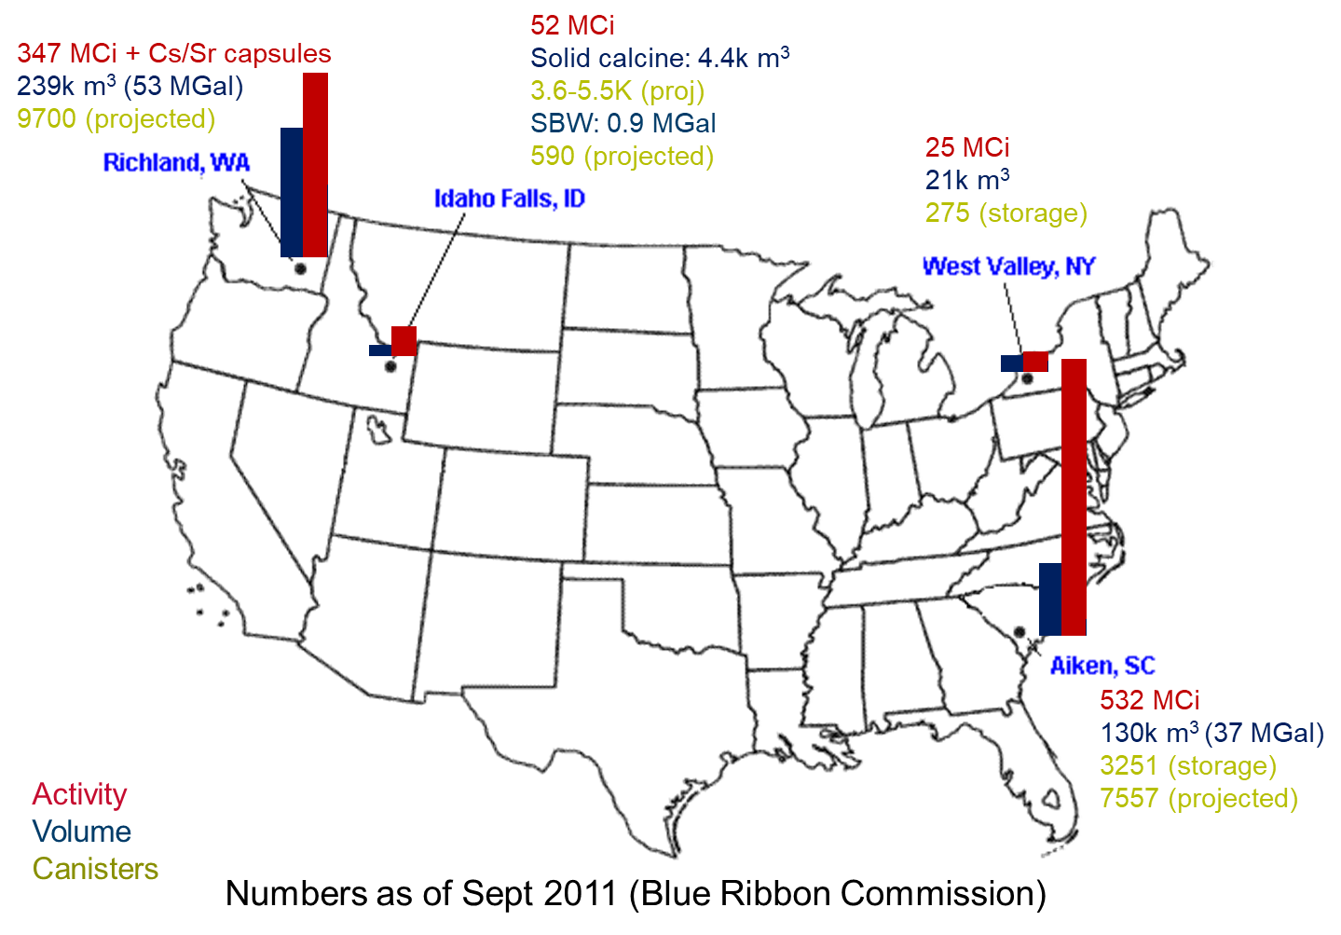
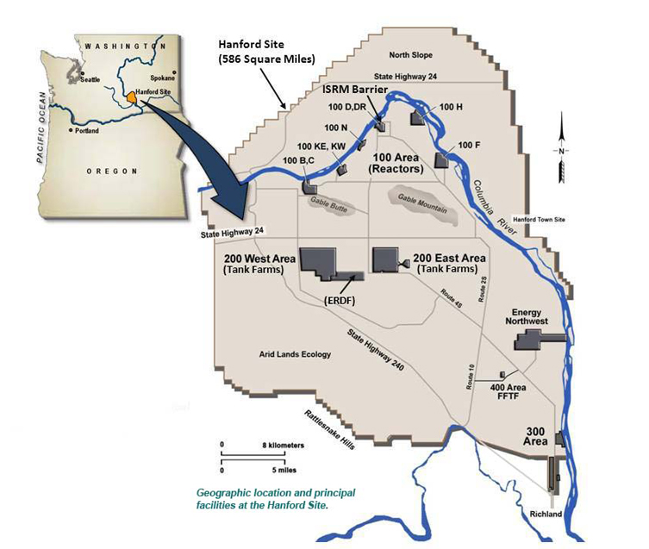
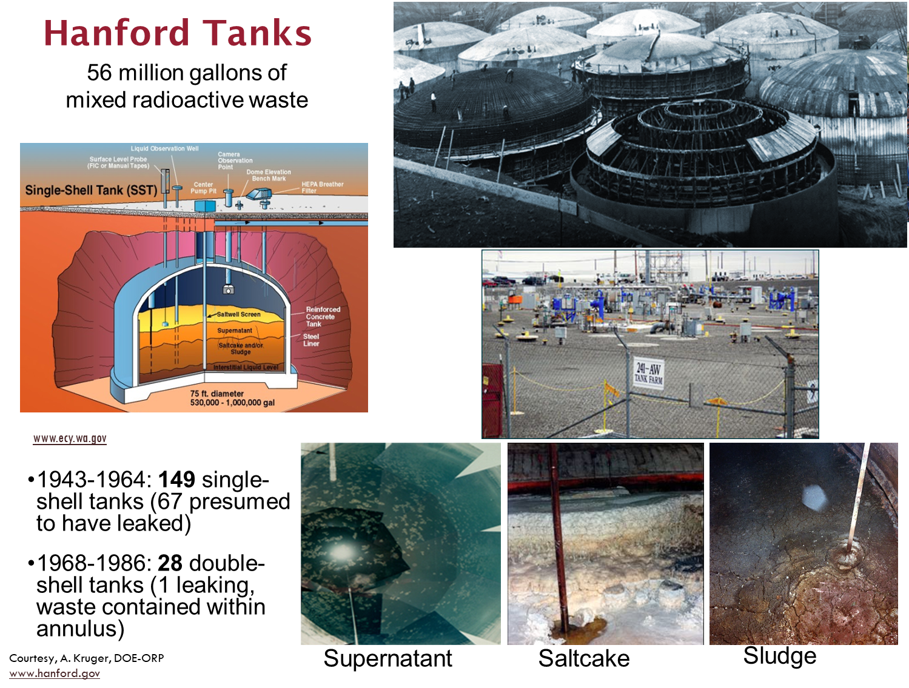
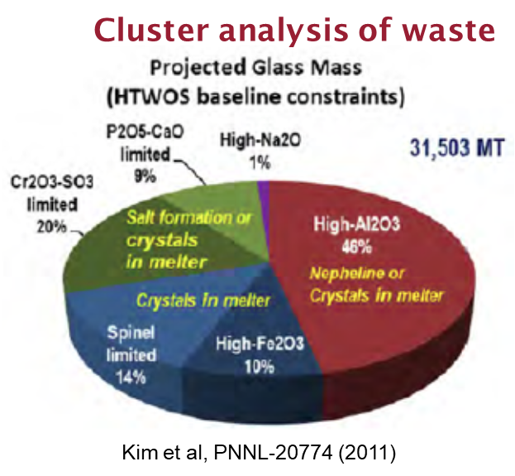
Motivation
US HLW
Hanford site
Notes:
Of >100 US nuclear waste sites, Hanford, WA is the largest
177 tanks of >56 million gallons from Pu-production
Much of the High-level waste (HLW) is high in Al & Na
HLW will be mixed with glass-forming additives and vitrified
Desired result: permanent disposal in a geological repository

Slide 3
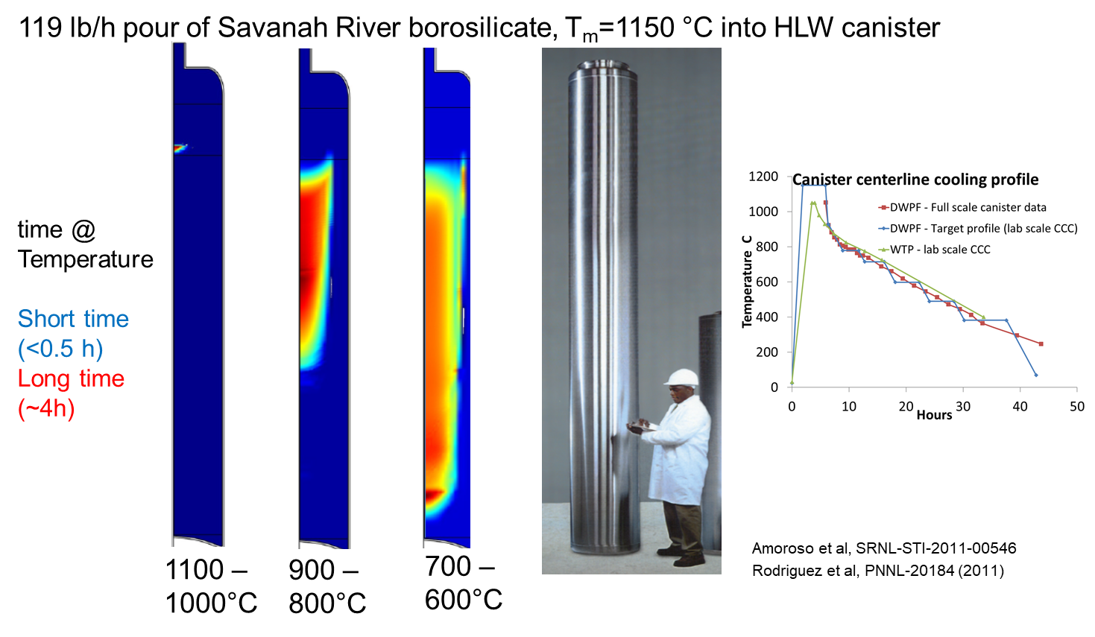
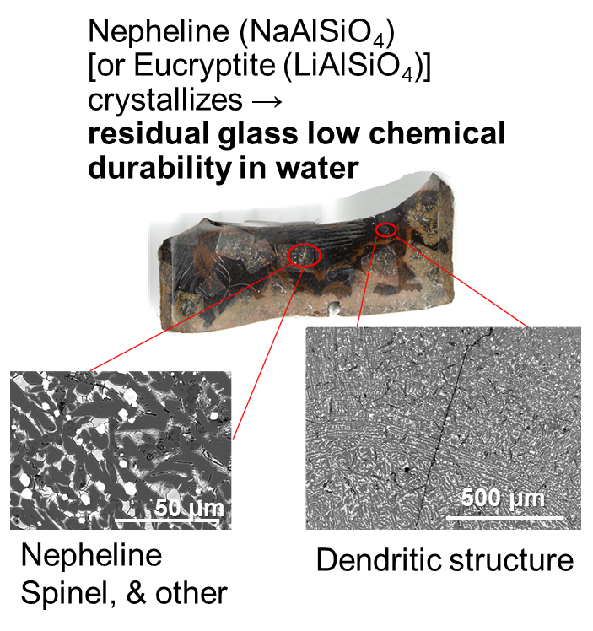
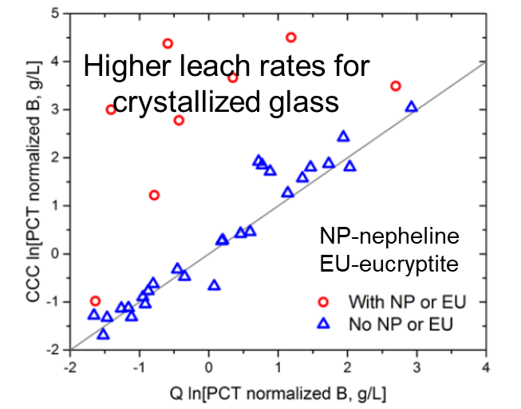
The Nepheline problem
Canister centerline cooling
Large crystals in some cases
Increased leach rate
Marcial et al, Proc MRS 1744, 85 (2015)
Kroll et al, Ceram Trans 260, 159 (2016)
Notes:
HLW glasses will be poured into canisters and cooled
HLW glass composition may result in nepheline (NaAlSiO₄) crystallization
Primary concern: Nepheline extracts Al₂O₃ and SiO₂ from glass
Increases susceptibility of HLW glass to chemical attack
Challenge to understand crystallization with many components
Seek to understand similarities between mid-range order and crystalline structures.
==
Riley, B.J., B.T. Rieck, J.S. McCloy, J.V. Crum, S.K. Sundaram, and J.D. Vienna, "Tellurite glass as a waste form for mixed alkali–chloride waste streams: Candidate materials selection and initial testing," Journal of Nuclear Materials, 424(1–3), 29-37 (2012).
Kroll, J.O., J.D. Vienna, and M.J. Schweiger, "Effects of Al2O3, B2O3, Li2O, Na2O, and SiO2 on Nepheline Crystallization in Hanford High Level Waste Glasses," In Ceramics Transactions 260: Advances in Materials Science for Environmental and Energy Technologies V, John Wiley & Sons, Inc., 159-169 (2016).

Slide 4
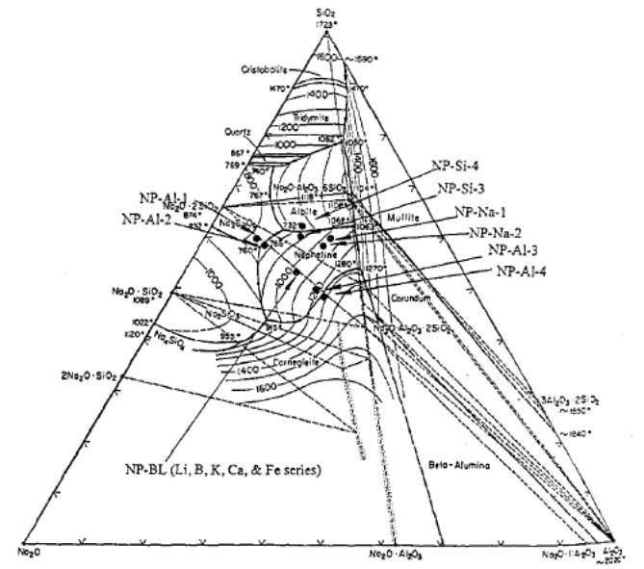

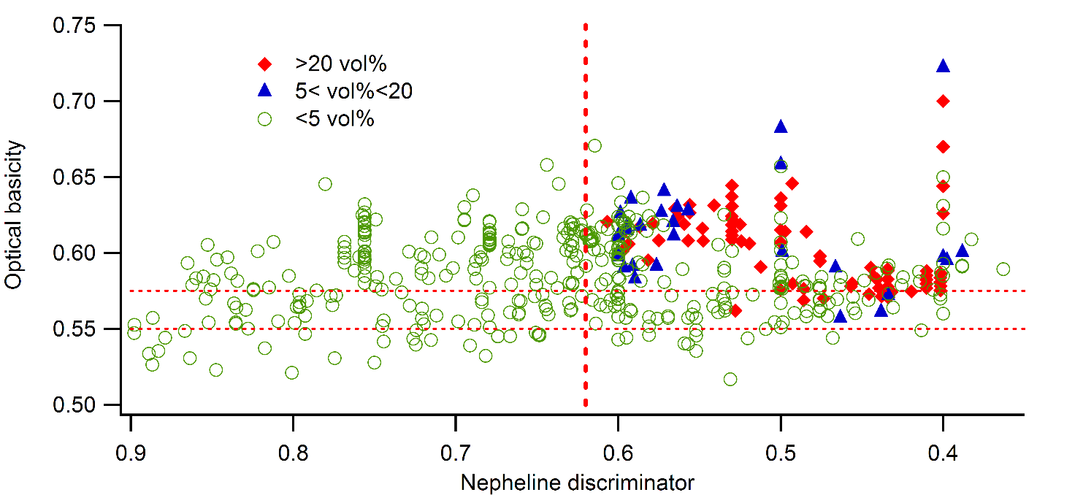
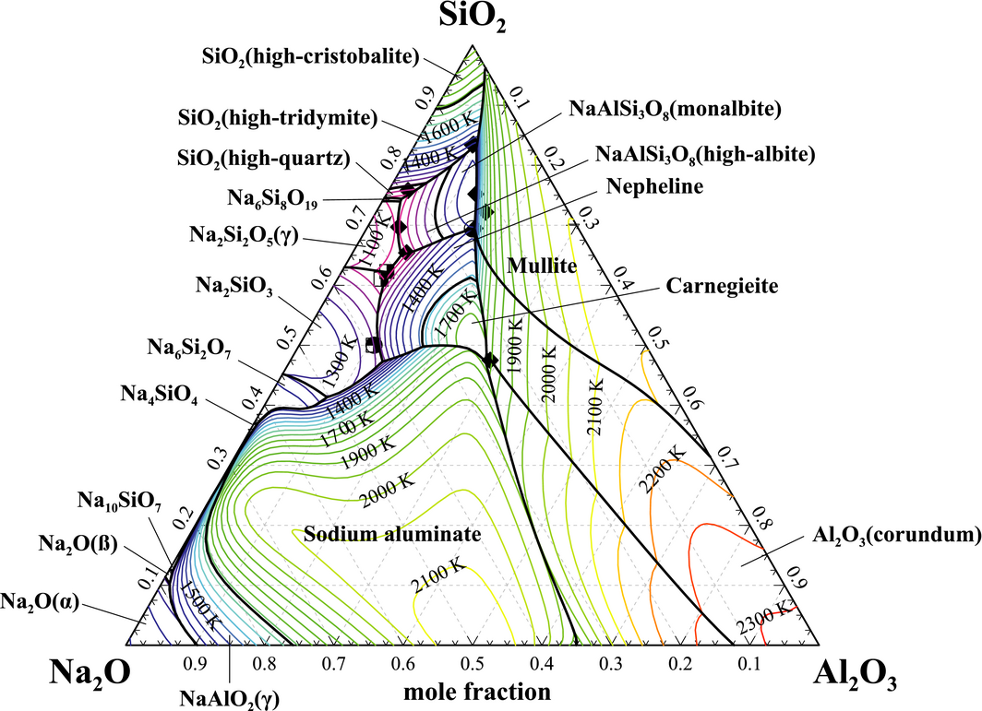
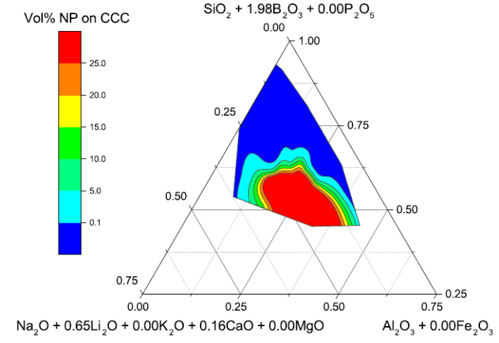
Previous work on nepheline formation
Normalized ternary and SiO₂
Optical Basicity
~0.62
McCloy et al, IJAGS 2, 201 (2011)
Li et al, Cer Trans 87, 279 (1998)
Thermodynamic
  ND = SiO₂/(SiO₂+Al₂O₃+Na₂O) > 0.62
Neural network and quantification
Vienna et al, IJAGS 8, 143 (2016)
Utlak & Besmann, JACERS in press (2017)
Notes:
Li, H., B. Jones, P. Hrma, and J.D. Vienna, "Compositional effects on liquidus temperature of Hanford simulated high-level waste glasses precipitating nepheline (NaAlSiO₄)," In Ceramic Transactions, D.K. Peeler and J.C. Marra, ed., 87, Environmental Issues and Waste Management Technologies in the Ceramic and Nuclear Industries III, American Ceramic Society, Westerville, OH, 279-288 (1998).
McCloy, J.S., M.J. Schweiger, C.P. Rodriguez, and J.D. Vienna, "Nepheline Crystallization in Nuclear Waste Glasses: Progress Toward Acceptance of High-Alumina Formulations," International Journal of Applied Glass Science, 2(3), 201-214 (2011).
Vienna, J.D., J.O. Kroll, P.R. Hrma, J.B. Lang, and J.V. Crum, "Submixture Model to Predict Nepheline Precipitation in Waste Glasses," International Journal of Applied Glass Science, 8(2), 143-157 (2016).
Utlak, S.A. and T.M. Besmann, "Thermodynamic assessment of the pseudoternary Na2O–Al2O3–SiO2 system," Journal of the American Ceramic Society, n/a-n/a).

Slide 5
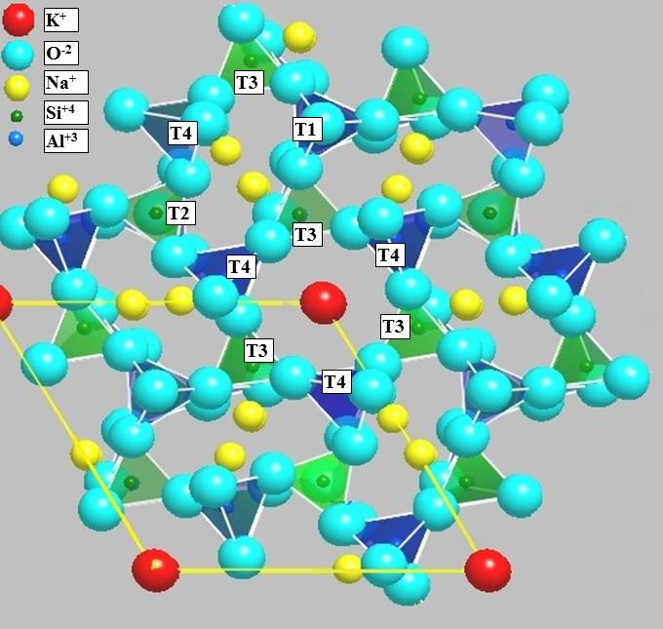
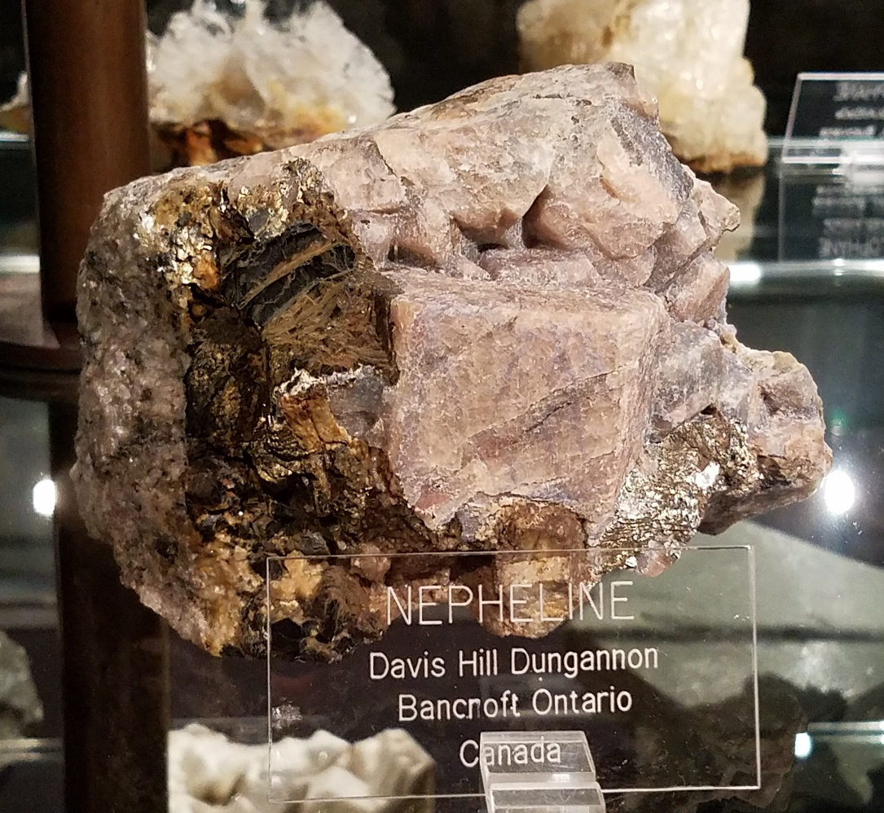
Overview
Crystallography – nepheline & related minerals
Composition from complex waste glasses
Effect of different cooling conditions
Glass composition effects
  Al/B
  Al/Fe
  Na/Ca
  Na/Li

Slide 6
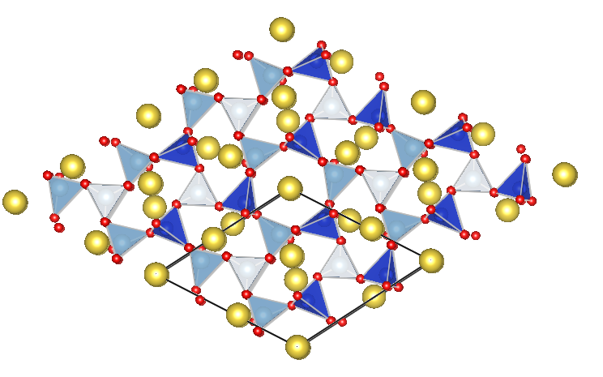
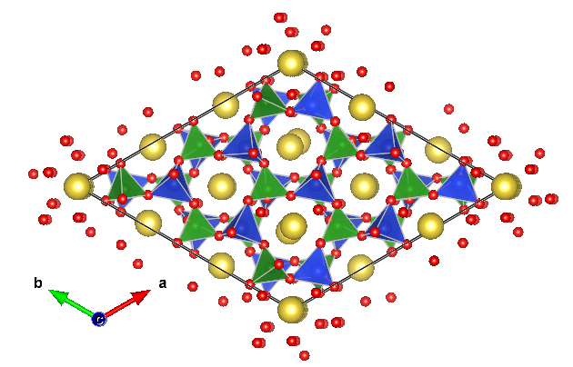
Crystallography: (A,AE)(Al,B,Fe)SiO₄
Nepheline (NE) NaAlSiO₄
Hex P6₃
Eucryptite (EU)
LiAlSiO₄
Hex P6₄22
Malinkoite (MA)
NaBSiO₄
Hex P6₃
Na, Fe: no mineral
Li, Fe: no mineral
Ca, Al: Anorthite
Ca, B: Danburite
  NEPHELINE: (Na,Ca,Mg,□)_{0.75}^{oval}(K,Na,Ca,□)_{0.25}^{hex}(Al,Fe)SiO₄

Slide 7
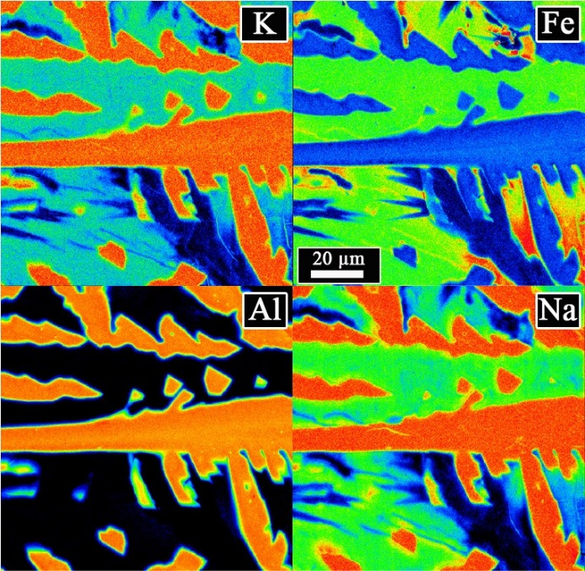
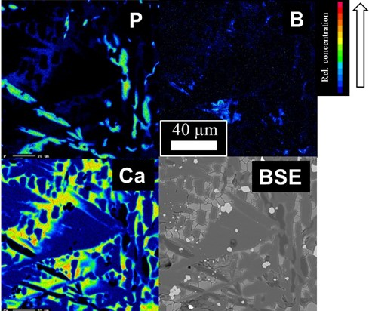
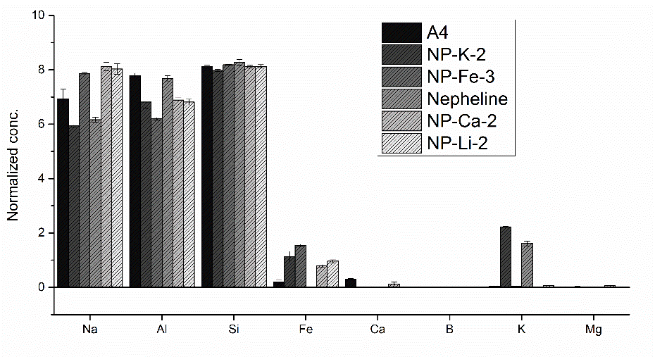
Nepheline in complex HLW glasses
Selective partitioning
Compositional maps, NP-K-2 CCC
Compositional maps, A4 CCC
Nepheline crystal composition (WDS)
Marcial et al., Amer. Min., 101(2), 266-276 (2015).
Marcial et al, Proc MRS 1744, 85 (2015)
Notes:
Crystallize nephelines of varying composition
Depends on starting melt comp.
Crystals partition components
Microstructures depend on composition

Slide 8
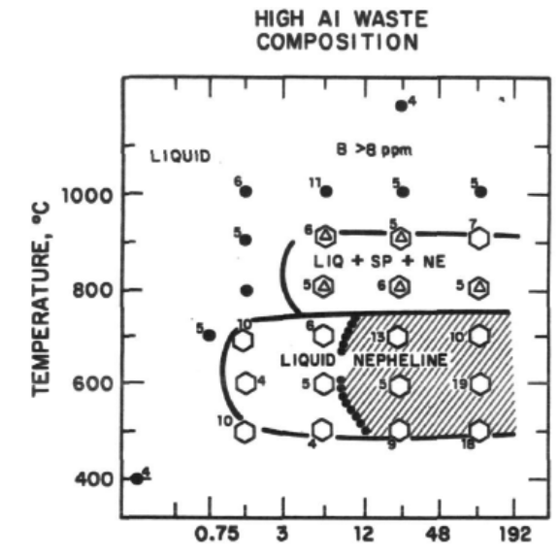
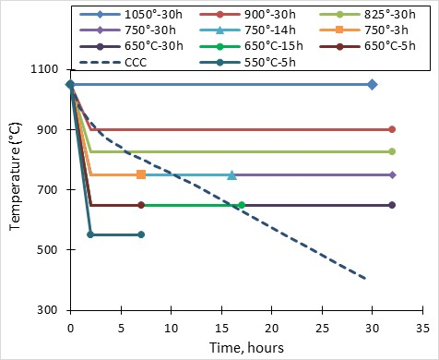
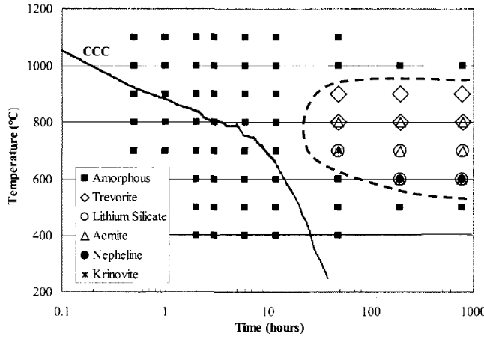
Effect of heat treatments
Time-Temperature-Transformation
A4 glass (high Li)
Eucryptite = LiAlSiO₄
Apatite = Ca₅(PO₄)₃(OH)
SRL-131
Nepheline = NaAlSiO₄
Spinel = Fe₃O₄
Sp
Nepheline morphology but NOT composition changes
Sp,Ne
β-Eu, Ap
ɣ-Eu, Ne, Sp
CCC: Sp, Ne, ß-Eu
Jantzen et al., Proc. Mat. Res. Soc., 44 (1985).
SB3-Frit 418
825°C
30hr
Euhedral
nepheline
Billings et al, Adv Mat Sci ENT 222, 51 (2010)
Marcial et al., Proc. Mat. Res. Soc., 1744 (2015).
Notes:
Varying HT schedule of HLW glasses:
Affects phases
Affects microstructure
Does not affect nepheline comp
Billings, A.L., C.M. Jantzen, C.C. Herman, and S.L. Marra, "Phase Stability of Defense Waste Processing Facility (DWPF) Type High Level Nuclear Waste Glasses," In Advances in Materials Science for Environmental and Nuclear Technology, K. Fox, et al., ed., 222, John Wiley & Sons, Inc., Hoboken, NJ, 51-61 (2010).

Slide 9
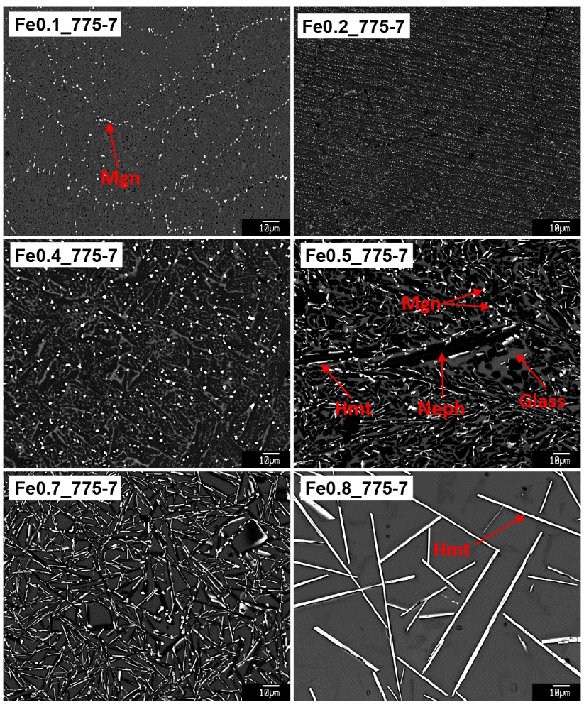
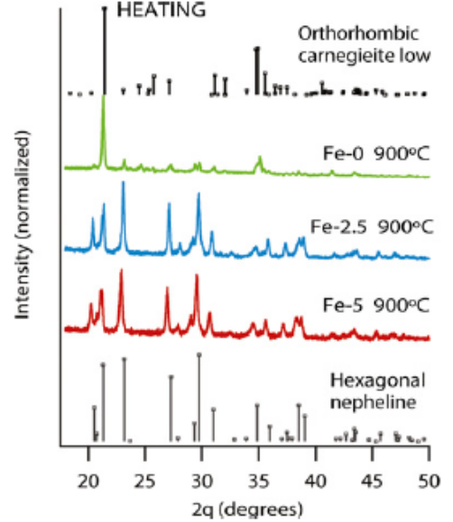
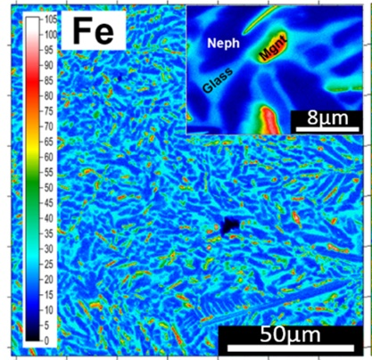
Effect of Al/Fe: NaAl_{1-x}Fe_{x}SiO₄
Fe favors bulk nucleation of Neph over surface nucleation of Carneg
Ne and Fe-oxides
Fe substitutes on Al site at least x=0.37
Shaharyar et al., JACERS 99, 2306 (2016)
Highest Fe: no Neph
Magnetic Meas.
Ahmadzadeh et al., J Geophys Res Sol Ear 122, 2504 (2017)
Notes:
Along the Na(Al,Fe)SiO₄ join:
Fe influences nepheline crystallization in Na(Al_{1-x}Fe_{x})SiO₄, leading to highest nepheline fractions when 0.2<x<0.6.
EPMA measurements determine maximum Fe incorporation of x=0.37 in nepheline
Mossbauer spectroscopy indicates that Fe redox state (Fe³⁺/Fe^{total}) increases by adding more Fe to the glasses.
---
Ahmadzadeh, M., J. Marcial, and J. McCloy, "Crystallization of iron-containing sodium aluminosilicate glasses in the NaAlSiO₄-NaFeSiO₄ join," Journal of Geophysical Research: Solid Earth, 122(4), 2504-2524 (2017).
Shaharyar, Y., J.Y. Cheng, E. Han, A. Maron, J. Weaver, J. Marcial, J.S. McCloy, and A. Goel, "Elucidating the Effect of Iron Speciation (Fe²⁺/Fe³⁺) on Crystallization Kinetics of Sodium Aluminosilicate Glasses," Journal of the American Ceramic Society, 99(7), 2306-2315 (2016).

Slide 10
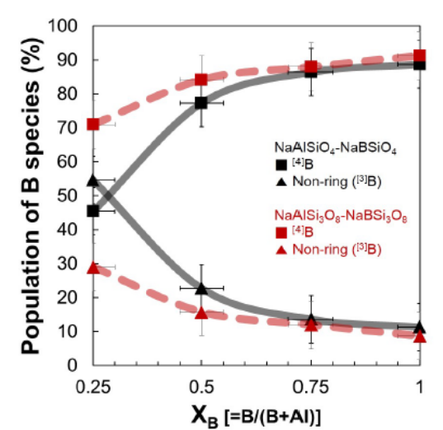
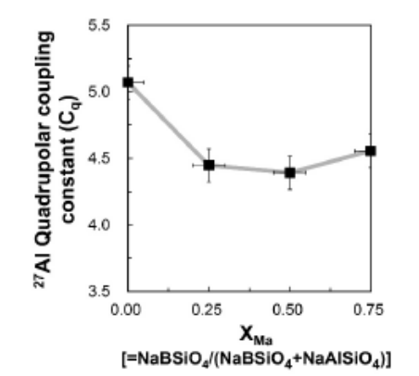
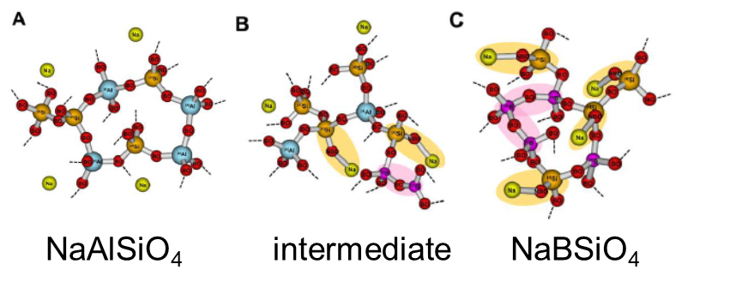
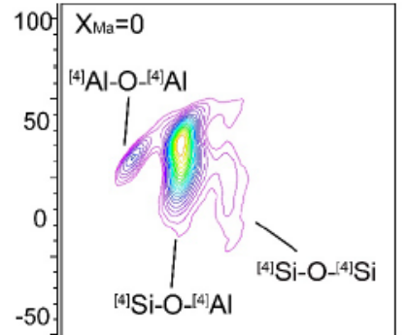
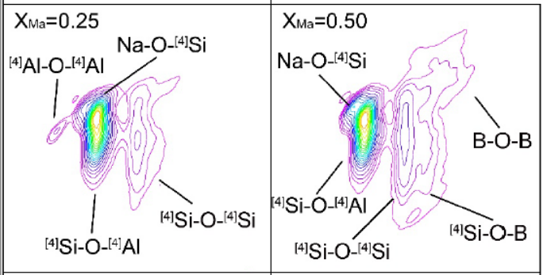
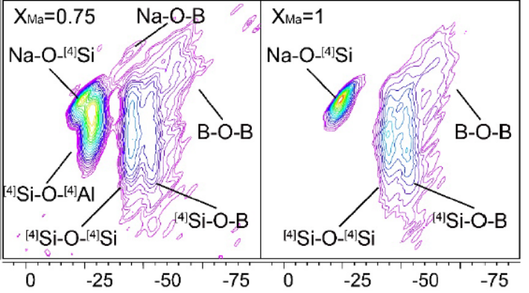

Effect of Al/B: NaAl_{1-x}B_{x}SiO₄ glass structure
↑B → (Malink or B-albite) B4↑ & B3↓
↑B → ordered around Al
B-11
B4
Al-27
B3
Na-O-Si
B-Ø-B
↑B → Na-O-Si (NBO on Si) formed not Na-O-B (NBO on B)
O-17
Nepheline
Malinkoite
Lee, MS thesis, Seoul Natl Univ, 2017

Slide 11
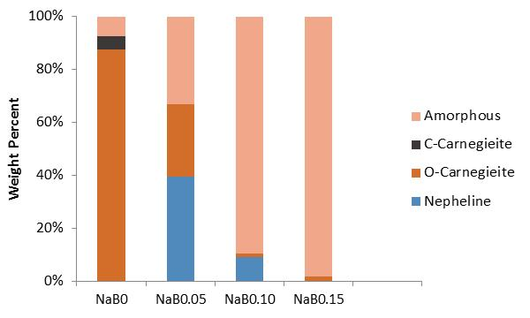
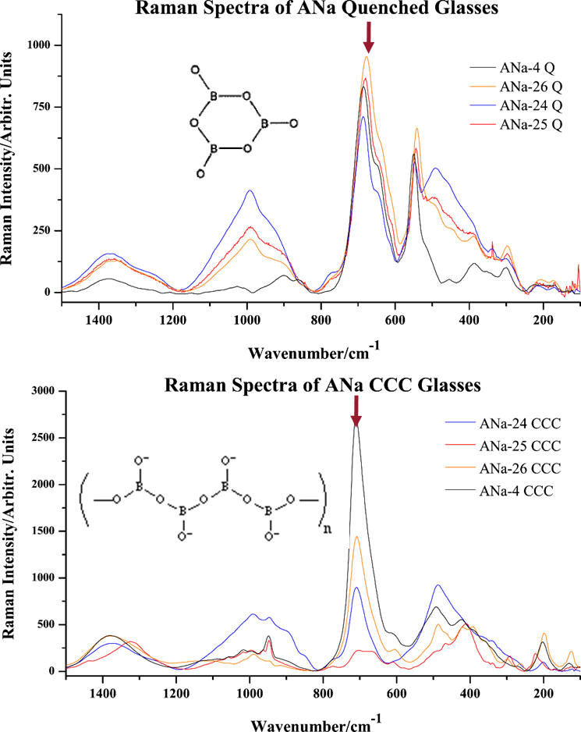
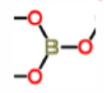
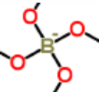
Effect of Al/B: Nepheline crystallization
Low B in NaAl_{1-x}B_{x}SiO₄ allows Nepheline to form
Some compositions with Si~B~Al (molar) crystallize a lot of Nepheline; changes ring to chain metaborates
XRD Rietveld
15-19 wt% B₂O₃
Marcial et al., Proc WM 1632 (2016)
Change in B4/B3 when Nepheline crystallizes
B-11 MAS NMR
B/Al
Heat treated
Quenched
McCloy et al, JNCS 409, 149 (2015)
Marcial et al., unpublished data
Notes:
Various experiments have studied the effect of Al/B in Na(Al,B)SiO₄ and Na(Al,B)Si₃O₈:
Increasing B/(Al+B) increases ^{[4]}B/^{[3]}B
All B species are believed to be non-ring
Trends in dissolution behavior & density caused by residual Na forming Si-NBO, weak B-O-B bonds
Evidenced by ^{[3]}B when Na/(Al+B)=1, Na-O-^{[4]}Si and B-O-B in ¹⁷O 3Q MAS
Strong nepheline bands for highly crystallized glasses
Important bands not due to nepheline
~685 cm⁻¹ (Q glass)
Ring metaborates
~705 – 710 cm⁻¹ (CCC glass)
Chain metaborates
---
McCloy, J., N. Washton, P. Gassman, J. Marcial, J. Weaver, and R. Kukkadapu, "Nepheline crystallization in boron-rich alumino-silicate glasses as investigated by multi-nuclear NMR, Raman, & Mössbauer spectroscopies," Journal of Non-Crystalline Solids, 409, 149-165 (2015).
Marcial, J., J. Kabel, M. Saleh, Y. Shaharyar, A. Goel, and J. McCloy, "Effect of B on Crystallization of Li and Na aluminosilicates," Proc. Waste Management WM2016, 16323 (2016).

Slide 12
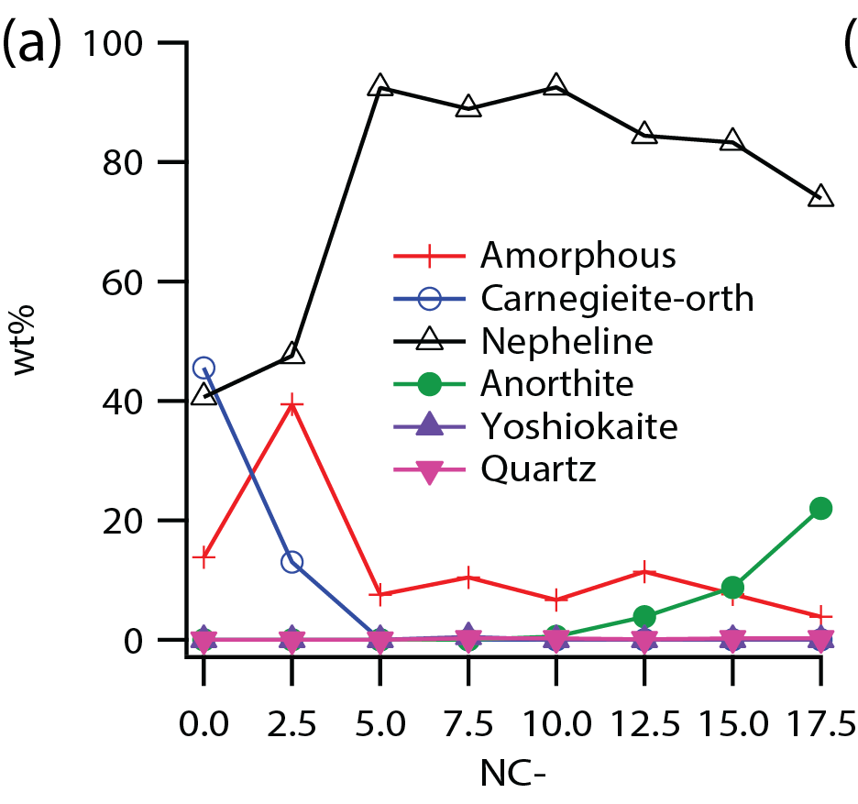
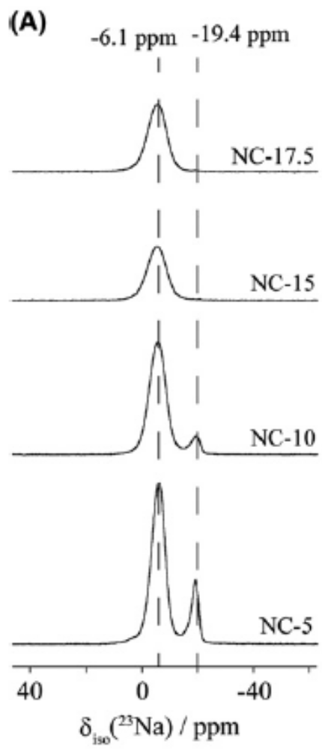
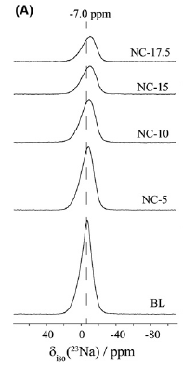
Effect of Na/Ca: Nepheline crystallization
Na-23 in Na_{1-x}Ca_{x}AlSiO₄;
↑Ca, Na-O bond lengthen;
Ca goes into Neph Hex channel
Large amounts of Neph after HT when Ca added
NEPH.
XRD Rietv. of HT
oval
hex
Ca for Na →
Na_{0.3}Ca_{0.7}AlSiO₄
Ca
Deshkar et al, JACERS 100, 2859 (2017)
Notes:
Along the (Na,Ca_{0.5})AlSiO₄ join:
^{[4]}Al-O and ^{[4]}Si-O tetrahedra are preferred in glass & crystal
Increasing additions of Ca/Na deshields Na
Small Ca additions favor nepheline crystallization over Carnegieite
Near endmembers; Ca may enters nepheline
²³Na peak position shifts towards lower frequencies with increasing CaO/Na₂O ratio implying towards increase in average Na–O bond length (d_{Na–O} increases from 2.80 Å to 2.90 Å with increasing CaO content) – since the cationic field strength of Ca²⁺ is higher than Na⁺, calcium can draw oxygen bonds towards itself, thus forcing sodium site to become bigger.
--
Deshkar, A., J. Marcial, S.A. Southern, L. Kobera, D.L. Bryce, J.S. McCloy, and A. Goel, "Understanding the structural origin of crystalline phase transformations in nepheline (NaAlSiO4)-based glass-ceramics," Journal of the American Ceramic Society, 100(7), 2859-2878 (2017).

Slide 13
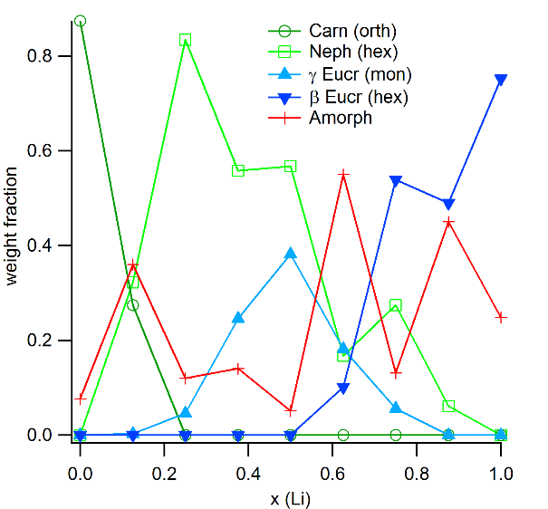
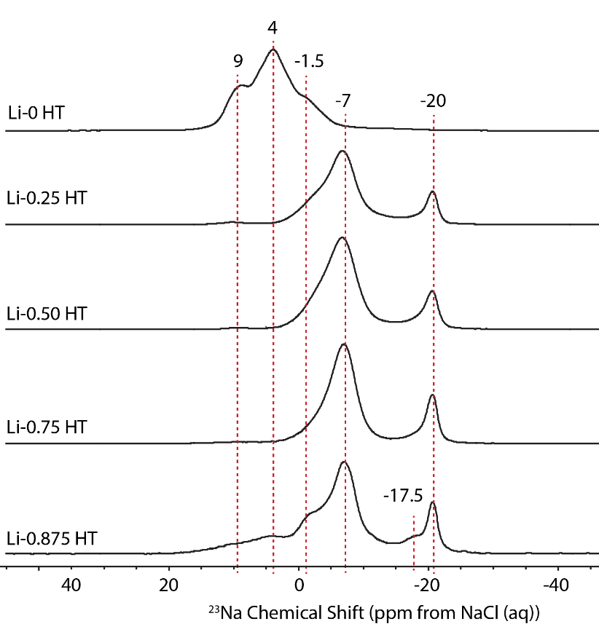
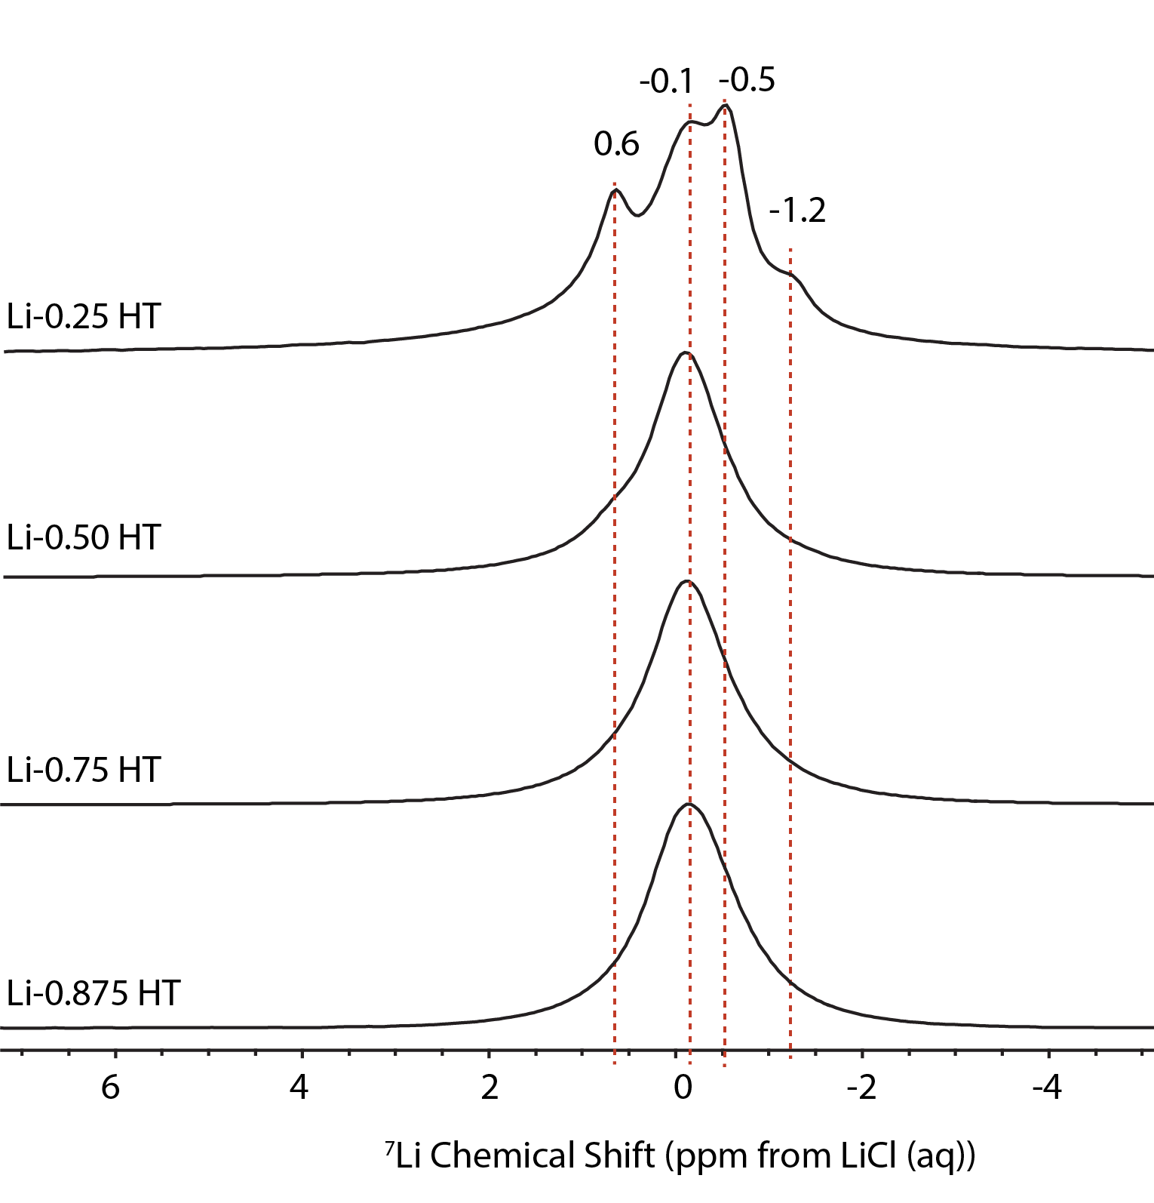
Effect of Na/Li: Nepheline crystallization
Na_{1-x}Li_{x}AlSiO₄
Neph max at low Li
Eucr phases at mid/high Li
XRD Rietv. of HT
NEPH.
No Li: Na→Orth Carneg
Low Li: Li→Neph; complex Li environ.
Mid Li: Na env ~ Neph; Li env ~ γ Eucr
High Li: Na→Eucr; complex Na environ.
Na-23
Li-7
Marcial et al., submitted
Notes:
Along the (Na,Li)AlSiO₄ join:
^{[4]}Al-O and ^{[4]}Si-O tetrahedra are preferred in glass & crystal
Small Li additions favor nepheline crystallization over Carnegieite
Near endmembers; Li may enter nepheline & Na may enter eucryptite
Na_{0.375}Li_{0.625}SiO₄ highest amorphous fraction after HT through Rietveld

Slide 14
Implications
Glasses & crystallized glasses should be studied
  NMR, Raman, EPMA, XRD, magnetic methods, Mössbauer
Cooling conditions strongly influence amounts of nepheline, in some cases phases and/or compositions
Fe, Ca, and likely Li go into nepheline; B does NOT go in
High Fe and B generally suppress nepheline
Li and Ca have more complex effects
Future
Quantify amount of Ca that can go into nepheline
Further defined the change in B with crystallization
Explore any role of Ti and of combined effects
Role of alkali/AE coordination on crystallization tendency
Recommend composition adjustments to avoid crystallization
In-situ synchrotron crystallization experiments
Notes:
NMR on crystallized glasses aids understanding of environments in glass
offered insight into early vibrational spectroscopy:
Influences on chemical durability from B are believed to be due to network breaking and NBOs
Gained insight on influence of mixed cations which promote nepheline over Carnegieite
Determined that the major influence in total suppression of crystallization is the addition of B and Fe in simple glasses

Slide 15











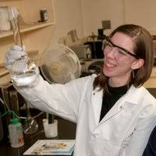
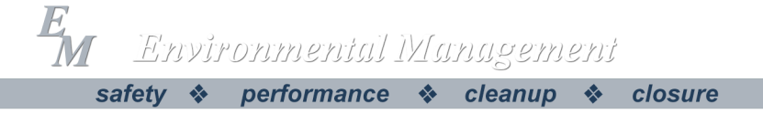
















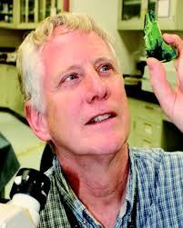
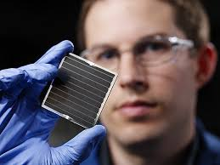








Collaborators
Funding
Notes:
DON’T HAVE A PIC OF PAUL GASSMAN (PNNL) or JAKE AMOROSO (SRNL)

Slide 16
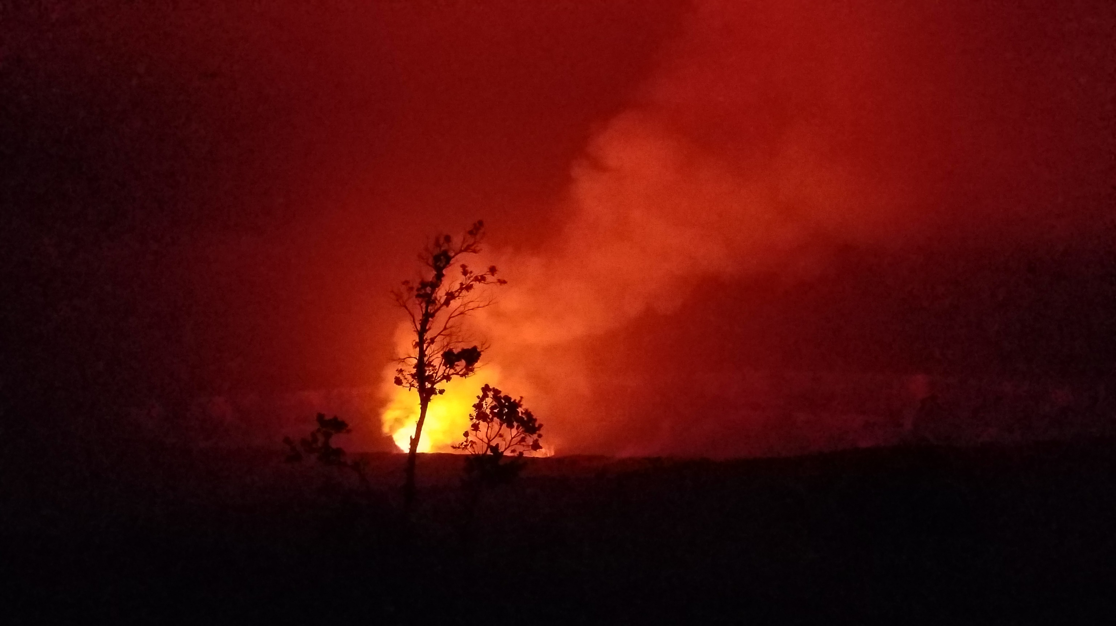
Thanks!

