Slide 1



Characterization of Sodalite Based Waste Forms
for Immobilization of ¹²⁹I
John McCloy,^{1,2} Saehwa Chong,¹ Brian Riley,^{1,2} Junghune Nam¹
1. Washington State University
Pacific Northwest National Laboratory
November 1, 2017

Slide 2
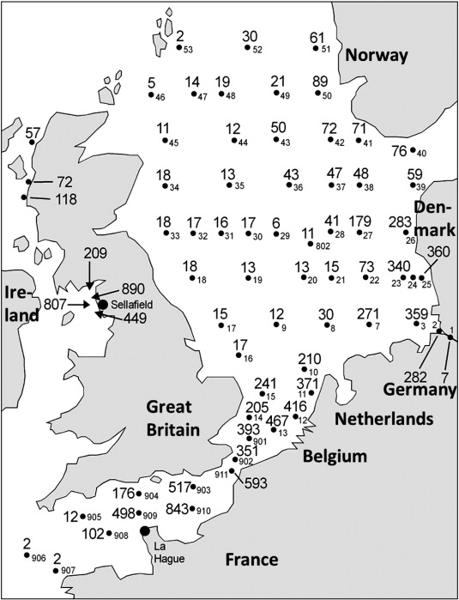
Radioiodine management
Iodine-129
Half-life of 15.7 million yrs.
High mobility when dissolved in ground water
Difficult to use conventional vitrification method
Baselines in other countries
  La Hague, Sellafield: discharge to sea
Baselines for US reprocessing case
  AgZ (mordenite) + low T glass (Bi,Zn) bonding
  AgZ (mordenite) + HIP
  Ag functionalized silica aerogel + consolidate
Recently (re)considered alternatives
  Glass-bonded sodalite
  Glass-bonded vanado-apatite
¹²⁹I [mBq m⁻³] in water from the North Sea (2005-6 surveys)
Michel et al, Science of the Total Environment, 419, 151 (2012)
Notes:
Obtaining potential precursors for waste forms
Iodox: HI₃O₈, Ba(IO₃)₂
AgZ: reduction by H₂, AgI -> Ag + HI(g), capture HI by caustic or other
React HIO₃ or HI to get NaI
Hydrogen iodide: HI
Iodic acid: HIO3
HI3O8 or HIO3-I2O5 [iodic acid–diiodine pentaoxide (1/1)]
--
Michel, R., A. Daraoui, M. Gorny, D. Jakob, R. Sachse, L. Tosch, H. Nies, I. Goroncy, J. Herrmann, H.A. Synal, M. Stocker, and V. Alfimov, "Iodine-129 and iodine-127 in European seawaters and in precipitation from Northern Germany," Science of The Total Environment, 419, 151-169 (2012).
The variability of the ¹²⁹I/¹²⁷I isotopic ratios is exclusively determined by admixture of ¹²⁹I released from the reprocessing facilities Sellafield and La Hague to the seawater. The ¹²⁹I/¹²⁷I ratios were between 4 × 10⁻ ⁹and 3 × 10⁻ ⁶: at least 3 orders of magnitude higher than the natural equilibrium isotopic ratio. (from abstract)
Fig. 3. ¹²⁹I in water from the North Sea [mBq m⁻ ³] sampled during the August 2005 cruise and from the Irish Sea (sampled in 2006). The smaller numbers are station numbers, the bold face numbers are the experimental data.

Slide 3
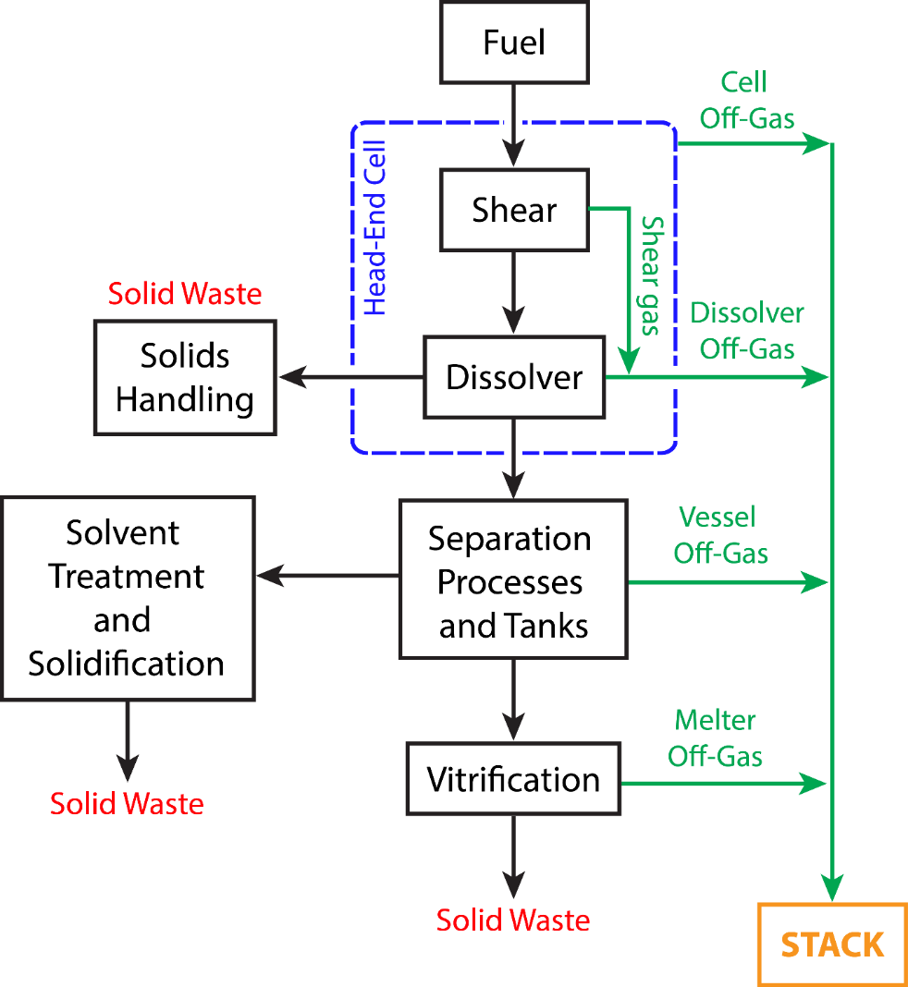
Capture & Immobilization
Capture/immobilize different technologies
  MOF + cement
  Caustic scrub + mineral
Capture/immobilize same technology
  AgZ + some consolidation
  Ag aerogel + some consolidation
  Empty cage sodalite?
DF>1000
DF>3000
Need plant decontamination factor (DF) ~2000
  Driven by total quantity of radionuclides released (EPA) and total dose to public (NRC)
To meet requirement
  Vapor capture only
  Caustic scrubber + vapor (organic forms of I)
DF>1000
DF>1000
Vapor capture, Caustic scrub,
Stack
Etc
Efficiency = fraction captured
Penetration = fraction not captured
Vienna et al., "Closed fuel cycle waste treatment strategy," PNNL-24114 (2015).
Riley et al, J Nucl Mater, 470, 307 (2015)
Notes:
J. Vienna et al., "Closed fuel cycle waste treatment strategy," PNNL-24114; FCRD-MRWFD-2015-000674 Rev 0., Pacific Northwest National Laboratory, Richland, WA (2015).
--
Common metrics used for describing the performance of a given
sorbent are the 1) loading capacity, 2) penetration of the target
species through the column (what does not get captured), 3) efficiency,
and 4) DF
The loading capacity is the amount of iodine
that can be captured by the sorbent. The efficiency is the fraction of
iodine captured, the penetration is defined in Equation (1) as the
difference (the iodine that did not get captured), and the DF is
defined in Equation (2) as the inverse of the penetration.
penetration = 1- efficiency (1)
DF = 1/(1-efficiency)= 1- penetration (2)

Slide 4
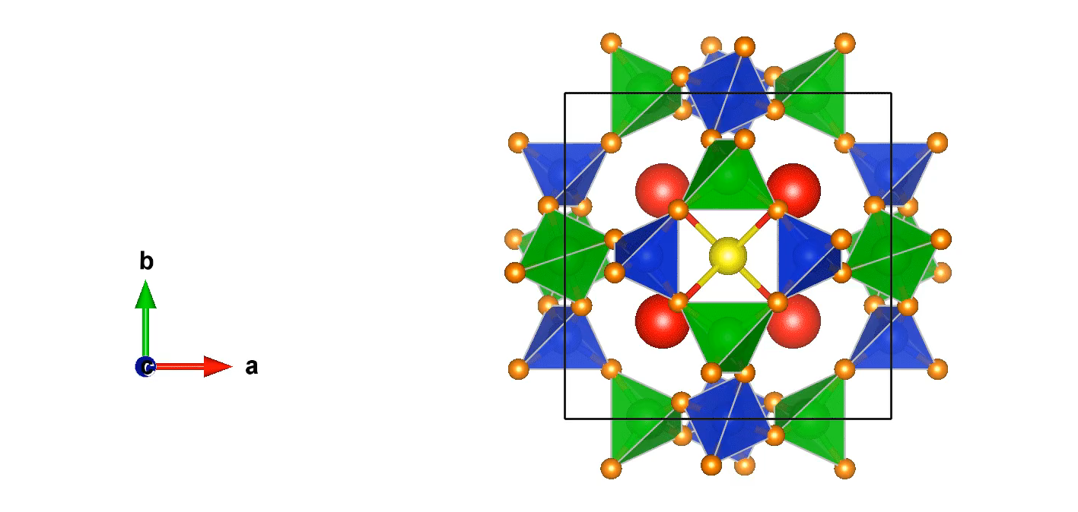
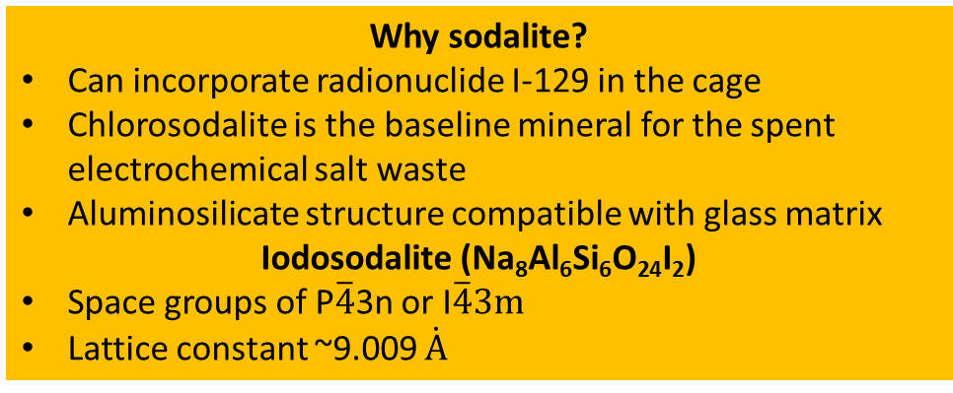


Sodalite
(I⁻, Cl⁻, OH⁻, Br⁻, SO₄²⁻, CO₃²⁻, etc.)
(Na⁺, Ag⁺, Cs⁺, Li⁺, Ca²⁺, Sr²⁺, etc.)
(Al³⁺, Ga³⁺, Si⁴⁺, Ge⁴⁺, etc.)
P$\overline{4}$3n
I$\overline{4}3m$
Six-membered ring in the β-cage of iodosodalite
Why sodalite?
Can incorporate radionuclide I-129 in the cage
Chlorosodalite is the baseline mineral for the spent electrochemical salt waste
Aluminosilicate structure compatible with glass matrix
Iodosodalite (Na₈Al₆Si₆O₂₄I₂)
Space groups of P$\overline{4}$3n or I$\overline{4}3m$
Lattice constant ~9.009 $\dot{A}$
Stacking of the β-cages in unit cell.

Slide 5
Iodosodalite as a waste form
  Rockwell (Strachan & colleagues), 1979-80
    Kaolinite & NaAlO₂ methods, cold press & high T fire or HUP
  CEA (Campayo & colleagues), 2008
    High T solid state synthesis (NaAlO₂+SiO₂+NaI, NaAlSiO₄+NaI)
    RT aqueous from Kaolinite+NaOH+NaI
  NNL/Sheffield (Maddrell, Hyatt & colleagues), 2003-present
    NaI occlusion in zeolite + HIP
    Nepheline (from NaOH+Al hydroxide+SiO₂)+NaI/AgI, ball mill+HIP
    Hydrothermal
  ANSTO (Vance, Gregg & colleagues), 2015-present
    HIP of iodosodalite
    Ag+ZeoliteA+I₂ vapor -> Na,Ag ISOD
ISOD has long history of consideration for Iodine waste form
Notes:
Rockwell (Sodalite):
Strachan, D. and H. Babad, "Iodide and Iodate Sodalites for the Long-Term Storage of Iodine-129," RHO-SA-83, Rockwell International-Rockwell Hanford Operations, Richland, WA (1979).
Babad, H. and D.M. Strachan, "Method for immobilizing radioactive iodine," The United States Of America As Represented By The United States Department Of Energy, USPTO US4229317 A, (1980).
Headley, T.J., J.T. Healey, P.F. Hlava, M.J. Kupfer, and D.M. Strachan, "Microstructural characterization of glass and ceramic simulated waste forms," Proc. MRS Vol. 2 Sci. Basis Nucl. Waste Manage., 249-54 (1980).
Winters, W.I., "The Effect of Hot-Pressing Conditions on the Properties of Iodide Sodalite," RHO-LD-153, Rockwell International-Rockwell Hanford Operations, Richland, WA (1980).
CEA (Sodalite):
Bardez, I., L. Campayo, D. Rigaud, M. Chartier, and A. Calvet, "Investigation of sodalites for conditioning halide salts (NaCl and NaI): Comparison of two synthesis routes," Proc. ATALANTE 2008, O4_19 (2008).
NNL/Sheffield (Sodalite):
Hyatt, N.C., J.A. Hriljac, A. Choudhry, L. Malpass, G.P. Sheppard, and E.R. Maddrell, "Zeolite - Salt Occlusion: A Potential Route for the Immobilisation of Iodine-129?," MRS Online Proceedings Library, 807 (2003).
Maddrell, E.R. and P.K. Abraitis, "A comparison of wasteforms and processes for the immobilization of iodine-129," Mater. Res. Soc. Symp. Proc., 807(Scientific Basis for Nuclear Waste Management XXVII), 261-266 (2004).
Sheppard, G.P., J.A. Hriljac, E.R. Maddrell, and N.C. Hyatt, "Silver Zeolites: Iodide Occlusion and conversion to Sodalite – a potential 129I waste form?," MRS Online Proceedings Library, 932 (2006).
Maddrell, E., A. Gandy, and M. Stennett, "The durability of iodide sodalite," Journal of Nuclear Materials, 449(1-3), 168-172 (2014).
Maddrell, E.R., E.R. Vance, and D.J. Gregg, "Capture of iodine from the vapour phase and immobilisation as sodalite," Journal of Nuclear Materials, 467, Part 1, 271-279 (2015).
Vance, E.R., D.J. Gregg, C. Grant, A. Stopic, and E.R. Maddrell, "Silver iodide sodalite for 129I immobilisation," Journal of Nuclear Materials, 480, 177-181 (2016).
---------------------

Slide 6
Glass-bonded Sodalite
Waste Form
Objectives
Selection of optimum precursors
Synthesize and characterize glass-bonded iodosodalite waste forms
Variables
Outputs Investigated
Iodosodalite synthesis (hydrothermal and aqueous)
Glass binders (NBS-4 and SA-800)
Mixed glass binder mass% (0, 10, 20 %)
Sintering temperature (650, 750, 850 °C)
Iodide sodalite fraction (XRD)
Elemental mapping (SEM/EDS)
T-O vibrations (T=Si, Al), (FTIR)
Density and porosity (pycnometer)
Thermal analysis (TGA/DSC)
Iodine quantification (NAA, Volumetric, Rietveld)
Chemical durability (ASTM-1308)

Slide 7
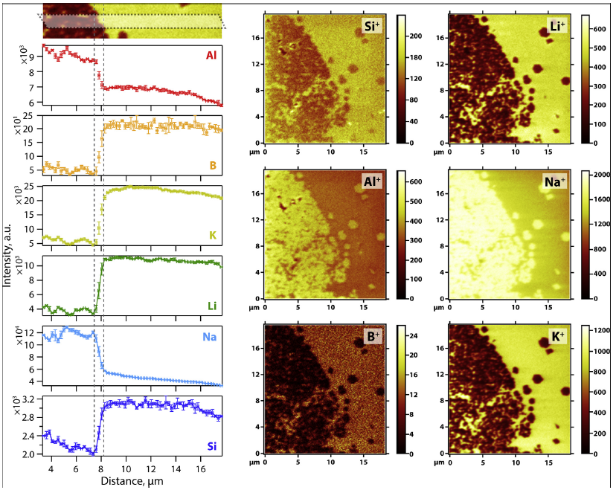
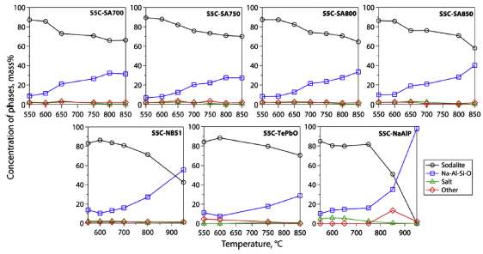
Glass binders selected from best in chlorosodalite studies
Glass binder composition in mass%
Time-of-flight SIMS
(Cl) “Ceramic Waste Form” with NBS glass
Glass | SiO₂ | B₂O₃ | Al₂O₃ | CaO | Na₂O | ZrO₂
NBS-4 | 58.87 | 8.98 | 5.99 | 3.99 | 20.17 | 2.00
SA-800 | 42.50 | 24.62 | 0.00 | 0.00 | 32.88 | 0.00
Phase distribution in pellets with different glass binders
NBS-4
Showed the best result for the ceramic waste form study for Cl-
Na₂O helped chlorosodalite production
Higher sodalite yield in ceramic waste form
Lower halite and amorphous fraction
CTE close to sodalite’s
Best chemical durability among NBS series
SA-800
Max densification at 750-850 °C compared to >950 °C for NBS glass
Lowest porosity among SA series
High sodalite yield
Riley et al. Journal of Nuclear Materials 468, 140 (2016)
Riley et al. Journal of Nuclear Materials 489, 42 (2017)
Notes:
Riley, B.J., W.C. Lepry, and J.V. Crum, "Solution-Derived Sodalite Made with Si- and Ge-Ethoxide Precursors for Immobilizing Electrorefiner Salt," Journal of Nuclear Materials, 468, 140-146 (2016).
2017 paper is the glass binder one.

Slide 8
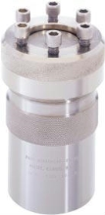
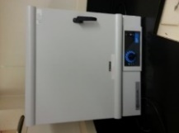
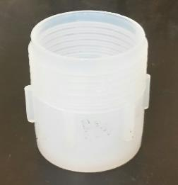
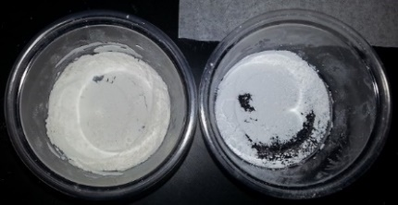

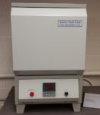
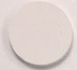
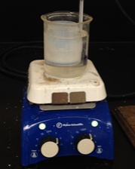
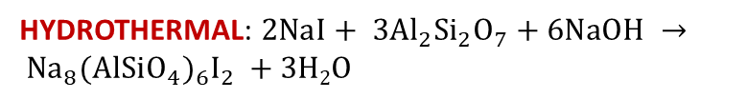
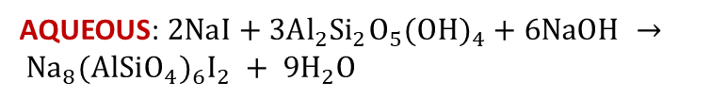
Synthesis of Glass-bonded Iodosodalite Waste Form
4 experimental variables
Previous study looked at various precursors on ISOD formation
This study optimized ISOD for unwashed powder (i.e. possible unreacted material)
Baseline iodosodalte | Glass binder composition | Glass binder (mass%) | Sintering T (°C)
Hydrothermal Aqueous | NBS-4 SA-800 | 0 10 20 | 650 750 850
Metakaolin
HYDROTHERMAL: $2NaI+ 3Al_{2}{Si}_{2}O_{7}+6NaOH → {Na}_{8}(AlSiO_{4})_{6}I_{2} +3H2O$
Autoclave
Oven
180°C, 2d
Solution
to vessel
Drying
90°C
Kaolinite
Sodalite
Powder
Mix with glass
& press pellet
650-850°C, 8h
GB sodalite
~20 mm Ø
~2 mm thk.
AQUEOUS: $2NaI+3Al_{2}{Si}_{2}O_{5}(OH)_{4}+6NaOH → {Na}_{8}(AlSiO_{4})_{6}I_{2} + 9H_{2}O$
70 °C,
1 h stir
Oven
100°C, 16 h

Slide 9
XRD
(hydrothermal)
XRD spectra of ISOD (hydrothermal)+10% NBS4 sintered at different T
At 650 °C, not completely sintered; crystallization of ‘interstitial carnegieite’ (Na₆Al₄Si₄O₁₇)
At 750 °C, ones with SA-800 are sintered; crystallization of nepheline (Na_{7.85}Al_{7.85}Si_{8.15}O₃₂)
At 850 °C, low fraction iodosodalite, high fractions amorphous and nepheline

Slide 10
XRD Rietveld
Phase distribution of heat-treated samples
Hydrothermal ISOD + NBS-4/SA-800
Aqueous ISOD + NBS-4
10 wt%
20 wt%
750 °C with 10 mass% glass binder was best for sintering and ISOD yield.
NBS-4 samples had higher ISOD, but SA-800 ones were better sintered.
Glass binders did not seem to affect the yield of sodalite (unlike in chlorosodalite).

Slide 11
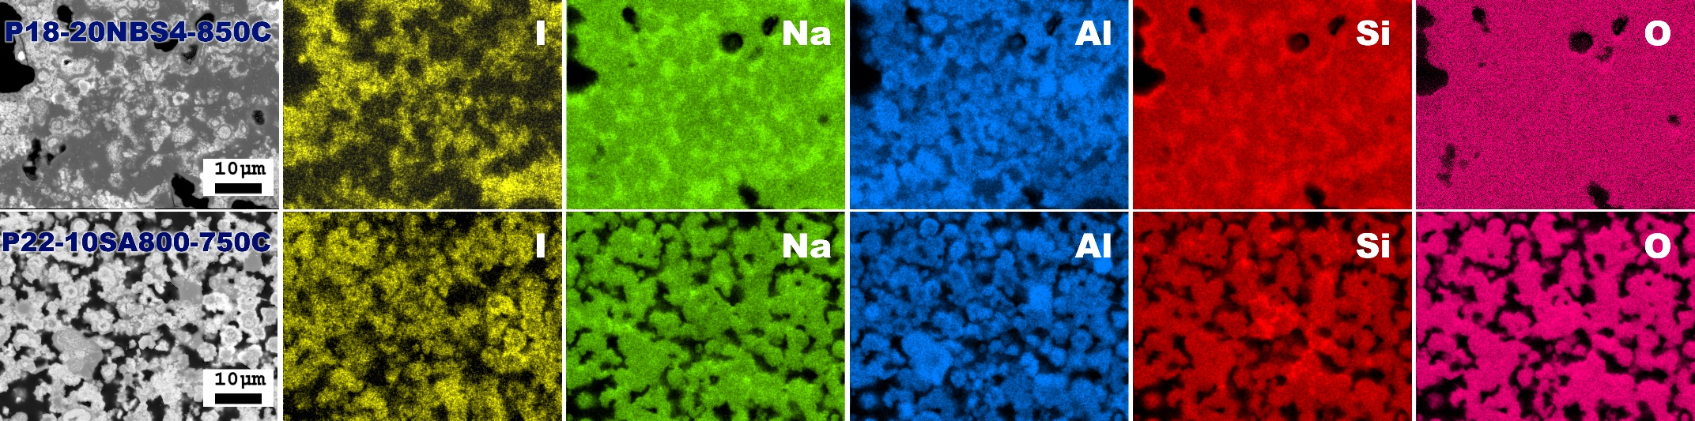
SEM/EDS & Porosity
(hydrothermal)
SEM and EDS elemental maps of heat-treated pellets
Brighter regions are ISOD; darker regions are nepheline and amorphous.
Elements are heterogeneously distributed.
SA-800 better closes pores due to lower T_{m}
Most Iodine atoms are in sodalite; not much iodine in the amorphous fraction.
NBS
SA
Notes:
Last bullet is easier to tell in the top line of micrographs: Can see I in particles, more Na & Si in glass
More difficult to see this in bottom

Slide 12
TGA/DSC & FTIR
(hydrothermal)
TGA/DSC
FTIR
ν_{s} (T-O)
S→N
ν_{as} (T-O)
CO₃²⁻
H₂O↑
I↑
No sintering
Sodalite → nepheline at 600-800°C; iodine volatilizes.
Sodalite decomposition >800 °C; iodine volatilizes.
Mass loss below 600 °C for baseline sodalite is due to dehydration of water on/in the structure (basic sodalite).
No significant change in heat flow → transition rate slow.
FTIR peaks related to T-O (T=Si, Al) from TO₄ tetrahedra.

Slide 13
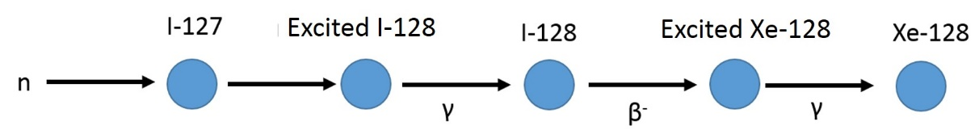
Iodine Quantification
TGA/DSC & FTIR
Volumetric
Neutron activation analysis (NAA)
Rietveld
Iodine in the sample is oxidized to iodate
Irradiate samples with the neutrons source
Obtain XRD spectra of a sample
Titrated with thiosulfate using starch as an indicator
Convert ¹²⁷I →¹²⁸I
Identify phases
Decay into the excited state of ¹²⁸Xe
Refine reference phases
Iodine mass% calculated using empirical formula
Calculate the fraction of iodosodalite phase
Gamma energy release as it comes down to ground state
Calculate iodine mass% in the sample
Gamma rays are detected and analyzed for iodine mass%
NAA scheme

Slide 14
Iodine Quantification
Hydrothermal ISOD+NBS-4 and ISOD+SA-800
heat-treated at 750°C.
Aqueous ISOD+NBS-4 and ISOD+SA-800
heat-treated at 750°C.
Note that “maximum” assumes all batched iodine is in ISOD.
~38-47% of iodine remained for hydrothermal ISOD+glass binders
~55-70% of iodine remained for aqueous ISOD+glass binders
Aqueous approach for sodalite seems better for waste form synthesis

Slide 15
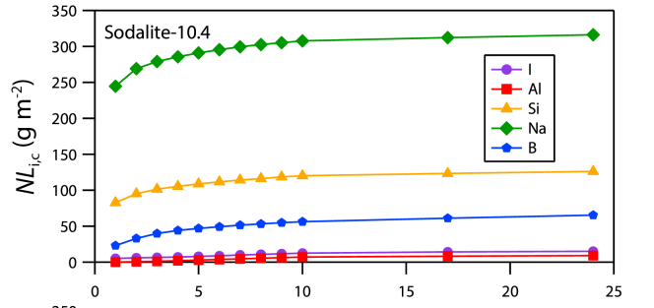
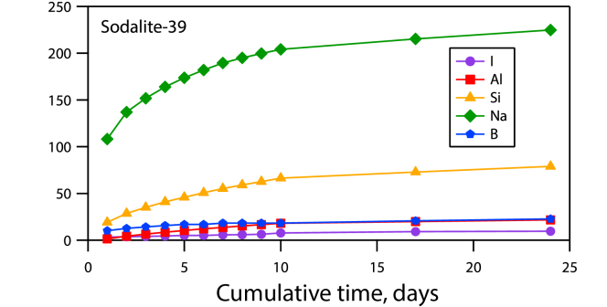
Chemical Durability
(ASTM 1308 on coupons)
P10-10N-750C (hydrothermal baseline WF)
P39-10N-750C (aqueous baseline WF)
Cumulative time, days
Normalized mass loss (Na, Al, Si, I) from best WF of hydrothermal & aqueous
The NL_{I,c} values, after the ten 1-d solution exchanges for sodalite samples @80 m⁻¹ surface to fluid volume, were 12.5 g m⁻² (hydrothermal) and 7.7 g m⁻² (aqueous)
Large initial releases of B, Na, and Si due to non-durable Na-Si-O amorphous phase
Release rate of iodine is high when compared to HIPPed (900 °C & 1100 °C 200 MPa - 2 h) different corrosion test: 0.005-0.01 g/m²/d between 7-14 days [1], powders, pH~11
  0.53 g/m²/d for hydrothermal and 0.36 g/m²/d for aqueous between 7-17 days
[1] Maddrell et al, Journal of Nuclear Materials, 449, 168 (2014)
Notes:
P39 and P40 are identical pellets.
[1] Maddrell, Gandy, Stennett, The durability of iodide sodalite. Journal of Nuclear Materials, 2014. 449(1): p. 168-172
--
Leach tests on the defined particle size fractions of wasteform were conducted at 90 °C in a
0.025 M KHCO3 + 0.015 M KOH solution which buffered to pH 11. This was deemed appropriate to
simulate the alkaline environment of many proposed geological disposal facilities and also to
stabilise leached iodine as iodide ions. The required wasteform mass was calculated from
geometric considerations to give a surface area of 50 cm2, and the leachant volume was 50 cm3
giving a surface area to volume ratio of 1 cm-1. Three leach tests were prepared for each
wasteform, to be terminated at each of 3, 7 and 14 days. The alkaline leachate was used to
determine the amount of leached iodine. Aliquots of acidified leachate were analysed for cations.
Analysis was by ICP-AES.

Slide 16
Conclusions
Glass-bonded iodosodalite waste forms were synthesized with varying baseline powder, glass fraction, glass type, & temperature
  Best condition: 750 °C, aqueously grown iodosodalite baseline (kaolinite precursor), 10 mass% of glass binder.
    However, more rigorous study of hydrothermal powder
  For glass binder, NBS-4 for higher iodosodalite yield, but SA-800 for lower porosity.
Iodine retention
  ~40-45% iodine retention for hydrothermal ISOD+glass binder
  ~60-70% iodine retention for aqueous ISOD+glass binder
Chemical durability results show relatively high iodine release rate compared to HIP iodosodalite; however test was different
Notes:
Crystallization of interstitial carnegieite at 650 °C and nepheline at 750-850 °C

Slide 17
Possible Future Work
Characterization and comparison of HIPped waste form to glass-bonded waste form
  The same powders used for glass-bonded waste forms were HIPPed at ORNL (900°C-175MPa-3h).
  Resulting phases, morphology, and porosity will be compared
Anion selectivity
  Effect of varied aging times on the anion selectivity (OH, Cl, I)
  Further investigate nonlinear incorporation behavior
Iodine capture by sodalite for direct transform into waste form
  Iodine gas flow to anhydrous sodalite (empty cage) and heat-treat at different temperature for possible transformation into iodosodalite
Effects of cations to iodosodalite synthesis
  Various cations (Li, K, Cs, etc) effects on iodosodalite yield
Notes:
HIP – Stefanie Bruffy – ORNL
Sent 10 samples – both hydrothermal & aqueous
baseline ISOD
ISOD+10NBS4
ISOD+20NBS4
ISOD+10SA800
ISOD+20SA800
Conditions
Temp = 900°C
Pressure = 175 MPa
Time = 3 h
Canister = stainless steel 304SS
OD ¾”
Wall 0.02”
Length 1”
Lid inset trepan with vent port

Slide 18




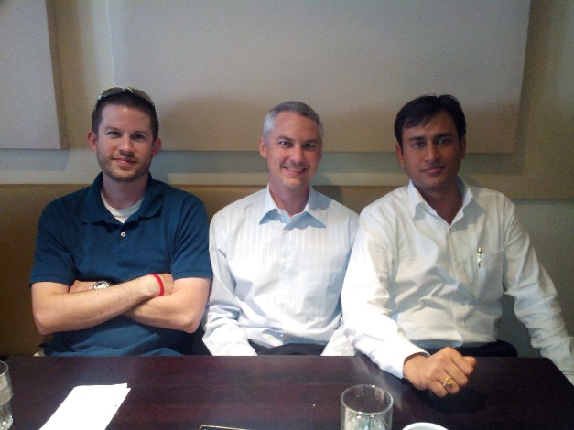




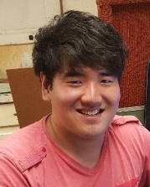






Acknowledgements
Apatite and sodalite based glass-bonded waste forms
for immobilization of ¹²⁹I and mixed halide radioactive wastes
Sodalite aerogel, sol-gel
Glass binder
Sodalite based waste form
Na₈Al₆Si₆O₂₄I₂
Apatite based waste form
  (Ca,Pb)₁₀(VO₄,PO₄)₆I₂
Brian Riley Josef Matyáš Jacob Peterson Jared Kroll
Dr. John McCloy Saehwa Chong Junghune Nam
Dr. Ashutosh Goel
Charlie Cao
Taihao Han
Dr. Donald Wall

