Slide 1
Glass Ceramic Corrosion Testing
J. Crum €, B. Riley €, J. Peterson €, J. Kroll €, J. Neeway € and M. Asmussen €, C. Crawford ₣
€Pacific Northwest National Laboratory, ₣ Savannah River National Laboratory
Scientific Basis for Nuclear Waste Management Symposium 2017

Slide 2
Glass Ceramic Development Background
Glass Ceramics are being developed to immobilize HLW from reprocessing used nuclear fuel
  Intentional crystallization of troublesome components (MoO₃, lanthanides, and alkaline earths)
  Targeted phases: powellite [(Ca,Sr,Ba)MoO₄], oxyapatite [Ca₂Nd₈(SiO₄)₆O₂], and RE₃BSi₂O₁₀
  Phase transformation upon slow cooling in the canister after pouring
Corrosion testing of glass ceramic waste form
  Flow through (SPFT) and static testing (PCT)
  Evaluation of corrosion data complicated by multiple phases and microstructural effects
Corrosion studies of individual phases in glass ceramic waste form (separately)
  Synthesis of phases
  Characterization of phases
  Corrosion studies by flow-through and static testing

Slide 3
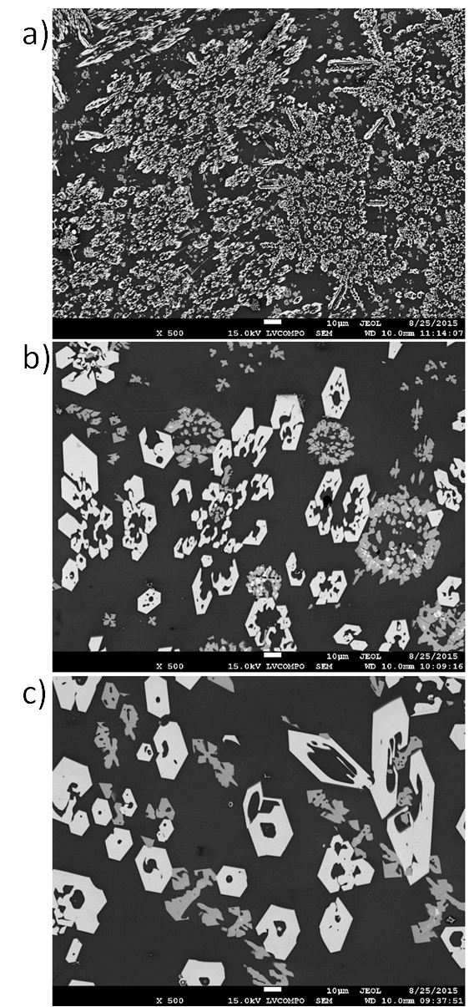
Dilute Corrosion Testing by SPFT
4×
Single-pass flow-through (SPFT) testing was performed on the centroid composition as a function of the following parameters:
  Variable microstructures (slow cooling rate varied 4×, 1 ×, and ¼ ×), see phase assemblage by XRD and microstructure
  4 different flow rates (on average 6, 17, 51, and 159 mL/d)
  2 different pHs (7 and 9)
XRD | Crystal Chemistry | ¼× SC | 1× SC | 4× SC
Oxyapatite | Ca₂Ln₈Si₆O₂₆ | 17.2 | 18.6 | 21.2
Powellite | Ca_{x}Sr_{1-x}MoO₄ | 10.1 | 9.1 | 10.3
Powellite 2 | Ca_{x}Ba_{1-x}MoO₄ | 0.6 | 0.4 | 0.9
Glass | - | 72.1 | 71.9 | 67.6
4×
1×
¼×

Slide 4
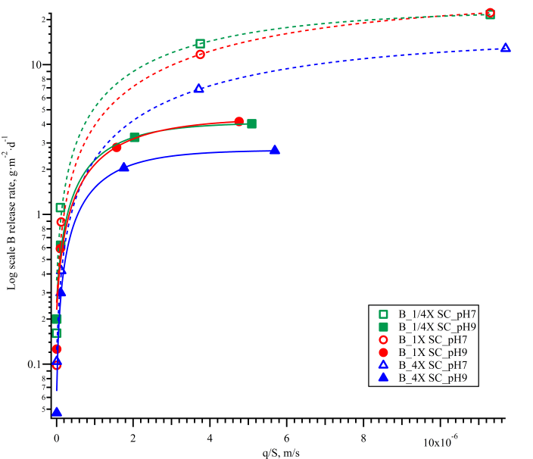
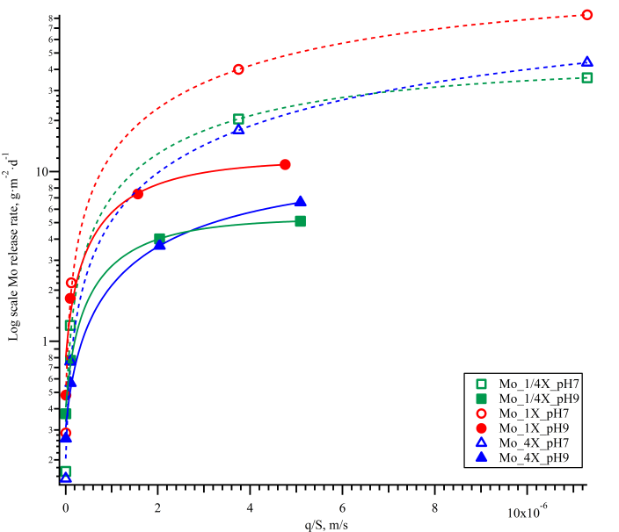
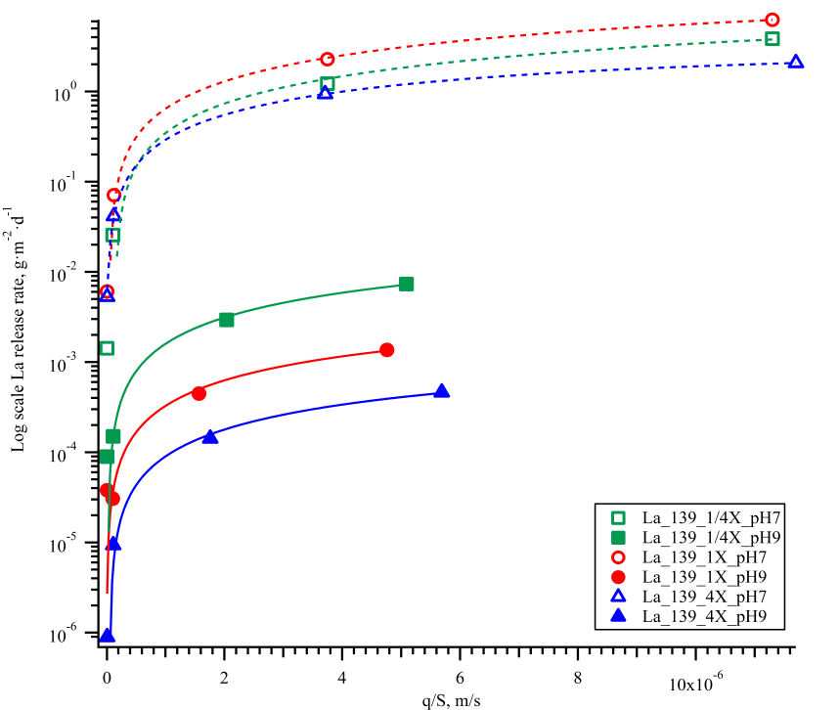
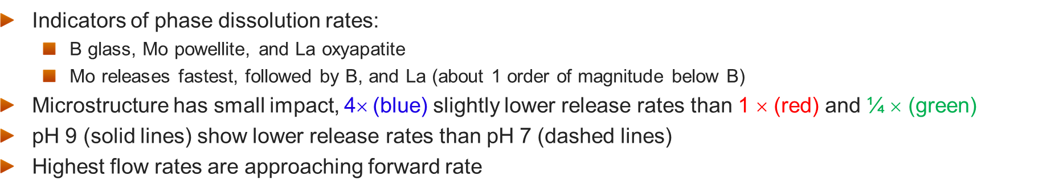
SPFT Results
Indicators of phase dissolution rates:
  B glass, Mo powellite, and La oxyapatite
  Mo releases fastest, followed by B, and La (about 1 order of magnitude below B)
Microstructure has small impact, 4$$(blue) slightly lower release rates than 1 $$ (red) and ¼ $$ (green)
pH 9 (solid lines) show lower release rates than pH 7 (dashed lines)
Highest flow rates are approaching forward rate
B
Mo
La
1/4×
1×
4×
1/4×
1×
4×
1/4×
1×
4×

Slide 5
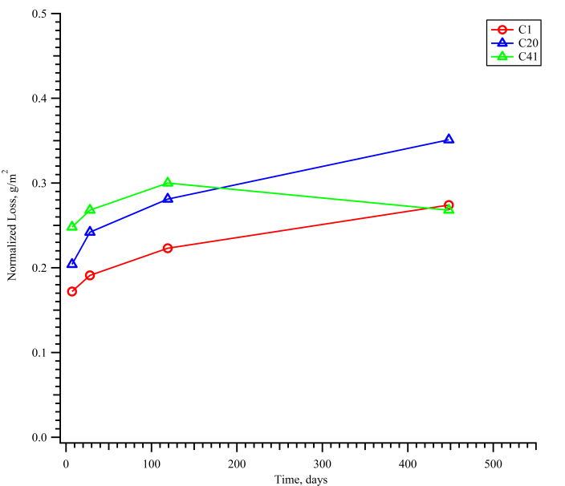
Static Corrosion Testing by PCT-B
Performed modified PCT-B on three replicates of the glass ceramic centroid composition
  Conditions: 90°C, DIW, SA/V ratio (density corrected 1440-1643 m⁻¹), times 7, 28, 119, and 448 days, stainless steel vessels, and Glass Ceramic waste form ground and sieved to 100-200 mesh
  Measured pH and solution concentrations (ICP-OES and MS)
NL(Na) increases quickly between 0-7 days, then increase moderately between 28-448 days

Slide 6
Summary of PCT and SPFT on glass ceramic waste form
The PCT and SPFT show different release rates for the elements depending upon the phase in which they reside
PCT data is modeled well for the waste form as a whole
  B, Li, and Na indicators for glass
  Mo for powellite
  La and Nd for oxyapatite (although BDL)
  Ca present in all phases and poorly modeled
With a multiphase waste form results of corrosion testing are less clear
  What is the encapsulating effect and interactions between phases that occur during corrosion of the waste form?
  We see Mo released faster than glass components in SPFT yet the glass is the continuous phase
  Are the lanthanide mainly released from the glass phase, the oxyapatite, or both phases?
These Results and Questions Prompted Testing of Single-Phase Materials

Slide 7
Single Phase Synthesis Outline
Synthesize individual phases, oxyapatite, powellite, and the remainder glass, targeting compositions observed in the centroid glass ceramic sample
  Oxyapatite (Ca₂Nd₈Si₆O₂₆)
  Powellite [(Ca_{x}Sr_{y}Ba_{1-x-y})MoO₄]
  Rare earth borosilicate (RE₃BSi₂O₁₀; not discussed here)
  Remainder Glass after canister centerline cooling profile
Characterize each phase
  SEM for elemental composition and morphology
  XRD for structure determination and phase assemblage
  EBSD for grain size and orientation mapping
Perform corrosion testing
  Test each phase separately
  Combined the phases together in the ratios seen in the centroid glass composition

Slide 8
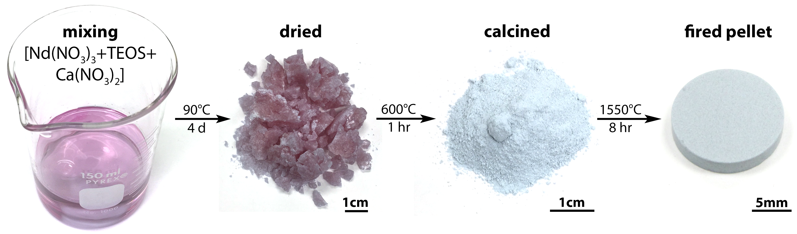
Oxyapatite Synthesis Method
Successfully synthesized oxyapatite Ca₂Nd₈Si₆O₂₆
  Powder preparation by solution-based method
  Calcined 600°C/1hr, crushed, then 1000°C/1hr
  Powders agglomerate during calcining, requires ball milling to achieve a fully dense pellet
  Best results achieved by ball milling overnight with 3/8” ZrO₂ media in EtOH. Bimodal distribution with D50 = 2 µm
  Cold isostatic pressed pellets to 0.35 GPa
  Fired at 1550°C for 8hr, ramped at 1°C/min up and down
Milling Method | Soak Temp | Ramp Rate | Firing Time | Bulk Density | % of Theoretical Density
 | °C | °C/min | hours | g/cm³ | 5.47g/cm³
Mortar and pestle | 1250 | 3 | 24 | 3.33 | 60.9%
WC ball milled | 1550 | 3 | 8 | 4.71 | 86.2%
ZrO₂ ball milled | 1550 | 3 | 8 | 5.11 | 93.4%
ZrO₂ ball milled (large batch) | 1550 | 1 | 8 | 5.16 | 94.4%
ZrO₂ ball milled (large batch #2) | 1550 | 1 | 8 | 5.14 | 93.9%

Slide 9
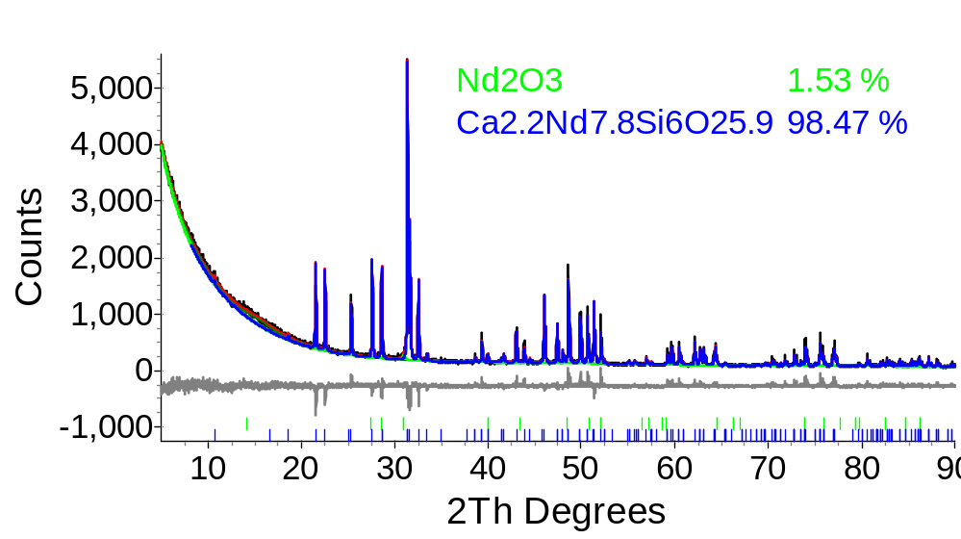
Oxyapatite Characterization
EBSD
  97.7 wt% Ca_{2.2}Nd_{7.8}Si₆O_{25.9} (yellow phase)
    Avg. grain size = 1 µm, Some large grains ~ 10 µm
  1.8 wt% Nd₂O₃ (blue phase)
  0.5 wt% ZrO₂ (milling contaminate) (pink phase)
  33.7 % non-detect (areas without good pattern quality)
XRD
  98.5 wt% Ca_{2.2}Nd_{7.8}Si₆O_{25.9}
  1.5 wt% Nd₂O₃
  ZrO₂ non-detect
Grain map
Phase map

Slide 10
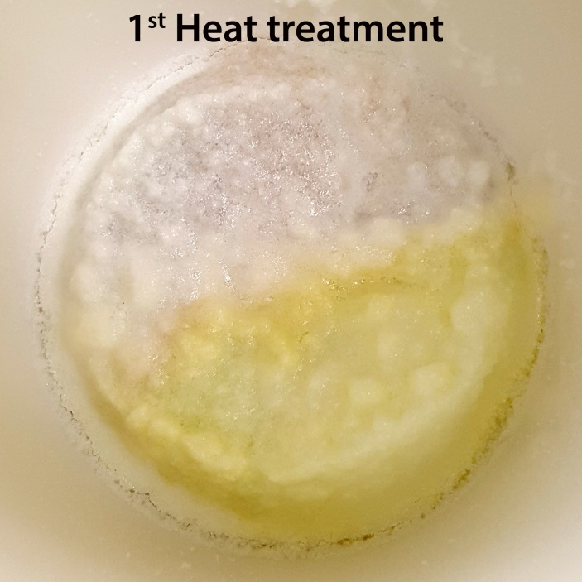
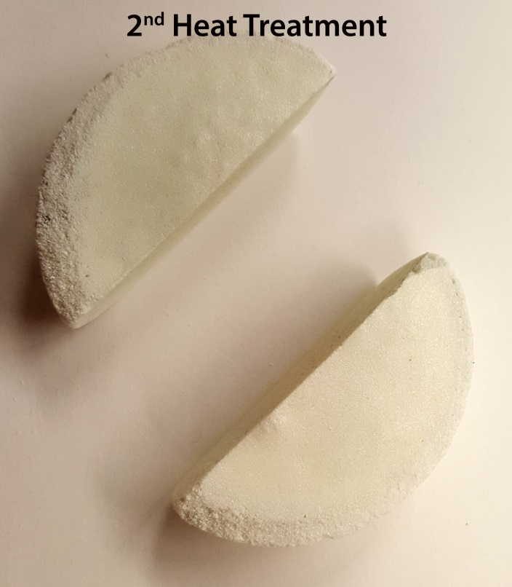
Powellite Synthesis
Method
Alkaline earth powellite
  Target composition Ca_{0.75}Sr_{0.19}Ba_{0.06}MoO₄
  Batched using carbonates and MoO₃
  Crystallized from a melt at 1500°C
  Ramp cooled 1°C/min to 1400°C
  Hold 1hr 1400°C
  Ramp cooled 1°C/min down
  The sample had two distinct colors after 1st heat treatment
  Ground to a fine powder and repeated heat treatment process
  Obtained a uniform white material after 2nd heat treatment
  Density 3.73 g/cm³ (86.3% of theoretical) by Archimedes method

Slide 11
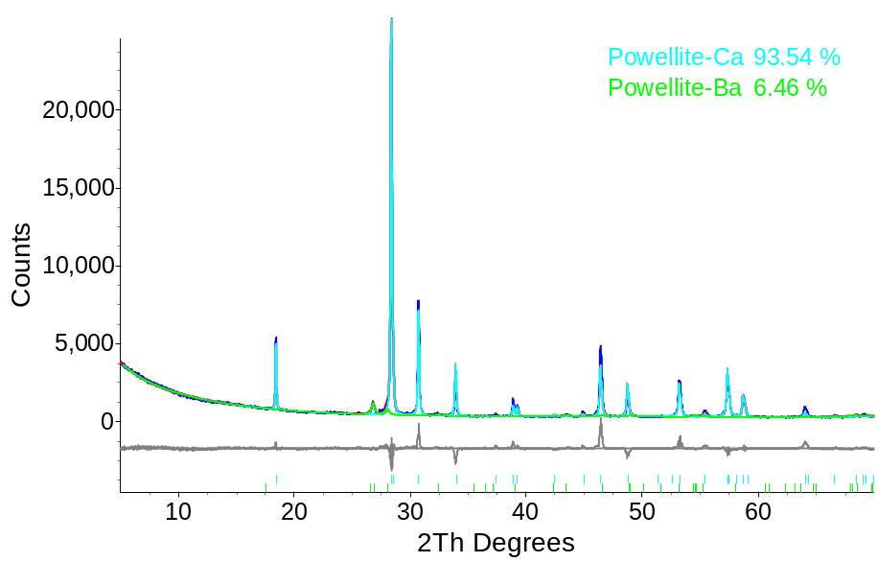
Powellite Characterization
EBSD shows two powellites
  99.8 wt% (Ca,Sr,Ba)MoO₄ (blue phase)
    Avg. grain size = 43 µm
  0.2 wt% BaMoO₄ (green phase)
  Non-detect 6.3%
XRD shows two powellites
  93.5 wt% (Ca,Sr,Ba)MoO₄
  6.5 wt% (Ba,Sr,Ca)MoO₄
Grain map
Phase map

Slide 12
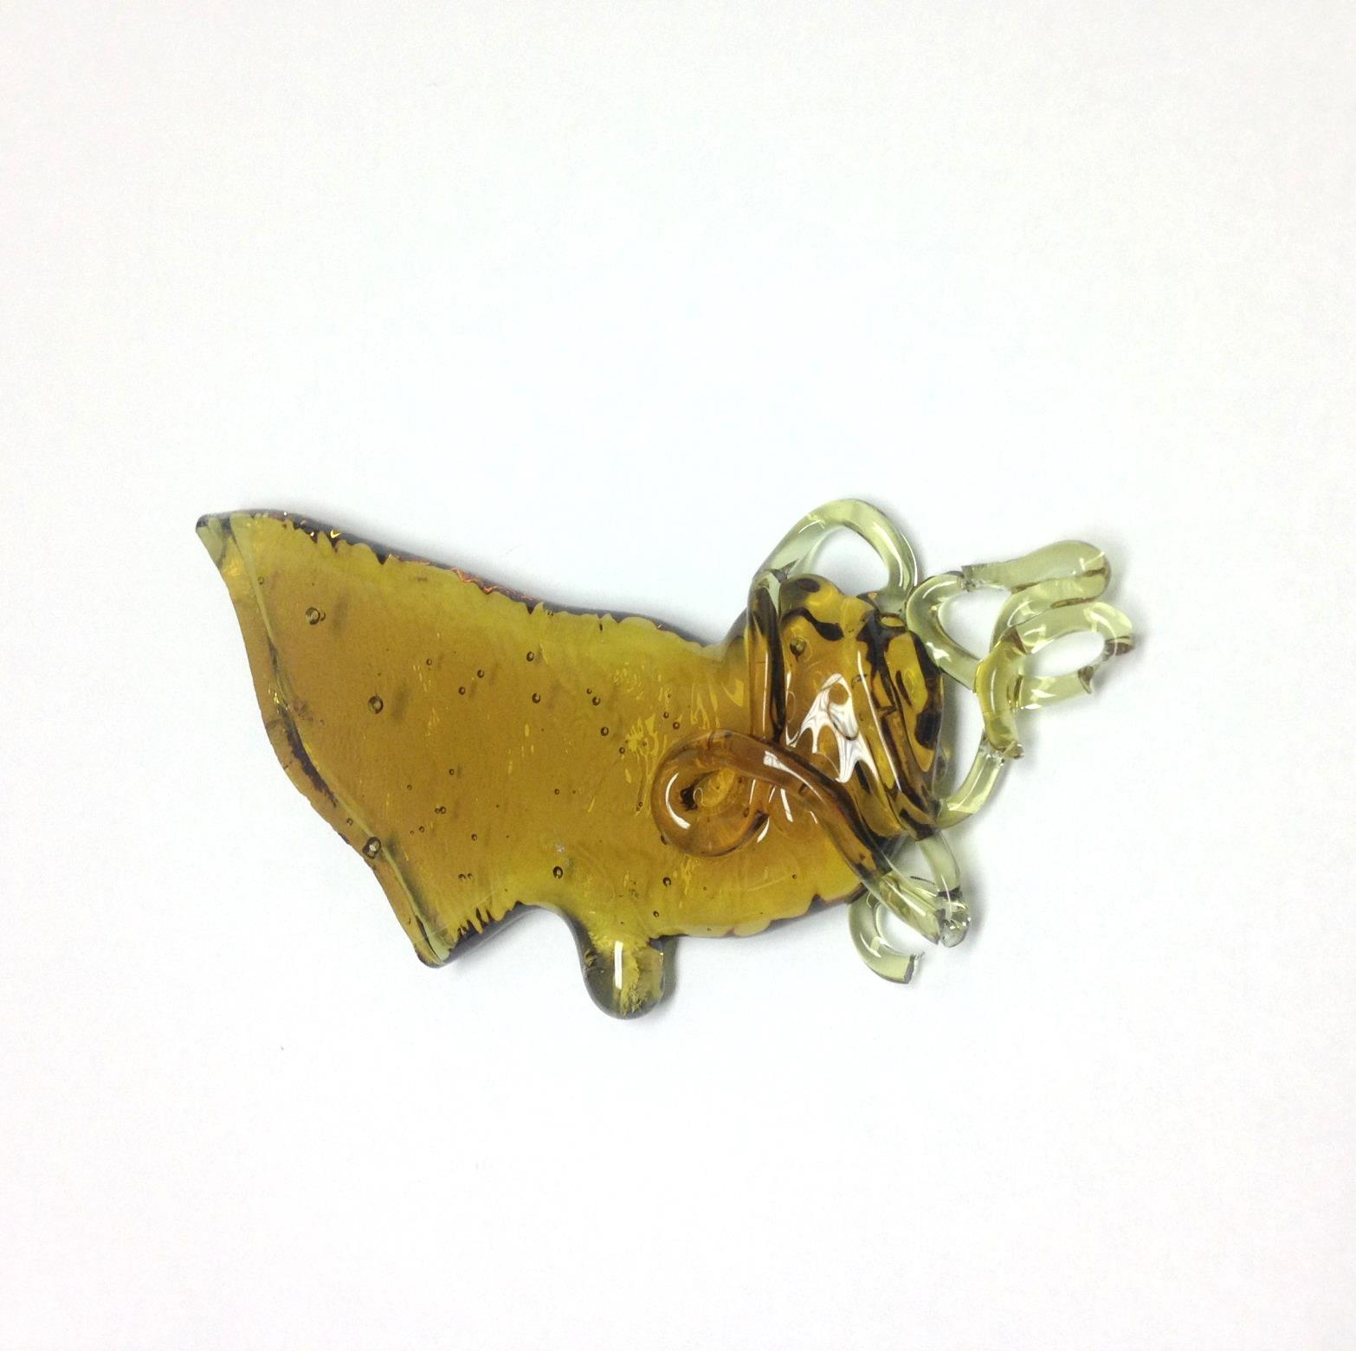
Remainder Glass After Slow Cool
The remainder glass (without NMO) has been fabricated
  Composition based on SEM-EDS analysis of centroid glass after SC
No evidence of phase separation, oxyapatite, powellite, or Ln-borosilicate visually in the pour patty
Components | Mole Fraction
Al₂O₃ | 0.0474
B₂O₃ | 0.1419
RO | 0.0775
R₂O | 0.1126
SiO₂ | 0.5286
Ln₂O₃ | 0.0342
MoO₃ | 0.0001
ZrO₂ | 0.0473
SeO₂ | 0.0015
SnO₂ | 0.0009
TeO₂ | 0.0080
Total | 1.0000

Slide 13
Corrosion Testing of Single-Phase Materials
Static testing by PCT and dilute testing by SPFT
Phases tested separately (remainder glass, oxyapatite, and powellite)
Combined together in the ratios seen in the centroid glass composition
Compared these results with the results previously measured for the centroid glass ceramic
  The glass phase is the continuous phase and is expected to impact the release of the powellite and oxyapatite
  However the Mo, which resides in powellite, is sometimes higher in solution than the elements found in the glass phase such as B
  These tests are very useful in helping determine the fraction of elemental release that is coming from the glass phase versus the powellite and oxyapatite in the SPFT and PCT done here and at SRNL on the centroid glass

Slide 14
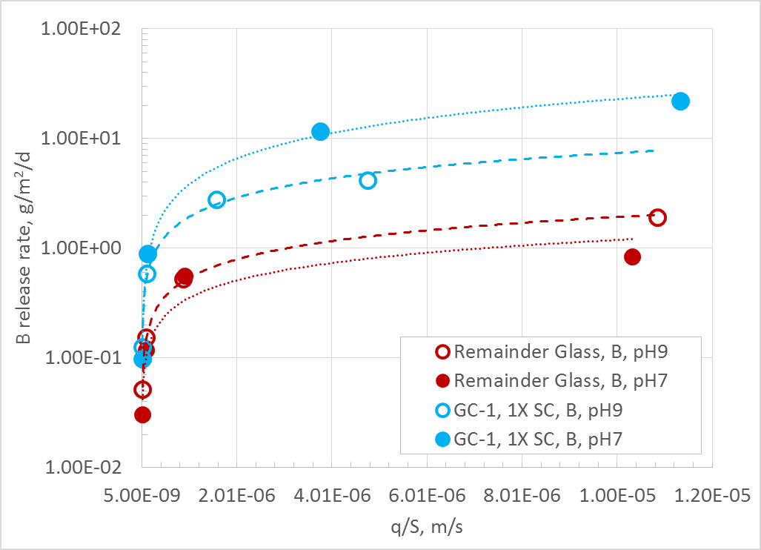
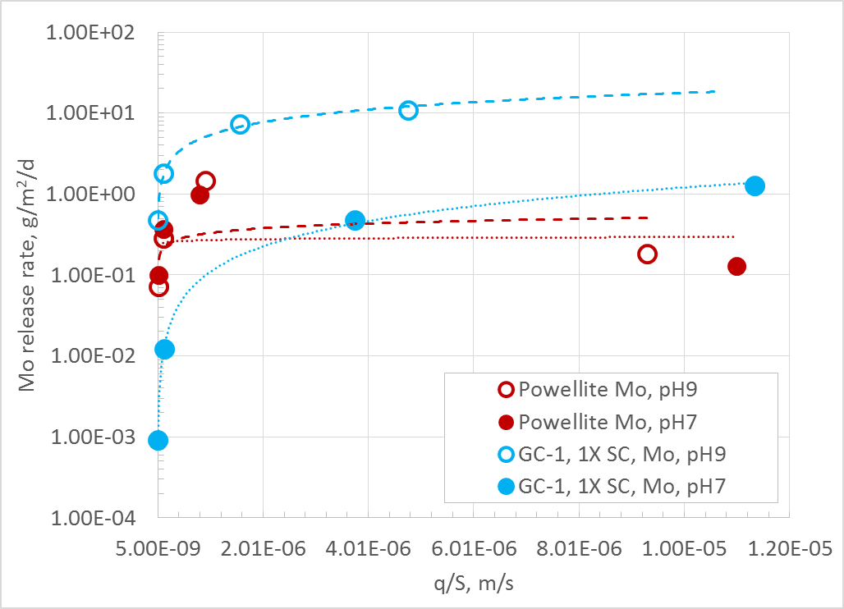
Comparison of GC-1 Slow Cooled at 1X to Single Phase Materials by SPFT
Compared the glass and powellite phases with the glass ceramic waste form
The multi-phase glass-ceramic waste form has higher release rates than single phase materials
The oxyapatite (not shown) had lower release rates and was near or below the detection limits in these tests.
B
Mo

Slide 15
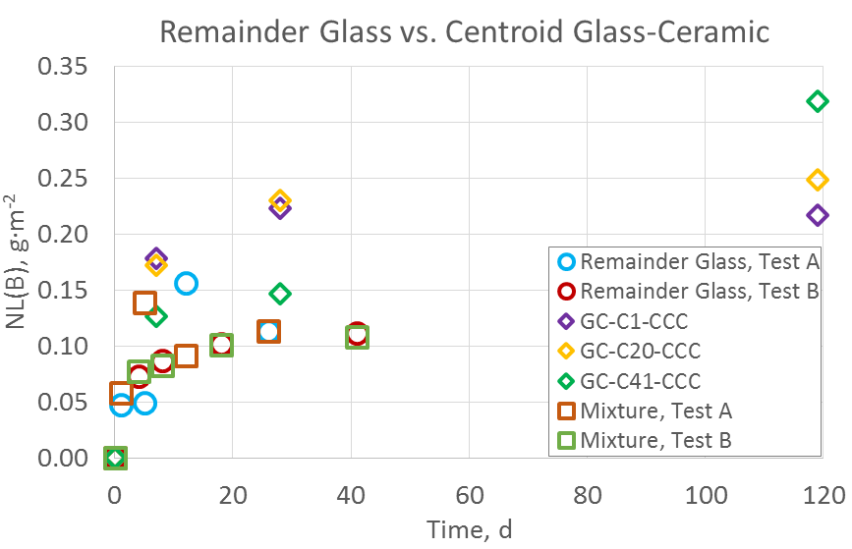
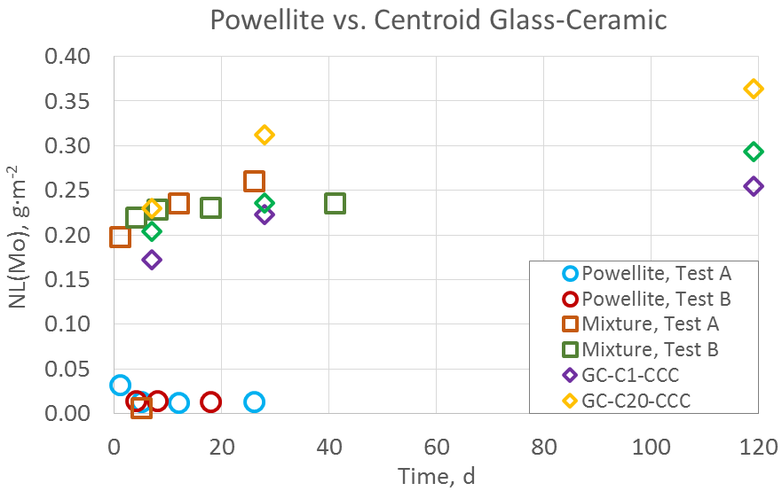
Static Dissolution Testing Single Phase Materials
The glass-ceramic centroid sample has higher NL(B) and NL(Mo) than the single-phase materials
  Waiting on longer testing times to determine if the difference is due to a rapid release at the start of the test or if the long release is also effected
When the single-phase materials are reacted together (mixture) in the same reactor, the NL(Mo) is on par with the glass ceramic centroid
The corrosion behavior of the glass phase is not affected by the phase mixture
B
Mo

Slide 16
Summary
Oxyapatite, powellite, and residual glass present in the glass ceramic waste form were synthesized and characterized
The glass ceramic waste form has crystal-glass interface stress that leads to higher release rates in both dilute and static conditions
The crystal-glass interface stress occurs because of differences in CTE between the glass, oxyapatite, and powellite phases
The effect of cooling rate on crystal size was most pronounced between the 4X and 1X slow cooling rates, resulting in a lower release rate in dilute conditions for the 4X-cooled sample
In static conditions, the powellite normalized loss is noticeably impacted by the solution feedback when the glass phase is present

Slide 17
Acknowledgements
The Authors would like to thank the Department of Energy, Office of Nuclear Energy, for funding the glass ceramic development work. This work was part of the Materials Recovery and Waste Form Development Campaign.

Slide 18
Backup Slides

Slide 19
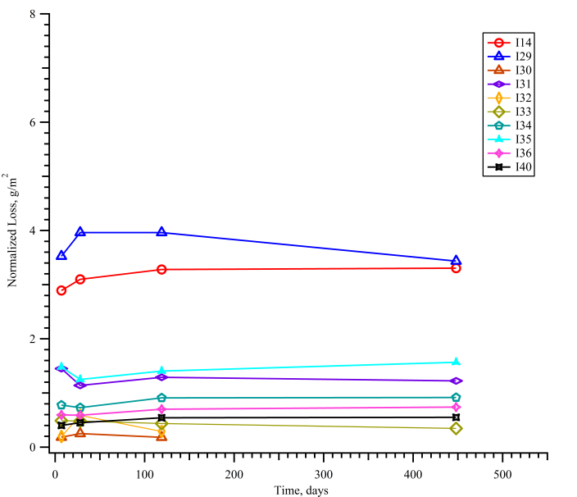
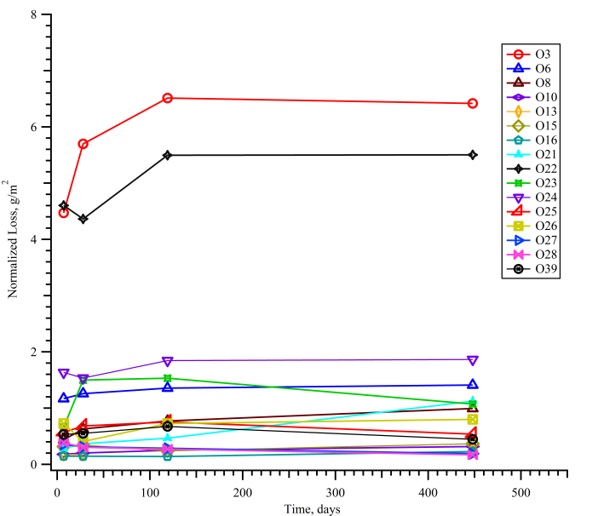
NL(Na) Versus Time
NL(Na) for the majority are below 2 g/m²
Glasses with low or no Al₂O₃ generally performed poorer
NL(Na) quickly levels off between 28-119 days
Some samples show drop in concentration with higher times, reason unknown at this time

Slide 20
Modeling of Modified PCT Data as a Function of Composition
The ln(NL) were fit to first-order models to show component effects on NL
Observations of modeling
  Modeling longer corrosion times lead to better fits vs. target composition.
    7 day PCT does not generate the best models and the coefficients change in magnitude with time
    28 day shows improvement, 119 day tests showed the best model fits, 448 days no significant change
    Not surprising because samples have more time to reach residual dissolution rate, as shown on slide 4
Component coefficient changes with time
  B₂O₃ and Lanthanides become more detrimental
  ZrO₂, Li₂O, Na₂O, and MoO₃ become less detrimental
  Al₂O₃, CaO, and SiO₂ do not significantly change
  “Others” is quite variable
ln(NL), g/m² | 7d ln(B) | 28d ln(B) | 119d ln(B) | 448d ln(B)
Al₂O₃ | -30.30 | -33.34 | -32.81 | -31.75
B₂O₃ | 11.60 | 14.12 | 14.71 | 14.68
CaO | -2.36 | -1.68 | -1.74 | 0.11
Li₂O | 12.42 | 8.66 | 6.84 | 4.45
Na₂O | 9.40 | 8.13 | 5.57 | 6.38
SiO₂ | -5.05 | -3.43 | -4.29 | -4.43
MoO₃ | 13.85 | 11.50 | 10.80 | 6.13
ZrO₂ | -14.89 | -11.94 | -17.75 | -23.32
Ln₂O₃ | 8.81 | 7.83 | 13.96 | 19.47
Others | 0.50 | -7.44 | 0.06 | -1.20
R² | 0.7344 | 0.7936 | 0.8500 | 0.7857
R² Adj | 0.6086 | 0.6958 | 0.7790 | 0.6843
RMSE | 0.7329 | 0.6412 | 0.5152 | 0.6348
Mean | -0.7618 | -0.5679 | -0.2916 | -0.2728
Observations | 29 | 29 | 29 | 29

Slide 21
Modeling of Modified PCT Data as a Function of Composition, Continued
Observations of modeling, Continued
  B, Li, Na, and Si models show similar component effects
  Mo is quite different since Mo is found primarily in the powellite phase
  The best fits were to B, Si, and Mo
ln(NL), g/m² | 119d ln(B) | 119d ln(Li) | 119d ln(Na) | 119d ln(Si) | 119d ln(Mo)
Al₂O₃ | -32.81 | -37.50 | -29.68 | -28.81 | -13.26
B₂O₃ | 14.71 | 17.96 | 13.71 | 8.78 | -6.37
CaO | -1.74 | -1.19 | -1.69 | -1.11 | -6.09
Li₂O | 6.84 | -5.01 | 2.38 | 8.44 | 24.40
Na₂O | 5.57 | 6.00 | 7.03 | 1.22 | 31.05
SiO₂ | -4.29 | -3.19 | -3.65 | -4.66 | -9.54
MoO₃ | 10.80 | 9.40 | 3.25 | 7.14 | -17.64
ZrO₂ | -17.75 | -25.43 | -15.23 | -18.33 | 0.40
Ln₂O₃ | 13.96 | 15.41 | 17.37 | 0.57 | 22.66
Others | 0.06 | 3.24 | -4.00 | 4.73 | 27.77
R² | 0.8500 | 0.8012 | 0.7915 | 0.9156 | 0.9319
R² Adj | 0.7790 | 0.6385 | 0.6872 | 0.8572 | 0.8996
RMSE | 0.5152 | 0.6010 | 0.5897 | 0.3262 | 0.4123
Mean | -0.2916 | 0.1012 | -0.3612 | -1.6477 | -1.1628
Observations | 29 | 21 | 28 | 23 | 29

