Slide 1


Gerencia de Área
Seguridad y Medio Ambiente
Gerencia de Química
Departamento de Aplicaciones y
Fundamentos de la Química
Laboratorio de Fisicoquímica
~~~~~~~~~~~~~~~~~~~~~~~~~~~~~~~~~~~~~~~~~~~~~~
Dr. Hugo L. Bianchi
Comisión Nacional de Energía Atómica
Química, Centro Atómico Constituyentes,
Av. General Paz 1499,
(1650) San Martín, Pcia de Buenos Aires
ARGENTINA
Phone:(54)11 6772 7195 FAX:(54)11 6772 7886
Mobile: (54) 911 4078 8239
bianchi@cnea.gov.ar
bianchi.hugo@gmail.com
~~~~~~~~~~~~~~~~~~~~~~~~~~~~~~~~~~~~~~~~~~~~~~~

Slide 2
Pyrolysis and Plasma applied to Nuclear ion Exchange Resins Treatment
Hugo L. Bianchi, Vittorio Luca, Hernán Castro and Raúl Ariel Rodriguez
Constituyentes Atomic Center, CNEA
Sydney, Nov. 2, 2017

Slide 3
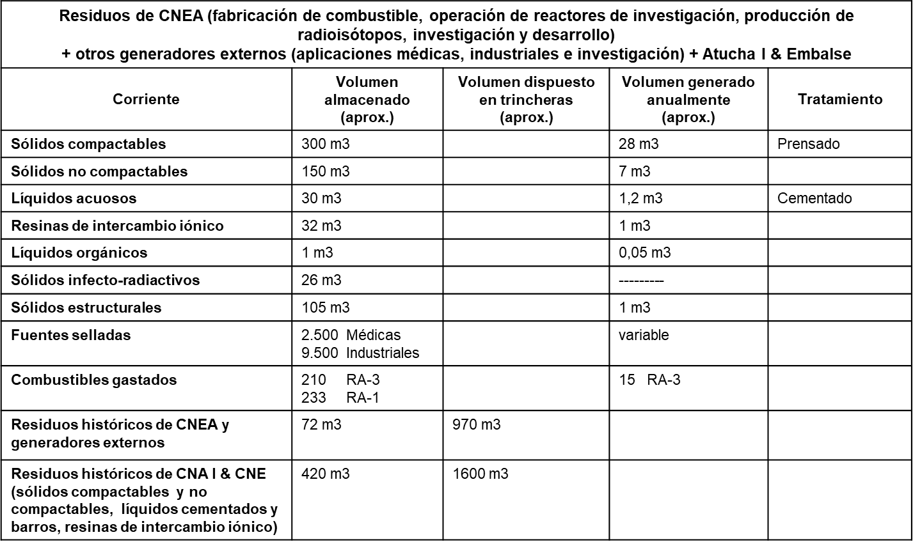
Argentinean Nuclear
Waste Streams (Set 2016)
Nuclear waste Input to AGE (Ezeiza Atomic Center Area)

Slide 4
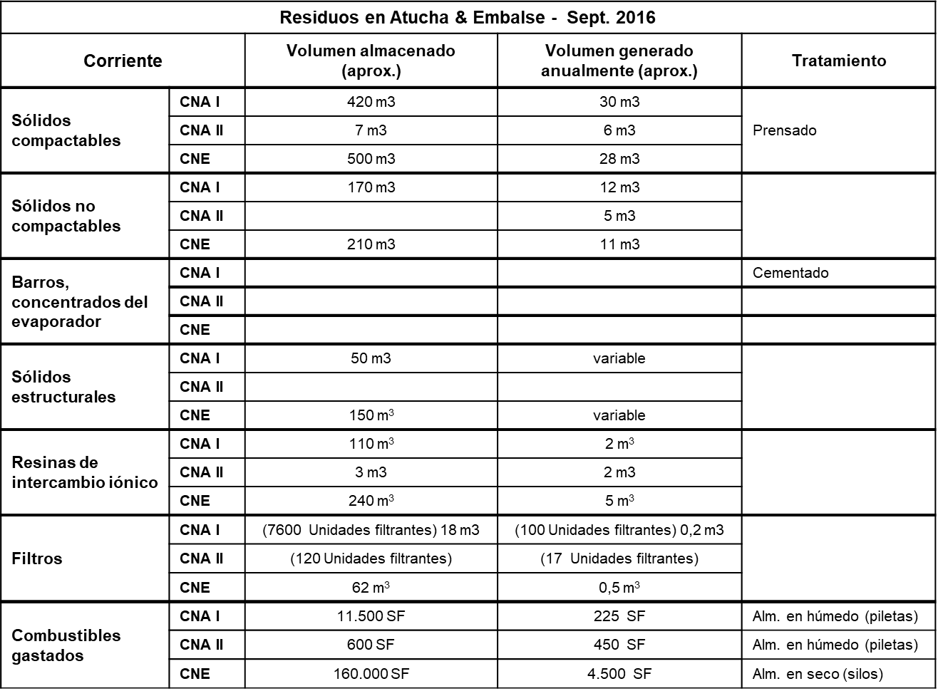
Argentinean Nuclear
Waste Streams (Set 2016)
Nuclear waste stock at the nuclear power facilities

Slide 5

Ion Exchange resins as a problematic waste
Need of a low scale process for Argentina (10 m³ per year generation)
Low temperature pyrolysis as good alternative
Plasma treatment for gas conditioning

Slide 6
Optimal process requierements
Product stability
Adecuate economic scale
Safety
Environmental Safety
Radiological Safety

Slide 7
Low Temperature Pyrolisis
Volume Reduction
Low mass transfer to gas phase
The product is the confinement of the mayor fraction of the radionucleides inventory
Stable Product (carbon)
High Safety profile process

Slide 8
Low Temperature Pyrolysis Process
Plasma (HPPT)
Selective Sorbents
Filters and Scrubber
Interim
Storage
Low Temperature Pyrolysis
Solid Product
Solid Product

Slide 9
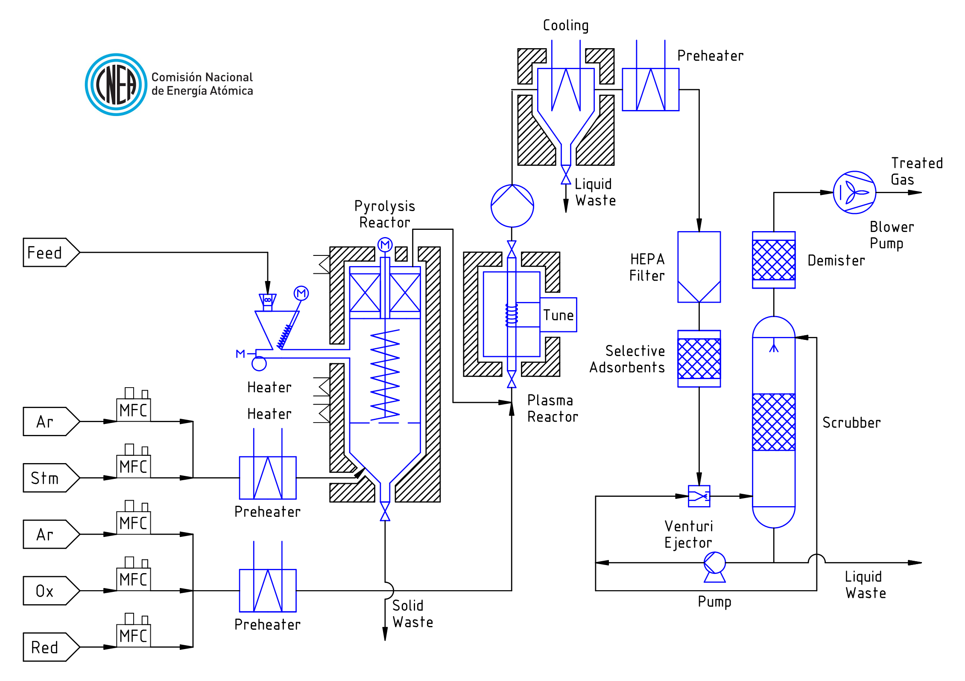

Slide 10
Research advances

Slide 11
Low Temperature Pyrolysis Process
Plasma (HPPT)
Selective Sorbents
Filters and Scrubber
Interim
Storage
Low Temperature Pyrolysis
Solid Product
Solid Product

Slide 12
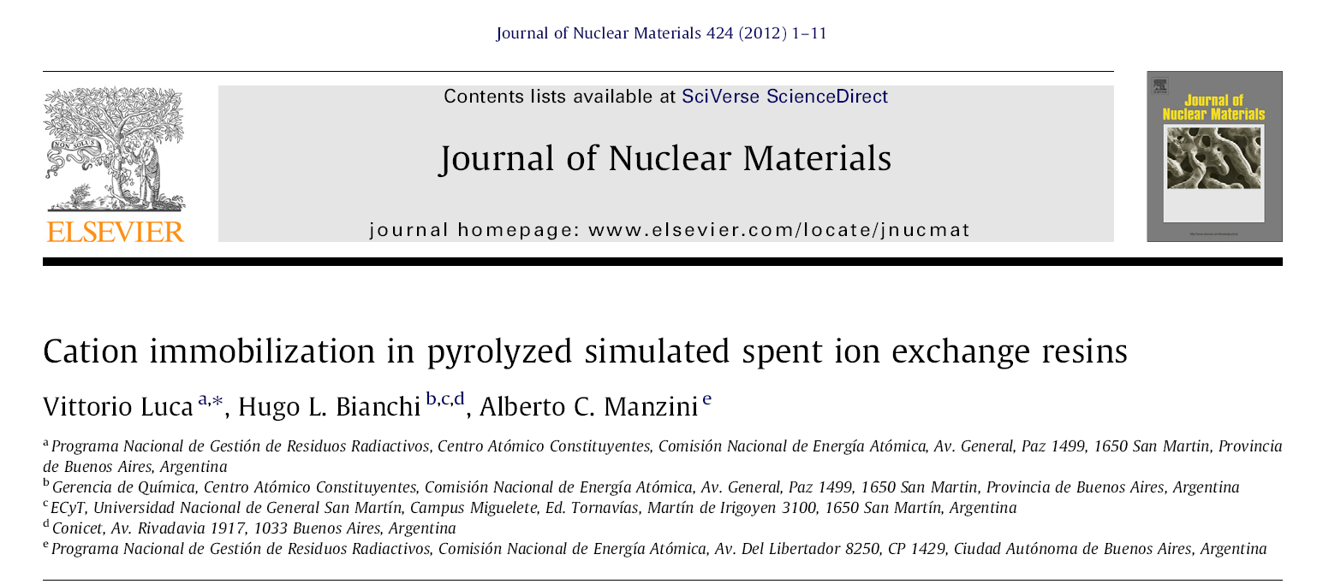
Cation Exchange Resins

Slide 13
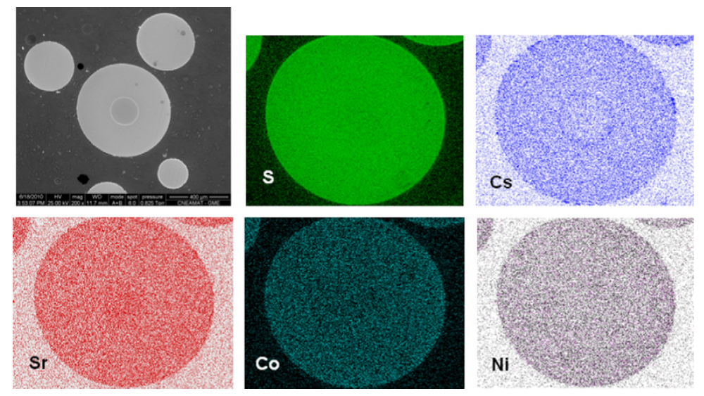

Slide 14
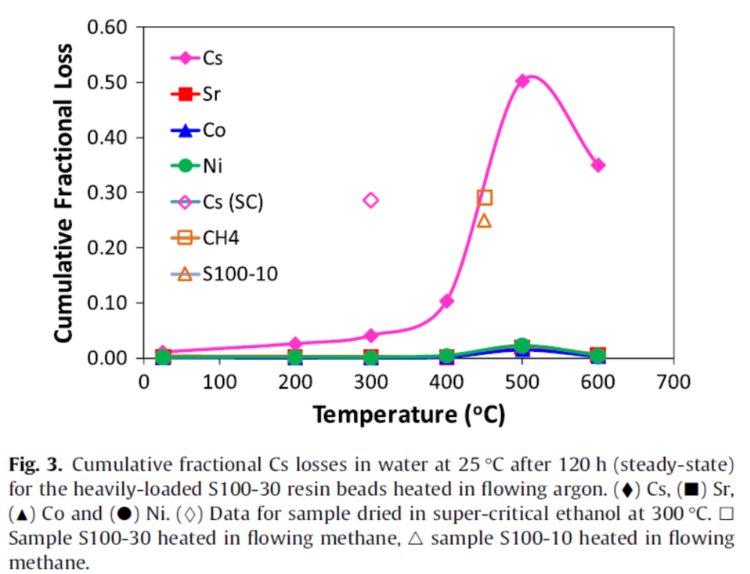

Slide 15
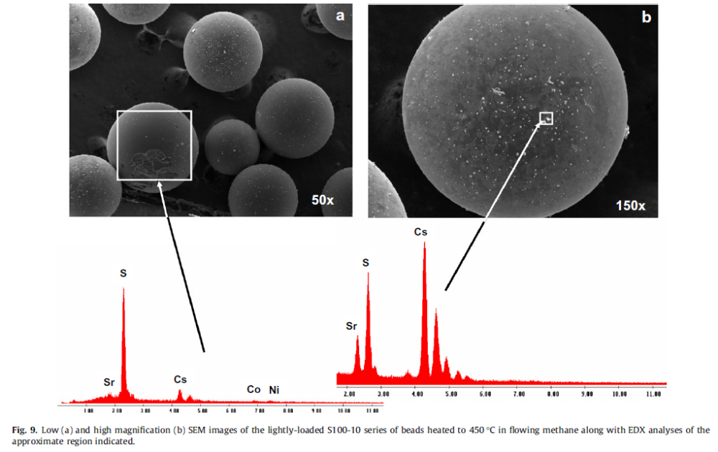

Slide 16
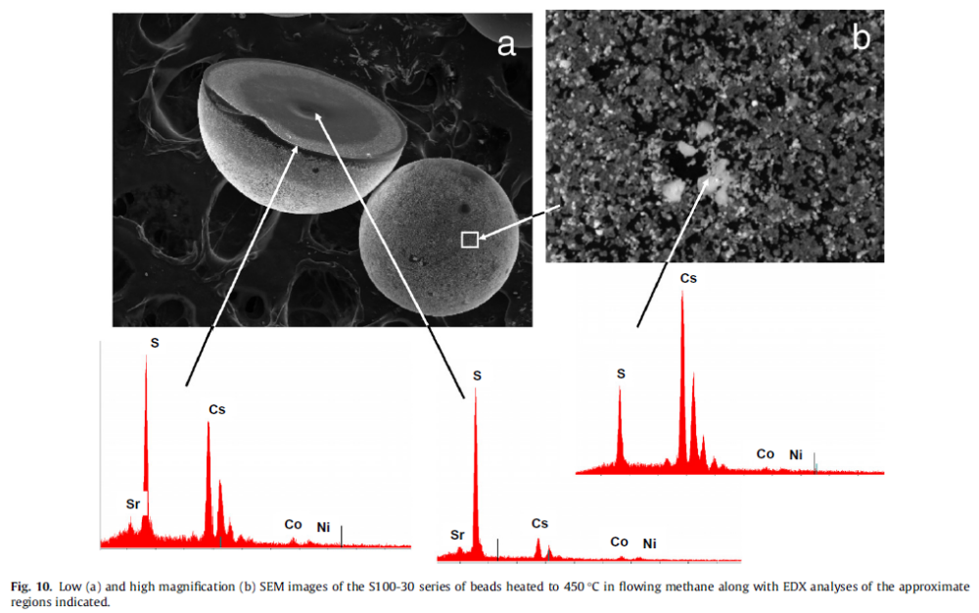

Slide 17
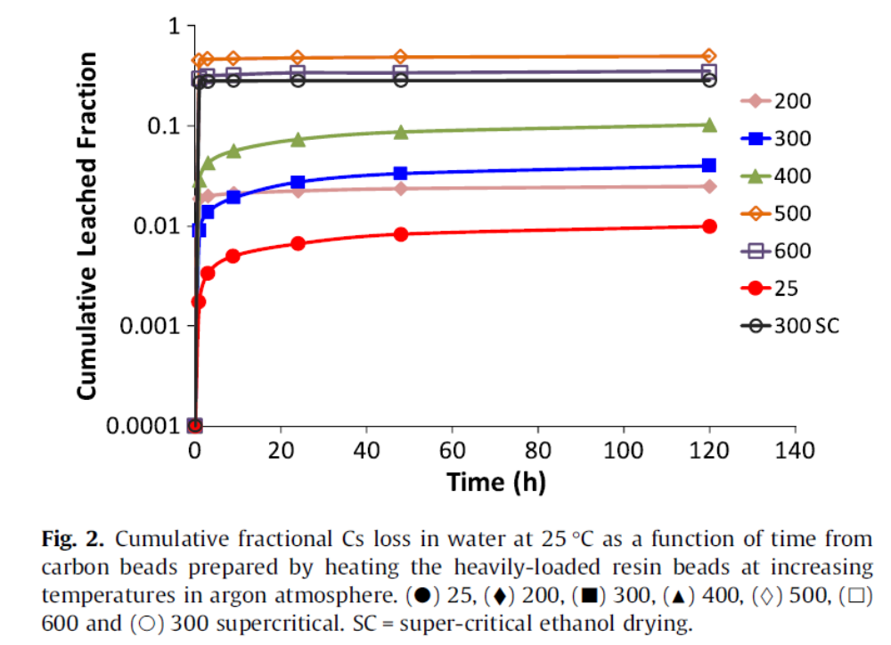

Slide 18
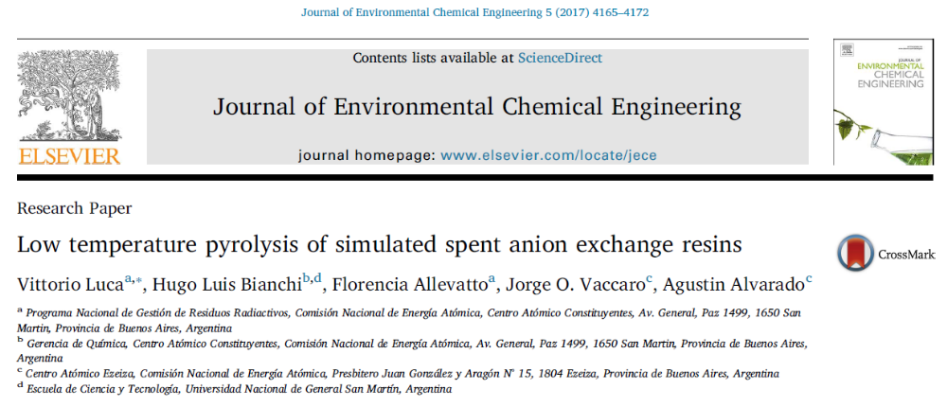
Anion Exchange Resins

Slide 19
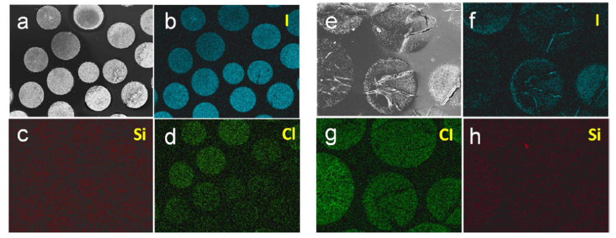

Slide 20
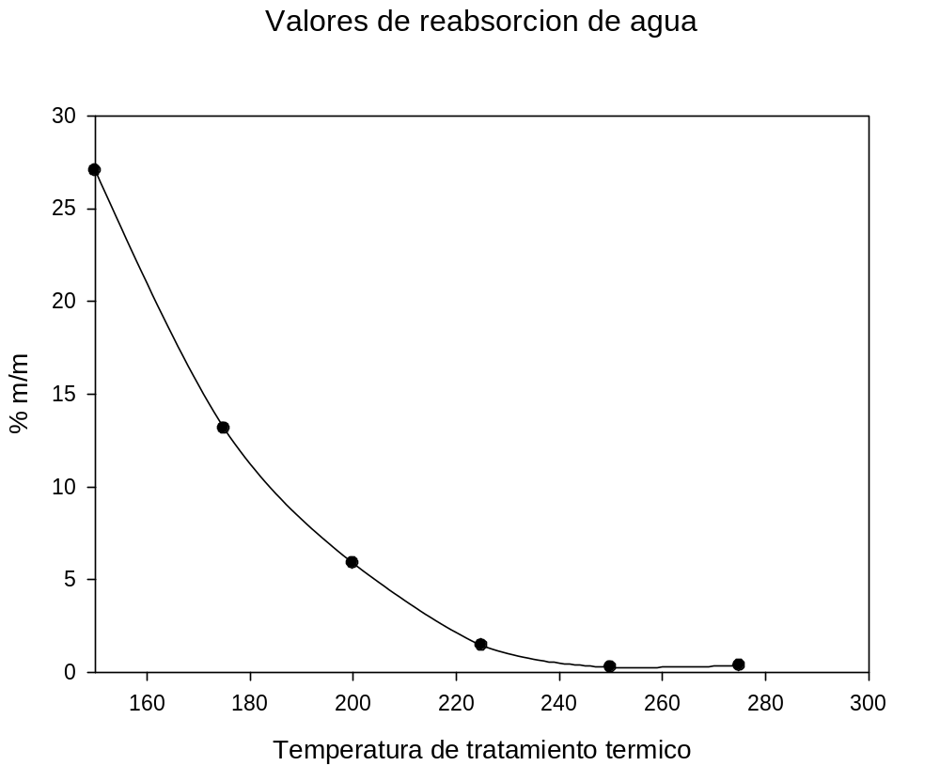
Anionic resins water reabsortion

Slide 21
Low Temperature Pyrolysis Process
Plasma (HPPT)
Selective Sorbents
Filters and Scrubber
Interim
Storage
Low Temperature Pyrolysis
Solid Product
Solid Product

Slide 22
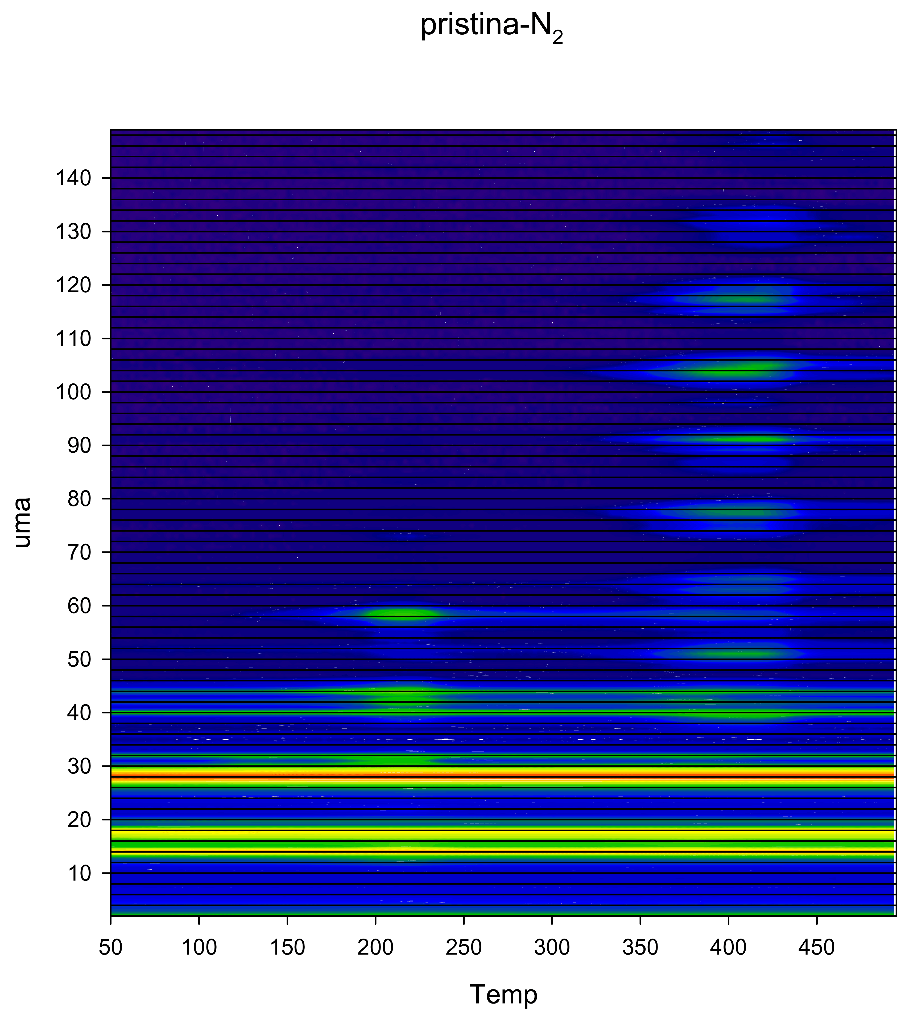
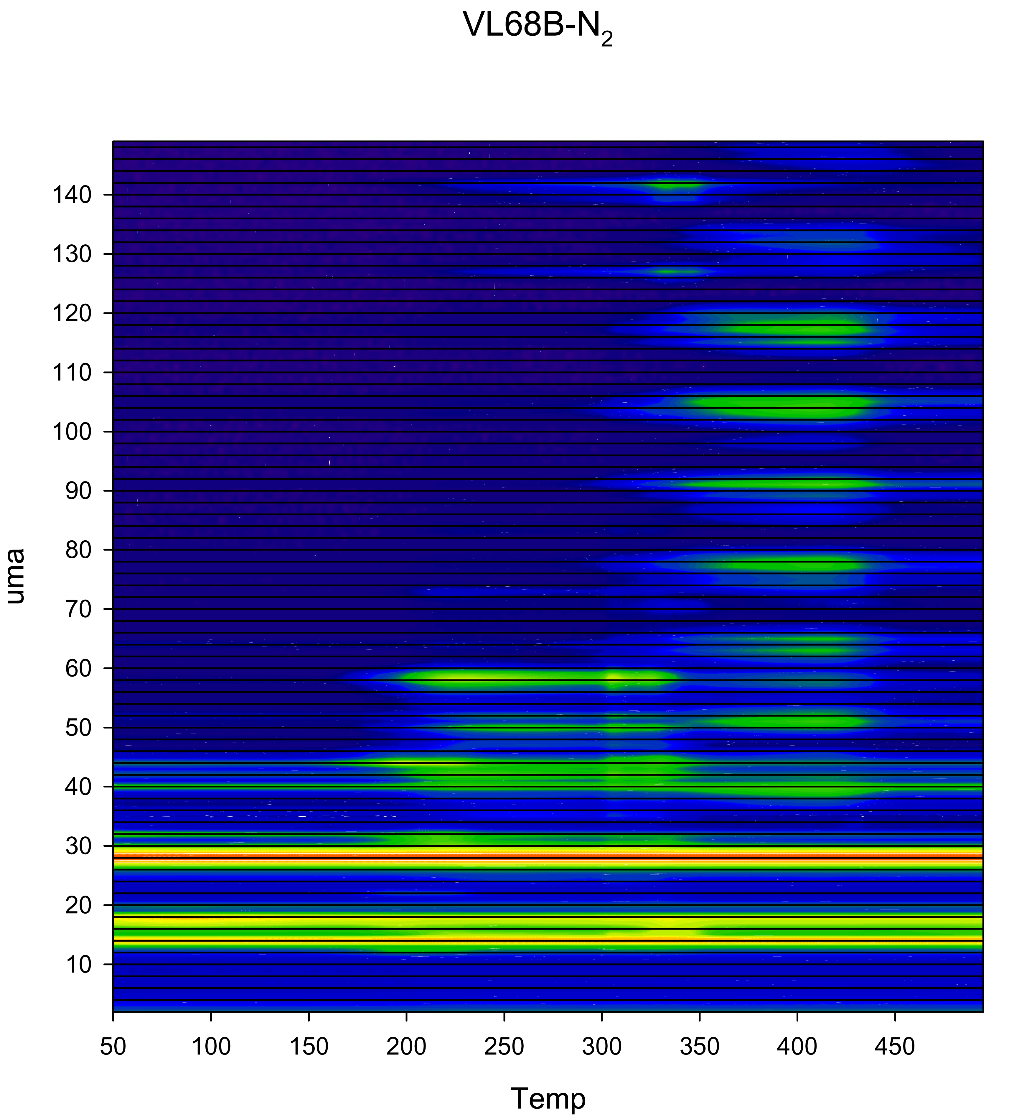
Complex Gas Mixture from anionic spent resin

Slide 23
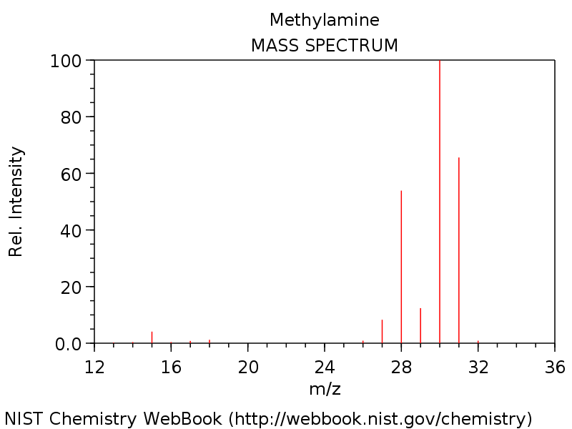
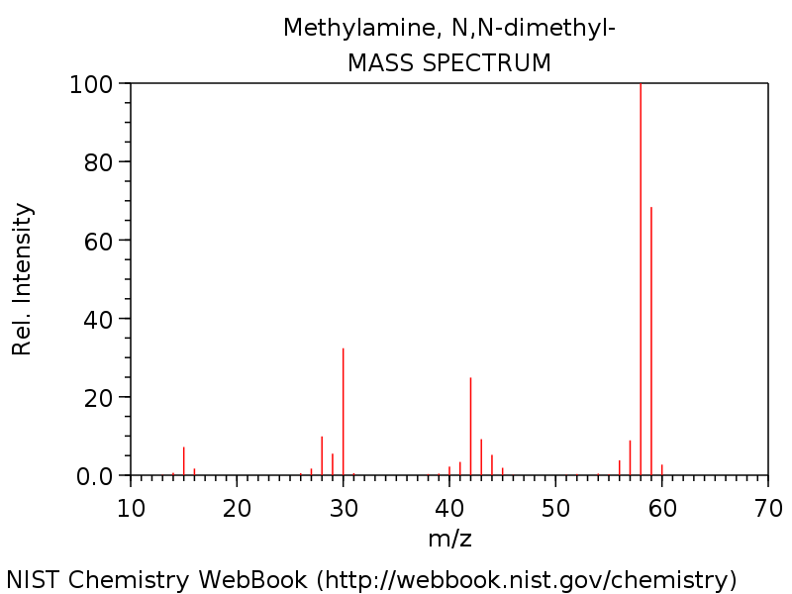
Anionic funtional group loss start at 125C

Slide 24
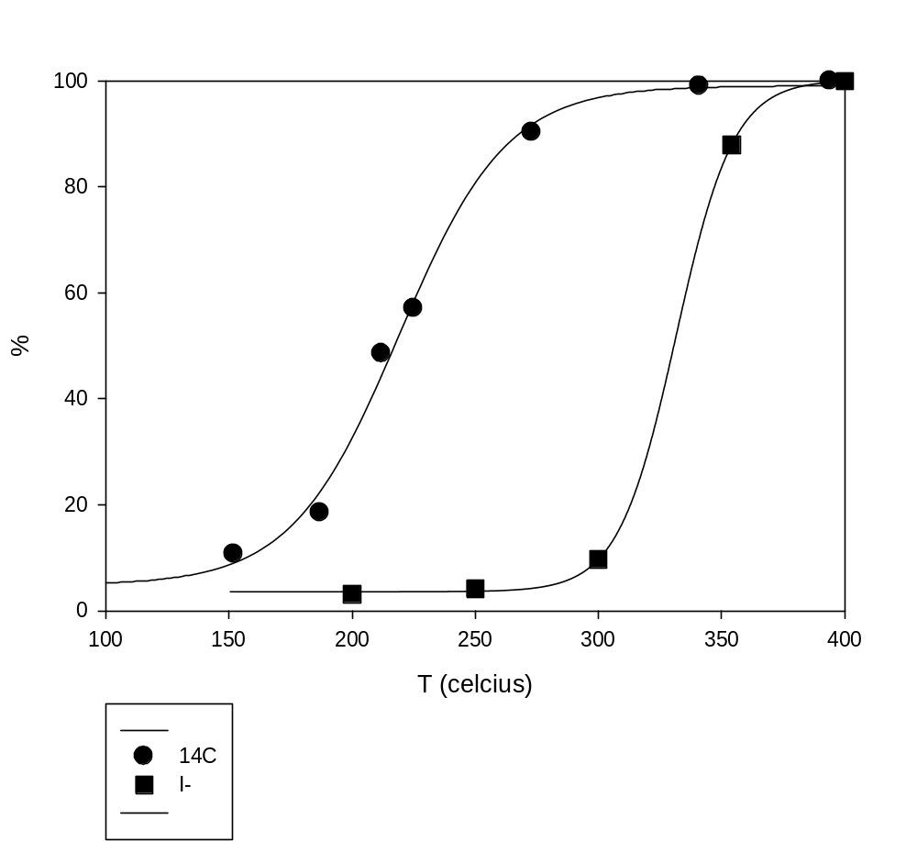
Anion resin C¹⁴ behavior
Colaboración con Vaccaro y Alvarado

Slide 25
Complex Gas Mixture from anionic spent resin

Slide 26
Complex Gas Mixture from anionic spent resin

Slide 27
Complex Gas Mixture from anionic spent resin

Slide 28
Complex Gas Mixture from anionic spent resin

Slide 29
Why to use Plasma as gas treatment process?

Slide 30

Plasma is a promising technology on nuclear aplications
Plasma is a well known technology for gas treatment
No dilution
Flame less
Safe and controllable
Smaller filtering and gas cleaning

Slide 31
High Performance Plasma Treatment advantages
High Safety Profile
High efficiency reaction media
Subatmosferic operation
No dilution of reaction products
If ICP is used, no electrodes needed
Low temperature process
NOx control

Slide 32
Chemical reactions in plasma conditions

Slide 33
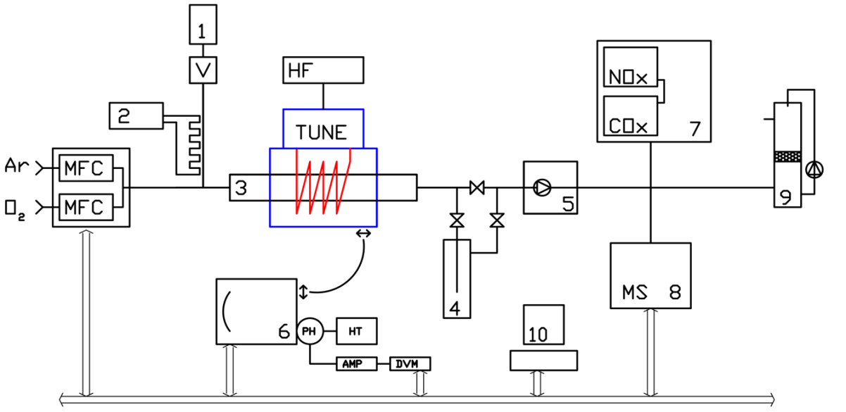
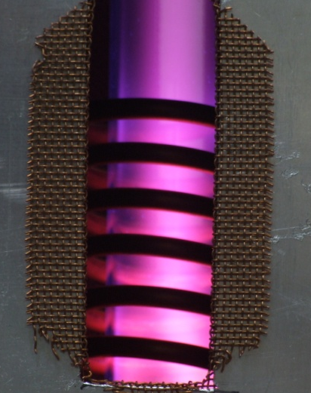
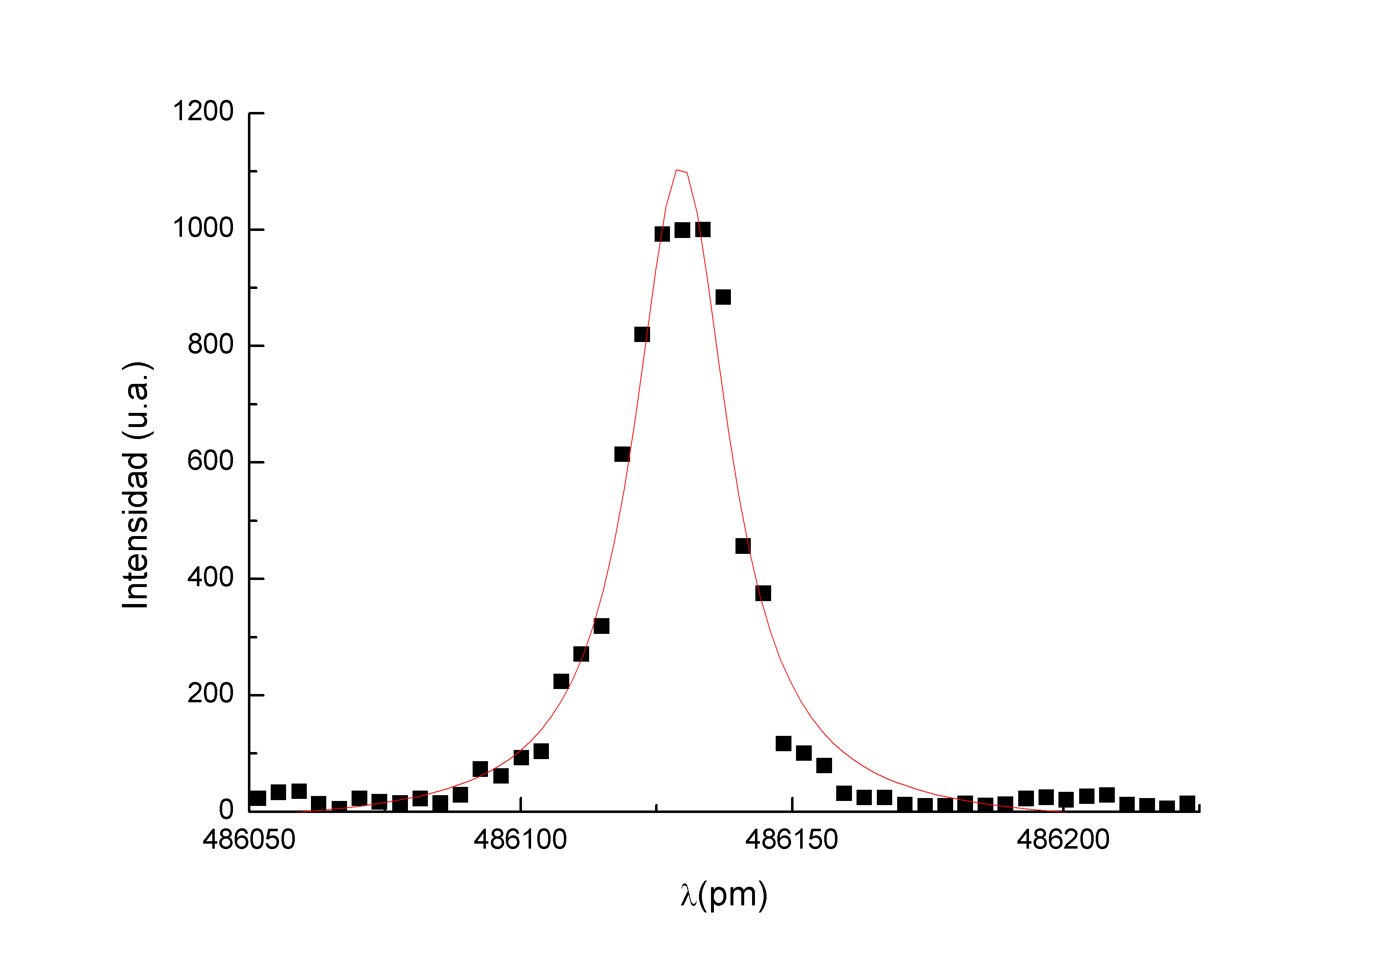
Experimental arrangement: inductively coupled plasma laboratory scale flow reactor operating under sub-atmospheric conditions
1. Sample, 2. Injection heater, 3. Quartz reactor, 4. Cold trap,
5. Chemical resistant vacuum pump, 6. High resolution spectrometer, 7. Multi-gas analyzer, 8. Gas mass spectrometer, 9. Scrubber,
10. PC, MFC: Mass Flow Controllers,
HF y Tune: RF generator and matching network.
N_{e} ≈ 10¹⁹ m⁻³
T_{e} ≈ 7000 K T_{g} ≈ 350 K

Slide 34
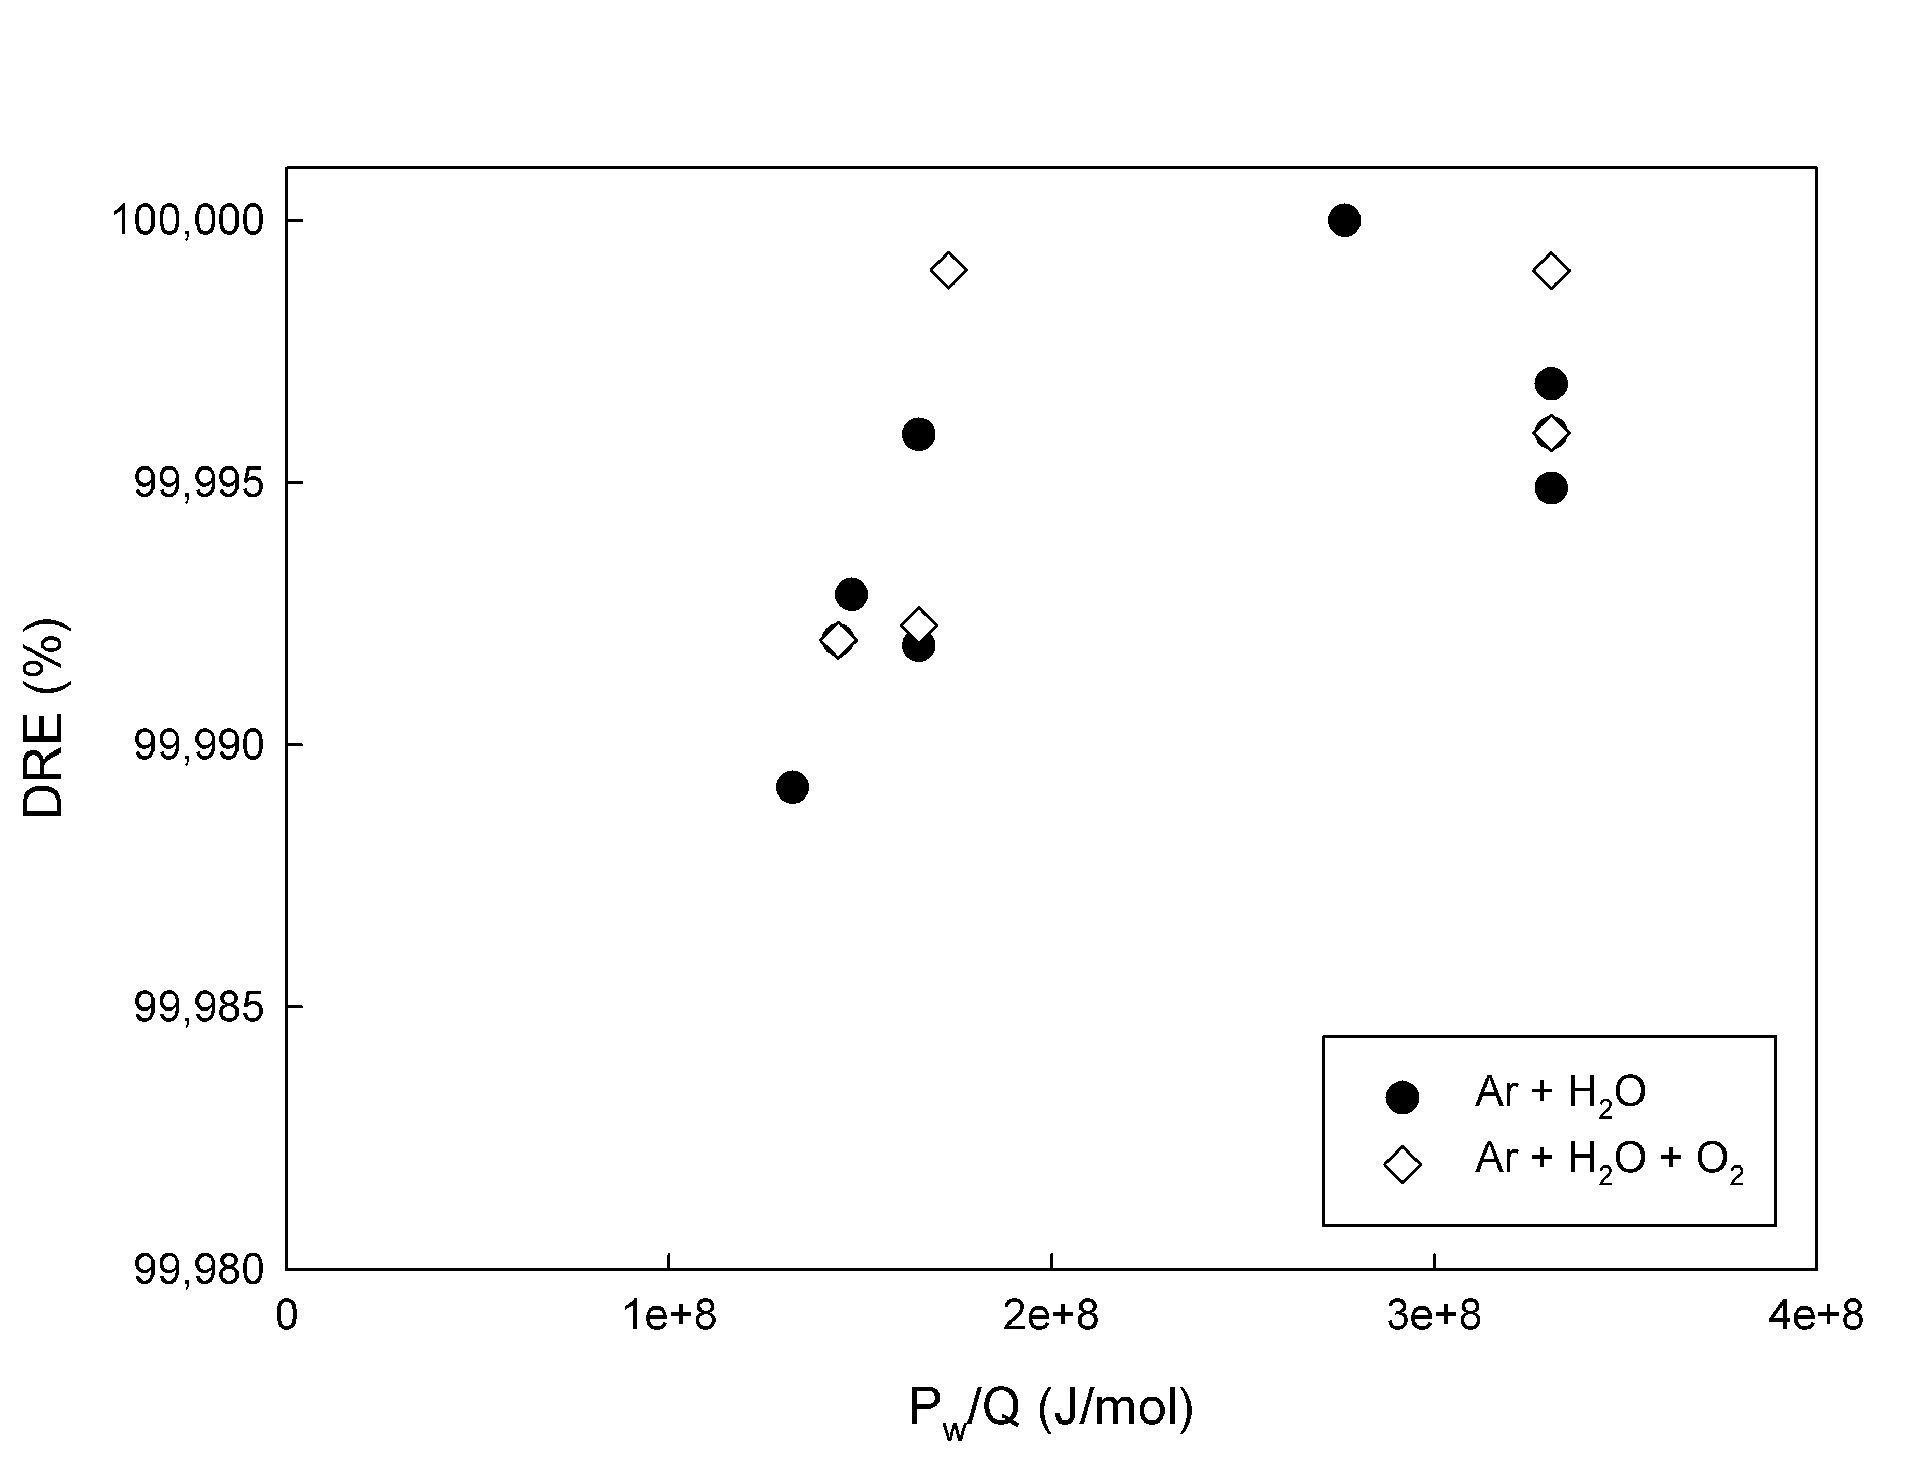
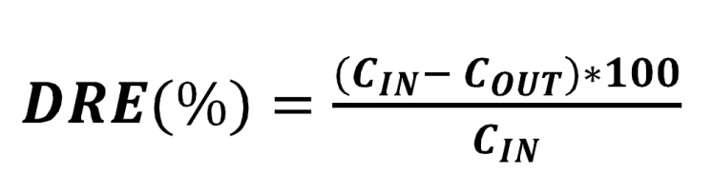
Destruction and removal ratio with water
Compuesto | m/z | DRE (%)
ETILENDIAMINA | 61 (+) / 121 (+) | 99,9214
N-PROPILAMINA | 60 (+) | 99,9916
N-BUTILAMINA | 74 (+) | 99,0834

Slide 35
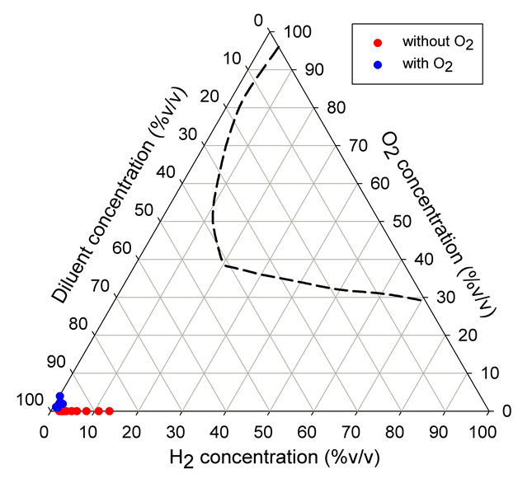
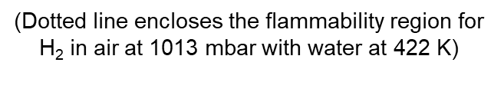
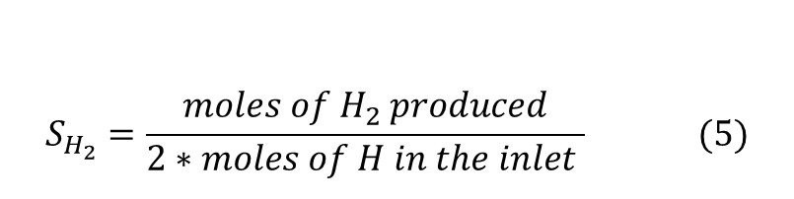
$$S_{H_{2}}=\frac{moles of H_{2} produced}{2∗moles of H in the inlet } (5)$$

Slide 36
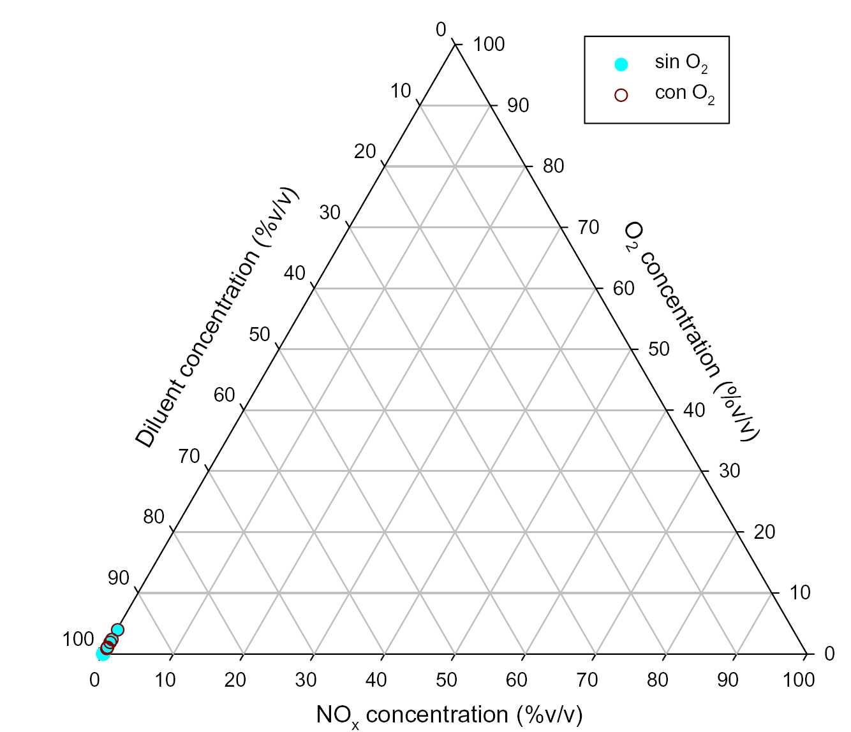
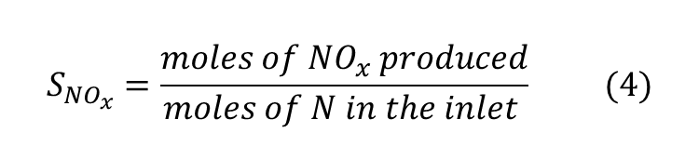
$$S_{{NO}_{x}}=\frac{moles of {NO}_{x} produced}{moles of N in the inlet } (4)$$

Slide 37
Conclusion
We got a reasonable anhydrous product.
The off gas treatment is simple safe and compact.
The off gas can trap all the C14 emissions if necessary.
A bench scale is needed to validate the concept.

Slide 38
Thank you

Slide 40
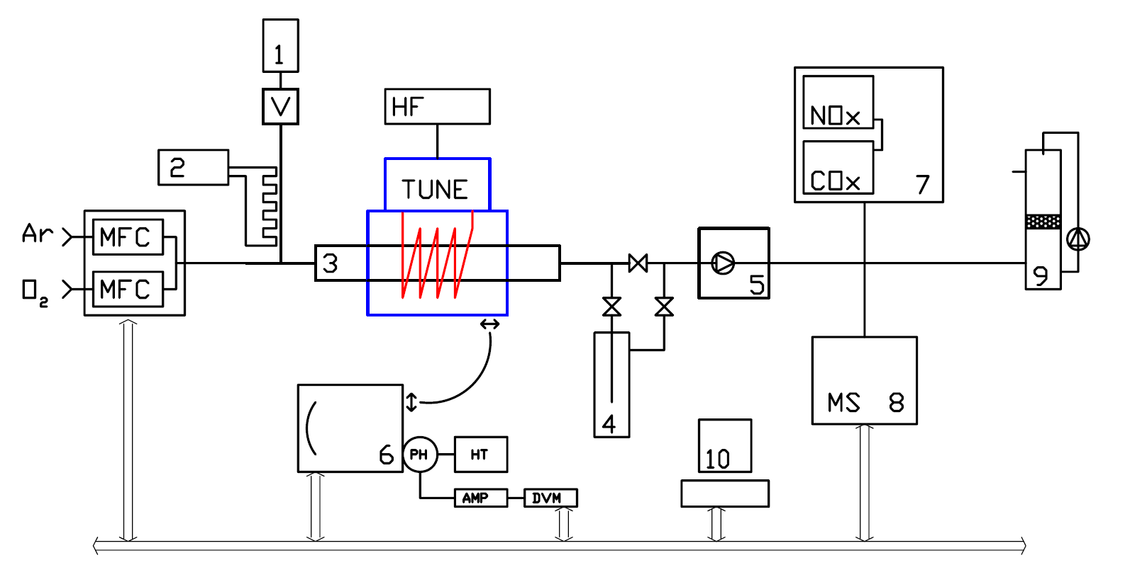
Setup experimental instrumentado con MS, OES y análisis de gases

Slide 41
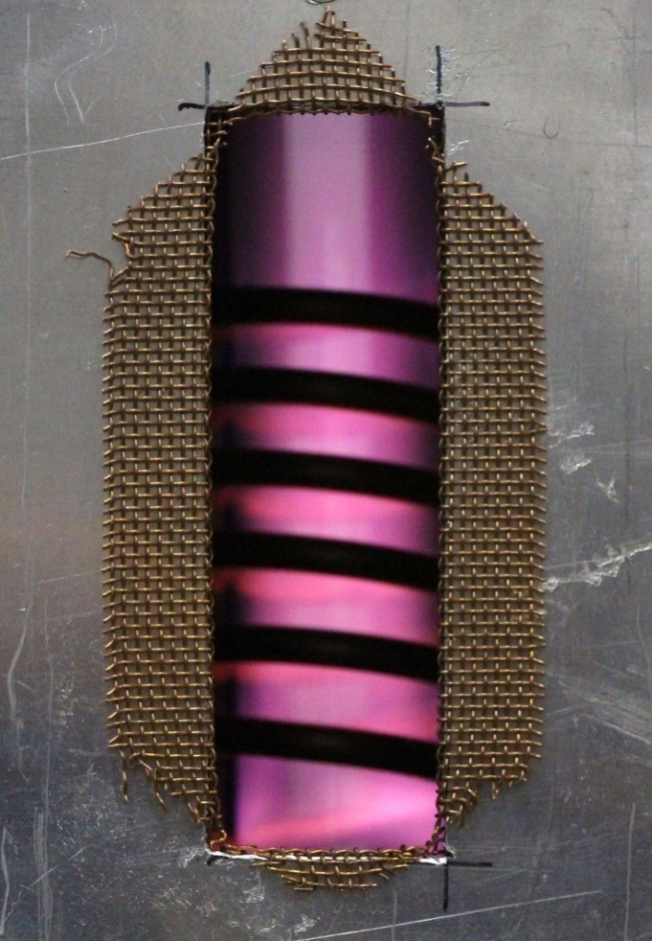
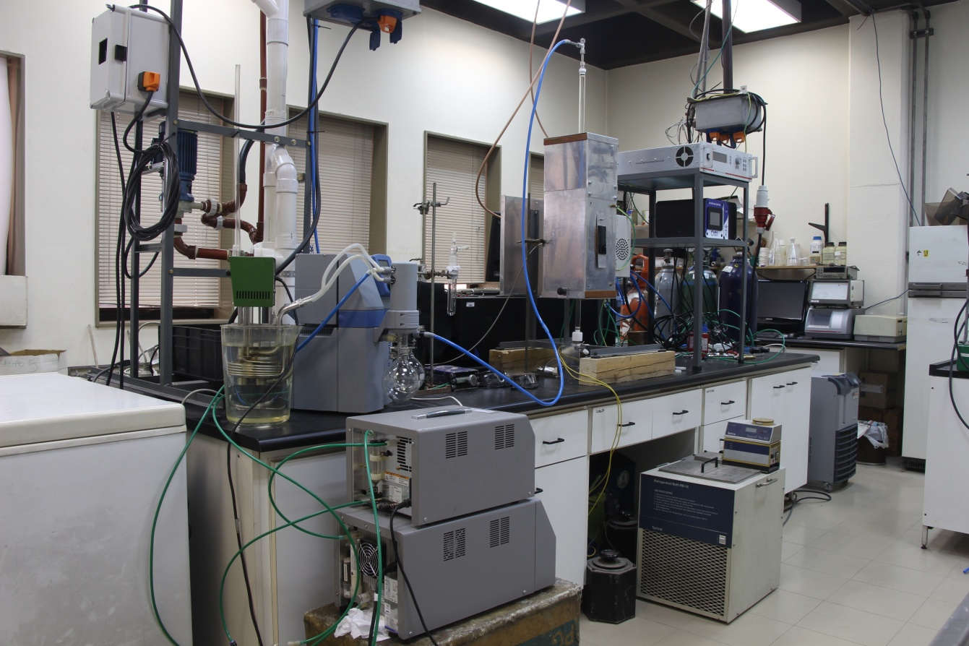
Facilidad de estudio de reacciones químicas en condiciones de plasma

Slide 43
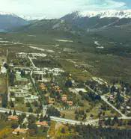
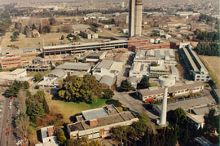
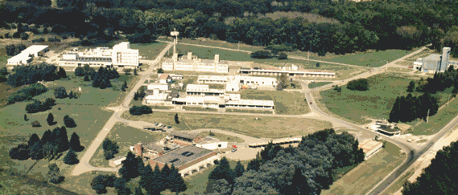
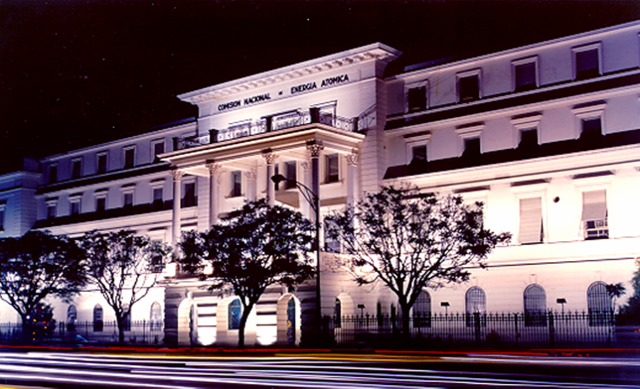
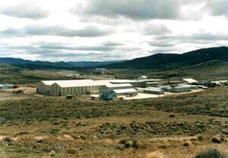
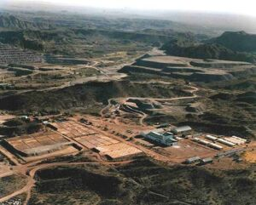
NUCLEAR FIELD IN ARGENTINA
COMISIÓN NACIONAL DE ENERGÍA ATÓMICA
Ezeiza Nuclear Research Center
Constituyentes Nuclear Research Center
Bariloche Nuclear Research Center
Pilcaniyeu
Technological Center
(Río Negro)
Uranium mining and milling
(San Rafael - Mendoza)
CNEA Headquarters

Slide 44
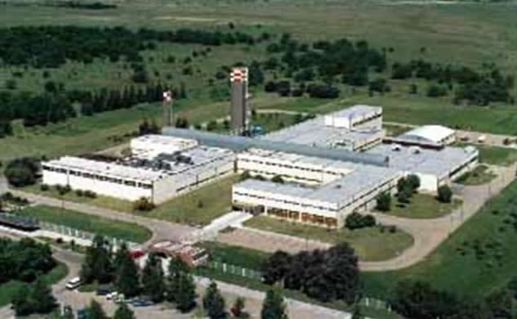
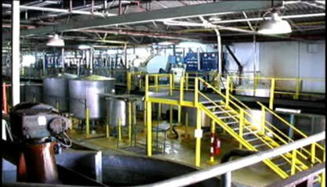
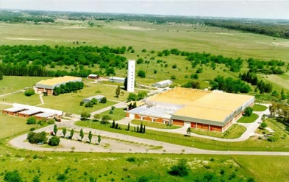
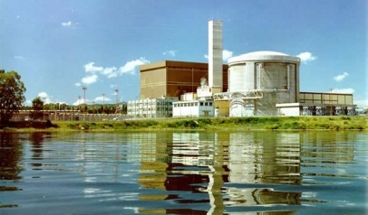
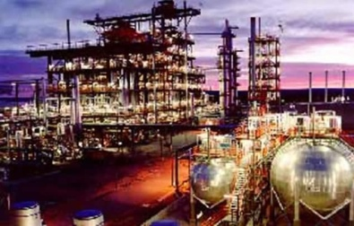
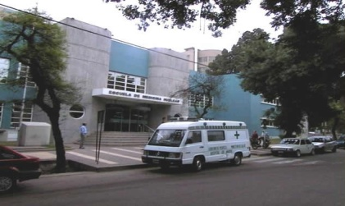
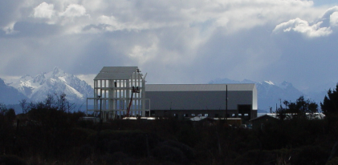
NUCLEAR ENTITIES IN ARGENTINA
FAE
Special alloys production
DIOXITEK
UO2 Production Plant
CONUAR
Fuel elements production
NASA
Nuclear Energy
ENSI
D2O Production Plant
FUESMEN
Nuclear Medicine
INVAP
Technological development

Slide 45
NUCLEAR ACTIVITIES
2 NUCLEAR POWER PLANTS
1 NUCLEAR POWER PLANT UNDER CONSTRUCTION
6 RESEARCH REACTORS
4 ACCELERATORS
3 NUCLEAR RESEARCH CENTERS
1 TECHNOLOGICAL CENTER
1 HEAVY WATER PLANT
2 IRRADIATION PLANTS
2 URANIUM MINING FACILITIES
1 URANIUM ENRICHMENT FACILITY
376 INDUSTRIAL APPLICATION FACILITIES
3 NUCLEAR MEDICINE SCHOOLS
68 COBALT THERAPY CENTERS
57 BRAQUITHERAPY CENTERS
309 NUCLEAR MEDICINE CENTERS
45 MEDICAL ACCELERATORS
408 IMMUNE ESSAYS LABS

Slide 46
MAIN PLANTS AND FACILITIES
NUCLEAR POWER PLANTS
• Atucha I (350 MWe)
• Embalse (650 MWe)
• Atucha II (750 Mwe), to be started
RESEARCH AND PRODUCTION REACTORS
➢ MEDICAL AND INDUSTRIAL APPLICATIONS
Radioisotopes for medicine and industry, produced in:
• One research/production reactor: ⁹⁹Mo, ¹³¹I, ³²P, ¹⁵³Sm, ⁵¹Cr, ¹⁷⁷Lu, ¹⁹²Ir
• Two cyclotrons: ²⁰¹Tl, ¹⁸F, ⁶⁷Ga, ¹¹¹In
• Embalse NPP: ⁶⁰Co
NUCLEAR INDUSTRY
• Uranium mines and UO₂ conversion plant
• Fuel elements fabrication for the NPP’s and RR’s
• Zy tubes manufacturing for fuel cladding
• Heavy water production
RADWASTE IS GENERATED DURING OPERATION, MAINTENANCE & FUTURE
DECOMMISSIONING

Slide 47
NUCLEAR POWER PLANTS
NPP | REACTOR TYPE | POWER [MW] | START UP | EOL (foreseen)
ATUCHA-I | HWR Pressure vessel (Siemens design) | 350 | 1974 | 2019 (extension to 2027)
EMBALSE | HWR-CANDU Pressure tubes (AECL design) | 650 | 1984 | 2012 (extension to 2039)
ATUCHA-II | HWR Pressure vessel (Siemens design) | 750 | • Construction started in 1981 • Interrupted in 1994 Re-started in 2006 Start up 2012-2013

