Slide 1
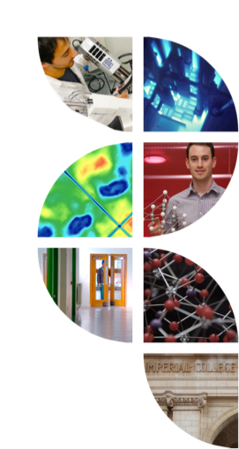

Atomisitc simulation
of interfaces in glass/crystal composites
for nuclear wasteforms
Paul C. M. Fossati, Michael J. D. Rushton & William E. Lee
p.fossati@imperial.ac.uk

Slide 2
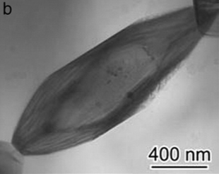
Context
Effect of secondary phases
in glassy wasteforms
Change melt and glass thermophysical properties
Change radiation resistance?
Change long-term behaviour?
RuO2 crystals in borosilicate glass
Common crystallite in glass waste forms
Simple structure
Durability of GCC wasteforms
From an atomistic point of view
Crystal picture: Rose et al., 2011

Slide 3
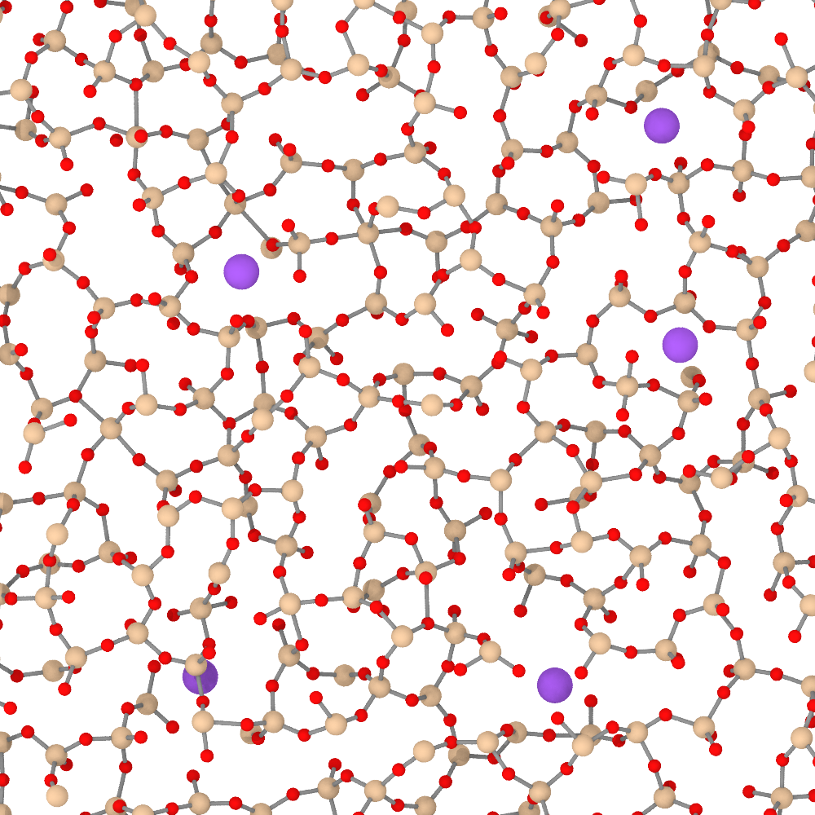
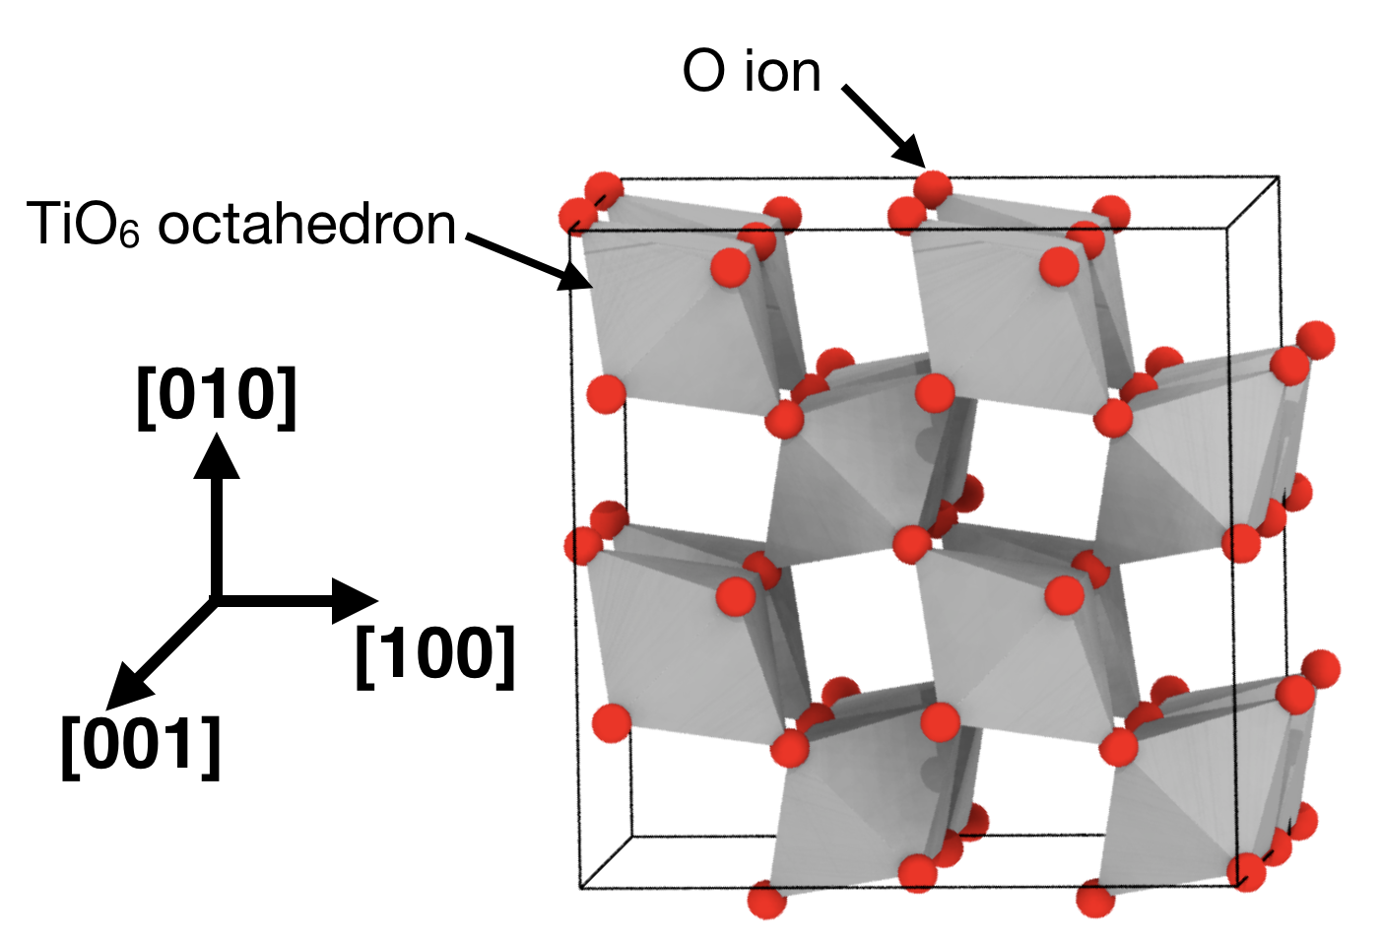


Modelling approach: material
Simplified material
Sodium silicate glass (Na2O)x(SiO2)1-x
Rutile TiO2, isomorphous with RuO2
Parameter 1: Na concentration (glass polymerisation)
Parameter 2: crystal orientation (interface topology)
Si
Na
O

Slide 4
Molecular Dynamics model
Atomistic model
Empirical (classical) force fields
Calculate atomic trajectories
Empirical potentials
Rigid-ion
Pair interactions (simple and efficient)
Wide range of compounds
Simulation parameters
~ 300 000 atoms
~ 130x130x180 Å
Quench rate: 2.5 K/ps
Scalable
~ ns simulation time, necessary for diffusion
million+ atoms, necessary for fracture
Potential: Pedone et al., 2006

Slide 5
Glass/Crystal Composite (GCC) creation
Temperature
Ṫ
Relaxation
1
Relaxation
2
Final relaxation
+ production
Quenching
Time
Glass
Quench rate Ṫ
as small as practically possible (but still very high)
needs to be consistent across simulations
Crystal
Frozen during quenching
Glass density
fixed to experimental room-temperature values
volume kept constant during quenching
Variations considered
crystal orientation (12 interfaces with indices lower than 3)
glass composition (0%, 10% and 20% Na2O)

Slide 6
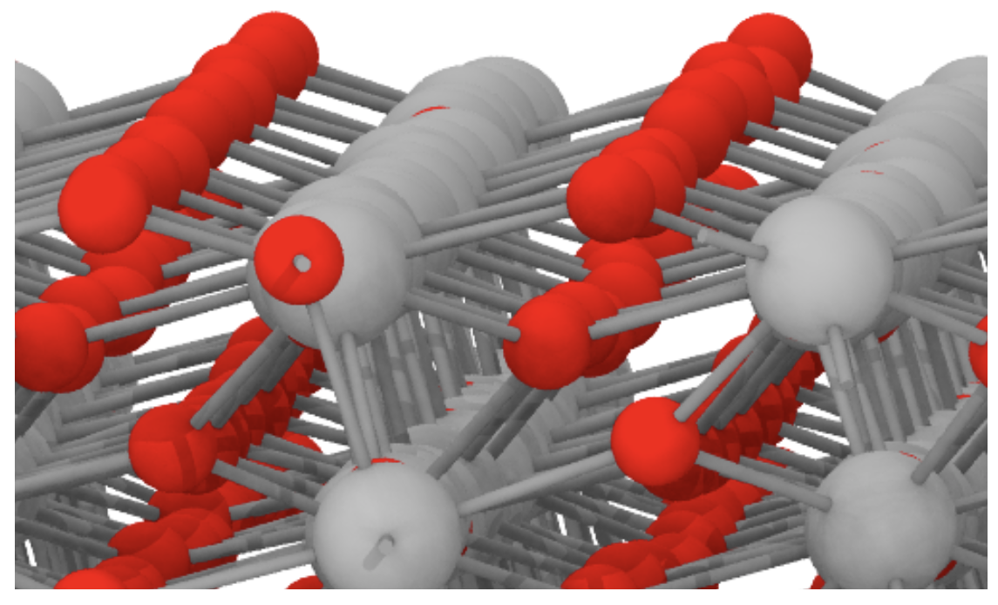
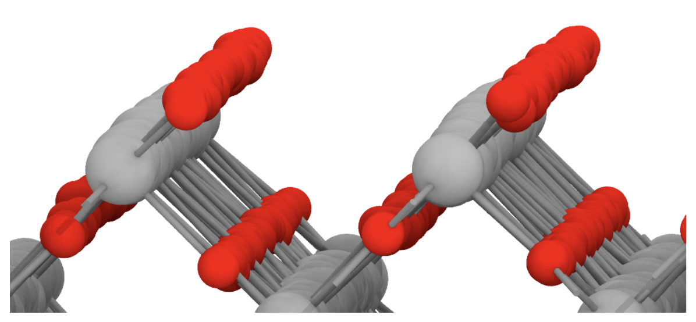
Interfaces
(100) rutile surface
(121) rutile surface
Interface orientations
All planes with indices ≤ 2 tested
Examples shown here: (100) and (121)

Slide 7
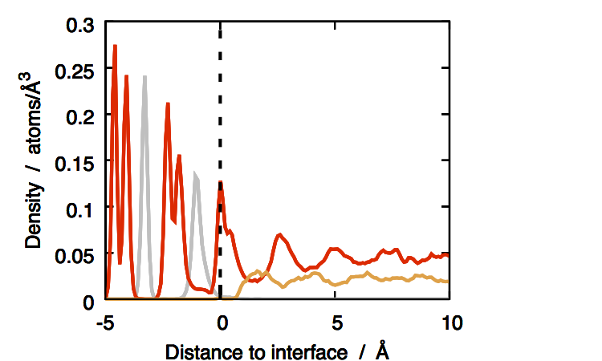
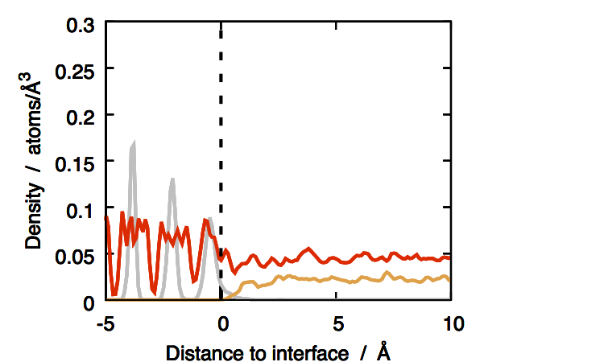
Composition of GCC interfaces
z-density plots
show concentration of each species as a function to distance from interface
peaks correspond to enriched layers
on the crystal side: clear, well-defined peaks for most interfaces
Colour code:
Ti
O
Si
(100) interface; SiO2 glass
(121) interface; SiO2 glass
Pure SiO2 glass:
➔ Some interfaces show layers in the glass, e.g. (111)
➔ Some don’t, e.g. (121)
➔ Layering up to ~5–8 Å into glass phase

Slide 8
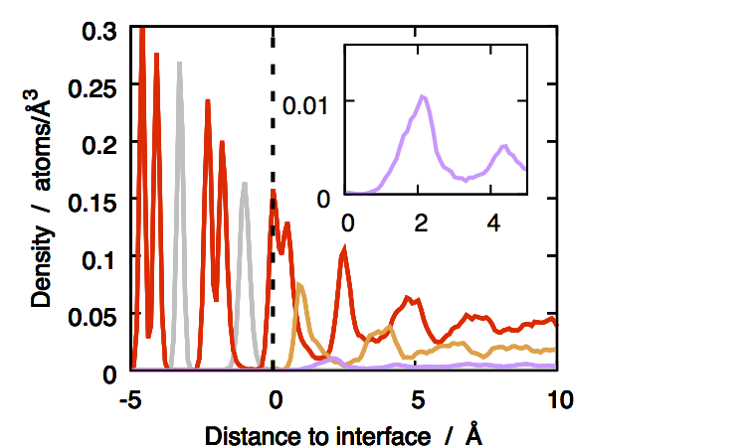
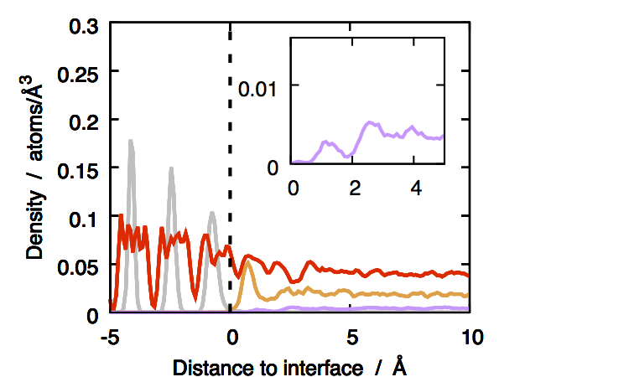
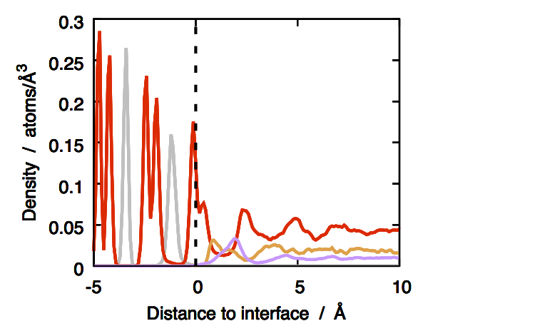
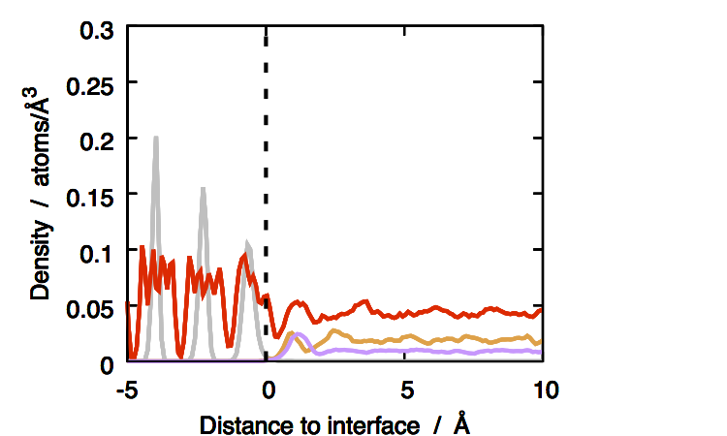
Composition of GCC interfaces
(100) interface; 10% Na2O
Colour code:
(121) interface; 10% Na2O
Ti
O
Si
Na
(100) interface; 20% Na2O
(121) interface; 20% Na2O
Effect of sodium:
➔ Does not change interfaces without layers much
➔ At first increases layering
➔ Then reduce it
➔ No real segregation in any case

Slide 9
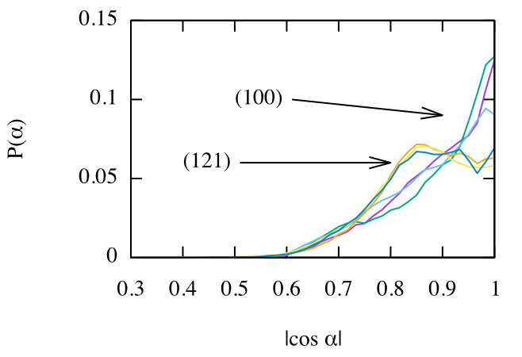
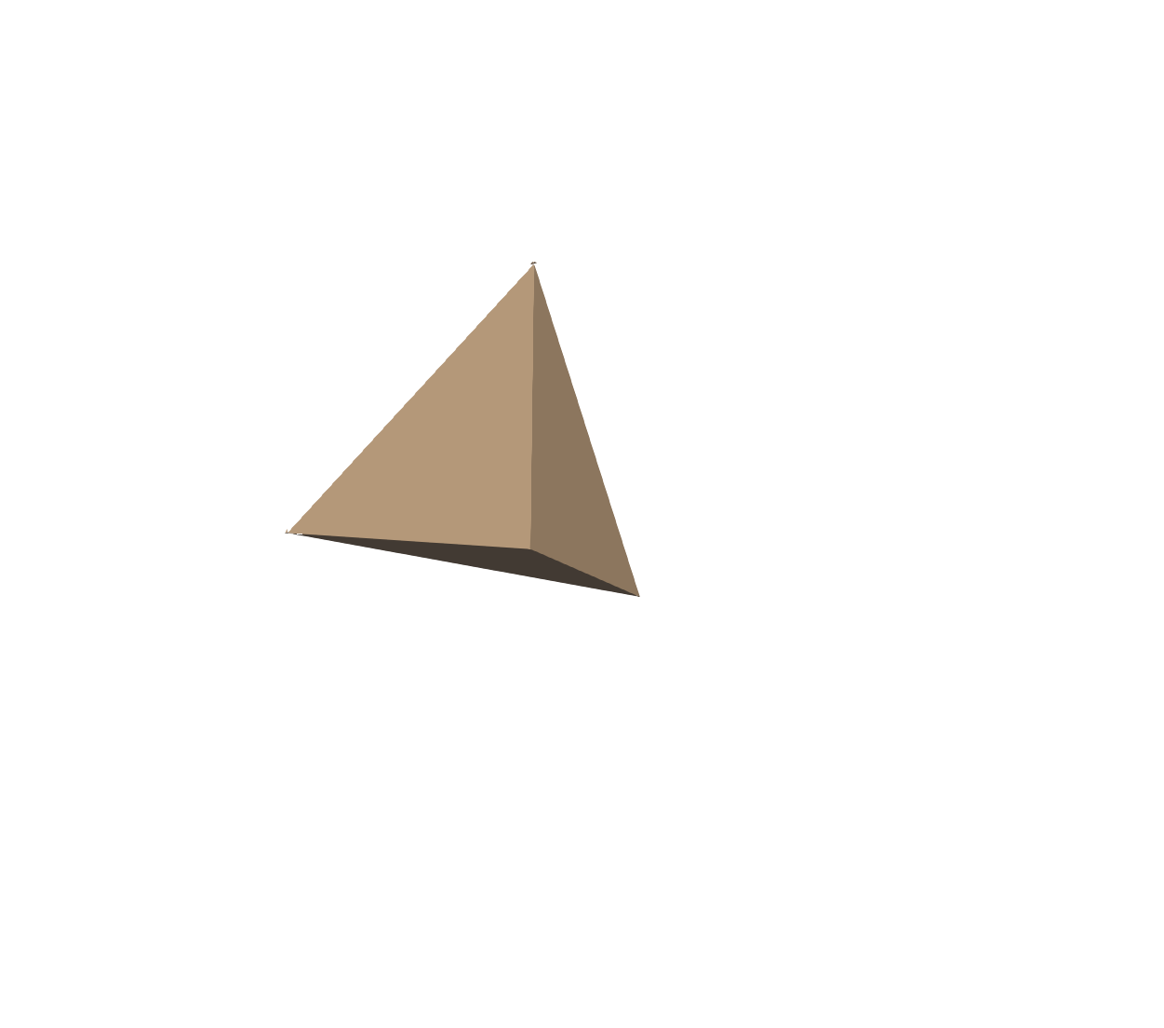
Interface layer structure
SiO4 tetrahedron orientation:
α
Interface
Orientation distribution of SiO4 in first interface layers
➔ More aligned tetrahedra for layered interfaces (100)

Slide 10
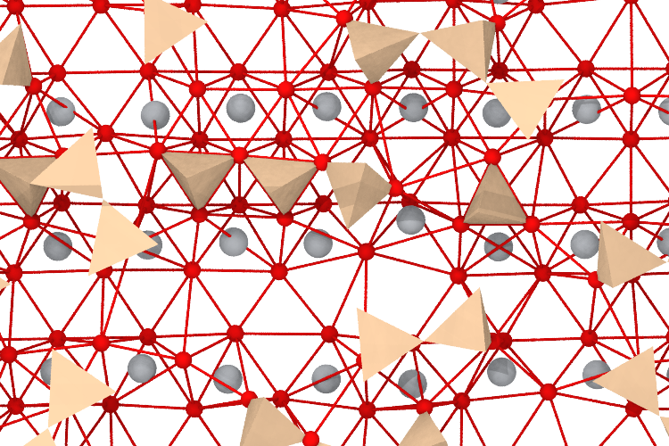
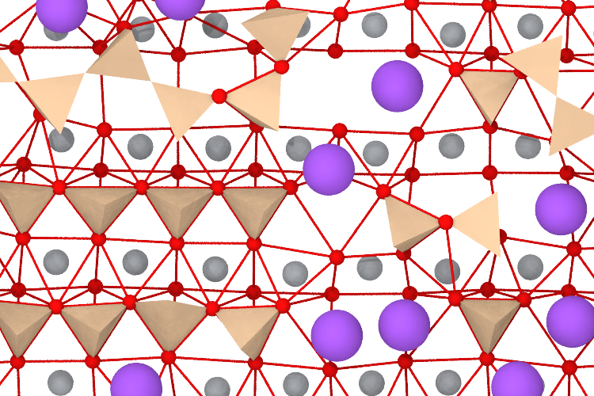
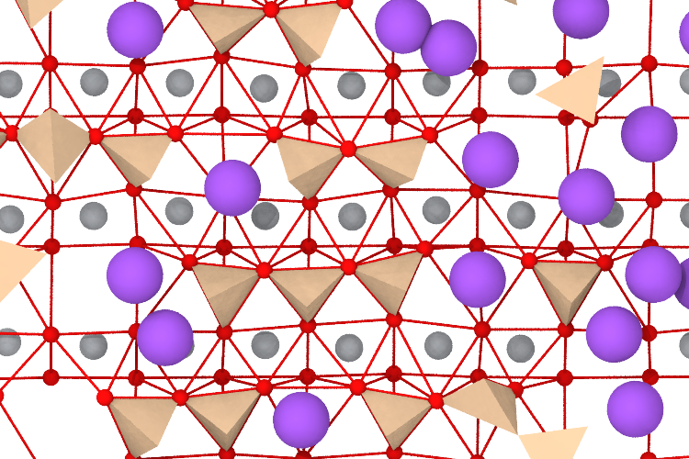
Interface layer: (100)
SiO4 tetrahedra
Representation of the first silicate layer
Colour code:
Na ions
TiO6 octahedra not shown
10% Na2O: most tetrahedra are face-connected
20% Na2O: Na compete with tetrahedra
0% Na2O
Sodium effect
Na promotes ordering initially
But then limits population of aligned SiO4
Higher Na concentration: Na lines
With Na: most tetrahedra connected to the crystal by 3 O (face-connected)

Slide 11
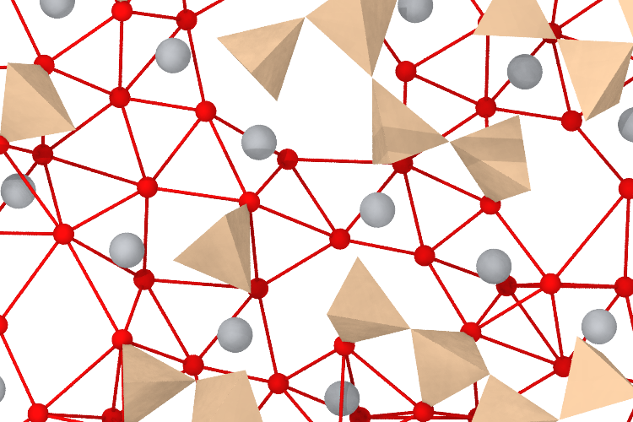
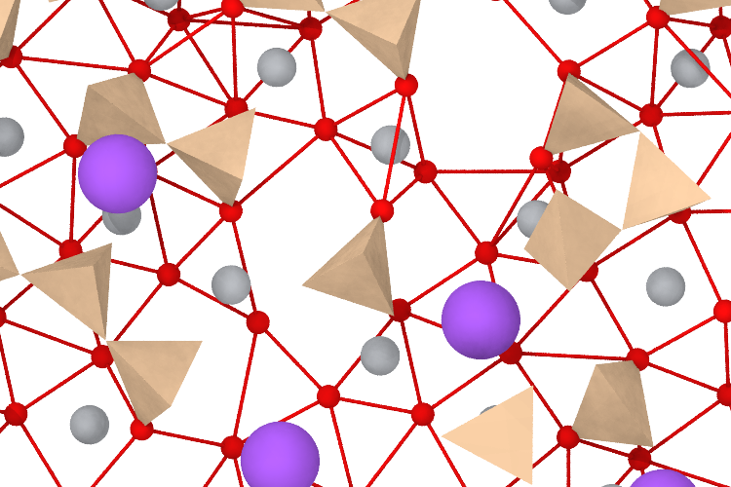
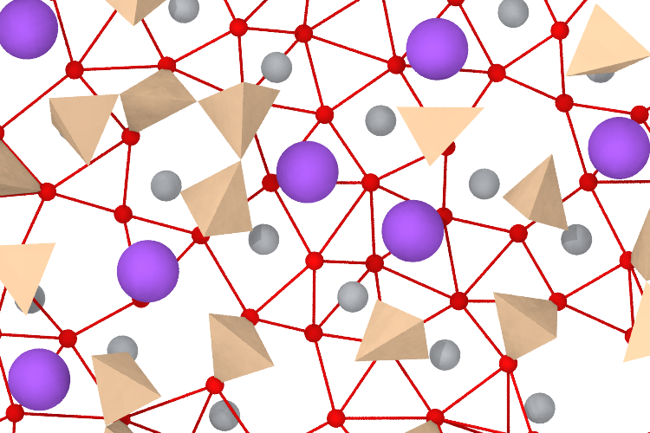
Interface layer: (121)
SiO4 tetrahedra
Representation of the first silicate layer
Colour code:
Na ions
TiO6 octahedra not shown
0% Na2O
10% Na2O
20% Na2O: aligned Na
Sodium effect
Na-rich channels
Na concentration does not seem to change SiO4 ordering
Face-connected tetrahedra not dominant

Slide 12
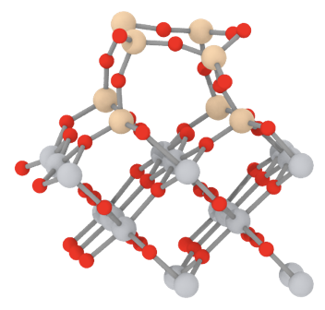
Ordering beyond the first glass layer: (100) interface
Arches: successive rings with 4 Si and 1 Ti
Face-connected SiO4
TiO2 crystal
Face-connected tetrahedra
Constrain the glass network
Cause layering in the glass phase
Open possible diffusion channels

Slide 13
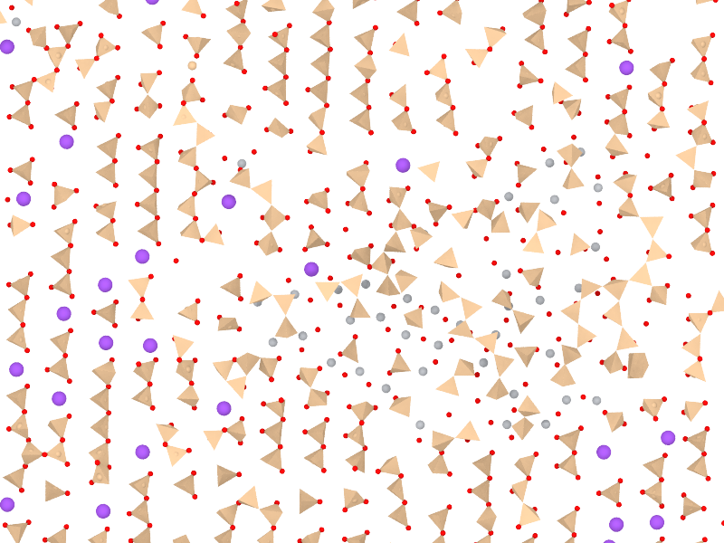
Radiation damage
10 keV cascade on (100) interface (x=0.1)
Ordering perturbations
Ti-rich regions in the silicate layer
Ti coordination environments
  4 (tetrahedra)
  5 (truncated octahedra)
  6 (octahedra)
Core poor in Na

Slide 14
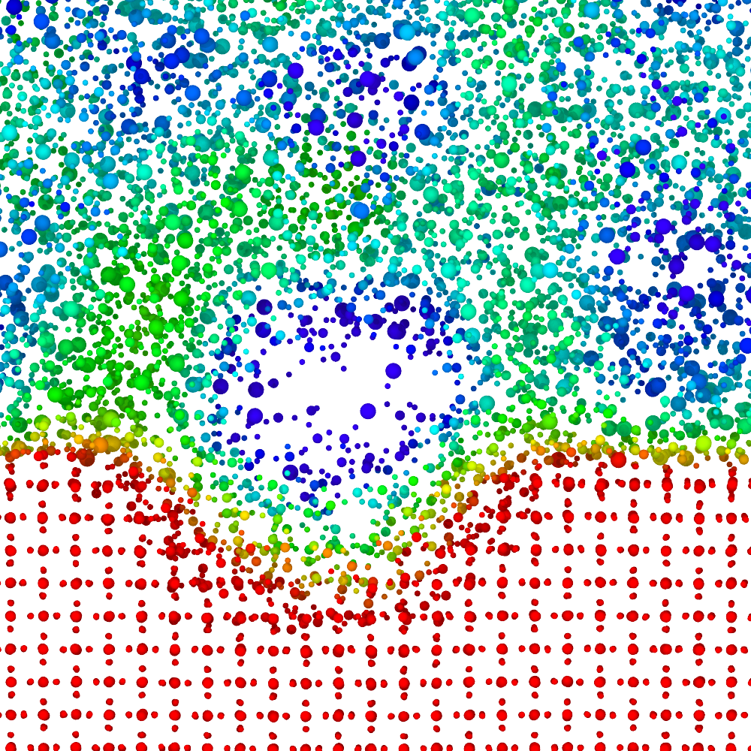

Radiation damage: density
Colour code:
local density
3 g/cm³
1.5 g/cm³
Slice of a 10 keV thermal spike on a (100) interface
On the glass side
Low-density core, high-density shell
On the crystal side
Much better reconstruction (smaller low-density core)
No high-density shell

Slide 15
Interfaces: defect energies
Defect | ∆E
Tiglass | 0.5 eV
Tii | 3.5 eV
Nai | 0.7 eV
SiTi | 1 eV
Estimates from simulations with x=0.1
Driving force for Tii to move to the glass once they have formed
Si tends to be substitutional
Na tends to be interstitial

Slide 16
Acknowledgments
Robin Grimes
Erik Hansen
Computing facilities
Imperial College HPC cluster
Thomas (Materials and Molecular Modelling Hub)

Slide 17
Atomisitc simulation
of interfaces in glass/crystal composites
for nuclear wasteforms
Paul C. M. Fossati, Michael J. D. Rushton & William E. Lee
p.fossati@imperial.ac.uk

