Slide 1
Composition of radionuclide containing solid phases on the inner surface of Zircaloy-4
E. González-Robles¹, M. Herm¹, N. Müller¹, K. Dardenne¹, J. Rothe¹, D. Schild¹, R. Dagan², V. Metz¹
¹ Karlsruhe Institute of Technology, Institute for Nuclear Waste Disposal, P.O. Box 3640, 76021 Karlsruhe, Germany
² Karlsruhe Institute of Technology, Institute for Neutron Physics and Reactor Technology, P.O. Box 3640, 76021 Karlsruhe, Germany
Materials Research Society
Scientific Basis for Nuclear Waste Management XLI
29th October – 3rd November 2017
Sydney (Australia)

Slide 2
Outline
Introduction
Objectives
Material
Sample preparation
Results
Conclusions

Slide 3
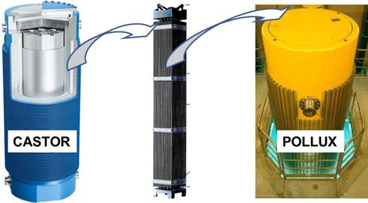
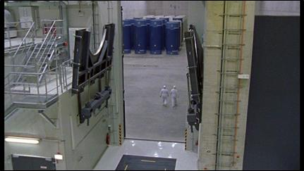
Introduction
  Dry Storage
Expected significant prolongation (> 40 a) of SNF above surface interim storage requires (besides actively monitored and protected facilities)
  better understanding of the effects of thermal, mechanical and radiological stress
  better understanding of the corrosion of Zircaloy claddings induced by deposition of volatile fission products
  to deal with possibly limited integrity of fuel pins affecting transport and conditioning for final disposal→ handling of fuel assemblies

Slide 4
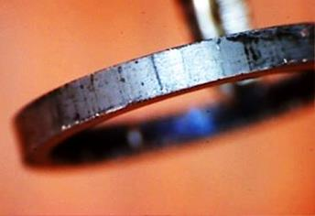
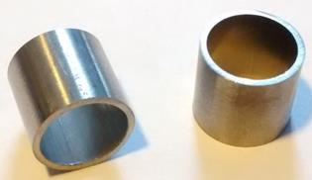
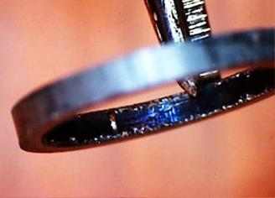

Objectives
Possible presence of black/blueish precipitates on the inner surface of the irradiated cladding
Characterisation of inner and outer surface of Zr-cladding
Volatile elements released during reactor operation from subjacent fuel pellets
→ contribution to clad corrosion?
SEM-EDS
XPS
XAS @ ANKA

Slide 5
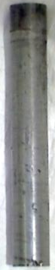
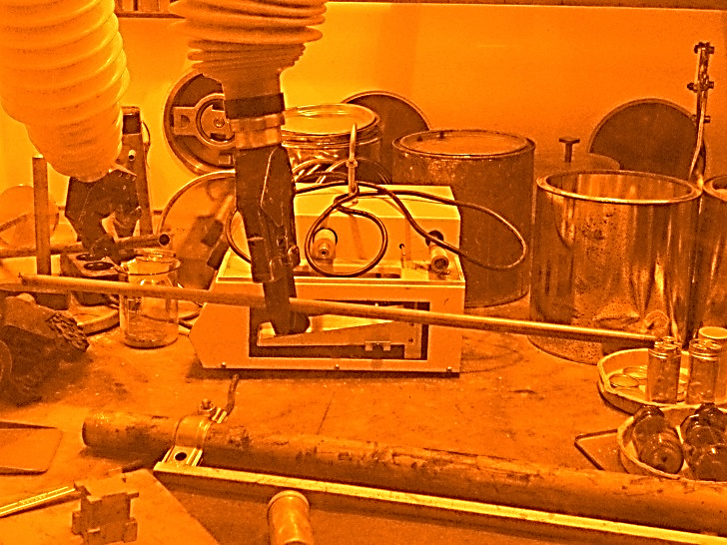
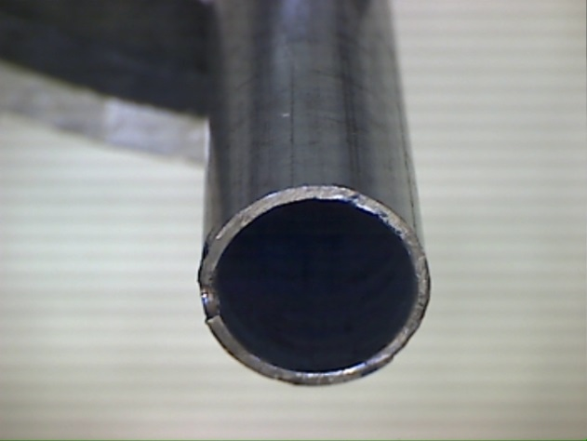
Material
Irradiation characteristics
Zircaloy-4 cladding sampled from plenum of fuel rod segment SBS1108–N0204
Irradiated in the Swiss Gösgen PWR (1985–1989)
Effective full power: 1226 days
Average burn-up: 50.4 GWd/t_{HM}
Average linear power: 260 W/cm
Stored gas tight until 2012
75 mm
500 mm
UO₂
dose rate ~20 mSv/h

Slide 6
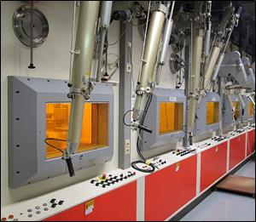
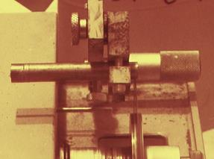
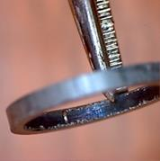
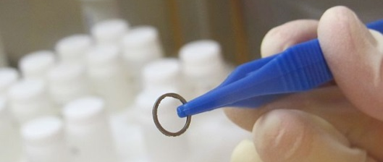
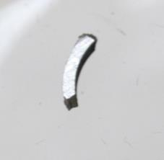
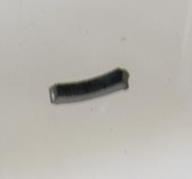
Sample preparation
dissolution experiments in glove box
shielded box-line
Characterisation of the cross section and inner surface of the Zircaloy

Slide 7
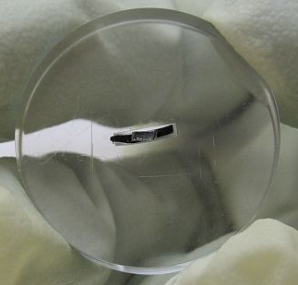
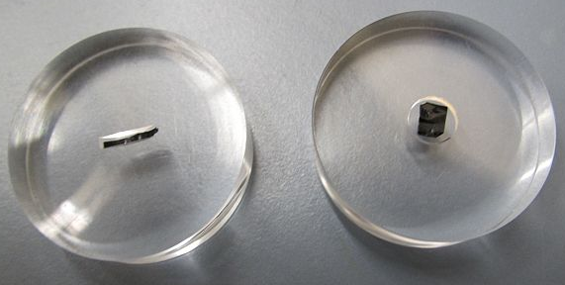
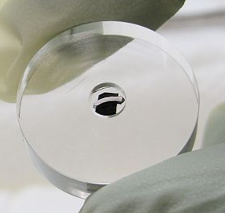
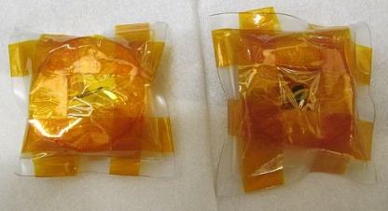
Sample preparation
Preparation of Zry-4 ring segments for SEM-EDS, XPS and XAFS/XRF experiments at INE-Beamline
  Sample A: ring segment inner surface
  Sample B: ring segment cross section
Contact dose rate ~30 µSv/h
A
B

Slide 8
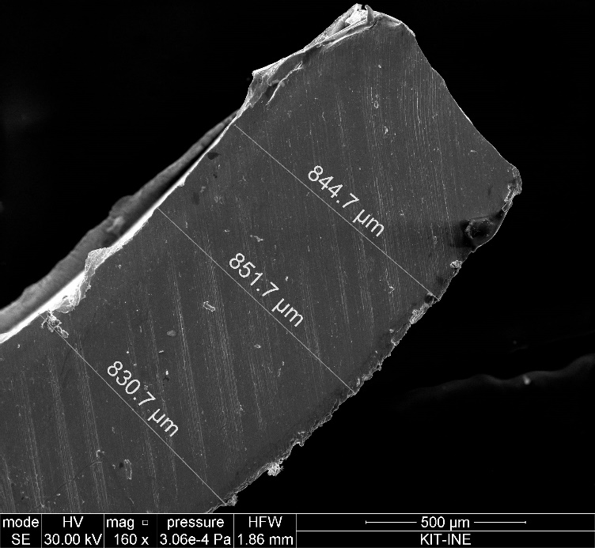
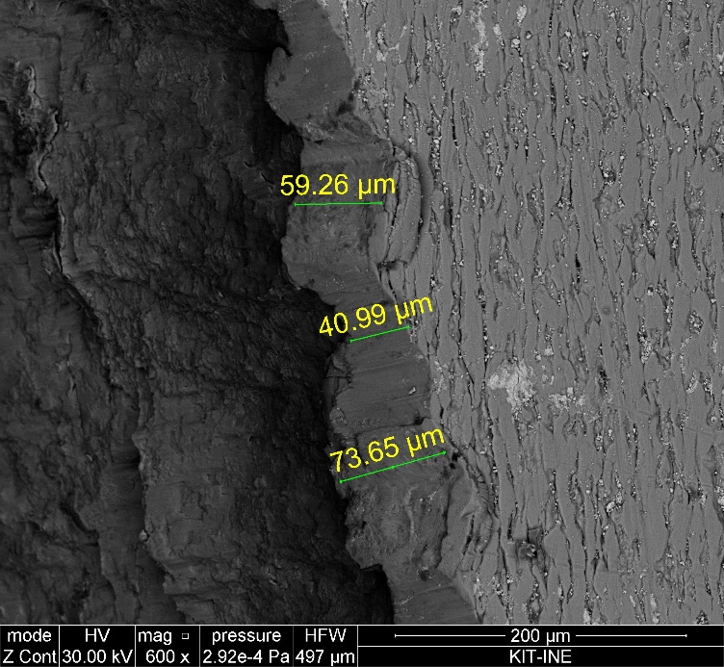
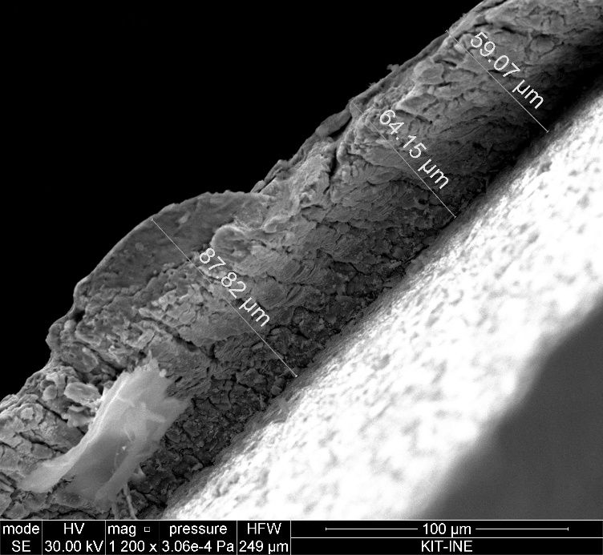
Results
SEM-EDS investigations:
cladding dimensions:
→ nominal: 0.725 mm (Zry-4 DX ELS 0.8)
→ experimental: 0.830 to 0.851 mm
thickness of precipitates on inner surface:
→ experimental: 0.041 to 0.088 mm
Zircaloy
ZrO_{x}
chemical analysis: U, Zr
ZrO_{x}
Zircaloy

Slide 9
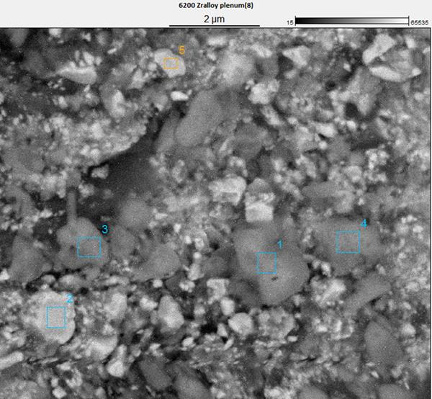
Results
SEM-EDS investigations:
                Sections 1, 3 and 4:
                Same composition
                Presence of O, Rb, Zr, Cs and U
                Section 2:
                Presence of O and U
                Section 5:
                Presence of O, Fe, Rb, Zr and U
5
3
4
1
Image Resolution: 2048 by 1766 Image Pixel Size: 0.00 µm
Acc. Voltage: 10.0 kV Magnification: 30844

Slide 10
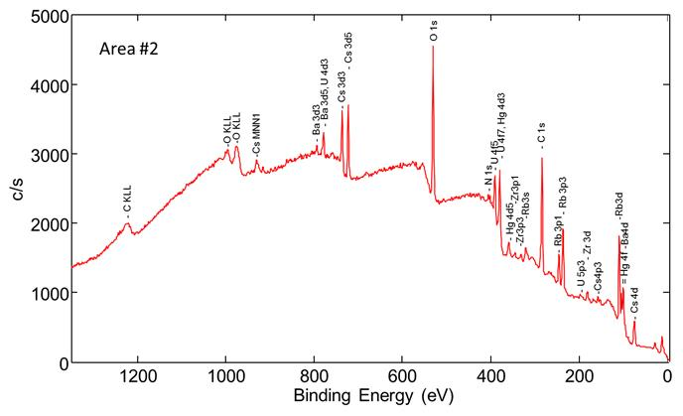
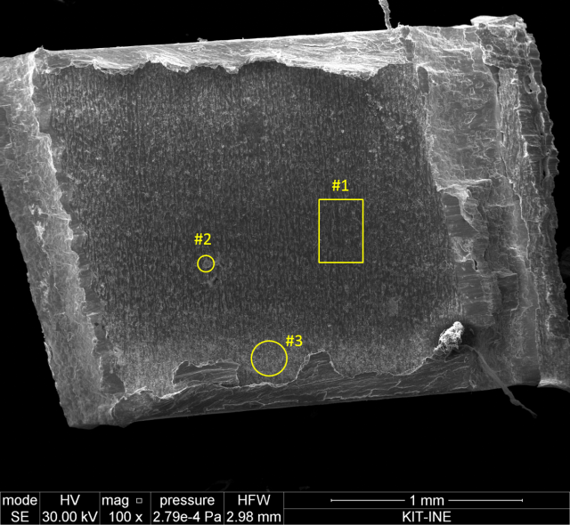
Results
XPS investigations:
Besides Cs, precipitates on inner Zircaloy-4 surface contain significant amounts of Rb (1–7 at.%), Ba (0.1–0.2 at.%), U (0.1–0.7 at.%), and Zr (≥ 0.2 at.%)
Zr originates from adjacent Zircaloy-4
U is heterogeneously distributed, probably remnants of filling fuel pellets into cladding tubes

Slide 11
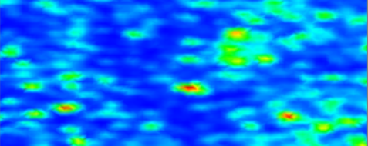
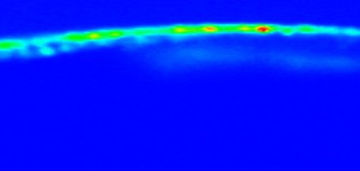
Results
XAS/µ-XAS/µ-XRF investigations:
U is heterogeneously distributed on inner Zircaloy-4 surface
→ max. thickness of U layer: 25 µm
Various fission products detectable (e.g. Rb, Ba) also Fe, Ti
Cs/I not detected due to overlap with U M-edge
→ ACT: Cs/I K-edge measurements (no overlap with U M-lines)
U Lα fluorescence maps
inner surface
cross section
1000 µm X 400 µm
U layer
ca. 25 µm
1000 µm X 450 µm

Slide 12
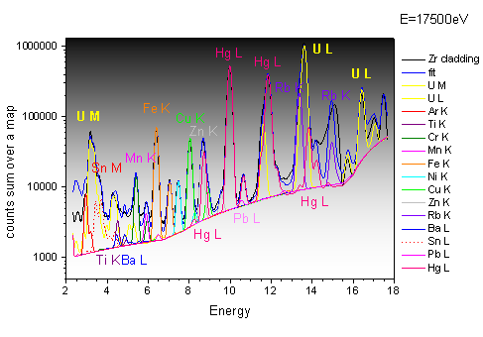
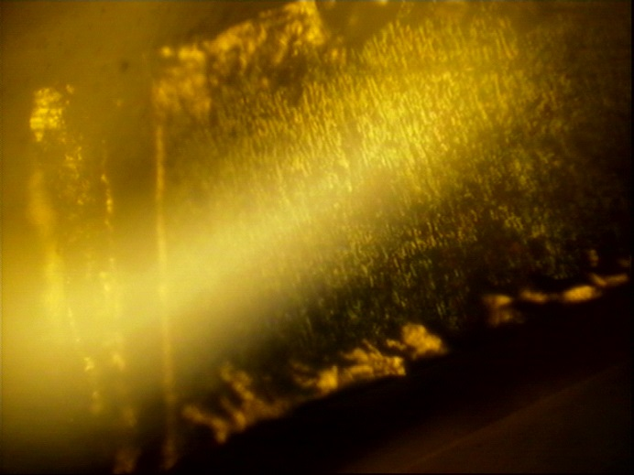
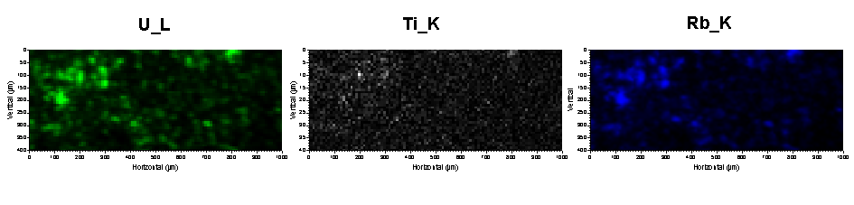
Results
XAS/µ-XAS/µ-XRF investigations:
element lines (MCA spectrum)
inner surface: VLM image
~1.5 mm

Slide 13
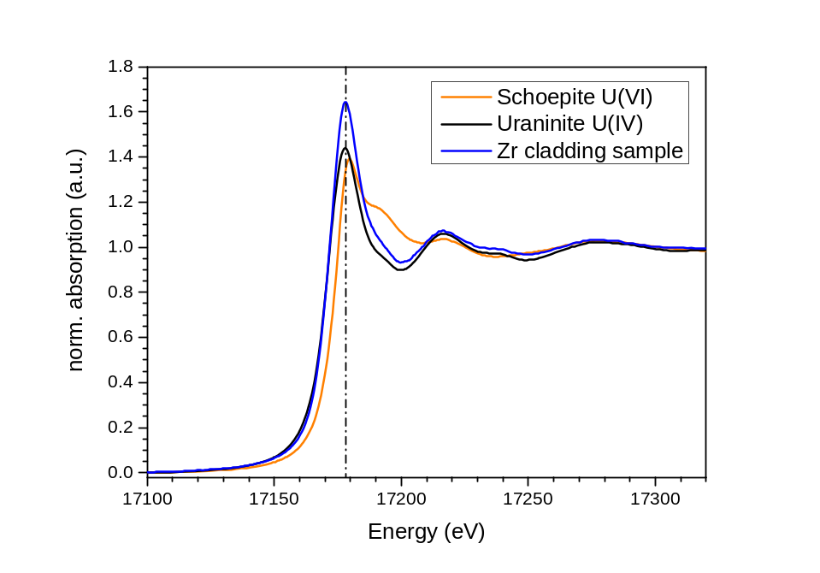
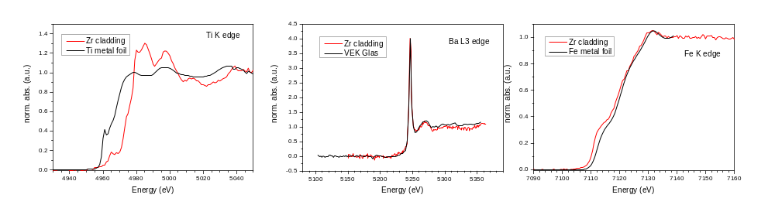
Results
XAS/µ-XAS/µ-XRF investigations:
U, and Ti present as U(IV) and Ti(IV)
Ba present as Ba(II)
Fe present as metallic Fe(0)
[Pu] too low for XANES measurements
Ti K Ba L3 Fe K

Slide 14
Summary and conclusions
Characterisation of Zircaloy-4 from plenum
Presence of black/blueish precipitates on the inner surface was confirmed
Thickness of precipitates on inner surface was 0.041 to 0.088 mm
                SEM-EDX and XPS analysis shown precipitates contain O, Rb, Zr, Ba, Cs and U
                XPS analysis: Rb (1–7 at.%), Ba (0.1–0.2 at.%), U (0.1–0.7 at.%), and Zr (≥ 0.2 at.%)
                U is probably coming from filling fuel pellets into cladding tubes and is heterogeneously distributed
XAS/µ-XAS/µ-XRF investigations determined the oxidation state:
  U, and Ti present as U(IV) and Ti(IV) respectively
  Ba present as Ba(II) determined by

Slide 15
Acknwoledgements
E. Soballa (KIT)
G. Christill (KIT)
C. Marquardt (KIT)
S. Schmitt (KIT)
Thank you for your attention!

