Slide 1


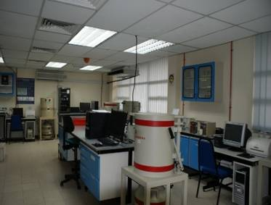
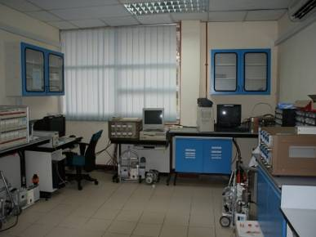

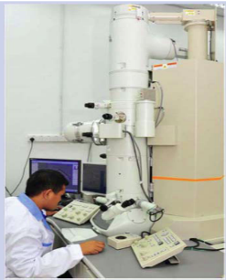
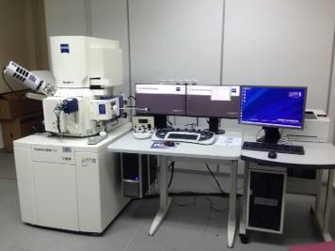
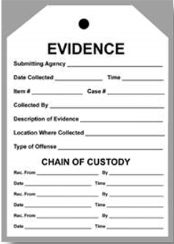
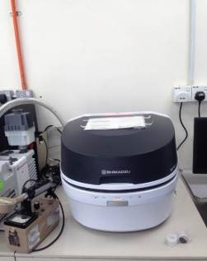
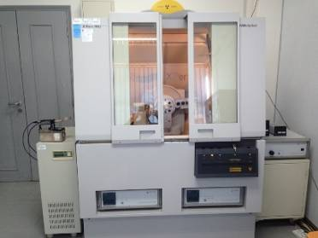
ATOMIC ENERGY LICENSING BOARD & MALAYSIAN NUCLER AGENCY
MALAYSIA
Aliyah MOHD SAAD, Zalina LAILI, Hishamuddin HUSAIN, Norhayati ABDULLAH
MALAYSIA Approach to Nuclear Forensics
National Laws
Roles and Responsibilities
ATOMIC ENERGY LICENSING ACT 1984
To control any activity dealing with radioactive materials, nuclear materials, prescribed substances or irradiating apparatus in medical and non-medical application.
STRATEGIC TRADE ACT 2010
Legislation that controls the export, transshipment, transit and brokering of strategic items and technology, including arms and related material, as well as activities that will or may facilitate the design, development, production and delivery of weapons of mass destruction.
EVIDENCE ACT 1950
This Act shall apply to all judicial proceedings in or before any court, but not to affidavits presented to any court or officer nor to proceedings before an arbitrator.
NATIONAL SECURITY COUNCIL DIRECTIVES
  DIRECTIVE 18 : COUNTER TERRORISM MANAGEMENT
  DIRECTIVE 20 : DISASTER MANAGEMENT
MINISTRY / AGENCY | RESPONSIBILITIES
Atomic Energy Licensing Board (AELB) | Leading Agency Regulatory Body
Royal Malaysian Police | LAW ENFORCEMENT
Royal Malaysia Custom | BORDER SECURITY
Malaysian Nuclear Agency | ANALYSIS LAB
Chemistry Department | ANALYSIS LAB
Ministry of Health | ANALYSIS LAB
Universities | ANALYSIS LAB
Science Technology Research Institute of Defense (STRIDE) | ANALYSIS LAB
Ministry of Science, Technology & Innovation | POLICY
Ministry of Home Affairs | POLICY
Ministry of Defense | POLICY
National Response Plan to Cases of Nuclear and Other
Radioactive Material Out of Regulatory Control
Existing Nuclear Forensics Capabilities
Nuclear Forensics Model Action Plan
WASTE AND ENVIRONMENT
TECHNOLOGY DIV.
RADIOCHEMISTRY LAB
AELB
Border security
Police/law enforcement
Custom
LAB ANALYSIS
Malaysian Nuclear Agency
Chemistry Department
Ministry Of Health
STRIDE
Universities
ANALYTICAL CHEMISTRY LAB
FORENSIC
GAMMA SPECT
ALPHASPECT
RADIATION SAFETY & HEALTH DIV.
DOSE MEASUREMENT & PHYSICAL INSPECTION
Communication of Findings
RADIATION PROCESSING DIV.
MATERIAL (POLYMER) TESTING LAB
LAB → Investigation Officer (AELB) → PROSECUTION
Aligned with Investigation procedures set by the regulatory
authority
TEM
SEM/EDAX
INDUSTRIAL TECHNOLOGY DIV.
MATERIAL (INDUSTRIAL) TESTING LAB
XRF
XRD

