Slide 1

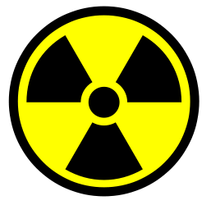
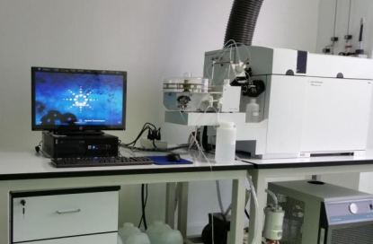
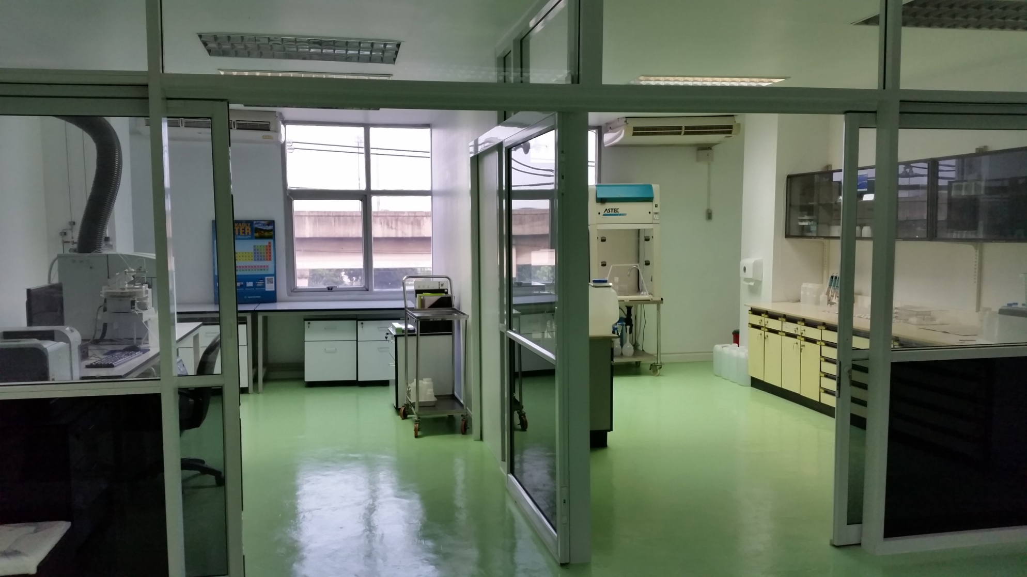
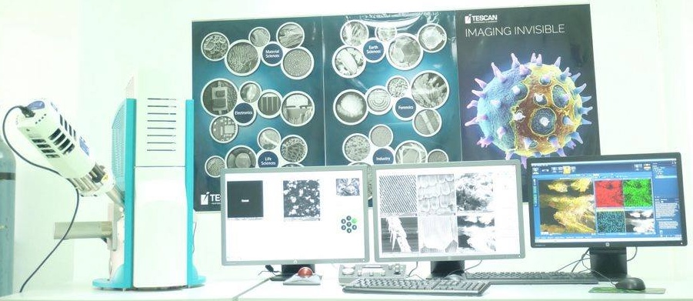
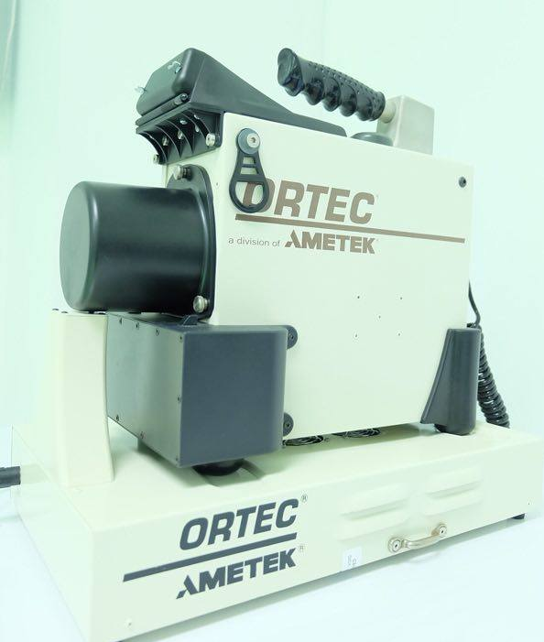
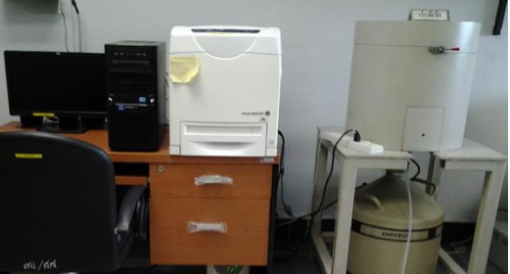

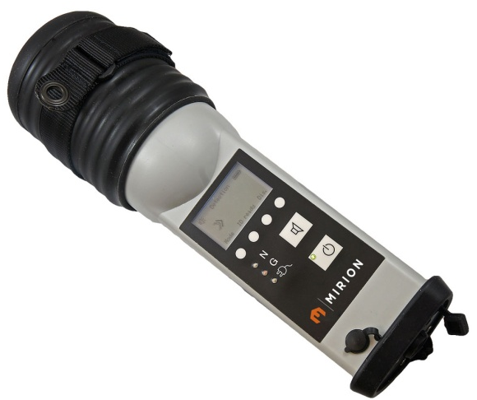
Office of Atoms for Peace
THAILAND
Areerak Rueanngoen, Kalaya Changkrueng
THAILAND Approach to Nuclear Forensics
National Laws
Roles and Responsibilities
Nuclear Energy for Peace Act in the national gazette in August 2016
Draft Act on Prevention and Suppression the Financial Support of Terrorism and the proliferation of weapons of mass destruction
Draft Act on Prevention and Suppression the Financial Support of Terrorism and the proliferation of weapons of mass destruction
Draft Act against the amended CPPNM texts the AP texts (Thai Nuclear Energy for Peace Commission Regulation on Security Measures on Nuclear Material and Facilities)
Ministry of Commerce Regulation on Dual Used Items Authorization and Other Required Goods Handling (will be effective from January 1, 2018 forward)
Government (Prime Minister)
MOST
Nuclear Energy Commission
Ministry of Energy
National Energy Policy Council (NEPC)
Office of Atoms for Peace (OAP)
Nuclear Energy Study and Coordination Office
University
Chulalongkorn
University
Thailand Institute of Nuclear Technology (TINT)
Electricity Generating Authority of Thailand (EGAT)
Establish rules, regulations and measure for the control and regulation of the use of nuclear energy and waste management; to control and regulate peaceful uses of nuclear energy and nuclear facilities;
Control functions (inspections) in general are performed through competent officials appointed by the Minister who takes charge and control of the execution of the Act;
To be the Secretariat of the Nuclear Energy for Peace Commission
To regulate safety and security utilizations of radiation and nuclear materials.
To coordinate formulation of national policy and strategic plans on peaceful utilization of atomic energy.
To coordinate and support national security safety and safeguards relevant to atomic energy issues.
To coordinate and carry out commitments and obligations with international organizations and with foreign institutes and technical co-operation with organizations in Thailand and abroad
Receiving evidence
Radiation measurement and evidence characterization
Analysis plan
Destructive analysis
Analysis Result
NDA
Interpretation
Nuclear Forensics Laboratory Procedure
Nuclear Forensics Model Action Plan and Communication of Findings
Border Security and Frontline Officers Networking
Existing Nuclear Forensics Capabilities
Central Institute of Forensic Science
Department of Disaster Prevention and Mitigation
Office of Police Forensic Science
Ministry of Defense
Nuclear or Radioactive Material Evidence
5 Nuclear Chemists responsible in Nuclear Forensics
1 Laboratory with ICP-MS, SEM/EDX, HPGe, RIDs, PRDs equipments
Transport Sample Safely and Securely
TINT / OAP
Ministry of transportation
Examination Plan and Laboratory Analysis
&
Integration using a Comparative Database or Library
OAP (Nuclear Forensics Laboratory)
Findings support criminal prosecution
International Cooperation
Ministry of Justice
OAP
Ministry of Foreign Affairs

