Slide 1
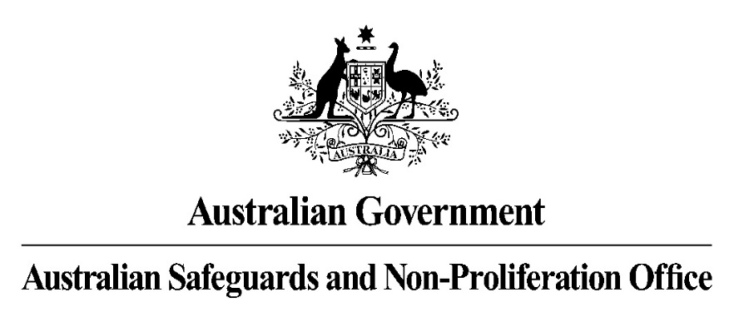

ANSTO, ARPANSA, ASNO
Australia
Stephen Marks and Lyndell Evans
Australian Approach to Nuclear Forensics
National Laws
Roles and Responsibilities
Nuclear Non-Proliferation (Safeguards) Act – 1987
ARPANS Act -1998
Weapons of Mass Destruction Act 1995
Customs Act 1901
Every State and Territory has its own response plan for nuclear material out of regulatory control. Generally covered under a standard CBRN plan.
Local Authorities (police) - Run the investigation with the assistance of one or more of the following agencies:
State Regulators – varying degree of capabilities
ANSTO – Nuclear forensic capability
ARPANSA – National regulator with search, characterisation and recovery capability
ASNO – Control of nuclear material and reporting to the IAEA
Nuclear Forensics Model Action Plan
Local Authorities work with the regulators and national experts to conduct an investigation.
State or National Regulator
IAEA
Existing Nuclear Forensics Capabilities
Local Authorities (Police)
ANSTO has the designated nuclear forensics laboratory which includes the following capabilities:
Accelerator Mass Spectrometry (AMS)
Inductively Coupled Plasma Mass Spectrometry
Radiochemical Laboratory
Gamma spectrometry Laboratory
Scanning electron microscopy
ASNO
(Nuclear Safeguards)
ANSTO
(Nuclear Forensics)
Communication
of Findings
Safeguards - reports to IAEA
Nuclear material - reports to ITDB
Forensics - reports to GICNT, INTERPOL, PSI, Global Partnership

