Slide 1

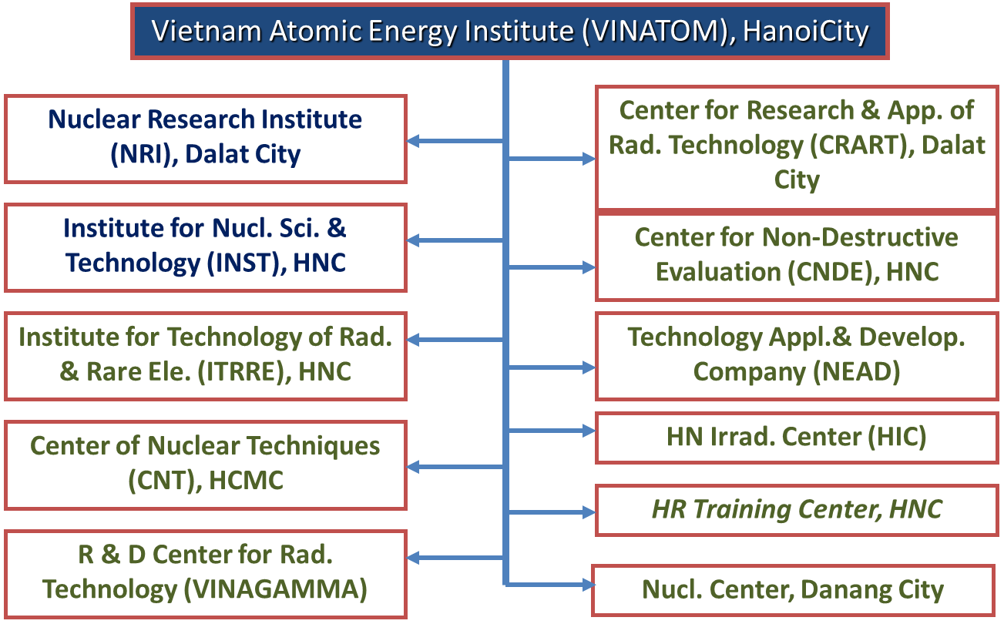
VIETNAM ATOMIC ENERGY INSTITUTE
Vietnam
BUI Dang Hanh and HA Lan Anh
Vietnam Approach to Nuclear Forensics
National Laws
Roles and Responsibilities
Law on Atomic Energy Article 30 provides: Organizations, individuals in possession or storage of radioactive sources, nuclear materials shall bear all expense for searching and handling of the lost, arrogated, …radioactive sources, nuclear materials; and shall be subjected to administrative sanctions, disciplinary penalty, or criminal prosecution, depending on the nature and scope of the violation.
The MOST receive information, report the National Committee for Incident Response. The Committee decides the response activities, establishes the Headquarter in the field. The Headquarter in the field directs response activities.
* National Committee for Incident Response is responsible for directing to respond the incident.
* Headquarter in the field is responsible for directing response activities in the field.
* The Ministry of Science and Technology is responsible for coordinating with other ministries and relevant agencies to search for and recover the lost, arrogated nuclear material.
* The Ministry of Public Security would lead an investigation of nuclear or other radioactive material out of regulatory control.
Nuclear Forensics Model Action Plan
Existing Nuclear Forensics Capabilities
Conduct of operations
In Vietnam, Vietnam Atomic Energy Institute (VINATOM) is R&D Institute in the field of Atomic Energy. VINATOM has been providing the technical support to serve the state management on radiation protection and nuclear safety. VINATOM has laboratories on radiation measurement and nuclear analysis to meet requirements for nuclear forensics.
Transport of evidence
Examination and analytical plans
Nuclear and other radioactive material analysis and interpretation
Traditional forensic analysis and interpretation radionuclides present
Traditional forensic analysis and interpretation no radionuclides present
Forensic conclusions
Communication of Findings
All nuclear forensic findings should be communicated in a written report in a timely manner. The reports must be presented in the form of a scientific report that follows a specified standard format required by Vietnam Agency for radiation and nuclear safety.
The preparation of reports may follow the 24 hour, 1 week and 2 month timescales typical for completion of analyses. The results are sent to Vietnam Agency for radiation and nuclear safety

