Slide 1

Lateral Graphene/h-BN Heterostructures from Chemically Converted Epitaxial Graphene on SiC (0001)
Jonathan Bradford¹, Josh Lipton-Duffin¹, Mahnaz Shafiei^{1,2}, Jennifer MacLeod¹ and Nunzio Motta¹
¹ Institute for Future Environments and School of Chemistry, Physics and Mechanical Engineering, Queensland University of Technology, Brisbane, Queensland, Australia.
² Faculty of Science, Engineering and Technology, Swinburne University of Technology, Hawthorn, Victoria, Australia

Slide 2

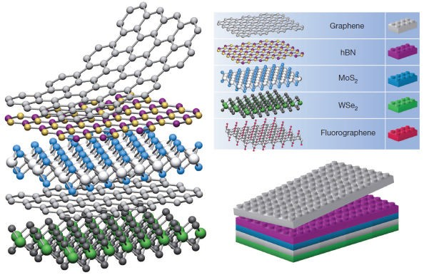
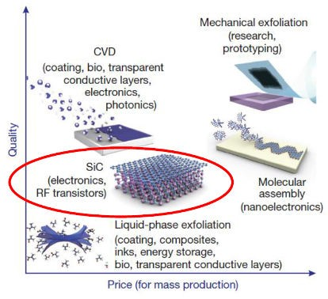
Epitaxial Graphene Heterostructures on SiC
2D Material Heterostructures Why Epitaxial Graphene/SiC?
Use 2D materials like building blocks
Engineer heterostructures with new properties
Tailor properties to suit applications
SiC is a common material for electronics
No transfer required – direct growth on a wide bandgap semiconductor
Compatibility with semiconductor industry
1
Geim, A.K., et al. Nature 499(7459) 419 (2013)
Geim, A.K., Science 324(5934) 1530 (2009)

Slide 3
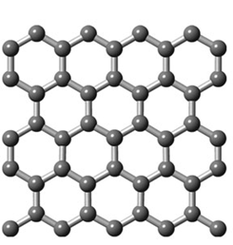
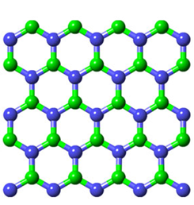
h-BN/Graphene Heterostructures
Hexagonal Boron Nitride
Graphene
Zero bandgap semimetal
Insulating with a 5.9 eV bandgap
Structurally similar materials with vastly different electronic properties
h-BN previously demonstrated as an ideal substrate for graphene
Small lattice mismatch (1.7%) allows the materials to be stitched together laterally
2

Slide 4
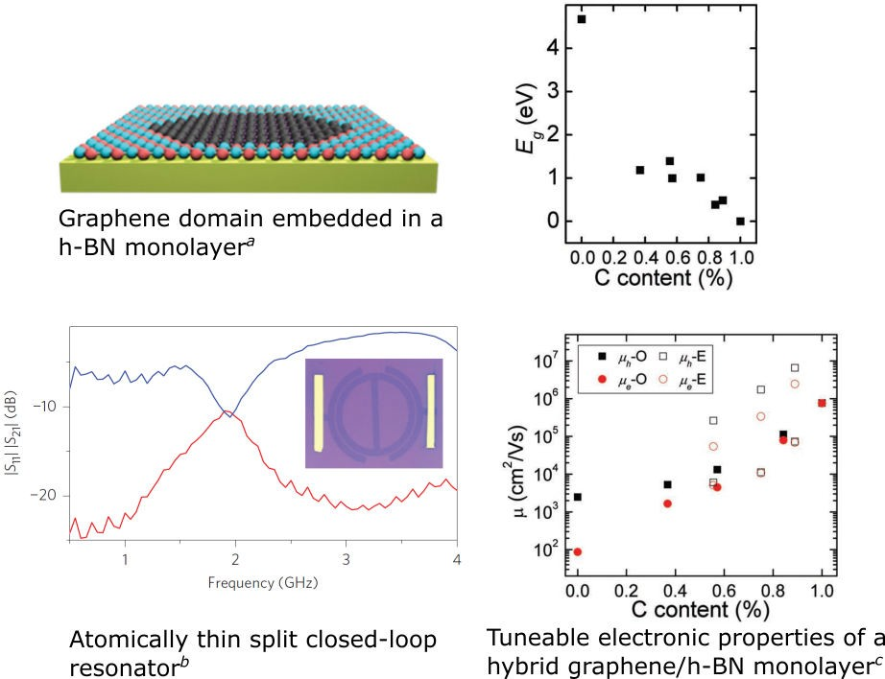
In-Plane Graphene/h-BN – Properties and Applications
Tuneable electronic properties depending on:
C/BN concentrations
Domain size/shape
Interface structure
Applications:
Semiconducting graphene
Atomically thin circuitry
Photocatalysis
Energy storage
a
Li, Q., et al. Small 12(1) 1373 (2016)
b
Liu, Z., et. al. Nat Nanotechnol 8(2) 119 (2013)
c
3
Wang, J., et al. Small 9(8) 1373 (2013)
Notes:
Theoretical studies have shown that both the carrier mobility and bandgap can be tuned according to the carbon content
If domains are large then the two materials retain their properties – useful for atomically thin circuitry. For example split closed loop resonator
For zig-zag edges a bandgap can be opened by applying an electric field. For armchair a gap can be opened by quantum confinement effects.

Slide 5
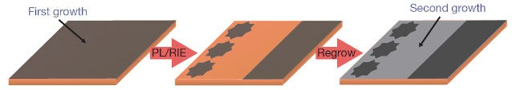
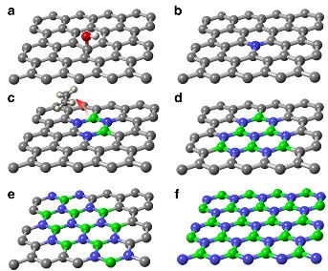
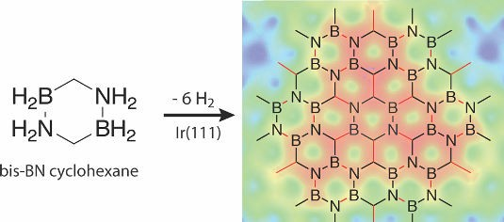
In-Plane Graphene/h-BN – Synthesis
Chemical Vapour Deposition:ª
Bottom-up Molecular Assembly:^{b}
Substitution reaction:^{c}
Methane and ammonia borane/borazine precursors
Composition determined by precursor concentrations
Patterning achieved by multiple etching/growth steps
Limited to metal surfaces
Atomically precise
Stoichiometry determined by precursor molecules
Limited to metal surfaces
Graphene substituted with h-BN
Concentration of h-BN controlled by reaction time
• Patterning achieved by applying masks
a
Levendorf, M., et. al. Nature 488(7413) 627 (2012)
b
Beniwal, S., et. al. ACS Nano 11(3) 2486 (2017)
c
Gong, Y., et al. Nat Commun 5 3193 (2014)
4

Slide 6
In-Plane Graphene/h-BN – Synthesis
Chemical Vapour Deposition:ª
Bottom-up molecular assembly:^{b}
Substitution reaction:^{c}
Methane and ammonia borane/borazine precursors
Composition determined by precursor concentrations
Patterning achieved by multiple etching/growth steps
Limited to metal surfaces
Atomically precise
Stoichiometry determined by precursor molecules
Limited to metal surfaces
Graphene substituted with h-BN
Concentration of h-BN controlled by reaction time
• Patterning achieved by applying masks
a
Levendorf, M., et. al. Nature 488(7413) 627 (2012)
b
Beniwal, S., et. al. ACS Nano 11(3) 2486 (2017)
c
Gong, Y., et al. Nat Commun 5 3193 (2014)
4
Notes:
Substitution reaction is the best option for h-BN on SiC substrates

Slide 7
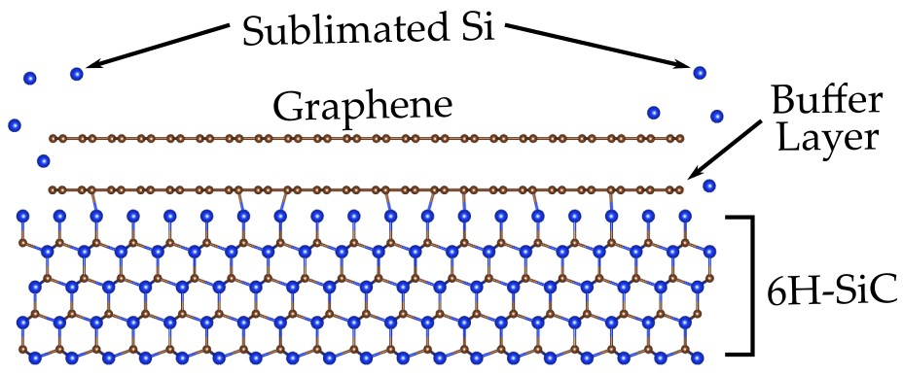
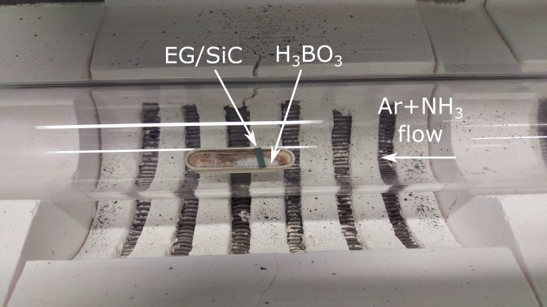
Chemical Conversion of Graphene to h-BN
Graphene grown by high temperature annealing in UHV.
h-BN grown by chemical conversion of graphene.
Substitution reaction performed by evaporation of H₃BO₃ at 1000◦C, 50 Torr under flow of 200 sccm Ar and 50 sccm NH₃.

Slide 8
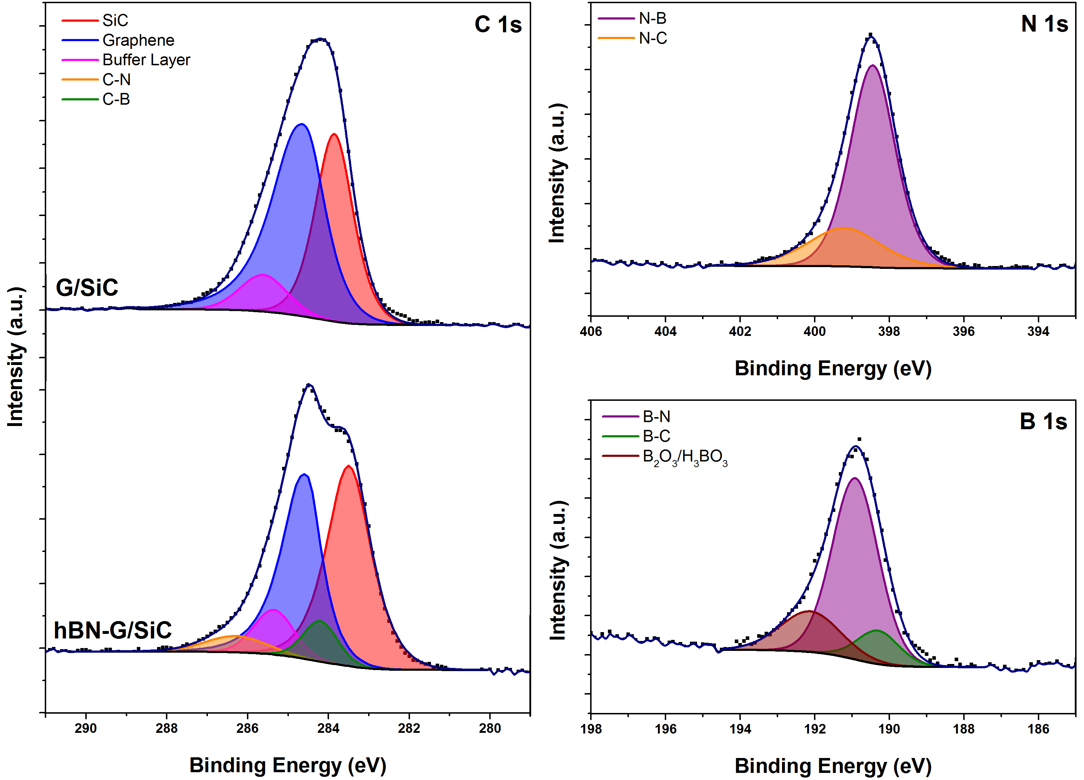
XPS Characterisation
Graphene coverage is multilayer
Decrease in graphene peak intensity suggests a substitution reaction
C-N and C-B components attributed to graphene/h-BN interface
h-BN:graphene ratio ~0.25
Notes:
Purple peaks in N 1s and B 1s indicate growth of h-BN
Orange and green peaks correspond to C-N and C-B bonds, respectively.
C 1s shows a decrease in the graphene peak intensity relative to SiC.
These results suggest h-BN is growing in-plane with graphene.
Presence of the buffer layer has been confirmed by LEED and STM
Boron oxide residue can be removed by further rinsing in hot water

Slide 9
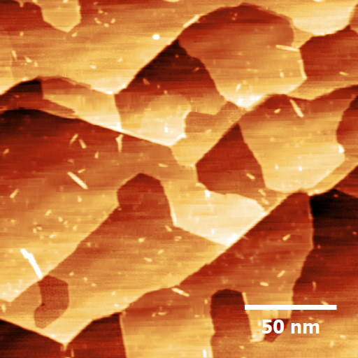
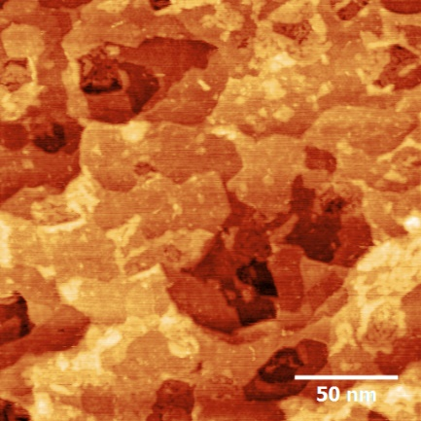
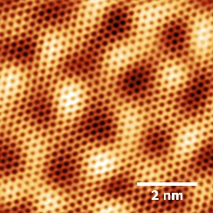
Graphene/h-BN Interface - STM
G/SiC
hBN-G/SiC
Notes:
h-BN patches are mostly seen at step edges
This is expected since these are the points with highest reactivity
It is possible there are some areas where h-BN sits on top of the graphene
(arrows only point to a few areas)

Slide 10
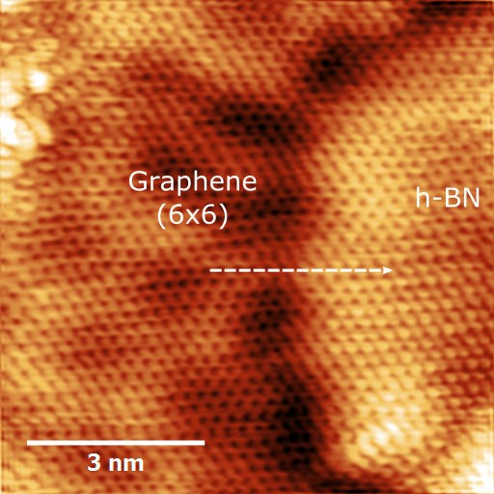
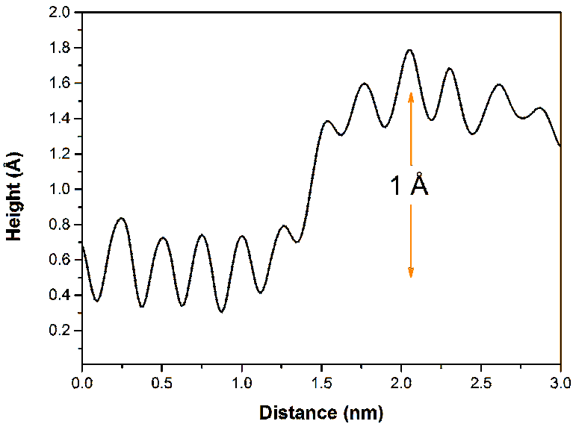
Graphene/h-BN Interface - STM
Identify graphene from moir´e pattern
h-BN step height is bias dependent;
0.74-1.25 ˚A between -200 mV and -10 mV
V = −20 mV; I = 600 pA
Notes:
Step height of the h-BN/graphene domain is too small to be a SiC or graphene step edge
Change in step height with tip bias is due a density of states effect
Bright “hump” at the interface suggests the creation of interface states
This is consistent previous reports in the literature (Park, et. al., Nat Commun. 5 (2014))

Slide 11
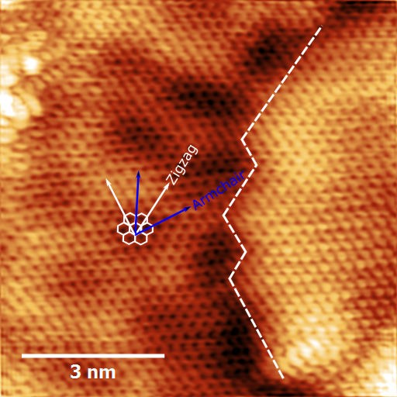
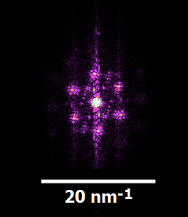
Graphene/h-BN Interface - STM
Interface between h-BN and graphene is formed along zig-zag directions with no rotational misalignment.
V = −20 mV; I = 600 pA
2D FFT

Slide 12
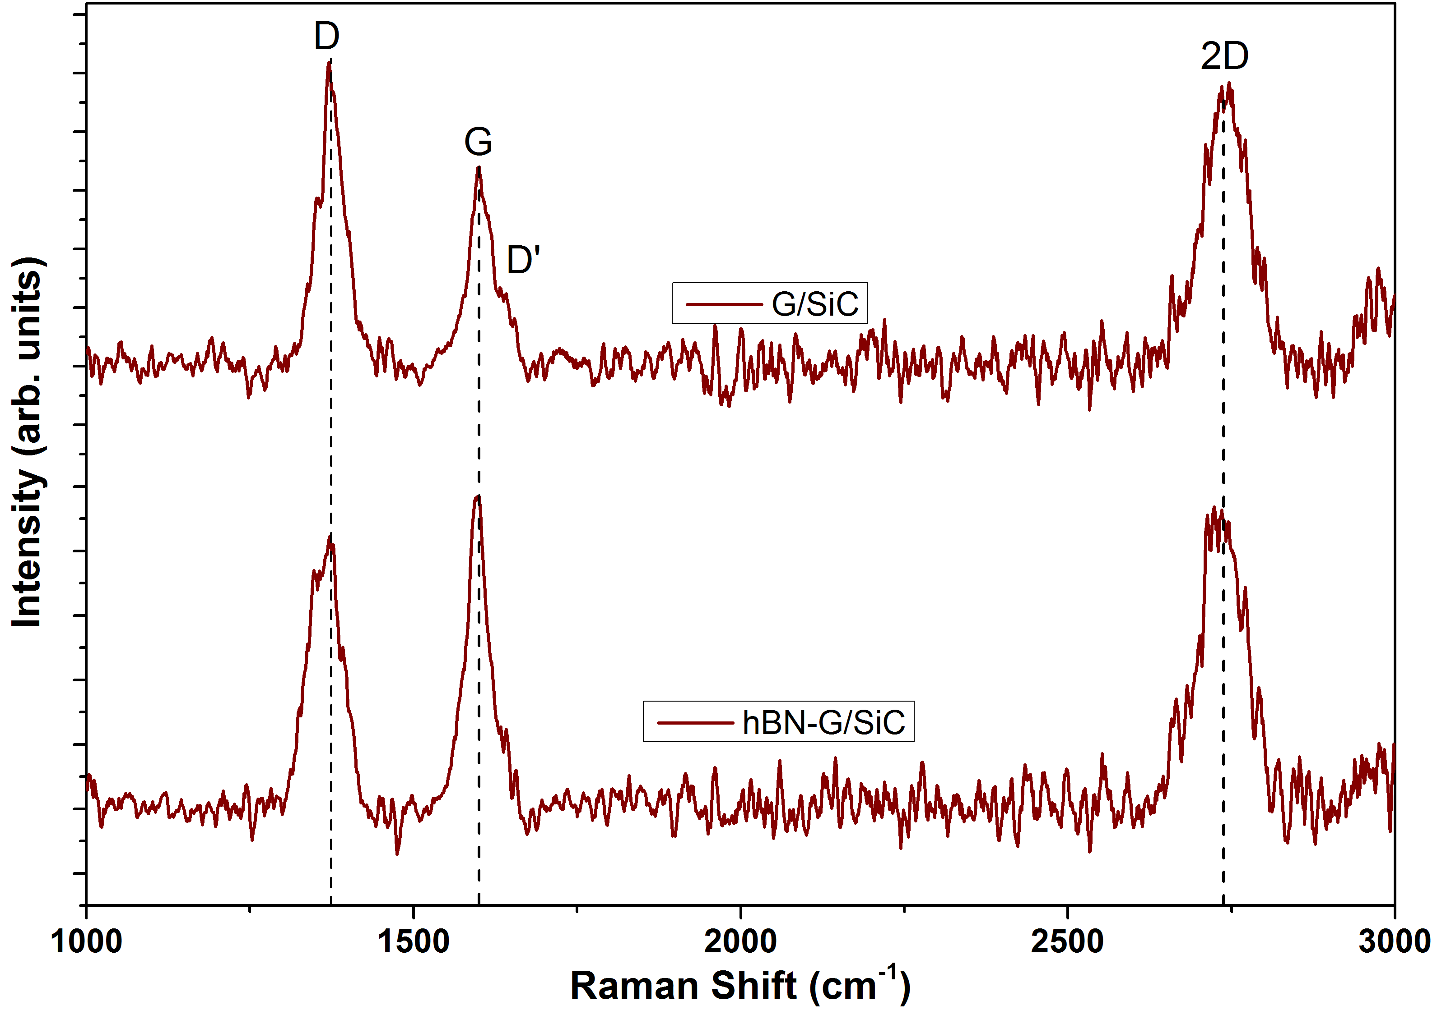
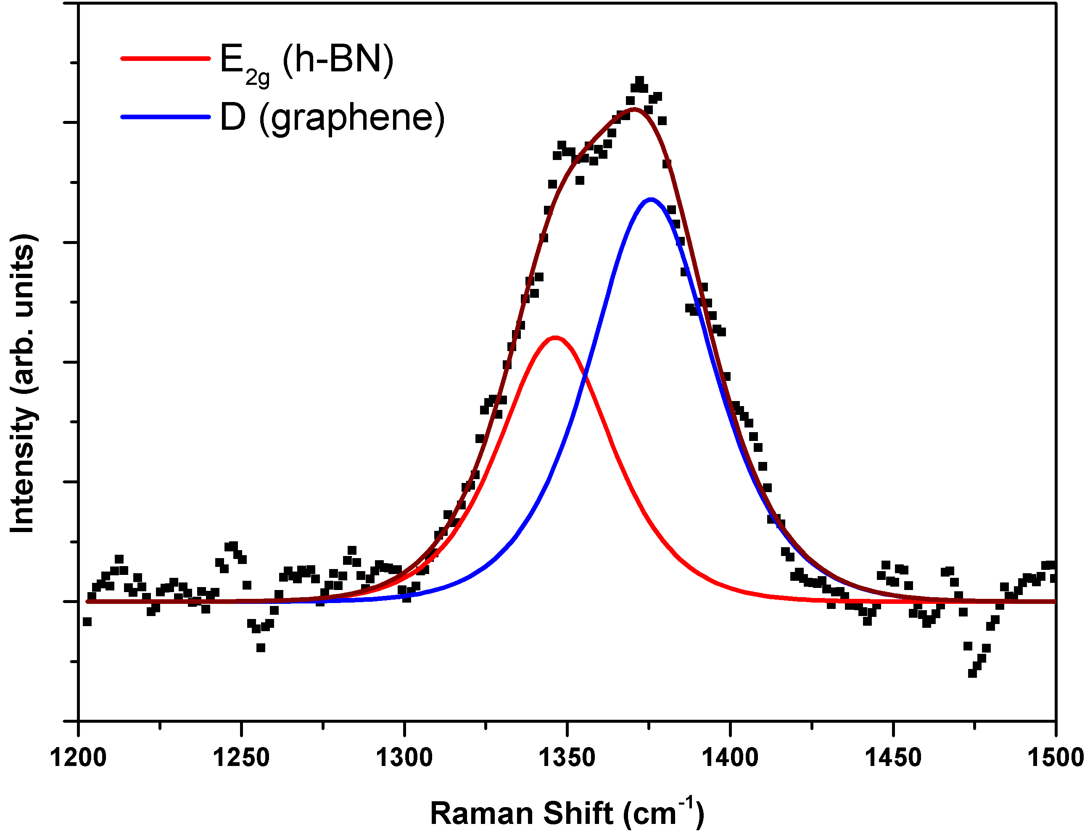
Raman Spectroscopy
Decrease in I_{D} /I_{G} ratio and broadening of the D band is consistent with the substitution of h-BN at defects.
Notes:
Plot on the right is a peak model of the D band after h-BN growth

Slide 13
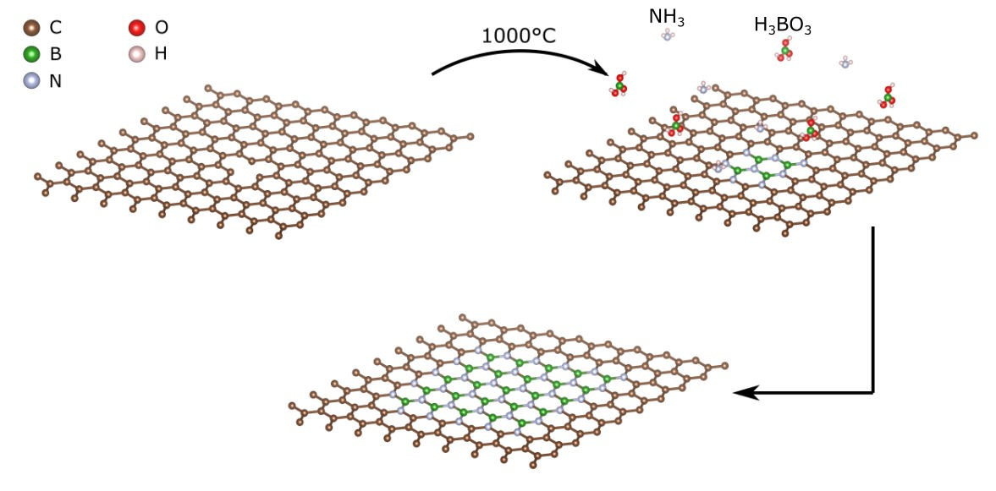
Substitution Reaction Mechanism
Substitution of h-BN nucleates at defects or functionalised carbon atoms and extends with the reaction time with B-N bonds forming preferentially.
Gong, Y., et al. Nat Commun 5 3193 (2014)
11
Notes:
- Proposed a method of patterning h-BN domains by inducing defects into the lattice to control the nucleation sites.
- Can potentially control the interface structure by patterning along certain lattice directions since graphene grows epitaxially on SiC with a 30 degree rotation.

Slide 14
Summary
Hybrid monolayers of graphene and h-BN offer tuneable electronic properties which could be tailored to specific applications.
XPS confirms the growth of h-BN after conversion reaction.
Observed graphene and h-BN domains with a zig-zag interface by STM.
Raman spectroscopy measurements in agreement with the expected reaction mechanism.

Slide 15
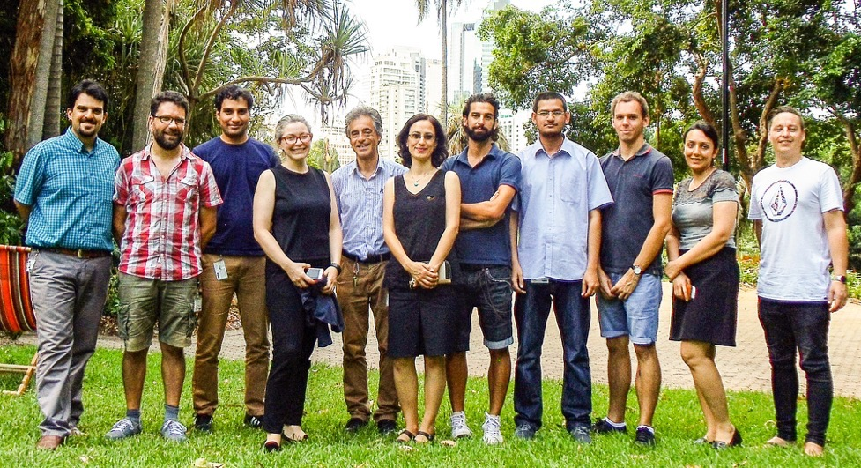

Acknowledgements
Supervisors
Prof. Nunzio Motta Dr. Jennifer MacLeod Dr. Mahnaz Shafiei
Dr. Josh Lipton-Duffin
Group members
Research Facilities
Central Analytical Research Facility (QUT) ANFF – Queensland Node
Notes:
Luca helped out with the STM

