Slide 1
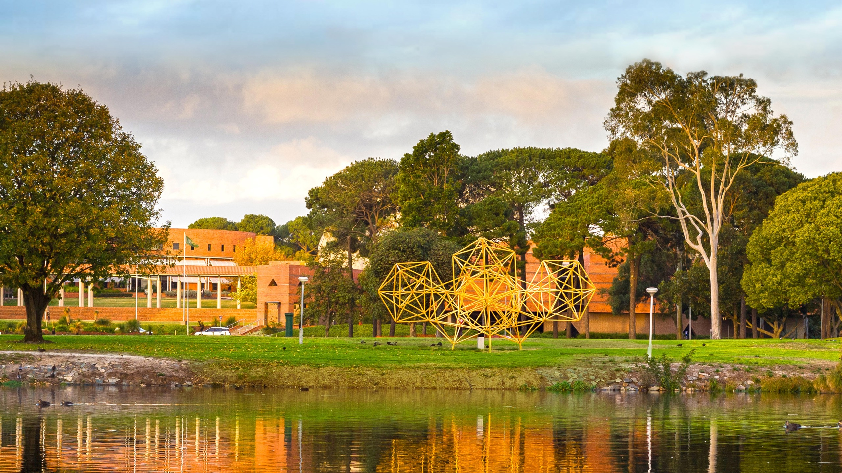

An ex situ NEXAFS study of MPc catalysts for CO₂ reduction
Jean-Pierre Veder
16 August 2018
Collaborators: Dr. Yi Cheng, Shiyong Zhao, Prof. San Ping Jiang
A global university Western Australia | Dubai | Malaysia | Mauritius | Singapore
Notes:
Good afternoon everyone. My talk today will showcase some of the work I’ve been involved in relating to synchrotron studies of electrocatalytic materials. In particular, the materials have specific application in carbon dioxide reduction.

Slide 2





Outline
Electrocatalysis – Motivation for this work
Synthesis and performance testing of catalyst electrode materials
Ex situ near edge X-ray absorption fine structure (NEXAFS) spectroscopy experiments
Recent progress with the development of an in situ X-ray absorption spectroscopy cell
Studying nickel oxide nanoclusters via in situ XAS - a test case
Notes:
The first part of this presentation will provide a brief background on what has motivated us to study the electrocatalytic reduction of carbon dioxide and, in particular, what has attracted us to the particular electrocatalytic materials we’re interested in, those being metal phthalocyanine molecular complexes, or more specifically FePc.
I’ll then provide details on how we go about synthesising the FePc-based catalysts, showing some characterisation results and also evidence for how they perform in an electrochemical context.
This will lead us to the use of near edge x-ray absorption fines structure (or NEXAFS) spectroscopy to try to understand the underlying mechanism for CO2 reduction.
And finally, I’ll give a bit of a teaser of our latest investigations into CO2 reduction electrocatalysts via in situ X-ray absorption spectroscopy.

Slide 3
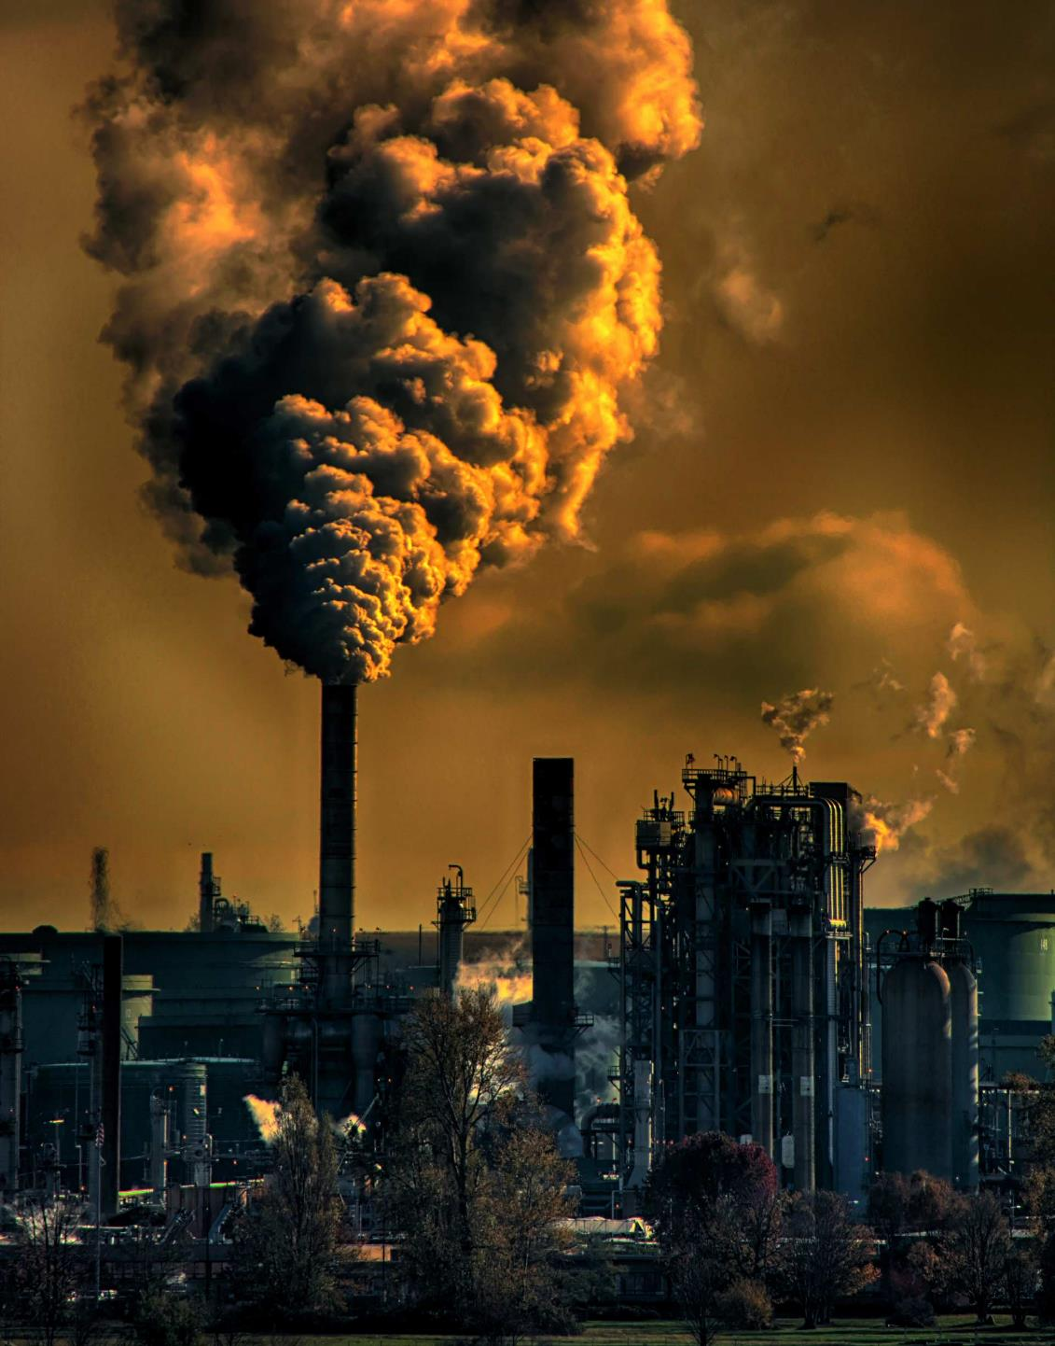


Motivation
Carbon dioxide reduction
  Conversion to carbon monoxide (valuable fuel)
Reaction is directly controllable via the applied electrode potential
Can be coupled with renewable energy, offering attractive energy storage option
Notes:
So as we all know, carbon dioxide pollution is a huge problem that currently faces society. So it’s obvious that any technology that seeks to remediate or to remove CO2 as a pollutant will have a certain attraction to it. But one of the huge drawcards in this case is the ability to convert the product, carbon monoxide, into valuable liquid fuels via the fischer tropsch process..
Adding to that, using electrochemistry to drive the reactions affords a large amount of control over the process via the applied electrode potential.
And finally, if the electrochemistry is driven via renewable energy, it can be thought of as an attractive option for energy storage.

Slide 4
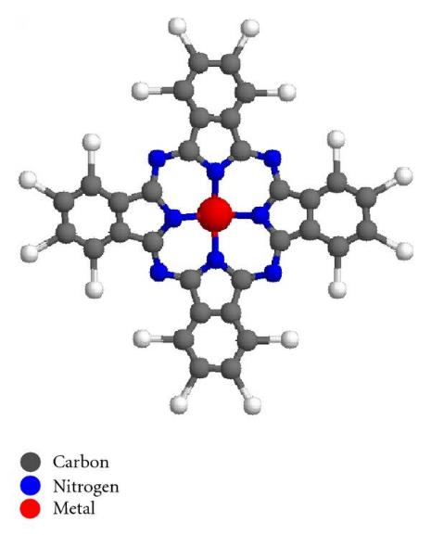
Background – Iron Phthalocyanine (FePc)
Metal Phthalocyanine (MPc)
Why FePc?
Low overpotential for CO₂ reduction
Easy to modify and tune the activity
Not stable under CO₂ reduction conditions
Metal oxide nanoclusters are added to enhance stability, activity & selectivity
Co-supported with metal oxide nanoclusters on graphene
Notes:
As I mentioned previously, we’ve been studying metal phthalocyanine molecules for their properties as electrocatalysts, specifically FePc.
The reason we’ve chosen FePc to study is first of all because it has a low overpotential and is quite active for CO2 reduction.
Not only that but these molecules are quite flexible in the sense that the activity can be tuned via the addition of certain functional groups.
But whilst FePc is active and has a low onset potential for CO2 reduction, a major drawback is that it’s not so stable under CO2 reduction conditions and what tends to happen is that we get demetallisation of metal centre.
So to combat this, we experimented with the addition of metal oxide nanoclusters in order to not only enhance the stability, but also in a bid to improve the activity and selectivity.
So essentially we have FePc and metal oxide nanoclusters, specifically focussed on cobalt oxide, assembled onto graphene to enhance electrical conductivity.

Slide 5
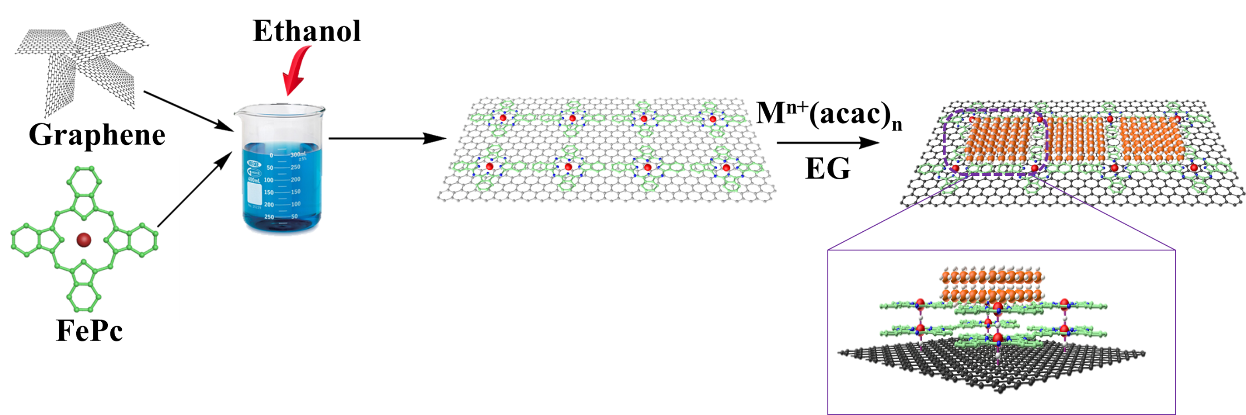
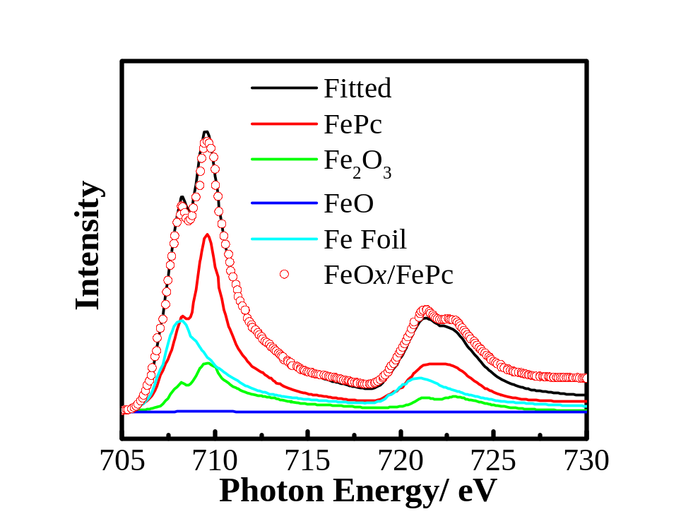
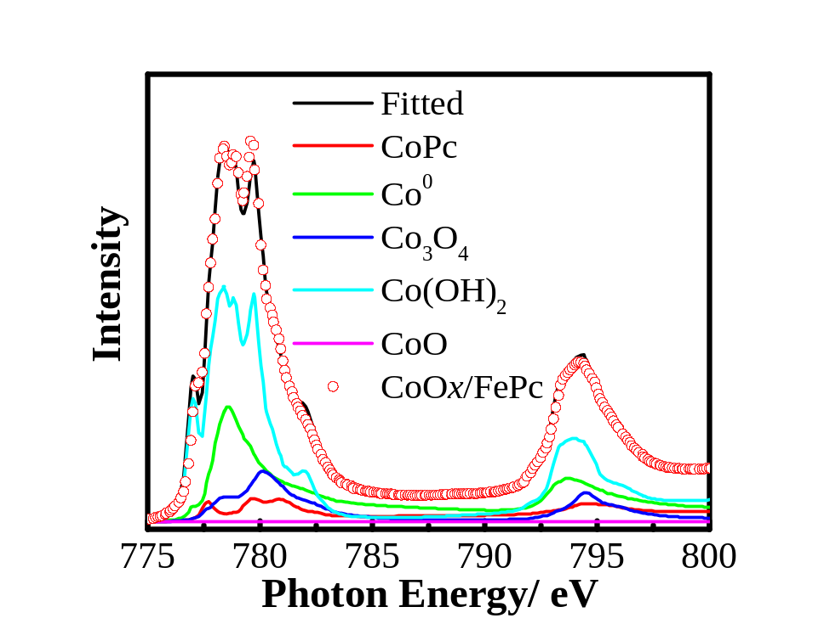
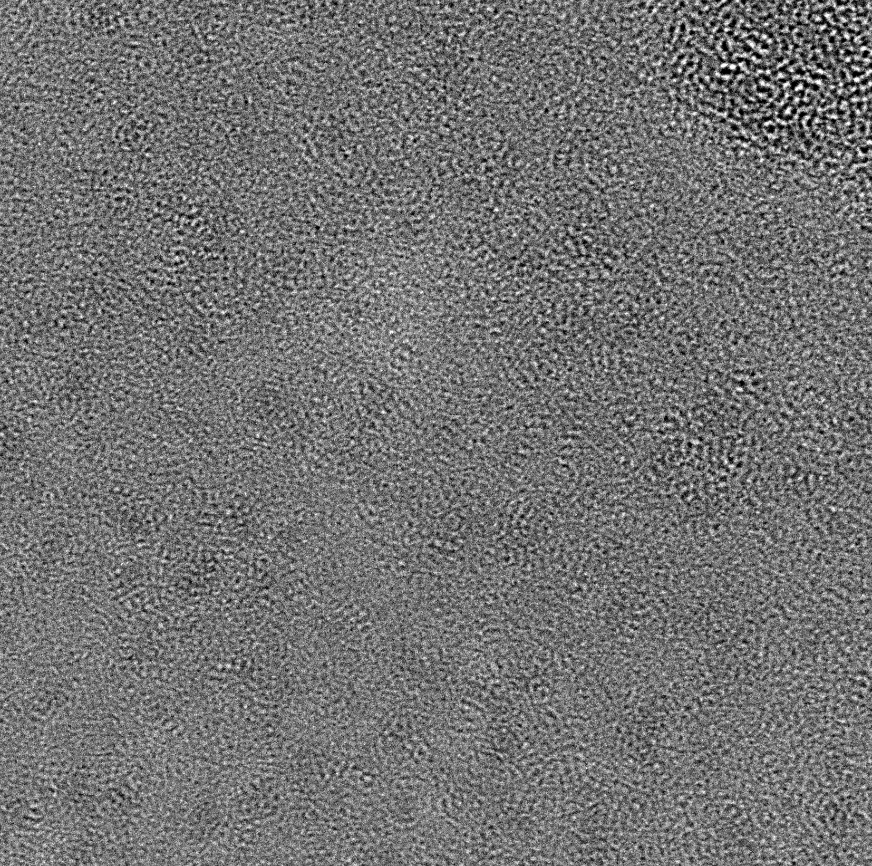
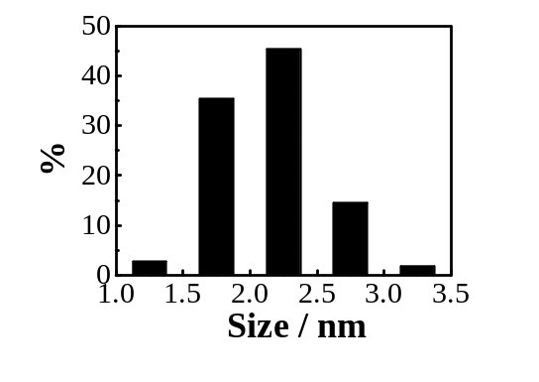
Synthesis
TEM studies
NEXAFS Characterisation
FePC
CoO_{x}/FePC
Fe L-edge
Co L-edge
10 nm
b)
10 nm
Cheng Y., Veder J.-P., Thomsen L., Zhao S., Saunders M., Demichelis R., Liu C., De Marco R., Jiang S.P., J Mater. Chem. A 6, 1370 (2018).
Notes:
The way we go about synthesising these materials is fairly straightforward, which I guess is another advantage of these materials. Graphene and FePc are stirred in ethanol which results in the self assembly of FePc onto graphene. It’s subsequently refluxed in ethylene glycol with a cobalt complex to produce the desired electrocatalyst system.
Here we have some TEM images that show the homogenous distribution of FePc on the graphene support. After refluxing with the cobalt complex, you can see the distribution of cobalt oxide nanoclusters with an average size of 2-3 nanometers.
Here are some near edge x-ray absorption fine structure (NEXAFS) measurements we performed on the products. We performed linear combination analysis using a range of standards to understand the makeup of the final product. As you can see, the final product is predominantly FePc-like, but can also be modelled with a small amount of iron metal and Fe2O3. The cobalt L-edge shows that the nanoclusters are comprised of a probable mixture of cobalt hydroxide, cobalt metal and Co3O4.

Slide 6
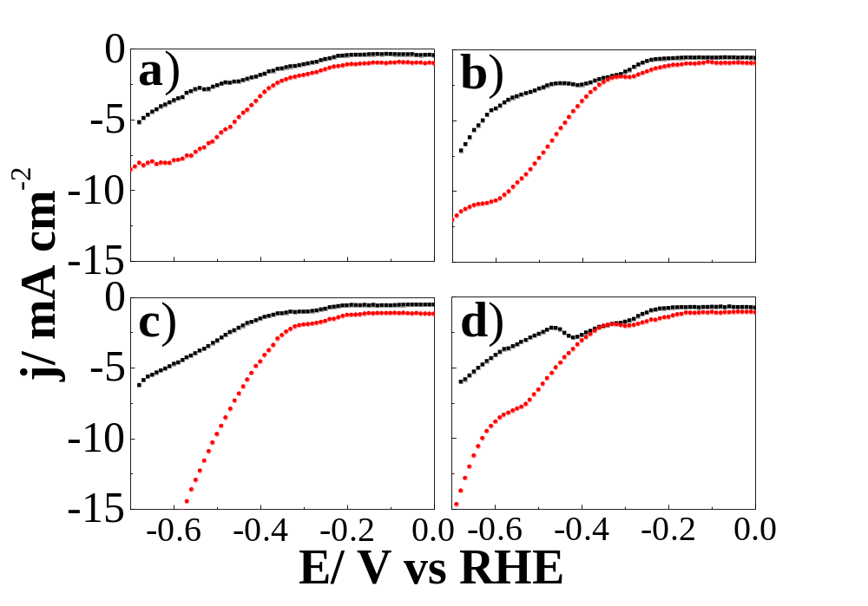
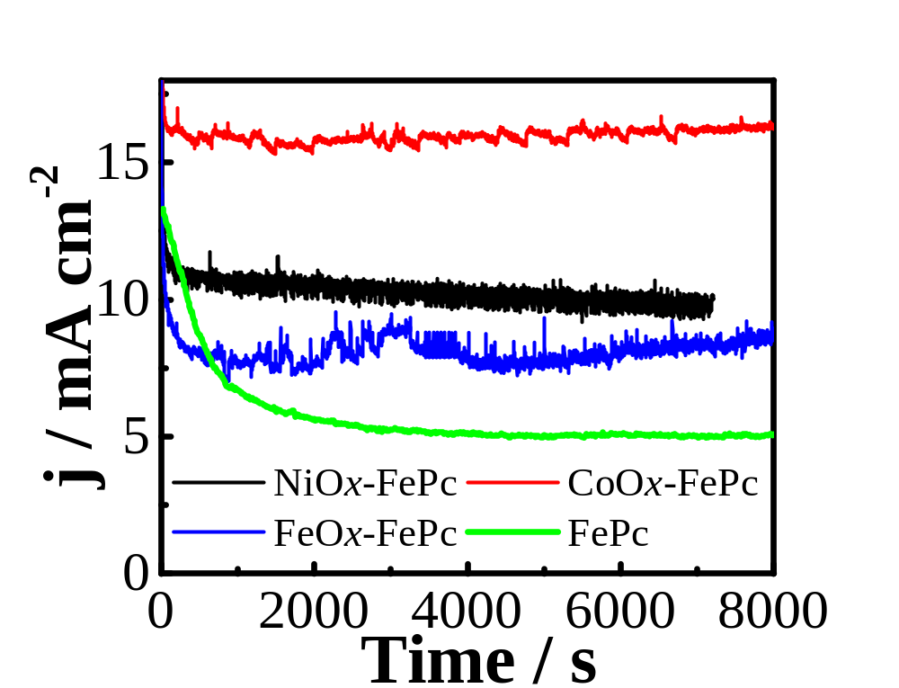
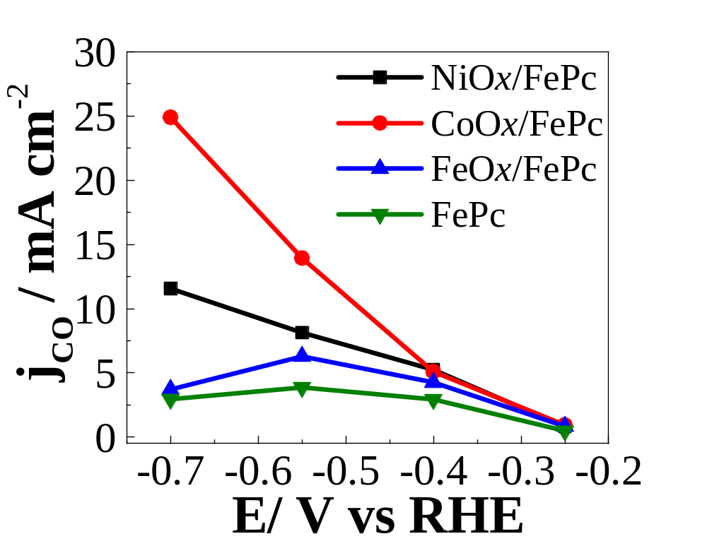
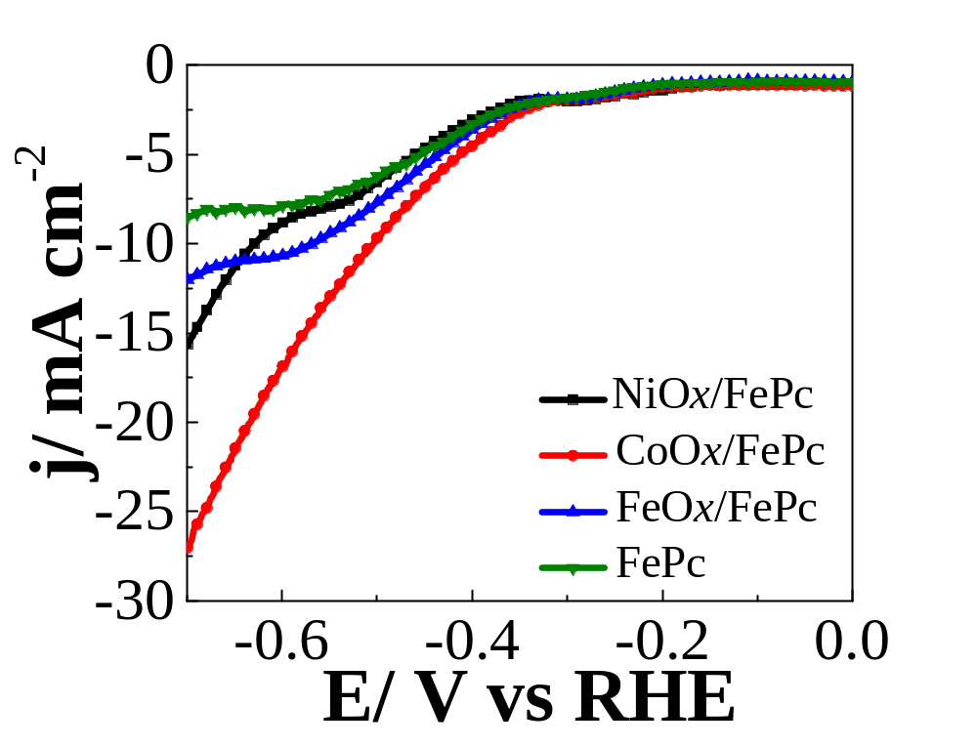
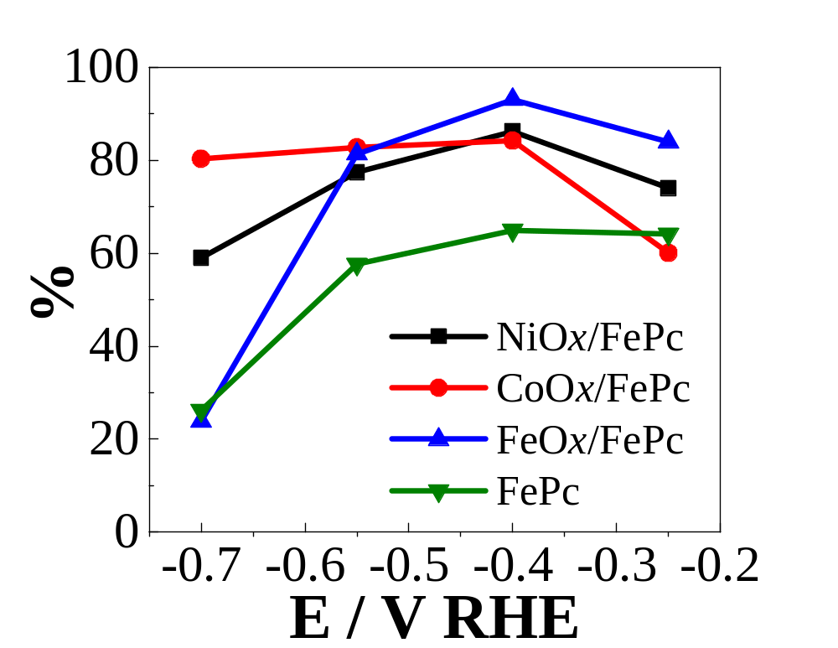
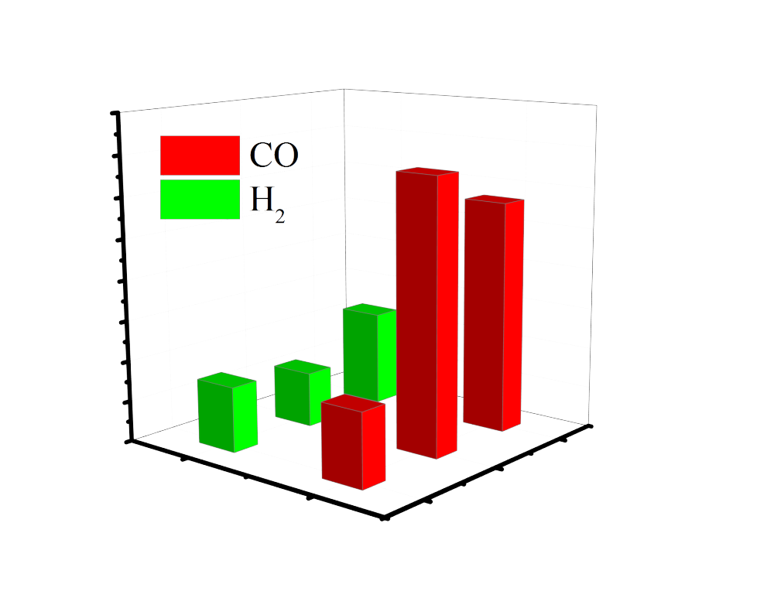
Electrocatalytic performance
Black = N₂-sat.
Red = CO₂-sat.
FePc
FeO_{x}/FePc
CoO_{x}/FePc
NiO_{x}/FePc
4.0
3.0
Yield/ mM cm⁻² min⁻¹
2.0
1.0
0.0
CoPc
CoO_{x}/FePc
CoO_{x}
Cheng Y., Veder J.-P., Thomsen L., Zhao S., Saunders M., Demichelis R., Liu C., De Marco R., Jiang S.P., J Mater. Chem. A 6, 1370 (2018).
Notes:
So here’s a snapshot of how the material performs as electrocatalysts for carbon dioxide reduction.
In the top left panel, you can see the linear sweep voltamograms for different variations of the electrocatalyst in a nitrogen saturated solution, and then in a carbon dioxide saturated environment. You can see that all variations have some activity for CO2 reduction, but when we overlay the traces that arise from the CO2 saturated environment as in the bottom left panel, it’s clear that the cobalt oxide nanocluster system has the lowest onset potential and highest current densities.
When we look at the current density associated with carbon monoxide production, again the cobalt oxide nanocluster system is the best performing. Here’s a plot of the faradaic efficiency for the yield of carbon monoxide. As you can see, just in general, the addition of metal oxide nanocluster results in an improvement in the selectivity compared against that of FePc.
Finally, as you can see from the chronoamperometry trace here, the addition of cobalt oxide nanoclusters actually significantly improve the stability vs that of the FePc where you can see a substantial drop in the current density after about 2000 seconds.
But perhaps the most interesting thing about this system is that the cobalt oxide nanoclusters by themselves are not all that great in terms of their performance. So the improvement to the FePc performance isn’t simply a result of mixing in a better electrocatalyst. Instead, it appears as though there is some synergistic effect that is leading to the improvement in performance.

Slide 7
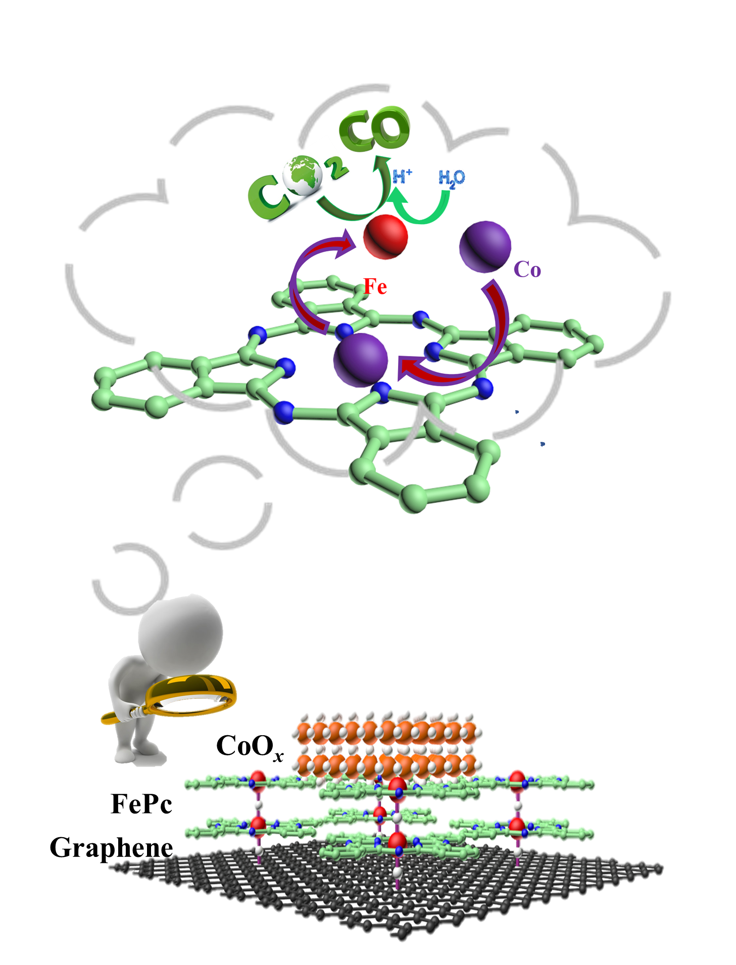
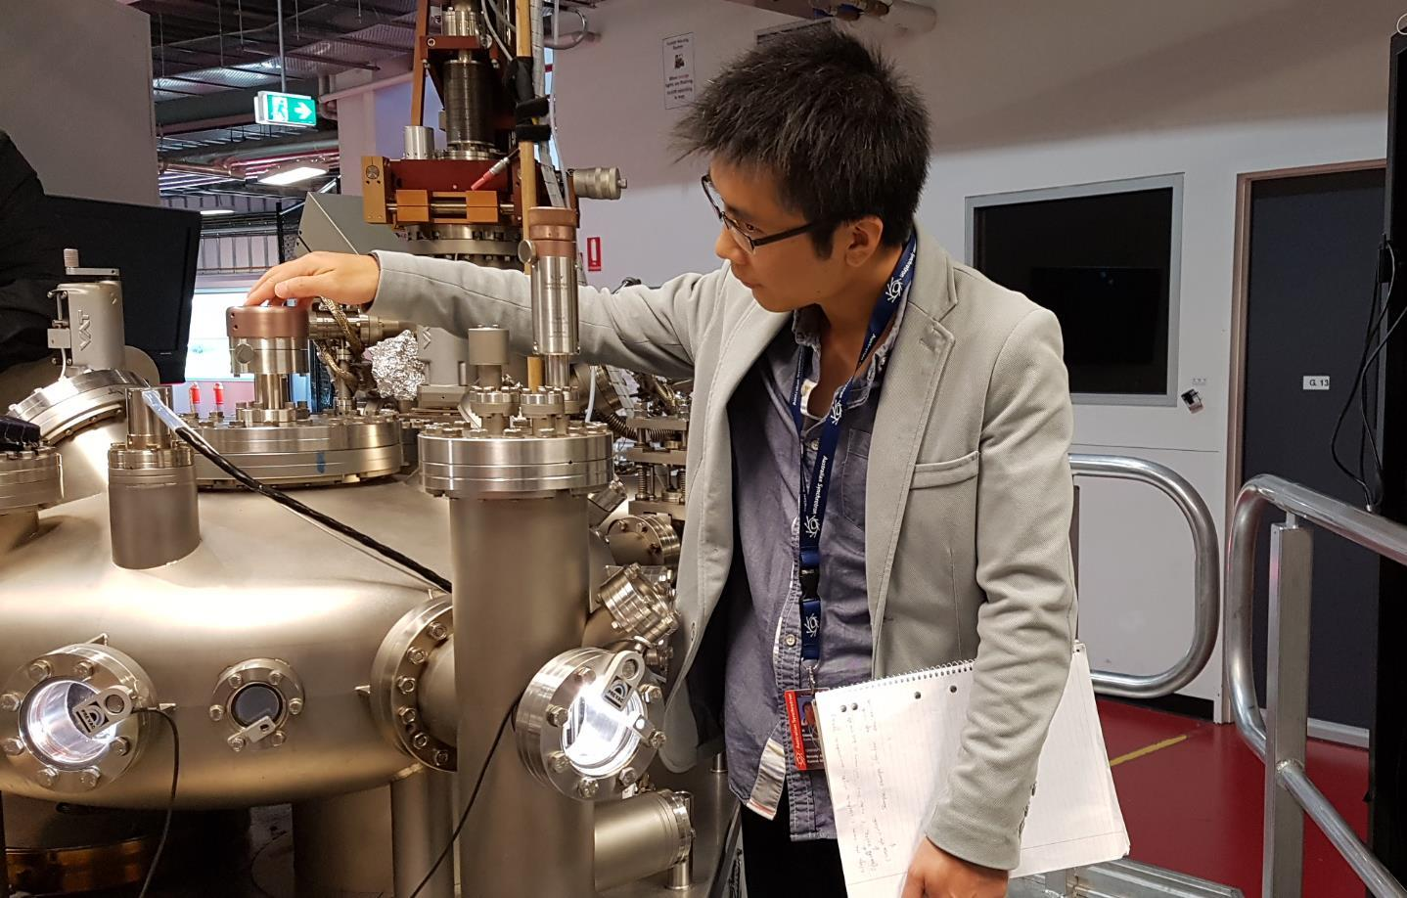
Ex situ Near Edge X-ray Absorption Fine Structure
Experiments conducted at the Soft X-ray beamline of the Australian Synchrotron
System of interest: CoO_{x}/FePc on graphene
Electrochemistry was conducted, samples were freeze-dried, then transferred into UHV for NEXAFS
Notes:
So after characterising the materials in terms of their composition, and electrochemical performance, we decided to conduct a series of ex situ measurements at the SXR beamline of the Australian synchrotron in a bid to understand the mechanism for CO2 reduction. The way we did this was by applying a given reduction potential for 20 minutes under a CO2 saturated environment, removing the samples from solution, freeze drying for several hours and then introducing them to the UHV for NEXAFS analysis.
Here you can see my collaborator Yi Cheng working at the beamline.

Slide 8
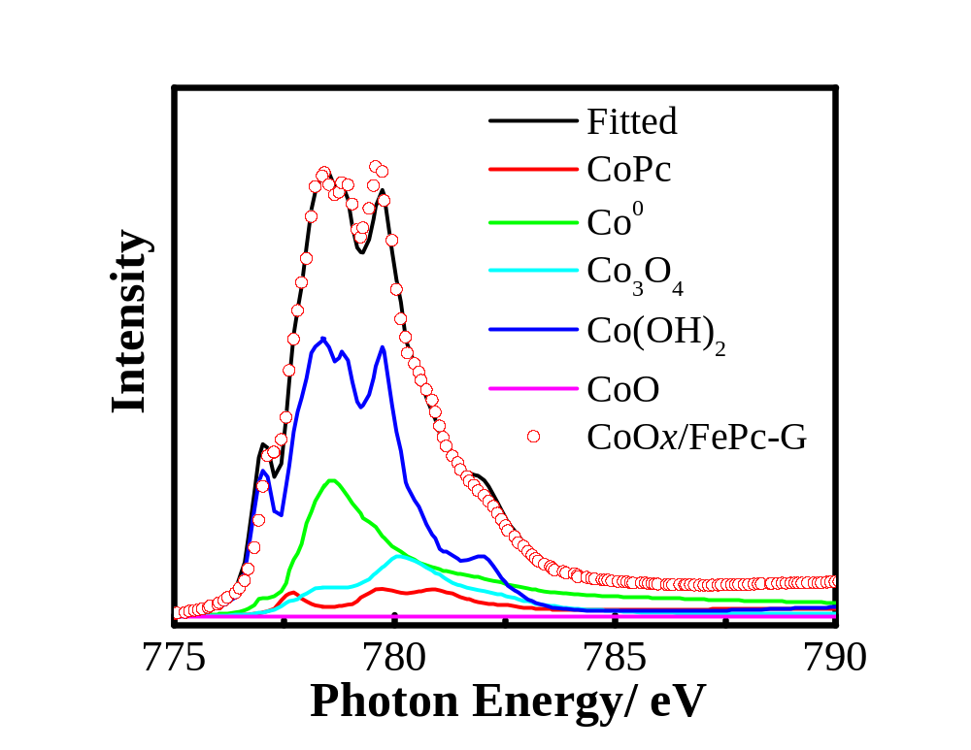
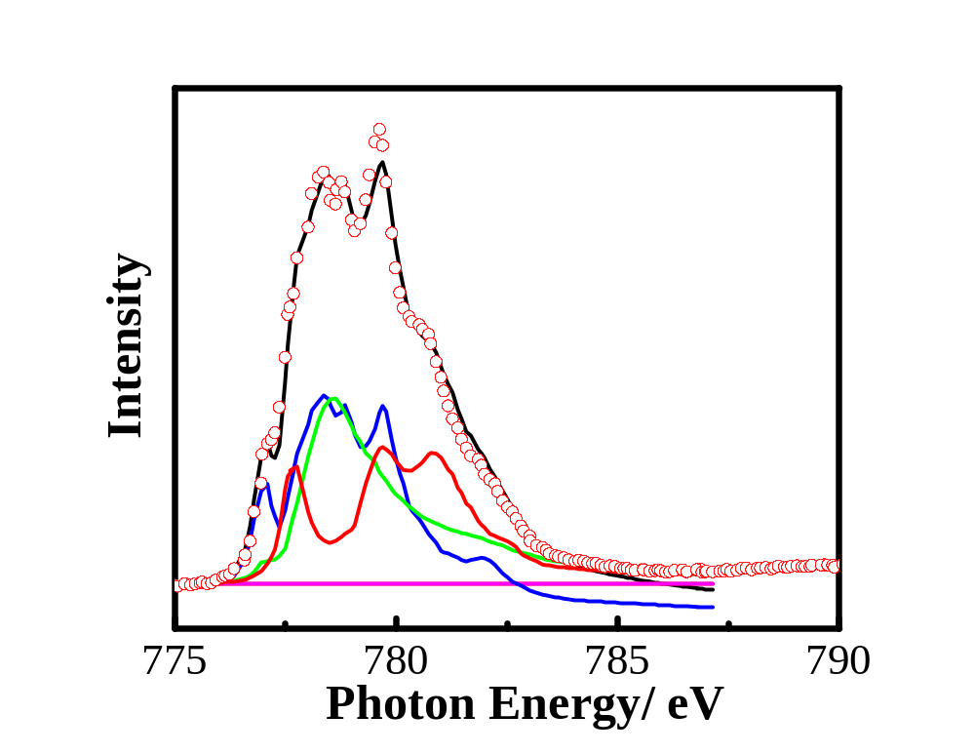
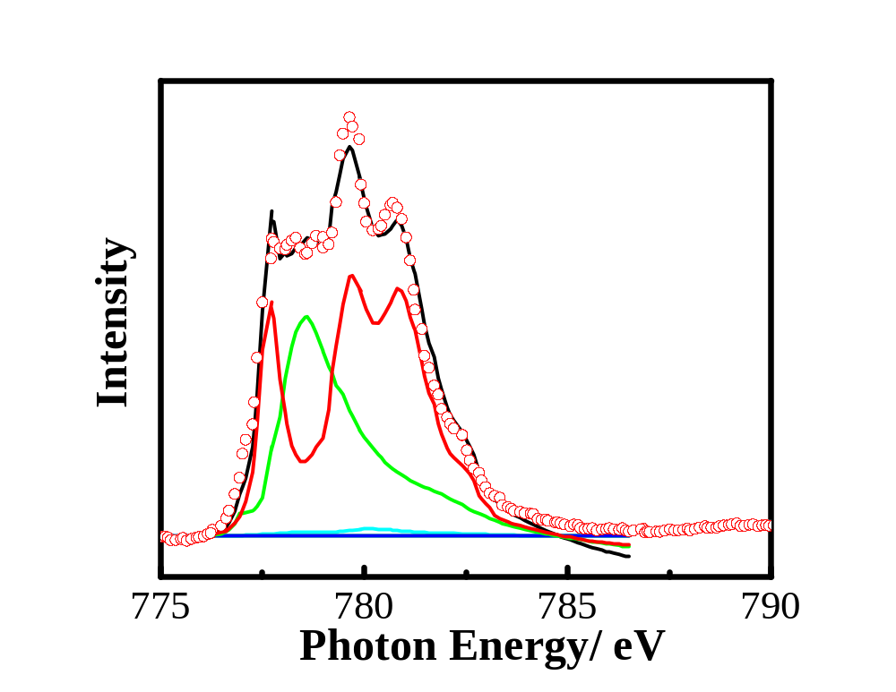
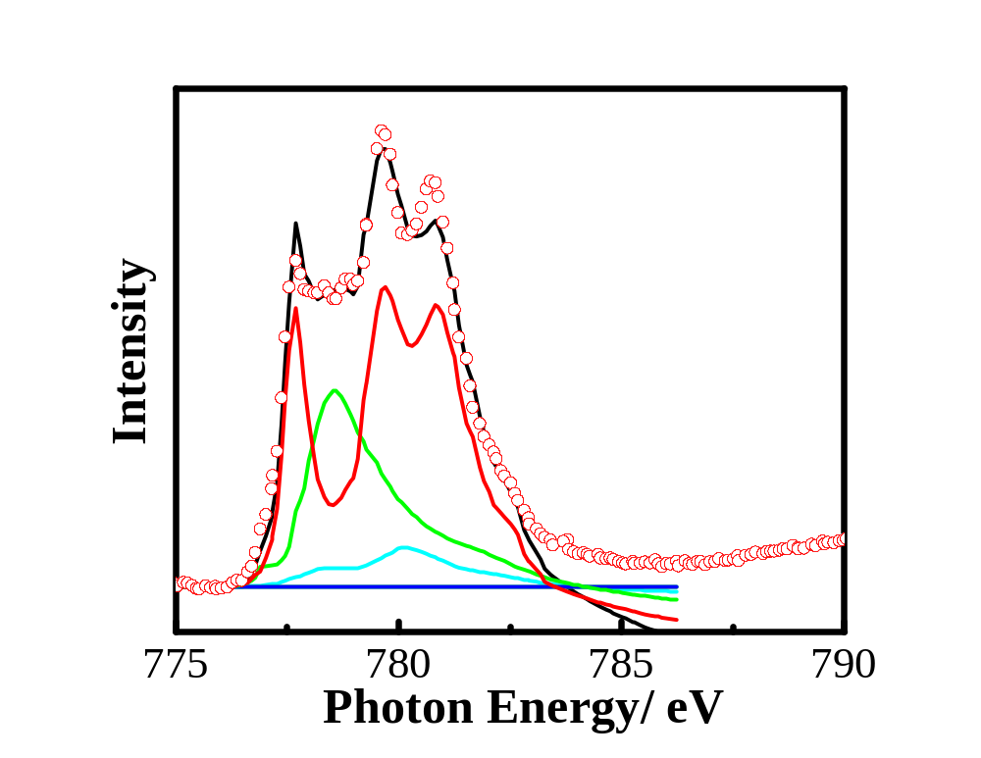
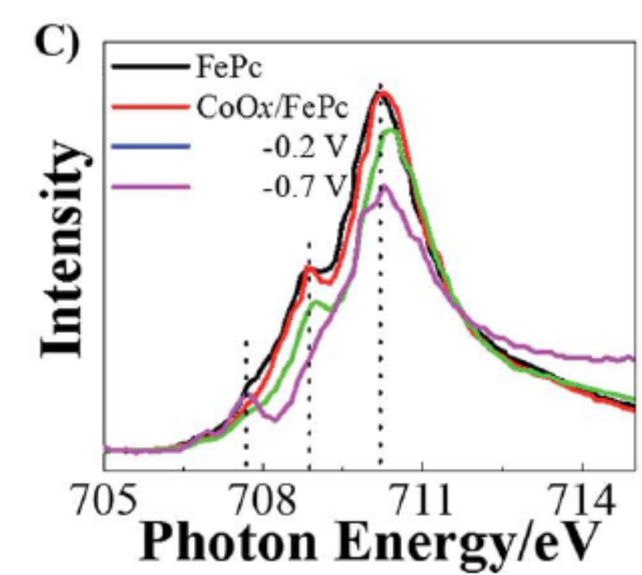
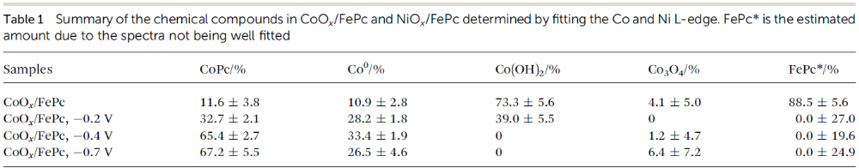
Ex situ NEXAFS
Raw
-0.2 V
-0.4 V
-0.7 V
Cheng Y., Veder J.-P., Thomsen L., Zhao S., Saunders M., Demichelis R., Liu C., De Marco R., Jiang S.P., J Mater. Chem. A 6, 1370 (2018).
Notes:
We got some quite fascinating results which helps to understand the system more comprehensively. As you can see in the cobalt L-edge spectra above, the spectra changes substantially at more negative potentials.
In fact, when we perform linear combination analysis using a wide range of standards, the really interesting thing is that the material actually picks up more and more CoPc-like qualities. In other words, the bonding environment becomes more similar to that of CoPc. The table here summarised the LCA results, showing an increase in the CoPc proportion as well as an increase in the cobalt metal content which makes sense given that we’re applying a reducing potential.
Finally, I’ve included the iron L-edge spectra just to show hor the spectra changes dramatically as a function of applied reduction potential.

Slide 9




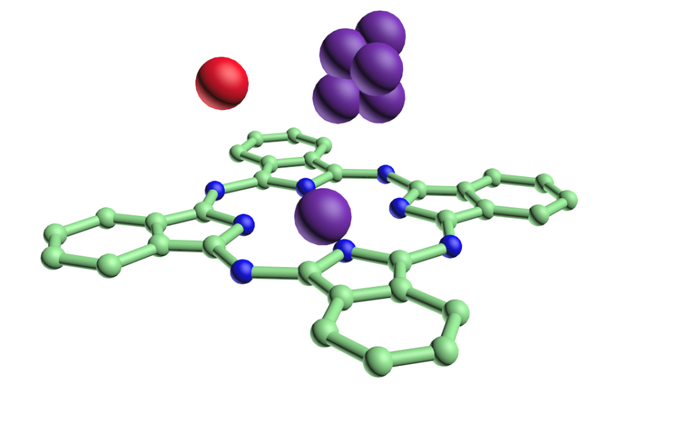
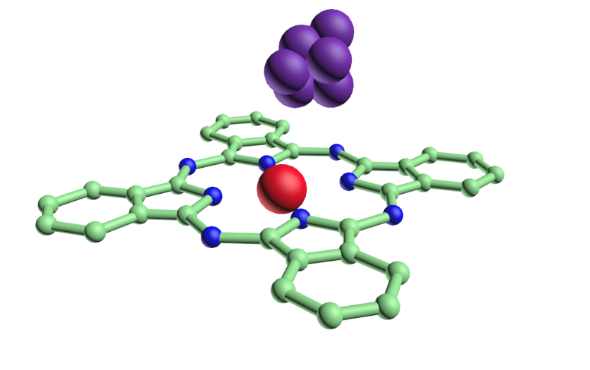
Electrochemically substituted FePc
1) FePc + Co²⁺ + 2e⁻ → CoPc + Fe⁰
2) CoPc··CO₂ + 2H··Co⁰/Fe⁰ → CoPc··CO + H₂O
3) CoPc··CO → CoPc + CO
Co
Fe
Electrochemical
Notes:
So basically, these results all lead us to the conclusion that what we actually observe is an electrochemical substitution of the iron centre for cobalt. I’ve put up a proposed mechanism here but we have more work to confirm this.

Slide 10
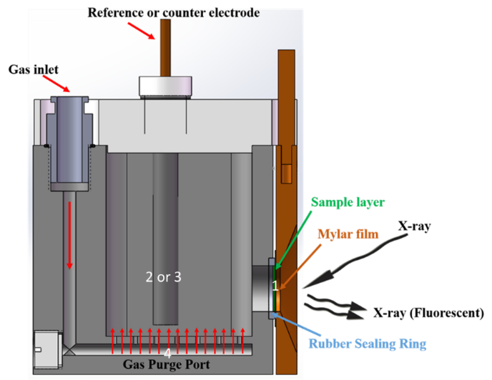
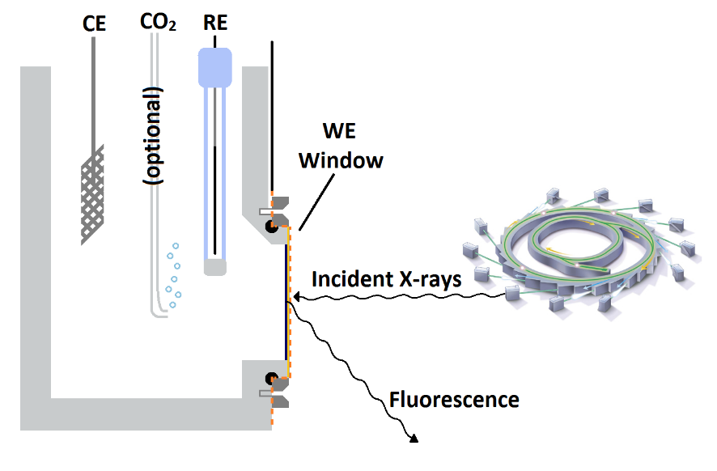
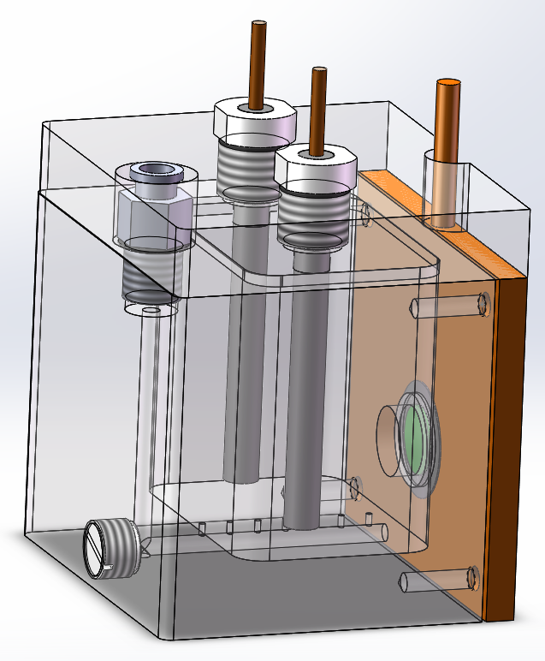
In situ X-ray absorption Spectroscopy
Conducted at the XAS beamline of the Australian Synchrotron
Carbon Paper
Notes:
Inspired by these results, we have since embarked on a mission to design an in situ experiment to investigate the bonding environment of the catalyst materials whilst under electrochemical control. We only finished this experiment 2 weeks ago so I’ll only briefly introduce it just to show where the research has evolved to.
Using the XAS beamline, we figured that we could in principle design an electrochemical cell that could be positioned in the beam in order to conduct NEXAFS measurements. I’ve got a schematic here which shows the concept. Essentially, we have a standard electrochemical cell with a counter and reference electrode. There’s also gas flow to bubble CO2 into solution. The main difference is that the carbon paper working electrode is also the X-ray window. The X-rays make it through to the interface between the solution and the catalyst and the signal is then detected in fluorescence mode.
Here are two more schematics that show a more accurate design. As you can see, the electrode window is pressed firmly against an o-ring by a removable faceplate.

Slide 11

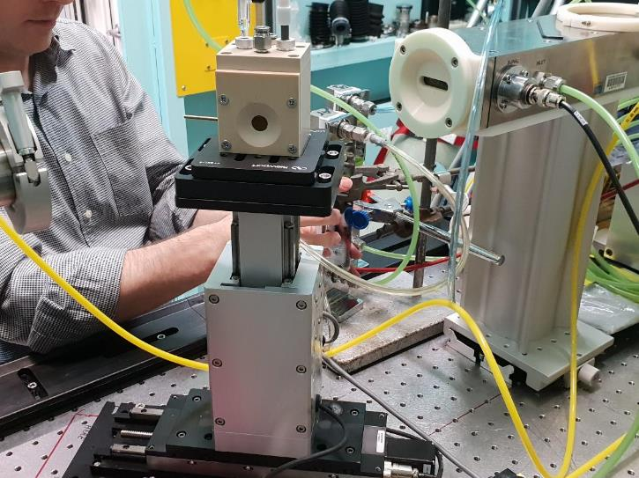
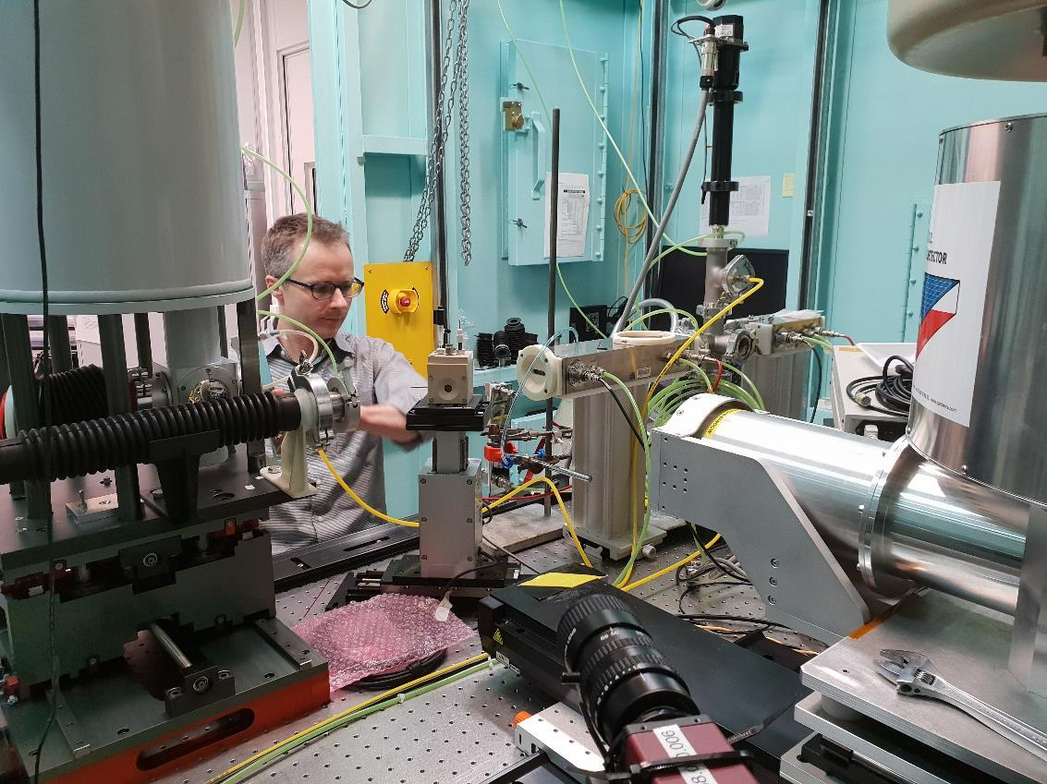
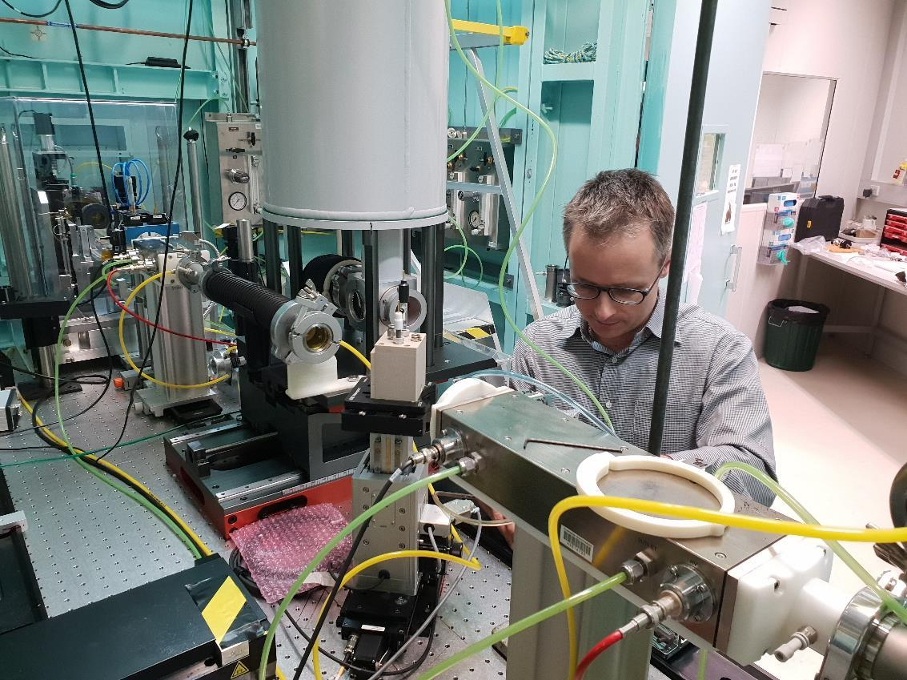
At the beamline
Notes:
And these are the photos of the actual cell in action.

Slide 12
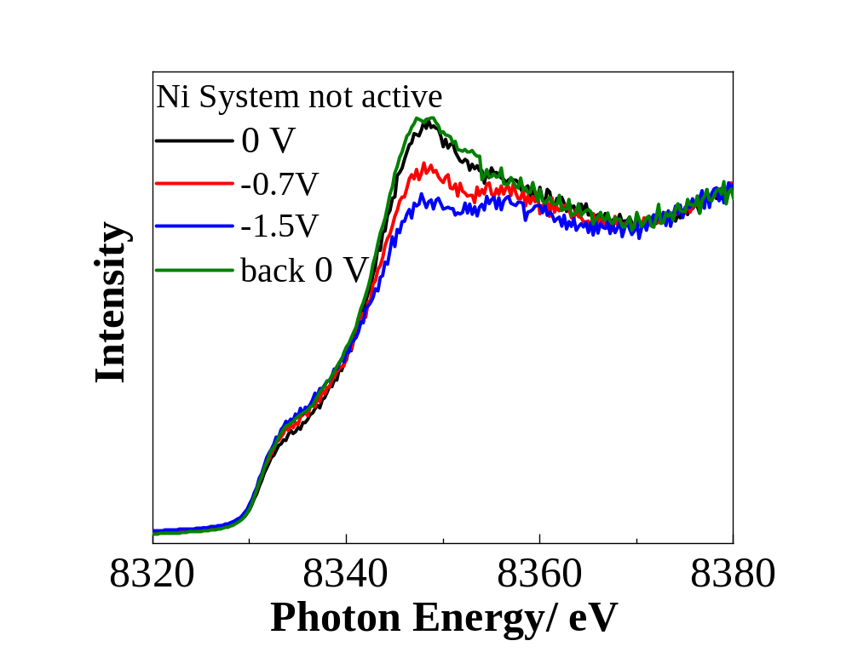
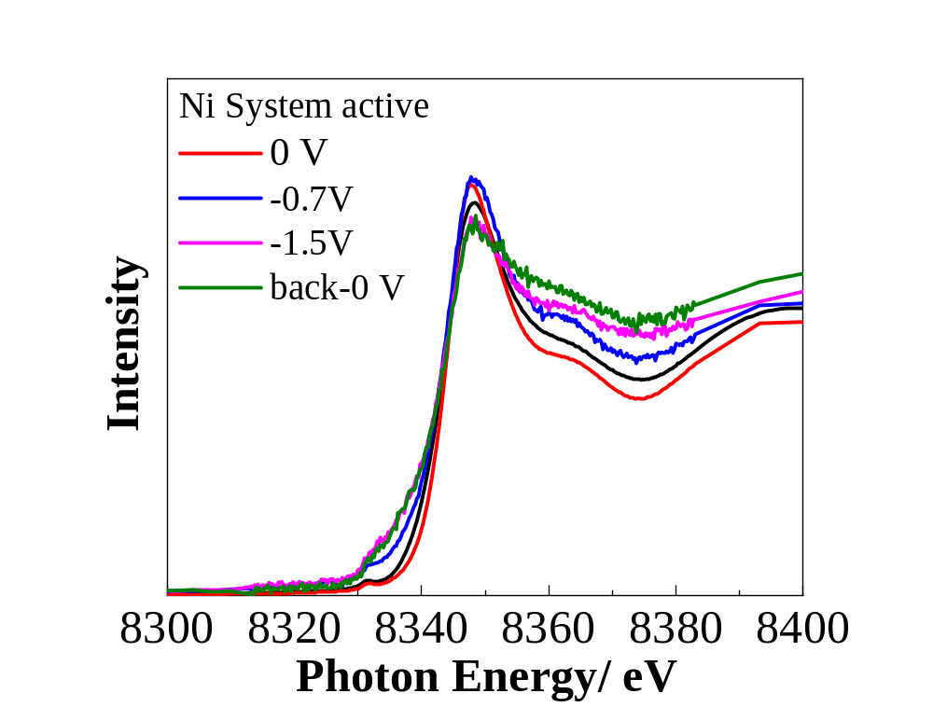
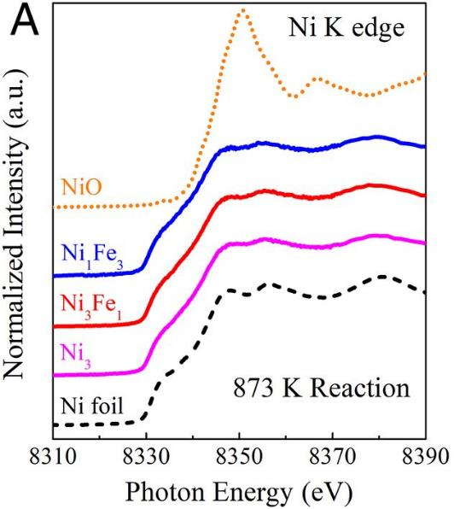
In situ results
Inset obtained from: B. Yan, S. Yao, S. Kattel, Q. Wu, Z. Xie, E. Gomez, P. Liu, D. Su, J. Chen (2018) Active sites for tandem reactions of CO₂ reduction and ethane dehydrogenation, Proc. National Academy of Sciences of the USA.
Notes:
So as I mentioned before, these results are hot off the press. I really just wanted to share these two results with you just to demonstrate proof of concept with the in situ cell. Basically, what we have here is a different catalyst system to what I’ve described in this presentation so far. I won’t bother going into detail about what it is, except to say that the system is based on nickel oxide nanoclusters. On the left is a system that we know is not active for CO2 reduction. What you can see is that the spectra changes dramatically as a function of potential. What’s more, it’s also very reversible as when we go back to the original potential, the peak reverts back to as it was initially. Comparing it to literature, we can see that at -1.5V, the peak looks roughly similar to that of nickel metal. Which makes sense given that we are operating at a reducing potential.
On the other hand, when we look at the active system, its clear that it isn’t all that reversible for whatever reason. There may be some change to the oxidation state but what’s interesting is the change to the pre-edge region which may point to some sort of change to the symmetry of the nickel centre.

Slide 13
Acknowledgements
Dr. Yi Cheng & Mr. Shiyong Zhao
Prof. San Ping Jiang
Drs. Anton Tadich, Lars Thomsen & Bruce Cowie (SXR beamline, Australian )
Dr. Bernt Johannessen & Peter Kappen (XAS beamline)
John de Laeter Centre

Slide 14

Thank you
Make tomorrow better.

