Slide 1

Surface defect engineering in semiconducting photocatalyst and electrocatalyst
Haifeng Feng
24-07 2018

Slide 2
Outlines
1. Background
2. Rutile TiO₂(110) surface: OV point defects
3. BiOBr nanosheets: lateral pseudo-heterojunctions

Slide 3
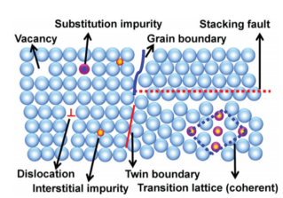
Background
Surface defect in catalysis
Vacancy
Boundaries
Stacking fault
Adatom
Substitution
Dislocation
Hetero-structure
……
Chemical and physical properties
Active sites
Catalytic activity and selectivity
G. Li, et al. Chem. Soc. Rev. 2017, 46, 1693

Slide 4
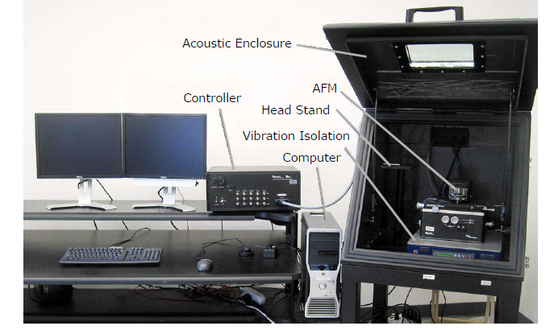
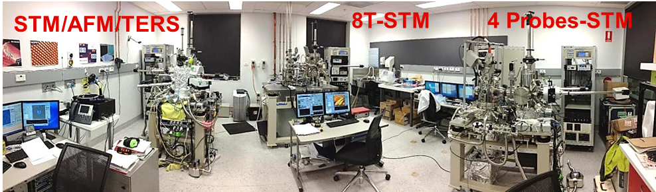
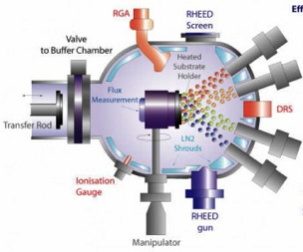
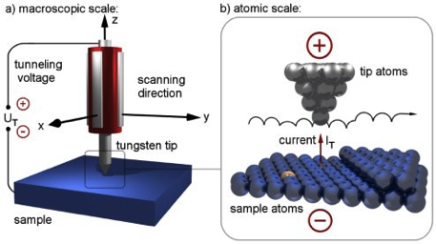
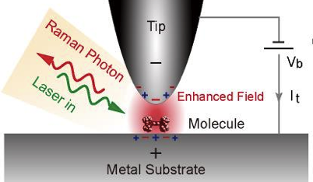
Background
AFM System
*Scanning tunneling microscopes: high resolution > 1 Å
*Molecular beam epitaxial (MBE) deposition: UHV < 5 × 10⁻¹¹ Torr
*Low temperature: 4 K to 300 K
*In-situ annealing (up to 1200 ºC)
*High purity oxygen and water source
*SNOM: ex/in-situ Raman system (TERS and confocal Raman)
*Atomic force microscope:
high resolution > 1 Å in Z, > 30 nm
*Kelvin probe force microscope:
surface potential measurement
*Force curves and mapping
* Conductive AFM
IV curves and conductivity mapping

Slide 5
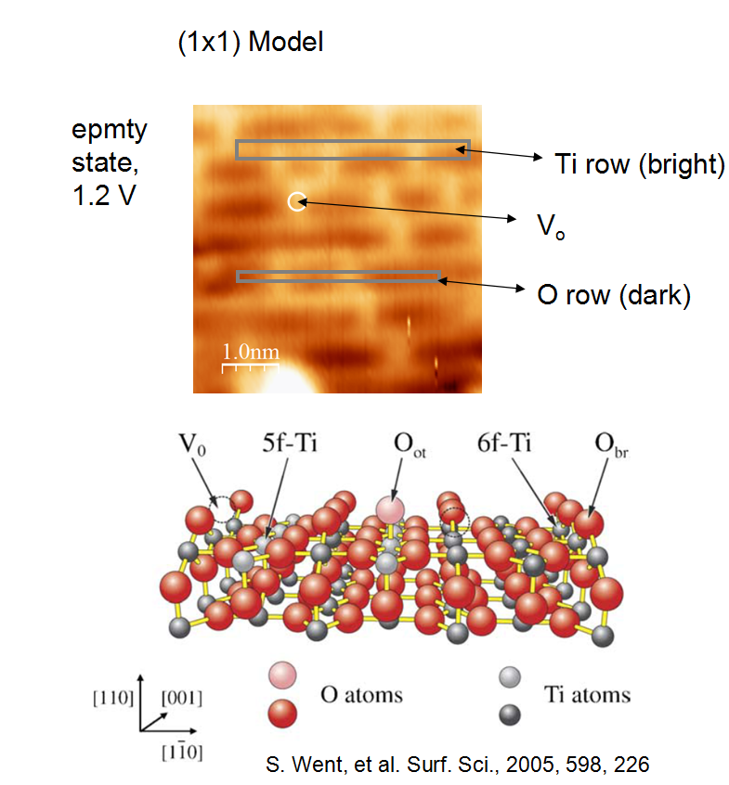
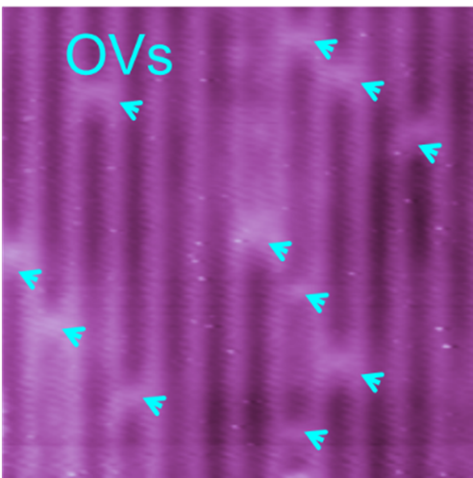
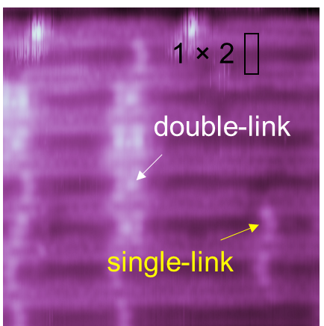
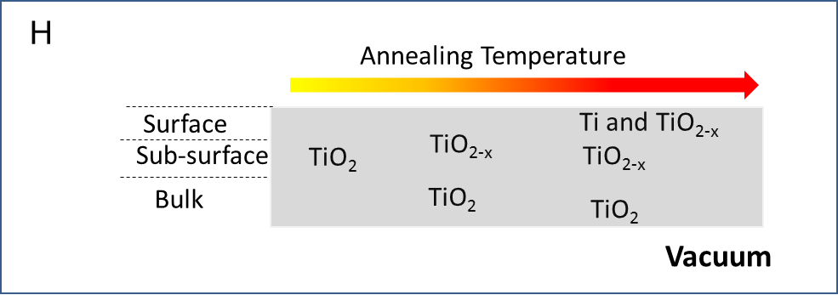
Rutile TiO₂(110) surface: OV point defects
1 × 1 600 ºC
1 × 2 900 ºC
A
B
Oxygen vacancy (OV)
STM image
surface with OVs
surface with cross-links
C
400 ºC
600 ºC
900 ºC

Slide 6
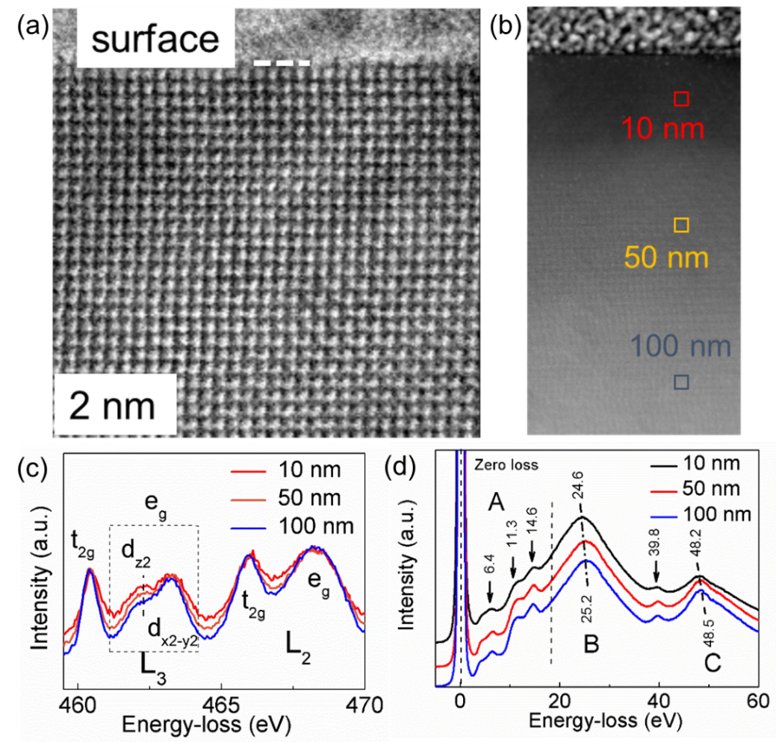
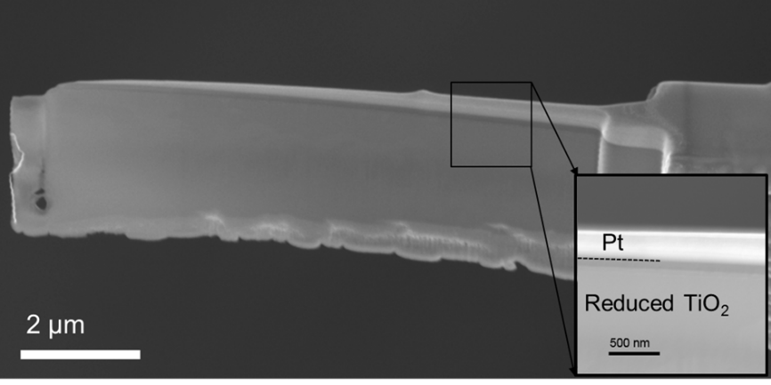
Rutile TiO₂(110) surface: OV point defects
Scanning transparent electron microscopy (STEM)
(a) Cross-sectional STEM in ABF (b) Cross-sectional STEM HAADF mode (c) and (d) In-situ EELS Ti-L edge and low-level spectra
SEM image of reduced TiO₂ single crystal sample cut by a focused ion beam (FIB); inset is an enlarged image of the selected area.

Slide 7
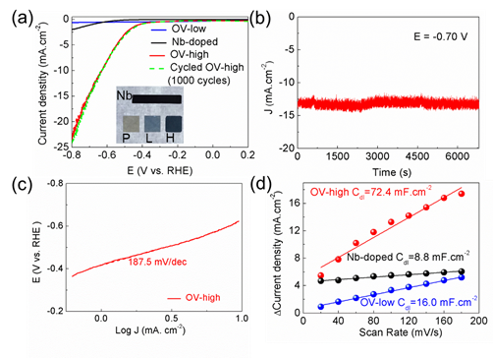
Rutile TiO₂(110) surface: OV point defects
Hydrogen evolution reaction (HER) in alkaline media
(a) LSV data, red solid and green dashed lines are LVS curves before and after cycling1000 cycles, respectively. (b) Cycling stability over 18 h. (c) Tafel plot of the OV-high TiO₂. (d) C_{dl} determined from the linear fitting of the capacitive current vs. scan rate, measured from the cyclic voltammetry (CV) curves.
H. Feng, et al. ACS Catal. 2018, 8, 4288

Slide 8
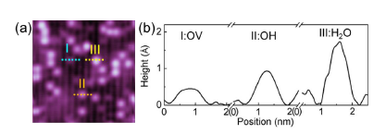
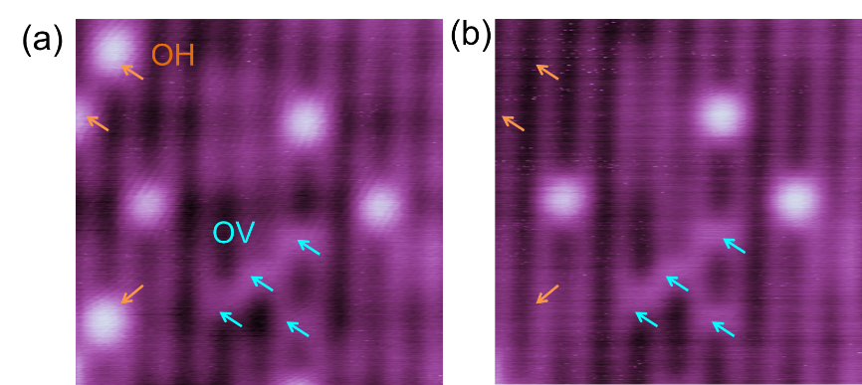
Rutile TiO₂(110) surface: OV point defects
Height difference
Behaviours under tip plus

Slide 9
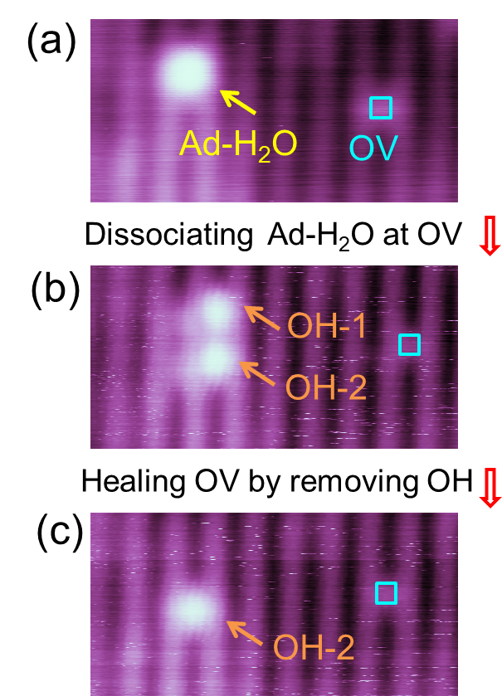
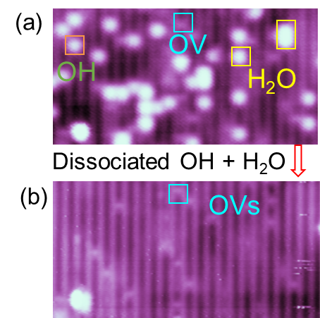
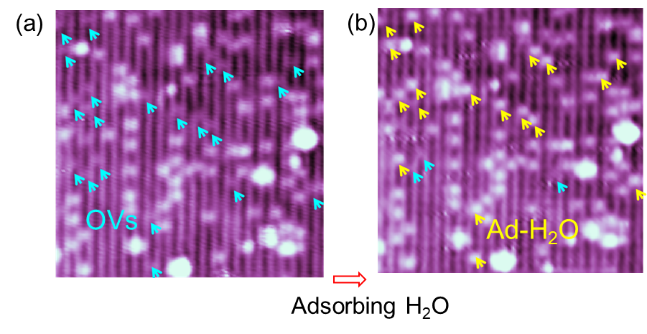
Rutile TiO₂(110) surface: OV point defects
In-situ STM studies on electrocatalytic dynamics occurring on TiO₂(110) surface associated with oxygen vacancies
In-situ STM observation of dissociation of H₂O and OH

Slide 10
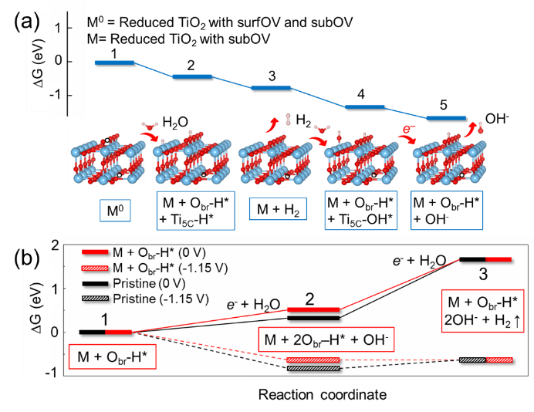
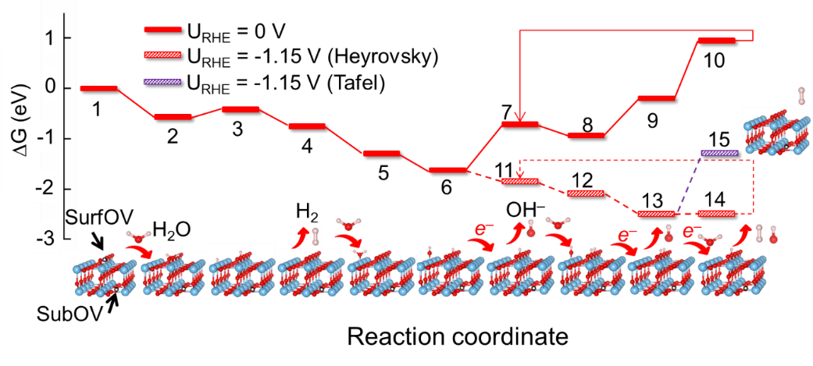
Rutile TiO₂(110) surface: OV point defects
Overall Pathways
(c)
Surface OV
In summary, sublayer OVs are most important in the electrocatalytic activity!
Sublayer OV

Slide 11
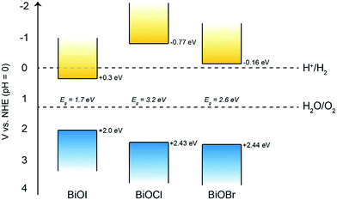
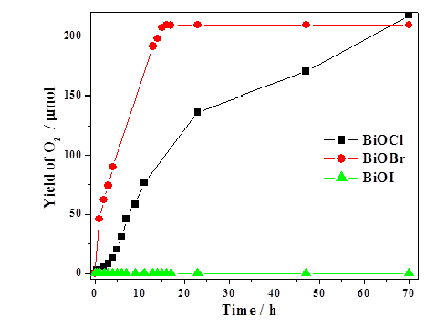
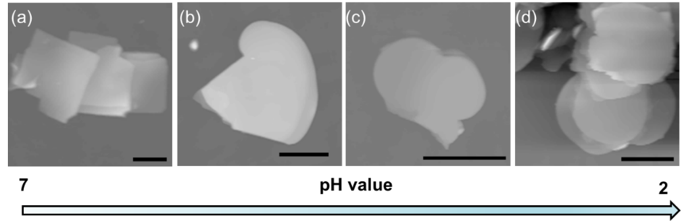
BiOBr nanosheets: lateral pseudo-heterojunctions
Close collaboration with Prof. Weichang Hao group in Beihang University:
J. Mater. Chem. A 2018, 6, 2193
2D Mater. 2017, 4, 025102
Dalton Trans. 2017, 46, 15582
J. Phys. Chem. C 2016, 120, 8589
J. Mater. Chem. A 2016, 4, 10992
ACS Appl. Mater. Interfaces 2015, 7, 27592
J. Phys. Chem. C 2015, 119: 14094
Scientific Reports 2014,4:7384
ACS Catal. 2014,4:954-961
(a)
(b)
(c)
H. Feng, et al. 2D Mater. 2017, 4, 025102.
D. S. Bhachu, et al. Chem. Sci. 2016, 7, 4832.
H. An, et al. Rare Metal 2008, 27, 243.
AFM images of BiOBr nanosheets. Scale bars are 1μm.

Slide 12
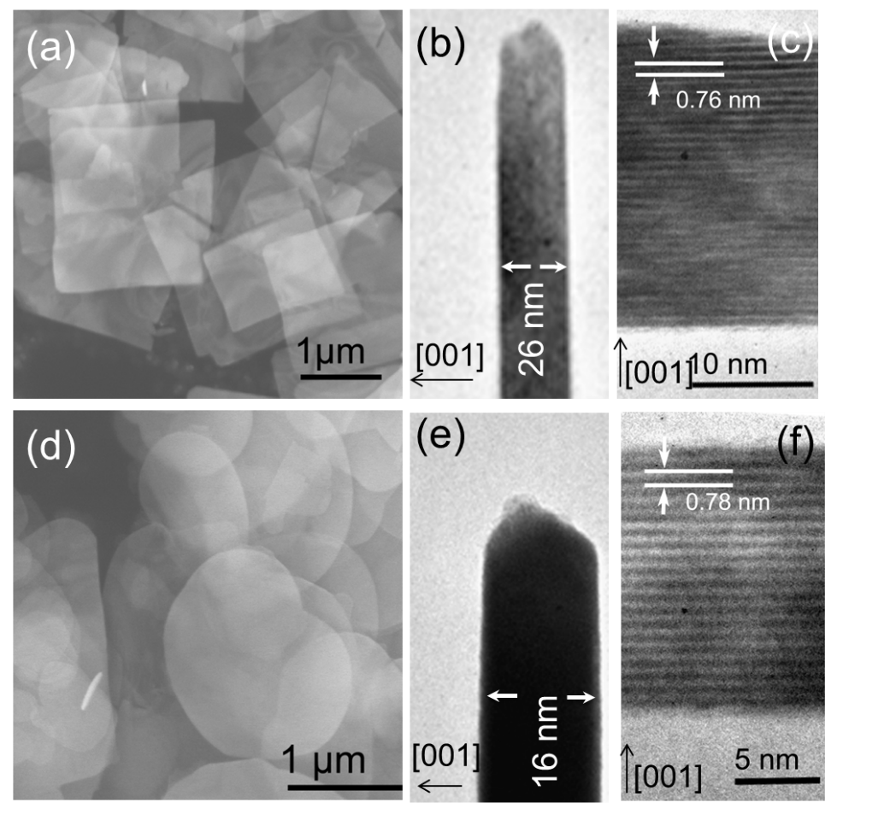
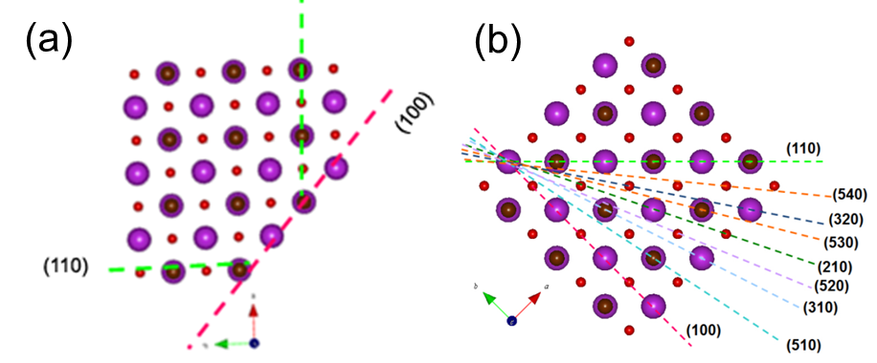
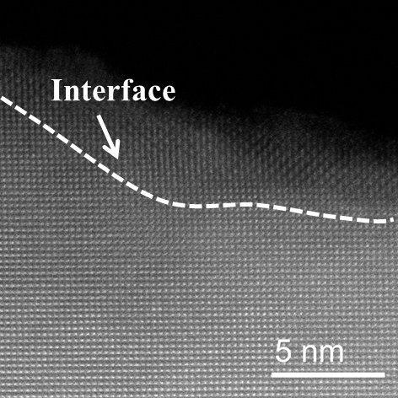
BiOBr nanosheets: lateral pseudo-heterojunctions
(a)
(b)
(c)
(d)
(e)
(f)
(g)
(h)
(i)
(g)
SEM, TEM and cross-sectional images of BiOBr nanosheets.
H. Feng, et al. 2D Mater. 2017, 4, 025102

Slide 13
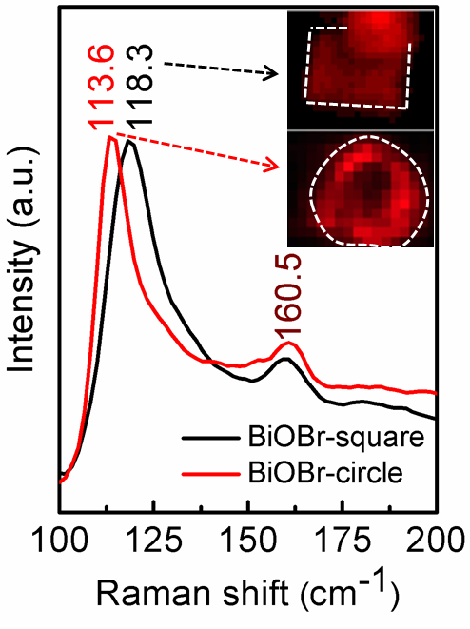
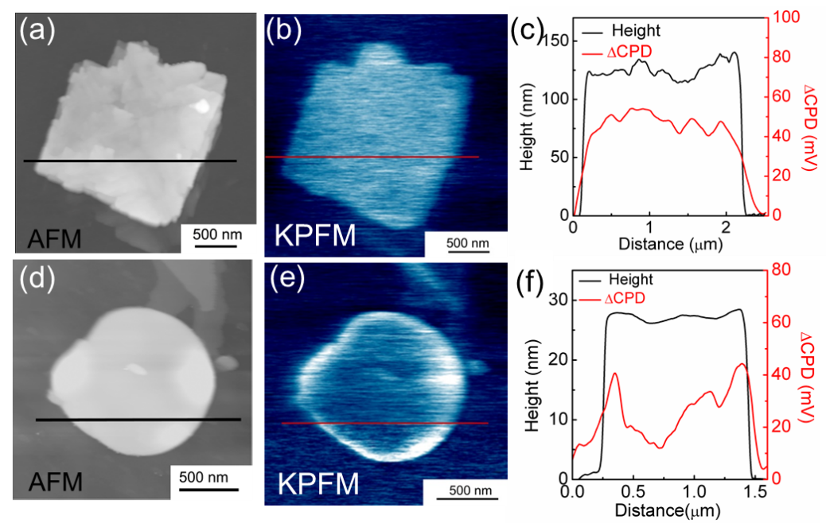
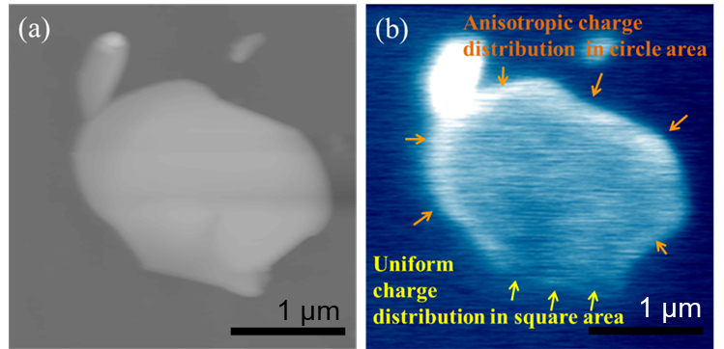
BiOBr nanosheets: lateral pseudo-heterojunctions
KPFM can measure the surface potential distribution
Confocal Raman mapping

Slide 14
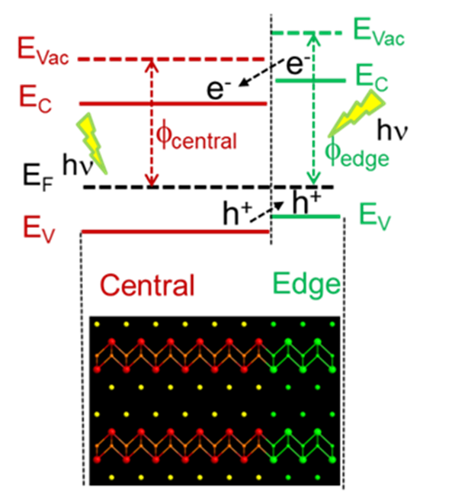
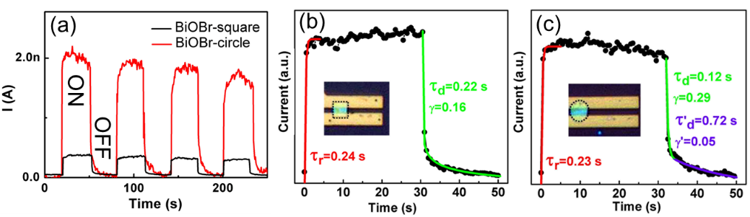
BiOBr nanosheets: lateral pseudo-heterojunctions
Photocurrent of individual BiOBr nanosheets.
Proposed diagram of the band alignment at the pseudo-heterointerface in BiOBr-circle nanosheets.
In summary, the lateral pseudo-heterojunctions can promote the charge separation and photo-response.

Slide 15
Acknowledgement
Research Grants
These works were supported by the Australian Research Council (ARC) through LIEF grants (LE100100081 and LE110100099), Discovery Projects (DP140102581, DP160102627, and DP170101467), BUAA-UOW Joint Research Centre Research Grants, aUniversity of Wollongong Research Council (URC) Small Grantnd two.
Colleagues and Collaborators
University of Wollongong: Prof. Shi Xue Dou, Dr. Yi Du, Dr. Xun Xu, Dr. Jincheng Zhuang, Mr. Long Ren, Mr. Liang Wang, A/Prof. Michael Higgins, Dr. David Mitchell in electron microscope centre (EMC) in UOW
Collaborators: Prof. Weichang Hao’s group (Beihang Uni), A/Prof. Zhenpeng Hu (Nankai Uni), Dr. Dr. Jiaou Wang’s group (IHEP, CAS), Dr. Ashley D Slattery (Uni of Adelaide)
STM Team @ UOW

Slide 16

Closer Title

