Slide 1

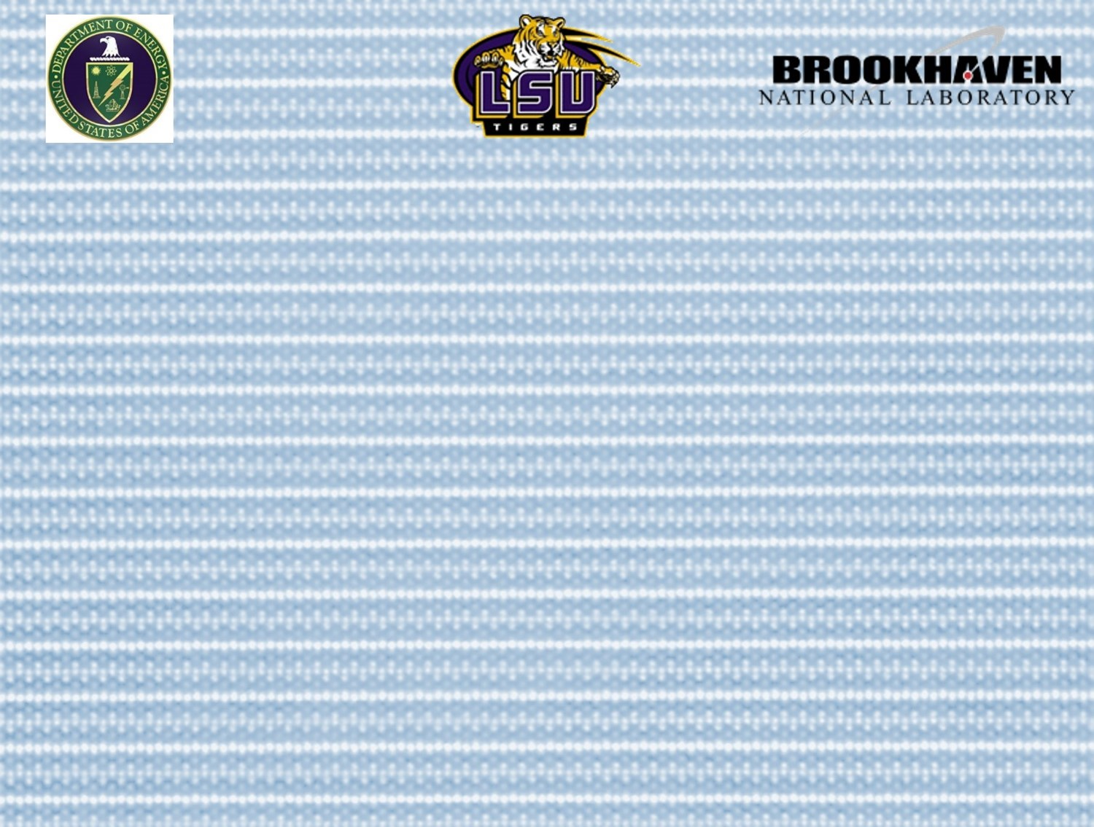
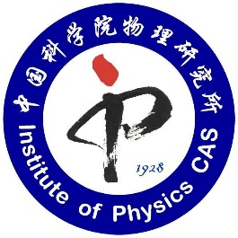
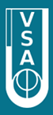
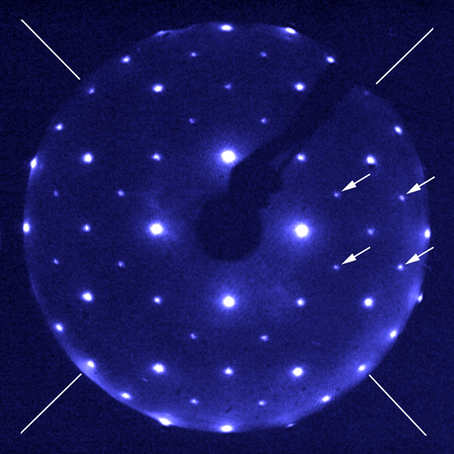

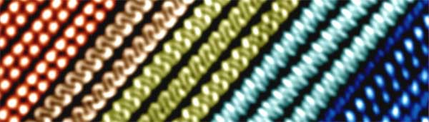

Interface-induced Magnetic Polar Metals in Complex Oxides
Meng Meng, Institute of Physics, CAS
mengm@iphy.ac.cn
VASSCAA-9, Sydney, August. 13th, 2018
Funded by U.S. DOE under Grant No. DOE DE-SC0002136.

Slide 2
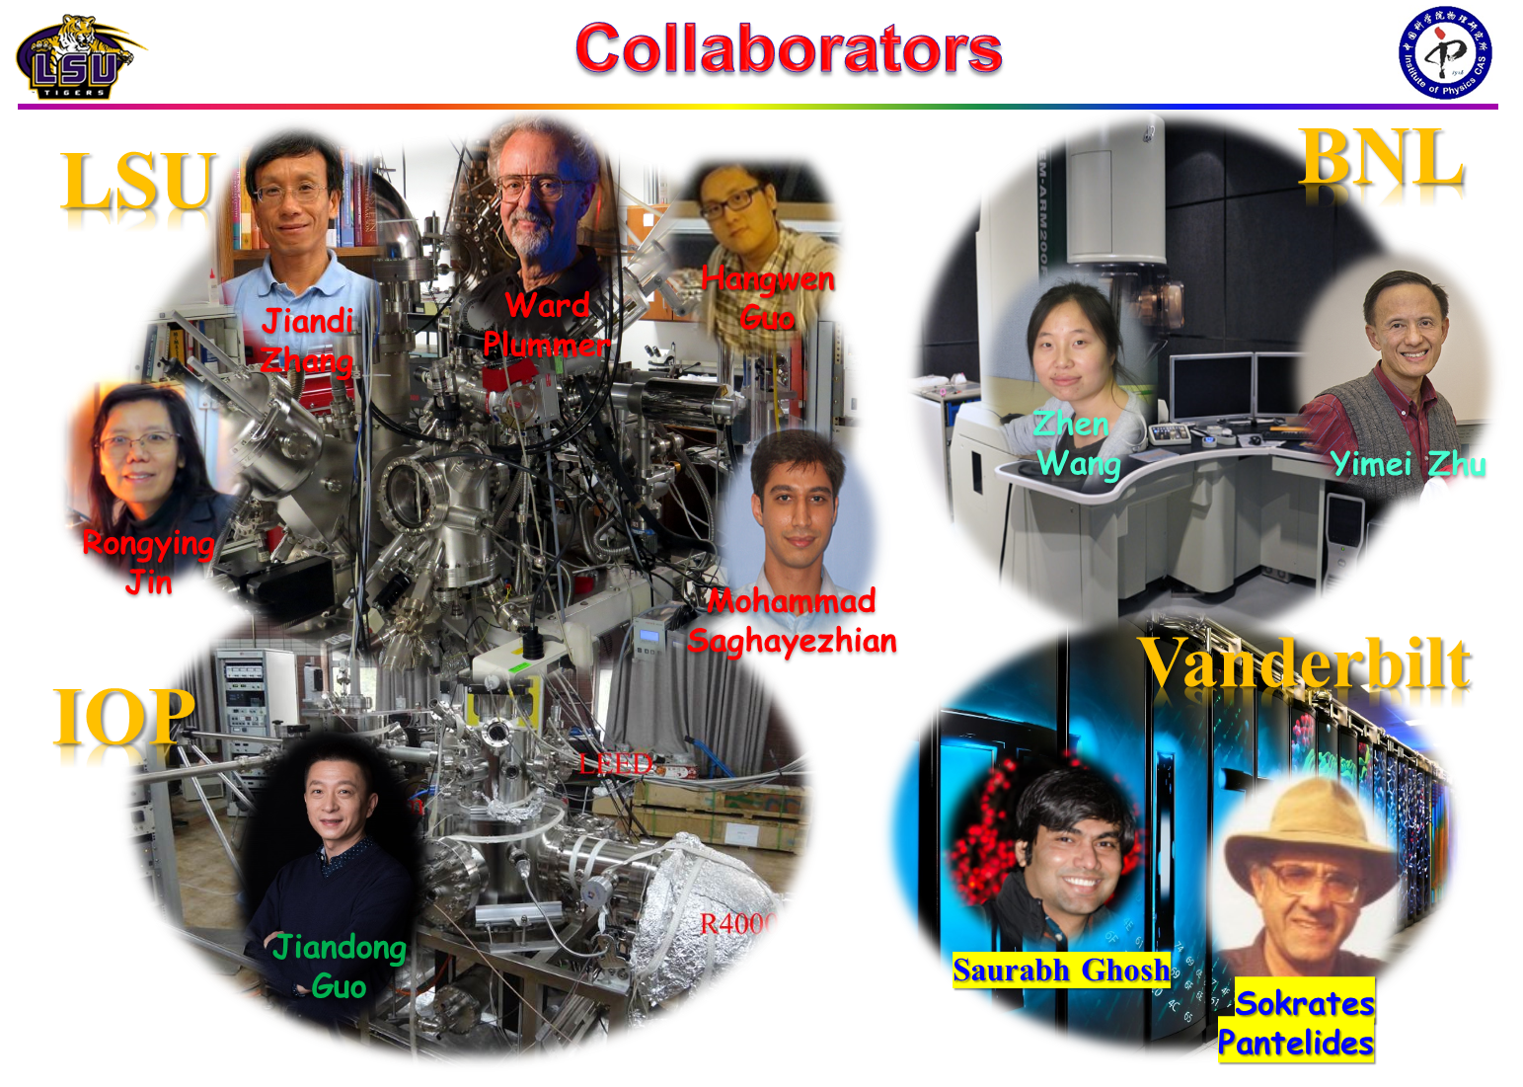

Slide 3


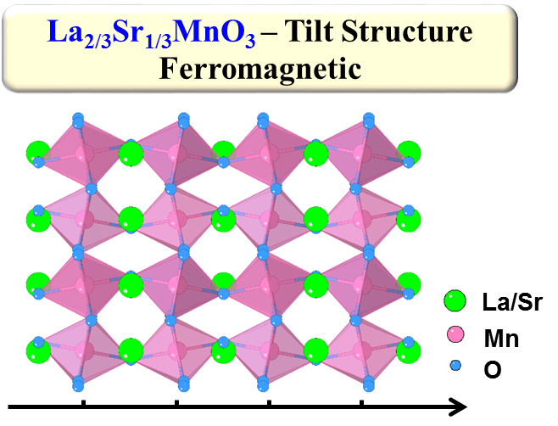
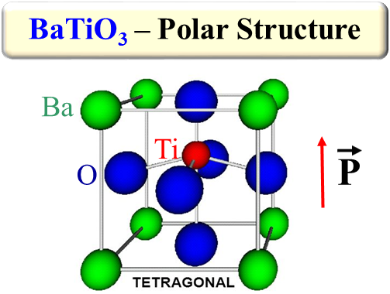
Oxide Polar Metals
Can ferroelectrics marry metallicity?
Simple answer: No!
The net electric field inside a conductor is zero by effective charge screening.
dipole
Perovskites with octahedral tilt tend not polar or ferroelectric.
Off-centering polar distortions are driven by B-site bonding preference, but result in insulating phase. (zero electron in d orbitals)

Slide 4

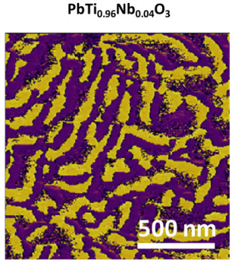
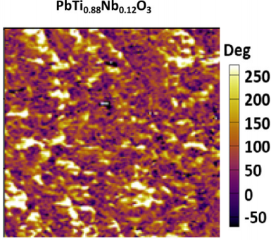
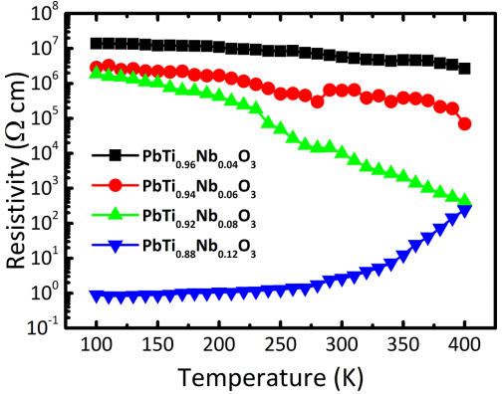
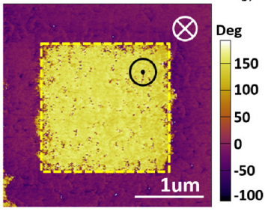
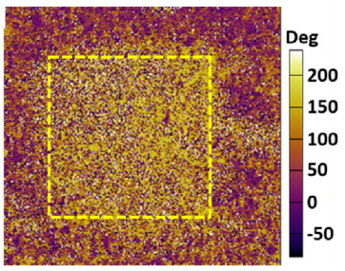
Oxide Polar Metals
Criteria: Coexistence of polar structural displacement & metallicity.
Material survey: Oxide polar metals are extremely scarce.
Few oxide examples: BaTiO_{3-δ}, PbTi_{1-x}Nb_{x}O₃ films, LiOsO₃, NdNiO₃ films, BaTiO₃/SrTiO₃/LaTiO₃ superlattice
No magnetism
Criteria: Coexistence of polar structural displacement & metallicity.
Material survey: Oxide polar metals are extremely scarce.
Few oxide examples: BaTiO_{3-δ}, PbTi_{1-x}Nb_{x}O₃ films, LiOsO₃, NdNiO₃ films, BaTiO₃/SrTiO₃/LaTiO₃ superlattice
No magnetism
Upon electron doping, conduction electrons can be induced.
Polar Metals
PHYSICAL REVIEW B 96, 165206 (2017)
the amplitude of polar distortion suppressed rapidly

Slide 5
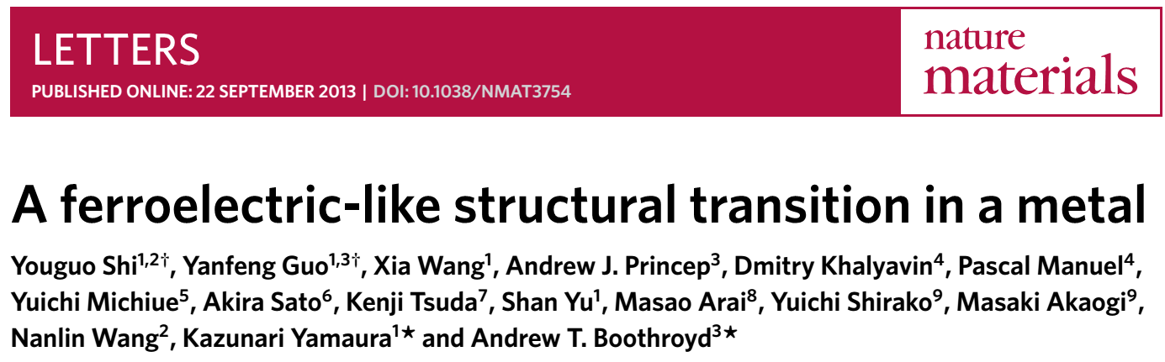
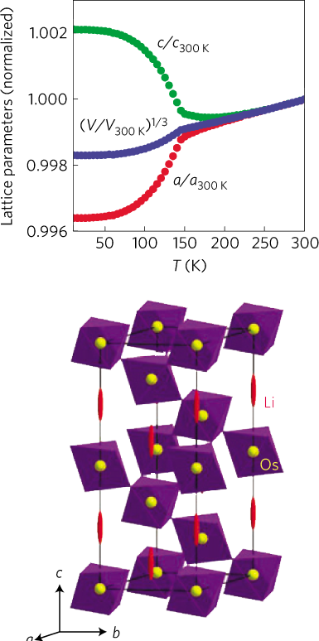
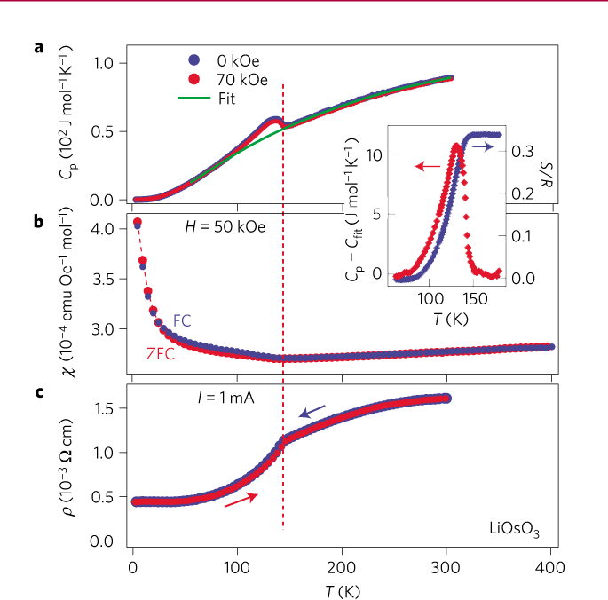
Bulk Polar Metal
-
A centrosymmetric (R3c) to non-centrosymmetric (R3c)
transition in metallic LiOsO₃
Exhibit a polar distortion by a continuous shift of Li⁺ ions below 140 K

Slide 6
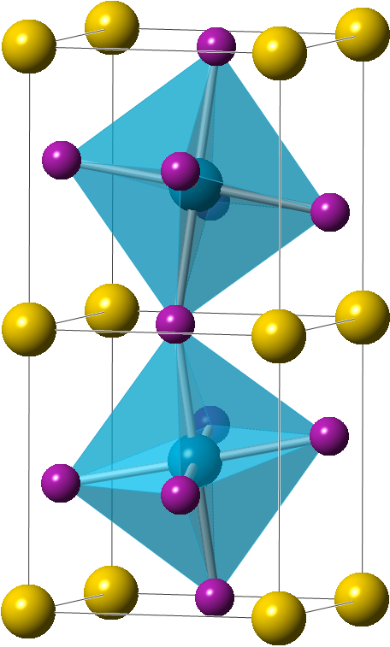
Oxide Polar Metals
Criteria: Coexistence of polar structural displacement & metallicity.
Material survey: Oxide polar metals are extremely scarce.
Few oxide examples: PbTi_{1-x}Nb_{x}O₃ films, BaTiO_{3-δ}, LiOsO₃, NdNiO₃ films, BaTiO₃/SrTiO₃/LaTiO₃ superlattice
No magnetism
weak electron-lattice coupling principle
A site ions displacement: Polar Structure
B site (B-O-B bond): Metallicity
Polar Metals
Charge
de-coupled
Lattice

Slide 7
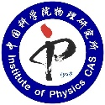
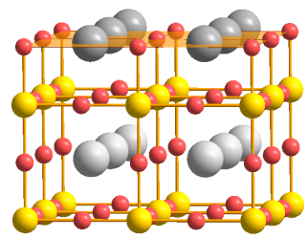

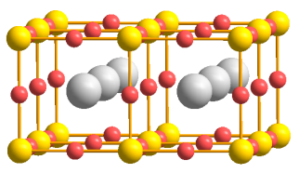
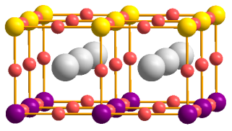
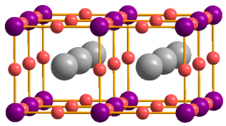
Designing Oxide Polar Metals
film
Coupled
Interface
Magnetic
Polar Metals
(N+1)*BTO
M*SRO
N*BTO
Charge
Coupling?
Lattice
STO substrate
Coupling?
Coupling?
?
?
SrRuO₃
Itinerant ferromagnetic metal with Tc~160 K
Nonmagnetic Insulator below 4 u.c.
Spin
Substrate (SrTiO₃)

Slide 8
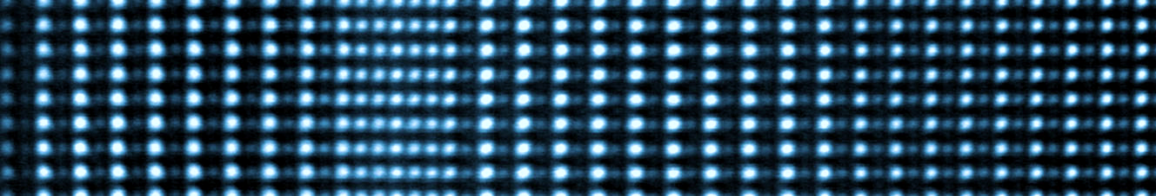
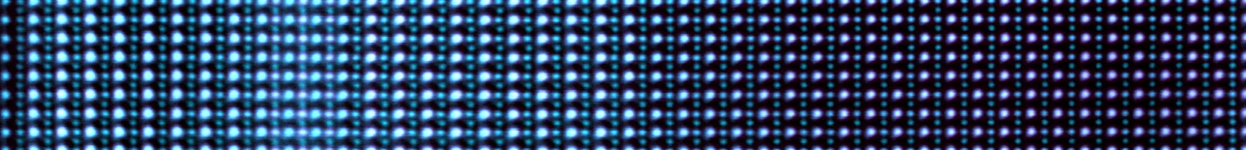
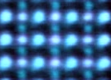
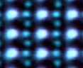
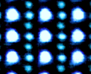
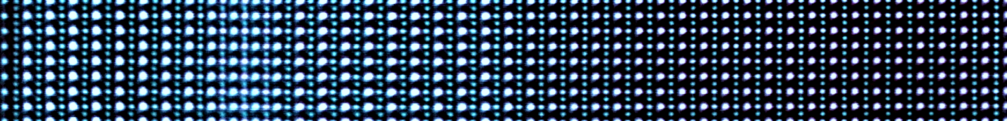
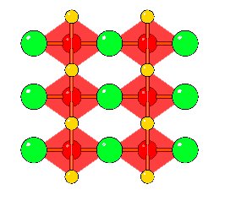
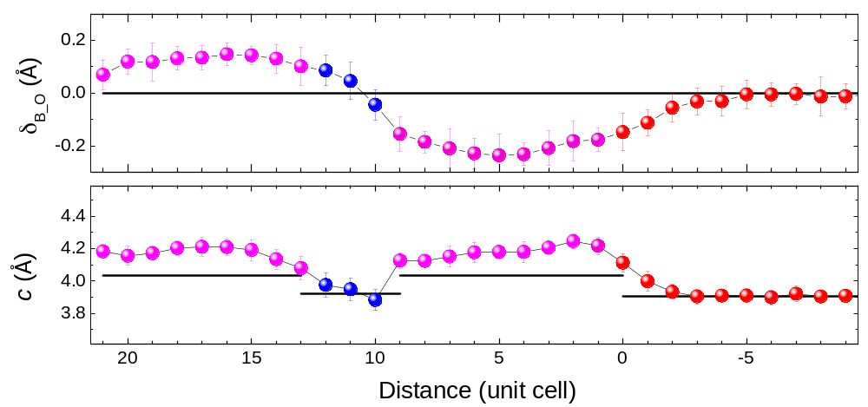


STEM Structure Characterization
Growth direction
Growth direction
BTO
SRO
BTO
STO
HAADF
10*BTO
3*SRO
9*BTO
Image along [110] direction
STO substrate
ABF
B
O
Ti
O
Ru
O
O
Ti
O
ABO₃
$$\overset{⃑}{P}$$
$$\overset{⃑}{P}$$
Polar Displacement from Ru-O-Ru Bonds
BTO
SRO
BTO
STO
4.036 Å
3.92 Å
c_{STO} = 3.905 Å

Slide 9
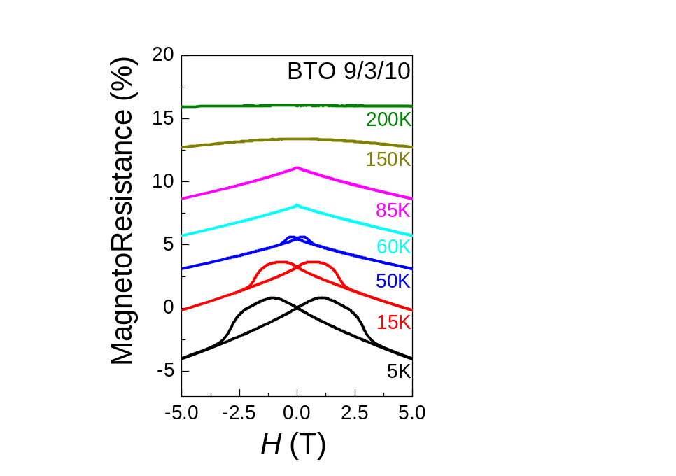
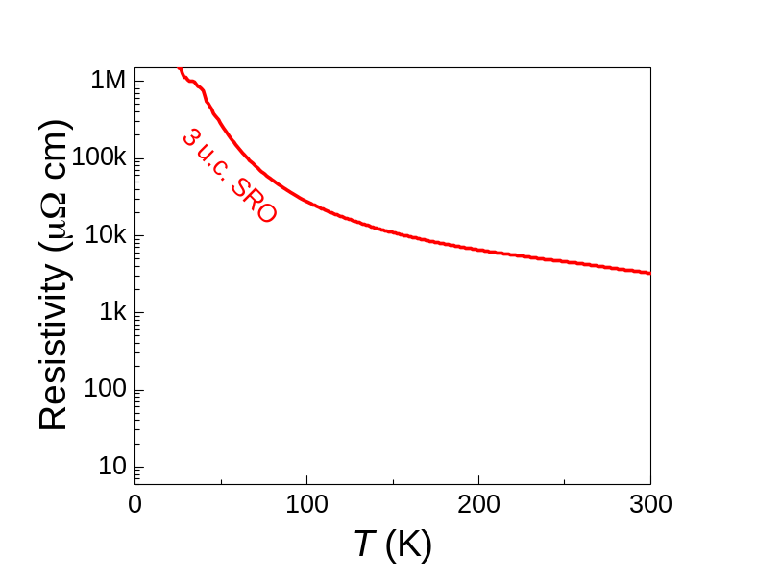
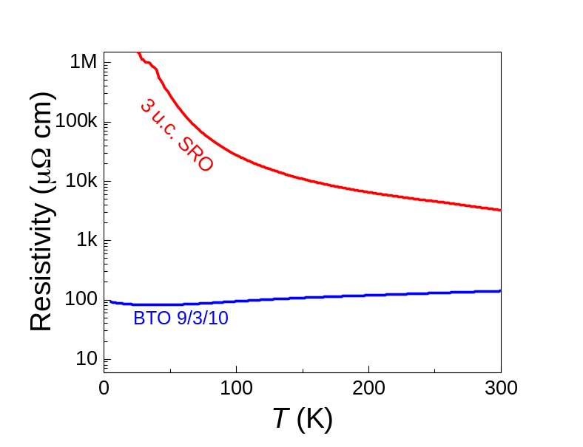
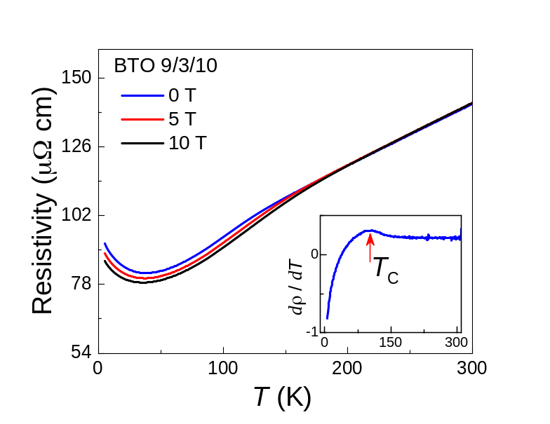
Electric Transport Properties
10*BTO
10*BTO
3*SRO
3*SRO
3*SRO
3*SRO
9*BTO
9*BTO
STO
STO
STO
STO
Re-emergent Metallicity
Magneto-Resistance
Behave ferromagnetic metal in 3 uc sandwiched SrRuO₃

Slide 10
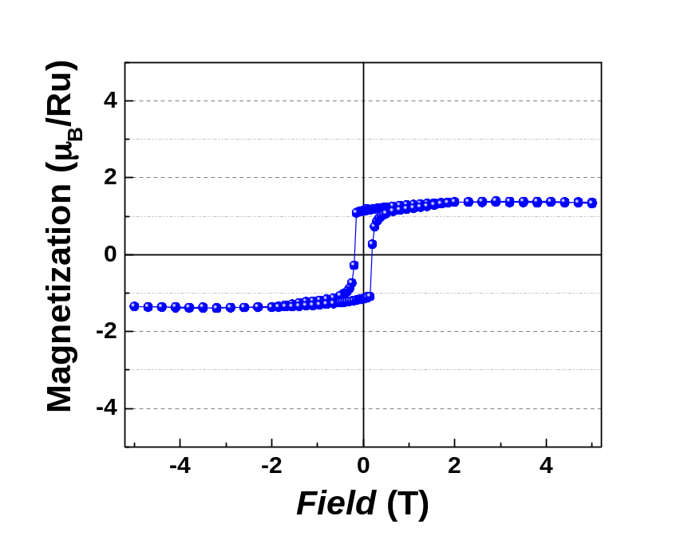
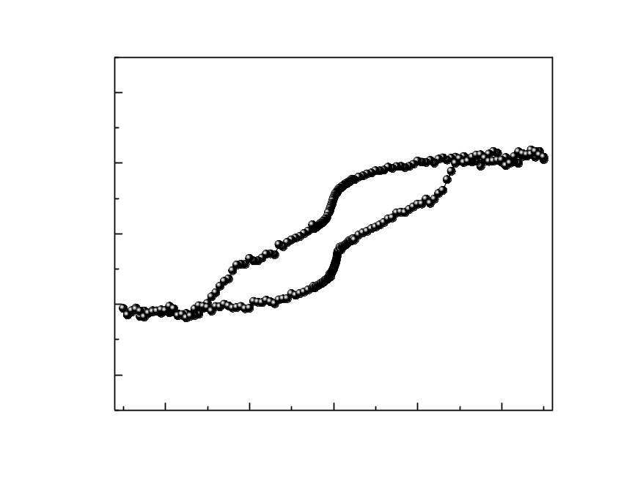
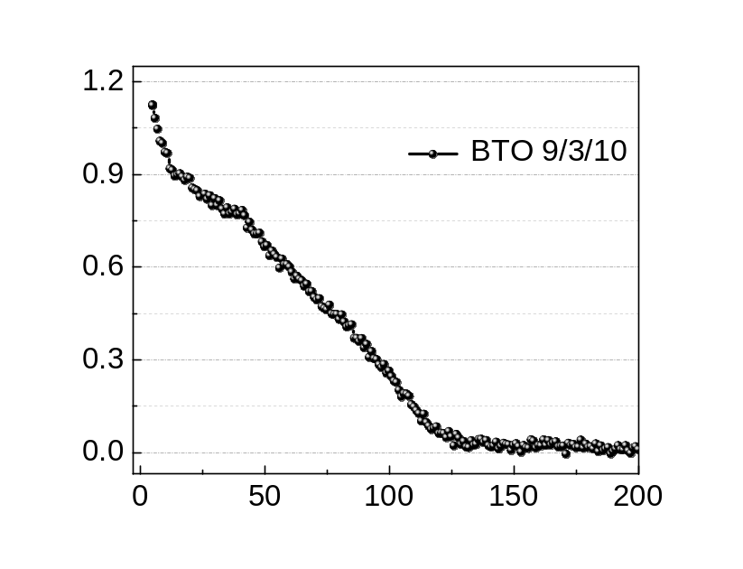
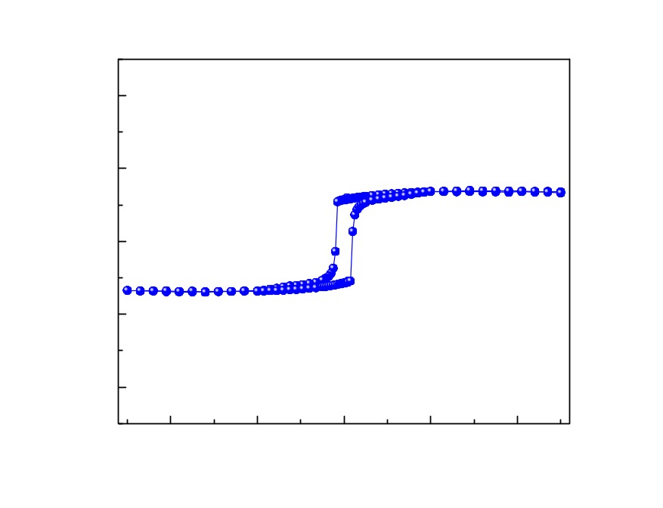
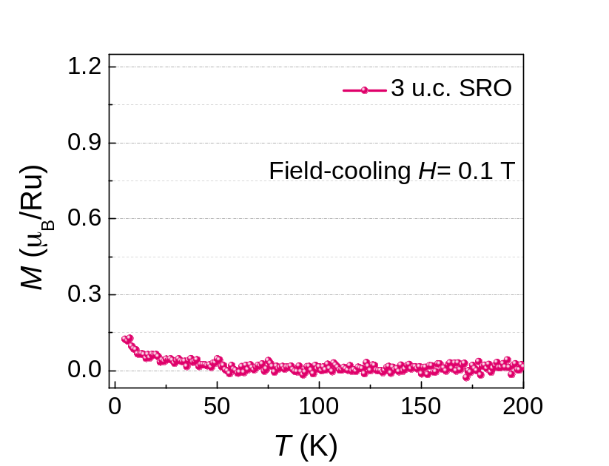
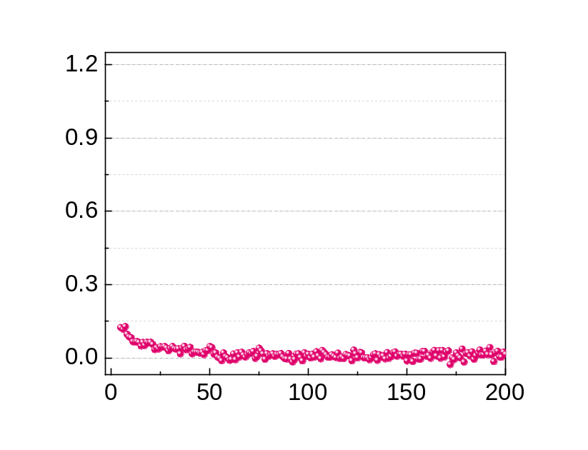
Magnetic Properties
60*SRO
10*BTO
10*BTO
3*SRO
3*SRO
Emergent Ferromagnetism
9*BTO
9*BTO
High Spin State
STO
STO
e_{g}
e_{g}
Ru 4d:
t_{2g}
t_{2g}
Show strong enhancement of ferromagnetism in SrRuO₃

Slide 11
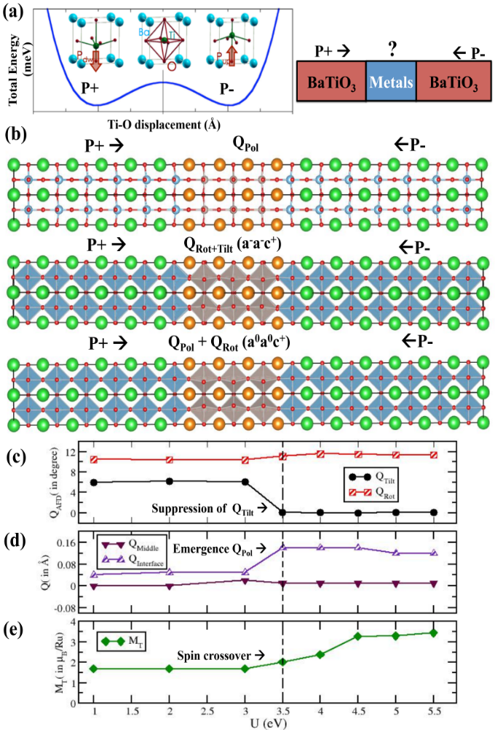
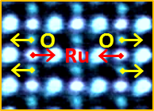
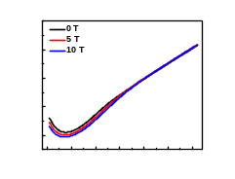
Density Functional Theory
Structure & Magnetic Property
as function of on-site Coulomb U
Magnetic
Metal
Ru-O
Polar
As function of on-site coulomb U:
Emergence of polar mode
Total suppression of tilt mode
Low-spin to High-spin crossover
Large Spin-Lattice Coupling

Slide 12
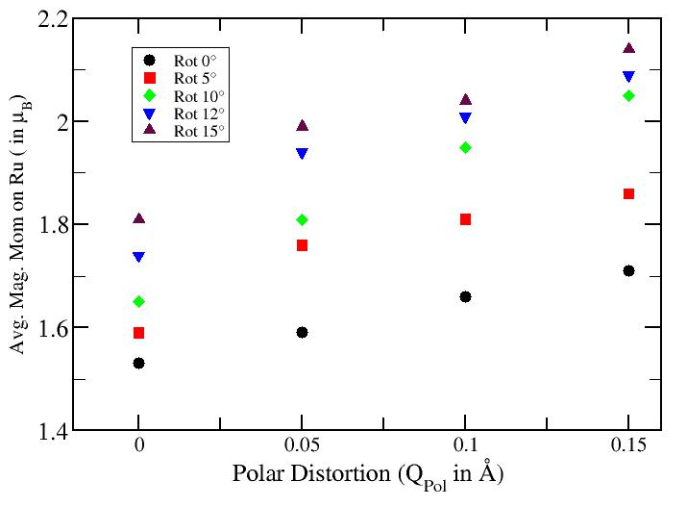
Role of Spin-Lattice Coupling
Q_{pol}^{exp.} ~ 0.1 Å
φ_{bulk}=7.65°
Figure 4 (b): Variation of the average magnetic moment on Ru (in μ_{B}) as a function of magnitude of polar distortion Q_{pol} ( in Å) for different tilt angle Q_{tilt} (in degree °) for U= 3.5 eV
Ferroelectric-like distortion can drive a spin-crossover intermediate spin to high spin state

Slide 13
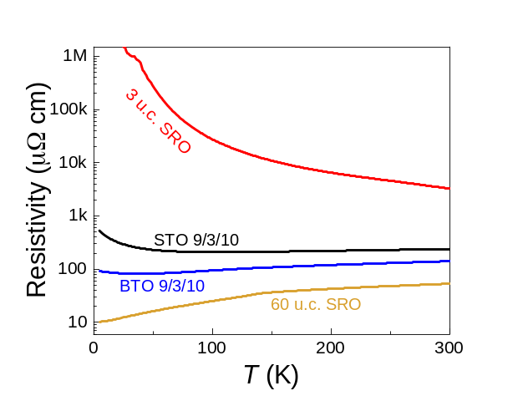
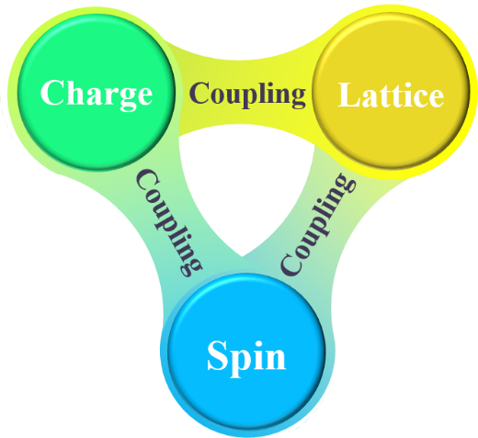
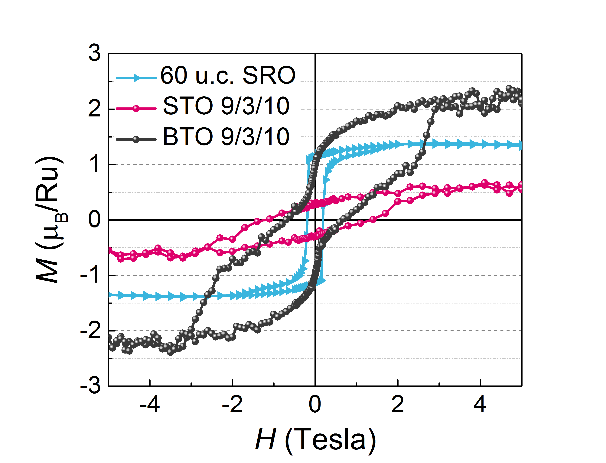
Magnetic Polar Metal Phase at Interface
We did create magnetic polar metal phase through designing oxide heterostructure
O
O
Ru
Ru

Slide 14
Thank you!

Slide 15
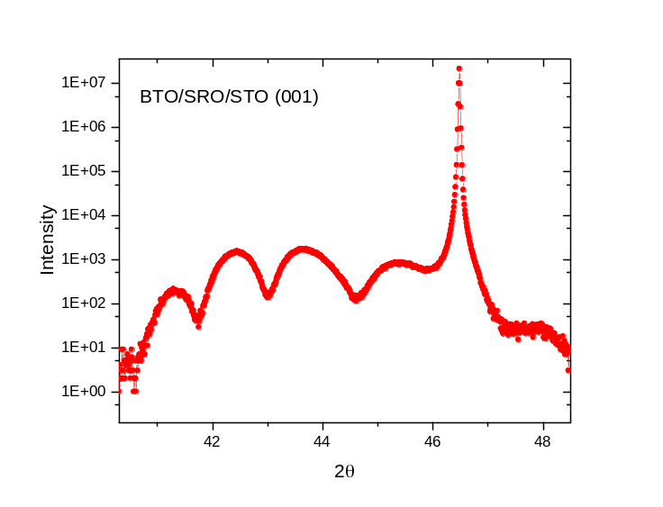
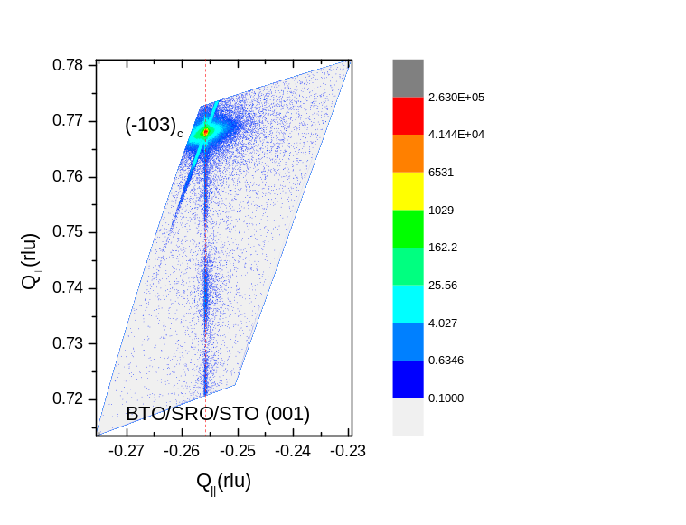
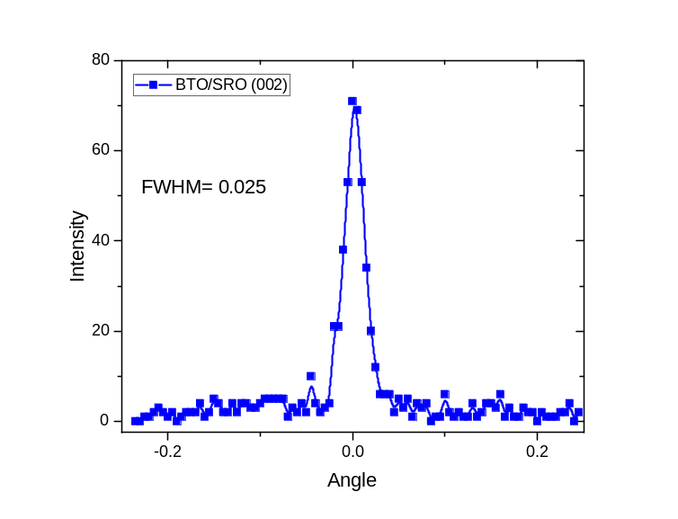
Experiments: Growth & XRD
Many BTO(N+1)/SRO(M)/BTO(N) on STO with combination of N, M are grown, typical samples includes BTO11/SRO4/BTO10, BTO10/SRO3/BTO9, BTO7/SRO3/BTO6, BTO5/SRO2/BTO4 etc.
The reason of one more layer on surface is that the surface layer of BTO is usually gone during STEM sample preparation
Below shows XRD of BTO11/SRO4/BTO10, there are several features:
  1) Film quality is very good (FWHM = 0.025 is very small for BTO on STO)
  2) Trilayer is fully strained on STO from RLM plot
Trilayer system
(N+1)*BTO
M*SRO
N*BTO
STO substrate

Slide 16






STEM EELS Characterization
10*BTO
EELS elemental maps for BTO/SRO/BTO/STO film
3*SRO
Sr
Sr
9*BTO
STO substrate
HAADF
Ti
STO substrate terminates with TiO₂ layer
BTO terminates with TiO₂ layer and SRO starts with SrO layer
SRO terminates with SrO layer.
The SRO/BTO interface near substrate side is very sharp with almost no intermixing, the other SRO/BTO interface close to surface has some Ba/Sr intermixing . This is interesting.
Ru
Ba
Sr
BTO
SRO
BTO
STO
ADF
Growth direction

Slide 17


Electric Transport Properties
10*BTO
10*STO
60*SRO
3*SRO
3*SRO
3*SRO
3*SRO
9*BTO
9*STO
STO
STO
STO
STO
STO
Re-emergent Metallicity
Magneto-Resistance
Behave ferromagnetic metal in SrRuO₃

Slide 18

Electric Transport Properties
Thickness dependence of resistivity
The metallicity should not just from the interface

Slide 19



Geometric Designed Oxide Polar Metals
NdNiO₃ on LaAlO₃ (111)
BUT the films are not metallic!!
The films are non-centrosymmetric

Slide 20


Geometric Designed Oxide Polar Metals
BaTiO₃/SrTiO₃/LaTiO₃ “tri-color” superlattice
Nat. Com. 9, 1547 (2018)
ABF image
Ba
Ti
Sr
La
O
HAADF image
Exhibit non-centrosymmetric quasi-two-dimensional metal

Slide 21


Main Issue: Understanding Interface
Polar Metals
Charge
de-coupled
Lattice
the role of octahedral rotations in suppressing ferroelectricity in these materials and show that, as the tolerance factor decreases, rotations alone cannot fully suppress ferroelectricity. Our results show that it is cation displacements (“hidden” in Glazer notation) that accompany the rotations, rather than the rotations themselves, that play the decisive role in suppressing ferroelectricity in these cases.

Slide 22

Martenstic transitions
It is a first order solid-solid phase transition with displacive nature (without atomic diffusion) consisting of a homogeneous lattice deformation leading to the new crystal structure.
The Middle Age Knights used to heat their swords in fire and quench them in cold water; after that, the swords became much harder. This method has long been used in the steel industry. The hardening comes from a characteristic microstructure formed by quenching, which is denoted by the term martensite in honour of the German metallographer A. Martens. Initially, the term was ambiguously adopted to denote the microstructure of quenched steels, but, as the nature of this microstructure became better known, the meaning of the word has been gradually clarified and extended to other alloys. The process (a phase transformation) by which the martensite is obtained is a martensitic transformation (MT).

Slide 23















Collaborators
BNL
LSU
Hangwen
Guo
Jiandi
Zhang
Ward
Plummer
Zhen
Wang
Yimei Zhu
Rongying
Jin
Mohammad
Saghayezhian
Vanderbilt
IOP
Jiandong
Guo
Saurabh Ghosh
Sokrates
Pantelides

